Slide 1
Microsoft Ignite

Slide 2
A New Frontier: Building the Future Firm with AI
Jared Spataro
CMO, AI at Work, Microsoft

Slide 3
CMO, AI at Work, Microsoft
Jared Spataro

Slide 4
Recent Benchmarks
Google-Proof Q&A Test
PhDs with access to the internet:
87%
34%
81%
score outside their specialty
score inside their specialty
score achieved by o3
Source: Ethan Mollick, One Useful Thing

Slide 5
Recent Benchmarks
Frontier Math
2%
25%
highest score ever achieved by AI
score achieved by o3
Source: Ethan Mollick, One Useful Thing

Slide 6




Recent Benchmarks
Smaller Models Get Better
Smallest AI models scoring above 60% on MMLU
PaLM
100B
LLaMA-65B
Number of parameters (log scale)
Llama 2 34B
10B
Mistral 7B
Phi-3-mini
May
Sep
Jan
May
Sep
Jan
May
2022
2023
2024
Source: Abdin et al., 2024 | Chart: Stanford 2025 AI Index report

Slide 7


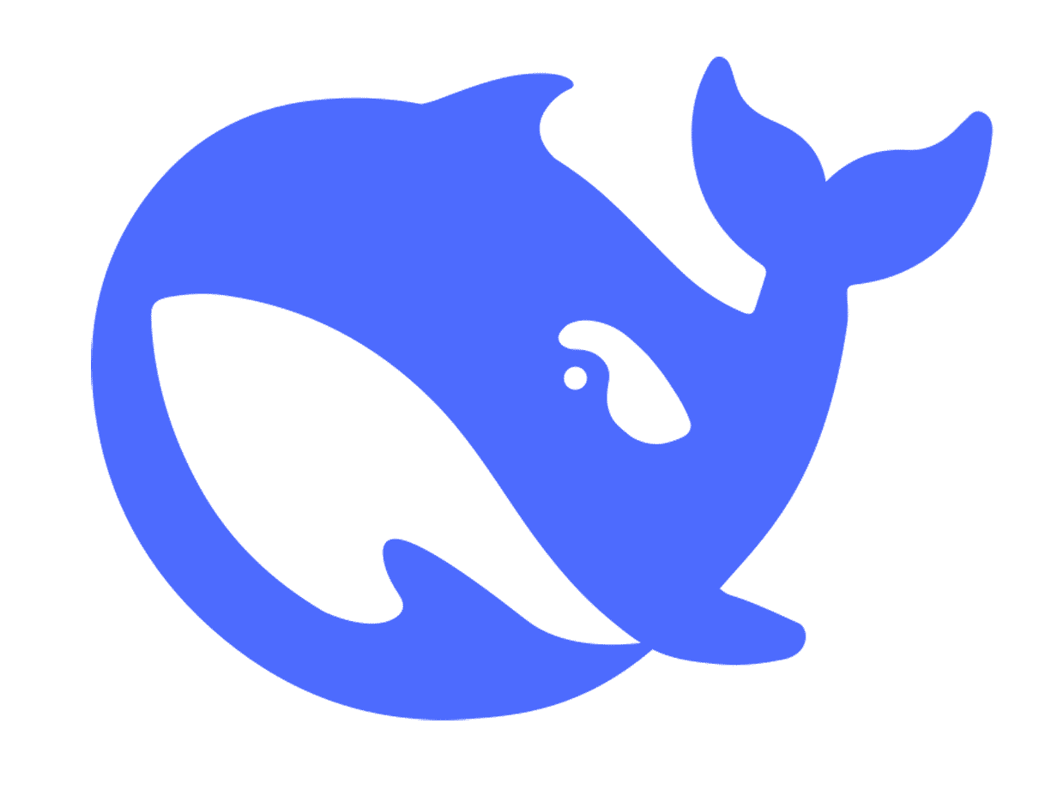
Recent Benchmarks
Models Become Cheaper to Use
GPT-3.5 level+ in multitask language understanding (MMLU)
GPT-4 level+ in code generation (HumanEval)
GPT-4o level+ in PhD-level science questions (GPQA Diamond)
GPT-4o level+ in LMSYS Chatbot Arena Elo
GPT-3.5
GPT-4-0314
Inference price across select benchmarks
10
GPT-4o-2024-05
Claude-3.5 Sonnet-2024-06
Inference price (in USD per million tokens – log scale)
1
DeepSeek-V3
0.1
Phi 4
Llama-3.1-Instruct-8B
Gemini-1.5-Flash-8B
SEP
Jan
May
Sep
Jan
May
SEP
Jan
2022
2023
2024
2025
Source: Epoch AI, 2025; Artificial Analysis, 2025 | Chart: Stanford 2025 AI Index report

Slide 8
Recent Benchmarks
The Rise of More Useful Agents
Claude 3.5 Sonnet (Old) (Modular)
Claude 3.5 Sonnet (New) (Modular)
Claude 3.5 Sonnet (New) (AIDE)
o1-preview (AIDE)
Human
1.4
RE-Bench: average normalized score
1.2
1.0
Average normalized score
0.8
0.6
0.4
0.2
30M
2H
8H
16H
32H
64H
Time budget (time limit per run x number of attempts)
Source: Wijk et al., 2024 | Chart: Stanford 2025 AI Index report

Slide 9
Intelligence on tap

Slide 10


Slide 11
45%
of leaders say expanding team capacity with digital labor is a top priority in the next 12 – 18 months
Source: Microsoft Work Trend Index Survey 2025, 78% (n = 9,037).

Slide 12
46%
of leaders say their companies are using agents to fully automate workflows or business processes
Source: Microsoft Work Trend Index Survey 2025, 78% (n = 9,037).

Slide 13

The Frontier Firm

Slide 14


Slide 15
CEO, Mercor
Brendan Foody

Slide 17
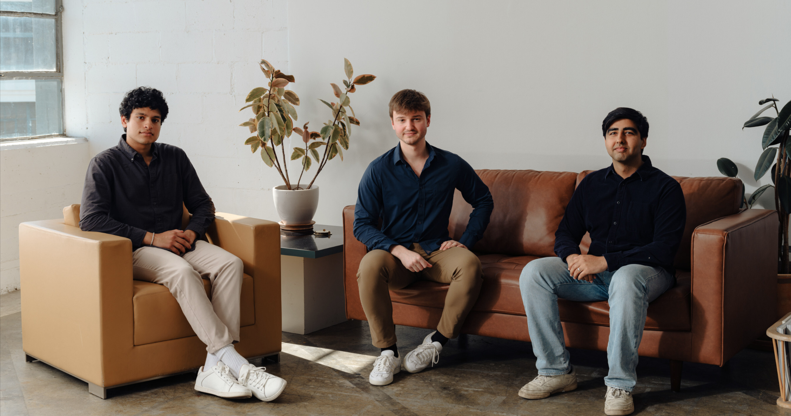

Slide 18
Collaborating with:
$1-$100M
6/7
of the Magnificent 7
Revenue in 11 months
5/5
of the top AI labs

Slide 19
75%
Human experts
Talent assessment
82%
AI models
50%
75%
100%

Slide 20
AI-native companies
Capture low hanging fruit
Automate and create evals
Leverage proprietary data

Slide 21
The Frontier Firm

Slide 22


Phase 1
Phase 2
Human with assistant
Human-agent teams

Slide 23
Phase 1
Phase 2
Phase 3
Human with assistant
Human-agent teams
Human-led, agent operated

Slide 24
Phase 1
Phase 2
Phase 3
Human with assistant
Human-agent teams
Human-led, agent operated

Slide 25


Slide 26
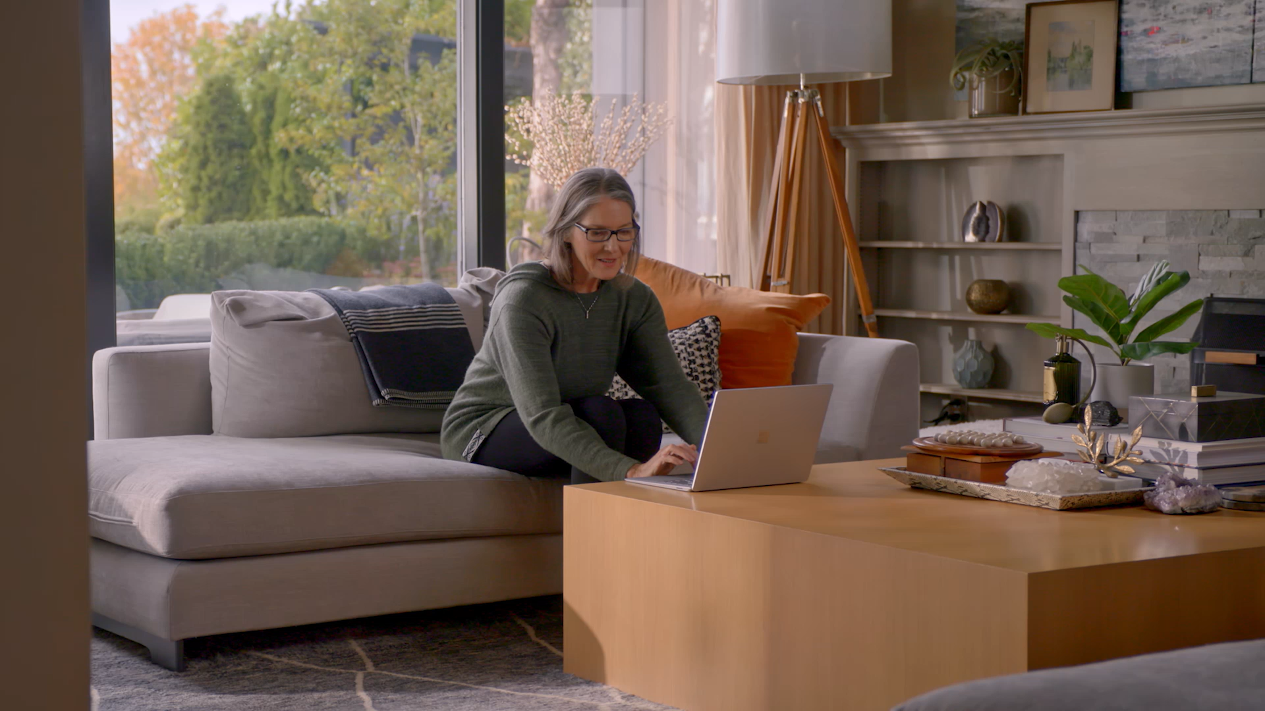

Slide 27
Senior Director, E-commerce, Holland America Line
Scot Pettit

Slide 29
Cruise Journey
Discover
Book
“What is a cruise tour?”
“Does Holland America offer flight packages?”
“How cold is Alaska in May?”

Slide 30
Cruise Journey
Discover
Book
Pre-Cruise
“Can I pay with installments?”
“What is the lowest verandah price for this cruise?”
“What is a cruise tour?”
“How cold is Alaska in May?”
“Can I combine these deals together?”
“Does Holland America offer flight packages?”

Slide 31
Cruise Journey
Discover
Book
Pre-Cruise
On-board
“Can I pay with installments?”
“How do I check in?”
“What is a cruise tour?”
“What is the lowest verandah price for this cruise?”
“Do I need a passport for this cruise?”
“How cold is Alaska in May?”
“Can I combine these deals together?”
“Can I bring alcohol onboard?”
“Does Holland America offer flight packages?”
“What is there to do on the ship?”

Slide 32
Cruise Journey
Discover
Book
Pre-Cruise
On-board
“How do I connect to the ship wi-fi?”
“How do I book a group dinner reservation?”
“Can I pay with installments?”
“How do I check in?”
“How do I find my transfer time?”
“What is the lowest verandah price for this cruise?”
“What is a cruise tour?”
“How cold is Alaska in May?”
“Do I need a passport for this cruise?”
“Can I combine these deals together?”
“Can I see the details for this charge?”
“Can I bring alcohol onboard?”
“What is there to do on the ship?”
“Does Holland America offer flight packages?”

Slide 33
How do we scale ecommerce cruise bookings and onboard revenue?

Slide 34
How do we support our customers digitally 24x7?

Slide 35
Generative AI

Slide 36





Generative AI

Slide 37


Generative AI
digital concierge

Slide 38

Meet Anna

Slide 39
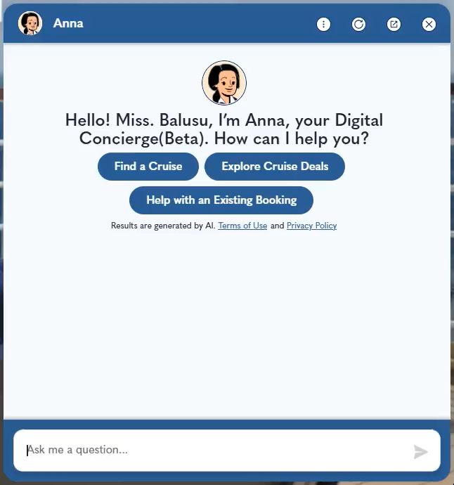
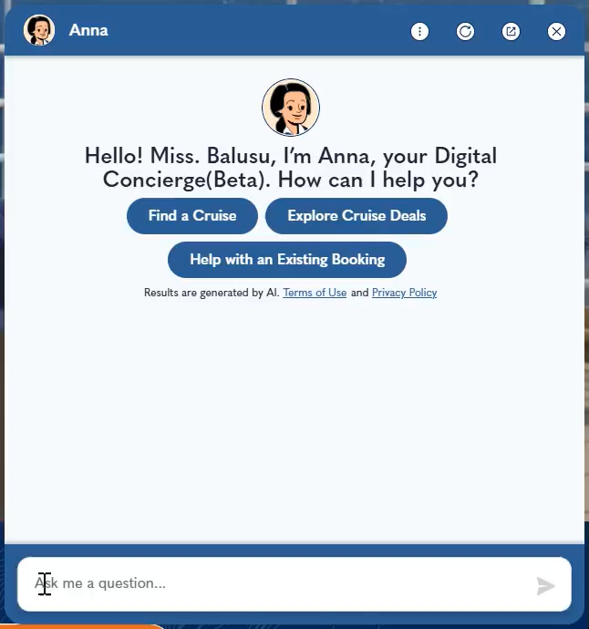
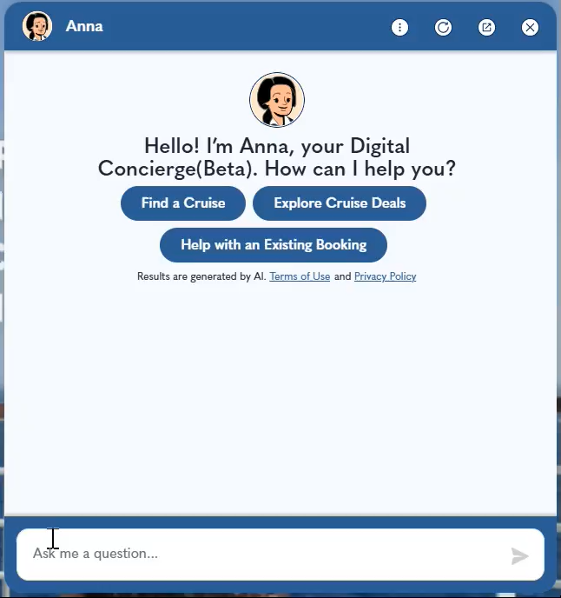
Finding a Cruise
Finding shore excursion
Needing passport

Slide 40
Show me options for cruises to Europe Transatlantic from Amsterdam in May 2025.
As a 3 star mariner, did I receive the 25% discount when I booked and paid for 3 specialty restaurant dinners?
I’m looking for a European cruise in May, departing from Barcelona for 10 days.
On a wait list for excursion, what are the chances of getting to go? Or should we book something else?
I would like to see my onboard credits?
Find me 5-day cruises to the Bahamas in March leaving from New York?
I would like to see my itinerary details?
I’m looking for a 10-day cruise to Europe in May 2025, leaving from Rome. Any options?
I would like to see my past cruise history?
Booked a cruise onboard holland America and need to transfer booking to Costco travel
Can you help me find a 7-day cruise to Alaska in July 2025, departing from Seattle?
I would like to upgrade my upcoming booking with "Have it all" package.
I would like to purchase a gift to my friend.
I would like to purchase "premium wifi plan" for my existing booking
Are there gluten free options in the breakfast meal plan?
How many outlets are there in a cabin?
I’m looking at the 7 Day Alaska Inside Passage. I would prefer to depart and arrive in Vancouver, BC. We would like to cruise on one of your smaller ships; Nieuw Amsterdam is our preferred ship. We are looking to travel in June, July, Aug of 2026.
I need to make sure I have Orange Club on my reservation
I am making my own airline reservations. When do the transfers from the Fairbanks airport to the hotel operate?
How can I find the ship layout, like where my room is?
Tell me more about the Volendam?
What kind of financing do you offer?

Slide 41
15K
Customers who engage with Anna convert at a higher rate
queries a week
93%
positive interactions

Slide 42
Challenges
Risk averse approach to launch
Content, content, content
Engagement

Slide 43
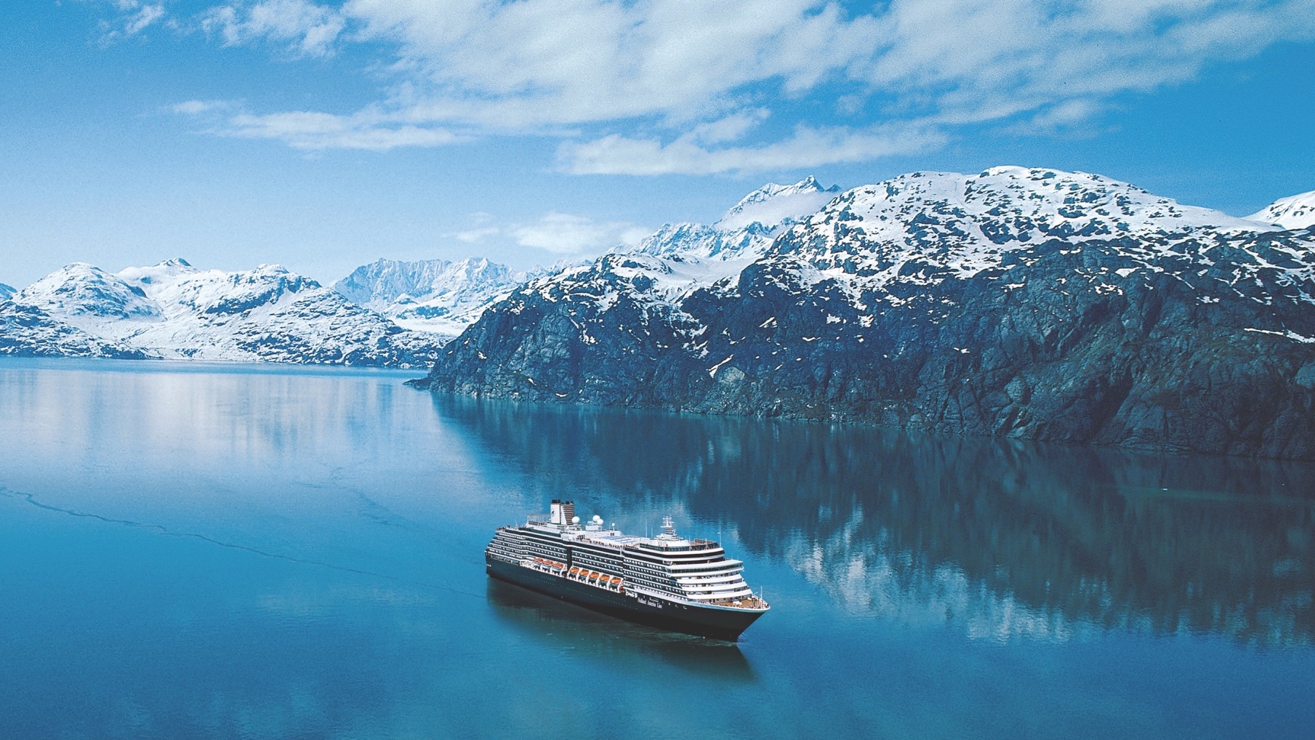

Slide 44
The Frontier Firm

Slide 45
Professor of Business Administration, Harvard Business School
Karim Lakhani

