Slide 1
We will get started at 10 min after the hour
Grab a refreshment!
General Session
September 17, 2024

Slide 2
Microsoft Event Code of Conduct
Microsoft’s mission is to empower every person and every organization on the planet to achieve more. This includes all Microsoft events and gatherings, including on digital platforms and in person, where we seek to create a respectful, friendly, enjoyable, and inclusive experience for all participants.
​
We expect all event participants to uphold the principles of this Code of Conduct. The Code of Conduct applies to all aspects of the main event and any related activities, whether digital or in person. Microsoft does not tolerate the following in any aspect of the event program, including business and social activities:
Behavior that is disruptive, disrespectful, or degrading to others, including any messages, images, or interactions by anyone, in any form, regardless of location.​
Harassment or discrimination based on age, ancestry, color, gender identity or expression, national origin, physical or mental disability, religion, sexual orientation, or any other characteristic protected by applicable local laws, regulations, and ordinances.​
​
We encourage everyone to assist in creating a welcoming and safe environment. Please report any concerns, harassing behavior, or suspicious or disruptive activity to venue staff, the event host or owner, or the nearest event staff.
​
We also encourage everyone to contact Microsoft’s Business Conduct Hotline at any time if you feel anything or anyone is not following this Code of Conduct or is inconsistent with Microsoft’s culture. The Hotline is available regardless of whether you are a Microsoft employee and can be reached at buscond@microsoft.com or +1 (877) 320-MSFT, or call collect outside the United States at +1 (720)-904-6844. Microsoft employees can also report any concerns to their Microsoft Manager.
Microsoft reserves the right to refuse admittance to or remove any person from a Microsoft event at any time at its sole discretion.

Slide 3
Agenda
Intro
Guest Speaker: Rachel Irabor- Creating an Inclusive Community
Announcements | Newest releases in community
Community events & updates
Open discussion forum

Slide 4
Rachel Irabor
Creating an Inclusive Community

Slide 5
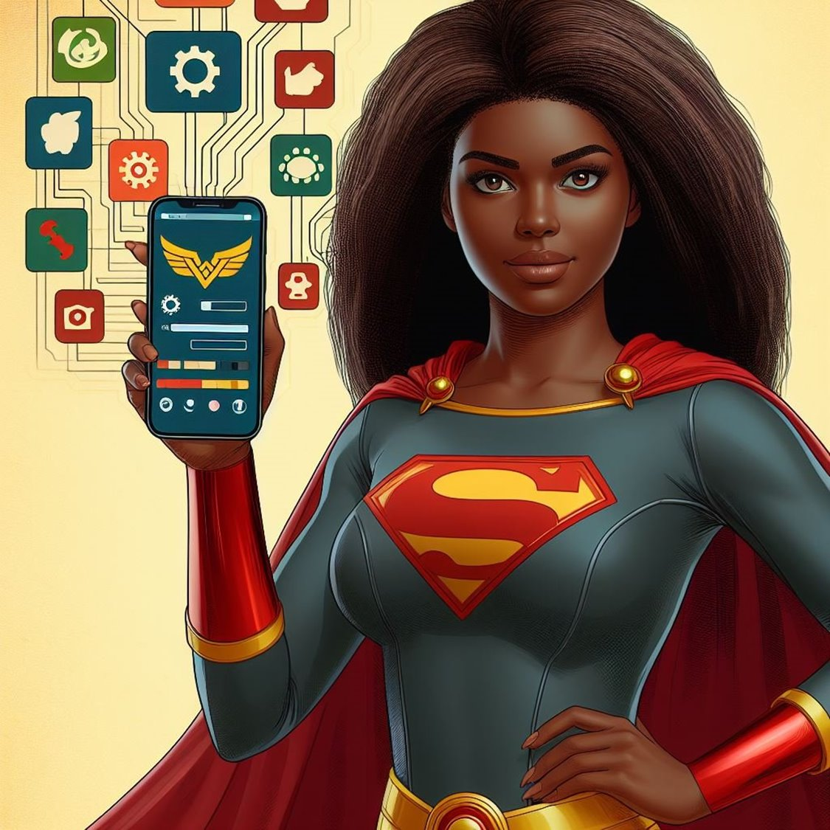
•Microsoft MVP for Business Applications.
•Power Platform and Dynamics 365 CRM Developer.
•Power Platform Advocate
•Organizer of Dynamics 365 and Power Platform User Group Malta.
•Part of the Lead for the Power Platform User Group Nigeria.
•Community Builder.
•YouTuber.
•Podcaster.

Slide 6
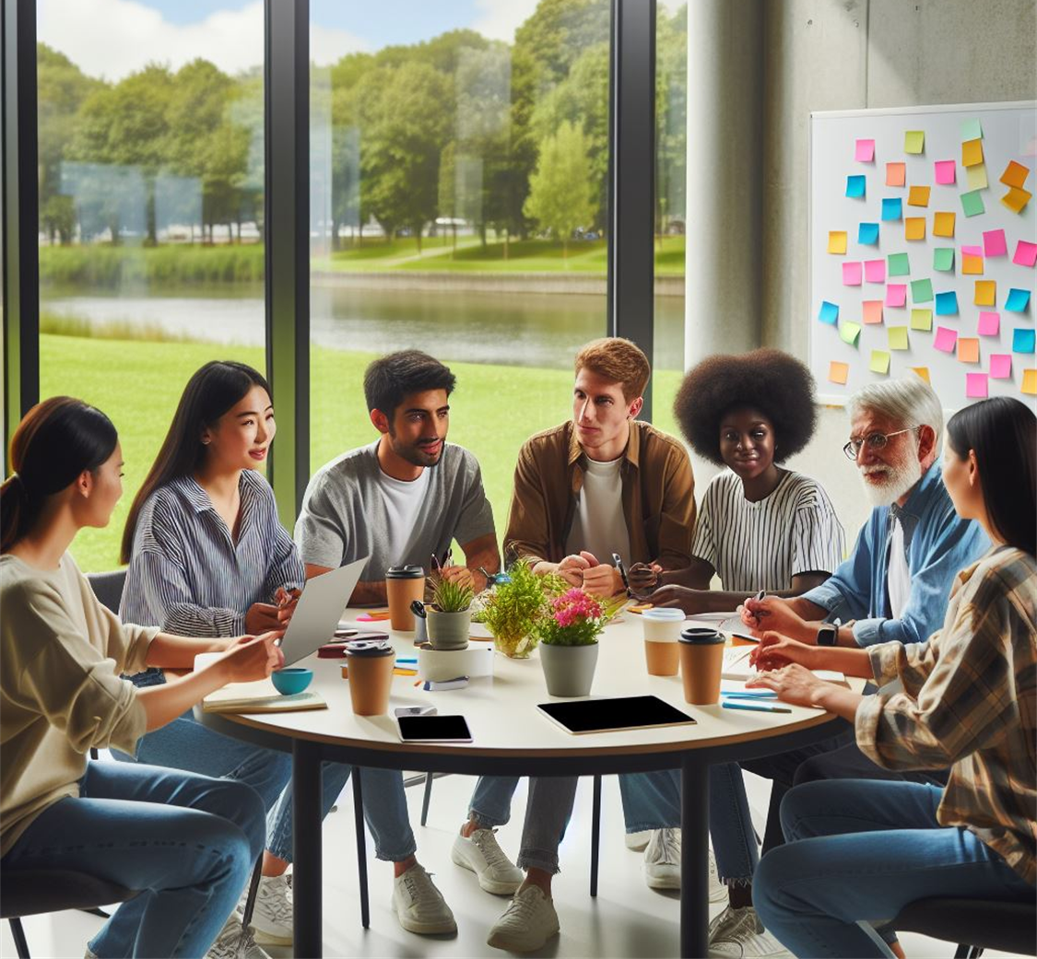
Inclusivity
What does it mean?
Why do you want one?

Slide 7
Inclusivity: providing equal access to opportunities and resources for people who might otherwise be excluded. Such as those having disabilities or belonging to a minority group.
Notes:
Creating a safe space where people of different backgrounds, career experiences, and ethnicities.
Inclusion must be your priority. We create a better community for everyone
Create a community for everyone
Question the wrong things happening around you not just in the community but in your workplace
Be an Ally – open doors for others to come in – a lot of people find it hard to find their place
Why do you want one?

Slide 8
What does the community mean to you?
Notes:
A place to be myself without judgment.

Slide 9
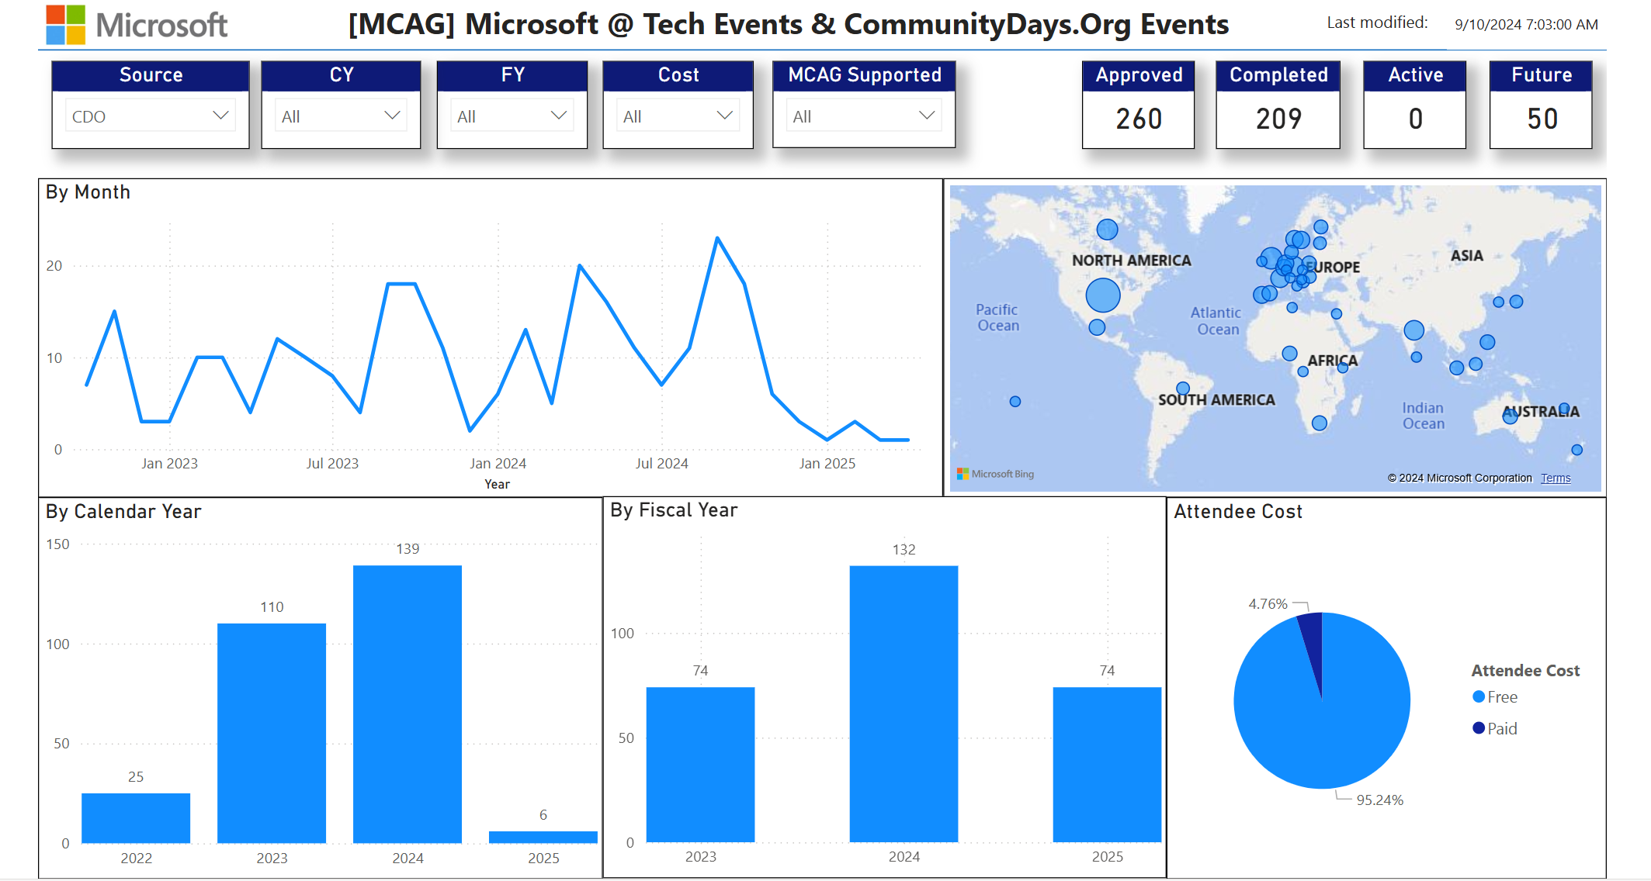
Communitydays.org statistics (Live)
Note: Guest attendees may have challenge viewing this data in this slide.

Slide 10
Communitydays.org Contributors
https://www.communitydays.org/about
Contributions are bug finding, feature contributions, content contributions, testing. Don't see your name – reach out and let us know!
Last Month's Contributors
All Time Contributors
Notes:
Speakerboard Filtering Issue - the filter events only prevents items from coming in. It does not remove them if they already exist. update the code so it also would remove events that hit the filter.

Slide 11
Communitydays.org feature updates
Complete / Rolling Out​
💎Organizer / Co-organizer Tab on Event Page Sept 9
💎Add Speaker Name on Calendar Sept 9
⚙️Update style and function of the User review page ️Sept 9
⚙️Add User Last Login Time ️Sept 9
🪲Missing Characters in Speaker Sessions from Sessionize [reported by Wes Preston] Sept 9
🪲Event Cards - Days Until Badges Showing for all Months within same date range [reported by Mike Maadarani] Sept 10
🪲HTML Content Saving in Page Editor Zones [reported by Michal Ziemba] Sept 9
🪲Schedule not working in some scenarios Sept 9
Working on it​
💎Integration of Run.Events to Speakerboard [90%]
💎Web Subscription calendar for Calls
🪲Speakerboard Filtering Issue
Filtering Speakers & Missing Speaker Name
on Run.Events powered events
Up Next
💎Show Events as a Calendar / List
💎Show Calls as Cards/List
💎Consolidated Listing Layout / Template
️⚙️Event Dashboard Enhancements
💎 Feature
🪲 Bug
⚙️ Admin
Notes:
Speakerboard Filtering Issue - the filter events only prevents items from coming in. It does not remove them if they already exist. update the code so it also would remove events that hit the filter.

Slide 12
Volunteers for Testing and Features
We are looking for few more folks who would like to contribute. The commitment is one meeting a week with Tom.
Basic coding skills needed. We have a whole ADO that could be tackled.
https://aka.ms/MGCI/CDOTechSignUp - added in the question about working on the videos.

Slide 13
Community Event Organizer Training and Office Hours
WHEN:
The last Thursday of each month, 8:10am PT
September 26 at 8:10am PDT
WHERE:
Community Tenant,
invite sent from mgci@msftcommunity.com
WHO:
Organizers of Community Led Events
Join us for Community Event Organizer Training & Office Hours where you’ll be able to get all the help you need with our tools, training and support to do a fun and impactful event.
Ask questions in our Events & Sponsor channel

Slide 14
Event training upcoming dates
Date | Host | Topic
August | N/A | Community Break – No meeting
September 26 | TBA | Demo: Run.event Event App - TBA Lessons Learned: “Is Meetup a great tool to manage your Community OR not” Nicolas Georgeault
October 24 | TBA | Demo: Whova Event App – David Wilhelm Lessons Learned: Ben Rupp
November 28 | TBA | Demo: Just attend demo - TBC Lessons Learned: From LA Event – Dave - TBA
December |  | Community Break – No meeting

Slide 15
Announcement
Starting in October – we will change the format of these meetings by streaming MGCI general session meetings to Microsoft Community Learning YouTube Channel - https://aka.ms/community/learning
And on the Microsoft Tech Community for comments and questions.

Slide 16
Microsoft Global Community Initiative
See you at our next general session October 15 at 8:10am and 5:10pm PDT
Top asks:
Complete our monthly survey:
https://aka.ms/MGCIFeedbackSeptember
Invite colleagues to hold a community day event at communitydays.org

Slide 17
Upcoming Microsoft Flagship Events
.DotNet Conference – Nov 12-12, 2024 - Virtual
Microsoft Ignite - Nov 18-22, 2024 – Chicago, IL

Slide 18
Upcoming Community Produced Events – Sept thru Oct
Professionally produced community events draw from 1k-5k attendees (in-person). Attendance fees are charged, and pre/post event workshops delivered by Microsoft MVPs are often part of the event. Event organizers ask for our help in driving attendance and providing MSFT corporate speakers.
Event name | Start date | End date | City | State | Country | Primary tech
Experts Live Europe | 9/23/2024 | 9/25/2024 | Budapest |  | Hungary
Umbraco US Festival | 10/3/2024 | 10/4/2024 | Chicago | IL | United States | .NET;#Developer tools + DevOps
NDC Porto 2024 | 10/14/2024 | 10/18/2024 | Porto |  | Portugal | .NET;#AI / ML;#Azure / Cloud;#Containers / Kubernetes;#Data;#Developer tools + DevOps
JavaScript Bangkok 2.0.0 | 10/18/2024 | 10/19/2024 | Bangkok |  | Thailand | JavaScript
Umbracokalaset 2024 | 10/23/2024 | 10/23/2024 | Stockholm |  | Sweden | .NET;#Developer tools + DevOps
Albanian Power Platform Summit | 10/26/2024 | 10/26/2024 | Tirana |  | Albania | Power Platform
Tunisia Dev Days | 11/1/2024 | 11/2/2024 | Sousse |  | Tunisia | .NET;#Developer tools + DevOps
DevDay 2024 | 11/7/2024 | 11/7/2024 | Mons |  | Belgium | Azure / Cloud;#AI / ML;#.NET;#Developer tools + DevOps
TechCon365 Dallas | 11/11/2024 | 11/15/2024 | Dallas | TX | United States | Microsoft 365
Update Conference Prague 2024 | 11/14/2024 | 11/15/2024 | Prague | Czech Republic | Czech Republic | .NET;#Developer tools + DevOps

Slide 19
Upcoming Community Led Events : Sept
These events often serve underrepresented or emerging markets. They are organized by volunteers and are free to attendees. Newly branded “Community Days” events may cover any part of the Microsoft technical stack and/or cater to roles or industries. These are a vibrant opportunity for recruiting, career development and technical skilling. A full list of community led events can be found at CommunityDays.org.
Event name | Start date | End date | City | State | Country
aMP Bordeaux | 9/19/2024 | 9/19/2024 | Bruges | Nouvelle-Aquitaine | France
CollabDays Portugal | 9/21/2024 | 9/21/2024 | Porto | Porto | Portugal
European Microsoft Fabric Community Conference | 9/24/2024 | 9/27/2024 | Stockholm | Sweden | Sweden
Nerdearla Argentina | 9/24/2024 | 9/28/2024 | Buenos Aires |  | Argentina
Summit NA Roadshow - Atlanta | 9/25/2024 | 9/25/2024 | Atlanta | GA | United States
Future Data Driven Summit 2024 | 9/25/2024 | 9/25/2024 |  |  | United States
CollabDays at The National Museum of Computing - Bletchley Park | 9/25/2024 | 9/25/2024 | Bletchley | Milton Keynes | United Kingdom
Logic Apps Community Day | 9/26/2024 | 9/26/2024 |  |  | United States
aMS Leipzig 2024 | 9/27/2024 | 9/27/2024 | Leipzig | Saxony | Germany
M365 Summit - Microsoft Cloud Engineering | 9/27/2024 | 9/28/2024 | Manchester | Manchester | United Kingdom
AI Community Conference - Boston 2024 | 9/27/2024 | 9/27/2024 | Cambridge | MA | United States

Slide 20
Upcoming Community Led Events : Oct
These events often serve underrepresented or emerging markets. They are organized by volunteers and are free to attendees. Newly branded “Community Days” events may cover any part of the Microsoft technical stack and/or cater to roles or industries. These are a vibrant opportunity for recruiting, career development and technical skilling. A full list of community led events can be found at CommunityDays.org.
Event name | Start date | End date | City | State | Country
Memphis Microsoft Community Days | 10/3/2024 | 10/4/2024 | Memphis | TN | United States
aMS Montpellier 2024 | 10/3/2024 | 10/3/2024 | Montpellier | Nouvelle Occitanie | France
MICROSOFT 365 OTTAWA | 10/4/2024 | 10/4/2024 | Ottawa | ON | Canada
M365 Saturday Coimbatore | 10/5/2024 | 10/5/2024 | Coimbatore | TAMIL NADU | India
Community Summit North America 2024 | 10/13/2024 | 10/17/2024 | San Antonio | TX | United States
CollabDays Cape Town | 10/14/2024 | 10/14/2024 | Newlands | Western Cape | South Africa
International conference on modern intranets and communication | 10/15/2024 | 10/15/2024 | Stockholm | Stockholm | Sweden
Scottish Summit 2024 | 10/16/2024 | 10/19/2024 | Aberdeen | Scotland | United Kingdom
CollabDays - Johannesburg | 10/16/2024 | 10/16/2024 | Bryanston | Gauteng | South Africa
Power 365 2024 Edition 5 | 10/17/2024 | 10/17/2024 | Lille | Hauts-de-France | France
CollabDays New England | 10/18/2024 | 10/18/2024 | Burlington | MA | United States
AI Community Conference - Vancouver 2024 | 10/18/2024 | 10/18/2024 | Vancouver | BC | Canada
CollabDays Durban | 10/18/2024 | 10/18/2024 | Ballito | Kwazulu Natal | South Africa
CollabDays Belgium | 10/19/2024 | 10/19/2024 | Brussels | Brussels | Belgium
AI Community Conference - Redmond 2024 | 10/19/2024 | 10/19/2024 | Redmond | WA | United States
D365UG Sverige | 10/23/2024 | 10/23/2024 | Stockholm | Norrmalm | Sweden
MN M365 13TH BI-ANNUAL FALL WORKSHOP DAY | 10/25/2024 | 10/25/2024 | Edina | MN | United States
M365 COMMUNITY DAYS MTL 2024 | 10/26/2024 | 10/26/2024 | Montreal | QC | Canada
Iowa Code Camp 2024 | 10/26/2024 | 10/26/2024 | Ankeny | Iowa | United States

Slide 22
Experts Live
Europe 2024
Where the Microsoft community connects.
www.expertslive.eu

Slide 23
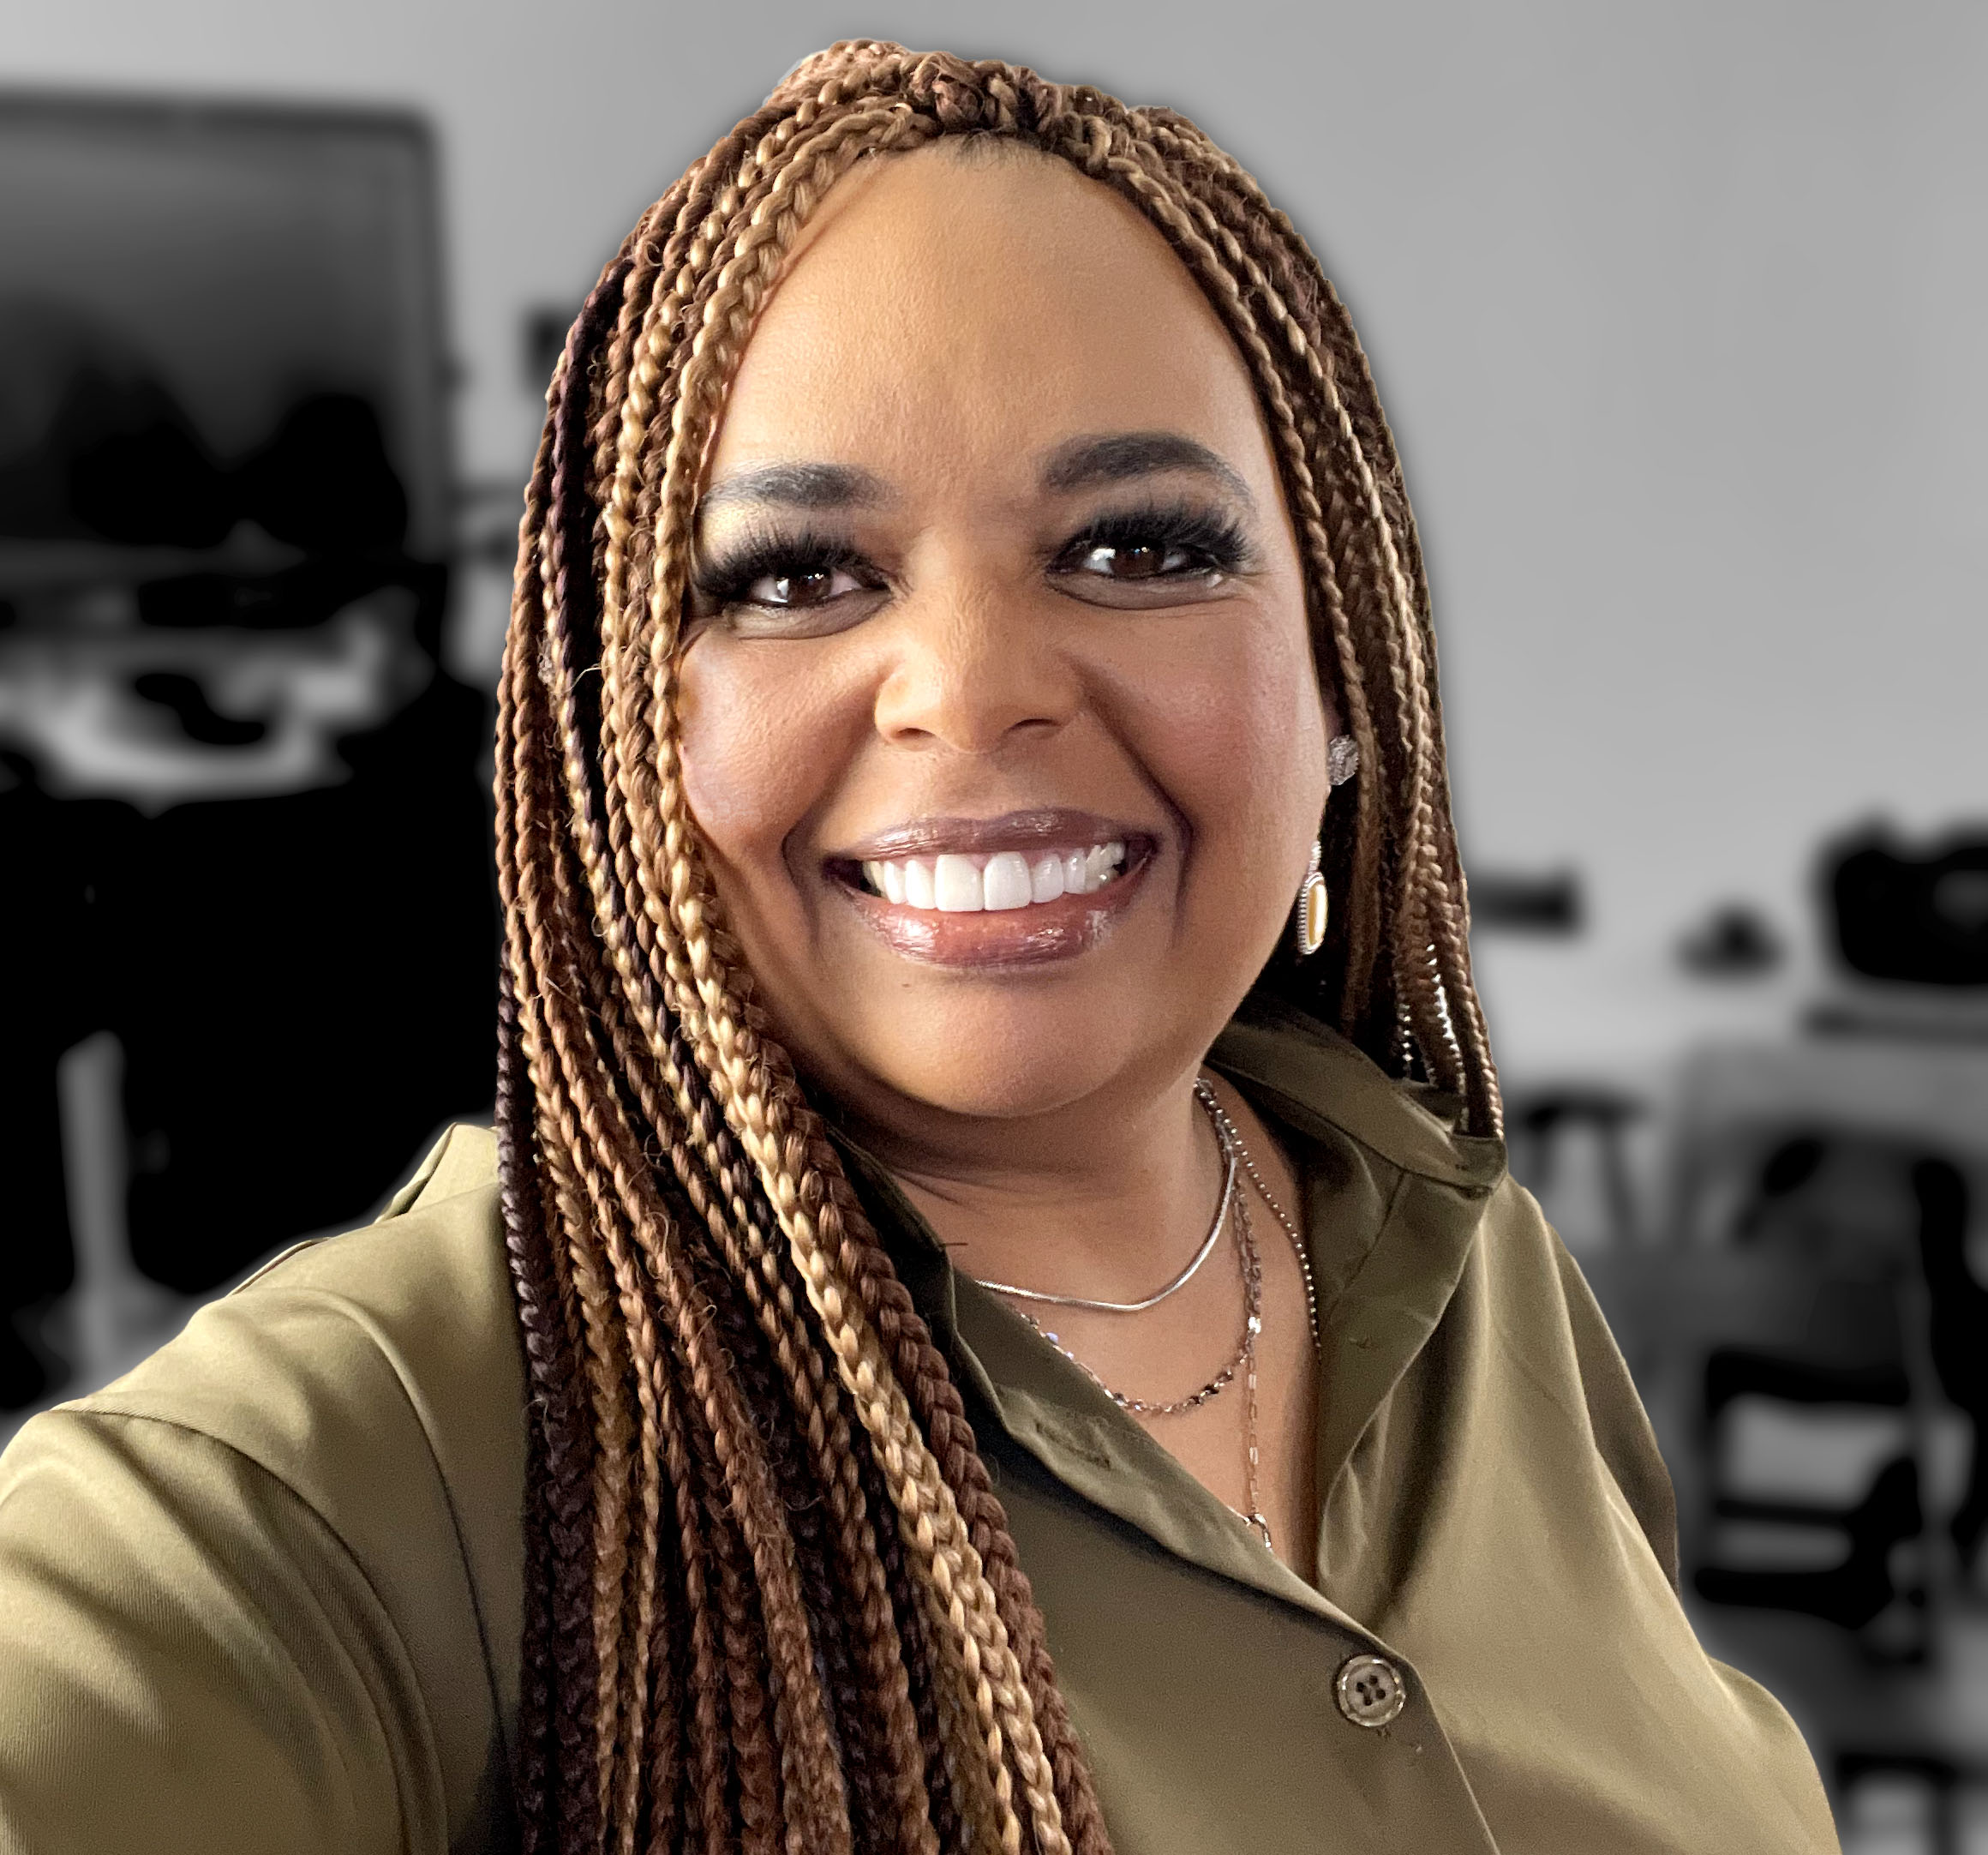
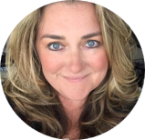
Monday’s at Microsoft with Karuana & Heather
Karuana Gatimu
Learn - Explore – Connect In the Microsoft Community
Bi-weekly @ 8am PT
Watch on
Microsoft Community Linked
Heather Cook
https://aka.ms/microsoftcommunitylinkedin
Notes:
Last used May 2023, Heather Cook

Slide 24
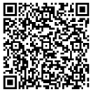
We want your feedback!
https://aka.ms/MGCIFeedbackSeptember

