Slide 1
Microsoft Global Community Initiative general session
November 2024
We will get started at 10 min after the hour
Grab a refreshment!

Slide 2
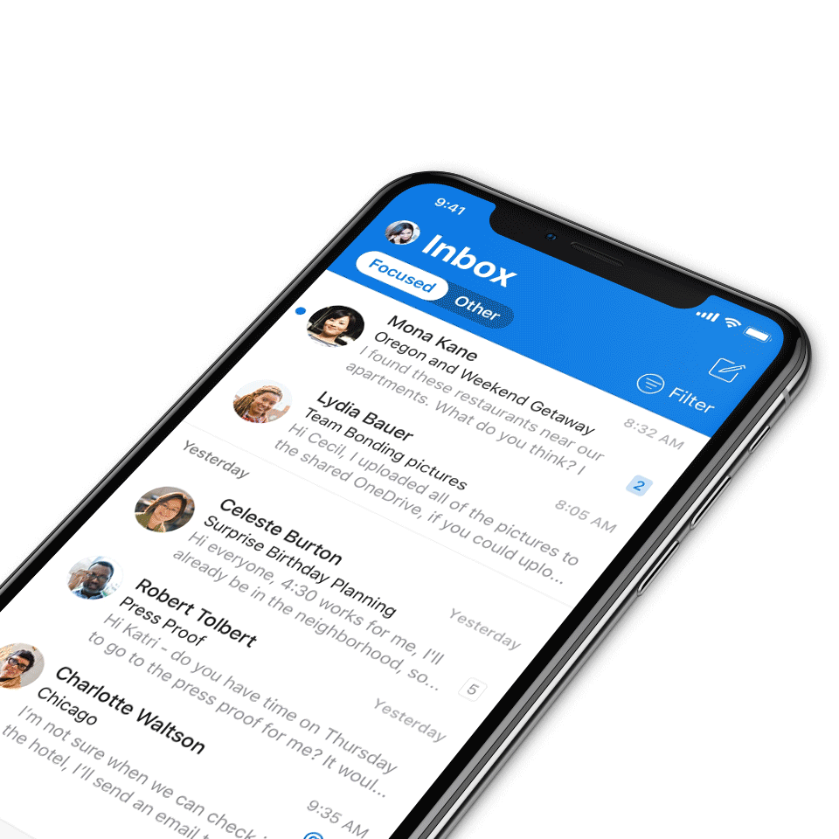
Digital Event Code of Conduct
Microsoft’s mission is to empower every person and every organization on the planet to achieve more. This includes all Microsoft events and gatherings, including on digital platforms, where we seek to create a respectful, friendly, fun and inclusive experience for all participants.​
We expect all digital event participants to uphold the principles of this Code of Conduct, which covers the main digital event and all related activities. We do not tolerate disruptive or disrespectful behavior, messages, images, or interactions by any party participant, in any form, at any aspect of the program including business and social activities, regardless of location.​
Microsoft will not tolerate harassment or discrimination based on age, ancestry, color, gender identity or expression, national origin, physical or mental disability, religion, sexual orientation, or any other characteristic protected by applicable local laws, regulations, and ordinances.​
We encourage everyone to assist in creating a welcoming and safe environment.
For more info, click here.

Slide 3
Agenda
Announcements
Sub Committee Updates
Topic: Community days Ottawa
Speaker: Mike Maadarani, Habib Mankal
Community events & updates
Open discussion forum
Join MGCI today! https://aka.ms/MGCI

Slide 4
Our updated call format
We’re enabling new call formats to embrace new community interactions and reach.
How to watch:
The show will now stream live to the Microsoft Tech Community (MTC) and the Microsoft Community Learning YouTube channel. The join links remain the same and clicking through will take you to the MTC event page. Our community call times are still the same: 3rd Tuesday of every month at 8:10 AM and 5:10 PM Pacific Time.
https://aka.ms/MGCIMtgAM
https://aka.ms/MGCIMtgPM
How to join the open discussion at the end of the call:
If you're watching on the Tech Community, ask your questions by leaving comments on the Tech Community page.
Reason for the new format:
Our community calls will be more accessible to worldwide audiences. All calls will be immediately available on demand once the call ends.
Microsoft Global Community Initiative https://aka.ms/MGCI

Slide 5
Announcements
Microsoft Community
Mondays at Microsoft with Karuana and Heather
Hosted in the Microsoft Community on LinkedIn, Mondays at Microsoft is a bi-weekly show that aggregates new product announcements and upcoming community events to drive technical skilling and engagement.
Missed it? Watch past Mondays at Microsoft episodes at https://aka.ms/MondaysAtMicrosoft
Join the Microsoft Community on LinkedIn so you can get ready for our next call at https://aka.ms/MondaysAtMicrosoft/LI

Slide 6
Communications Workstream Update
Nov 2024
​Social Media #CommunityLuv (get featured in our monthly newsletter)
November newsletter coming up
MGCI conference sessions (Microsoft AI Tour Paris, Low Code | No Code Power Platform Conference)
Hosting an event yourself? Invite Board Members to present MGCI sessions (online, in-person)
MGCI at Microsoft Ignite (Community Area)

Slide 7
Communitydays.org Feature Update
Nov 2024
Completed/Rolling Out
[368] Auto disable a tab [sessions, speakers, schedule, sponsors]
Up Next
Sync Dev / Staging Pipelines
[618] Slow Event Form Next/Prev
[619] Style Adjustments September'24
[620] Schedule Missing Information
[621] Merge Profile disappears on new create
Working on it
[622] Force users to add a name if there is no name from the auth provider
[631] Event Date out of order for some timezones
[521] Ability to list Events as a List
[626] Redirect Other Events
[630] Speakerboard Event Dates Sorting Incorrectly
[629] October'24 Style Adjustments
[627] Home Content - Requirements
[628] Adding Date to Session Times
[599] Admin Event Review Enhancements
[567] Automated reminders for Draft calls and events
[593] Change Timezone on Calendar
[625] Event Guidelines
[374] Social Sharing of Events
[364] Integration with Sessionize or Run.Events Mobile
[520] Ability to show Events as a Calendar
[469] Enhance Event Status [Cancel/Postpone/Resubmit]
[531] Address Map Integration using Bing API

Slide 8
Training Workstream Update
Nov 2024
​Complete / Rolling Out​
Summary of survey we sent out asking for topic ideas
Training & Office Hours – Topics ​
Upcoming event training dates
Date | Host | Topic
November 22nd | David L | Topic: Event Recaps and Lessons Learned from LA and MN – David L and Wes P Office Hours Open Discussion
December |  | Community Break – No meeting

Slide 9
M365 Ottawa Community Day
October 04, 2024
M365Ottawa.com
#M365Ottawa

Slide 10
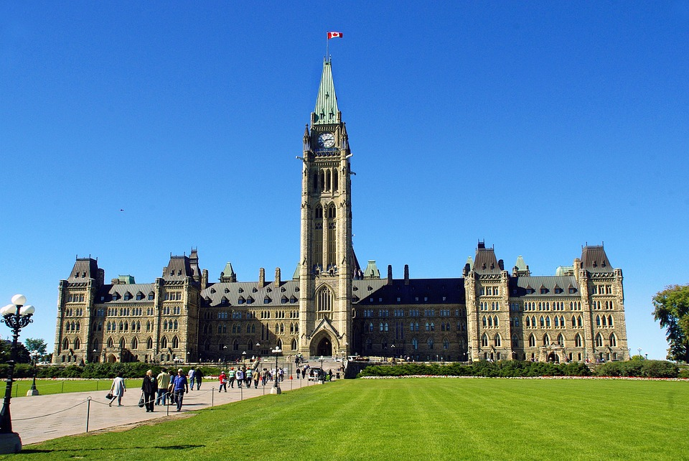
ABOUT M365 OTTAWA
Microsoft 365 Ottawa Event is a free community‐focused technology event dedicated to educating and engaging members of the local technical community.
The event draws upon the expertise of IT professionals, developers and solutions architects who come together to share their real-world experiences, lessons learned, best practices, and general knowledge with other like‐minded individuals.
The 2024 event was our 12th annual event!
We are a proud part of the Microsoft Global Community Initiative, a movement that seeks to empower individuals and organizations to achieve more with technology.
M365Ottawa.com
M365MIAMI.COM
@M365MIAMI

Slide 11
M365 Ottawa 2024 Recap
6 Rooms
6 Tracks
30 Sessions
32 Speakers
21 Microsoft/ MVPs
M365Ottawa.com
M365MIAMI.COM
@M365MIAMI

Slide 12
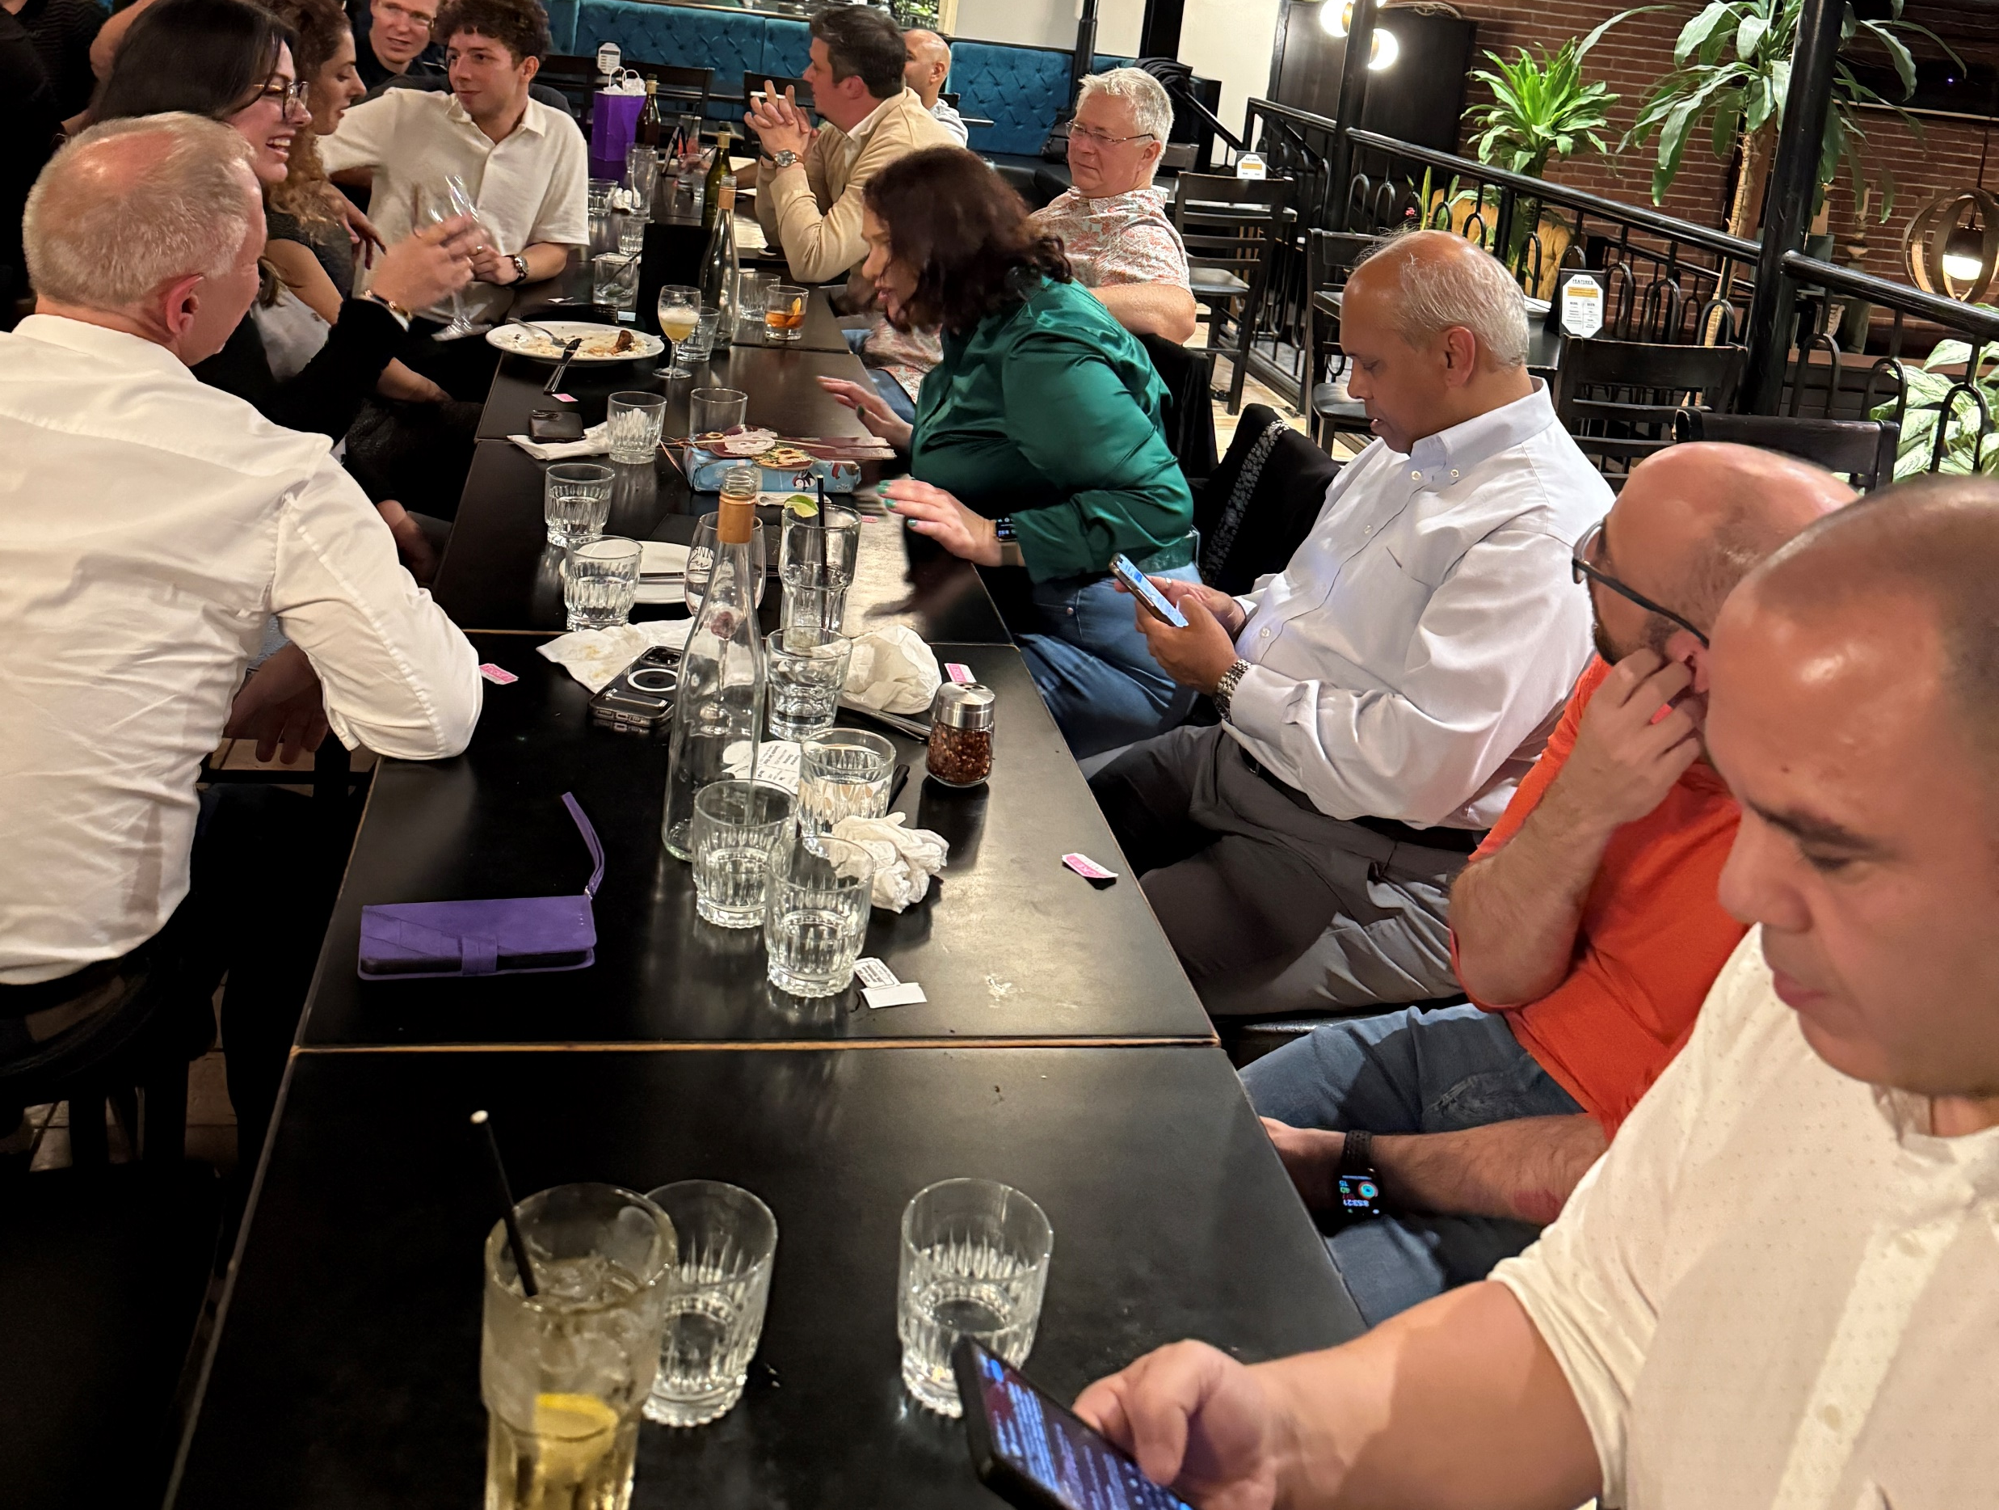
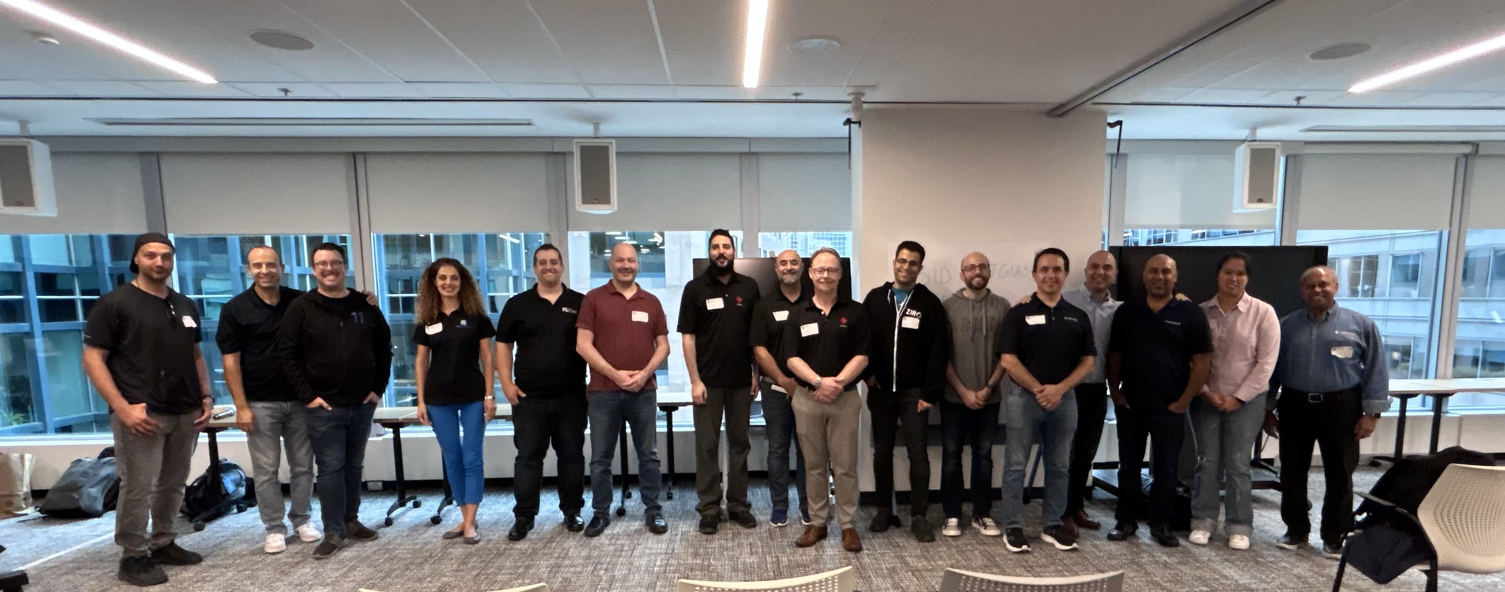
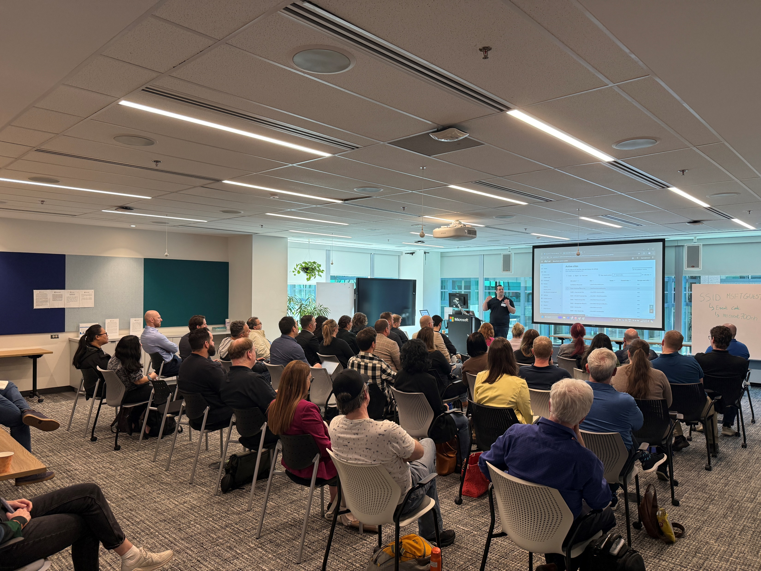
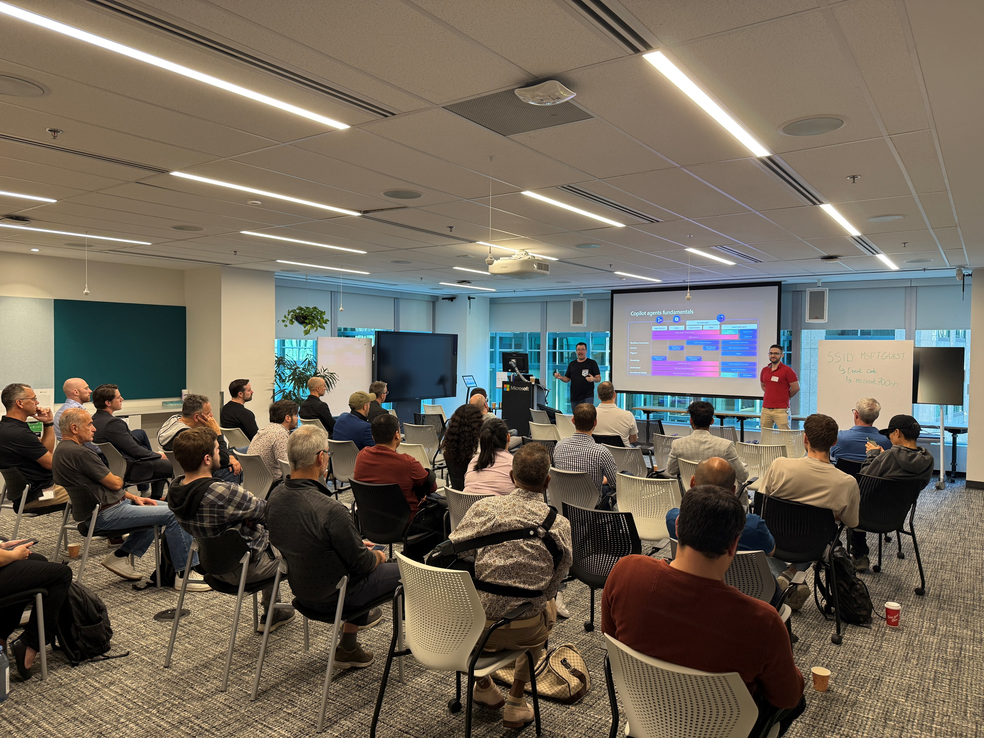
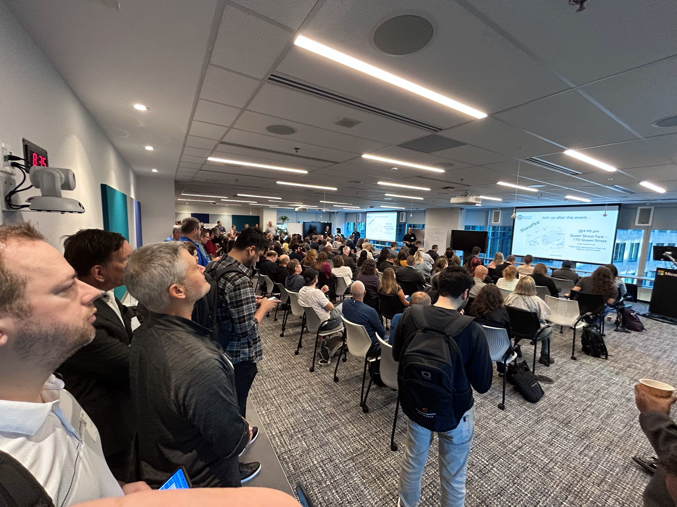
M365 Ottawa 2024 Recap
M365Ottawa.com
M365MIAMI.COM
@M365MIAMI

Slide 13
M365 Ottawa 2024 Recap
Sold out for the 3rd year in a row
Total registration: 340
Attendance: 245 (70% of the General Admission)
Sponsors: 9
2 Platinum, 3 Gold, 3 Silver, 1 Track
Committee: Total of 5 (4 MVPs) + 6 volunteers during the event
Platforms used
M365Ottawa.com
M365MIAMI.COM
@M365MIAMI

Slide 14
Attendance Overview
M365Ottawa.com
M365MIAMI.COM
@M365MIAMI

Slide 15
Success Criteria
Repeat the same success year over year
Listen to attendees’ feedback (event survey)
Listen and implement speakers’ and sponsors’ feedback (where possible)
Do a lesson’s learned right after the event
Note and correct mistakes
Invest in Technology and new ideas
Keep improving attendees, speakers and sponsors experience
M365Ottawa.com
M365MIAMI.COM
@M365MIAMI

Slide 16
Our Message…
Start early
Establish a strong committee
Make sure you secure the venue first
Reach out to your network of speakers
Broadcast your event
Close your Call for Speakers early (3 months before)
Pick your speakers minimum 8 weeks before
Show the value to sponsors
M365Ottawa.com
M365MIAMI.COM
@M365MIAMI

Slide 17
Thank you
Q&A
M365Ottawa.com

Slide 18
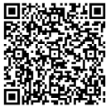
We want your feedback!
https://aka.ms/MGCIFeedback

Slide 19
Upcoming Community Led Events : Nov thru Dec
These events often serve underrepresented or emerging markets. They are organized by volunteers and are free to attendees. Newly branded “Community Days” events may cover any part of the Microsoft technical stack and/or cater to roles or industries. These are a vibrant opportunity for recruiting, career development and technical skilling. A full list of community led events can be found at CommunityDays.org.

Slide 20
Upcoming Community Produced Events – Nov thru Dec
Professionally produced community events draw from 1k-5k attendees (in-person). Attendance fees are charged, and pre/post event workshops delivered by Microsoft MVPs are often part of the event. Event organizers ask for our help in driving attendance and providing MSFT corporate speakers.

Slide 21
Holding slide for Ignite and Airlift.
aka.ms/ignite

Slide 22
What’s next
Share your feedback https://aka.ms/MGCIFeedback
Reminder:
No call in December-
Happy Holidays!
Invite colleagues to join MGCI https://aka.ms/MGCI
Join the Microsoft Tech Community https://techcommunity.microsoft.com

Slide 23
Stay Connected! Engage with the best community in tech… There’s something for everyone!
Microsoft Tech Community
The community platform for Microsoft 365 – forums, blogs, and events
aka.ms/joinMTC
aka.ms/MicrosoftCommunity
Ask and answer questions in the community forums by product and role
CommunityDays.org
Find or host a local event in your area or to match your interests
Microsoft Community on LinkedIn
News, announcements and training delivered to your news feed aka.ms/microsoftcommunitylinkedin

Slide 24
Thank you for attending
https://aka.ms/MGCIFeedback

