Slide 1
We will get started at 10 min after the hour
Grab a refreshment!
General Session
May 21, 2024

Slide 2
Microsoft Event Code of Conduct
Microsoft’s mission is to empower every person and every organization on the planet to achieve more. This includes all Microsoft events and gatherings, including on digital platforms and in person, where we seek to create a respectful, friendly, enjoyable, and inclusive experience for all participants.
​
We expect all event participants to uphold the principles of this Code of Conduct. The Code of Conduct applies to all aspects of the main event and any related activities, whether digital or in person. Microsoft does not tolerate the following in any aspect of the event program, including business and social activities:
Behavior that is disruptive, disrespectful, or degrading to others, including any messages, images, or interactions by anyone, in any form, regardless of location.​
Harassment or discrimination based on age, ancestry, color, gender identity or expression, national origin, physical or mental disability, religion, sexual orientation, or any other characteristic protected by applicable local laws, regulations, and ordinances.​
​
We encourage everyone to assist in creating a welcoming and safe environment. Please report any concerns, harassing behavior, or suspicious or disruptive activity to venue staff, the event host or owner, or the nearest event staff.
​
We also encourage everyone to contact Microsoft’s Business Conduct Hotline at any time if you feel anything or anyone is not following this Code of Conduct or is inconsistent with Microsoft’s culture. The Hotline is available regardless of whether you are a Microsoft employee and can be reached at buscond@microsoft.com or +1 (877) 320-MSFT, or call collect outside the United States at +1 (720)-904-6844. Microsoft employees can also report any concerns to their Microsoft Manager.
Microsoft reserves the right to refuse admittance to or remove any person from a Microsoft event at any time at its sole discretion.

Slide 3
Agenda
Intro
Announcements | Newest releases in community
Guest Speaker | Microsoft Loop- Rebecca Keys
Community events & updates
Open discussion forum

Slide 4
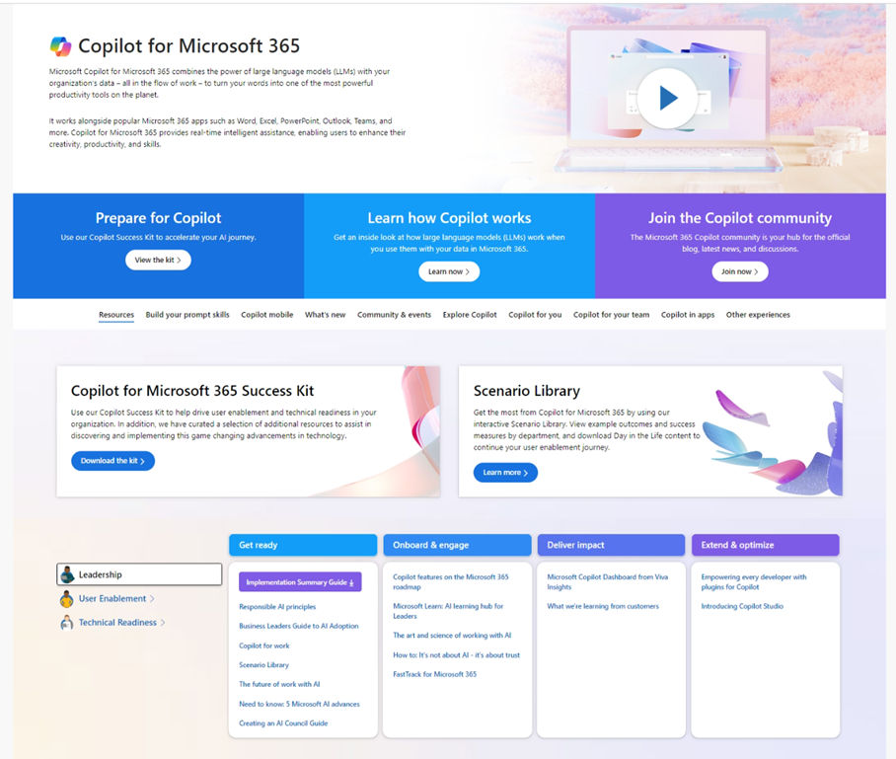
Copilot Resources on Microsoft Adoption
One site for all your Copilot needs
https://adoption.microsoft.com/copilot
Copilot Success Kit
Interactive Scenario Library
Product announcements and news
Links to all other Microsoft sites
Extended links for Small/Medium business, Copilot in Sales, Microsoft Viva, and more
Notes:
Primary home for Copilot resources from across Microsoft

Slide 5
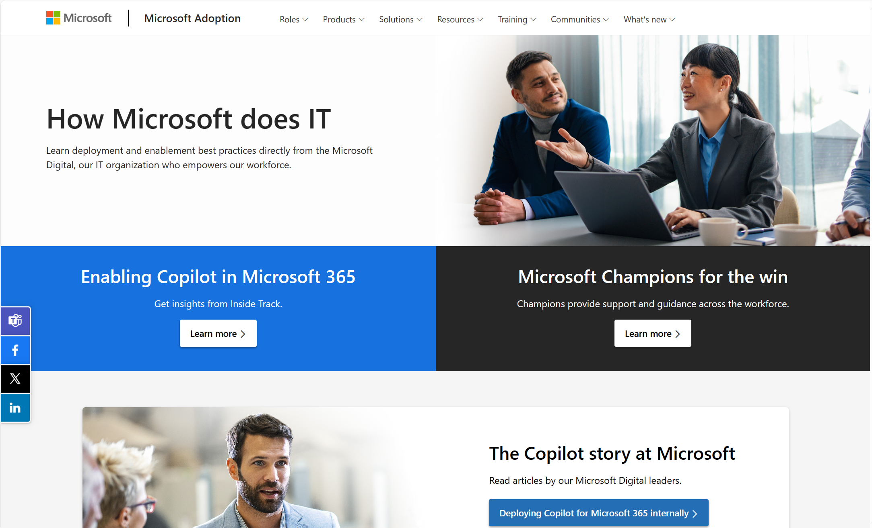
How Microsoft does IT on Microsoft Adoption
https://aka.ms/howmicrosoftdoesit
Notes:
Provides resources by role/area, such as leader, user enablement, and technical readiness, to help them deploy, use, and scale Copilot for their needs.
Showcases what’s new in Copilot, such as Copilot for SMB, Copilot for Sales, Copilot for Microsoft 365, and more.
Invites users to explore what’s possible with Copilot, such as building prompt skills, creating content, joining the community, and using Copilot in different apps.
Offers links to other Copilot experiences, such as Copilot for Sales, Copilot Studio, and Microsoft Copilot.

Slide 6
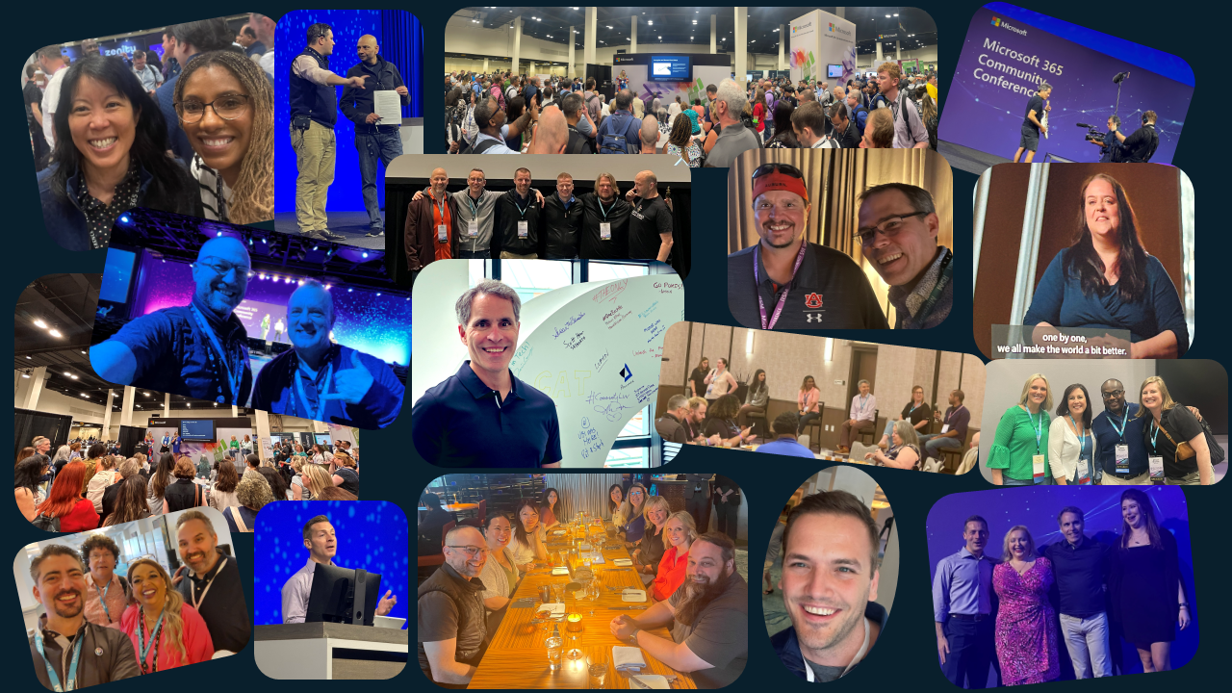
Check out the M365 Conference Recap
Microsoft Community
It was a packed week filled with insights, feedback, and fun. Check out the link below for a recap of various aspects of the event - across keynotes, general sessions, breakout sessions, our booth in the Expo Hall, the Community Lounge and Lightning Talks, roundtable discussions, and user research sessions. Our community cup runneth over!
Click here to read the recap!

Slide 7
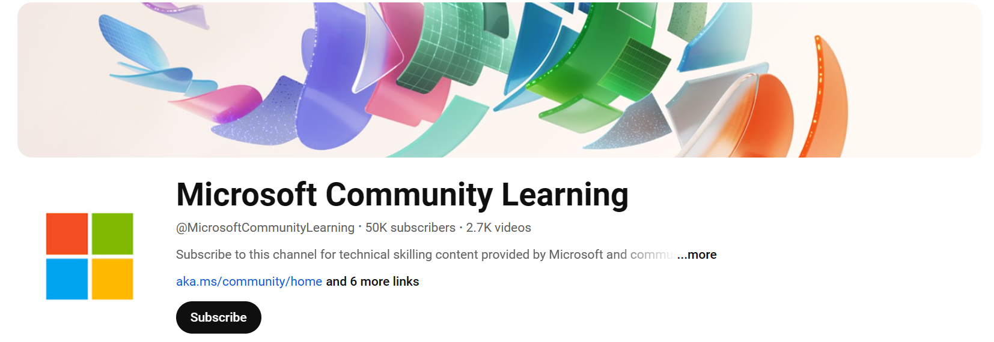
5/23 Launch of Microsoft Community Youtube & Community News Desk
Microsoft Community
Announced on Mondays at Microsoft on 5/13:
On 5/23 previously known as the M365 and Power Platform Youtube channel will be expanding and will be known as Microsoft Community Learning
On Microsoft Community Learning Youtube channel, you'll get content from Viva, Windows, including the Microsoft 365 Champions community calls, and more!
One stop shop for your technical skilling, demos, tutorials and community calls
In addition, keep up to date on community at our new Microsoft Community News Desk
Click here to watch the announcement from Mondays at Microsoft!

Slide 8
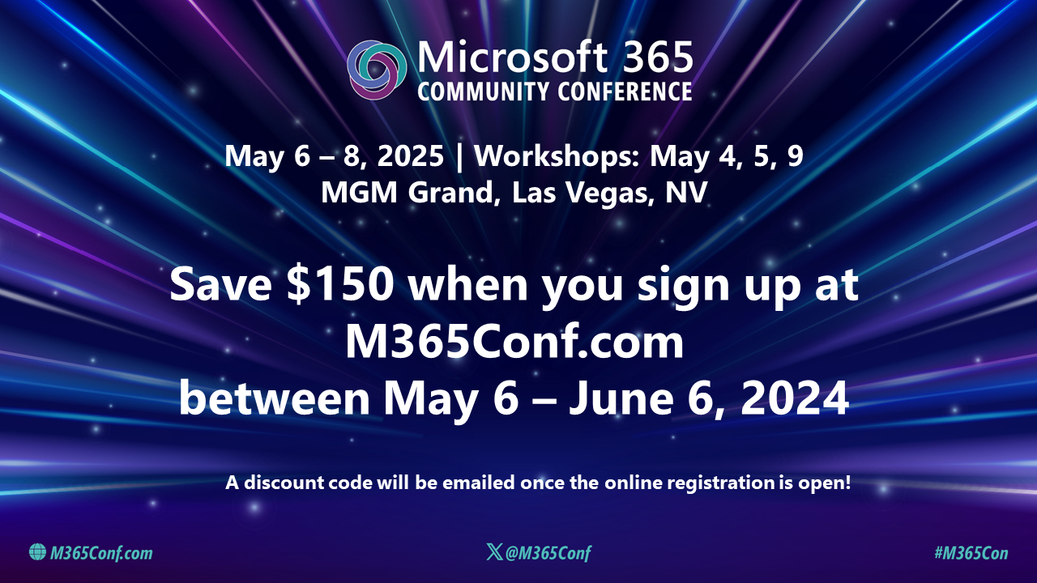
Check out the M365 Conference Recap
Microsoft Community
It was a packed week filled with insights, feedback, and fun. Check out the link below for a recap of various aspects of the event - across keynotes, general sessions, breakout sessions, our booth in the Expo Hall, the Community Lounge and Lightning Talks, roundtable discussions, and user research sessions. Our community cup runneth over!
Click here to read the recap!

Slide 9
Communitydays.org Statistics
CommunityDays.org current numbers:
Total in tool: 224
CY22 Events: 25 | FY23: 74
CY23 Events: 110 | FY24: 130
CY24 Events: 88 | FY25: 20
CY25 Events: 1

Slide 10
Communitydays.org Feature Update
​Updates and feature list for Communitydays.org​
Complete / Rolling Out​
Community Calls Calendar
Redirect Fix
​
Working on it​
Organizers Tab
Community Calls - Add/Manage
​
Up Next​
Events as List / Calendar

Slide 11
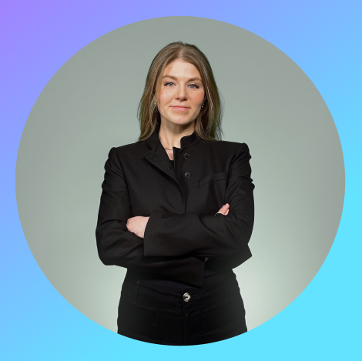
Rebecca Keys
Microsoft Loop Product Manager
@RebeccasWorking

Slide 12
How does Loop work?
Outlook
Teams
Word on the web
Whiteboard
Loop components stay in sync across tools…
and the Loop app keeps everything important to your project in one place
Notes:
TAMINE
Users see the most value when they use the Loop app and Loop components together.
Loop components can be started in the Loop app or in other M365 app, and they stay in sync across tools.
The Loop app keeps your components, pages, links, and anything important to your project in one place so you can stay organized.

Slide 13
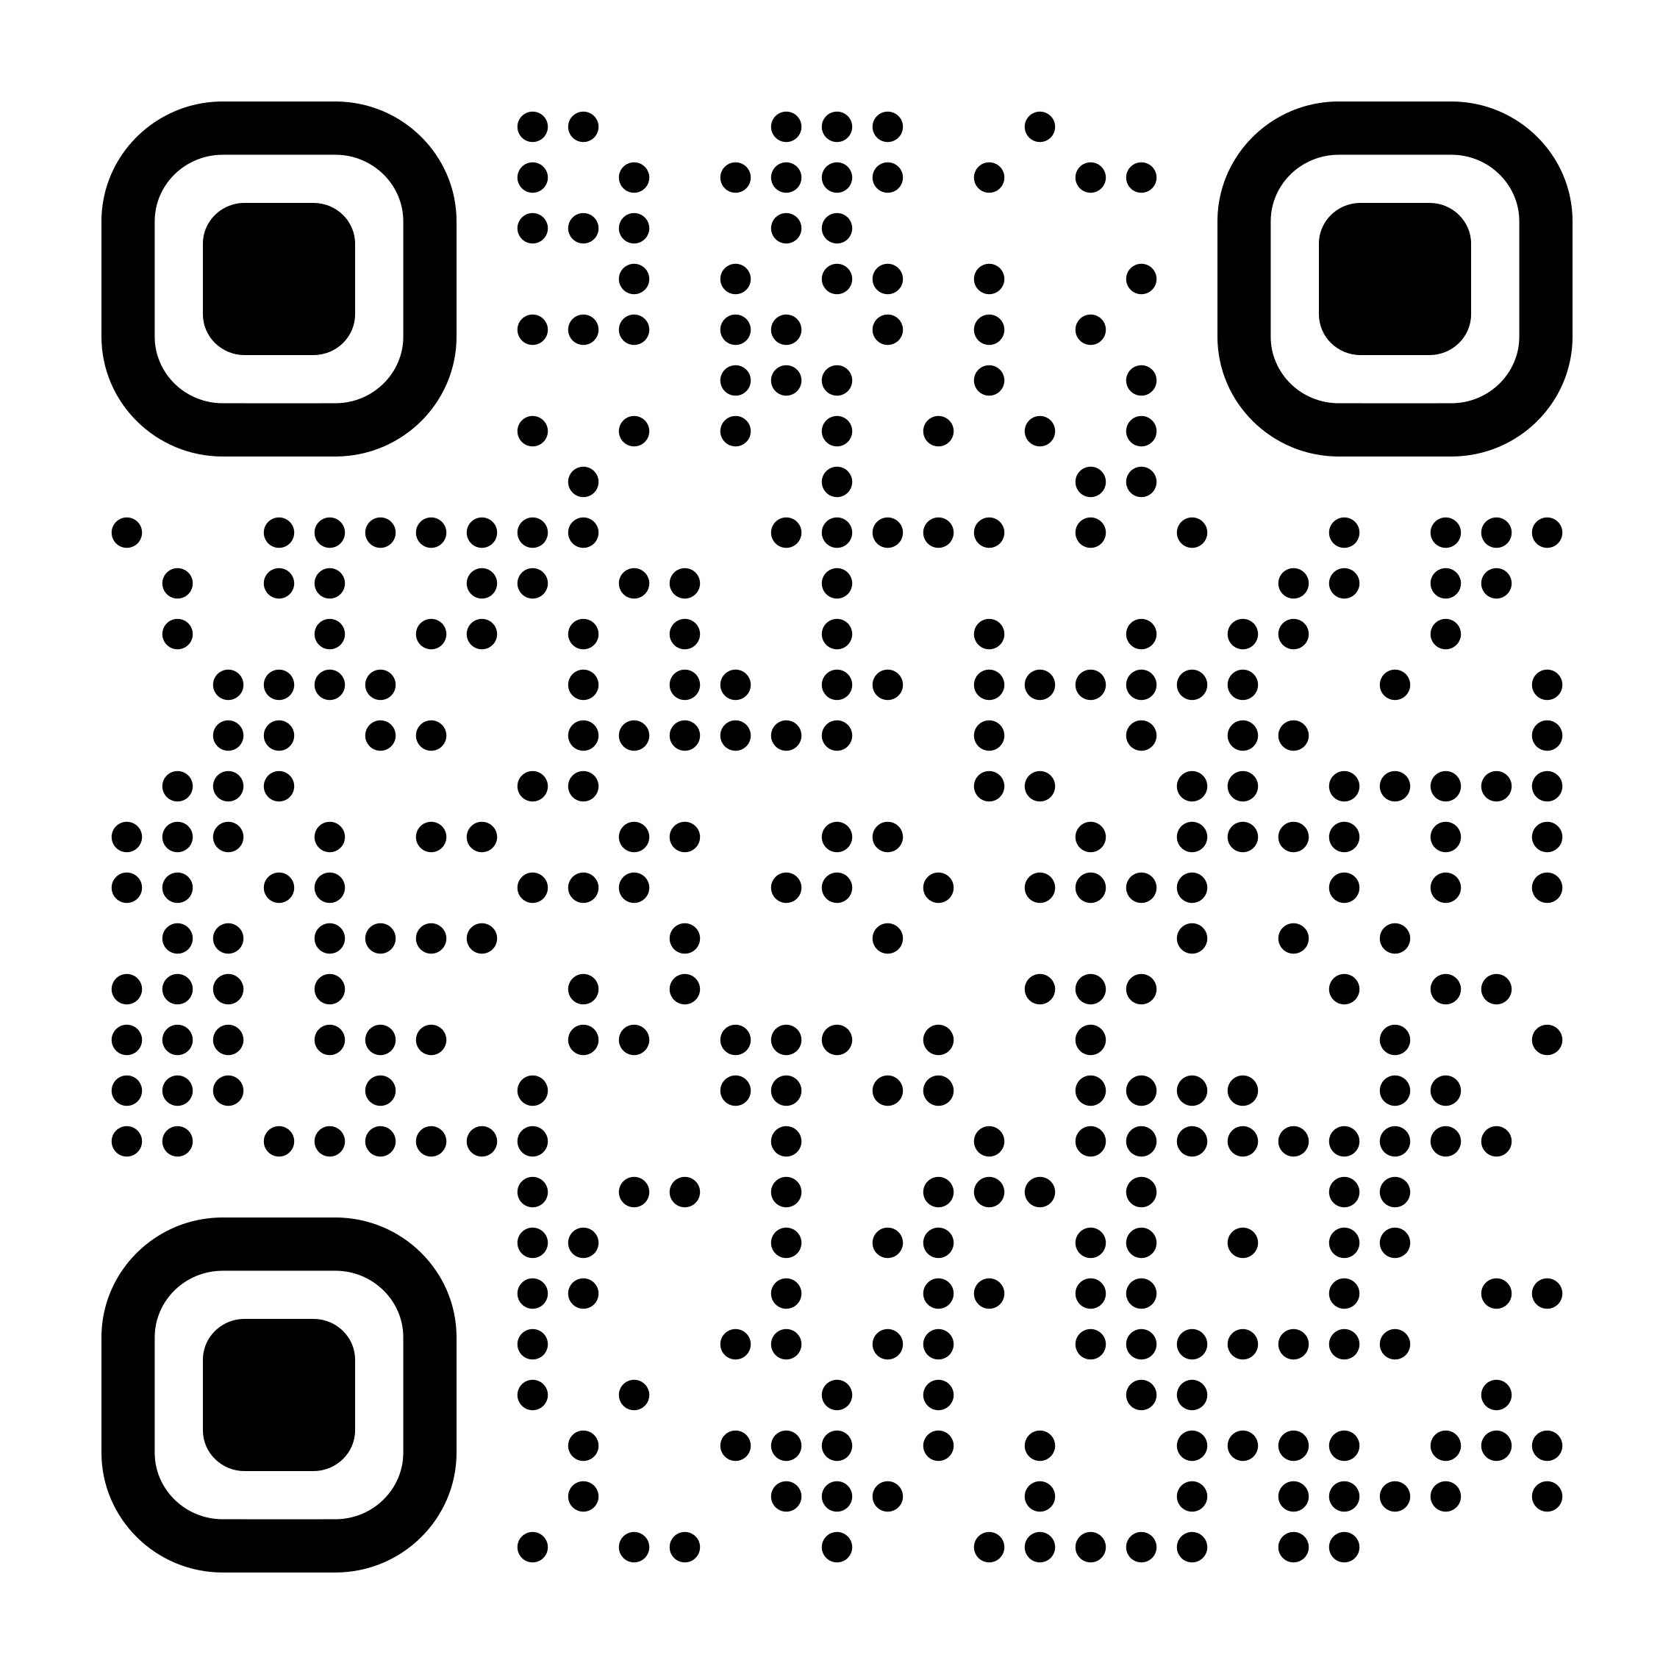
More Loop resources
https://aka.ms/LearnAboutLoop

Slide 14
Upcoming Community Produced Events: May – July 2024
Professionally produced community events draw from 1k-5k attendees (in-person). Attendance fees are charged, and pre/post event workshops delivered by Microsoft MVPs are often part of the event. Event organizers ask for our help in driving attendance and providing MSFT corporate speakers.
Event name | Start date | End date | City | State/Province | Country | Products
Tehcorama | 5/6/2024 | 5/8/2024 | Antwerp |  | Belgium | .NET; Azure / Cloud; Containers / Kubernetes; Data; Developer tools + DevOps; Microsoft 365
DynamicsCon LIVE | 5/13/2024 | 5/16/2024 | Denver | Colorado | United States | Dynamics 365; Power Platform
European Collaboration Summit 2024 | 5/14/2024 | 5/16/2024 | Wiesbaden |  | Germany | Microsoft 365; Power Platform
IM Tech Summit Europe 2024 | 5/15/2024 | 5/15/2024 | Brighton |  | United Kingdom | AI/ML
DevSum | 5/15/2024 | 5/17/2024 | Stockholm |  | Sweden | .NET; Azure / Cloud; Career / D&I (Diversity and Inclusion); AI / ML; Containers / Kubernetes; Data; Developer tools + DevOps
Get-CsLatam Conference and Expo 2024 | 5/16/2024 | 5/17/2024 | Mexico City |  | Mexico
DynamicsMinds 2024 | 5/26/2024 | 5/29/202 | Portoroz |  | Slovenia | Dynamics 365; Power Platform
Thrive Conference | 5/28/2024 | 5/29/2024 | Podcetrtek |  | Slovenia | Azure / Cloud; Microsoft 365; Power Platform
TechCon365 and PWRCON - A Microsoft 365 and Power Platform Conference | 6/3/2024 | 6/7/2024 | Seattle | Washington | United States | Microsoft 365; Power Platform
NDC Oslo | 6/10/2024 | 6/14/2024 | Oslo |  | Norway | .NET, AI / ML, Azure / Cloud, Containers / Kubernetes, Data, Developer tools + DevOps

Slide 15
Upcoming Community Produced Events: Continued
Event name | Start date | End date | City | State/Province | Country | Products
European Power Platform Conference | 6/11/2024 | 6/13/2024 | Brussels |  | Belgium | Microsoft 365; Power Platform
Update Days: .NET Performance | 6/26/2024 | 6/27/2024 | Krakow |  | Poland | NET, Developer tools + DevOps
Experts Live Kenya 2024 | 7/26/2024 | 7/26/2024 | Nairobi | Nairobi | Kenya | AI / ML, Azure / Cloud, Containers / Kubernetes, Data, Developer tools + DevOps, Dynamics 365, Microsoft 365, Power Platform, Security / Compliance, Python
Digital Workplace Conference Australia | 7/31/2024 | 8/1/2024 | Sydney |  | Australia | Microsoft 365; Power Platform

Slide 16
Upcoming Community Led Events: May – July 2024
These events often serve underrepresented or emerging markets. They are organized by volunteers and are free to attendees. Newly branded “Community Days” events may cover any part of the Microsoft technical stack and/or cater to roles or industries. These are a vibrant opportunity for recruiting, career development and technical skilling. A full list of community led events can be found at CommunityDays.org.
Event name | Start date | End date | City | State/Province | Country
Power Platform Study Session 1 | 5/8/2024 | 5/8/2024 | Osaka | Osaka | Japan
M365 Philly 2024 | 5/18/2024 | 5/18/2024 | Malvern | Pennsylvania | United States
Americas - SharePoint Intranet Festival | 5/22/2024 | 5/22/2024 | Virtual
EMEA - SharePoint Intranet Festival | 5/22/2024 | 5/22/2024 | Virtual
APAC - SharePoint Intranet Festival | 5/22/2024 | 5/22/2024 | Virtual
Power Platform Developer Summit 2024 | 5/25/2024 | 5/25/2024 | London |  | United Kingdom
DynUG Spring Conference | 5/28/2024 | 5/29/2024 | Oslo |  | Norway
BeConnected day 12 - CollabDays Italy 2024 | 5/30/2024 | 5/30/2024 | Milan |  | Italy
CollabDays Netherlands 2024 | 6/1/2024 | 6/1/2024 | Vianen | Utrecht | Netherlands
AI Community Event - NYC 2024 | 6/7/2024 | 6/7/2024 | New York | New York | United States
aMS Aix-Marseille 2024 | 6/11/2024 | 6/11/2024 | Marseille |  | France
CollabDays Madrid 2024 | 6/14/2024 | 6/14/2024 | Madrid |  | Spain
M365 COMMUNITY DAYS MTL 2024 | 6/14/2024 | 6/14/2024 | Montreal | Quebec | Canada

Slide 17
Upcoming Community Led Events: Continued
Event name | Start date | End date | City | State/Province | Country
Intranets and AI on Microsoft 365 | 6/19/2024 | 6/20/2024 | Virtual
AI Community Event - NYC 2024 | 6/21/2024 | 6/21/2024 | New York | New York | United States
aMS Brazzaville 2024 | 6/25/2024 | 6/25/2024 | Brazzaville | Republic du Congo | Congo
Workplace Ninjas UK – Manchester | 7/2/2024 | 7/2/2024 | Manchester | Greater Manchester | Great Britain
AI Community Event - Toronto 2024 | 7/12/2024 | 7/12/2024 | Toronto | Ontario | Canada
M365 Community Days NYC 2024 | 7/26/2024 | 7/26/2024 | New York | New York | United States

Slide 18
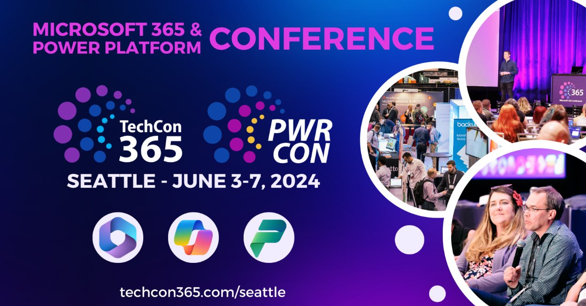

Slide 19
Experts Live
Europe 2024
Where the Microsoft community connects.
www.expertslive.eu

Slide 20
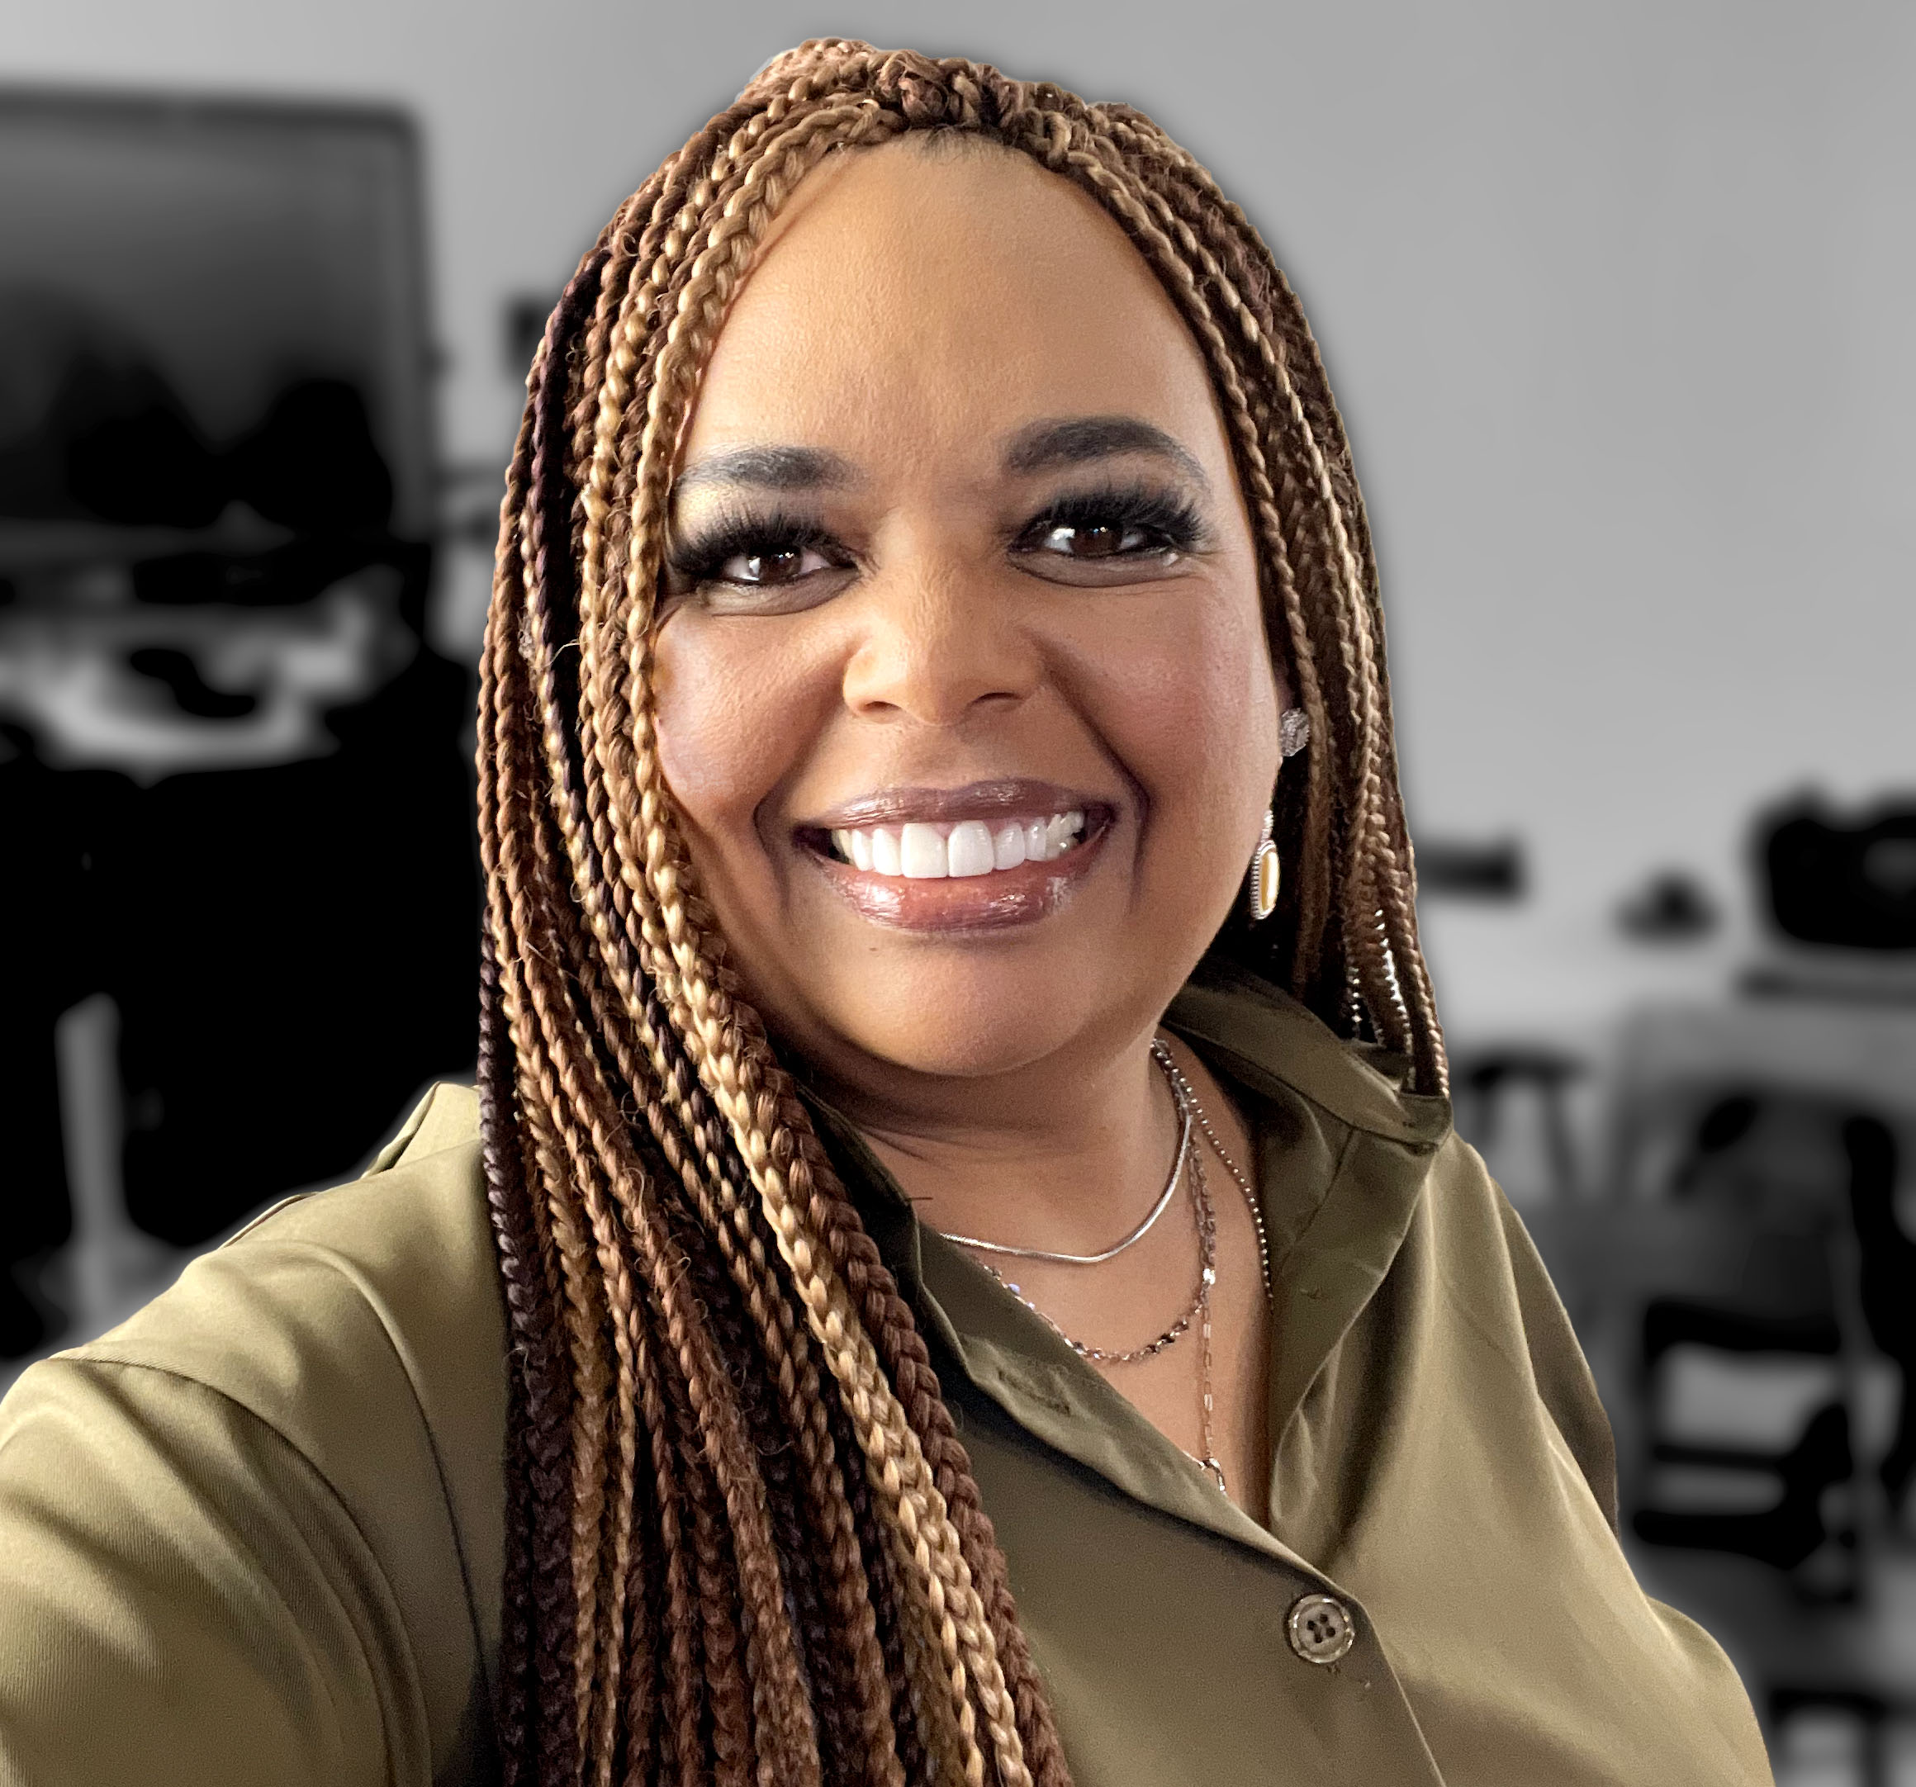
Monday’s at Microsoft with Karuana & Heather
Karuana Gatimu
Learn - Explore – Connect In the Microsoft Community
Bi-weekly @ 8am PT
Watch on
Microsoft Community Linked
Heather Cook
https://aka.ms/microsoftcommunitylinkedin
Notes:
Last used May 2023, Heather Cook

Slide 21
Community Event Organizer Training and Office Hours
WHEN:
The last Thursday of each month, 8:10am PT
May 30 at 8:10am PDT
WHERE:
Community Tenant,
invite sent from mgci@msftcommunity.com
WHO:
Organizers of Community Led Events
Join us for Community Event Organizer Training & Office Hours where you’ll be able to get all the help you need with our tools, training and support to do a fun and impactful event.
Ask questions in our Events & Sponsor channel

Slide 22
Community Event
Producer Roundtables
WHEN:
NEW! Quarterly, the fourth Tuesday. 8:10am & 5:10pm PT
June 25 at 8:10am & 5:10pm PDT
WHERE:
Community Tenant,
invite sent from mgci@msftcommunity.com**
WHO:
Organizers of Community Produced Events
INTERESTED?
Let us know at https://aka.ms/3PEventProducers
Please share this sign-up link with your co-organizers or others that you know are also producers, all are welcome.
**Once a non-disclosure agreement (NDA) is complete, you will be added to the private channel and a meeting invitation will be sent. A separate NDA is required for this set of meetings even if you have another via a different Microsoft program.
As a part of the Microsoft Global Community Initiative, we have put together a series of Community Event Producer monthly roundtables. The roundtables will require a signed non-disclosure agreement (NDA) specific to this set of meetings as we will share information, flagship event dates and upcoming strategies and planning with you regarding Microsoft events. As we discuss many topics together, we want to have a safe, private space for all of us to have these discussions. The goal of these roundtables is to both inform you of internal initiatives and to listen to your feedback on how Microsoft can continue to support community efforts and events in the future.

Slide 23
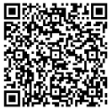
We want your feedback!
https://aka.ms/MGCIFeedbackMay2024

