Slide 1
Women In Tech & Allies:
Strengthening Community Across the Microsoft Ecosystem

Slide 2
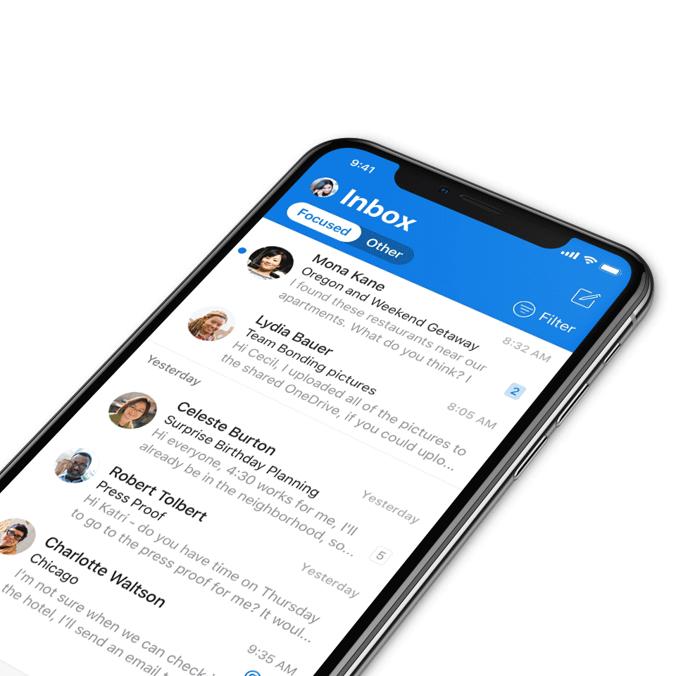
Digital Event Code of Conduct
Microsoft’s mission is to empower every person and every organization on the planet to achieve more. This includes all Microsoft events and gatherings, including on digital platforms, where we seek to create a respectful, friendly, fun and inclusive experience for all participants.​
We expect all digital event participants to uphold the principles of this Code of Conduct, which covers the main digital event and all related activities. We do not tolerate disruptive or disrespectful behavior, messages, images, or interactions by any party participant, in any form, at any aspect of the program including business and social activities, regardless of location.​
Microsoft will not tolerate harassment or discrimination based on age, ancestry, color, gender identity or expression, national origin, physical or mental disability, religion, sexual orientation, or any other characteristic protected by applicable local laws, regulations, and ordinances.​
We encourage everyone to assist in creating a welcoming and safe environment.
For more info, click here.

Slide 3
All General Sessions are recorded and posted on-demand on the Microsoft Community Learning YouTube channel if you do not want to be recorded, please leave the call or stay on mute. ​
​
Speaker video and audio will be shown in the recordings.​
Attendee questions audio will be also be shared.​
​
​
We do not allow outside AI notetakers in this meeting.

Slide 4

MGCI Mission and Tagline
The Microsoft Global Community Initiative (MGCI) - Empowering global Microsoft communities with the tools, training, and resources to create impactful events and amplify diverse voices.
Learn, Share, Grow.
Join MGCI today! https://aka.ms/MGCI

Slide 5

Agenda
Panelist intros
Moderated panel questions
Lightning round
Wrap‑up + call to action

Slide 6
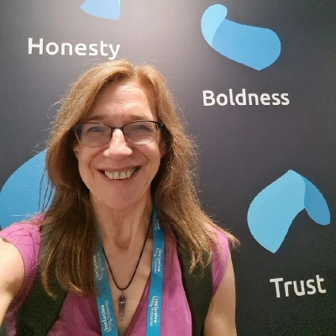
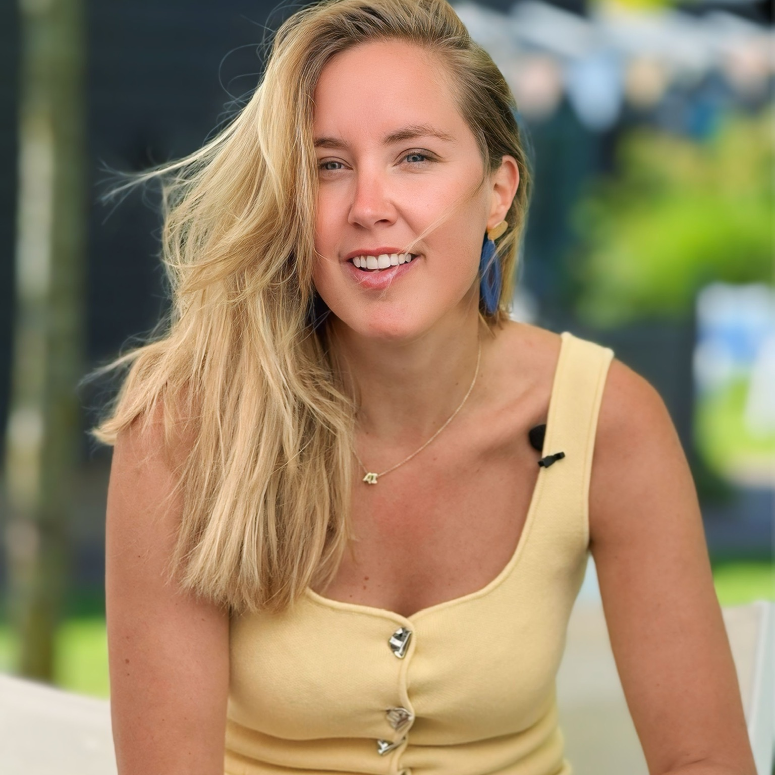
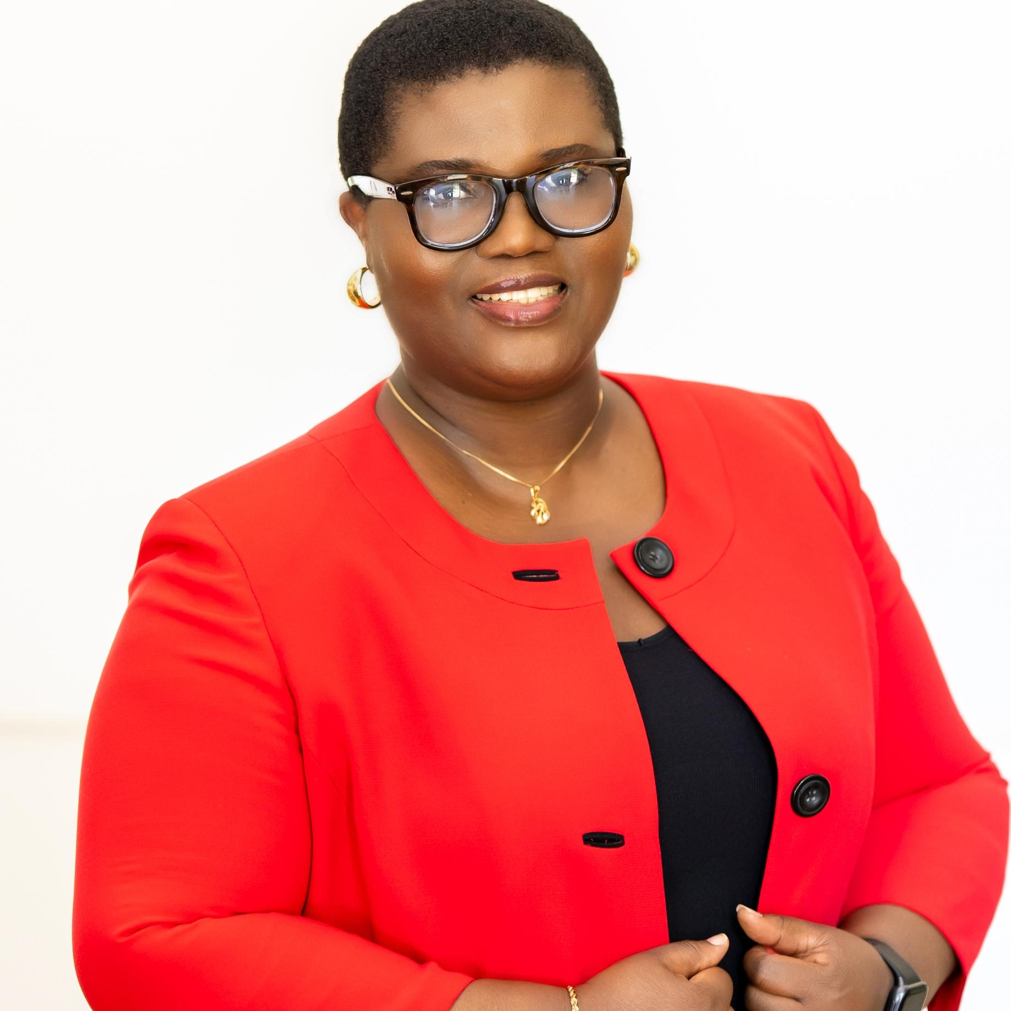
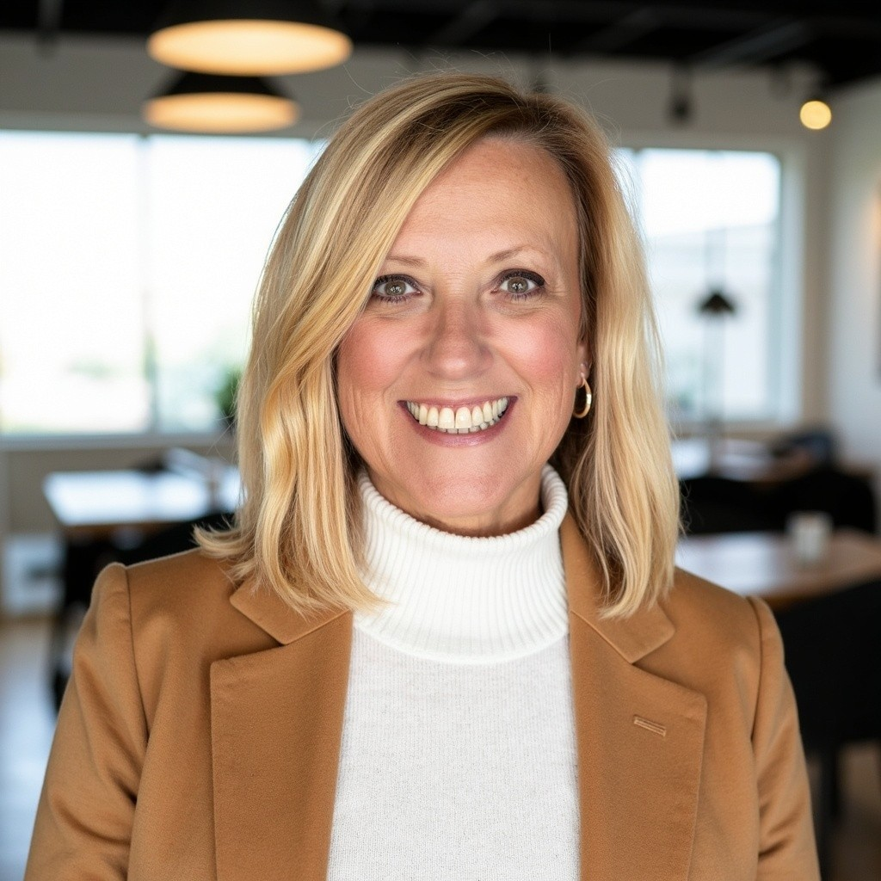
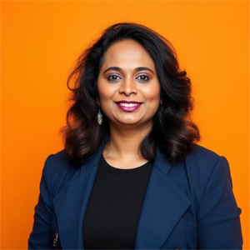

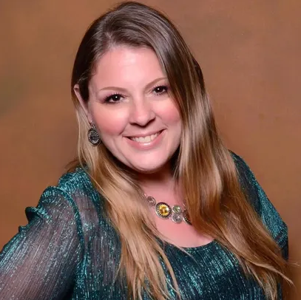
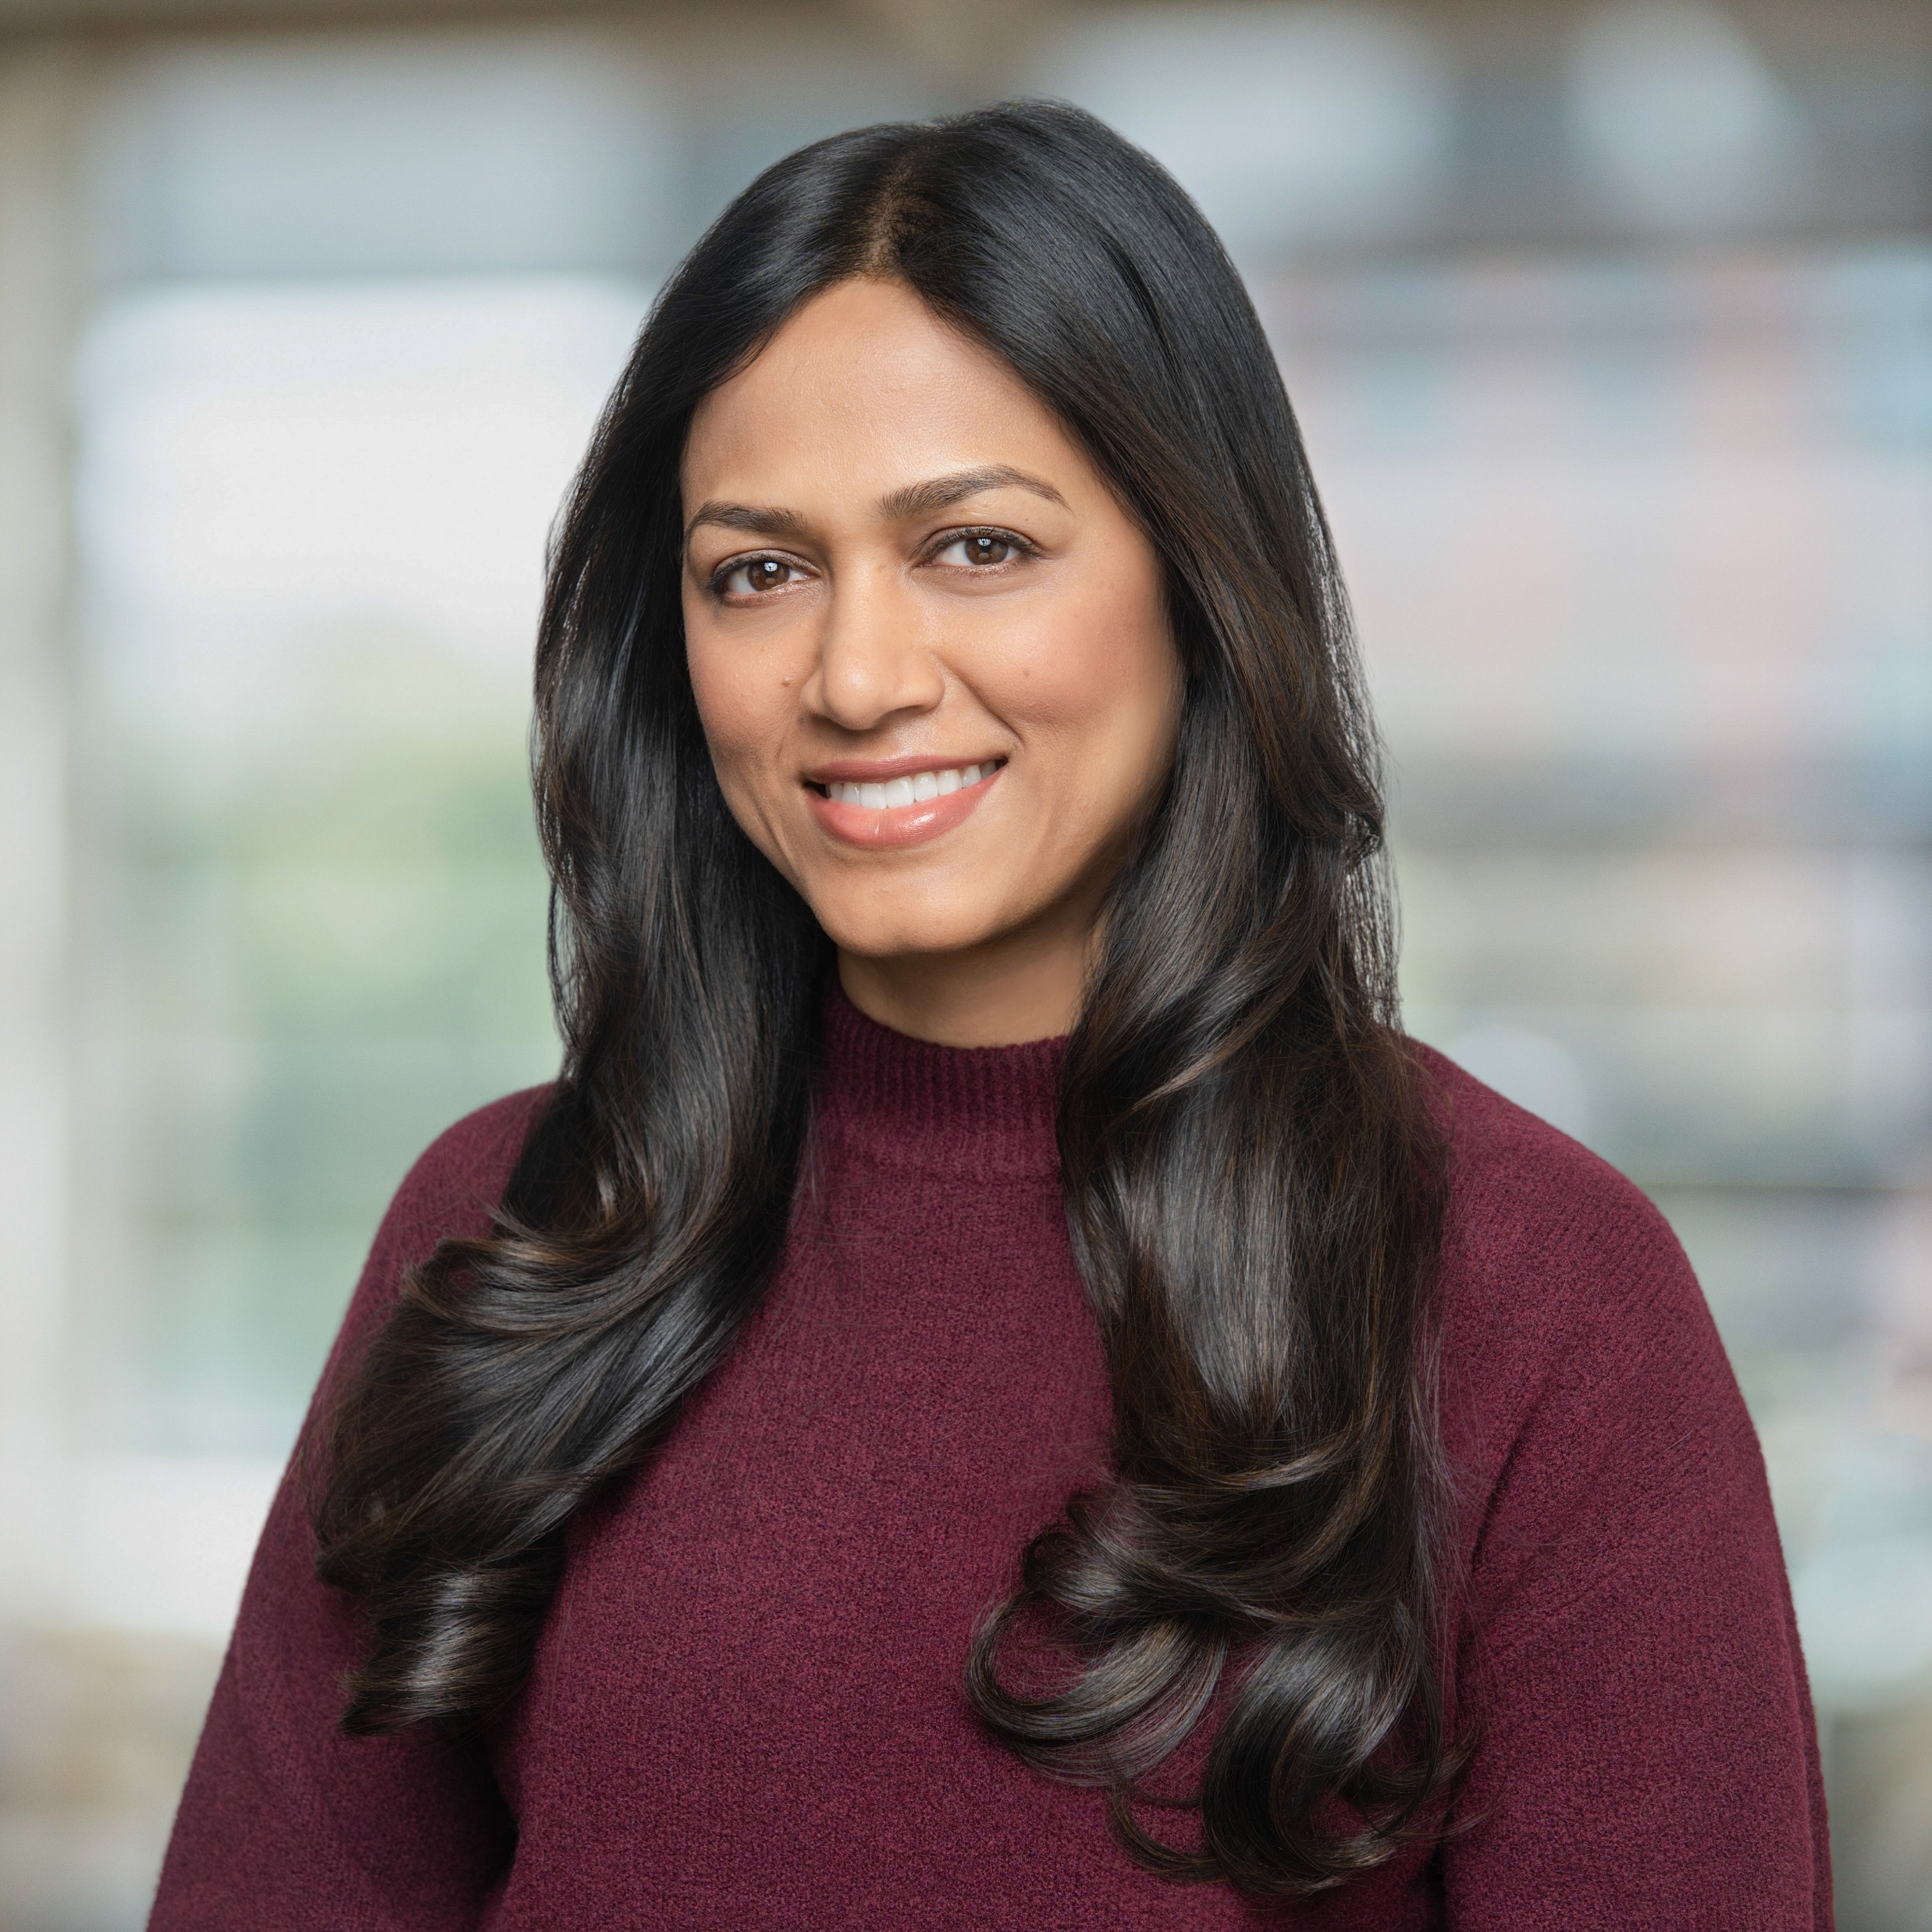
Today's Panel (AM Session)
Sharon Smith
The Mentoring Hub
Femke Cornelissen
Rockstar Women in AI& Security
Olajumoke Toriola
TechStylers
Christine Bongard
The WIT Network
Chaitra Vedullapalli
Women in Cloud
Rachel Sullivan
Sharon Weaver
Women in M365
Sravani Seethi
Women in Power

Slide 7
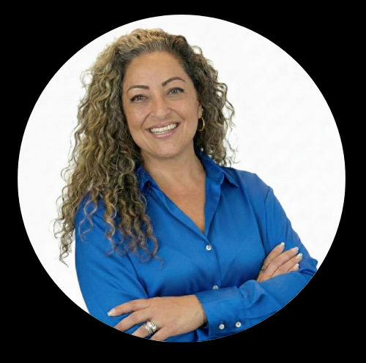
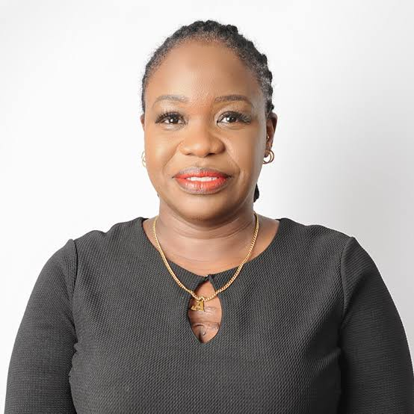
Today's Panel (PM Session)
Sharon Smith
The Mentoring Hub
Melissa Ballesteros
Rockstar Women in AI& Security
Nihinlola Adeyemi
TechStylers
Christine Bongard
The WIT Network
Chaitra Vedullapalli
Women in Cloud
Rachel Sullivan
Sharon Weaver
Women in M365
Sravani Seethi
Women in Power

Slide 8
The Communities

Slide 9

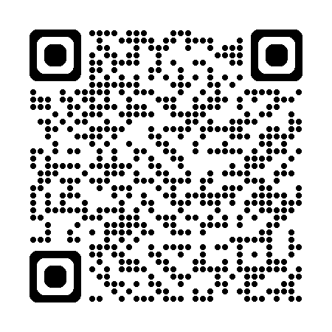
The Mentoring Hub
Group Logo
One Connection can Change Everything: Start here.
Connecting underrepresented people in Tech with mentors, resources, and opportunities. Empowering everyone to thrive.
For every women in UK tech, there are four men. Similar statistics are seen worldwide. But together we’re rewriting this story.
We don’t ‘meet’ in the traditional sense, but we provide programs that bring people together to support, learn and thrive together.
QR Code for Community or Group Page

Slide 10
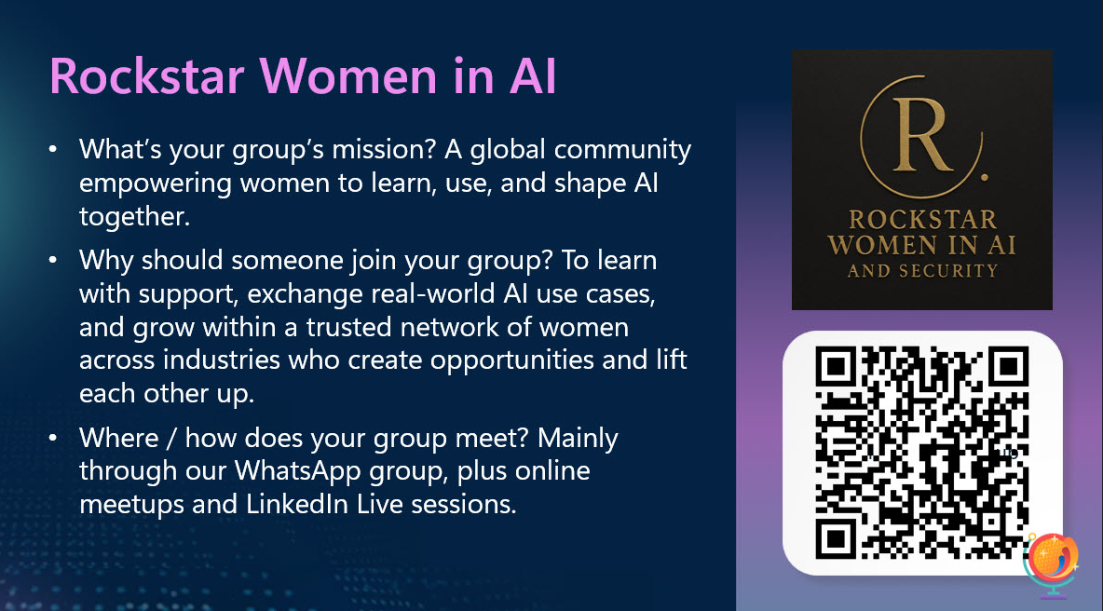

Slide 11

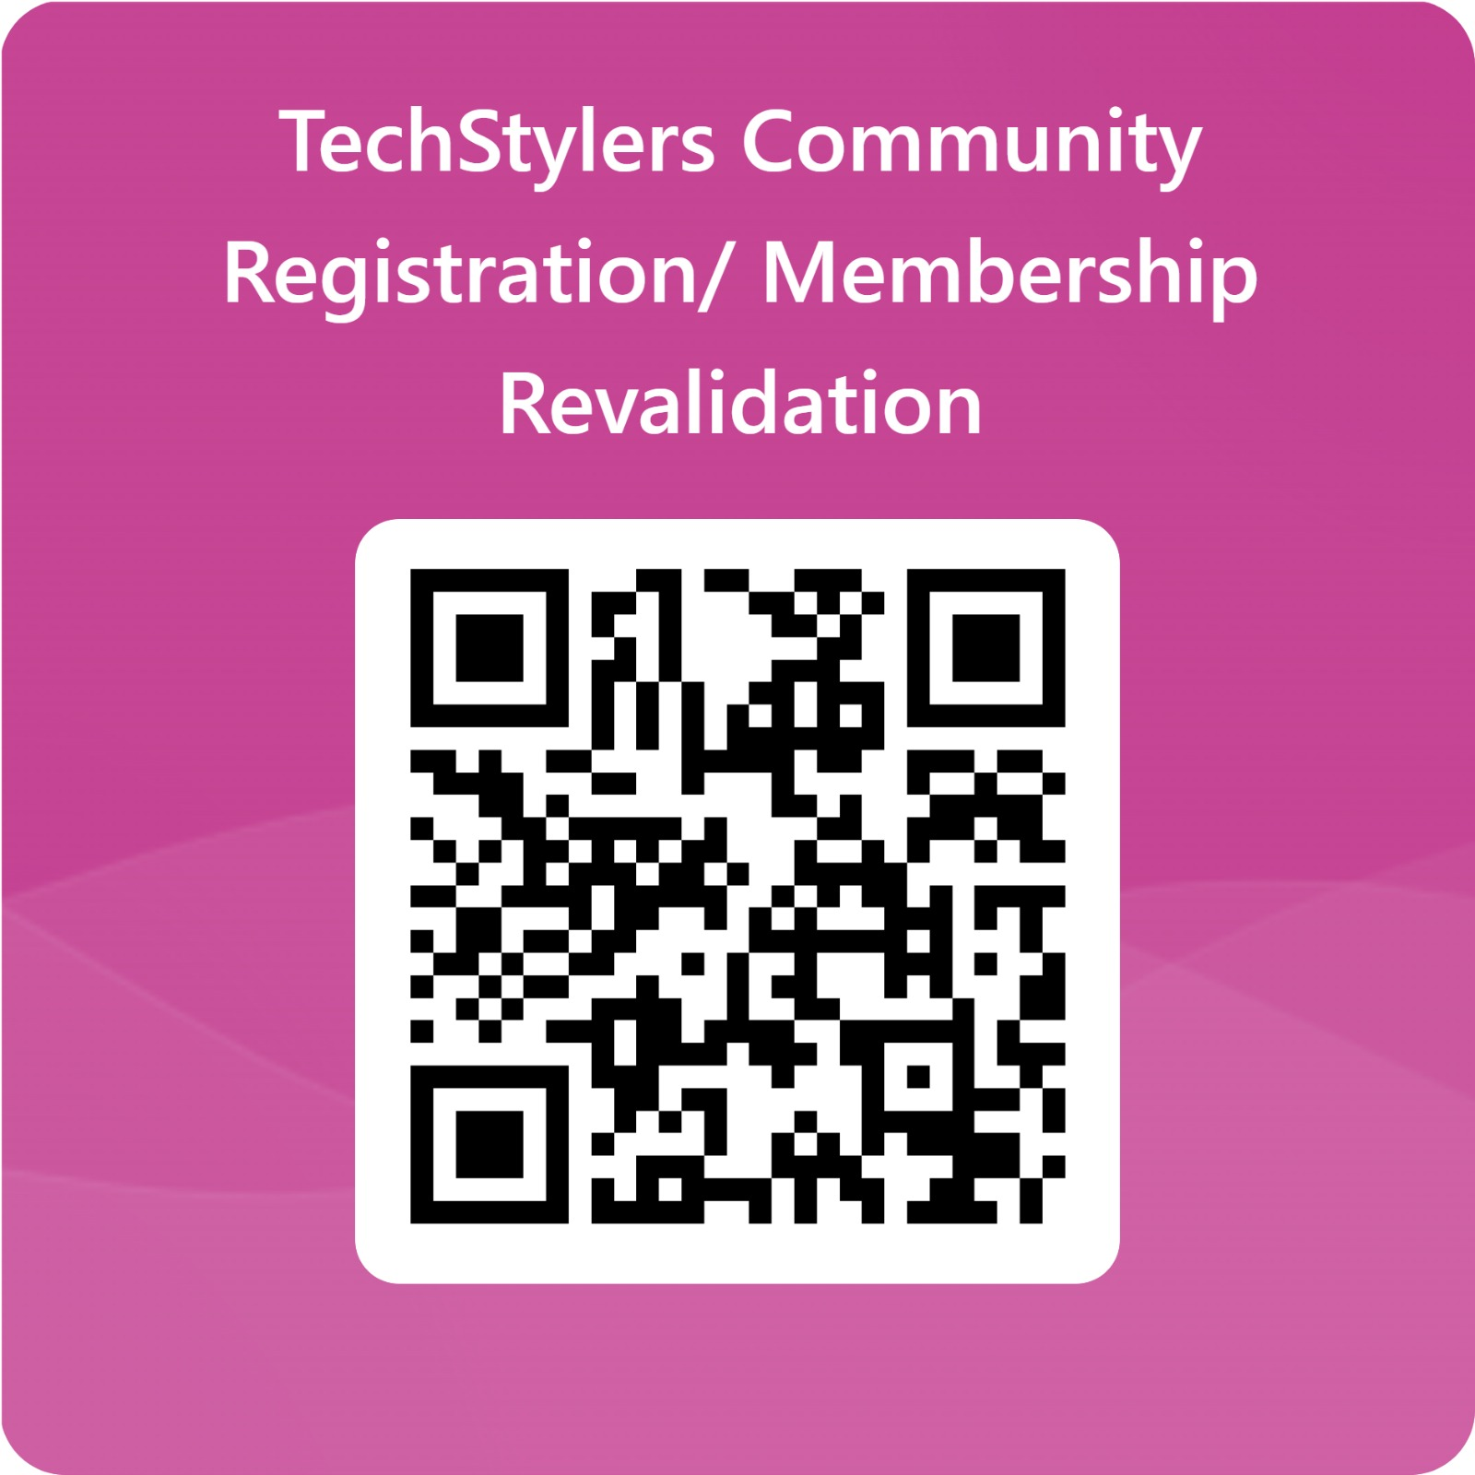
TECHSTYLERS
About Us
  Founded on May 30, 2020, TechStylers is a community focused on supporting women who desire growth in technology.
Our mission:
  Support girls to build a career in technology​.
  Support women who desire to have a career in technology.
  Help these women define a career path. ​
  Support women who have their tech careers but are not confident enough to demonstrate their wealth of knowledge.
  Support women who have already defined their tech path and wish to deepen their skills.
  Provide a platform for the established women in technology to empower and mentor upcoming women in technology.
Why should someone join your group?
  Joining TechStylers offers more than just knowledge; it provides a community, mentorship, growth, and the confidence needed to thrive in tech. This is a space where women are supported, inspired, and equipped with the skills and network necessary for success.
Where / how does your group meet?
  Inspirational Sessions - Every last Saturday of the month at 6 pm (GMT +1).
  Tech Deep Dive – A free 8 to 10-week intensive technical cohort.
  EvolveCon – A yearly conference for the TS community, celebrating women and strength.
Group Logo
QR Code for Community or Group Page

Slide 12


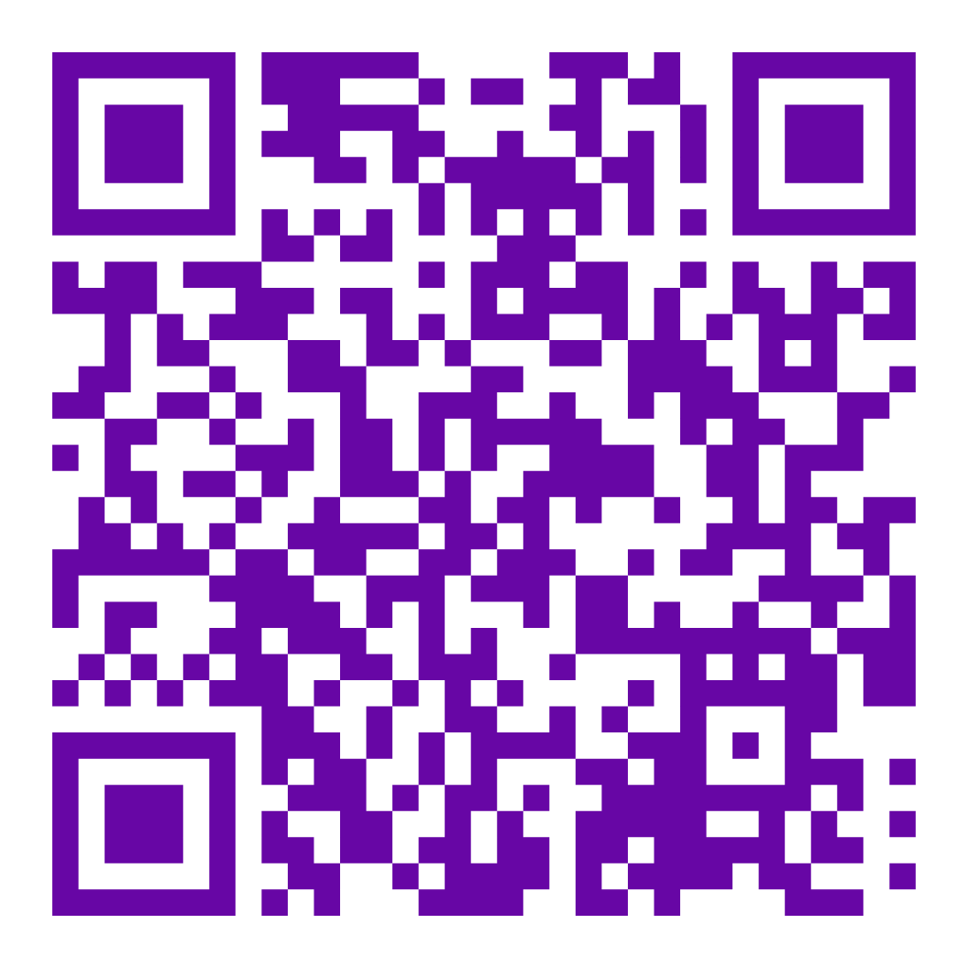
The WIT Network is a global community that supports, connects and elevates women and their allies – through educational programs, mentorship and networking that turn development into transformation.
Join 15,000 women and allies from 68 countries on a mission to drive transformation in their careers. We offer webinars, workshops, mentoring circles, network events, leadership and professional development, technology training to help you upskill and achieve success.
It’s not just a network.
It’s a vibe.
www.TheWITNetwork.com

Slide 13

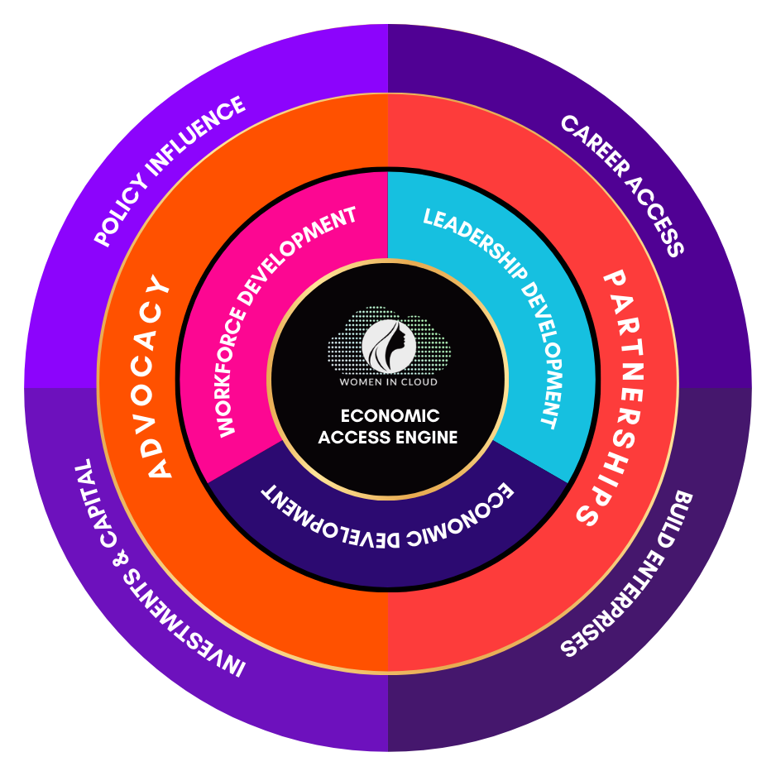
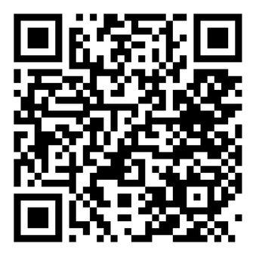
Women In Cloud
MISSION: $1B Economic Access Movement
Ecosystem: 150,000+ members across 120 countries
Our mission is to create structured pathways for women to build economic power in the AI economy. We focus on three outcomes:
  Career Access — helping women professional secure industry certifications & high-growth tech jobs
  Enterprise Access — helping women founders access customers, cloud marketplaces and strategic partnerships
  Leadership Access — helping women executives access industry stages, AI investments and board advisor's opportunities
People join Women in Cloud because it provides real economic opportunity, not just networking. For many members, WIC becomes a launchpad for careers, companies, and industry leadership.
Women in Cloud operates as a global hybrid ecosystem. Members connect through: Digital Community Platform, Global Events and Summits, Certification Programs, Confidence Circle Program, Investment Funds, Co-Authorship, Movies and more. It is an economic engine designed to turn talent, ideas, and partnerships into real opportunities in the AI-powered economy.

Slide 14

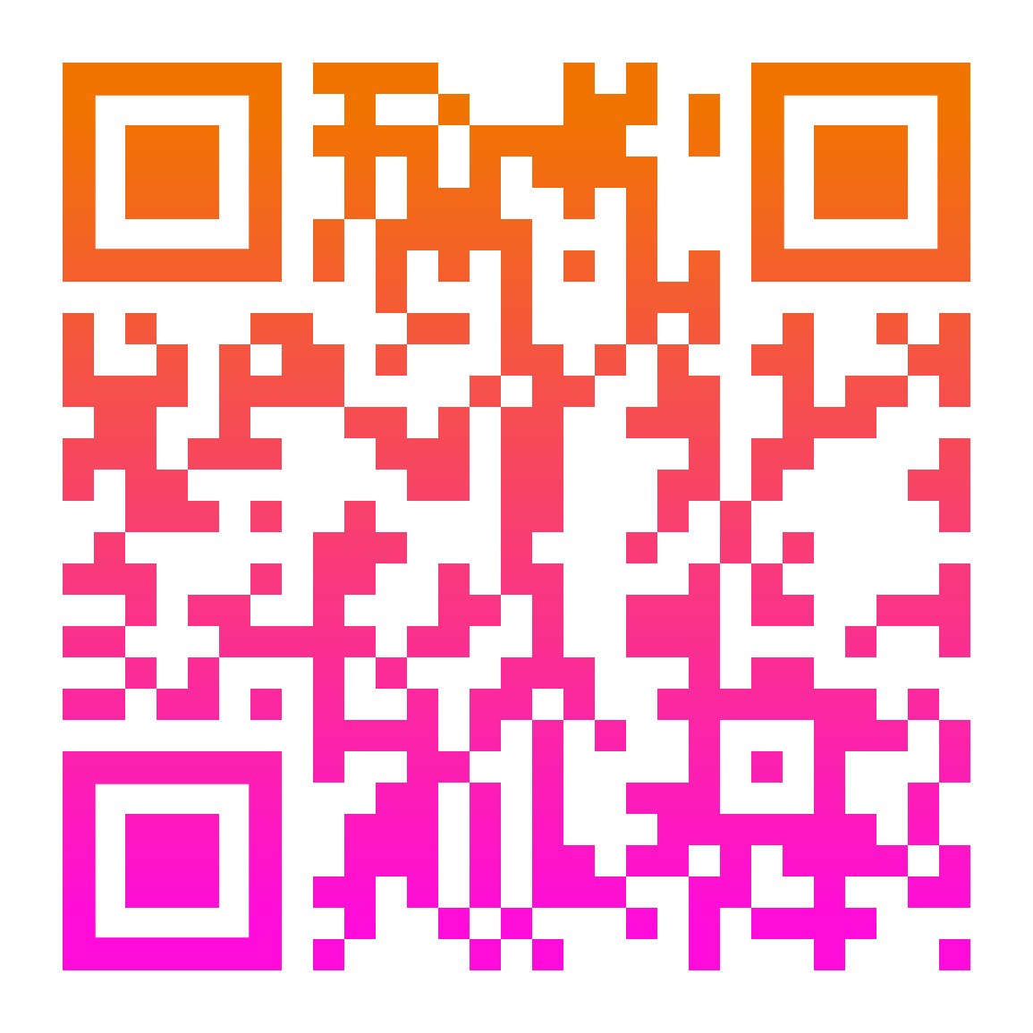
Women in M365
Group Logo
We are a diverse group of humans passionate about Microsoft 365 and Women in Technology.
We are a community on a mission to elevate women, share practical knowledge, and improve how we work together in the Microsoft world.
We meet virtually on the first Wednesday of every month via Teams at 12:00 EST.
QR Code for Community or Group Page

Slide 15

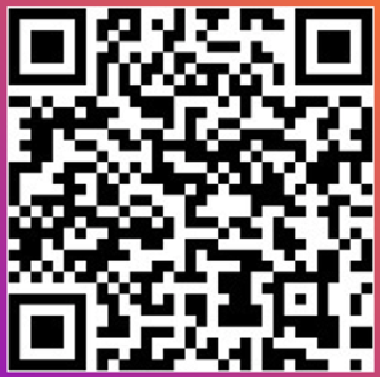
Women in Power (Platform)
Group Logo
Who we are
Empowering Women to Lead
The Women in Power Platform is a dynamic community dedicated to fostering leadership, empowerment, and professional growth for women across diverse sectors. We offer resources, mentorship, and networking opportunities to support women in reaching their full potential.
Why Join us?
Connect with Leaders: Engage with inspiring women & allies
Access Exclusive Resources: Receive access to webinars, coaching, and mentorship tailored for women.
Be Part of a Movement: Empower yourself while empowering others.
How to Join?
We invite you to join our community on LinkedIn to stay updated and connected with the latest news, events, and inspiring stories.
Follow us on YouTube where you can watch and celebrate the incredible achievements of the remarkable women!

Slide 16


Slide 17
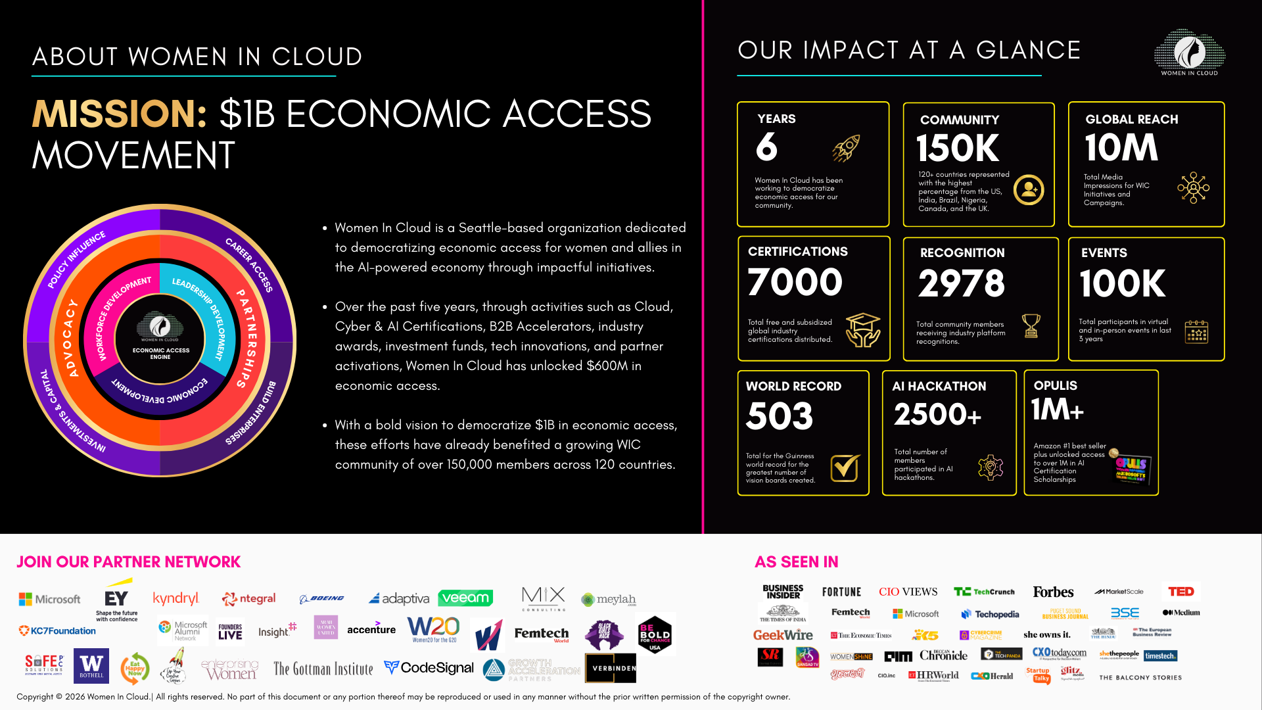

Slide 18
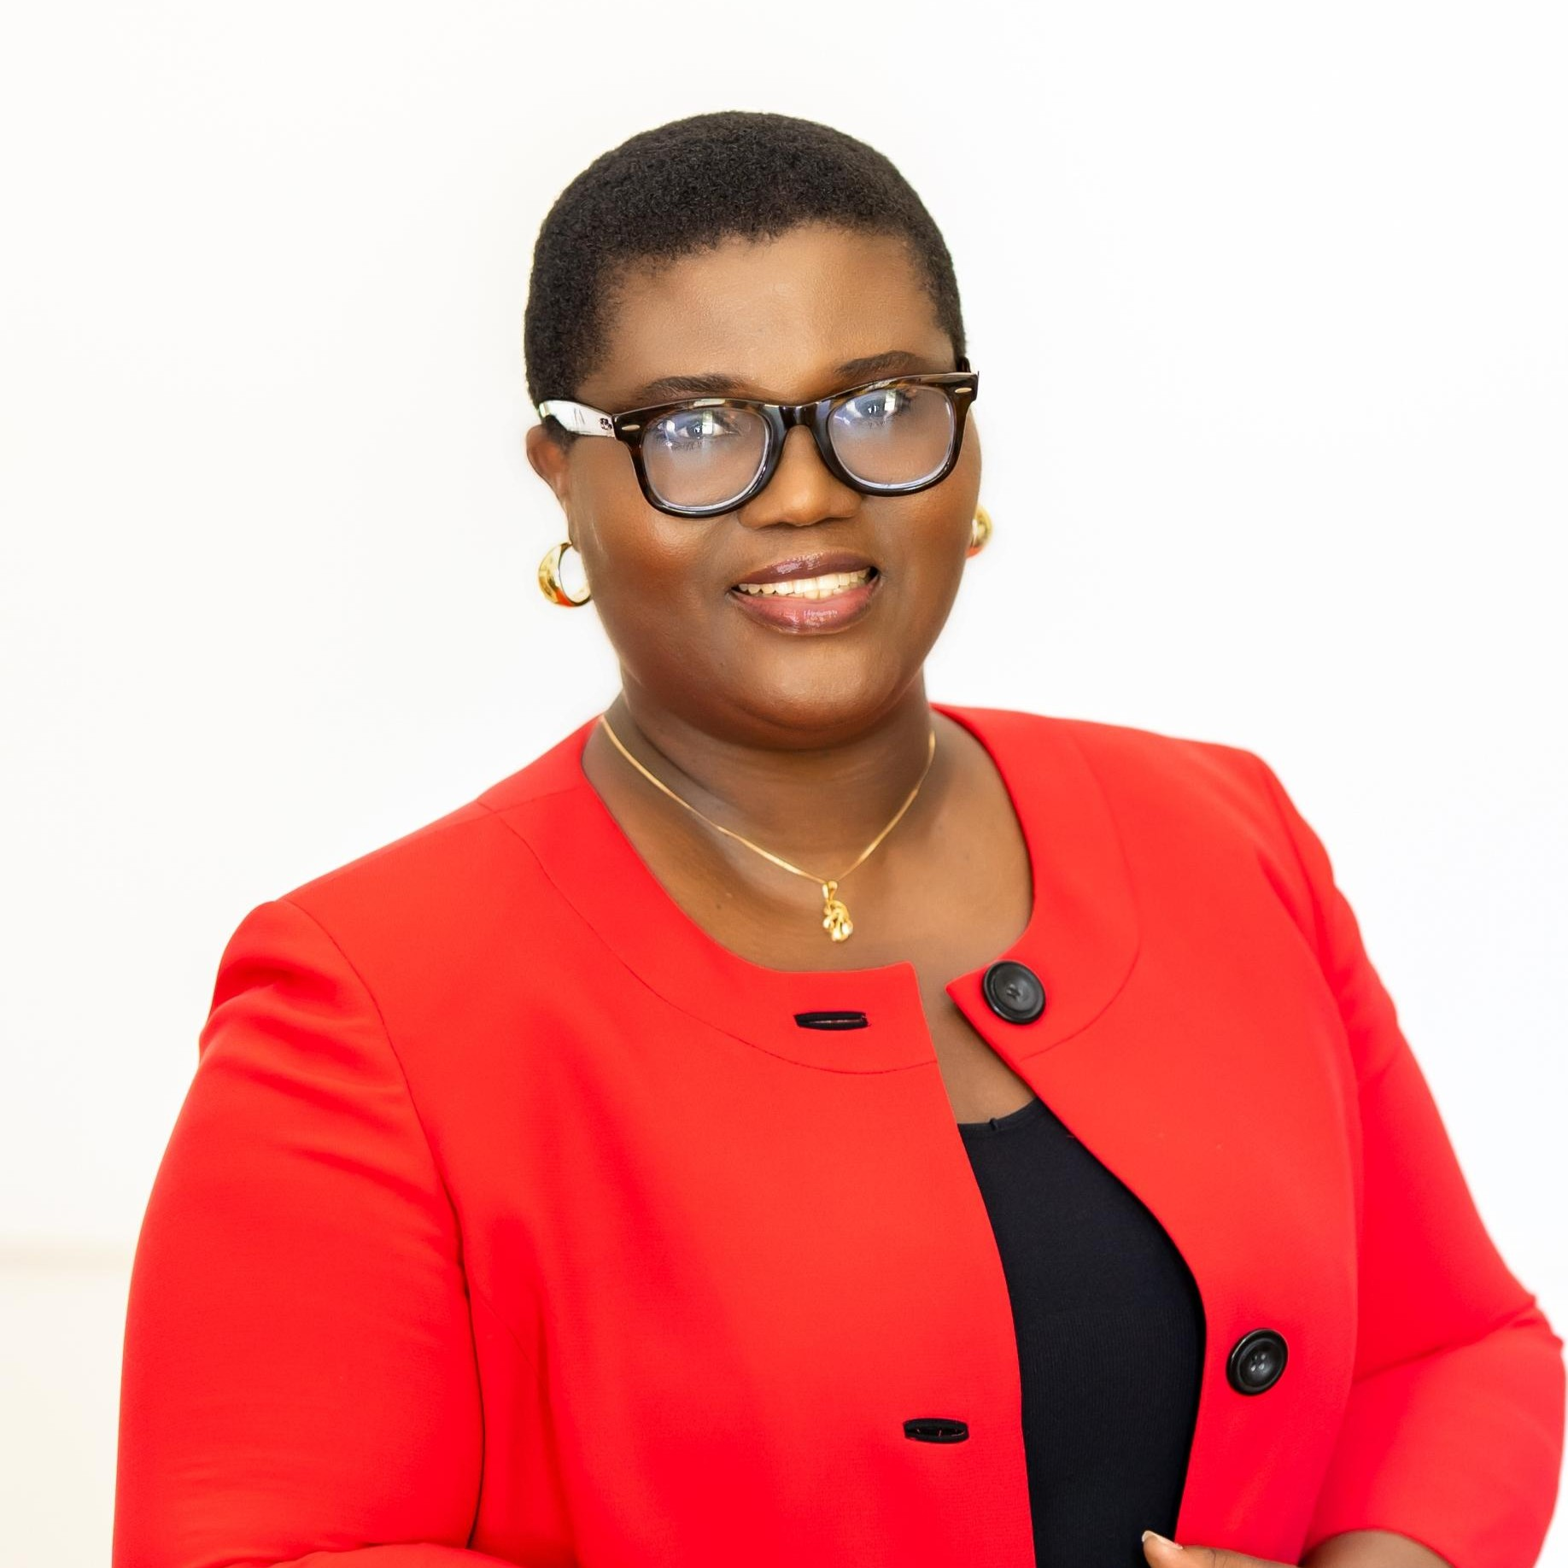



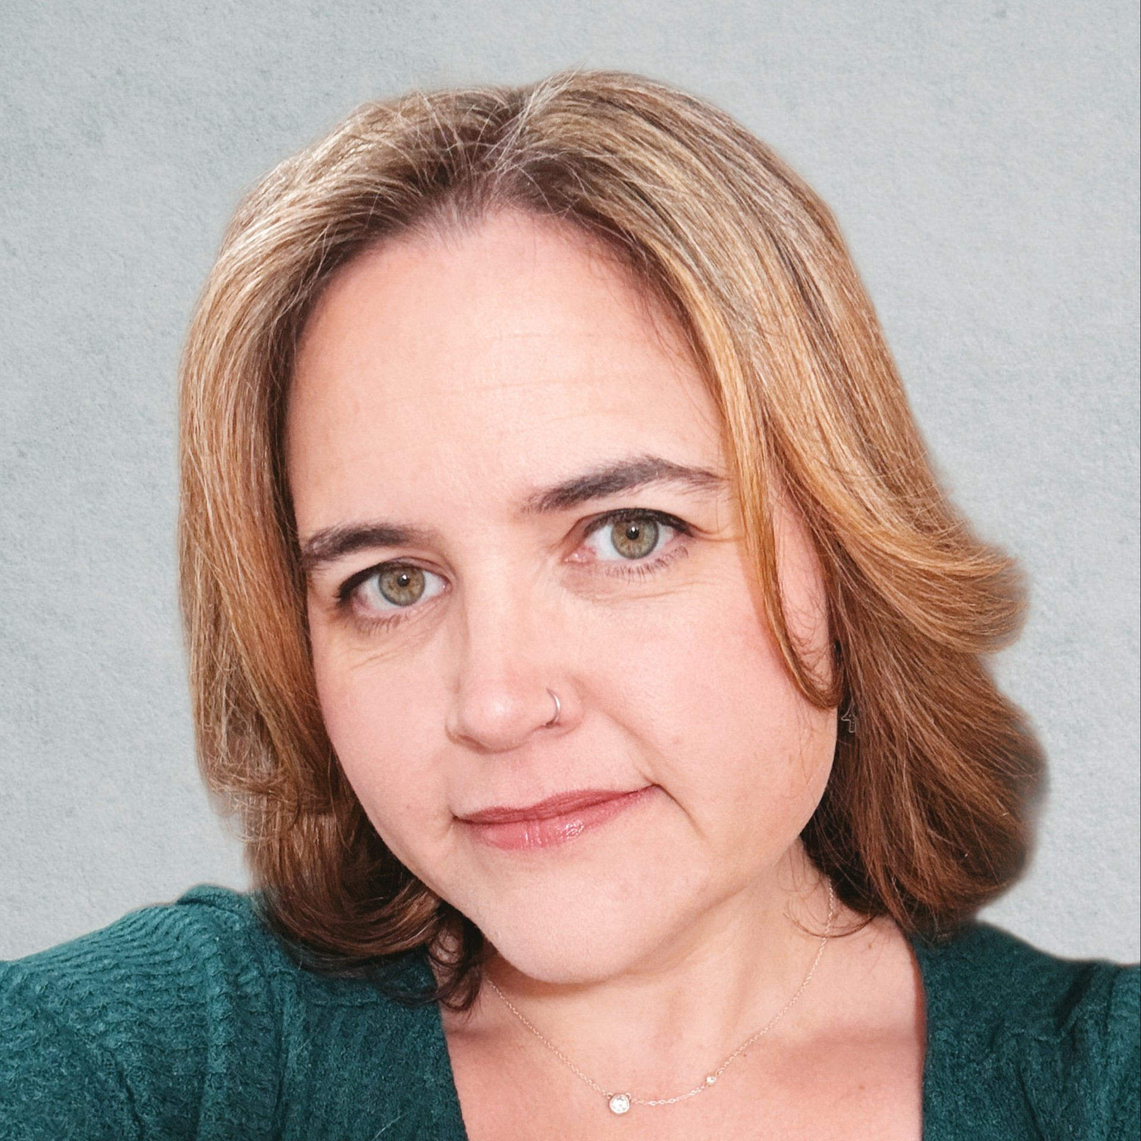



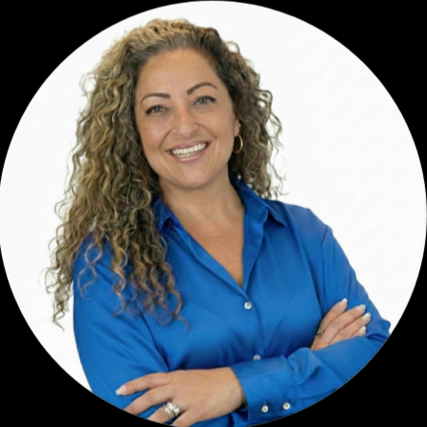
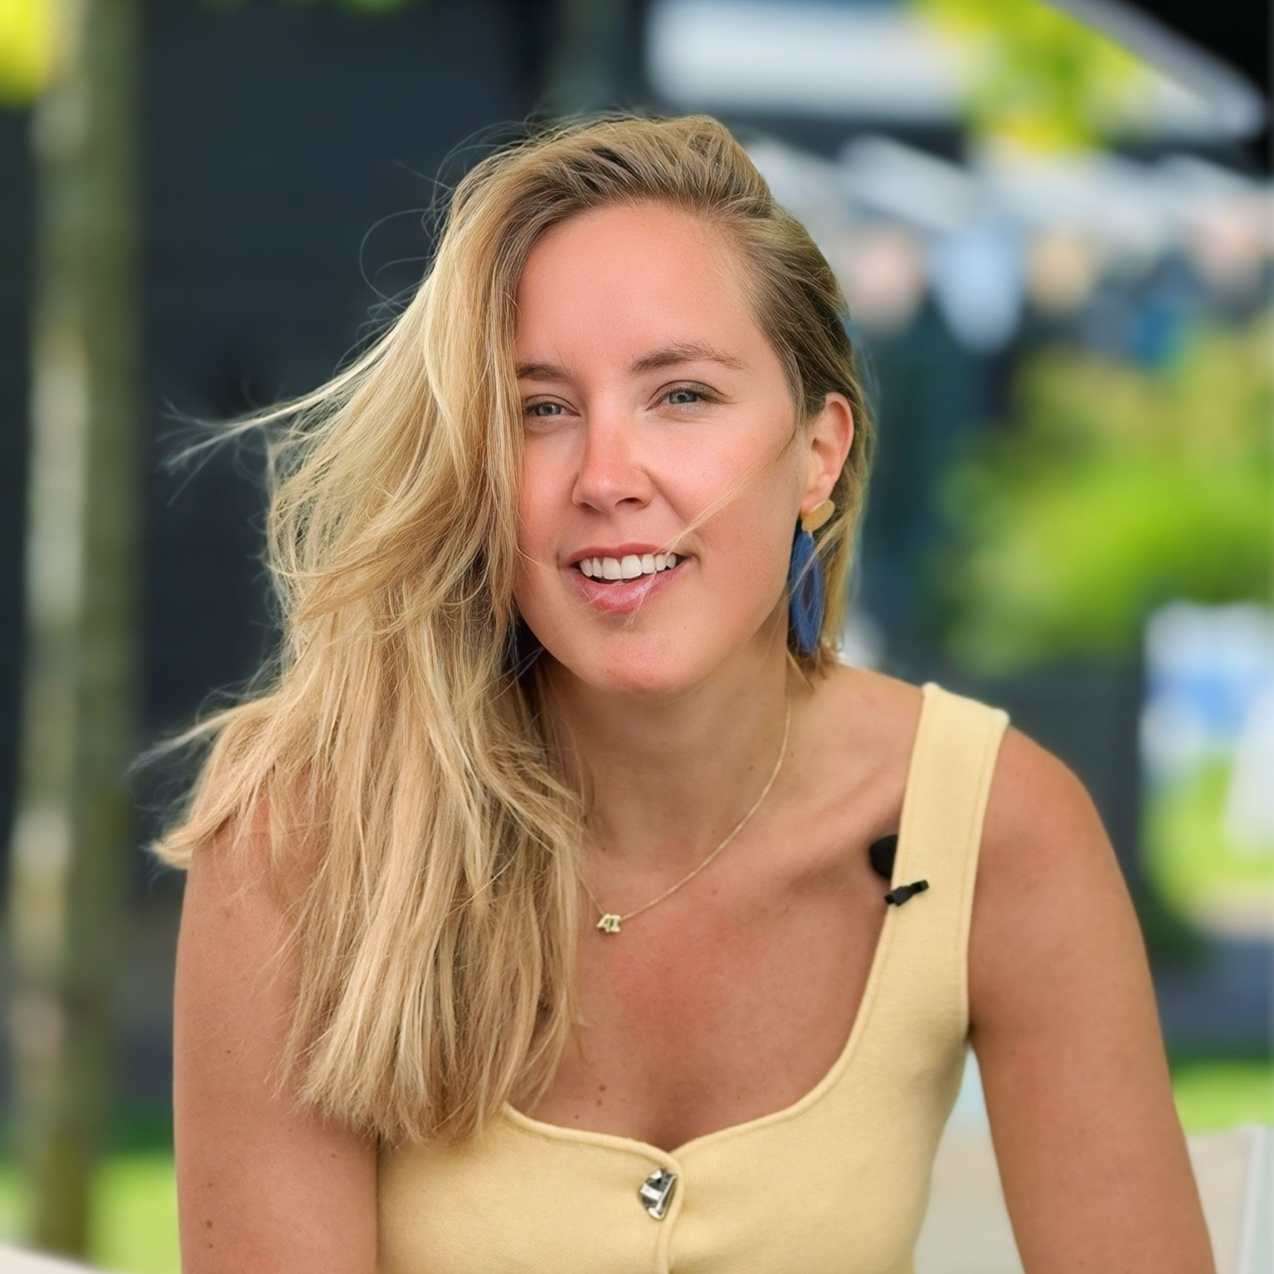


Thank You Women In Tech & Allies Panel
Strengthening Community Across the Microsoft Ecosystem
Sharon Smith
The Mentoring Hub
Nihinlola Adeyemi
President, TechStylers
Olajumoke Toriola
Cofounder, TechStylers
Sharon Weaver
Women in M365
Rachel Sullivan
Women in M365
Sravani Seethi
Women in Power
Christine Bongard
The WIT Network
Chaitra Vedullapalli
Women in Cloud
Melissa Ballesteros
Rockstar Women in AI & Security
Femke Cornelissen
Rockstar Women in AI & Security

Slide 19

Stay Connected!
Engage with the best community in tech…
There’s something for everyone!
Microsoft Tech Community
The community platform for Microsoft 365 – forums, blogs, and events
https://aka.ms/joinMTC
CommunityDays.org
Find or host a local event in your area
or to match your interests www.communitydays.org
Microsoft Community on LinkedIn
News, announcements and training delivered to your news feed https://aka.ms/microsoftcommunitylinkedin

Slide 20
MGCI General Sessions
AM Session: https://aka.ms/MGCIMtgAM
PM Session: https://aka.ms/MGCIMtgPM
Learn from your peers and get updates on the MGCI program.
3rd Tuesday of every month at 8:10 AM and 5:10 PM PT.
Date | Presenter | Topic
Jan 20 | Heather Cook | Community Update and AMA
Feb17 | Tom Daly | CDO – Backstage Pass
Mar 17 | Heather Cook | Women in Tech and Allies Panel
Apr 21 | Tracey Salem | Microsoft Student Ambassadors Program
May 19 | Heather Cook Partick McGowan | M365 DC Event Spotlight
Jun 16 | TBD | Community Spotlight
Jul 21 | TBD | Community Spotlight
All sessions are also available on-demand via the Microsoft Community Learning YouTube channel:
https://aka.ms/community/learning

Slide 21
Community Event Organizer Trainings
Learn from your peers and get updates on the MGCI program.
4th Thursday of every month at 8:10 AM PT.
Join: https://aka.ms/MGCIMtgAM
All sessions are also available on-demand via the Microsoft Community Learning YouTube channel:
https://aka.ms/community/learning

Slide 22

▶️ Watch now: https://msft.it/6047Q91yX
#SPat25 #SharePoint #Microsoft365 #CommunityLuv

Slide 23
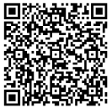
Thank you. https://aka.ms/MGCIFeedback

Slide 24
Women In Tech & Allies:
Microsoft Global Community Initiative
general session
March 17 8:10AM PT and 5:10PM PT
Strengthening Community Across the Microsoft Ecosystem

Slide 25
Women In Tech & Allies:
Microsoft Global Community Initiative
general session
March 17 8:10AM PT and 5:10PM PT
Strengthening Community Across the Microsoft Ecosystem

Slide 26

Women In Tech & Allies:
Microsoft Global Community Initiative
general session
March 17 8:10AM PT and 5:10PM PT
Strengthening Community Across the Microsoft Ecosystem

Slide 27
Women In Tech & Allies:
Microsoft Global Community Initiative
general session
March 17 8:10AM PT and 5:10PM PT
Strengthening Community Across the Microsoft Ecosystem

Slide 28
Women In Tech & Allies:
Strengthening Community Across the Microsoft Ecosystem | Mar 17, 8AM & 5PM PDT
Sharon Smith
The Mentoring Hub
Nihinlola Adeyemi
President, TechStylers
Olajumoke Toriola
Cofounder, TechStylers
Sharon Weaver
Women in M365
Rachel Sullivan
Women in M365
Sravani Sethi
Women in Power
Christine Bongard
The WIT Network
Chaitra Vedullapalli
Women in Cloud
Melissa Ballesteros
Rockstar Women in AI & Security
Femke Cornelissen
Rockstar Women in AI & Security

