Slide 1
Agenda
Intro
Guest Speaker: Nikkia Carter- How to Start a Tech Community/User Group
Announcements | Newest releases in community
Community events & updates
Open discussion forum

Slide 2
We will get started at 10 min after the hour
Grab a refreshment!
General Session
July 16, 2024

Slide 3
Microsoft Event Code of Conduct
Microsoft’s mission is to empower every person and every organization on the planet to achieve more. This includes all Microsoft events and gatherings, including on digital platforms and in person, where we seek to create a respectful, friendly, enjoyable, and inclusive experience for all participants.
​
We expect all event participants to uphold the principles of this Code of Conduct. The Code of Conduct applies to all aspects of the main event and any related activities, whether digital or in person. Microsoft does not tolerate the following in any aspect of the event program, including business and social activities:
Behavior that is disruptive, disrespectful, or degrading to others, including any messages, images, or interactions by anyone, in any form, regardless of location.​
Harassment or discrimination based on age, ancestry, color, gender identity or expression, national origin, physical or mental disability, religion, sexual orientation, or any other characteristic protected by applicable local laws, regulations, and ordinances.​
​
We encourage everyone to assist in creating a welcoming and safe environment. Please report any concerns, harassing behavior, or suspicious or disruptive activity to venue staff, the event host or owner, or the nearest event staff.
​
We also encourage everyone to contact Microsoft’s Business Conduct Hotline at any time if you feel anything or anyone is not following this Code of Conduct or is inconsistent with Microsoft’s culture. The Hotline is available regardless of whether you are a Microsoft employee and can be reached at buscond@microsoft.com or +1 (877) 320-MSFT, or call collect outside the United States at +1 (720)-904-6844. Microsoft employees can also report any concerns to their Microsoft Manager.
Microsoft reserves the right to refuse admittance to or remove any person from a Microsoft event at any time at its sole discretion.

Slide 4
Creating and Running Your First Technical User Group Community
Fostering Knowledge Sharing and Professional Networking
Notes:
In this presentation, we will cover the essential steps needed to create and run a technical user group community. From coming up with a name for your group to forming a team, we will provide you with the tools you need to get started on building your community.

Slide 5
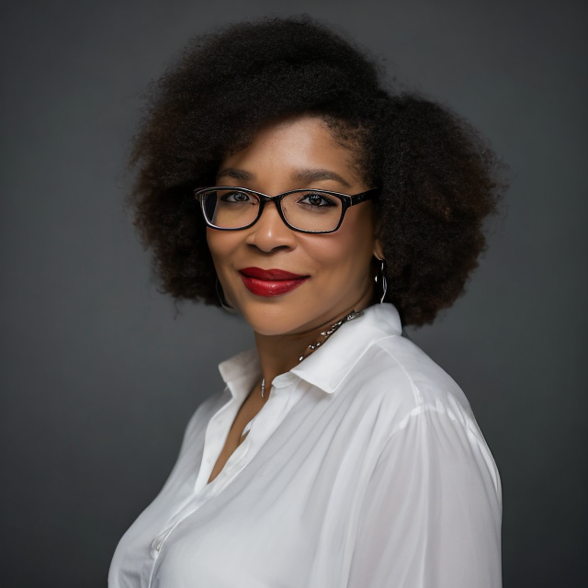
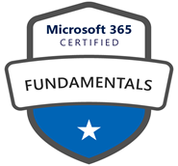
Introducing Nikkia T. Carter, MGCI Regional Lead MEA!
Nikkia T. Carter
Current
2023-Present Co-CEO, NTC Tech Consultancy, LLC
Microsoft Cloud Solution Partner
Location: Washington (state), US
Tech: Microsoft/Office 365, Power Platform, CoPilot, Wix, WordPress
Services: consulting/strategy, organization IT transformation, collaboration solutions, AI, automated business process, modernized online forms, data visualization, documentation, migration, governance, adoption, training
2023- Present Current Member of Black Channel Partner Alliance (BCPA)
2024 – Present Microsoft Global Community Initiative Regional Lead – MEA
2024 – Present Ananse Tech Community Founder and Sponsor Chair
Past
2019-2023 Former Microsoft Employee - Microsoft HQ
Worldwide Modern Work & Security Tech Strategy Lead
Global CSA Role Lead
2012-2019 Previous Microsoft Partner Company Owner – Carter-McGowan Services, LLC
2010-~2019 User Group Membership and Leadership
Federal SharePoint User Group & Women in SharePoint DC (FEDSPUG/WSPDC), Member & Board Member
SharePoint User Group of DC (SUGDC), Speaker Chair > President

Slide 6
Presentation Overview
Selecting a Name for Your Group
The name of your technical user group is important as it should accurately represent your community and be easy to remember. A good name can help attract more members and sponsors to your group.
Topics for Your Group
Choosing the right topics is critical to the success of your technical user group. You should select topics that are relevant and interesting to your members and align with the goals of your group.
Forming a Team
To ensure the success of your group, it is important to form a team of dedicated volunteers who can take on different roles. This will help you to manage your group more effectively and ensure that all tasks are completed on time.
Logistical Operations of Your Group
To ensure that your group runs smoothly, you need to have good logistical operations. You should establish standard operating procedures for tasks such as event planning and member management.
Notes:
We will start by discussing the importance of selecting a name for your group that accurately represents your community. Next, we will explore the topics that your group could cover, followed by tips on forming a team and ensuring a successful logistical operation of your technical user group.

Slide 7
Naming Your Group
Relevance
The name of your group should be relevant to the purpose and objective of your group. It should reflect the type of technical expertise and interests that your group aims to promote.
Memorability
The name of your group should be catchy and memorable. It should leave a lasting impression on people and make them want to learn more about your group.
Uniqueness
The name of your group should be unique and stand out from the crowd. It should not be similar to any other technical user group's name.
Notes:
Picking the right name for your technical user group is crucial to creating an identity and attracting interested members. Here are tips on how to select a relevant and catchy name for your group. (Talk about naming Ananse.)

Slide 8
Topics To Cover
General Technical Topics
Technical user groups often cover topics related to programming languages, software development, data science, and cybersecurity, among others. TIP: Choose tech you know or are interested in.
Choosing Relevant Topics
Choosing relevant topics is essential to attracting members and creating a community of shared interests. It is important to consider the interests and needs of your group when selecting topics. TIP: If you can, list out as many session ideas you have on the topics from intro to advanced. Also, try surveying for topics.
Guest Speakers
Inviting guest speakers is an excellent way to bring fresh perspectives and new insights to your group. Guest speakers can also help attract new members and expand your network. TIP: Create a signup sheet in Microsoft Forms and promote socially and in relevant presentations. This is what we use: https://forms.office.com/Pages/ResponsePage.aspx?id=eAALoIcFqUaYJz87oQDSsrujgMo66lhOr7do5IJ4fRlUM05FNzAyU09PNzEyNjFTRjEzQjVKRkxKRS4u.
Notes:
The topics that your technical user group will cover are essential to attracting members and creating a community of shared interests. In this section, we will discuss some general topics that technical user groups often cover and how to choose topics that are relevant to your group.

Slide 9
Forming a Team
Roles and Responsibilities
Creating a well-functioning team requires defining roles and responsibilities for each team member. This ensures everyone knows what is expected of them and prevents confusion and overlap. TIP: Consider the positions on the next slide.
Recruiting Team Members
Recruiting the right people for your team is critical to its success. You want to find team members who are passionate about the group's goals and have the skills and experience needed to fulfill their roles. TIP: Find people who are passionate and give them ways to shine! Remind them that this looks good on a resume. If you find people who are not being helpful, try to find out the why as life happens. If not, find someone else.
Retaining Team Members
Retaining team members is just as important as recruiting them. You want to create a positive and inclusive team environment that values everyone's contributions and provides opportunities for growth and development.
Notes:
Creating a team to organize and run your technical user group is essential to ensuring its success. In this section, we will discuss the roles and responsibilities needed for a well-functioning team and provide tips on how to recruit and retain team members.

Slide 10
Roles and Responsibilities
Team Leader
The team leader is responsible for overseeing the user group team and ensuring that tasks are distributed effectively. They are also responsible for guiding the team and making executive decisions.
Co-Leader
The co-leader works closely with the team leader and takes on some of the leader's responsibilities, such as making executive decisions and guiding the team. They also act as a backup for the leader when they are not available.
Event Coordinator
The event coordinator is responsible for planning and organizing user group events, such as meetings and conferences. They work closely with the marketing coordinator to ensure that events are well-attended and successful.
Marketing Coordinator
The marketing coordinator is responsible for promoting user group events and activities and ensuring that they are well-attended. They work closely with the event coordinator to ensure that events are successful.
Sponsor Coordinator
The sponsor coordinator will coordinate all sponsorships, whether they be in-kind donations for food or space accommodations, swag/prizes, money, etc. They work closely with the event coordinator to ensure that events are successful.
Speaker Coordinator
The speaker coordinator will find and coordinate speakers. They work closely with the event coordinator to ensure that events are successful.
Technical Expert
If the Leader or Co-Leader is not technical, you will need this person. The technical expert is responsible for providing technical expertise and guidance to the team. They work closely with the team leader and co-leader to ensure that tasks are distributed effectively and that the team is working efficiently.
Notes:
A typical technical user group team consists of a leader, co-leader, event coordinator, marketing coordinator, and technical expert. We will discuss the roles and responsibilities of each team member and provide tips on how to divide tasks effectively.

Slide 11
Retaining Team Members
Engagement
Engaging team members in decision-making and problem-solving can help foster a sense of ownership and increase job satisfaction. It also provides opportunities for team members to develop new skills and take on new challenges.
Recognition and Feedback
Recognizing and providing feedback to your team members is crucial in retaining them. Positive feedback and recognition can boost employee morale and foster a sense of belonging, which can lead to increased loyalty and retention. TIP: Recognize them during community events.
Provide Opportunities for Growth
Providing opportunities for professional growth and development is an important factor in retaining team members. Offering training programs, mentorship, and career advancement can help employees feel valued and encouraged to stay with the company.
TIP: If you have a budget, treat them quarterly. Also, remind them that helping running a tech community looks good on a resume.
Notes:
To retain team members, you need to provide them with opportunities for growth, recognition, and engagement. We will discuss some strategies for motivating and supporting your team members, such as providing training, recognition, and feedback.

Slide 12
Logistics of Running a Technical User Group
Organizing Events
Organizing events is a critical part of running a technical user group. You need to find a suitable venue, select a date and time, and plan the event content and agenda to ensure that it meets the needs of the attendees. TIP: Try to survey on social or your initial audience for the best day/time for most. Once a day/time is chosen stay consistent for at least 6 months.
Managing Finances
Managing finances is essential for the smooth operation of a technical user group. You need to keep track of expenses, collect dues or donations, and ensure that the group's finances are transparent and well-managed.
Promoting Your Group
Promoting your group is essential to attract new members and keep the existing ones engaged. You need to use various channels such as social media, email marketing, and word-of-mouth to reach out to the target audience and promote your group's mission and activities.
Notes:
Running a technical user group requires careful planning and execution. Let’s look at some of the logistical considerations that you need to take into account when organizing events, managing finances, and promoting your group.

Slide 13
Organizing Events
Event Venue
Choosing the right venue is crucial when organizing events. Consider the size, location, and amenities of the venue to ensure that it meets the needs of your attendees. TIP: You may want to start off online then switch to in person after you get a location or go hybrid.
Speaker Selection
Selecting the right speakers is essential for the success of your event. Choose speakers who are knowledgeable, engaging, and can connect with your audience. TIP: Don’t forget to maintain communication with speaker so they know all of the logistics and show up to your meeting prepared.
Agenda Planning
Having a clear and concise agenda is important for the success of your event. Plan your agenda to include key topics, guest speakers, and interactive sessions that engage your attendees. TIP: Create a deck that includes all of your community info such as greeting, meet the team, call for speaker, sponsor, and volunteer. Feel free to use our deck for Ananse Tech as well as our roating slides for premeeting as examples: AnanseSlides Jan2024.pptx and AnanseRotatingStarterSlides.pptx. Also, if you can schedule out in advance, do so but don’t slack on getting the next sessions so you stay ahead.
Logistics Management
Managing logistics such as registration, accommodations, and transportation is important to ensure a smooth and successful event. Plan ahead and communicate effectively with your attendees to avoid any issues. TIP: Don’t forget to send out reminders! If using LinkedIn for posting your events, keep an eye on the attendee link to ensure it is still there before meeting time. Consider adding the meeting info into each event description as well as the reminder emails or use a Microsoft Forms or other method to gather registrants.
Notes:
When organizing events, you need to consider the venue, the speaker, the agenda, and the logistics of attendance. We will provide tips on how to plan and execute successful events that meet the needs of your community.

Slide 14
Managing Finances
Effective Budgeting
Budgeting is an essential component of financial management. Effective budgeting involves creating a detailed plan for income and expenses, tracking spending, and making adjustments when necessary.
Fundraising Strategies
Fundraising is an important aspect of financial management for technical user groups. Successful fundraising strategies include identifying potential donors, creating compelling fundraising campaigns, and leveraging social media to increase visibility.
Expense Management
Effective expense management involves tracking expenses, prioritizing spending, and seeking cost-saving opportunities. This helps ensure that your technical user group stays within budget and avoids financial strain.
TIP: To mitigate the risk of handling money, set up a nonprofit with a bank account or have the sponsors pay directly for specific things.
Notes:
Managing finances is crucial to ensuring the long-term sustainability of your technical user group. We will provide tips on how to budget, fundraise, and manage expenses effectively.

Slide 15
Promoting Your Group
Social Media
Social media is a powerful tool for promoting your technical user group. You can use platforms like Twitter, LinkedIn, and Facebook to share updates, engage with members, and attract new followers. TIP: You may also want to try WhatsApp Business if it is big in your market.
Newsletters
Newsletters are a great way to keep your members informed about the latest news and events happening in your group. Consider sending out regular newsletters with updates and relevant information to keep your members engaged and informed.
Other Channels
There are many other channels you can use to promote your technical user group, including community events, online forums, and word-of-mouth. Consider reaching out to other groups or organizations in your industry to see if you can collaborate or cross-promote your events. TIP: You may want to set up a separate website for the community, just be sure that it is its own brand.
Notes:
Promoting your technical user group is essential to attracting new members and maintaining engagement. We will discuss some strategies for promoting your group through social media, newsletters, and other channels.

Slide 16
Conclusion
Creating and running a technical user group is a challenging but rewarding experience. By following the steps outlined in this presentation, you will be well on your way to building a thriving community of like-minded individuals.
Notes:
Creating and running a technical user group is a challenging but rewarding experience. By following the steps outlined in this presentation, you will be well on your way to building a thriving community of like-minded individuals.

Slide 17
Thank You!
Feel free to check out my new Ghana based tech community, Ananse Tech!
GMT
(2:30 pm -5 pm ET / 11:30 am - 2 pm PT)

Slide 18
Communitydays.org Event Statistics
As of July 10, 2024 9:34 am PDT
Total in tool: 240
CY22 Events: 21 | FY23 Events: 65
CY23 Events: 101 | FY24 Events: 124
CY24 Events: 114 | FY25 Events: 51
CY25 Events: 4

Slide 19
Communitydays.org feature updates
Complete / Rolling Out​
Community Calendar - Ability to Add/Manage Calls
Fixes
Image Cropper Updates
Fix transparent images background going black on save
Fix sizing issue
Typo on Contact page
Event Form refreshing when navigate away from tab
Working on it​
Organizer/Co-organizer Tab on Event Page
Integration of Run.Events to Speakerboard
Internet calendar subscription for Calls
Up Next​
Show Events as a Calendar / List
Show Calls as Cards/List

Slide 20
Community Event Organizer Training and Office Hours
WHEN:
The last Thursday of each month, 8:10am PT
July 25 at 8:10am PDT
WHERE:
Community Tenant,
invite sent from mgci@msftcommunity.com
WHO:
Organizers of Community Led Events
Join us for Community Event Organizer Training & Office Hours where you’ll be able to get all the help you need with our tools, training and support to do a fun and impactful event.
Ask questions in our Events & Sponsor channel

Slide 21
Event training upcoming dates
Date | Host | Topic
July 25 | Dave Leveille | Demo: Lessons Learned: TBA
August | N/A | Community Break – No meeting
September 26 | TBA | Demo: Run.event Event App - TBA Lessons Learned: Montreal Event - Nicolas Georgeault
October 24 | TBA | Demo: Whova Event App – David Wilhelm Lessons Learned: Ben Rupp
November 28 | TBA | Demo: Just attend demo - TBC Lessons Learned:
December |  | Community Break – No meeting

Slide 22
Upcoming Community Produced Events – June thru August
Professionally produced community events draw from 1k-5k attendees (in-person). Attendance fees are charged, and pre/post event workshops delivered by Microsoft MVPs are often part of the event. Event organizers ask for our help in driving attendance and providing MSFT corporate speakers.
Event name | Start date | End date | City | State/Province | Country | Products
TechCon365 and PWRCON - A Microsoft 365 and Power Platform Conference | 6/3/2024 | 6/7/2024 | Seattle | Washington | United States | Microsoft 365; Power Platform
NDC Oslo | 6/10/2024 | 6/14/2024 | Oslo |  | Norway | .NET, AI / ML, Azure / Cloud, Containers / Kubernetes, Data, Developer tools + DevOps
European Power Platform Conference | 6/11/2024 | 6/13/2024 | Brussels |  | Belgium | Microsoft 365; Power Platform
dotNET 2024 | 6/25/2024 | 6/25/2024 | Madrid |  | Spain | [".NET"]
Update Days: .NET Performance | 6/26/2024 | 6/27/2024 | Krakow |  | Poland | NET, Developer tools + DevOps
Biz Apps Partner Summit | 7/24/2024 | 7/25/2024 | Bellevue | Washington | United States | Azure / Cloud, Dynamics 365, Power Platform
Experts Live Kenya 2024 | 7/26/2024 | 7/26/2024 | Nairobi | Nairobi | Kenya | AI / ML, Azure / Cloud, Containers / Kubernetes, Data, Developer tools + DevOps, Dynamics 365, Microsoft 365, Power Platform, Security / Compliance, Python
Digital Workplace Conference Australia | 7/31/2024 | 8/1/2024 | Sydney |  | Australia | Microsoft 365; Power Platform
Techbayanihan 2024 Copilot para sa bayan | 8/2/2024 | 8/3/2024 | Pasay City | Metro Manila | Philippines | AI / ML

Slide 23
Upcoming Community Produced Events: Continued
Professionally produced community events draw from 1k-5k attendees (in-person). Attendance fees are charged, and pre/post event workshops delivered by Microsoft MVPs are often part of the event. Event organizers ask for our help in driving attendance and providing MSFT corporate speakers.
Event name | Start date | End date | City | State/Province | Country | Products
VSLive! @ Microsoft HQ | 8/5/2024 | 8/9/2024 | Redmond | Washington | United States | .NET, AI / ML, Azure / Cloud, Containers / Kubernetes, Data, Developer tools + DevOps
TechCon365 Washington DC | 8/12/2024 | 8/16/2024 | Washington | DC | United States | Microsoft 365
Copenhagen Developers Festival 2024 | 8/26/2024 | 8/30/2024 | Copenhagen |  | Denmark | AI / ML, .NET, Azure / Cloud, Containers / Kubernetes, Data, Developer tools + DevOps

Slide 24
Upcoming Community Led Events : June thru August
These events often serve underrepresented or emerging markets. They are organized by volunteers and are free to attendees. Newly branded “Community Days” events may cover any part of the Microsoft technical stack and/or cater to roles or industries. These are a vibrant opportunity for recruiting, career development and technical skilling. A full list of community led events can be found at CommunityDays.org.
Event name | Start date | End date | City | State/Province | Country
CollabDays Netherlands 2024 | 6/1/2024 | 6/1/2024 | Vianen | Utrecht | Netherlands
aMS Aix-Marseille 2024 | 6/11/2024 | 6/11/2024 | Marseille |  | France
CollabDays Madrid 2024 | 6/14/2024 | 6/14/2024 | Madrid |  | Spain
M365 COMMUNITY DAYS MTL 2024 | 6/14/2024 | 6/14/2024 | Montreal | Quebec | Canada
Intranets and AI on Microsoft 365 | 6/19/2024 | 6/20/2024 | Virtual
Summit NA Roadshow - Chicago | 6/19/2024 | 6/19/2024 | Lisle | Illinois | United States
AI Community Event - NYC 2024 | 6/21/2024 | 6/21/2024 | New York | New York | United States
aMS Brazzaville 2024 | 6/25/2024 | 6/25/2024 | Brazzaville | Republic du Congo | Congo
Workplace Ninjas UK – Manchester | 7/2/2024 | 7/2/2024 | Manchester | Greater Manchester | Great Britain
AI Community Event - Toronto 2024 | 7/12/2024 | 7/12/2024 | Toronto | Ontario | Canada
Microsoft Community Days Chicago 2024 | 7/20/2024 | 7/20/2024 | Chicago | Illinois | United States
Summit NA Roadshow - Seattle | 7/23/2024 | 7/23/2024 | Bellevue | Washington | United States

Slide 25
Upcoming Community Led Events: Continued
These events often serve underrepresented or emerging markets. They are organized by volunteers and are free to attendees. Newly branded “Community Days” events may cover any part of the Microsoft technical stack and/or cater to roles or industries. These are a vibrant opportunity for recruiting, career development and technical skilling. A full list of community led events can be found at CommunityDays.org.
Event name | Start date | End date | City | State/Province | Country
M365 Community Days NYC 2024 | 7/26/2024 | 7/26/2024 | New York | New York | United States
aMP Colombo | 8/1/2024 | 8/1/2024 | Colombo | Sri Lanka | Sri Lanka
AI Community Conference - DC 2024 | 8/2/2024 | 8/2/2024 | Washington | DC | United States
Summit NA Roadshow - New York | 8/14/2024 | 8/22/2024 | New York | New York | United States
aMP Salem | 8/27/2024 | 8/27/2024 | Salem | Tamil Nadu | India
Dynamics User Group Ohio Regional Meetup 2024 | 8/27/2024 | 8/28/2024 | Dublin | OH | United States
CollabDays Hamburg 2024 | 8/31/2024 | 8/31/2024 | Hamburg | Hamburg | Germany

Slide 27
Experts Live
Europe 2024
Where the Microsoft community connects.
www.expertslive.eu

Slide 28
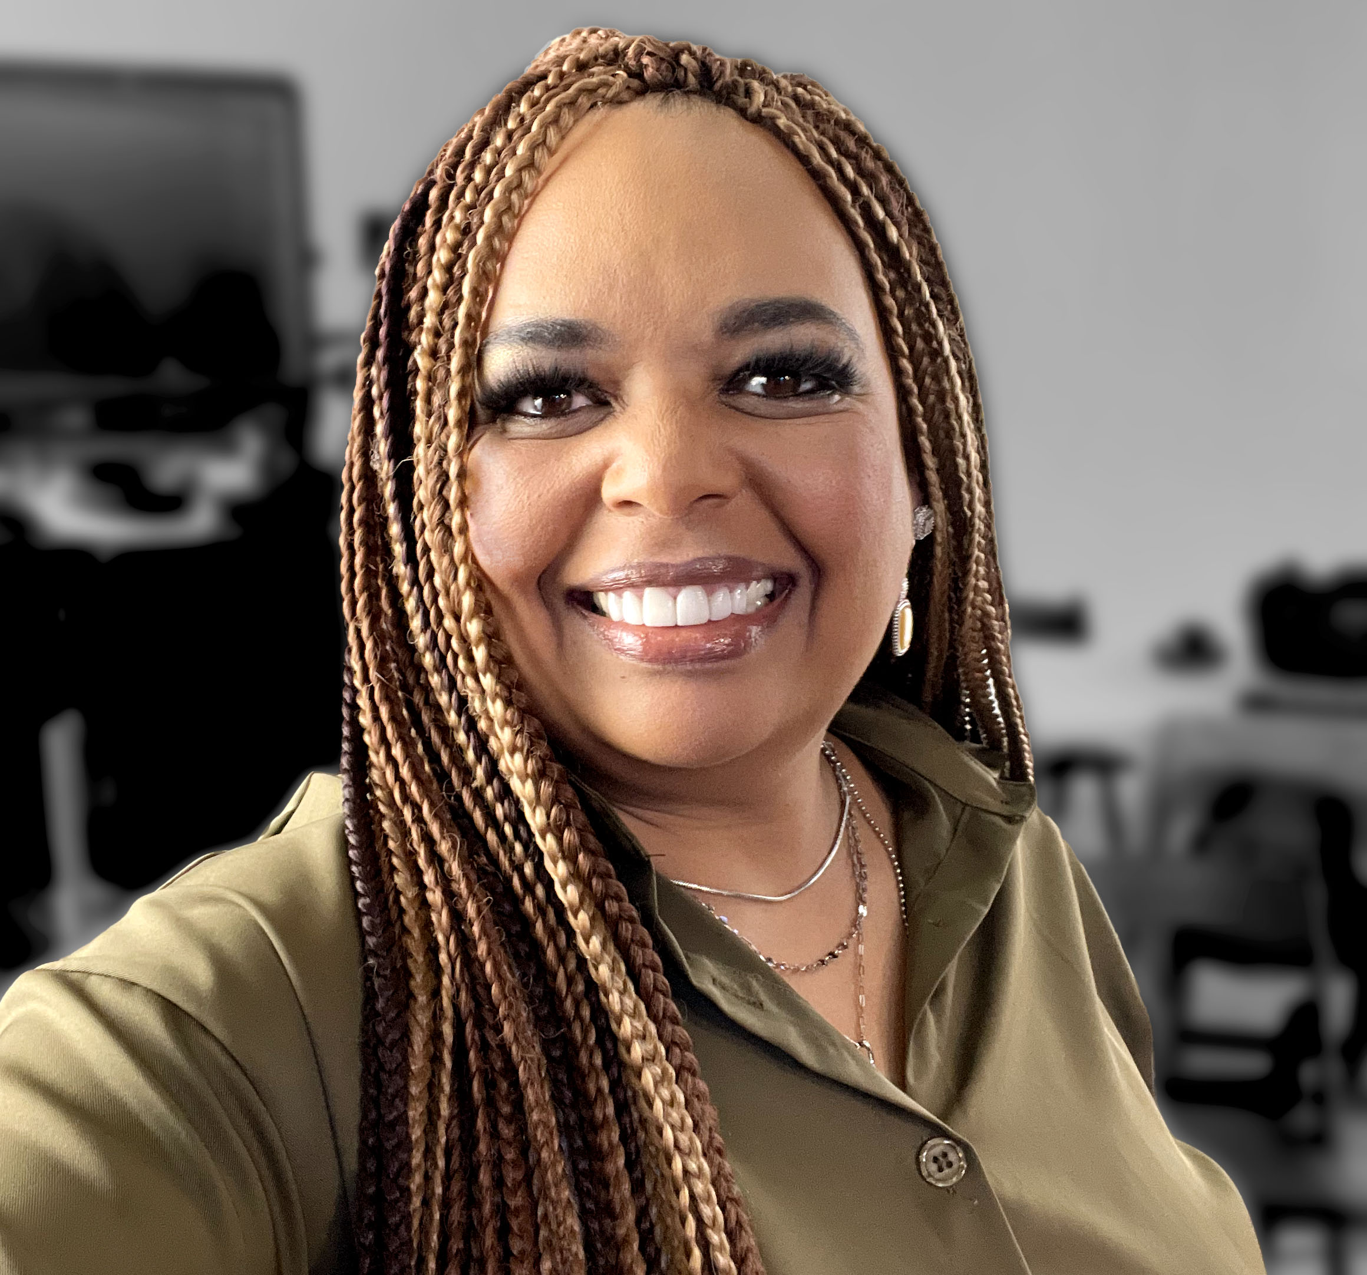
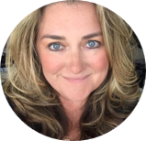
Monday’s at Microsoft with Karuana & Heather
Karuana Gatimu
Learn - Explore – Connect In the Microsoft Community
Bi-weekly @ 8am PT
Watch on
Microsoft Community Linked
Heather Cook
https://aka.ms/microsoftcommunitylinkedin
Notes:
Last used May 2023, Heather Cook

Slide 29
Community Event
Producer Roundtables
WHEN:
Quarterly, the fourth Tuesday. 8:10am & 5:10pm PT
8:10am & 5:10pm PDT
WHERE:
Community Tenant,
invite sent from mgci@msftcommunity.com**
WHO:
Organizers of Community Produced Events
INTERESTED?
Let us know at https://aka.ms/3PEventProducers
Please share this sign-up link with your co-organizers or others that you know are also producers, all are welcome.
**Once a non-disclosure agreement (NDA) is complete, you will be added to the private channel and a meeting invitation will be sent. A separate NDA is required for this set of meetings even if you have another via a different Microsoft program.
As a part of the Microsoft Global Community Initiative, we have put together a series of Community Event Producer monthly roundtables. The roundtables will require a signed non-disclosure agreement (NDA) specific to this set of meetings as we will share information, flagship event dates and upcoming strategies and planning with you regarding Microsoft events. As we discuss many topics together, we want to have a safe, private space for all of us to have these discussions. The goal of these roundtables is to both inform you of internal initiatives and to listen to your feedback on how Microsoft can continue to support community efforts and events in the future.

Slide 30
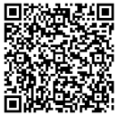
We want your feedback!
https://aka.ms/MGCIFeedbackJuly2024

Slide 31
Microsoft Global Community Initiative
See you at our next general session September 17 at 8:10am and 5:10pm PDT
Community Break- No community call in August
Top asks:
Complete our monthly survey: https://aka.ms/MGCIFeedbackJune2024
Invite colleagues to hold a community day event at communitydays.org

