Slide 1
We will get started at 10 min after the hour
Grab a refreshment!
General Session
January 16, 2024

Slide 2
Microsoft Event Code of Conduct
Microsoft’s mission is to empower every person and every organization on the planet to achieve more. This includes all Microsoft events and gatherings, including on digital platforms and in person, where we seek to create a respectful, friendly, enjoyable, and inclusive experience for all participants.
​
We expect all event participants to uphold the principles of this Code of Conduct. The Code of Conduct applies to all aspects of the main event and any related activities, whether digital or in person. Microsoft does not tolerate the following in any aspect of the event program, including business and social activities:
Behavior that is disruptive, disrespectful, or degrading to others, including any messages, images, or interactions by anyone, in any form, regardless of location.​
Harassment or discrimination based on age, ancestry, color, gender identity or expression, national origin, physical or mental disability, religion, sexual orientation, or any other characteristic protected by applicable local laws, regulations, and ordinances.​
​
We encourage everyone to assist in creating a welcoming and safe environment. Please report any concerns, harassing behavior, or suspicious or disruptive activity to venue staff, the event host or owner, or the nearest event staff.
​
We also encourage everyone to contact Microsoft’s Business Conduct Hotline at any time if you feel anything or anyone is not following this Code of Conduct or is inconsistent with Microsoft’s culture. The Hotline is available regardless of whether you are a Microsoft employee and can be reached at buscond@microsoft.com or +1 (877) 320-MSFT, or call collect outside the United States at +1 (720)-904-6844. Microsoft employees can also report any concerns to their Microsoft Manager.
Microsoft reserves the right to refuse admittance to or remove any person from a Microsoft event at any time at its sole discretion.

Slide 3
Agenda
Intro | Welcome
Announcements | Newest releases in community
David Wilheim | Working with Microsoft as an Event Producer
Community events & updates
Open discussion forum

Slide 4
Microsoft Community
Working with Microsoft as an event producer
David Wilhelm – President: TechCon365 & PWRCON
1) Understand your event tier
Event size requirements for tiering (1k+, 250-1K, etc.)
Ask for tiering details if unfamiliar (finalizing circa Q1 CY’24)
“Co-Produced” & Community Produced event differentiation
Understand the limitations that the PGs have on coverage of events
Decide on using local Microsoft facility or external venue - MGCI regional lead may assist, request link in MGCI SharePoint site.

Slide 5
Microsoft Community
Working with Microsoft as an event producer
2) Product and engineering group engagement
For content and speakers - session library, generate an “ask” with a specified amount of sessions and content focus.
Understand limitations of the amount of events they have to support.
For sponsorship
Value of Microsoft as a sponsor “in name” – legitimization & share interest in success.
Been doing events 14 years without a financial contribution, it shouldn’t be expected unless outlined in event tier.
For event demand generation
Reference event tiers. If no direct marketing is available, utilize CommunityDays.org, Community sites, Community social media properties.
Ask speakers, sponsors, and personal connections to share social posts to do grassroots social marketing. LinkedIn groups provide cost-free targeted audiences. Don’t rely on your feed!

Slide 6
Microsoft Community
Working with Microsoft as an event producer
3) Local field engagement
Grassroots + MGCI + PG assist – Most of the engagement at the local field level will rely on you and your team to do the networking, awareness, and value building.
LinkedIn is tremendous resource and highly recommend having a Sales Navigator account.
MGCI regional leads can possibly assist with contacts. PG can possibly assist with top-down connections for larger events.
For content and speakers
Focus on technical, but look to have licensing resource(s) involved
For event demand generation
Target groups within local resources
Not sales! Focus on technical resources already engaged with customers and who understand their environments.
Ie. CSAs, Cloud Solution Architects. MWAs, Modern Work Architects. CEEs (aligned with engineering), Customer Experience Engineers.

Slide 7
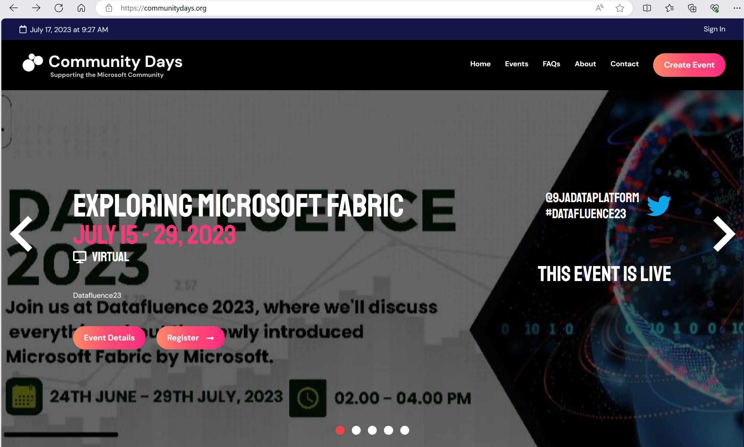
Microsoft Community
CommunityDays.org Updates
Complete / Rolling Out
Sponsors- Accepting sponsors through CDO[optional setting]
User profile- change picture, name
Speaker board- listing of CDO speakers by sessions/events/hours
**CDO speakers = speakers from any Sessionize integrated event**
Duplicate event- instant copy of previous event
New page URL system-/draft,/rejected,/pending, /event [better for search indexing/faster initial indexing]
Update to Next.js 14
Working on it
Integration with MS events
Up Next
Smart Detect to auto hide unused sections/Alternate layouts

Slide 8
Open call For Microsoft Community Regional Leaders
A MGCI Regional Leader is a working volunteer position that helps to create and support Community Days(communitydays.org) events, spread the word about the Microsoft Global Community Initiative and ensure global access to community resources.
Apply now at
aka.ms/MGCIRegionalLead

Slide 9
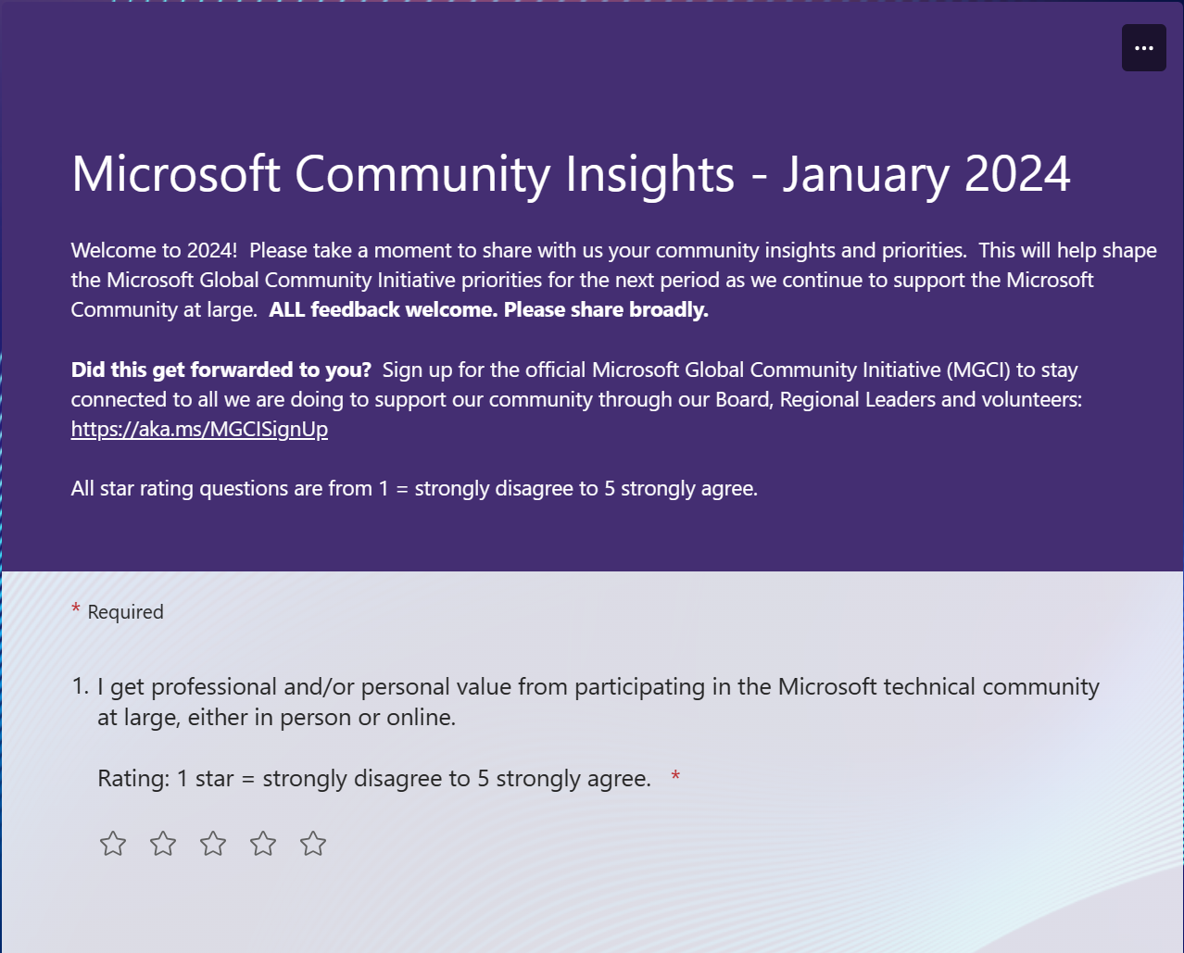
Microsoft Community
Community Insights survey
Fill out our annual community insights survey at
Open until 2/29
https://aka.ms/CommunityInsights

Slide 10
Upcoming Community Produced Events
Professionally produced community events draw from 1k-5k attendees (in-person). Attendance fees are charged and pre/post event workshops delivered by Microsoft MVPs are often part of the event. Event organizers ask for our help in driving attendance and providing MSFT corporate speakers.
Event name | Start date | End date | City | State/Providence | Country | Products
NDC Sydney | 2/12/2024 | 2/16/2024 | Sydney |  | Australia | .NET; AI / ML; Azure / Cloud; Containers / Kubernetes; Data; Developer tools + DevOps; IoT; Mixed Reality; Open Source; Python
AzureDay PL 2024 | 2/15/2024 | 2/15/2024 | Warsaw |  | Poland | AI / ML; Azure / Cloud; Developer tools + DevOps; Security / Compliance
Digital Workplace Conference | 2/27/2024 | 2/28/2024 | Christchurch |  | New Zealand | Dynamics 365; Industry events; Microsoft 365; Power Platform
DevDay 2024 | 3/28/2024 | 3/28/2024 | Mons |  | Belgium | .NET; Developer tools + DevOps; Azure / Cloud; AI / ML
Dotnet Days RO | 4/18/2024 | 4/20/2024 | Lasi |  | Romania | .NET; Azure / Cloud
Global Azure Bootcamp 2024 - Melbourne Australia | 4/20/2024 | 4/20/2024 | Melbourne | Victoria | Australia | .NET; AI / ML; Containers / Kubernetes; Azure / Cloud; Developer tools + DevOps; Security / Compliance; Data
Microsoft 365 Conference | 4/28/2024 | 5/2/2024 | Orlando | Florida | United States | Employee Experience; Microsoft 365

Slide 11
Upcoming Community Led Events
These events often serve underrepresented or emerging markets. They are organized by volunteers and are free to attendees. Newly branded “Community Days” events may cover any part of the Microsoft technical stack and/or cater to roles or industries. These are a vibrant opportunity for recruiting, career development and technical skilling. A full list of community led events can be found at CommunityDays.org.
Event name | Start date | End date | City | State/Providence | Country
aMS Strasbourg 2024 | 1/17/2024 | 1/18/2024 | Strasbourg | Bas-Rhin | France
Azure OpenAI and ChatGPT Fest 2024 | 1/18/2024 | 1/19/2024 | Reston | Virginia | United States
M365 Community Days Lagos 2023 | 1/27/2024 | 1/27/2024 | Lagos | Lagos | Nigeria
Cloud Technology Townhall Tallinn 2024 | 2/1/2024 | 2/2/2024 | Tallinn | Harjumaa | Estonia
Microsoft 365 Community Day Miami | 2/2/2024 | 2/2/2024 | Miami | Florida | United States
M365 Community Days at Sea 2024 | 2/4/2024 | 2/11/2024 | Miami | Florida | United States
M365 Saturday DC - A Community Day Event | 2/10/2024 | 2/10/2024 | Reston | Virginia | United States
YYC Microsoft Community Day | 2/24/2024 | 2/24/2024 | Calgary | Alberta | Canada
Knoxville Microsoft 365 Community Day | 2/29/2024 | 3/1/2024 | Friendsville | Tennessee | United States
CollabDays Utah | 3/1/2024 | 3/1/12024 | Sandy | Utah | United States
aMS Lausanne 2024 | 4/5/2024 | 4/5/2024 | Lausanne | Canton de Vaud | Switzerland
D365UG Sverige | 4/17/2024 | 4/17/2024 | Stockholm | Stockholm | Sweden
Dynamics 365 Summit 2024 | 4/26/2024 | 4/27/2024 | Lisbon | Portugal | Portugal

Slide 12
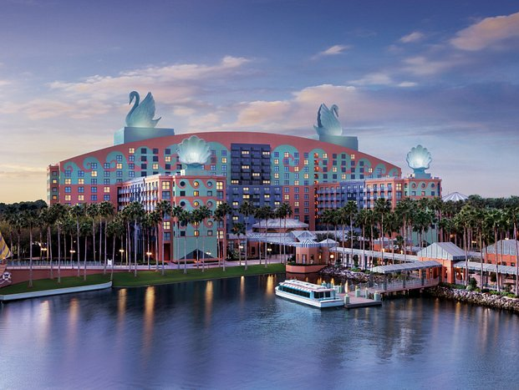
A Community Produced technology conference
Event Dates: April 30 – May 2, 2024
Workshops: April 28, 29, and May 3, 2024
$100 discount for customers with code: MSCUST
Why attend?
Microsoft delivered content on AI, Microsoft 365, Microsoft Viva, Windows and more.
Learn from experts how to leverage Microsoft Copilot to boost productivity, creativity, and collaboration
Network with thousands of Microsoft experts, industry leaders, and peers who all share a passion for Microsoft 365 and AI
Build skills and knowledge through hands-on demos and workshops
Location: Walt Disney World Swan & Dolphin Resort Orlando, FL
Event Website
#M365Conf

Slide 13
Community Event Organizer Training and Office Hours
WHEN:
The fourth Thursday of each month, 8:10am PT
January 25 at 8:10am PT
WHERE:
Community Tenant,
invite sent from mgci@msftcommunity.com
WHO:
Organizers of Community Led Events
Join us for Community Event Organizer Training & Office Hours where you’ll be able to get all the help you need with our tools, training and support to do a fun and impactful event.
Ask questions in our Events & Sponsor channel

Slide 14
Community Event
Producer Roundtables
WHEN:
The second Tuesday of each month, 8:10am & 5:10pm PT
February 13 at 8:10am & 5:10pm PT
WHERE:
Community Tenant,
invite sent from mgci@msftcommunity.com**
WHO:
Organizers of Community Produced Events
INTERESTED?
Let us know at https://aka.ms/3PEventProducers
Please share this sign-up link with your co-organizers or others that you know are also producers, all are welcome.
**Once a non-disclosure agreement (NDA) is complete, you will be added to the private channel and a meeting invitation will be sent. A separate NDA is required for this set of meetings even if you have another via a different Microsoft program.
As a part of the Microsoft Global Community Initiative, we have put together a series of Community Event Producer monthly roundtables. The roundtables will require a signed non-disclosure agreement (NDA) specific to this set of meetings as we will share information, flagship event dates and upcoming strategies and planning with you regarding Microsoft events. As we discuss many topics together, we want to have a safe, private space for all of us to have these discussions. The goal of these roundtables is to both inform you of internal initiatives and to listen to your feedback on how Microsoft can continue to support community efforts and events in the future.

Slide 15
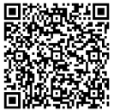
We want your feedback!
https://aka.ms/MGCIFeedbackJan2024

Slide 16
Microsoft Global Community Initiative
See you at our next general session Feb 20 at 8:10am PST
Top asks:
Complete our monthly survey: https://aka.ms/MGCIFeedbackJan2024
Participate in:
Community Event Organizer Training and Office Hours on January 25 at 8:10am PST
Invite colleagues to hold a community day event at communitydays.org

