Slide 1
We will get started at 10 min after the hour
Grab a refreshment!
General Session
April 16, 2024

Slide 2
Microsoft Event Code of Conduct
Microsoft’s mission is to empower every person and every organization on the planet to achieve more. This includes all Microsoft events and gatherings, including on digital platforms and in person, where we seek to create a respectful, friendly, enjoyable, and inclusive experience for all participants.
​
We expect all event participants to uphold the principles of this Code of Conduct. The Code of Conduct applies to all aspects of the main event and any related activities, whether digital or in person. Microsoft does not tolerate the following in any aspect of the event program, including business and social activities:
Behavior that is disruptive, disrespectful, or degrading to others, including any messages, images, or interactions by anyone, in any form, regardless of location.​
Harassment or discrimination based on age, ancestry, color, gender identity or expression, national origin, physical or mental disability, religion, sexual orientation, or any other characteristic protected by applicable local laws, regulations, and ordinances.​
​
We encourage everyone to assist in creating a welcoming and safe environment. Please report any concerns, harassing behavior, or suspicious or disruptive activity to venue staff, the event host or owner, or the nearest event staff.
​
We also encourage everyone to contact Microsoft’s Business Conduct Hotline at any time if you feel anything or anyone is not following this Code of Conduct or is inconsistent with Microsoft’s culture. The Hotline is available regardless of whether you are a Microsoft employee and can be reached at buscond@microsoft.com or +1 (877) 320-MSFT, or call collect outside the United States at +1 (720)-904-6844. Microsoft employees can also report any concerns to their Microsoft Manager.
Microsoft reserves the right to refuse admittance to or remove any person from a Microsoft event at any time at its sole discretion.

Slide 3
Agenda
Intro
Announcements | Newest releases in community
Guest Speaker | Isidora Katanic- Experts Live Europe
Community events & updates
Open discussion forum

Slide 4
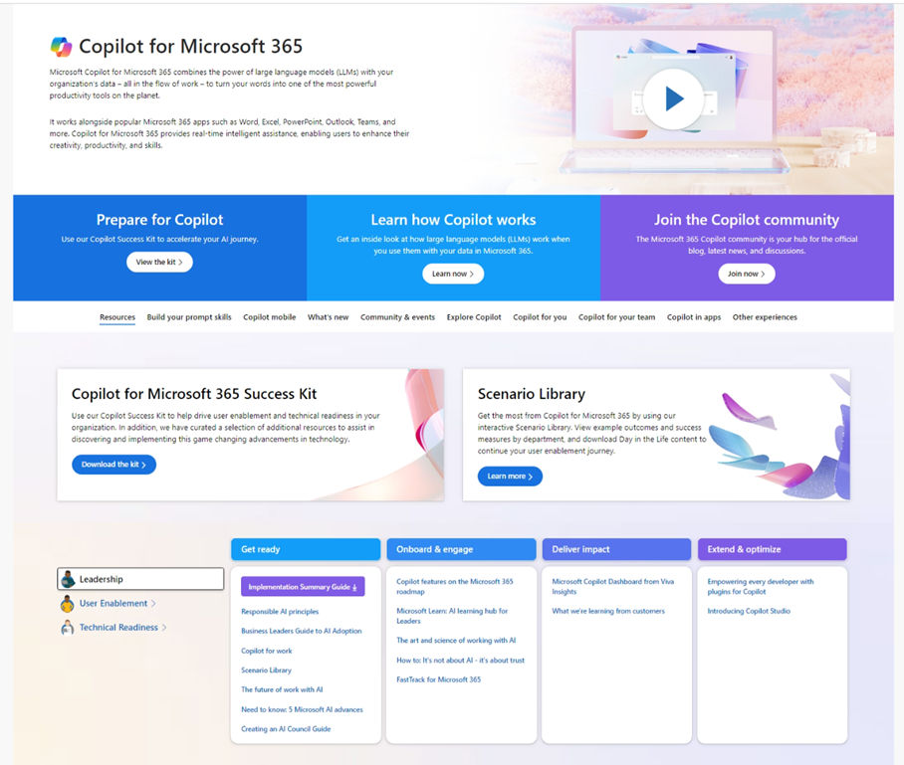
Copilot Resources on Microsoft Adoption
One site for all your Copilot needs
https://adoption.microsoft.com/copilot
Copilot Success Kit
Interactive Scenario Library
Product announcements and news
Links to all other Microsoft sites
Extended links for Small/Medium business, Copilot in Sales, Microsoft Viva, and more
Notes:
Primary home for Copilot resources from across Microsoft

Slide 5
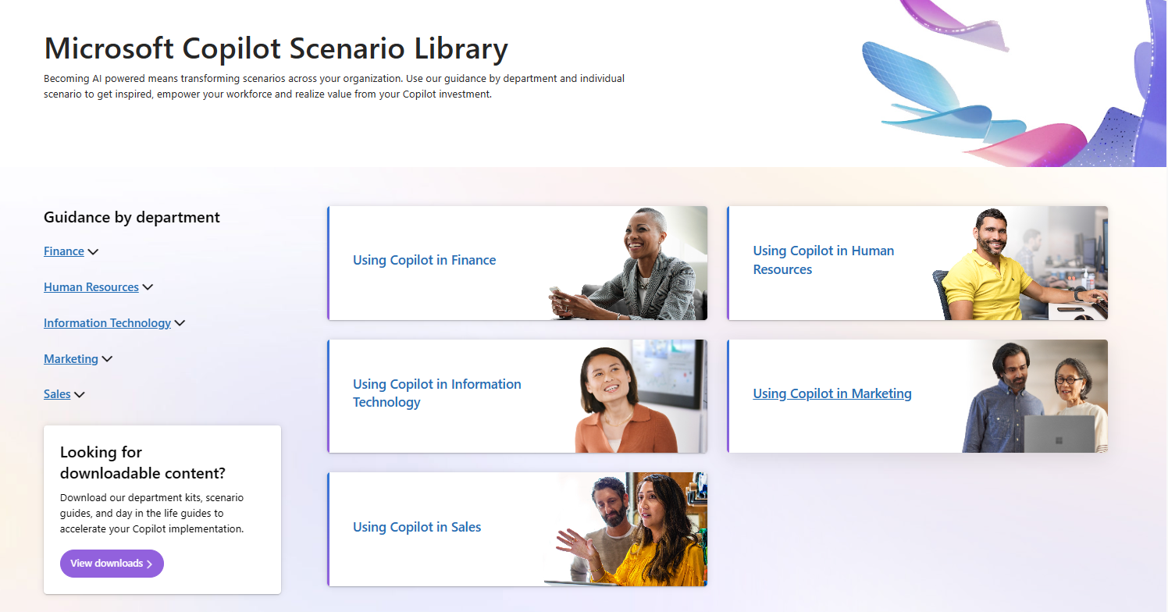
Interactive Scenario Library on Microsoft Adoption
https://aka.ms/Copilot/ScenarioLibrary
Notes:
Provides resources by role/area, such as leader, user enablement, and technical readiness, to help them deploy, use, and scale Copilot for their needs.
Showcases what’s new in Copilot, such as Copilot for SMB, Copilot for Sales, Copilot for Microsoft 365, and more.
Invites users to explore what’s possible with Copilot, such as building prompt skills, creating content, joining the community, and using Copilot in different apps.
Offers links to other Copilot experiences, such as Copilot for Sales, Copilot Studio, and Microsoft Copilot.

Slide 6
Upcoming Customer Hub Sessions!
All times listed in US Pacific Time
Round 1
Tuesday, March 5 | Tuesday, March 12 | Tuesday, March 19
8:00am - 9:30am Discover Microsoft Copilot for Microsoft 365 | 8:00am - 9:30am Drive user enablement in the Era of Microsoft Copilot | 8:00am - 9:30am Succeed in Organizational Transformation with Microsoft Copilot for Microsoft 365
Round 2
Tuesday, April 2 | Tuesday, April 9 | Tuesday, April 16
8:00am - 9:30am Discover Microsoft Copilot for Microsoft 365 | 8:00am - 9:30am Drive user enablement in the Era of Microsoft Copilot | 8:00am - 9:30am Succeed in Organizational Transformation with Microsoft Copilot for Microsoft 365
Round 3
Tuesday, May 7 | Tuesday, May 14 | Tuesday, May 21
8:00am - 9:30am Discover Microsoft Copilot for Microsoft 365 | 8:00am - 9:30am Drive user enablement in the Era of Microsoft Copilot | 8:00am - 9:30am Succeed in Organizational Transformation with Microsoft Copilot for Microsoft 365
Check out the Copilot Customer Hub page for upcoming sessions, updates, and session slides & recordings!!
Notes:
Today, we are in our third and final session of this round, but there are two additional rounds of this series, if you missed a session for Copilot for M365.

Slide 7
Communitydays.org Statistics
CommunityDays.org current numbers:
Total in tool: 208
CY22 Events: 25 | FY23: 74
CY23 Events: 110 | FY24: 125
CY24 Events: 72 | FY25: 9
CY25 Events: 1

Slide 8
Communitydays.org Feature Update
​Updates and feature list for Communitydays.org​
Complete / Rolling Out​
Bug – Unable to Remove Sponsor Package from Sponsor Application
Event Page - Searching Sessionize Sessions & Speakers
Community Calls in testing
​
Working on it​
Events as a List & Calendar [Design Phase]
Community Calls Calendar [Design Phase]
Microsoft 'Other' Events Sync [Testing]
​
Up Next​
Organizer / Co-Organizer Tab

Slide 9
Isidora Katanic
MGCI Board Member
Microsoft MVP | Switzerland

Slide 10
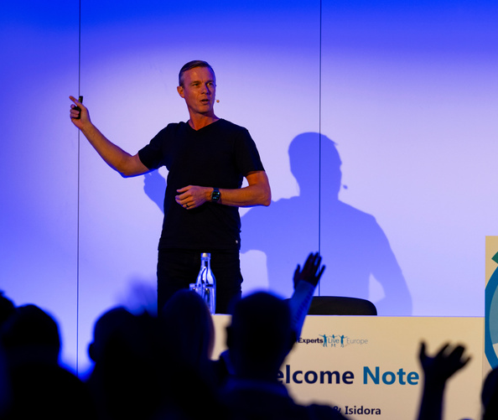
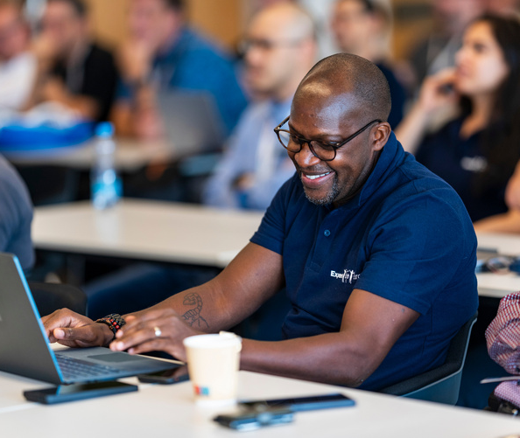
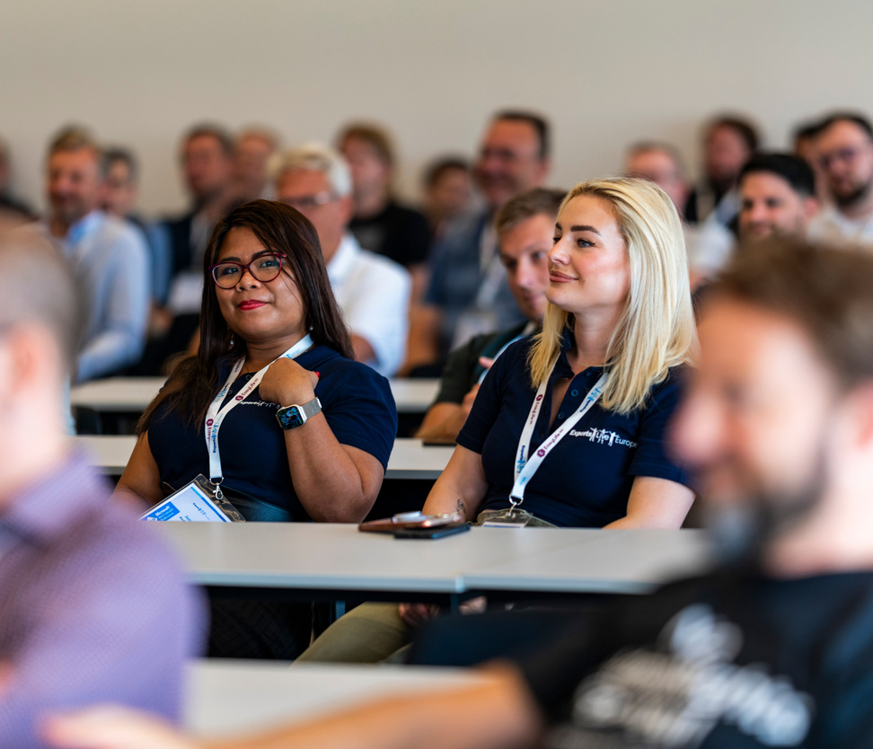
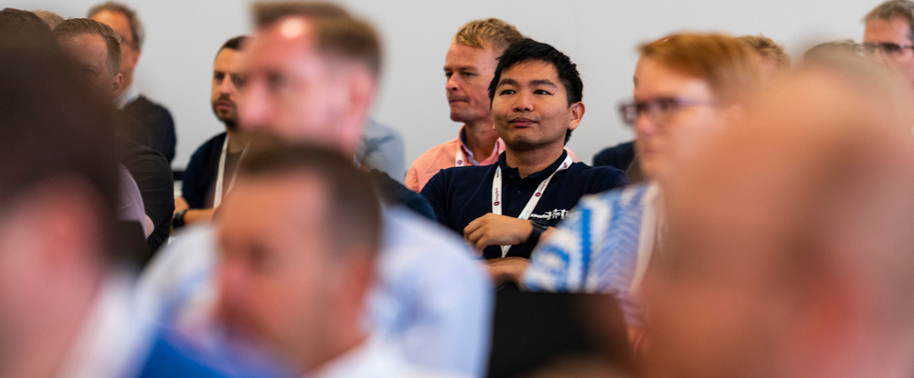

Slide 11
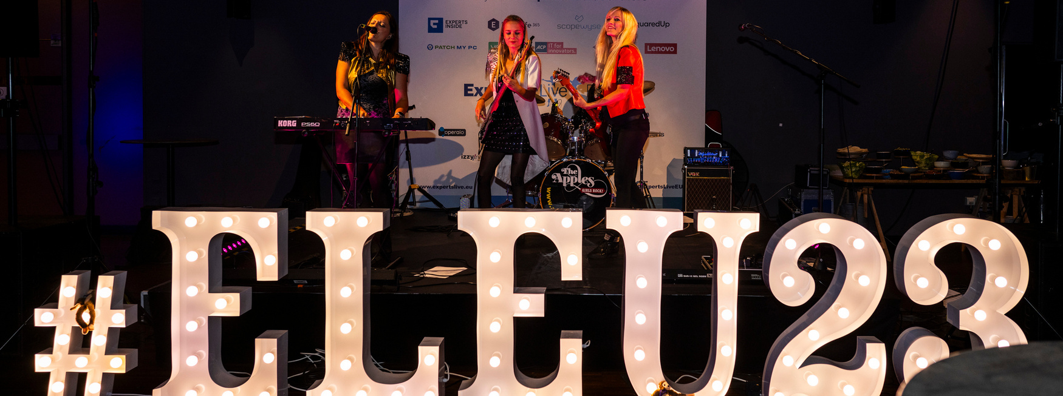
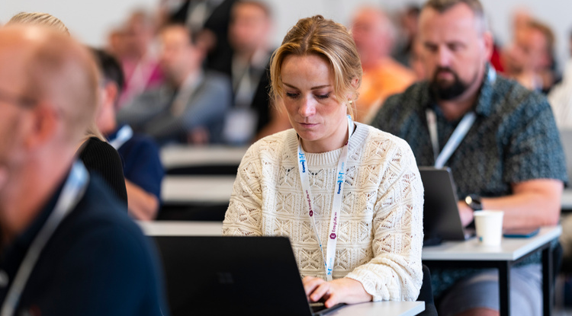
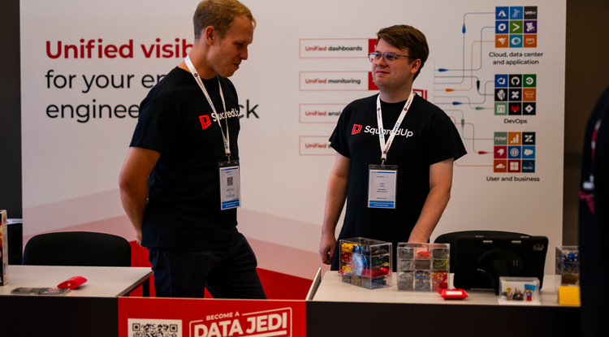
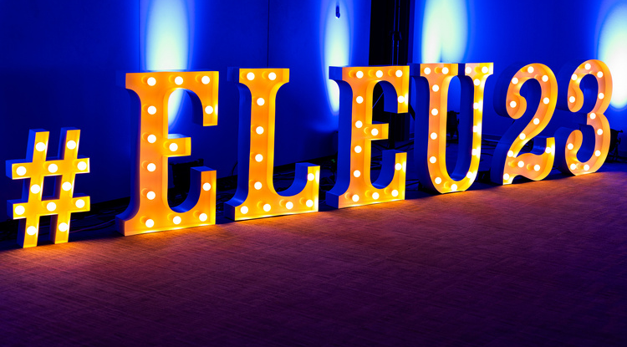
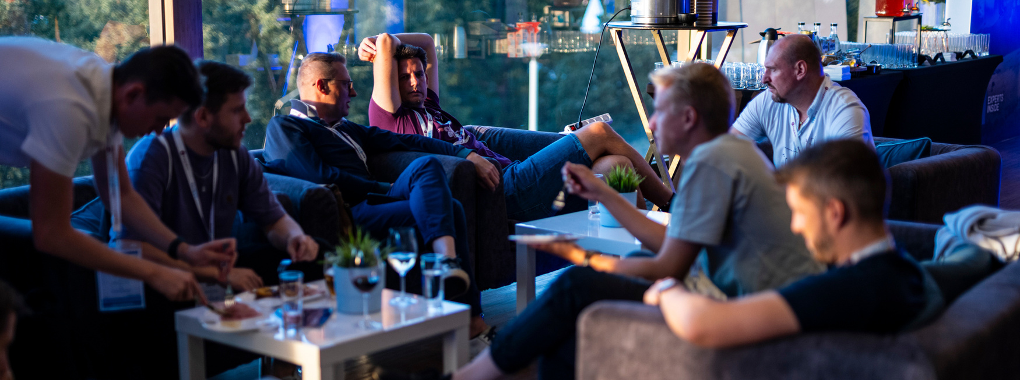
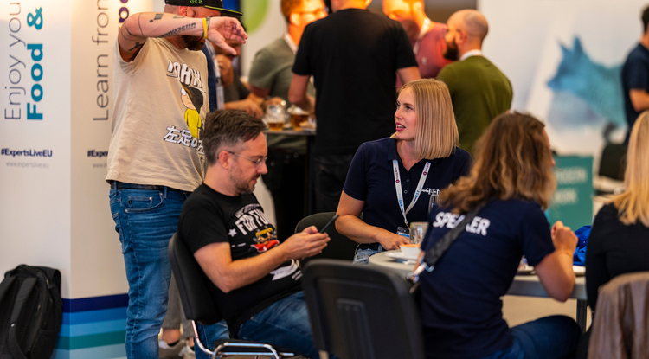

Slide 12
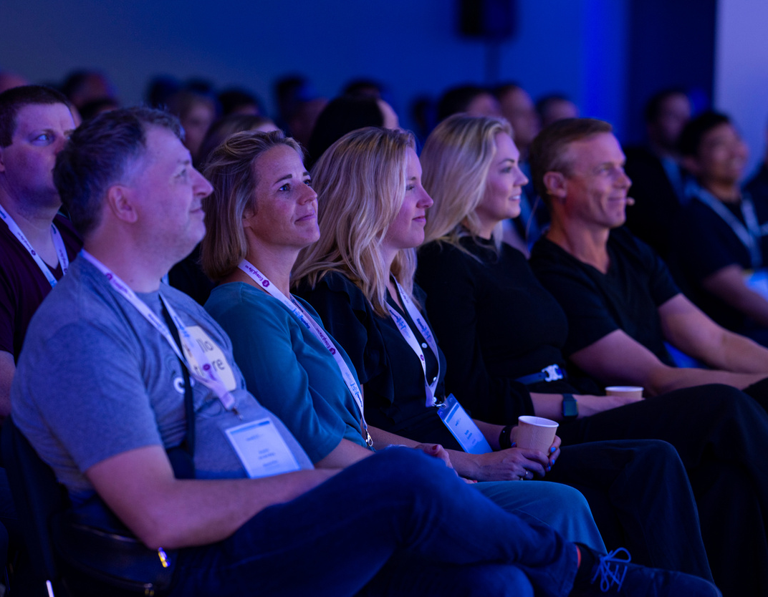
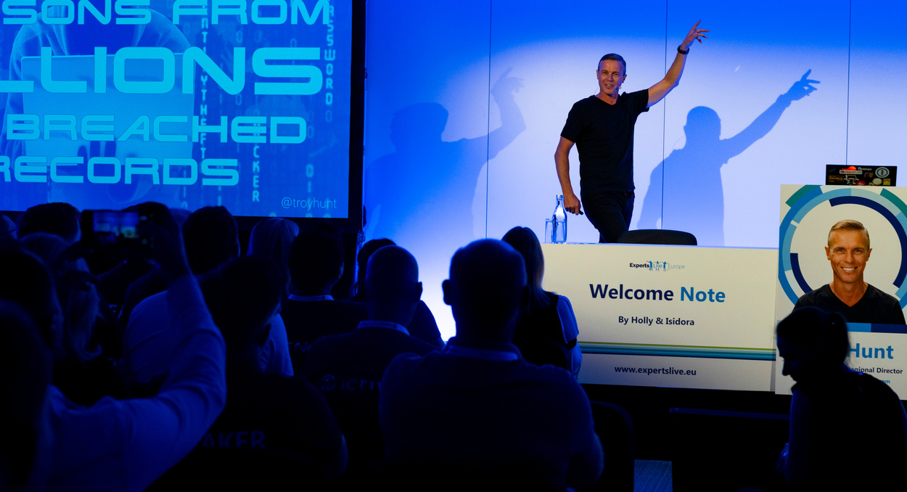
Key Facts & Figures
01
September 23-25, 2024
02
Budapest Congress Center
06
1 keynote
03
500+ IT Pros on-site
07
50+ breakouts
04
60+ speakers (MVP/RD/FTE)
08
3 pre-con workshops
05
20+ sponsor booths
09
100% MicrosoftLuv
10
Cloud, Datacenter, AI, Modern Workplace, Security & more

Slide 13
Sessions and speakers are carefully selected by the Community, for the Community www.expertslive.eu/sessions

Slide 14
Experts from the community will be on stage sharing their passion for Microsoft technologies www.expertslive.eu/speakers

Slide 15
MGCI SPECIAL!
For MGCI Members 💙
20% DISCOUNT CODE:
COMMUNITYLUV
Valid until July 1st, 2024
expertslive.eu/register

Slide 16
Get in touch with us directly expertslive@izzyevents.ch if you / your company is interested in discussing sponsorship

Slide 17
20% DISCOUNT CODE:
COMMUNITYLUV
expertslive.eu/register

Slide 18
Upcoming Community Produced Events: April – June 2024
Professionally produced community events draw from 1k-5k attendees (in-person). Attendance fees are charged and pre/post event workshops delivered by Microsoft MVPs are often part of the event. Event organizers ask for our help in driving attendance and providing MSFT corporate speakers.
Event name | Start date | End date | City | State/Providence | Country | Products
Windows Server Summit 2024 | 4/8/2024 | 4/9/2024 | Wuerzburg | Bavaria | Denmark
DEVIntersection | 4/9/2024 | 4/9/2024 | Orlando | Florida | United States
Microsoft Azure & AI Conference | 4/9/2024 | 4/9/2024 | Orlando | Florida | United States | .NET; AI / ML; Azure / Cloud; Power Platform
Intranets and AI on Microsoft 365 | 4/9/2024 | 4/10/2024 | Copenhagen |  | Denmark | Microsoft 365; AI/ML
North American Cloud and Collaboration Summit | 4/9/204 | 4/11/2024 | Irving | Texas | United States | Power Platform; Microsoft 365; Azure / Cloud
CollabDays Poland 2024 | 4/11/2024 | 4/12/2024 | Warsaw | Mazowieckie | Poland | Power Platform; Microsoft 365
Future Tech | 4/17/2024 | 4/17/2024 | Utrecht |  | Netherlands | .NET; Azure / Cloud; Data; Developer tools + DevOps
Modern Endpoint Management Summit 2024 EMEA EDITION | 4/17/2024 | 4/19/2024 | Issy-les-Moulineaux |  | France | Microsoft 365: AI/ML
ColorCloud | 4/18/2024 | 4/19/2024 | Hamburg | Hamburg | Germany | Microsoft 365
Dotnet Days RO | 4/18/2024 | 4/20/2024 | Lasi |  | Romania | .NET; Azure / Cloud
Global Azure Sydney 2024 | 4/18/2024 | 4/20/2024 | Sydney | NSW | Australia | AI / ML; Azure / Cloud; Containers / Kubernetes; Developer tools + DevOps; Security / Compliance; Open Source; IoT
Global Azure Bootcamp 2024 - Melbourne Australia | 4/20/2024 | 4/20/2024 | Melbourne | Victoria | Australia | .NET; AI / ML; Containers / Kubernetes; Azure / Cloud; Developer tools + DevOps; Security / Compliance; Data

Slide 19
Upcoming Community Produced Events (continued)
Event name | Start date | End date | City | State/Providence | Country | Products
mDevCamp | 4/23/2024 | 4/23/2024 | Prague |  | Czech Republic | .NET; Developer tools + DevOps
Comms vNext | 4/23/2024 | 4/24/2024 | Denver | Colorado | United States | Microsoft 365
Dynaway CONNECT | 4/23/2024 | 4/24/2023 | Greenville | South Carolina | United States | Dynamics 365
Microsoft 365 Community Conference | 4/28/2024 | 5/2/2024 | Orlando | Florida | United States | Employee Experience; Microsoft 365
Visual Studio Live | 4/29/2024 | 5/3/2024 | Chicago | Illinois | United States | .NET; Developer tools + DevOps; Azure / Cloud; AI / ML
Tehcorama | 5/6/2024 | 5/8/2024 | Antwerp |  | Belgium | .NET; Azure / Cloud; Containers / Kubernetes; Data; Developer tools + DevOps; Microsoft 365
DynamicsCon LIVE | 5/13/2024 | 5/16/2024 | Denver | Colorado | United States | Dynamics 365; Power Platform
European Collaboration Summit 2024 | 5/14/2024 | 5/16/2024 | Wiesbaden | Hesse | Germany | Microsoft 365; Power Platform
IM Tech Summit Europe 2024 | 5/15/2024 | 5/15/2024 | Brighton | England | United Kingdom | AI/ML
Get-CsLatam Conference and Expo 2024 | 5/16/2024 | 5/17/2024 | Mexico City |  | Mexico
DevSum | 5/15/2024 | 5/17/2024 | Stockholm |  | Sweden | .NET; Azure / Cloud; Career / D&I (Diversity and Inclusion); AI / ML; Containers / Kubernetes; Data; Developer tools + DevOps
DynamicsMinds 2024 | 5/26/2024 | 5/29/202 | Portoroz |  | Slovenia | Dynamics 365; Power Platform
Thrive Conference | 5/28/2024 | 5/29/2024 | Podcetrtek |  | Slovenia | Azure / Cloud; Microsoft 365; Power Platform
TechCon365 and PWRCON - A Microsoft 365 and Power Platform Conference | 6/3/2024 | 6/7/2024 | Seattle | Washington | United State | Microsoft 365; Power Platform
European Power Platform Conference | 6/11/2024 | 6/13/2024 | Brussels |  | Belgium | Microsoft 365; Power Platform

Slide 20
Upcoming Community Led Events : April – June 2024
These events often serve underrepresented or emerging markets. They are organized by volunteers and are free to attendees. Newly branded “Community Days” events may cover any part of the Microsoft technical stack and/or cater to roles or industries. These are a vibrant opportunity for recruiting, career development and technical skilling. A full list of community led events can be found at CommunityDays.org.
Event name | Start date | End date | City | State/Providence | Country
aMS Lausanne 2024 | 4/5/2024 | 4/5/2024 | Lausanne | Canton de Vaud | Switzerland
M365 Community Days NJ | 4/6/2024 | 4/6/2024 | East Brunswick | New Jersey | United States
Copilot Days 2024 | 4/15/2024 | 4/15/2024 | Pozuelo de Alarcon | Madrid | Spain
D365UG Sverige | 4/17/2024 | 4/17/2024 | Stockholm | Stockholm | Sweden
CollabDays Utah | 4/19/2024 | 4/19/2024 | Sandy | Utah | United States
Minnesota M365 Spring Workshop Day | 4/19/2024 | 4/19/2024 | Edina | Minnesota | United States
Microsoft Fabric and Open AI day - London Ont - Free Event | 4/24/2024 | 4/24/2024 | London | Ontario | Canada
aMS Papeete | 4/25/2024 | 4/25/2024 | PIRAE Cedex Papeete | Tahiti | French Polynesia
BizApps-Palooza 2024 | 4/26/2024 | 4/26/2024 | Toronto | Ontario | Canada
Dynamics 365 Summit 2024 | 4/26/2024 | 4/27/2024 | Lisbon | Portugal | Portugal
aMS Noumea | 4/30/2024 | 4/30/2024 | Noumea | New Caledonia | New Caledonia
M365 Philly 2024 | 5/18/2024 | 5/18/2024 | Malvern | Pennsylvania | United States
Americas - SharePoint Intranet Festival | 5/22/2024 | 5/22/2024 | Virtual
EMEA - SharePoint Intranet Festival | 5/22/2024 | 5/22/2024 | Virtual
APAC - SharePoint Intranet Festival | 5/22/2024 | 5/22/2024 | Virtual
Power Platform Developer Summit 2024 | 5/25/2024 | 5/25/2024 | London |  | United Kingdom
DynUG Spring Conference | 5/28/2024 | 5/29/2024 | Oslo |  | Norway
BeConnected day 12 - CollabDays Italy 2024 | 5/30/2024 | 5/30/2024 | Milan |  | Italy

Slide 21
Upcoming Community Led Events (continued)
These events often serve underrepresented or emerging markets. They are organized by volunteers and are free to attendees. Newly branded “Community Days” events may cover any part of the Microsoft technical stack and/or cater to roles or industries. These are a vibrant opportunity for recruiting, career development and technical skilling. A full list of community led events can be found at CommunityDays.org.
Event name | Start date | End date | City | State/Providence | Country
CollabDays Netherlands 2024 | 6/1/2024 | 6/1/2024 | Vianen | Utrecht | Netherlands
AI Community Event - NYC 2024 | 6/7/2024 | 6/7/2024 | New York | NY | United States
CollabDays Madrid 2024 | 6/14/2024 | 6/14/2024 | Pozuelo de Alarcon | Madrid | Spain

Slide 22
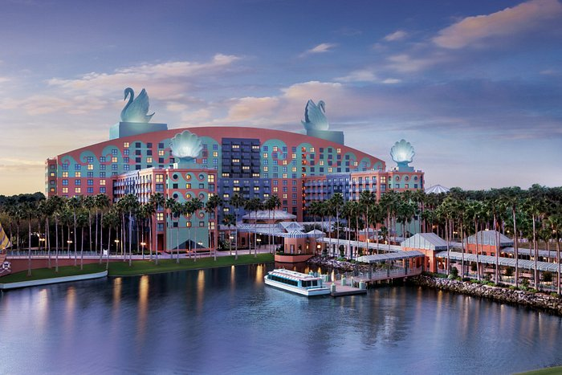
SPONSORED BY
Event Dates: April 30 – May 2, 2024
Workshops: April 28, 29, and May 3, 2024
Location: Walt Disney World Swan & Dolphin Resort, Orlando, FL
Reg Goal: 4,000
$100 discount for the community
Discount Code: MSCMTY
150+ Sessions
50+ Exhibitors
Event Website
18 Workshops
#M365Con

Slide 23
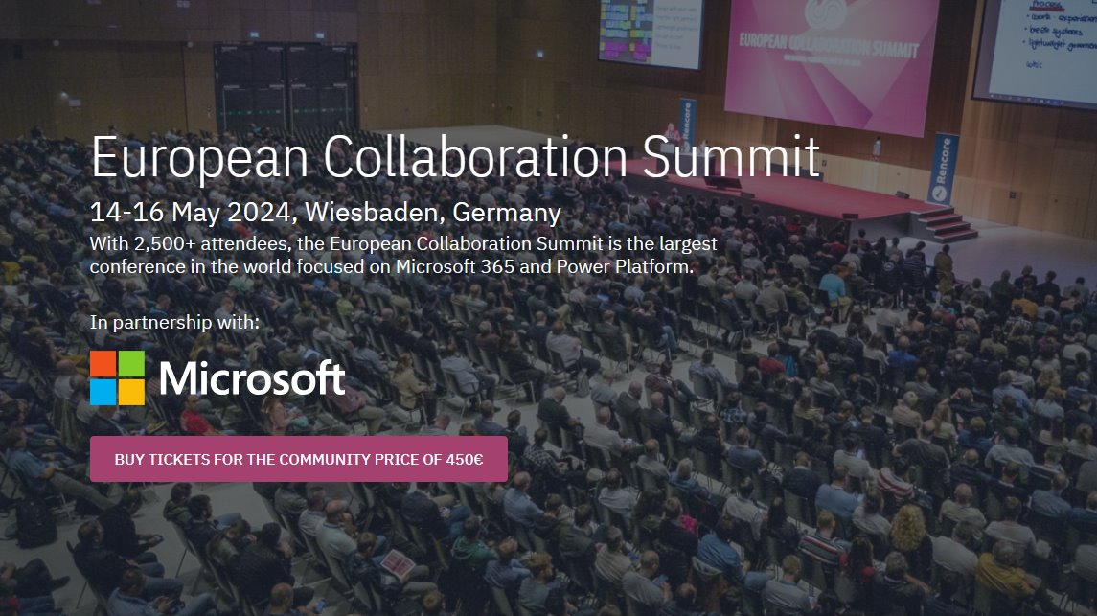

Slide 25
Experts Live
Europe 2024
Where the Microsoft community connects.
www.expertslive.eu

Slide 26
Monday’s at Microsoft with Karuana & Heather
Karuana Gatimu
Learn - Explore – Connect In the Microsoft Community
Bi-weekly @ 8am PT
Watch on
Microsoft Community Linked
Heather Cook
https://aka.ms/microsoftcommunitylinkedin
Notes:
Last used May 2023, Heather Cook

Slide 27
Community Event Organizer Training and Office Hours
WHEN:
The fourth Thursday of each month, 8:10am PT
April 25 at 8:10am PDT
WHERE:
Community Tenant,
invite sent from mgci@msftcommunity.com
WHO:
Organizers of Community Led Events
UPCOMING TOPICS:
April – Budget
May – Event Brite
June – Community Overview
Join us for Community Event Organizer Training & Office Hours where you’ll be able to get all the help you need with our tools, training and support to do a fun and impactful event.
Ask questions in our Events & Sponsor channel

Slide 28
Community Event
Producer Roundtables
WHEN:
NEW! Quarterly, the fourth Tuesday. 8:10am & 5:10pm PT
June 25 at 8:10am & 5:10pm PDT
WHERE:
Community Tenant,
invite sent from mgci@msftcommunity.com**
WHO:
Organizers of Community Produced Events
INTERESTED?
Let us know at https://aka.ms/3PEventProducers
Please share this sign-up link with your co-organizers or others that you know are also producers, all are welcome.
**Once a non-disclosure agreement (NDA) is complete, you will be added to the private channel and a meeting invitation will be sent. A separate NDA is required for this set of meetings even if you have another via a different Microsoft program.
As a part of the Microsoft Global Community Initiative, we have put together a series of Community Event Producer monthly roundtables. The roundtables will require a signed non-disclosure agreement (NDA) specific to this set of meetings as we will share information, flagship event dates and upcoming strategies and planning with you regarding Microsoft events. As we discuss many topics together, we want to have a safe, private space for all of us to have these discussions. The goal of these roundtables is to both inform you of internal initiatives and to listen to your feedback on how Microsoft can continue to support community efforts and events in the future.

Slide 29
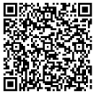
We want your feedback!
https://aka.ms/MGCIFeedbackApril2024

Slide 30
Microsoft Global Community Initiative
See you at our next general session May 21 at 8:10am and 5:10pm PDT
Top asks:
Complete our monthly survey: https://aka.ms/MGCIFeedbackApril2024
Invite colleagues to hold a community day event at communitydays.org

