Slide 1



MGCI Community Builders Network Call
Microsoft Global Community Initiative
September 2026
Topic: Host: Heather Cook
Principal PM, Global Evangelism and Events, SCALE Team, Microsoft
Guest Speaker: Diego Domingos da Silva
M365 Principal Solutions Architect, Cambay Solutions, Microsoft MVP and MGCI Regional Leader

Slide 2
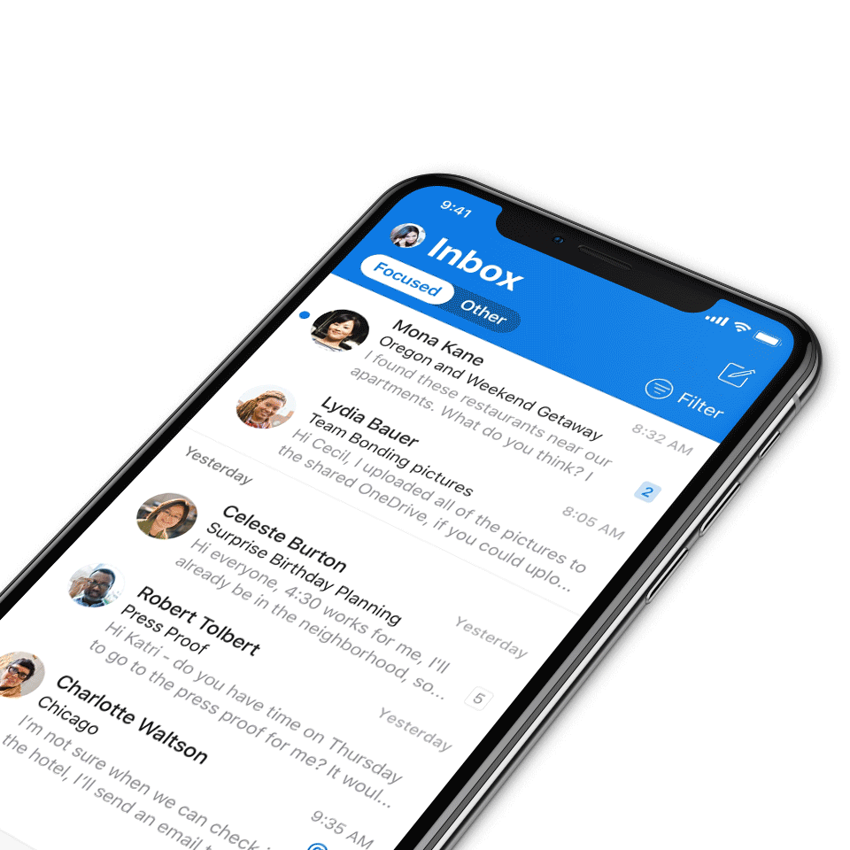
We expect all digital event participants to uphold the principles of this Code of Conduct, which covers the main digital event and all related activities. We do not tolerate disruptive or disrespectful behavior, messages, images, or interactions by any party participant, in any form, at any aspect of the program including business and social activities, regardless of location.​
Microsoft will not tolerate harassment or discrimination based on age, ancestry, color, gender identity or expression, national origin, physical or mental disability, religion, sexual orientation, or any other characteristic protected by applicable local laws, regulations, and ordinances.​
AI notetakers are not permitted and will not be admitted to meetings.
Digital Event Code of Conduct
Microsoft’s mission is to empower every person and every organization on the planet to achieve more.
This includes all Microsoft events and gatherings, including on digital platforms, where we seek to create a respectful, friendly, fun and inclusive experience for all participants.​
We encourage everyone to assist in creating a welcoming and safe environment.
For more info, click here.

Slide 3
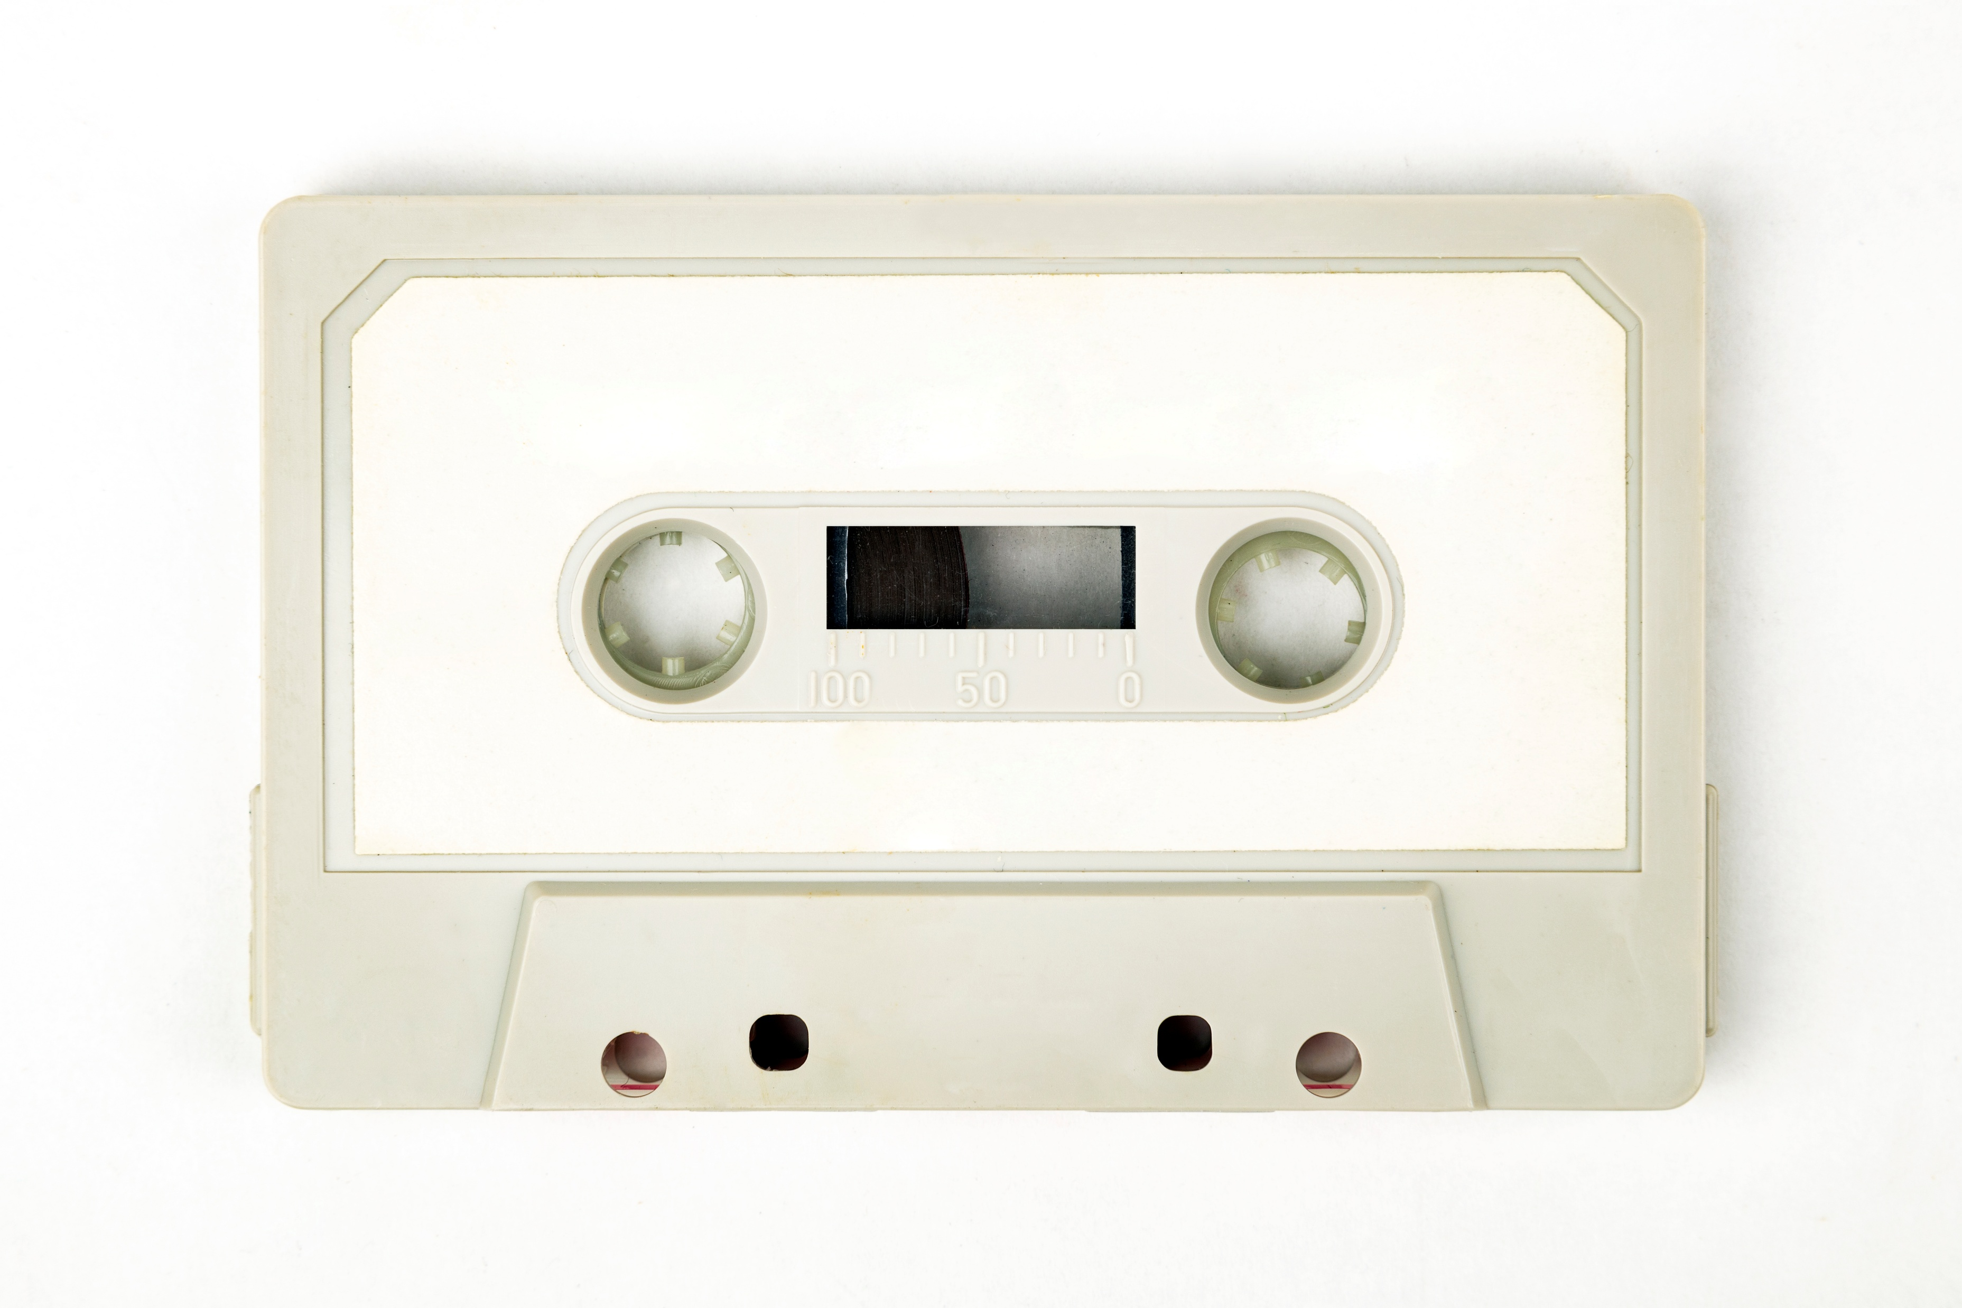
Recordings
All Community Builders Network Calls are recorded and posted on-demand on the Microsoft Community Learning YouTube channel.
If you do not want to be recorded, please leave the call or stay on mute.
Speaker video and audio will be shown in the recordings.
Attendee questions audio will be also be shared.

Slide 4

Mission and Tagline
The Microsoft Global Community Initiative (MGCI) - Empowering global Microsoft communities with the tools, training, and resources to create impactful events and amplify diverse voices.
Learn, Share, Grow.
Join MGCI today! https://aka.ms/MGCI

Slide 5
Announcements
Monthly Topic: Creating community before the event: Lessons from M365 NYC
Sub Committee Updates
Community Events & Updates
Open Discussion Forum
Agenda

Slide 6

Thank You!
To our Microsoft Most Valuable Professionals (MVP) and Regional Directors.

Slide 7
Topic of the Month:
Creating community before the event: Lessons from M365 NYC
Guest Speaker:
Diego Domingos da Silva
M365 Principal Solutions Architect, Cambay Solutions, Microsoft MVP and MGCI Regional Leader

Slide 8
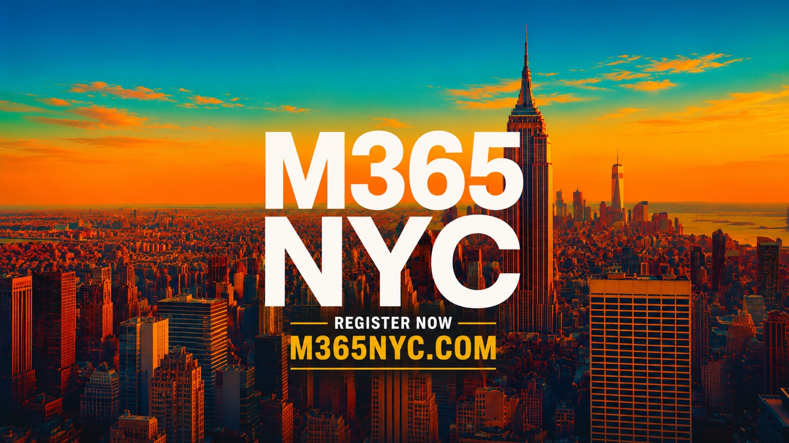
I never actually
attended M365 NYC.
And that completely changed how I contributed to it.
MGCI Community Builders monthly call
Diego Domingos da Silva • UnsuckM365

Slide 9
Weeks before
Event day
Weeks after
Conversations
The physical gathering
Reuse+continuation
The event starts before the event.
Registration day should not be Day 1 of the community experience.
If we are community builders, why wait until everyone is in the same room to start building the community around the event?

Slide 10
Promotion is not the same thing as community.
EVENT ANNOUNCED
SPEAKER GRAPHIC
REGISTER NOW
SPEAKER GRAPHIC
Save the date!
Meet our next speaker
Seats are limited!
Another headshot
None of this is wrong. But it is advertising.
The opportunity is to make the promotion itself worth consuming.

Slide 11
Let people meet the people.
Speakers are more than headshots. Sponsors are more than logos.
Speaker
Conversation
Human
What are you excited to talk about?
What are you seeing in the community?
What happens when we go off script?
They do not have to become content creators. They just have to have a conversation.

Slide 12
Sponsors can be community members too.
Traditional sponsorship
What else?
Logo
Conversations
Booth
Expertise
Thank-you post
Stories
Sponsored session
People
Give sponsors something better than logo exposure.

Slide 13
Stop thinking video. Think source material.
Full interview
Speaker posts
1 conversation
LinkedIn
Sponsor posts
Short clips
Post-event
One recording. Many assets.

Slide 14
A 60-second video does not take 60 seconds.
Schedule
Record
Review
Clip
Edit
Reframe
Caption
Export
Write
Schedule
Budget production based on finished assets, not recording time.
A 20-minute interview that produces 6 clips is not one deliverable. It is seven.

Slide 15
What I would change next time.
Build this into the event from Day 1
1
Set expectations during speaker onboarding
5
Build social into sponsor packages
2
Start recordings much earlier
6
Give people finished assets to share
3
Batch whenever possible
7
Plan before + during + after together
4
Design for vertical video from the start

Slide 16
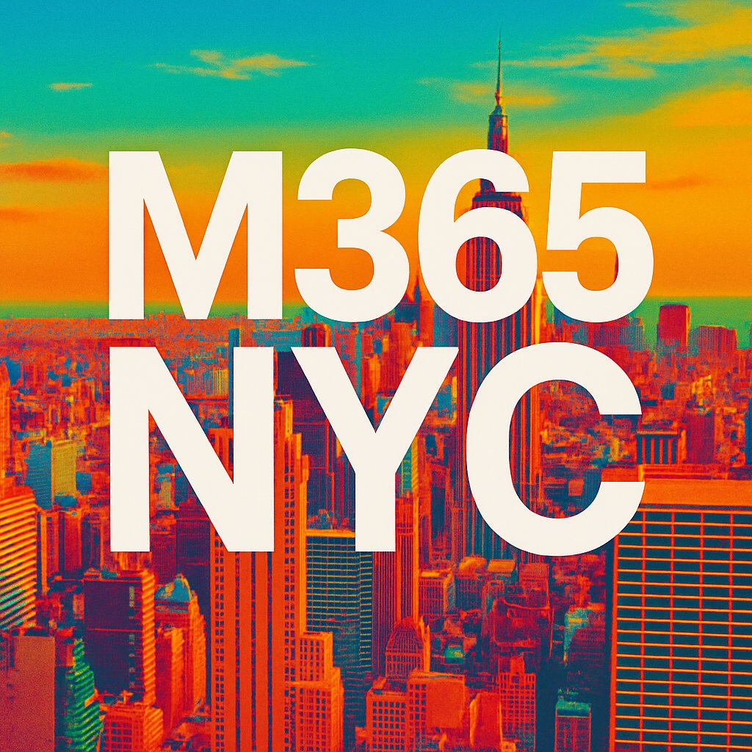
Community content first. Event advertising second.
The physical event can be the center of the community without being its boundary.
M365 NYC had already started long before anybody checked in.
Our job is not just to get people into the building. It is to create connections between people.

Slide 17
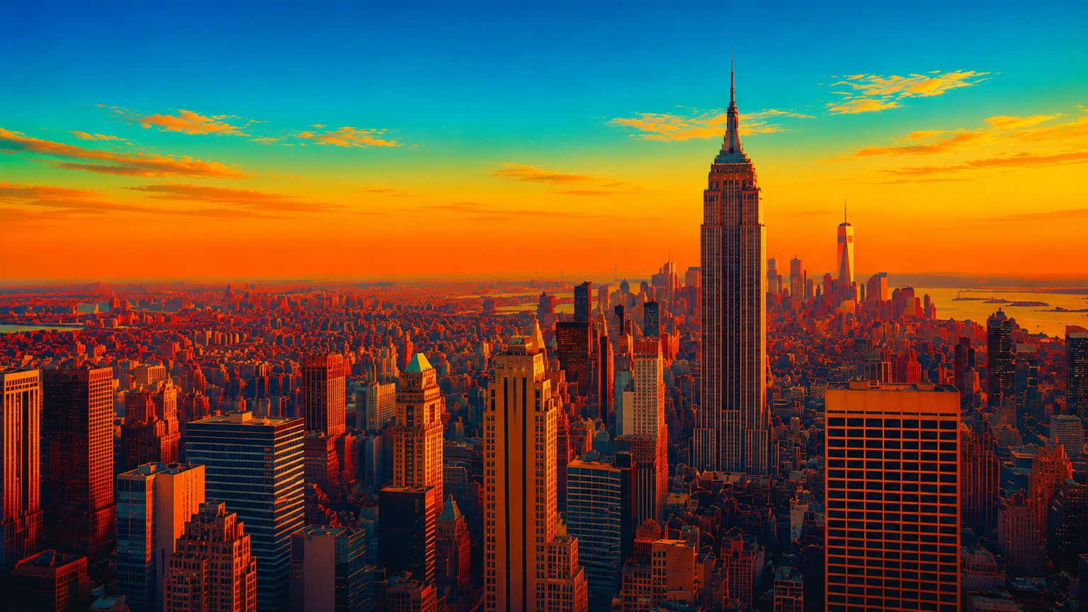
Follow this for your next event.
Start earlier.
Talk to people.
Record conversations.
Reuse everything.
Give people something worth sharing.
Keep the community going afterward.
Questions?

Slide 18
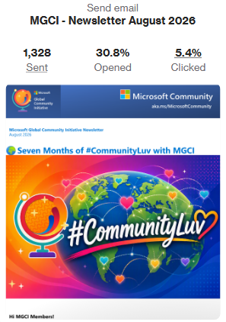
Communications Workstream Update
Board Officer Leads
Jennifer Mason
Isidora Katanic
August email sent and posted on the Microsoft Tech Community: 🌍 Seven Months of #CommunityLuv with MGCI | Microsoft Community Hub
Watch out for the next newsletter coming 2nd week of October.
Please use #CommunityLuv on socials so we can include your posts.
Monthly Newsletter

Slide 19
Sponsors & Sponsorship - Subcommittee Update
Goal: Helping the MGCI community leverage sponsorship opportunities through shared knowledge and support.
Board Officer Leads & Members
Update / Progress
Mark Rackley
Sharon Sumner
Neil Patel
No new updates.
Open for new volunteers to join!

Slide 20

Tech & Tools Sub Committee
Meets on the second Tuesday of every month. A working group of volunteers shaping the Community Days platform alongside MGCI.
Purpose
Align on overall technical direction and vision
Review and shape the product roadmap
Hands-on with new features (beta testing & feedback)
Serve as eyes and ears within the community
Help guide improvements based on real community needs
Support evangelism and platform adoption
Participate in monthly alignment meetings on Discord
JOIN US
MGCI Tech & Tools Team
Help shape the platform: design, code, test, content. Open to all skill levels.
Fill out the form →
https://aka.ms/MGCI-CDO-TestandTechSignUp
communitydays.org

Slide 21
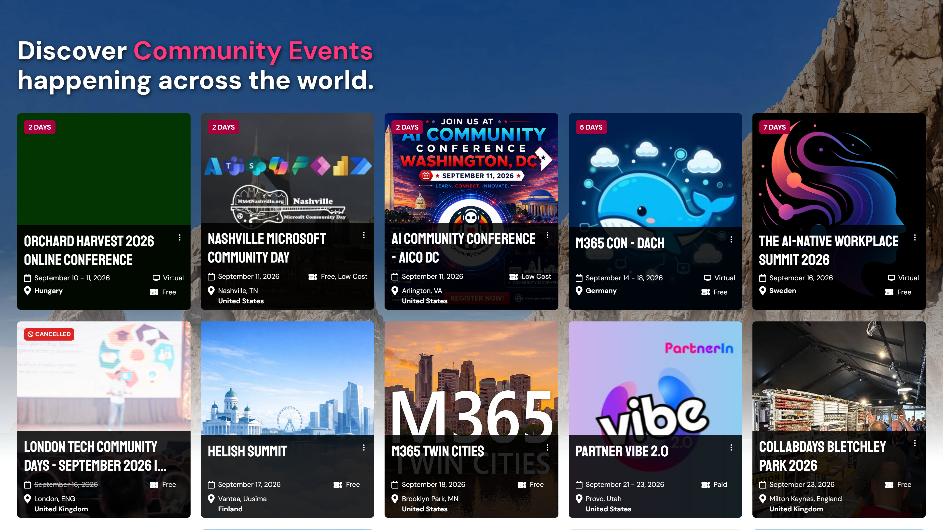

Slide 22
PAST 2 MONTHS
What's New
Jul 8 — Sep 8, 2026
ORGANIZERS & SPONSORS
PLATFORM & QUALITY
Venue maps — organizers add venue map layers to an event; attendees open them straight from the schedule
Faster event saves — saving an event dropped from 24 requests to 2; duplicate web addresses are refused
Global sponsor management — site-wide sponsors and their logos are now managed in one place
Cleaner search results — cancelled and postponed events dropped from search; addresses no longer repeat the city or country
Sponsors finish their own application — an “interested” sponsor gets an emailed link to complete a full application
Accessibility — keyboard focus outlines and navigation across search, date pickers and organizer controls
Sponsorship dashboard filters — KPI tiles are one-click filters, and pending counts are accurate
Security hardening — closed access gaps in the alerts and co-organizer APIs; fixed uploads blocked by the firewall
Schedule filters — search plus Topic / Level / Track filters on the Schedule tab
Maintenance — Next.js 16.3, dependency and security updates, bot-reviewed performance fixes
communitydays.org
ENGINEERING UPDATE

Slide 23
ROADMAP / 30-90 DAYS
What's Next
Sep — Nov 2026
NOW — IN FLIGHT
NEXT — 30 TO 90 DAYS
Microsoft Clarity — session insights running cookieless, in consent mode, keeping our zero-cookie promise
Calendar view — browse the events page by month
Events near you — the first row of the events page shows events within ~300 km of the visitor
Sponsor uploads by event — sponsor-application files stored under their event for easier cleanup
Map of events — browse upcoming events on a map
One-click admin filters — KPI tiles as filter presets across the admin pages
Article editor upgrade — moving the event page-content editor to Redactor
communitydays.org
ROADMAP

Slide 24
GET INVOLVED
Focus Areas
Pick a lane
DEVELOPMENT
CONTENT
CREATIVE
QA & TESTING
EVANGELISM
Localized events
Videos
Brand & design
Speaker board
Platform adoption
DAVID OPDENDRIES
· AI enablement
OPEN
JAMEL ABED
OPEN
· Introduction to Community Days
Platform features & fixes
Credly badges
Testers
Community feedback
· How to create an event
OPEN
· Try new features before release
OPEN
OPEN
OPEN
OPEN
Docs & how-tos
OPEN
communitydays.org
FOCUS AREAS

Slide 25
RECENT CONTRIBUTIONS
Team Updates
Jul 8 — Sep 8, 2026
No new changes
No new teammates
No new contributions
communitydays.org
TEAM UPDATE

Slide 26
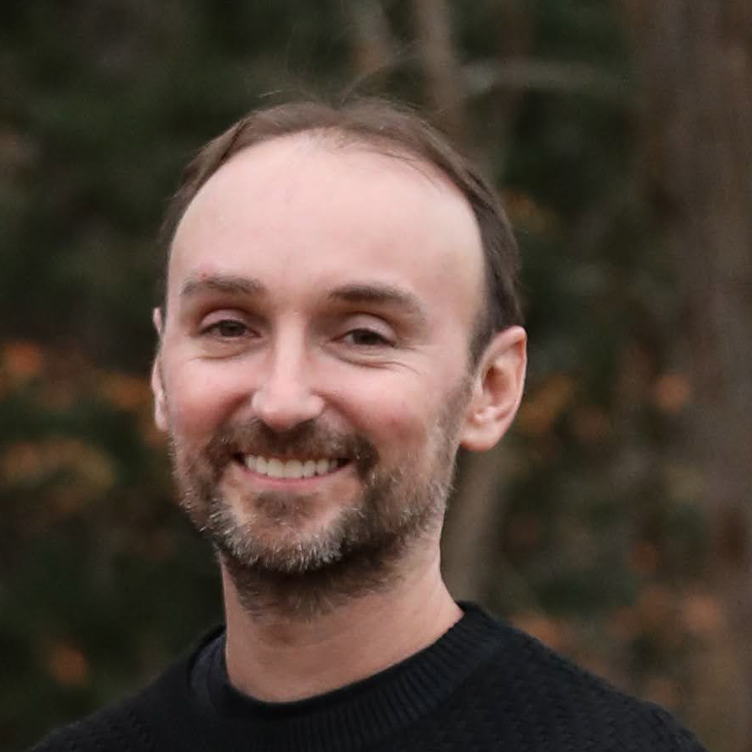
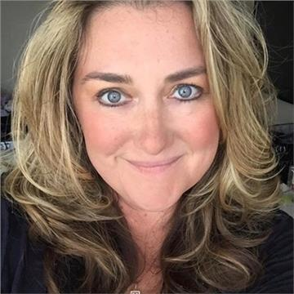
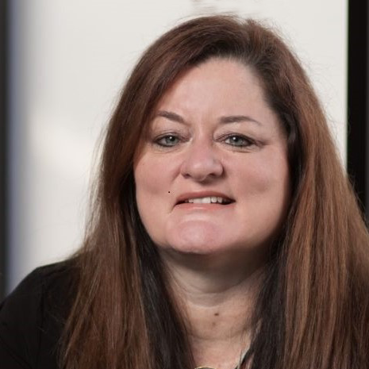
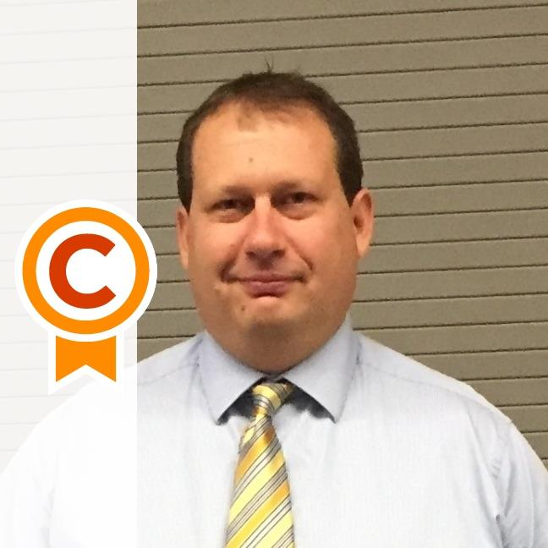
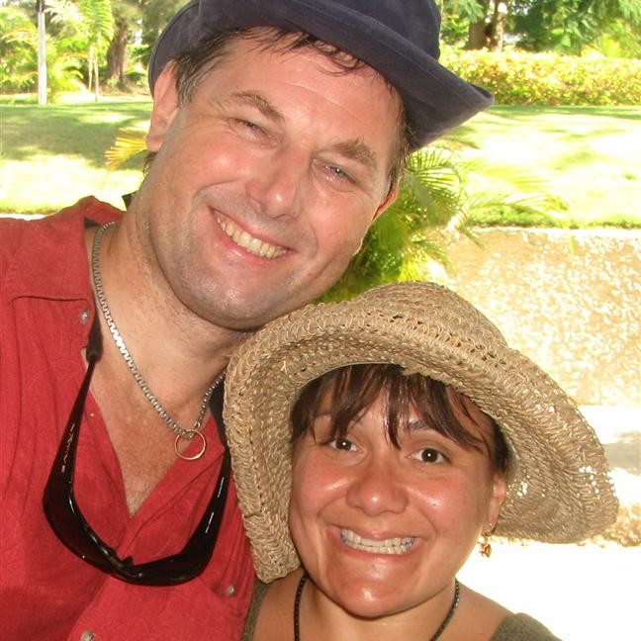
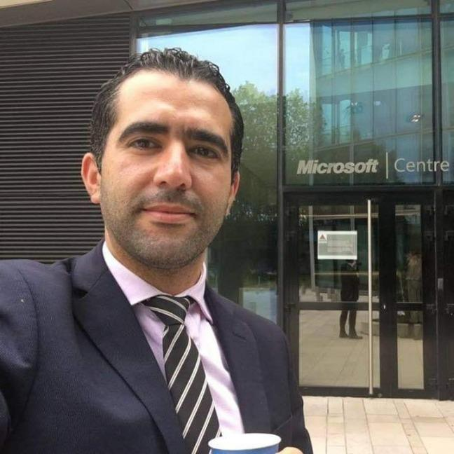
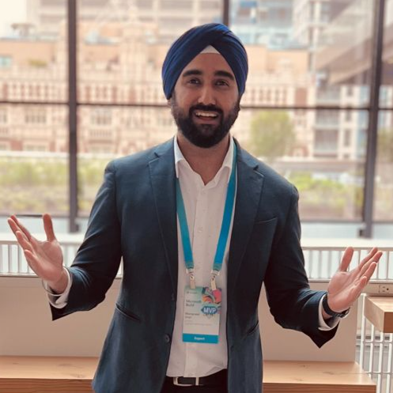
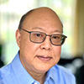
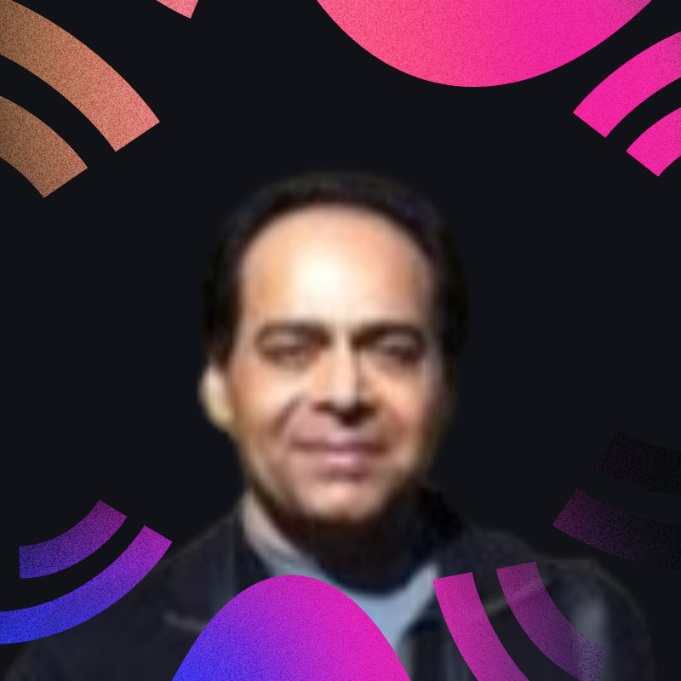
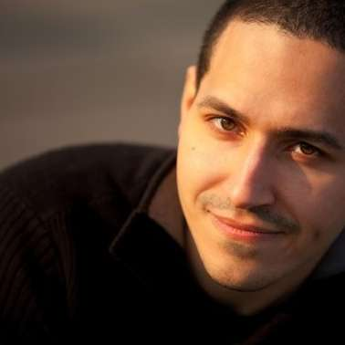
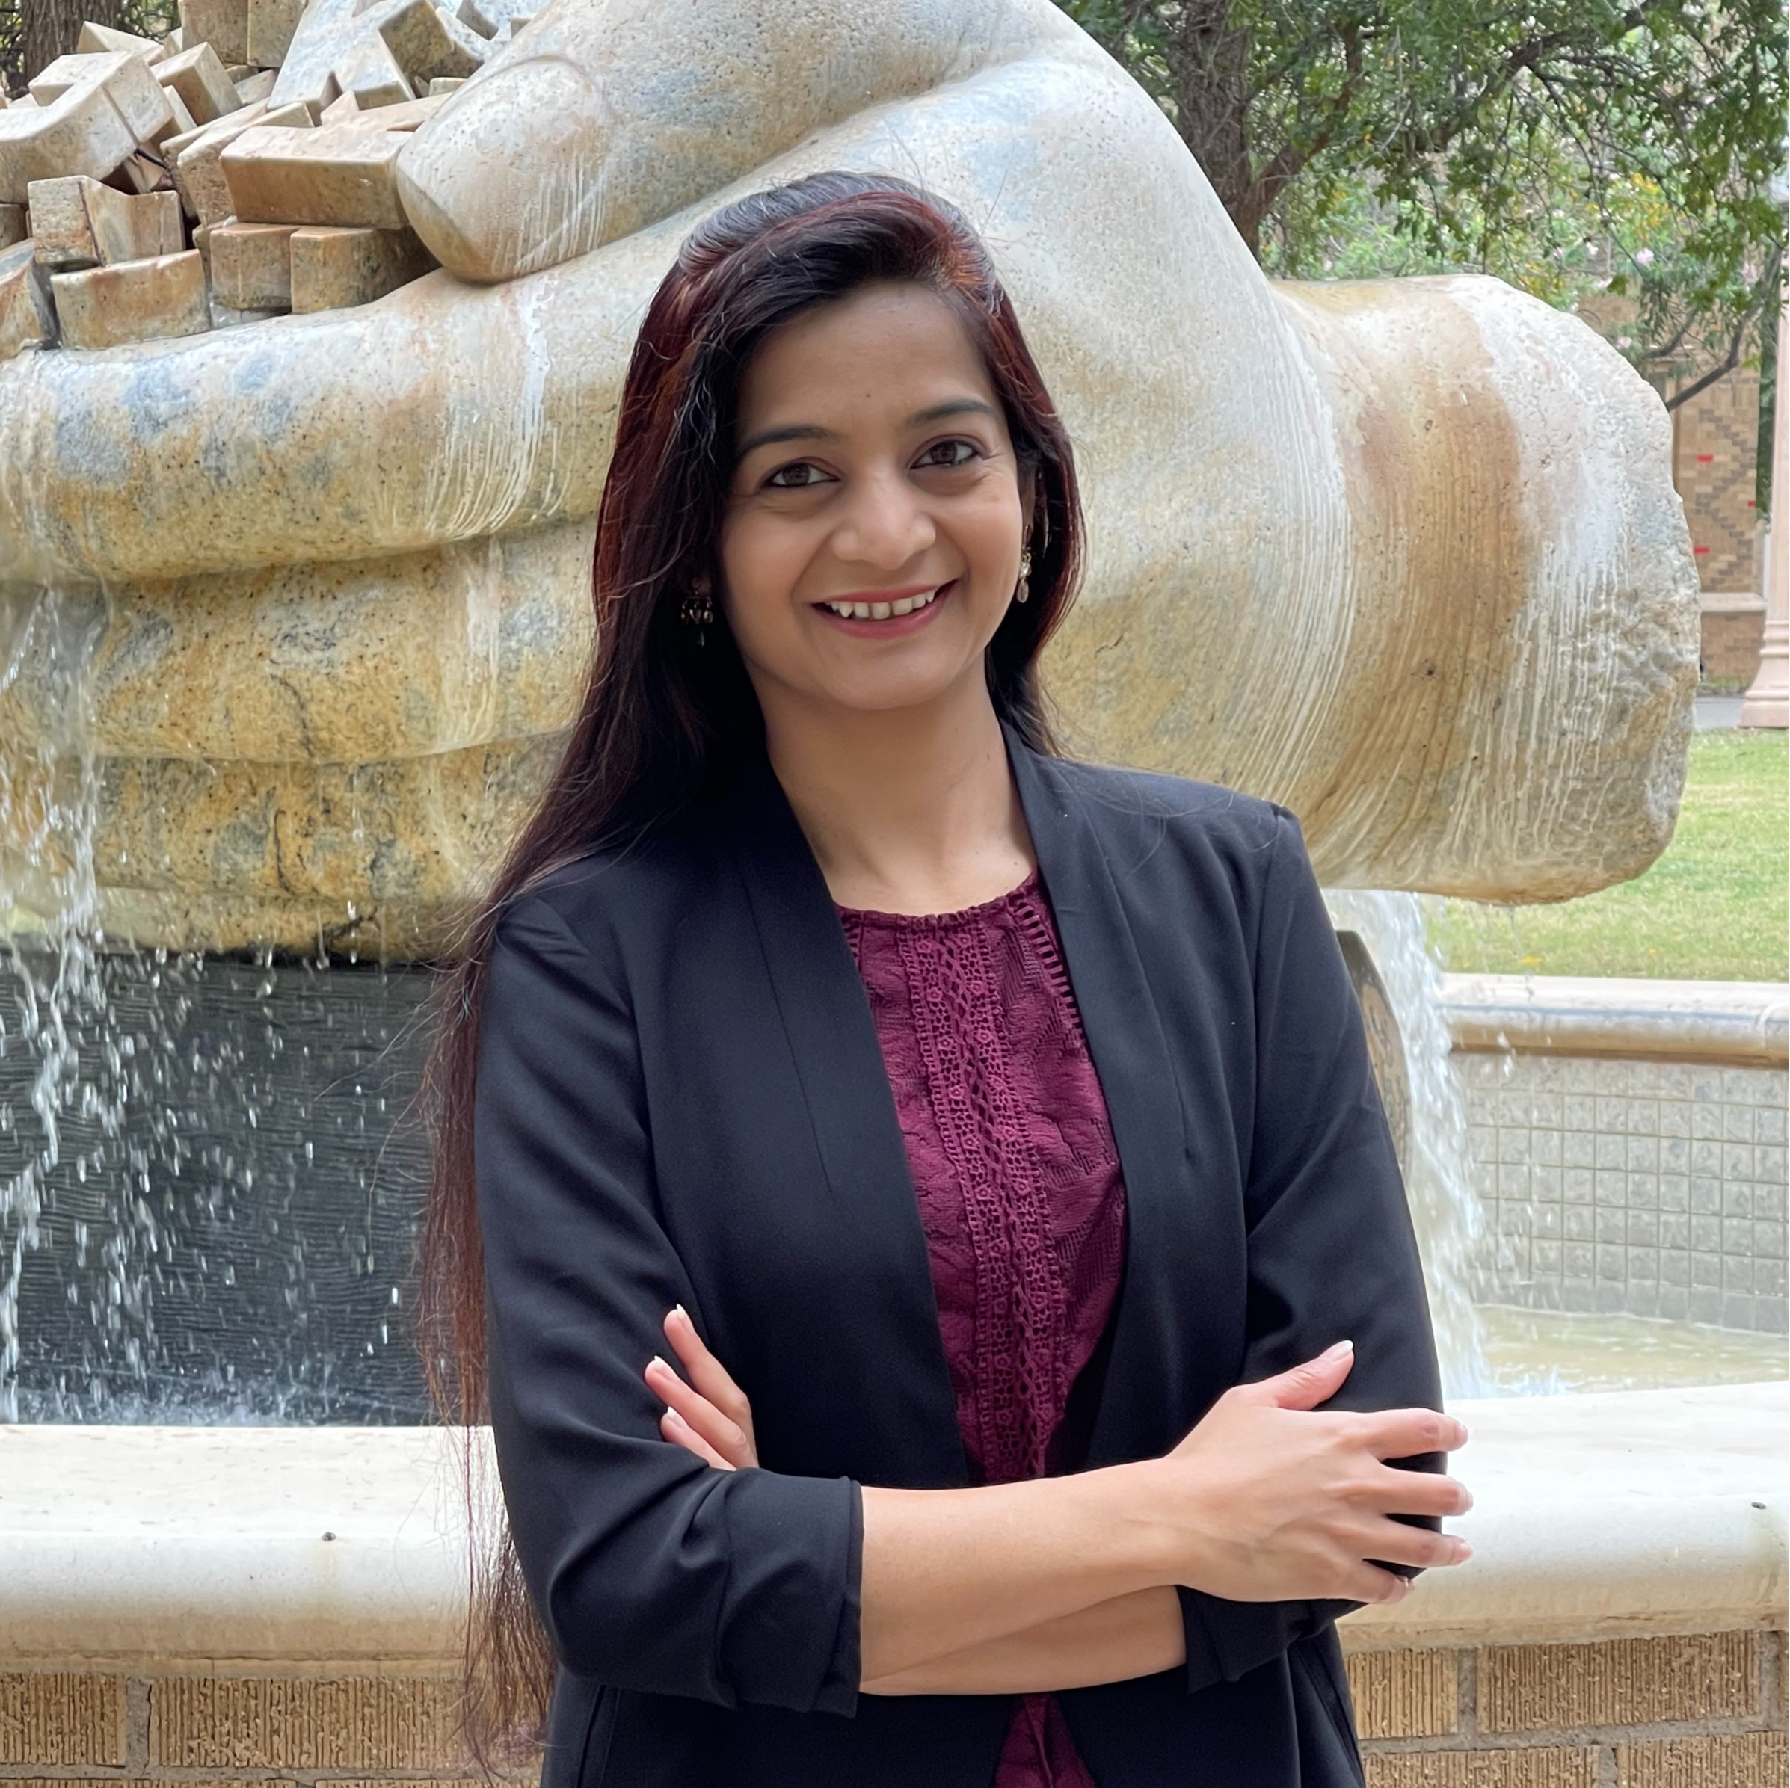
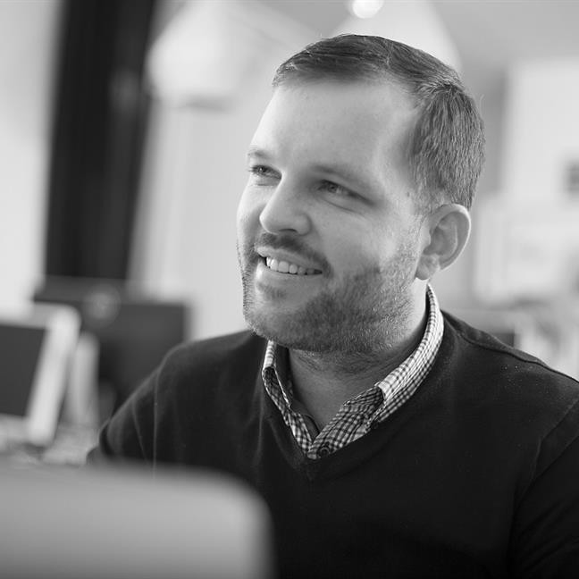
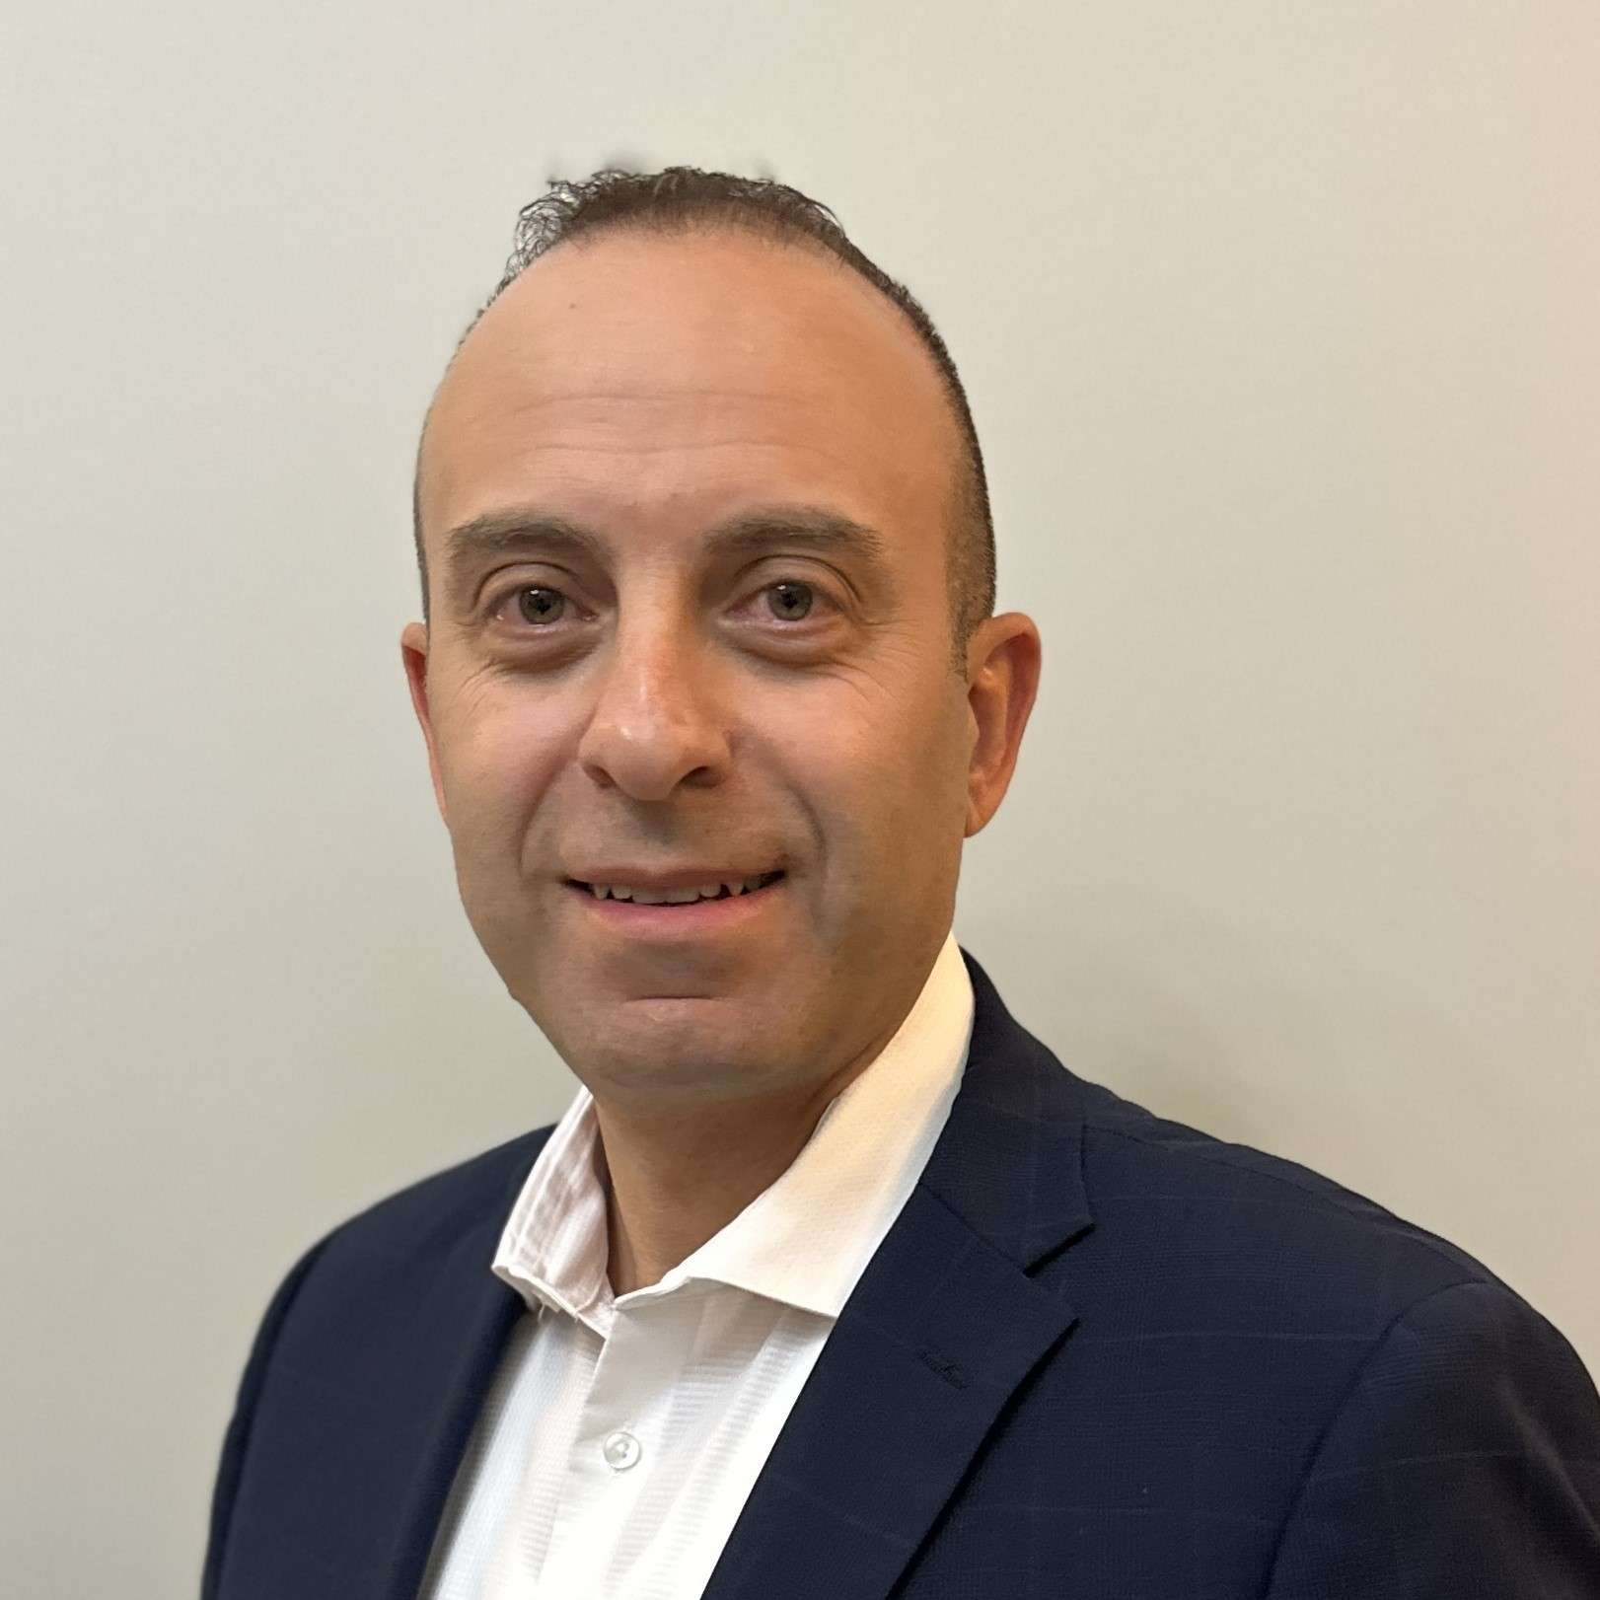
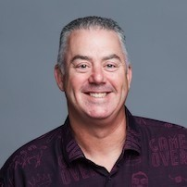
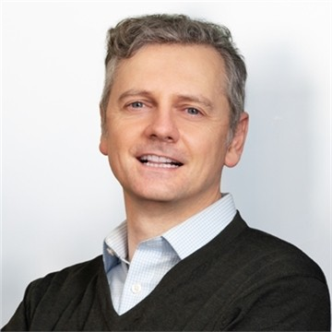
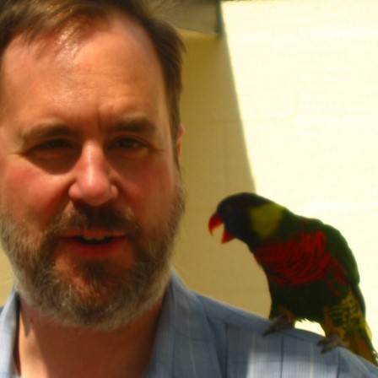
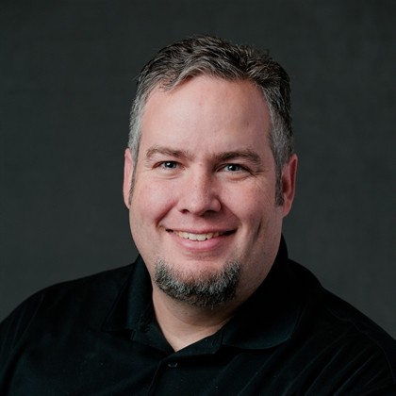
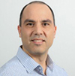

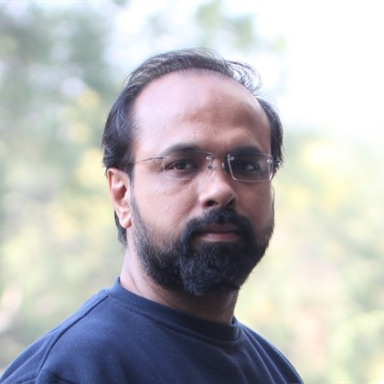
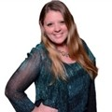
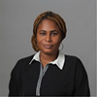
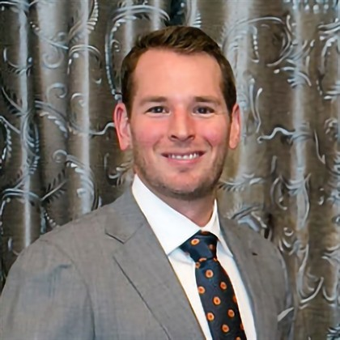
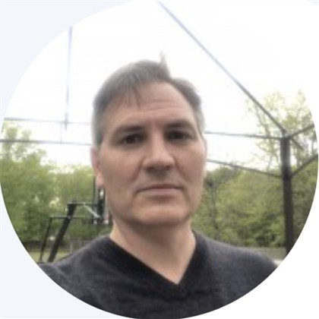
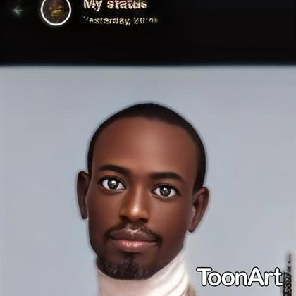
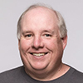
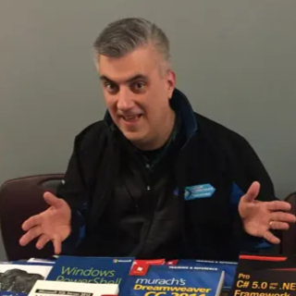
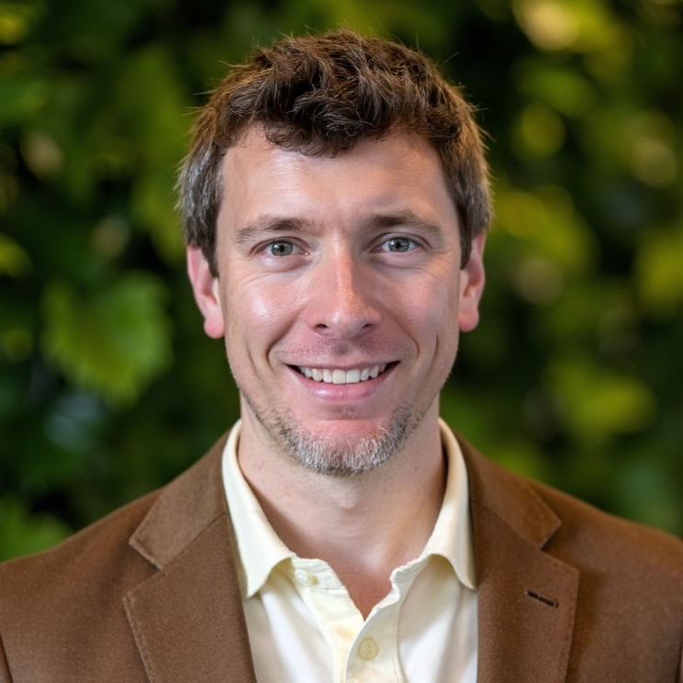
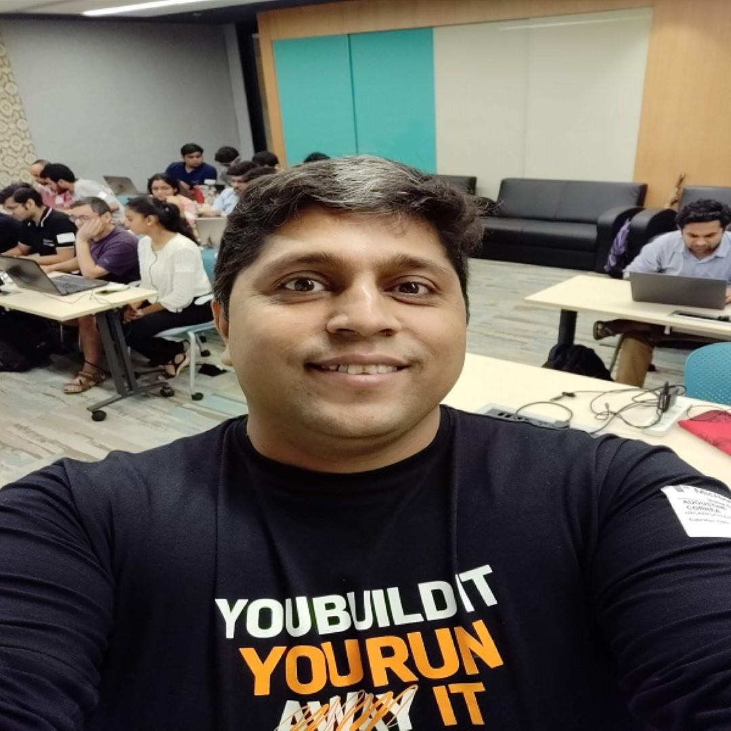
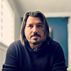
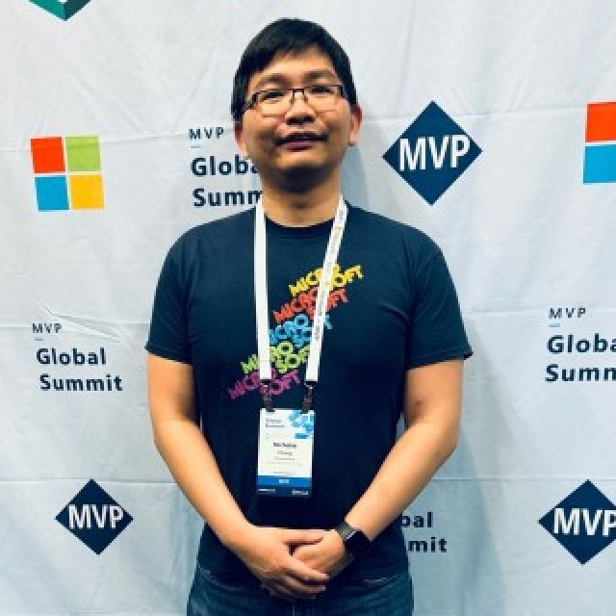
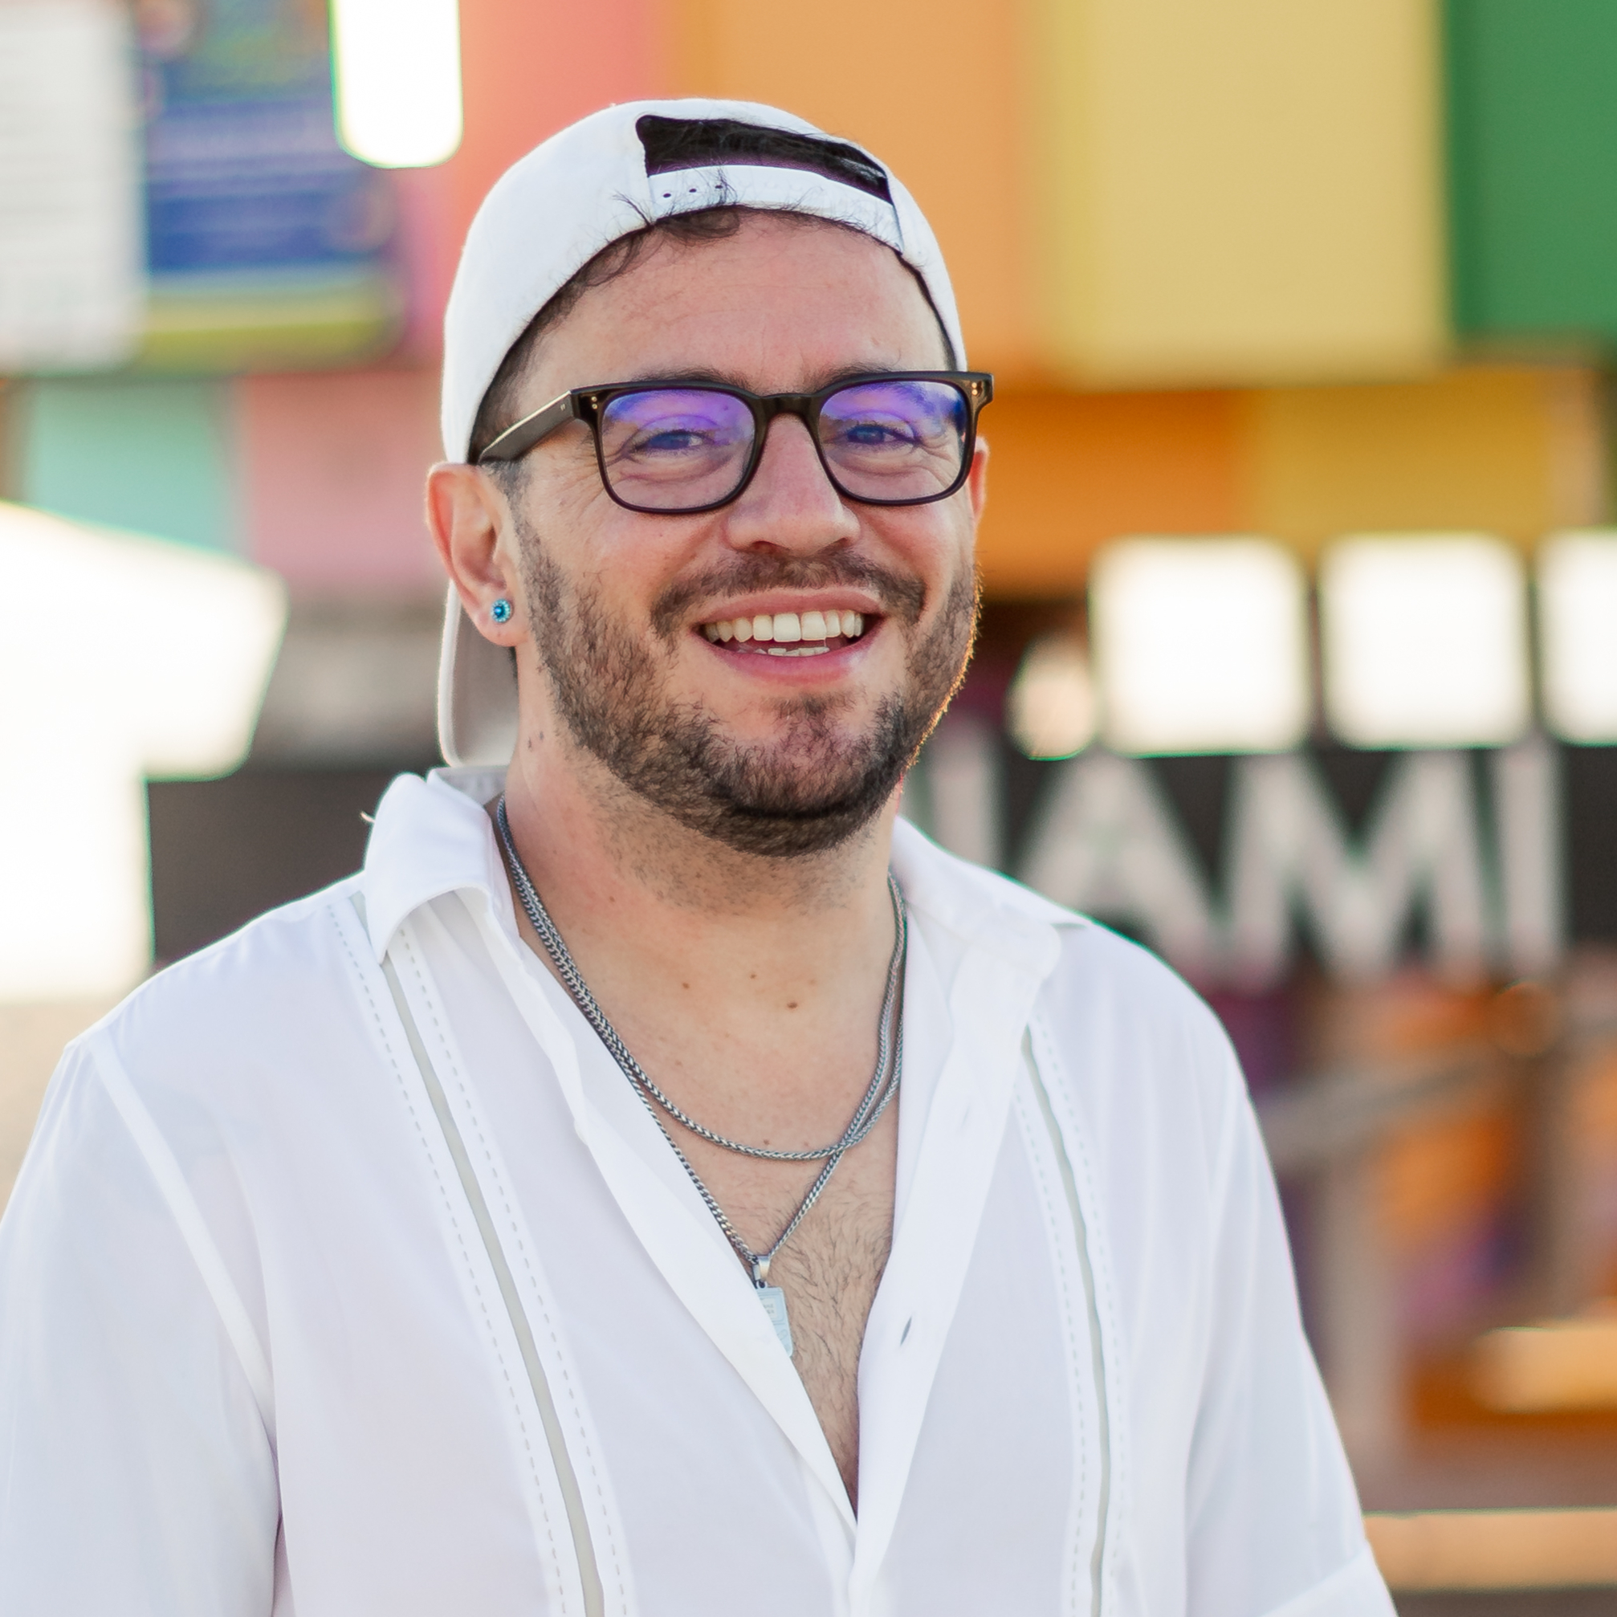
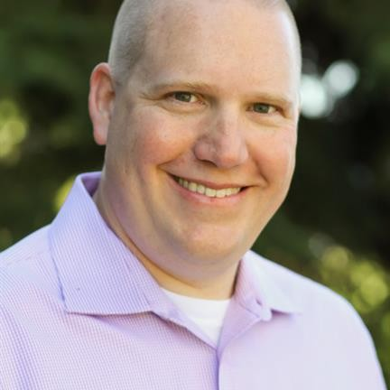
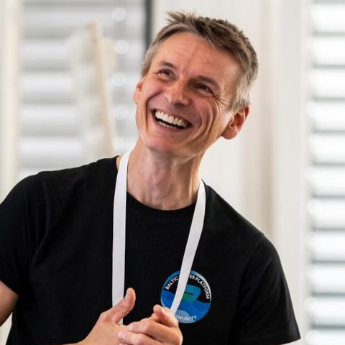
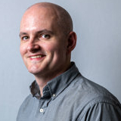
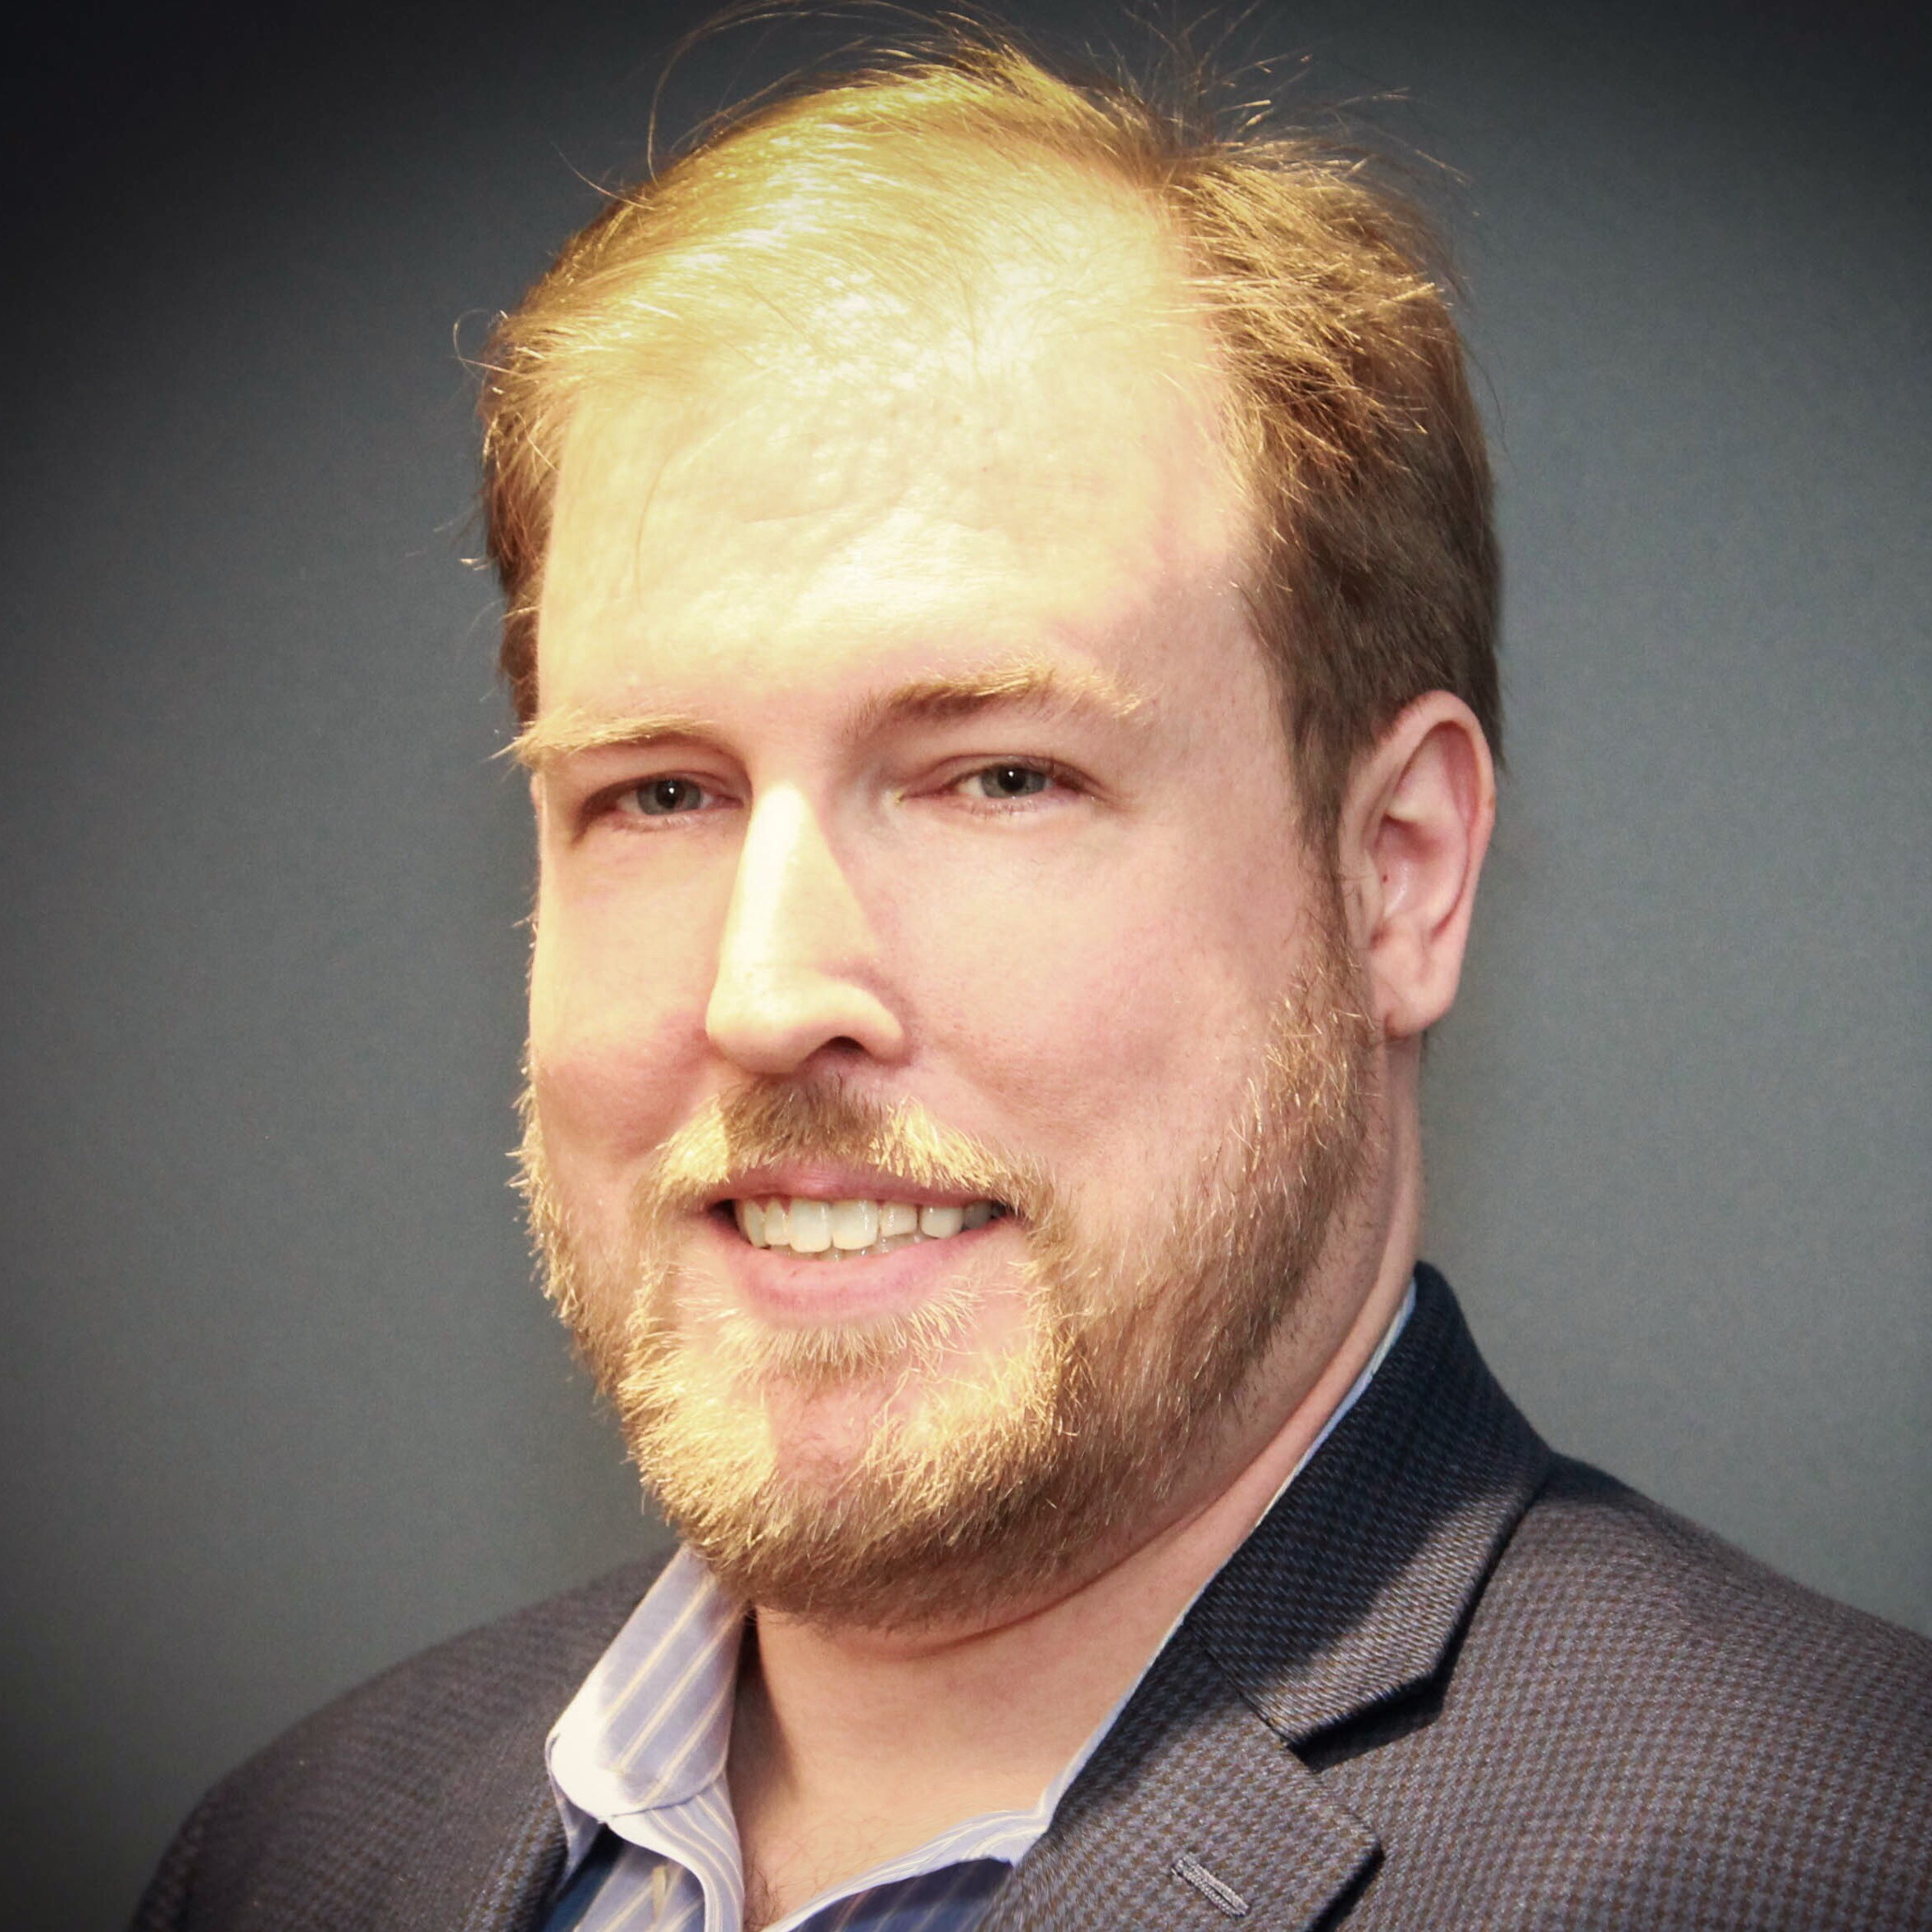
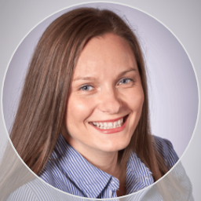

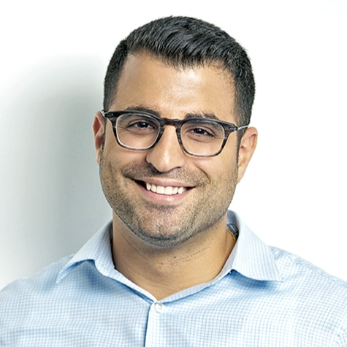
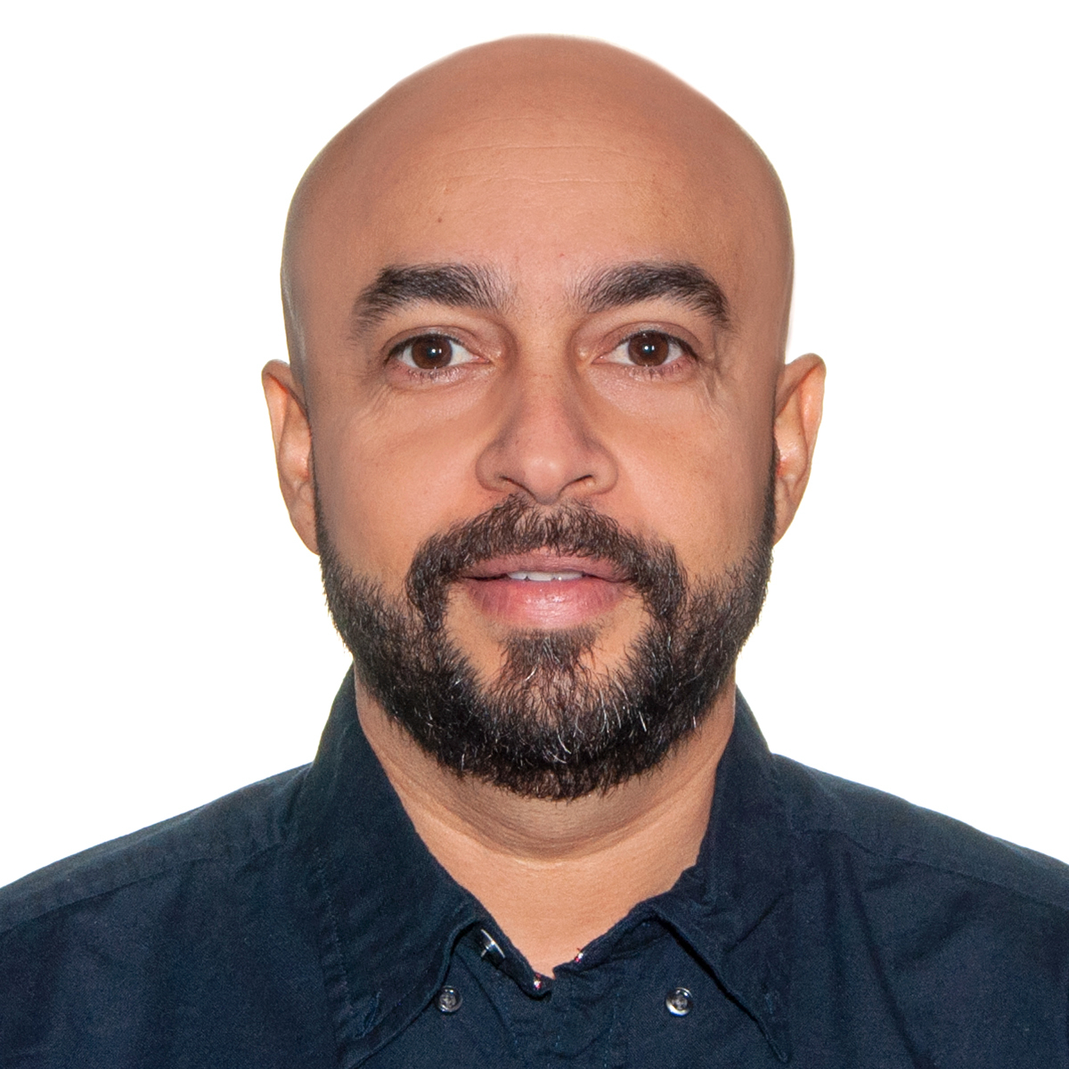
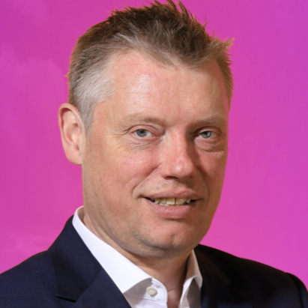
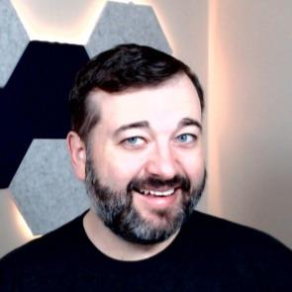
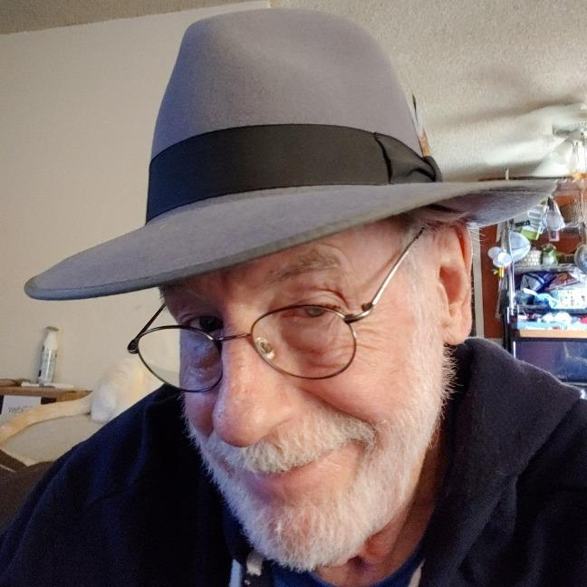
VOLUNTEERS
Thank you to all the volunteers!
Jul 8 — Sep 8, 2026
Your feedback is vital. We are constantly shipping changes and we listen to every suggestion.
ACTIVE 12
Thomas Daly
Heather Cook
Shari L. Oswald, MVP, MCT
Bryan Hart
Christine Geluk
Jamel ABED
Manpreet Singh
Russ Onizuka
Iqbal Nadiadi
GET INVOLVED
Join the Tech & Tools Team
Jason Rivera
Sucheta Gawade
David Opdendries
MGCI — CommunityDays.org Tech and Tools Team Sign-Up. Help shape the platform: design, code, test, content.
ALL VOLUNTEERS 43
communitydays.org
VOLUNTEERS

Slide 27
Community Event Organizer Trainings
Learn from your peers and get updates on the MGCI program.
4th Thursday of every month at 8:10 AM PT.
Join: https://aka.ms/MGCITrainingMTG
All sessions are also available on-demand via the Microsoft Community Learning YouTube channel:
https://aka.ms/community/learning

Slide 28
Training Workstream Update
2026 Schedule
Date | Presenter | Topic
JAN 29 | Sharon Sumner | Sponsors and Sponsorship
FEB 26 | Tom & Heather | Community Days, MTC User Groups & AMC
MAR 26 | NO MEETING | SPRING BREAK
APR 30 | Sharon Weaver | Run of Show – Day of Event Lessons Learned
MAY 28 | TBD | Event & Committee Planning
JUN 25 | TBD | How to find and select speakers
JUL 30 | TBD | FOOD! Meals, Snacks, and Beverages
AUG 27 | NO MEETING | SUMMER BREAK
SEP 24 | TBD | Event branding – Graphics & Image tips
OCT 29 | TBD | Filling seats! How to market your event
NOV 26 | NO MEETING | HOLIDAY BREAK
DEC 24 | NO MEETING | HOLIDAY BREAK
Join the discussion:
https://aka.ms/MGCI-SepEventTrainingDiscussionEventBranding

Slide 29
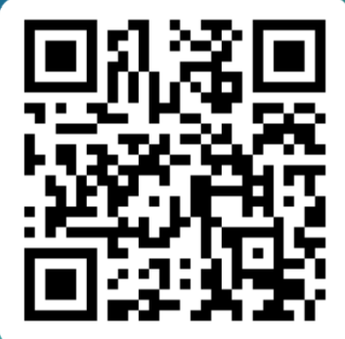
Please Provide Feedback for Event Training!
https://aka.ms/MGCI-EventOrganizerFeedback

Slide 30
MGCI Community Builders Network Call
2026 Schedule
Date | Presenter | Topic
Sep 16 | Diego Domingos da Silva | M365 NYC
Oct 21 | Isidora Katanic | Game on: building Community together (yes it’s a team sport)
Nov 18 | Sharon Sumner Christian Buckley | APPE Community Day and Innovative Sponsorship Strategies
Dec | Holiday Break
Jan 20 | Ryan Yates
Feb 17
Mar 17
Apr 21
Learn from your peers and get updates on the MGCI program.
3rd Wednesday of every month at 8:10 AM PT.
All sessions are also available on-demand via the Microsoft Community Learning YouTube channel:
https://aka.ms/community/learning
AM Session: https://aka.ms/MGCIMtgAM

Slide 31

Your Turn at the Mic 🎤
Got a story, a lesson, or a tip? We've got 10 minutes with your name on it.
Why speak at a Community Builders Network Call?
Low stakes, real audience - test new material with people who want you to succeed
Sharpen your delivery - practice before the big conference stage
Get known - put your name and expertise in front of community leaders worldwide
Give back - someone in the room is exactly where you were a year ago
Build the reel - a recorded session you can point to in speaker applications
No polish required. Just something worth passing on.
MGCI Speaker Interest Form

Slide 32
MGCI Community Builders Network Call
(formerly called MGCI General Session)
Learn from your peers and get updates on the MGCI program.
The 3rd Wednesday of every month at 8:10 AM PT.
Join: https://aka.ms/MGCIMtgAM
All sessions are also available on-demand via the Microsoft Community Learning YouTube channel:
https://aka.ms/community/learning
Notes:
Introduce the monthly MGCI General Sessions — 3rd Tuesday of every month at 8:10 AM PT. Encourage them to attend live; replays are on the Microsoft Community Learning YouTube channel.

Slide 33
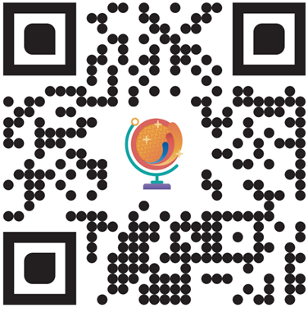
Join the MGCI Mailing List
https://aka.ms/MGCI
Best practices. Training. Connections.
Joining the MGCI gives you access to the Community Initiative team on the Microsoft Community Tenant, where you get exclusive benefits, such as invites to our monthly General Session meetings and opportunities to network and learn from other community members.
You can also promote your event(s), access resources, join event producer training, and interact with the board members, regional leaders, and Microsoft steering leaders.
Receive our monthly newsletter.
Receive day before reminders of meetings.
Directly to your email inbox.

Slide 34
Event | Date | City
AI Tour | Various | Various
Microsoft Airlift | November 2-5, 2026 | Online
Microsoft Ignite | November 17-20, 2026 | San Francisco and online
MVP Summit | March 16-18, 2027 | Redmond, WA
Microsoft Ability | TBD May 20272027 | Redmond, WA
Microsoft Build | TBD May/June 2027 | San Francisco and online
Upcoming Microsoft Flagship Events

Slide 35

Six AI Tour stops are announced for October and November
City | Date
Singapore | Oct 12, 2026
Paris | Oct 20, 2026
London | Oct 21, 2026
Cologne | Oct 22, 2026
Mexico City | Oct 29, 2026
Dubai | Nov 3, 2026
REGISTRATION
Each city registers separately on the AI Tour site.
Requests are reviewed, so encourage members to request early.
More cities are still being announced - check the site for updates.
Confirm cities, dates and registration links on aitour.microsoft.com more stops are expected through December.

Slide 36

Microsoft Ignite returns November 17–20; registration is open now
REGISTRATION
November 17–20, 2026
Register at ignite.microsoft.com
In-person and online options are listed on the event site.
SPEAKING OPPORTUNITIES
There are no speaking opportunities available at this time.
Check out ignite.Microsoft.com, sessions and the full agenda are published there.
Regional Leaders can plan local watch parties around the keynote and on-demand sessions.

Slide 37



Mondays at Microsoft
Get the latest AI new, product announcements, and Microsoft Community insights from Karuana Gatimu and Heather Cook, every Monday.
Live every Monday at 8:00 AM PT.
Fuel your week
aka.ms/MondaysAtMicrosoft

Slide 38

Get the latest AI new, product announcements, and
Microsoft Community insights from Karuana Gatimu and Heather Cook, every Monday.
Live every Monday at 8:00 AM PT
Fuel your week
aka.ms/MondaysAtMicrosoft

Slide 39

Mondays at Microsoft
GUEST INVITATION
Join us as a guest on an upcoming episode
A 30-minute live show that keeps customers, partners, MVPs, and the wider Microsoft community current on what's new, from AI and Copilot to Microsoft 365, Power Platform, developer news, and community events.
YOU'RE INVITED!
EPISODE DATE
TBD
TOPIC / NEWS WE'LL SHARE
TBD
Our goal
Your guest segment
• Help customers understand what's new and why it matters
• Give product teams a stage for announcements, roadmap, and real-world scenarios
• Connect the community with the experts behind the technology
• Drive awareness and adoption through authentic conversations
• A relaxed 5–10 minute live conversation with the hosts
• Share your product news, roadmap, or a real-world scenario
• Bring one expert from your product/topic area
• Live audience Q&A to wrap up
Sample graphic from previous episode
Livestream requirements:
• Tech check — 7:45 AM PT
• Live show — 8:00–8:30 AM PT
• Fully virtual via StreamYard
• 5–10 min segment + live Q&A
Hosted by Karuana Gatimu · Heather Cook · Jonathan Jones
Link to apply: https://aka.ms/MondaysatMicrosoft/GuestForm

Slide 40

🎤 Women Speakers | Microsoft Ecosystem
💜 Curated Women in Tech speaker directory
🌍 Resource for community leaders & event organizers
🚀 Speak Microsoft tech → create a profile & get listed
✨ Amplify voices. Build inclusive events. Grow the community.
Microsoft Solutions Women in Tech speaker directory on Sessionize

Slide 41
Roles and Opportunities
The Microsoft Global Community Initiative Board will be made of no less than five (5) voting community members with worldwide representation supported by four (4) voting Microsoft full time employees.
Board members are appointed by the Microsoft Steering Committee. Regional Leads are self-nominated and voted on and approve by board members.
Board Officers
Regional Leads
General Assembly
MS Full-Time Employee
Appointed positions with one 18-month initial term
Can be extended with approval
Voting member
Must lead one sub-committee
Self-nominated, approved by board and Microsoft
1 year term, can be extended, with renewal and approval
Active participation in one sub-committee
Broad referendum voting
Attend general and other offered meetings
Voting members
Duties part of core role
Succession planning for continuity
Responsible for Microsoft budget
Provide your feedback on our Board structure & operations at https://aka.ms/MGCIFeedback.
Notes:
Regions will not match the MS Regions. They will be Community centric to reflect the local regions.

Slide 42









Appointed Board Officers
Isidora Katanic
Community Manager
Experts Inside AG
Switzerland
Jennifer Mason
VP, Workforce Transformation & Learning
Planet Technologies
United States
Mark Rackley
Co-Founder & Strategic Advisor
ThaiMed Elite International
United States
Oluwaseyi Oluwawumiju (Seyi)
Management Executive
Convenant Technologies
Africa
Rodolfo Castro
Solutions Architect
MS and Unified Communications
LATAM
Sharon Sumner
CEO, M365 & Sharepoint Governance and Managed Migration Tool
Castper365
UK
Sharon Weaver
CEO
Smarter-Consulting
United States
Thomas Daly
Collaboration Director
SoHo Dragon
United States
Wes Preston
Consultant
TrecStone, Level 5 Profiles
United States

Slide 43
Add text here.

Slide 44

Next MGCI Community Builders Network Call
Wed Oct 21, 8:10AM PT
Join us!

Slide 45
Microsoft Tech Community
The community platform for Microsoft 365 – forums, blogs, and events aka.ms/joinMTC.
Stay Connected!
CommunityDays.org
Find or host a local event in your area
or to match your interests.
Engage with the best community in tech…
There’s something for everyone!
Microsoft Community on LinkedIn
News, announcements and training delivered to your news feed aka.ms/microsoftcommunitylinkedin.

Slide 46

We Want Your Feedback!
https://aka.ms/MGCIFeedback

Slide 47
Thank You.

Slide 48
What can I expect when I join the MGCI Community Hub on the Microsoft Tech Community?
Monthly Community Builders Network Call
Direct Contact to Microsoft via Monthly Newsletters
Request Amplification for your Events
Access to Useful Resources
Interactions with a Global Community
Overall Microsoft & Community Support
https://aka.ms/MGCI

Slide 49
MGCI Subcommittees
Subcommittee | Board Member Leads
Communications & Amplification | Isidora Katanic & Jennifer Mason
Sponsorship & Sponsors | Mike Maadarani, Mark Rackley and Sharon Sumner
Tech & Tools | Tom Daly
Training | Sharon Weaver & Wes Preston
https://aka.ms/MGCISubcommittee

Slide 50
MGCI Meeting Rhythm of Business
 | Monday | Tuesday | Wednesday | Thursday
Week 1
Week 2 |  | Board Member Monthly Meeting Host: Heather & Rotating Board Members Audience: Board & MSFT 7:10am PT | Board/RL/MSFT Monthly Meeting Host: Heather & Rotating Board Members Audience: BO, RL and MSFT 11:00am PT
Week 3 |  |  | General Session Host: Heather Audience: Open to public 8:10am
Week 4 |  |  |  | Event Training & Office Hours (One time only) Host: Sharon & Wes Audience: MGCI Membership 8:10am PT

Slide 51
MGCI ROB Dates
Month | Board | Board / RL | General Session | Event Training
Jan | Tue 13 | Wed 14 | Tue 20 | Thu 29
Feb | Tue 10 | Wed 11 | Tue 17 | Thu 26
Mar | Tue 10 | Wed 11 | Tue 17 | MVP Summit
Apr | Tue 7 | Wed 8 | Tue 21 | Thu 23
May | Tue 12 | Wed 13 | Tue 19 | Thu 28
Jun | Tue 9 | Wed 10 | Tue 16 | Thu 25
Jul | Tue 7 | Wed 8 | Tue 21 | Thu 30
Aug | Summer Break
Sep | Tue 8 | Wed 9 |  | Thu 24
Oct | Tue 13 | Wed 14 |  | Thu 29
Nov | Tue 10 | Wed 11 |  | Holiday Break
Dec | Tue 8 | Wed 9 |  | Holiday Break

Slide 52
Resources and Opportunities to Participate
Item | URL
Join the CDO Tech and Test Team | https://aka.ms/MGCI/CDOTechSignUp
Request Social Amplification | https://aka.ms/communitysocial
Submit news item for monthly MGCI Newsletter | https://aka.ms/MGCINewsletterTopics
MGCI General Session Sign Up to Host | https://aka.ms/GeneralSessionGuest
MGCI Blog Author Sign Up | https://aka.ms/MGCIBlogAuthorSignUp
Monday at Microsoft Moderator Sign Up | https://aka.ms/MondaysatMicrosoft/ModSignUp

Slide 53
Resources and Short Links
External Links
Item | URL
MGCI AMC Home Page - website | https://aka.ms/MGCI
MGCI Sign Up Form – link to newsletter sign up | https://aka.ms/MGCISignUP
MGCI Advisors Page - website | https://aka.ms/MGCIAdvisors
MGCI General Session AM Meeting Link | https://aka.ms/MGCIMtgAM
MGCI General Session PM Meeting Link | https://aka.ms/MGCIMtgPM
MGCI Event Training Meeting Link | https://aka.ms/MGCITrainingMTG
MGCI Meeting Feedback Survey | https://aka.ms/MGCIFeedback
MGCI General Session Recordings on CT | https://aka.ms/MGCI/MeetingRecordings
MGCI Post-Event Survey to Producers | https://aka.ms/MGCIProducerPostEventSurvey
MGCI Event Producers History | https://aka.ms/MGCIEventProducerHistoryForm

Slide 54
Resources and Short Links
Internal Links
Item | URL
Join the CDO Tech and Test Team | https://aka.ms/MGCI/CDOTechSignUp
Request a Microsoft Venue | https://aka.ms/MGCI/MSOffice/VenueRequest
Request Social Amplification | https://aka.ms/communitysocial
Link to Event Budget Template | https://aka.ms/MGCIBudgetTemplate
Submit news item for monthly MGCI Newsletter | https://aka.ms/MGCINewsletterTopics

Slide 55
Resources and Short Links
Board & Regional Leads Only
Item | URL
BO/RL Meeting Assets | https://aka.ms/MGCI/BORLMeetingAssets
MGCI ADO Backlog | https://aka.ms/MGCIBacklog
Choose a subcommittee | https://aka.ms/MGCISubcommittee
Apply to be a Regional Lead | https://aka.ms/MGCIRegionalLead
Collect Regional Leader Info | https://aka.ms/MGCIRegLeaderInfo
Collect Board & Regional Leader Detailed Info | https://aka.ms/MGCILeaderContactInfo

Slide 56


Credly Badges
Board & Regional Leads Only
Badges are issued to Board Members and Regional Leaders​
Email from "MGCI Board and Regional Leader Contact Information" was used to issue badges https://aka.ms/MGCIBoardRLContactList​
Question/Support - Please email Heather – heather.cook@msftcommunity.com

Slide 57
Microsoft Event Code of Conduct
Microsoft’s mission is to empower every person and every organization on the planet to achieve more. This includes all Microsoft events and gatherings, including on digital platforms and in person, where we seek to create a respectful, friendly, enjoyable, and inclusive experience for all participants.
​
We expect all event participants to uphold the principles of this Code of Conduct. The Code of Conduct applies to all aspects of the main event and any related activities, whether digital or in person. Microsoft does not tolerate the following in any aspect of the event program, including business and social activities:
Behavior that is disruptive, disrespectful, or degrading to others, including any messages, images, or interactions by anyone, in any form, regardless of location.​
Harassment or discrimination based on age, ancestry, color, gender identity or expression, national origin, physical or mental disability, religion, sexual orientation, or any other characteristic protected by applicable local laws, regulations, and ordinances.​
​
We encourage everyone to assist in creating a welcoming and safe environment. Please report any concerns, harassing behavior, or suspicious or disruptive activity to venue staff, the event host or owner, or the nearest event staff.
​
We also encourage everyone to contact Microsoft’s Business Conduct Hotline at any time if you feel anything or anyone is not following this Code of Conduct or is inconsistent with Microsoft’s culture. The Hotline is available regardless of whether you are a Microsoft employee and can be reached at buscond@microsoft.com or +1 (877) 320-MSFT, or call collect outside the United States at +1 (720)-904-6844. Microsoft employees can also report any concerns to their Microsoft Manager.
Microsoft reserves the right to refuse admittance to or remove any person from a Microsoft event at any time at its sole discretion.

