Slide 1



MGCI Community Builders Network Call
Microsoft Global Community Initiative
October 2026
Topic: Host: Heather Cook
Principal PM, Global Evangelism and Events, SCALE Team, Microsoft
Guest Speaker: Isidora Katanic
Community Manager at Experts Inside AG, Microsoft 365 MVP, Board Member MGCI, Organizer of Experts Live Switzerland & Europe

Slide 2
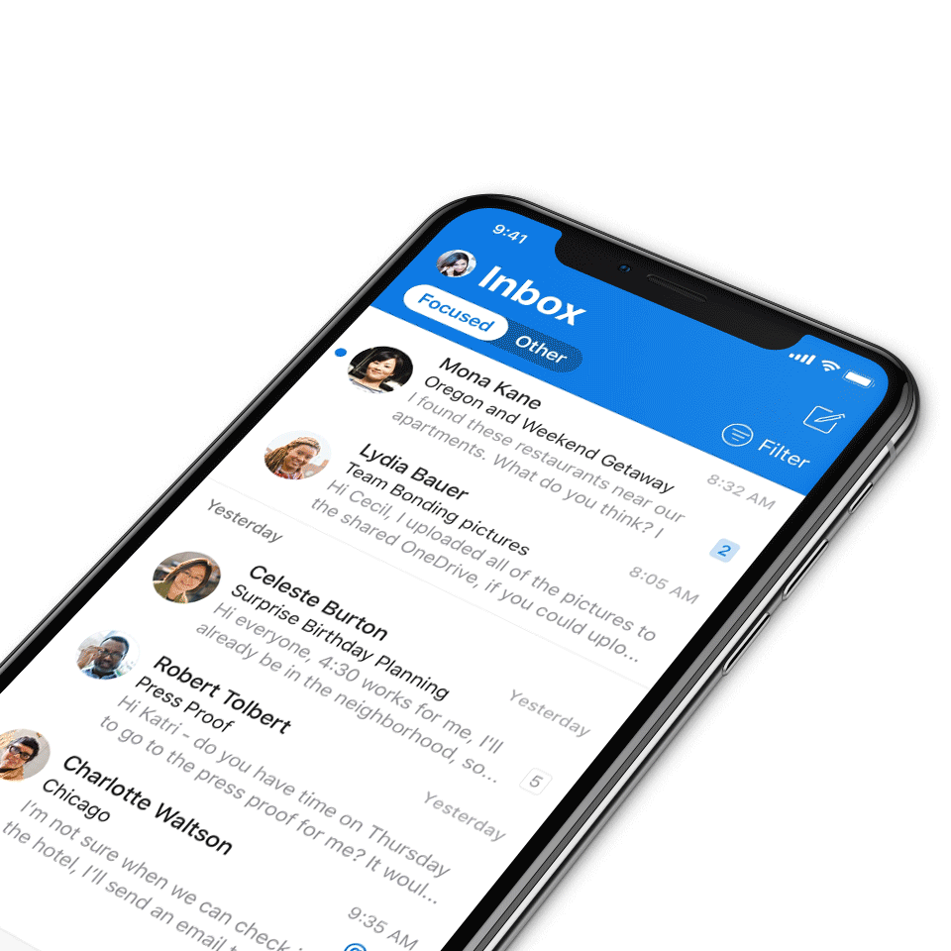
We expect all digital event participants to uphold the principles of this Code of Conduct, which covers the main digital event and all related activities. We do not tolerate disruptive or disrespectful behavior, messages, images, or interactions by any party participant, in any form, at any aspect of the program including business and social activities, regardless of location.​
Microsoft will not tolerate harassment or discrimination based on age, ancestry, color, gender identity or expression, national origin, physical or mental disability, religion, sexual orientation, or any other characteristic protected by applicable local laws, regulations, and ordinances.​
AI notetakers are not permitted and will not be admitted to meetings.
Digital Event Code of Conduct
Microsoft’s mission is to empower every person and every organization on the planet to achieve more.
This includes all Microsoft events and gatherings, including on digital platforms, where we seek to create a respectful, friendly, fun and inclusive experience for all participants.​
We encourage everyone to assist in creating a welcoming and safe environment.
For more info, click here.

Slide 3
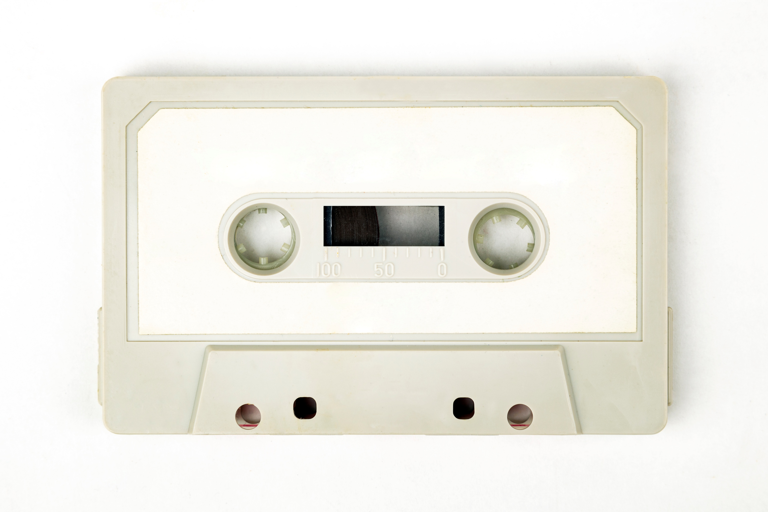
Recordings
All Community Builders Network Calls are recorded and posted on-demand on the Microsoft Community Learning YouTube channel.
If you do not want to be recorded, please leave the call or stay on mute.
Speaker video and audio will be shown in the recordings.
Attendee questions audio will be also be shared.

Slide 4

Mission and Tagline
The Microsoft Global Community Initiative (MGCI) - Empowering global Microsoft communities with the tools, training, and resources to create impactful events and amplify diverse voices.
Learn, Share, Grow.
Join MGCI today! https://aka.ms/MGCI

Slide 5
Announcements
Monthly Topic: Game On: Building Community Together (Yes, It’s a Team Sport)
Sub Committee Updates
Community Events & Updates
Open Discussion Forum
Agenda

Slide 6

OCTOBER
Breast Cancer
Awareness Month
Awareness. Support. Hope.
A moment to raise awareness, show support, and stand together with everyone impacted by breast cancer.
Together, we make support visible.

Slide 7

Thank You!
To our Microsoft Most Valuable Professionals (MVP) and Regional Directors.

Slide 8
Explore a stories and learn from others on MGCI Hub on Microsoft Tech Community.
MGCI HUB · TECH COMMUNITY
Go Read the MGCI Blog on Tech Community!
RECENT HIGHLIGHTS
EVENT STORY
LESSONS LEARNED
Lessons from the Shift+Enter Summit
Creating community before the event: lessons from M365 NYC
Read, like, comment and share your own story!
NEW TEMPLATE
NEWSLETTER
New Event Recap Template for Event Producers to share their event stories
MGCI – Your October Launchpad
Read the latest!
Notes:
Link: https://techcommunity.microsoft.com/blog/mgci-news
CTA: Read, like, comment, and share your own story! Recent highlights: Lessons from the Shift+Enter Summit; Creating community before the event: lessons from M365 NYC; New Event Recap Template for Event Producers to share their event stories; MGCI – Your October Launchpad newsletter.

Slide 9
Your Regional Leaders Have Been Busy! 🤝
MGCI Regional Leaders, working for the community!
Working in regional cohorts this fall, they put a new Event Charter Template to the test.
🧩
📝
🎁
Can’t wait?
Dig into the MGCI Organizer Toolkit:
https://aka.ms/MGCI-Resources
More on the way 👀
Tested for real
Your head start
Yours to keep
Each cohort picked a real event in their region and planned it together using the template.
Fill in the blanks for goals, audience, speakers, venue, budget and follow-up.
Coming oon on the MGCI site, ready to download and make your own.
🎉 Danke to the Austrian Power Platform Enthusiasts, who reviewed it ahead of their second-ever Community Day on Oct 23!
Notes:
Talk track: Our Regional Leaders have been busy, and it's all for you, our organizers.
This fall they worked in regional cohorts to put a new Event Charter Template to the test: a fill-in-the-blanks starting point for planning a CollabDays, an M365 Community Day, or any community-led event, whether in person, virtual or hybrid.
Tested for real: each cohort chose a real event in their region and worked through the charter together.
Your head start: one plan that walks you through purpose and goals, audience, format, speakers, venue, accessibility, sponsorship and budget, marketing, timeline, and what happens after the event.
Shout-out: Danke to the Austrian Power Platform Enthusiasts, who reviewed it ahead of their second-ever Community Day on October 23!
Yours to keep: the cohorts wrap up this round over the next few weeks, then the refreshed template joins the event production templates on the MGCI site, free for anyone to download and make their own.
Can't wait? Dig into the MGCI Organizer Toolkit at https://aka.ms/MGCI-Resources. More on the way!
MGCI Regional Leaders, working for the community!

Slide 10

ESPC 2026 · 30 NOV – 3 DEC
See you in Amsterdam!
Come say hi!
Find our Regional Leaders, Board Officers and fellow community builders around the event.

Slide 11
ESPC 2026
30 Nov – 3 Dec
Amsterdam
MGCI at ESPC 2026
We’ve got lots of community in store for you!
TUE 1 DEC
MGCI Community Meetup
Who’s coming?
Say ‘Aye’ in the chat!
TUE 1 DEC
Table at the Expo Drinks Reception
WED 2 DEC
Lightning Talk
11:45–12:05 CET
“Powered by Community: Inside the Microsoft Global Community Initiative”
https://aka.ms/ESPC26_EventGuide
More ways to connect
WITA
Affinity groups
MVPs
Women in Tech & Allies lunch, meetup and Inspire Stage breakout
Round tables
Photo, meetups & round tables

Slide 12
Topic of the Month:
Game On: Building Community Together (Yes, It’s a Team Sport)
Guest Speaker:
Isidora Katanić , Community Manager at Experts Inside AG, Microsoft 365 MVP, Board Member MGCI, Organizer of Experts Live Switzerland & Europe

Slide 13
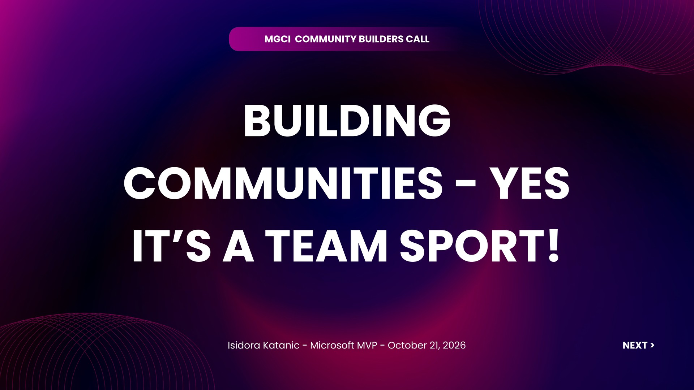

Slide 14
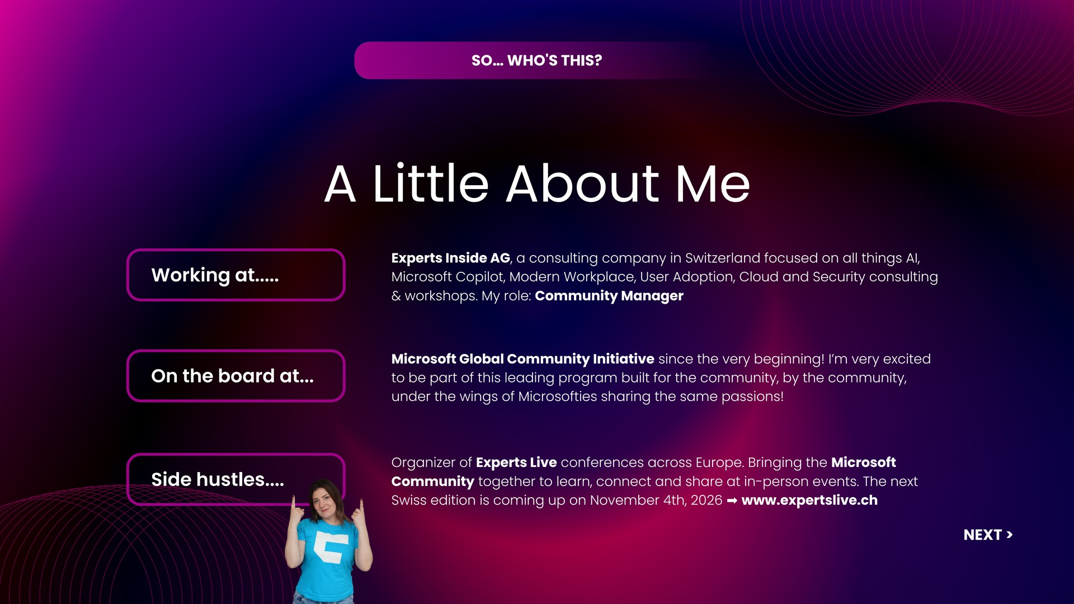

Slide 15

BEYOND THE JOB TITLE...
The Human Behind the Role
Born in Belgrade (ex-Yugoslavia), left the country with my family in 1992. Grew up in Amsterdam, the Netherlands, and living in Switzerland since 2017. (TIP: Come for the cheese, stay for the chocolate!) 🍫
Whereabouts:
Mom life:
Managing a tiny 5-year old CEO who doesn't pay me but expects 24/7 service 😉
In love with my little bundle joy!
Spontaneously went paraglading, pure adrenaline, and questioning every life decision that led me there! But proud I did it 💪 So with overcoming that fear.......
Crazy thing I did in 2026:
NEXT >

Slide 16


Slide 17
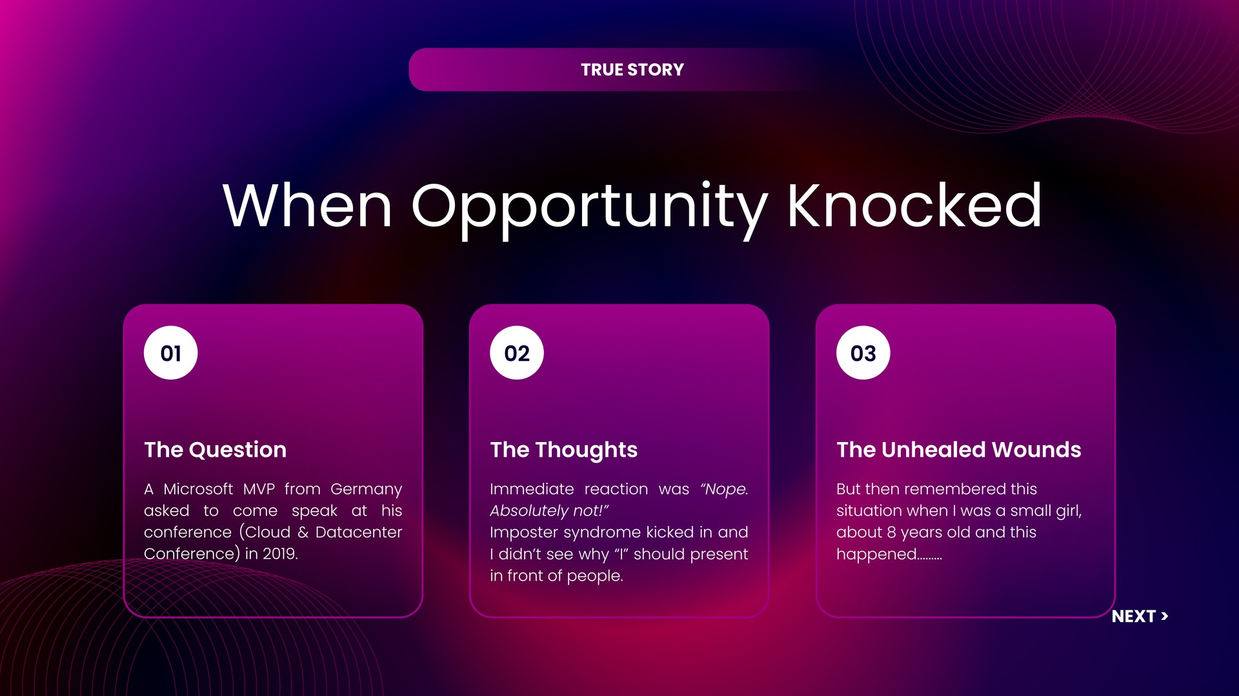

Slide 18


Slide 19
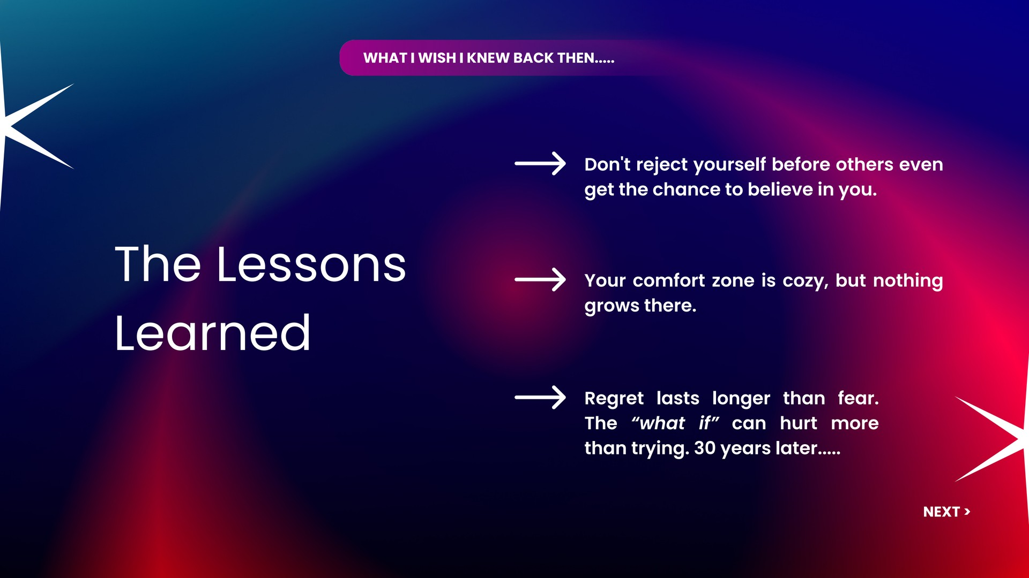

Slide 20
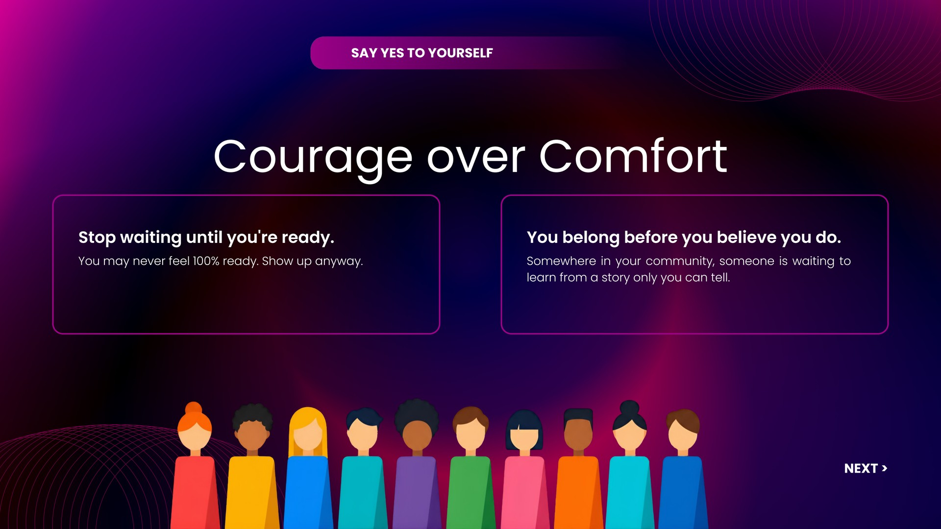

Slide 21
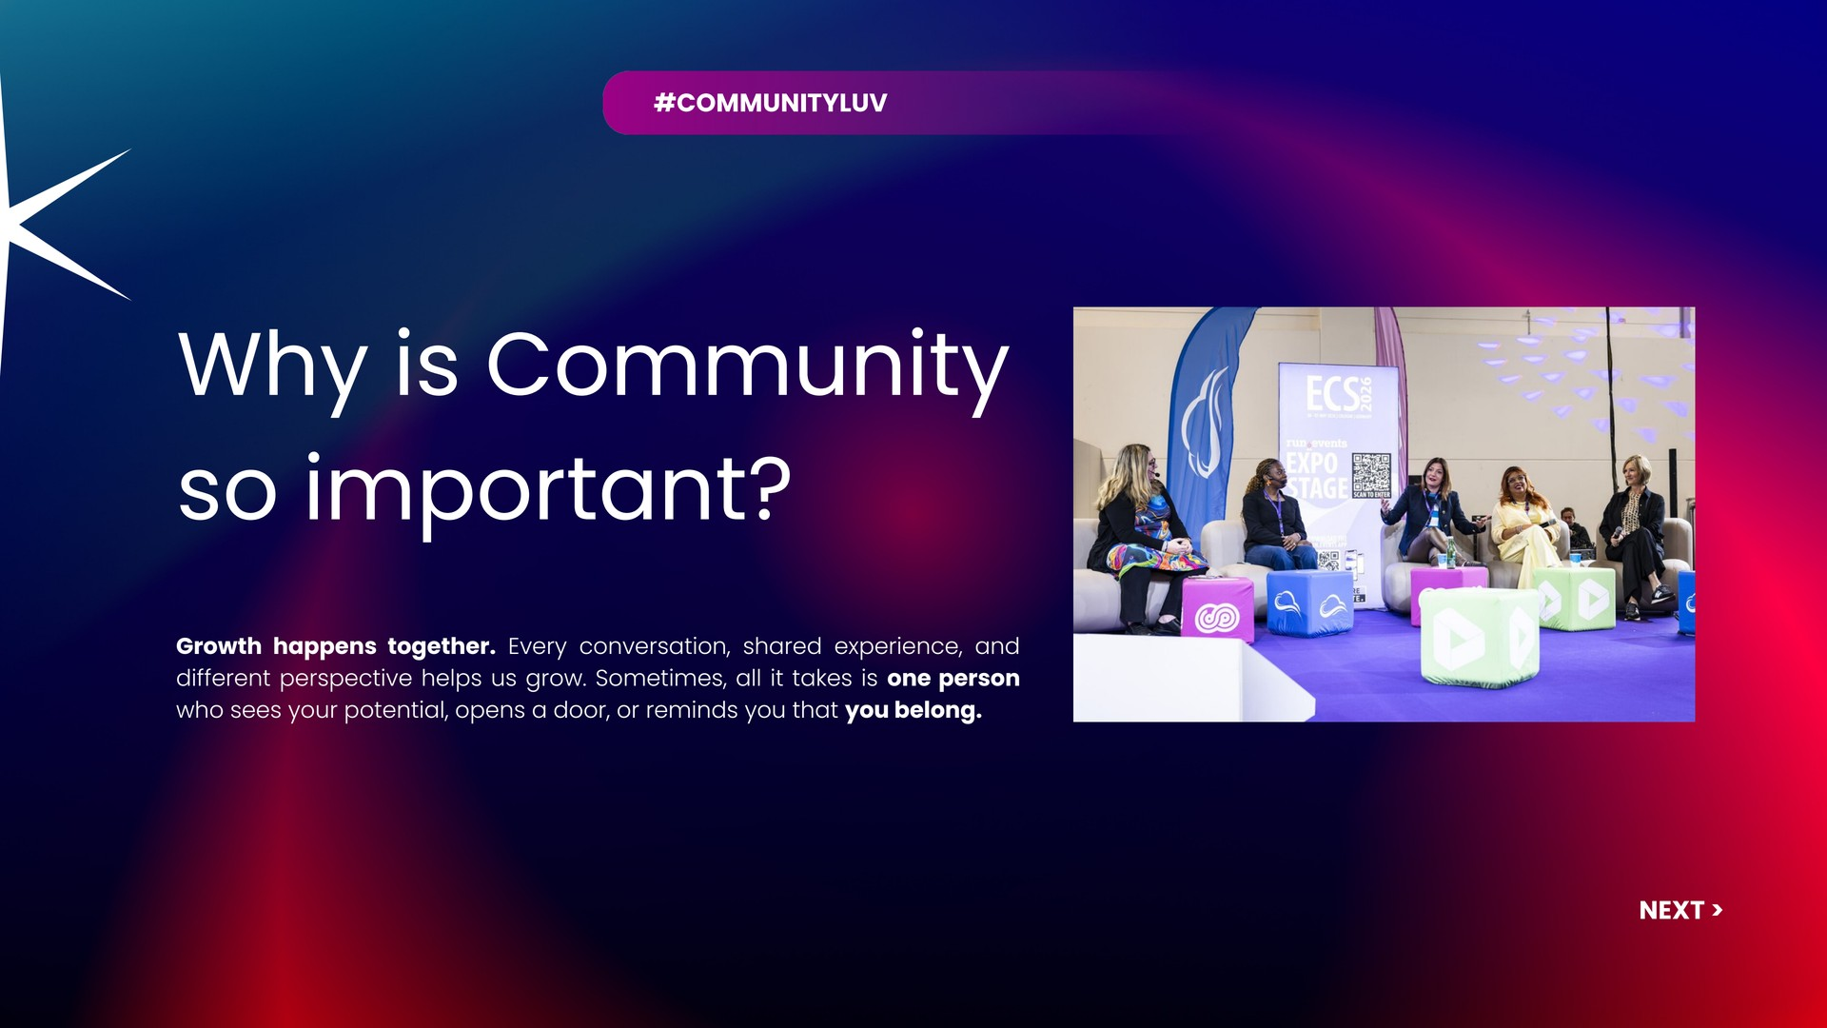

Slide 22
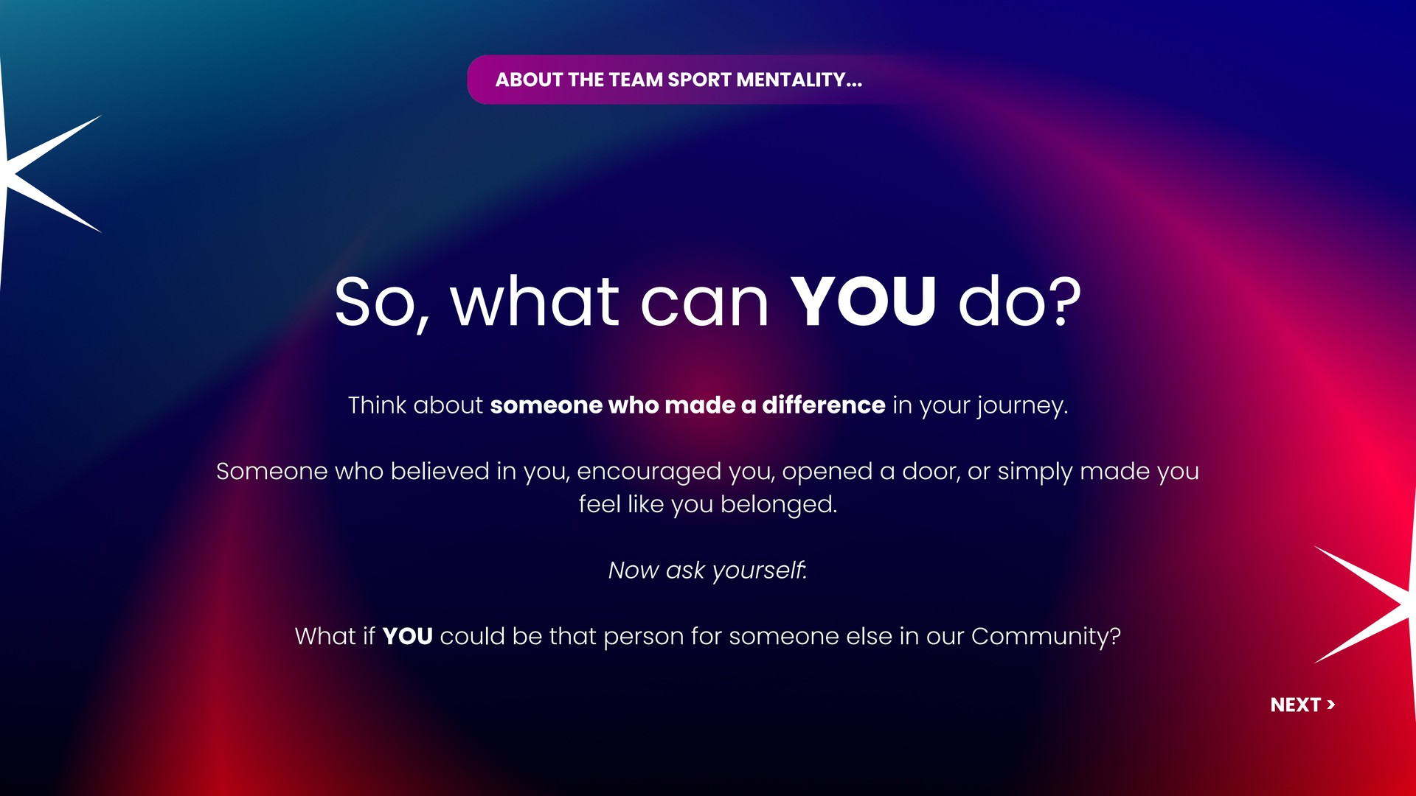

Slide 23
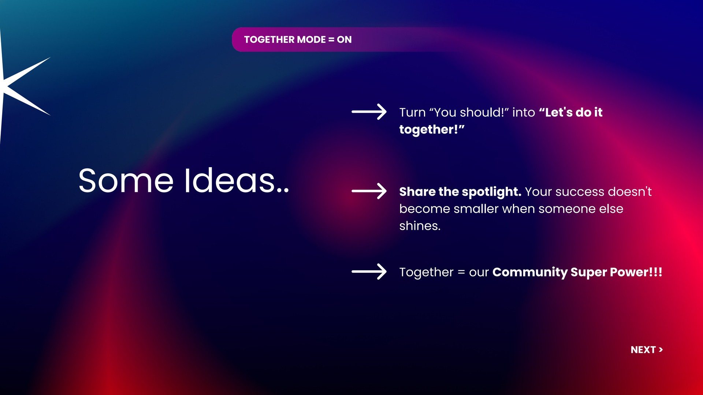

Slide 24
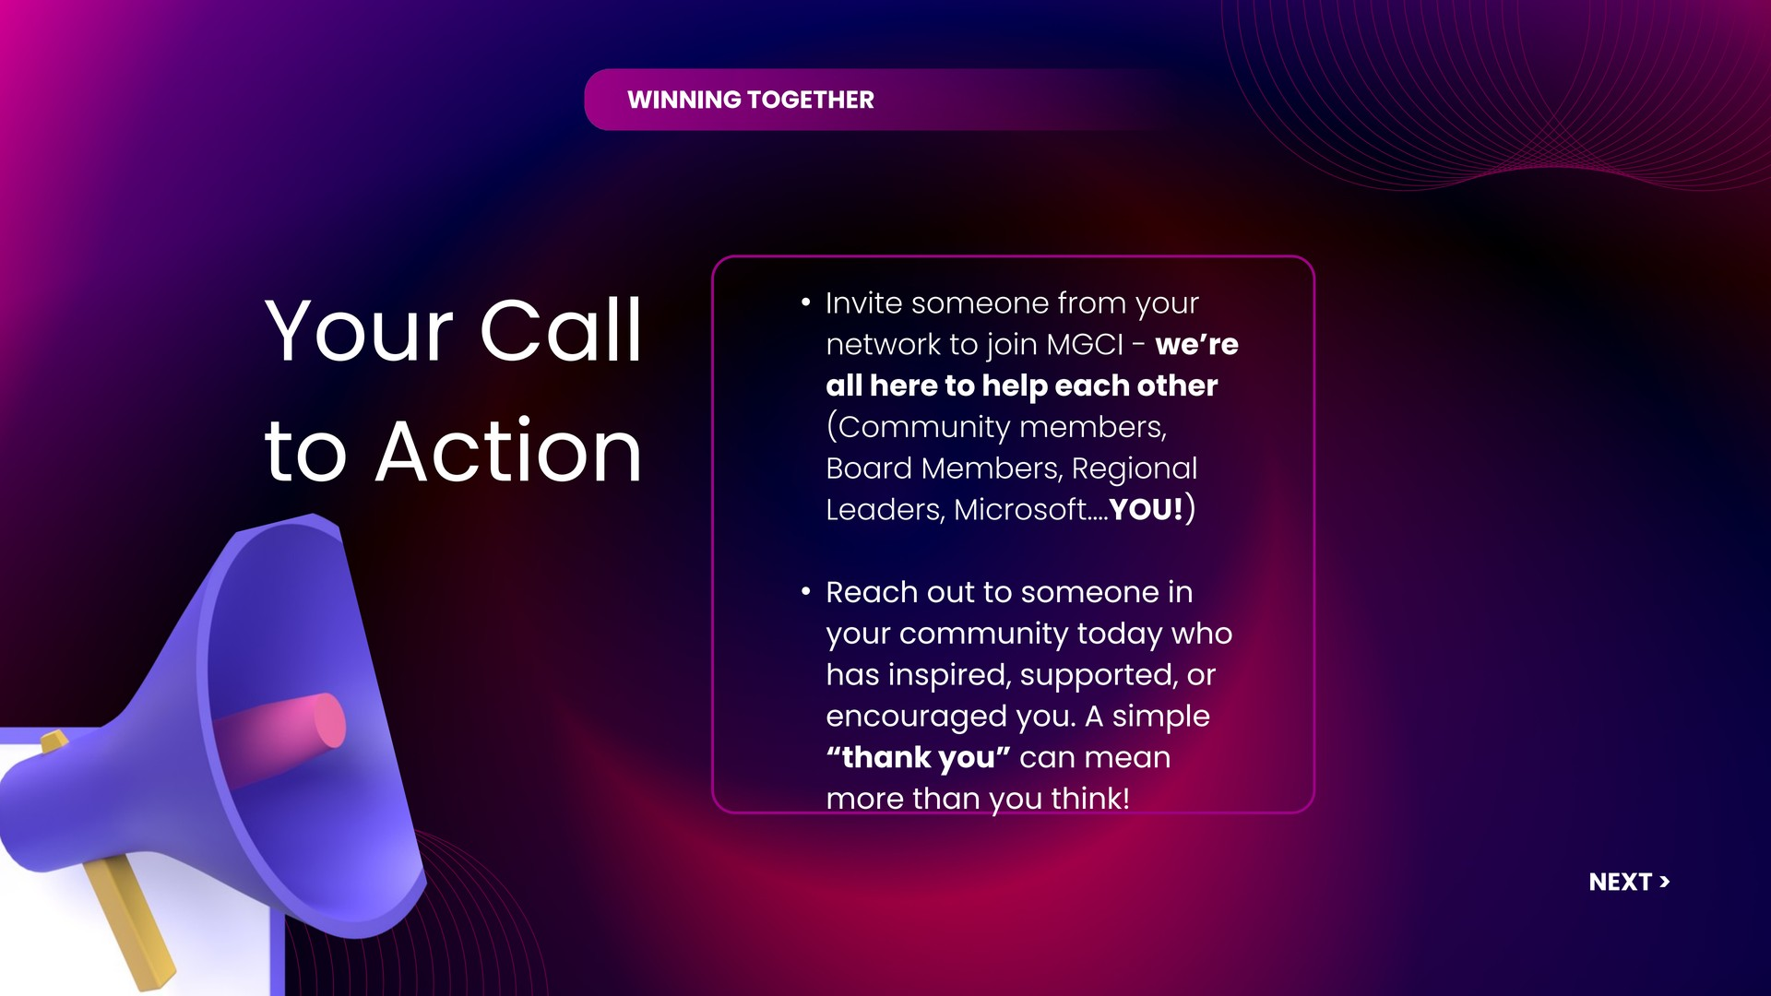

Slide 25
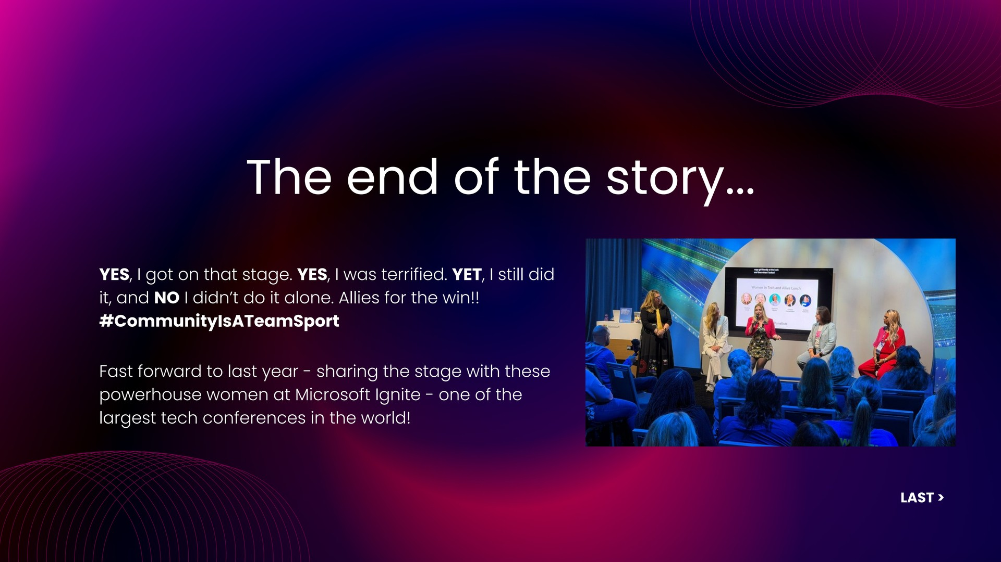
👉

Slide 26
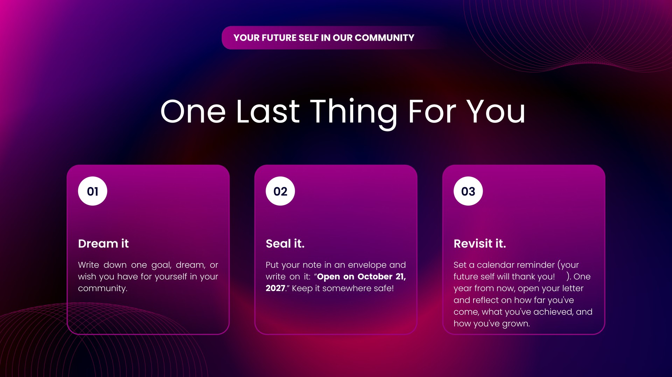
✨
💌
🚀
😉

Slide 27
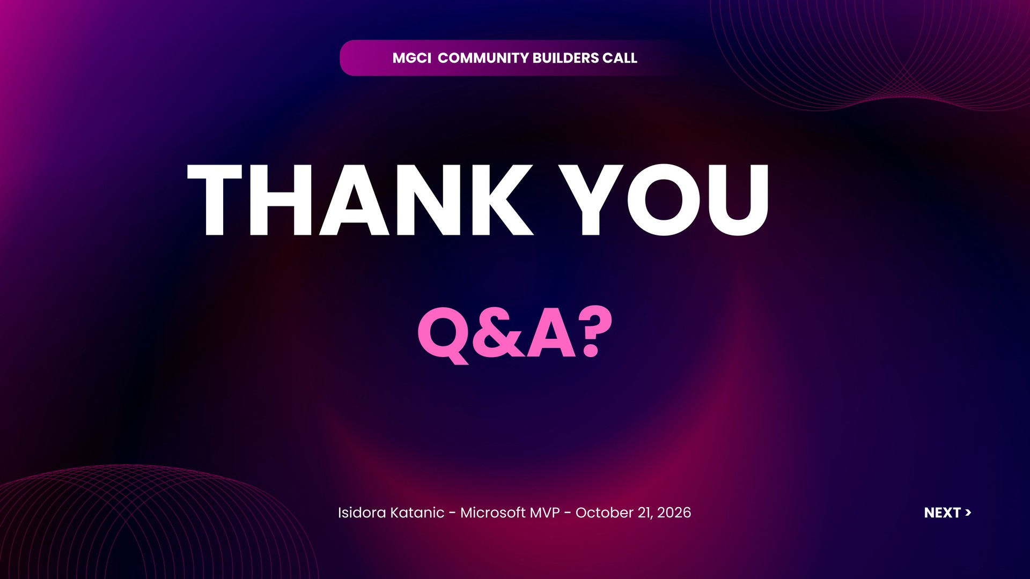
🫶

Slide 28

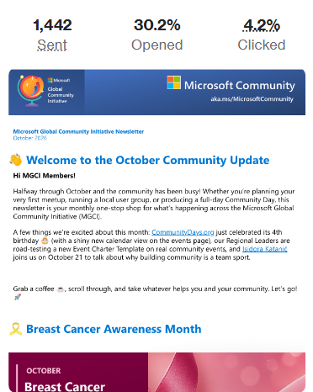
Communications Workstream Update
Board Officer Leads
Jennifer Mason
Isidora Katanic
September newsletter paused due to summer break
October newsletter sent Oct 16!!
Please use #CommunityLuv on socials so we can include your posts.
Monthly Newsletter

Slide 29
Sponsors & Sponsorship - Subcommittee Update
Goal: Helping the MGCI community leverage sponsorship opportunities through shared knowledge and support.
Board Officer Leads & Members
Update / Progress
Mark Rackley
Sharon Sumner
Neil Patel
No new updates.
Open for new volunteers to join!

Slide 30

Tech & Tools Sub Committee
Meets on the second Tuesday of every month. A working group of volunteers shaping the Community Days platform alongside MGCI.
Purpose
Align on overall technical direction and vision
Review and shape the product roadmap
Hands-on with new features (beta testing & feedback)
Serve as eyes and ears within the community
Help guide improvements based on real community needs
Support evangelism and platform adoption
Participate in monthly alignment meetings on Discord
JOIN US
MGCI Tech & Tools Team
Help shape the platform: design, code, test, content. Open to all skill levels.
communitydays.org

Slide 31
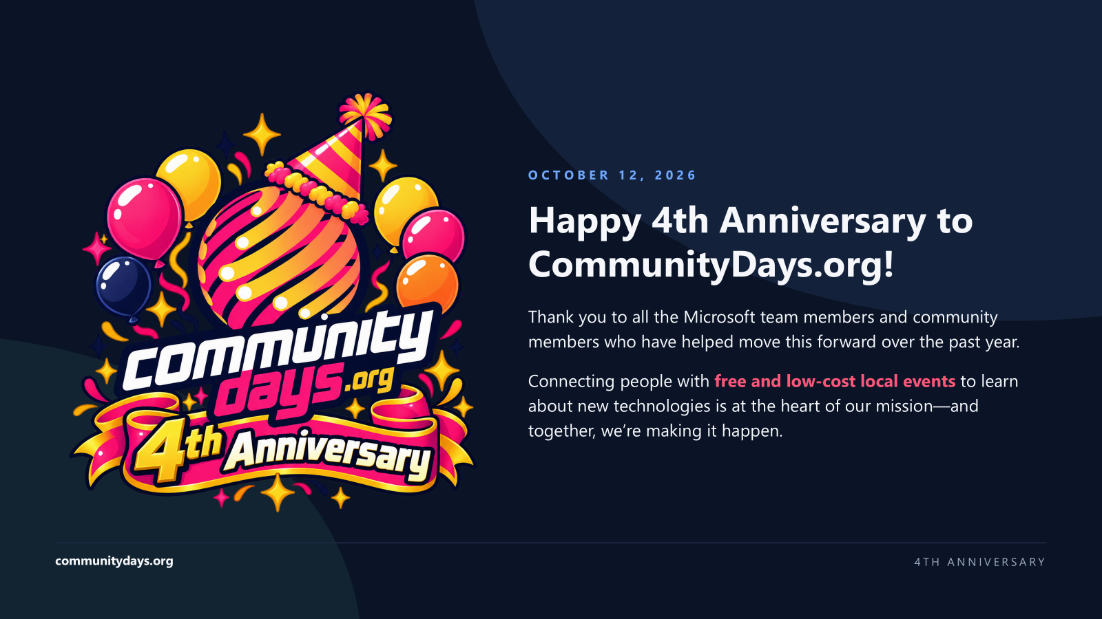

Slide 32
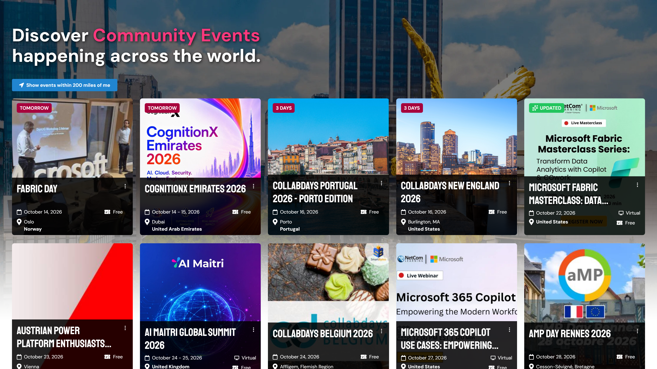

Slide 33
TECH & TOOLS
What's Happening
Sep 8 — Oct 13, 2026
JUST SHIPPED
NEXT UP
Calendar view — browse events month by month; click one to see its card
Search by state — searching “Tennessee” finds events there
New home — the site moved to www.communitydays.org, with matching email
Credly badges — badges for contributions to Community Days
About Us map — a shorter About Us page with a map of every event city
Cookie-free analytics — Microsoft Clarity runs without cookies, and the cookie banner says so
More events — bring in Data Saturdays and CollabDays events
Transfer calls — community calls can be handed to another organizer, like events
MCP server — AI assistants can search events and speakers
Quick approver checklist — see at a glance if a pending event is ready
102 pull requests merged: 20 new features · 20 fixes · 15 security, speed & accessibility · 17 infrastructure · 30 upkeep — plus 20 releases to production
communitydays.org
WHAT'S HAPPENING

Slide 34
GET INVOLVED
Focus Areas
Pick a lane
DEVELOPMENT
CONTENT
CREATIVE
QA & TESTING
EVANGELISM
New features, maintenance & bug fixes
Videos
Brand & design
Speaker board
Community outreach
· AI enablement
OPEN
JAMEL ABED
ARIK FLETCHER
DAVID OPDENDRIES
· Introduction to Community Days
· How to create an event
Credly badges
Testers
Platform adoption
MCP server
OPEN
OPEN
· Try new features before release
OPEN
ROB WINDSOR
OPEN
Docs & how-tos
Community feedback
AI SEO guidance
OPEN
OPEN
MIRKO PETERS
FAQs
Platform features & fixes
NIKKIA CARTER
OPEN
Event reviewer
SUCHETA GAWADE
CHRISTINE GELUK
communitydays.org
FOCUS AREAS

Slide 35
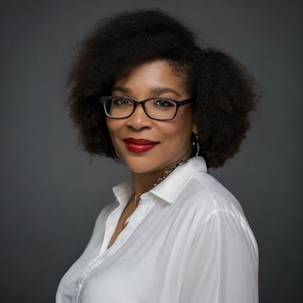
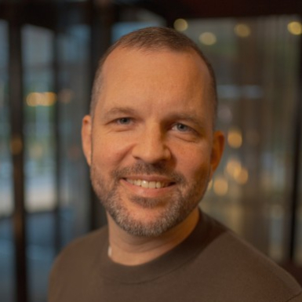
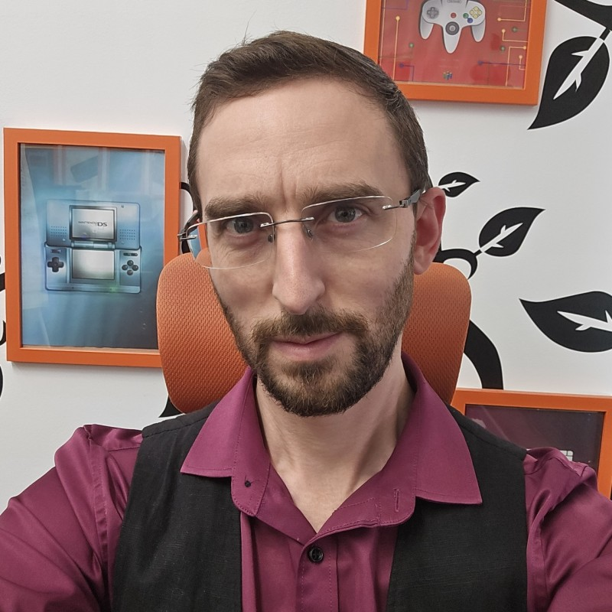
RECENT CONTRIBUTIONS
Team Shout Outs
Sep 8 — Oct 13, 2026
★
Nikkia Carter
David Opdendries
Arik Fletcher
CONTENT
CLOSING PRS
COMMUNITY OUTREACH
★ FIRST-TIME CONTRIBUTOR
communitydays.org
TEAM SHOUT OUTS

Slide 36
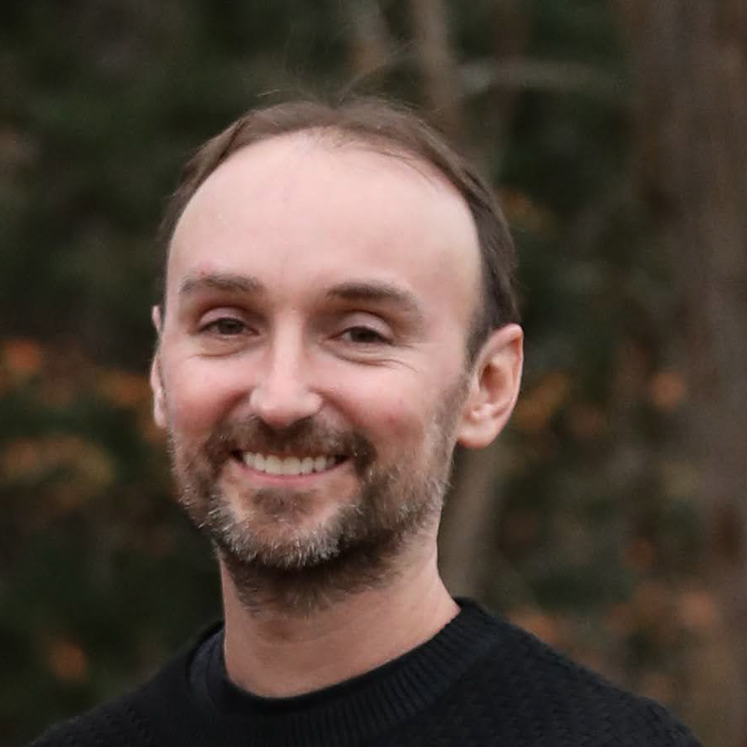
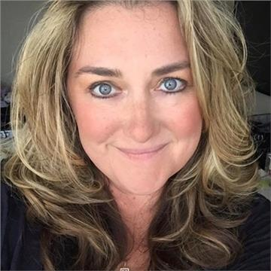
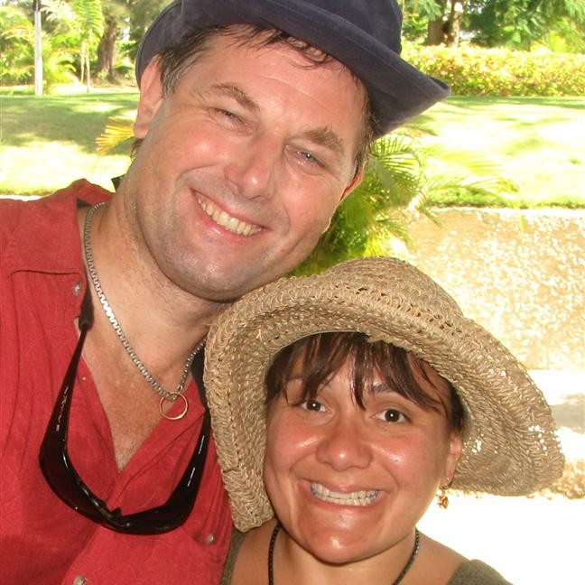
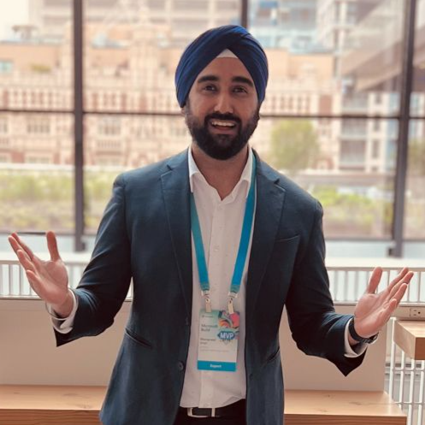
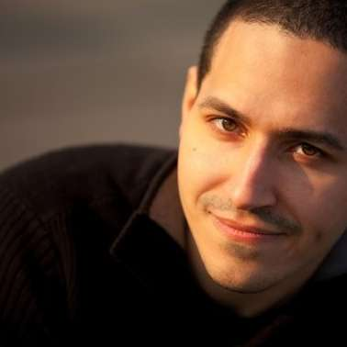
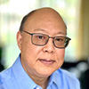
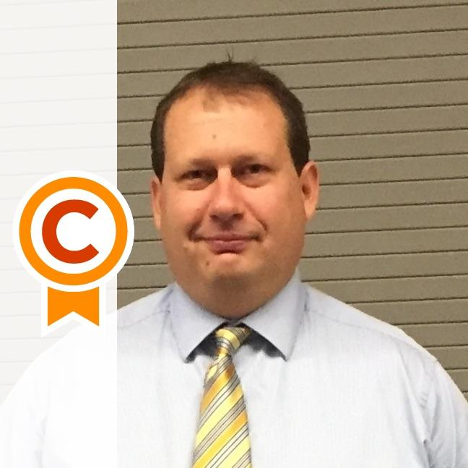
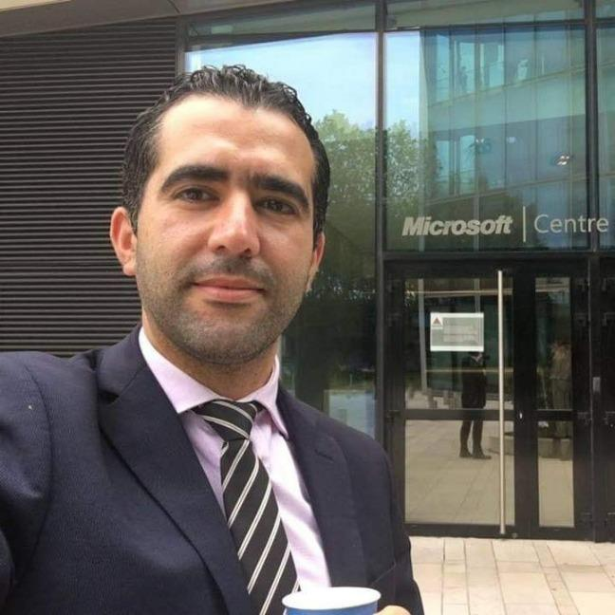
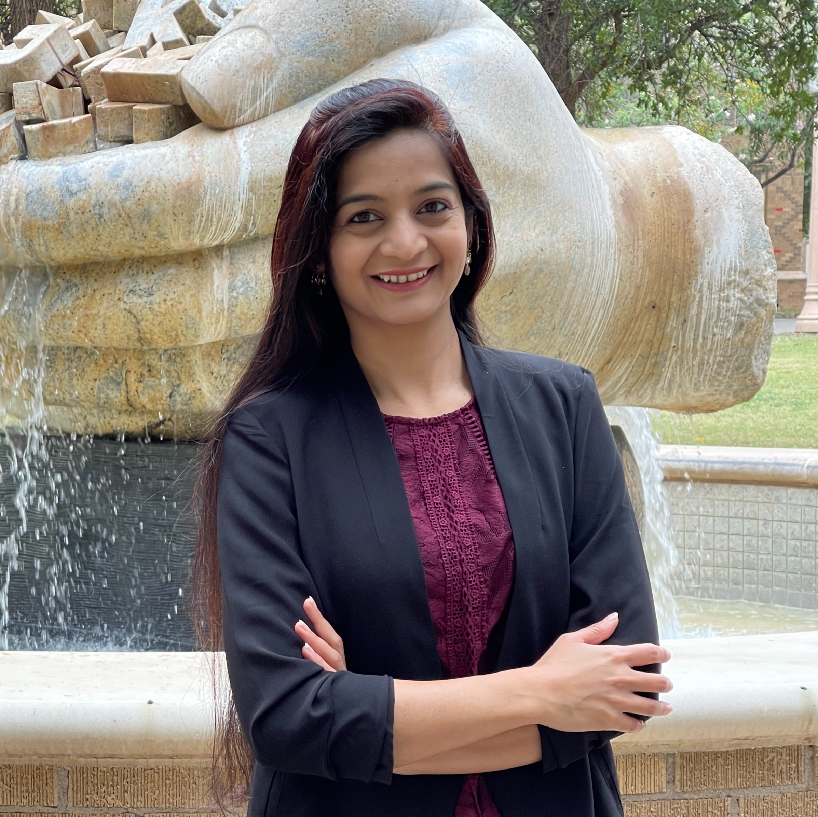


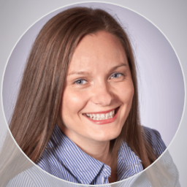
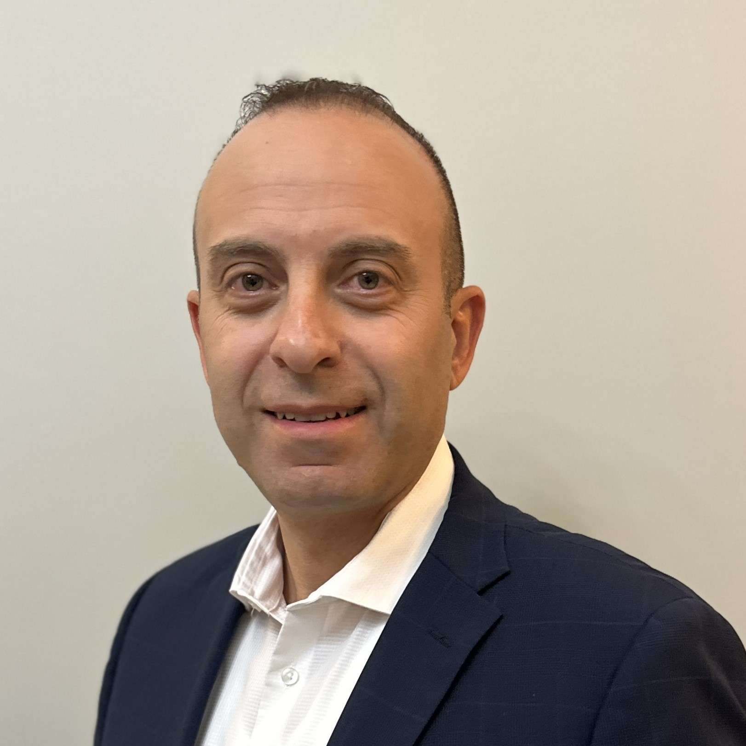
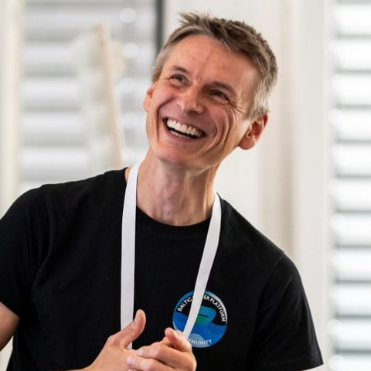
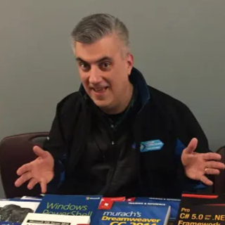

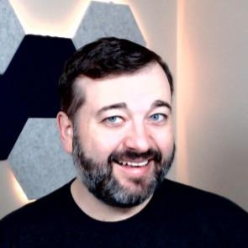
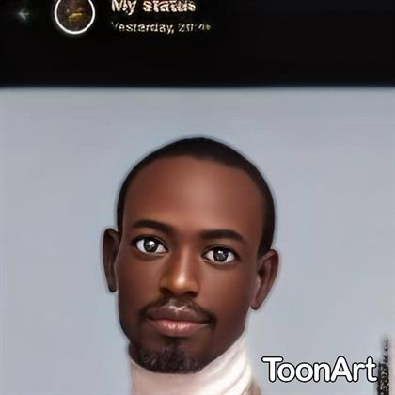
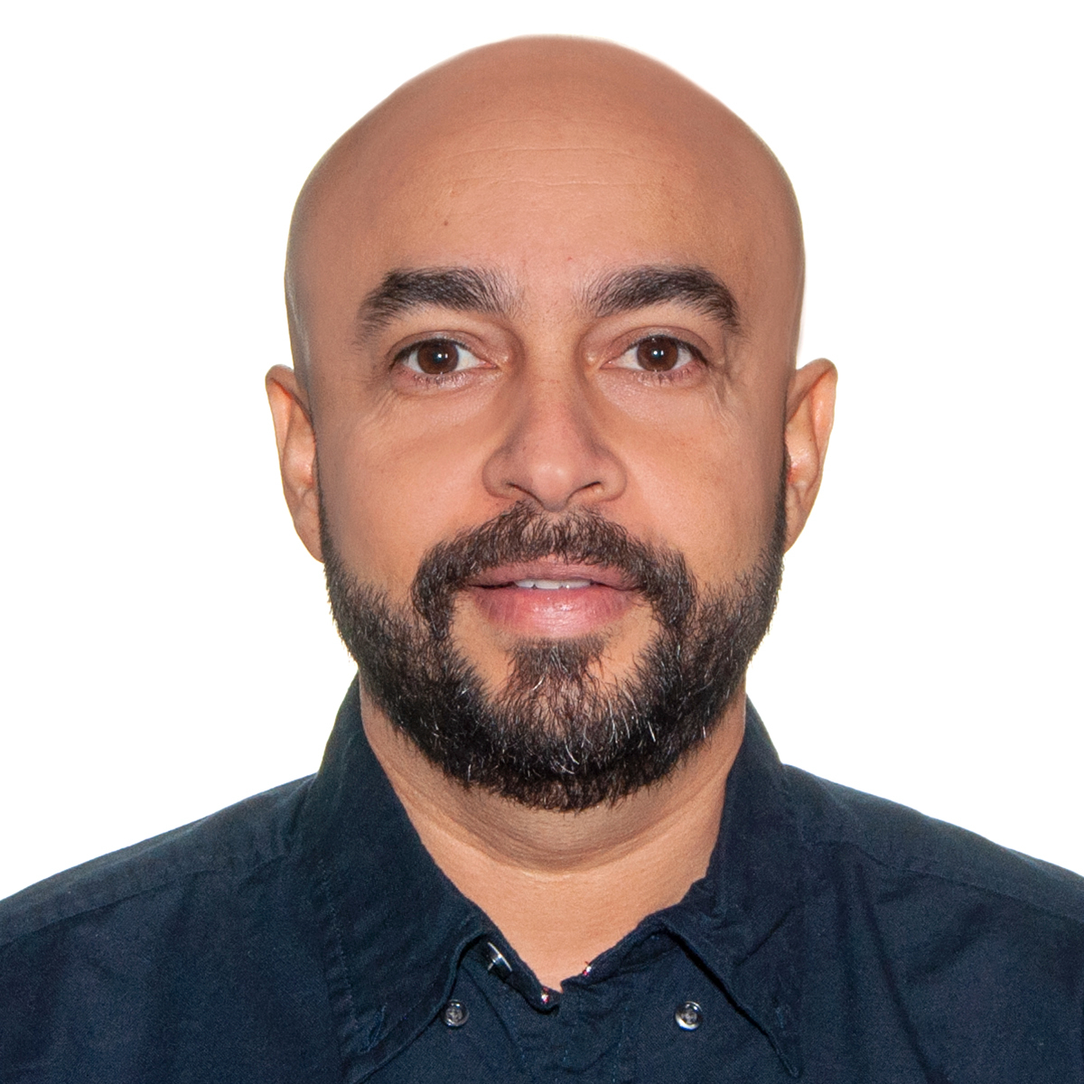
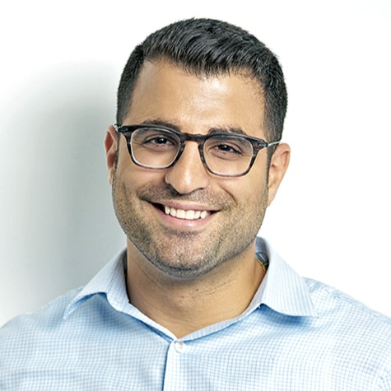
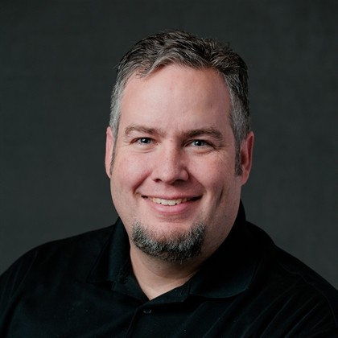
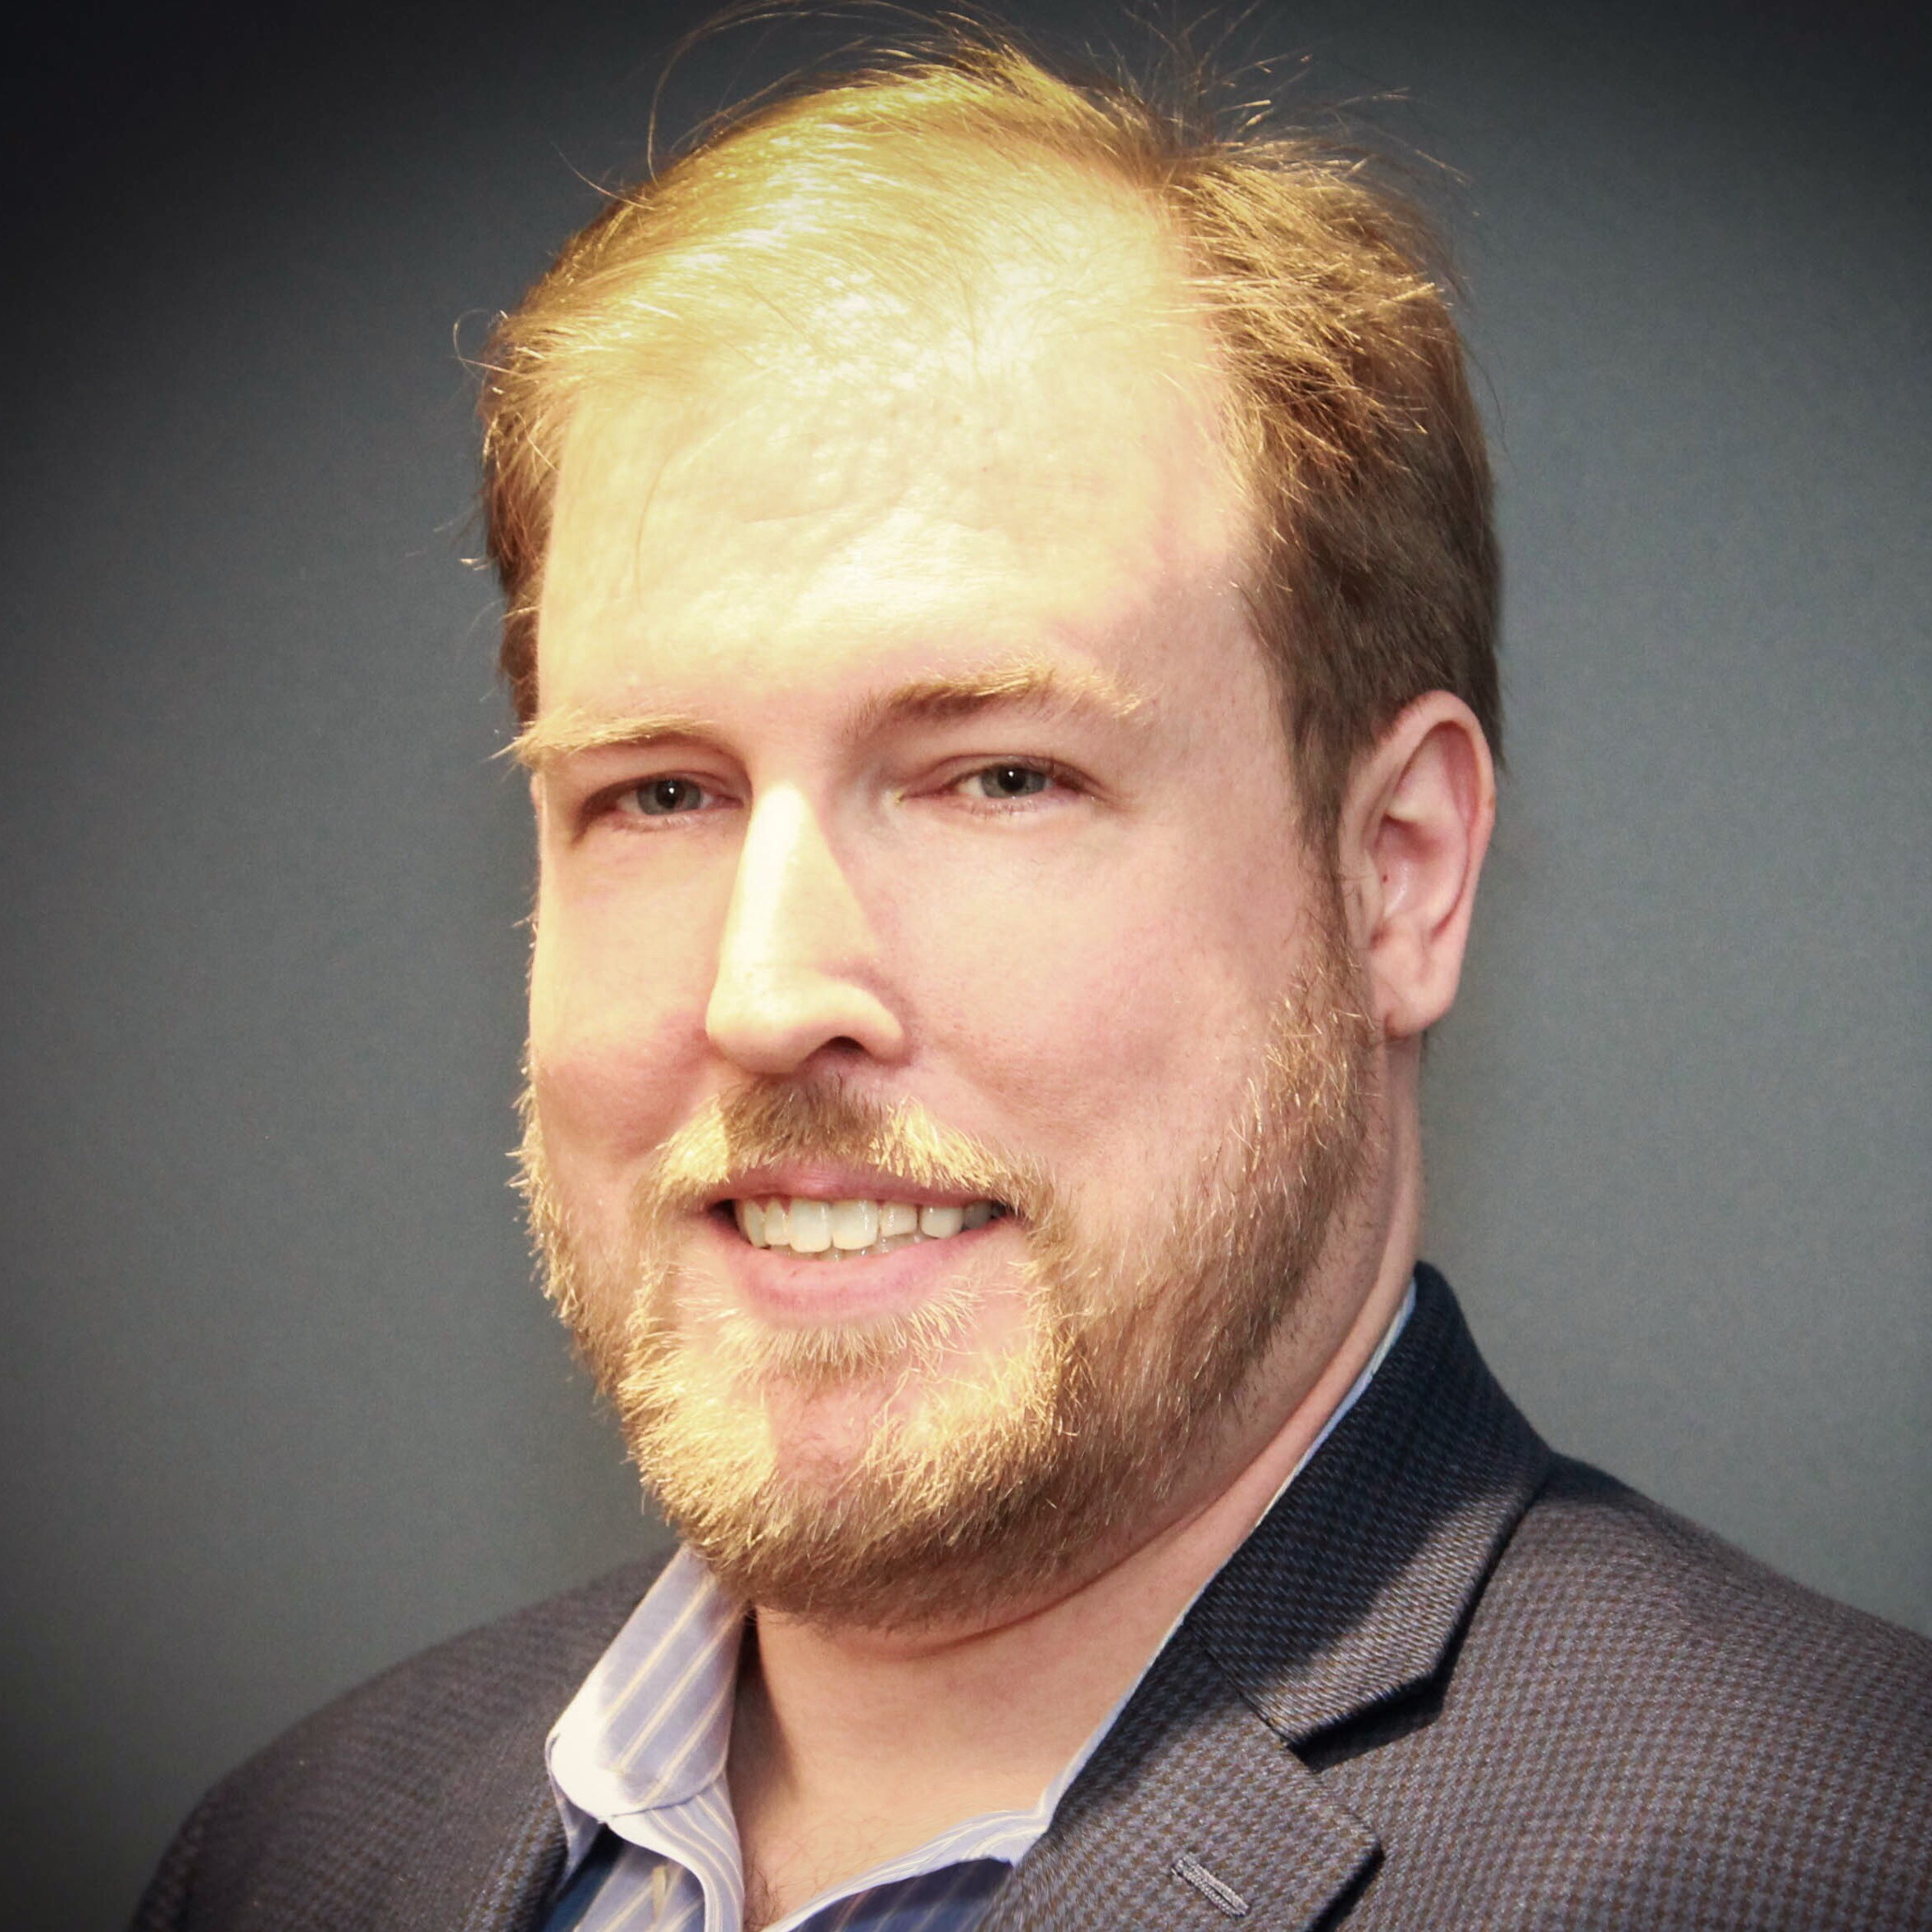
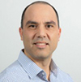
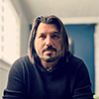
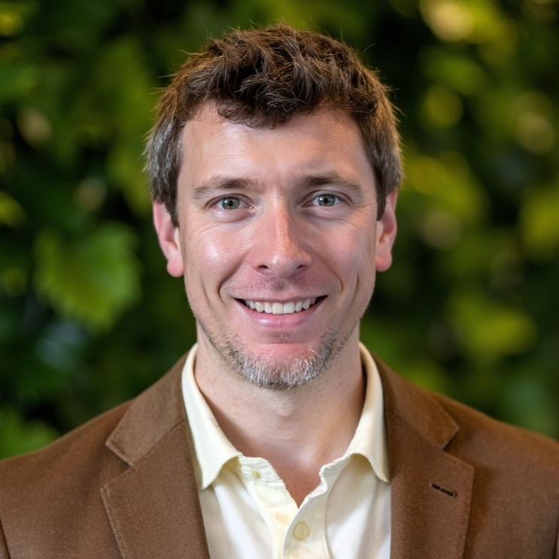
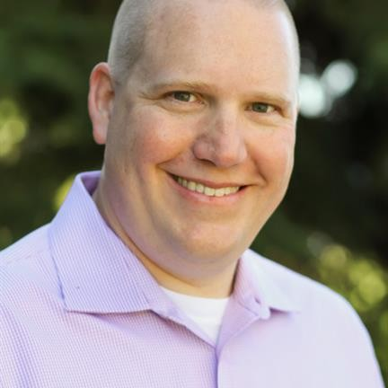
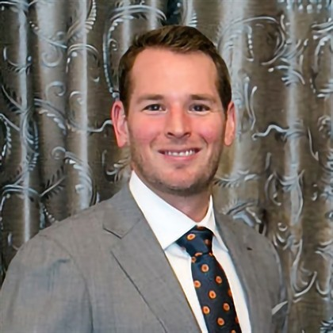
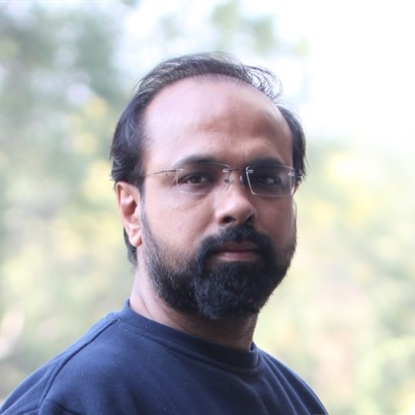
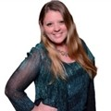
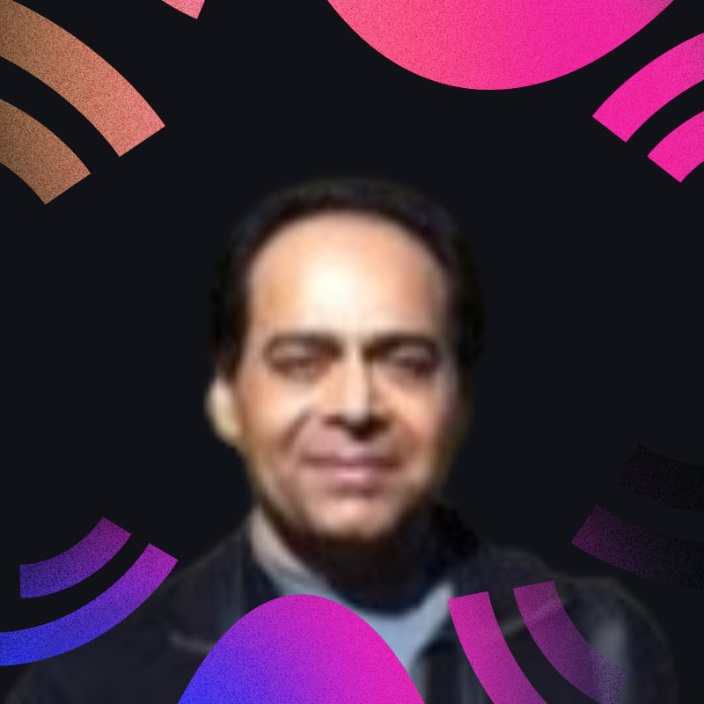
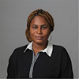
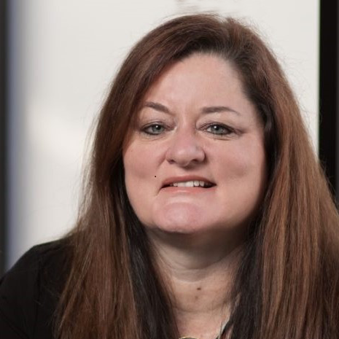
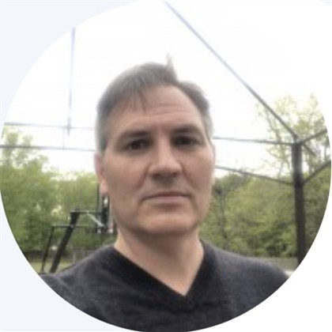










VOLUNTEERS
Thank you to all the volunteers!
Sep 8 — Oct 13, 2026
Your feedback is vital. We are constantly shipping changes and we listen to every suggestion.
ACTIVE 12
Thomas Daly
Heather Cook
David Opdendries
Christine Geluk
Manpreet Singh
Jason Rivera
Russ Onizuka
Bryan Hart
Jamel ABED
GET INVOLVED
Join the Tech & Tools Team
MGCI — CommunityDays.org Tech and Tools Team Sign-Up. Help shape the platform: design, code, test, content.
Nikkia Carter
Sucheta Gawade
Mirko Peters
ALL VOLUNTEERS 45
Sign up →
communitydays.org/volunteer
communitydays.org
VOLUNTEERS

Slide 37
Community Event Organizer Trainings
Learn from your peers and get updates on the MGCI program.
4th Thursday of every month at 8:10 AM PT.
Join: https://aka.ms/MGCITrainingMTG
All sessions are also available on-demand via the Microsoft Community Learning YouTube channel:
https://aka.ms/community/learning

Slide 38
Training Workstream Update
2026 Schedule
Date | Presenter | Topic
JAN 29 | Sharon Sumner | Sponsors and Sponsorship
FEB 26 | Tom & Heather | Community Days, MTC User Groups & AMC
MAR 26 | NO MEETING | SPRING BREAK
APR 30 | Sharon Weaver | Run of Show – Day of Event Lessons Learned
MAY 28 | TBD | Event & Committee Planning
JUN 25 | TBD | How to find and select speakers
JUL 30 | TBD | FOOD! Meals, Snacks, and Beverages
AUG 27 | NO MEETING | SUMMER BREAK
SEP 24 | Sharon Weaver | Event branding – Graphics & Image tips
OCT 29 | Sharon Weaver Christian Buckley | Filling seats! How to market your event
NOV 26 | NO MEETING | HOLIDAY BREAK
DEC 24 | NO MEETING | HOLIDAY BREAK
Join the discussion:
https://aka.ms/MGCI-SepEventTrainingDiscussionEventBranding

Slide 39

Please Provide Feedback for Event Training!
https://aka.ms/MGCI-EventOrganizerFeedback

Slide 40
MGCI Community Builders Network Call
2026 Schedule
Date | Presenter | Topic
Sep 16 | Diego Domingos da Silva | M365 NYC
Oct 21 | Isidora Katanic | Game on: building Community together (yes it’s a team sport)
Nov 18 | Sharon Smith Christian Buckley | Creative Ways to Find Sponsors for Your Community Events
Dec | Holiday Break
Jan 20 | Ryan Yates | Is building a community worth it…? (shh course it is)
Feb 17 | Femke Cornelissen | From Allyship to Action: Building Inclusive Speaker Line-ups and Events
Mar 17 | Ibrahima Bah | From Accessibility to Inclusion: A Practical Journey with Microsoft 365
Apr 21 | TBD
Learn from your peers and get updates on the MGCI program.
3rd Wednesday of every month at 8:10 AM PT.
All sessions are also available on-demand via the Microsoft Community Learning YouTube channel:
https://aka.ms/community/learning
AM Session: https://aka.ms/MGCIMtgAM

Slide 41

Your Turn at the Mic 🎤
Got a story, a lesson, or a tip? We've got 10 minutes with your name on it.
Why speak at a Community Builders Network Call?
Low stakes, real audience - test new material with people who want you to succeed
Sharpen your delivery - practice before the big conference stage
Get known - put your name and expertise in front of community leaders worldwide
Give back - someone in the room is exactly where you were a year ago
Build the reel - a recorded session you can point to in speaker applications
No polish required. Just something worth passing on.
MGCI Speaker Interest Form

Slide 42
MGCI Community Builders Network Call
(formerly called MGCI General Session)
Learn from your peers and get updates on the MGCI program.
The 3rd Wednesday of every month at 8:10 AM PT.
Join: https://aka.ms/MGCIMtgAM
All sessions are also available on-demand via the Microsoft Community Learning YouTube channel:
https://aka.ms/community/learning
Notes:
Introduce the monthly MGCI General Sessions — 3rd Tuesday of every month at 8:10 AM PT. Encourage them to attend live; replays are on the Microsoft Community Learning YouTube channel.

Slide 43

Join the MGCI Mailing List
https://aka.ms/MGCI
Best practices. Training. Connections.
Joining the MGCI gives you access to the Community Initiative team on the Microsoft Community Tenant, where you get exclusive benefits, such as invites to our monthly General Session meetings and opportunities to network and learn from other community members.
You can also promote your event(s), access resources, join event producer training, and interact with the board members, regional leaders, and Microsoft steering leaders.
Receive our monthly newsletter.
Receive day before reminders of meetings.
Directly to your email inbox.

Slide 44
Event | Date | City
AI Tour | Various | Various
Microsoft Ignite | November 17-20, 2026 | San Francisco and online
MVP Summit | March 16-18, 2027 | Redmond, WA
Microsoft Ability | TBD May 20272027 | Redmond, WA
Microsoft Build | TBD May/June 2027 | San Francisco and online
Upcoming Microsoft Flagship Events

Slide 45

Six Frontier Tour stops are announced for October and November
City | Date
London | Oct 21, 2026
Cologne | Oct 22, 2026
Mexico City | Oct 29, 2026
Dubai | Nov 3, 2026
REGISTRATION
Each city registers separately on the AI Tour site.
Requests are reviewed, so encourage members to request early.
More cities are still being announced - check the site for updates.
Confirm cities, dates and registration links on aitour.microsoft.com more stops are expected through December.

Slide 46

Microsoft Ignite returns November 17–20; registration is open now
REGISTRATION
November 17–20, 2026
Register at ignite.microsoft.com
In-person and online options are listed on the event site.
SPEAKING OPPORTUNITIES
There are no speaking opportunities available at this time.
Check out ignite.Microsoft.com, sessions and the full agenda are published there.
Regional Leaders can plan local watch parties around the keynote and on-demand sessions.

Slide 47



Mondays at Microsoft
Get the latest AI new, product announcements, and Microsoft Community insights from Karuana Gatimu and Heather Cook, every Monday.
Live every Monday at 8:00 AM PT.
Fuel your week
aka.ms/MondaysAtMicrosoft

Slide 48

Get the latest AI new, product announcements, and
Microsoft Community insights from Karuana Gatimu and Heather Cook, every Monday.
Live every Monday at 8:00 AM PT
Fuel your week
aka.ms/MondaysAtMicrosoft

Slide 49

Mondays at Microsoft
GUEST INVITATION
Join us as a guest on an upcoming episode
A 30-minute live show that keeps customers, partners, MVPs, and the wider Microsoft community current on what's new, from AI and Copilot to Microsoft 365, Power Platform, developer news, and community events.
YOU'RE INVITED!
EPISODE DATE
TBD
TOPIC / NEWS WE'LL SHARE
TBD
Our goal
Your guest segment
• Help customers understand what's new and why it matters
• Give product teams a stage for announcements, roadmap, and real-world scenarios
• Connect the community with the experts behind the technology
• Drive awareness and adoption through authentic conversations
• A relaxed 5–10 minute live conversation with the hosts
• Share your product news, roadmap, or a real-world scenario
• Bring one expert from your product/topic area
• Live audience Q&A to wrap up
Sample graphic from previous episode
Livestream requirements:
• Tech check — 7:45 AM PT
• Live show — 8:00–8:30 AM PT
• Fully virtual via StreamYard
• 5–10 min segment + live Q&A
Hosted by Karuana Gatimu · Heather Cook · Jonathan Jones
Link to apply: https://aka.ms/MondaysatMicrosoft/GuestForm

Slide 50


🎤 Women Speakers | Microsoft Ecosystem
💜 Curated Women in Tech speaker directory
🌍 Resource for community leaders & event organizers
🚀 Speak Microsoft tech → create a profile & get listed
✨ Amplify voices. Build inclusive events. Grow the community.
Microsoft Solutions Women in Tech speaker directory on Sessionize

Slide 51
Roles and Opportunities
The Microsoft Global Community Initiative Board will be made of no less than five (5) voting community members with worldwide representation supported by four (4) voting Microsoft full time employees.
Board members are appointed by the Microsoft Steering Committee. Regional Leads are self-nominated and voted on and approve by board members.
Board Officers
Regional Leads
General Assembly
MS Full-Time Employee
Appointed positions with one 18-month initial term
Can be extended with approval
Voting member
Must lead one sub-committee
Self-nominated, approved by board and Microsoft
1 year term, can be extended, with renewal and approval
Active participation in one sub-committee
Broad referendum voting
Attend general and other offered meetings
Voting members
Duties part of core role
Succession planning for continuity
Responsible for Microsoft budget
Provide your feedback on our Board structure & operations at https://aka.ms/MGCIFeedback.
Notes:
Regions will not match the MS Regions. They will be Community centric to reflect the local regions.

Slide 52









Appointed Board Officers
Isidora Katanic
Community Manager
Experts Inside AG
Switzerland
Jennifer Mason
VP, Workforce Transformation & Learning
Planet Technologies
United States
Mark Rackley
Co-Founder & Strategic Advisor
ThaiMed Elite International
United States
Oluwaseyi Oluwawumiju (Seyi)
Management Executive
Convenant Technologies
Africa
Rodolfo Castro
Solutions Architect
MS and Unified Communications
LATAM
Sharon Sumner
CEO, M365 & Sharepoint Governance and Managed Migration Tool
Castper365
UK
Sharon Weaver
CEO
Smarter-Consulting
United States
Thomas Daly
Collaboration Director
SoHo Dragon
United States
Wes Preston
Consultant
TrecStone, Level 5 Profiles
United States

Slide 53
Add text here.

Slide 54

Next MGCI Community Builders Network Call
Wed Nov 18, 8:10AM PT
Join us!

Slide 55
Microsoft Tech Community
The community platform for Microsoft 365 – forums, blogs, and events aka.ms/joinMTC.
Stay Connected!
CommunityDays.org
Find or host a local event in your area
or to match your interests.
Engage with the best community in tech…
There’s something for everyone!
Microsoft Community on LinkedIn
News, announcements and training delivered to your news feed aka.ms/microsoftcommunitylinkedin.

Slide 56

We Want Your Feedback!
https://aka.ms/MGCIFeedback

Slide 57
Thank You.

Slide 58
What can I expect when I join the MGCI Community Hub on the Microsoft Tech Community?
Monthly Community Builders Network Call
Direct Contact to Microsoft via Monthly Newsletters
Request Amplification for your Events
Access to Useful Resources
Interactions with a Global Community
Overall Microsoft & Community Support
https://aka.ms/MGCI

Slide 59
MGCI Subcommittees
Subcommittee | Board Member Leads
Communications & Amplification | Isidora Katanic & Jennifer Mason
Sponsorship & Sponsors | Mike Maadarani, Mark Rackley and Sharon Sumner
Tech & Tools | Tom Daly
Training | Sharon Weaver & Wes Preston
https://aka.ms/MGCISubcommittee

Slide 60
MGCI Meeting Rhythm of Business
 | Monday | Tuesday | Wednesday | Thursday
Week 1
Week 2 |  | Board Member Monthly Meeting Host: Heather & Rotating Board Members Audience: Board & MSFT 7:10am PT | Board/RL/MSFT Monthly Meeting Host: Heather & Rotating Board Members Audience: BO, RL and MSFT 11:00am PT
Week 3 |  |  | General Session Host: Heather Audience: Open to public 8:10am
Week 4 |  |  |  | Event Training & Office Hours (One time only) Host: Sharon & Wes Audience: MGCI Membership 8:10am PT

Slide 61
MGCI ROB Dates
Month | Board | Board / RL | General Session | Event Training
Jan | Tue 13 | Wed 14 | Tue 20 | Thu 29
Feb | Tue 10 | Wed 11 | Tue 17 | Thu 26
Mar | Tue 10 | Wed 11 | Tue 17 | MVP Summit
Apr | Tue 7 | Wed 8 | Tue 21 | Thu 23
May | Tue 12 | Wed 13 | Tue 19 | Thu 28
Jun | Tue 9 | Wed 10 | Tue 16 | Thu 25
Jul | Tue 7 | Wed 8 | Tue 21 | Thu 30
Aug | Summer Break
Sep | Tue 8 | Wed 9 |  | Thu 24
Oct | Tue 13 | Wed 14 |  | Thu 29
Nov | Tue 10 | Wed 11 |  | Holiday Break
Dec | Tue 8 | Wed 9 |  | Holiday Break

Slide 62
Resources and Opportunities to Participate
Item | URL
Join the CDO Tech and Test Team | https://aka.ms/MGCI/CDOTechSignUp
Request Social Amplification | https://aka.ms/communitysocial
Submit news item for monthly MGCI Newsletter | https://aka.ms/MGCINewsletterTopics
MGCI General Session Sign Up to Host | https://aka.ms/GeneralSessionGuest
MGCI Blog Author Sign Up | https://aka.ms/MGCIBlogAuthorSignUp
Monday at Microsoft Moderator Sign Up | https://aka.ms/MondaysatMicrosoft/ModSignUp

Slide 63
Resources and Short Links
External Links
Item | URL
MGCI AMC Home Page - website | https://aka.ms/MGCI
MGCI Sign Up Form – link to newsletter sign up | https://aka.ms/MGCISignUP
MGCI Advisors Page - website | https://aka.ms/MGCIAdvisors
MGCI General Session AM Meeting Link | https://aka.ms/MGCIMtgAM
MGCI General Session PM Meeting Link | https://aka.ms/MGCIMtgPM
MGCI Event Training Meeting Link | https://aka.ms/MGCITrainingMTG
MGCI Meeting Feedback Survey | https://aka.ms/MGCIFeedback
MGCI General Session Recordings on CT | https://aka.ms/MGCI/MeetingRecordings
MGCI Post-Event Survey to Producers | https://aka.ms/MGCIProducerPostEventSurvey
MGCI Event Producers History | https://aka.ms/MGCIEventProducerHistoryForm

Slide 64
Resources and Short Links
Internal Links
Item | URL
Join the CDO Tech and Test Team | https://aka.ms/MGCI/CDOTechSignUp
Request a Microsoft Venue | https://aka.ms/MGCI/MSOffice/VenueRequest
Request Social Amplification | https://aka.ms/communitysocial
Link to Event Budget Template | https://aka.ms/MGCIBudgetTemplate
Submit news item for monthly MGCI Newsletter | https://aka.ms/MGCINewsletterTopics

Slide 65
Resources and Short Links
Board & Regional Leads Only
Item | URL
BO/RL Meeting Assets | https://aka.ms/MGCI/BORLMeetingAssets
MGCI ADO Backlog | https://aka.ms/MGCIBacklog
Choose a subcommittee | https://aka.ms/MGCISubcommittee
Apply to be a Regional Lead | https://aka.ms/MGCIRegionalLead
Collect Regional Leader Info | https://aka.ms/MGCIRegLeaderInfo
Collect Board & Regional Leader Detailed Info | https://aka.ms/MGCILeaderContactInfo

Slide 66


Credly Badges
Board & Regional Leads Only
Badges are issued to Board Members and Regional Leaders​
Email from "MGCI Board and Regional Leader Contact Information" was used to issue badges https://aka.ms/MGCIBoardRLContactList​
Question/Support - Please email Heather – heather.cook@msftcommunity.com

Slide 67
Microsoft Event Code of Conduct
Microsoft’s mission is to empower every person and every organization on the planet to achieve more. This includes all Microsoft events and gatherings, including on digital platforms and in person, where we seek to create a respectful, friendly, enjoyable, and inclusive experience for all participants.
​
We expect all event participants to uphold the principles of this Code of Conduct. The Code of Conduct applies to all aspects of the main event and any related activities, whether digital or in person. Microsoft does not tolerate the following in any aspect of the event program, including business and social activities:
Behavior that is disruptive, disrespectful, or degrading to others, including any messages, images, or interactions by anyone, in any form, regardless of location.​
Harassment or discrimination based on age, ancestry, color, gender identity or expression, national origin, physical or mental disability, religion, sexual orientation, or any other characteristic protected by applicable local laws, regulations, and ordinances.​
​
We encourage everyone to assist in creating a welcoming and safe environment. Please report any concerns, harassing behavior, or suspicious or disruptive activity to venue staff, the event host or owner, or the nearest event staff.
​
We also encourage everyone to contact Microsoft’s Business Conduct Hotline at any time if you feel anything or anyone is not following this Code of Conduct or is inconsistent with Microsoft’s culture. The Hotline is available regardless of whether you are a Microsoft employee and can be reached at buscond@microsoft.com or +1 (877) 320-MSFT, or call collect outside the United States at +1 (720)-904-6844. Microsoft employees can also report any concerns to their Microsoft Manager.
Microsoft reserves the right to refuse admittance to or remove any person from a Microsoft event at any time at its sole discretion.

