Slide 1


Community Days [Insert City/Name] Overview Deck
Insert Date

Slide 2
Microsoft Event Code of Conduct
Microsoft’s mission is to empower every person and every organization on the planet to achieve more. This includes all Microsoft events and gatherings, including on digital platforms and in person, where we seek to create a respectful, friendly, enjoyable, and inclusive experience for all participants.
​
We expect all event participants to uphold the principles of this Code of Conduct. The Code of Conduct applies to all aspects of the main event and any related activities, whether digital or in person. Microsoft does not tolerate the following in any aspect of the event program, including business and social activities:
Behavior that is disruptive, disrespectful, or degrading to others, including any messages, images, or interactions by anyone, in any form, regardless of location.​
Harassment or discrimination based on age, ancestry, color, gender identity or expression, national origin, physical or mental disability, religion, sexual orientation, or any other characteristic protected by applicable local laws, regulations, and ordinances.​
​
We encourage everyone to assist in creating a welcoming and safe environment. Please report any concerns, harassing behavior, or suspicious or disruptive activity to venue staff, the event host or owner, or the nearest event staff.
​
We also encourage everyone to contact Microsoft’s Business Conduct Hotline at any time if you feel anything or anyone is not following this Code of Conduct or is inconsistent with Microsoft’s culture. The Hotline is available regardless of whether you are a Microsoft employee and can be reached at buscond@microsoft.com or +1 (877) 320-MSFT, or call collect outside the United States at +1 (720)-904-6844. Microsoft employees can also report any concerns to their Microsoft Manager.
Microsoft reserves the right to refuse admittance to or remove any person from a Microsoft event at any time at its sole discretion.

Slide 3
Agenda
Event Dates
Venue Details
Featured Speakers
Event Schedule
Event Sponsors
Marketing and Promotion
Notes:
We will cover the event dates and important milestones, provide details about the venue and its amenities, introduce our featured speakers, outline the event schedule, recognize our sponsors, and discuss marketing strategies to promote the event.

Slide 4

Event Dates
Notes:
Understanding the timeline is crucial for a successful event. This section will highlight key dates that attendees and organizers need to be aware of, ensuring everything runs smoothly.

Slide 5

Event Details
Date: April 15, 2023.
Day: Saturday.
Venue: Downtown Convention Center, 123 Main St, Cityville.
Notes:
This slide captures the essential details of the event, including the date, day of the week, and the venue address. The event is scheduled for Saturday, April 15, 2023, at the Downtown Convention Center located at 123 Main St, Cityville. Ensuring attendees have this information is crucial for planning their participation.

Slide 6
Event Duration and Specific Dates
One-Day Event
The Community Days event will span one day, enhancing participation and engagement within the community.
Thematic Focus
The focus for the day will be
Community Engagement
The event aims to foster community engagement, encouraging participation and interaction among attendees.
Notes:
The Community Days event will take place over three days, from June 15 to June 17. Each day will focus on different themes and activities, fostering community engagement.

Slide 7

Important Deadlines and Milestones
Registration Cut-Offs
  Registration cut-offs are crucial deadlines for participants to secure their spots, ensuring smooth event planning.
Submission Dates for Speakers
  Submission dates for speakers are important for gathering presentations and organizing the agenda effectively.
Sponsorship Commitments
  Deadlines for sponsorship commitments are vital for securing funding and support from sponsors for the event.
Notes:
Key deadlines include registration cut-offs, submission dates for speakers, and deadlines for sponsorship commitments. Keeping track of these milestones is essential for organization.

Slide 8

Pre-Event and Post-Event Activities
Pre-Event Promotions
  Pre-event activities involve creating promotional campaigns to attract attendees and boost early registrations for the event.
Early Registrations
  Encouraging early registrations is crucial to understand attendee interest and logistics before the event takes place.
Post-Event Feedback
  Collecting feedback after the event is essential for evaluating success and improving future events based on attendee experiences.
Follow-Up Communication
  Post-event activities include maintaining communication with attendees to nurture relationships and provide updates for future events.
Notes:
Pre-event activities include promotional campaigns and early registrations, while post-event activities will focus on feedback collection and follow-up communication with attendees.

Slide 9

Venue Details
Notes:
The venue plays a vital role in shaping the event experience. This section will provide insights into the location, amenities, and accommodations available to attendees.

Slide 10
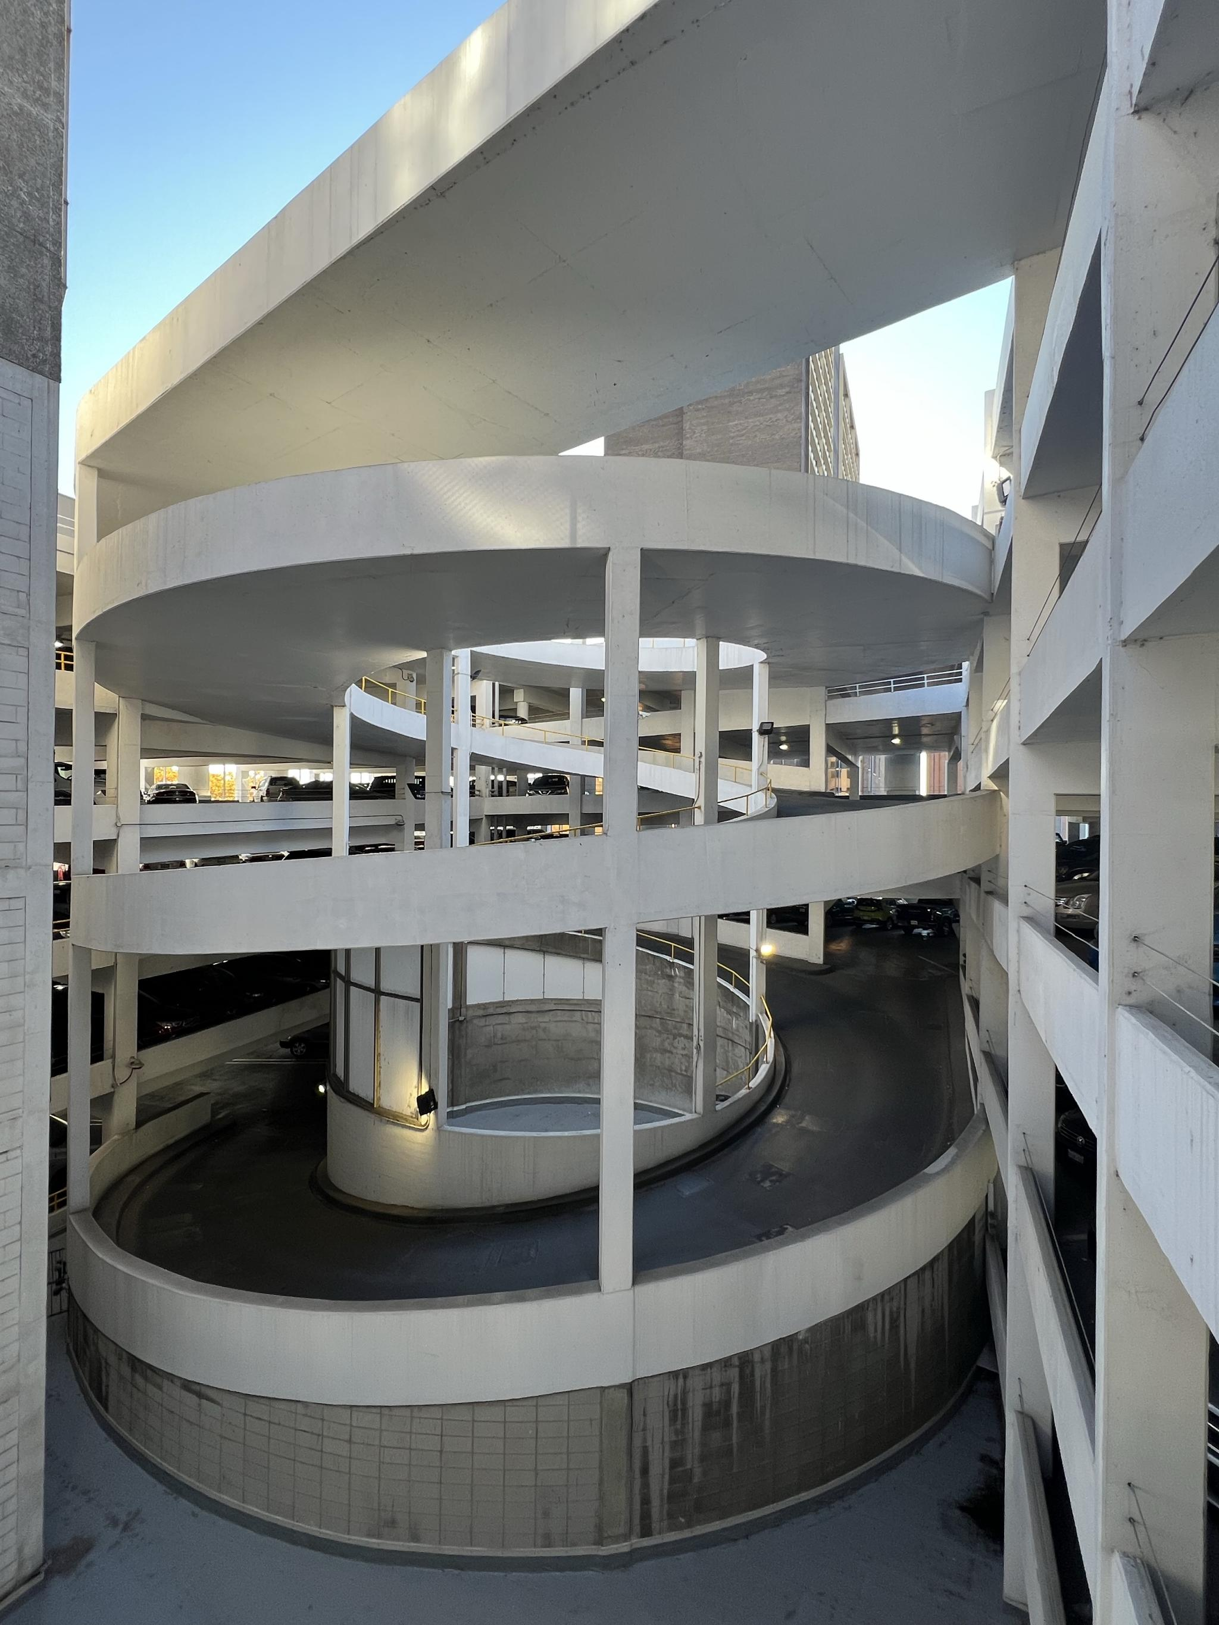
Location and Accessibility
Centrally Located Venue
  The Downtown Convention Center is centrally located, making it ideal for attendees traveling from various parts of the city.
Public Transportation Access
  The venue is easily accessible via public transportation, ensuring that all attendees can reach it with ease.
Attendee Convenience
  The prime location of the Downtown Convention Center offers convenience for attendees, enhancing their overall experience.
Notes:
The Community Days event will be held at the Downtown Convention Center, which is centrally located and easily accessible by public transportation. Its prime location ensures convenience for all attendees.

Slide 11
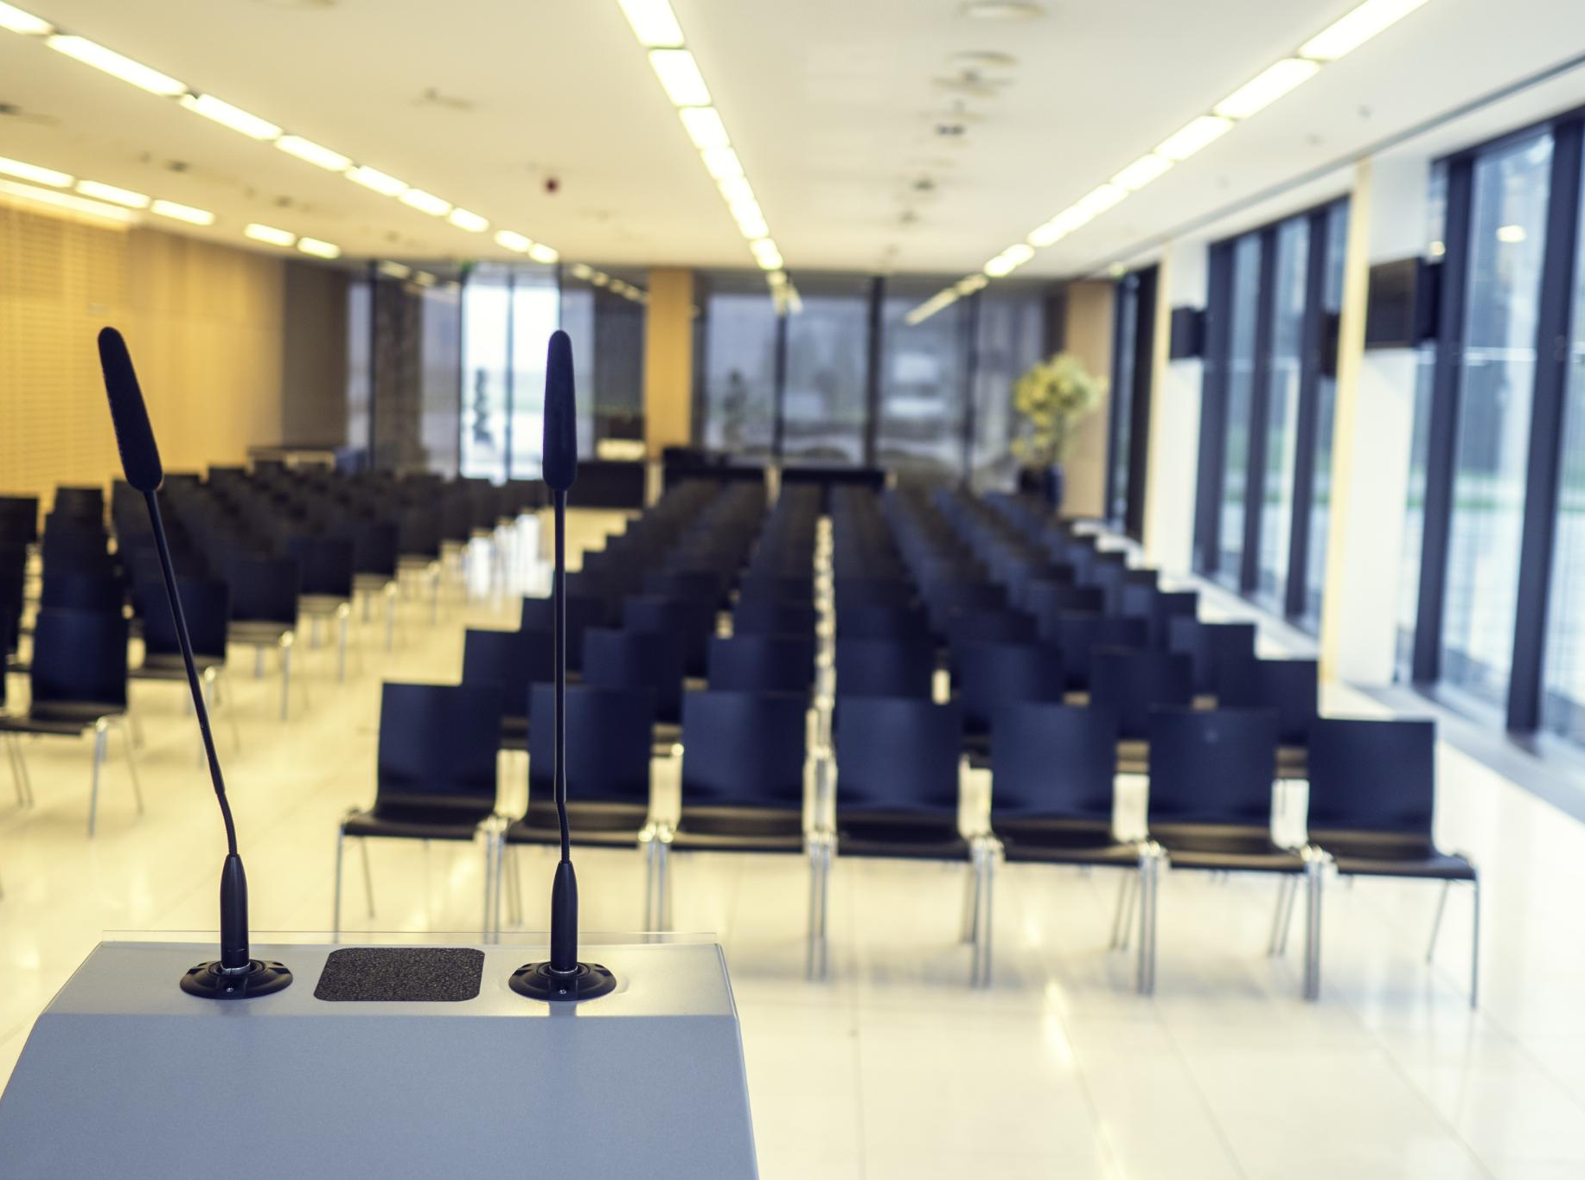
Venue Facilities and Amenities
Conference Rooms
  The venue features multiple conference rooms equipped for various sizes and types of events, ensuring flexibility for every occasion.
Audio-Visual Equipment
  State-of-the-art audio-visual equipment is available to ensure seamless presentations and engagement during events.
Catering Services
  Catering services are provided to enhance the event experience, offering a variety of food and beverage options.
Free Wi-Fi
  Complimentary Wi-Fi is available throughout the venue, ensuring all guests can stay connected during their event.
Notes:
The venue offers state-of-the-art facilities, including multiple conference rooms, audio-visual equipment, catering services, and free Wi-Fi. These amenities will enhance the overall event experience.

Slide 12

Accommodation Options Nearby
Variety of Hotels
  A range of hotels is available nearby, catering to different budgets and preferences for attendees.
Recommended Accommodations
  Attendees will receive a list of recommended accommodations that are conveniently located near the venue.
Amenities Offered
  The hotels provide various amenities such as free Wi-Fi, dining options, and fitness centers for guests.
Notes:
Several hotels are conveniently located near the venue, offering various price ranges and amenities. A list of recommended accommodations will be provided to attendees for their convenience.

Slide 13

Event Schedule
Notes:
An organized schedule is crucial for maintaining flow during the event. This section presents the daily agenda and highlights key sessions planned for attendees.

Slide 14

Day Agenda
Keynote Presentations
  Each day will feature inspiring keynote presentations from industry leaders to set the tone for the event.
Breakout Sessions
  Breakout sessions will provide opportunities for smaller group discussions and networking among attendees.
Notes:
The event will be structured into three focused days, each featuring keynotes, breakout sessions, and interactive workshops designed to engage the community and foster learning.

Slide 15
Overall Schedule

Slide 16

Session Breakdown and Timings
Designated Time Slots
  Each day will feature specific time slots for various sessions, enhancing the organization of the event.
Effective Participation
  With a structured schedule, attendees can efficiently plan their participation according to their interests.
Comprehensive Experience
  This organized approach ensures all attendees have a comprehensive experience throughout the event.
Notes:
Each day will include designated time slots for different sessions, allowing attendees to plan their participation effectively. This structured approach ensures a comprehensive experience.

Slide 17

Networking and Social Events
Networking Opportunities
  Networking opportunities will facilitate valuable connections among attendees, enhancing professional relationships.
Collaboration Promotion
  The events will encourage collaboration by allowing participants to share ideas and experiences in a relaxed setting.
Social Engagement
  Social events will create a friendly atmosphere where attendees can unwind and build connections outside formal sessions.
Notes:
In addition to educational sessions, networking opportunities and social events will be integrated into the schedule, promoting connection and collaboration among attendees.

Slide 18

Featured Speakers
Notes:
The success of the event will be highlighted by the expertise of our featured speakers. This section will introduce the keynote and guest speakers and their respective topics.

Slide 19

Keynote Speakers
Leaders in Their Fields
  Our keynote speakers are recognized leaders who excel in their areas of expertise, bringing valuable insights to the event.
Inspiring Talks
  Each speaker is prepared to deliver inspiring talks that will motivate and engage our audience, fostering impactful conversations.
Aligning with Event Themes
  The themes of the talks will resonate with our event's goals, ensuring relevance and engagement for attendees.
Insert name and bio of speakers
Notes:
We are excited to announce our keynote speakers, who are leaders in their respective fields and will deliver inspiring talks that resonate with our audience and align with the event's themes.

Slide 20

Guest Speakers and Panelists
Diverse Perspectives
  Our guest speakers bring a wide range of experiences, providing unique insights into various topics.
Dynamic Discussions
  Panelists will foster engaging conversations, encouraging audience participation and interaction.
Insights and Experiences
  Speakers will share their personal insights and experiences, enriching the overall learning experience.
Notes:
In addition to the keynote speakers, we will have a diverse group of guest speakers and panelists sharing their insights and experiences, fostering dynamic discussions throughout the event.

Slide 21

Speaker Biographies and Topics
Wealth of Knowledge
  Attendees will gain valuable insights from the wealth of knowledge shared by our experienced speakers during the sessions.
Diverse Topics Covered
  The sessions will cover a wide range of topics, ensuring a comprehensive learning experience for all attendees.
Engaging Speaker Biographies
  The detailed biographies of our speakers will highlight their expertise and the rich experiences they bring to the event.
Notes:
Detailed biographies of our speakers, along with the topics they will cover, will be provided to give attendees a glimpse into the wealth of knowledge they will gain during the sessions.

Slide 22
Session Schedule

Slide 23
Speaker List

Slide 24
Event Sponsors
Notes:
Our sponsors play a vital role in the success of the Community Days event. This section will acknowledge their contributions and detail the benefits of sponsorship.

Slide 25

List of Sponsors and Partners
Gratitude to Sponsors
  We express our sincere gratitude to the sponsors who support our event, making it possible to enhance the attendee experience.
Collaborative Partnerships
  Our partners play a crucial role in the success of our event by providing resources and expertise that enrich the experience.
Enhanced Attendee Experience
  Thanks to our sponsors and partners, we can offer a diverse range of activities and resources for all attendees.
Notes:
We are grateful to our sponsors and partners who have committed to supporting the event. Their generosity enables us to provide a rich experience for all attendees.

Slide 26
Sponsors
Sponsor Company | Contact Name | Website URL | Sponsor Level

Slide 27

Sponsorship Packages and Benefits
Diverse Sponsorship Options
  Various sponsorship packages cater to different business needs, allowing for tailored involvement in the event.
Branding Opportunities
  Sponsorship offers unique branding opportunities, allowing sponsors to showcase their brand prominently at the event.
Promotional Visibility
  Sponsors gain promotional visibility at the event, ensuring their brand reaches a wide audience of attendees.
Notes:
Various sponsorship packages are available, each offering unique benefits, including branding opportunities and promotional visibility at the event, ensuring maximum exposure for sponsors.

Slide 28

Thank You Message to Sponsors
Gratitude to Sponsors
  We extend our heartfelt thanks to our sponsors for their generous contributions and unwavering support.
Importance of Partnerships
  Our partnerships are essential for the success of the Community Days event and create lasting impacts.
Community Impact
  With the support of our sponsors, we are able to make a meaningful impact in the community.
Notes:
A heartfelt thank you to all our sponsors and partners for their contributions. Their support is invaluable to the success and impact of the Community Days event.

Slide 29

Marketing and Promotion
Notes:
Effective marketing strategies are essential for maximizing attendance and engagement. This section covers our approach to promoting the event and reaching our target audience.

Slide 30

Marketing Strategies and Channels
Email Campaigns
  Email campaigns are an effective way to directly reach potential attendees with personalized content and updates about the event.
Newsletters
  Newsletters help maintain engagement with potential attendees by providing regular updates and valuable information about the event.
Flyers
  Flyers are a traditional yet effective marketing tool to attract attention and provide information about the event in a visually appealing way.
Notes:
We will leverage multiple marketing channels, including email campaigns, newsletters, and flyers, to reach potential attendees and keep them informed about event details.

Slide 31
Marketing Schedule
Date of Publication | What | Where | Link | Notes

Slide 32

Social Media Campaigns
Engagement through Social Media
  Social media platforms will be used to actively engage with the community and promote event participation, fostering a sense of connection.
Promotional Strategy
  Our promotional strategy will focus on leveraging popular platforms like Facebook, Twitter, and Instagram to maximize outreach.
Event Participation
  Encouraging event participation through targeted posts and campaigns on various social media channels to reach a wider audience.
Notes:
Social media will be a focal point of our promotional strategy, utilizing platforms like Facebook, Twitter, and Instagram to engage with the community and encourage event participation.

Slide 33
Social Media Channels
Channel | Account | Owner | Notes
Facebook
Twitter
LinkedIn
Instagram
Threads
TikTok
Other

Slide 34

Engaging the Community and Attendees
Pre-Event Engagement
  Engaging the community before the event helps to create anticipation and gather valuable insights from potential attendees.
Interactive Content During Event
  Implementing interactive content during the event encourages participation and enriches the attendee experience.
Feedback Opportunities Post-Event
  Gathering feedback after the event is essential to understand community impact and improve future events.
Notes:
Engagement with the community is key to the event's success. We will implement strategies to involve attendees before, during, and after the event through interactive content and feedback opportunities.

Slide 35
Conclusion
Enriching Experience
The Community Days event aims to provide an enriching experience for all attendees, enhancing personal and professional growth.
Diverse Voices
Bringing together diverse voices is vital for collaboration, creativity, and innovation during the event.
Fostering Collaboration
The event encourages collaboration among attendees, promoting networking and knowledge sharing.
Notes:
The Community Days event promises to be an enriching experience, bringing together diverse voices and fostering collaboration. We look forward to welcoming attendees and making this event a memorable one.

