Slide 1


We will get started at 10 min after the hour
Grab a refreshment!
Event Organizer Training and Office Hours
April 24, 2025

Slide 2


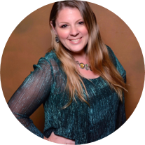
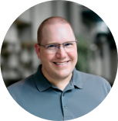

Microsoft Global Community Initiative general session
April 2025
Hosts: Sharon Weaver & Wes Preston

Slide 3
AGENDA Feb 27 2025
Introductions
Topic: Event Venues
Open Q&A
Ask Me Anything
Notes:
Other potential Topics:
NDA Updates - Onboarding Next steps
VOC Topic - Organizer Toolkit assets discussion
Regional Community Support – How to engage regional leads

Slide 4
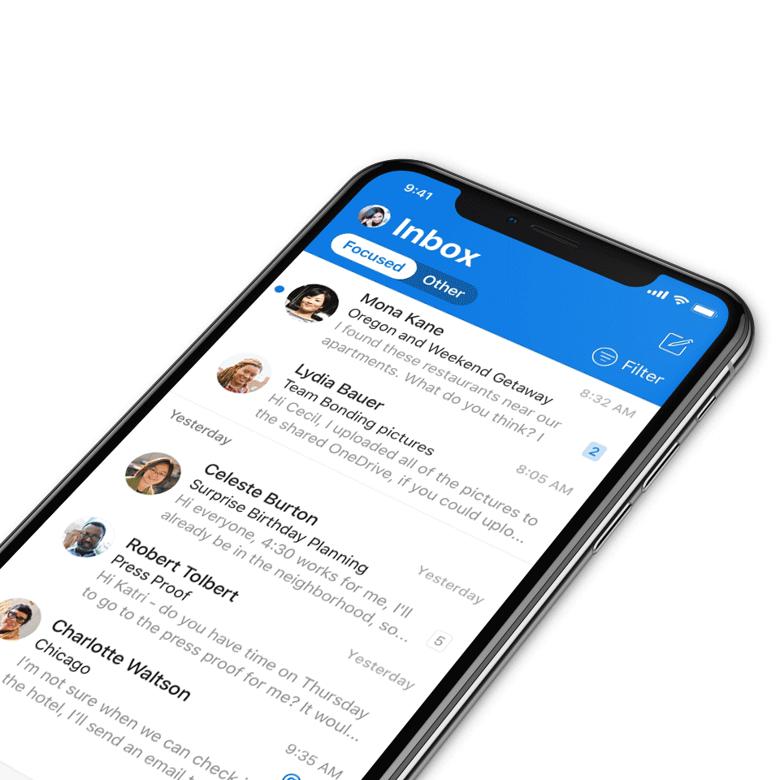
Digital Event Code of Conduct
Microsoft’s mission is to empower every person and every organization on the planet to achieve more. This includes all Microsoft events and gatherings, including on digital platforms, where we seek to create a respectful, friendly, fun and inclusive experience for all participants.​
We expect all digital event participants to uphold the principles of this Code of Conduct, which covers the main digital event and all related activities. We do not tolerate disruptive or disrespectful behavior, messages, images, or interactions by any party participant, in any form, at any aspect of the program including business and social activities, regardless of location.​
Microsoft will not tolerate harassment or discrimination based on age, ancestry, color, gender identity or expression, national origin, physical or mental disability, religion, sexual orientation, or any other characteristic protected by applicable local laws, regulations, and ordinances.​
We encourage everyone to assist in creating a welcoming and safe environment.
For more info, click here.

Slide 5

Mission
The Microsoft Global Community Initiative (MGCI) features event amplification, event production training, blogs, networking, technology and tools best practices, resources, playbooks, and more for the Microsoft Community.
Join MGCI today! https://aka.ms/MGCI

Slide 6

Introductions
Introduce yourself in chat!
What’s your name?
Where are you from?
What events do you work on?
What’s the link to your LinkedIn profile?
Notes:
Other potential Topics:
NDA Updates - Onboarding Next steps
VOC Topic - Organizer Toolkit assets discussion
Regional Community Support – How to engage regional leads

Slide 7
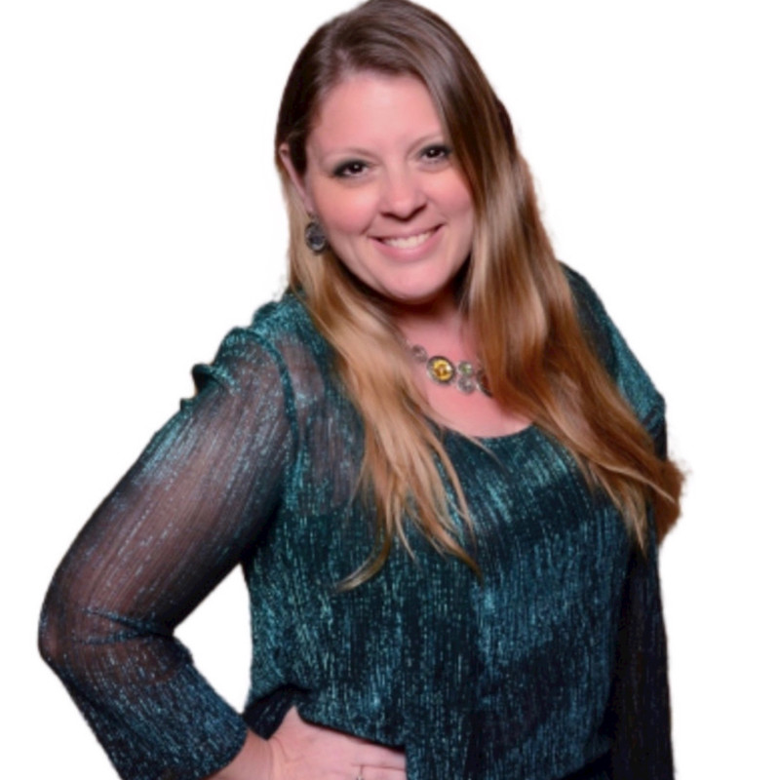
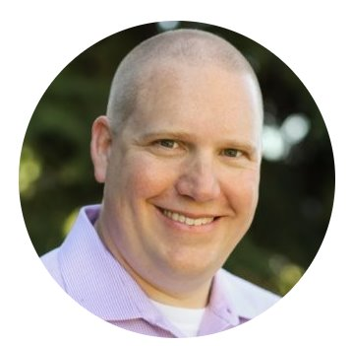
Meet your trainers
Sharon Weaver
Founder, CEO Smarter Consulting
Microsoft RD | MVP | MCT
Primary Event:
CollabCon - https://www.collabconforall.com/
Sharon Weaver | LinkedIn
Wes Preston
Minneapolis, MN
Owner, TrecStone
Primary event:
M365 Saturday - Twin Cities (m365tc.com)
Wes Preston | LinkedIn
Notes:
Other potential Topics:
NDA Updates - Onboarding Next steps
VOC Topic - Organizer Toolkit assets discussion
Regional Community Support – How to engage regional leads

Slide 8
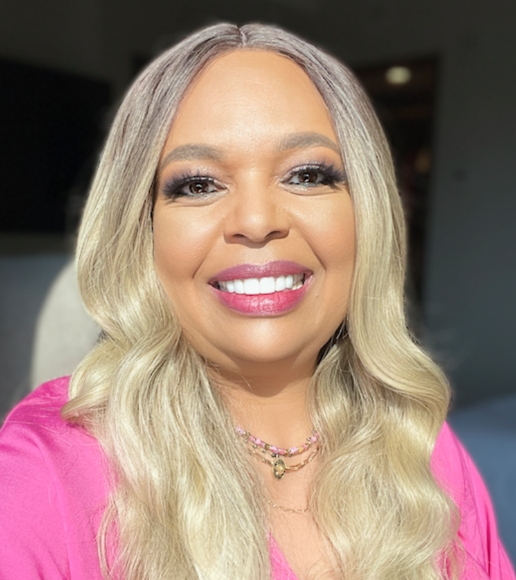
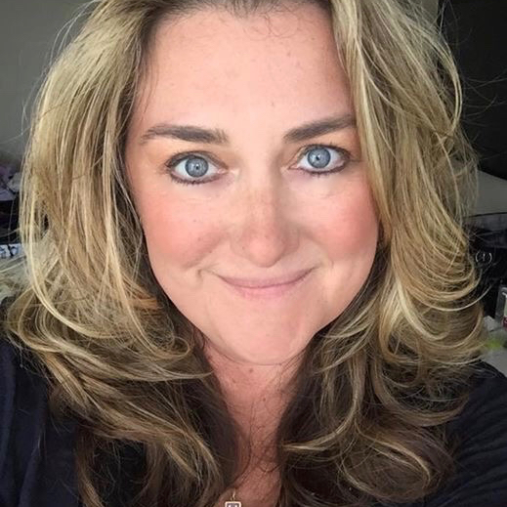
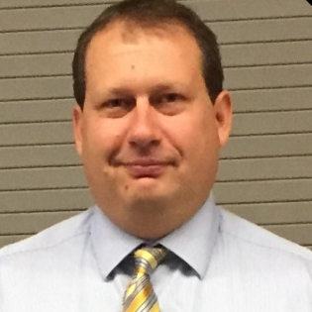
Meet the Microsoft Team
Karuana Gatimu
Community Lead
Olympia, Washington
Phoenix, AZ
Karuana Gatimu | LinkedIn
Heather Cook
Community Manager
Marina del Rey, CA
Heather (Heather Newman) Cook | LinkedIn
Bryan Hart
Technology Lead
Shoreline, WA
Bryan Hart | LinkedIn
Notes:
Other potential Topics:
NDA Updates - Onboarding Next steps
VOC Topic - Organizer Toolkit assets discussion
Regional Community Support – How to engage regional leads

Slide 9
Topic -
Securing Space: A Practical Guide to Booking & Event Venues

Slide 10
Venue Cost
Free, if possible. Otherwise, as cost effective as possible…
Options
  Microsoft facilities
  Vendor spaces
  Community Colleges, Universities
  Convention spaces - $$$

Slide 11
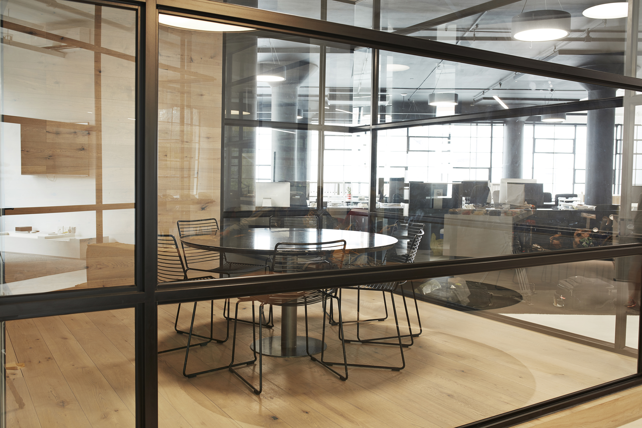
Request event venue support
Event producers for free Community Days events can request the use of a Microsoft office via this form.
Space will be requested by Heather Cook and you will need a local full time Microsoft employee to be an onsite contact. Spaces are limited depending on dates.
Weekdays only for requests, Microsoft offices are no longer staffed on the weekends.
There are charges to be covered by the event producer depending on the office: security, catering, extended AV, air conditioning.
https://aka.ms/MGCI/MSOffice/VenueRequest

Slide 12
What’s included
… What requires additional cost
  Tables and covers
  Internet connectivity
  Projectors, screens, microphones, easels
  Signage, where can you hang stuff on walls…

Slide 13
Insurance
Do you need insurance, where to look, how much it costs, etc.
Get requirements from venues – This is standard for them
Ask what factors affect pricing. If you purchase for 2 yrs worth, it can be less expensive per event

Slide 14
Right-sizing
Number and size (capacity) of rooms
How many folks can the venue support
How many sessions can it support
Do you need classroom PCs
Don’t forget a speaker room and storage…
Note: As your event matures, might consider fewer rooms (fewer options for attendees) to keep audience sizes up for speakers…

Slide 15
Other Considerations
Food:
  Do they require using their food ($$$)?
  Can you bring in food?
  Availability of off-site dining options
Parking $$
Transit convenience (bus lines, light rail, etc.)
Staffing: IT, catering, security, etc.
Getting in pre-event to set up.
Lockable rooms

Slide 16

Request Community Amplification
Looking for help amplifying your event via Microsoft Community LinkedIn and MSFT Adoption twitter handle?
Fill out this form:
https://aka.ms/communitysocial
The SLA is 3 business days.
Microsoft Global Community Initiative https://aka.ms/MGCI

Slide 17
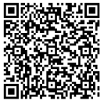
We want your feedback!
https://aka.ms/MGCIFeedback

Slide 18

Q&A

Slide 19

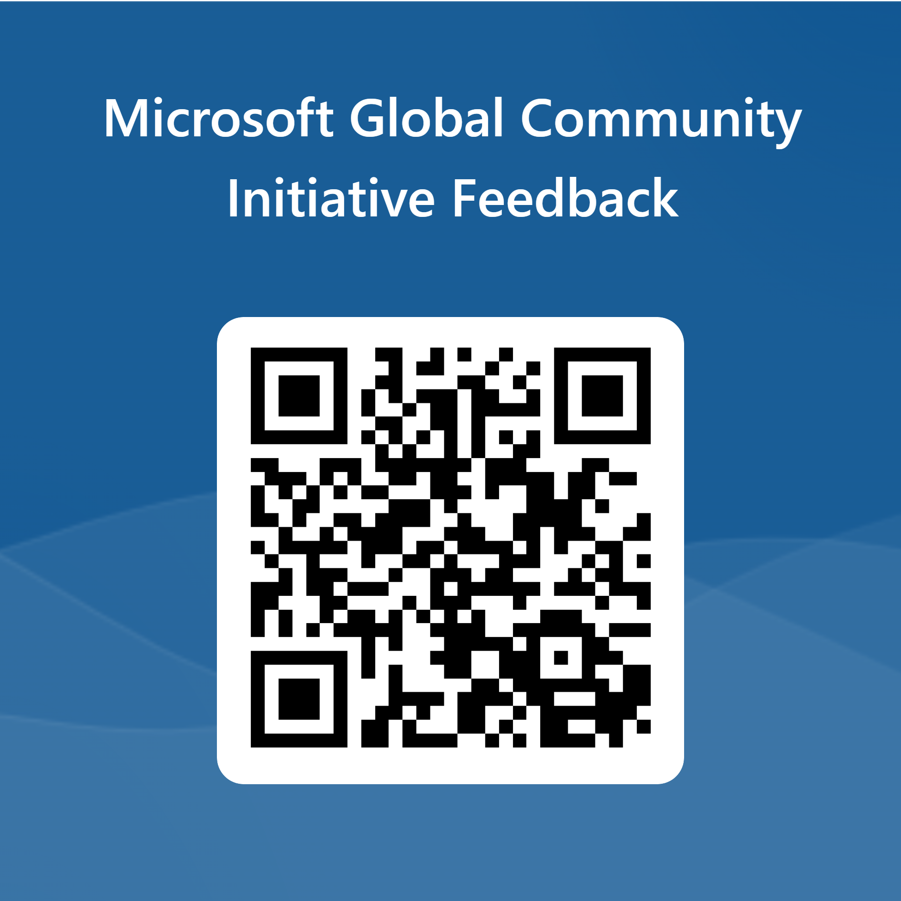
Love your feedback on this meeting
https://aka.ms/MGCIMeetingFeedback

Slide 20
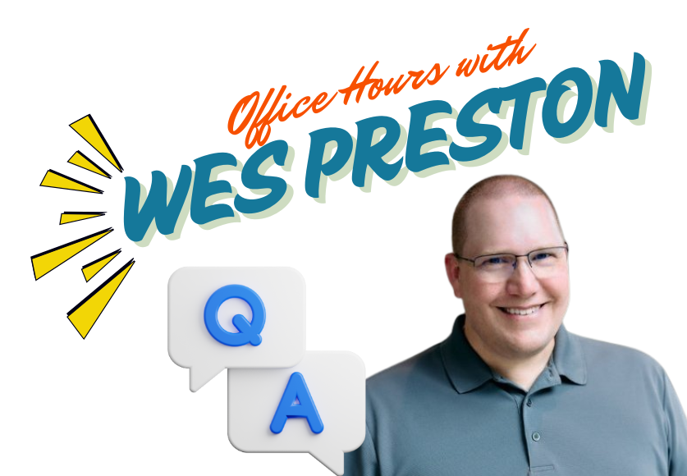
Training Workstream Update
UPCOMING EVENTS
Date | Presenter | Topic
May 29 | Panel | Venues & Event Insurance
Jun 26 | Panel | Committee Roles & Responsibilities
Jul 31 | Panel | Speaker Selection
Aug 28 | NO MEETING | SUMMER BREAK
Sep 25 | Panel | Graphics & Branding
Oct 30 | Panel | Marketing & Social Media
Nov 27 | NO MEETING | HOLIDAY BREAK
Dec 25 | NO MEETING | HOLIDAY BREAK
Please join us for our monthly MGCI Event Training meeting.​
​
When: 4th Thursday of the month 8:10am PT.
After the presentation stick around for...

Slide 21
MGCI Event Training Monthly Topics
Date | Presenter | Topic
Jan 30 | Sharon Weaver | Event Planning 101
Feb 27 | Tom Daly | CommunityDays.org
Mar 27 | TBD | Sponsors
Apr 24 | TBD | Venue & Event Insurance
May 29 | TBD | Committee Roles & Responsibilities
Jun 26 | TBD | Speaker Selection
Jul 31 | TBD | Communications Planning
Aug 28 | NO MEETING | SUMMER BREAK
Sep 25 | TBD | Graphics & Branding
Oct 30 | TBD | Marketing & Social Media
Nov 27 | NO MEETING | HOLIDAY BREAK
Dec 25 | NO MEETING | HOLIDAY BREAK
Please join us for our monthly MGCI Event Training meeting.
When: 4th Thursday of the month 8:10am PT.
Training & Office Hours – Topics ​​
New presented topics list pinned to channel​
Links to decks and recordings ​
List of potential upcoming topics

Slide 22
MGCI General Sessions – The Third Tuesday of the Month
Learn from your peers and get updates on the MGCI program!
3rd Tuesday of every month at 8:10 AM and 5:10 PM Pacific Time.
https://aka.ms/MGCIMtgAM
https://aka.ms/MGCIMtgPM
All MGCI General Sessions and Event Training Sessions will be available on-demand on the
Microsoft Community Learning YouTube Channel: https://aka.ms/community/learning
Date | Presenter | Topic
Jan 30 | Tim Balk | Event Planning 101
Feb 27 | Michal Ziemba | Automate Your Events
March 18 | Pat McGown | Amplify Your Events
April 15 | Adam Salah | Microsoft Loop for Content Creation & Event Production
May 20 | TBA | TBA
June 17 | Tim Balk | Unconventional Ways to Promote Community Events
July 15 | Oluwaseyi Oluwawumiju | Thriving Against the Odds: Building a Formidable Community in Unfavorable Environments
Sep 16
Oct 21
Nov 18
Dec 25 | NO MEETING | HOLIDAY BREAK
Microsoft Global Community Initiative https://aka.ms/MGCI

Slide 23

MGCI General Sessions – The Third Tuesday of the Month
Want to share best practices or lessons learned on producing events or building community in an upcoming session?
Fill out this form:
https://aka.ms/GeneralSessionGuest
We are looking for a speakers for the rest of 2025!
Microsoft Global Community Initiative https://aka.ms/MGCI

Slide 24
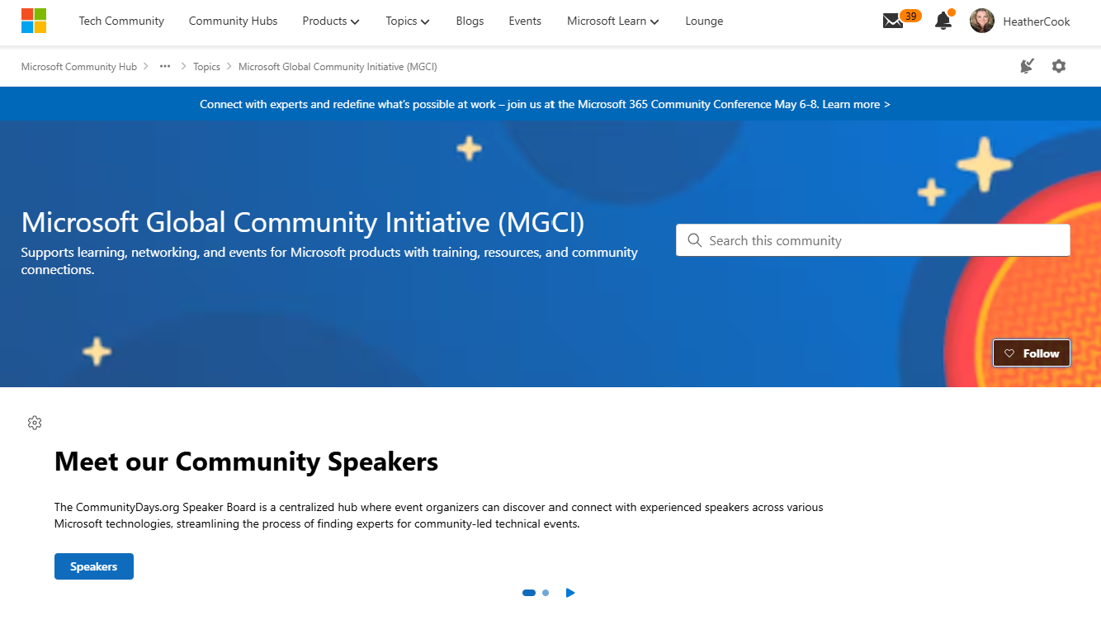
MGCI on MTC
https://aka.ms/MGCICommunityHub
Microsoft Global Community Initiative https://aka.ms/MGCI

Slide 25
Lessons Learned

Slide 26
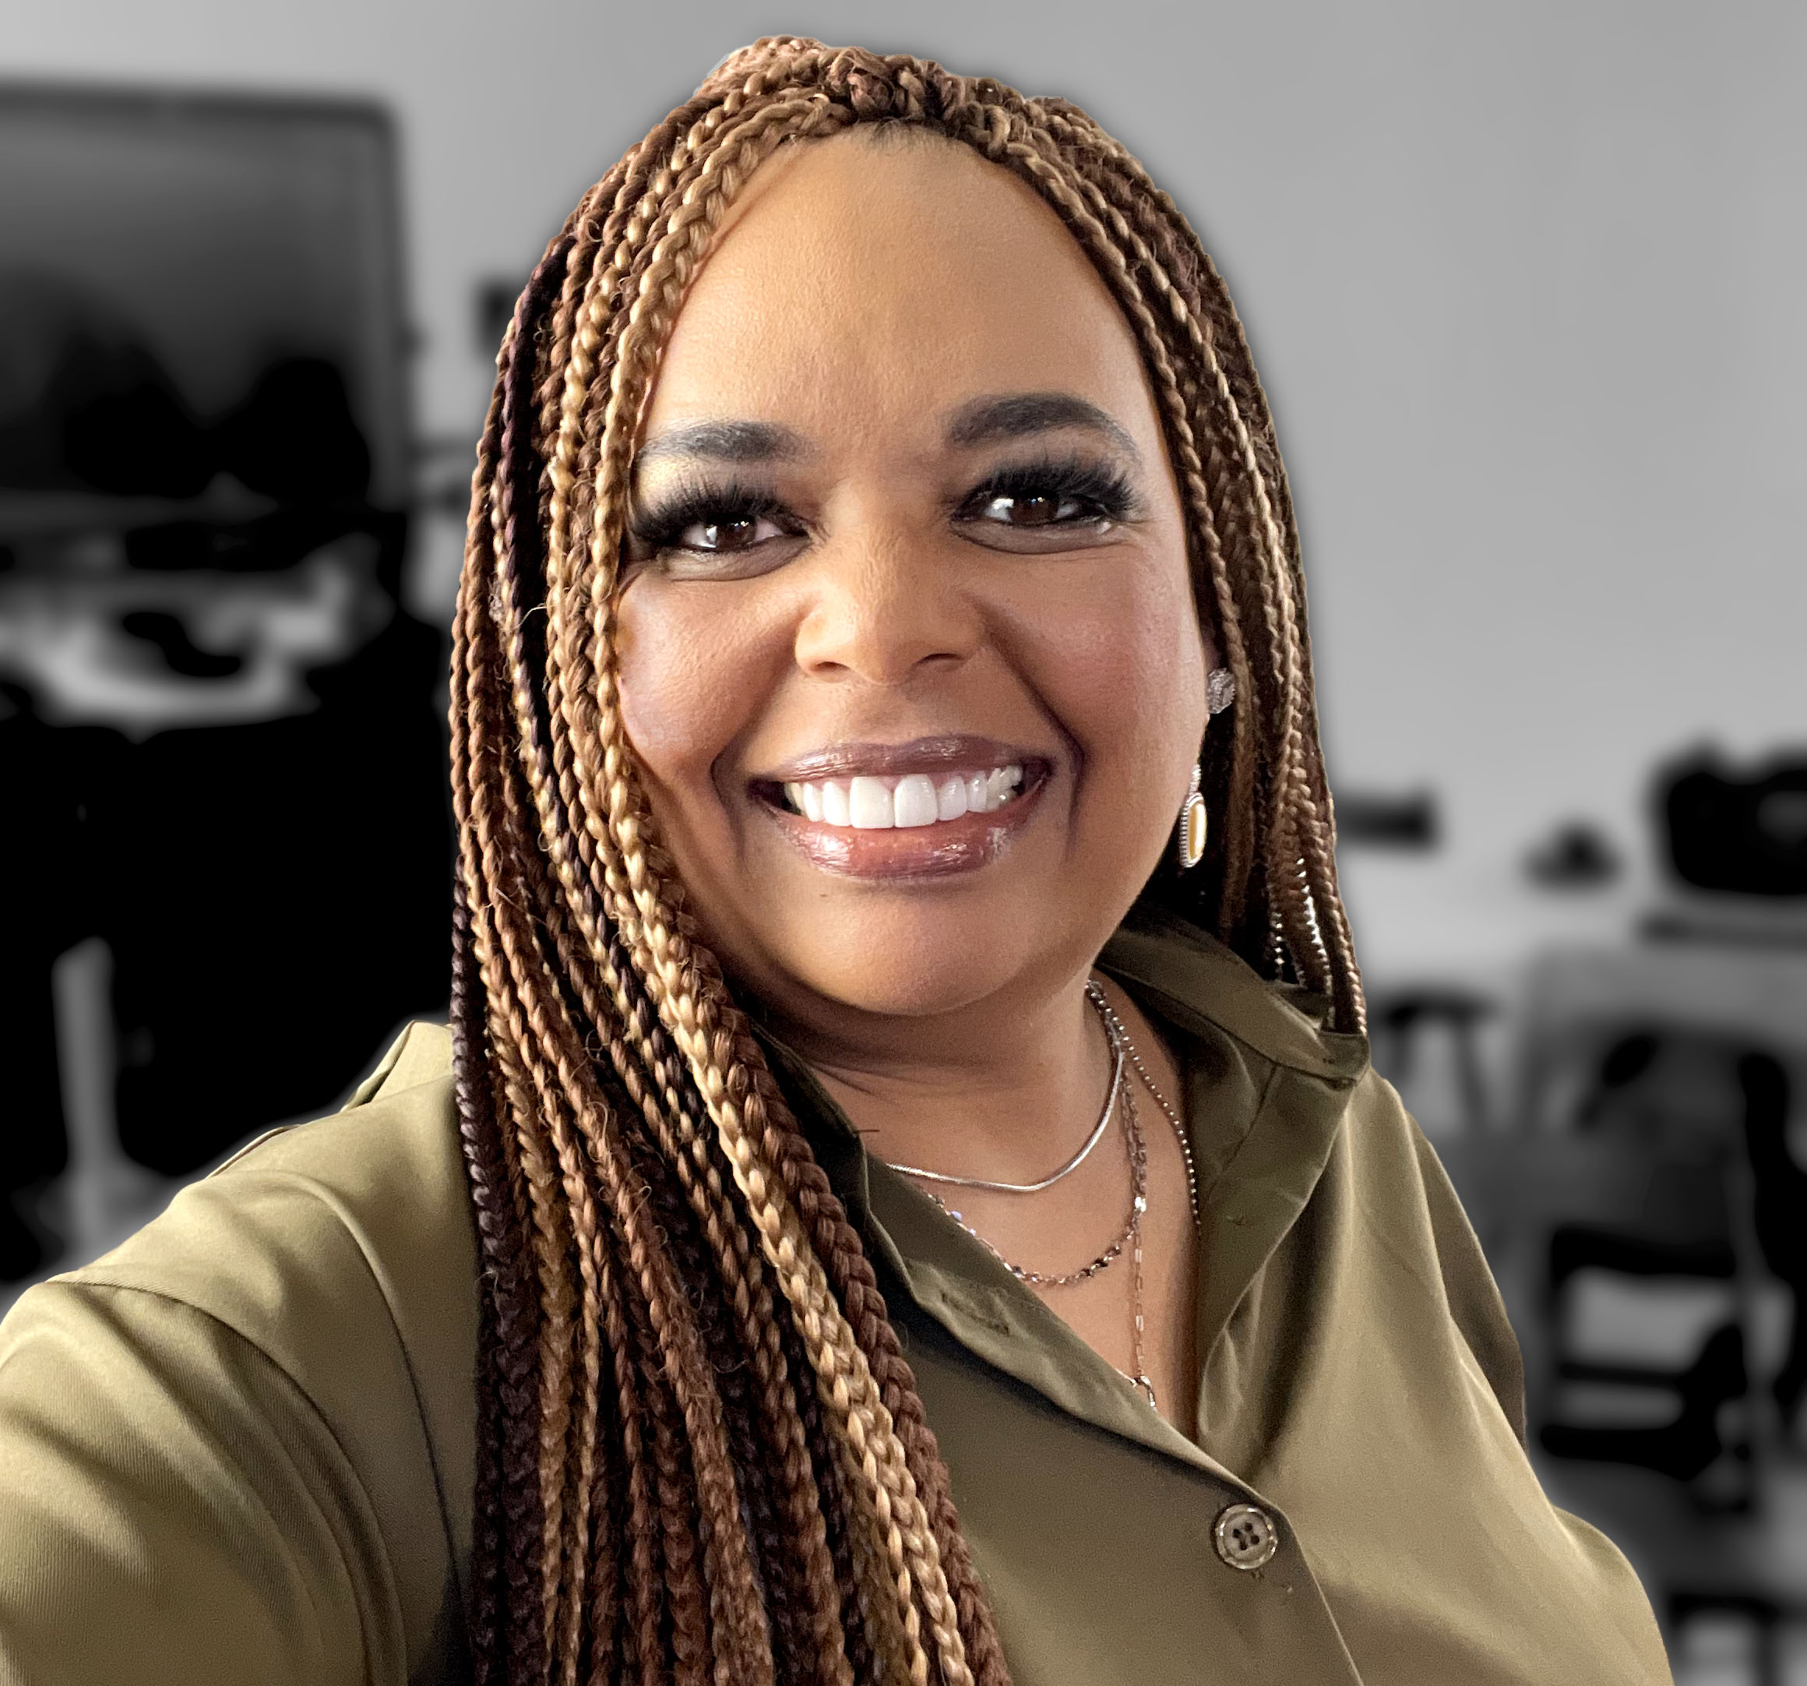

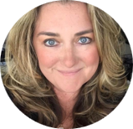

Monday’s at Microsoft
with Karuana & Heather
Karuana Gatimu
Learn - Explore – Connect In the Microsoft Community
Bi-weekly @ 8am PT
Watch on
Microsoft Community Linked
Heather Cook
https://aka.ms/microsoftcommunitylinkedin
Notes:
Last used May 2023, Heather Cook

Slide 27



Stay Connected!
Engage with the best community in tech…
There’s something for everyone!
Microsoft Tech Community
The community platform for Microsoft 365 – forums, blogs, and events
aka.ms/joinMTC
CommunityDays.org
Find or host a local event in your area
or to match your interests
Microsoft Community on LinkedIn
News, announcements and training delivered to your news feed aka.ms/microsoftcommunitylinkedin

Slide 28
Thank you!

