Slide 1


We will get started at 10 min after the hour
Grab a refreshment!
Event Organizer Training and Office Hours
Oct 30, 2025

Slide 2

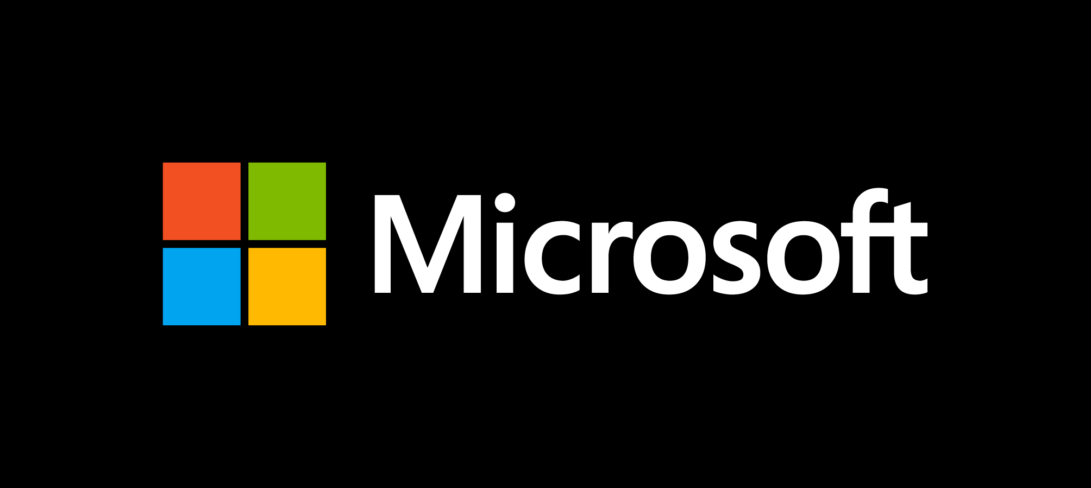
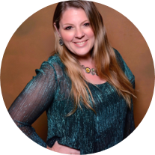
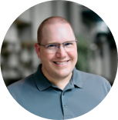
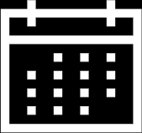
Microsoft Global Community Initiative Event Organizer Training and Office Hours
October 2025
Hosts: Sharon Weaver & Wes Preston
Guest Star: Christian Buckley

Slide 3
AGENDA
Introductions
Event Training: Marketing & Social Media
Ask Me Anything
Notes:
Other potential Topics:
NDA Updates - Onboarding Next steps
VOC Topic - Organizer Toolkit assets discussion
Regional Community Support – How to engage regional leads

Slide 4
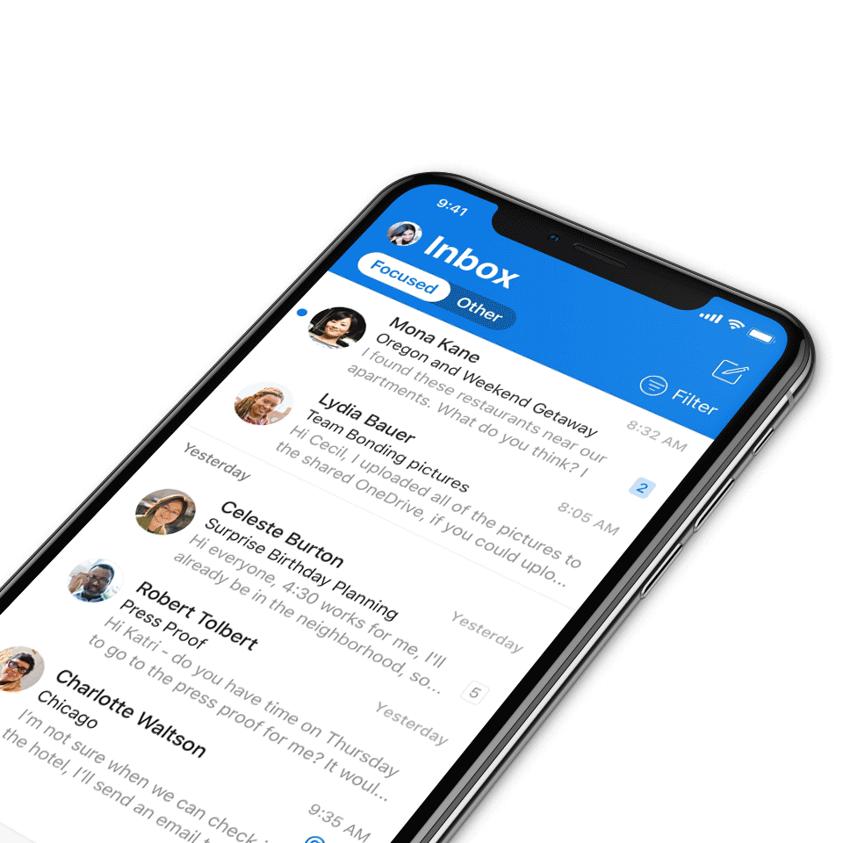
Digital Event Code of Conduct
Microsoft’s mission is to empower every person and every organization on the planet to achieve more. This includes all Microsoft events and gatherings, including on digital platforms, where we seek to create a respectful, friendly, fun and inclusive experience for all participants.​
We expect all digital event participants to uphold the principles of this Code of Conduct, which covers the main digital event and all related activities. We do not tolerate disruptive or disrespectful behavior, messages, images, or interactions by any party participant, in any form, at any aspect of the program including business and social activities, regardless of location.​
Microsoft will not tolerate harassment or discrimination based on age, ancestry, color, gender identity or expression, national origin, physical or mental disability, religion, sexual orientation, or any other characteristic protected by applicable local laws, regulations, and ordinances.​
We encourage everyone to assist in creating a welcoming and safe environment.
For more info, click here.

Slide 5

Mission
The Microsoft Global Community Initiative (MGCI) features event amplification, event production training, blogs, networking, technology and tools best practices, resources, playbooks, and more for the Microsoft Community.
Join MGCI today! https://aka.ms/MGCI

Slide 6

Introductions
Introduce yourself in chat!
What’s your name?
Where are you from?
What events do you work on?
What’s the link to your LinkedIn profile?
Notes:
Other potential Topics:
NDA Updates - Onboarding Next steps
VOC Topic - Organizer Toolkit assets discussion
Regional Community Support – How to engage regional leads

Slide 7
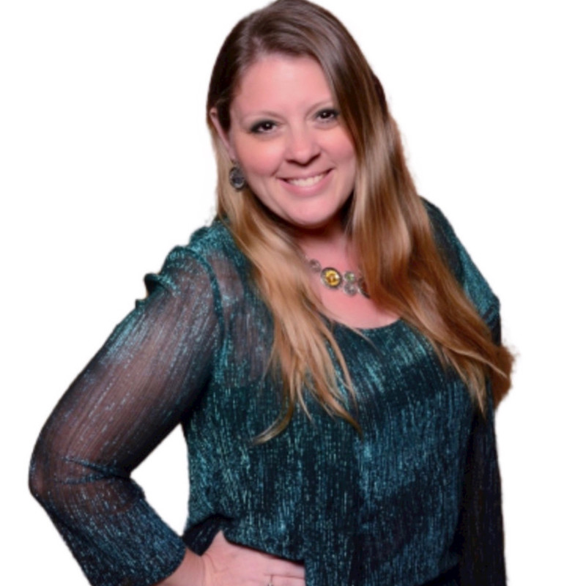
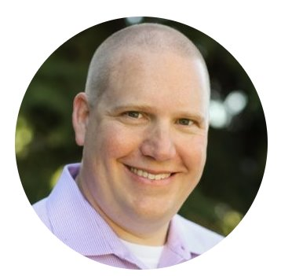
Meet your trainers
Sharon Weaver
Founder, CEO Smarter Consulting
Microsoft RD | MVP | MCT
Primary Event:
CollabCon - https://www.collabconforall.com/
Sharon Weaver | LinkedIn
Wes Preston
Minneapolis, MN
Owner, TrecStone
Primary event:
M365 Saturday - Twin Cities (m365tc.com)
Wes Preston | LinkedIn
Notes:
Other potential Topics:
NDA Updates - Onboarding Next steps
VOC Topic - Organizer Toolkit assets discussion
Regional Community Support – How to engage regional leads

Slide 8
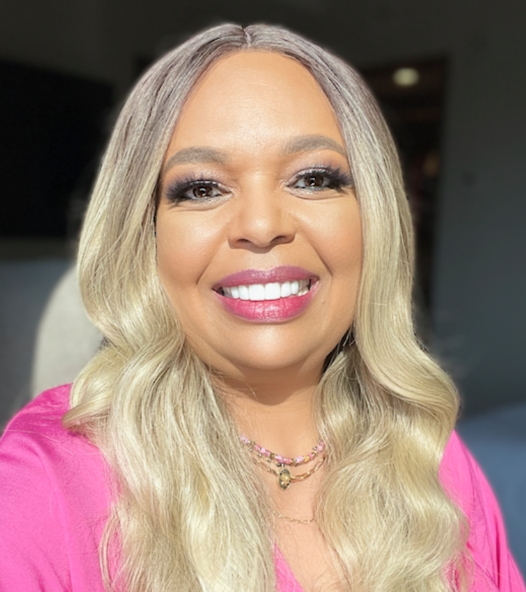
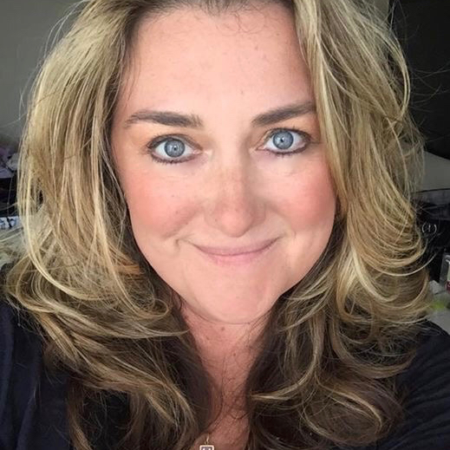
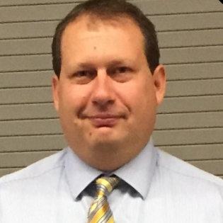
Meet the Microsoft Team
Karuana Gatimu
Community Lead
Olympia, Washington
Phoenix, AZ
Karuana Gatimu | LinkedIn
Heather Cook
Community Manager
Marina del Rey, CA
Heather (Heather Newman) Cook | LinkedIn
Bryan Hart
Technology Lead
Shoreline, WA
Bryan Hart | LinkedIn
Notes:
Other potential Topics:
NDA Updates - Onboarding Next steps
VOC Topic - Organizer Toolkit assets discussion
Regional Community Support – How to engage regional leads

Slide 9
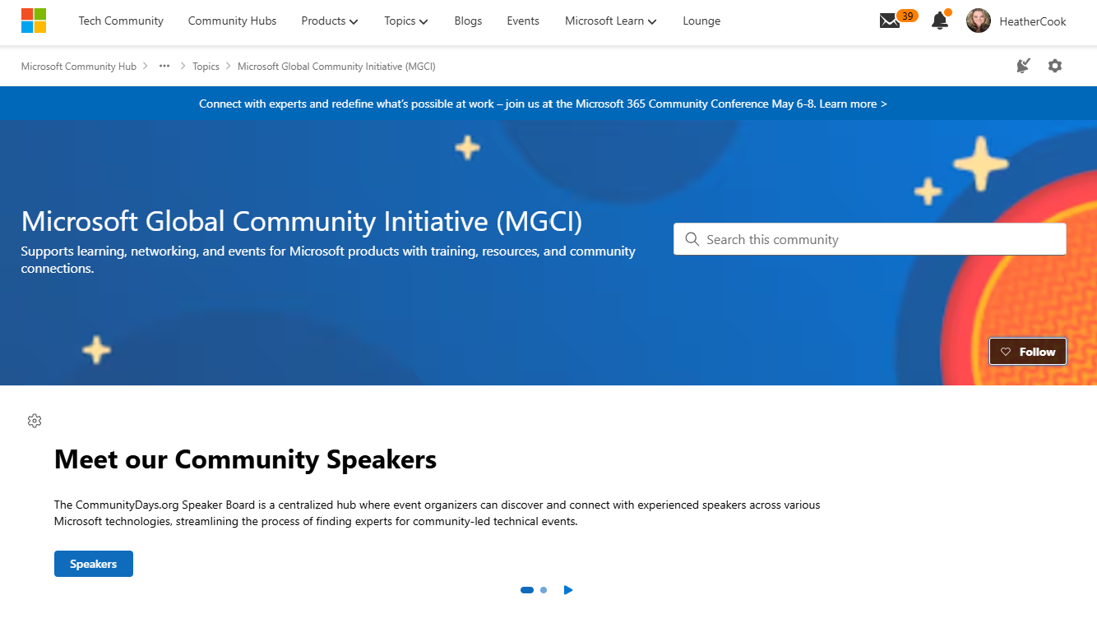
MGCI on MTC
https://aka.ms/MGCICommunityHub
Microsoft Global Community Initiative https://aka.ms/MGCI

Slide 10
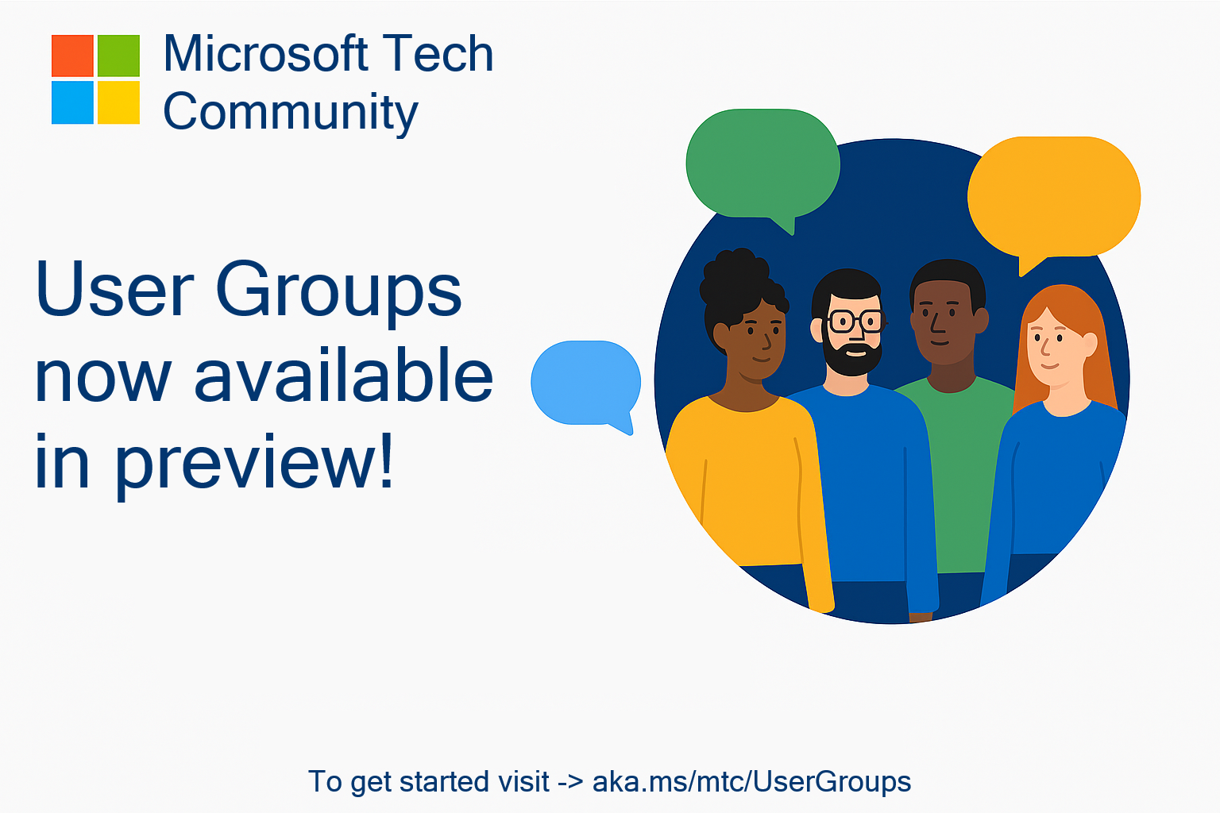
🥳 User Groups on Microsoft Tech Community
Connecting Communities. Empowering Collaboration.
Introducing Tech Community User Groups
User Groups are a new feature currently in preview on the Microsoft Tech Community – fully launching by end of September, designed to bring together individuals with shared interests, roles, or technologies, and enable deeper collaboration, discussion, and learning.
Join the Preview Today
Next Steps:
Visit https://aka.ms/mtc/usergroups
Sign in with your Microsoft account to participate
Browse available groups or select create a new user group to start your own!
Share feedback to help shape the future of User Groups

Slide 11
Topic -
Marketing and Social Media
With Christian Buckley

Slide 12

5 Ways to Promote Your Community Events

Slide 13
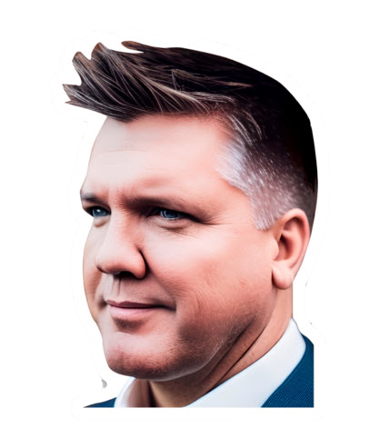


Email: Christian.Buckley@Smarter-Consulting.com
Blog: buckleyplanet.com
Twitter: @buckleyplanet
LinkedIn: /christianbuckley
YouTube: /@buckleyplanet
Some of my community activities:
Weekly interviews on technology, business productivity, and collaboration culture (#CollabTalk Podcast)
Weekly livestream on project management best-practices (#ProjectFailureFiles)
Weekly interviews with Microsoft MVPs (#MVPbuzzChat)
Monthly livestream of the Guardians of M365 Governance (#GoM365gov) covering all-things governance
Multiple posts each month with a panel of experts answering community questions (#M365AMA)
Christian Buckley
Author, Podcaster, MBA
Dallas, Texas

Slide 14
#1
Define
Your Value Proposition
If you can’t explain why someone should attend, no amount of promotion will fix it. Define and communicate your value proposition. Spell out the specific benefits attendees and sponsors gain.
Clarify the Purpose: What problem are you solving or opportunity are you creating?
  “Learn something new” isn’t enough. Instead: “Discover practical AI use cases for small businesses.”
Articulate 3–4 Clear Takeaways: Be explicit about what attendees will walk away with: skills, insights, or relationships.
Craft a ‘Why Attend’ Statement: One strong sentence you can repeat everywhere.
  For example: “In one evening, you’ll learn how to automate tasks, meet local experts, and leave with tools you can use tomorrow.”
Align Everything: Your event title, description, speakers, and sponsor outreach should reinforce those takeaways.
Sponsor Value: If attendee value is fuzzy, sponsor value will be too. Be sure to connect the two.
Reality Check: Ask someone outside your community to read your event post. Do they understand the value instantly?
Remember: Write your promo materials after you’ve nailed the takeaways, not before.
Lead with the “Why,”
not the date.

Slide 15
#2
Activate Your Advocates
Your most effective promotion doesn’t come from your account, but from believers sharing their enthusiasm.
Identify Your Ambassadors:
  Past attendees who loved the experience.
  Speakers, sponsors, or volunteers with followings.
  Local community connectors and superusers.
Create Easy “Share Packs”:
  Pre-written posts, event graphics, hashtags, registration links.
  Make it frictionless to promote.
Encourage Authenticity: Ask advocates to share why they care, not just copy-paste.
Recognize & Reward:
  Public shout-outs on social media.
  Special seating, early access, or post-event thank-you notes.
Involve Sponsors:
  Give them co-branded content and sample posts.
  Let them highlight why they’re supporting your community.
Keep Momentum After the Event:
  Post quotes, photos, and testimonials featuring advocates.
Remember: You don’t need influencers, just enthusiasts with networks.
Your members are
your marketing team.

Slide 16
#3:
Show,
Don’t Tell
People engage with people — not posters. Visual storytelling builds connection, excitement, and trust.
Feature Faces, Not Logos:
  Short 30–60 sec clips from speakers or organizers.
  “Here’s what I’m sharing next week. Hope to see you there!”
Behind-the-Scenes Content:
  Setup day, first arrivals, the human side of event prep.
  Builds anticipation and authenticity.
Countdown or Teaser Series:
  “3 days to go! Here’s one session we’re excited about.”
  Mix info, enthusiasm, and energy.
After the Event:
  Highlight reels, short testimonials, visual recaps, or quote graphics.
Design Tools:
  Canva, Clipchamp, CapCut, and OpusClip are all simple and effective.
Accessibility:
  Always use captions, alt text, and @mentions. Inclusion grows reach.
Remember: A genuine smile on a phone video outperforms a perfect flyer.
Make it human and focus on the visual.

Slide 17
#4:
Plan the Promotion Journey
Good promotion isn’t a single post. It’s a planned sequence that builds awareness and anticipation.
Map Out a Timeline:
  4 Weeks Out: Announce date, topic, and clear value proposition.
  2 Weeks Out: Speaker spotlight or key session teaser.
  1 Week Out: Logistics, giveaways, or Q&A reminder.
  2 Days Out: Direct, personal invitation.
  Day After: Thank-you + recap + “next event” teaser.
Use Multiple Channels:
  LinkedIn for visibility, Facebook/Meetup for reach, email for conversions.
  Eventbrite, Microsoft Tech Community, or local calendars for discoverability.
Automate & Schedule:
  Buffer, Hootsuite, Teams posts, or even Viva Amplify.
  Batch content once, schedule it everywhere.
Track & Learn:
  Monitor registrations, engagement, and what content drives clicks.
  Save what works as a repeatable playbook for next time.
Remember: Your reputation grows between events. Post light updates year-round.
Be consistent & build momentum over time.

Slide 18
#5
Expand Beyond the Tech Bubble
Don’t market only to people already in your space. Partner with civic, educational, and local organizations that can amplify your reach.
Partner With Education:
  Community colleges, universities, and tech programs.
  Co-host sessions, offer mentorship, or share your event through student networks.
Engage Local Civic Groups:
  City innovation boards, chambers of commerce, libraries, and workforce orgs.
  Ask them to include your event in newsletters or host a joint workshop.
Collaborate With Non-Tech Audiences:
  Entrepreneurs, small businesses, civic tech, arts, and education groups.
  Reframe your topics around “digital skills” or “career growth.”
Use Local Media:
  Contact community radio, newsletters, and blogs that love featuring local initiatives.
Be Inclusive:
  Offer hybrid options, free registration, and accessible locations.
  Provide parking, directions, and clear communication.
Build Relationships:
  Offer value in return: guest lectures, workshops, or volunteering.
  Keep civic partnerships alive between events.
Remember: The bigger your tent, the stronger your community.
Reach into the broader community.

Slide 19

Q&A

Slide 20

Request Community Amplification
Looking for help amplifying your event via Microsoft Community LinkedIn and MSFT Adoption twitter handle?
Fill out this form:
https://aka.ms/communitysocial
The SLA is 3 business days.
Microsoft Global Community Initiative https://aka.ms/MGCI

Slide 21

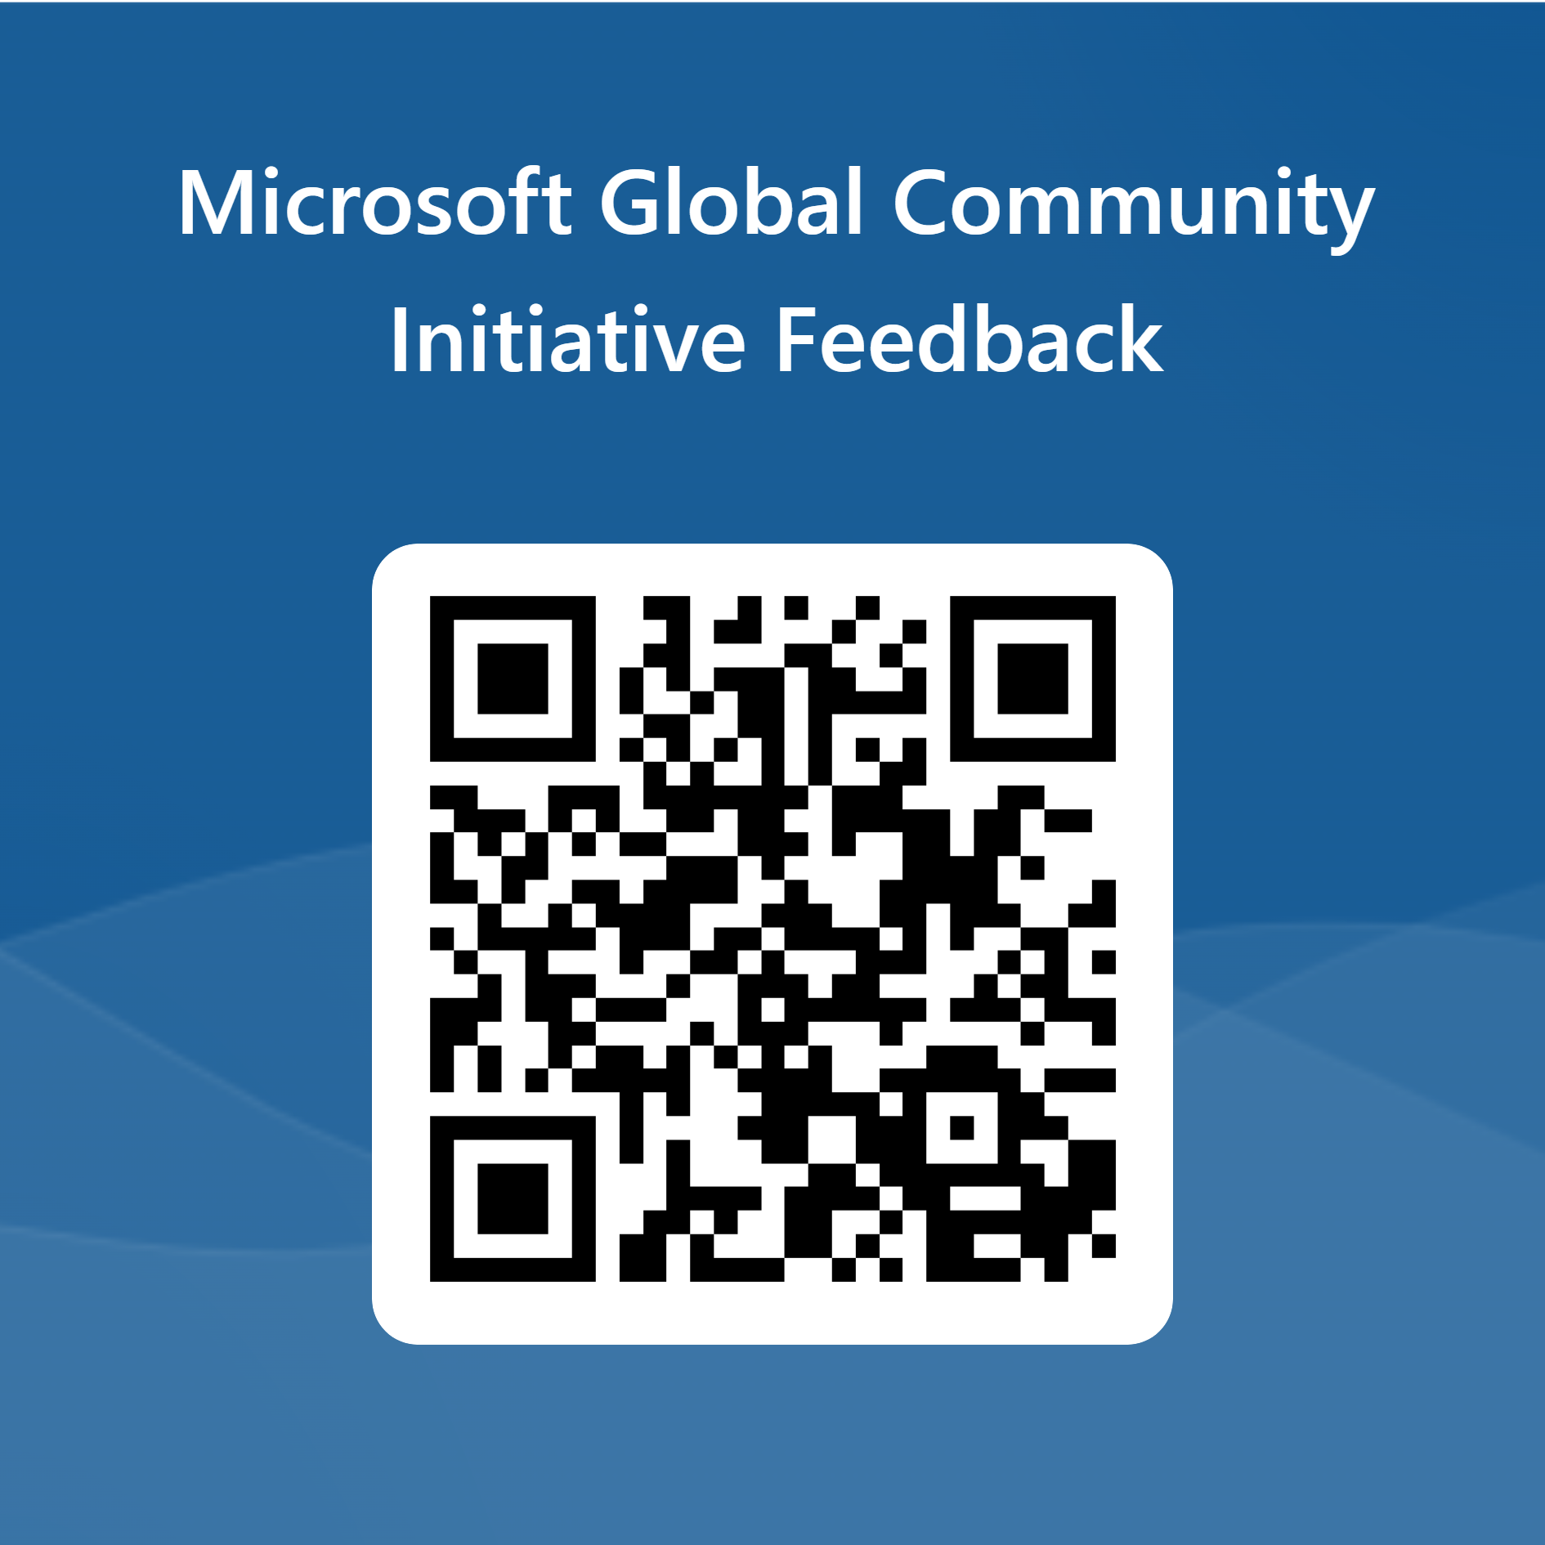
Love your feedback on this meeting
https://aka.ms/MGCIMeetingFeedback

Slide 22
Training Workstream Update
​Workstream Leads – Sharon Weaver & Wes Preston
Upcoming event training dates
Date | Host | Guest Speaker | Topic
NOV 27 | HOLIDAY BREAK | HOLIDAY BREAK | HOLIDAY BREAK
DEC 25 | HOLIDAY BREAK | HOLIDAY BREAK | HOLIDAY BREAK
JAN 29 | Wes & Sharon | TBD | Finding and Managing Sponsors
FEB 26 | Wes & Sharon | TBD | Run of Show: What to do the day of the event?
MAR 26 | Wes & Sharon | TBD | Planning 101: Event in a box & Organizer Checklist
APR 30 | Wes & Sharon | TBD | How to add your event to the Community Days website
MAY 28 | Wes & Sharon | TBD | Finding and Managing Venues
JUN 25 | Wes & Sharon | TBD | Building and running a committee
JUL 30 | Wes & Sharon | TBD | Finding and Managing Speakers
AUG 27 | SUMMER BREAK | SUMMER BREAK | SUMMER BREAK
SEP 24 | Wes & Sharon | TBD | Event Images & Graphics
OCT 29 | Wes & Sharon | TBD | How to effectively market your event

Slide 23

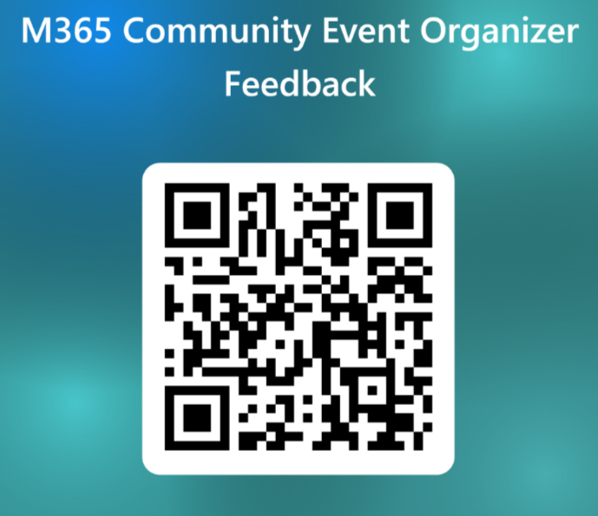
Training Workstream Feedback
We want to hear from you!
Please fill out the form by scanning the QR Code so we can work to bring you the best content!
https://forms.office.com/r/G3sP4wTViA

Slide 24
MGCI General Sessions – The Third Tuesday of the Month
Date | Presenter | Topic
Jan 30 | Tim Balk | Event Planning 101
Feb 27 | Michal Ziemba | Automate Your Events
March 18 | Pat McGown | Amplify Your Events
April 15 | Adam Salah | Microsoft Loop for Content Creation & Event Production
May 20 | Matt Slaga | Microsoft for Non-Profits
June 17 | Tim Balk | Unconventional Ways to Promote Community Events
July 15 | Heather Cook | Thriving Against the Odds: Building a Formidable Community in Unfavorable Environments
Sep 16 | Nikkia Carter | Harnessing Microsoft Copilot: Empowering Global Communities with AI
Oct 21 | Perla Ramirez | Behind the Mic: Powering Great Sessions with Speaker Support
Nov 18 | Augustine Correa Seyi Oluwawumiju | How do we run our Events? Thriving Against the Odds: Building a Formidable Community in Unfavorable Environments
Dec 25 | NO MEETING | HOLIDAY BREAK
Learn from your peers and get updates on the MGCI program!
3rd Tuesday of every month at 8:10 AM and 5:10 PM Pacific Time.
https://aka.ms/MGCIMtgAM
https://aka.ms/MGCIMtgPM
All MGCI General Sessions and Event Training Sessions will be available on-demand on the
Microsoft Community Learning YouTube Channel: https://aka.ms/community/learning
Microsoft Global Community Initiative https://aka.ms/MGCI

Slide 25

MGCI General Sessions – The Third Tuesday of the Month
Want to share best practices or lessons learned on producing events or building community in an upcoming session?
Fill out this form:
https://aka.ms/GeneralSessionGuest
We are looking for speakers for 2026!
Microsoft Global Community Initiative https://aka.ms/MGCI

Slide 26
MGCI on MTC
https://aka.ms/MGCICommunityHub
Microsoft Global Community Initiative https://aka.ms/MGCI

Slide 27
Lessons Learned

Slide 28
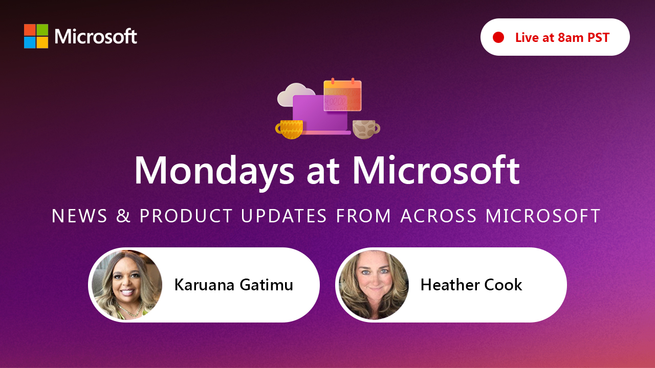
https://aka.ms/mondaysatmicrosoft
Learn - Explore – Connect In the Microsoft Community
Bi-weekly @ 8am PT
Watch on
Microsoft Community Linked
https://aka.ms/microsoftcommunitylinkedin
Notes:
Last used May 2023, Heather Cook

Slide 29




Stay Connected!
Engage with the best community in tech…
There’s something for everyone!
Microsoft Tech Community
The community platform for Microsoft 365 – forums, blogs, and events
aka.ms/joinMTC
CommunityDays.org
Find or host a local event in your area
or to match your interests
Microsoft Community on LinkedIn
News, announcements and training delivered to your news feed aka.ms/microsoftcommunitylinkedin

Slide 30
Thank you!

