Slide 1


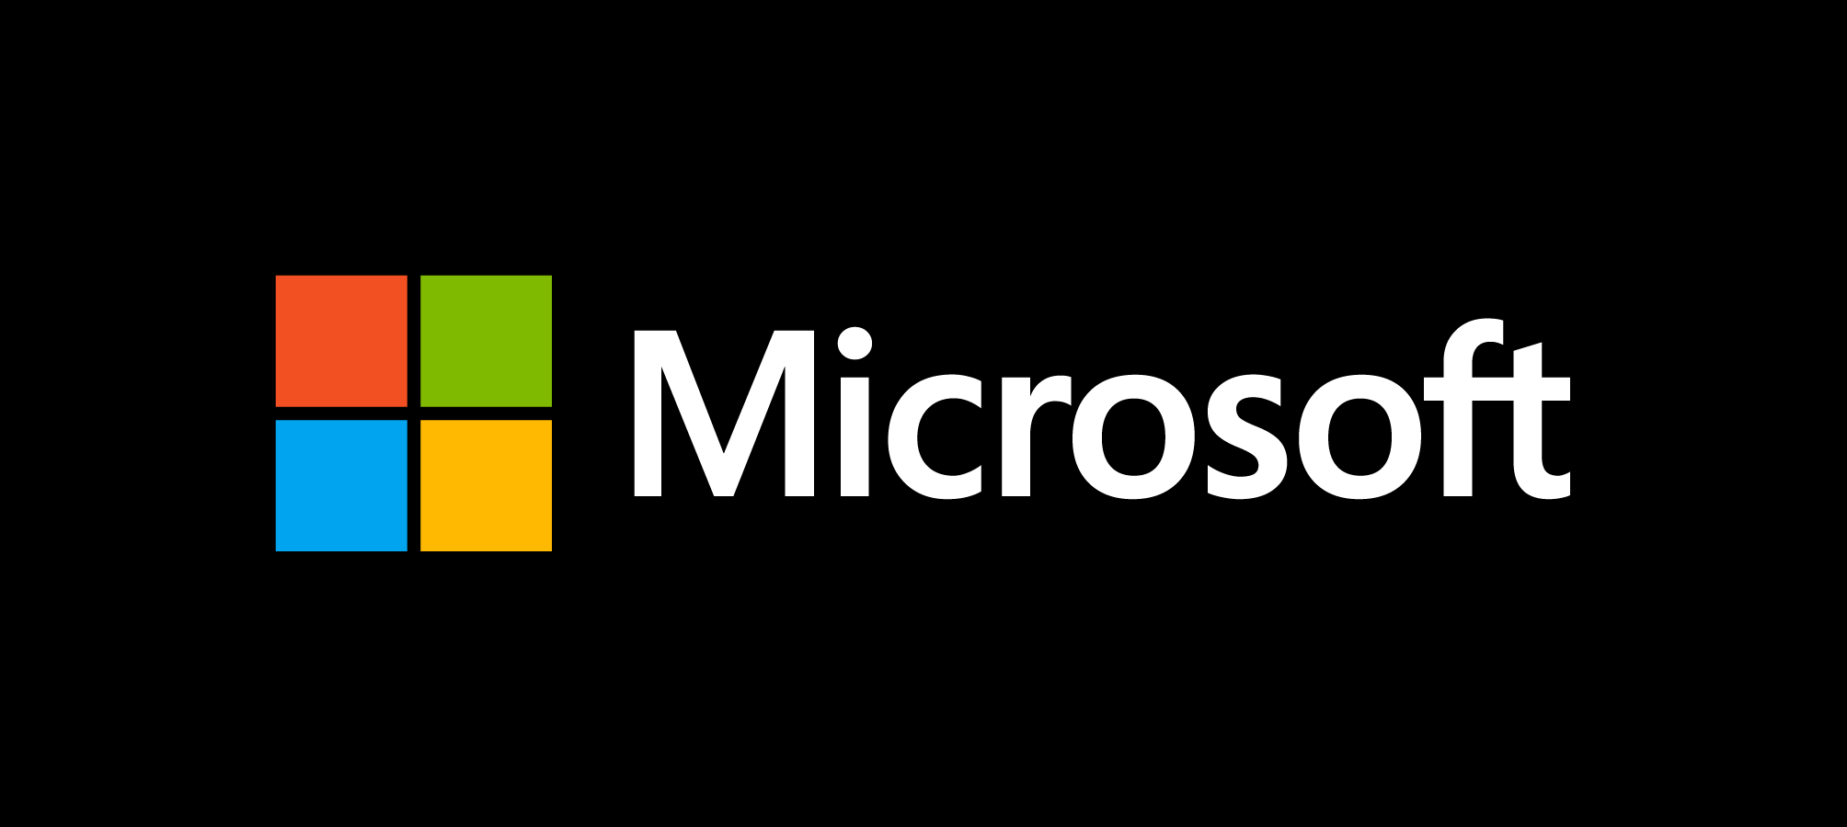
We will get started at 10 min after the hour
Grab a refreshment!
Notes:
Let's all get connected, please share your LinkedIn profile and where you're joining from.

Slide 2
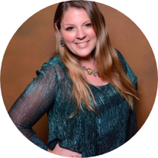
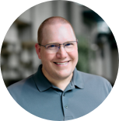
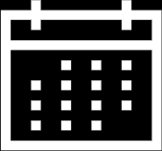
Microsoft Global Community Initiative Event Training and Office Hours
Sep 24, 2026
Hosts: Sharon Weaver & Wes Preston

Slide 3

Microsoft Global Community Initiative: Event Training and Office Hours
MONTHLY TOPIC:
Filling Seats! How to market your event
Thursday, October 29, 2026
8:10 AM PT | https://aka.ms/MGCITrainingMTG

Slide 4
Introductions
Event Training:
Filling Seats! How to market your event
Ask Me Anything
Agenda

Slide 5
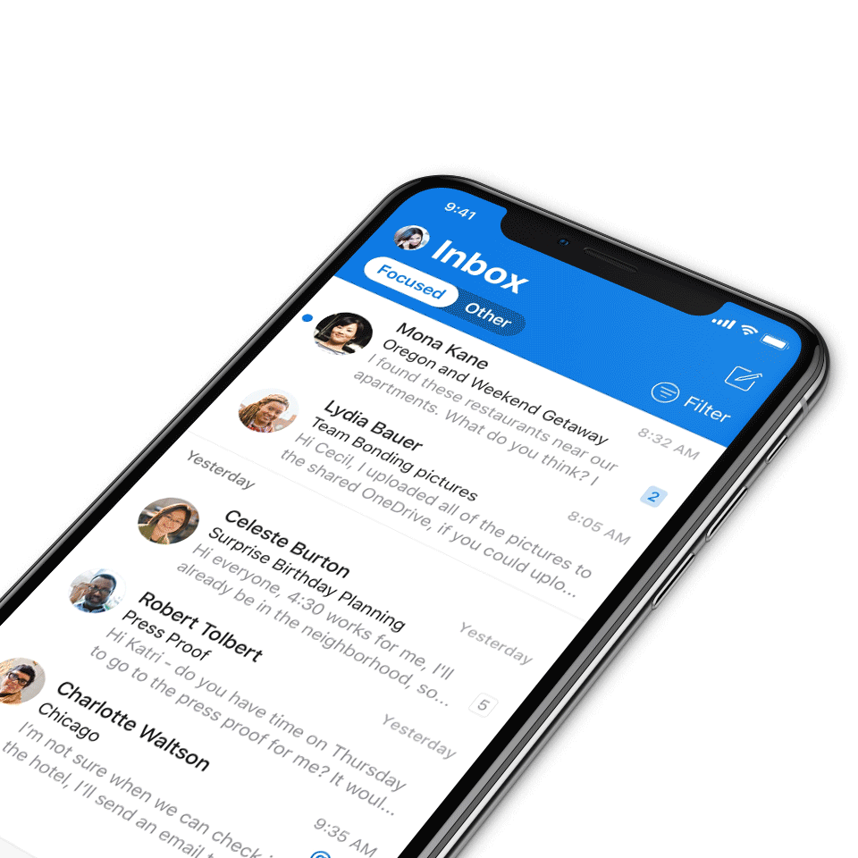
We expect all digital event participants to uphold the principles of this Code of Conduct, which covers the main digital event and all related activities. We do not tolerate disruptive or disrespectful behavior, messages, images, or interactions by any party participant, in any form, at any aspect of the program including business and social activities, regardless of location.​
Microsoft will not tolerate harassment or discrimination based on age, ancestry, color, gender identity or expression, national origin, physical or mental disability, religion, sexual orientation, or any other characteristic protected by applicable local laws, regulations, and ordinances.​
AI notetakers are not permitted and will not be admitted to meetings.
Digital Event Code of Conduct
Microsoft’s mission is to empower every person and every organization on the planet to achieve more.
This includes all Microsoft events and gatherings, including on digital platforms, where we seek to create a respectful, friendly, fun and inclusive experience for all participants.​
We encourage everyone to assist in creating a welcoming and safe environment.
For more info, click here.

Slide 6
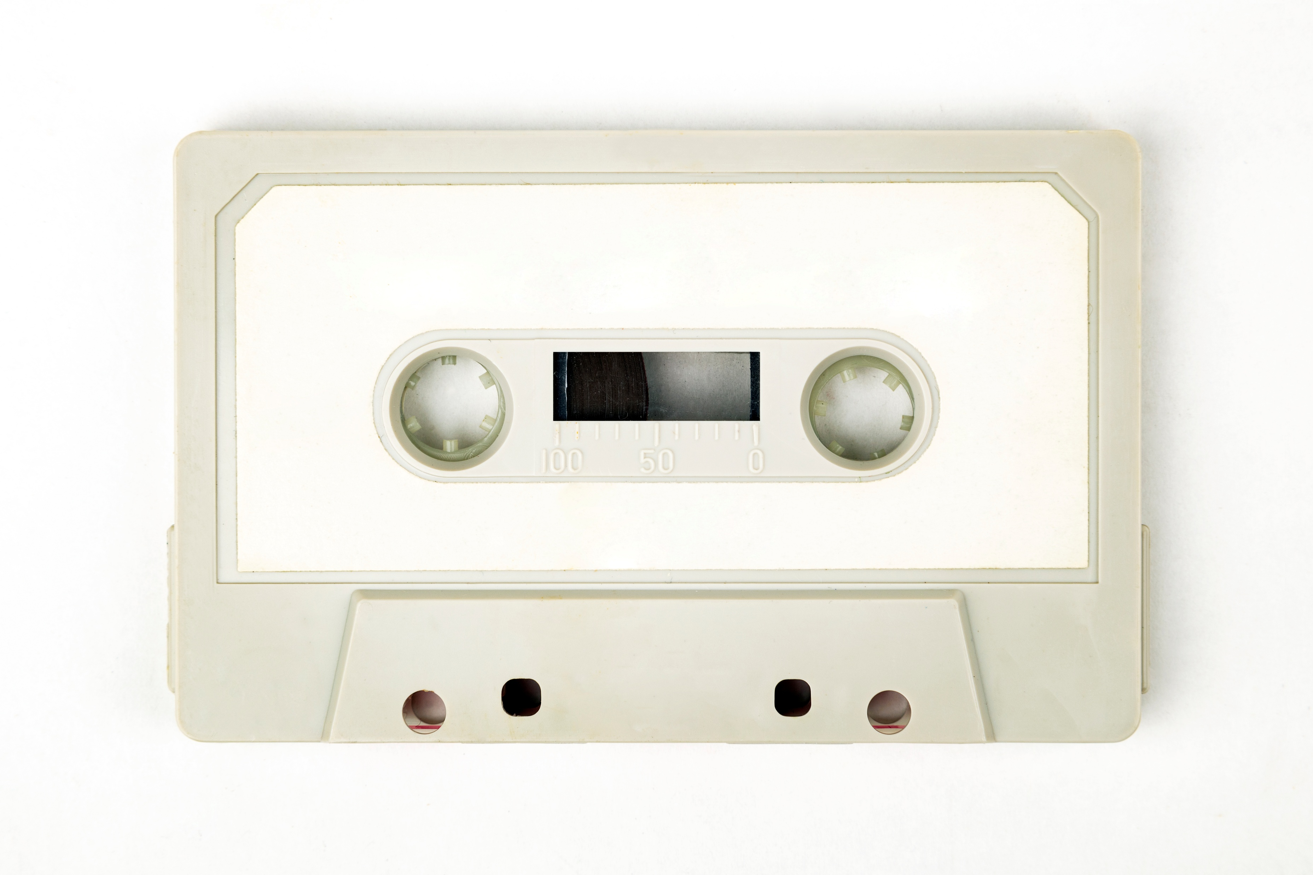
Recordings
All Community Builders Network Calls are recorded and posted on-demand on the Microsoft Community Learning YouTube channel.
If you do not want to be recorded, please leave the call or stay on mute.
Speaker video and audio will be shown in the recordings.
Attendee questions audio will be also be shared.

Slide 7
Mission and Tagline
The Microsoft Global Community Initiative (MGCI) - Empowering global Microsoft communities with the tools, training, and resources to create impactful events and amplify diverse voices.
Learn, Share, Grow.
Join MGCI today! https://aka.ms/MGCI

Slide 8
We want to know about you
Introduce yourself in chat!
Share your LinkedIn profile
What events do you work on?
What’s one thing you’re hoping to learn today?
If you could have any tech superpower, what would it be?

Slide 9
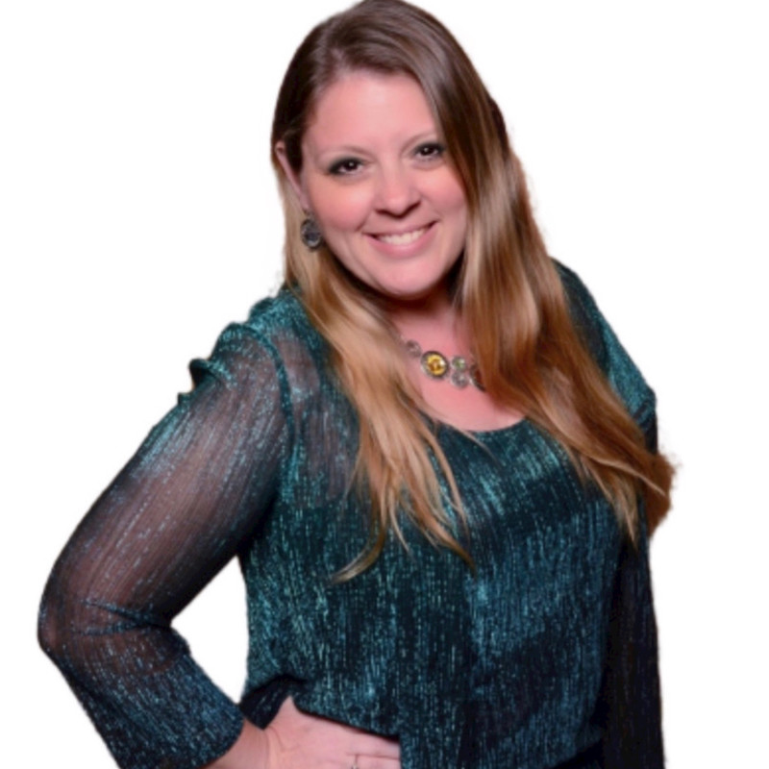
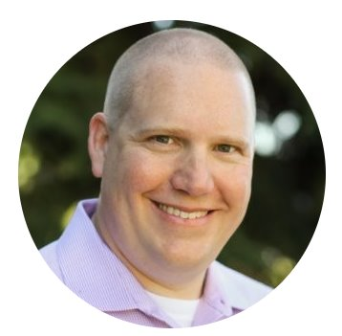
Your Trainers
Sharon Weaver
Founder, CEO Smarter Consulting
Microsoft RD | MVP | MCT
Primary Event:
Women in M365 - aka.ms/womeninm365
Sharon Weaver | LinkedIn
Wes Preston
Minneapolis, MN
Owner, TrecStone
Primary event:
M365 Saturday - Twin Cities (m365tc.com)
Wes Preston | LinkedIn
Guest Speaker:
Christian Buckley
Microsoft 365 & Copilot Training + Advisory Services | xMicrosoft | Award-Winning Technology Evangelist | Product, Partner & Channel Marketing | Microsoft MVP & Microsoft RD, MGCI Regional Leader

Slide 10
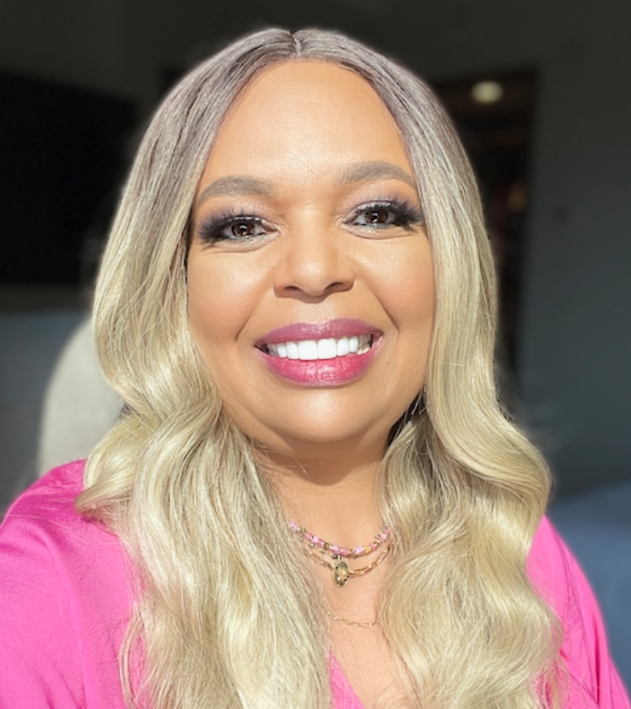
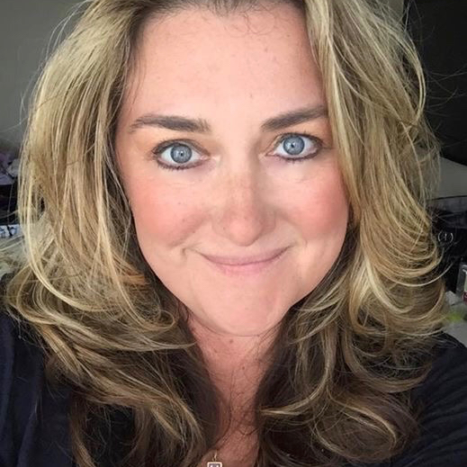
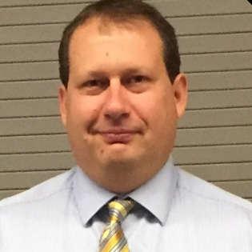
The Microsoft Team
Karuana Gatimu
Community Lead
Olympia, Washington
Phoenix, AZ
Karuana Gatimu | LinkedIn
Heather Cook
Community Manager
Marina del Rey, CA
Heather (Heather Newman) Cook | LinkedIn
Bryan Hart
Technology Lead
Shoreline, WA
Bryan Hart | LinkedIn

Slide 11
Microsoft Global Community Initiative
MONTHLY TOPIC:
Filling Seats! How to market your event

Slide 12
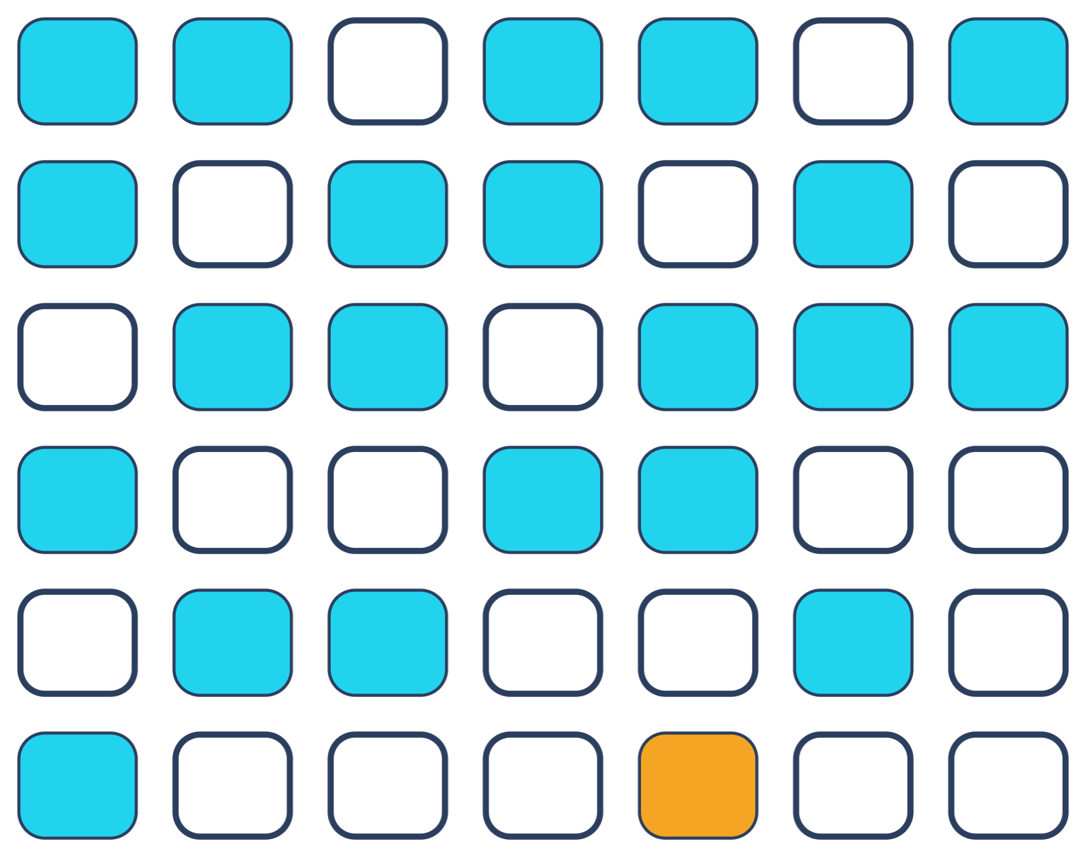
Filling Seats
MGCI EVENT PRODUCTION TRAINING · OCT 29, 2026
How to market your event so people
actually show up
Christian Buckley with Sharon Weaver
Microsoft MVP & Regional Director · CollabTalk · buckleyplanet.com
Notes:
Welcome, and thanks Sharon for the hand-off. Quick context on why I’m up here: I organized SharePoint Saturday Redmond for 7 years, SharePoint Saturday Utah for 10, and I’ve helped run dozens more. I’ve stood in plenty of full rooms and a few half-empty ones. About a year ago I gave this community “5 Proven Ways to Promote Your Community Events.” Today builds on that instead of repeating it. The lens this time is seats: not how many people register, but how many actually show up. Visual note: the seat grid is about half full, which is roughly what a free event looks like on a typical night. We’ll come back to that number in two slides.

Slide 13
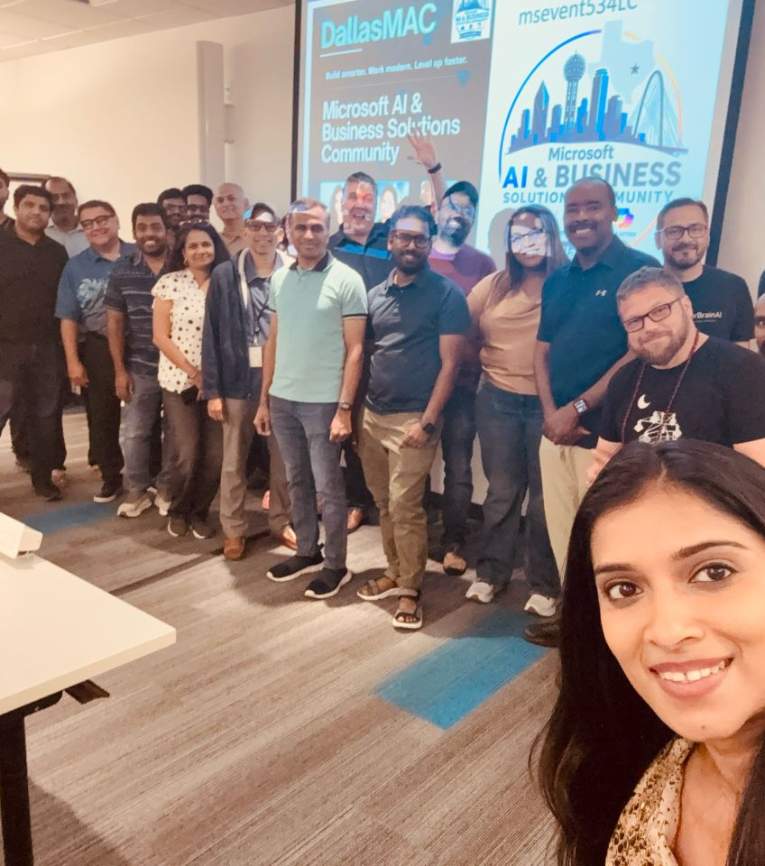
Community doesn’t just happen, it gets organized
WHY THIS MATTERS
Technology changes fast. Community is what keeps creating value long after the slides are forgotten.
Every seat is a person who decided your event was worth an evening.
#DallasMAC
Filling Seats · 02
@buckleyplanet
Notes:
Big picture: an empty room is a promise that didn’t land. The marketing is just how the promise travels. Technology changes fast, and community is what keeps creating long-term value. That’s the point of my July post, “Community doesn’t just happen, it gets organized.” Every seat is a person who looked at everything else competing for their evening and decided your event was worth it. That’s the bar we’re marketing against. [YOUR STORY: a packed-room moment, and if you’re willing, an empty-room one. SPS Redmond, SPS/CollabDays Utah, or the #DallasMAC launch on Jul 22, 2026.] The photo is a #DallasMAC meeting: point at it as proof that people will still leave the house for the right format.

Slide 14
The real number is who shows up
THE TWO NUMBERS YOU MANAGE
REGISTERED · 100%
SHOWED UP · 40–50%
EMPTY SEATS
40–50%
~37%
57%
of RSVPs show up for free events (70–85% with a fee)
median no-show, small free events (~28% for all free events)
of online registrants attend, counting on-demand viewers
Meetup Blog · undated
PheedLoop · 1,070+ events
ON24 · vendor data, B2B webinars
Filling Seats · 03
CHAT → What’s your typical show rate?
Notes:
Narrow from the big picture to the two numbers every organizer manages: registrations, and the people who actually walk in (or log in). Meetup says only 40 to 50 percent of RSVPs show up for free events, versus 70 to 85 percent when there’s a fee. That stat is undated, so treat it as directional. PheedLoop looked at 1,070+ live events: the median no-show for free events is about 28 percent, and about 37 percent for small free events of 10 to 49 people. That’s most of us. For online events, ON24’s 2024 data shows 57 percent of registrants attend, but that counts on-demand viewers and it’s B2B marketing webinars, not community events. Whatever the format, plan on losing a big share of your RSVPs. [YOUR NUMBERS: real RSVP-to-attendance from DallasMAC or Meetup would beat every benchmark here.] CHAT PROMPT 1 (moved here from slide 14): “What’s your typical show rate?” Sharon can read a few out while we move to the gaps. Sources: meetup.com/blog/how-to-get-people-to-show-up-to-your-events · pheedloop.com/blog/event-data-lab-report-5 · on24.com/blog/key-takeaways-from-the-2025-webinar-benchmarks-report

Slide 15

Five reasons seats stay empty
THE GAPS
01
02
03
04
05
A vague “why attend”
Organizers promoting alone
Logos with no faces
One post, then silence
Stuck in the same bubble
“It’ll be a great time” isn’t a reason
People come to see people
An announcement is not a campaign
Same channels, same people, every time
Your reach stops at your own network
Filling Seats · 04
@buckleyplanet
Notes:
Big picture: seats stay empty for a few predictable reasons, and most of them are decided before the first promo post goes out. These are the five weak spots from last year’s talk, reframed as gaps: 1. A vague “why attend.” “It’ll be a great time” gives nobody a reason to rearrange their evening. 2. Organizers doing all the promotion alone. Your reach stops at the edge of your own network. 3. Logos and flyers with no faces. People come to see people. 4. One announcement and then silence. A single post is a notice, not a campaign. 5. Promoting only inside the same bubble. Same channels, same people, every time. Light touch: most of us have committed at least three of these in the last year. I know I have.

Slide 16


The post-COVID passive problem
THE GAPS
Many user groups never made it back from online-only. The ones that did had to give people a reason to leave the couch.
THE OLD MODEL
WHAT BRINGS PEOPLE BACK
Sit and watch
Build it yourself
vs
Sit through a lecture, then watch someone else build something.
Hands-on labs, practical expertise, and time to actually meet the people around you.
If the experience is passive, the next invitation is easy to ignore.
Filling Seats · 05
@buckleyplanet
Notes:
Many user groups never made it back from online-only after COVID. The old model was to sit through a lecture and watch someone else build something. We could all do that from home, and during the pandemic we did. So when the in-person invitation comes back, the question in everyone’s head is: what do I get in the room that I can’t get on YouTube? That’s why we built #DallasMAC around hands-on work, and why “Community doesn’t just happen” makes the same point: if the experience is passive, the next invitation is easy to ignore. Bridge to the next slide: this isn’t only my take. Other organizers keep landing in the same place. Sources: Introducing #DallasMAC (Jul 2026); Community Doesn’t Just Happen, It Gets Organized (Jul 2026), buckleyplanet.com

Slide 17
Different communities, the same lessons
WHAT OTHER ORGANIZERS OBSERVE
The invitation starts the event
Repeat attendance is the real metric
Welcome first-timers personally
Design something atypical
Priya Parker · The Art of Gathering
David Spinks · CMX
Carrie Melissa Jones · CMJ Group
Seth Godin
Direct contact raises turnout
Lightweight formats, more voices
Borrow other groups’ stages
Show the real feel of the day
Ben Weger · Meetup
Rosie Sherry · Rosieland
David Giard · Detroit Day of Azure
Haroon Mota · Muslim Hikers
Filling Seats · 06
@buckleyplanet
Notes:
About 2 minutes. Teal-topped cards are the four to speak to; the amber ones can sit on screen.
SPEAK TO:
Priya Parker (The Art of Gathering): the invitation is the start of the event, not just logistics. Give it a clear name and purpose, and tell people what to expect.
David Spinks (CMX): you know your events work when people keep coming back. Turn what works into a repeatable playbook.
Carrie Melissa Jones (CMJ Group): people want an easy way to show up that won’t feel awkward, so personally welcome first-time RSVPs.
David Giard (Detroit Day of Azure): great content isn’t enough if your audience doesn’t know about it. Borrow other user groups’ stages, universities, and podcasts.
Seth Godin: emotion moves people more than facts; typical events get typical results.
Ben Weger (Meetup): repeat attendees are more reliable, and direct contact before the event raises turnout.
Rosie Sherry (Rosieland): lightweight formats like LinkedIn audio spaces are easy to run and give members a voice.
Haroon Mota (Muslim Hikers, via Eventbrite TRNDS 2025): show the real feel of event day, not just an announcement.

Slide 18

Three levers and a loop
THE FRAMEWORK
01
02
03
04 · LOOP
Promise
People
Persistence
Proof
A concrete reason
to show up
Others amplify your reach
Cadence turns RSVPs into seats
The recap sells the next one
The recap from each event becomes the promise of the next one
Filling Seats · 07
@buckleyplanet
Notes:
About 1 minute. Everything we just heard boils down to three levers and a loop. Promise: a concrete value and a format worth showing up for. People: speakers, sponsors, ambassadors, and partners do the amplifying, so you’re not shouting alone. Persistence: cadence and reminders turn RSVPs into attendees. Proof: the recap. Photos, highlights, a thank-you, and a tease of the next date. That recap becomes the Promise for the next event, which is why it loops. The next seven slides walk the levers in order: Promise, then People, then where to promote, then Persistence. [CONFIRM: these labels are new and not from your posts. Keep, rename, or drop “Proof” and go back to three plus a loop.]

Slide 19


Write the one-line “why attend” first
LEVER 01 · PROMISE
BEFORE
AFTER
Learn
about AI
Discover 3 ways small businesses are using
AI to save time and cut costs
List 3–4 concrete takeaways
Name who it’s for
Then write the promo
Filling Seats · 08
@buckleyplanet
Notes:
First lever, Promise. About 1 minute. The example is straight from last year’s post. “Learn about AI” tells me nothing: what will I learn, and is it for me? “Discover 3 ways small businesses are using AI to save time and cut costs” names the audience, the payoff, and a number I can hold you to. The practice: list 3 to 4 concrete takeaways before you design anything. Write the promo materials after the value is clear, never before. If you can’t write the one line, the event isn’t ready to promote yet. (“Name who it’s for” is my addition for the chip; drop it if you’d rather keep strictly to the post.) Source: 5 Proven Ways to Promote Your Community Events, buckleyplanet.com (Oct 2025)

Slide 20




Design a format people will leave home for
LEVER 01 · PROMISE
STEP 1
STEP 2
STEP 3
The talk
The lab
The room
Practical expertise,
not a product pitch
Hands-on, at every meeting
Food and real networking
Come curious. Leave capable.
#DALLASMAC
Filling Seats · 09
@buckleyplanet
Notes:
Still Promise. About 1 minute. The format itself is marketing. When we launched #DallasMAC, every meeting promised the same three things: practical expertise, a hands-on lab, and networking. That promise is what we market, not the speaker of the month. The tagline does the work: “Come curious. Leave capable.” It tells you exactly what changes for you by showing up. If your agenda reads like a webinar, people will treat it like one and watch the recording. [OPTIONAL: one line on how the lab changed turnout or retention at DallasMAC, if you have it.] Sources: Introducing #DallasMAC, a user group built for how people actually learn (Jul 2026); Community Doesn’t Just Happen (Jul 2026), buckleyplanet.com

Slide 21




Give speakers and sponsors a share kit
LEVER 02 · PEOPLE
share-kit/
One post per session
Name the speaker in each one, so every speaker reshares their own.
Pre-written posts
Images and hashtags
Daniel Glenn, MVP · SPS Nashville
40–50%
30-second speaker video
Registration link
Partner list overlap in my ISV days. Every co-promotion reached a big pool of new people through a trusted intro.
Experience, not a benchmark
Filling Seats · 10
@buckleyplanet
Notes:
Second lever, People. About 1 minute. Your speakers and sponsors want the event to succeed, but most of them won’t write promo copy from scratch. So hand them a kit: pre-written posts, images, hashtags, and the registration link. Ask every speaker for a 30-second phone video: “here’s what I’m covering.” Faces beat logos every time. Give sponsors co-branded versions they can post as their own. A tip from fellow MVP Daniel Glenn, who ran SPS Nashville: publish one post per session that names the speaker. Each speaker reshares their own post, and suddenly you have twenty promoters instead of one. Partner math: back in my ISV days, partner lists only overlapped about 40 to 50 percent. So every co-promotion reached a big pool of new people, and they heard about you through someone they already trusted. That’s my experience, not a benchmark. Sources: 5 Proven Ways (Oct 2025); The Guest-to-Creator Feedback Loop (Jul 2026), buckleyplanet.com; danielglenn.com, Organizing a SharePoint Saturday: Promotional materials (Feb 25, 2016)

Slide 22


Step outside the tech bubble
LEVER 02 · PEOPLE
REFRAME THE TOPIC
Microsoft 365 Governance
Colleges
Digital tools for small business growth
Local media
Your group
Chambers
Make attending easy: directions, parking, accessibility, hybrid where you can
Show up for partners year-round, not only when you need promotion
Libraries
Filling Seats · 11
@buckleyplanet
Notes:
Still People. About 1 minute. Most of us promote to the same people every time: the same user group list, the same LinkedIn followers, the same Meetup members. Those people already know you exist. Go around them. Colleges, chambers of commerce, libraries, and local media all have audiences who would come if the topic were framed for them. “Microsoft 365 Governance” means nothing to a small business owner. “Digital tools for small business growth” does, and it can be the exact same session. Then make attending easy: directions, parking, accessibility, and a hybrid option where you can manage it. And stay involved year-round. If the only time the chamber hears from you is when you need promotion, you’re a vendor, not a partner. Source: 5 Proven Ways to Promote Your Community Events, buckleyplanet.com (Oct 2025)

Slide 23




Meetup for discovery, LinkedIn for visibility
WHERE TO PROMOTE
Meetup
DISCOVERY ENGINE
LinkedIn
WHERE PROS ALREADY ARE
Keyword-rich titles and a regular schedule feed
topic emails and search
Create a LinkedIn Event and have speakers
post personally
Message first-timers personally before the event
Try an audio event for a lighter format
+20%
RSVPs from Meetup’s redesigned
iOS Explore page
4.4×
more registrations with Event Ads
(31× more viewers)
Meetup’s own data · 2024
LinkedIn internal pilot · 2023–24
Filling Seats · 12
@buckleyplanet
Notes:
About 1 minute. Two channels most of this audience already uses, with different jobs. MEETUP is a discovery engine. It promotes groups by topic: emails to members with matching interests, Topic pages, and search. Keyword-rich titles and a regular schedule help it find you the right people. Meetup’s 2025 progress report says its redesigned iOS Explore page produced 20 percent more RSVPs from Explore, and group joins from search rose 9 percent. That’s Meetup’s own data. Meetup also notes that repeat attendees show up more reliably than first-timers, and that direct messages before an event raise turnout (Ben Weger, Meetup Blog). So message your first-timers personally. LINKEDIN is where professional audiences already are. Create a LinkedIn Event, invite your connections, and have speakers post personally. For a lighter format, try LinkedIn audio events, the way Rosie Sherry does. LinkedIn reports that events promoted with Event Ads got 31x more viewers and 4.4x more registrations than unpromoted ones. Caveat out loud: that’s LinkedIn’s internal data from a select pilot group, 2023 to 2024, not an independent study. Good segue into the next slide. Sources: meetup.com/blog/2025-meetup-progress-report · help.meetup.com, Promoting new Meetup groups · meetup.com/blog/how-to-get-people-to-show-up-to-your-events · rosiesherry.medium.com (2023) · linkedin.com/business/marketing/blog/events/b2b-live-event-streaming (2024)

Slide 24
Free vs paid promotion
WHERE TO PROMOTE
No independent study shows that paid ads fill seats at free community events. The closest data comes from vendors.
TOP-3 REGISTRATION CHANNELS
■ free ■ paid
“I haven’t noticed an increase in attendance due to paying Facebook.”
Email
86.3%
Organic social
43.3%
Daniel Glenn, MVP · SPS Nashville, 2016
Paid social
20.4%
Speaker promotion
10.6%
Paid search
3.2%
Livestorm 2026 · 853 GTM pros · vendor data, B2B webinars
Filling Seats · 13
@buckleyplanet
Notes:
About 1.5 minutes. The question everyone asks: should I pay for ads? The honest answer: no independent study shows that paid ads fill seats at free community events. The closest data comes from vendors, and it’s worth knowing what it measures. Livestorm’s 2026 report surveyed 853 go-to-market professionals in December 2025 about their top-3 registration channels. Email leads at 86 percent, organic social 43, paid social 20, speaker promotion 11, paid search 3. That’s B2B webinars, not user groups, but the order tells you something: the free channels you control do most of the work. Eventbrite (2023) says events using its email and social-ad tools sold 63 percent more tickets. Note that’s tickets sold, not attendance, and it’s Eventbrite talking about Eventbrite. Then Daniel Glenn, back in 2016 running SPS Nashville: he hadn’t noticed any attendance bump from paying Facebook, and he warned that ad-type posts on any service could be wasted money. [YOUR STORY: your own paid-ads experience goes here. This is what makes the slide land.] Sources: livestorm.co/webinar-benchmark-report-2026 · eventbrite.com/blog/eventbrite-find-your-people (Mar 28, 2023) · danielglenn.com/organizing-a-sharepoint-saturday-promotional-materials (Feb 25, 2016)

Slide 25




Turn RSVPs into attendees
LEVER 03 · PERSISTENCE
49.7%
15.3%
registered in the
final 7 days
registered on the
day itself
Livestorm · 7.06M registrations · vendor data, B2B webinars
REGISTER
−7 DAYS
−2 DAYS
−1 DAY
−1 HOUR
LIVE
Calendar invite (.ics)
Reminder #1
Personal last-chance notes
Reminder #2, parking
or join link
Final reminder
Doors open
Keep registration open until start time
Overbook from your own show rate, and
open a waitlist
Filling Seats · 14
CHAT → Which reminder worked best for you?
Notes:
Third lever, Persistence. About 1.5 minutes including the chat prompt. People register late. In Livestorm’s data across 7.06 million registrations, about half registered in the final 7 days, and 15 percent on the day itself. That’s B2B webinars, so treat it as directional, but it matches what most of us see. Keep registration open until start time and push hardest in the last week. We already covered show rates on slide 3, so the question here is what you do about them. Reminders: send a calendar invite at registration, then reminders 1 week, 1 day, and 1 hour before. That cadence is common practice, not a measured effect. Two days out, send personal last-chance notes. Those are the ones people actually answer. Overbook and waitlist: set your registration target from your own historical show rate, and ask people who can’t come to release their spot. CHAT PROMPT: “Which reminder worked best for you?” (Show-rate question moved to slide 3.) Sources: livestorm.co/webinar-benchmark-report-2026 · 5 Proven Ways to Promote Your Community Events, buckleyplanet.com (Oct 2025)

Slide 26


A promotion rhythm you can repeat
RHYTHM · THE HANDOUT
6 / 4 wks
3 wks
2 wks
1 wk
2 days
1 day
Day of
Day after
+1 wk
Announce, send share kits
First email, speaker spotlight
Speaker video, partner news
Logistics, reminder #1
Last-chance notes, waitlist
Reminder #2
Doors-open post, photos
Recap, tease the next date
Survey, RSVPs vs check-ins
Proof loops back: the recap becomes the next event’s promise
LinkedIn
Meetup, Facebook
Email
Community calendars
visibility
reach
conversions
discovery
Filling Seats · 15
Full checklist in the handout
Notes:
About 1.5 minutes. A repeatable rhythm beats heroic last-minute pushes. Walk the handout: 6 weeks out for larger events, 4 weeks for meetups. Announce the date, topic, and value; post the LinkedIn event, Meetup or Eventbrite, and community calendars; send share kits; contact partners. 3 weeks: first email to your list, speaker spotlight #1, ambassadors share their personal “why.” 2 weeks: feature a speaker with a short video, partner newsletters go out. Most online signups land 1 to 2 weeks out (ON24). 1 week: logistics, giveaways, reminder #1, a behind-the-scenes post. 2 days: personal last-chance invites, ask no-shows to release their spot, open the waitlist. 1 day: reminder #2, what to bring, where to park or how to join. Day of: 1-hour reminder, a “doors open” post, photos and short clips, record check-ins. Day after: thank-you, highlights, slides or recording, tease the next date. 1 week after: short survey, compare RSVPs to check-ins, note which channel drove signups. Channel roles: LinkedIn for visibility, Meetup and Facebook for reach, email for conversions, community calendars for discovery. The recap is the Proof step from the framework: ask attendees to help tell the story, track check-ins and not just RSVPs, and use it to sell the next one. Sources: 5 Proven Ways (Oct 2025); Preparing for CollabDays Utah (Apr 2024), buckleyplanet.com; on24.com/webinar-benchmarks; metabase.com/metrics/rsvp-to-attendance-conversion

Slide 27
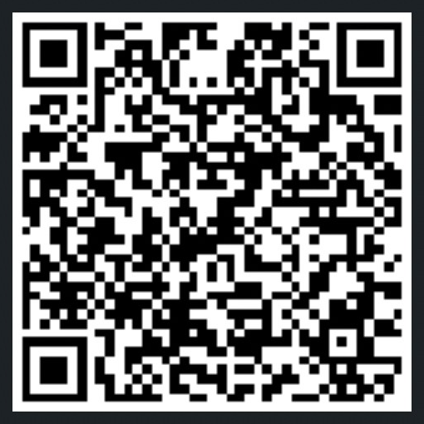
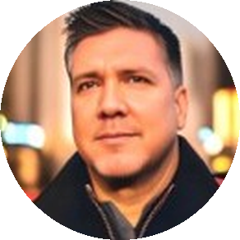
Communicate smarter, not louder
PICK ONE LEVER FOR YOUR NEXT EVENT
Christian Buckley
buckleyplanet.com · @buckleyplanet
Scan to connect on LinkedIn
OFFICE HOURS · IN CHAT
OFFICE HOURS · IN CHAT
Who’s your most underused amplifier: speakers, sponsors, past attendees, or a local partner?
Rewrite your next event’s title as a “why attend”
line, right now.
Notes:
About 1.5 minutes, then this slide stays up for office hours. Close with the line from last year’s post: promotion isn’t about shouting louder, it’s about communicating smarter. Everything today was a version of that: a clearer promise, more people carrying it, a steadier rhythm, and a recap that does the next round of work for you. Ask: pick one lever, just one, and try it at your next event. Then tell me how it went. Soft CTA: if you want the checklist or want to compare notes, reach out. The QR code goes to my LinkedIn profile, so connect there and message me. OFFICE HOURS (about 5 min, Sharon moderates chat): Prompt 2: Who’s your most underused amplifier: speakers, sponsors, past attendees, or a local partner? Prompt 3: Rewrite your next event’s title as a “why attend” line right now in chat. Christian and Sharon react to a few live. Then open Q&A. [TO DO: confirm the split with Sharon on chat moderation vs. Q&A.] Source: 5 Proven Ways to Promote Your Community Events, buckleyplanet.com (Oct 2025)

Slide 28
Q+A
Ask Me Anything
Join the discussion on Microsoft Tech Community:
https://aka.ms/MGCI-OctTrainingDiscussion

Slide 29
2026 Schedule
Event Training
Schedule
Date | Topic
JAN 29 | Sponsors and Sponsorship
FEB 26 | Community Days, MTC User Groups & AMC
MAR 26 | SPRING BREAK
APR 30 | Run of Show – Day of Event Lessons Learned
MAY 28 | Event & Committee Planning
JUN 25 | How to find and select speakers
JUL 30 | FOOD! Meals, Snacks, and Beverages
AUG 27 | SUMMER BREAK
SEP 24 | Event branding – Graphics & Image tips
OCT 29 | Filling seats! How to market your event
NOV 26 | HOLIDAY BREAK
DEC 24 | HOLIDAY BREAK

Slide 30
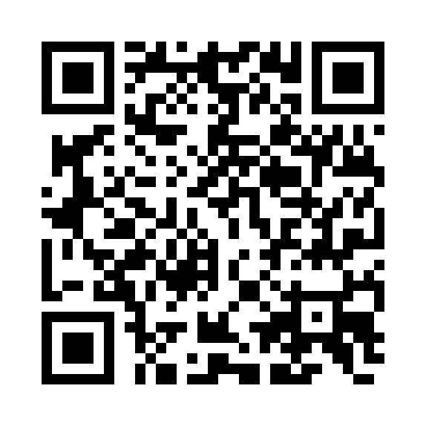
We Want Your Feedback!
https://aka.ms/MGCIFeedback

Slide 31
Keep the questions coming – about this topic or other event production topics on TechCommunity

Slide 32
Community Event Organizer Trainings
Learn from your peers and get updates on the MGCI program.
4th Thursday of every month at 8:10 AM PT.
Join: https://aka.ms/MGCITrainingMTG
All sessions are also available on-demand via the Microsoft Community Learning YouTube channel:
https://aka.ms/community/learning

Slide 33
MGCI Community Builders Network Call
3rd Wednesday of the month
Learn from your peers and get updates on the MGCI program
Nov 18: Game on: building Community together (yes! it’s a team sport)
Join: https://aka.ms/MGCIMtgAM
All sessions are also available on-demand via the Microsoft Community Learning YouTube channel:
https://aka.ms/community/learning
Notes:
Introduce the monthly MGCI General Sessions — 3rd Tuesday of every month at 8:10 AM PT. Encourage them to attend live; replays are on the Microsoft Community Learning YouTube channel.

Slide 34
MGCI Community Builders Network Call
Want to share best practices or lessons learned on producing events or building community in an upcoming session?
Fill out this form:
https://aka.ms/GeneralSessionGuest
We are looking for speakers for 2026!
Microsoft Global Community Initiative https://aka.ms/MGCI

Slide 35


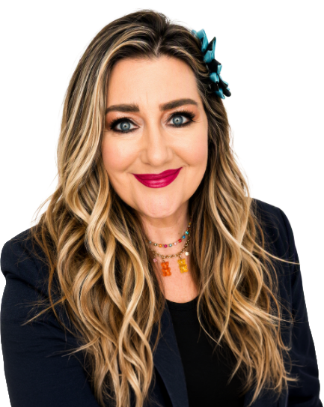
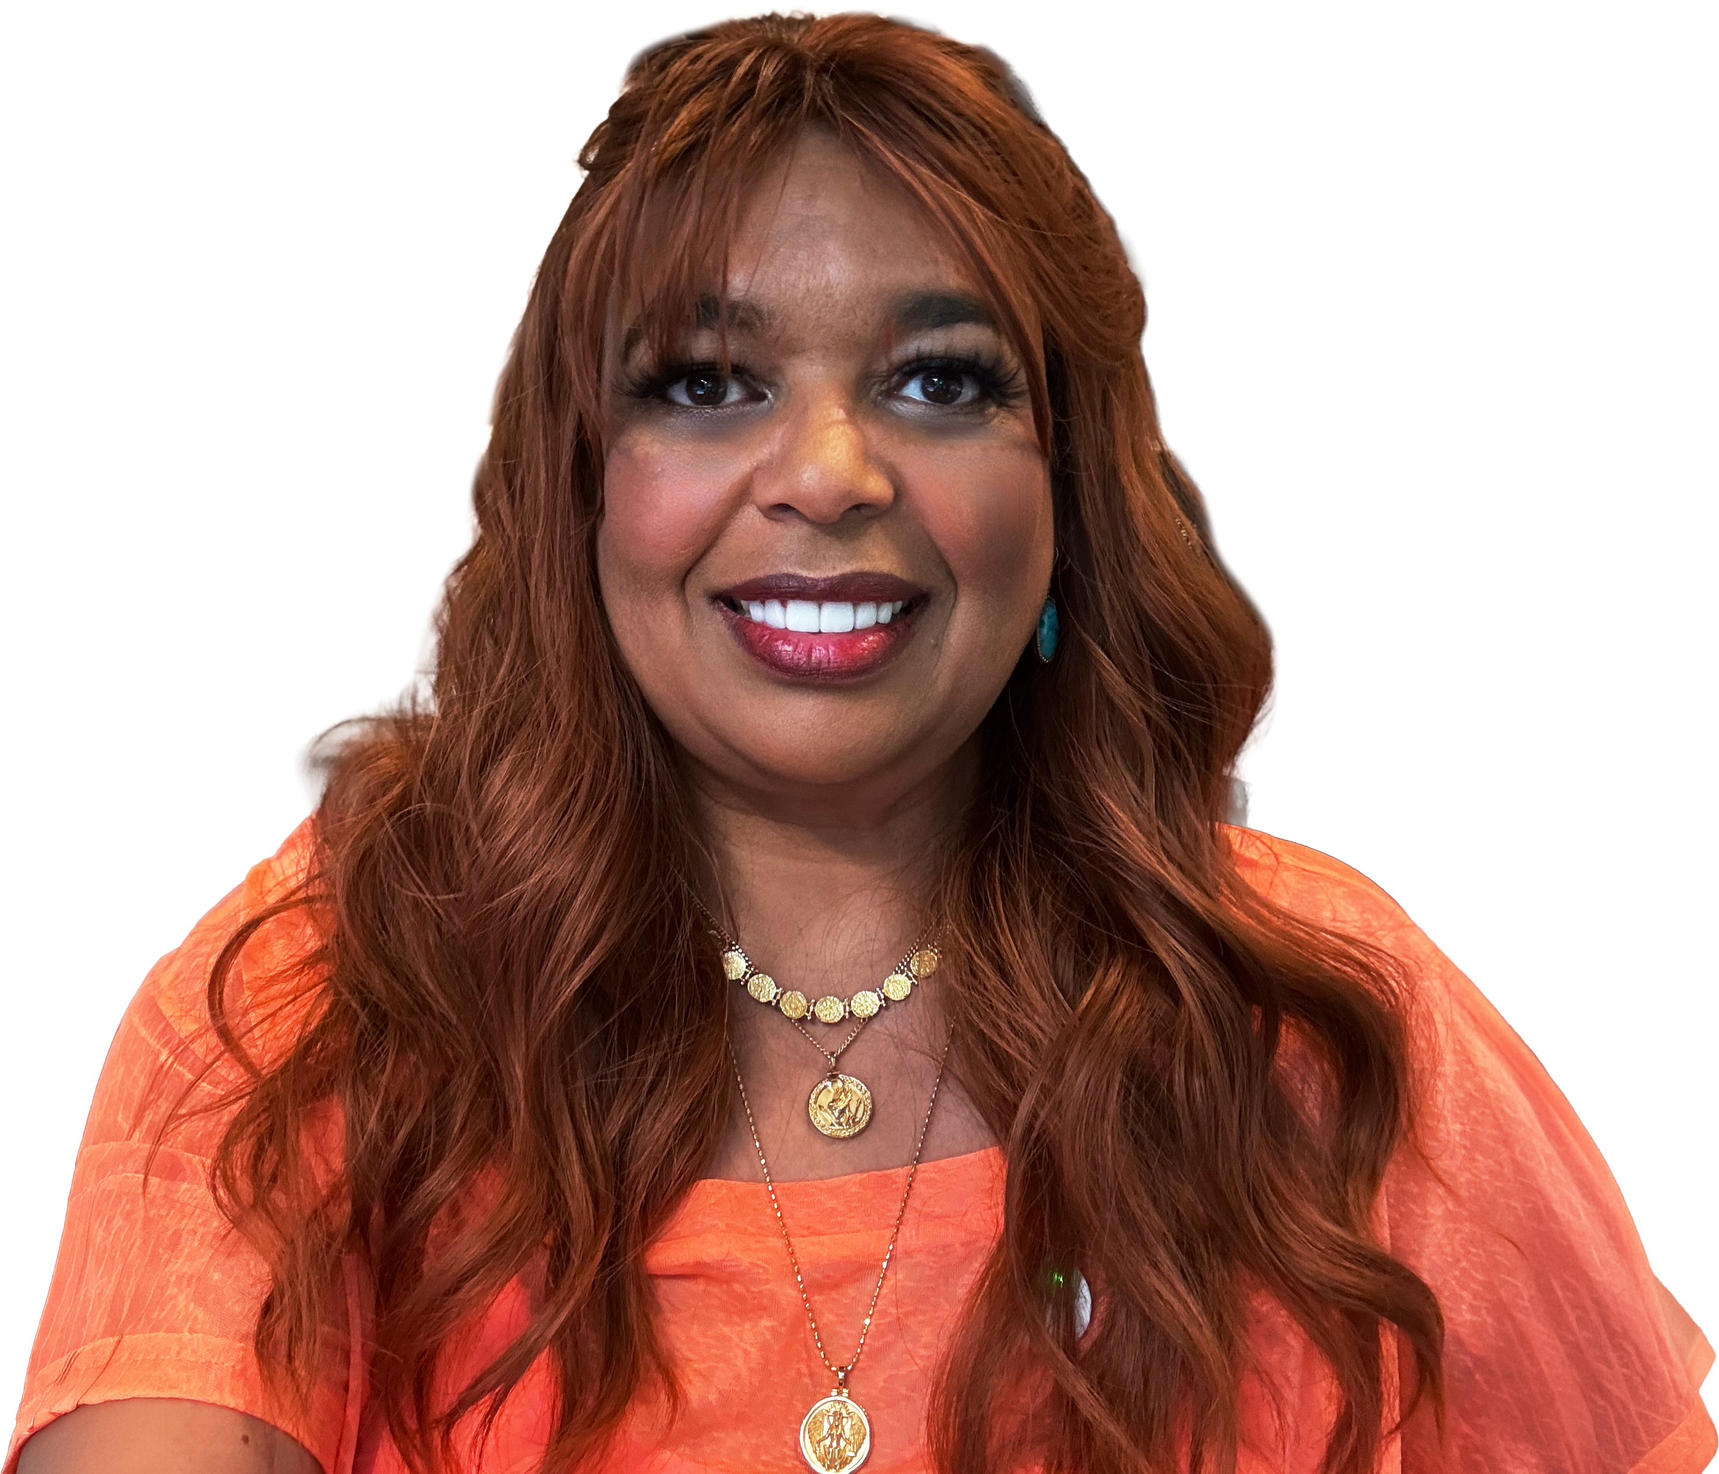
Get the latest AI new, product announcements, and
Microsoft Community insights from Karuana Gatimu and Heather Cook, every Monday.
Live every Monday at 8:00 AM PT
Fuel your week
aka.ms/MondaysAtMicrosoft

Slide 36
Microsoft Tech Community
The community platform for Microsoft 365 – forums, blogs, and events aka.ms/joinMTC.
Stay Connected!
CommunityDays.org
Find or host a local event in your area
or to match your interests.
Engage with the best community in tech…
There’s something for everyone!
Microsoft Community on LinkedIn
News, announcements and training delivered to your news feed aka.ms/microsoftcommunitylinkedin.

Slide 37
Thank you!

Slide 38
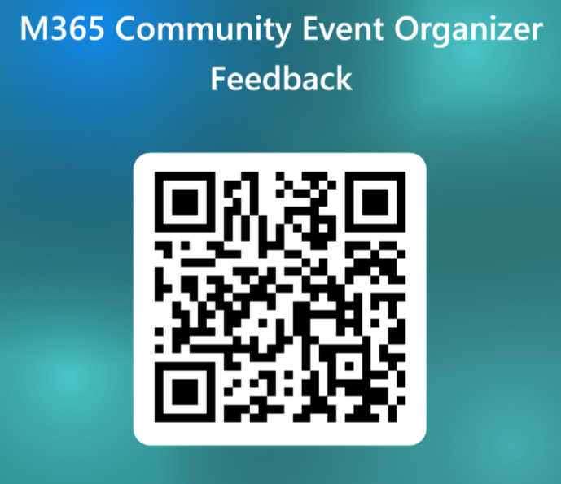
TRAINING
Please Provide Feedback!
Your feedback shapes the topics, formats, and speakers for upcoming sessions — it takes about two minutes.
WHAT WE'RE ASKING
Topics you want more guidance on
Speakers and formats that worked well
What we should improve next time
Open the feedback form →
aka.ms/MGCI-EventOrganizerFeedback
Scan to open the form
communitydays.org
TRAINING

