Slide 1



We will get started at 10 min after the hour
Grab a refreshment!
Notes:
Let's all get connected, please share your LinkedIn profile and where you're joining from.

Slide 2
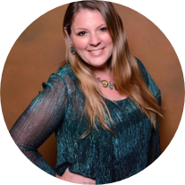
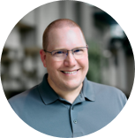

Microsoft Global Community Initiative Event Training and Office Hours
Sep 24, 2026
Hosts: Sharon Weaver & Wes Preston

Slide 3

Microsoft Global Community Initiative: Event Training and Office Hours
MONTHLY TOPIC:
Event Branding – Graphics and Image Tips
Thursday, September 24, 2026
8:10 AM PT | https://aka.ms/MGCITrainingMTG

Slide 4
Introductions
Event Training:
Event Branding – Graphics & Image Tips
Ask Me Anything
Agenda

Slide 5
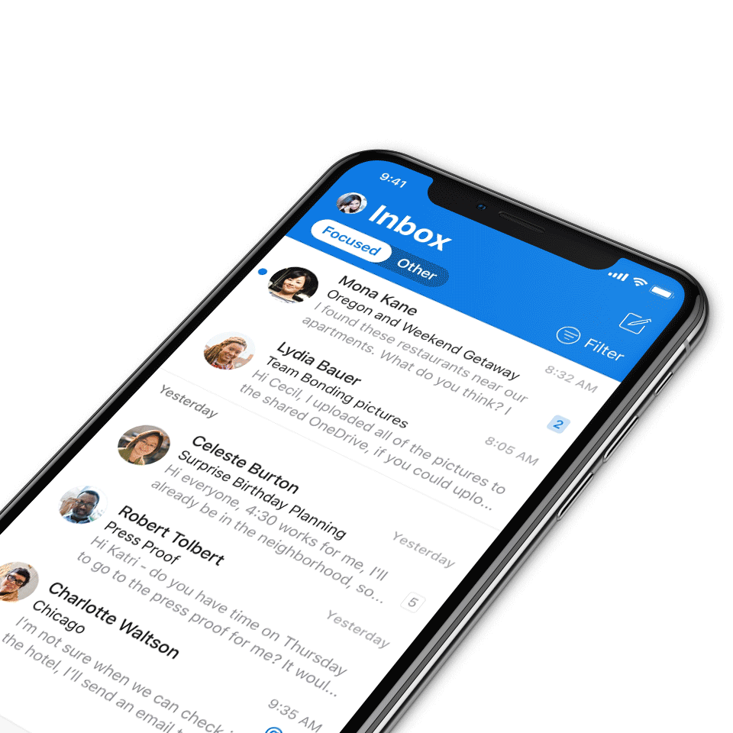
We expect all digital event participants to uphold the principles of this Code of Conduct, which covers the main digital event and all related activities. We do not tolerate disruptive or disrespectful behavior, messages, images, or interactions by any party participant, in any form, at any aspect of the program including business and social activities, regardless of location.​
Microsoft will not tolerate harassment or discrimination based on age, ancestry, color, gender identity or expression, national origin, physical or mental disability, religion, sexual orientation, or any other characteristic protected by applicable local laws, regulations, and ordinances.​
AI notetakers are not permitted and will not be admitted to meetings.
Digital Event Code of Conduct
Microsoft’s mission is to empower every person and every organization on the planet to achieve more.
This includes all Microsoft events and gatherings, including on digital platforms, where we seek to create a respectful, friendly, fun and inclusive experience for all participants.​
We encourage everyone to assist in creating a welcoming and safe environment.
For more info, click here.

Slide 6
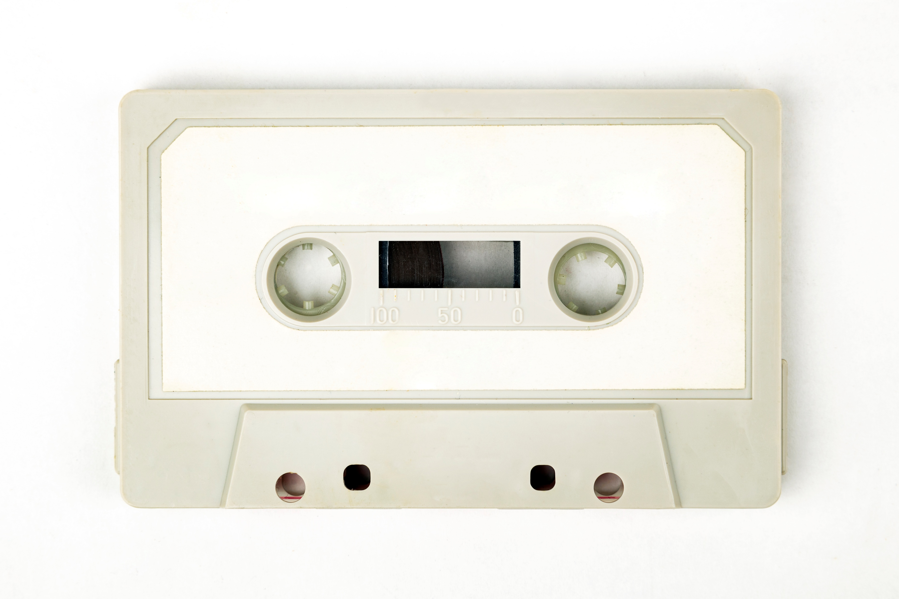
Recordings
All Community Builders Network Calls are recorded and posted on-demand on the Microsoft Community Learning YouTube channel.
If you do not want to be recorded, please leave the call or stay on mute.
Speaker video and audio will be shown in the recordings.
Attendee questions audio will be also be shared.

Slide 7
Mission and Tagline
The Microsoft Global Community Initiative (MGCI) - Empowering global Microsoft communities with the tools, training, and resources to create impactful events and amplify diverse voices.
Learn, Share, Grow.
Join MGCI today! https://aka.ms/MGCI

Slide 8
We want to know about you
Introduce yourself in chat!
Share your LinkedIn profile
What events do you work on?
What’s one thing you’re hoping to learn today?
If you could have any tech superpower, what would it be?

Slide 9
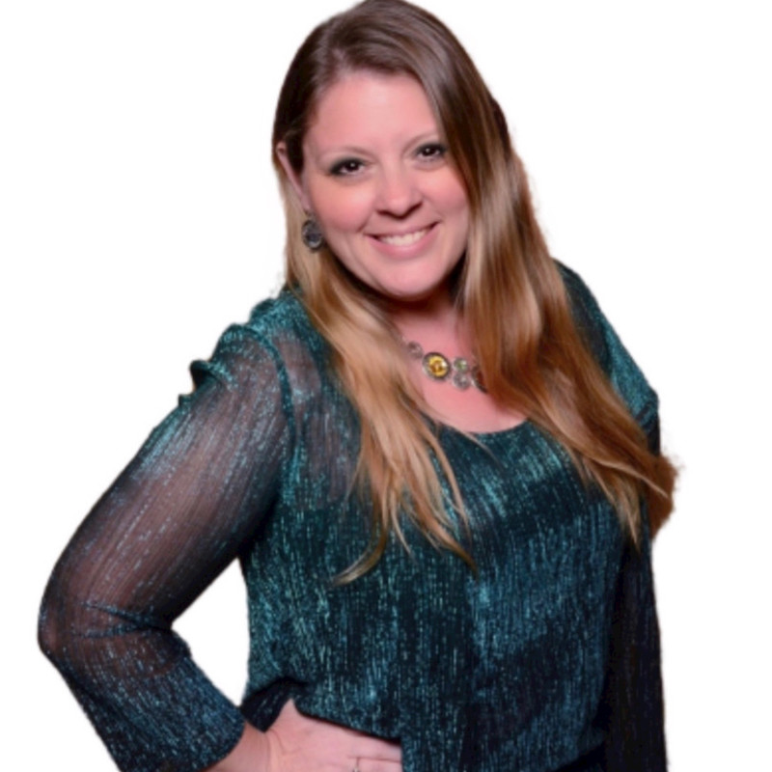
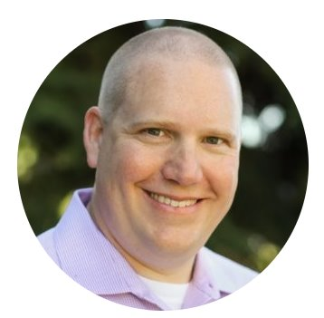
Your Trainers
Sharon Weaver
Founder, CEO Smarter Consulting
Microsoft RD | MVP | MCT
Primary Event:
Women in M365 - aka.ms/womeninm365
Sharon Weaver | LinkedIn
Wes Preston
Minneapolis, MN
Owner, TrecStone
Primary event:
M365 Saturday - Twin Cities (m365tc.com)
Wes Preston | LinkedIn

Slide 10
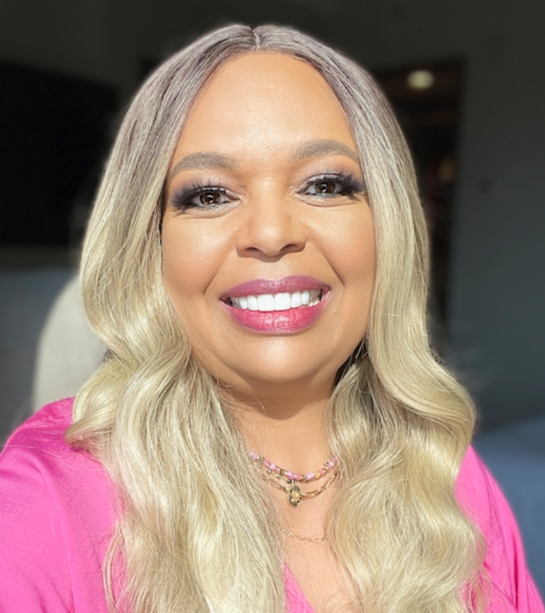
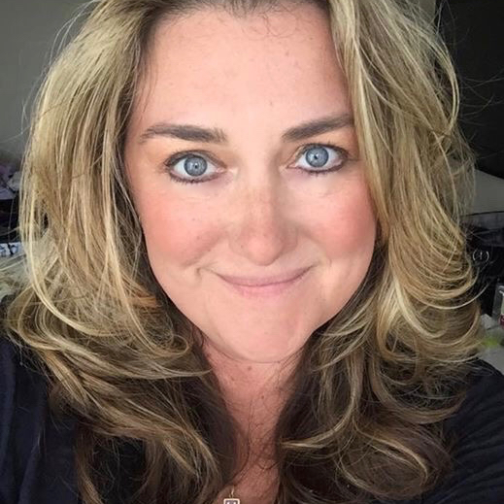
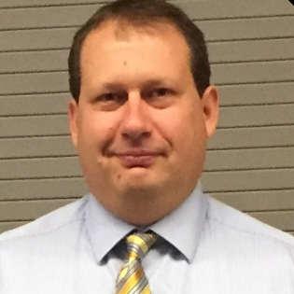
The Microsoft Team
Karuana Gatimu
Community Lead
Olympia, Washington
Phoenix, AZ
Karuana Gatimu | LinkedIn
Heather Cook
Community Manager
Marina del Rey, CA
Heather (Heather Newman) Cook | LinkedIn
Bryan Hart
Technology Lead
Shoreline, WA
Bryan Hart | LinkedIn

Slide 11
Microsoft Global Community Initiative
MONTHLY TOPIC:
Event branding – Graphics and Image Tips

Slide 12

Creating Impactful Event Graphics: Strategies for Success

Slide 13
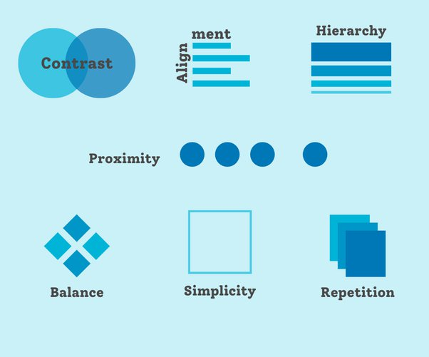
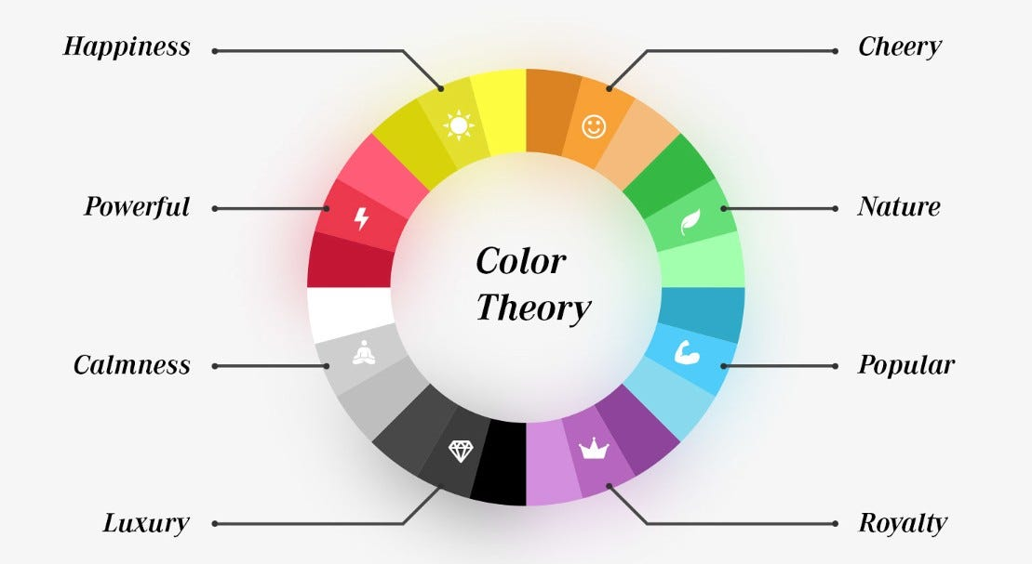
Fundamentals of Effective Event Graphics
Key design principles
  Balance
  Contrast
  Repetition
  Proximity
  Hierarchy
Psychology of colors and fonts in event promotion
  Basics of color theory
  Emotional impact of colors
  Choosing and combining fonts

Slide 14
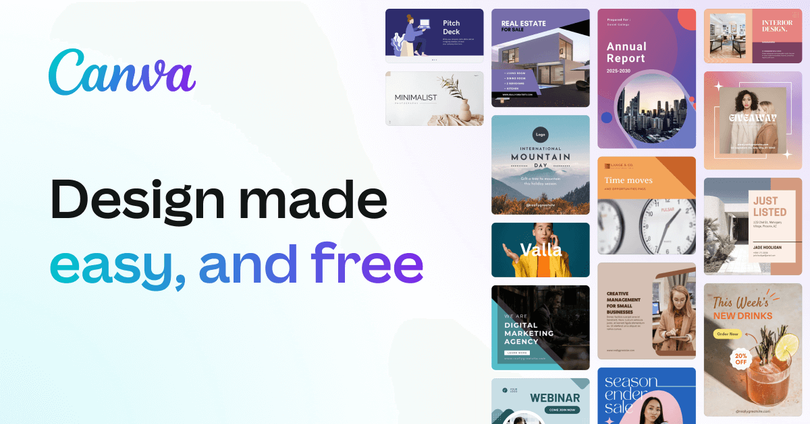
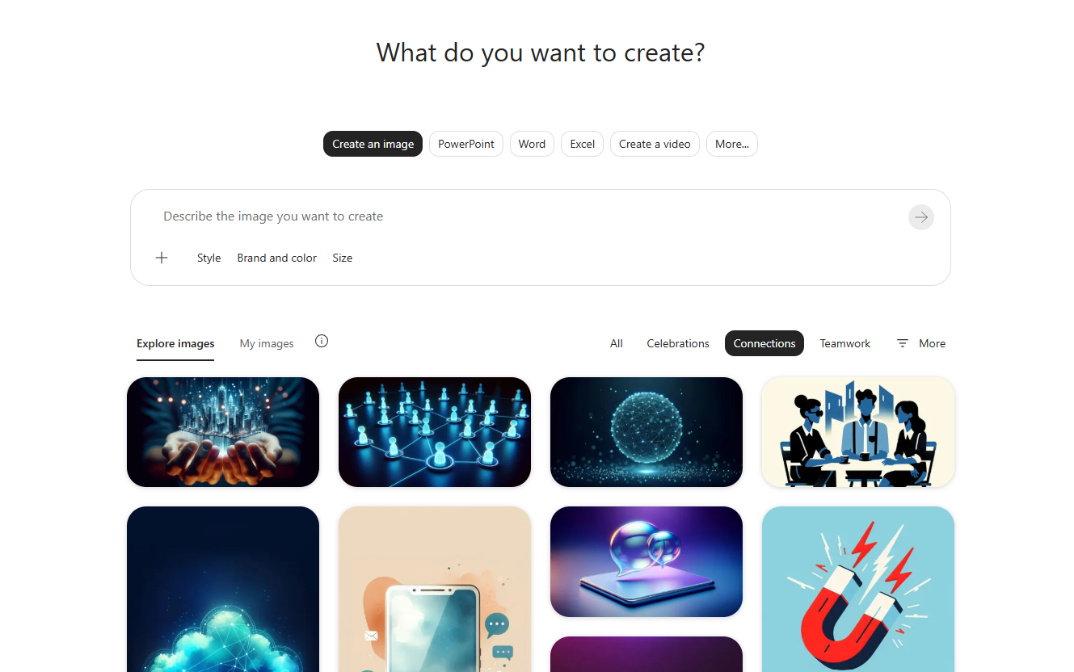
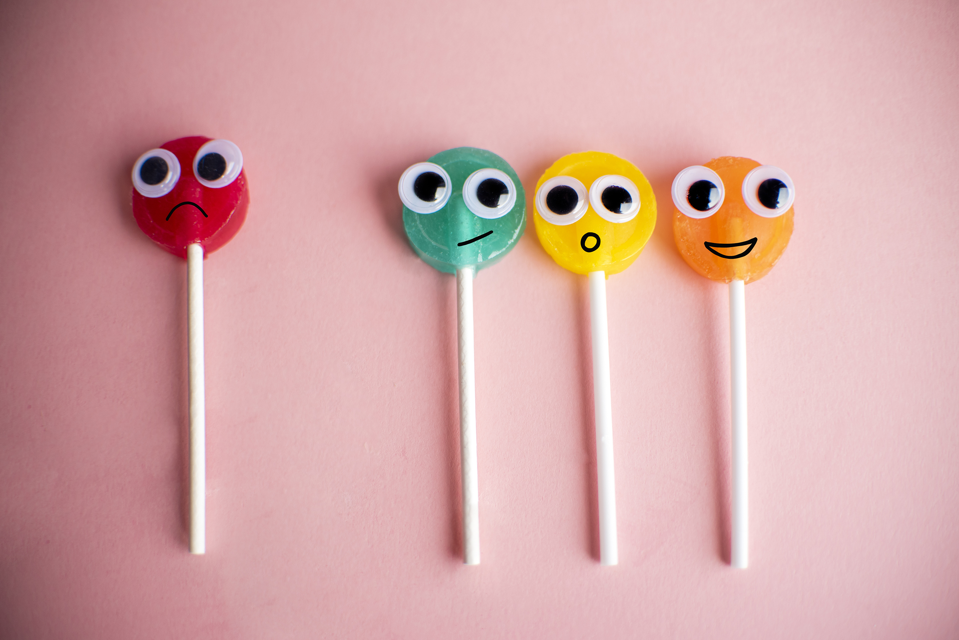
Tools and Resources
Overview of popular design tools and software
  Canva
  M365 Create
  Copilot Chat
  Adobe Firefly
  ChatGPT
  Support a designer/graphic artist

Slide 15
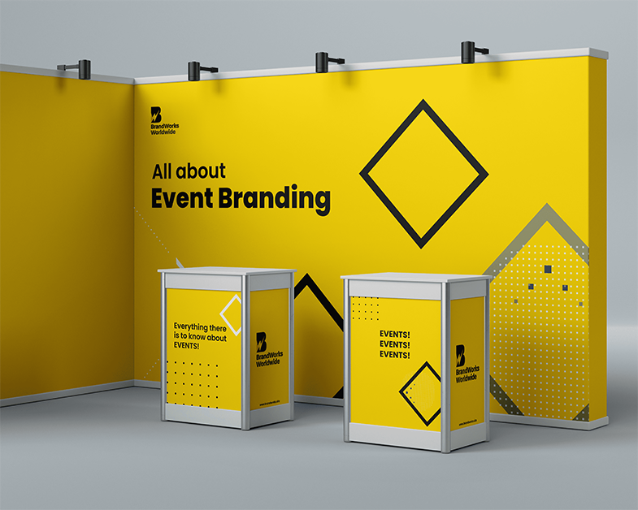
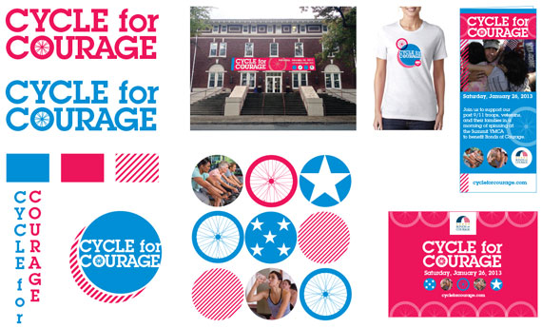
Practical Design Techniques
Create eye-catching graphics
Have a purpose and message
Know the size and format
Plan colors and fonts
Add design elements
Finalize and export with purpose
Best practices for optimizing graphics
Social media
Websites
Print Materials

Slide 16

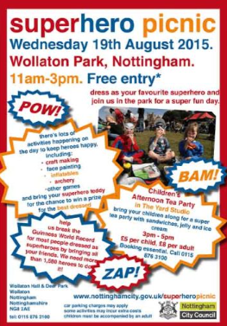

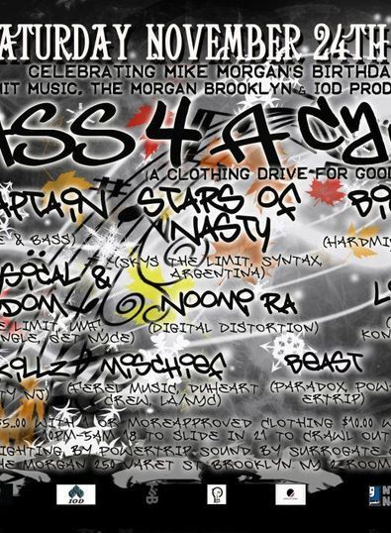
Case Studies and Examples
Common pitfalls to avoid in event graphic design
  Clutter
  Poor Color Choices
  Low-quality images
  Platform-specific issues

Slide 17
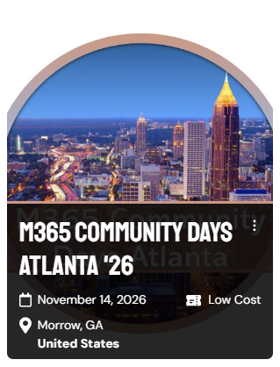


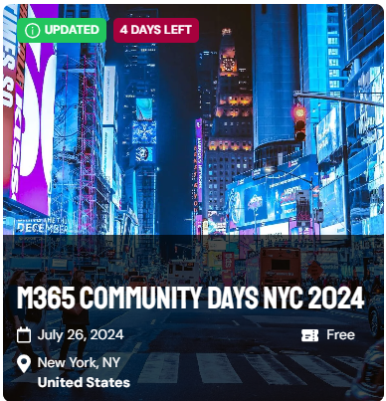

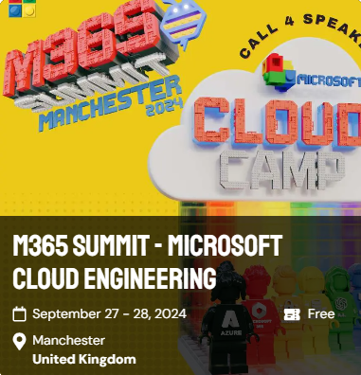
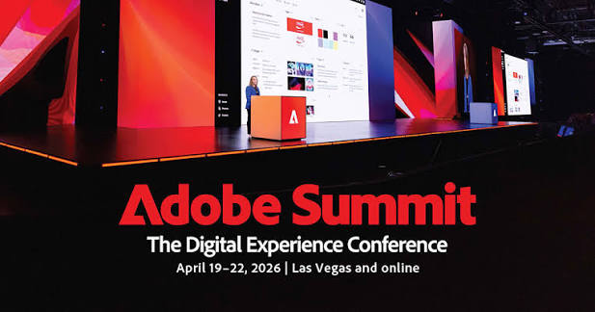
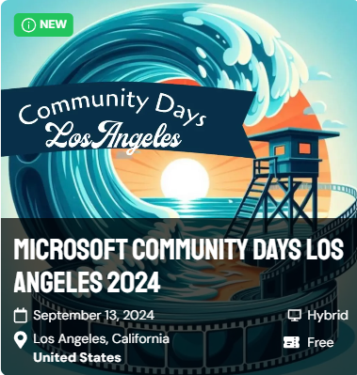
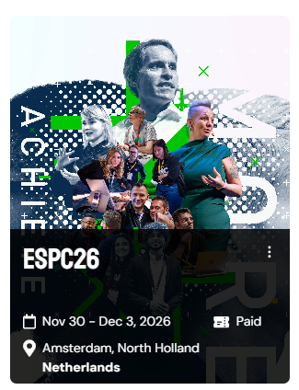


Successful Event Graphics – K.I.S.S.

Slide 18
Event graphics prompts
Prompt formula: Role + Task + Context + Output
Swap the [brackets] for your own event details
1. Plan your graphics
You are an event marketing manager. List every graphic I need to promote and run my event. It's a free, one-day [Microsoft 365] community event in [city] on [date] with [150] attendees, [8] speakers and [3] sponsors. Give me a checklist table with graphic, size, file type and due date.
2. Create your event logo
You are a brand designer. Create a logo for [Event Name]. It's a community tech event for [cloud and AI] pros with a friendly, modern feel in [blue and teal]. Make it a flat, square logo on a white background with the event name in clean, readable text.
3. Write promotional posts
You are a social media copywriter for tech communities. Write posts announcing that registration is open for [Event Name]. The audience is IT pros and developers; it's free, seats are limited, and it's on [date] at [venue]. Give me 3 LinkedIn posts under 100 words, each with a hook, a call to action with [link] and 3 hashtags.
4. Design a speaker card
You are a graphic designer for tech conferences. Design a speaker announcement graphic. [Speaker name], [job title], presents "[session title]" at [Event Name]; leave space for a headshot and use [#0078D4] and white. Make it 1200 x 627 px for LinkedIn with bold, readable text and nothing extra.

Slide 19
Event graphics checklist
Done? | Graphic Item | File Type | Description
 | Event Logo | .PNG, .SVG | High-resolution logo for branding and marketing materials.
 | Social Media Banners | .JPG, .PNG | Facebook, Twitter, LinkedIn cover photos and posts.
 | Event Flyers | .PDF, .JPG | Printable and digital flyers for promotion.
 | Email Headers | .JPG, .PNG | Custom headers for email campaigns.
 | Presentation Templates | .PPTX | Branded PowerPoint templates for speakers.
 | Name Badges | .PDF, .JPG | Printable badges for attendees and staff.
 | Event Schedule | .PDF, .JPG | Printable and digital schedule of events.
 | Event Program | .PDF, .JPG | Detailed program booklet or single-page overview.
 | Session Announcements | .JPG, .PNG | Graphics for announcing sessions on social media and digital signage.
 | Speaker Cards | .JPG, .PNG | Individual graphics highlighting each speaker.
 | Sponsor Logos | .PNG, .SVG | Logos of sponsors for promotional materials.
 | Website Banners | .JPG, .PNG | Banners for event website.
 | Virtual Backgrounds | .JPG, .PNG | Branded backgrounds for virtual sessions.
 | Registration Buttons | .PNG, .SVG | Call-to-action buttons for registration.
 | Thank You Cards | .JPG, .PNG | Graphics for thanking attendees, sponsors, and speakers post-event.
 | Event Countdown | .GIF, .JPG | Countdown graphics for social media and emails.
 | Directional Signage | .PDF, .JPG | Signage for directing attendees at the venue.
 | Event Feedback Forms | .PDF, .JPG | Printable and digital feedback forms for attendees.
 | Event App Icons | .PNG, .SVG | Icons for any event-related mobile app.
 | Merchandise Designs | .JPG, .PNG, .AI | Designs for t-shirts, mugs, and other merchandise.

Slide 20
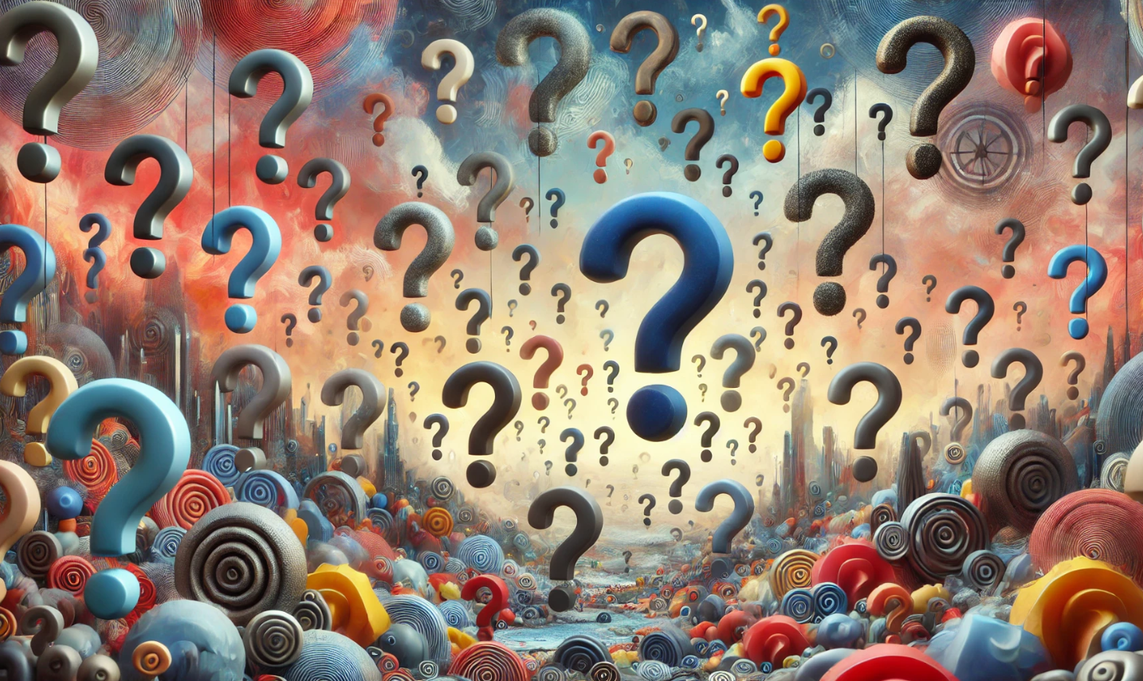
Q&A
Prompt: “A land of question marks of all styles and sorts, abstract”

Slide 21
Q+A
Ask Me Anything
Join the discussion on Microsoft Tech Community:
https://aka.ms/MGCI-SepEventTrainingDiscussionEventBranding

Slide 22
2026 Schedule
Event Training
Schedule
Date | Topic
JAN 29 | Sponsors and Sponsorship
FEB 26 | Community Days, MTC User Groups & AMC
MAR 26 | SPRING BREAK
APR 30 | Run of Show – Day of Event Lessons Learned
MAY 28 | Event & Committee Planning
JUN 25 | How to find and select speakers
JUL 30 | FOOD! Meals, Snacks, and Beverages
AUG 27 | SUMMER BREAK
SEP 24 | Event branding – Graphics & Image tips
OCT 29 | Filling seats! How to market your event
NOV 26 | HOLIDAY BREAK
DEC 24 | HOLIDAY BREAK

Slide 23
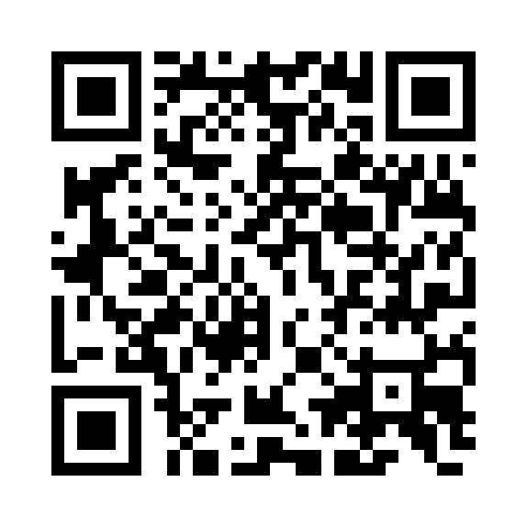
We Want Your Feedback!
https://aka.ms/MGCIFeedback

Slide 24
Keep the questions coming – about this topic or other event production topics on TechCommunity

Slide 25
Community Event Organizer Trainings
Learn from your peers and get updates on the MGCI program.
4th Thursday of every month at 8:10 AM PT.
Join: https://aka.ms/MGCITrainingMTG
All sessions are also available on-demand via the Microsoft Community Learning YouTube channel:
https://aka.ms/community/learning

Slide 26
MGCI Community Builders Network Call
3rd Wednesday of the month
Learn from your peers and get updates on the MGCI program
Oct 21: Game on: building Community together (yes! it’s a team sport)
Join: https://aka.ms/MGCIMtgAM
All sessions are also available on-demand via the Microsoft Community Learning YouTube channel:
https://aka.ms/community/learning
Notes:
Introduce the monthly MGCI General Sessions — 3rd Tuesday of every month at 8:10 AM PT. Encourage them to attend live; replays are on the Microsoft Community Learning YouTube channel.

Slide 27
MGCI Community Builders Network Call
Want to share best practices or lessons learned on producing events or building community in an upcoming session?
Fill out this form:
https://aka.ms/GeneralSessionGuest
We are looking for speakers for 2026!
Microsoft Global Community Initiative https://aka.ms/MGCI

Slide 28


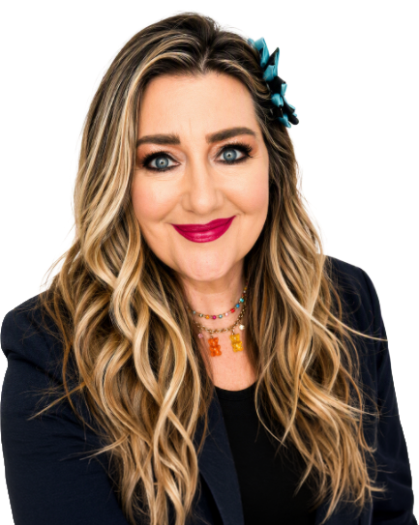
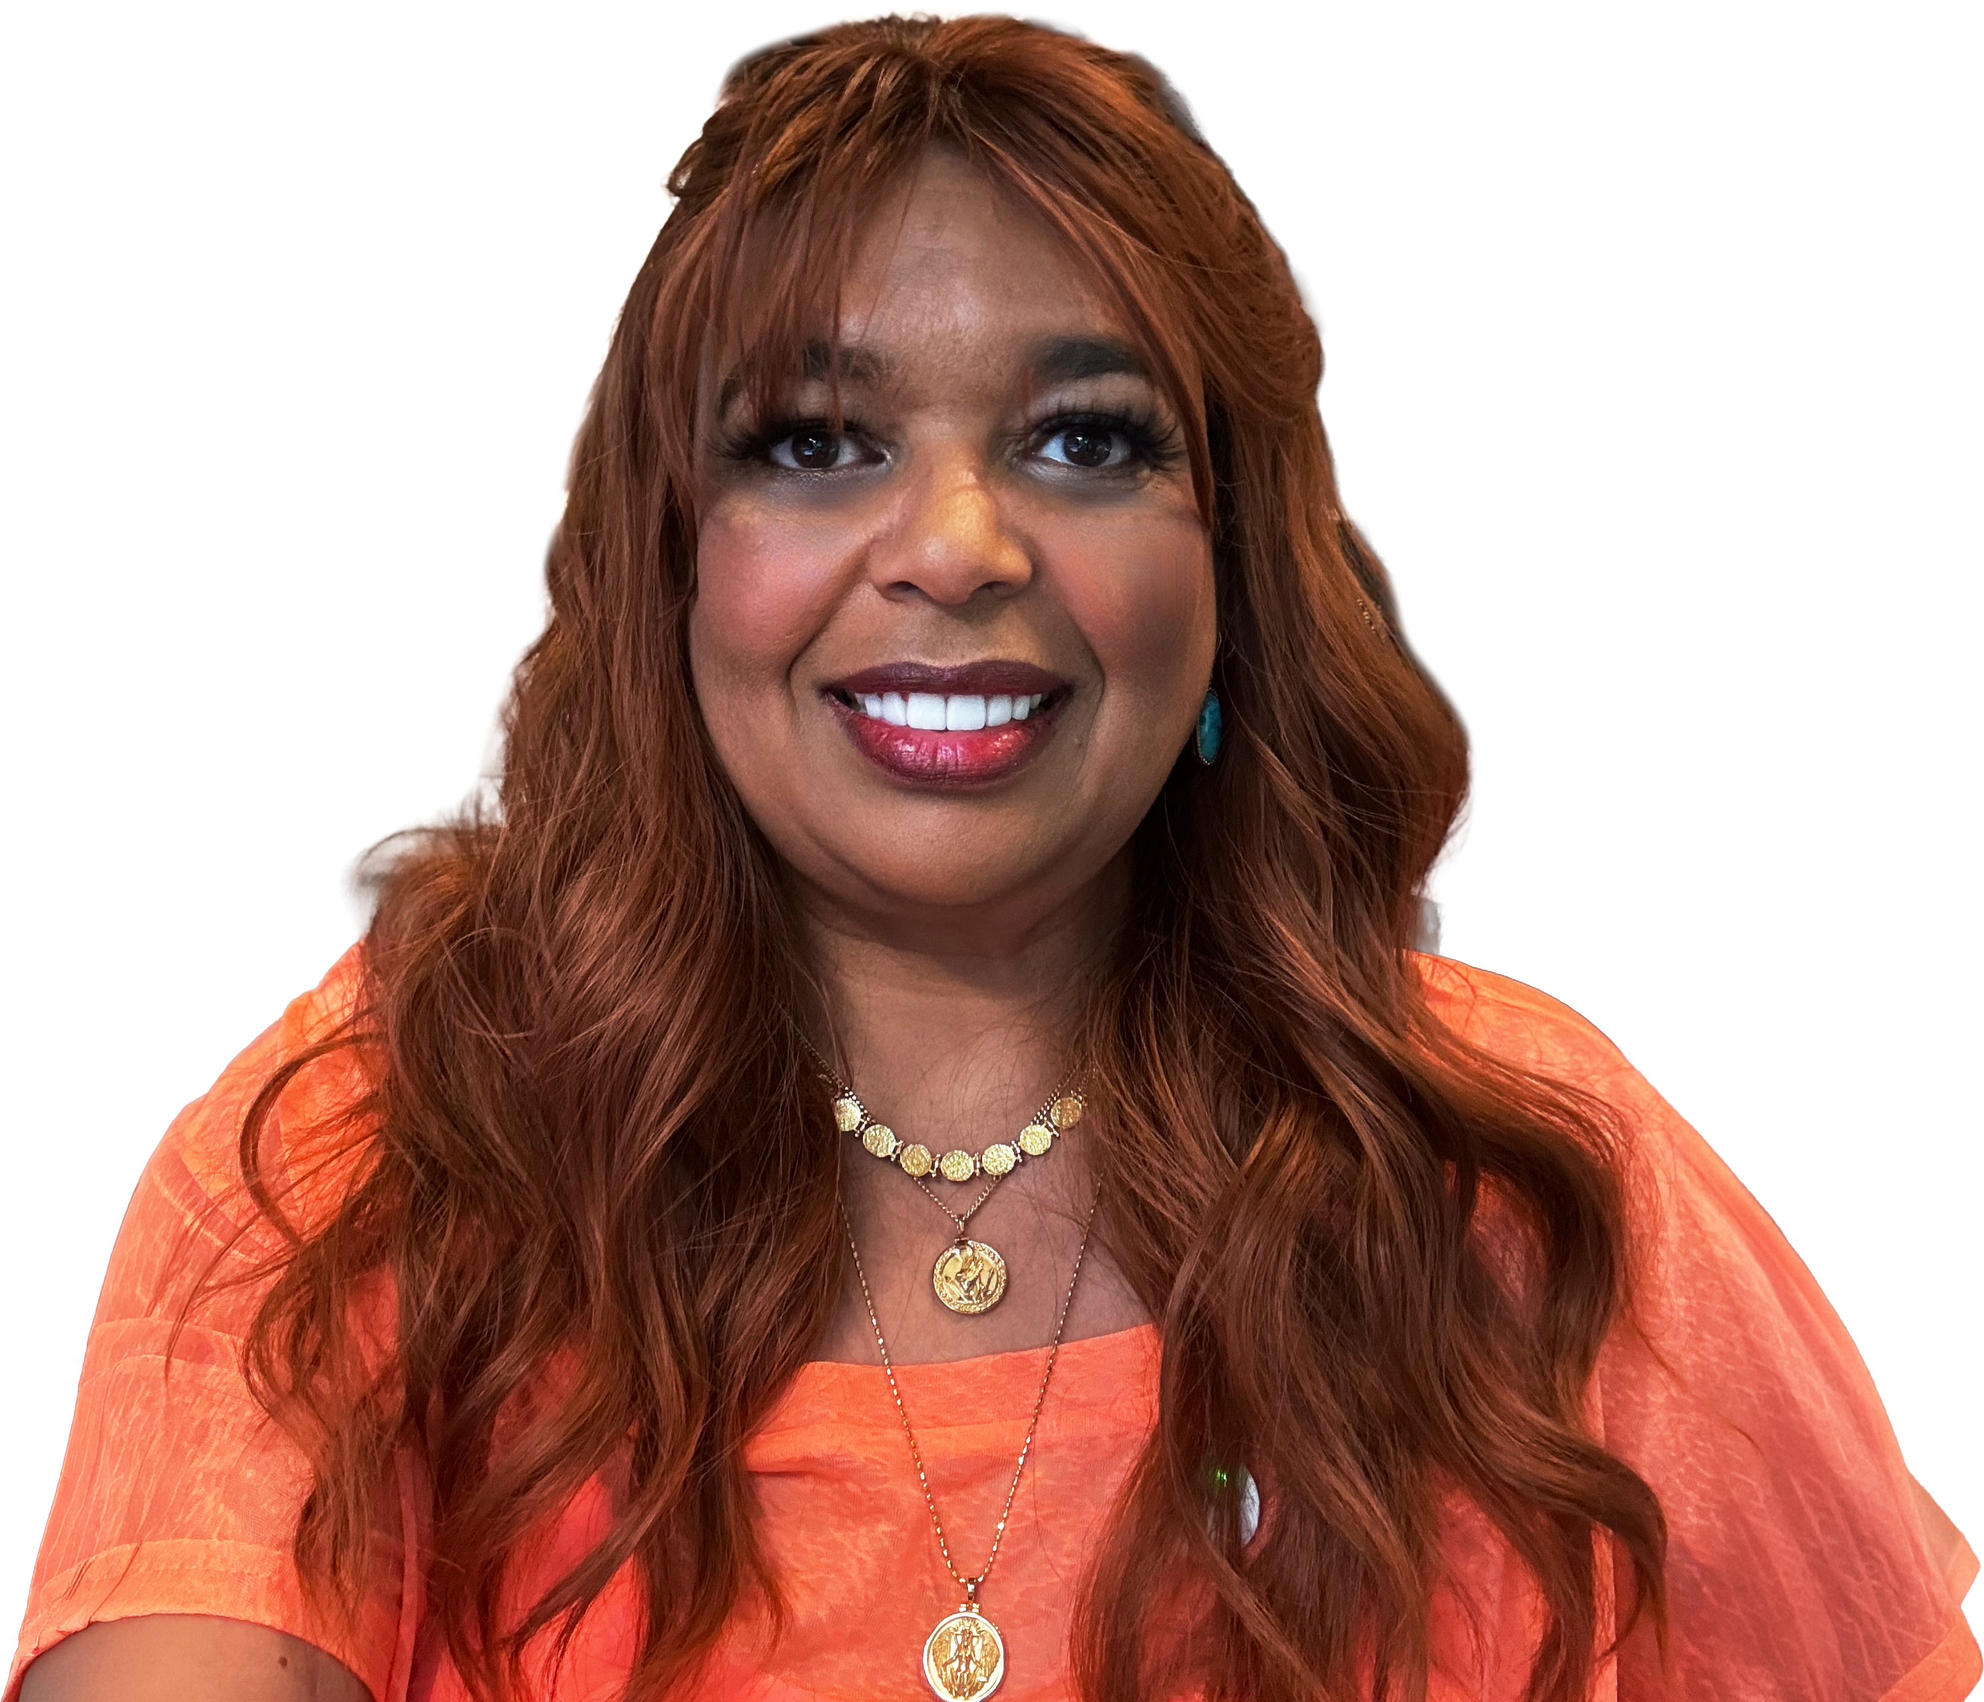
Get the latest AI new, product announcements, and
Microsoft Community insights from Karuana Gatimu and Heather Cook, every Monday.
Live every Monday at 8:00 AM PT
Fuel your week
aka.ms/MondaysAtMicrosoft

Slide 29
Microsoft Tech Community
The community platform for Microsoft 365 – forums, blogs, and events aka.ms/joinMTC.
Stay Connected!
CommunityDays.org
Find or host a local event in your area
or to match your interests.
Engage with the best community in tech…
There’s something for everyone!
Microsoft Community on LinkedIn
News, announcements and training delivered to your news feed aka.ms/microsoftcommunitylinkedin.

Slide 30
Thank you!

Slide 31
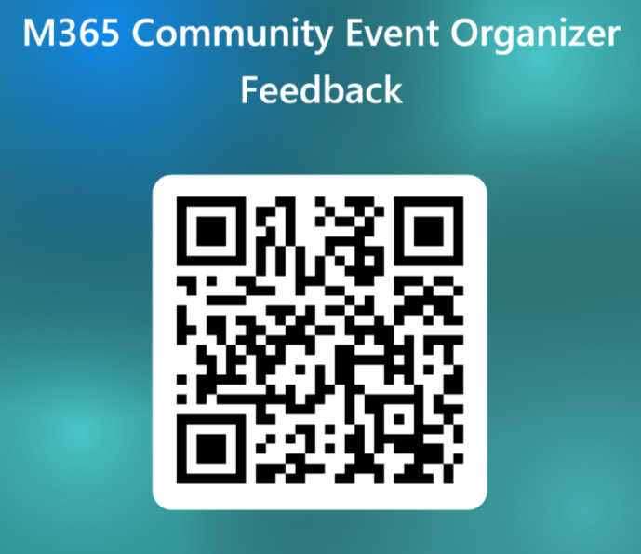
TRAINING
Please Provide Feedback!
Your feedback shapes the topics, formats, and speakers for upcoming sessions — it takes about two minutes.
WHAT WE'RE ASKING
Topics you want more guidance on
Speakers and formats that worked well
What we should improve next time
Open the feedback form →
aka.ms/MGCI-EventOrganizerFeedback
Scan to open the form
communitydays.org
TRAINING

