Slide 1


We will get started at 10 min after the hour
Grab a refreshment!
Event Organizer Training and Office Hours
July 30, 2026

Slide 2


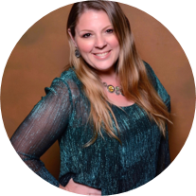
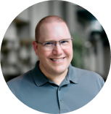

Microsoft Global Community Initiative Event Training and Office Hours
July 2026
Hosts: Sharon Weaver & Wes Preston

Slide 3
AGENDA
Introductions
Event Training: Food! Meals, Snacks and Beverages
Ask Me Anything
Notes:
Other potential Topics:
NDA Updates - Onboarding Next steps
VOC Topic - Organizer Toolkit assets discussion
Regional Community Support – How to engage regional leads

Slide 4
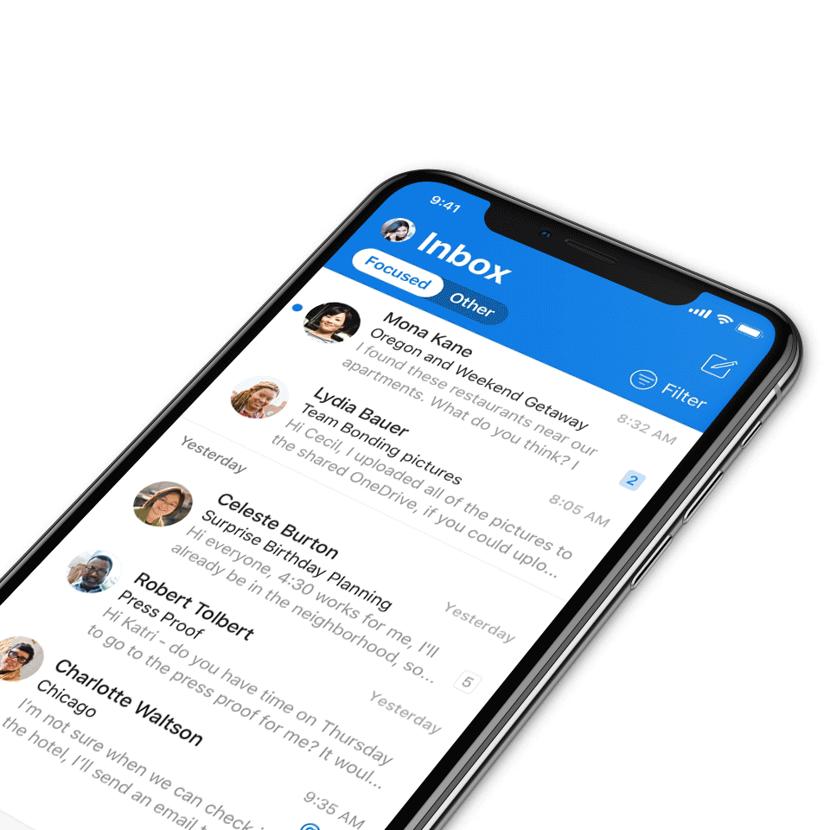
Digital Event Code of Conduct
Microsoft’s mission is to empower every person and every organization on the planet to achieve more. This includes all Microsoft events and gatherings, including on digital platforms, where we seek to create a respectful, friendly, fun and inclusive experience for all participants.​
We expect all digital event participants to uphold the principles of this Code of Conduct, which covers the main digital event and all related activities. We do not tolerate disruptive or disrespectful behavior, messages, images, or interactions by any party participant, in any form, at any aspect of the program including business and social activities, regardless of location.​
Microsoft will not tolerate harassment or discrimination based on age, ancestry, color, gender identity or expression, national origin, physical or mental disability, religion, sexual orientation, or any other characteristic protected by applicable local laws, regulations, and ordinances.​
AI notetakers are not permitted and will not be admitted to meetings.
We encourage everyone to assist in creating a welcoming and safe environment.
For more info, click here.

Slide 5

Microsoft branding slide
All General Sessions are recorded and posted on-demand on the Microsoft Community Learning YouTube channel if you do not want to be recorded, please leave the call or stay on mute.
Speaker video and audio will be shown in the recordings.
Attendee questions audio will be also be shared.

Slide 6

MGCI Mission and Tagline
The Microsoft Global Community Initiative (MGCI) - Empowering global Microsoft communities with the tools, training, and resources to create impactful events and amplify diverse voices.
Learn, Share, Grow.
Join MGCI today! https://aka.ms/MGCI

Slide 7

We want to know about you
Introduce yourself in chat!
Share your LinkedIn profile
What brings you here today?
What events do you work on?
What’s the best event you’ve ever attended?
Why?
What’s the best food or most efficient food you’ve had at an event?
What’s one thing you’re hoping to learn today?
If you could have any tech superpower, what would it be?
Notes:
Other potential Topics:
NDA Updates - Onboarding Next steps
VOC Topic - Organizer Toolkit assets discussion
Regional Community Support – How to engage regional leads

Slide 8
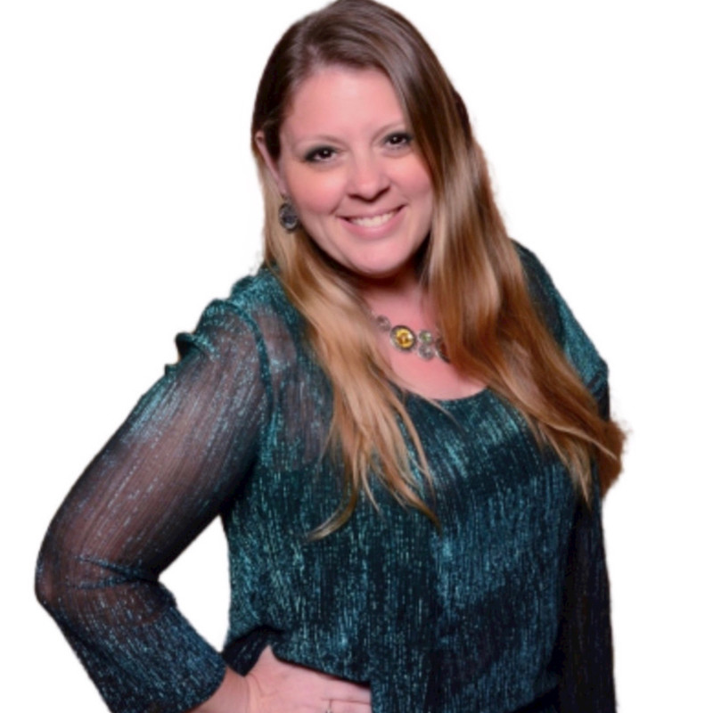
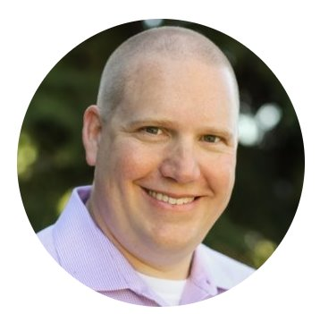
Meet your trainers
Sharon Weaver
Founder, CEO Smarter Consulting
Microsoft RD | MVP | MCT
Primary Event:
CollabCon - https://www.collabconforall.com/
Sharon Weaver | LinkedIn
Wes Preston
Minneapolis, MN
Owner, TrecStone
Primary event:
M365 Saturday - Twin Cities (m365tc.com)
Wes Preston | LinkedIn
Notes:
Other potential Topics:
NDA Updates - Onboarding Next steps
VOC Topic - Organizer Toolkit assets discussion
Regional Community Support – How to engage regional leads

Slide 9
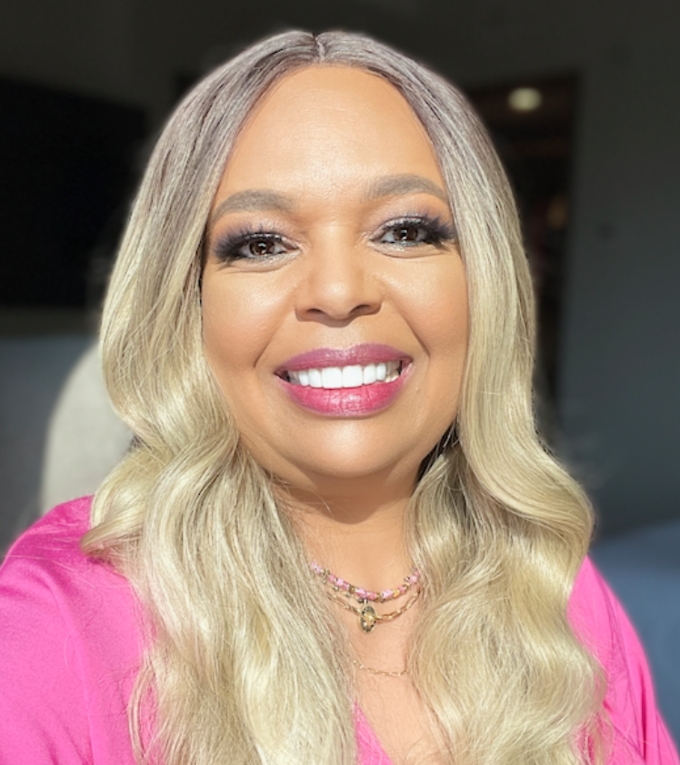
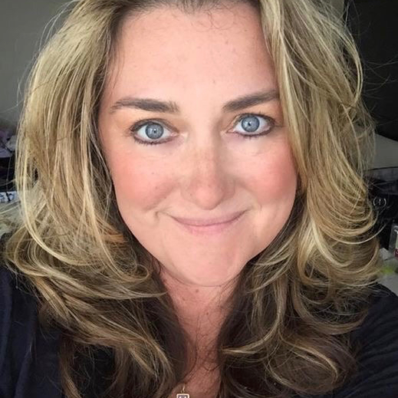
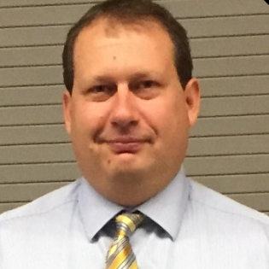
Meet the Microsoft Team
Karuana Gatimu
Community Lead
Olympia, Washington
Phoenix, AZ
Karuana Gatimu | LinkedIn
Heather Cook
Community Manager
Marina del Rey, CA
Heather (Heather Newman) Cook | LinkedIn
Bryan Hart
Technology Lead
Shoreline, WA
Bryan Hart | LinkedIn
Notes:
Other potential Topics:
NDA Updates - Onboarding Next steps
VOC Topic - Organizer Toolkit assets discussion
Regional Community Support – How to engage regional leads

Slide 10
Microsoft Global Community Initiative
MONTHLY TOPIC:
Food! Meals, Snacks and Beverages

Slide 11
Food! Meals, Snacks & Beverages
Facilitated Discussion
A guided conversation for Microsoft Community event organizers.
Buffets
Snacks
Coffee & Tea
Boxed Lunches
Stations, lines and flow
Breaks that keep energy up
All-day beverage service
Grab-and-go for tight agendas
Every attendee eats safely, comfortably and within budget.
HOW THIS WORKS
Each topic opens with one talking point. Bring your own examples! What worked, and what you would never do again.

Slide 12
Dietary Restrictions & Allergies
1 of 6
TALKING POINT
Assume every event has attendees with allergies, medical diets and faith-based needs. Plan for it.
Discussion Questions
Watch Out For
Practical Tips
How do you collect dietary needs at registration — and how late can someone update them?
Who at the venue can confirm ingredients and cross-contact risk on event day?
Are the alternate options as appealing as the main menu?
Shared utensils and buffet lines creating cross-contact
“Vegetarian” dishes hiding fish sauce, gelatin or chicken stock
Special meals arriving late, singling people out
Label every dish with allergens in plain language
Make 10–15% of the menu naturally vegan and gluten-free
Hold two or three sealed backup meals in reserve

Slide 13
Accurate Headcounts & Quantities
2 of 6
TALKING POINT
Registrations are not attendance — build the order on your historical show rate, not on the RSVP list.
Discussion Questions
Watch Out For
Practical Tips
What is your typical no-show rate, and do you track it by event type?
When is the caterer's final guarantee deadline, and what can still change after it?
Who counts heads on site, and how fast can you add food?
Free events commonly see 30–50% no-shows
Running out during the first break — the story people remember
Paying for food that goes straight to the bin
Walk-ins and plus-ones nobody planned for
Order to show rate, not registrations
Reconfirm counts 48 hours out and again the morning of
Agree a same-day add-on window with the caterer
Choose menus that scale — trays, not plated meals

Slide 14
Food Safety & Temperature Control
3 of 6
TALKING POINT
The danger zone is 40–140°F (4–60°C). Food sitting out past two hours is a liability, not leftovers.
Discussion Questions
Watch Out For
Practical Tips
Is your caterer licensed, insured and food-handler certified?
Who watches hold times and pulls food off the line?
What is the plan for leftovers — donation, disposal or nothing?
Dairy and protein sitting warm through a long session
Self-serve refills without changing utensils
No sanitizer or handwashing near the service line
Guests taking home unlabeled food
Set a timer — two hours out, then it goes
Use chafers for hot and ice beds for cold
Put sanitizer at the entry to every line
Never re-serve food that left the service area

Slide 15
Budget & Cost Management
4 of 6
TALKING POINT
Food is usually the largest variable line item — set your cost per head, then design the menu backwards from it.
Discussion Questions
Watch Out For
Practical Tips
What is your all-in cost per attendee, including service, tax and gratuity?
Where can you trade down without hurting the experience?
Could a sponsor or venue package cover part of the catering?
Service charges and taxes of 20–25% found after signing
Per-person pricing billed on the guarantee, not attendance
Beverage and coffee upgrades quietly doubling the bill
Last-minute additions charged at premium rates
Ask for quotes as one all-in per-person number
Heavier snacks often beat a thin full meal
Put change orders and cut-offs in writing
Track actual spend per head after every event

Slide 16
Service Logistics & Timing
5 of 6
TALKING POINT
Food timing is agenda design — slow service eats your content, and food that lands early goes cold.
Discussion Questions
Watch Out For
Practical Tips
How long does it really take to serve your headcount through the lines you have?
Where do delivery, setup and teardown happen without crossing attendee flow?
Who is the caterer's on-site contact, and who owns food on your team?
One serving line turning a break into a 25-minute queue
Delivery arriving in the middle of a session
No plan for tables, trash, refills or ice
Venue access hours that cut setup short
Plan two double-sided lines per 100 guests
Build a 10-minute buffer before and after service
Confirm access times, power and trash in writing
Name one person to own food all day

Slide 17
Food as a Motivator
6 of 6
TALKING POINT
Food is your cheapest attendance lever — people register for the content, but they come back for how the event felt.
Discussion Questions
Watch Out For
Practical Tips
Which food moment shows up most in your post-event feedback?
Does your agenda give people a reason to stay through the last session?
What would make an attendee bring a colleague next time?
Promising “lunch provided” and serving chips and soda
Snack tables emptying before the second half
The same menu every time — the novelty wears off
Food that is fun but impossible to eat while networking
Put one hot item on the menu — it signals real hospitality
Hold a treat for the final session and say so in the agenda
Rotate a local or seasonal crowd-pleaser each event
Name the food in your invite and reminder emails

Slide 18
Q+A
Ask Me Anything
Join the discussion on Microsoft Tech Community:
https://aka.ms/MGCI-June2026EventTrainingDiscussion

Slide 19
TRAINING
Training Schedule
Monthly Series · Jan – Dec 2026
2026 SCHEDULE
Monthly virtual sessions for event organizers — share lessons learned and help shape upcoming topics.
Date | Topic
JAN 29 | Sponsors and Sponsorship
FEB 26 | Community Days, MTC User Groups & AMC
MAR 26 | SPRING BREAK
APR 30 | Run of Show – Day of Event Lessons Learned
MAY 28 | Event & Committee Planning
JUN 25 | How to find and select speakers
JUL 30 | FOOD! Meals, Snacks, and Beverages
AUG 27 | SUMMER BREAK
SEP 24 | Event branding – Graphics & Image tips
OCT 29 | Filling seats! How to market your event.
NOV 26 | HOLIDAY BREAK
DEC 24 | HOLIDAY BREAK

Slide 20
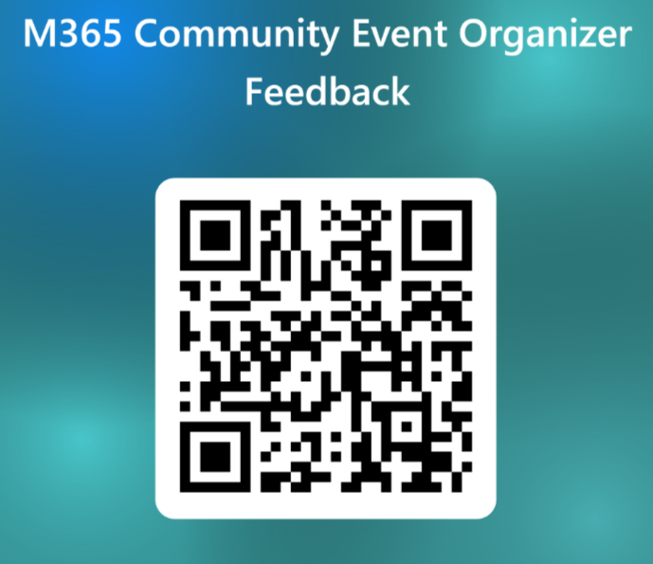
TRAINING
Please Provide Feedback!
Your feedback shapes the topics, formats, and speakers for upcoming sessions — it takes about two minutes.
WHAT WE'RE ASKING
Topics you want more guidance on
Speakers and formats that worked well
What we should improve next time
Open the feedback form →
aka.ms/MGCI-EventOrganizerFeedback
Scan to open the form
communitydays.org
TRAINING

Slide 21

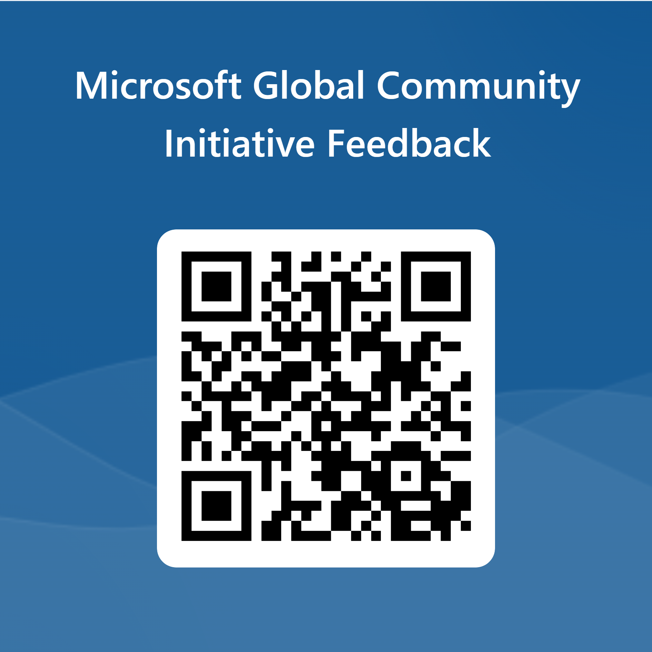
Love your feedback on this meeting
https://aka.ms/MGCIMeetingFeedback

Slide 22
Keep the questions coming – about this topic or other event production topics on TechCommunity

Slide 23

Request Community Amplification
Looking for help amplifying your event via Microsoft Community LinkedIn and MSFT Adoption twitter handle?
Fill out this form:
https://aka.ms/communitysocial
The SLA is 3 business days.
Microsoft Global Community Initiative https://aka.ms/MGCI

Slide 24
Community Event Organizer Trainings
Learn from your peers and get updates on the MGCI program.
4th Thursday of every month at 8:10 AM PT.
Join: https://aka.ms/MGCITrainingMTG
All sessions are also available on-demand via the Microsoft Community Learning YouTube channel:
https://aka.ms/community/learning

Slide 25
MGCI Community Builders Network Call
(formerly called MGCI General Session)
Learn from your peers and get updates on the MGCI program.
Break in August
Starting in September, the 3rd Wednesday of every month at 8:10 AM PT.
Join: https://aka.ms/MGCIMtgAM
All sessions are also available on-demand via the Microsoft Community Learning YouTube channel:
https://aka.ms/community/learning
Notes:
Introduce the monthly MGCI General Sessions — 3rd Tuesday of every month at 8:10 AM PT. Encourage them to attend live; replays are on the Microsoft Community Learning YouTube channel.

Slide 26
MGCI Community Builders Network Call
Want to share best practices or lessons learned on producing events or building community in an upcoming session?
Fill out this form:
https://aka.ms/GeneralSessionGuest
We are looking for speakers for 2026!
Microsoft Global Community Initiative https://aka.ms/MGCI

Slide 27
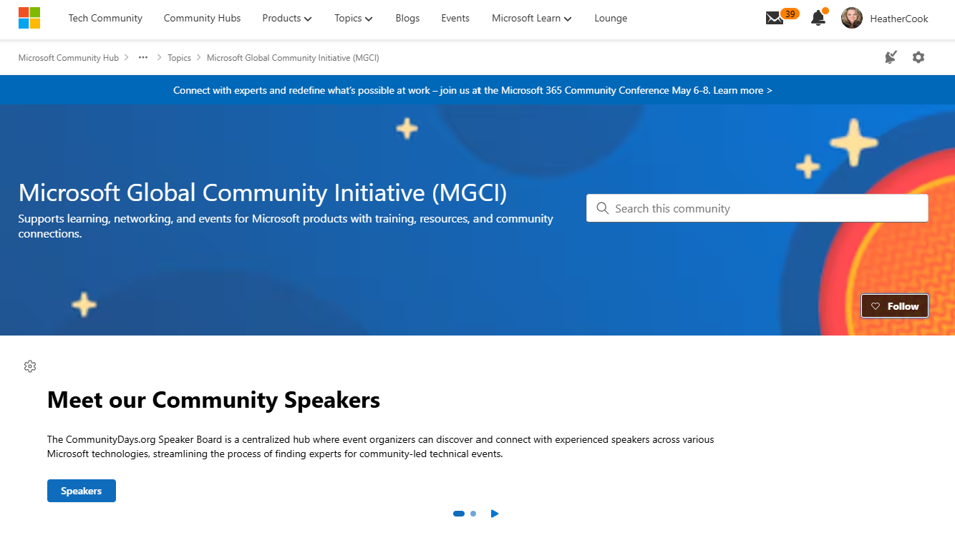
MGCI on MTC
https://aka.ms/MGCICommunityHub
https://aka.ms/MGCI-Events
https://aka.ms/MGCI-NewsandBlogs
Microsoft Global Community Initiative https://aka.ms/MGCI
https://aka.ms/MGCI-Discussions

Slide 28
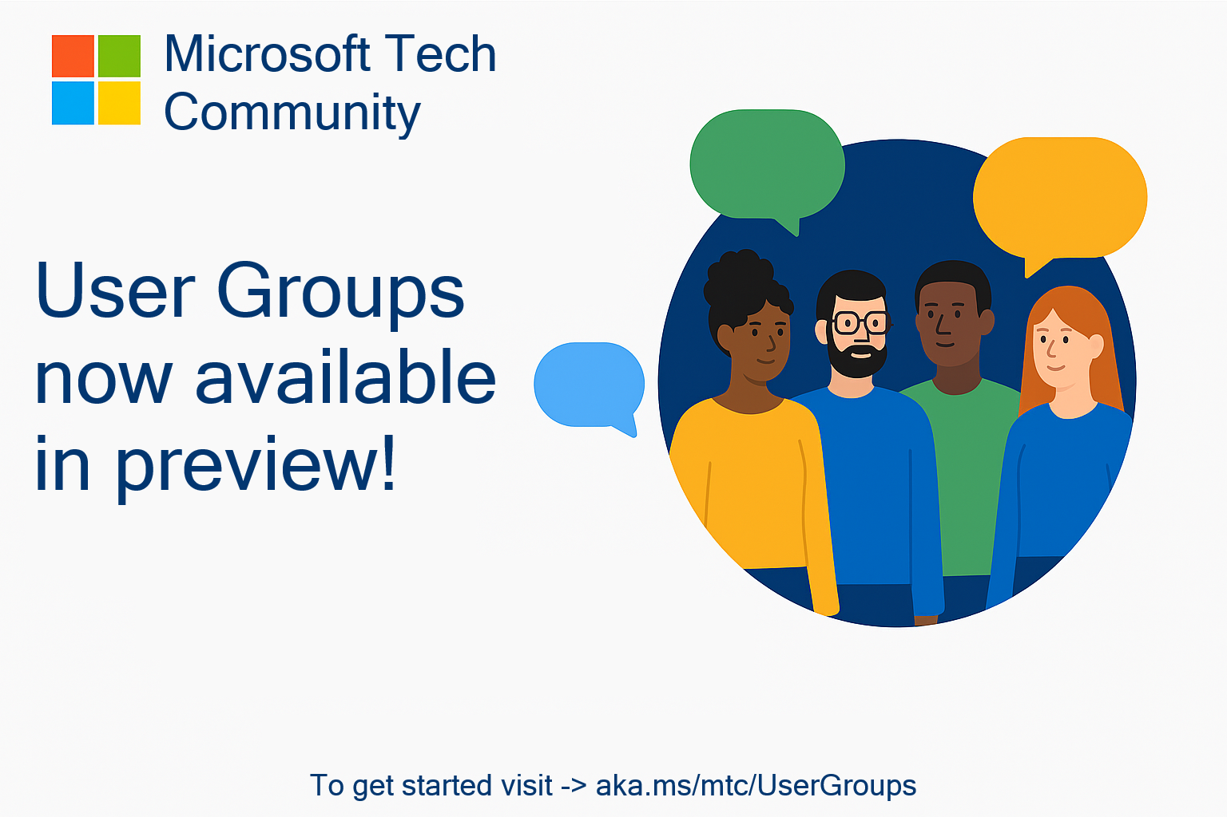
🥳 User Groups on Microsoft Tech Community
Connecting Communities. Empowering Collaboration.
Introducing Tech Community User Groups
User Groups are a new feature currently in preview on the Microsoft Tech Community – fully launching by end of September, designed to bring together individuals with shared interests, roles, or technologies, and enable deeper collaboration, discussion, and learning.
Join the Preview Today
Next Steps:
Visit https://aka.ms/mtc/usergroups
Sign in with your Microsoft account to participate
Browse available groups or select create a new user group to start your own!
Share feedback to help shape the future of User Groups

Slide 29


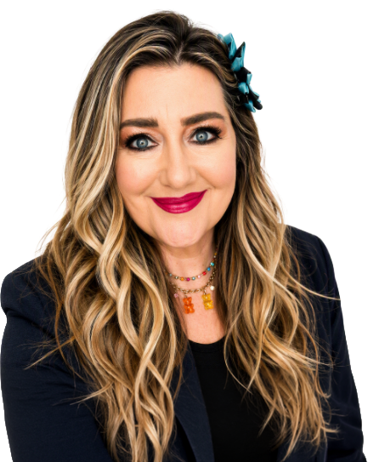
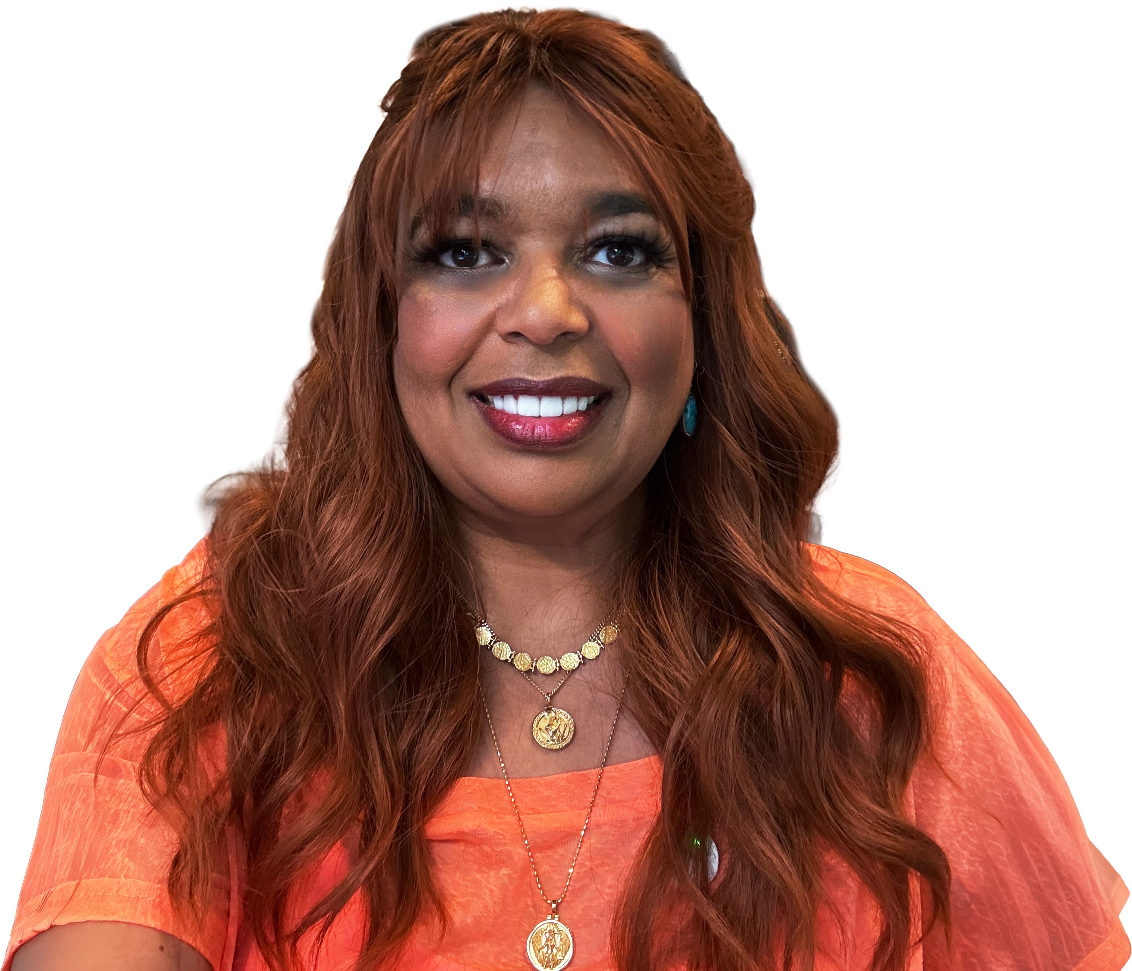
Get the latest AI new, product announcements, and
Microsoft Community insights from Karuana Gatimu and Heather Cook, every Monday.
Live every Monday at 8:00 AM PT
Fuel your week
aka.ms/MondaysAtMicrosoft

Slide 30

Stay Connected!
Engage with the best community in tech…
There’s something for everyone!
Microsoft Tech Community
The community platform for Microsoft 365 – forums, blogs, and events
aka.ms/joinMTC
CommunityDays.org
Find or host a local event in your area
or to match your interests
Microsoft Community on LinkedIn
News, announcements and training delivered to your news feed aka.ms/microsoftcommunitylinkedin

Slide 31
Thank you!

