Slide 1


We will get started at 10 min after the hour
Grab a refreshment!
Event Organizer Training and Office Hours
June 26, 2025

Slide 2


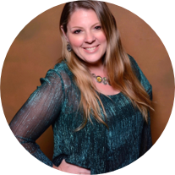
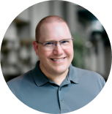

Microsoft Global Community Initiative general session
June 2025
Hosts: Sharon Weaver & Wes Preston

Slide 3
AGENDA
Introductions
Topic: Speaker Selection
Ask Me Anything
Notes:
Other potential Topics:
NDA Updates - Onboarding Next steps
VOC Topic - Organizer Toolkit assets discussion
Regional Community Support – How to engage regional leads

Slide 4
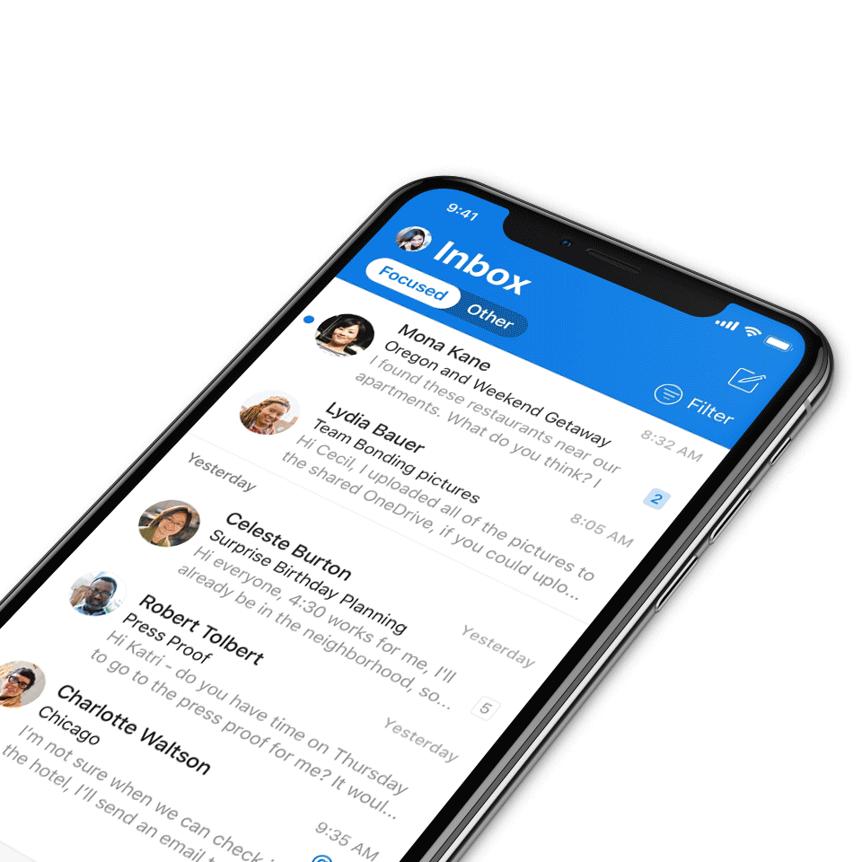
Digital Event Code of Conduct
Microsoft’s mission is to empower every person and every organization on the planet to achieve more. This includes all Microsoft events and gatherings, including on digital platforms, where we seek to create a respectful, friendly, fun and inclusive experience for all participants.​
We expect all digital event participants to uphold the principles of this Code of Conduct, which covers the main digital event and all related activities. We do not tolerate disruptive or disrespectful behavior, messages, images, or interactions by any party participant, in any form, at any aspect of the program including business and social activities, regardless of location.​
Microsoft will not tolerate harassment or discrimination based on age, ancestry, color, gender identity or expression, national origin, physical or mental disability, religion, sexual orientation, or any other characteristic protected by applicable local laws, regulations, and ordinances.​
We encourage everyone to assist in creating a welcoming and safe environment.
For more info, click here.

Slide 5

Mission
The Microsoft Global Community Initiative (MGCI) features event amplification, event production training, blogs, networking, technology and tools best practices, resources, playbooks, and more for the Microsoft Community.
Join MGCI today! https://aka.ms/MGCI

Slide 6

Introductions
Introduce yourself in chat!
What’s your name?
Where are you from?
What events do you work on?
What’s the link to your LinkedIn profile?
Notes:
Other potential Topics:
NDA Updates - Onboarding Next steps
VOC Topic - Organizer Toolkit assets discussion
Regional Community Support – How to engage regional leads

Slide 7
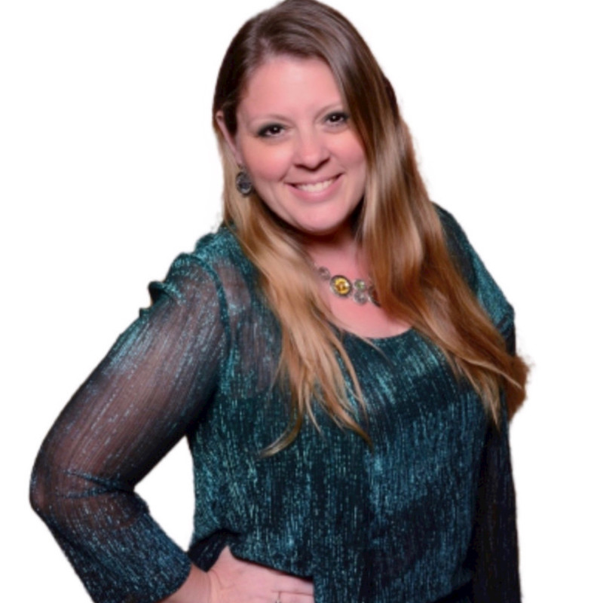
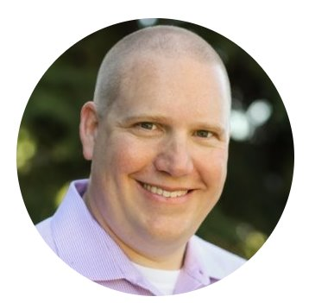
Meet your trainers
Sharon Weaver
Founder, CEO Smarter Consulting
Microsoft RD | MVP | MCT
Primary Event:
CollabCon - https://www.collabconforall.com/
Sharon Weaver | LinkedIn
Wes Preston
Minneapolis, MN
Owner, TrecStone
Primary event:
M365 Saturday - Twin Cities (m365tc.com)
Wes Preston | LinkedIn
Notes:
Other potential Topics:
NDA Updates - Onboarding Next steps
VOC Topic - Organizer Toolkit assets discussion
Regional Community Support – How to engage regional leads

Slide 8
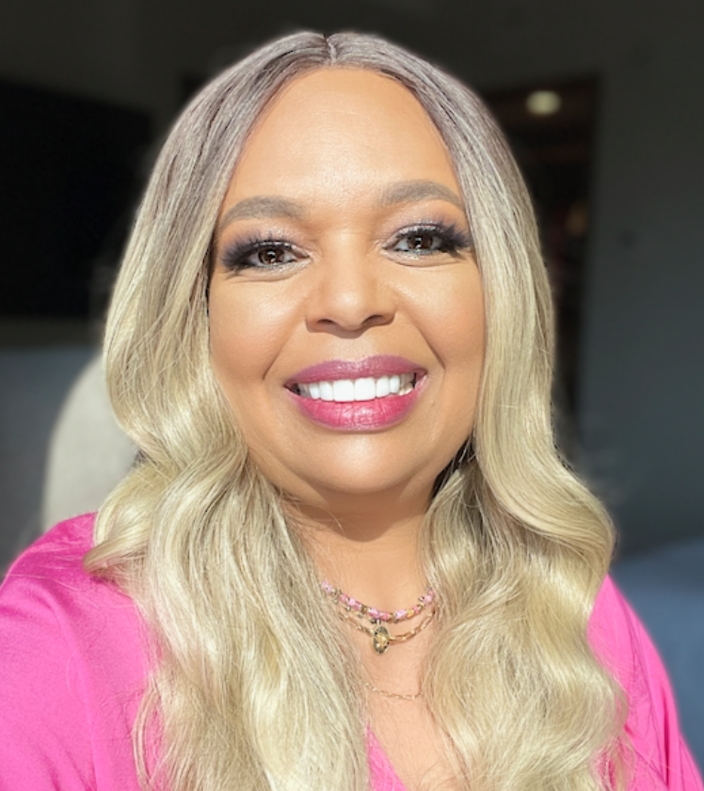
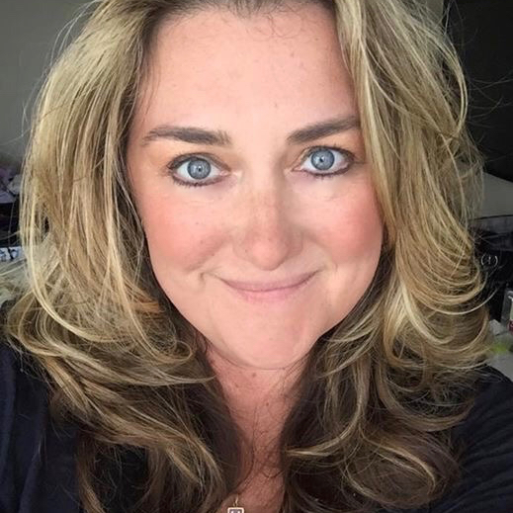
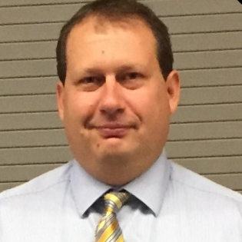
Meet the Microsoft Team
Karuana Gatimu
Community Lead
Olympia, Washington
Phoenix, AZ
Karuana Gatimu | LinkedIn
Heather Cook
Community Manager
Marina del Rey, CA
Heather (Heather Newman) Cook | LinkedIn
Bryan Hart
Technology Lead
Shoreline, WA
Bryan Hart | LinkedIn
Notes:
Other potential Topics:
NDA Updates - Onboarding Next steps
VOC Topic - Organizer Toolkit assets discussion
Regional Community Support – How to engage regional leads

Slide 9
Topic -
Speaker and Session Selection

Slide 10
What is your Session and Speaker Selection Process?
Notes:
The selection process for sessions and speakers is critical to the success of any community event. It involves various criteria that must be carefully considered to ensure relevance and engagement.

Slide 11
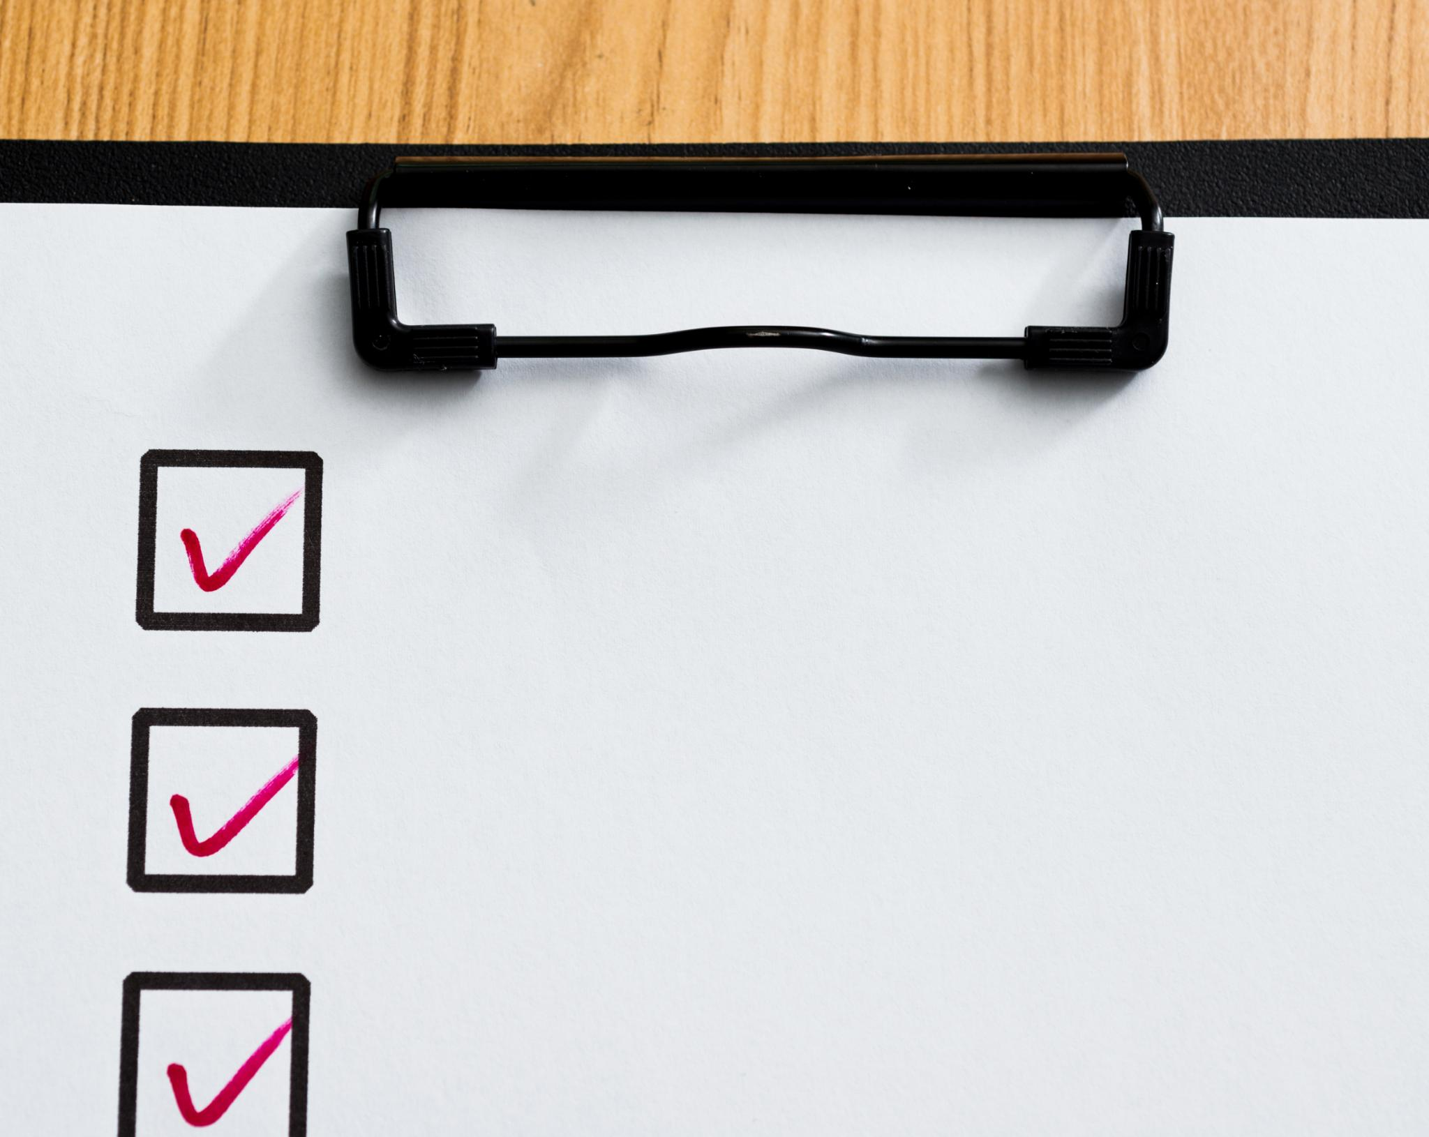
Criteria for Selecting Sessions
Relevance to Audience
  Choosing sessions that align with the interests and needs of the audience ensures engagement and value.
Speaker Expertise
  The expertise and credentials of the speaker play a crucial role in the session's credibility and effectiveness.
Uniqueness of Topic
  Sessions should offer unique insights or perspectives that distinguish them from other offerings, attracting interest.
Promoting Participation
  Encouraging active participation fosters a lively environment and enhances the learning experience for attendees.
Different Session Types
  Consider a few different types of sessions. Case studies, customer/partner stories, panels and AMA sessions...
Notes:
When selecting sessions, it's important to consider relevance to the audience, the expertise of the speaker, and the uniqueness of the topic. Sessions should provide value and promote active participation.

Slide 12

Criteria for Selecting Speakers
Expertise Evaluation
  Assessing a speaker's expertise is crucial to ensure they have the knowledge and experience relevant to the topic.
Communication Skills
  Effective communication skills are vital for speakers to convey their messages clearly and engage the audience.
Audience Engagement
  Choosing speakers who can engage and interact with the audience enhances the overall experience of the presentation.
New, Local, and Visiting Speakers
  Look at the potential for bringing in new speakers, potentially mentoring or partnering them with others.
  Consider a mix of local vs. visiting speakers. Building community and bringing in fresh ideas and perspectives.
Notes:
Selecting the right speakers involves evaluating their expertise, communication skills, and ability to engage the audience. It's essential to choose speakers who can present complex topics in an accessible manner.

Slide 13
What Tools and Platforms Do You Use?
Notes:
Utilizing the right tools and platforms is essential for effective event management. These tools facilitate the organization, promotion, and execution of community events.

Slide 14
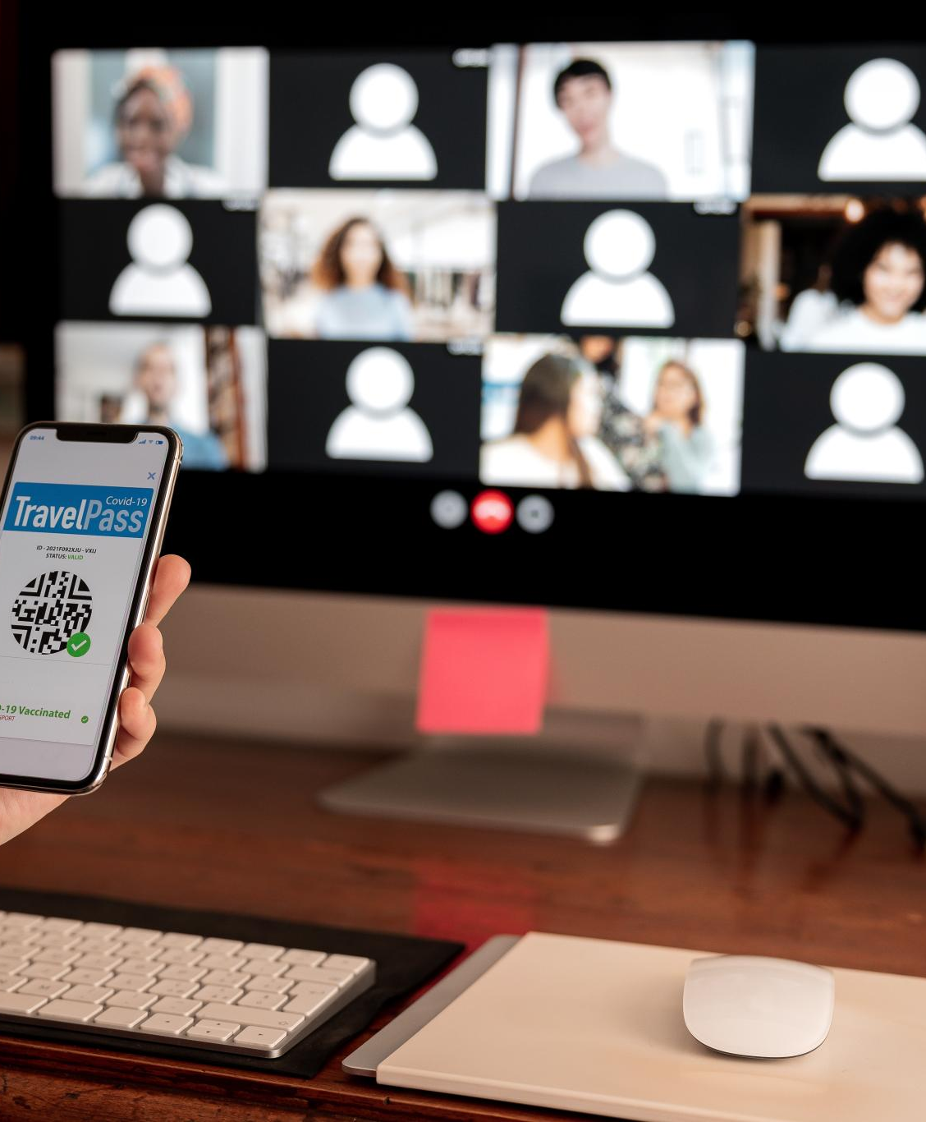
Speaker & Session Submission Tools
Ease of Submission
  Submission tools streamline the process for potential speakers, making it easier to propose their sessions.
Diverse Topics and Speakers
  These tools encourage a variety of topics and speakers, promoting inclusivity and innovation in session proposals.
Simplified Evaluation Process
  Organizers benefit from an efficient evaluation process, allowing for better selection of sessions and speakers.
Sessionize vs. ?
  Sessionize offers a configurable session selection process that assists with ranking, prioritizing, selecting, and then scheduling sessions. The output goes directly to CommunityDays.org
Notes:
Utilizing submission tools allows potential speakers to propose sessions easily. This process encourages diverse topics and speakers while simplifying the evaluation process for organizers.

Slide 15
Do you have Selection Committees?
Notes:
Effective planning requires the establishment of committees focused on various aspects of event management. These committees work collaboratively to ensure a successful outcome.

Slide 16

Speaker Selection Committee
Evaluation of Proposals
  The committee carefully evaluates session proposals to ensure they meet the established criteria and standards.
Selection Criteria
  Speakers are chosen based on predetermined criteria, ensuring the relevance and quality of each session.
Expertise in Selection
  The committee's expertise is crucial for selecting speakers who can deliver valuable and insightful sessions.
Notes:
A dedicated speaker selection committee evaluates session proposals and chooses speakers based on predetermined criteria. Their expertise helps ensure the quality and relevance of the sessions.

Slide 17

Session Scheduling Team
Creating Event Agenda
  The session scheduling team plays a crucial role in designing a comprehensive event agenda that outlines all sessions.
Timing Sessions
  It is essential to appropriately time sessions to maximize attendance and engagement during the event.
Avoiding Schedule Conflicts
  The team ensures that there are no conflicts in the schedule, allowing participants to attend all desired sessions.
Notes:
The session scheduling team is responsible for creating the event agenda. They ensure that sessions are appropriately timed and that there are no conflicts in the schedule.

Slide 18

Timeline and Milestones for Planning
Importance of Timelines
  A well-established timeline is crucial for effective planning. It provides a structured approach to completing tasks.
Setting Milestones
  Clear milestones help to track progress and ensure that the project remains on schedule during the planning process.
Successful Event Planning
  Timely completion of tasks leads to a successful event. Proper planning minimizes the risk of last-minute issues.
Notes:
Establishing a timeline with clear milestones helps keep the planning process on track. This ensures all tasks are completed in a timely manner, leading to a successful event.

Slide 19
What are your Best Practices and Challenge tips?
Notes:
Identifying best practices and understanding common challenges in event management are critical for continuous improvement. Learning from past experiences allows us to refine our processes.

Slide 20
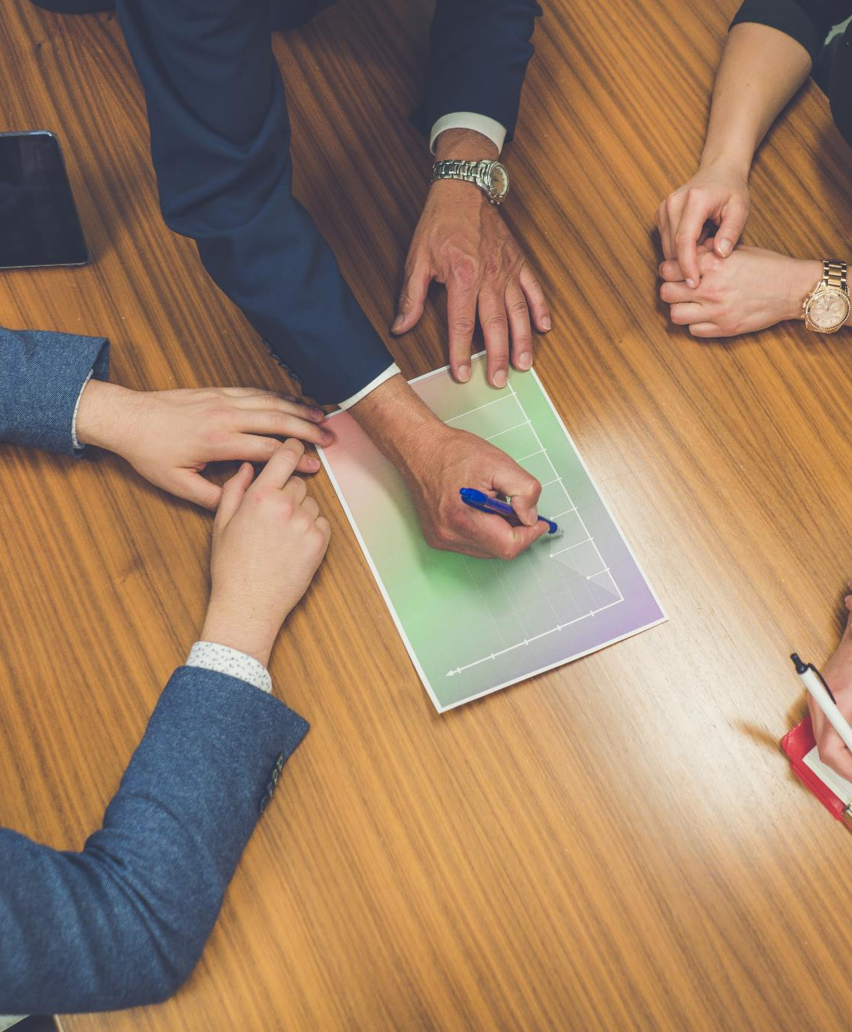
Best Practices for Session and Speaker Selection
Inclusive Outreach
  Implementing inclusive outreach ensures diverse participation and representation in sessions, enhancing the event experience for all attendees.
Transparent Selection Criteria
  Establishing transparent selection criteria fosters trust and fairness in the process, leading to high-quality sessions and speakers.
Robust Communication
  Maintaining robust communication throughout the selection process helps keep all stakeholders informed and engaged, ensuring a successful event.
Notes:
Implementing best practices such as inclusive outreach, transparent selection criteria, and robust communication can enhance the quality of sessions and the overall event experience.

Slide 21
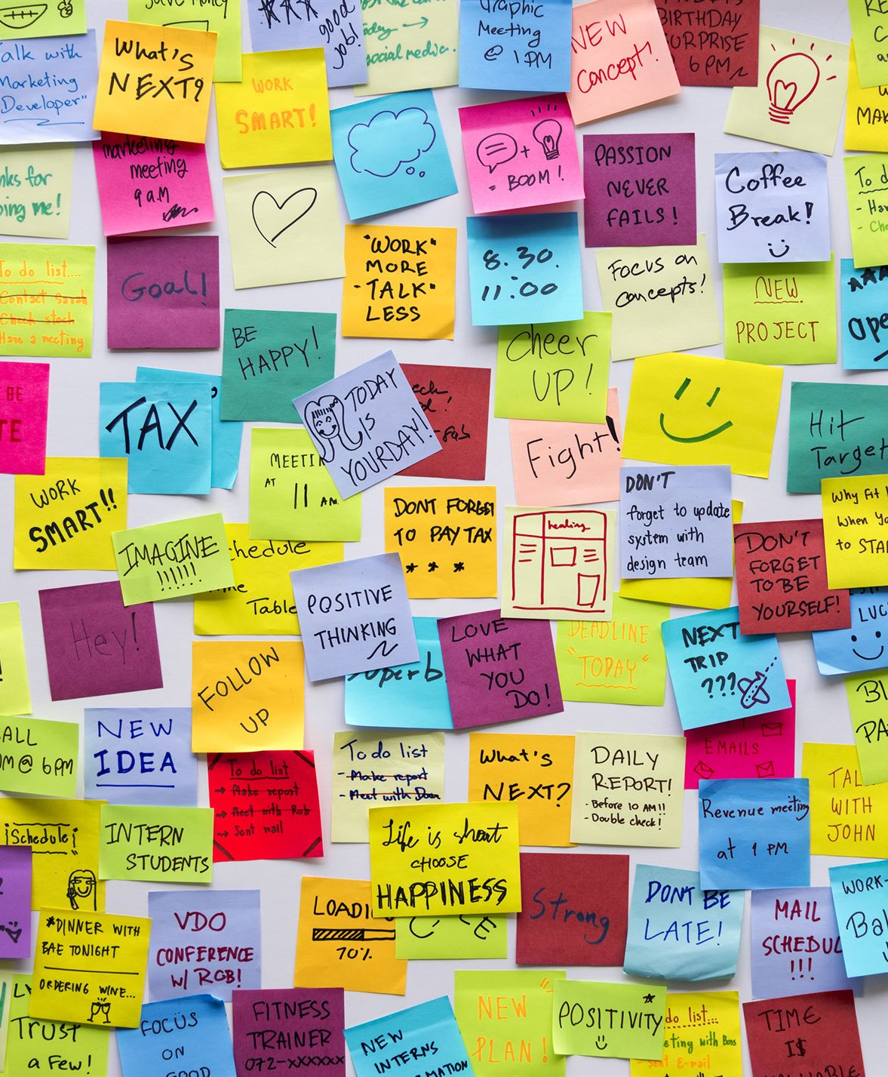
Lessons Learned From Past Events
Valuable Insights
  Reflecting on past events allows organizers to gain insights that can enhance the quality of future events.
Analyzing Feedback
  By analyzing feedback and outcomes from past events, organizers can identify strengths and areas for improvement.
Implementing Changes
  Implementing changes based on past lessons leads to the development of more successful and well-received future events.
Notes:
Reflecting on previous events provides valuable insights. By analyzing feedback and outcomes from past events, organizers can implement changes that lead to improved future events.

Slide 22

Q&A

Slide 23

Request Community Amplification
Looking for help amplifying your event via Microsoft Community LinkedIn and MSFT Adoption twitter handle?
Fill out this form:
https://aka.ms/communitysocial
The SLA is 3 business days.
Microsoft Global Community Initiative https://aka.ms/MGCI

Slide 24


Love your feedback on this meeting
https://aka.ms/MGCIMeetingFeedback

Slide 25
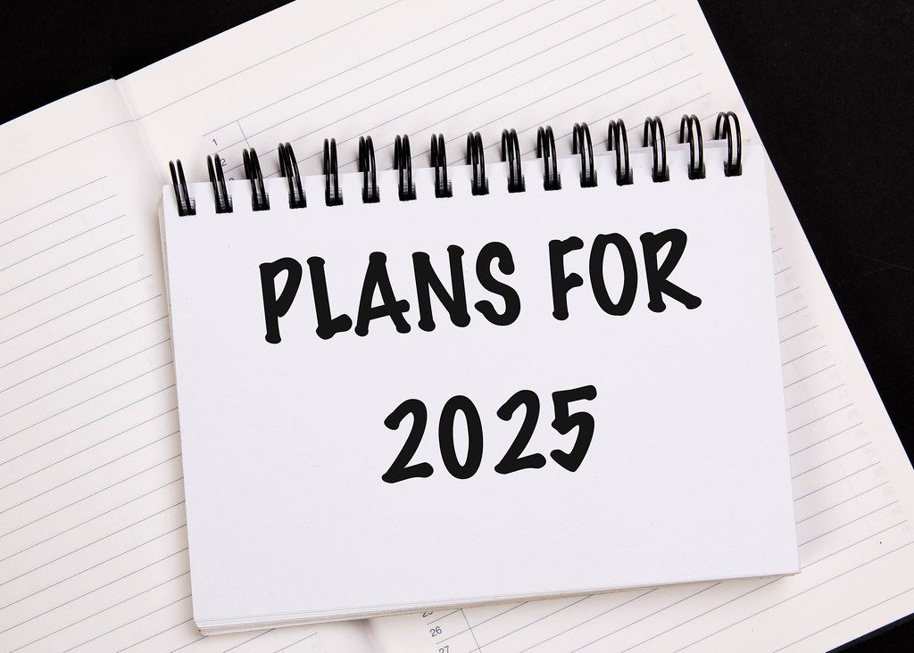
Training Workstream Update
​Workstream Leads – Sharon Weaver & Wes Preston
Upcoming event training dates
Date | Host | Guest Speaker | Topic
Jan 30th | Sharon Weaver | Sharon Weaver | Event Planning 101
Feb 27th |  | Tom Daly | Communitydays.org - How to use it.
March 27th | Cancelled | Cancelled | All sub-committee leads will be at MVP Summit
April 24th | Sharon/Wes | Panel | Securing the Space: A Practical Guide to Booking and Insuring Tech Event Venues
May 29th | Sharon/Wes | Panel | Building an event committee: Roles and Responsibilities
June 26th | Sharon/Wes | Panel | Speaker and Session Selection

Slide 26
Training Workstream Update
​Workstream Leads – Sharon Weaver & Wes Preston
Upcoming event training dates
Date | Host | Guest Speaker | Topic
July 13 | Wes & Sharon | AMA Panel | Communications Planning
Aug 28 | NO MEETING |  | SUMMER BREAK
Sep 25 | Wes & Sharon | AMA Panel | Graphics & Branding
Oct 30 | Wes & Sharon | AMA Panel | Marketing & Social Media
Nov 27 | Wes & Sharon | AMA Panel | HOLIDAY BREAK
Dec 25 | Wes & Sharon | AMA Panel | HOLIDAY BREAK

Slide 27
MGCI General Sessions – The Third Tuesday of the Month
Learn from your peers and get updates on the MGCI program!
3rd Tuesday of every month at 8:10 AM and 5:10 PM Pacific Time.
https://aka.ms/MGCIMtgAM
https://aka.ms/MGCIMtgPM
All MGCI General Sessions and Event Training Sessions will be available on-demand on the
Microsoft Community Learning YouTube Channel: https://aka.ms/community/learning
Date | Presenter | Topic
Jan 30 | Tim Balk | Event Planning 101
Feb 27 | Michal Ziemba | Automate Your Events
March 18 | Pat McGown | Amplify Your Events
April 15 | Adam Salah | Microsoft Loop for Content Creation & Event Production
May 20 | Matt Slaga | Microsoft for Non-Profits
June 17 | Tim Balk | Unconventional Ways to Promote Community Events
July 15 | Oluwaseyi Oluwawumiju | Thriving Against the Odds: Building a Formidable Community in Unfavorable Environments
Sep 16
Oct 21
Nov 18
Dec 25 | NO MEETING | HOLIDAY BREAK
Microsoft Global Community Initiative https://aka.ms/MGCI

Slide 28

MGCI General Sessions – The Third Tuesday of the Month
Want to share best practices or lessons learned on producing events or building community in an upcoming session?
Fill out this form:
https://aka.ms/GeneralSessionGuest
We are looking for a speakers for the rest of 2025!
Microsoft Global Community Initiative https://aka.ms/MGCI

Slide 29
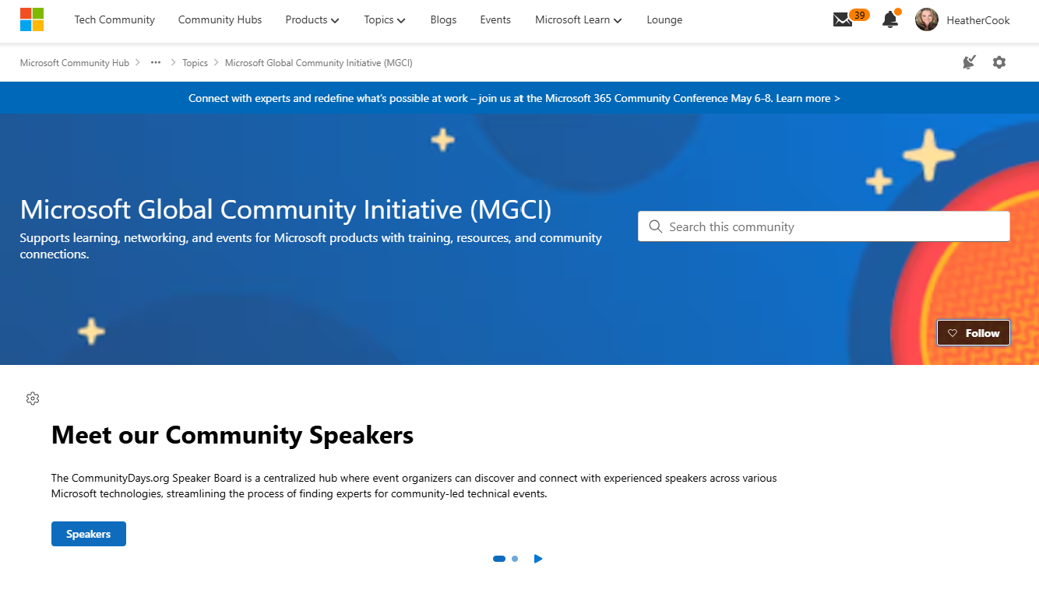
MGCI on MTC
https://aka.ms/MGCICommunityHub
Microsoft Global Community Initiative https://aka.ms/MGCI

Slide 30
Lessons Learned

Slide 31
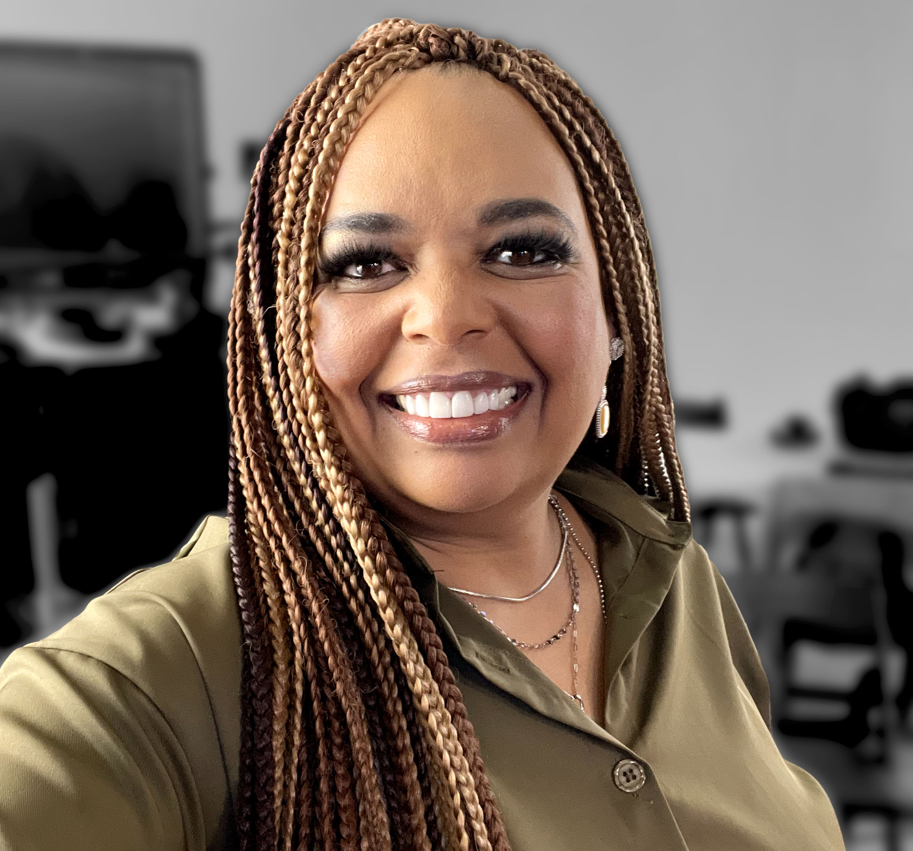

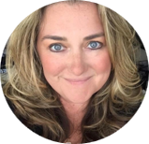

Monday’s at Microsoft
with Karuana & Heather
Karuana Gatimu
Learn - Explore – Connect In the Microsoft Community
Bi-weekly @ 8am PT
Watch on
Microsoft Community Linked
Heather Cook
https://aka.ms/microsoftcommunitylinkedin
Notes:
Last used May 2023, Heather Cook

Slide 32



Stay Connected!
Engage with the best community in tech…
There’s something for everyone!
Microsoft Tech Community
The community platform for Microsoft 365 – forums, blogs, and events
aka.ms/joinMTC
CommunityDays.org
Find or host a local event in your area
or to match your interests
Microsoft Community on LinkedIn
News, announcements and training delivered to your news feed aka.ms/microsoftcommunitylinkedin

Slide 33
Thank you!

