Slide 1


We will get started at 10 min after the hour
Grab a refreshment!
Event Organizer Training and Office Hours
May 29, 2025

Slide 2


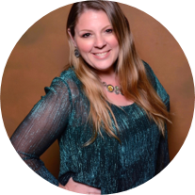
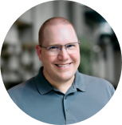

Microsoft Global Community Initiative general session
May 2025
Hosts: Sharon Weaver & Wes Preston

Slide 3
AGENDA
Introductions
Topic: Committee Roles & Responsibilities
Ask Me Anything
Notes:
Other potential Topics:
NDA Updates - Onboarding Next steps
VOC Topic - Organizer Toolkit assets discussion
Regional Community Support – How to engage regional leads

Slide 4
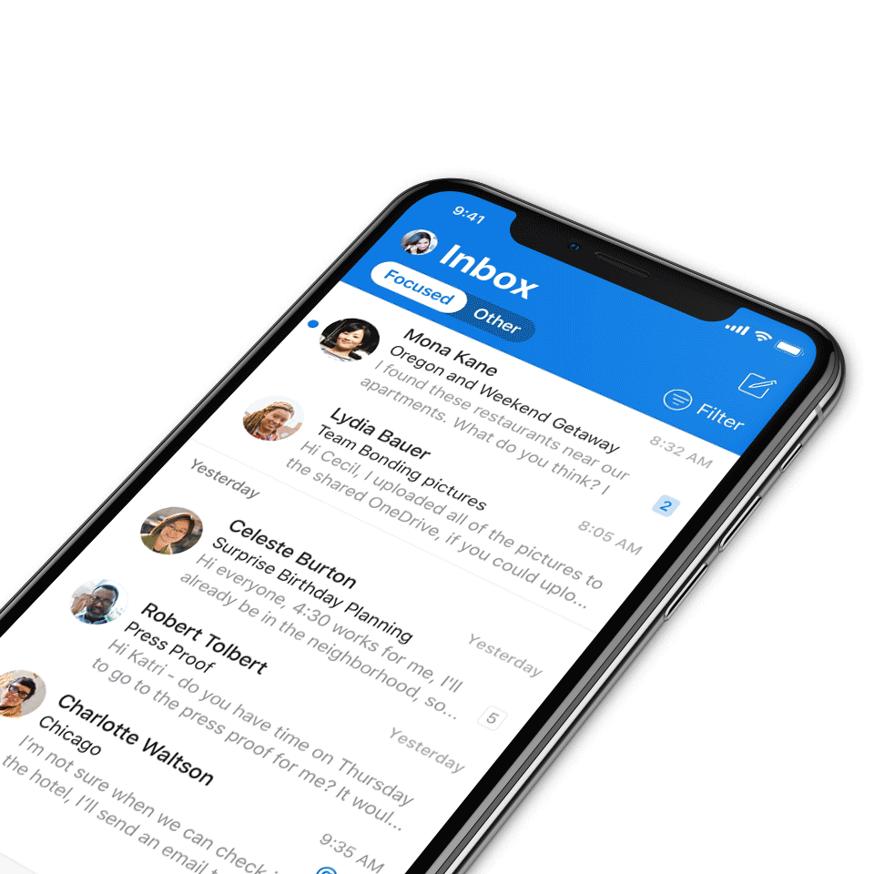
Digital Event Code of Conduct
Microsoft’s mission is to empower every person and every organization on the planet to achieve more. This includes all Microsoft events and gatherings, including on digital platforms, where we seek to create a respectful, friendly, fun and inclusive experience for all participants.​
We expect all digital event participants to uphold the principles of this Code of Conduct, which covers the main digital event and all related activities. We do not tolerate disruptive or disrespectful behavior, messages, images, or interactions by any party participant, in any form, at any aspect of the program including business and social activities, regardless of location.​
Microsoft will not tolerate harassment or discrimination based on age, ancestry, color, gender identity or expression, national origin, physical or mental disability, religion, sexual orientation, or any other characteristic protected by applicable local laws, regulations, and ordinances.​
We encourage everyone to assist in creating a welcoming and safe environment.
For more info, click here.

Slide 5

Mission
The Microsoft Global Community Initiative (MGCI) features event amplification, event production training, blogs, networking, technology and tools best practices, resources, playbooks, and more for the Microsoft Community.
Join MGCI today! https://aka.ms/MGCI

Slide 6

Introductions
Introduce yourself in chat!
What’s your name?
Where are you from?
What events do you work on?
What’s the link to your LinkedIn profile?
Notes:
Other potential Topics:
NDA Updates - Onboarding Next steps
VOC Topic - Organizer Toolkit assets discussion
Regional Community Support – How to engage regional leads

Slide 7
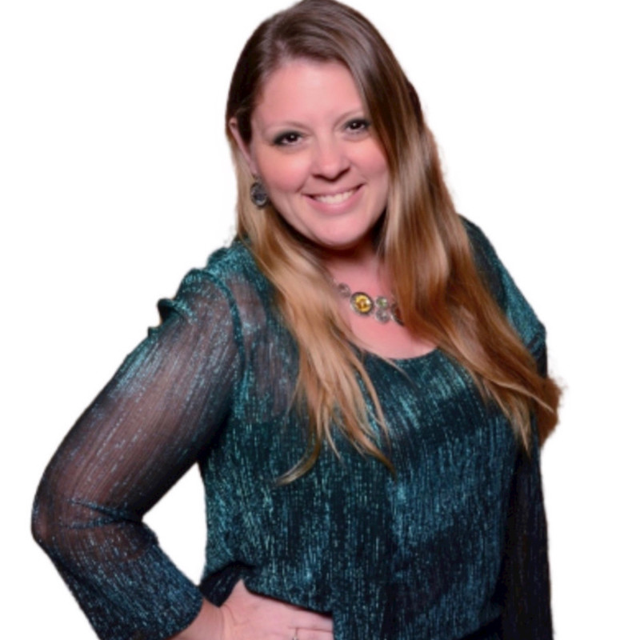
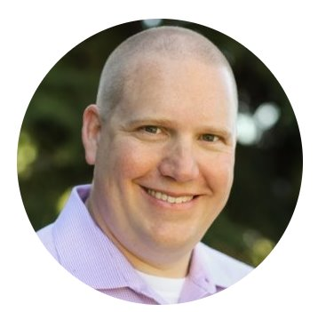
Meet your trainers
Sharon Weaver
Founder, CEO Smarter Consulting
Microsoft RD | MVP | MCT
Primary Event:
CollabCon - https://www.collabconforall.com/
Sharon Weaver | LinkedIn
Wes Preston
Minneapolis, MN
Owner, TrecStone
Primary event:
M365 Saturday - Twin Cities (m365tc.com)
Wes Preston | LinkedIn
Notes:
Other potential Topics:
NDA Updates - Onboarding Next steps
VOC Topic - Organizer Toolkit assets discussion
Regional Community Support – How to engage regional leads

Slide 8
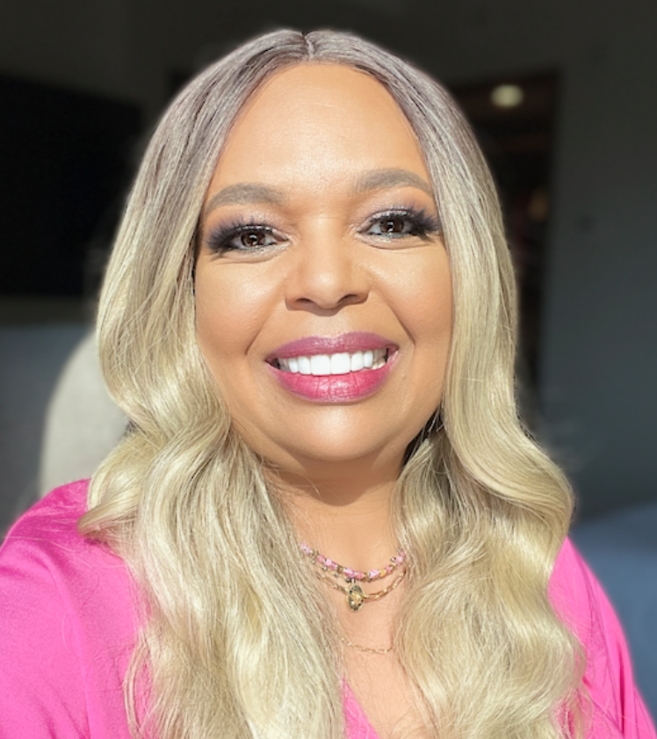
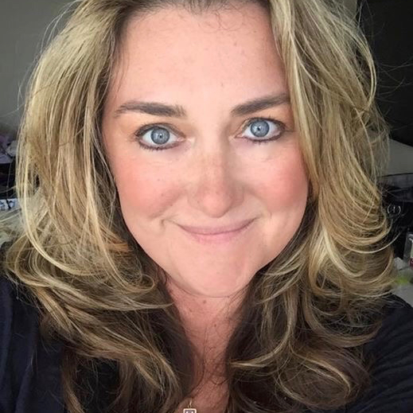
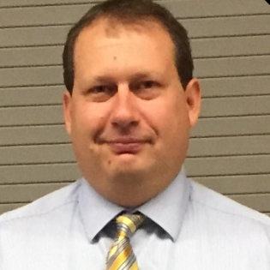
Meet the Microsoft Team
Karuana Gatimu
Community Lead
Olympia, Washington
Phoenix, AZ
Karuana Gatimu | LinkedIn
Heather Cook
Community Manager
Marina del Rey, CA
Heather (Heather Newman) Cook | LinkedIn
Bryan Hart
Technology Lead
Shoreline, WA
Bryan Hart | LinkedIn
Notes:
Other potential Topics:
NDA Updates - Onboarding Next steps
VOC Topic - Organizer Toolkit assets discussion
Regional Community Support – How to engage regional leads

Slide 9
Topic -
Committee Roles and Responsibilities

Slide 10
Committee Roles & Duties
Committee Lead
Responsibilities:
Oversee the overall direction, strategy, and execution of training initiatives.
Set meeting agendas, facilitate discussions, and ensure follow-through on action items.
Act as the primary point of contact.
Identify opportunities to expand or improve offerings.
Coordinate with external stakeholders, including guest speakers, sponsors, and partner organizations.
Notes:
For a community event, committee roles and responsibilities are crucial for smooth execution. Key roles include Event Chairperson, responsible for overall coordination; Treasurer, managing the budget; Volunteer Coordinator, overseeing volunteer activities; Marketing Lead, handling promotion; and Logistics Manager, ensuring all logistical aspects are covered. Each role must collaborate effectively to ensure the event's success.

Slide 11
Committee Roles & Duties
Event Planning Manager
Responsibilities:
Develop and maintain a structured rolling 6-month program plan for training sessions.
Identify key training topics and ensure they align with community needs.
Maintain a speaker pipeline and secure presenters for each session.
Work with the Content Development Lead to ensure presentations and materials are ready.
Track the effectiveness of past sessions and gather feedback for improvements.
Notes:
For a community event, committee roles and responsibilities are crucial for smooth execution. Key roles include Event Chairperson, responsible for overall coordination; Treasurer, managing the budget; Volunteer Coordinator, overseeing volunteer activities; Marketing Lead, handling promotion; and Logistics Manager, ensuring all logistical aspects are covered. Each role must collaborate effectively to ensure the event's success.

Slide 12
Committee Roles & Duties
Speaker & Content Development Lead
Responsibilities:
Work with subject matter experts to develop and refine training content.
Ensure training materials are high-quality, accessible, and align with best practices.
Maintain a library of reusable training materials (presentations, templates, guides).
Conduct content reviews to ensure consistency and up-to-date information.
Support speakers with presentation preparation and delivery.
Notes:
For a community event, committee roles and responsibilities are crucial for smooth execution. Key roles include Event Chairperson, responsible for overall coordination; Treasurer, managing the budget; Volunteer Coordinator, overseeing volunteer activities; Marketing Lead, handling promotion; and Logistics Manager, ensuring all logistical aspects are covered. Each role must collaborate effectively to ensure the event's success.

Slide 13
Committee Roles & Duties
Promotion & Engagement Lead - Work with communication team to coordinate
Responsibilities:
Develop marketing and promotional strategies to increase attendance at training sessions.
Create and manage event promotions across MGCI channels (email, social media, website).
Engage with the community and respond to inquiries about upcoming training events.
Partner with the Event Logistics Lead to ensure registration and attendance tracking.
Create promotion material to share with main communication committee
Notes:
For a community event, committee roles and responsibilities are crucial for smooth execution. Key roles include Event Chairperson, responsible for overall coordination; Treasurer, managing the budget; Volunteer Coordinator, overseeing volunteer activities; Marketing Lead, handling promotion; and Logistics Manager, ensuring all logistical aspects are covered. Each role must collaborate effectively to ensure the event's success.

Slide 14
Committee Roles & Duties
Event Logistics Lead
Responsibilities:
Manage the end-to-end logistics of training events (virtual and in-person).
Set up and manage event registration, Zoom/Teams/Webinar logistics, and technical support.
Ensure smooth event execution, including handling speaker logistics and troubleshooting issues.
Maintain an event calendar and ensure proper coordination with other MGCI events.
Notes:
For a community event, committee roles and responsibilities are crucial for smooth execution. Key roles include Event Chairperson, responsible for overall coordination; Treasurer, managing the budget; Volunteer Coordinator, overseeing volunteer activities; Marketing Lead, handling promotion; and Logistics Manager, ensuring all logistical aspects are covered. Each role must collaborate effectively to ensure the event's success.

Slide 15
Committee Roles & Duties
Community Feedback & Continuous Improvement Lead
Responsibilities:
Develop and distribute post-training surveys to measure impact and gather feedback.
Analyze feedback data and recommend improvements to training content and delivery.
Track trends and evolving needs within the event organizer community.
Work with the Training Program Manager to refine future training topics.
Notes:
For a community event, committee roles and responsibilities are crucial for smooth execution. Key roles include Event Chairperson, responsible for overall coordination; Treasurer, managing the budget; Volunteer Coordinator, overseeing volunteer activities; Marketing Lead, handling promotion; and Logistics Manager, ensuring all logistical aspects are covered. Each role must collaborate effectively to ensure the event's success.

Slide 16
Committee Roles & Duties
Volunteer & Outreach Coordinator
Responsibilities:
Recruit and onboard new volunteers to assist with training initiatives.
Engage with volunteers and match them with appropriate tasks based on skills and interests.
Coordinate volunteer appreciation and recognition efforts.
Maintain a volunteer database and ensure smooth transitions as roles change.
Notes:
For a community event, committee roles and responsibilities are crucial for smooth execution. Key roles include Event Chairperson, responsible for overall coordination; Treasurer, managing the budget; Volunteer Coordinator, overseeing volunteer activities; Marketing Lead, handling promotion; and Logistics Manager, ensuring all logistical aspects are covered. Each role must collaborate effectively to ensure the event's success.

Slide 17
Committee Roles & Duties
Partnerships & Sponsorships Lead (Optional, if applicable)
Responsibilities:
Identify potential sponsors or partners to support training initiatives.
Develop sponsorship packages and engage potential partners.
Manage sponsor relationships and ensure deliverables are met.
Explore opportunities for cross-collaborations with other event communities.
Notes:
For a community event, committee roles and responsibilities are crucial for smooth execution. Key roles include Event Chairperson, responsible for overall coordination; Treasurer, managing the budget; Volunteer Coordinator, overseeing volunteer activities; Marketing Lead, handling promotion; and Logistics Manager, ensuring all logistical aspects are covered. Each role must collaborate effectively to ensure the event's success.

Slide 18
Committee Roles & Duties
Finance & Operations Lead
Responsibilities:
Develop and manage the event budget, including tracking income (e.g., sponsorships, registrations) and expenses.
Ensure timely payments for vendors, venues, and service providers.
Coordinate procurement of supplies, equipment, and materials for events.
Prepare financial summaries and reports for the Committee Lead and stakeholders.
Support contract negotiations and manage logistical agreements (e.g., venues, A/V providers).
Collaborate with the Event Logistics Lead to align financial planning with event execution.
Monitor cost-saving opportunities and ensure responsible resource allocation.
Notes:
For a community event, committee roles and responsibilities are crucial for smooth execution. Key roles include Event Chairperson, responsible for overall coordination; Treasurer, managing the budget; Volunteer Coordinator, overseeing volunteer activities; Marketing Lead, handling promotion; and Logistics Manager, ensuring all logistical aspects are covered. Each role must collaborate effectively to ensure the event's success.

Slide 19

Q&A

Slide 20

Request Community Amplification
Looking for help amplifying your event via Microsoft Community LinkedIn and MSFT Adoption twitter handle?
Fill out this form:
https://aka.ms/communitysocial
The SLA is 3 business days.
Microsoft Global Community Initiative https://aka.ms/MGCI

Slide 21


Love your feedback on this meeting
https://aka.ms/MGCIMeetingFeedback

Slide 22
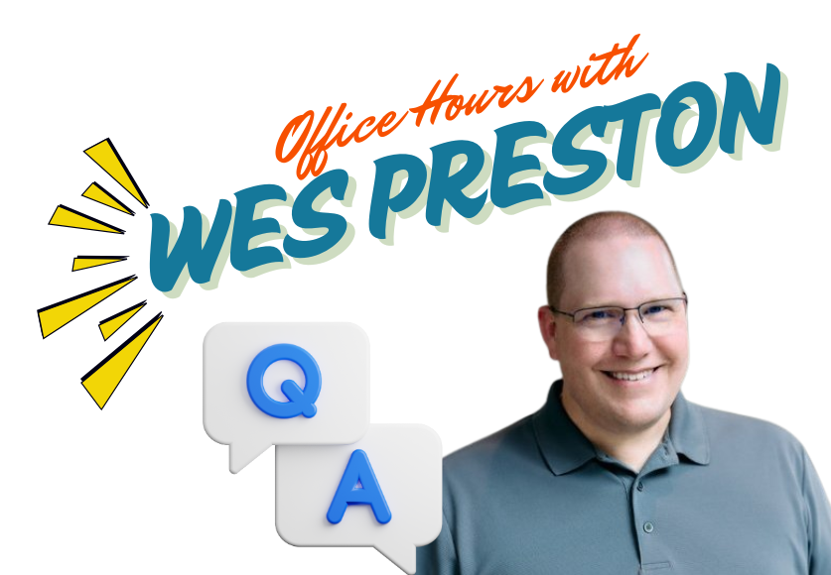
Training Workstream Update
UPCOMING EVENTS
Please join us for our monthly MGCI Event Training meeting.​
​
When: 4th Thursday of the month 8:10am PT.
Date | Presenter | Topic
May 29 | Panel | Committee Roles & Responsibilities
Jul 31 | Panel | Speaker Selection
Aug 28 | NO MEETING | SUMMER BREAK
Sep 25 | Panel | Graphics & Branding
Oct 30 | Panel | Marketing & Social Media
Nov 27 | NO MEETING | HOLIDAY BREAK
Dec 25 | NO MEETING | HOLIDAY BREAK
After the presentation stick around for...

Slide 23
MGCI Event Training Monthly Topics
Date | Presenter | Topic
Jan 30 | Sharon Weaver | Event Planning 101
Feb 27 | Tom Daly | CommunityDays.org
Mar 27 | AMA Panel | Sponsors
Apr 24 | AMA Panel | Venue & Event Insurance
May 29 | AMA Panel | Committee Roles & Responsibilities
Jun 26 | AMA Panel | Speaker Selection
Jul 31 | AMA Panel | Communications Planning
Aug 28 | NO MEETING | SUMMER BREAK
Sep 25 | AMA Panel | Graphics & Branding
Oct 30 | AMA Panel | Marketing & Social Media
Nov 27 | NO MEETING | HOLIDAY BREAK
Dec 25 | NO MEETING | HOLIDAY BREAK
Please join us for our monthly MGCI Event Training meeting.
When: 4th Thursday of the month 8:10am PT.
Training & Office Hours – Topics ​​
New presented topics list pinned to channel​
Links to decks and recordings ​
List of potential upcoming topics

Slide 24
MGCI General Sessions – The Third Tuesday of the Month
Learn from your peers and get updates on the MGCI program!
3rd Tuesday of every month at 8:10 AM and 5:10 PM Pacific Time.
https://aka.ms/MGCIMtgAM
https://aka.ms/MGCIMtgPM
All MGCI General Sessions and Event Training Sessions will be available on-demand on the
Microsoft Community Learning YouTube Channel: https://aka.ms/community/learning
Date | Presenter | Topic
Jan 30 | Tim Balk | Event Planning 101
Feb 27 | Michal Ziemba | Automate Your Events
March 18 | Pat McGown | Amplify Your Events
April 15 | Adam Salah | Microsoft Loop for Content Creation & Event Production
May 20 | Matt Slaga | Microsoft for Non-Profits
June 17 | Tim Balk | Unconventional Ways to Promote Community Events
July 15 | Oluwaseyi Oluwawumiju | Thriving Against the Odds: Building a Formidable Community in Unfavorable Environments
Sep 16
Oct 21
Nov 18
Dec 25 | NO MEETING | HOLIDAY BREAK
Microsoft Global Community Initiative https://aka.ms/MGCI

Slide 25

MGCI General Sessions – The Third Tuesday of the Month
Want to share best practices or lessons learned on producing events or building community in an upcoming session?
Fill out this form:
https://aka.ms/GeneralSessionGuest
We are looking for a speakers for the rest of 2025!
Microsoft Global Community Initiative https://aka.ms/MGCI

Slide 26
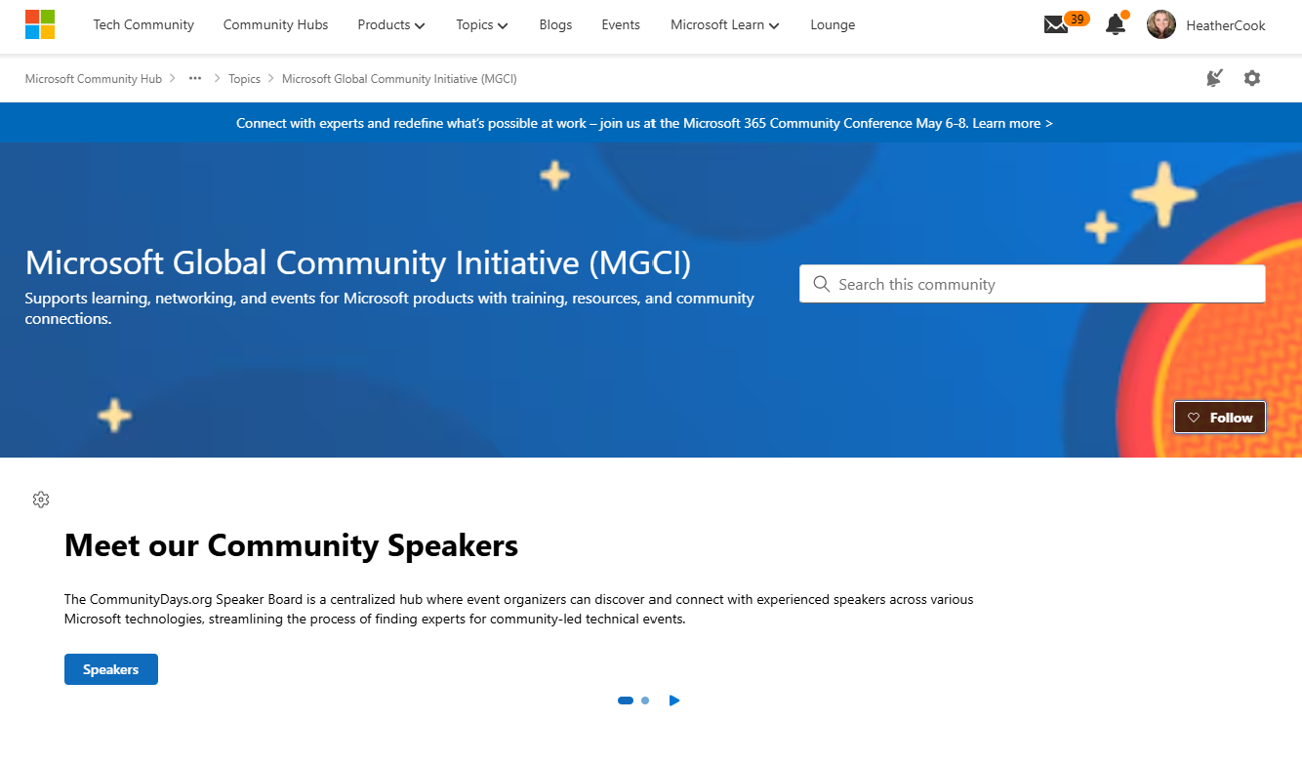
MGCI on MTC
https://aka.ms/MGCICommunityHub
Microsoft Global Community Initiative https://aka.ms/MGCI

Slide 27
Lessons Learned

Slide 28
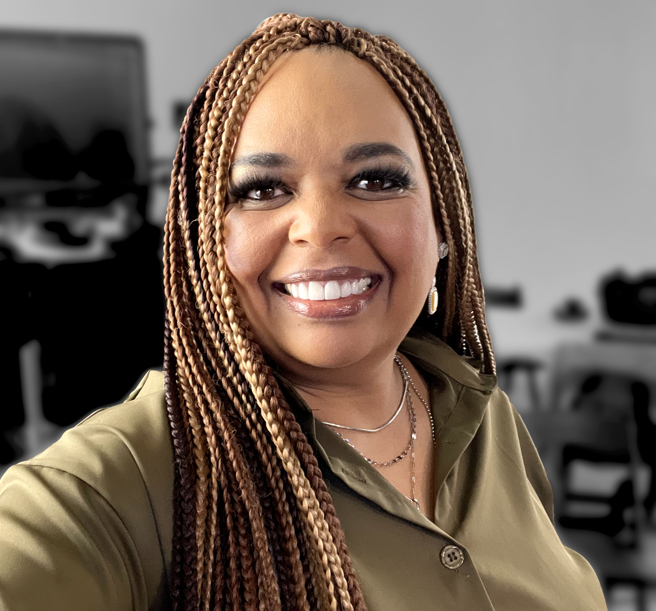

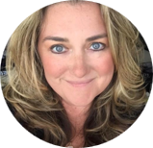

Monday’s at Microsoft
with Karuana & Heather
Karuana Gatimu
Learn - Explore – Connect In the Microsoft Community
Bi-weekly @ 8am PT
Watch on
Microsoft Community Linked
Heather Cook
https://aka.ms/microsoftcommunitylinkedin
Notes:
Last used May 2023, Heather Cook

Slide 29




Stay Connected!
Engage with the best community in tech…
There’s something for everyone!
Microsoft Tech Community
The community platform for Microsoft 365 – forums, blogs, and events
aka.ms/joinMTC
CommunityDays.org
Find or host a local event in your area
or to match your interests
Microsoft Community on LinkedIn
News, announcements and training delivered to your news feed aka.ms/microsoftcommunitylinkedin

Slide 30
Thank you!

