Slide 1


We will get started at 10 min after the hour
Grab a refreshment!
Event Organizer Training and Office Hours
Feb 26, 2026

Slide 2


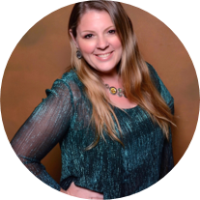
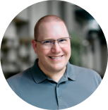

Microsoft Global Community Initiative Event Training and Office Hours
Feb 2026
Hosts: Sharon Weaver & Wes Preston

Slide 3
AGENDA
Introductions
Event Training: Community Days, MTC User Groups and AMC
Ask Me Anything
Notes:
Other potential Topics:
NDA Updates - Onboarding Next steps
VOC Topic - Organizer Toolkit assets discussion
Regional Community Support – How to engage regional leads

Slide 4
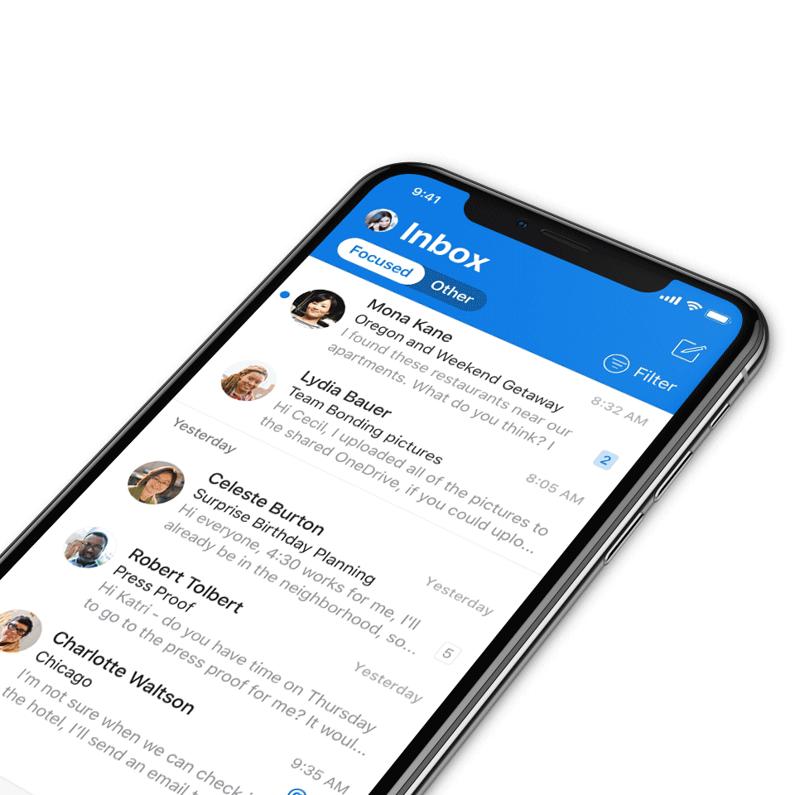
Digital Event Code of Conduct
Microsoft’s mission is to empower every person and every organization on the planet to achieve more. This includes all Microsoft events and gatherings, including on digital platforms, where we seek to create a respectful, friendly, fun and inclusive experience for all participants.​
We expect all digital event participants to uphold the principles of this Code of Conduct, which covers the main digital event and all related activities. We do not tolerate disruptive or disrespectful behavior, messages, images, or interactions by any party participant, in any form, at any aspect of the program including business and social activities, regardless of location.​
Microsoft will not tolerate harassment or discrimination based on age, ancestry, color, gender identity or expression, national origin, physical or mental disability, religion, sexual orientation, or any other characteristic protected by applicable local laws, regulations, and ordinances.​
We encourage everyone to assist in creating a welcoming and safe environment.
For more info, click here.

Slide 5

MGCI Mission and Tagline
The Microsoft Global Community Initiative (MGCI) - Empowering global Microsoft communities with the tools, training, and resources to create impactful events and amplify diverse voices.
Learn, Share, Grow.
Join MGCI today! https://aka.ms/MGCI

Slide 6

Introductions
Introduce yourself in chat!
What’s your name?
Where are you from?
What events do you work on?
What’s the link to your LinkedIn profile?
Notes:
Other potential Topics:
NDA Updates - Onboarding Next steps
VOC Topic - Organizer Toolkit assets discussion
Regional Community Support – How to engage regional leads

Slide 7
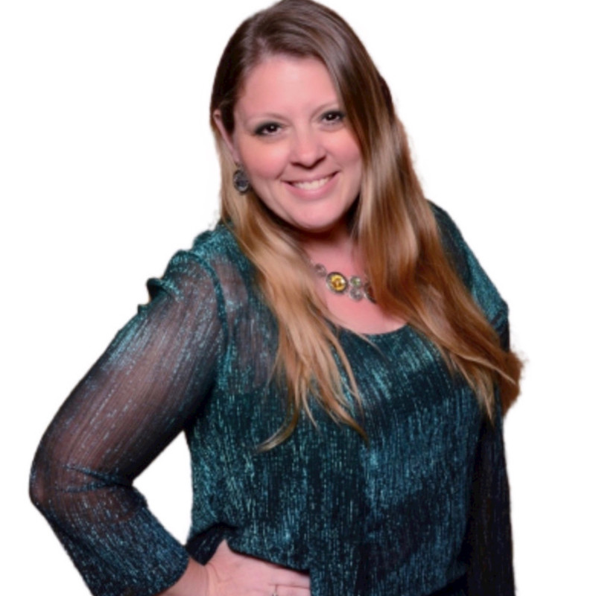
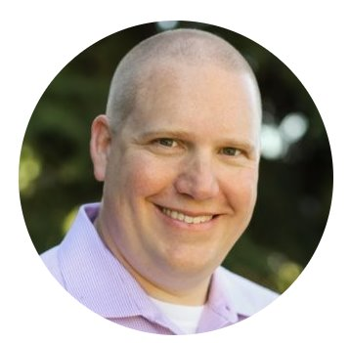
Meet your trainers
Sharon Weaver
Founder, CEO Smarter Consulting
Microsoft RD | MVP | MCT
Primary Event:
Women in M365
Sharon Weaver | LinkedIn
Wes Preston
Minneapolis, MN
Owner, TrecStone
Primary event:
M365 Saturday - Twin Cities (m365tc.com)
Wes Preston | LinkedIn
Notes:
Other potential Topics:
NDA Updates - Onboarding Next steps
VOC Topic - Organizer Toolkit assets discussion
Regional Community Support – How to engage regional leads

Slide 8
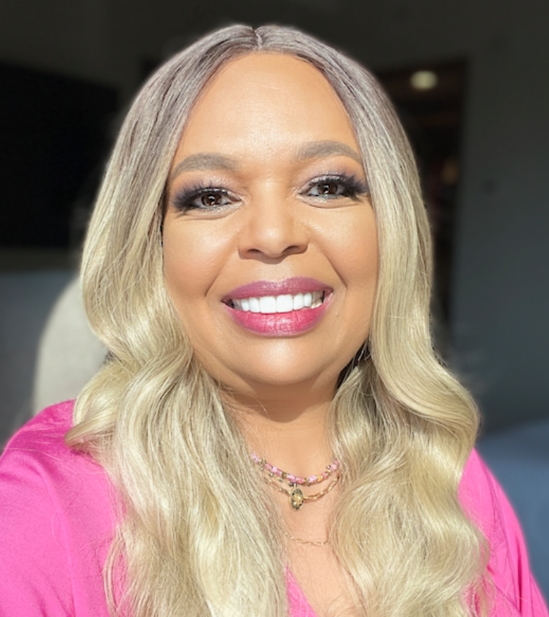
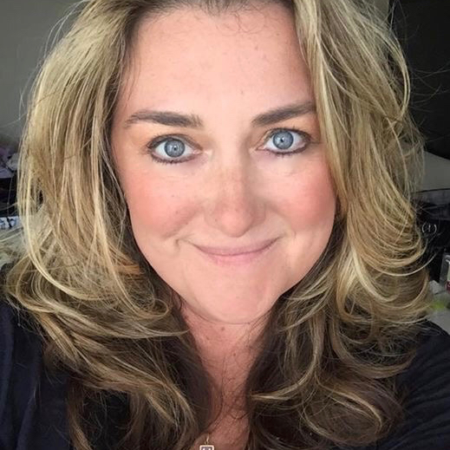
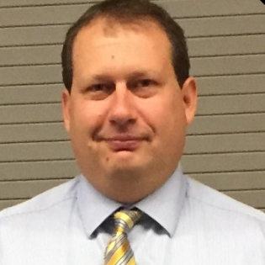
Meet the Microsoft Team
Karuana Gatimu
Community Lead
Olympia, Washington
Phoenix, AZ
Karuana Gatimu | LinkedIn
Heather Cook
Community Manager
Marina del Rey, CA
Heather (Heather Newman) Cook | LinkedIn
Bryan Hart
Technology Lead
Shoreline, WA
Bryan Hart | LinkedIn
Notes:
Other potential Topics:
NDA Updates - Onboarding Next steps
VOC Topic - Organizer Toolkit assets discussion
Regional Community Support – How to engage regional leads

Slide 9
Topic -
Community Days, MTC User Groups and AMC

Slide 10
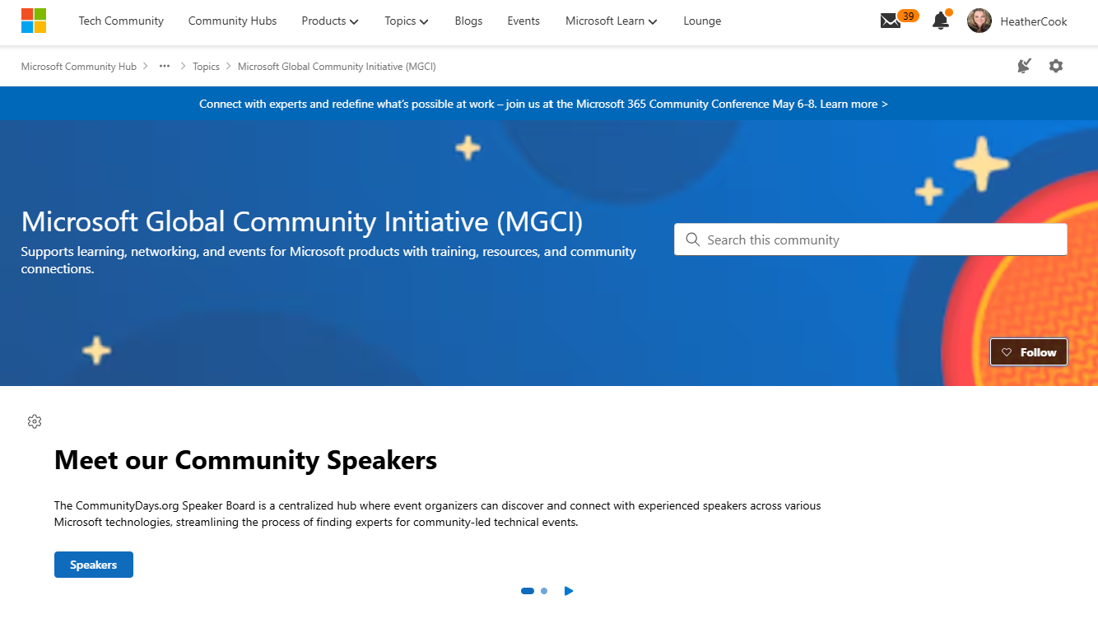
MGCI on MTC
https://aka.ms/MGCICommunityHub
Microsoft Global Community Initiative https://aka.ms/MGCI

Slide 11
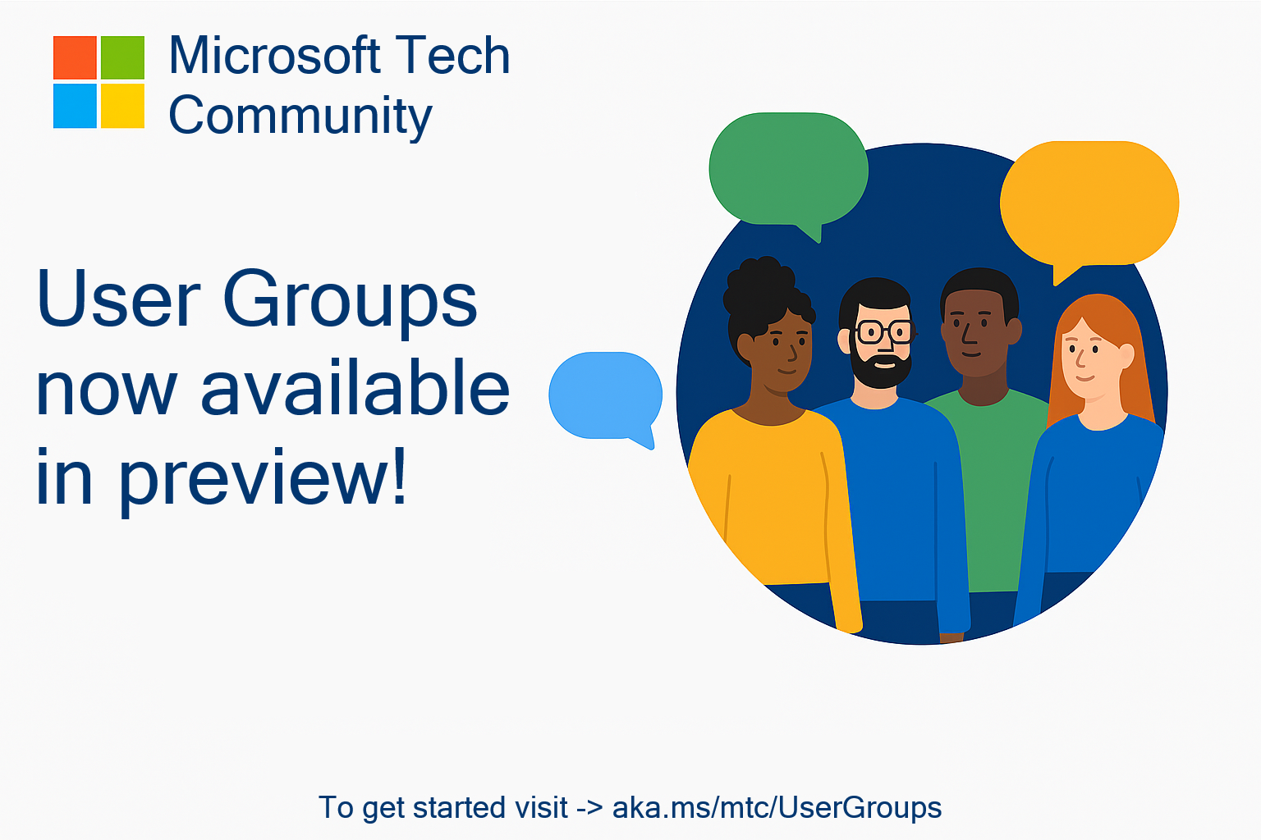
🥳 User Groups on Microsoft Tech Community
Connecting Communities. Empowering Collaboration.
Introducing Tech Community User Groups
User Groups are a new feature currently in preview on the Microsoft Tech Community – fully launching by end of September, designed to bring together individuals with shared interests, roles, or technologies, and enable deeper collaboration, discussion, and learning.
Join the Preview Today
Next Steps:
Visit https://aka.ms/mtc/usergroups
Sign in with your Microsoft account to participate
Browse available groups or select create a new user group to start your own!
Share feedback to help shape the future of User Groups

Slide 12



The Scenario
"
I'm organizing M365 New York City, planning 6 months out.
I already have a date, a venue, and a team.
Date Set
Venue Booked
Team Ready
Aug 15, 2026
NYC
Co-organizers
Notes:
Set the scenario: You're organizing M365 NYC, 6 months out. Date set, venue booked, team ready.

Slide 13


What You Need Before You Start
HAVE READY
CAN COME LATER
Event name
Sessionize key
Date & time (with end time)
Run.Events key
Contact email
Call for speakers link + dates
Banner image (1200×400)
Call for sponsors link + dates
Preview/logo image (thumbnail)
Sponsor prospectus
Event description (min 150 words)
Website, hashtag, social links
Registration URL
Tagline
Registration open/close dates
Venue address / location
Notes:
Walk through what organizers should have prepared before starting the form. Emphasize the 'Can Come Later' column.

Slide 14





The 7-Step Form
1
General
Title, dates, timezone, contact, social links
2
Co-Organizer
Invite team members to manage the event
3
Images
Banner image + preview image with attribution
4
Location
Event type, address, country
5
Call to Action
Registration URL, costs, Sessionize, CFS
6
Sponsors
Call for sponsors, sponsorship levels
7
Page Content
Rich text event description (150+ words)
Notes:
Overview of the 7 steps. This sets expectations for what the demo will cover.

Slide 15
Save Options & Event Lifecycle
Save Progress
Save as Draft
Publish
Reviewed
incomplete
→
draft
→
pending
→
published
Validates title + start/end date only
Full validation, all required fields
Submits for content team review
Live on the site — or rejected with feedback
You can save progress at any point and come back later! You don't have to finish in one sitting.
Notes:
Explain the save options and lifecycle. Key point: you can save progress anytime.

Slide 16

LIVE DEMO
Walking through the form on CommunityDays.org
Notes:
Transition to live demo. Switch from slides to the CommunityDays.org website.

Slide 17
What Happens After You Submit
1
You Click Publish
Event status → Pending
2
Content Team Reviews
Images, description, registration link checked
3
Published or Rejected
Published = live on the site
Rejected = feedback provided, edit & resubmit
If rejected, you'll get specific feedback. Edit your event and resubmit — it's not a dead end!
Notes:
After submitting: content team reviews. Published or rejected with feedback.

Slide 18

Tips & Best Practices
Start Early
Registration URL
Save Progress with just title + dates, fill in details over time
Set up your Eventbrite or ticketing platform first
Images Matter
Sessionize & Speakers
Have banner + preview ready
Can always be added later via the edit function
150 Word Minimum
Co-Organizers
Use a detailed and clear event description
Add your team so they can help manage the listing
Notes:
Tips slide. Reinforce key takeaways: start early, images ready, 150 words written, reg URL set up.

Slide 19


Questions?
CommunityDays.org/faqs
support@communitydays.org
Notes:
Q&A. Direct people to FAQs and support email.

Slide 20
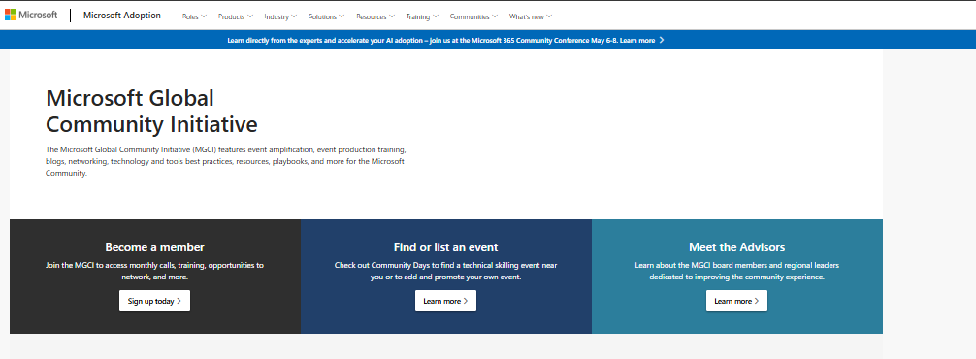
MGCI on Adoption.microsoft.com
Learn about MGCI here! - https://aka.ms/MGCI
Microsoft Global Community Initiative https://aka.ms/MGCI

Slide 21
Q+A

Slide 22

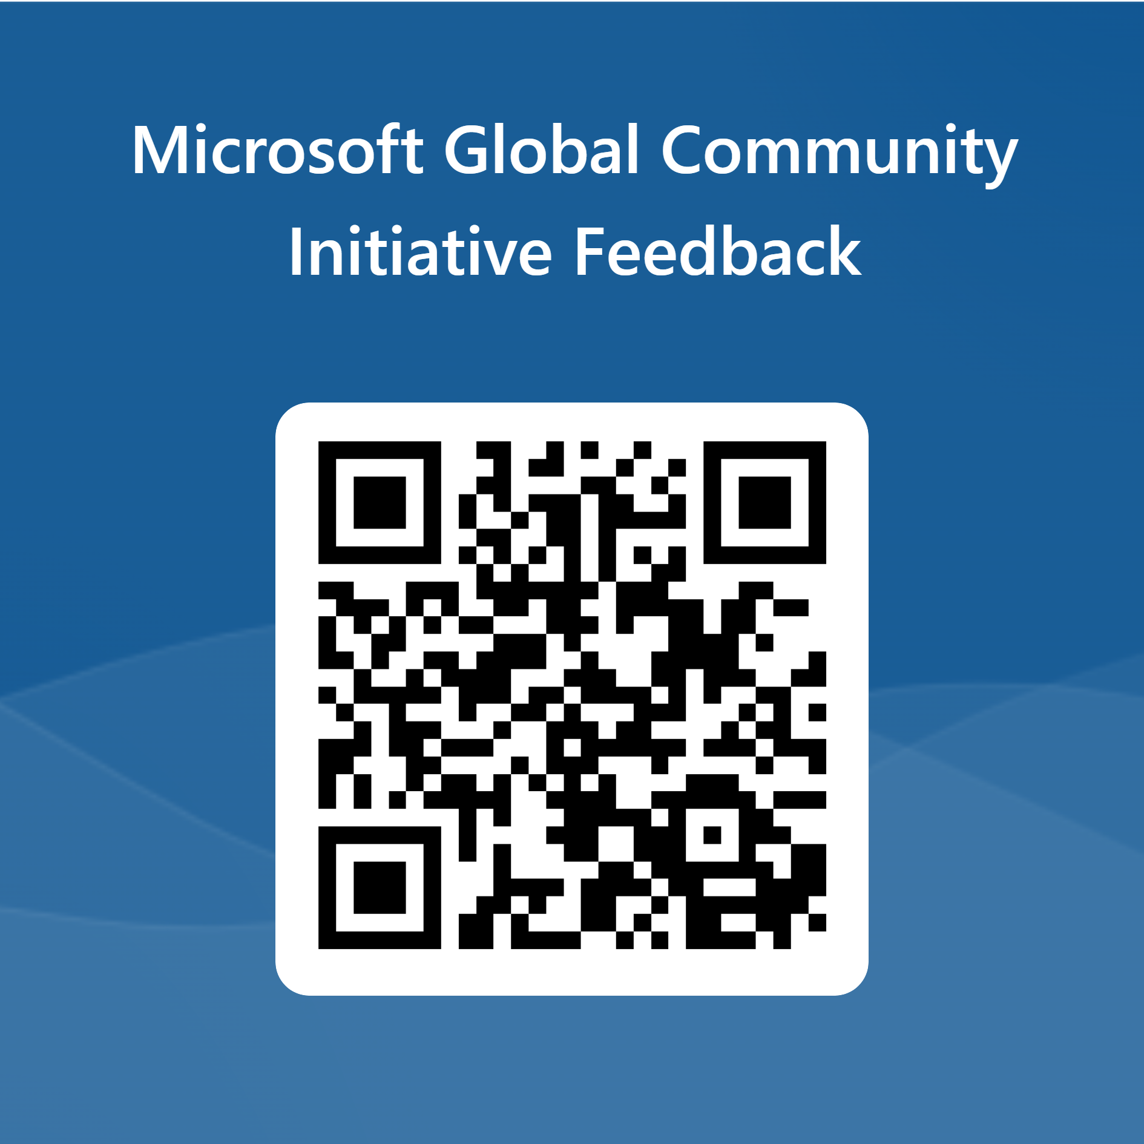
Love your feedback on this meeting
https://aka.ms/MGCIMeetingFeedback

Slide 23

Request Community Amplification
Looking for help amplifying your event via Microsoft Community LinkedIn and MSFT Adoption twitter handle?
Fill out this form:
https://aka.ms/communitysocial
The SLA is 3 business days.
Microsoft Global Community Initiative https://aka.ms/MGCI

Slide 24

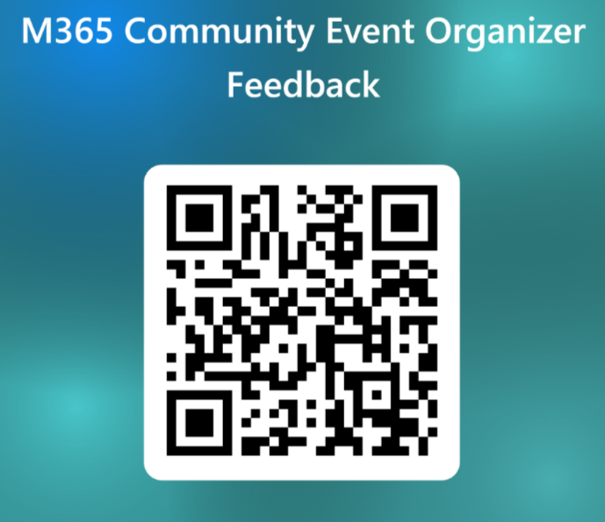
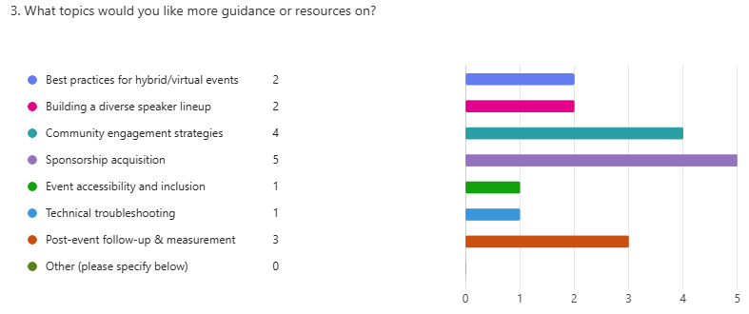
Training Workstream Update
Date | Presenter | Topic
JAN 29 | Wes Preston | Finding and Managing Sponsors
FEB 26 | Tom & Heather | Community Days, MTC User Groups & AMC
MAR 26 | NO MEETING | SPRING BREAK
APR 23 | TBD | Run of Show – Day of Event Lessons Learned
MAY 28 | TBD | Event & Committee Planning
JUN 25 | TBD | How to find and select speakers
JUL 30 | TBD | FOOD! Meals, Snacks, and Beverages
AUG 27 | NO MEETING | SUMMER BREAK
SEP 24 | TBD | Event branding – Graphics & Image tips
OCT 29 | TBD | Filling seats! How to market your event.
NOV 26 | NO MEETING | HOLIDAY BREAK
DEC 24 | NO MEETING | HOLIDAY BREAK
https://forms.office.com/r/G3sP4wTViA

Slide 25
MGCI General Sessions – The Third Tuesday of the Month
Learn from your peers and get updates on the MGCI program!
3rd Tuesday of every month at 8:10 AM and 5:10 PM Pacific Time.
https://aka.ms/MGCIMtgAM
https://aka.ms/MGCIMtgPM
All MGCI General Sessions and Event Training Sessions will be available on-demand on the
Microsoft Community Learning YouTube Channel: https://aka.ms/community/learning
Want to share best practices or lessons learned on producing events or building community in an upcoming session? We are looking for speakers for 2026!
Fill out this form:
https://aka.ms/GeneralSessionGuest
Date | Presenter | Topic
Jan 20 | Heather Cook | Community Update and AMA
Feb17 | Tom Daly | CommunityDays.org: Backstage Pass!
Mar 17 | Heather Cook and Women Community Leaders Panel | Women in Tech and Allies Panel
Apr 21 | Community Leader TBD | Community Spotlight
May 19 | Community Leader TBD | Community Spotlight
Jun 16 | Community Leader TBD | Community Spotlight
Jul 21 | Community Leader TBD | Community Spotlight
Microsoft Global Community Initiative https://aka.ms/MGCI

Slide 26

Join in the fun for the SharePoint 25th Birthday Digital Event on Monday March 2, 9:00am PT. https://aka.ms/SPat25
Use the hashtag #SPat25 on your social posts and download graphics to share your stories and watch parties. https://aka.ms/SPat25/graphics

Slide 27
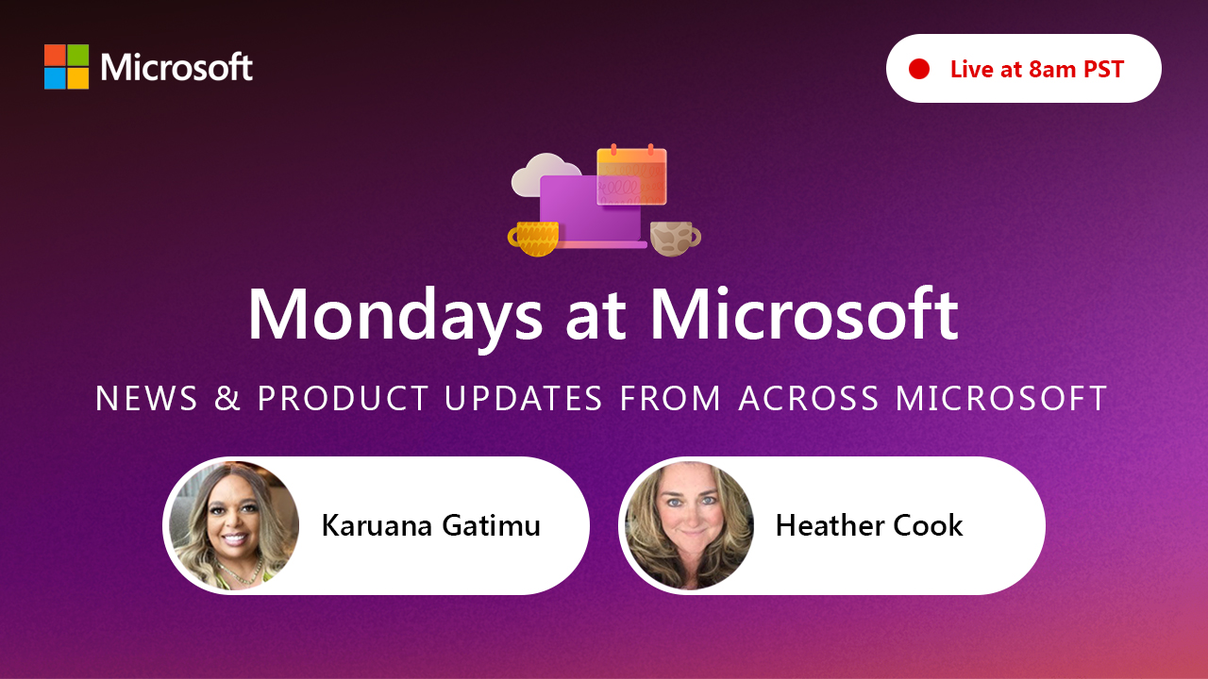
https://aka.ms/mondaysatmicrosoft
Learn - Explore – Connect In the Microsoft Community
Bi-weekly @ 8am PT
Watch on
Microsoft Community Linked
https://aka.ms/microsoftcommunitylinkedin
Notes:
Last used May 2023, Heather Cook

Slide 28

Stay Connected! Engage with the best community in tech… There’s something for everyone!
Microsoft Tech Community
The community platform for Microsoft 365 – forums, blogs, and events
aka.ms/joinMTC
CommunityDays.org
Find or host a local event in your area or to match your interests
Microsoft Community on LinkedIn
News, announcements and training delivered to your news feed aka.ms/microsoftcommunitylinkedin

Slide 29
Thank you!

Slide 30
Microsoft Global Community Initiative Event Training and Office Hours
Feb 2026

Slide 31

Event Training and Office Hours
Run of Show: What to do the day of the event

Slide 32
Microsoft Global Community Initiative
Event Training and Office Hours
February 26 at 8:10A PT
Run of Show: What to do the day of the event

Slide 33
MGCI on MTC
https://aka.ms/MGCICommunityHub
Microsoft Global Community Initiative https://aka.ms/MGCI

