Slide 1


Event Organizer Training and Office Hours
Topic: Sponsors and Sponsorship
Thursday, Jan 29 - 8:10A PT

Slide 2
We will get started at 10 min after the hour
Grab a refreshment!
Event Organizer Training and Office Hours
Jan 29, 2026

Slide 3


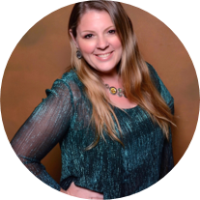


Microsoft Global Community Initiative Event Training and Office Hours
Jan 2026
Hosts: Sharon Weaver & Wes Preston

Slide 4

Event Training and
Office Hours
Sponsors and Sponsorships

Slide 5

Microsoft Global Community Initiative
Event Training and Office Hours
January 29th 8:10A PT
Sponsors and Sponsorships

Slide 6
AGENDA
Introductions
Event Training: Sponsors and Sponsorship
Ask Me Anything
Notes:
Other potential Topics:
NDA Updates - Onboarding Next steps
VOC Topic - Organizer Toolkit assets discussion
Regional Community Support – How to engage regional leads

Slide 7
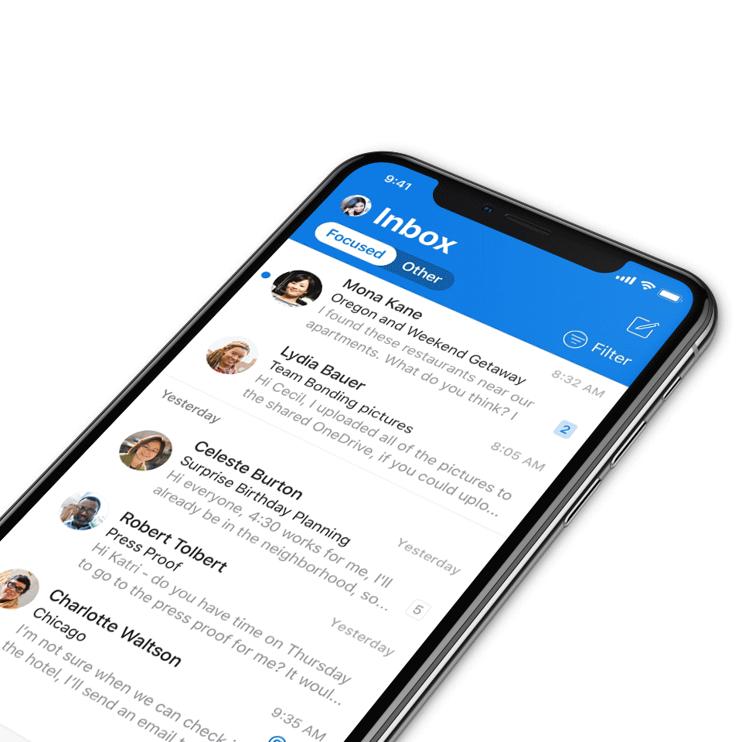
Digital Event Code of Conduct
Microsoft’s mission is to empower every person and every organization on the planet to achieve more. This includes all Microsoft events and gatherings, including on digital platforms, where we seek to create a respectful, friendly, fun and inclusive experience for all participants.​
We expect all digital event participants to uphold the principles of this Code of Conduct, which covers the main digital event and all related activities. We do not tolerate disruptive or disrespectful behavior, messages, images, or interactions by any party participant, in any form, at any aspect of the program including business and social activities, regardless of location.​
Microsoft will not tolerate harassment or discrimination based on age, ancestry, color, gender identity or expression, national origin, physical or mental disability, religion, sexual orientation, or any other characteristic protected by applicable local laws, regulations, and ordinances.​
We encourage everyone to assist in creating a welcoming and safe environment.
For more info, click here.

Slide 8
MGCI Mission and Tagline
The Microsoft Global Community Initiative (MGCI) - Empowering global Microsoft communities with the tools, training, and resources to create impactful events and amplify diverse voices.
Learn, Share, Grow.
Join MGCI today! https://aka.ms/MGCI

Slide 9

Introductions
Introduce yourself in chat!
What’s your name?
Where are you from?
What events do you work on?
What’s the link to your LinkedIn profile?
Notes:
Other potential Topics:
NDA Updates - Onboarding Next steps
VOC Topic - Organizer Toolkit assets discussion
Regional Community Support – How to engage regional leads

Slide 10
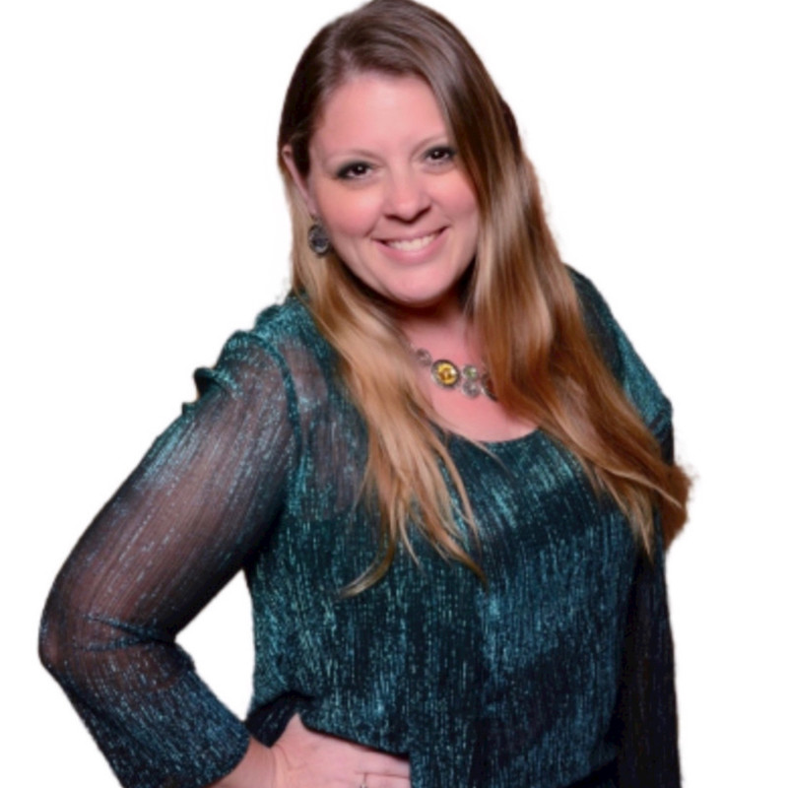
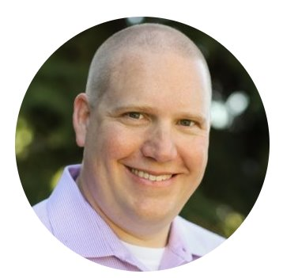
Meet your trainers
Sharon Weaver
Founder, CEO Smarter Consulting
Microsoft RD | MVP | MCT
Primary Event:
CollabCon - https://www.collabconforall.com/
Sharon Weaver | LinkedIn
Wes Preston
Minneapolis, MN
Owner, TrecStone
Primary event:
M365 Saturday - Twin Cities (m365tc.com)
Wes Preston | LinkedIn
Notes:
Other potential Topics:
NDA Updates - Onboarding Next steps
VOC Topic - Organizer Toolkit assets discussion
Regional Community Support – How to engage regional leads

Slide 11
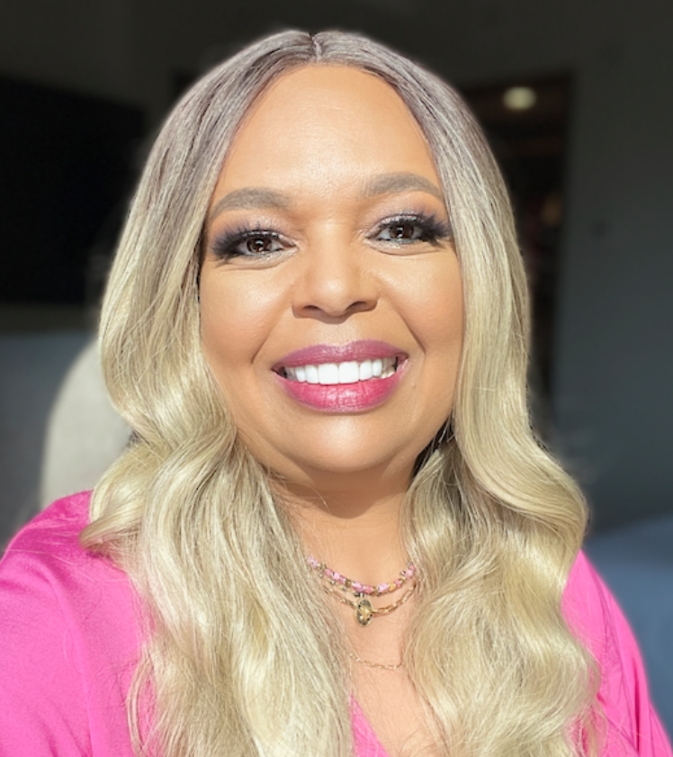
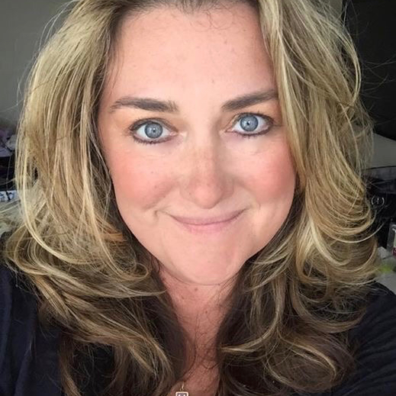
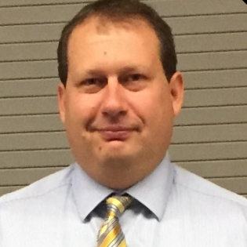
Meet the Microsoft Team
Karuana Gatimu
Community Lead
Olympia, Washington
Phoenix, AZ
Karuana Gatimu | LinkedIn
Heather Cook
Community Manager
Marina del Rey, CA
Heather (Heather Newman) Cook | LinkedIn
Bryan Hart
Technology Lead
Shoreline, WA
Bryan Hart | LinkedIn
Notes:
Other potential Topics:
NDA Updates - Onboarding Next steps
VOC Topic - Organizer Toolkit assets discussion
Regional Community Support – How to engage regional leads

Slide 12
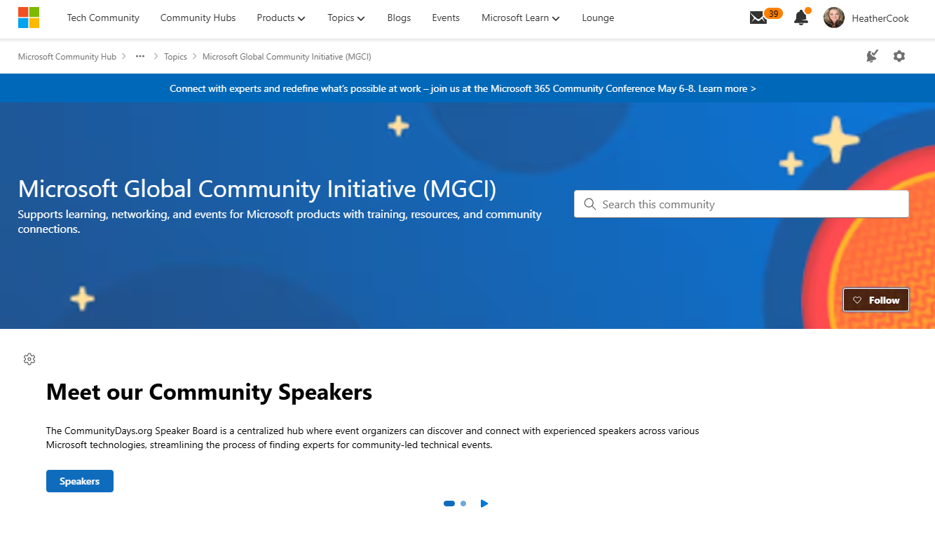
MGCI on MTC
https://aka.ms/MGCICommunityHub
Microsoft Global Community Initiative https://aka.ms/MGCI

Slide 13
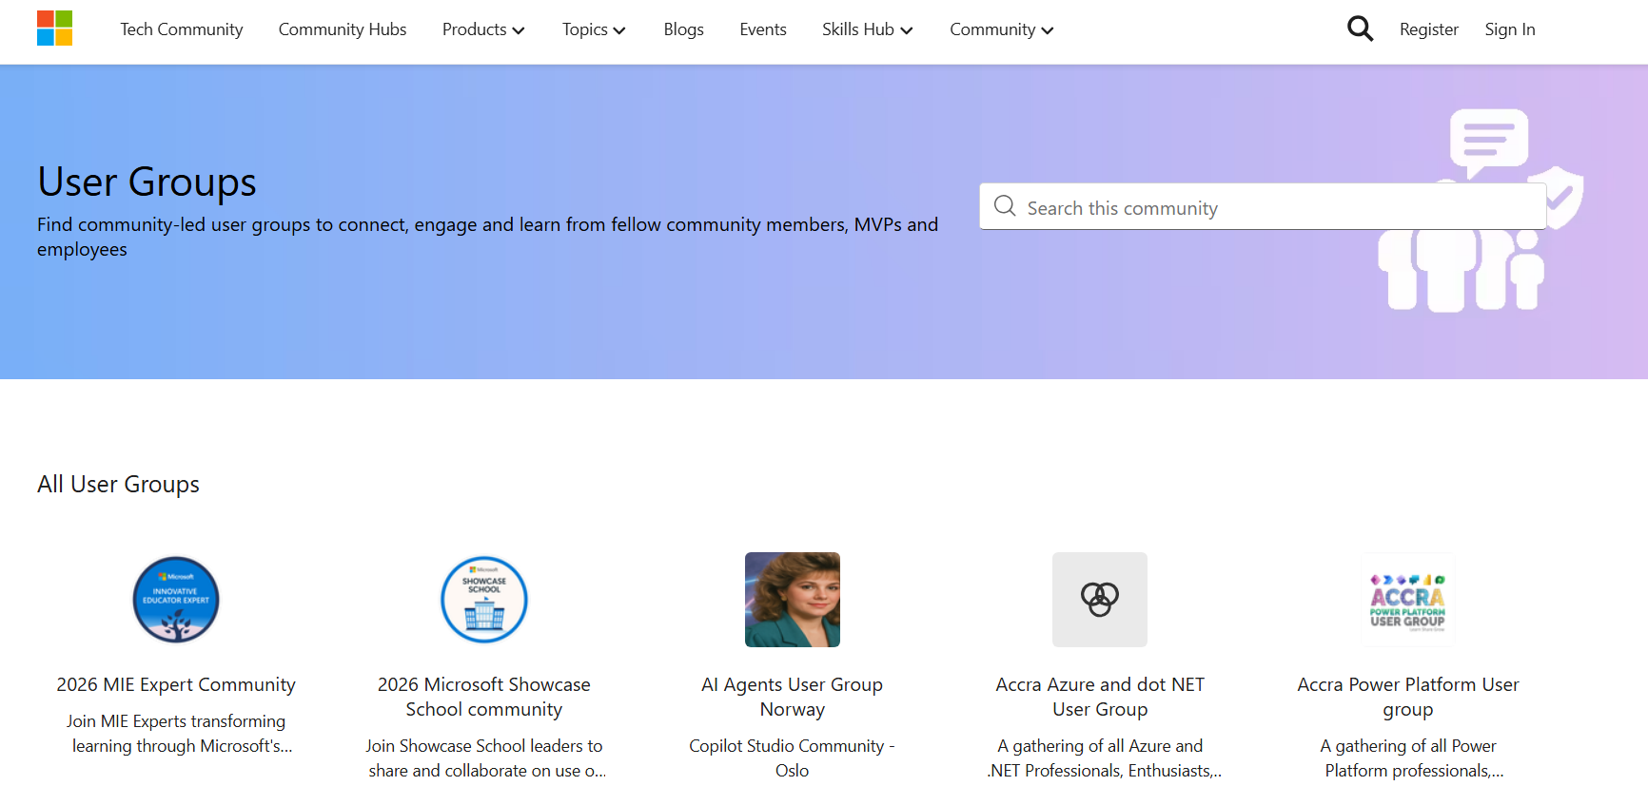
User Groups on Microsoft Tech Community
Connecting Communities. Empowering Collaboration.
Tech Community User Groups
User Groups are featured on Microsoft Tech Community – designed to bring together individuals with shared interests, roles, or technologies, and enable deeper collaboration, discussion, and learning.
Check out user groups from around the globe
Visit https://aka.ms/mtc/usergroups
Sign in with your Microsoft account to participate
Browse available groups or select create a new user group to start your own!
Share feedback to help shape the future of User Groups

Slide 14
Topic -
Sponsors and Sponsorship

Slide 15

Sponsors and Sponsorship
Building Sustainable Partnerships
Presented by MGCI Sponsorship Subcommittee
Sharon Sumner - Microsoft Regional Director UK, MVP
Mark Rackley – MVP, Microsoft Practice Lead

Slide 16


Today's Agenda
► Introduction to sponsorship
► Types of sponsors and how to find them
► Approaching and engaging sponsors
► Sponsorship packages and partnerships
► Sponsor interview with Mark Rackley
► Managing the sponsorship lifecycle
► Getting paid and compliance

Slide 17
What is Sponsorship?
DEFINITION
A mutually beneficial partnership where businesses provide financial support, products, or services to events in exchange for marketing exposure and brand association.
Key Components:
► Businesses get targeted audience access and brand visibility
► Events get resources to deliver high-quality experiences
► Communities benefit from knowledge sharing

Slide 18
Why Sponsorship Matters
For Event Organisers
For Sponsors
Enables high-quality events: Financial support and resources allow you to deliver better experiences and attract quality speakers.
Targeted audience access: Reach engaged communities aligned with business objectives and market segments.
For Communities
Long-term Benefits
Community value: Shared investment in knowledge sharing and professional development creates lasting impact.
Builds partnerships: Focus on trust and retention for repeat sponsorship, reducing work year-over-year.

Slide 19
Who Are Your Sponsors?
Local Businesses
Technology Brands
Community presence and regional awareness
Product visibility and market positioning
National Companies
Service Providers
Broader reach and brand alignment
Recruiters, staffing firms, consultancies

Slide 20
Finding Sponsors: Platforms
Use established platforms: List your call for sponsors on CommunityDays.org to reach audiences already engaged with Microsoft community events. Leverage Microsoft Partner Network directories.
Network at events: Start conversations at Expo Halls during Microsoft events to establish new relationships.
Connect with MVPs and RDs: These community leaders often have strong corporate ties.

Slide 21
Approaching Sponsors: Tactics
Engage your existing network: Ask speakers to connect with their employers. Request referrals from past sponsors.
Target local & regional businesses: Identify businesses aligned with technology. Approach tech recruiters and staffing firms.
Expand digital outreach: Share posts on LinkedIn, tag relevant companies, and join Microsoft-focused groups.
Highlight benefits: Emphasise branding opportunities on event materials and social media.

Slide 22
Sponsorship Packages
Package Types
Single event or multiple event packages. Consider annual partnerships for recurring events.
Non-Monetary Sponsorships
Not all sponsors can provide cash. Accept in-kind contributions:
Tiered Levels
► Venue space
Bronze, Silver, Gold, Platinum with increasing visibility at each level.
► Food and beverage
► Swag or services
À la Carte Options
Note: Each event location is different. Your mileage may vary – consider these as suggestions.
Add keynote slots, booth space, or social media campaigns.

Slide 23
Sponsor Interview
Mark Rackley
Microsoft MVP
Director, Microsoft Practice at Protiviti
Organiser of The North American Collaboration Summit
25+ years M365/SharePoint expertise
Sharing insights from the sponsor perspective

Slide 24
The Sponsorship Lifecycle
Builds long-term relationships: Treat sponsorship as a partnership, not a transaction. Focus on trust and mutual value.
Enhances brand experience: Consistent engagement before, during, and after the event strengthens sponsor perception of your professionalism.
Maximises ROI: Clear visibility into benefits and outcomes ensures sponsors feel their investment is worthwhile.
Improves retention: A well-managed lifecycle increases likelihood of repeat sponsorship, reducing your work year-over-year.

Slide 25
End-to-End Support Best Practices
Onboarding with clarity: Provide sponsors with a welcome kit outlining timelines, deliverables, and branding opportunities.
Regular check-ins: Maintain proactive communication to address questions and share progress updates throughout the event lifecycle.
Personalised engagement: Tailor sponsorship packages and touchpoints to align with each sponsor's specific goals and objectives.
Transparent reporting: Share post-event metrics including attendance, engagement, and social reach to demonstrate tangible impact.
Feedback loop: Collect sponsor feedback to refine future experiences and show commitment to continuous improvement.

Slide 26
Sponsor Experience Principles
Empathy
Responsiveness
Understand sponsor objectives and design experiences that meet their specific needs.
Quick, clear communication builds confidence and trust throughout the partnership.
Consistency
Value Delivery
Ensure every interaction feels seamless and professional from start to finish.
Highlight tangible benefits at every stage to demonstrate ongoing worth.

Slide 27
Getting Paid & Handling Compliance
Specify payment options: Include ePayments (PayPal, Stripe, crypto), cheques, ACH transfers, and wire transfers in contracts.
Work with accounting teams: Coordinate with both teams to ensure smooth processing. Have you supplied everything needed?
Be prepared with your bank: Understand requirements for receiving payments, especially international transfers.
Know documentation requirements: 1099s, W-9s, invoices, and receipts based on your jurisdiction.

Slide 28
Key Takeaways
► Sponsorship is partnership, not transaction
► Find sponsors through multiple channels
► Offer flexible packages and tiers
► Manage the full lifecycle with CX principles
► Ensure clear payment terms and compliance

Slide 29

Q&A

Slide 30

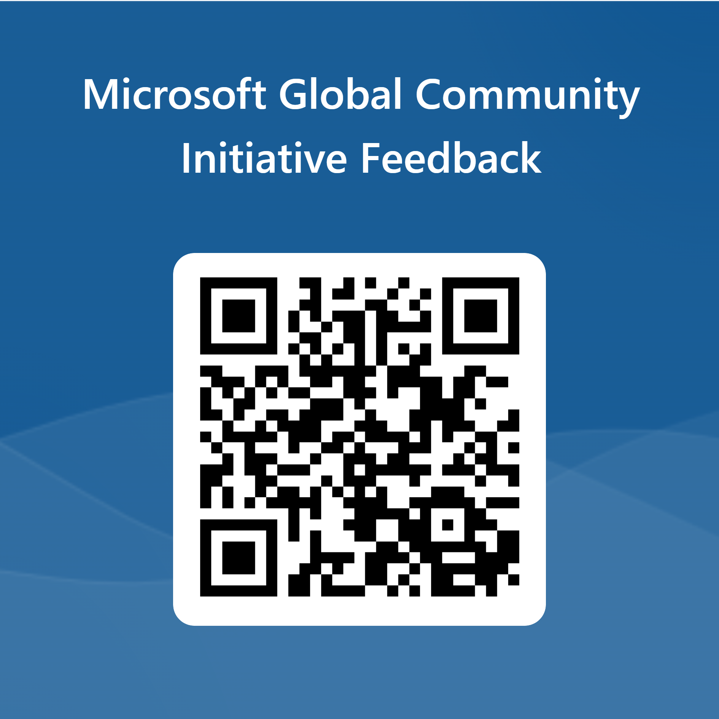
Love your feedback on this meeting
https://aka.ms/MGCIMeetingFeedback

Slide 31

Request Community Amplification
Looking for help amplifying your event via Microsoft Community LinkedIn and MSFT Adoption twitter handle?
Fill out this form:
https://aka.ms/communitysocial
The SLA is 3 business days.
Microsoft Global Community Initiative https://aka.ms/MGCI

Slide 32

Training Workstream Update
​Workstream Leads – Sharon Weaver & Wes Preston
Upcoming event training dates
Date | Host | Guest Speaker | Topic
JAN 29 | Wes & Sharon | Sharon Sumner and Mark Rackley | Finding and Managing Sponsors
FEB 26 | Wes & Sharon | AMA Panel | Run of Show: What to do the day of the event?
APR 23 | Wes & Sharon | AMA Panel | TBD

Slide 33
MGCI General Sessions – The Third Tuesday of the Month
Learn from your peers and get updates on the MGCI program!
3rd Tuesday of every month at 8:10 AM and 5:10 PM Pacific Time.
https://aka.ms/MGCIMtgAM
https://aka.ms/MGCIMtgPM
All MGCI General Sessions and Event Training Sessions will be available on-demand on the
Microsoft Community Learning YouTube Channel: https://aka.ms/community/learning
Quarter 3
Date | Presenter | Topic
Jan 20 | Heather Cook | Community Update and AMA
Feb 17 | TBA | Women In Tech & Allies: Strengthening Community Across the Microsoft Ecosystem
March 17 | TBA | Microsoft Non Profits
Microsoft Global Community Initiative https://aka.ms/MGCI

Slide 34

MGCI General Sessions – The Third Tuesday of the Month
Want to share best practices or lessons learned on producing events or building community in an upcoming session?
Fill out this form:
https://aka.ms/GeneralSessionGuest
We are looking for speakers for 2026!
Microsoft Global Community Initiative https://aka.ms/MGCI

Slide 35
Lessons Learned

Slide 36
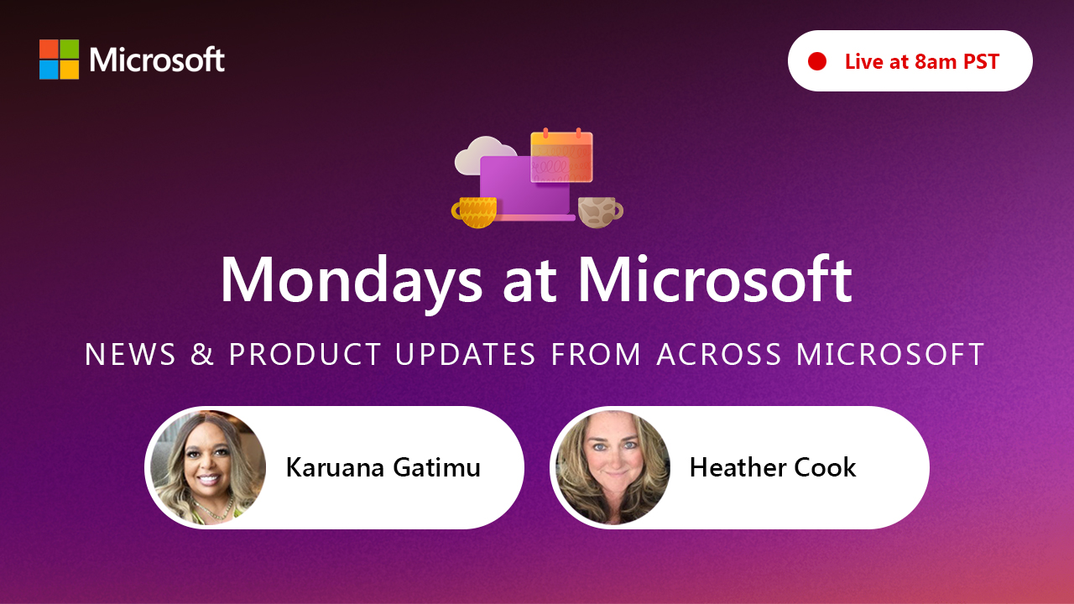
https://aka.ms/mondaysatmicrosoft
Learn - Explore – Connect In the Microsoft Community
Bi-weekly @ 8am PT
Watch on
Microsoft Community Linked
https://aka.ms/microsoftcommunitylinkedin
Notes:
Last used May 2023, Heather Cook

Slide 37




Stay Connected!
Engage with the best community in tech…
There’s something for everyone!
Microsoft Tech Community
The community platform for Microsoft 365 – forums, blogs, and events
aka.ms/joinMTC
CommunityDays.org
Find or host a local event in your area
or to match your interests
Microsoft Community on LinkedIn
News, announcements and training delivered to your news feed aka.ms/microsoftcommunitylinkedin

Slide 38
Thank you!

