Slide 1
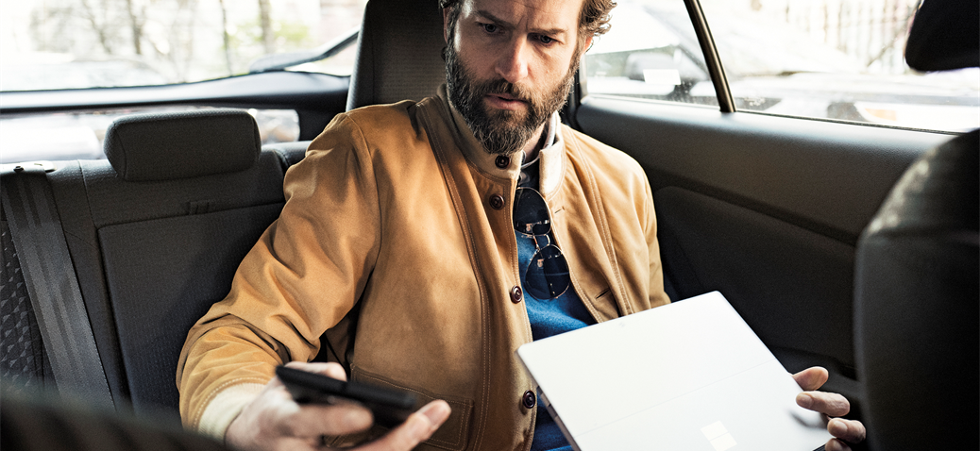
Your productivity experience Create, collaborate & communicate on any device with Microsoft 365
During morning coffee
Check e-mail Manage your calendar
Check chats & stay up to date on projects
Create or review documents
On your commute
Join personal meetings or chat with voice to text
Catch up on company news
Connect to a meeting right from Outlook
Meeting at the office
Conduct private or channel meetings with teammates. Take notes, share meeting recordings and action items
Track and share meeting actions with Planner and other apps in Teams
Collaborating with your team
Chat, video, screen sharing, and file co- authoring in context via Teams
Co-author content with PowerPoint, Excel or Word
Save & share documents from the cloud
Connecting across the company
Use Yammer for organizational updates, knowledge sharing, finding answers or providing feedback
Use communication sites & news to keep broad groups of stakeholders up to date
Notes:
A day in your digital life
Get the most from Office 365 in ways that work for you. All activities shown can be accomplished from your desktop, tablet or mobile device.

