Slide 1
Maximize M365 Copilot Chat value with better prompts
Notes:
Welcome & Session Overview
Welcome everyone and set a friendly, informal tone.
“Today, we’re going to explore how to get the most out of Microsoft 365 Copilot Chat. The goal is to make this session practical and interactive.”

Slide 2


AGENDA
1
Quick introduction to Copilot Chat
2
Maximize impact through prompting tips
3
Follow along demonstration
Next Steps & Call to Action
Notes:
Session Agenda
Welcome and Framing
Let’s start by reviewing our agenda for today’s session on maximizing your experience with Microsoft 365 Copilot Chat.”
“This session is designed to be practical and interactive, so feel free to ask questions or share your thoughts at any time.”
Agenda Overview
“Here’s what we’ll cover today:”
Introduction to Copilot Chat: “We’ll begin with a quick overview of what Copilot Chat is and how it fits into your workflow.”
Prompting Tips: “We’ll dive into tips and best practices for writing effective prompts, so you can get the most out of Copilot Chat.”
Live Demo: “I’ll walk you through a demonstration of Copilot Chat, including how to use agents to enhance your productivity.”
Encourage Participation
“This session is meant to be hands-on and conversational. Please jump in with questions, comments, or examples from your own experience.”
“The more you participate, the more you’ll get out of today’s training.”
Transition
“Let’s get started with a brief introduction to Copilot Chat and what makes it a valuable tool for your daily work.”

Slide 3

Copilot is the UI for AI
Copilot
Agents
Notes:
What is Microsoft 365 Copilot Chat?
Introduction
“Let’s talk about what Microsoft 365 Copilot Chat actually is and why it’s valuable for your daily work.”
Key Points to Cover
Copilot as the UI for AI:
“Microsoft 365 Copilot is designed to be the user interface for artificial intelligence within the Microsoft 365 ecosystem.”
“It’s like having an assistant that works alongside you, helping with business productivity and even personal tasks.”
How Copilot Chat Works:
“Copilot Chat is included for free as part of Microsoft 365.”
“It can work with a limited number of agents out-of-the-box, and you can add more agents as needed, sometimes at an additional cost.”
“Some users may only need Copilot Chat and specific agents, rather than the full Copilot experience.”
Integration with Workflow:
“Copilot Chat is designed to integrate seamlessly into your regular business workflow, making AI accessible and useful for everyone.”
Encourage Engagement
“Think of Copilot Chat as a helpful partner that can assist you with tasks, answer questions, and streamline your work.”
“If you have examples of how you’d like to use Copilot Chat, feel free to share them as we go.”
Transition
“Next, we’ll look at how Copilot Chat fits into your daily workflow and how you can start using it right away.”

Slide 4
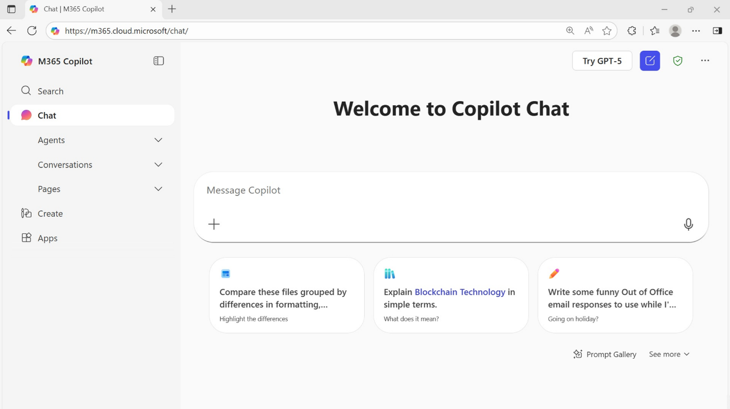
Microsoft 365 Copilot Chat
Powered by the
Latest GPT Model
Secure AI chat powered by the latest models, grounded in web data, and context-aware, understanding the content you’re working on and tailoring responses accordingly.
Notes:
Copilot Chat User Experience Overview
Introduction
“Let’s take a closer look at the user experience with Copilot Chat and how it fits into your daily workflow.”
Key Points to Cover
Consistent Experience Across Users:
“The Copilot Chat interface is consistent for all users, making it easy to get started no matter your role or background.”
“The full version of Copilot can reason over all your work data, but Copilot Chat focuses on the open document and any files you upload.”
“Copilot Chat can be accessed from the Microsoft 365 Copilot app, the web, the Edge browser, and the M365 Apps.”
Uploading and Prompting:
“With Copilot Chat, you can upload individual files and add information to your prompts as you go.”
“This flexibility allows you to get targeted help on specific documents or tasks.”
Practical Use Case:
“If you need a quick summary or want to prepare an outline, you can open a document, ask Copilot Chat for assistance, and then copy the results wherever you need them.”
Accessibility:
“Copilot Chat is designed to be accessible and easy to use, even for those who haven’t used AI tools before.”
Encourage Engagement
“Feel free to experiment with uploading different types of files and see how Copilot Chat can help you.”
“If you have questions about how to use Copilot Chat with your documents, let’s discuss them now.”
Transition
“Next, we’ll explore how Copilot Chat is integrated into various Microsoft 365 apps and how you can use it alongside your favorite tools.”

Slide 5
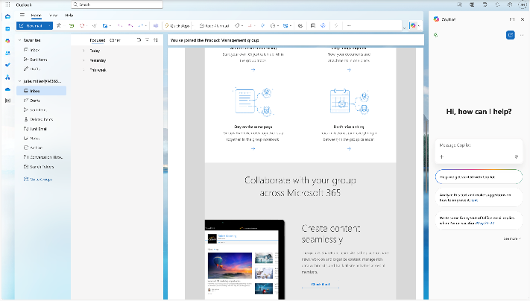







Available across Microsoft 365 apps
Microsoft 365 Copilot Chat available as a side-by-side experience in Word, Excel, PowerPoint, Outlook, OneNote, and Teams, to help users access AI in their flow of work.
Copilot Chat will open in the side pane and users can manage this behavior through their settings in the app.
Notes:
Copilot Chat in Microsoft 365 Apps
Introduction
“Let’s talk about how Copilot Chat is integrated into the Microsoft 365 apps you use every day.”
Key Points to Cover
Integration Across Apps:
“Copilot Chat is now available in a sidebar in Word, Excel, PowerPoint, OneNote, Outlook, and Teams.”
“You’ll see Copilot Chat as a pane on the right side of your screen, allowing you to interact with it directly over the document you’re working on.”
Practical Use Cases:
“This integration makes it easy to ask Copilot Chat for a quick summary, prepare an outline, or get help with your open document.”
“You can cut and paste results from Copilot Chat into other documents or emails, streamlining your workflow.”
Testing and Adoption:
“This feature is included as part of Microsoft 365, so you can try it out and see how it fits your use case before deciding if you need the full Copilot experience.”
Encourage Engagement
“Feel free to experiment with Copilot Chat in different apps and see how it can help you with your daily tasks.”
“If you have questions about using Copilot Chat in a specific app, let’s discuss them now.”
Transition
“Next, we’ll take a quick look at an overview of Copilot Chat in action.”

Slide 6
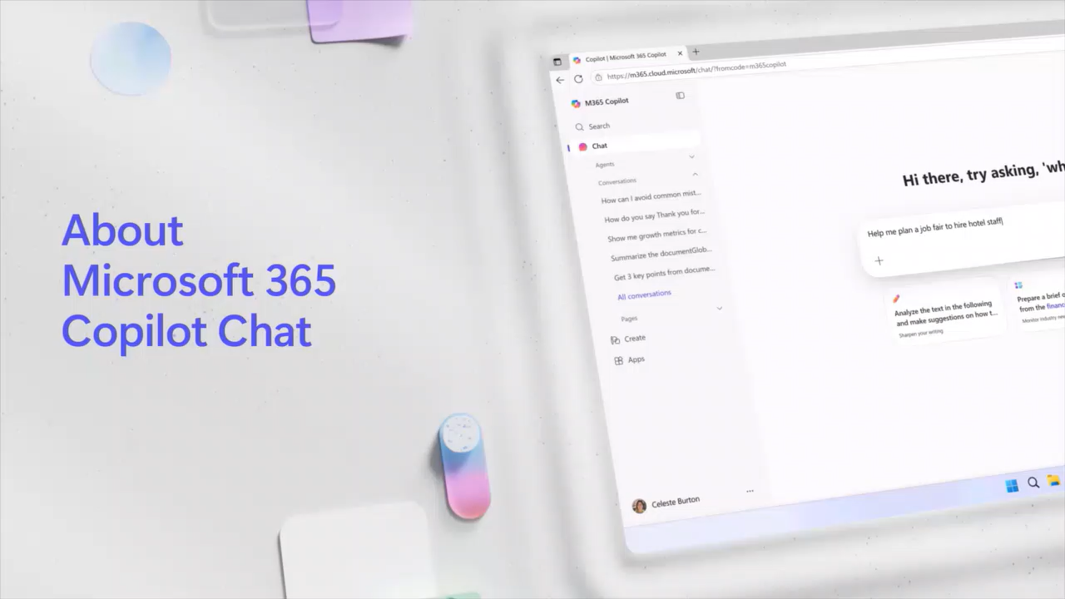
Video: Copilot Chat
Notes:
Quick Overview
Transition to a brief overview video
“Let’s take a quick look at how Copilot Chat works in practice.”
(Show the short demo.)

Slide 7
Art of Prompting
Notes:
Transition and Context
“Now, let’s move into one of the most important parts of working with Copilot Chat: how to write effective prompts.”
“This section is all about maximizing your impact by understanding how to communicate with Copilot Chat.”
Key Points to Cover
Importance of Prompting:
“The way you phrase your prompt directly affects the quality of the response you get from Copilot Chat.”
“We’ll look at both basic and advanced techniques, so everyone can improve their results—whether you’re just starting out or looking to refine your skills.”
Encourage Engagement:
“Feel free to ask questions or share your own experiences as we go through this section.”
“If you’ve ever struggled to get the answer you wanted, this is the perfect time to learn how to improve your prompts.”
Set Expectations
“By the end of this section, you’ll have practical tips and techniques you can use right away to get better, more relevant responses from Copilot Chat.”
Transition to Next Slide
“Let’s start by looking at some basic principles of prompting.”

Slide 8


The Art and Science of Prompting
Tell Copilot Chat what you need
Prompts are how you ask Copilot to do something for you — like creating, summarizing, editing, or transforming.
Think about prompting like having a conversation, using plain but clear language and providing context like you would with an assistant.
Learn about competing products:
“What are the top competitors to [Product] and who are the key Companies working on it?”
Edit text:
“Check this product launch rationale for inconsistencies.”
Transform documents:
“Transform this FAQ doc into a 10-slide onboarding guide.”
Summarize information:
“Write a session abstract of this [presentation]."
Create engaging content:
“Create a value proposition for [Product X.doc].”
Notes:
What is a Prompt?
Introduction
“Let’s talk about the basics of prompting—what it is and why it matters when working with Copilot Chat.”
Key Points to Cover
Definition of a Prompt:
“A prompt is simply what you use to tell Copilot Chat what you want it to do.”
“Think of it as a natural language instruction—just like you’re talking to a colleague.”
Examples of What Prompts Can Do:
“You can ask Copilot Chat to edit text, transform documents, summarize information, or create new content.”
How to Write a Prompt:
“Use natural language—write your prompt as if you’re having a conversation.”
“Be clear about what you want Copilot Chat to do. The more specific you are, the better the response.”
Encourage Engagement
“If you’re unsure how to start, just describe your goal in plain English.”
“Don’t worry about making it perfect—Copilot Chat is designed to understand and respond to everyday language.”
Transition
“Next, we’ll look at the four main ingredients that make a prompt truly effective.”

Slide 9
The Art and Science of Prompting
Include the right prompt ingredients
To get the best response, it’s important to focus on some of the key elements when phrasing your Copilot prompts.
Goal
Goal
Context
Context
Source
Expectations
Source
Expectations
What
response do you want from Copilot?
Why
do you need it and who is involved?
Which information sources or samples should Copilot use?
How
should Copilot respond
to best
meet your expectations?
Notes:
Four Ingredients of an Effective Prompt
Introduction
“Now that we know what a prompt is, let’s talk about how to make your prompts truly effective.”
“There are four main ingredients that go into a really good prompt.”
Key Points to Cover
Goal
“Start by stating your goal—what do you want Copilot Chat to do?”
“For example, are you asking it to draft an email, create a list, brainstorm ideas, or summarize something?”
“Make sure your goal is clear and appears at the beginning of your prompt.”
Context
“Next, provide context. This helps Copilot Chat understand why you need the information or who it’s for.”
“For instance, if you’re creating a presentation for a CEO, mention that. The response will be tailored for that audience.”
“Context isn’t always natural for us to include, but even a little bit goes a long way.”
Source
“Tell Copilot Chat where to get the information. If you don’t specify, it will search broadly, which might not give you the best results.”
“You can narrow the search by specifying a source and adding guardrails, like limiting to the last two years or a specific website.”
Expectations
“Finally, set your expectations for the response. How do you want the information presented?”
“You can ask for a professional tone, a specific format (like a table or paragraph), or a word limit.”
“If you don’t set expectations, Copilot Chat will choose how to respond, which might not match what you want.”
Transition
“Next, we’ll look at how these ingredients come together in a sample prompt.”

Slide 10
Include the right prompt ingredients
Goal
Context
What response do you want from Copilot?
Why do you need it and who is involved?
Generate a list of the labor force participation rates from the Bureau of Labor Statistics over the last 5 years. I’m trying to understand trends. Provide the results in an easy to read table.
Which information sources or samples should Copilot use?
How should Copilot respond
to best meet your expectations?
Source
Expectations
Notes:
Example of a Well-Structured Prompt
Introduction
“Let’s see how all four ingredients—goal, context, source, and expectations—come together in a real prompt.”
Key Points to Cover
Walk Through the Example Prompt:
“Here’s a sample prompt: ‘Generate a list of the labor force participation rates from the Bureau of Labor Statistics over the last 5 years. I’m trying to understand trends. Provide the results in an easy to read table.’”
“Notice how the goal is stated right up front: generate a list of labor force participation rates.”
“The source is specified: Bureau of Labor Statistics.”
“A guardrail is added: limit the data to the last five years, so Copilot Chat doesn’t search too broadly.”
“Context is included: ‘I’m trying to understand trends.’ This helps Copilot Chat know why you want the information and may lead to more insightful results.”
“Expectations are set: ‘Provide the results in an easy-to-read table.’ This tells Copilot Chat exactly how you want the information presented.”
Why This Works:
“By including all four ingredients, you make it much easier for Copilot Chat to deliver exactly what you need.”
“You get a focused, relevant, and well-formatted response.”
Encourage Engagement
“Try building your own prompts using these four ingredients.”
“If you’re not getting the results you want, check which ingredient might be missing and refine your prompt.”
Transition
“Next, we’ll look at more prompting tips and how to make your instructions even more effective.”

Slide 11





The Art and Science of Prompting
Keep the conversation going
Following up on your prompts helps you collaborate with Copilot, to gain more useful, tailored responses.
Generating content ideas
Lead with broader requests, then give specific details about the content.
Gaining insights
Ask for a summary of a specific file,
then ask relevant questions to gain
deeper insights.
Storytelling assistance
Ask Copilot to write a story, then guide it by giving more specific, relevant details​.
Translating languages
Ask Copilot to translate a sentence to one of the supported languages, then ask for more context or a regional dialect.
Solving technical problems
Present a technical problem, then narrow it down, or ask for step-by-step guidance​.
Notes:
The Art and Science of Prompting
Introduction
“Let’s explore how to make Copilot Chat truly collaborative and productive by mastering the art and science of prompting.”
Key Points to Cover
Keep the Conversation Going:
“Prompting isn’t just about a single question—it’s about having an ongoing dialogue. Lead with broad requests, then add specific details to guide Copilot’s responses.”
Generating Content Ideas:
“Start with a general idea, then refine your prompt to get more targeted content. For example, ask Copilot to brainstorm story ideas, then specify the genre or audience.”
Storytelling Assistance:
“Copilot can help you write stories. Begin with a basic request, then add details about characters, setting, or tone to shape the narrative.”
Gaining Insights:
“Ask Copilot to summarize a file or meeting, then follow up with questions to dig deeper into the insights or action items.”
Translating Languages:
“Request a translation, then ask for more context or a specific dialect to get the most accurate result.”
Solving Technical Problems:
“Present a technical issue, then narrow it down or ask for step-by-step guidance. Iterative prompting helps Copilot deliver more precise solutions.”
Walk Through an Example
“Let’s see how these techniques work in practice. Start with a broad prompt, then refine it step by step. For example:
‘Summarize this file.’
‘Now, highlight the main risks discussed.’
‘Translate the summary into Spanish, using a business tone.’
Each follow-up makes the output more relevant and actionable.”
Why This Works
“By keeping the conversation going and refining your prompts, you unlock Copilot’s full potential for collaboration, creativity, and problem-solving.”
Transition
“Next, we’ll look at more prompting tips and how to make your instructions even more effective.”

Slide 12


What makes an effective prompt?
More Effective
Less Effective
Specific and detailed
Vague
In full sentences, with instructions
Just a few words
States the tone, purpose, preferred format, etc.
No context on preferred output
Example: I work in marketing and focus on competitor research. Give me a concise summary of recent news about [company name]. Focus on announcements about new product lines. Provide the answer in two to three paragraphs and use a business tone.
Example: Summarize news about [company name].
The recap may be more vague than desired, or in a format that you were not seeking.
But there are no ‘wrong’ prompts because natural, conversational language is welcome.
Experiment away!
Notes:
Tips for More Effective Prompts
Introduction
“Let’s talk about some practical tips for making your prompts more effective when working with Copilot Chat.”
Key Points to Cover
Be Specific and Detailed:
“The more specific and detailed your prompt, the better the response you’ll get.”
“Avoid vague or general instructions—Copilot Chat works best when it knows exactly what you want.”
Write in Full Sentences:
“Use complete sentences and avoid abbreviations or company-specific acronyms that Copilot Chat might not recognize.”
“Spelling things out clearly helps Copilot Chat understand your request.”
Give Clear Instructions:
“You can include step-by-step instructions in your prompt. For example, ask Copilot Chat to find data, then analyze it, then summarize the findings.”
“Clearly stating what you want Copilot Chat to do at each step leads to better results.”
State Tone, Purpose, and Format:
“Set expectations for the response—do you want a professional tone, a summary in 500 words or less, or a table with specific columns?”
“If you don’t specify, Copilot Chat will choose how to respond, which might not match what you want.”
No Wrong Prompts:
“Don’t worry about making mistakes—there are no wrong prompts. Some prompts are just more effective than others.”
“If you don’t get the result you want, refine your prompt and try again.”
Transition
“Next, we’ll look at a few more tips for refining your prompts and getting even better results.”

Slide 13


Prompting Tips
Communicating
Sequence
Quotes
Correct punctuation, capitalization, and grammar produce better quality output.
The order in which you present information in your prompt may impact the output, so try resequencing or rephrasing if you aren’t getting what you expect.
Use quotation marks to indicate the exact content you want Copilot to write, modify, or replace.
Notes:
More Tips for Better Prompts
Introduction
“Let’s wrap up our tips for writing effective prompts with a few more practical suggestions.”
Key Points to Cover
Use Correct Punctuation, Capitalization, and Grammar:
“While Copilot Chat is very good at understanding what you mean—even if you make a typo—using proper punctuation, capitalization, and grammar will help ensure you get the best quality output.”
“It’s especially important for clarity and for more complex requests.”
Sequence Matters:
“The order in which you present information in your prompt can affect the response.”
“If you’re not getting the result you want, try moving your goal or context to the beginning of your prompt.”
Try Using Quotes for Specificity:
“If you want Copilot Chat to use an exact phrase or title, put it in quotes.”
“For example, if you want a summary on ‘Project Falcon,’ using quotes tells Copilot Chat to focus only on that specific project.”
Iterate and Refine:
“If your first prompt doesn’t give you what you want, don’t hesitate to revise it and try again.”
“Small changes—like adjusting the order or adding more detail—can make a big difference.”
Transition
“Next, we’ll look at how to revise vague prompts to make them more specific and clear.”

Slide 14
Be Specific and Clear
Initial Prompt
Potential Problems
Revised Prompt
Summarize this meeting transcript
May not capture all relevant details or may
omit critical information
Analyze this meeting transcript and
summarize the meeting, especially all the key points made by <person>
Rewrite this document to be more concise
Lack of context on which sections to prioritize
or maintain
Rewrite the introduction and conclusion of this document to be more concise while preserving the main points.
Write a personal narrative about a memorable experience
Could generate a narrative that lacks depth
or detail, possibly producing a generic story
without emotional resonance or vivid imagery.
Write a personal narrative about a
memorable experience you had in nature, using vivid sensory details and emotions.
Draft a response to this customer complaint
Too generic; the tone, solutions offered, or the
depth of the response may not match company standards or the complaint’s severity
Draft a polite response to this customer’s complaint about shipping delays, offering a
10% discount on their next order.
Summarize the product reviews from our
latest launch
Could result in a too general summary that
doesn't provide actionable insights
Summarize the top three positive and top three negative points from the product reviews of our latest smartphone launch.
Notes:
Making Prompts Specific and Clear
Introduction
“Let’s look at how we can improve our prompts by making them more specific and clear.”
Key Points to Cover
Start with Common Prompt Issues:
“Often, our first attempt at a prompt is a bit vague or ‘gray.’ For example, asking Copilot Chat to ‘summarize this meeting transcript’ might get you a general summary, but it could miss important details or context.”
“If you don’t specify what you want, Copilot Chat has to guess—and that can lead to incomplete or less useful responses.”
How to Fix Vague Prompts:
“To get better results, revise your prompt to add clarity and detail.”
“For example, instead of ‘summarize this meeting transcript,’ you could say: ‘Analyze this meeting transcript and summarize the meeting, especially all the key points made by the project manager.’”
“This tells Copilot Chat exactly what you want, and who to focus on.”
General Principle:
“The more specific and clear your prompt, the more relevant and actionable the response will be.”
“Use natural language and don’t be afraid to spell out what you need.”
Transition
“Next, we’ll dive into best practices for refining and iterating on your prompts to get even better results.”

Slide 15
Iterate and Regenerate
Often, the first result may not be the final or best response. If you're not satisfied with the result Copilot gave you, revise your prompt and try again. Try the following three iterations and see how the responses can improve with each iteration.
Prompt 1
Write about advancements in renewable energy technologies.
Prompt 2
Write a technical article discussing recent advancements in renewable energy technologies, focusing on solar and wind energy, for an audience of engineers and environmental scientists.
Prompt 3
Compose a detailed technical article for engineers and environmental scientists, exploring recent advancements and innovations in renewable energy technologies, with a focus on solar and wind energy. Discuss the scientific principles behind these technologies, their efficiency improvements, and real-world applications. Refer to recent research papers, patents, and industry reports for accurate and up-to-date information.
Goal
Context
Source
Expectations
Notes:
Prompting Best Practices: Iteration, Elaboration, and Context
Introduction
“Now let’s dive into some advanced best practices for prompting—specifically, how to refine your prompts through iteration, rich elaboration, and contextual understanding.”
Key Points to Cover
Iterate and Regenerate
“Often, we don’t know exactly what we’re looking for until we see the first response from Copilot Chat.”
“Start with a basic prompt, then refine it based on what you get back.”
“For example, a simple prompt like ‘Write about advancements in renewable energy technologies’ might give you a general answer.”
“You can then iterate: ‘Write a technical article discussing recent advancements in renewable energy technologies, focusing on solar and wind energy for an audience of engineers and environmental scientists.’”
“Notice how the second prompt adds context and expectations, leading to a much better response.”
“The third iteration might be even more detailed, specifying the scientific principles, efficiency improvements, and asking for references to recent research papers and industry reports.”
“Longer, more specific prompts—around 21 words—tend to get the best results.”
Transition
“Next, we’ll look at how to elaborate on a prompt to get better results.”

Slide 16


Rich Elaboration
Initial Prompt
Create an image of a group of product people in a virtual meeting.
Regenerated w/elaboration
Regenerate the image. The focus of the image should be a view of the female speaker and a data slide. The rest of the audience should look engaged, and one person is giving a thumb up sign.
Notes:
Rich Elaboration in Prompts
Introduction
“Let’s talk about how adding rich detail and elaboration to your prompts can dramatically improve the results you get from Copilot Chat.”
Key Points to Cover
Start Simple, Then Elaborate:
“Often, we start with a basic prompt, like ‘Create an image of a group of product people in a virtual meeting.’”
“This will give you a generic image, but it might not capture the specific details you want.”
Refining with Rich Elaboration:
“You can refine your prompt by adding more detail. For example: ‘Regenerate the image. The focus should be a view of the female speaker and a data slide. The rest of the audience should look engaged, and one person should be giving a thumbs up.’”
“Notice how the second prompt is much more specific. It tells Copilot Chat exactly what elements to include and what the focus should be.”
Why Elaboration Matters:
“The more you elaborate, the more tailored and accurate the output will be.”
“Copilot Chat remembers your previous prompt until you start a new chat, so you can build on what you’ve already asked for.”
Practical Tip:
“Don’t hesitate to ask Copilot Chat to regenerate or refine its output based on your feedback. Iteration and elaboration are key to getting the best results.”
Transition
“Next, we’ll look at how Copilot Chat uses context from previous prompts to deliver even more relevant and personalized responses.”

Slide 17

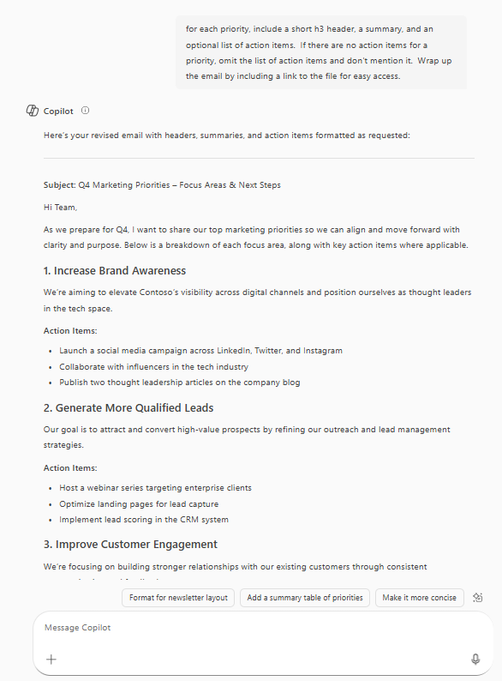
Contextual Understanding
Write an email to my team about our top priorities for next quarter from [file]
We can then follow up with:
For each priority, include a short H3 header, a summary, and an optional list of action items. If there are no action items for a priority, omit the list of action items and don't mention it.
Wrap up the email by including a link to the file for easy access.
Notes:
Contextual Understanding in Copilot Chat
Introduction
“Let’s explore how Copilot Chat uses contextual understanding to deliver more relevant and personalized responses.”
Key Points to Cover
What is Contextual Understanding?
“Contextual understanding means Copilot Chat can interpret not just your literal prompt, but also the surrounding information and previous interactions.”
“It remembers what you’ve been talking about in the current conversation until you start a new chat.”
Why is This Useful?
“You don’t have to repeat yourself or retype information—Copilot Chat keeps track of your prior prompts and builds on them.”
“This allows you to drill deeper into a topic, refine outputs, and get more tailored responses.”
Practical Example:
“For instance, you might start by asking Copilot Chat to write an email about your team’s top priorities for next quarter, using information from a file.”
“If you want to refine the output, you can follow up with another prompt: ‘For each priority, include a short header, a summary, and a list of action items. If there are no action items, omit the list.’”
“Copilot Chat understands you’re still working on the same email and adjusts its response accordingly.”
“You can keep building on your previous prompts, asking for changes or additions, and Copilot Chat will incorporate your instructions.”
How to Reset Context:
“If you want to start fresh, use the ‘new chat’ button. This clears the previous context and lets you begin a new topic.”
Encourage Engagement
“Try using follow-up prompts to refine or expand on Copilot Chat’s responses.”
“Notice how the tool remembers your instructions and builds on them, making your workflow smoother and more efficient.”
Transition
“Next, we’ll see how to use this contextual understanding to combine information and create comprehensive outputs.”

Slide 18
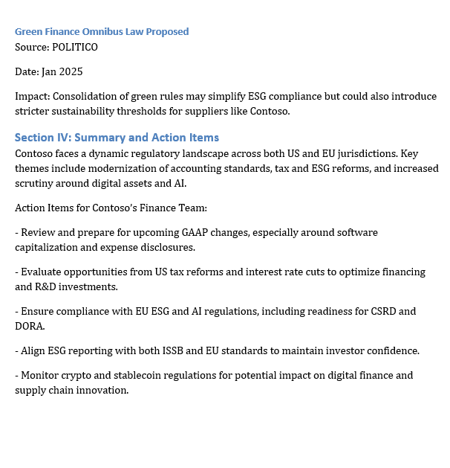
Prompts
I’m a financial analyst at Contoso. Help me get up to speed on the latest changes in regulations by summarizing all US GAAP updates from the
last 3 months.
What are some recent changes in US financial regulations or policies that could affect Contoso? Give me headline worthy changes over the last few months. Respond in table format with the following columns: Headline, Source, Date, How it could Impact Contoso.
Now do the same, but for the EU instead of US.
Combine all into one report. I want to see the US GAAP changes, the US regulation/policy changes, and the EU regulation/policy changes. Wrap it up with a nice summary and some action items for Contoso’s finance team.
Notes:
Ok, lets have a little fun. Follow along on your desktop by entering these prompts as you listed to our Customer Hub presenters Mike and Nick explain how you can use the prompting skills to improve the quality of a report Copilot is generating.

Slide 19
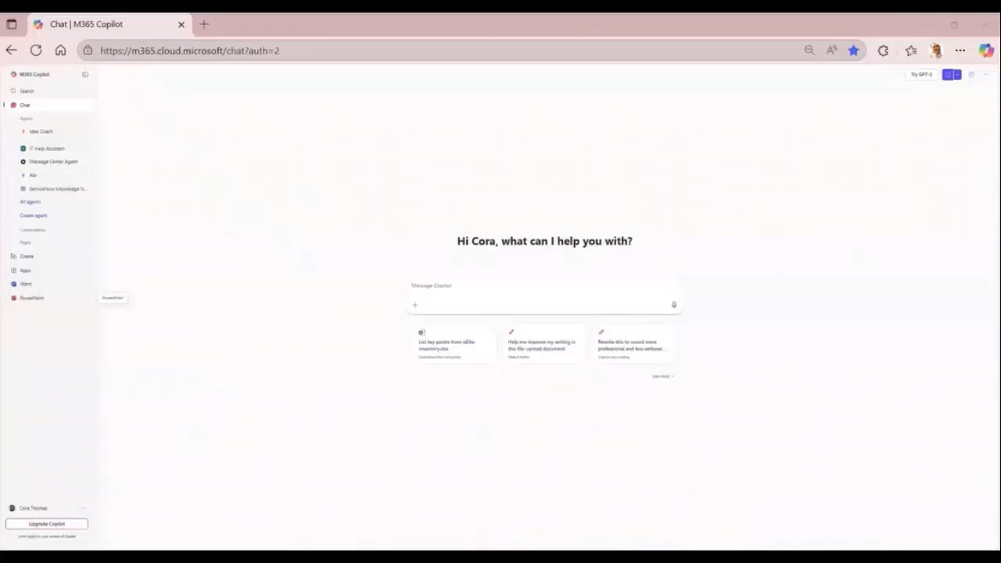
Chat prompting demo
Notes:
Use the prompts from the previous slide to follow along with the demo. Pause the demo as needed to allow people to copy the prompts into Copilot.

Slide 20
Next Steps and Call to Action

Slide 21

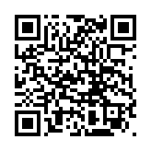
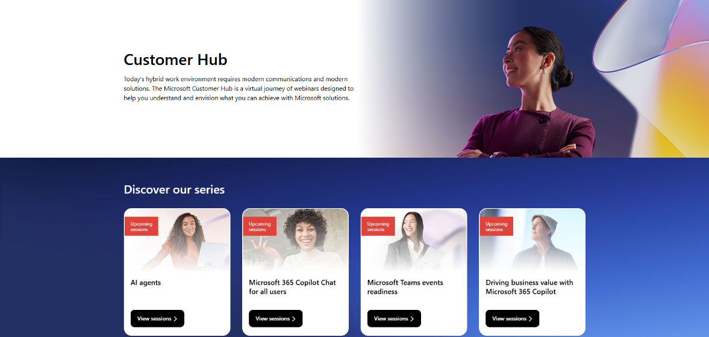
Customer Hub
Visit Customer Hub website for upcoming sessions, updates, and on demand contents!
https://aka.ms/CustomerHubSessions​
Notes:
Customer Hub
Introduction
“As we wrap up, I want to highlight some resources that can help you and your organization get even more value from Copilot Chat.”
Key Points to Cover
Customer Hub
“Get the latest information from Microsoft experts with extensive demos.”
“If you want to deliver the full version of the course you can access is on Customer Hub”
“Next, we’ll look at where to get the content you need for adoption.”

Slide 22
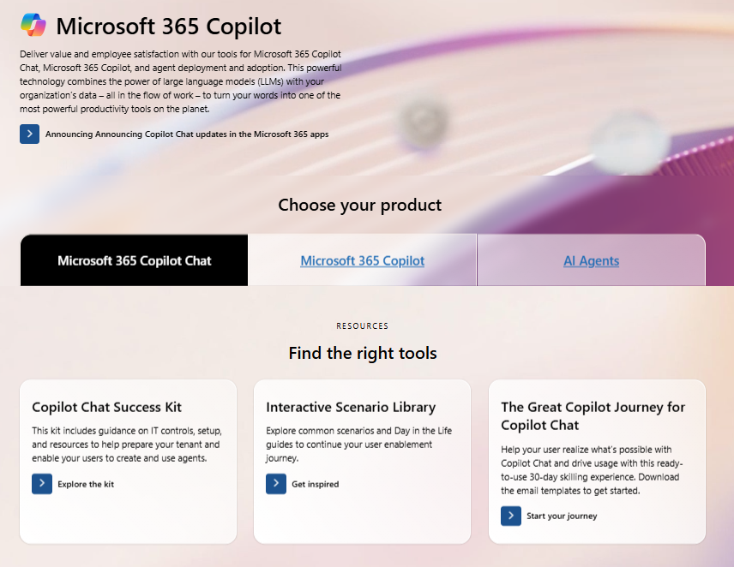
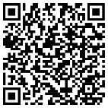
Copilot Chat Adoption Hub
adoption.microsoft.com/copilot-chat/
Notes:
Copilot Chat Success Kit & Support Resources
Introduction
“The Adoption Hub has content organized by role and adoption stage to make it easy to find what you need.”
Key Points to Cover
Copilot Chat Success Kit:
“There’s a Copilot Chat Success Kit available, which is a great resource for organizations looking to deploy Copilot Chat. It includes helpful materials like IT controls guides, user onboarding email templates, a trainer kit, user training guides, handouts, and links to other useful resources.”
“We also have great programs like the Great Copilot Journey to help your users make Copilot a habit and the Scenario Library to learn how to improve your key business processes with Copilot.”
“Next, we’ll look at how to access Copilot Chat on your mobile device and wrap up with final tips.”

Slide 23
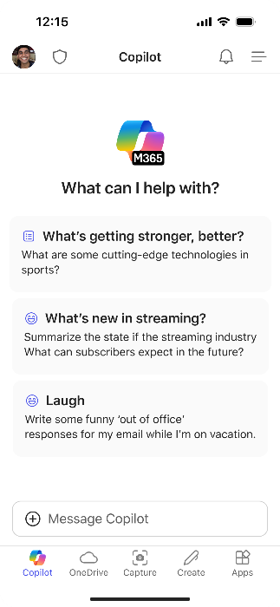
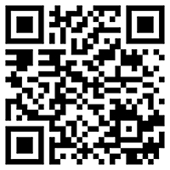
Use Copilot Chat on the go
Download the Microsoft 365 Copilot mobile app and sign in with your work or school account to access Copilot Chat
Notes:
Speaker Notes: Copilot Chat on Mobile Devices
Introduction
“Before we finish, let’s talk about how you can use Copilot Chat on your mobile device.”
Key Points to Cover
Mobile Access:
“Copilot Chat isn’t just for your desktop or laptop—it’s also available on mobile devices.”
“You can download the Copilot Chat app using the QR code provided on this slide.”
“Having Copilot Chat on your phone means you can get quick answers, summaries, and support wherever you are—even outside the office.”
Practical Benefits:
“This is great for staying productive on the go, resolving questions in meetings, or even settling debates at a restaurant!”
“You’ll have the same secure, enterprise-grade experience as on your desktop, with all your data protected.”
Encourage Experimentation:
“If you haven’t tried Copilot Chat on mobile yet, I encourage you to download it and explore its features.”
“It’s a handy way to keep Copilot close at hand for work and personal use.”
Wrap-Up
“That brings us to the end of our session. Thank you for participating and exploring Copilot Chat with me today.”

Slide 24
Thankyou !

