Slide 1
Hello and welcome to the Modern Work Customer Hub!
We’ll get started at 2 minutes past the hour

Slide 2
Microsoft 365 Copilot Extensibility
Session 2
Unlocking enterprise content with Microsoft Graph Connector to further enrich Microsoft Copilot’s data Reasoning Capabilities
Notes:
Hit Record
Hello everyone – and welcome to the Customer Hub series, “Microsoft 365 Copilot Extensibility’
My name is XXX and I’m on the XXX team here at Microsoft and I’ll be your host today. Before we get started, I have information I’d like to share.

Slide 3
Copilot Extensibility Sessions!
Session | Date | Time | Register
Session 1: Understanding the why and when of Microsoft 365 Copilot extensibility | September 18, 2024 | 9:00 PM PT for Asia | Register Here
Session 1: Understanding the why and when of Microsoft 365 Copilot extensibility | September 19, 2024 | 8:00 AM PT for Americas and Europe | Register Here
Session 2: Unlocking enterprise content with Microsoft Graph connector to further enrich Microsoft 365 Copilot data reasoning capabilities | September 25, 2024 | 9:00 PM PT for Asia for Americas and Europe | Register Here
Session 2: Unlocking enterprise content with Microsoft Graph connector to further enrich Microsoft 365 Copilot data reasoning capabilities | September 26, 2024 | 8:00 AM PT for Americas and Europe | Register Here
Session 3: Enable Microsoft 365 Copilot to take actions and trigger workflows via Copilot agents | October 2, 2024 | 9:00 PM PT for Asia | Register Here
Session 3: Enable Microsoft 365 Copilot to take actions and trigger workflows via Copilot agents | October 3, 2024 | 8:00 AM PT for Americas and Europe | Register Here
Visit https://aka.ms/CustomerHubSessions for more upcoming sessions, updates, and on demand content!!
Notes:
Today, we are kicking off the first session of the M365 Copilot Extensibility series. This series consists of three session delivered over three weeks.
Also, you can check out our customer hub webpage to sign up for the rest of the series if you haven’t already, or share the webpage with your colleagues so they can register. Also all Customer Hub session recordings and session slides will be posted here within 3 - 4 business days after the session is delivered, so please make sure you bookmark this page.

Slide 4
Make a difference Become a Champion
Get more from Copilot and Microsoft 365
Help others do the same
Expand your knowledge and enhance your career
Join the free program at aka.ms/M365Champions
Notes:
If you would like to continue the conversation after the session, and you are not already a member of the M365 Champions community, please consider joining. This community brings customers and Microsoft together to answer questions, provide resources, and many more.

Slide 5
House Keeping Rules
During the Presentation
We will mute your microphone for the first part of today’s call
Ask your questions via chat, we will get to all of them, live or after. Common questions will get addressed out loud.
After the Presentation
Raise your hand and we will call on you
Open mic 🙌 Come off mute and ask away!
Notes:
To avoid disruptions during today’s sessions we have muted lines just for now.
However, I do want to encourage you to ask questions as we go. And you can do this by typing your questions into the chat pane.
We have small army of very knowledgeable Subject matter experts in the background to get all your questions answered.
When we get to the end of today’s session you absolutely will have the opportunity to ask verbal questions to our presenter today.
We’ll give you a heads up when we get to that point in the presentation – at which time we’ll allow you to unmute your line and you’ll be able to ask your questions.

Slide 6
Unlocking Enterprise Content with Graph connectors: Boosting M365 Copilot’s Data Reasoning Capabilities
Bharath Bhat
Cloud Solution Architect
Microsoft Customer Success
Microsoft 365 Copilot Extensibility
Customer Hub Session 2 | September 26, 2024

Slide 7
Unlocking Enterprise Content with Graph connectors: Boosting M365 Copilot’s Data Reasoning Capabilities
Mike Francis
Cloud Solution Architect
Microsoft Customer Success
Microsoft 365 Copilot Extensibility
Customer Hub Session 2 | September 26, 2024

Slide 8
What you’ll learn today
In this session of the Microsoft 365 Copilot Extensibility Customer Hub Series, you will learn:
The benefits and functionalities of pre-built Graph connectors, including ServiceNow and Enterprise Websites Connector.
How Graph connectors enhance the accuracy, relevance, and comprehensiveness of Microsoft Search and Microsoft 365 Copilot.
The installation and configuration process for the Enterprise Websites Connector Graph connector.
How to effectively integrate and utilize Graph connectors to enrich your organizational knowledge and improve productivity.

Slide 9
Agenda
Recap: Extending Microsoft 365 Copilot
Graph connectors
Overview
Data Sources
Experiences
Building Blocks
Setup Prerequisites
Q&A
Notes:
Agenda * Introduction * Recap Graph Connector Overview * What are Microsoft Graph connectors? * Benefits * Pre-built Graph connectors * Introduction to Pre-built Graph connectors * ServiceNow * Jira * Enterprise Web Sites Connector * User Experience - Search and Copilot Demos * Search Experience * Jira * ServiceNow * Enterprise Web Sites Connector * Copilot Demos * Walkthrough of Installation and Configuration of ServiceNow (Admin Experience) * Installation Process * Configuration Settings * Best Practices * Q&A and Wrap-up * Questions and Answers * Summary * Next Steps * Additional Notes * Interactive Elements * Visual Aids * Conclusion

Slide 10
Copilot for Microsoft 365
Natural Language
Large Language Models
Microsoft Graph - Your Data -
Microsoft 365 Apps
The Web
Notes:
On its own, Copilot for Microsoft 365 is a powerful productivity tool for keeping users in the flow of their work across Microsoft 365 applications. It provides users with general skills such as understanding, summarizing, predicting, recalling, translating, and generating content. It draws from a baseline of your organizational knowledge by indexing content in the Microsoft Graph, such as the emails, chats and documents that users have permission to access.

Slide 11
Your AI Strategy is anchored in your Data Strategy
What if your data is outside of Microsoft 365?
World Knowledge
Enterprise data
General Knowledge
Enterprise Knowledge
Artificial Intelligence
Data in Apps Silo
Natural Language
M365 Graph
Notes:
However, business workflows don't typically run exclusively on Microsoft 365 applications and data formats.

Slide 12
Copilot Extensions Value
Skills
+ Copilot Agents
Enrich and focus with
Plugins
Your business data
Microsoft
Copilot
Your apps
Your workflows
Microsoft 365 Apps
Your automation
Knowledge
Microsoft Graph (Your Data)
Internet
Connectors
Notes:
You can extend copilot by adding:
Adding knowledge - You can enrich the organizational knowledge accessible to Copilot by ingesting your enterprise data and content with Microsoft Graph connectors.
Adding skills - You can extend Copilot's actionable knowledge by transforming your apps into plugins that increase user productivity across daily tasks and workflows.
Enhancing overall experience (Preview) - With combining extra data sources that contain specific domain knowledge in a declarative copilot that includes instructions to guide the user through the workflow and match intents. Declarative copilots can seamlessly integrate with plugins and connectors.
https://learn.microsoft.com/en-us/microsoft-365-copilot/extensibility/#what-can-you-do-to-extend-microsoft-copilot

Slide 13
Copilot Extensibility Options
Declarative Copilots
Graph Connector
M365 Identity – (Internal Users)
M365 Hubs UX
Workflow instructions
Custom Prompt Instructions
Actions
Triggers
Knowledge
Additional Semantic Grounding
Microsoft Graph Data
Orchestrator
Microsoft Copilot Orchestration
Foundational Models
Microsoft Copilot Foundation Model
Notes:
Example Scenarios:
Graph Connector:
GCs are used for expanding the organizational knowledge. So, again in the context of "serviceNow", with Copilot, you would like to ask information and query the LLM of not only about word documents or team meetings in your Graph, but also about information that is stored in into these tickets.
Plugins:
Plugins are used in extending user skills. By integrating Copilot with other applications, you use your work environment to perform other tasks and activities. For example, in the scenario you are using "serviceNow" for managing the tickets of your company, you might want to pull information from these tickets or to create a ticket on behalf of the user.

Slide 14
Copilot Extensibility Options
Declarative agents
Graph Connector
M365 Identity – (Internal Users)
M365 Hubs UX
Workflow instructions
Custom Prompt Instructions
Actions
Triggers
Knowledge
Additional Semantic Grounding
Microsoft Graph Data
Orchestrator
Microsoft Copilot Orchestration
Foundational Models
Microsoft Copilot Foundation Model

Slide 15
Copilot Extensibility Options
Declarative agents
Graph Connector
Graph Connector
Plugin
Custom Engine Copilot
M365 Identity – (Internal Users)
Entra ID (Internal Users)
M365 Hubs UX
Workflow instructions
Custom Prompt Instructions
Custom Prompt Instructions
Actions
RAG / Real time external Data
RAG / Real time external Data
Triggers
Triggers
Knowledge
Additional Semantic Grounding
Additional Semantic Grounding
Microsoft Graph Data
Custom Semantic Grounding
Orchestrator
Microsoft Copilot Orchestration
Custom Orchestration
Foundational Models
Microsoft Copilot Foundation Model
Azure AI Studio Models

Slide 16
Copilot Extensibility Options
Declarative agents
Custom engine agents
Graph Connector
Graph Connector
Plugin
M365 Identity – (Internal Users)
Entra ID (Internal Users)
M365 Hubs UX
Workflow instructions
Custom Prompt Instructions
Custom Prompt Instructions
Actions
RAG / Real time external Data
RAG / Real time external Data
Triggers
Triggers
Knowledge
Additional Semantic Grounding
Additional Semantic Grounding
Microsoft Graph Data
Custom Semantic Grounding
Orchestrator
Microsoft Copilot Orchestration
Custom Orchestration
Foundational Models
Microsoft Copilot Foundation Model
Azure AI Studio Models

Slide 17
Copilot Extensibility Options
Declarative agents
Custom engine agents
Graph Connector
Graph Connector
Plugin
M365 Identity – (Internal Users)
Entra ID (Internal Users)
External Users
M365 Hubs UX
Custom UX
Workflow instructions
Custom Prompt Instructions
Custom Prompt Instructions
Actions
RAG / Real time external Data
RAG / Real time external Data
Triggers
Triggers
Knowledge
Additional Semantic Grounding
Additional Semantic Grounding
Microsoft Graph Data
Custom Semantic Grounding
Orchestrator
Microsoft Copilot Orchestration
Custom Orchestration
Foundational Models
Microsoft Copilot Foundation Model
Azure AI Studio Models
BYO Models
https://aka.ms/extendcopilotm365/decide

Slide 18
Copilot Connectors
Ground responses
Focused user experiences
Connectors
Agents
Your business knowledge
Your business knowledge
Your apps
Your workflows
Your automation

Slide 19
What are Graph connectors?
“Can you give me guidance on operational efficiency?”
Large Language Model
Microsoft Graph
Indexed Items
Microsoft 365 boundary
External system
Notes:
Microsoft Graph APIs to index items from other systems

Slide 20
Graph Connector Experiences

Slide 21
Microsoft Graph Connector Experiences
Existing experiences
New
Search
Microsoft 365 App
Context IQ
Copilot
GA
GA
Preview
GA
Microsoft Graph
External data sources
Notes:
Viva Topics: Viva Topics includes content from third-party data sources via Graph connectors. This integration helps in bringing relevant content into the Microsoft Search index, enhancing the overall user experience
https://techcommunity.microsoft.com/t5/viva-topics-blog/introducing-microsoft-viva-topics/ba-p/2107007

Slide 22
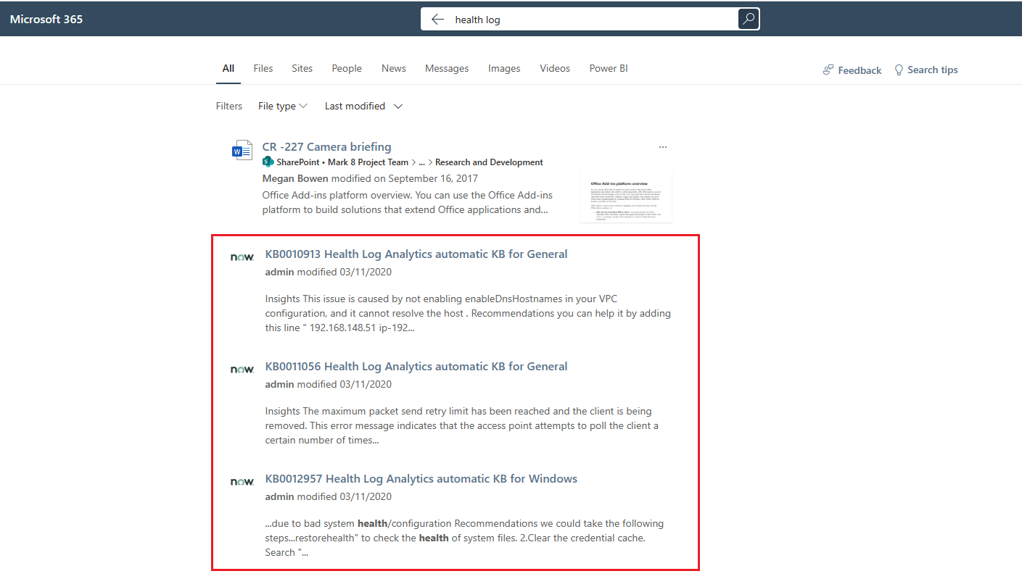
Graph Connectors examples
Microsoft 365 App
Context IQ
Copilot
Graph Connector Experience in Microsoft Search
When you use Graph connectors to add data sources, your users are able to search for them in the All vertical by default.
Users can see the results from Graph Connector data sources merged inline with all the other results from Microsoft apps in SharePoint
Graph connectors honor the source permissions as configured in your content source
You can customize and configure search results
In this example, you can see how Graph connectors have merged result from ServiceNow data source inline with SharePoint results
Notes:
Microsoft App -> (for example, SharePoint, OneDrive for Business, or Power BI

Slide 23
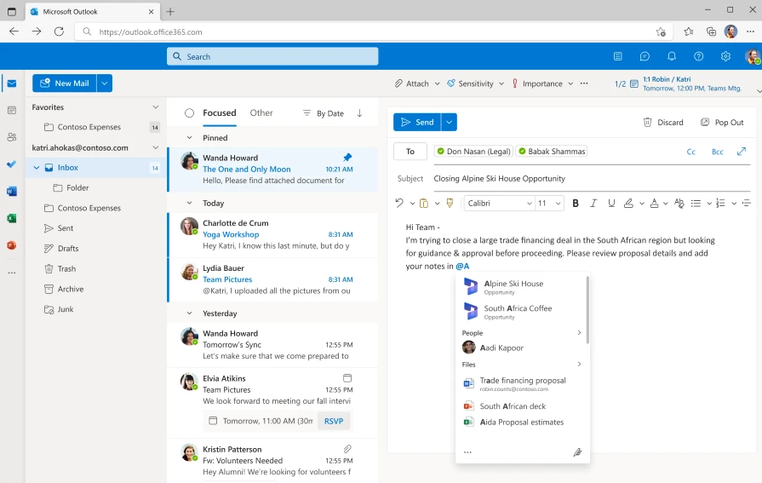
Graph Connector Experience in Copilot for Context IQ
Microsoft 365 App
Context IQ
Copilot
Context IQ in Outlook on the web with Microsoft Graph connectors allows users to find in-content suggestions from third-party data while composing emails in Outlook on the web.
Editors using Context IQ surface relevant people, files, and Microsoft Graph connector content that users can select and embed as an adaptive card within the email.
Preview

Slide 24
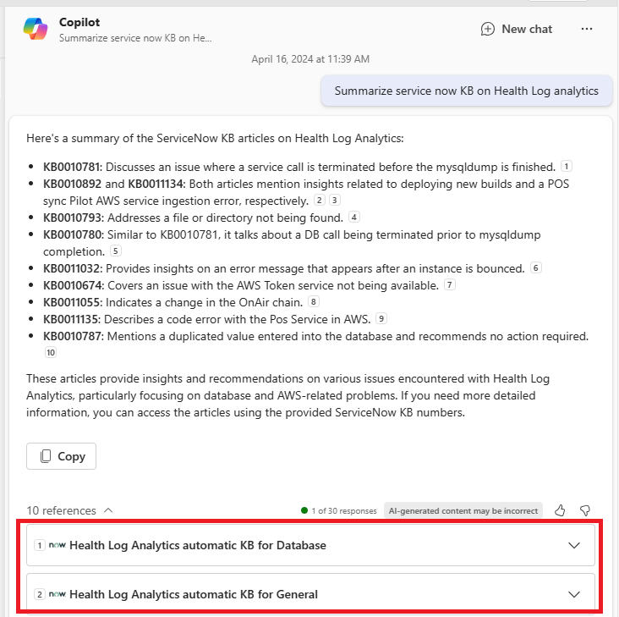
Graph Connectors Examples
Microsoft 365 App
Context IQ
Copilot
Graph Connector Experience in Copilot for Microsoft 365
Users can find, summarize, and learn from line-of-business data through natural language prompts with Microsoft Graph connectors and Copilot for Microsoft 365.
Users can hover over in-text citations to preview external items referenced in Copilot responses.
User can click reference links at the bottom of the response to dive deeper into the referenced content.
Notes:
To ensure Copilot for Microsoft 365 uses your content effectively, apply semantic labels, ingest content as text, use the searchable property label, add a urlToItemResolver, include user activities, provide meaningful descriptions, and enable inline results in the Admin Center.
Copilot for Microsoft365 with Graph connectors allows users to
Easily find, summarize, and learn important details about all content relevant to a user's natural language prompts.
Ground Copilot in external data
Search across more information

Slide 25
Demo External data in Copilot for M365
Notes:
Graph Connector data in Copilot for M365

Slide 26
Graph Connector Data Sources

Slide 27
Overview of Graph connector Data Sources
{api}
Graph connectors by Microsoft
Graph connectors
by Partners
Custom
Graph connectors

Slide 28
Custom Graph Connectors
Graph connectors By Microsoft
Graph connectors By Partners
{api}
Custom Graph connectors
Salesforce
CSV
Media Wiki
ADLS Gen2
Confluence
Azure SQL
Oracle SQL
ServiceNow
SQL Server
Custom Connector
File Share
Enterprise Web
Jira Cloud
Azure DevOps
On-prem Connector available

Slide 29
Service Now Knowledge
Graph connectors By Microsoft
Graph connectors By Partners
{api}
Custom Graph connectors
Example
Connects the ServiceNow Knowledge Base with Microsoft Graph, making knowledge articles searchable within Microsoft 365.
Users can quickly find relevant ServiceNow knowledge articles and reason about it in Copilot, improving productivity and reducing the need to switch between different platforms.
You can set the search permissions to either Everyone or Only people with access to this data source.
ServiceNow Catalog and Tickets are available as separate connectors.
Find all knowledge articles related to ITIL best practices in ServiceNow and summarize in 5 bullet points.
Copilot Prompts - Example

Slide 30
Jira
Cloud
Graph connectors By Microsoft
Graph connectors By Partners
{api}
Custom Graph connectors
Example
The Jira Connector helps index content from Jira so that end users can search for Jira issues within Copilot and Microsoft Search.
You can choose to index either the entire Jira site or specific projects.
Filters can be applied using JQL (Jira Query Language) to index specific issue types.
You can set the search permissions to either Everyone or Only people with access to Jira.
Show me all open JIRA issues assigned to me.
Provide a brief overview of the top 5 high-priority JIRA issues in the 'Backend Development' project
Copilot Prompts - Example

Slide 31
Enterprise Websites
Graph connectors By Microsoft
Graph connectors By Partners
{api}
Custom Graph connectors
Example
The Enterprise websites connector helps index and find content from company-owned websites, making it accessible through Microsoft Search
Supports search permissions visible to everyone, meaning indexed data appears in search results and is visible to all users in the organization
Connector will use the sitemap for crawling if available. If not available, it will perform a deep crawl
You can index up to 50 different site URLs in a single connection.
Summarize the key points of the latest Customer Success Stories section on our enterprise website
Copilot Prompts - Example

Slide 32
Azure
DevOps Wiki
Graph connectors By Microsoft
Graph connectors By Partners
{api}
Custom Graph connectors
Example
The Azure DevOps Wiki Connector helps index and find content from Azure DevOps
You can index either the entire organization or specific projects within the selected organization.
To allow the connector to connect to your Azure DevOps Organization, you must enable Third-party application access via OAuth
List the main insights from the 'Retrospective Meetings' section of our Azure DevOps Wiki and draft an email to share that with my team.
Copilot Prompts - Example

Slide 33
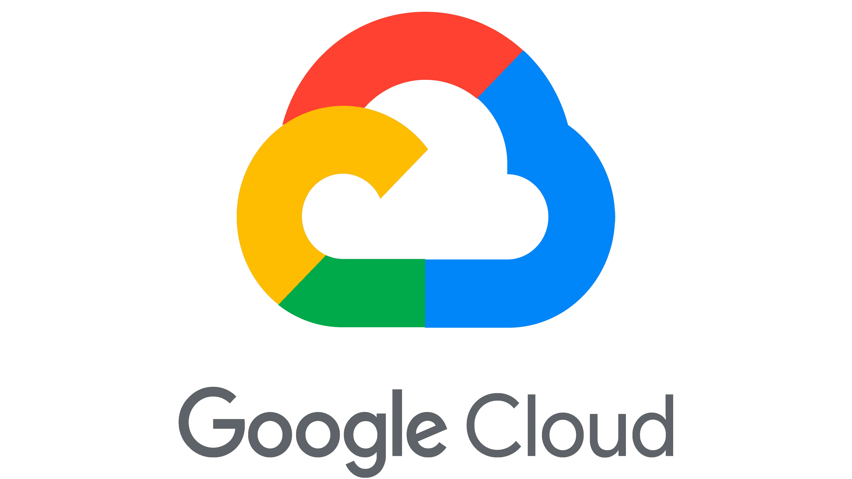
Custom Graph connectors
Graph connectors By Microsoft
Graph connectors By Partners
{api}
= also developing a plugin
Notes:
Microsoft-built connectors are developed and maintained by Microsoft. Partner connectors, on the other hand, are developed by third-party companies. These connectors extend the range of data sources that can be integrated with Microsoft 365, offering specialized functionalities and support for a broader array of non-Microsoft services and platforms.
Read More -> https://learn.microsoft.com/en-us/microsoftsearch/connectors-gallery

Slide 34
Custom Graph Connectors
Graph connectors By Microsoft
Graph connectors By Partners
{api}
Custom Graph connectors
You can build custom connectors with Microsoft Graph connectors APIs or SDK for data sources not in the Microsoft Admin Center or Connector gallery.
Use Graph Connector REST APIs for full control over custom Microsoft Graph connections.
Use Graph Connector SDK to reduce coding, leveraging its framework and tools.
Community samples can be found at Microsoft Adoption Portal
Custom Connector Data Flow Example for Connector SDK
Microsoft 365 Admin Center
Microsoft Graph Connector Agent
Custom Connector
Orchestration Framework
Your Connector Code
gRPC over HTTP
Your VM
Data Source
Notes:
For Data flow diagram refer: how does the custom connector work here- > https://learn.microsoft.com/en-us/graph/custom-connector-sdk-sample-overview#how-does-the-custom-connector-work

Slide 35
Graph Connector Agent
Some of your data sources, such as File Share, Websites and SQL Server, might be running on-premises.
Graph Connector Agent (GCA) software enables secure data retrieval from on-premises data sources for indexing in Microsoft 365.
Supports full and incremental crawl scheduling to keep the search index current.
Enterprise
Websites
Oracle
File Share
Azure SQL
ADLS Gen2
On-Premises
Cloud
Graph Connector Agent
Search Index

Slide 36
Demo Graph connectors in Microsoft Admin Center
Notes:
Tour of how to access Graph connectors by Microsoft in Microsoft Admin Center -> Search and Intelligence

Slide 37
Graph Connector Building Blocks

Slide 38
Graph Connector Concepts
Connector
A connector traverses an external data source and returns its data. Connector is mapped to specific data sources, such as Jira Cloud.
Crawling
Process of accessing, retrieving, and indexing data from an external source via a connector.
Indexing Process of making data searchable and accessible in services like Microsoft Search, Microsoft 365 Apps and Copilot for Microsoft 365 by connecting and indexing data from third-party sources via Graph connectors.

Slide 39
Graph Connector Concepts
Access Control Lists (ACLs)
Access control lists (ACLs) determine which users in your organization can access each indexed item.
Refresh settings determine how often data is synced between the data source and Microsoft Search, with options for full or incremental refreshes based on data modifications.
Refresh Settings

Slide 40
Microsoft Graph Connector Building Blocks
Connection
Schema
Index Items
Use Microsoft Admin Center to create connection and register connection settings.
Register your schema, a JSON definition of metadata properties along with aliases, semantic labels, and more.
Index external items and activities. Apply appropriate control for users and groups to define access to items.

Slide 41
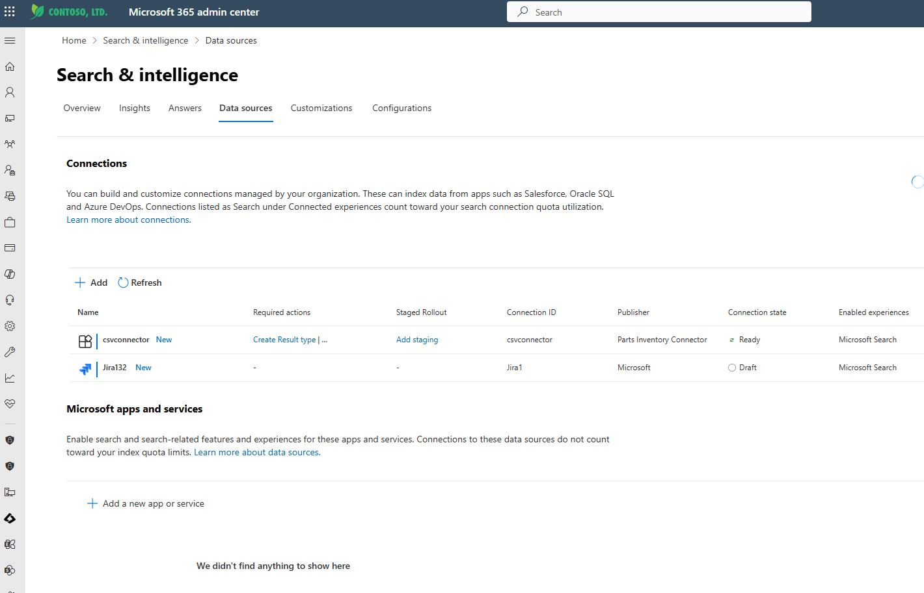
Connection view in Microsoft 365 Admin Center
Connection
Schema
Index Items
A connection is an instance of connector that connects to specific external data source.
A tenant can have multiple connections.
For Example: A tenant may have 2 file share connections or 2 Enterprise Web Connection etc.
Admins manage all tenant connections via Microsoft Admin Center.
Each tenant can create up to 30 connections.
Notes:
When you publish a Microsoft Graph connector, it can take a few minutes for the connection to be created. During that time, the connection shows its status as 'Publishing'.
There's a connection limit. Each tenant can create up to 30 connections. If you need more connections reach out to us by filling this form.
There are limited edit capabilities supported after publishing a connection. If you need to change any details other than ones enabled, you must delete and recreate the connection.

Slide 42
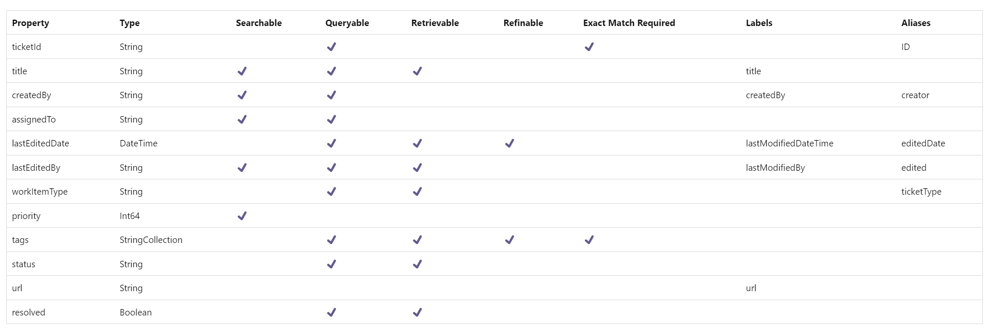
Schema in Microsoft 365 Admin Center
Connection
Schema
Index Items
Schema is a flat list of all the properties that you plan to add to the connection along with their attributes, labels, and aliases.
Schema defines the structure and properties of data to be indexed and made searchable within the Microsoft 365
You must register the schema before adding items into the connection.
Notes:
More here: https://learn.microsoft.com/en-us/microsoftsearch/configure-connector#step-7-manage-schema

Slide 43
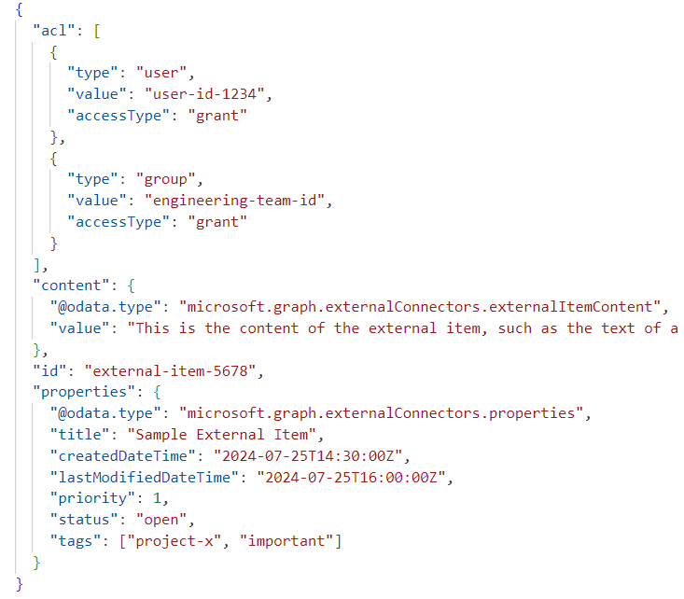
JSON representation of external item
Connections
Schema
Index Items
Items ingested by your connector to the Microsoft 365 are represented by the externalItem resource (external item API) in Microsoft Graph.
externalItem includes properties like acl (access control list), content (the main data content), id (unique identifier), and properties (additional metadata about the item).

Slide 44
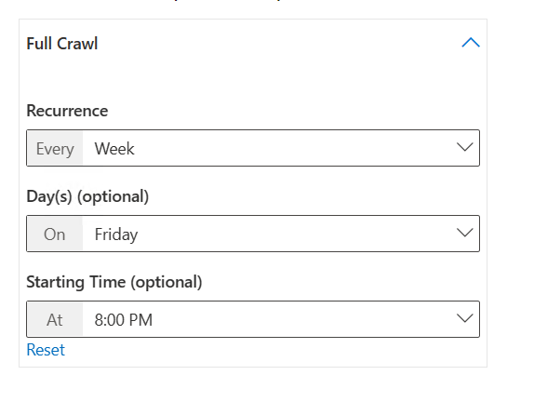
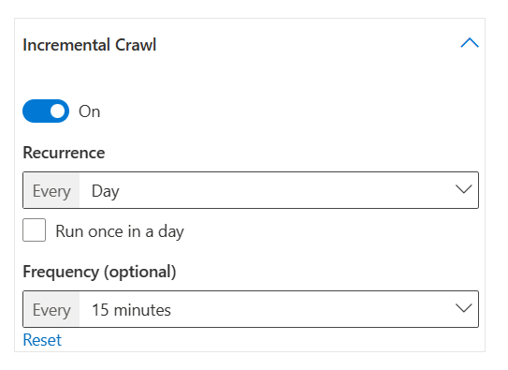
Refresh Settings
The refresh interval determines how often your data is synced between the data source and Microsoft Search.
Each type of data source has a different set of optimal refresh schedules based on how often data is modified and the type of modification
There are two types of refresh intervals, Full refresh and Incremental refresh*
Full Refresh: Processes and indexes all changed items in the content source. Ideal for detecting deletions, errors in incremental refreshes, modified ACLs, crawl rules, or updated schemas.
Incremental Refresh: Indexes only newly created or modified items since the last crawl. Best for detecting content, metadata, and other updates without reindexing all data.
*Incremental refreshes aren't available for some data sources.

Slide 45
Graph Connector Setup Prerequisites

Slide 46
Changes to Microsoft Graph connectors licensing & pricing
Current
Going forward
Targeting September 2024
Customer licensing
Customer licensing
Index quota entitlement of 500 items per M365 Copilot, M365 E5 or O365 E5, Viva Topics license (https://aka.ms/ConnectorsPricing)
No licensing required for index quota¹ for M365 and O365 tenants²
No add-on license
Add-on license for additional quota ($1k USD / 1MM items / month)
50M items per tenant
Get started with Microsoft Graph connectors today! (https://aka.ms/graph-connectors)
Graph connectors in Copilot for M365 still require Copilot for M365 license for end user
Applicable O365 and M365 subscriptions = O365 E1/E3/E5, M365 E3/E5, O365 F3, M365 F1/F3, Business Basic/Standard/Premium, O365 G1/G3/G5, M365 G3/G5, O365 A3/A5, M365 A3/A5
Private Preview

Slide 47
Prerequisites to setup Graph Connector
Index Quota
As of September 16, 2024, quota billing has been removed for Microsoft 365.
Graph connectors support up to the importing of 50 million items per tenant.
Notes:
Ask the customer: How many E3/E5 licenses to determine their free quota
An item is 1 unit of index quota. Each entity (or record) from the source system that you add to Microsoft Graph can be considered an item. Each item added to Microsoft Graph shows up as a unique citation in a Copilot response and as a unique search result in Microsoft Search. Depending on the type of data source, 1 item is –
1 document (word, excel, ppt, pdf, etc.) in file share
1 wiki page in Confluence
1 webpage in a website
1 ticket/issue in Jira
https://learn.microsoft.com/en-us/microsoftsearch/licensing
The following licenses include entitlement to 500 items of index quota, which counts towards your organization's quota for ingesting content from Microsoft Graph connectors:
Microsoft 365 Copilot
The Microsoft 365 E5 or Office 365 E5
Topics
For example, if your organization has 100 Microsoft 365 E5 licenses, then your organization has 100 x 500 = 50,000 items worth of Microsoft Graph connectors index quota.
By default, Microsoft Graph connectors support up to 50 million items of total index quota, which includes any built-in quota bundled into Microsoft 365 Copilot, Microsoft 365 or Office 365 E5 licenses. The per connection item limit is 5 million items by default. If you need higher item count per connection please reach out to your Microsoft account manager or fill up this form.
Preview connectors do not count against quota; after a connector becomes generally available, it starts to count on the total index quota.

Slide 48
Prerequisites to setup Graph Connector
Graph Connector Agent
If you are planning to index and search on-premises data sources in Microsoft 365, you must install Graph Connector Agent (GCA) software.
Here is the recommended configuration:
Windows 10, Windows Server 2016 R2 and higher versions
.NET Framework 4.7.2
.NET Core Desktop Runtime 8.0 (x64)
8 cores, 3 GHz
16 GB RAM, 2 GB Disk Space
Network access to data source and internet through 443
Using the recommended configuration of the machine, the connector agent instance can handle up to three connections. Any connections beyond that might degrade the performance of all connections on the agent
Notes:
https://learn.microsoft.com/en-us/microsoftsearch/graph-connector-agent

Slide 49
Prerequisites to setup Graph Connector
Connector Specific Prerequisites
There might be connector-specific prerequisites that need to be completed before setting up the connection.
For example: To set up the Microsoft Graph Connector for Jira could there might be specific prerequisites you need to complete:
Decide whether to index the entire Jira site or specific projects.
Use Jira Query Language (JQL) to create custom filters for indexing specific issues.
Configure the necessary permissions and scopes such as read:field:jira, read:project:jira, read:issue:jira, etc. if you would like to use OAuth 2.0 for authentication

Slide 50
Steps to Setup Graph Connector
Create Connection Name the Connection, Configure data source settings, Set access permissions
1
Start
Register Schema
Select Properties, Map identities, Assign property labels, Manage schema and refresh settings
2
Build
3
Publish Connection Publish your Graph Connector to limited users or everyone. .
Publish
Monitor Connection Monitor your connection state, crawl failures, index quota.
4
Manage

Slide 51
Thank you.
Copyright © 2024 Microsoft Corporation. All rights reserved.

Slide 52
Calls to Action
Modern Work Customer Hub
Notes:
Now we have a few Call to Actions/Resources we would love to share with you as you think about your AI journey

Slide 53
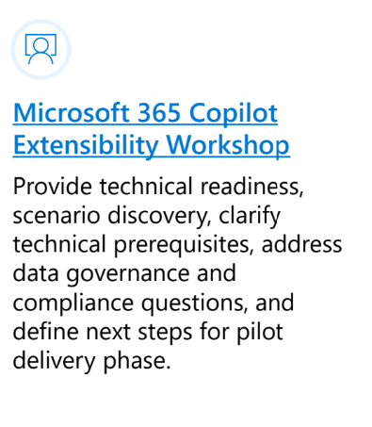
Unified offering: Copilot for Microsoft 365 Extensibility
Help maximize Copilot for Microsoft 365 Extensibility experiences through the expert-led Microsoft delivery
Connect with your Copilot CSA, CSAM for more details!
Notes:
And don’t forget to come back for the second session next week! If you haven’t registered yet, you can do so by clicking on the Register Here on the screen, or go to the Customer Hub website to sign up for the rest of the series.

Slide 54
Your feedback is critical
We're committed to making your Modern Work Customer Hub experience the best it can be - and your feedback is a critical component to that.
Before you scoot, please take a moment to provide some feedback.
Scan with your mobile device camera
-OR-
Visit
Customer Hub Survey
aka.ms/CustomerHubSurvey
Notes:
First off, I would like to ask a bit of feedback on today’s session to make sure the content we’re sharing is hitting the mark. Please take a few moments before you disconnect today to let us know your thoughts.

Slide 55
Copilot Extensibility Sessions!
All times listed in US Pacific Time
Session | Date | Time | Register
Session 1: Understanding the why and when of Microsoft 365 Copilot extensibility | September 18, 2024 | 9:00 PM PT | Register Here
Session 1: Understanding the why and when of Microsoft 365 Copilot extensibility | September 19, 2024 | 8:00 AM PT | Register Here
Session 2: Unlocking enterprise content with Microsoft Graph connector to further enrich Microsoft 365 Copilot data reasoning capabilities | September 25, 2024 | 9:00 PM PT | Register Here
Session 2: Unlocking enterprise content with Microsoft Graph connector to further enrich Microsoft 365 Copilot data reasoning capabilities | September 26, 2024 | 8:00 AM PT | Register Here
Session 3: Enable Microsoft 365 Copilot to take actions and trigger workflows via Copilot agents | October 2, 2024 | 9:00 PM PT | Register Here
Session 3: Enable Microsoft 365 Copilot to take actions and trigger workflows via Copilot agents | October 3, 2024 | 8:00 AM PT | Register Here
Visit https://aka.ms/CustomerHubSessions for more upcoming sessions, updates, and on demand content!!
Notes:
And don’t forget to come back for the second session next week! If you haven’t registered yet, you can do so by clicking on the Register Here on the screen, or go to the Customer Hub website to sign up for the rest of the series.

Slide 56
Make a difference Become a Champion
Get more from Copilot and Microsoft 365
Help others do the same
Expand your knowledge and enhance your career
Join the free program at aka.ms/M365Champions
Notes:
Reminder to join the community

Slide 57
Q&A
Please raise your hand and unmute when called on
1
2
Notes:
Stop Recording
OK - Let’s move into some Q&A. I am going to unmute the line so you can unmute your mic and ask verbal questions!
If you’d like to ask a question, please go ahead and raise your virtual hand and I’ll call on you in the order in which you raised your hand at which time you can unmute your line and ask your question.

Slide 58
Thank you.
Copyright © 2024 Microsoft Corporation. All rights reserved.

