Slide 1
Hello and welcome to Customer Hub
We’ll get started at 2 minutes past the hour

Slide 2


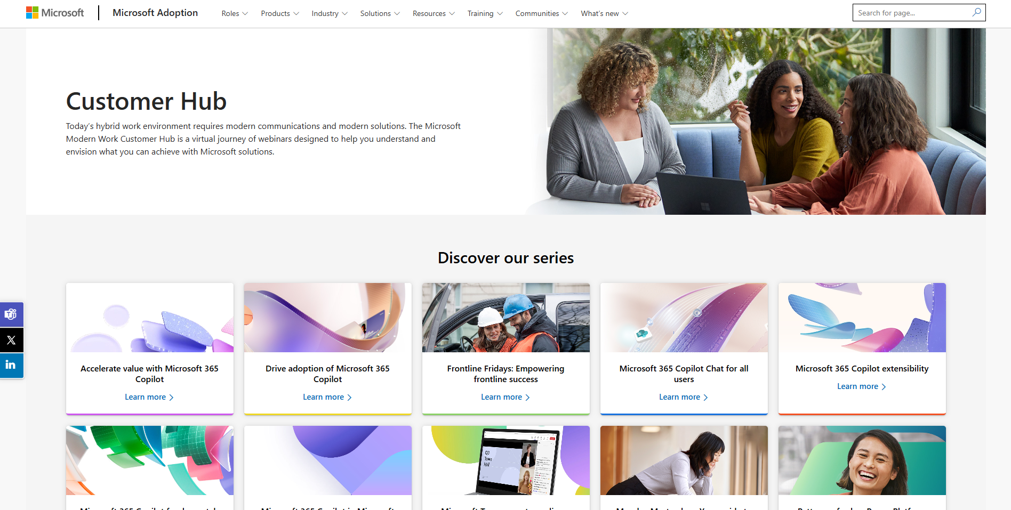
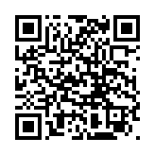
Visit Customer Hub website for upcoming sessions, updates, and on demand contents!
https://aka.ms/CustomerHubSessions​

Slide 3

Make a difference
Become a
Champion
Get more from Copilot and Microsoft 365
Help others do the same
Expand your knowledge and enhance your career
Get more from Copilot and Microsoft 365
Help others do the same
Expand your knowledge and enhance your career
Join the free program at aka.ms/M365Champions

Slide 4



After the presentation
During the presentation
We will mute your microphone for the first part of today’s call
Raise your hand and we will
call on you
Ask your questions via chat, we will get to all of them, live or after. Common questions will get addressed out loud
Open mic – come off mute and ask away!

Slide 5
Teams Events
What’s New In Town Hall and Webinar

Slide 6
Agenda
Devices and Host Controls
Production Controls/Studio
Shared Slide Controls
Town Hall Extensibility
Town Hall Attendance Engagement
Misc (Preview as Attendee, NDI, TLE)
Next Steps & Call to Action

Slide 7
Devices and Host Controls

Slide 8
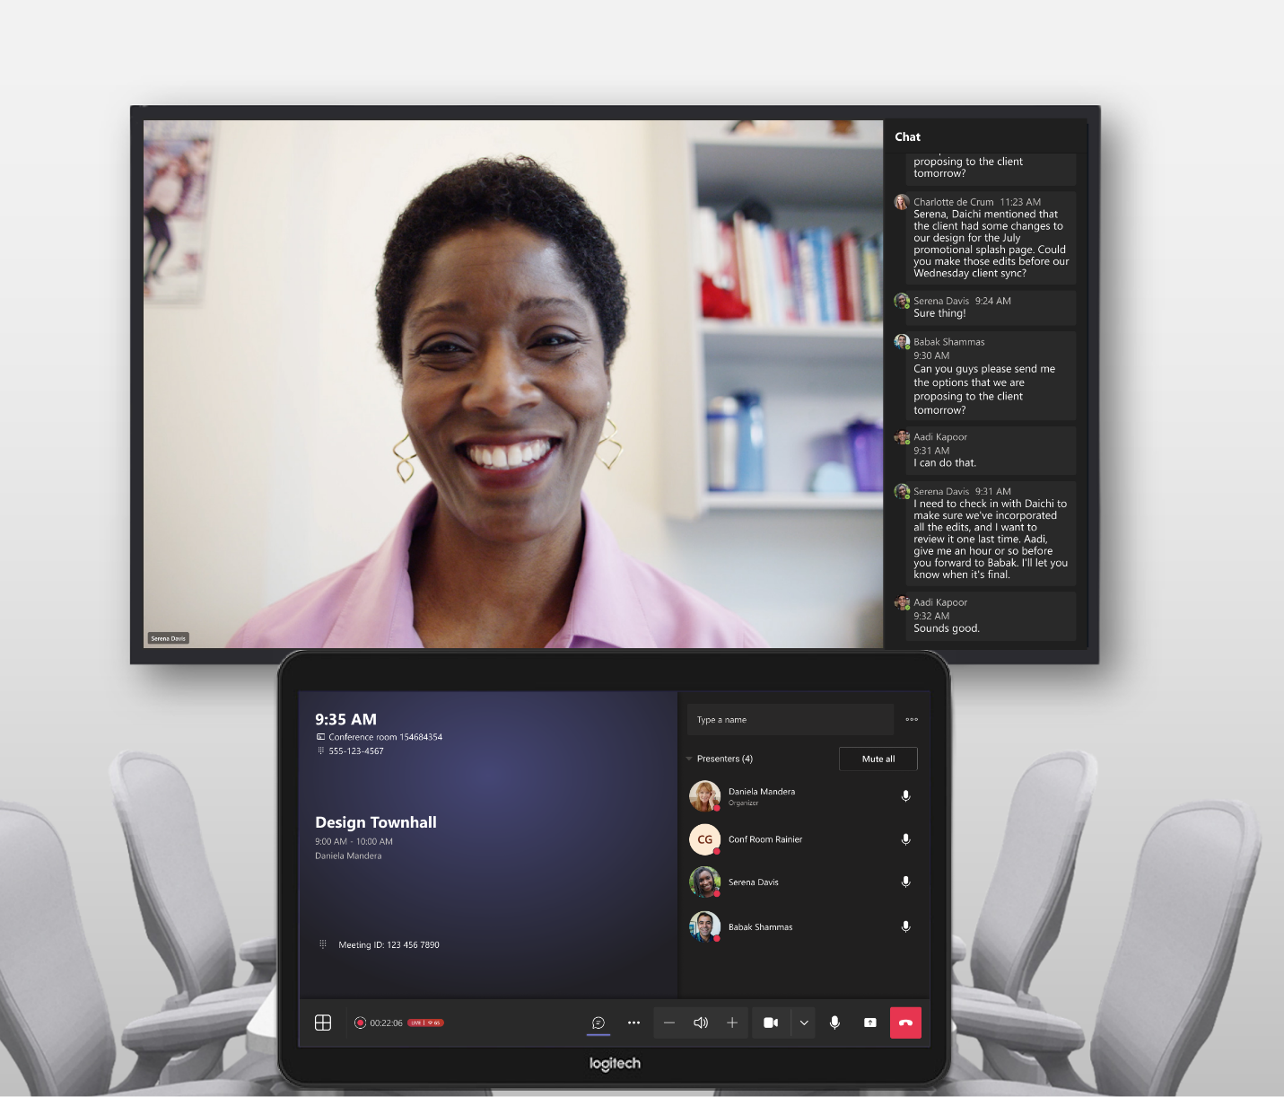
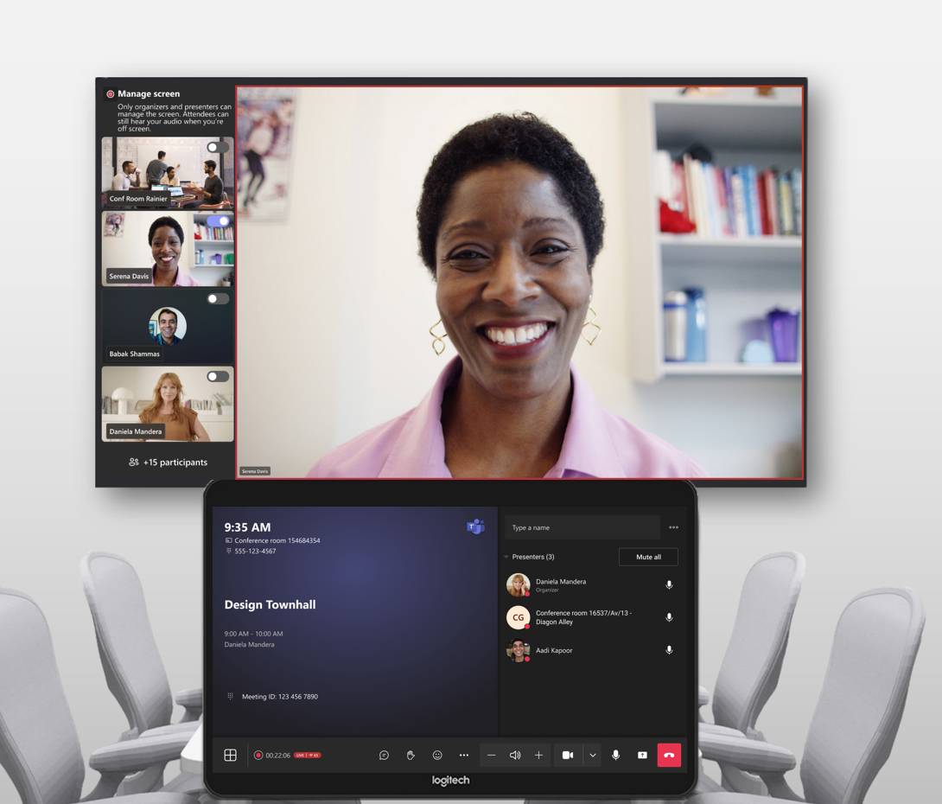
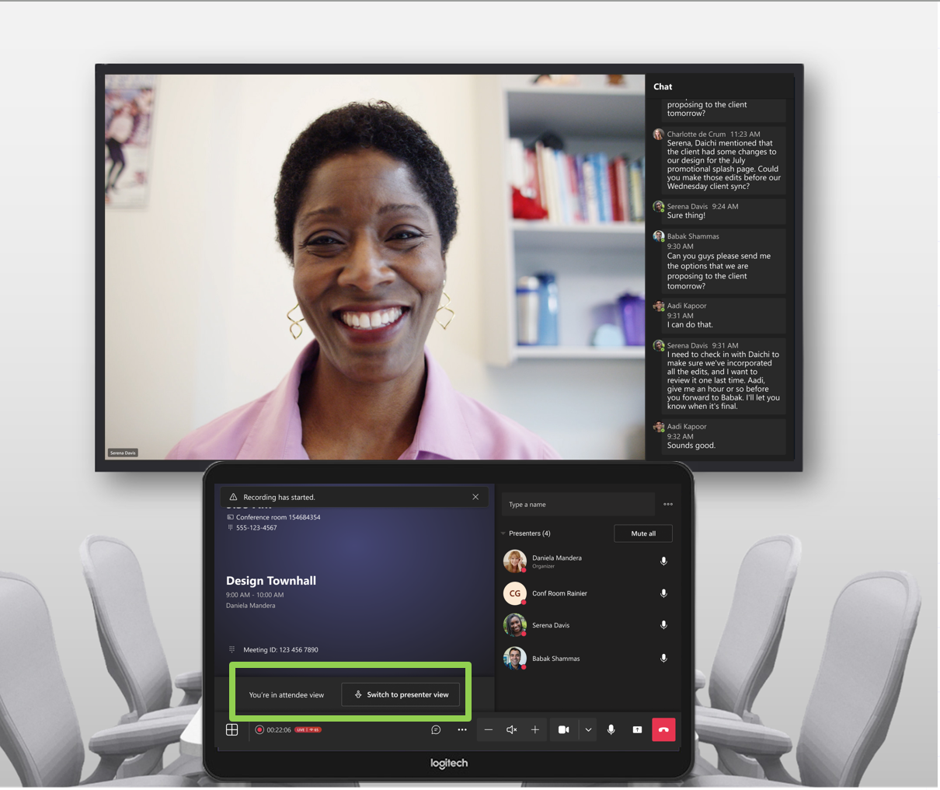
Events on Microsoft Teams Rooms on Windows Devices
What’s new:
  Using the town hall scheduling form, organizers can assign MTR-W devices in the presenter and attendee section. For webinars, it will be presenter section only.
  Devices will join in the respective roles with their respective features.
  For the co-located experience, there will be a new Location section. This will join the room showing the Attendee view at the Front of Room and presenter view on the console. Organizers can switch to presenter only view on the console.
In TAP
Join as attendee
Join as presenter
Presenters & attendees are co-located in a room

Slide 9
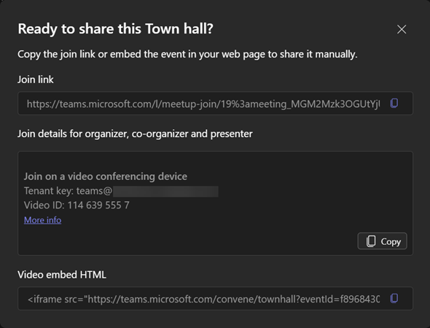
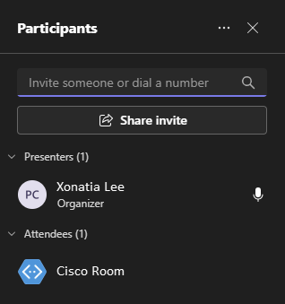
Events on Cloud Video Interop (CVI) for presenters
What’s new:
  For organizers/presenters only (not attendees)
  View CVI coordinates on the Share Dialog
  Trusted devices are the only devices that will join
  Join as an attendee & must be promoted to a presenter
  Will join Green Room

Slide 10
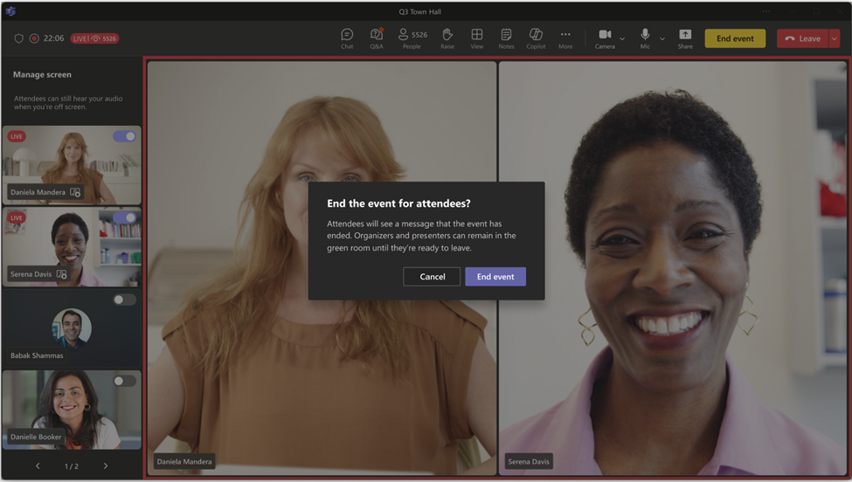
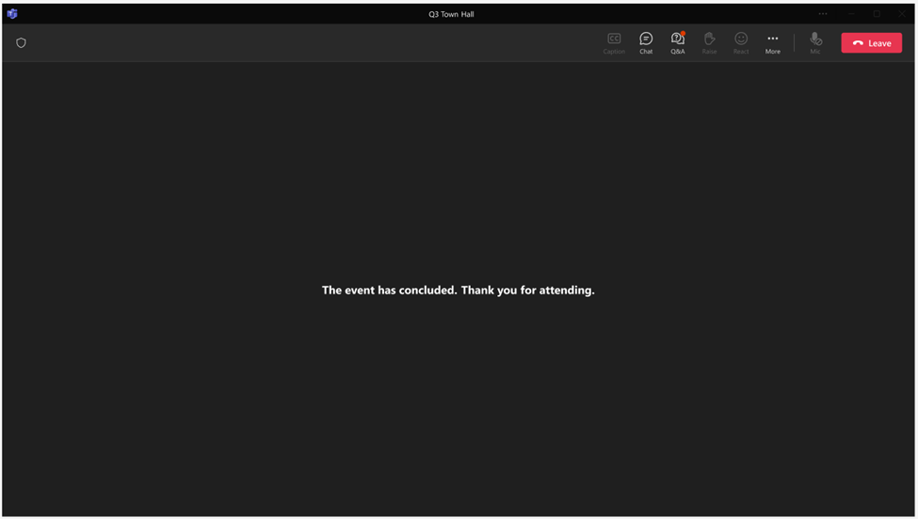
End session for attendees & return presenters to Green Room
What’s new:
  After the session has started, organizers/presenters can select the “End event” button & receive a confirmation that they will end the session
  Attendees will receive a message on stage that the session has ended
  Organizers/presenters will return to Green Room to debrief.
  Tip: to restart the session, all organizers/presenters must leave the session and after 5 minutes and when they rejoin they will return to the Green Room at the beginning of the session.
  Tip: use the producer role feature to define who can select “End Event”
Presenter view
Attendee view

Slide 11
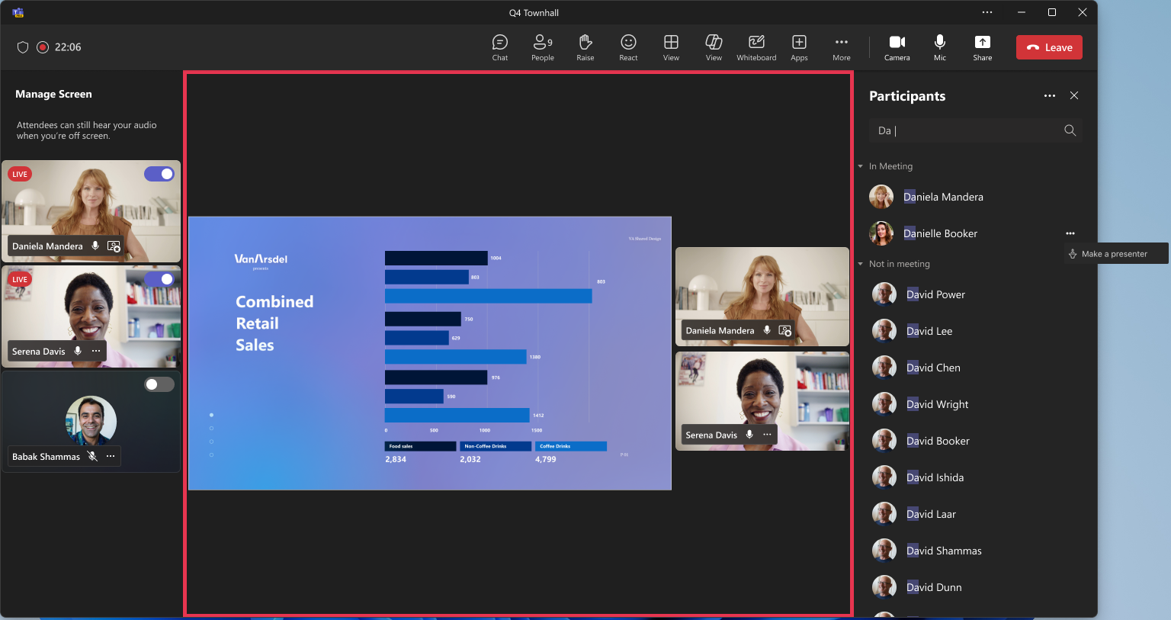
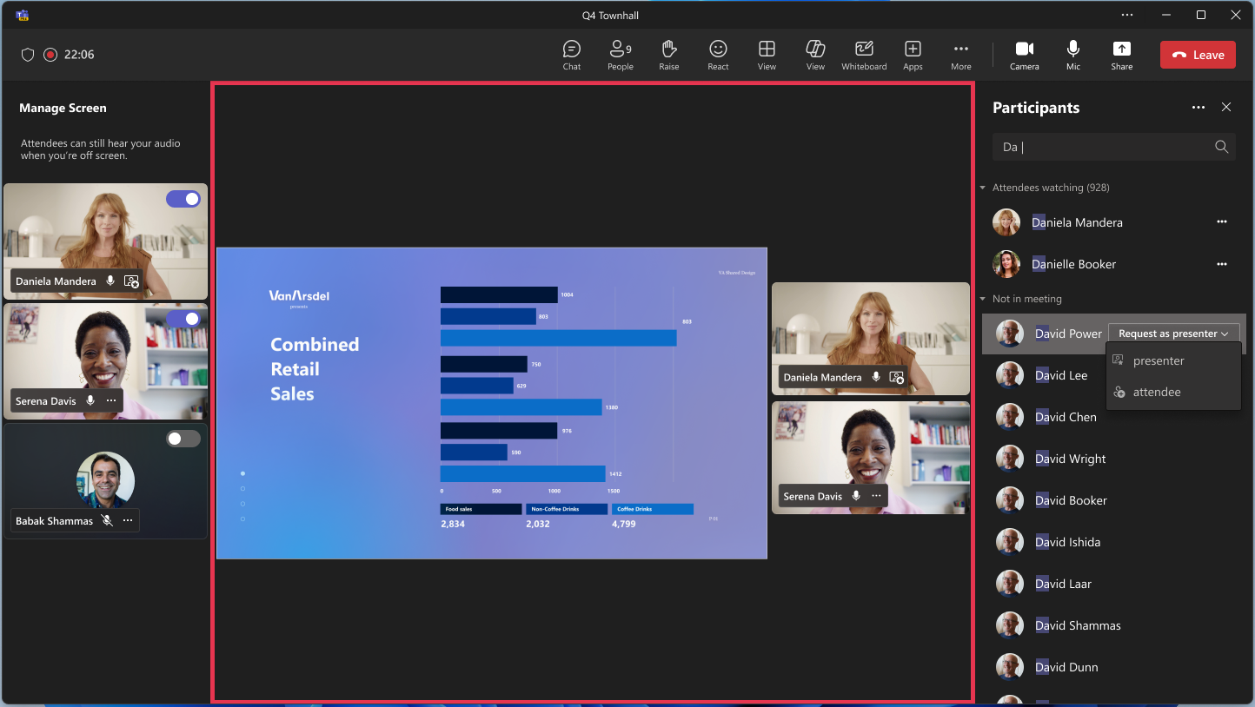
Easily Call in a Presenter or PSTN from the Roster
What’s new:
  Organizers/presenters can call in a missing presenter or phone number using the roster for meetings, webinars, and town halls
  For users joined as an attendee, organizers can bring them in by Making them a presenter
  For users who have not joined the session at all, organizers can request them to join as a presenter or attendee
  Phone numbers will join as an attendee and must be promoted to a presenter on the roster
  Note: Presenters joining on the web is still not a supported feature
User is joined the session as an attendee
User has not joined the session

Slide 12
Production Controls/Studio

Slide 13
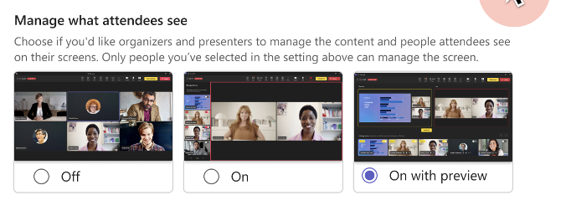
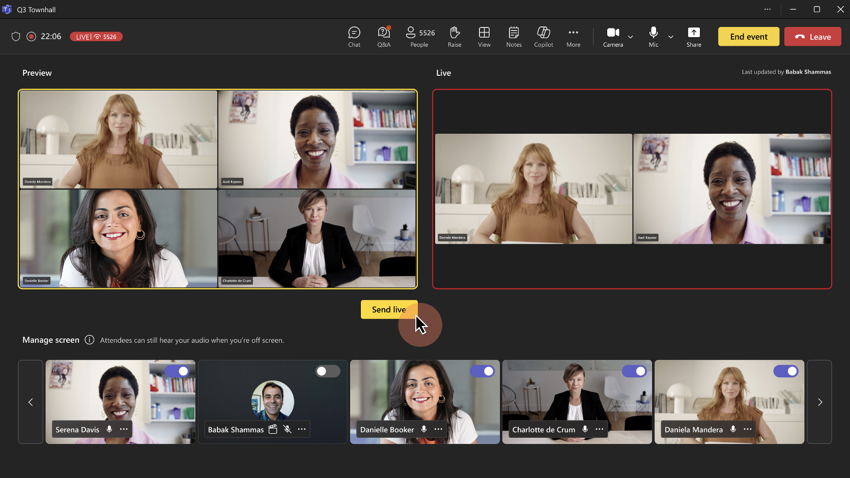
Manage what attendees see – On with preview
Available for Town hall only.
Select On with preview in the Meeting Options to queue up presenters to go on and off screen, before attendees see the changes live.
To manage what attendees, see with preview:
  Toggle presenter videos and shared content on and off under Manage screen to queue them up for the live feed.
  Preview the queued presenters and content in the Preview feed before sending them live. Audio from unmuted presenters in Preview can be heard while they're off screen.
  ​When you're ready to move the presenters and content from the Preview feed to the Live feed, select Send live.
  The Live feed will show what the attendees are seeing in the event.
Note: People who control production tools won't see what others are queueing in the Preview feed.

Slide 14
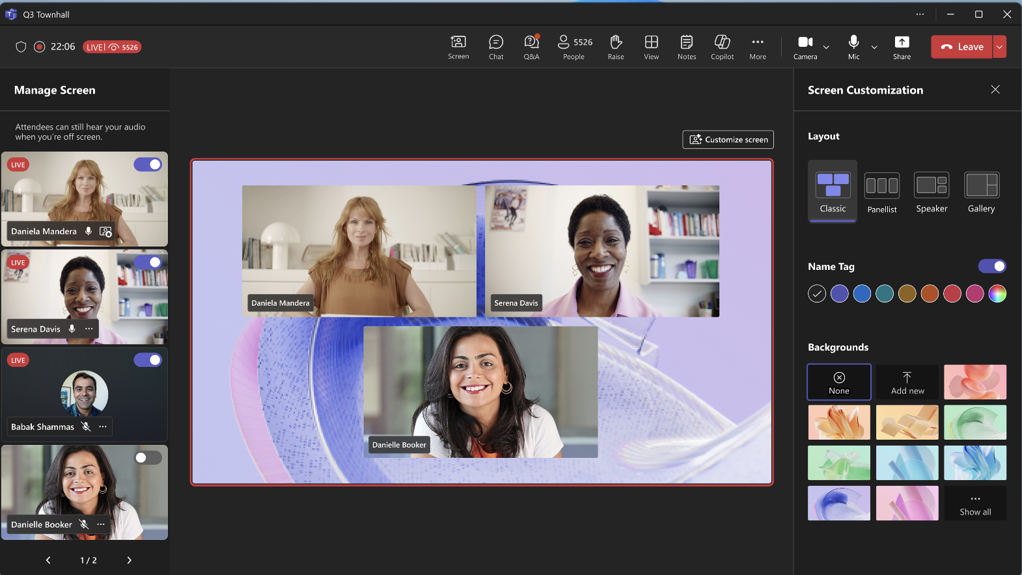
Manage what attendees see – Customize screen (Premium)
Available for Town hall only.
With Teams Premium, users would have the ability to customize their screen with new layouts, backgrounds, name tags, and theme colors.
The “Customize screen” option will be available for both On and On with preview
Layouts:
  Classic – The presenter’s videos on screen are displayed in a fit-to-frame format.
  Panelist – The presenter’s videos on screen are displayed in a fill-to-frame format.
  Active Speaker – The presenter that is actively speaking is the only one displayed on screen.
  Dynamic - The presenter’s video occupy the full meeting screen. No background is displayed.
Background: Microsoft-provided images or Tenant admin images are available.
Name tag: Only the presenter’s name is displayed.
Theme color: Changes the name tag color. Users can specify a HEX code in a color picker for granular control.

Slide 15
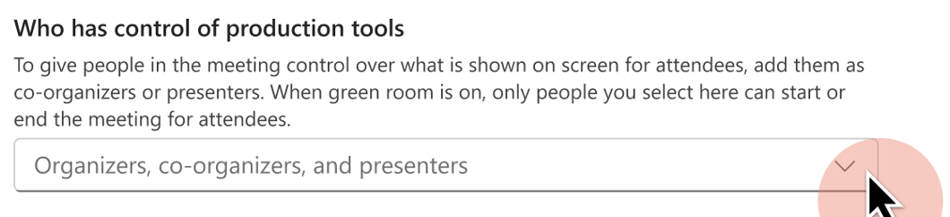
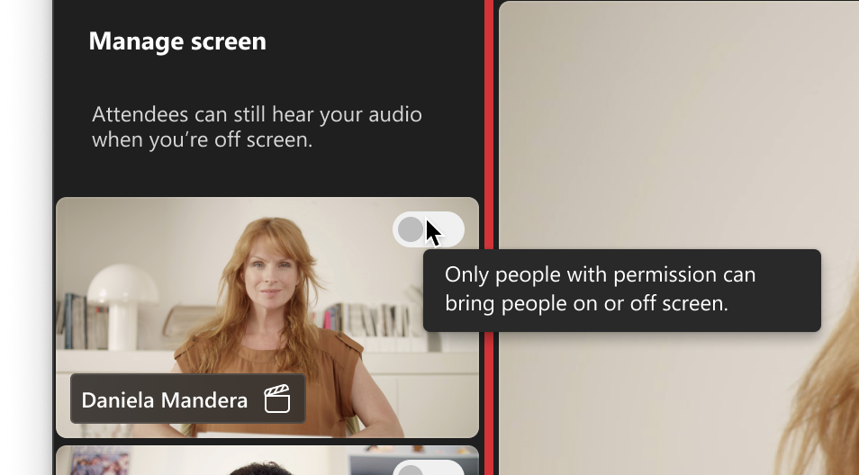
Who has control of production tools?
Before and during a town hall, open the event meeting options to designate which specific roles or people can control the production tools.
Specific organizers, co-organizers, or presenters who can control production tools can start the event, manage what attendees see, and end the event.
Select an option from the Who has control of production tools dropdown menu:
  Organizer and co-organizers: You and co-organizers you added to the town hall can control production tools.
  Organizer, co-organizers, and presenters: You, co-organizers, and presenters you added to the town hall can control production tools.
  Specific people: Only specific people can control production tools. People must already be added to the town hall to appear in the Search for participants field.

Slide 16
Shared Slide Control

Slide 17
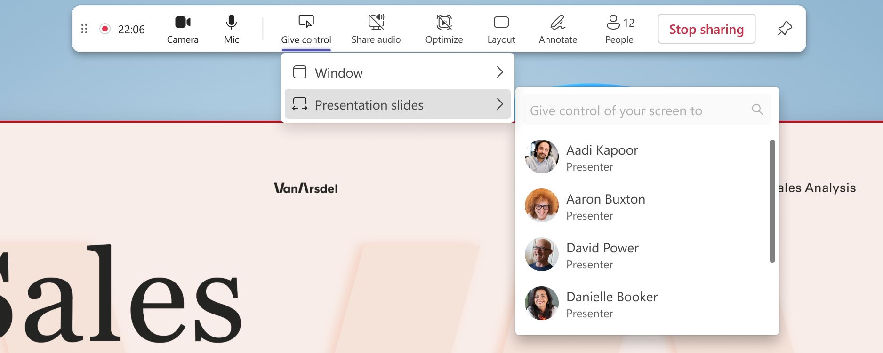
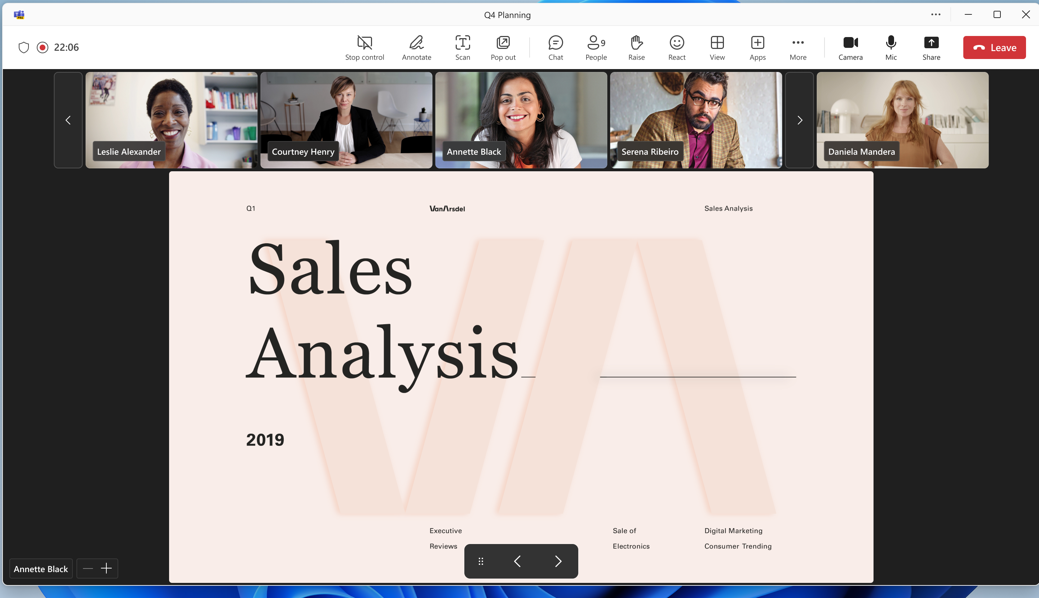
Slide Control for Meetings and Events
Share control of PowerPoint presentation slides with up to 20 other presenters at a time.
To give a user control of the slides they must have the ability to present content in the meeting or event.
When sharing slides the user must share a PowerPoint Window and enter slideshow mode.
Currently available in TAP.

Slide 18
Town Hall Extensibility

Slide 19
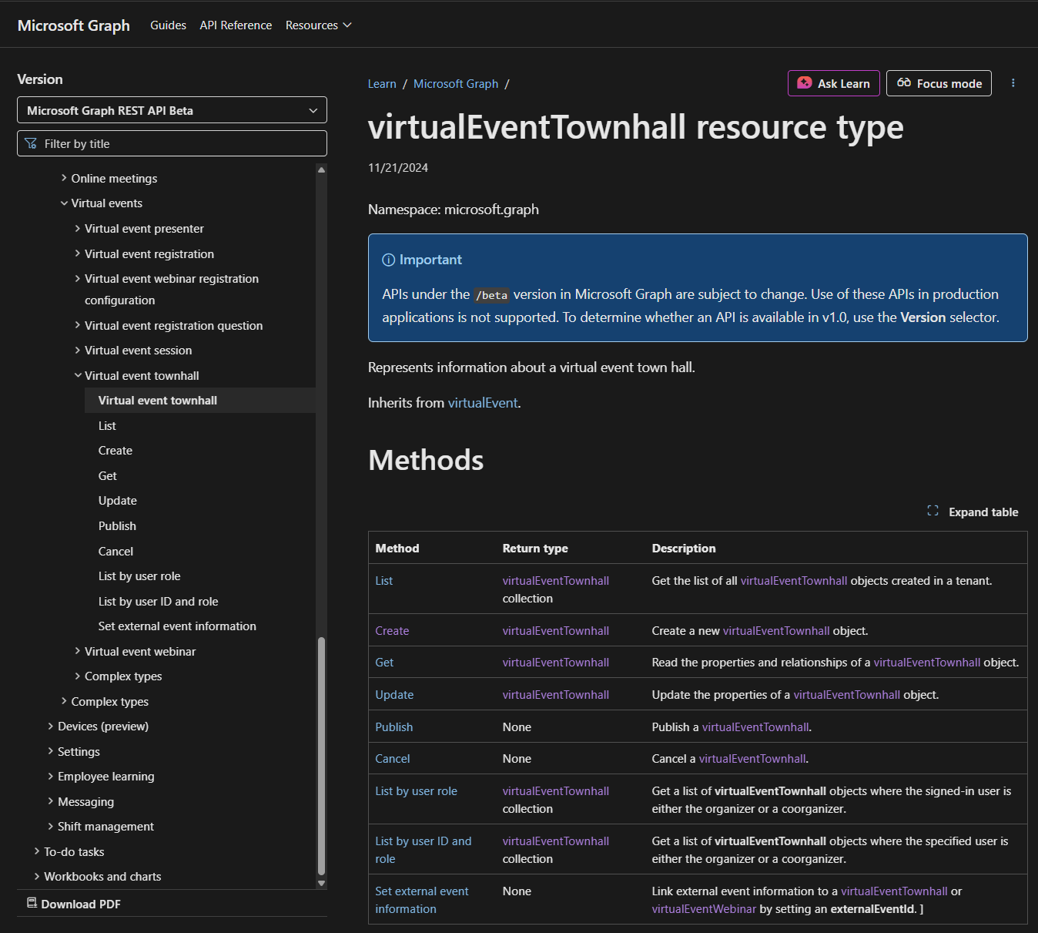
Teams Townhall Events Graph APIs GA
🧱 1. Create, Update, Delete
Automate scheduling and lifecycle management of Townhalls
Enable internal tools to create, modify, or cancel events programmatically
📊 2. Attendance Reports
Access participant join/leave data for each session
Use for internal reporting, engagement tracking, and compliance
🔔 3. Notifications
Subscribe to real-time updates on event changes
Trigger internal workflows when events are created, updated, published, or canceled
🔌 Integration Use Cases
Power internal dashboards and reporting tools
Automate event lifecycle tracking across systems
Enhance visibility into Townhall engagement metrics

Slide 20
Town hall Attendee Engagement

Slide 21
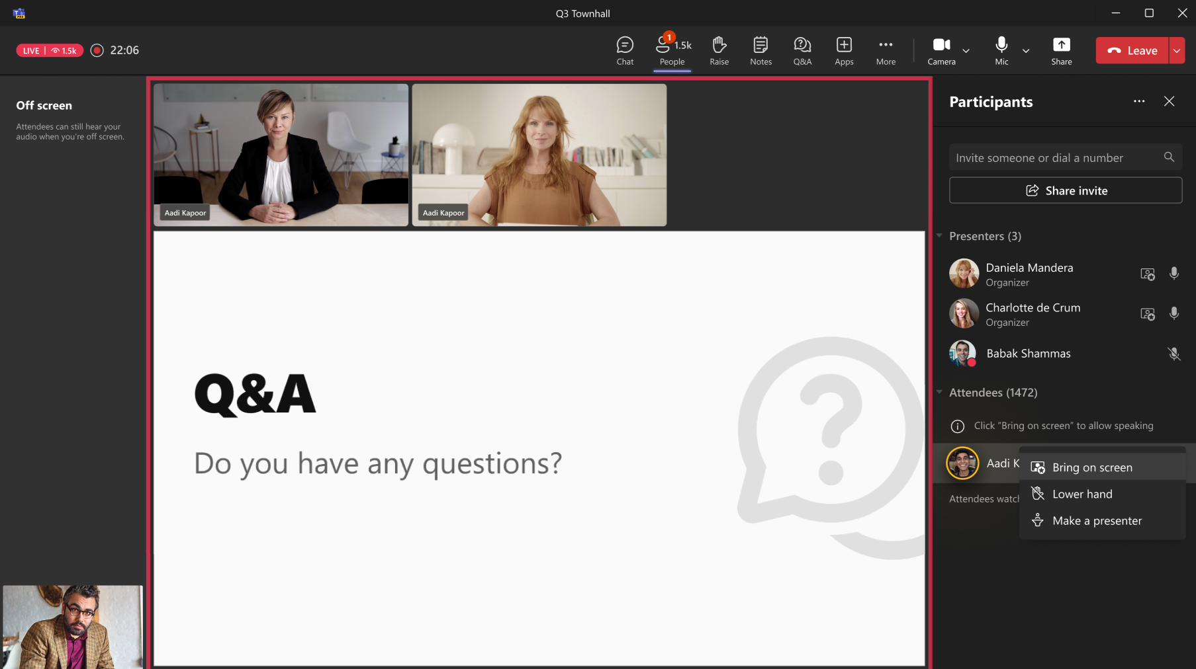
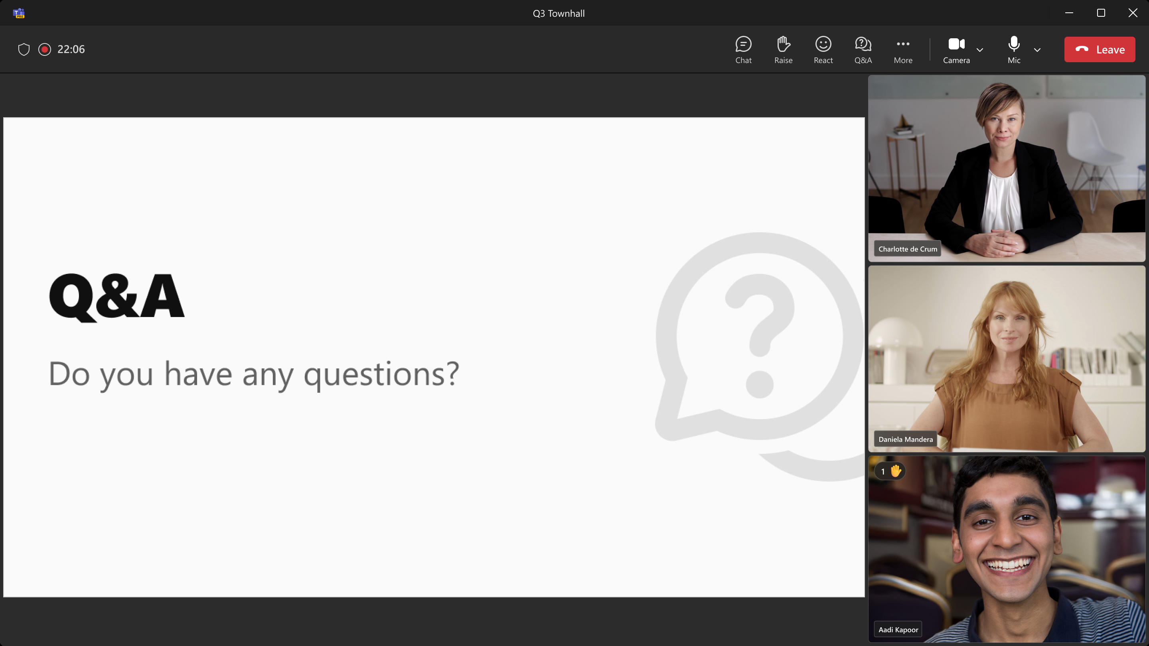
Raise Hands in Town hall (#499889) [Premium]
With Raise Hands in Town halls, Attendees can now raise their hands in a town hall. Once selected by the organizer, the attendee can share their Mic or Camera during the Event.
Target ETA: October 2025
Notes:
Enables speak in the event
When you bring an attendee on stage, they get AV capabilities
They can’t see the streaming attendee chat but not the inner meeting chat

Slide 22
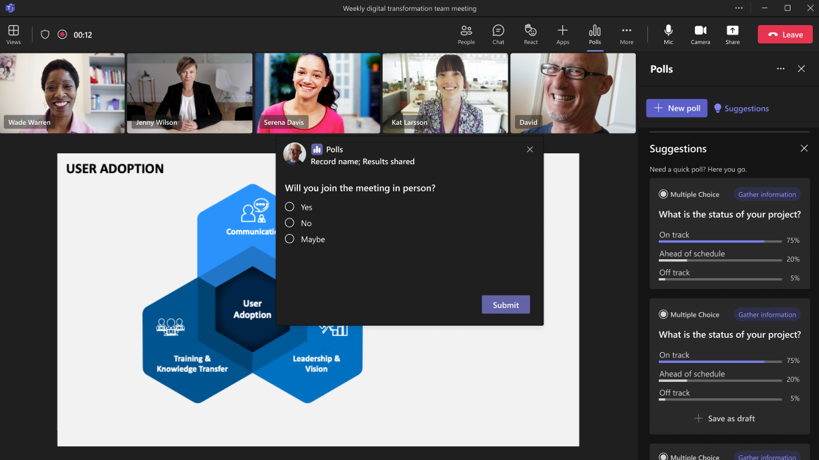
Polls in Town hall (#489808) [Premium]
With Polls support in Town halls, organizers and presenters can send polls for attendees to take during the Event including Multiple choice, rating, and ranking (Word Cloud to come in the future).
Target ETA: October 2025
Notes:
Same polls experience. Up to 20k to start, scaling more after
- no word cloud

Slide 23
Ultra Low Latency (ULL) in Town hall (#486535) [Premium]
With Ultra-low latency, attendees will now be able to view and participate in a town hall instance at a much lower latency than before, ensuring they are in sync with content being shared by presenters and organizers.
This update significantly improves the attendee experience compared to the typical 20-30 second delay experienced in the past. This feature is available for town hall organizers with a Teams Premium license.
Target ETA: October 2025
Notes:
Lowering latency to sub-3 sec (target)
Works OOB
No set up required
Still need to have enough eCDN licenses to cover the size of the event (10k event=10k eCDN licenses)

Slide 24
Preview as Attendee +
NDI Bandwidth Increase

Slide 25
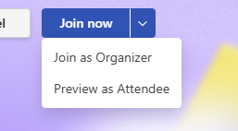
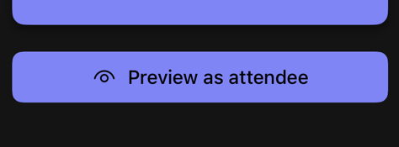

NDI Bandwidth Increase
Organizer Preview as Attendee
Event crew members can join a live Town hall as an Attendee during the event to monitor the experience
Must preview the event from a different endpoint than the organizer experience
Event must be started before the feature will populate
Limited features in the preview experience (no Q&A, raise hands, promotion)
Reporting will only reflect organizer, co-organizer, presenter attendance/engagement
Join from Desktop/Web
Join from Mobile
Bandwidth cap increased when NDI is broadcast from a Teams meeting
Increased bandwidth cap will permit up to eight NDI-out 1080p feeds
No manual action or pinning required, NDI feeds are automatically prioritized
Bespoke BW cap increase

Slide 26
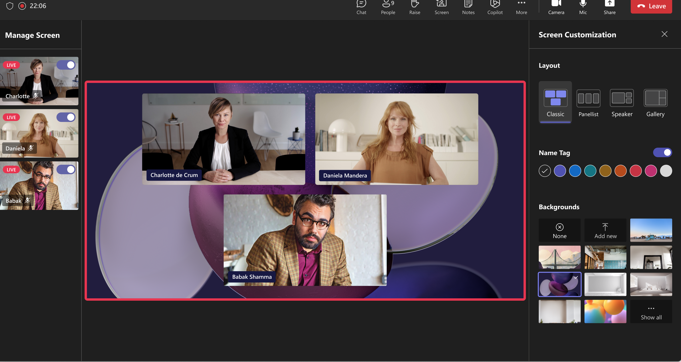
Moving from Teams Live Events to Teams Town Hall
Surpassing TLE in Features…
Streaming Chat
Reactions
Ultra-Low Latency (Q4)
Production Studio (Q4)
And more!

Slide 27
Questions?

Slide 28
Thank you!
Next session…
9/24/25 – Migrating from Teams Live Events to Teams Town Halls

Slide 29
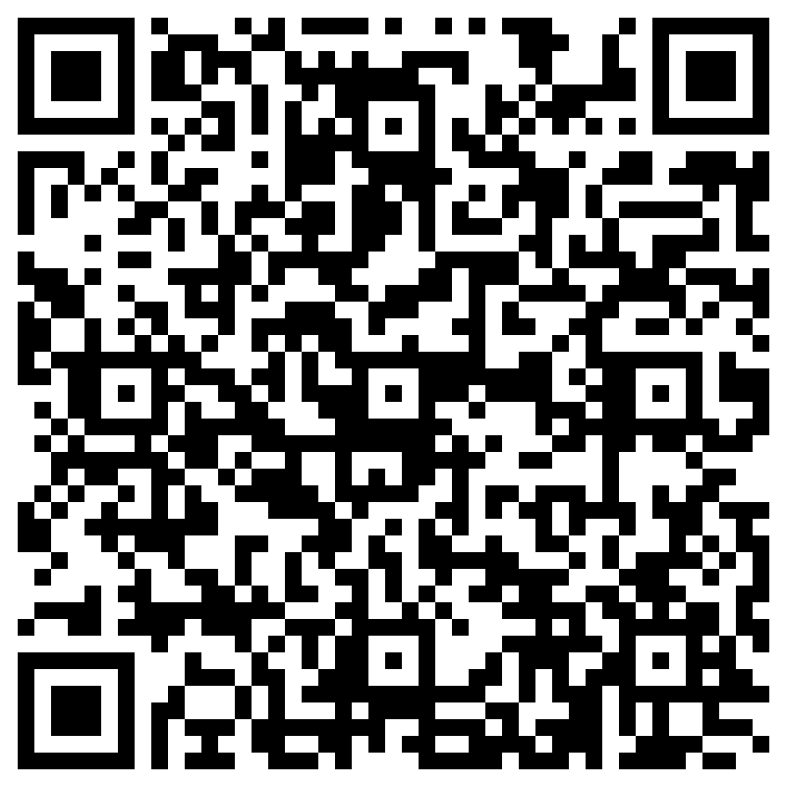
THANK YOU –
Your feedback is critical
Scan with your mobile device camera
-OR-
We’re committed to making your Customer Hub experience the best it can be – and your feedback is a critical component to that.
Before you scoot, please take a moment to provide some feedback.
Visit
Customer Hub Survey
aka.ms/CustomerHubSurvey
Select Frontline Friday Series

Slide 30
Visit Customer Hub website for upcoming sessions, updates, and on demand contents!
https://aka.ms/CustomerHubSessions​

Slide 31
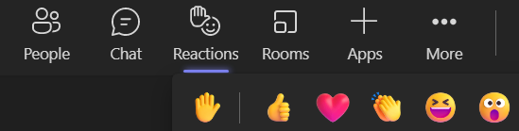
Q&A
1
Please raise your hand and unmute when called on
2

Slide 32
Thank you

