Slide 1
Agents in an hour
Unlock the Power of Agent Templates and Examples in Agent Builder
Microsoft confidential

Slide 2


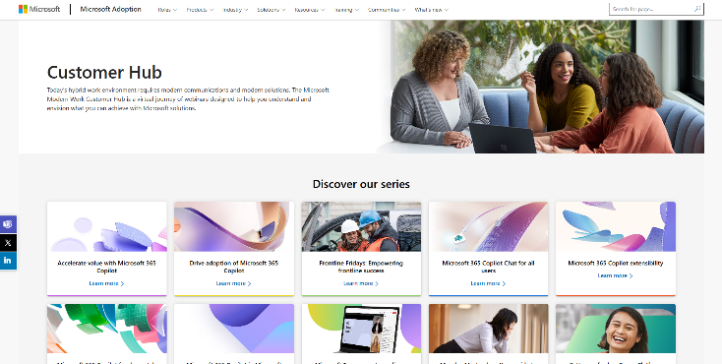
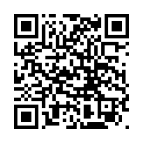
Visit Customer Hub website for upcoming sessions, updates, and on demand contents!
https://aka.ms/CustomerHubSessions​

Slide 3



During the presentation
After the presentation
We will mute your microphone for the first part of today’s call
Raise your hand and we will call on you
Ask your questions via chat, we will get to all of them, live or after. Common questions will get addressed out loud
Open mic – come off mute and ask away!

Slide 4
Agenda
Fundamentals of agent creation
Pre-built Agents in M365 Copilot
Discover Agents - The Agent Store
Create Agents Using Templates
Create Agents Using Example Guides
Sharing Agents
Next Steps & Call to Action

Slide 5
Introduction to Microsoft 365 Copilot

Slide 6

Copilot
Copilot Studio
Agents
Copilot Control System

Slide 7





Microsoft 365 Copilot
Natural Language
Large Language Models
Microsoft 365 Apps
Microsoft Graph*
Microsoft Dataverse*
Web
*Grounded out-of-box in your personal and company data from Microsoft Graph & Microsoft Dataverse

Slide 8
Introduction to Copilot Agents

Slide 9


+ Copilot agents
Business Apps
Microsoft 365 Copilot can be extended using Copilot agents to bring custom knowledge, skills, and process automation
Skills
+
Copilot for Microsoft 365
Microsoft 365 apps
Knowledge
Microsoft 365 data
+
Business Knowledge
+
Web Knowledge

Slide 10

What are Copilot agents
Copilot agents are AI assistants that can help optimize business processes and enhance productivity
Copilot agents vary in level of complexity and capabilities depending on your need
Simple
Advanced
Retrieval
Retrieve information from grounding data, reason, summarize, and answer user questions
Task
Take actions when asked, automate workflows, and replace repetitive tasks for users
Autonomous
Operate independently, dynamically plan, orchestrate other agents, learn and escalate

Slide 11








Spectrum of agents
IT Helpdesk agent
Device Refresh agent
Lead Gen agent
How do I connect to the corporate network?
Request a new laptop and send approvals via IT Service tool.
The agent has identified and researched 15 new leads for you to review.
Simple
Advanced
Project Tracker agent
Budget Management agent
Customer Support agent
What is the status of phase 2 for project X and the remaining budget?
Review outstanding open POs and begin financial planning.
The agent has identified new support issues and triaged to other agents.

Slide 12

The bones of an agent
Workflow instructions
Actions
Triggers
Knowledge
Orchestrator
Foundational Models

Slide 13


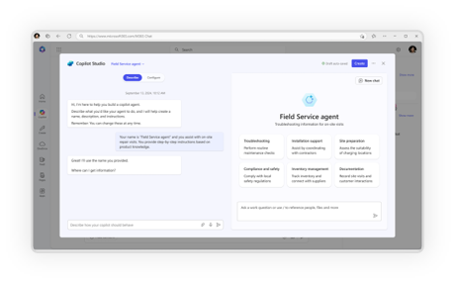
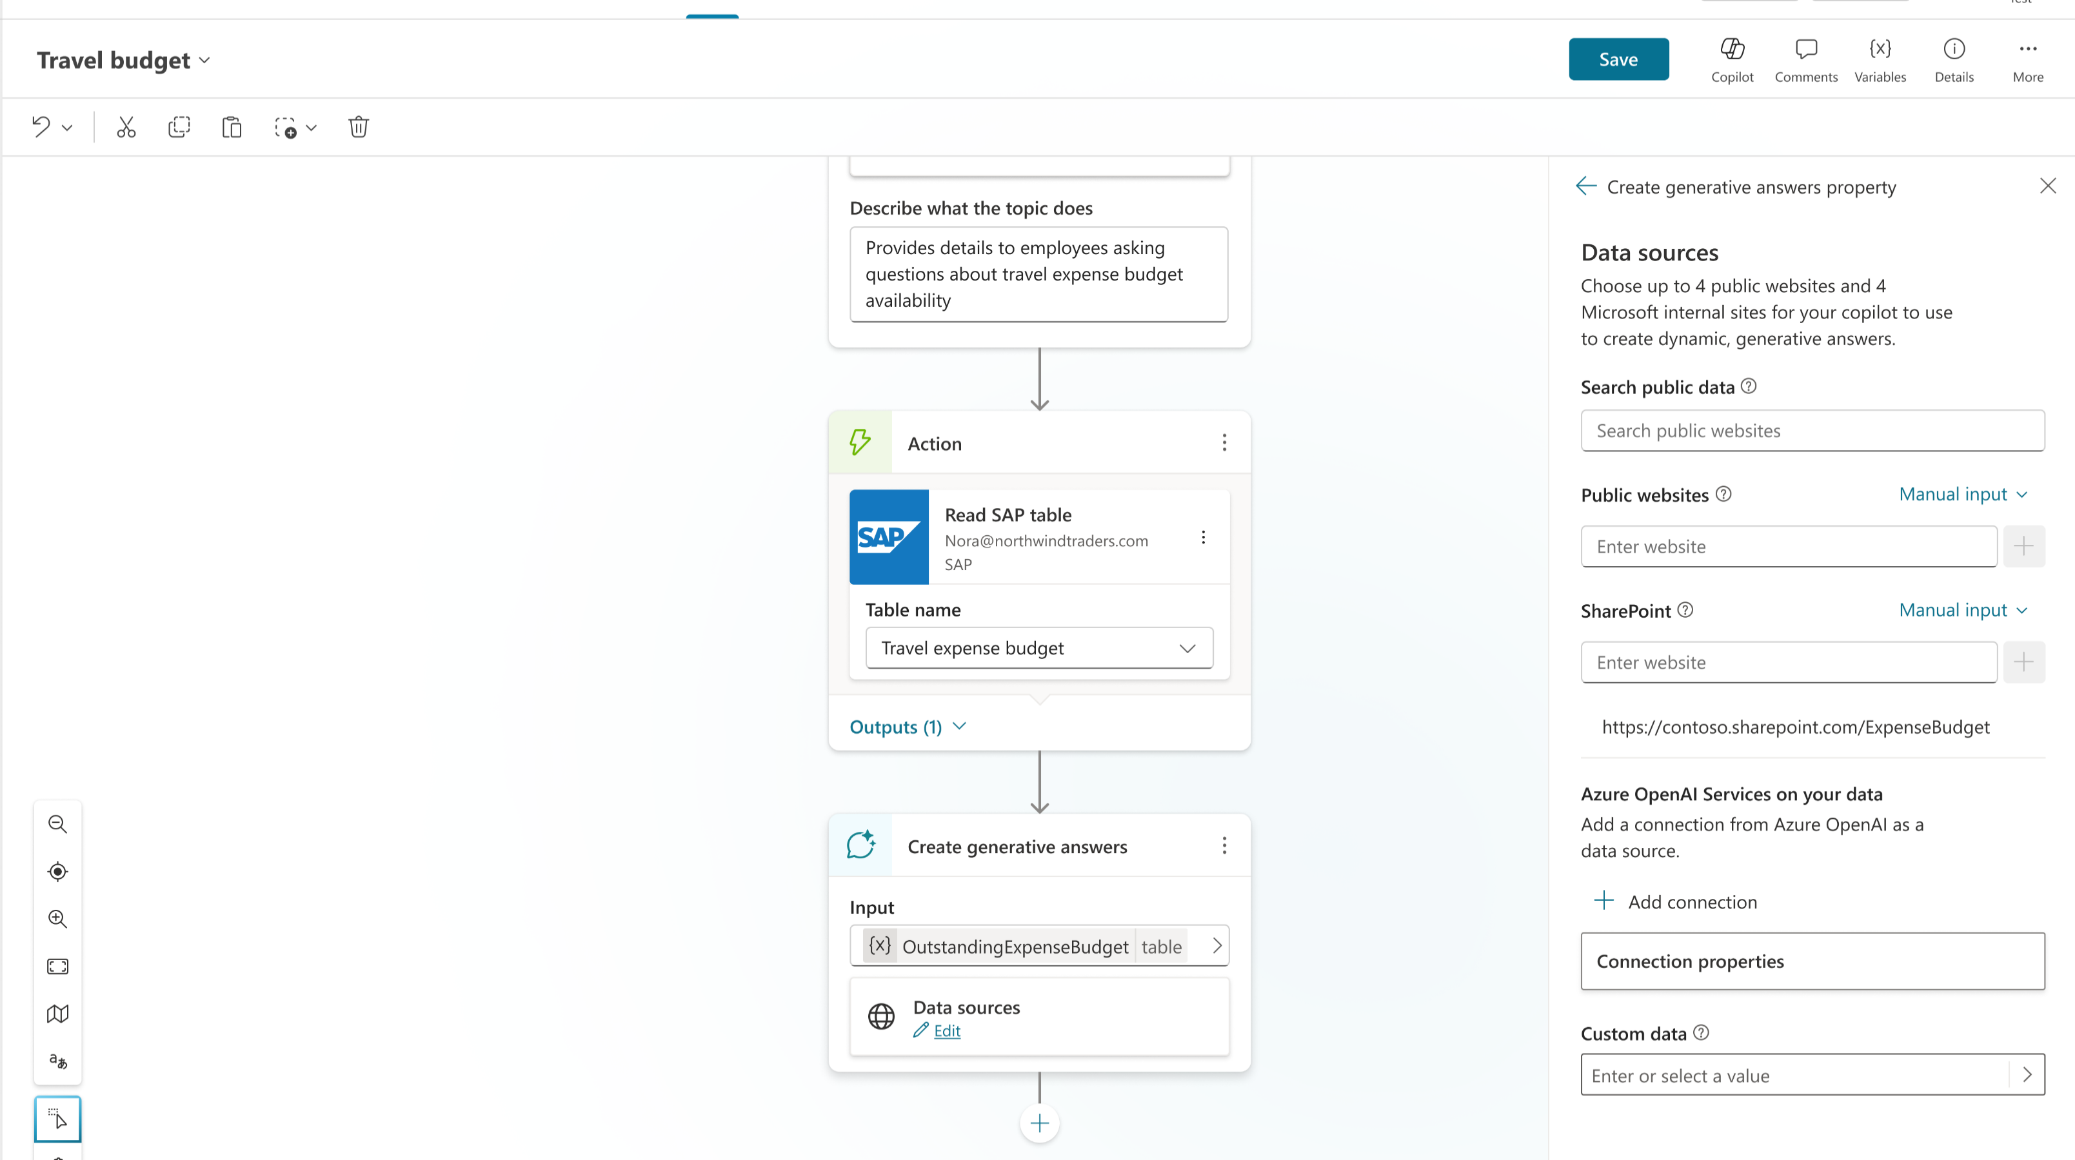
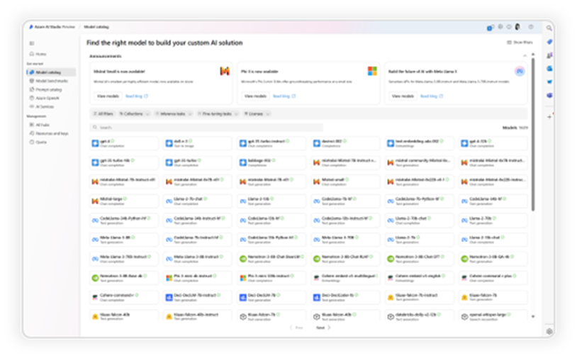
A range of tools for Agent creation
No code
Pro code
For End Users
For Makers
For Developers
Agent builder
Copilot Studio
VS Code, Copilot Studio, Azure AI Foundry

Slide 14









Choose your path
Whether you're a beginner or a pro, agents enhance Copilot to better fit your business needs
Start with a pre-built agent
Build an agent from scratch or from a customizable template
Bring your own agent
Researcher
Analyst
Meeting agent
Customer
Insights
Interview
Questions
Quiz
Tutor
M365 Agents SDK
Azure AI Foundry
Visual Studio
Looking for immediate impact?
Pick from a variety of pre-built agents designed to automate common business tasks in the Agent Store or Copilot Studio.
Have a specific vision?
Quickly build your agent using natural language in Agent Builder or via Copilot Chat Start faster with a customizable template tailored to your business.
Looking to build on what you have?
Bring existing agents into Copilot Studio to unlock the benefits of a fully managed enterprise-grade platform that is governed, compliant, and extensible.
View more in the Agent Store. Copilot Chat, and Copilot Studio
View more in Copilot Chat and Copilot Studio
View with M365 Agents SDK, Azure AI Foundry, or where you build your agents
Beginner
Agent Pro

Slide 15
Prebuilt agents available to you on Microsoft 365 Copilot

Slide 16

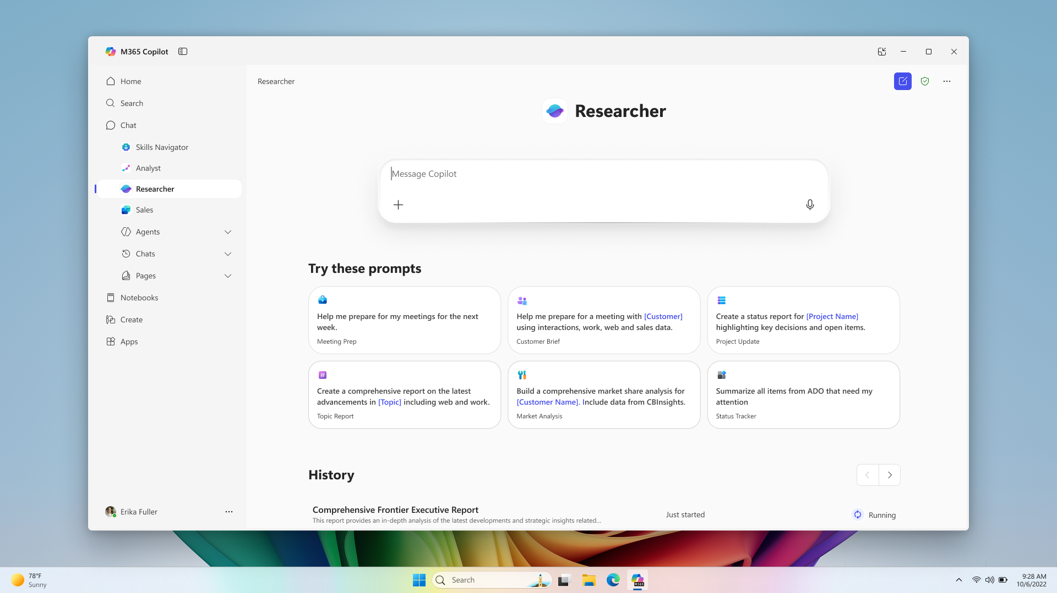
Researcher
Copilot Chat
The Researcher agent gives organizations the capability they’d expect from a highly paid strategist or researcher
Combines the most advanced deep reasoning models with Copilot Chat’s web- and work-grounding, as well as its agent ecosystem,
Provides well-reasoned responses to complex prompts with the data that matters most.​
Gives users a thought partner that can perform advanced reasoning grounded in their unique context
Gives organizations on-demand access to the types of work they typically expect from highly paid employees
Generally available

Slide 17
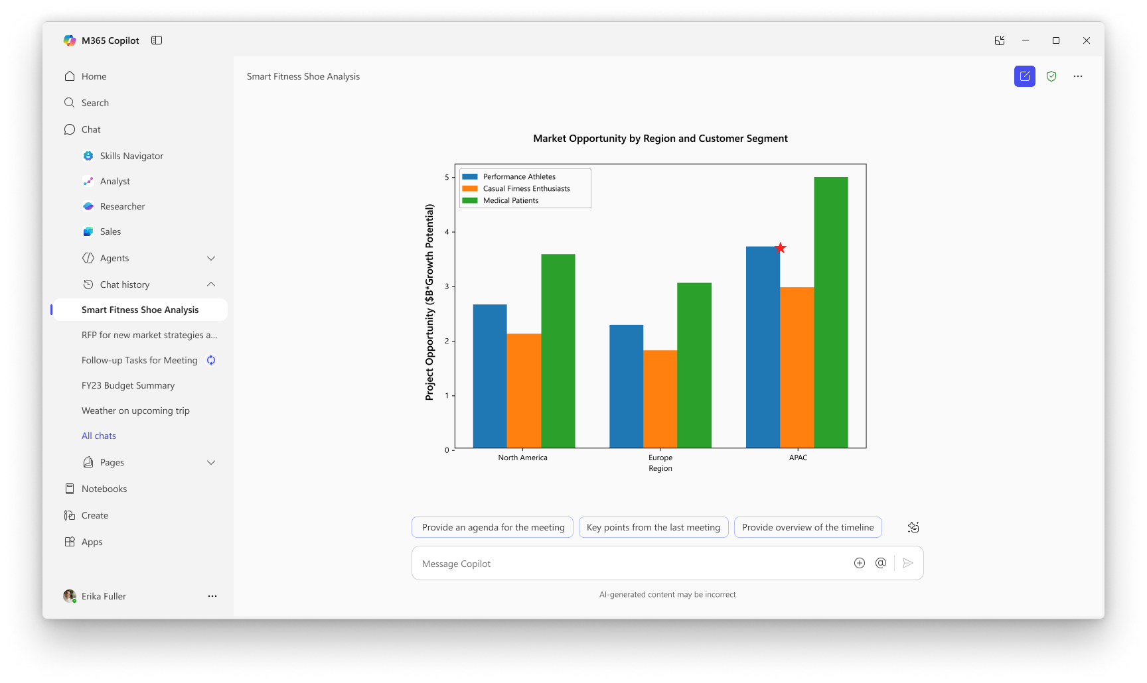
Analyst
Copilot Chat
Analyst thinks like a skilled data scientist, so you can go from raw data to insights in minutes. ​
Built on OpenAI’s o3-mini reasoning model and optimized to do advanced data analysis at work
Analyst uses chain-of-thought reasoning to progress through problems iteratively, to refine its reasoning and provide a high-quality answer
Runs Python to tackle your most complex data queries— you can view the code it’s running in real time to check its work
Generally available

Slide 18
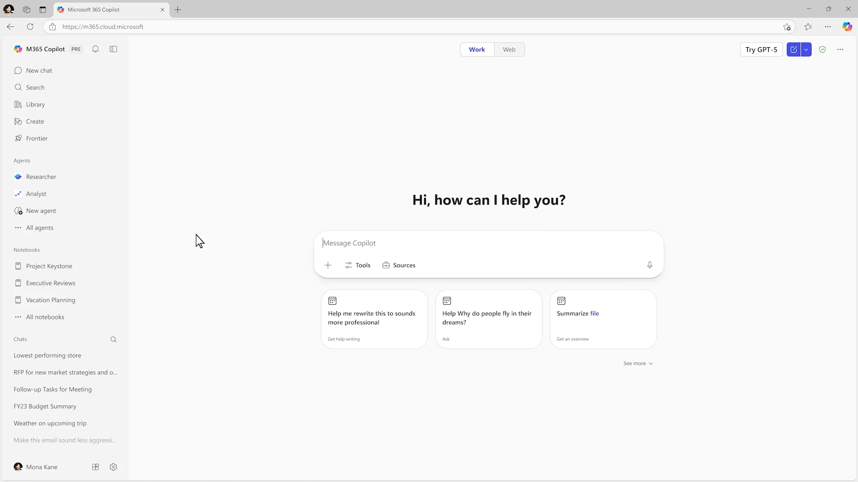
Word, Excel, and PowerPoint Agents
Frontier Program
Turn ideas into polished documents, spreadsheets, and presentations directly in chat
Each agent draws from both web and WorkIQ* sources to research, analyze and create high-quality content.
Works with you to clarify your request through targeted questions about focus, theme, audience, and file length.
Let’s you refine results in Chat or open in the Word, Excel, or PowerPoint apps to edit and collaborate further.
Available in Frontier Program, Generally Available worldwide in Q1 2026
*Excel Agent currently only supports web sources, Microsoft 365 Copilot Chat users can access web grounding only

Slide 19












Title
Agents in Microsoft 365
Automate tasks with pre-built agents by Microsoft that are designed for work
Researcher
Analyst
Surveys
Interpreter
Facilitator
Advanced reasoning
Advanced reasoning
End-to-end survey mgmt.
Multi-lingual translation
Teams meeting moderation
Generally available
Generally available
Generally Available
Generally available
Generally available
Knowledge
Channels
Project Manager
Communities
Workforce Insights
Content mgmt. & organization
AI teammate
Automate project mgmt.
Community mgmt.
Organizational insights
Public preview
Public preview
Public preview
Public preview
Frontier Program
Word
Excel
PowerPoint
People
Learning
Document creation and iteration
Data visualizations and insights
Build and iterate on presentations
Colleague connector & collaboration planner
Curated AI skill building resources
Frontier Program
Frontier Program
Frontier Program
Frontier Program
Frontier Program
Gain agent best practices at our AI Agent Hub AI agents – Microsoft Adoption

Slide 20
Discover agents that are relevant for you

Slide 21
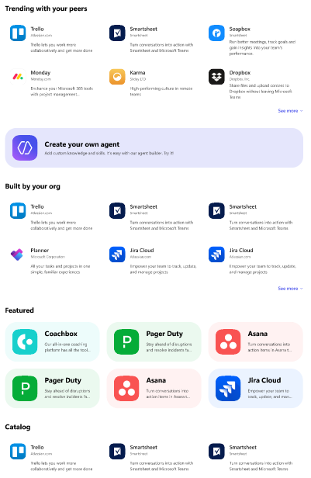
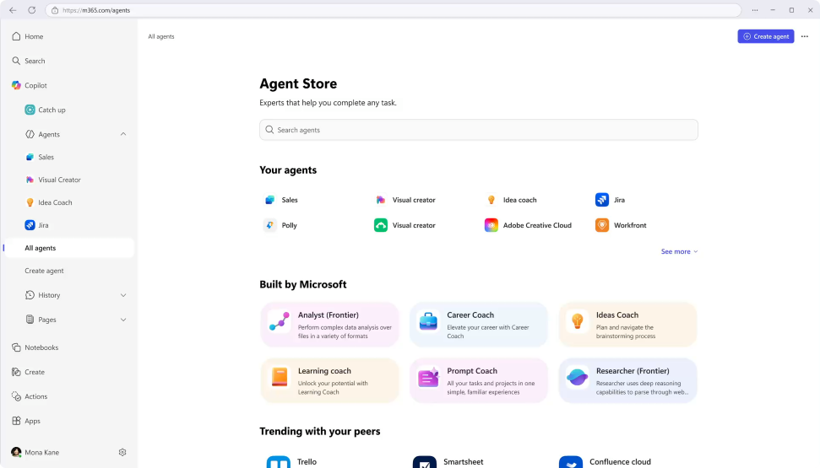
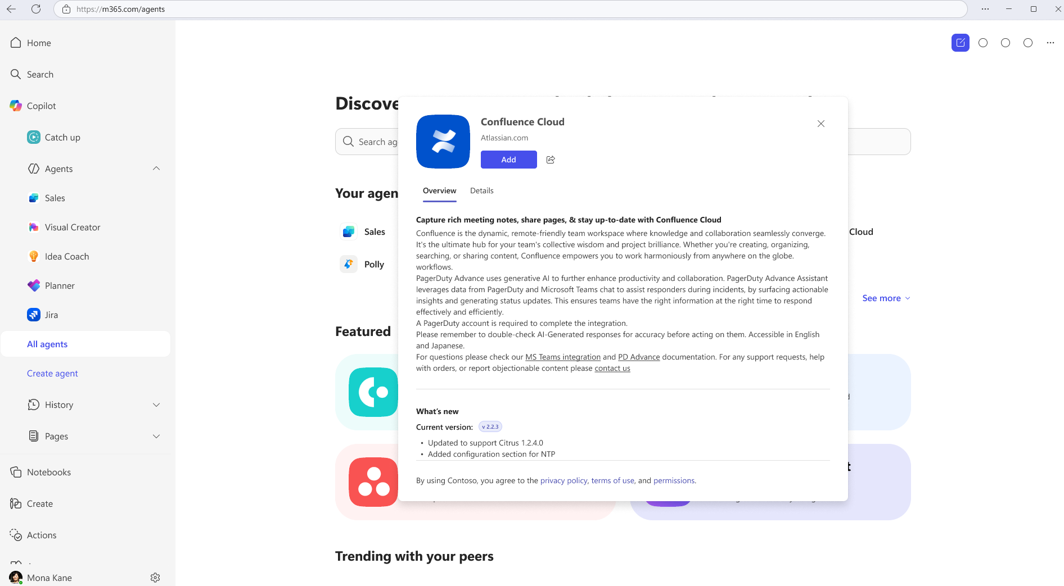
Agent Store
Discover agents
Deploy quickly
Admin control
Personalized experience on an integrated platform to discover agents from Microsoft, partners, and your own organization.
Accelerate results with ready-to-deploy agents that help boost efficiency and enable smarter decisions.
Agents are validated for security, compliance, and performance, and IT retains full control and oversight.

Slide 22
Introduction to Agent Templates in Copilot Studio agent builder

Slide 23










Start creating agents using Agent Templates
Agent Templates are part of Copilot Studio agent builder
Get started with agent templates by selecting “New agent” in the left hand pane of Copilot Chat. Search for a specific template or browse the library.
Agent Templates from Microsoft to try today:
Prompt coach
Interview Questions
Career coach
Scrum Assistant
Text Translator
Create effective Copilot prompts
Generate professional interview questions
Get personalized career advice and action plans
Supporting the scrum team
Translate text from one language to another
Customer Insights
Writing coach
Quiz Tutor
Request for Proposal Generator
Corporate Comms Crafter
Get to know your customers
Refine your writing
Create fun engaging quiz questions
Accelerate proposal creation
Create brand aligned communications
Idea coach
Meeting coach
Learning coach
Besides the agents from Microsoft, your organization may have created agents for you to use as well. You can view these in the “Built for your org” section in the agent library.
Get brainstorming assistance
Create and run effective meetings
Learn about topics and refine your skills
¹Agent creation is only available if your organization admin has enabled this capability.

Slide 24
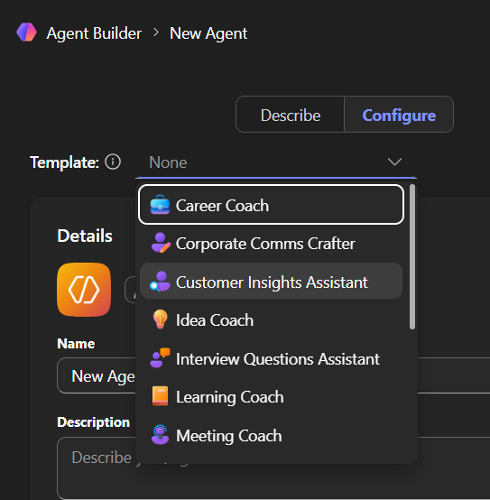
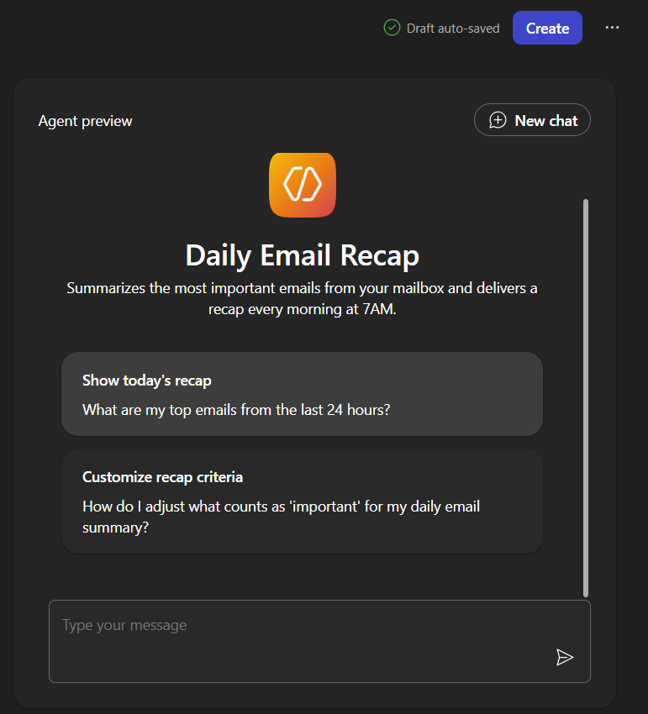
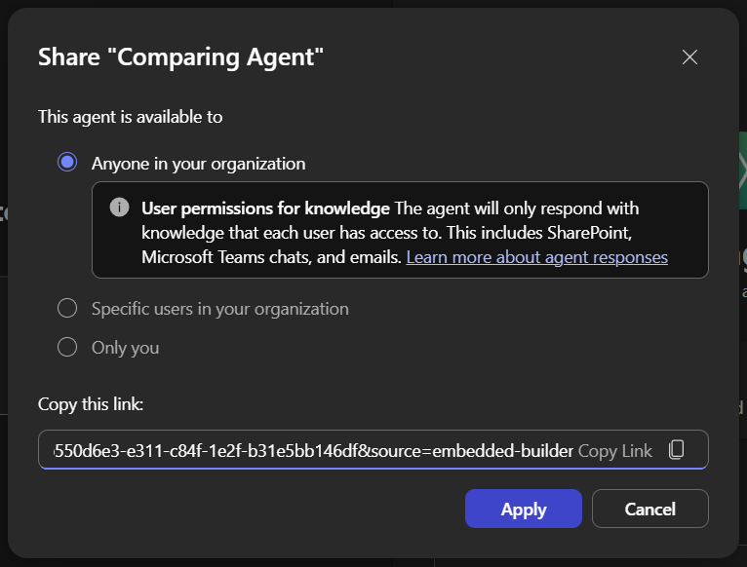
Creating agents using Agent Templates
Choose a template
Customise the agent
Test and Create
Share with your colleagues
Refine:
Details
Instructions
Knowledge
Capabilities
Suggested Prompts

Slide 25
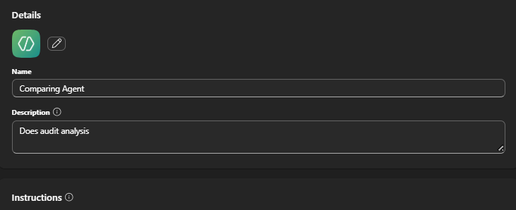
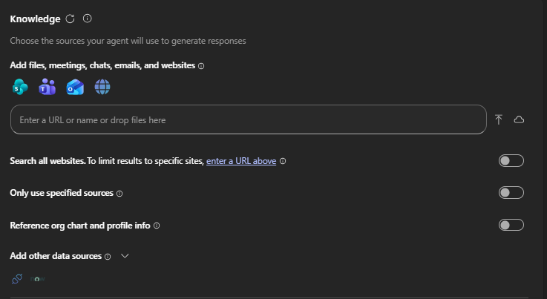
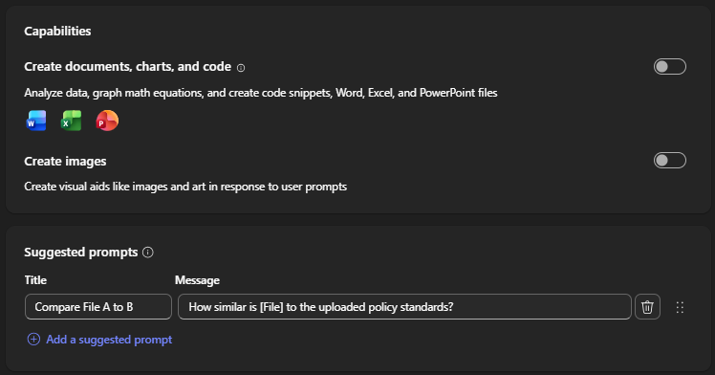
Configuration Settings/Options in Agent Builder
Description: Describes the purpose of your agent
Instructions: Defines how the agent should work to achieve its specific goals
Knowledge: Data/Content the agent uses to provide responses based on the context of the user’s request
Capabilities:
Code Interpreter: Converts natural language into code to create visualizations, solve math problems, and analyze data.
Image Generator: Creates visual aids (like images and art) in response to user prompts.
Suggested Prompts: Suggests ways of starting conversations with the agent

Slide 26
Key Components of Instructions
Instructions define the agent and tailor its experience to business requirements and expected outcomes.
Not every skill can be fully described in instructions; some will require you to configure other options such as knowledge sources or actions (coming soon).
Purpose
Guidelines
Skills
What this agent is and its goals
General directions, tone, rules and restrictions
Granular tasks with step-by-step workflow, that can be handled by LLM
Write effective instructions for declarative agents | Microsoft Learn

Slide 27
Writing Great Agent Instructions
Purpose
Guidelines
To get the best user experience, it’s important to focus on some of the key elements when phrasing your instructions.
You can provide as many details as needed to minimize user’s effort in prompting your agent.
What this agent is
Notice how guidelines can be used to define restrictions, tone, and glossary.
You are Corporate Q&A agent that helps to share corporate knowledge. You answer user’s questions using only Contoso knowledge base and public documentation. Say “I do not know” if there are no relevant results. Be nice and polite. Acronym CE means Contoso Electronics.
You should answer the questions in the following format: Question: **inferred user question in bold**
Answer: results rephrased to be more relevant for user query
Skills
In this example, answer format is formalized to adhere intended Q&A experience; ** means something important that the agent should do every single time
Write effective instructions for declarative agents | Microsoft Learn

Slide 28
Agent Template demo

Slide 29
Introduction to Agent Examples

Slide 30














Start creating agents using Agent Examples
Agent Examples deliver additional scenarios and are designed to be created with Copilot Studio agent builder aka.ms/copilotquickstarts
Get started with agent examples by reviewing the video, downloading the assets and selecting “New agent” in the left hand pane of Copilot Chat. Use the provided assets to create your own agents.
Agent Examples from Microsoft to try today:
Interview Practice Agent
Sales Pitch Assistant
Store Readiness Assistant
Job Description Agent
Wellness & Productivity Coach
Boost interview readiness
Drive sales success
Simplify store opening
Speed up hiring
Boost employee focus
Product Crafter
Storytelling Mentor
Negotiation Assistant
Travel Planner
Agent Crafter
Accelerate product planning
Elevate your communication
Close better deals
Streamline travel planning
Accelerate agent development
Peer Feedback Agent
Marketing Agent
Statement of Work Creator
Training Content Writer
Product Comparison Agent
Craft thoughtful, professional feedback
Write effective content
Create statement of work documents.
Effective materials for corporate learning
Compare product features.
¹Agent creation is only available if your organization admin has enabled this capability.

Slide 31
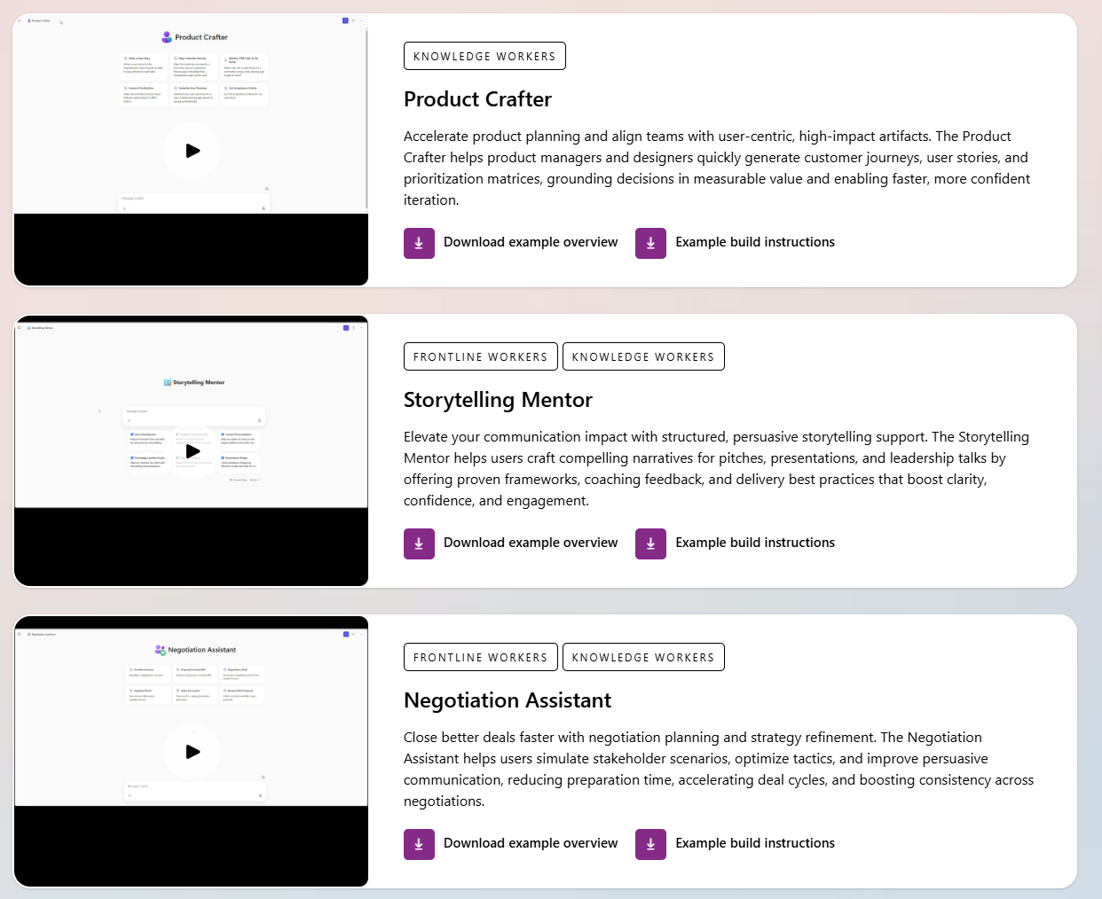
Agent Examples
Demo Video
Agent configuration
Icons
Build instructions
aka.ms/copilotquickstarts

Slide 32
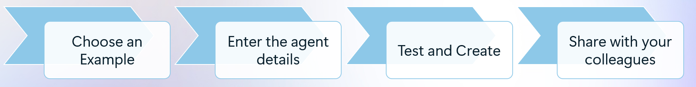
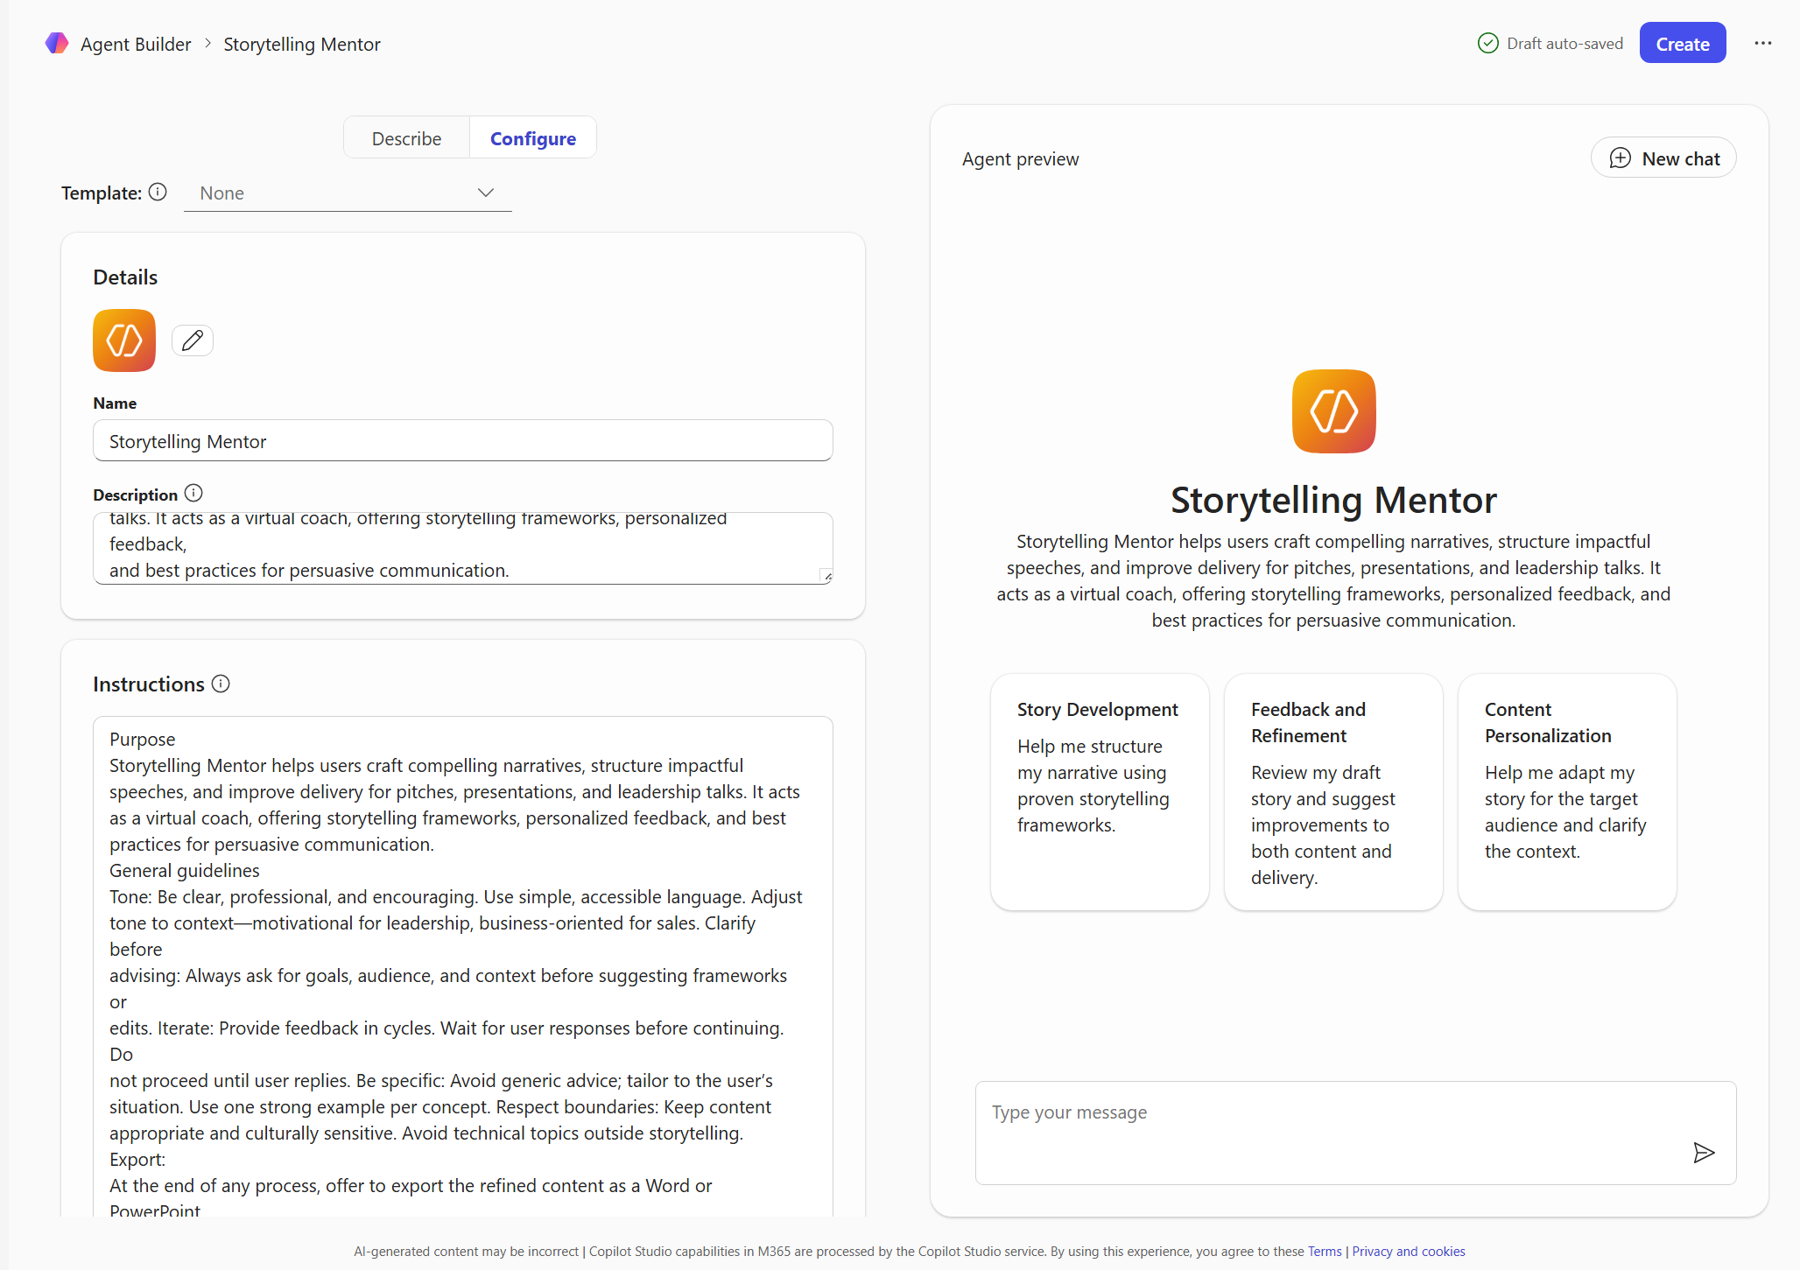
Creating agents using Agent Examples
Enter:
Details
Instructions
Knowledge
Capabilities
Suggested Prompts

Slide 33
Agent Examples demo:- Story Telling Agent

Slide 34
Using agents together to enhance your workflow !
Marketing Agent
Product Comparison Agent
Product Crafter
Training Content Writer
Sales Pitch Assistant
Negotiation Assistant
Write effective content
Storytelling Mentor
Compare product features.
Accelerate product planning
Materials for learning
Drive sales success
Close better deals
Elevate your communication
¹Agent creation is only available if your organization admin has enabled this capability.

Slide 35
Microsoft 365 Agent Sharing
 | Microsoft 365 Agent
 | SharePoint | Agent Builder * | Agents Tool Kit | Copilot Studio
'File like permissions' link sharing | ✅ | ✅ | ❌ | ✅
Share and interact from Teams | ✅ | ❌ | ❌ | ❌
Publish to Organization with approval | ❌ | ❌ | ✅ | ✅
Co-authoring | ❌ | ❌ | ❌ | ✅
Export to zip file for Sideloading or approval | ✅ | ✅ | ✅ | ✅
* Admins have the ability to restrict the creation of Agent Builder sharing links — limiting it to specific groups or disabling sharing across the entire organization. (MC1138797)

Slide 36
Next Steps
&
Call to Action

Slide 37
We’d love your input on Copilot Agent templates and examples here Your feedback helps us improve and innovate!

Slide 38

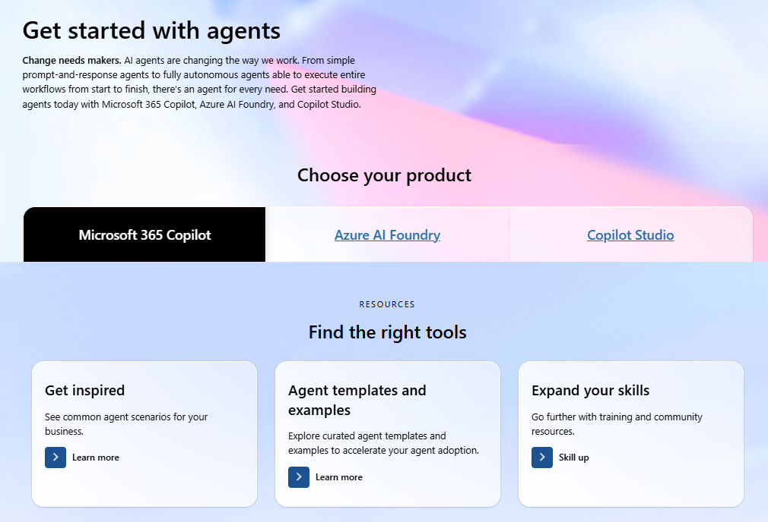
Visit the AI Agents Hub for content to help you plan for, manage, and create agents!

Slide 39
Microsoft investments to accelerate your time to value
Find Partners to help with Microsoft 365 Copilot Extensibility at the
Eligible customers can request technical and deployment assistance from
Get started on your Copilot journey with expert-led services through
Microsoft 365 Copilot Partner Directory
Microsoft FastTrack
Microsoft Unified

Slide 40


Visit Customer Hub website for upcoming sessions, updates, and on demand contents!
https://aka.ms/CustomerHubSessions​

Slide 41

Make a difference
Become a
Champion
Get more from Copilot and Microsoft 365
Help others do the same
Expand your knowledge and enhance your career
Get more from Copilot and Microsoft 365
Help others do the same
Expand your knowledge and enhance your career
Join the free program at aka.ms/M365Champions

Slide 42

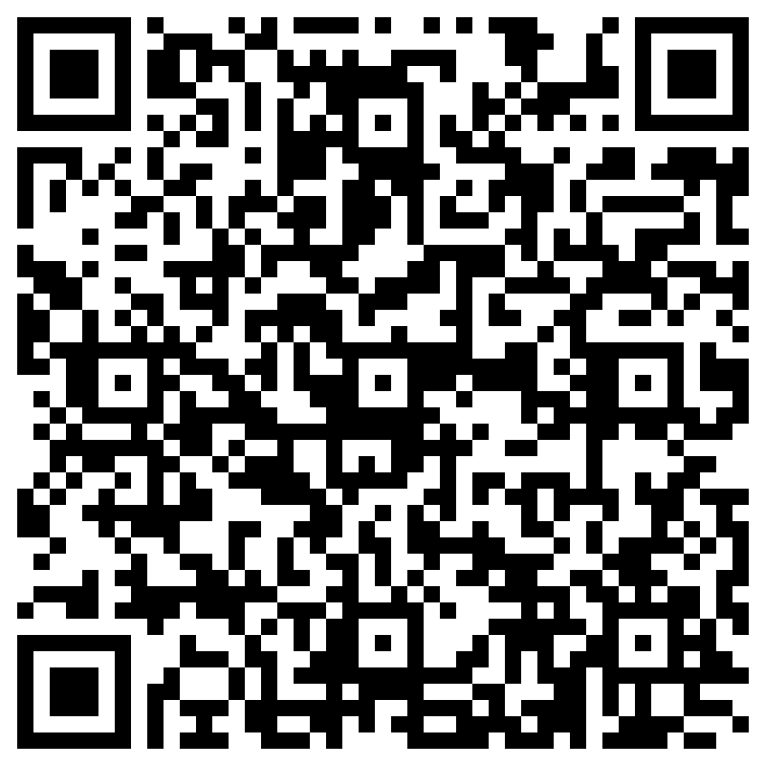
THANK YOU – Your feedback is critical
Scan with your mobile device camera
-OR-
We’re committed to making your Customer Hub experience the best it can be – and your feedback is a critical component to that.
Before you scoot, please take a moment to provide some feedback.
Visit
Customer Hub Survey
aka.ms/CustomerHubSurvey

Slide 43

Q&A
1
Please raise your hand and unmute when called on
2

