Slide 1
Hello and welcome to Customer Hub
We’ll get started at 2 minutes past the hour

Slide 2


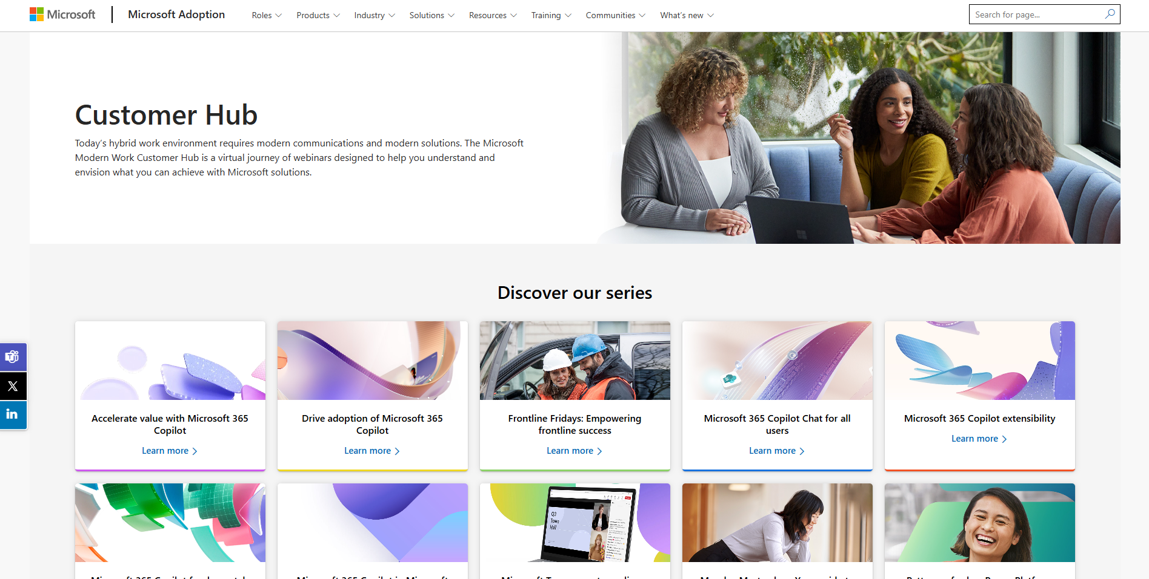
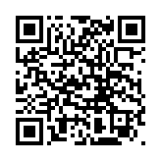
Visit Customer Hub website for upcoming sessions, updates, and on demand contents!
https://aka.ms/CustomerHubSessions​

Slide 3

Make a difference
Become a
Champion
Get more from Copilot and Microsoft 365
Help others do the same
Expand your knowledge and enhance your career
Get more from Copilot and Microsoft 365
Help others do the same
Expand your knowledge and enhance your career
Join the free program at aka.ms/M365Champions

Slide 4



After the presentation
During the presentation
We will mute your microphone for the first part of today’s call
Raise your hand and we will
call on you
Ask your questions via chat, we will get to all of them, live or after. Common questions will get addressed out loud
Open mic – come off mute and ask away!

Slide 5
Teams Events
Tips, Tricks, and Traps for Town halls and Webinars in Microsoft Teams

Slide 6
Agenda
Intro
General Tips
Specific Tips, Tricks, and Traps
Next Steps & Call to Action

Slide 7
Disclosure
The Tips, Tricks, and Traps shared in today’s sessions were collected from a team of event producers and are based on their personal experiences and preferences of managing events.
The views expressed today are the recommendations of those event producers and are not the official guidance of Microsoft. For the official Microsoft Teams Event Playbook please consult:
https://aka.ms/vitualeventplaybook
Note: No event producers were harmed in the making of this deck.

Slide 8
General
Thoroughly plan the attendee invite process.
Schedule event and configure options including Q&A in advance – many “mistakes” are due to incorrectly selected options.
Have a plan/run of show - Know who is speaking, to what, and when. Have a strategy on deciding who will be tossing to breaks/videos or end of the show to avoid awkward silence.
Check attendee link – Confirm it goes to the right place, specifically from the invitations received by attendees.
Hold Pre-Show rehearsals with on-camera team and support staff.
Computer Restart and Check for Windows Updates - Before a big event you should restart your computer and check for updates.
Confirm Settings - Always join your event at least a day before and confirm the appropriate settings.
Check Audio/Video Device Settings in Teams BEFORE starting/joining a meeting.
No one has gotten fired for using Green Room.
Hit Record - Even if it’s set to auto-record, always check.
Monitor Mics - Assign someone the job to monitor mics during the event and immediately mute if there are any audio disruptions.
Screenshots - Take screenshots of your events - or assign someone that role (especially useful to capture reactions – TP).

Slide 9
Town hall Specific
Publish - Don’t forget to publish your Town hall, but make sure the Event Access is set correctly first, as it cannot be changed once published. You can modify all other settings and add participants after publishing.
There is no attendee list during the event unless using an eCDN and then it’s only viewable through the eCDN analytics portal. Attendee count is viewable.
Attendees are anonymous (except for certain aspects of Q&A, Chat, and Reactions).
There are greyed out meetings options – greyed out options are locked/not applicable to Town halls.

Slide 10
Webinar Specific
Waitlist (TP) size equals the registration capacity.
Take extra care when inviting external presenters who have a Microsoft presence without a Teams license.
There is a toggle to include a link to share the registration landing page to social media - use as appropriate.
Hide Attendee Name (TP) is a great option if you want to keep attendees anonymous.
A Webinar is a great solution in place of breakout rooms when you want attendees to sign up for sessions ahead of time.
Chat and Q&A enabled by default - consider one or the other.
Once Breakout rooms are enabled in a Webinar, the Webinar limits the capacity to 300. If more than 300 are present, you cannot enable Breakout rooms.

Slide 11
Teams Specific
Some meeting options cannot be changed once the event group has joined the event. Simple fix – have the event group leave the meeting, update and save the option, then have them re-join and proceed as planned.
Some meeting options can be changed when the event is live. For example, almost all of the Q&A settings can be changed on the fly.
Manage attendee permissions on the fly via Participant panel.
Use Manage What Attendees See for better looking events in Meetings, Webinars or Town hall.

Slide 12
Town hall and Webinar: Organizer Tips
Use a vanity link in attendee invitations for enhanced invitation management.
Duplicate Events can be used to create a new event based on previous settings. This is especially useful if you’ve made many customizations to Webinar emails, etc.
Add reliable co-organizers as back up.
There are a total of two 2-step processes that you need to be aware:
  "Save and Send Invites" and "Publish"
  "Apply Settings" and "Save Settings"

Slide 13
Town hall and Webinar: Attendee and Presenter Invitations share the scheduled start time
Option 1: Create an Outlook block for your Presenters pre-join/prep session. Schedule it 15 minutes before the event and have the Join link to the event where they are assigned as presenters.
Beware the above does not work for External Presenters
Option 2: Manually send out an Outlook Invitation for Attendees so you can schedule the actual Town hall early for Presenters
Note: the above does not work for Webinars
Consider your use case and determine the best approach for having presenters join early.

Slide 14
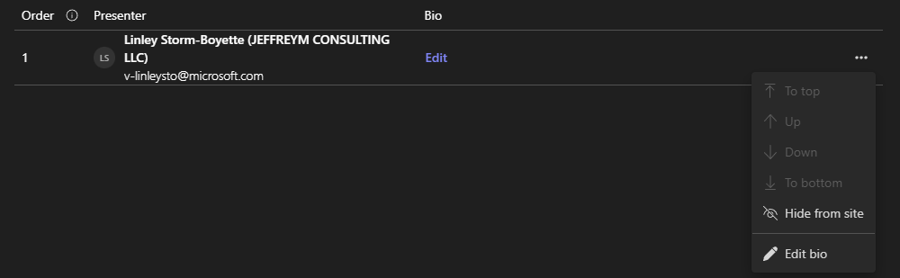
Town hall and Webinar: Branding + Theming Tips
Update Theming – Presenter invites leverage theming, so ensure it’s updated.
Use PowerPoint for simple designs and export a .jpeg for email theming in Webinar or Town hall.
For Webinars, upload photos of your speakers and note that you can hide presenters from the registration page and change the order they appear on the page.

Slide 15
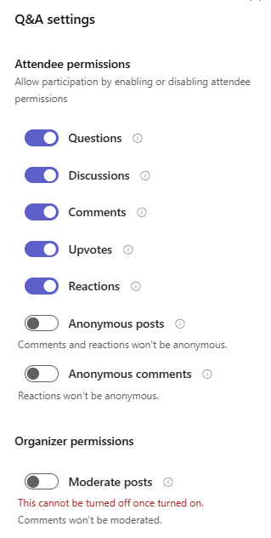
Town hall and Webinar: Q&A
Q&A is enabled and unmoderated by default.
Presenters do not moderate Q&A by default; you can enable Presenter moderation in options.
Access the Q&A settings without joining the Webinar/Town hall.
Download the Q&A report via Manage Event → Reports.
Deleted Q&A posts are not included in the download report. Instruct moderators accordingly.
You can “Pin” one announcement or question.

Slide 16
Town hall and Webinar: New Feature Releases
Some new features released are not retroactively applied to pre-scheduled events. For example: Preview Shared Content in Manage What Attendees See.
Some new features are retroactively applied to pre-scheduled events. For example: Scale is checked at event start.
Bonus Tip: This also applies to Teams Premium Licensing.

Slide 17
Town hall and Webinar: Producer Tips
Use the "Pin" feature to streamline presenter management in “Manage What Attendees See” mode.
Up to seven videos can be on stage in logical order.
Videos cannot be reordered once they are on stage.
Use Town hall “On with Preview” to reorder presenters in preview mode, then send live for “Manage What Attendees See”.
Manage What Attendees See does not require Teams Premium in Town hall.
Bonus Tip: Bring videos on/off stage via Participant panel.

Slide 18
Town hall and Webinar: Using RTMP
RTMP Settings: Encoder configuration for streaming in Microsoft Teams - Microsoft Teams | Microsoft Learn (Note: FFMPEG6 specifically to vMix encoder).
RTMP AI Captions are not currently available – RTMP events expect 708 Captions.
RTMP cannot be muted.
Consider using both RTMP and a capture card for redundancy.
Better yet, bypass RTMP altogether with a capture card and an audio interface.
Bonus Tip: There is a hack to get AI Captions working with RTMP.

Slide 19
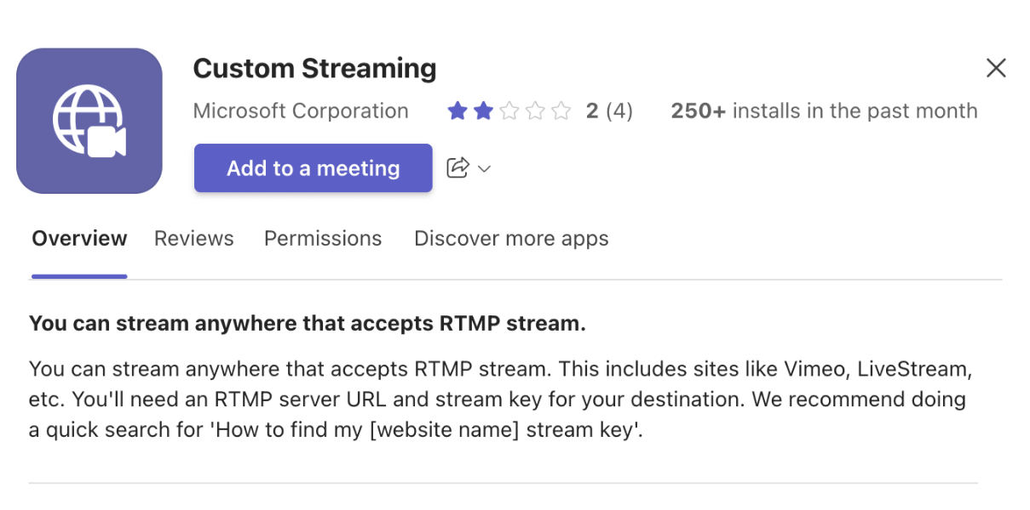
Town hall and Webinar: Using RTMP Out (Stream To)
Custom Streaming is an app that can be added to a Town hall or Webinar to stream the event via RTMP to another destination.

Slide 20
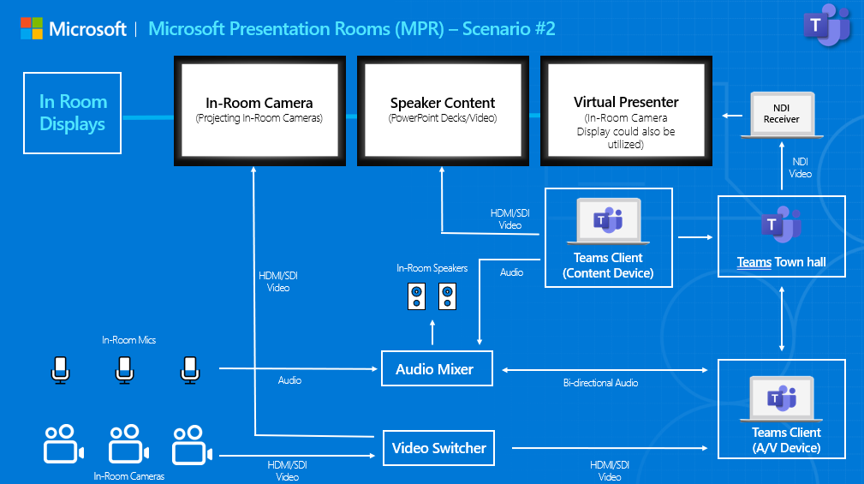
Town hall and Webinar: Hybrid Events
Teams NDI is a great way to bring a virtual presenter on screen in a physical space by using NDI Tools Studio Monitor running on a laptop.

Slide 21
Town hall and Webinar: Monitor, Monitor, Monitor…
RTA/CQD
Monitoring Devices
eCDN Analytics
Town hall Insights (TP)
Network Monitoring
VPN Monitoring

Slide 22






Town hall: Recording
Record upstream, if possible, at the highest resolution and frame rate.
OBS
Open Broadcaster Software

Slide 23
Town hall: Attendee Report
Attendee count is reported in several places: Town hall Insights (TP), the eCDN dashboard (if using), and the Town hall Attendee Report. The Town hall Attendee Report is the most accurate.
Ensure “Allow attendance report” is enabled in Meeting Options before going live; otherwise, it will not generate.
The Town hall Attendee Report will only populate once everyone leaves the green room and the RTMP feed has ended.

Slide 24
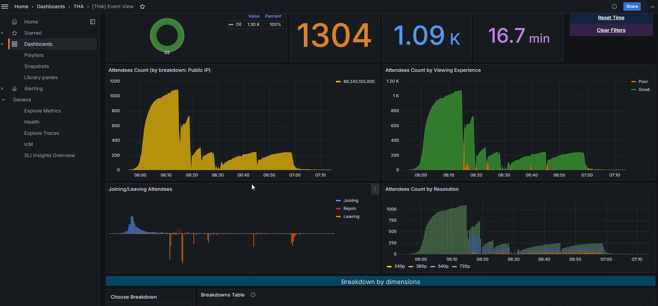
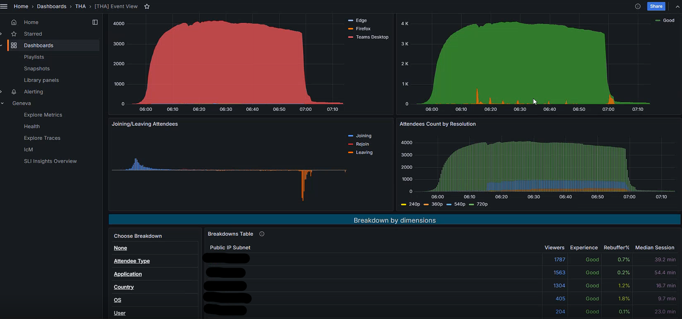
Town hall: Insight Report (TP)
Be sure to view the Town hall Insights during and after the event.
Use the breakdown tables to drill down into attendee experience by Application, Country, OS, User, and Public IP.
For richer engagement analysis, combine with the Attendee Report and look for drop-off points in the Join/Leave timeline, identify poor streaming experiences, and cross-reference with Q&A participation and/or poll data.

Slide 25
Town hall and Webinar: Presenter Tips
Bluetooth headsets and PTZ cameras are not advised by event producers.
Join the event early to test access and permissions.
Use a wired connection and test that connection prior to going live.
Join via the Teams desktop app for best performance.
Make note of the background, lighting, and ambient sound in the same place and time you will be presenting.
Download your content and have an easily accessible backup presentation ready.

Slide 26
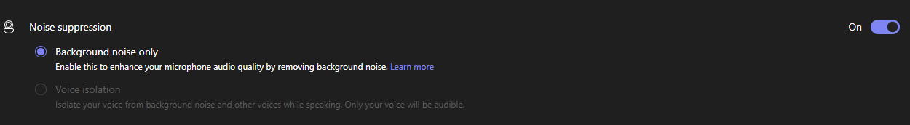
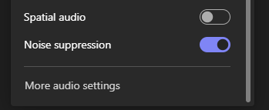
Town hall and Webinar: Noise Suppression Presenters
Make sure your presenters have it on!
Don't use noise suppression for studios or video playback.

Slide 27
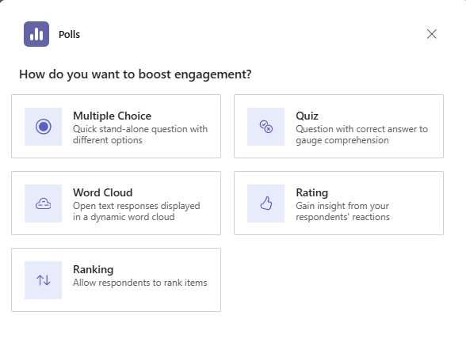
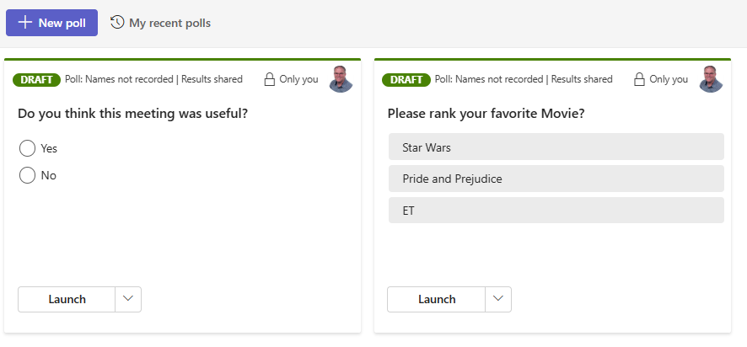
Town hall (coming soon) and Webinar: Polls
Create and test polls BEFORE your Town hall (TP) or Webinar.
Native polls in Town hall are only available with a Teams Premium license (coming soon).
Encourage attendee engagement by posting icebreaker, mid-session and feedback polls. Remind attendees multiple times to submit questions.

Slide 28
Town hall and Webinar: Sharing Content
Font size - Small font size in slide content will present challenges for attendee readability.
Assign someone off camera to drive content. This helps presenters focus on delivery and not troubleshooting.
Sharing the Wrong Screen or Window - Accidentally displaying private or unrelated content due to misusing the screen sharing feature.
Bonus Tip: Help your fellow presenters, if you notice private or unrelated content, do a quick share from your device which will remove their content. A quick stop share will remove your content as well.

Slide 29
Town hall and Webinar: Have a Second Monitor (a Third Monitor is Useful in Town halls)
Always have a second monitor for presenters or for sharing slides.
A third monitor is great so you can have one dedicated to the meeting, one to the content, and one to chat and/or PowerPoint notes. PowerPoint Live is not supported in Town hall.

Slide 30
Town hall and Webinar: Video Playback
Use ‘optimize playback’ when sharing high-motion video content.
Make sure ‘optimize playback’ is off for static content.
You can also share system audio from the sharing toolbar if you forget when starting the share.
Resource Link: Presenting content in Microsoft Teams Meetings

Slide 31
Town hall and Webinar: Video Playback Continued
Use a software encoder to playback video into a Teams meeting by using either RTMP or Shared Screen.
This allows for pausing and playback without exposing controls.
OBS
Open Broadcaster Software

Slide 32
Town hall and Webinar: External Presenter Tips
External presenters cannot be defined/selected in the “Specific people" fields in the meeting options (e.g., who can produce the event).
External presenters cannot join via Web.
External presenters have unique join links.
External presenters must be authenticated if they have a Teams license.

Slide 33
Town hall and Webinar: Attendee Tips
Banners will display at join time indicating which permissions you have as an event attendee.
Some attendee features are not available until the event is live.
Ensure you are signed in with a supported account. Teams (Free) accounts are not supported for joining Town halls at this time.
According to event producers, several audio/video difficulties can be resolved by dropping and rejoining the event.

Slide 34



Teams Town hall Specific Tips, Tricks, and Traps
Advanced Town halls
Town halls
  Included in Teams Premium
  Included in Office 365 & Microsoft 365
  Host up to 100,000 attendees with moderated Q&A
  Deliver up to 50 concurrent events
  Town hall Insights Dashboard
  Live translated captions in
  10 languages
  Attendee Reactions
  Live Streaming Chat
  Email customization
  Microsoft eCDN support
  Host up to 10,000 attendees with moderated Q&A
  Deliver up to 15 concurrent events
  Co-organizers
  Automated invitation and cancellation emails
  Green room
  Manage what attendees see
  RTMP-in
  Live translated captions in
  6 languages
  Attendee reporting
  On-demand recording
  3P eCDN support

Slide 35
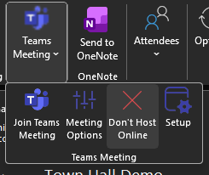
Town hall: If You are Sending Attendee Invitations Via Outlook…
Be sure to fully remove the associated Teams Meeting by selecting “Don’t Host Online” in the Teams Meeting Options.

Slide 36

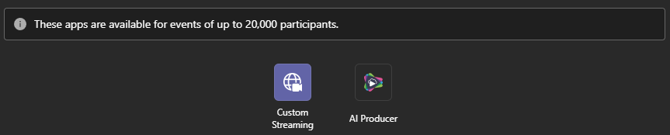
Town hall: Meeting Apps
Meeting Whiteboard and Breakout Rooms Apps appear in the Town hall calendar item but are not supported at this time.
Custom Steaming App and select 3rd Party Apps are available and more are coming soon!

Slide 37
Town hall: Producer Tips
Producer rights can be limited in Town hall Meeting Options.
Some production features do not support multi-device join scenarios.
If you don't have ULL, consider starting 20 seconds before the hour for an exact attendee start time.

Slide 38

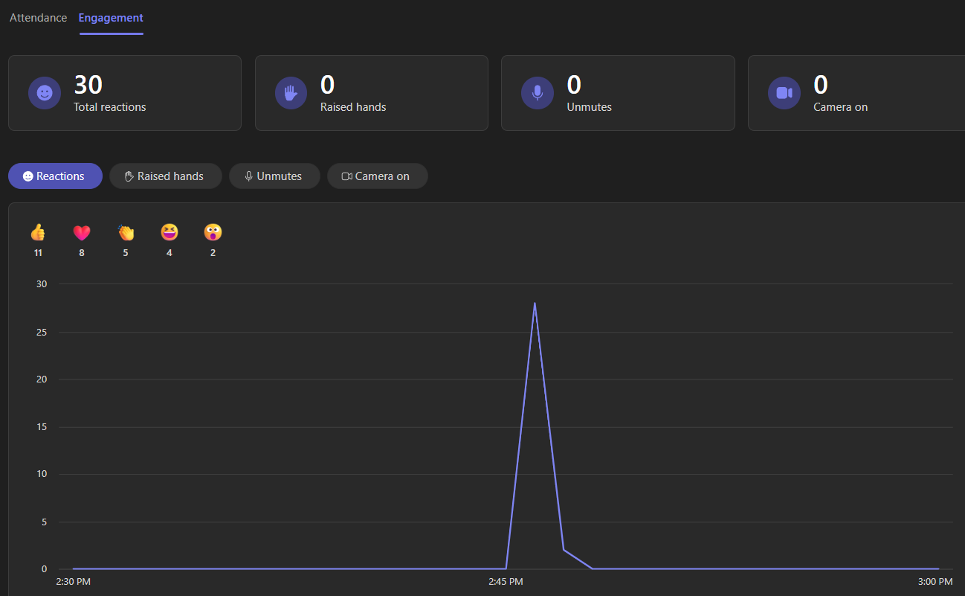
Town hall: Reactions
Due to the average 20-30 second delay, presenters may be confused by reactions if the event does not use ULL.
Data is captured in the post-event Engagement Report.
Reactions are not captured in the event recording. If you want to preserve them, screen record the event.

Slide 39
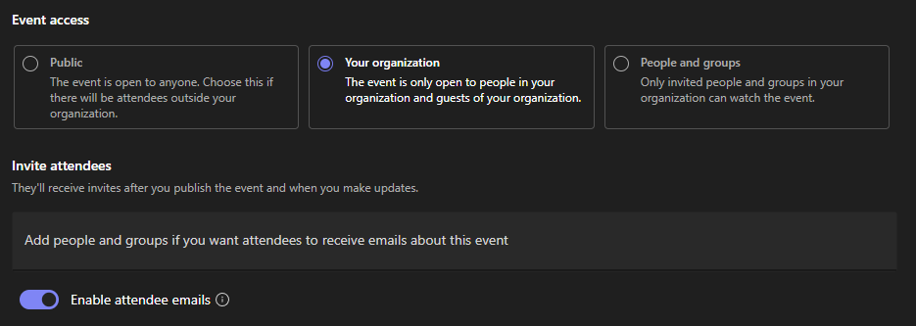
Town hall: Invite Attendees Toggle
Invite Attendees Toggle serves two purposes:
  If you want attendees to receive emails about the event.
  If you only want to invite specific people and groups in your organization to watch the event.
  Bonus Tip: Disable “Enable attendee emails” if you want #2 but not #1.

Slide 40
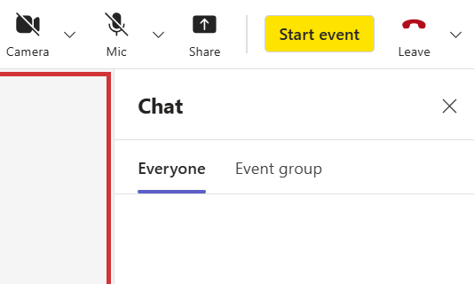
Town hall: Attendee Chat
Live Chat is enabled by default.
Live Chat is not captured/recorded (work is being done to allow this).
Attendee Chat Meeting Option could be more specific in Meeting Options.

Slide 41
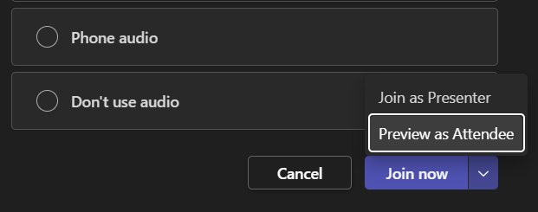
Town hall: Joining a Town hall as an Attendee
Free (TFL) Teams accounts are not supported for Town hall attendee joins.
Organizers, Co-organizers, and Presenters can now join as Attendees, but at least one event group member must be joined normally.

Slide 42
Town hall: Meeting Options By Default
Attendee Chat (TP)
Unmoderated Q&A
Reactions (TP)
ULL (TP) (no meeting option to disable) - rolling out now
Town hall (TP) Microsoft eCDN
Presenter Producer Rights - enabled by default
Presenter Q&A Moderations - disabled by default
Green Room
Manage What Attendees See
Default Translated Captions Languages (except for RTMP Town hall)

Slide 43
Teams Webinar Tips, Tricks, and Traps
Teams Webinar
Advanced Teams Webinar
  Included in Office 365 & Microsoft 365
  Included in Teams Premium
  Everything in webinar, plus:
  Enhanced Registration Controls
    Waitlist
    Manual Approval
    Registration date/time configuration
  Email customization
  RTMP-in
  Hide attendee names
  Engagement data and reports
  Host up to 1,000 attendees with full functionality
  Registration with confirmation and cancellation emails
  Automated reminder emails
  Registration page with presenter bios and event theming
  Co-organizers
  Presenter Modes
  Green room
  Dynamic Layouts
  Breakout Rooms
  Live Captions
  Attendee reporting
  Video on demand publishing

Slide 44
Webinar: Meeting Options On By Default
Attendees with a registration link can bypass lobby
Green Room
Q&A
Reactions
Chat
Webinar: Meeting Options Off By Default
Manage What Attendee See (TP)
RTMP-In
Attendee mic and camera
Hide attendee names (TP)
Let people edit their display name
Presenter Q&A Moderation

Slide 45
Bonus Topic: Teams NDI
Teams NDI resolution will dynamically adjust, so plan accordingly.
Pin Videos for NDI to ensure they remain prioritized.
Reserve Cameras for only those needed for NDI.
Pop-out content on Teams NDI device to prioritize video.
Use NDI Listening Devices.
Optimize encoder collection design to minimize inactive NDI sources.
Ensure Production PC GPU utilizes a video encoder than can be leveraged by the software encoder.

Slide 46
Bonus Topic: Ultra-Low Latency ULL (TP)
Will it use the same Town hall CDNs?
  No. Ultra-Low Latency operates its own delivery network within the M365 domains and IPs.
What eCDNs are compatible with ULL?
  Microsoft eCDN is the only eCDN solution compatible with ULL.
Will Ultra-Low Latency work with RTMP?
  Yes, but there is additional inherent latency with the RTMP protocol that is not reduced by Ultra-Low Latency.
What determines the location of Delivery Nodes and should we expect Ultra-Low Latency in locations such as China?
  Delivery nodes are determined by the location of the attendee and located throughout NOAM, APAC, and EMEA. There are no delivery nodes specifically in China and this traffic would be served from APAC.
Will Ultra-Low Latency work with town halls scheduled prior to the rollout to my organization?
  Yes, because Ultra-Low Latency usage is decided at runtime rather than during the scheduling process.
Can Ultra-Low Latency be enabled in meetings options during a town hall?
  For Premium events, Ultra-Low Latency is used by default, and if clients have issues with ULL, there is a fallback to HTTPS Live Streaming (HLS) our current streaming delivery protocol.
Will Ultra-Low Latency scale to 50k and/or 100k?
  Ultra-Low Latency currently supports up to 20K users. We are working to scale this to 50K and 100K in the future. For now, events exceeding 20K users will use the current HTTPS Live Streaming (HLS) protocol.

Slide 47
Additional Resources
Virtual Event Playbook
Plan for Teams town halls
Plan for Teams webinars
Town halls in Microsoft Teams – Microsoft Adoption
Microsoft 365 Roadmap
Microsoft Teams Premium licensing
Encoder configuration for streaming in Microsoft Teams
Teams Events Services

Slide 48


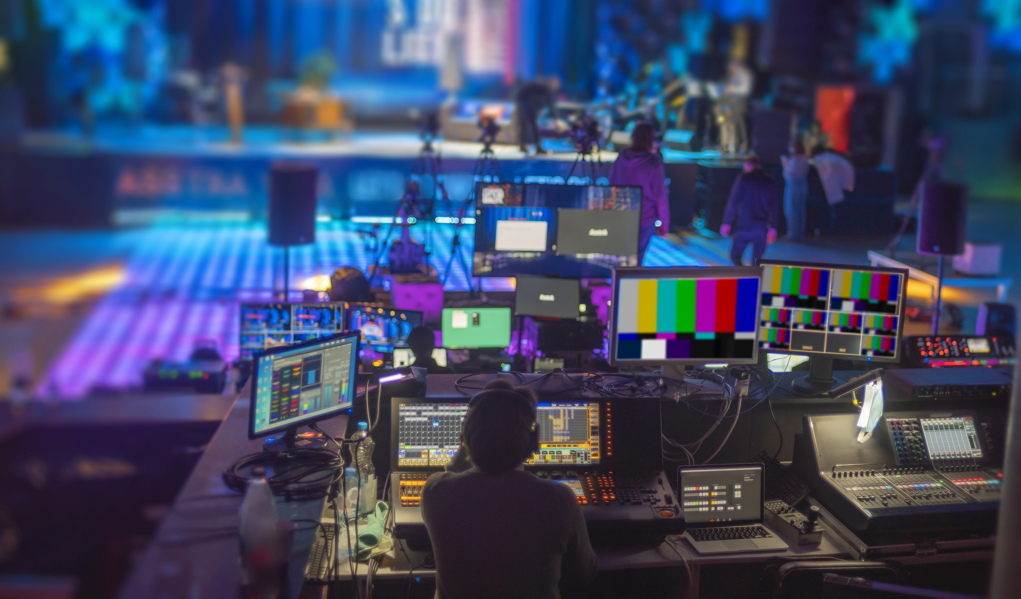
Advanced Events Team Customer Support
Leveraging the Microsoft Advanced Events Team (AET)
  Objectives: Help strategic customers successfully transition to a virtual or hybrid world with Teams Events. Support for all event types, including leadership summits, learning & development, virtual offsites, complex hybrid, or even external-facing webinars.
  How: Contact Your Local Microsoft Account or Email Us Directly:
  AdvancedEventsTeam@microsoft.com
  Activities:
  Define event format and approach
  Demonstrate the technology capabilities
  Educate and transfer knowledge to your Production and/or Technology team
  Advise on recommended best practices to create the ideal virtual event experience
  Assist in the preparation activities for the event to best leverage our solutions
  Provide Support and/or Moderation during practice sessions, dry runs and/or for the actual virtual event

Slide 49
Questions?

Slide 50
Thank you!
Next session…
10/22/25 – Bridging online and in-person attendees: hybrid events with Microsoft Teams and Teams Rooms

Slide 51

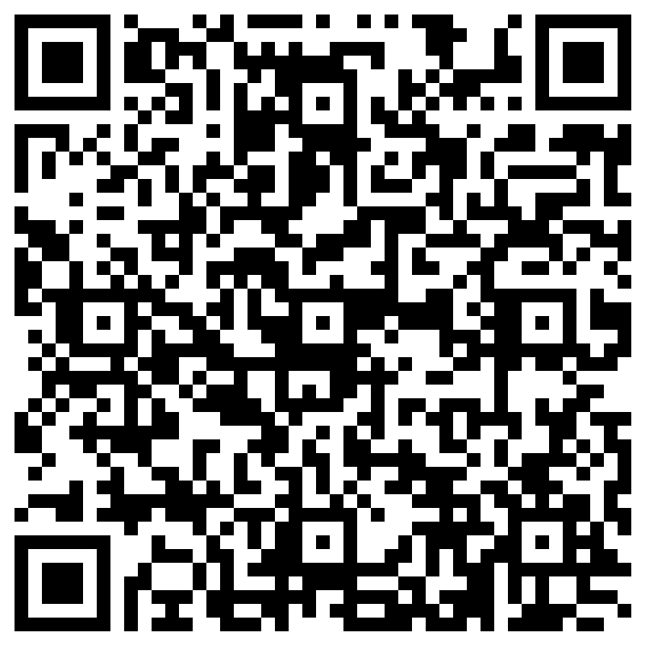
THANK YOU –
Your feedback is critical
Scan with your mobile device camera
-OR-
We’re committed to making your Customer Hub experience the best it can be – and your feedback is a critical component to that.
Before you scoot, please take a moment to provide some feedback.
Visit
Customer Hub Survey
aka.ms/CustomerHubSurvey
Select Frontline Friday Series

Slide 52
Visit Customer Hub website for upcoming sessions, updates, and on demand contents!
https://aka.ms/CustomerHubSessions​

Slide 53
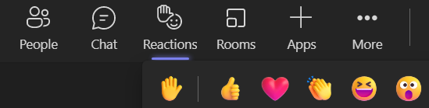
Q&A
1
Please raise your hand and unmute when called on
2

Slide 54
Thank you

