Slide 1
Copilot Chat
Prompt Mastery Series
February 25, 2026

Slide 2
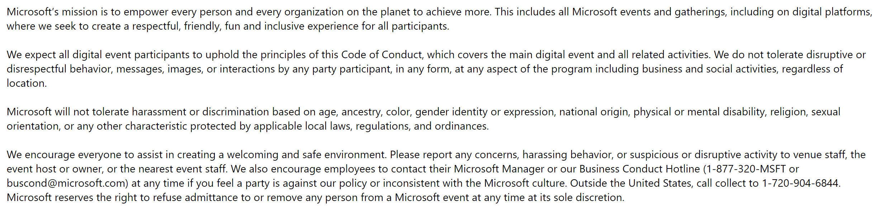
Microsoft Digital Event Code of Conduct

Slide 3
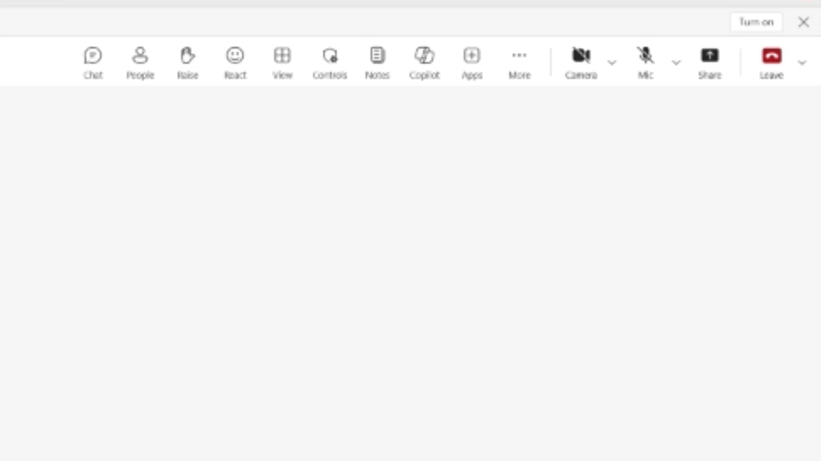

Accessibility Settings for your preference
  Close Captioning (on/off)
  Select More > Language and speech >
  Turn on (off) live captions
  Enlarge Content to your screen
  Press Windows logo Key and (+) to zoom in
  Press Windows logo Key and (Esc) to zoom out
  High contrast view
  Select Settings > Appearance and accessibility
  Under Theme choose High contrast.

Slide 4
Participation
  Session will be recorded
  Use Q&A for questions
  Resources will be shared during and after session
  Share feedback and request assistance

Slide 5


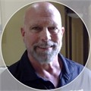







Sponsor & Lead
Host & Presenter
Stephanie Hernandez
Customer Success Lead
Director, Cloud Solution Architect – Oil Gas & Energy
Jennifer Snoddy
Senior Cloud Solution Architect Copilot
Presenters
Moderators
Tony Rodighiero
Senior Solution Engineer
Copilot
Sharon Salzar
Cloud Solution Architect Copilot
Wes Horn
Senior Cloud Solution Architect Copilot
Armando Hernandez
Senior Cloud Solution Architect Copilot
Greg Yee, Jr.
Cloud Solution Architect
Global Solution Architect | Copilot
Valene Samuels
Principal Cloud Solution Architect
Global Solution Architect | Copilot
Harumi Togo
Technical Program Manager
Lizz Hess
Program Manager

Slide 6
Objectives
Using Copilot Chat:
An overview of how to incorporate prompts into workflows for Copilot Chat. Using Copilot Chat within M365 Apps for Excel, Outlook, PowerPoint.
Live demonstrations:
Showcase high value prompts and related use cases.
Takeaway:
Discover Copilot use cases and use prompts in your own workspaces during and after session.

Slide 7
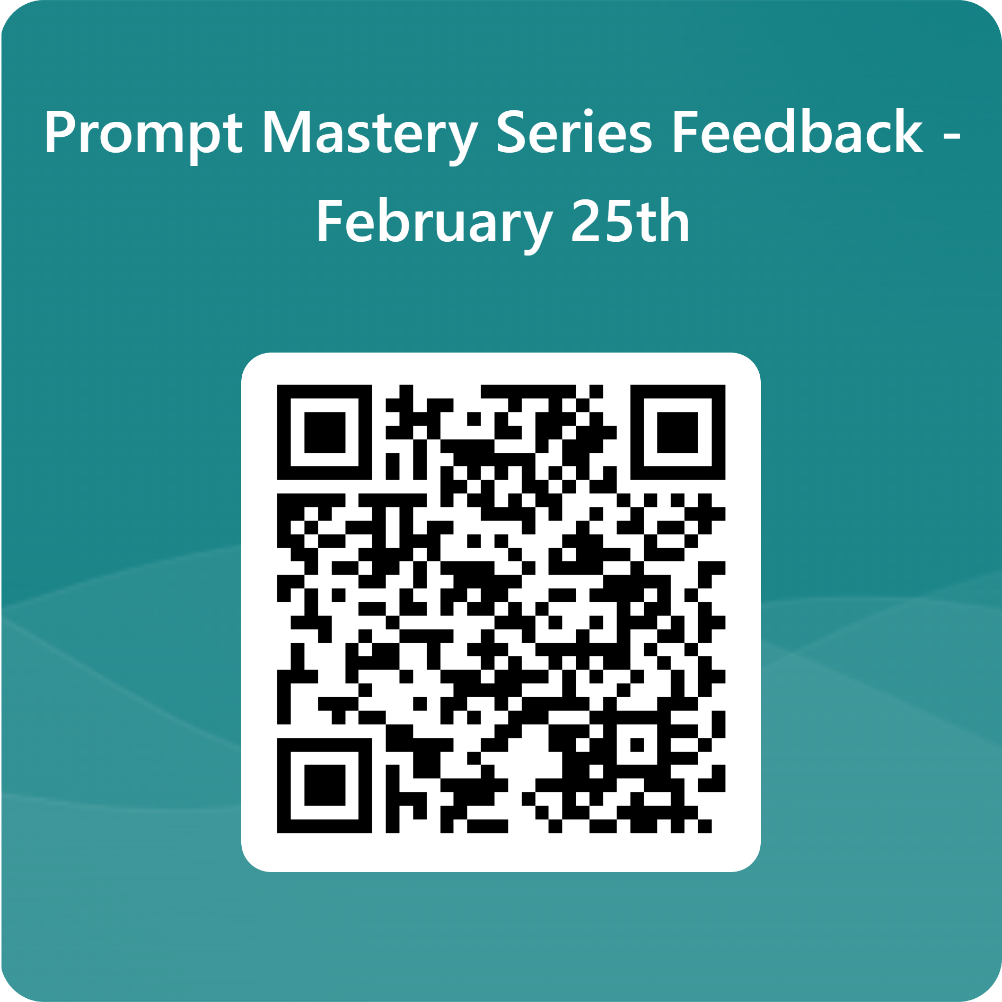
Thank You
Link to complete feedback survey HERE

