Slide 1
Hello and welcome to the Modern Work Customer Hub!
We’ll get started at 2 minutes past the hour

Slide 2
Teams Phone Customer Hub
Session 3
Teams Phone Calling Plans Deep Dive
Notes:
Hit Record
Hello everyone – and welcome to the Customer Hub series, “Teams Phone Customer Hub’
My name is Harumi Togo and I’m on the Technical Strategy team here at Microsoft and I’ll be your host today. Before we get started, I have information I’d like to share.

Slide 3
Make a difference Become a Champion
Get more from Copilot and Microsoft 365
Help others do the same
Expand your knowledge and enhance your career
Join the free program at aka.ms/M365Champions
Notes:
If you would like to continue the conversation after the session, and you are not already a member of the M365 Champions community, please consider joining. This community brings customers and Microsoft together to answer questions, provide resources, and many more.

Slide 4
Make a difference Become a Champion
Get more from Copilot and Microsoft 365
Help others do the same
Expand your knowledge and enhance your career
Join the free program at aka.ms/M365Champions

Slide 5
Insert Title
During the presentation
After the presentation
We will mute your microphone for the first part of today’s call
Raise your hand and we will call on you
Ask your questions via chat, we will get to all of them, live or after. Common questions will get addressed out loud
Open mic 🙌 Come off mute and ask away!
Notes:
To avoid disruptions during today’s sessions we have muted lines just for now.
However, I do want to encourage you to ask questions as we go. And you can do this by typing your questions into the chat pane.
We have small army of very knowledgeable Subject matter experts in the background to get all your questions answered.
When we get to the end of today’s session you absolutely will have the opportunity to ask verbal questions to our presenter today.
We’ll give you a heads up when we get to that point in the presentation – at which time we’ll allow you to unmute your line and you’ll be able to ask your questions.

Slide 6
Converged Communications: Teams Phone
Teams Phone Calling Plans Deep Dive
Daryl Hunter Global Technical Customer Success
Brooks Bevil
Senior Teams Subject Matter Expert
Teams Phone Customer Hub Session 2 | October 15th

Slide 7
What you’ll learn today
PSTN Connectivity Options
Calling Plans
Operator Connect
Direct Routing
Teams Phone Mobile
Shared Calling
What is Shared Calling?
How does Shared Calling work?
Considerations
Demo
Notes:
Pass to Daryl
PSTN Connectivity: Daryl
Shared Calling: Brooks

Slide 8
Connectivity overview
Notes:
[PRESENTER TALK TRACK]
Let’s get started by discussing Teams Phone connectivity options that your organization can select from.

Slide 9
Teams Phone overview
Teams Phone
Cloud-based phone system
Enables Voice over IP audio and video calls and PSTN calls when set up with a calling plan
Supports shared calling
Partners and integrations
Core call control and infrastructure
ISV integrations/APIs
Microsoft Teams Calling Plans
Microsoft is your operator
Third-party calling plans
Operator Connect
Seamless integration with qualified operators
Direct Routing
Bring your own operator and on-prem infrastructure
Teams Phone Mobile
Seamless integration of mobile identities with Teams
Connectivity options
System integrators
Devices and endpoints
Phones, peripherals, and softphone
Operators
Hardware/ softphone calling endpoints
OEMs
Notes:
[PRESENTER TALK TRACK]
It all starts with Teams Phone, the core call control and infrastructure for Microsoft.
For external connectivity, Teams Phone gives you the option to have Microsoft as your operator, select your own third party operator through Operator Connect, Direct Routing, or Teams Phone Mobile, or choose more than one connectivity path. And we will go into a little more detail in the next slides.
Teams Phone calling supports a broad range of devices and endpoints, from PCs and mobile phones, to headsets and desk phones, to Teams Displays and conference room devices – and users have the ability to transition between devices even during a call without interruptions.
Lastly, Microsoft has a partner ecosystem available to help enable your success, from ISVs and System Integrators, to Operators and OEMs.
This ecosystem gives virtually unlimited flexibility for deploying calling in your organization.

Slide 10
What is the right path for my organization?
Select one or more of these connectivity options to suit your users’ calling needs
Teams Calling Plans
Operator Connect
Teams Phone Mobile
Direct Routing
Customer value
A fast and Simple way to setup calling without additional technical configurations. It does not require a session border controller (SBC) or ‘voice trunk’.
A quick and easy way to integrate with calling while maintaining existing service provider agreements and leveraging the customization and flexibility of direct routing.
All the benefits of Operator Connect but assign a single business-provided mobile phone number as your Teams Phone number.
Highly customizable approach that allows customers to maintain existing service provider agreements and use on premises/hybrid hardware. Available globally through partners.
Why choose this option
Getting started quickly is a priority
Simplicity that comes with all-in-one solution is important
Easy to set up a rapid proof of concept
Available in 36 markets.
Needs a pure cloud (no hardware footprint), fully managed solution
Existing PSTN infrastructure (voice trunks) will continue to be used
Existing service provider agreements are in place
Integrated end-to-end number management experience in Teams admin center
Multi-national company with locations outside Microsoft Calling Plan markets
Can support third party Interop with PBXs for migration using downstream SBC’s
Available markets can be found here
Convenience of a single, business-provided number for Teams and mobile phone
Eliminate costs associated with fixed lines devices and hardware
Easy to deploy, configure, and manage
Apply security, compliance, and policy settings across mobile devices
Currently available in Canada through Rogers Business, Sweden through Telia, US through Verizon, Switzerland through Swisscom & Germany through Deutsche Telekom
Latest list of available markets can be found here
Existing PSTN infrastructure (SBC or voice trunks) will continue to be used
Required for PBX co-existence
Migration from legacy telephony Systems
Integration for analog devices (elevator phones overhead paging etc.)
Multi-national company with locations outside Microsoft Calling Plan countries
Existing service provider agreements are in place
Regulatory requirements around telephony in their region (examples include India, China, Australia)
Local PSTN survivability needs
Minimal configuration
As a service
Highly customizable
1st Party
3rd party
Notes:
[PRESENTER TALK TRACK]
This is the first of two times you’ll see this slide today. I wanted to drop it here to help set the stage for the next few minutes.
This side-by-side view of the connectivity options for Teams Phone provides a high-level comparison and reason to choose, ordered from minimal configuration to highly customizable.
You are able to select one or more of these connectivity options for your organization.

Slide 11
Teams Calling Plans are a quick and easy way to enable calling
Microsoft is your operator
Rapid provisioning
Number porting and dynamic emergency calling
Call with confidence knowing you have enough minutes
Local, long-distance, and international calling
Pay-As-You-Go
Procure and assign phone numbers to users in minutes with no on-premises equipment.
Use your existing phone numbers with Microsoft Teams Calling Plans and meet E911 and other legal and regulatory obligations.
Use Communications Credits to add minutes and international calling capabilities to Microsoft Teams Calling Plans and Audio Conferencing.
Different calling plan options enable you to reach the people that are important to your organization, wherever they are.
Have the flexibility to pay for domestic outbound and international PSTN calling on a per-minute basis, making more accessible across your organization.

Slide 12
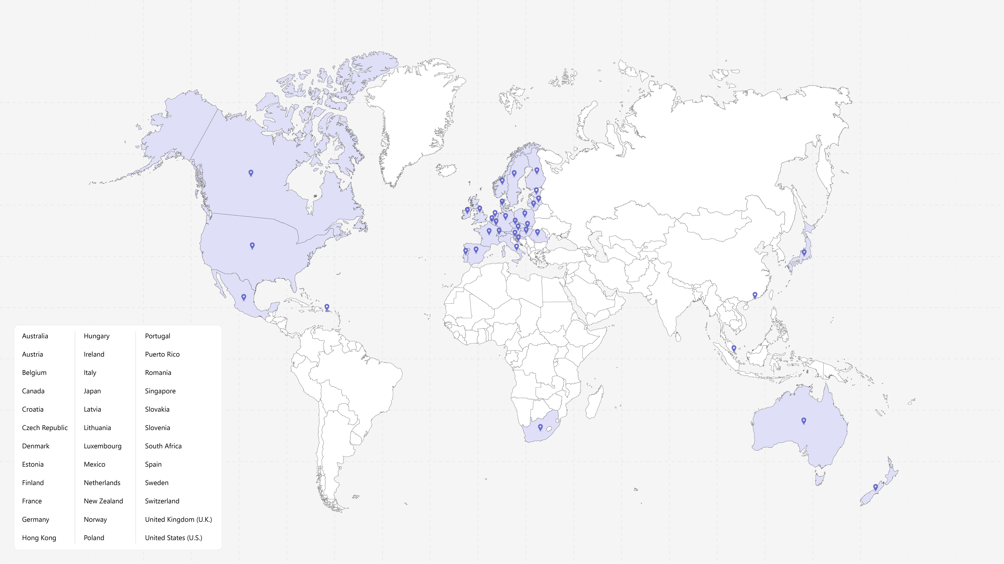
Teams Calling Plans
When combining Teams Phone and Teams Calling Plans, it can become your complete phone system. Teams Calling Plans provide employees with a primary phone number (either new or existing) and lets them make and receive phone calls outside of the organization.
Rapid provisioning
Procure and assign phone numbers to users in minutes, with no on-premises equipment
Local, long distance, and international calling
Reach the people important to your business, with a choice of calling plans. Available in 36 markets.
Number porting and dynamic emergency calling
Use your existing phone numbers with Microsoft Calling Plans, and meet E911 and other legal obligations
Ensure you always have enough minutes
Use Communication Credits to add minutes & international capabilities to Teams Calling Plan and Audio Conferencing
Learn more https://aka.ms/TeamsCallingPlans
Notes:
[PRESENTER TALK TRACK]
This is Microsoft’s 1st party solution. It is a fast and simple way to set up calling. This cloud-based solution does not require a session border controller or ’voice trunk’.
Teams Calling Plan provides users a primary phone number and calling minutes to make and receive phone calls via Microsoft Teams.
While easy to set up and manage, Teams Calling Plans do not offer the customization and flexibility of Operator Connect or Direct Routing.
Teams Calling Plans are currently available in 35 markets and continue to expand into new markets.

Slide 13
PSTN Architecture: Teams Calling Plans
Teams Calling Plans: An all-in-the-cloud solution with Microsoft as your PSTN carrier.
Microsoft-managed
Teams Users
Voice Trunk
Teams Phone
PSTN Network
Tip: Teams Calling Plans do not require any customer provided telephony infrastructure and can be set up in minutes.
Notes:
[PRESENTER GUIDANCE]
This slide requires a more detailed technical awareness of Teams Phone architecture.
Teams Calling Plans offer all-in-the-cloud solution with Microsoft as your PSTN carrier, users are enabled with Teams Phone Standard and have a Calling Plan assigned which can offer Local, long distance, and international calling
With Teams Calling Plans Microsoft provides your Cloud-based phone system, connectivity to the PSTN network and telephone numbers. Telephone numbers can be acquired new from Microsoft or ported from other PSTN carriers if you want to retain your existing phone numbers.
With Teams Calling Plans, users get a phone number and a certain amount of minutes per month, depending on the plan they choose. Microsoft acts as the PSTN carrier, so there is no need for a separate contract with another provider.

Slide 14
Teams Calling Plans options
Pay-As-You-Go¹
120-Minute Plan
Domestic Plan
International Plan
Domestic outbound calling
Pay-As-You-Go
Domestic outbound calling
120 min/u/m
Domestic outbound calling
3,000 min/u/m – US/PR/CA/UK
1,200 min/u/m – All other sell-to markets
Domestic outbound calling
3,000 min/u/m – US/PR/CA/UK
1,200 min/u/m – All other sell-to markets
International outbound calling
600 min/u/m
$2/Zone 1 (UK/CAN)² user/month
$3/Zone 1 (US)² user/month
$3/Zone 2² user/month
$6/user/month
$8/user/month (US/PR/UK/CA)
$12/user/month
(all other markets)
$24/user/month
¹ SKU availability is based on end user location.
² Zone 1 – US, Zone 1 – UK & Canada. Zone 2 = All other Microsoft Teams Calling Plan markets.
Minute limits are applied toward outbound minutes per-user per-month and pooled at the tenant level by Calling Plan and geography type.
Only assigned licenses count towards total pooled minute limit, not the total number of purchased licenses.
For more information, refer to Which Calling Plan is right for you?

Slide 15
Set up Teams Calling Plans for individual users or devices
Teams Calling Plans enable you to quickly deploy PSTN calling in as few as six easy steps
1
Find out if Teams Calling Plans are available in your country/region
2
Buy and assign licenses
3
Get phone numbers
4
Add emergency addresses and locations for your organization
5
Assign an emergency address and a phone number to a user
6
Tell your users about their new phone numbers

Slide 16
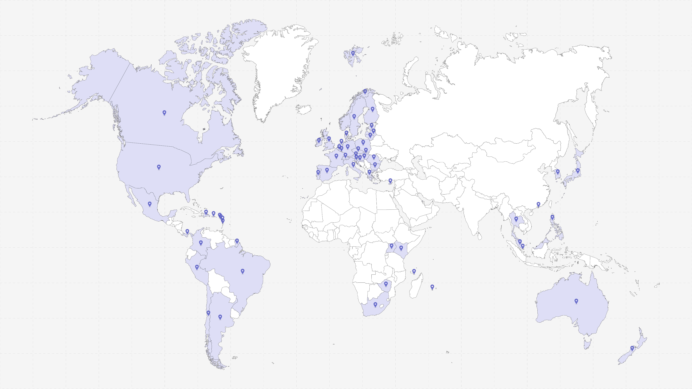
Operator Connect
Simply and seamlessly enable calling in Teams using your existing telephone operator
Bring your own operator
Maintain your operator contracts and relationships, while providing users a modern calling experience in Teams
Setup in minutes; simplify provisioning and management
Establish the connection to your operator, provision users, and assign phone numbers from the Teams Admin Center
Save on infrastructure purchase and management
Manage call control in the cloud with Teams Phone, eliminating need to purchase and maintain equipment
Feel confident with a reliable service
Operators provide technical support and service level agreements, and direct peering powered by Azure to enhance resilience
Learn more https://aka.ms/OperatorConnect
Notes:
[PRESENTER TALK TRACK]
Operator Connect gives you the ability to choose from participating operators to host and manage your PSTN connectivity.
Operator Connect enables you to speed your time of deployment, while saving on infrastructure and management costs by reducing the need to purchase, maintain, and manage equipment.
Select from 70+ participating operators.

Slide 17
PSTN Architecture: Operator Connect
Operator Connect: An all-in-the-cloud solution directly integrated with Teams with an Operator of your choice (based on availability) as your PSTN carrier.
Microsoft-managed
Operator-managed
Teams Users
Voice Trunk
Teams Phone
SBCaaS
PSTN Network
Tip: Operator Connect integrates the telephony infrastructure of your choice Operator directly into Teams and does not require any customer provided infrastructure.
Notes:
[PRESENTER GUIDANCE]
This slide requires a more detailed technical awareness of Teams Phone architecture.
Operator Connect is an all-in-the-cloud solution directly integrating Microsoft Teams Phone with a qualified Operator, Microsoft provides Microsoft Teams and Phone System and qualified operators in the Operator Connect program manage the service for bringing PSTN calling to Teams. The qualified operator manages the PSTN calling services and Session Border Controllers as a service (SBCaas), allowing you to save on hardware purchase and management.
Operator Connect allows you to quickly connect to your operator and assign phone numbers, directly from Teams Admin Center with enhanced support and reliability, operators provide technical support and shared service level agreements.

Slide 18
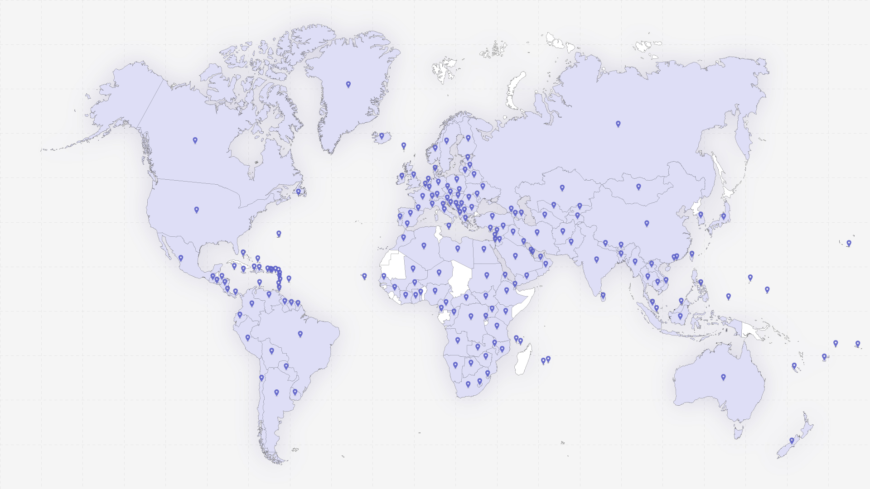
Direct Routing
Use your existing infrastructure.
A Highly customizable approach that allows you to maintain existing service provider agreements and use on premises/hybrid hardware. Available globally through partners.
Available in 180+ markets
Available for every market where Teams Phone is available
Manage voice quality with media optimization
Use Media Optimization to control media traffic flows to accommodate a multitude of network topologies and local telephony setups for various enterprises all over the world
Leverage existing PSTN service
Direct Routing allows you to connect your certified SBC to almost any telephony trunk or interconnect with third-party PSTN equipment
Pure cloud or managed
Flexible delivery models, from fully hosted on-premises managed by the customer or delivered by a partner as hosted or service billed per user per month (Direct Routing as-a-service)
Notes:
[PRESENTER TALK TRACK]
Direct Routing lets you connect a supported, customer-provided Session Border Controller (SBC) to Microsoft Teams Phone. With this capability, you can configure on-premises Public Switched Telephone Network (PSTN) connectivity with Teams,
You can connect any PSTN trunk with Microsoft Teams Direct Routing to continue leveraging benefits of your existing design and PBX setup. Direct Routing provides the greatest flexibility in PSTN connectivity including:
Interoperability with analogue devices
Seamless migration plan to the cloud
Ability to leverage existing contracts with service providers
Ability to leverage on-prem devices until end of life
Deployment Flexibility

Slide 19
PSTN Architecture: Direct Routing (Simple)
Direct Routing: A flexible deployment model which enables you to use your own PSTN carrier by connecting your Session Border Controller(s) (SBC) to Phone System. Direct Routing can be deployed in a self-hosted or partner-hosted (Direct Routing as a Service [DRaaS] model).
Microsoft-managed
Customer/Partner managed
Teams Users
SBC
Voice Trunk
Teams Phone
PSTN Network
Voice Apps
Legacy PBX
Tip: With Direct Routing, you integrate your existing telephony provider and any on-premises telephony infrastructure with Teams via your own SBC. Many partners and PSTN service providers offer Direct Routing as a Service (DRaaS) [hosted model].
Notes:
[PRESENTER GUIDANCE]
This slide requires a more detailed technical awareness of Teams Phone architecture.
With Direct routing you connect your own supported Session Border Controller (SBC) to Teams Phone to a PSTN telephony carrier.
Microsoft provides Microsoft Teams and Phone System and you configure and manage the SBC and PSTN carrier, or it can be configured and managed by your carrier or partner.
Direct routing offers interoperability between your telephony equipment—such as a third-party PBX, voice apps, contact center and analog devices—and Teams Phone.
This option requires:
Uninterrupted connection to Microsoft 365.
Deploying and maintaining a supported SBC.
A contract with a third-party carrier. (Unless deployed as an option to provide connection to third-party PBX, analog devices, or other telephony equipment for users who are on Teams Phone with Calling Plan.)

Slide 20
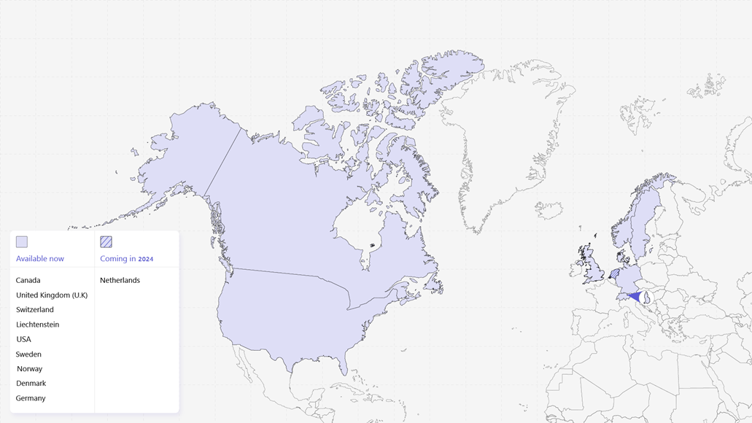
Teams Phone Mobile
Provide a secure and reliable calling solution enabling productive mobility for your mobile and hybrid workers.
Flexible and easy to use
Optimize and simplify your mobile experience with a single business-provided mobile and Teams number for increased flexibility and efficiency.
Intelligent and connected
Create meaningful engagements when you integrate your mobile native calling and the smart capabilities of Teams Phone in one connected solution.
Secure and reliable
Extend your security and compliance policies to all your calls regardless where it starts so you can feel confident your communications are protected.
Simple to manage
Consolidate redundant fixed-line and mobile service for streamlined management and support.
Learn more https://aka.ms/TeamsPhoneMobile
Notes:
[PRESENTER TALK TRACK]
Microsoft Teams Phone Mobile is an intuitive, mobile-first Teams experience that allows business users to access Teams capabilities through their mobile identity on both their native dialer and any Teams endpoint.
The solution delivers cellular network quality of service to Teams communications, while allowing customers to enforce business policies, reduce costs, and improve the user experience for the growing mobile workforce.

Slide 21
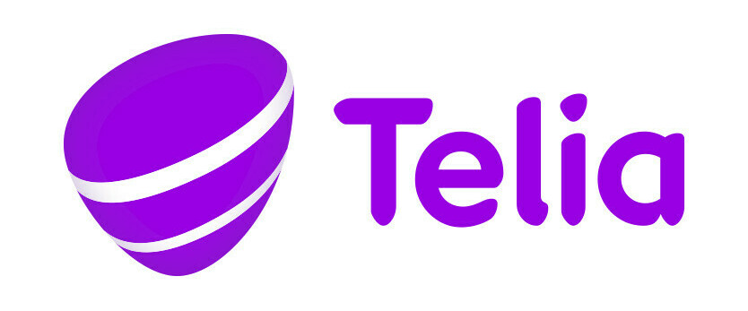
Teams Phone Mobile coverage
Generally available
Liechtenstein and Switzerland
Canada
UK
USA
Denmark, Norway and Sweden
Germany
Notes:
[Presenter Track]
Teams Phone Mobile participating operators and market coverage continues to grow. Let me know if there are any markets not listed here you would like us to add, and I’ll share with my team.

Slide 22
What is the right path for my organization?
Select one or more of these connectivity options to suit your users’ calling needs
Teams Calling Plans
Operator Connect
Teams Phone Mobile
Direct Routing
Customer value
A fast and Simple way to setup calling without additional technical configurations. It does not require a session border controller (SBC) or ‘voice trunk’.
A quick and easy way to integrate with calling while maintaining existing service provider agreements and leveraging the customization and flexibility of direct routing.
All the benefits of Operator Connect but assign a single business-provided mobile phone number as your Teams Phone number.
Highly customizable approach that allows customers to maintain existing service provider agreements and use on premises/hybrid hardware. Available globally through partners.
Why choose this option
Getting started quickly is a priority
Simplicity that comes with all-in-one solution is important
Easy to set up a rapid proof of concept
Available in 36 markets.
Needs a pure cloud (no hardware footprint), fully managed solution
Existing PSTN infrastructure (voice trunks) will continue to be used
Existing service provider agreements are in place
Integrated end-to-end number management experience in Teams admin center
Multi-national company with locations outside Microsoft Calling Plan markets
Can support third party Interop with PBXs for migration using downstream SBC’s
Available markets can be found here
Convenience of a single, business-provided number for Teams and mobile phone
Eliminate costs associated with fixed lines devices and hardware
Easy to deploy, configure, and manage
Apply security, compliance, and policy settings across mobile devices
Currently available in Canada through Rogers Business, Sweden through Telia, US through Verizon, Switzerland through Swisscom & Germany through Deutsche Telekom
Latest list of available markets can be found here
Existing PSTN infrastructure (SBC or voice trunks) will continue to be used
Required for PBX co-existence
Migration from legacy telephony Systems
Integration for analog devices (elevator phones overhead paging etc.)
Multi-national company with locations outside Microsoft Calling Plan countries
Existing service provider agreements are in place
Regulatory requirements around telephony in their region (examples include India, China, Australia)
Local PSTN survivability needs
Minimal configuration
As a service
Highly customizable
1st Party
3rd party
Notes:
[PRESENTER TALK TRACK]
As promised, this is the second (and last) time you’ll see this slide today. I want to be a good teacher and remind you of all the good things we just discussed.
This side-by-side view of the connectivity options for Teams Phone provides a high-level comparison and reason to choose, ordered from minimal configuration to highly customizable.
You are able to select one or more of these connectivity options for your organization.

Slide 23
Shared Calling for Teams Phone
Notes:
Daryl pass to Brooks

Slide 24
Shared calling for Teams Phone
This feature enables faster PSTN deployment to users who do not need a dedicated phone number.
One phone number for multiple users
Group users and provide the ability to receive incoming calls and make outgoing calls via a single company phone number.
Simplify deployment and reduce administrative overhead
Simple policy definition allows groups of users to be quickly enabled reducing time to value.
Multiple PSTN enablement options
Supports Pay-As-You-Go Calling Plan, Operator Connect, and Direct Routing.
Full functionality including Emergency Calling support
Teams Phone features including dynamic locations and callback are fully supported.
Notes:
[PRESENTER TALK TRACK]
We're here to talk about the shared calling capability in Teams Phone.
Shared calling allows you to enable groups of users to make and receive PSTN calls using a shared phone number and calling plan – enabling you to quickly deploy calling across groups or your entire organization, as well as pooling calling plan minutes across users.
With shared calling, a single phone number and calling plan can be shared across a users licensed for Teams Phone, either through E5 or Teams Phone Standard.
Whether supporting 10 people in a small office or 10,000 users in an enterprise, you can easily enable shared calling in the Teams admin center by creating a custom shared calling policy, assigning a resource and phone number to the custom policy, and then assigning users to this policy.
How it works
Inbound calling
External caller places a call to a shared number
Call is routed through name to desired call recipient
Call recipient answers call in the Teams app
Outbound calling
User dials a phone number from the Teams app
Call is routed through the resource account to the call recipient
Call is billed against calling plan associated with the resource account used for shared calling (can be Microsoft or 3rd party)

Slide 25
Why are organizations adopting shared calling?
Modern Calling behaviors for many users have changed.
Teams to Teams Calling
Users demonstrate a preference for utilizing Teams to Teams Calling for both internal and external communications.
Scheduled Calls
Users favor Teams Meetings over traditional phone-based interactions. Meetings are interactive and inclusive.
PSTN Usage
Light PSTN usage is needed, but tight budgets mean making decisions that could impact users.
Direct Inward Dial
The need for and associated costs with a dedicated number are not always necessary.

Slide 26
How shared calling works
Inbound calls
Outbound calls
PSTN connectivity
PSTN connectivity
1x Resource account
1x Resource account
(425) 882-8080
Shared phone number # i.e. (425) 882-8080
1xTeams Phone Standard
1xTeams Phone Standard
(425) 882-8080
Shared phone number # i.e. (425) 882-8080
1 x Teams Calling Plan or 3rd-party calling plan
1xTeams Phone Standard
1xTeams Phone Standard
1xTeams Phone Standard
1xTeams Phone Standard
1
External caller places a call to a shared number.
1
User dials a phone number from the Teams app.
2
Call is routed through name to desired call recipient.
2
Call is routed through the resource account to the call recipient.
3
Call recipient answers call in the Teams app.
3
Call is billed against calling plan associated with the resource account used for shared calling (can be Microsoft or 3rd party).
Notes:
[PRESENTER GUIDANCE]
This slide requires a more detailed technical awareness of shared calling for Teams Phone.
Here’s how it works:
Inbound calling
External caller places a call to a shared number
Call is routed through name to desired call recipient
Call recipient answers call in the Teams app
Outbound calling
User dials a phone number from the Teams app
Call is routed through the resource account to the call recipient
Call is billed against calling plan associated with the resource account used for shared calling (can be Microsoft or 3rd party)

Slide 27
How emergency calling works with shared calling
Emergency Call
Emergency Call Back
Emergency callback number
Caller ID Mask:
(425) 882-0911
PSTN connectivity
PSTN connectivity
Emergency callback number
Caller ID Mask:
(425) 882-0911
Shared calling User1
Shared Calling Policy Resource Account Number (425) 882-08080
Emergency Callback Numbers (425) 882-0911 (425) 882-0933
Public Safety
Answering Point
Public Safety
Answering Point
Shared Calling Policy Resource Account Number (425) 882-08080
Emergency Callback Numbers (425) 882-0911 (425) 882-0933
Shared calling User1
Shared calling User2
Shared calling User2
Shared calling User3
Shared calling User3
1
User 2 signs into Teams. Location Services initiates.
1
If the emergency call is disconnected, the emergency callback number is reserved for 60 minutes.
2
User 2 dials Emergency Number (911).
2
PSAP calls the allocated emergency callback number (presented as Caller ID Mask).
3
Security desk notification is sent.
4
Emergency Callback Number is allocated from shared calling policy. This number is used as Caller ID Mask.
3
Teams connects the inbound call from PSAP to User 2.
5
Location information (PIDF-LO) information is sent to PSAP.
Notes:
Emergency services must be able to call back the originator of an emergency call through the emergency callback number. The callback number serves as the caller ID or calling number used when an emergency call is made.
You define a list of emergency callback numbers in the Shared Calling policy by using the -EmergencyNumbers parameter. Each Shared Calling policy must have a unique emergency calling number. That is, you can't use the same emergency number in more than one Shared Calling policy.
When an emergency call is made, the next free number in the emergency number list will be used as the caller ID. This number will be reserved for the next 60 minutes.
If there are no free numbers available in the list, we'll reuse a phone number from the list.
If this list is empty, the phone number of the resource account is used as the emergency callback number--however, this process isn't supported if your resource account is assigned a Calling Plan toll free service number.
When emergency numbers are added to a policy:
The emergency numbers must be routable for inbound PSTN calls. For Calling Plan & Operator Connect, the emergency numbers must be available within the tenant.
The emergency numbers specified must all be of the same phone number type as the phone number assigned to the specified resource account--that's Calling Plan, Operator Connect, or Direct Routing.
The emergency numbers can’t be assigned to any user or resource account.
You can't delete or reassign an emergency number used in any Shared Calling policy. You must first remove the number from the Shared Calling policy before you delete or reassign the number.
You can view all Calling Plan and Operator Connect numbers by country, number sequence, or policy group by using the Teams admin center. For assigned Direct Routing numbers, you can use Get-CsPhoneNumberAssignment -NumberType DirectRouting.
Calling Plan service numbers
If the resource account has assigned a Calling Plan service number, then the emergency callback number must be a Calling Plan subscriber number--not a Calling Plan service number.
If your resource account is assigned a Calling Plan toll-free service number, you need to add Calling Plan subscriber numbers to emergency numbers in the Shared Calling policy.

Slide 28
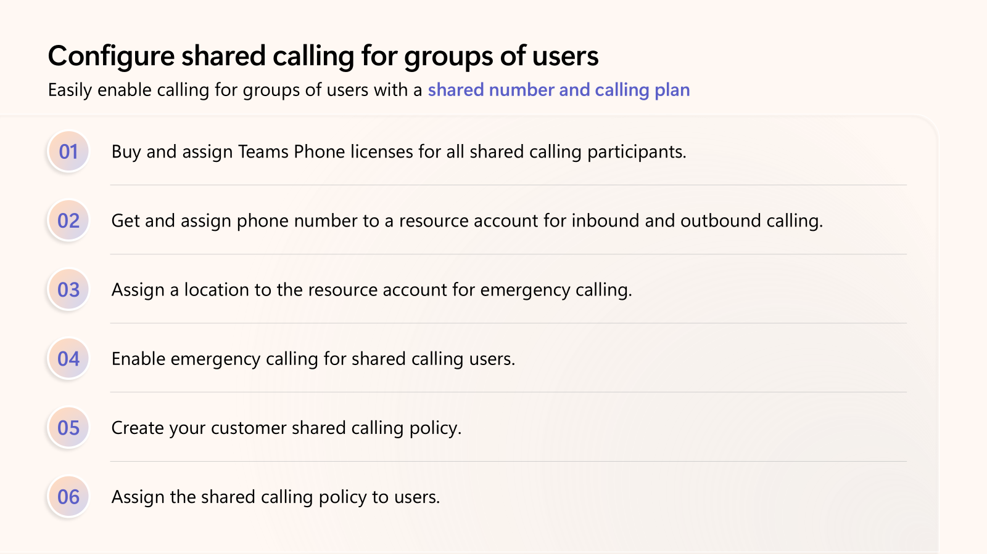
Configure shared calling for groups of users

Slide 29
Demo

Slide 30
Resources
Teams Academy – IT Pro Readiness | Documents, Videos and Playbooks
Teams Phone
Shared Calling
Teams Devices
Phone System documentation for Shared Calling
Plan for Shared Calling
Configure Shared Calling
Shared Calling Scenario

Slide 31
Resources
Resources
Teams Academy – IT Pro Readiness – Docs + Videos + Playbooks https://aka.ms/teamsacademy
Teams Phone - https://aka.ms/teams-phone-deployment-playbook
Shared Calling - https://aka.ms/teams-phone-shared-calling-playbook
Teams Devices - https://aka.ms/teams-devices-deployment-playbook
Phone System documentation for Shared Calling
Plan for Shared Calling - Microsoft Teams | Microsoft Learn
Configure Shared Calling - Microsoft Teams | Microsoft Learn
Shared Calling scenario - Microsoft Teams | Microsoft Lear

Slide 32
Thank you
Copyright© 2024 Microsoft Corporation. All rights reserved.

Slide 33
Calls to Action
Modern Work Customer Hub
Notes:
Now we have a few Call to Actions/Resources we would love to share with you as you think about your AI journey

Slide 34
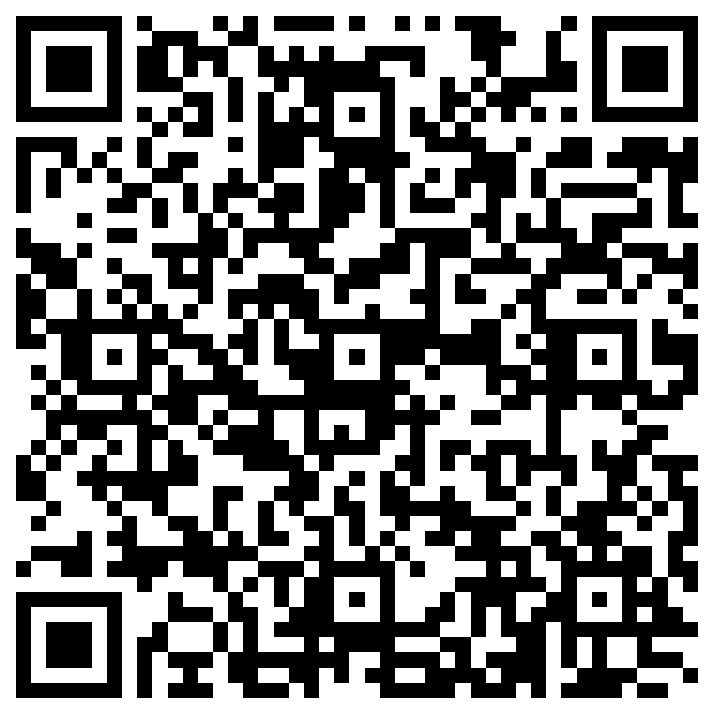
Your feedback is critical
Scan with your mobile device camera
We’re committed to making your Modern Work Customer Hub experience the best it can be – and your feedback is a critical component to that.
Before you scoot, please take a moment to reply to provide some feedback.
-OR-
Visit
Customer Hub Survey
aka.ms/CustomerHubSurvey
Notes:
I would also like to ask a bit of feedback on today’s session to make sure the content we’re sharing is hitting the mark. Please take a few moments before you disconnect today to let us know your thoughts.

Slide 35
Next Steps
Connect with your Microsoft Representative
Communicate with your Microsoft team about how you can utilize Unified Support or expectations and support you need for your Copilot journey.
Get help from
FastTrack Experts
If you are not a Unified Support customer but want Microsoft support, or need immediate engagement and result, get connected with FastTrack experts.
Fill out the Form and we will reach out!
Let us know what you need and how we can help by filling out the Form, and someone will reach out to you shortly.

Slide 36
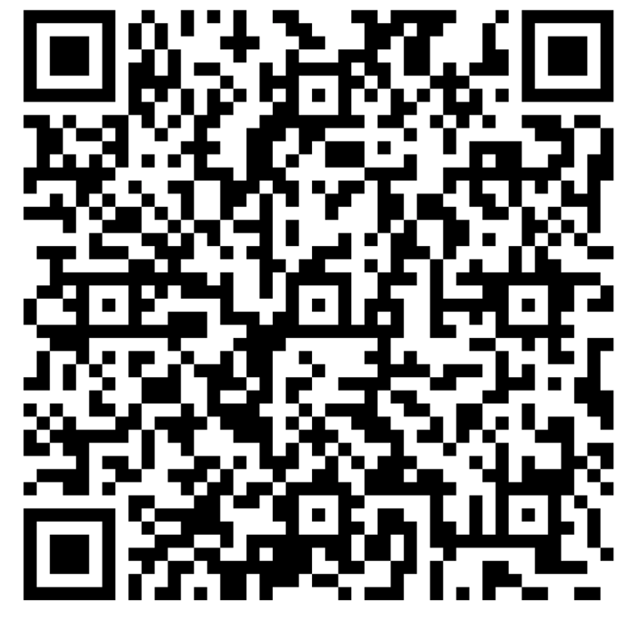
How can we help you?
aka.ms/MSCopilotHelp

Slide 37
Make a difference Become a Champion
Get more from Copilot and Microsoft 365
Help others do the same
Expand your knowledge and enhance your career
Join the free program at aka.ms/M365Champions
Notes:
If you would like to continue the conversation after the session, and you are not already a member of the M365 Champions community, please consider joining. This community brings customers and Microsoft together to answer questions, provide resources, and many more.

Slide 38
Q&A
1
Please raise your hand and unmute when called on
2
Notes:
Stop Recording
OK - Let’s move into some Q&A. I am going to unmute the line so you can unmute your mic and ask verbal questions!
If you’d like to ask a question, please go ahead and raise your virtual hand and I’ll call on you in the order in which you raised your hand at which time you can unmute your line and ask your question.

