Slide 1
Talent Transformed: AI-Powered Hiring & Performance with Microsoft Copilot
Andrea Fogel – Senior Global Solution Architect AI Business Solutions – AI Workforce
Microsoft confidential

Slide 2


Hello and welcome to Customer Hub
We’ll get started at 2 minutes past the hour

Slide 3
Objectives & Agenda

Slide 4
Agenda
HR Trends Driving AI
Microsoft's Own Journey – Customer Zero
Demo
Recruitment
Workforce Planning
Performance Management
Key Takeaways & Next Steps
Q&A & Resources

Slide 5
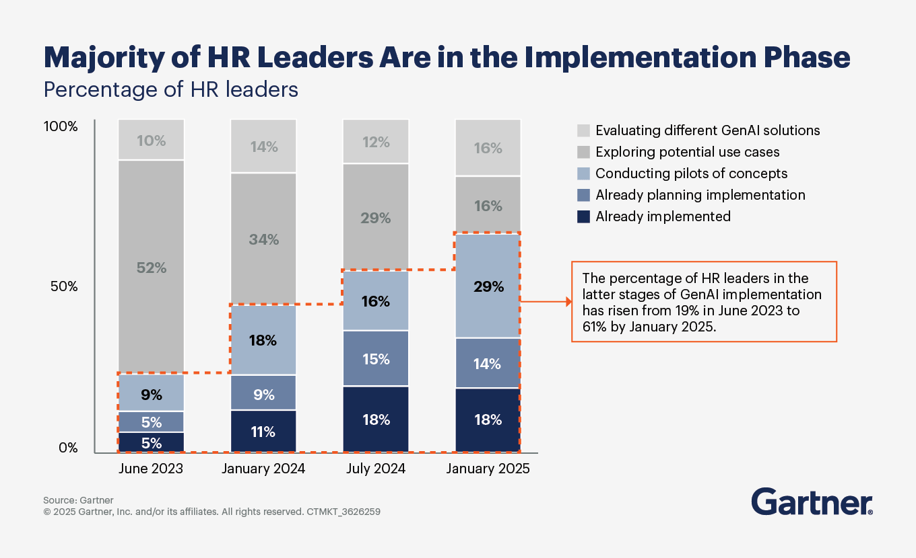
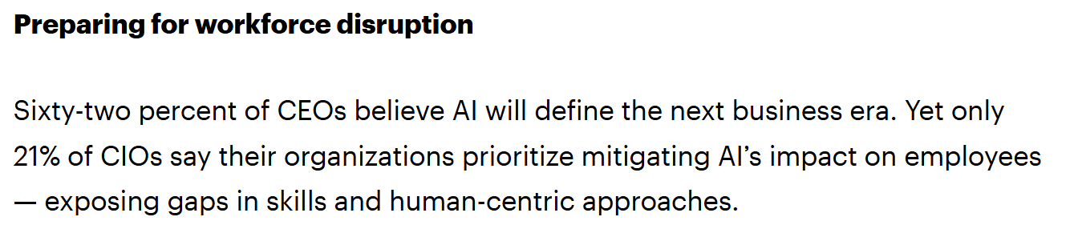
Source: Gartner

Slide 6
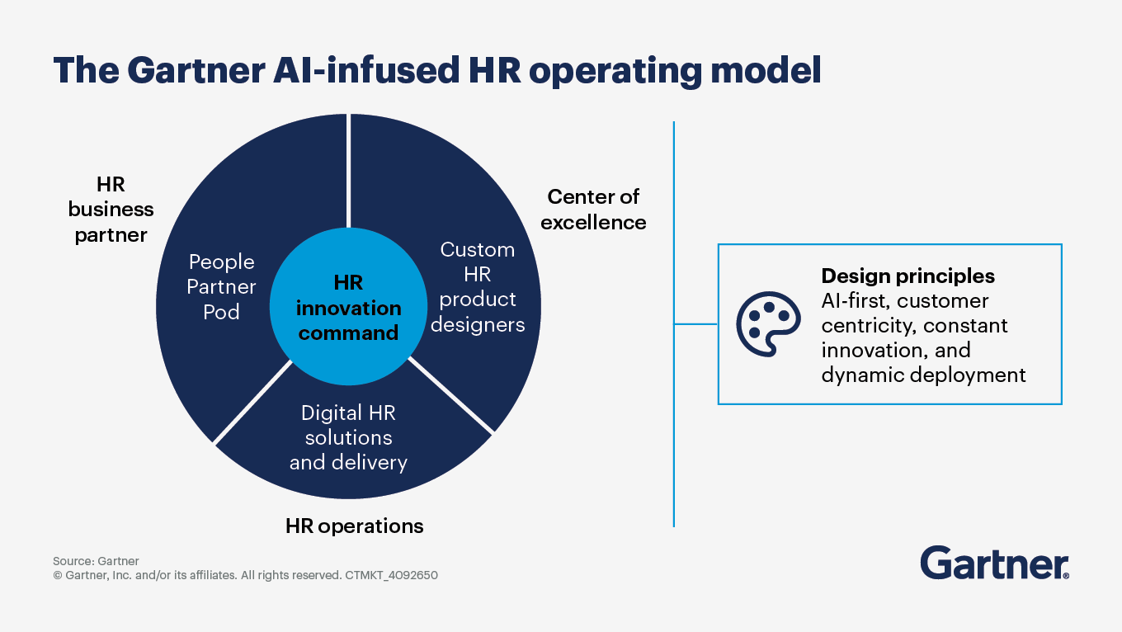
Future of Work – HR‘s Strategic Role in the AI Era
GenAI will reshape 37% of roles within five years, driving job redesign and new skills needs
HR leads ethical AI deployment, partnering with legal and data teams to build trust, transparency, and responsible governance
AI-infused HR models elevate core functions—HR Business Partners, Centers of Excellence, and HR Operations—into more strategic, data-driven roles
Sources: Gartner

Slide 7

Talent & Skills Transformation – From Roles to Skills
AI is powering dynamic skills management, enabling internal talent marketplaces and real-time capability mapping
Upskilling is now strategic—roles like HR technologist and AI ethicist are emerging to bridge tech and talent
Millennial managers are leading adoption, driving experimentation and embedding AI into daily workflows
Sources: Gartner, McKinsey, KPMG

Slide 8
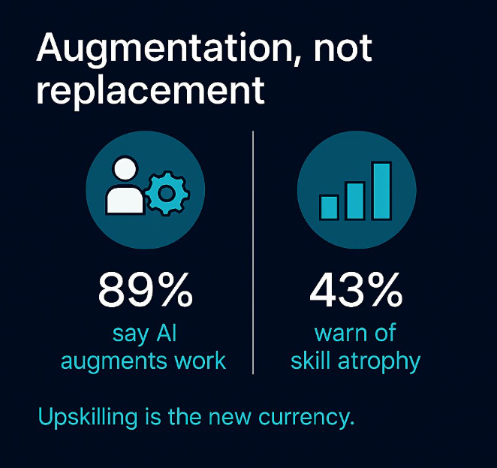
Productivity & Outlook
AI is streamlining core HR tasks like recruiting, onboarding, and performance management—unlocking time for strategic work
Only 1% of organizations have scaled AI in HR—most are held back by leadership gaps, unclear ownership, and lack of strategic commitment.
Responsible AI frameworks are emerging as a differentiator—boosting employee experience, trust, and adoption
Sources: Josh Bersin, Gartner, McKinsey, Wharton

Slide 9

The Evolution of HR – From Admin to Strategic Partner
HR drives business outcomes by aligning people strategy with company goals
Data-Driven HR predicts attrition, optimizes hiring and tracks key metrics.
HR leads digital tansformation through upskilling and future workforce planning

Slide 10

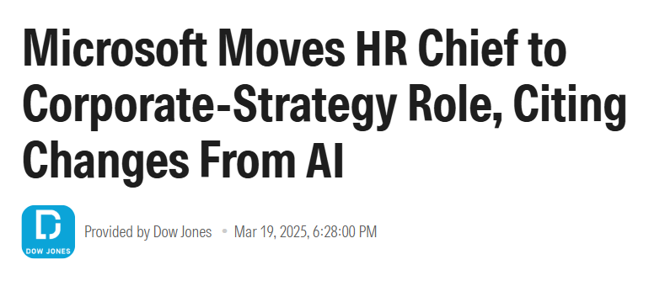
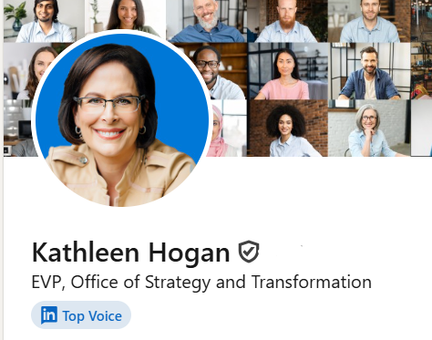
HR shifts from operations to driving strategy & growth.

Slide 11
Microsoft Case Study – ‘Customer Zero’

Slide 12

Three-tier adoption model:
Empower individuals - everyday productivity in the flow of work
Embed in departmental workflows - function‑specific Copilots
Integrate organization-wide - onboarding & enablement
Deployed to 300.000+ people internally

Slide 13


Evolution of our HR support model
Our history
Our vision
2010
2014
2016
2020
2023
2025+
Global HR
Shared Services
HR Self-Service (SharePoint Portal)
Chatbot (Q&A maker)
+Agents
Traditional Transformation
Acceleration with AI

Slide 14
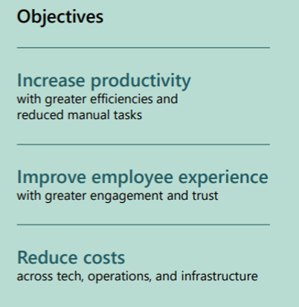
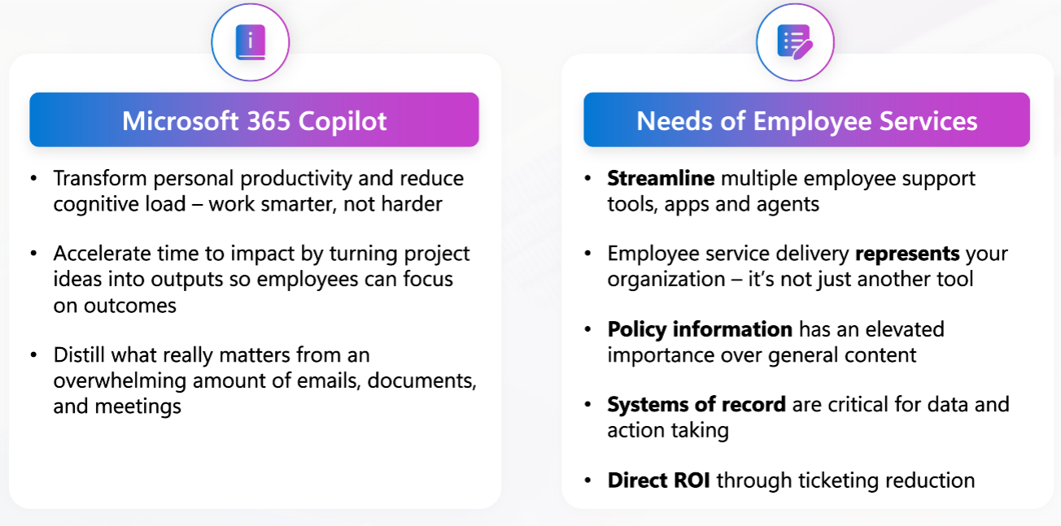
Microsoft HR Transformation – using Copilot & AI
Pilot Program
Initial rollout to HR Shared Services, Learning & Recruiting
Focus on automation & data insights
Key Solutions Deployed
AskHR Virtual Agent: Self-service HR inquiries.
HR Operational Efficiency: Citizen-developed automation apps
HR Data Analytics Acceleration: AI-driven data synthesis for headcount and recruiting
Enhanced Candidate Engagement: AI-assisted communications and sourcing
Jan
2023
HR Assisted Support: Copilot-generated summaries for faster resolution
Expansion to Strategic Roles
Adoption in Compensation and HR Business Partner functions.

Slide 15
Demo
Recruitment
Workforce Planning
Performance Insights

Slide 16
KPIs Impacted
1) Recruitment
Time-to-Hire (reduced through faster job description creation and candidate ranking)
Quality of Hire (better shortlist based on skills and readiness)
Candidate Experience Score (clear communication and structured interview plans)
2) Workforce Planning
Attrition Rate (proactive hiring reduces understaffing stress)
Headcount Accuracy (forecasting prevents over/under-hiring)
Critical Skill Coverage (closing gaps before they impact service levels)
3) Performance Insights
Employee Engagement Index (personalized growth plans boost morale)
Productivity per FTE (targeted development actions improve output)
Retention of High Potentials (mentoring and stretch assignments reduce churn)

Slide 17
Q&A and Discussion

Slide 18
Key Takeaways & Next Steps

Slide 19
Resources
Inside Microsoft: Being Customer Zero in an AI-powered world Explains how Microsoft acted as Customer Zero for Copilot and shares lessons learned for enterprise adoption. Read the article
Copilot Success Kit Comprehensive adoption framework, readiness guides, and templates for customer enablement. Download the kit
Copilot Scenario Library – Human Resources Downloadable guides for recruiting, onboarding, and employee self-service use cases. Explore HR scenarios

Slide 20
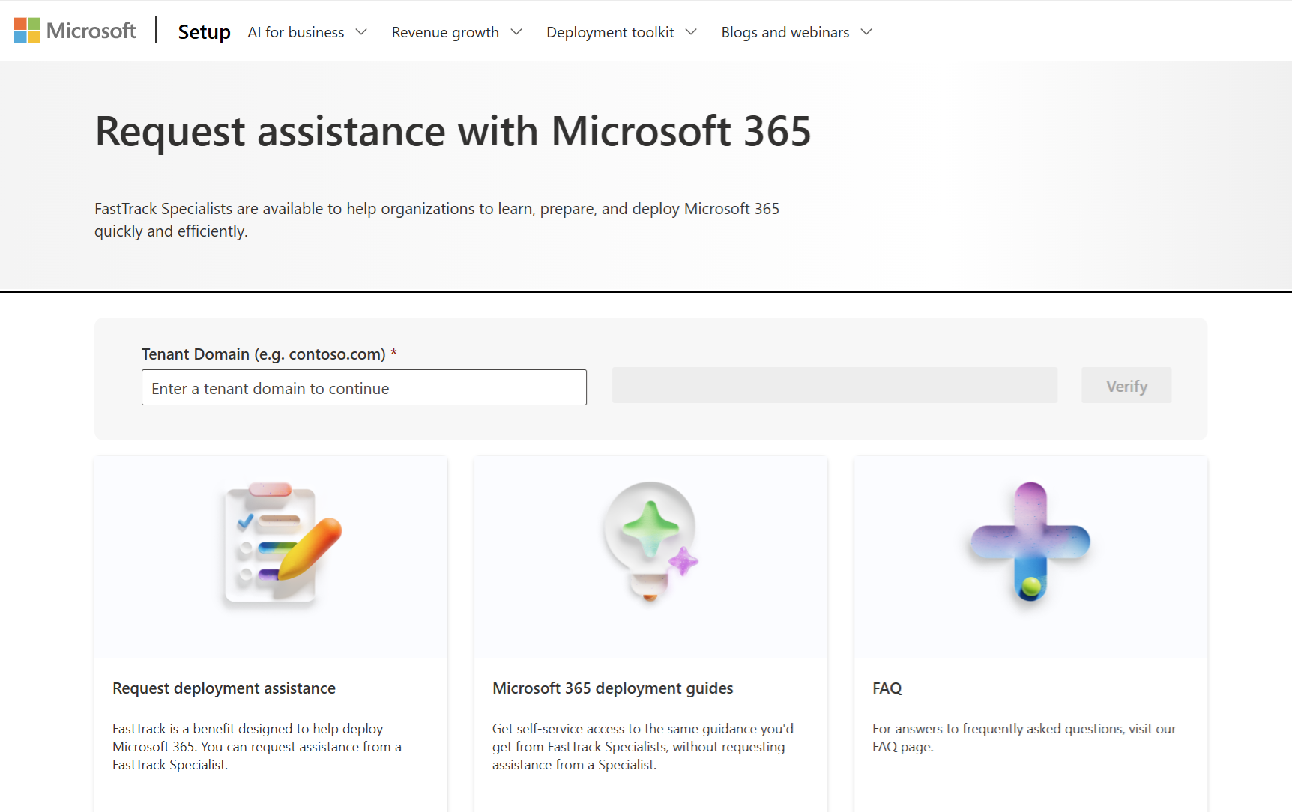
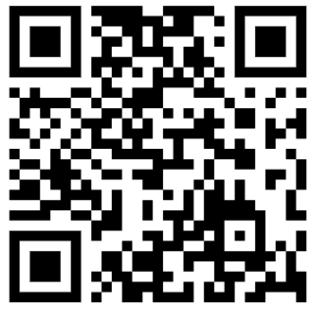
FastTrack Support helps organizations realize their AI transformation with Microsoft 365 Copilot Chat
Submit a Request for Assistance at: https://setup.cloud.microsoft/microsoft-365-fasttrack-assistance
FastTrack provides remote guidance and best practices to maximize deployment, adoption, and optimization.
Readiness & Deployment
Verify prerequisites for Copilot Chat
Manage user access and permissions
Pin Copilot Chat for easy access
Configure web grounding for secure, compliant use
Adoption & Value
Drive adoption with the Success Kit
Skill users with training and resources

Slide 21

The Microsoft 365 Copilot Chat offerings are designed specifically for our customers, providing comprehensive support and guidance to facilitate and accelerate your AI transformation journey.
Unified Support with Value Based Deliveries
Microsoft 365 Copilot Enablement Workshop – Fundamentals
Two new Copilot Chat offerings for IT-Admin and End-User/ BDMs will become available soon
Contact your Customer Success Account Manager (CSAM) or Account Team for more details

Slide 22

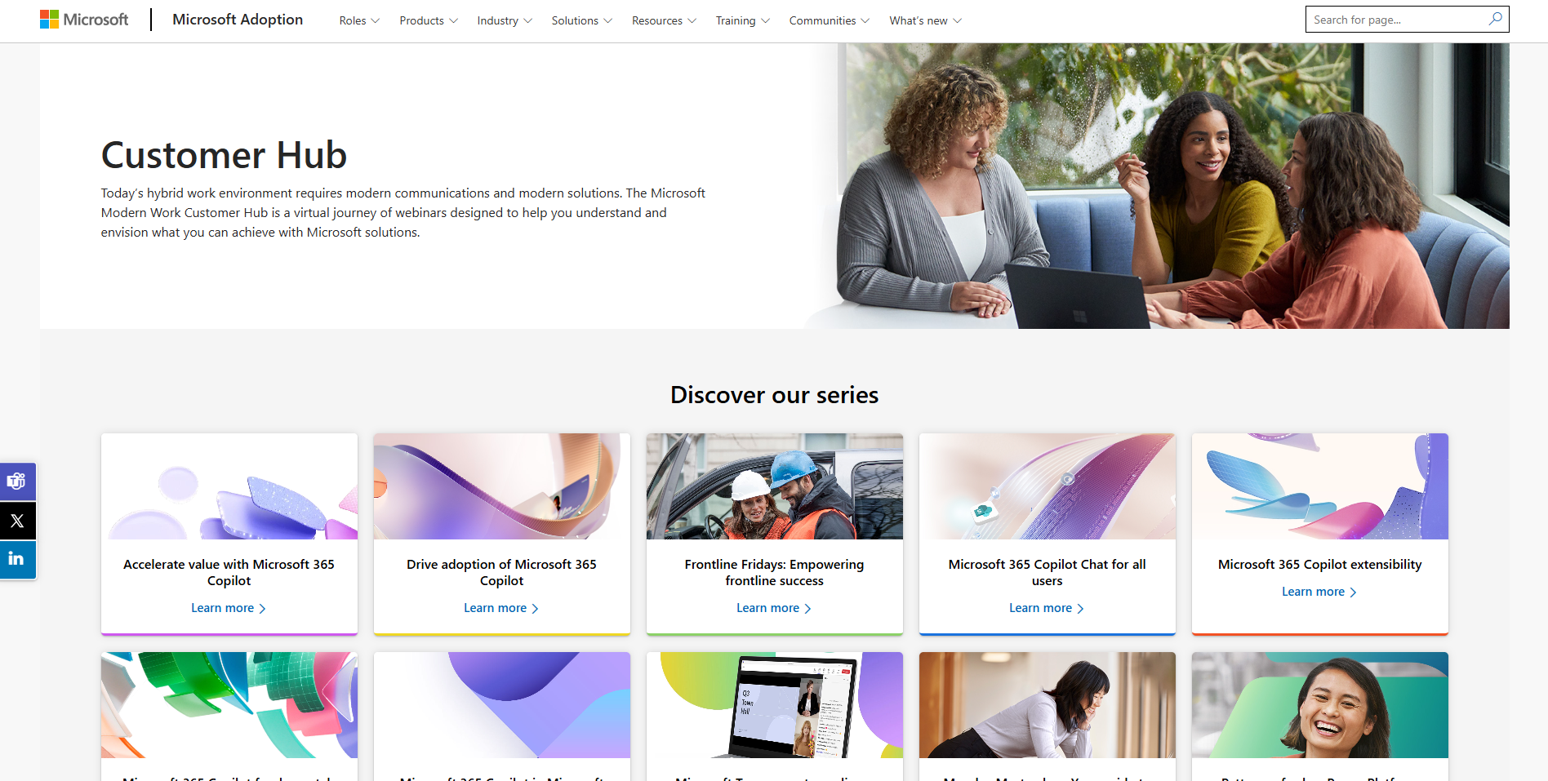
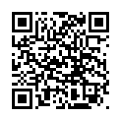
Visit Customer Hub website for upcoming sessions, updates, and on demand contents!
https://aka.ms/CustomerHubSessions​

Slide 23

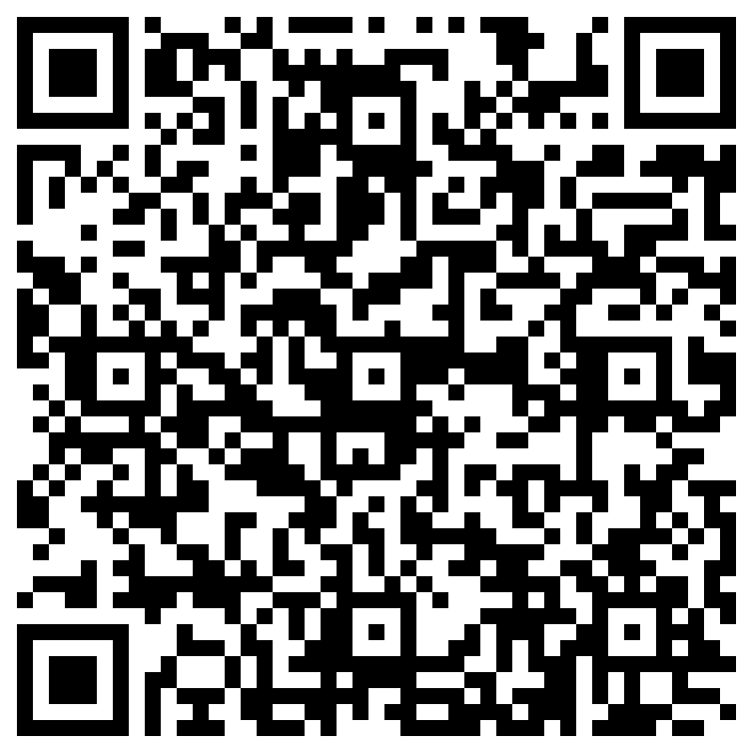
THANK YOU – Your feedback is critical
Scan with your mobile device camera
-OR-
We’re committed to making your Customer Hub experience the best it can be – and your feedback is a critical component to that.
Before you scoot, please take a moment to provide some feedback.
Visit
Customer Hub Survey
aka.ms/CustomerHubSurvey
Select Frontline Friday Series

Slide 24



During the presentation
After the presentation
We will mute your microphone for the first part of today’s call
Raise your hand and we will call on you
Ask your questions via chat, we will get to all of them, live or after. Common questions will get addressed out loud
Open mic – come off mute and ask away!

Slide 25

Q&A
1
Please raise your hand and unmute when called on
2

