Slide 1

Hello and welcome to Customer Hub
We’ll get started at 2 minutes past the hour

Slide 2
Enable Secure AI with Microsoft 365 Copilot Chat

Slide 3

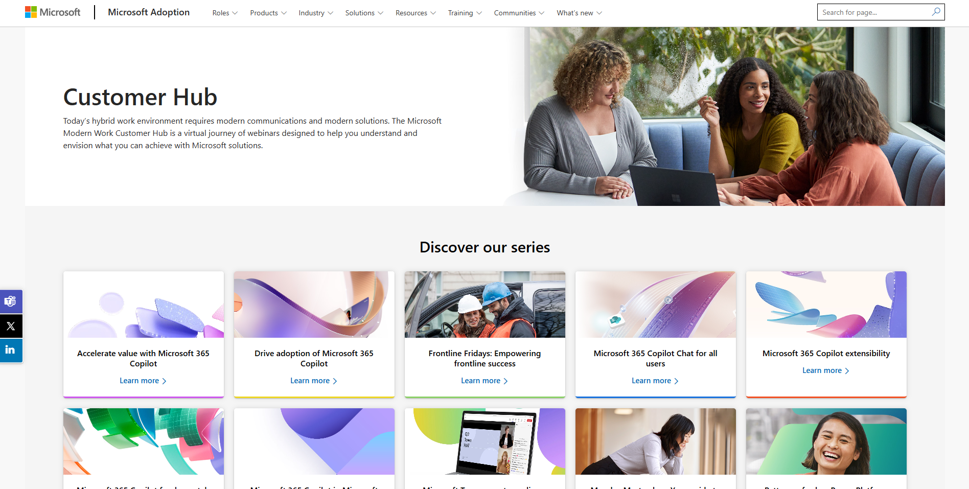
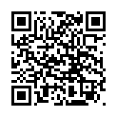
Visit Customer Hub website for upcoming sessions, updates, and on demand contents!
https://aka.ms/CustomerHubSessions​

Slide 4
Join us for all 4 sessions!
September 16th : Realize value with Microsoft 365 Copilot Chat for all
September 18th : Secure AI with Microsoft 365 Copilot Chat
September 23rd : Unlock the power: Navigating Microsoft 365 Copilot Chat
September 25th : Maximize your Microsoft 365 Copilot Chat experience
Click on the session name to register now!

Slide 5

Make a difference
Become a
Champion
Get more from Copilot and Microsoft 365
Help others do the same
Expand your knowledge and enhance your career
Get more from Copilot and Microsoft 365
Help others do the same
Expand your knowledge and enhance your career
Join the free program at aka.ms/M365Champions

Slide 6
During the presentation
After the presentation
We will mute your microphone for the first part of today’s call
Raise your hand and we will
call on you
Ask your questions via Q&A, we will get to all of them, live or after. Common questions will get addressed out loud
Open mic 🙌 Come off mute and
ask away!

Slide 7
Agenda
Introduction to Microsoft 365 Copilot Chat
Enterprise Data Protection & Shadow AI
Enable Microsoft 365 Copilot Chat
Manage and govern Microsoft 365 Copilot Chat
Microsoft 365 Copilot Chat Usage Reporting
Next Steps & Call to Action

Slide 8
Poll #1
Which business unit are you part of?
    Information Technology (IT)
    Finance
    Human Resources (HR)
    Legal
    Marketing
    Sales
    Other

Slide 9
Introduction to Microsoft 365 Copilot Chat

Slide 10

Copilot is the UI for AI
Copilot
Agents

Slide 11
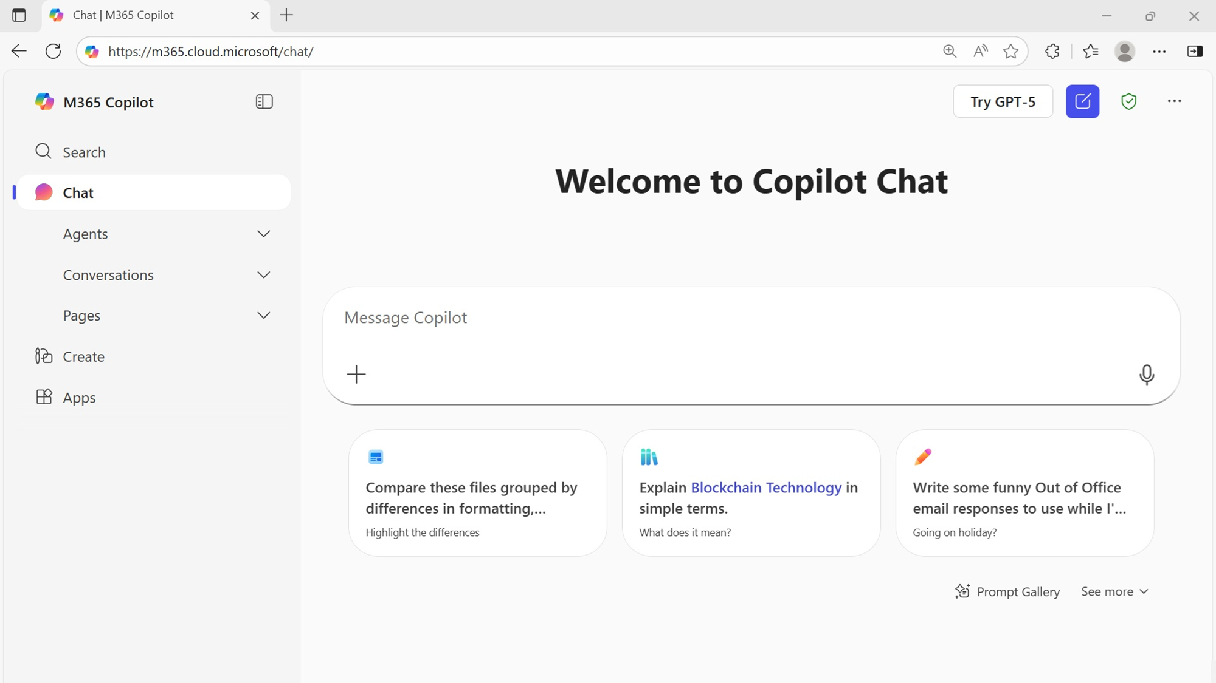
Microsoft 365 Copilot Chat
Powered by the
Latest GPT Model
Secure AI chat powered by the latest models, grounded in web data, and context-aware, understanding the content you’re working on and tailoring responses accordingly.

Slide 12
Commitment to Chat quality
Millions of users responded positively to Chat quality improvements within first week
2x
11%
30
Faster
response time¹
Increase in Chat quality satisfaction²
Day goal to incorporate mainstream features and quality enhancements
1.Test in English only. Data comes from a Microsoft-conducted study in May 2025 comparing Copilot Chat response time and satisfaction with a previous study in September 2024.
2.Data comes from a Microsoft-conducted study in May 1-7, 2025 comparing Microsoft 365 Copilot Chat response time and satisfaction (in-product thumbs up and thumbs down) with the previous version of Microsoft 365 Copilot Chat.

Slide 13

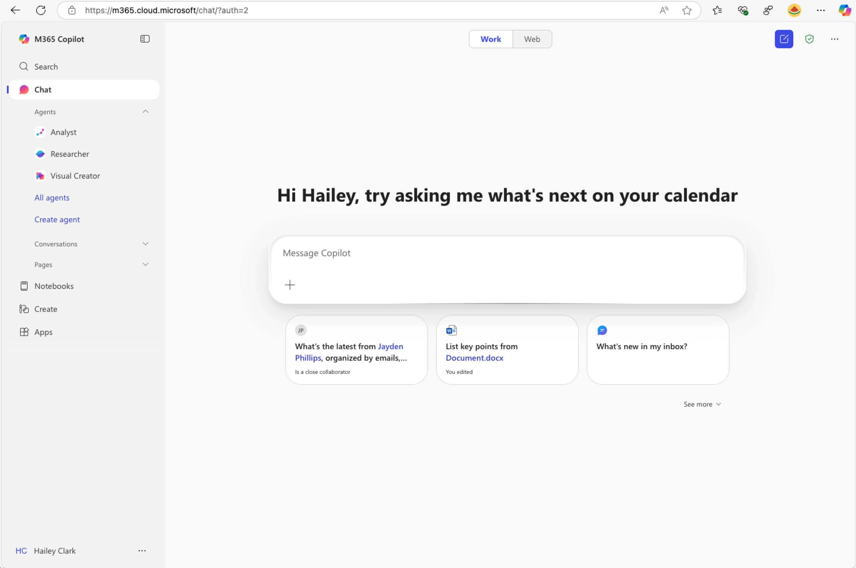
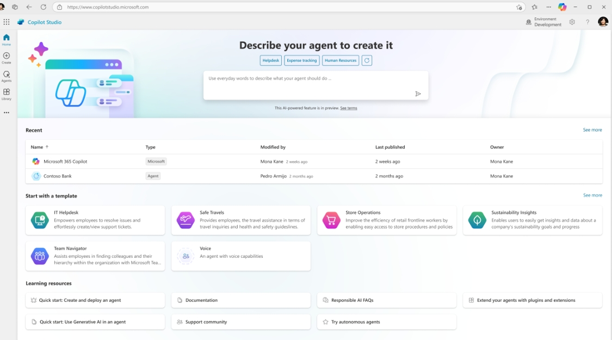
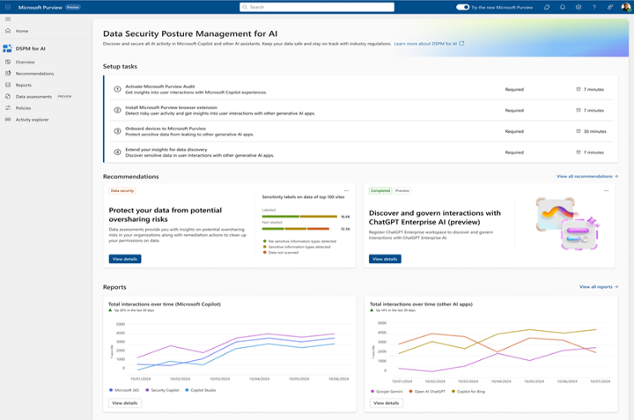
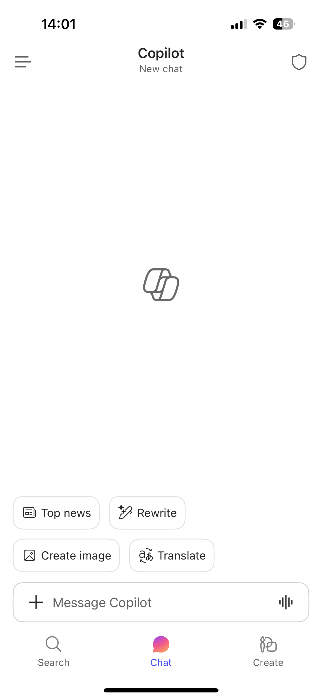
Microsoft 365 Copilot Chat
Components
Chat
Agents
IT Controls
Free, secure AI chat –
powered by the latest GPT models and web grounded
Integrated into the chat experience and paid for on a consumption basis
Enterprise Data Protection
and agent management

Slide 14
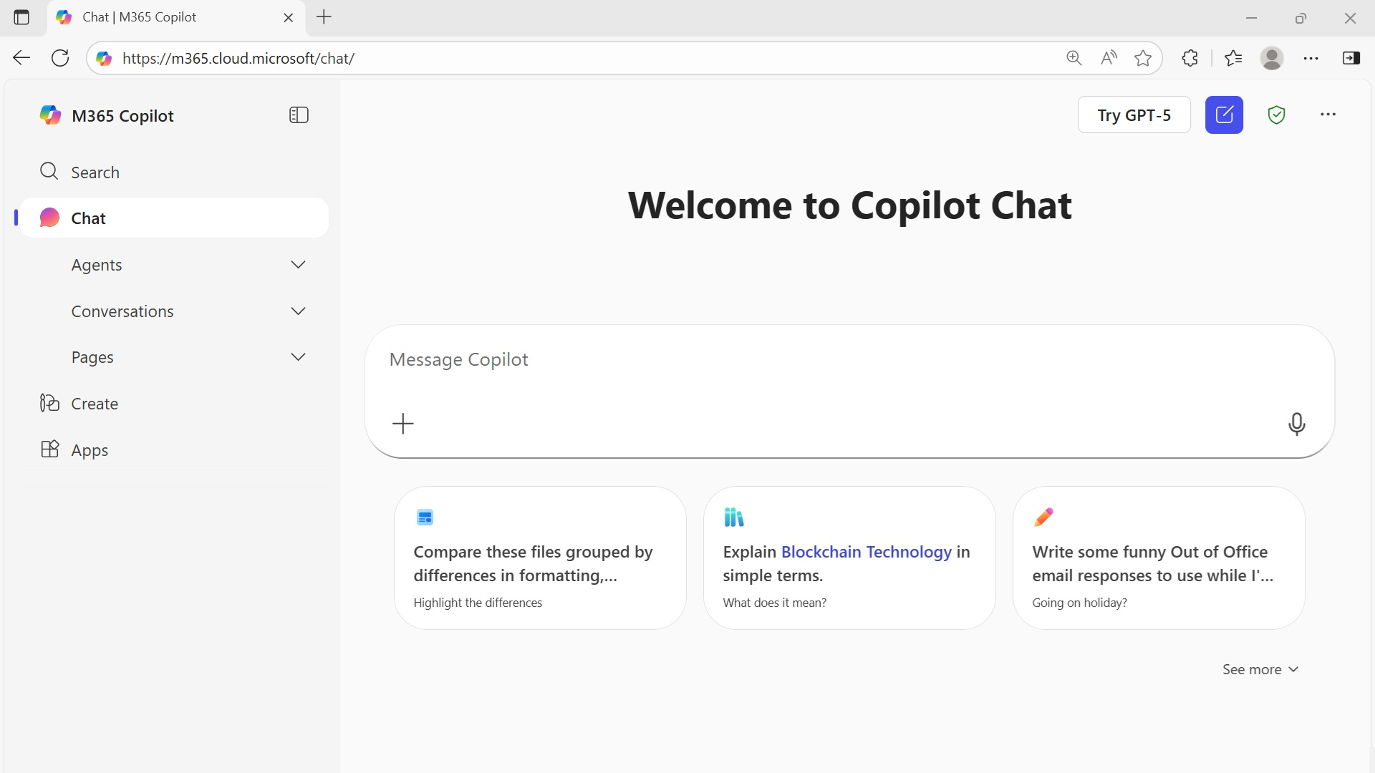


The UI for AI
https://m365.cloud.microsoft/chat
GPT-5 Access
Microsoft 365 Search
Enterprise Data Protection
Secure web-grounded AI chat, included in Microsoft 365
Manually add content
Save and
Collaborate
Chat
History
AI Based Content Creation
AI Agents
(Included and Metered)
Suggested Prompts and
Prompt Gallery

Slide 15




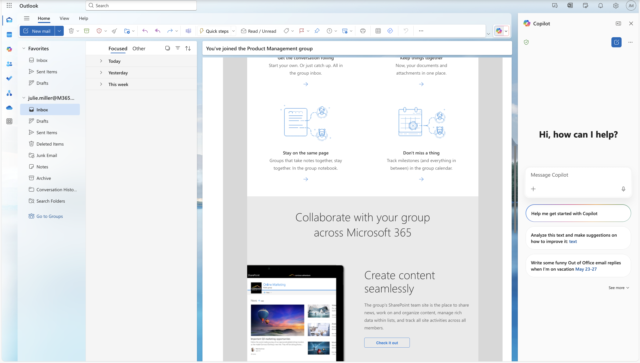



Available across
Microsoft 365 apps
Microsoft 365 Copilot Chat available as a side-by-side experience in Word, Excel, PowerPoint, Outlook, OneNote and available in Teams, Microsoft 365 Copilot app across the web to help users access AI in their flow of work.
Copilot Chat will open in the side pane and users can manage this behavior through their settings in the app.

Slide 16
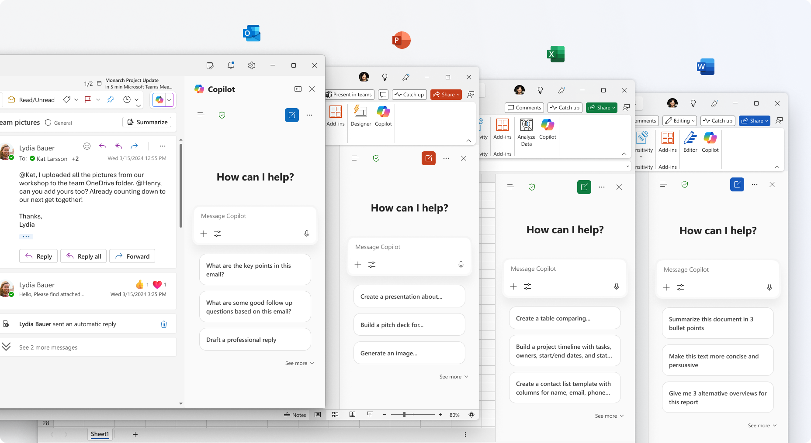

Slide 17
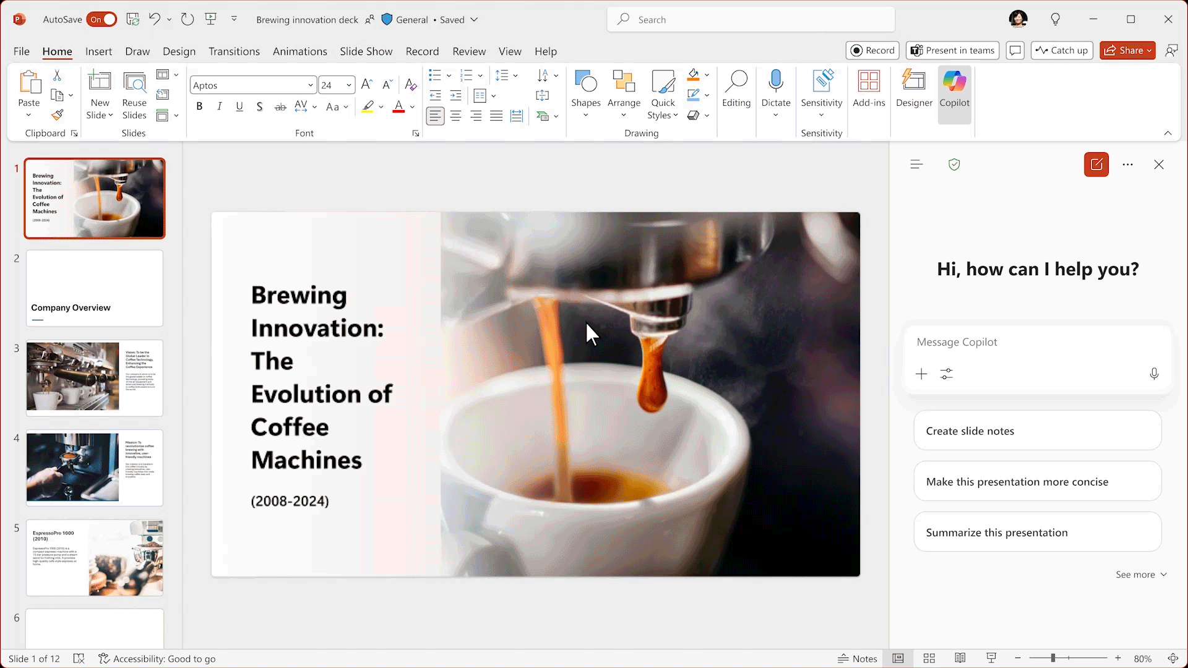
Available across the Microsoft 365 apps

Slide 18
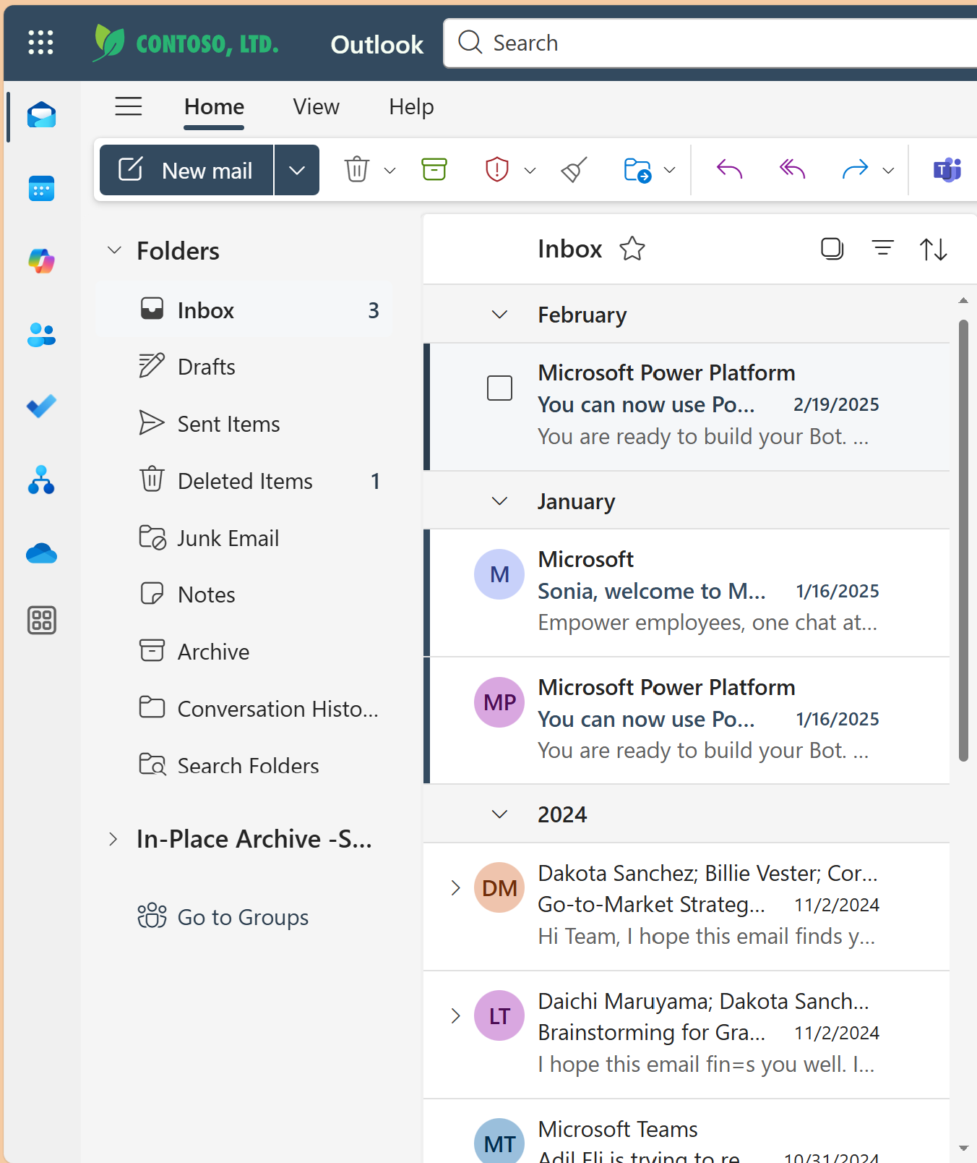
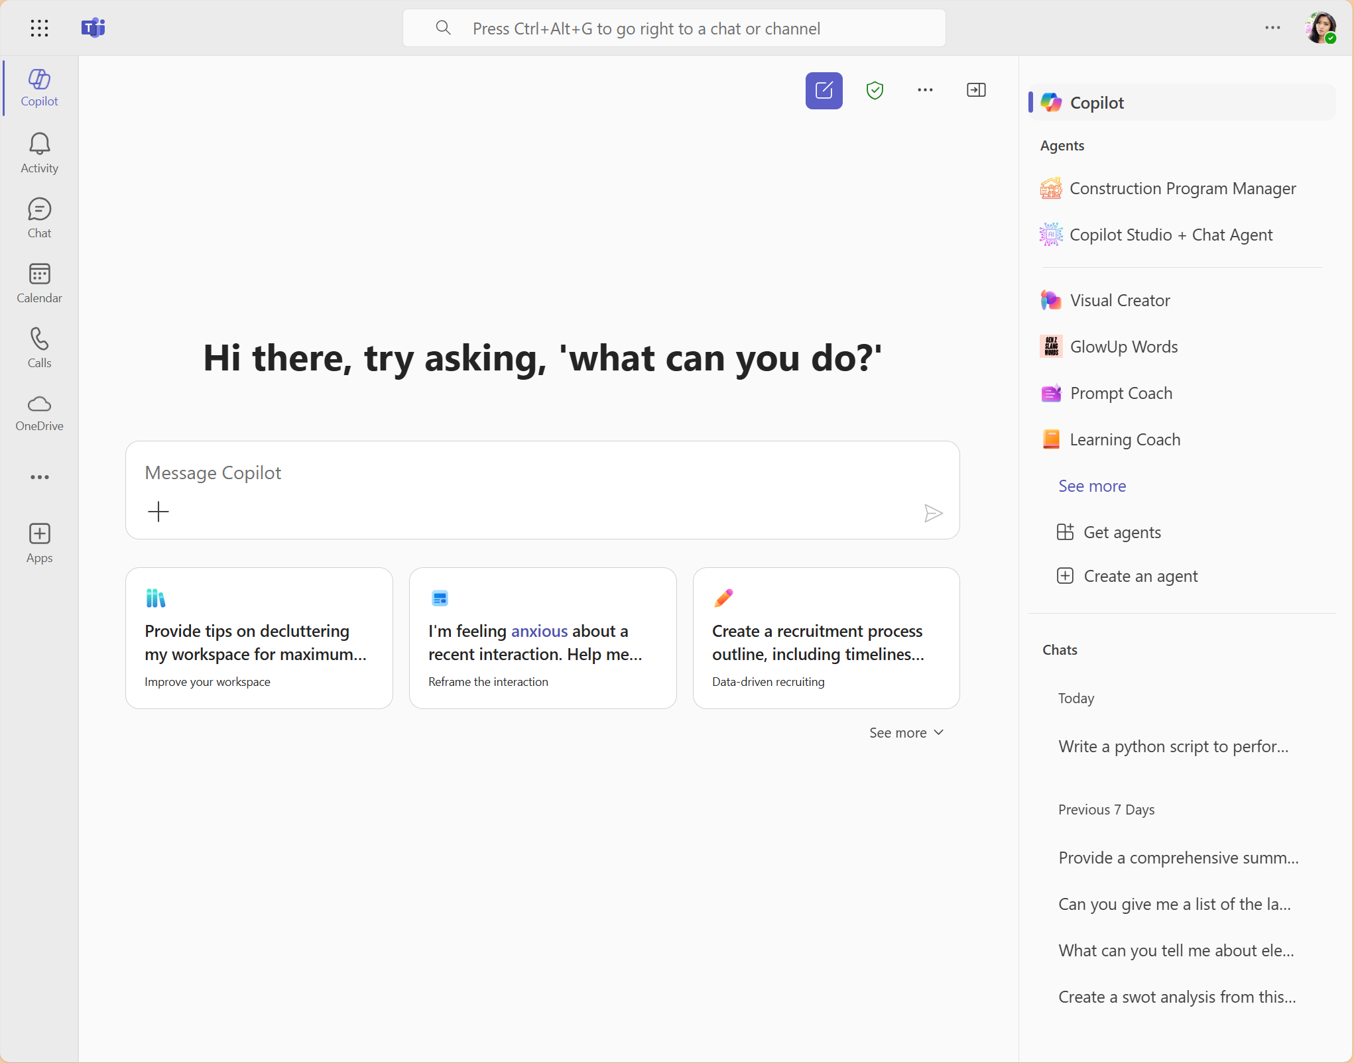
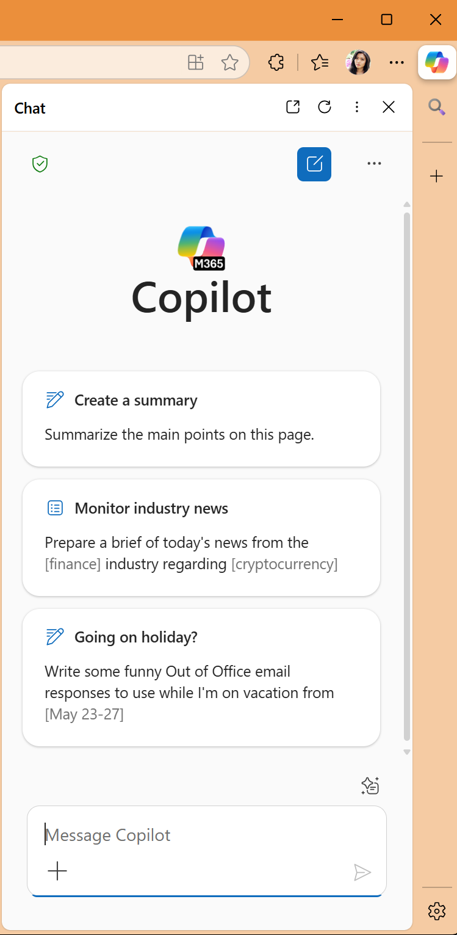
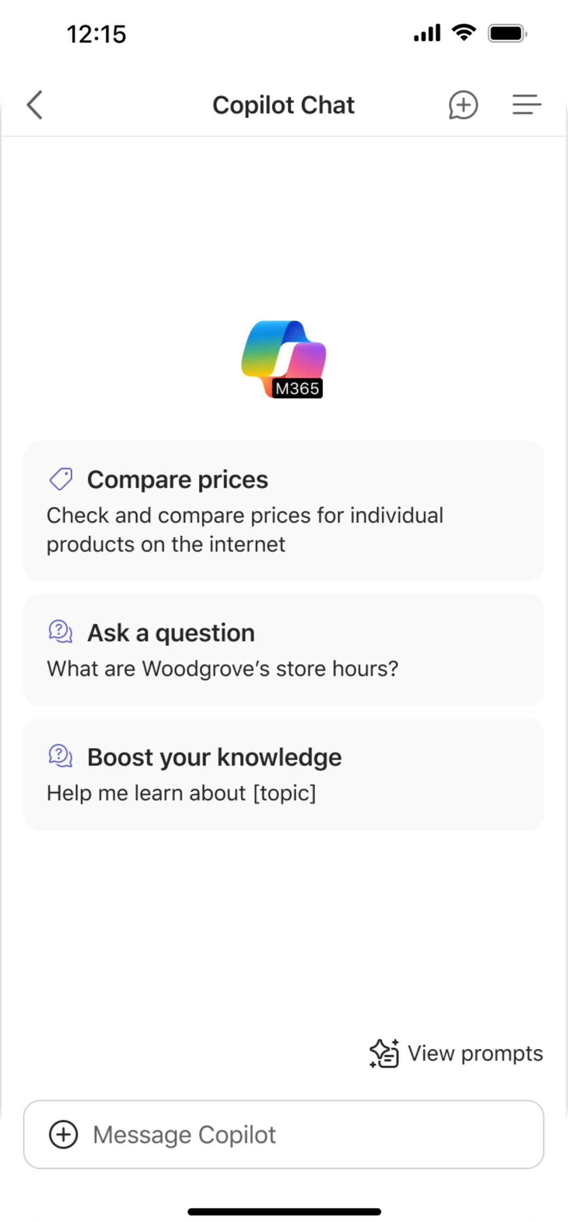
Access Copilot from wherever you’re working
Copilot Chat App in Outlook
Copilot Chat App in Teams and Office 365 Apps
Copilot in Edge
Copilot in Mobile
*Starting on May 1, 2025, Microsoft 365 Copilot Chat is pinned by default in the navigation bar of the M365 Copilot app, Teams, and Outlook for most users who are eligible for Copilot Chat across the web, mobile, and desktop.

Slide 19
Enterprise Data Protection

Slide 20
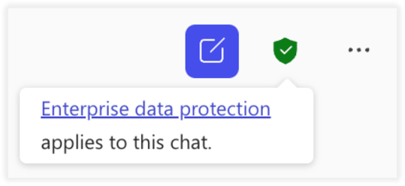
How Enterprise data protection aligns
to Copilot Chat
Prompts and responses are still not used to train foundation models. Prompts and responses are handled with EDP in both experiences with and without a Microsoft 365 Copilot license
 | Microsoft 365 Copilot Chat | Microsoft 365 Copilot
Data Protection | Enterprise data protection (EDP). DPA and Products Terms apply. Microsoft acts as a data processor.
Prompts and responses | Stored in the user Exchange email box for compliance scenarios (no difference if the plug in is on/off) Not used to train foundation models.
Search queries | Passed to the Bing Search service, to retrieve information from the web to ground a response. Abstracted/deidentified from the user's prompt and grounding data. The use of Bing is covered by the Microsoft Services Agreement between each user and Microsoft, together with the Microsoft Privacy Statement. This means that Microsoft acts as an independent data controller responsible for complying with all applicable laws and controller obligations. The Microsoft Products and Services Data Protection Addendum (DPA) doesn’t apply to the use of Bing.
User controls | Not available. | End users can turn on and off the web plugin for each session, if the admin did not turn off on the tenant / group (future feature) level.

Slide 21
Prompts and responses vs web search queries
Use of Microsoft 365 Copilot Chat and Microsoft 365 Copilot involves prompts (entered by users) and responses (content generated by Copilot). In both Microsoft 365 Copilot Chat and Microsoft 365 Copilot prompts and responses are protected by EDP.
Enterprise data protection
Bing Search Service
We secure your data: Encryption at rest and in transit, rigorous physical security controls, and data isolation between tenants.
Your data is private: We won’t use your data except as you instruct. Privacy commitments include support for GDPR, ISO/IEC 27018², and Data Protection Addendum.
Your access controls and policies apply to Copilot: Copilot respects your identity model, permissions, sensitivity labels, retention policies, audit log, and follows administrative settings. The specific controls and policies will vary depending on the underlying subscription plan.
You are protected against AI security and copyright risks: We help safeguard against AI-focused risks such as harmful content and prompt injections. For content copyright concerns, we provide protected material detection, and our Customer Copyright Commitment.
Your data isn’t used to train foundation models: Prompts, responses, and data accessed through Microsoft Graph aren’t used to train foundation models.
Web search queries: Short, few word web query derived from user prompt. Full prompt not sent to Bing.
Security: Sent via a secure connection with user and tenant identifiers removed.
Handling: Not shared with advertisers. No impact on search rankings, answers, rich captions, social features. Not used to train foundation models.
Web search policy: Allows direct management of web search in Copilot with options for same or separate access to web search for work vs. web.
User toggle: Microsoft 365 Copilot users have toggle for web search queries.
Prompt
Web search query²
Web grounding must be turned on to send web search queries out from the M365 service boundary
Response
Relevant web data
Microsoft 365 Service Boundary
¹Microsoft 365 Copilot runs on the ISO 27018 certified Microsoft 365 platform
²Web search queries are different from Microsoft Graph queries

Slide 22
Web query handling in Microsoft 365 Copilot Chat and Microsoft 365 Copilot
Web queries sent to the Bing search service are handled identically by both Microsoft 365 Copilot Chat and Microsoft 365 Copilot
Web queries are generated from the prompt don’t include the entire prompt (unless very short, e.g., one word)
Web queries are sent via a secure connection with user and tenant identifiers removed
Web queries are not shared with advertisers. They don’t impact search ranking, answers, rich captions, and social features (like auto suggest, trending, zero input).
Entity | Text
Prompt (written by the user) | We're considering a possible acquisition of Fabrikam. Help me put together a 200-word summary report of publicly available financial information on the company, including their business strategy.
Web queries (generated by Copilot and sent to the Bing search service) | Fabrikam strategy Fabrikam financials
Response (generated by Copilot) | Fabrikam is a CPG startup that offers healthier food alternatives but with the same familiar taste as traditional brands. The company gathered $4.5 million in seed funding in 2019 and raised $31.5 million in a series B funding round in 2022. As of January 2023, Fabrikam raised a total of $83.4 million in funding and is on target to more than double its sales this year. As the pandemic hit, Fabrikam faced the challenge of pivoting from brick-and-mortar stores to online sales, and that’s where their influencer marketing strategy came into play. Instead of relying on in-store events and promotions, Fabrikam turned to social media and influencer partnerships to build brand awareness and reach a wider audience. The company also approached innovation from a genuine angle, balancing traditional consumption drivers with better-for-you offerings and having a holistic, robust distribution strategy. In summary, Fabrikam has raised over $55 million in funding and has a strong influencer marketing strategy that has helped them pivot to online sales during the pandemic.
How Copilot uses queries when web grounding
The prompt is written by the user.
The Copilot LLM generates web queries that are sent to the Bing search API:
  Documents and files are not sent to Bing search service; only search key words are sent.
  Queries sent to Bing by Copilot are disassociated from the user ID or tenant ID.
  Web search queries generally don’t contain all the words from a user's prompt (unless very short). They're generally based off a few terms used to find relevant information on the web. However, they may still include some confidential data, depending on what the user included in the prompt.
The response is generated by the Copilot LLM.

Slide 23
Employees want AI at work – and they won’t wait for organizations to catch up
Three Out
of Four People Use AI at Work
75%
78%
of people are already using
AI at work
of AI users are bringing their own AI tools to work (BYOAI)
Source: Work Trend Index Report, May 2024

Slide 24
Mitigate Shadow AI risks with governance
What is Shadow AI and what are the risks?
Organization
BYOAI
Employees are excited to try Generative AI apps due to productivity benefits. Sometimes, they will use apps that are not sanctioned nor managed by IT
Left unchecked, sensitive data (e.g. PII, Intellectual Property) might be shared with “Shadow AI” apps, creating risk of leakage, malicious use, or use to train 3rd party algorithms
Monitoring Shadow AI can help uncover use in the business and manage security, privacy, and compliance risks
How to discover and govern Shadow AI use?
Gaining visibility on Shadow AI apps on the corporate environment (endpoints, network)
Audit & automatically block unsanctioned apps, while managing relevant apps with IT security
Enhance protection on managed apps by applying data classification best practices
Understand the security & compliance risks of the specific cloud AI apps against a common benchmark (GDPR, SOC reports, etc)

Slide 25
Best Practices
Block Unapproved AI apps:
Redirect the user access to a webpage with an Organization message & guiding users to use IT approved apps e.g. Copilot Chat with link https://m365copilot.com/

Slide 26
Poll #2
Are you using Microsoft 365 Copilot Chat or other AI solutions to empower your productivity?
    Microsoft 365 Copilot Chat
    Other AI solutions
    I haven’t used any AI solutions yet

Slide 27
Enable Copilot Chat

Slide 28
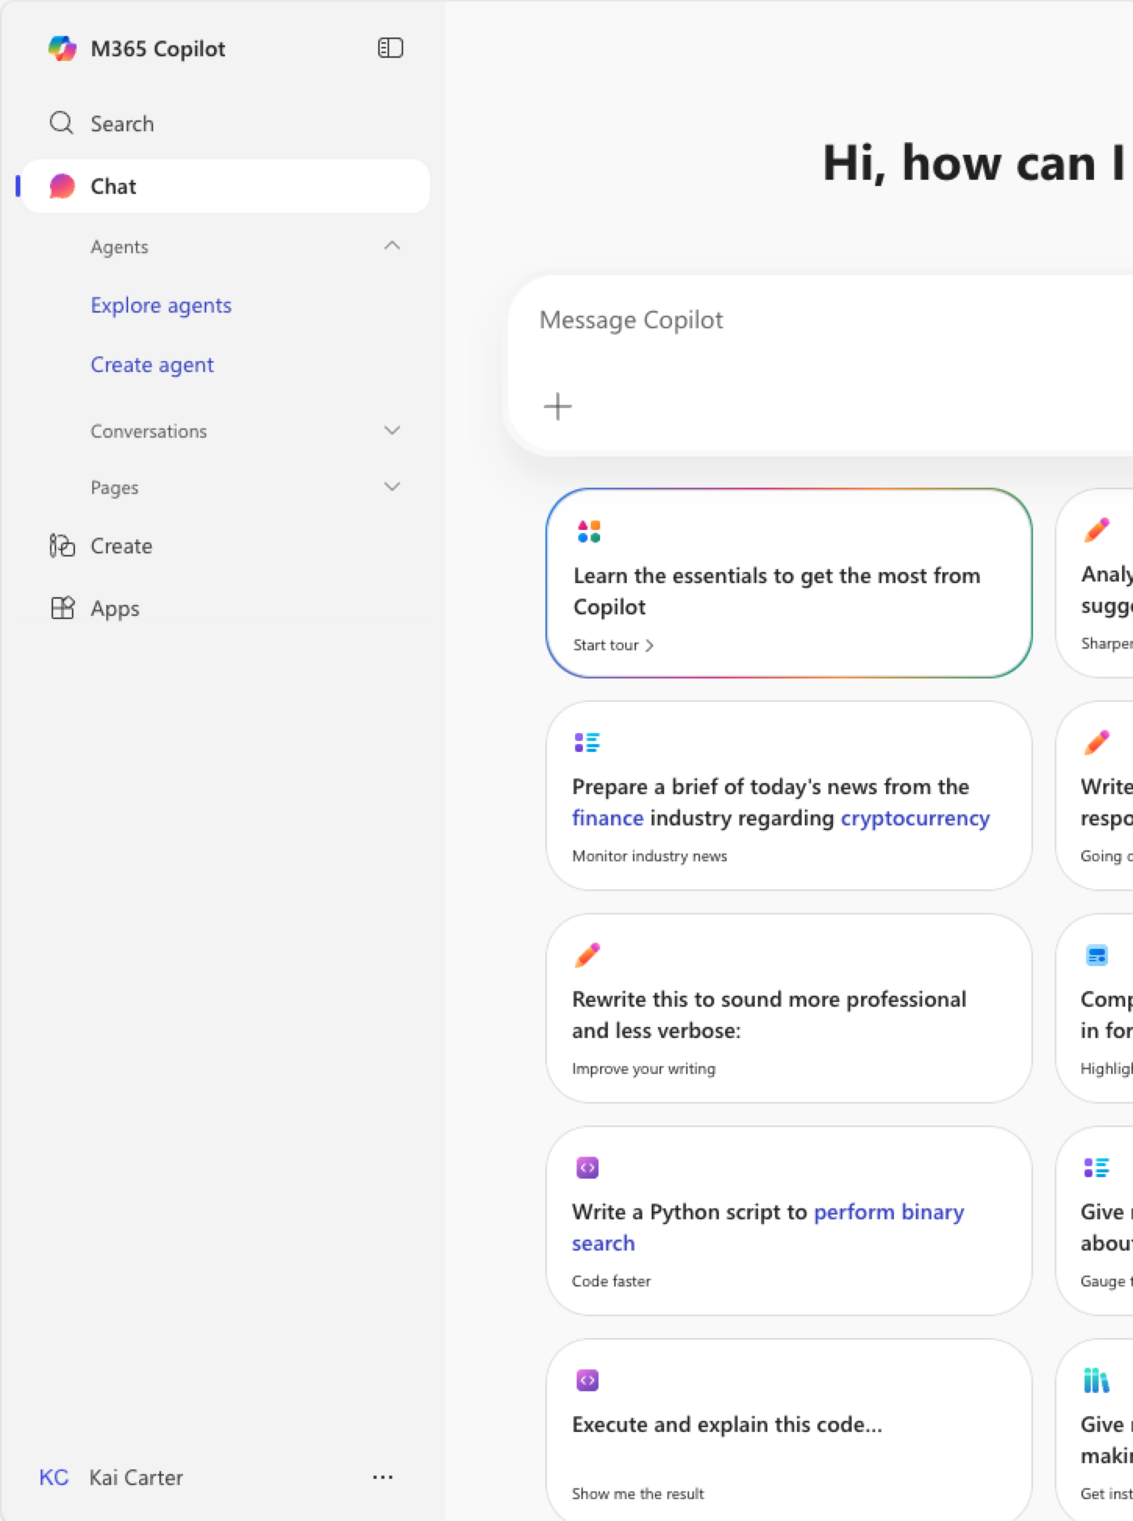
Licenses
Every Entra account user with one of the following licenses can use Microsoft Copilot Chat:
Microsoft 365 A1/A3/A5*
Microsoft 365 Business Basic/Business Standard/Business Premium
Microsoft 365 E3/E5
Microsoft 365 F1/F3
Microsoft Teams/Teams Enterprise/ Teams Essentials/Teams Rooms
Office 365 A1/A1 Plus/A3/A5
Office 365 E1/E1 Plus/E3/E5
Office 365 F3
*(including MA3/MA5 for students, MA3/MA5 for faculty, and MA3/MA5 student-use benefit)
Microsoft 365 Copilot Chat eligibility

Slide 29
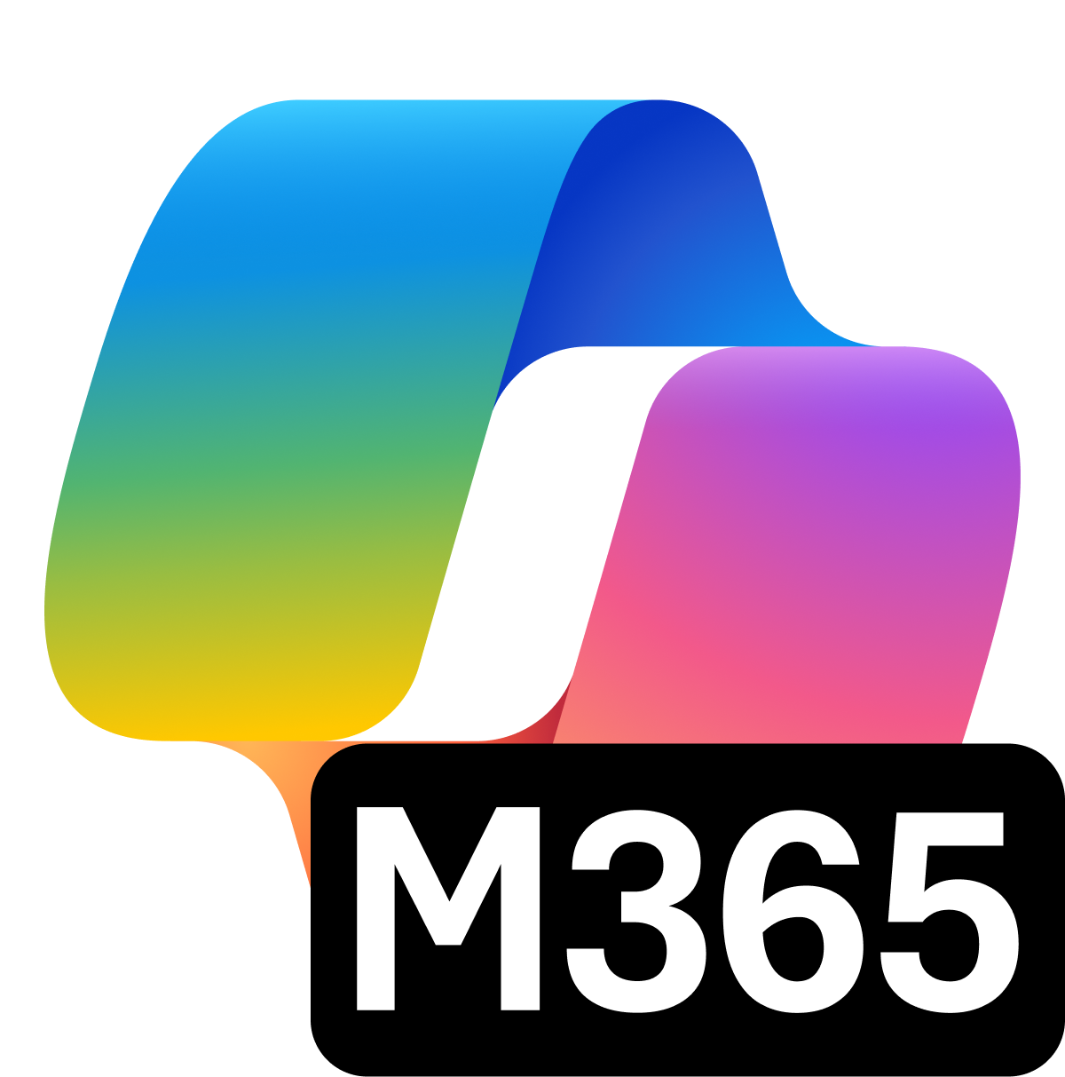
Configuration checklist
Pin Microsoft 365 Copilot Chat
Manage web search
in Copilot Chat
Network
requirements
Copilot Chat usage reporting
Validate Proxy configuration
Make sure every user enjoys seamless and direct access to Microsoft 365 Copilot Chat by pinning Copilot Chat.
Manage if Copilot Chat should base its responses on the latest web search results or leverage its existing knowledge.
Make sure all necessary network endpoints are allowed in your organization to guarantee seamless access to Copilot Chat.
Implement a process to regularly review the usage of Copilot Chat, gaining valuable insights into how users are interacting with the product.
Admins should verify the local proxy configuration to ensure users can seamlessly access the necessary endpoint for Copilot Chat:
M365copilot.com
Copilot.cloud.microsoft
microsoft365.com
office.com
m365.cloud.microsoft
Note: Additional endpoints are required and mentioned here:
Network requirements
Manage Copilot Chat
in Edge
Manage Copilot Chat on mobile devices
Manage Copilot Chat in 365 apps, M365 Copilot app and Web
Manage Copilot Chat
in Teams
Admins can control if and how use can access and use Copilot Chat in Microsoft Edge.
Admins can maintain the same security, privacy and compliance standards for their mobile users for Copilot Chat.
Admins can control through the Integrated Apps portal if Copilot Chat is available in the Microsoft 365 apps.
Admins can leverage the app centric management and the app setup policy to control Copilot Chat in Teams.

Slide 30
Manage and Govern

Slide 31
Manage Copilot Chat

Slide 32

Managing
Microsoft 365 Copilot Chat
The following administrative management options are available:
Manage access to Microsoft 365 Copilot Chat
Manage web search queries in Microsoft 365 Copilot Chat
Manage Copilot Edge settings and behavior
Manage Microsoft 365 Copilot Chat in Microsoft 365 mobile apps
Administrators have multiple options to manage the Microsoft 365 Copilot Chat experience for their users.
Manage Microsoft 365 Copilot Chat

Slide 33
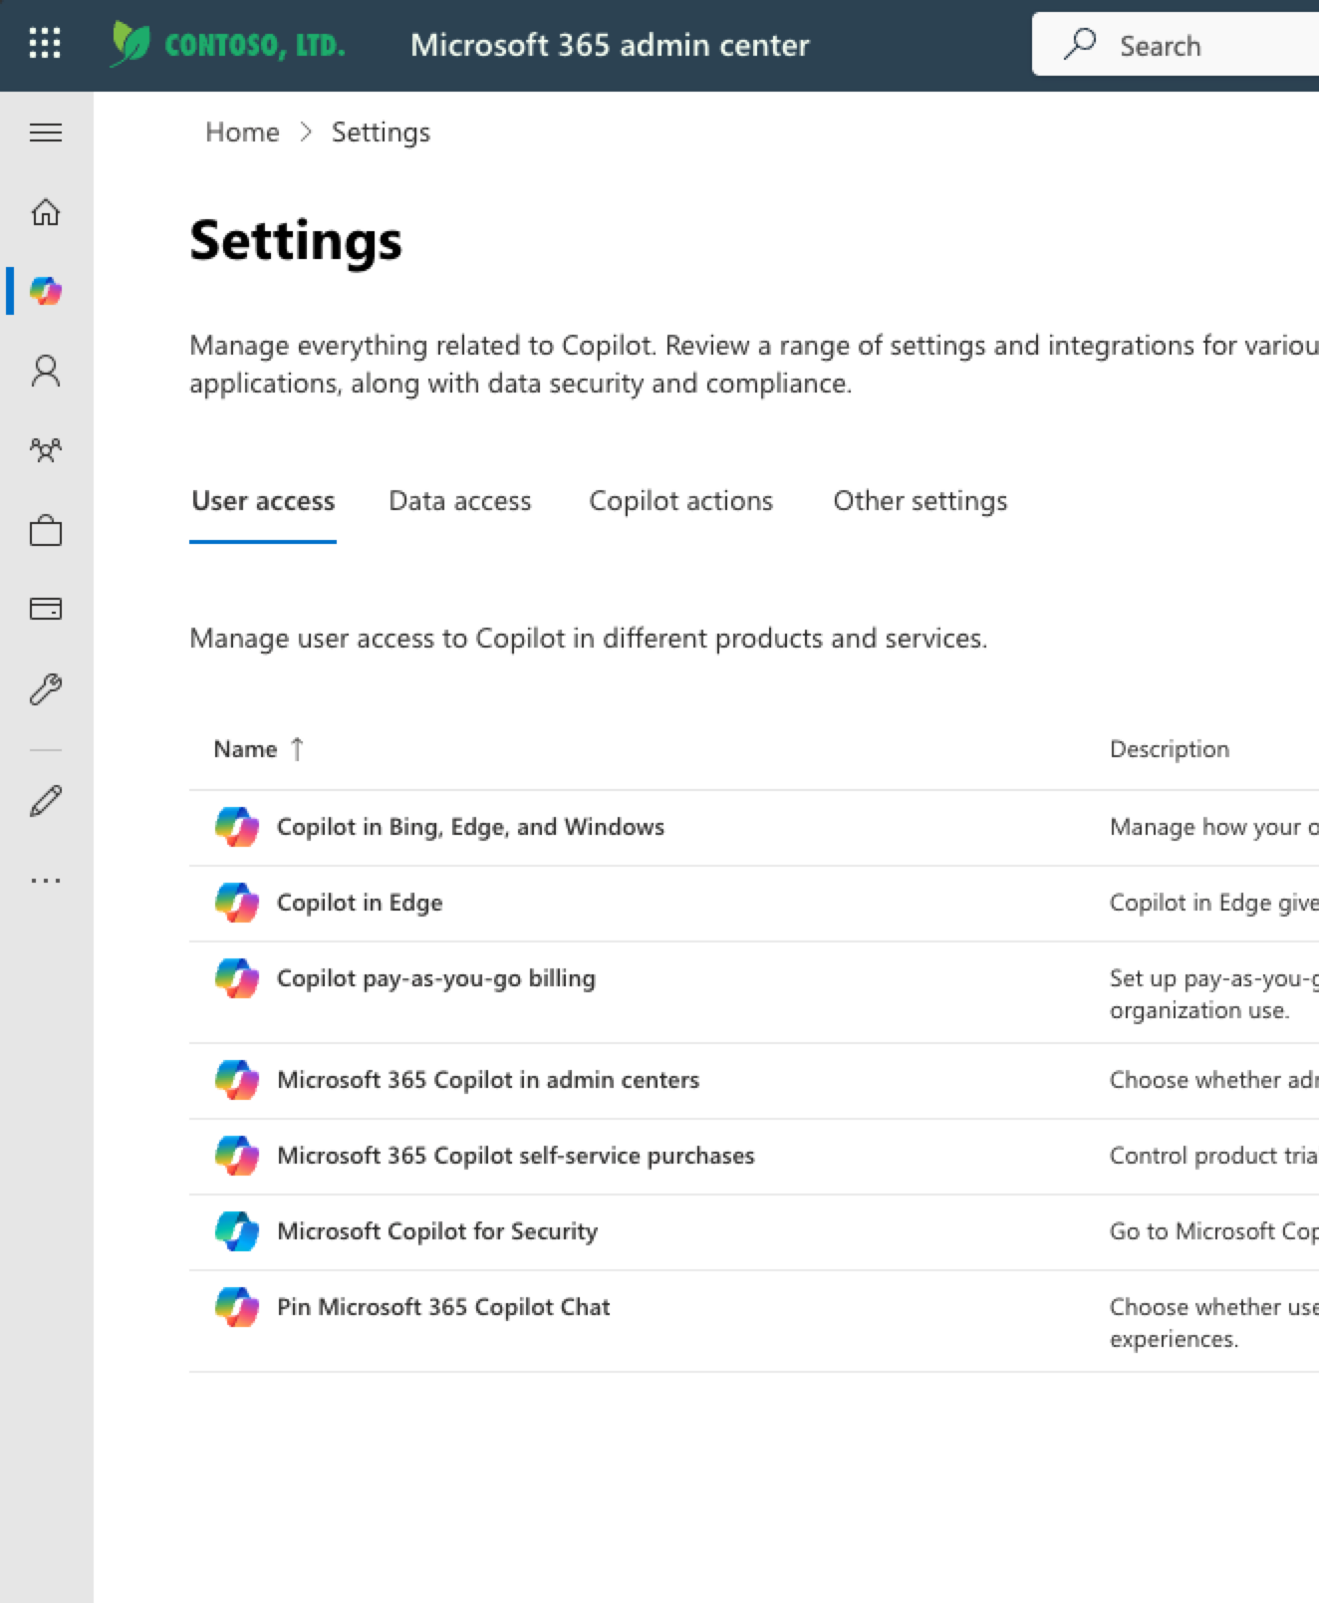
Pin Microsoft 365 Copilot Chat to the navigation bar
Administrators can encourage users to use Microsoft 365 Chat by pinning Microsoft 365 Copilot Chat to the navigation bar of Microsoft 365 apps, Microsoft 365 Copilot app across the web, desktop, and mobile.
Pin Microsoft 365 Copilot Chat to the navigation bar

Slide 34
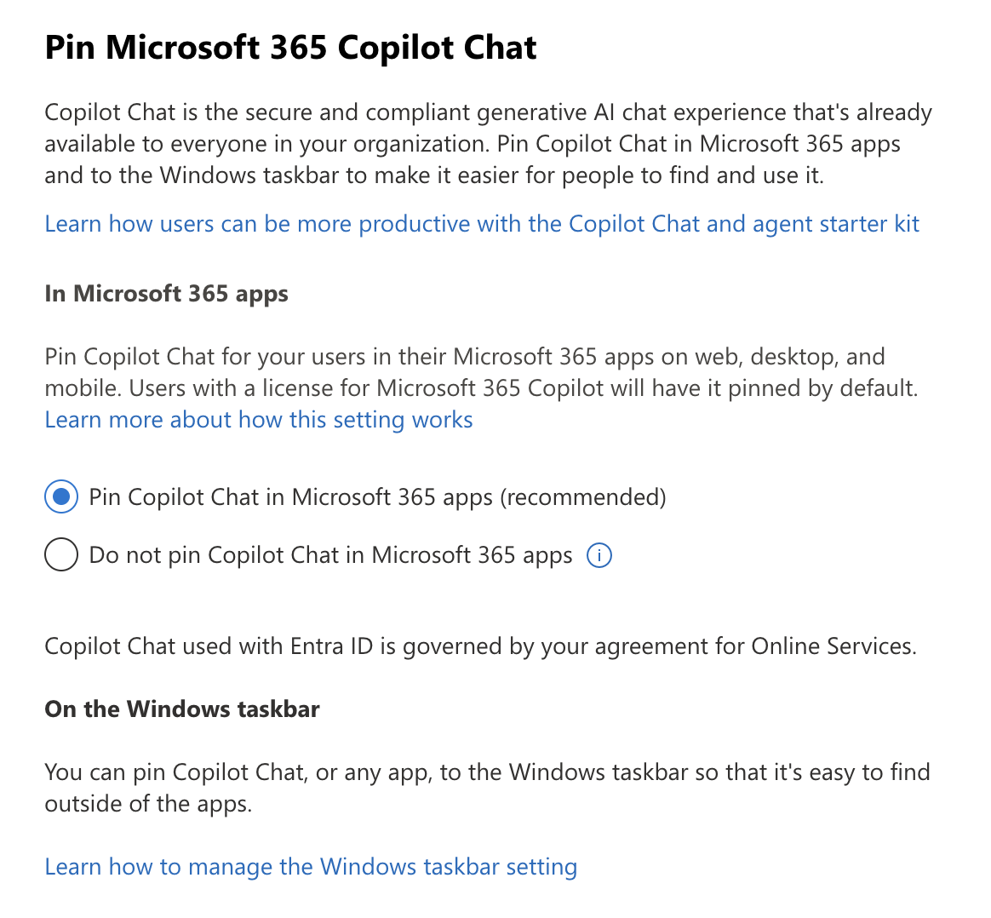
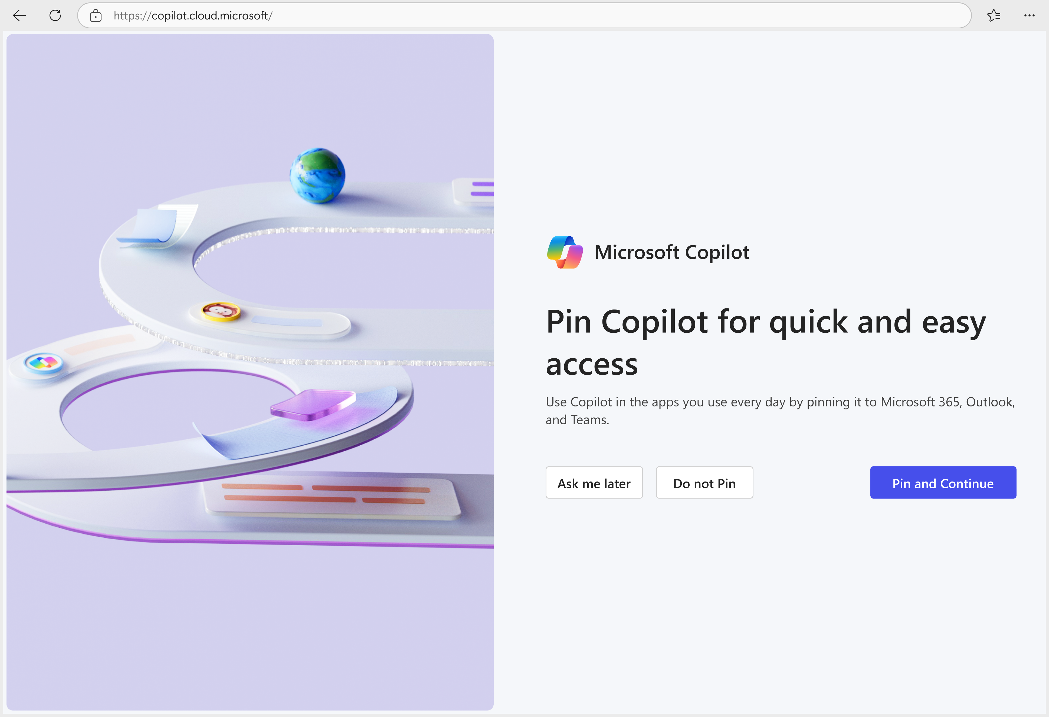
Pin Microsoft 365 Copilot Chat to the navigation bar
Global administrators can access this setting in the Microsoft 365 admin center by navigating to Copilot > Settings.

Slide 35
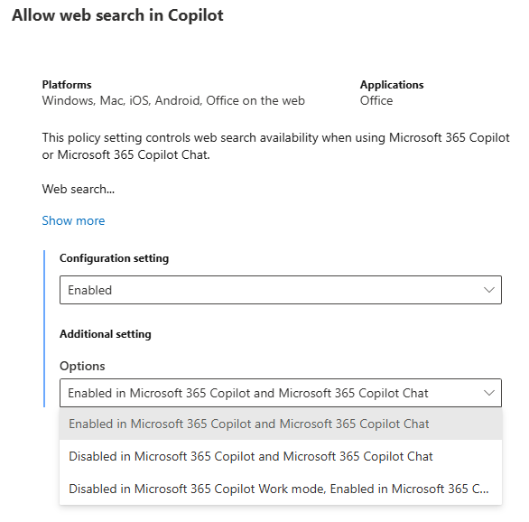
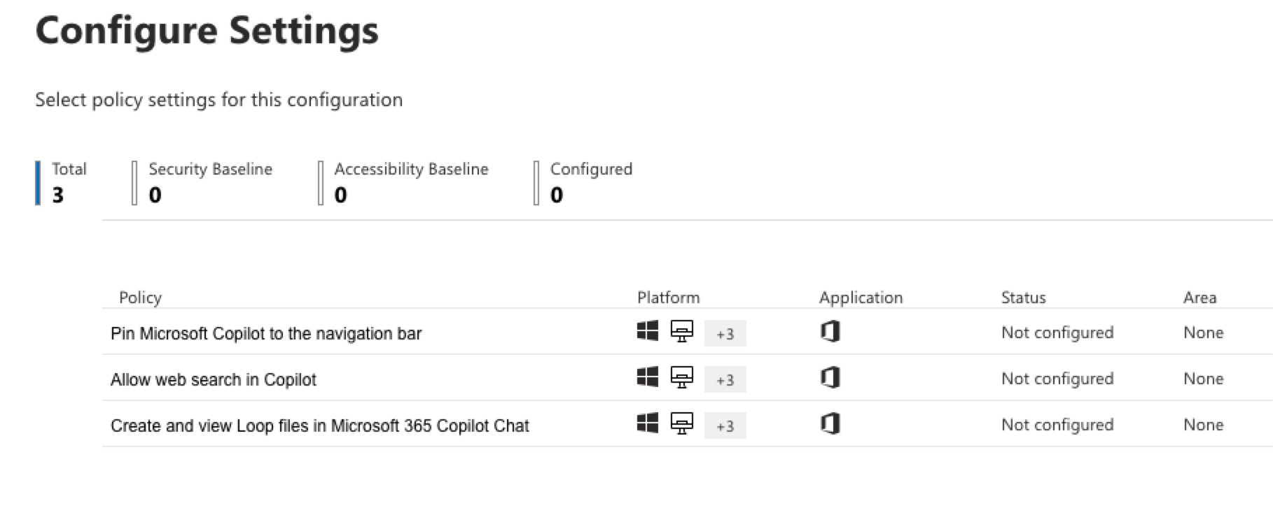
Control web search for Copilot Chat
This policy configuration manages only the availability of web search while utilizing Microsoft 365 Copilot or Microsoft 365 Copilot Chat. The data from web searches is governed by Bing's consumer terms, which are distinct from the terms related to the handling and processing of Microsoft 365 data.
The policy offers 3 options:
Enabled in Microsoft 365 Copilot and Microsoft 365 Copilot Chat
Disabled in Microsoft 365 Copilot and Microsoft 365 Copilot Chat
Disabled in Microsoft 365 Copilot Work mode; Enabled in Microsoft 365 Copilot Web mode and Microsoft 365 Copilot Chat
Controls available to manage web search

Slide 36
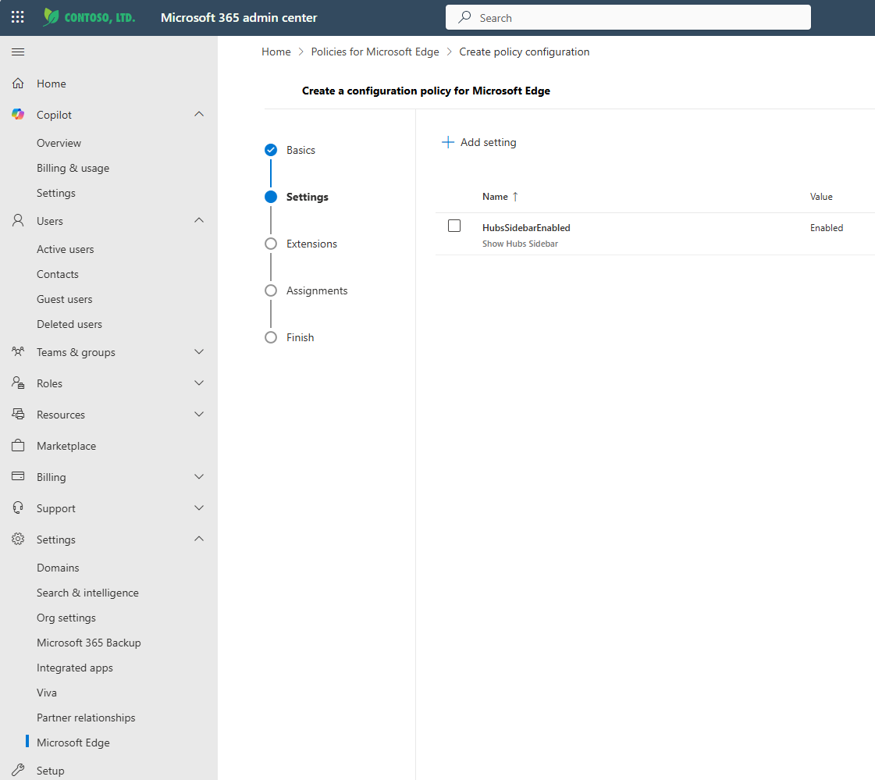

Copilot in
Edge controls
Administrators can use configuration profiles in the Microsoft 365 Admin Center to manage the settings and integrations available in Microsoft Edge for Microsoft 365 Copilot Chat.
Microsoft Edge management service | Microsoft Learn
Prerequisites:
Microsoft Edge 115.0.1901.7 or greater
Microsoft Edge Administrator to access the experience in Microsoft 365 Admin Center
Windows 10/11 or Windows Server 2016 or later

Slide 37
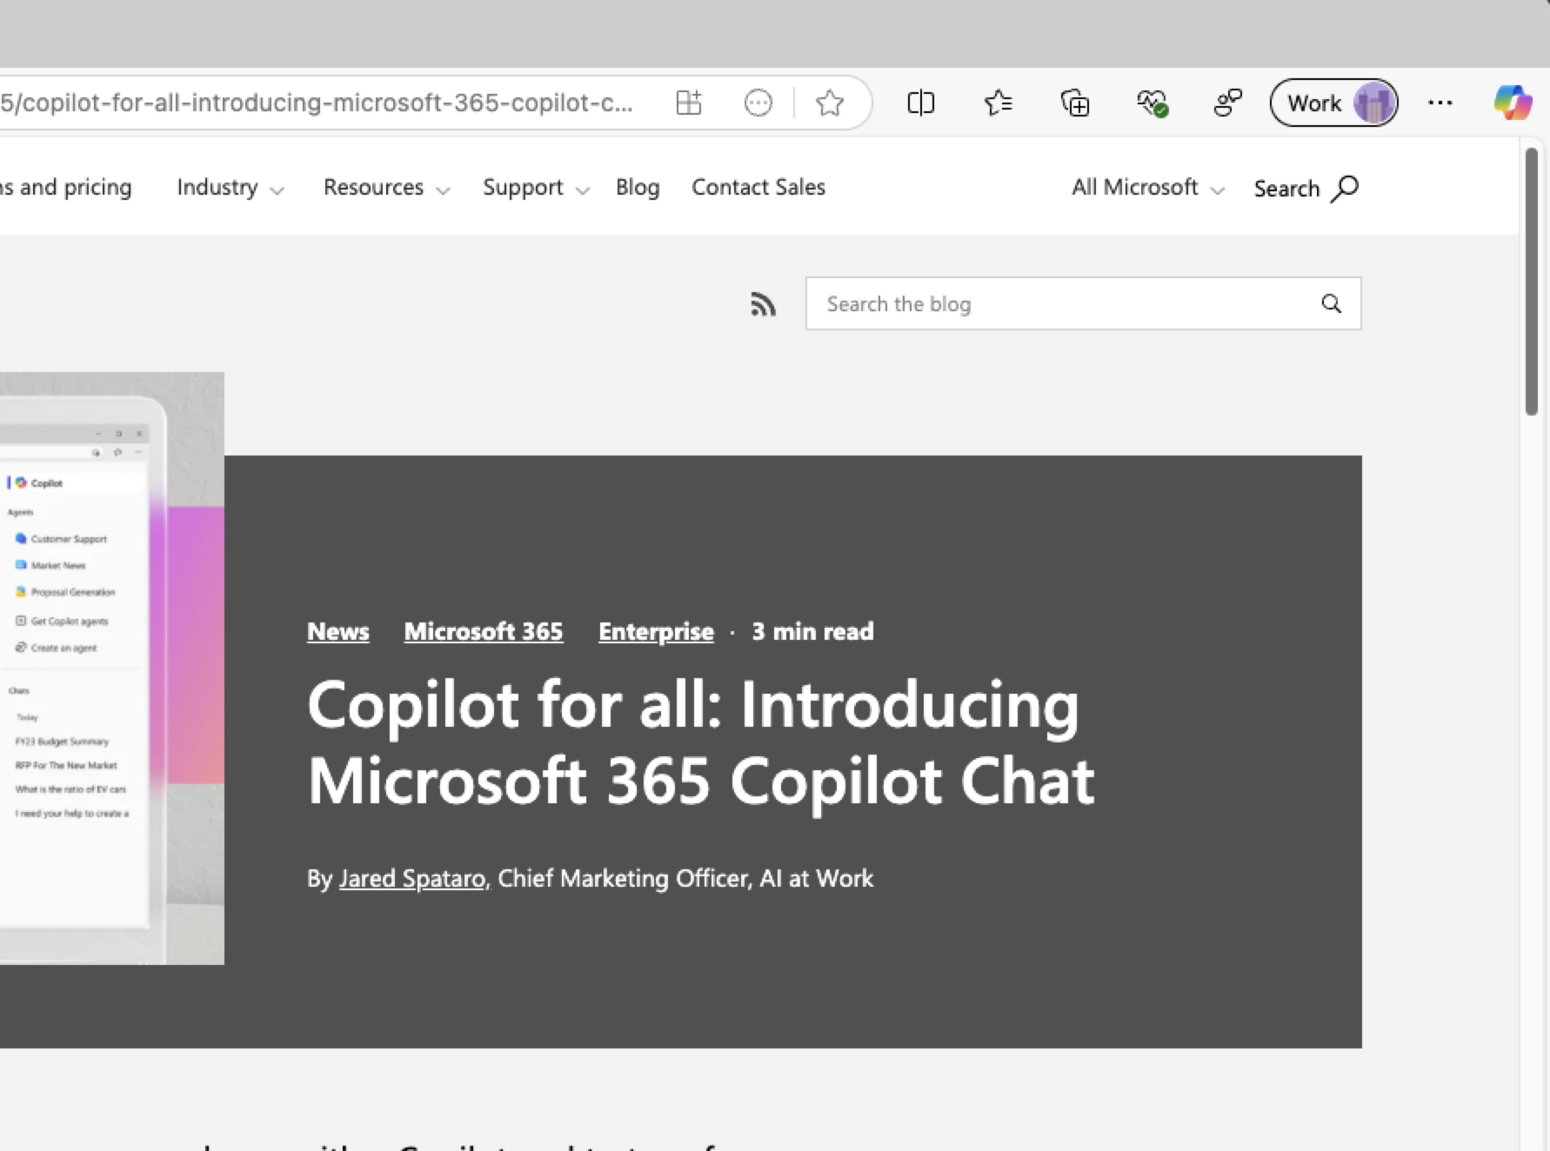
Admin Controls for Microsoft Edge
(Windows)
EdgeEntraCopilotPageContext
This policy controls access to page contents for Microsoft 365 Copilot Chat with enterprise data protection (EDP) in the Microsoft Edge sidebar for the web tab only. This policy controls whether Microsoft 365 Copilot Chat can perform page summarization and similar contextual queries.
Admins can use group policy settings to manage the behaviour of the Copilot in Edge sidebar.
Microsoft365CopilotChatIconEnabled
This policy controls whether the Microsoft 365 Copilot Chat icon will be shown in the Microsoft Edge for Business toolbar for Microsoft 365 Copilot licensed and unlicensed users. Microsoft365CopilotChatIconEnabled
CopilotPageContext
To allow or block Copilot in Edge from using browsing context when users are signed in with their personal MSA Bing account while in the Edge work profile, use the CopilotPageContext policy. This policy prevents the personal Copilot version without enterprise data protection from using webpage or PDF content when it formulates responses to prompts.

Slide 38
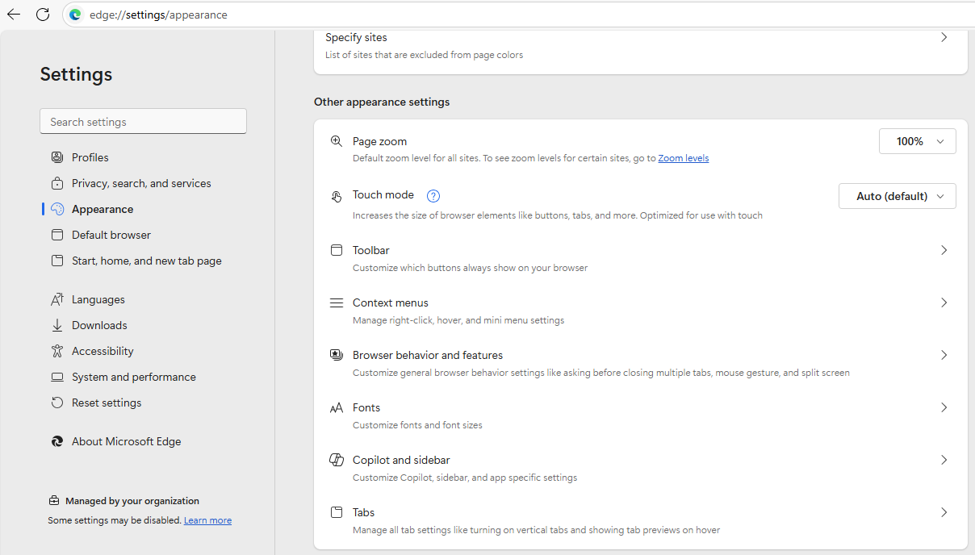
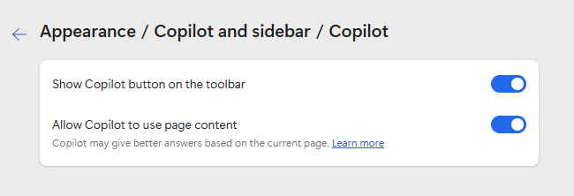
User Control in Microsoft Edge
User control in Microsoft Edge
User have full control over their Copilot experience within Microsoft Edge
Within the Microsoft Edge settings, under the Appearance > Copilot and sidebar section, users can manage the availability and behavior of Copilot in their browser experience.

Slide 39
Govern Copilot Chat

Slide 40
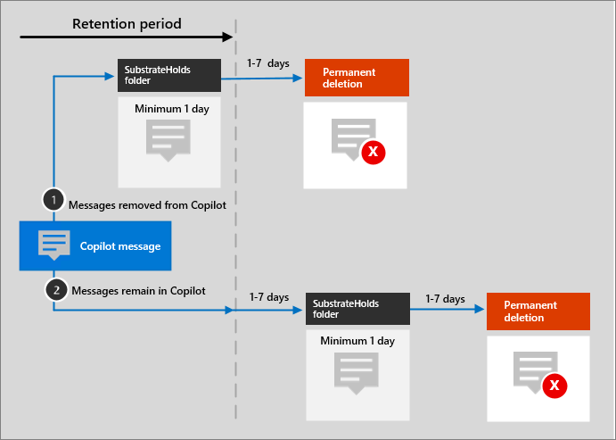
Retention of Copilot Chats
In a Copilot interaction, users can upload local files, which are automatically stored in the Microsoft Copilot Chat Files folder in the user's OneDrive.
Copilot chats are stored in a user's mailbox (hidden folder)
How long the Copilot Data (and Teams Chats) will be stored depends on you retention settings for Copilot Chats
For retention policies that support automatic retention and deletion, user prompts and responses are identified and included in the Microsoft Copilot Experiences policy location.
Learn about retention for Copilot & AI apps | Separate existing 'Teams chats and Copilot interactions' policy

Slide 41
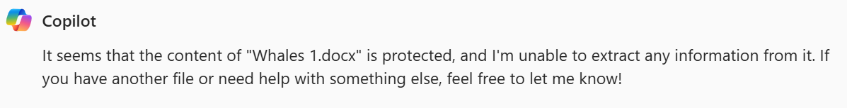
Copilot Chats and Sensitivity Labels
The sensitivity labels that you use to protect your organization's data are recognized and used by Microsoft 365 Copilot Chat to provide an extra layer of protection.
If the labels applied encryption from Microsoft Purview Information Protection, Copilot checks the usage rights for the user.
Only if the user is granted permissions to copy (the EXTRACT usage right) from an item, is data from that item returned by Copilot.
Sensitivity labels for Microsoft 365 Copilot and Microsoft 365 Copilot Chat

Slide 42
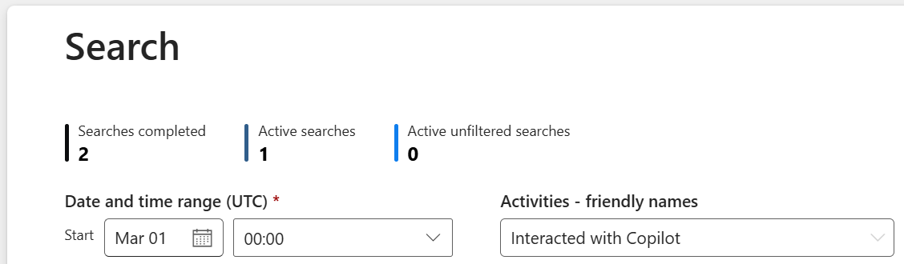
Auditing Copilot Chats interactions
Every interaction with Copilot generates an audit log entry in the same way as user actions in SharePoint, OneDrive, or Teams do today, searchable by the audit activity named Interacted with Copilot.
Review end-user activity with Copilot Chat through the Edge browser's Copilot sidebar, and Microsoft 365 Apps
Audit logs for Copilot and AI activities

Slide 43
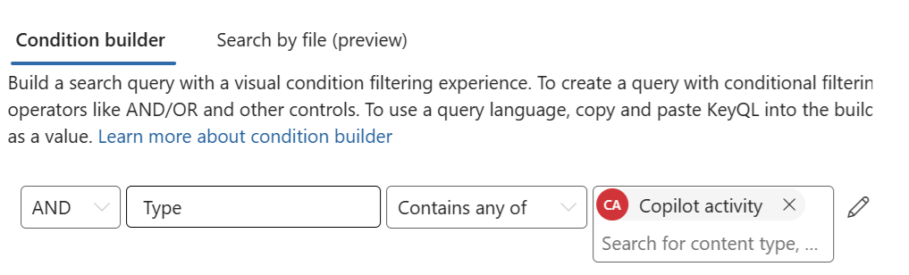
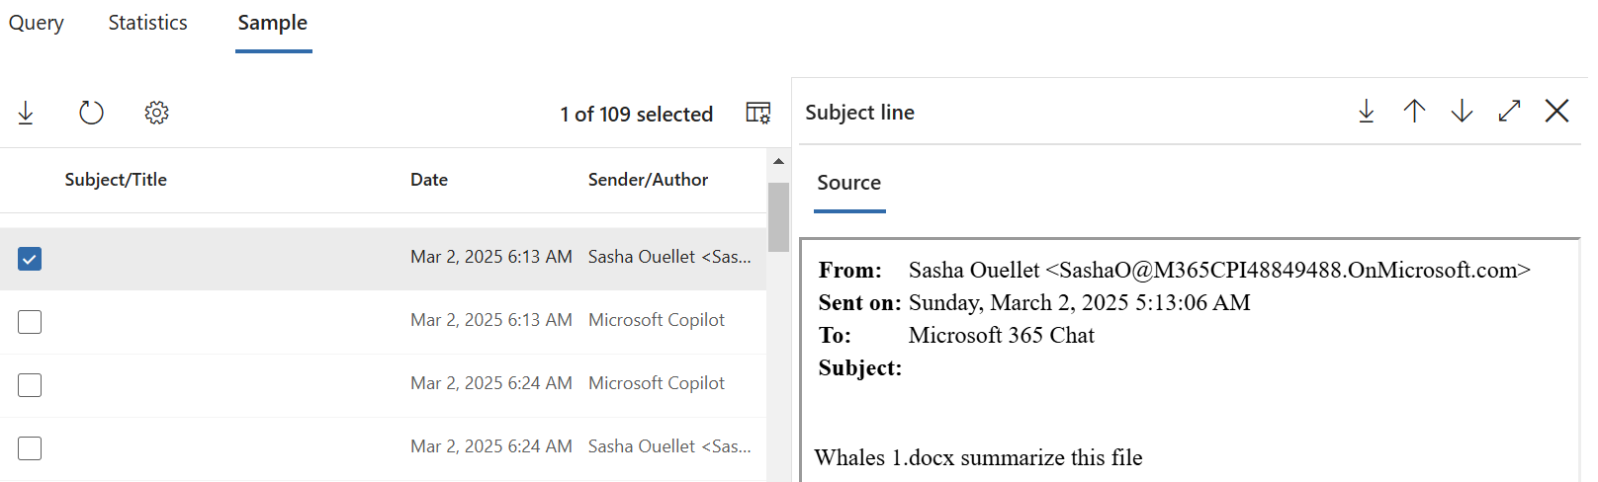
Searching Copilot Chats interactions
As Microsoft 365 Copilot Chat interactions are stored in the same manner as chat messages from Microsoft Teams, the same Content Search and eDiscovery features are available to customers to access them.
Microsoft 365 Copilot Chat interactions are searchable with Content Search and eDiscovery administrator tools.
Administrators can search and preview the prompts that end-users send to Microsoft 365 Copilot Chat.
Search for and delete Copilot data

Slide 44
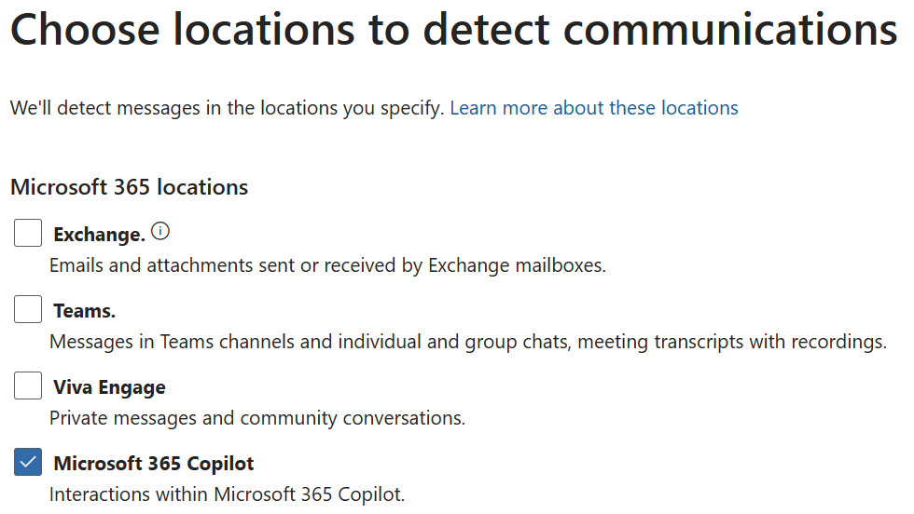
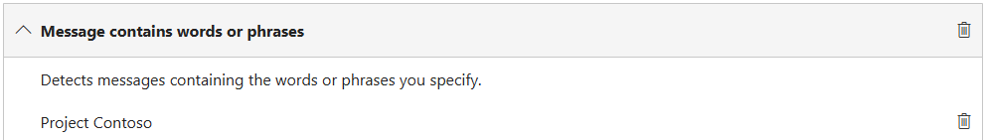
Searching Copilot Chats interactions
Communication compliance policies can analyze Microsoft 365 Copilot Chat prompts and responses to detect for inappropriate or risky interactions or sharing of confidential information entered interactions that include sensitive information.
Copilot and Communication Compliance

Slide 45
Usage Reporting

Slide 46
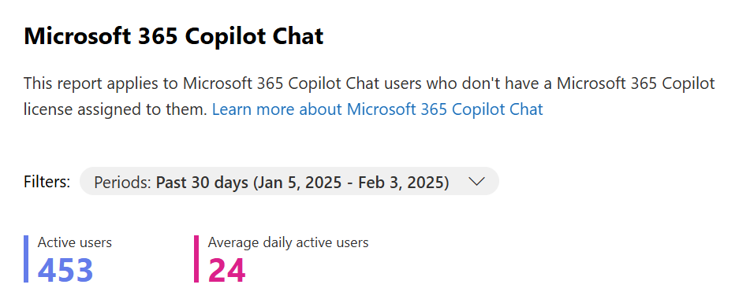
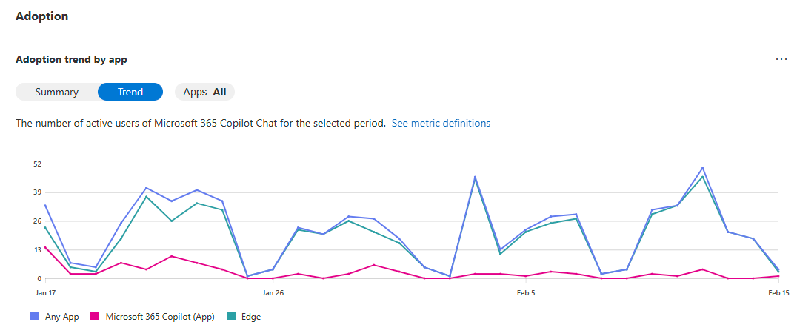
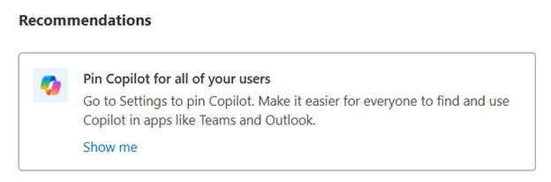
Copilot Chat Usage Report
The Microsoft 365 Copilot Chat usage report provide insights into usage of Microsoft 365 Copilot Chat in your organization.
Active Users (overall and daily)
Reports are available for the past 7, 30, 90 and 180 days
Recommendations to improve the adoption
Adoption trends by app (Copilot Chat and Edge)
Detailed last activity table
Microsoft 365 Copilot Chat Usage Report

Slide 47
Join our upcoming Copilot Customer Hub sessions
Microsoft 365 Copilot Chat for All Users
Realize value with Microsoft 365 Copilot Chat for all
Secure AI with Microsoft 365 Copilot Chat
Unlock the power: Navigating Microsoft 365 Copilot Chat
Maximize your Microsoft 365 Copilot Chat experience
📅 Tuesday, September 16, 2025
🕑8 AM PST
🔗Register now
📅 Thursday, September 18, 2025
🕑8 AM PST
🔗Register now
📅 Tuesday, September 23, 2025
🕑8 AM PST
🔗Register now
📅 Thursday, September 25, 2025
🕑8 AM PST
🔗Register now
AI Agents
Agents in an hour
Agents governance
Deep reasoning agents in action
📅 Wednesday, September 10, 2025
🕑8 AM PST - 🔗Register now
🕑8 PM PST - 🔗Register now
📅 Wednesday, September 24, 2025
🕑8 AM PST - 🔗Register now
🕑8 PM PST - 🔗Register now
📅 Wednesday, October 8, 2025
🕑8 AM PST - 🔗Register now
🕑8 PM PST - 🔗Register now
Driving business value with Copilot
Defining business value for your organization
Follow-Along: Measuring impact with Copilot Analytics
Maximizing business value & ROI
📅 Thursday, September 25, 2025
🕑8 AM PST
🔗Register now
📅 Thursday, October 2, 2025
🕑8 AM PST
🔗Register now
📅 Thursday, October 9, 2025
🕑8 AM PST
🔗Register now
https://aka.ms/CustomerHubSessions​

Slide 48
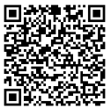
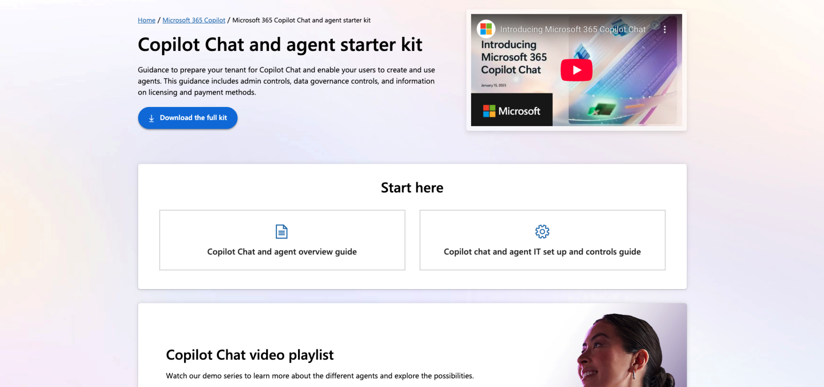
Starter Kit
Copilot Chat & Agent Starter Kit

Slide 49
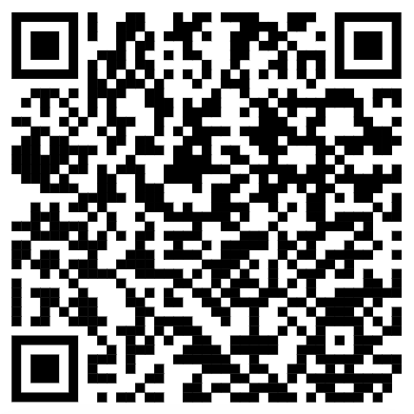
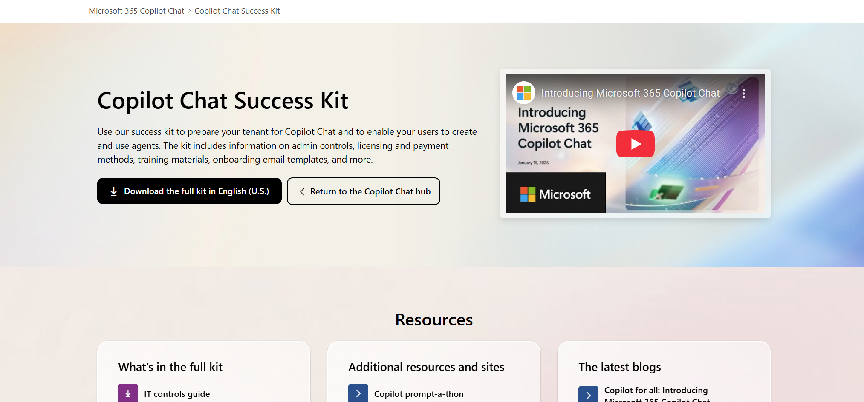
Copilot Chat Success Kit adoption.microsoft.com/copilot-chat/success-kit

Slide 50
Unlock the full potential of Copilot with exclusive programs and expert support
Customized support and expert-led services to transform the way you work with AI through
Expert guidance for technical and deployment
assistance to ensure a smooth rollout from
Find trusted Partners to help with Microsoft 365 Copilot solution, integration & innovation at the
Microsoft Unified
Microsoft FastTrack
Microsoft 365 Copilot
Partner Directory
Connect with your Microsoft representative for more information and to discuss the best options for your organization.

Slide 51
Explore key resources to accelerate your Copilot journey
Customer Hub
Discover upcoming sessions, updates and on-demand content
Customer Adoption
Access guides, success kits, and best practices
Microsoft Learn
Take training, get certified, deep-dive into Copilot and AI productivity topics
Copilot Scenario Library
Explore real-world use cases and inspiration

Slide 52
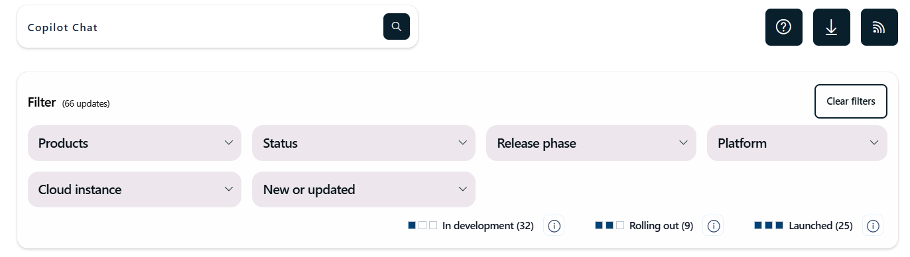
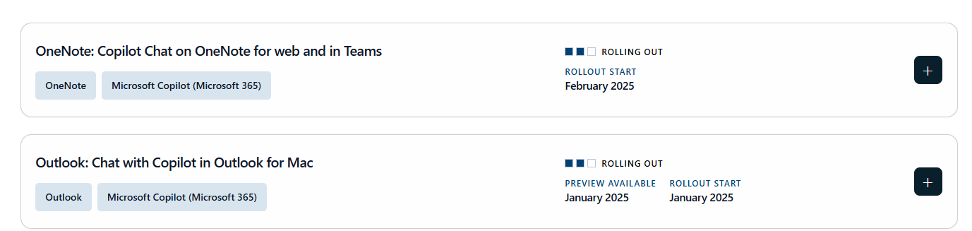
Microsoft 365 Copilot Chat Roadmap

Slide 53

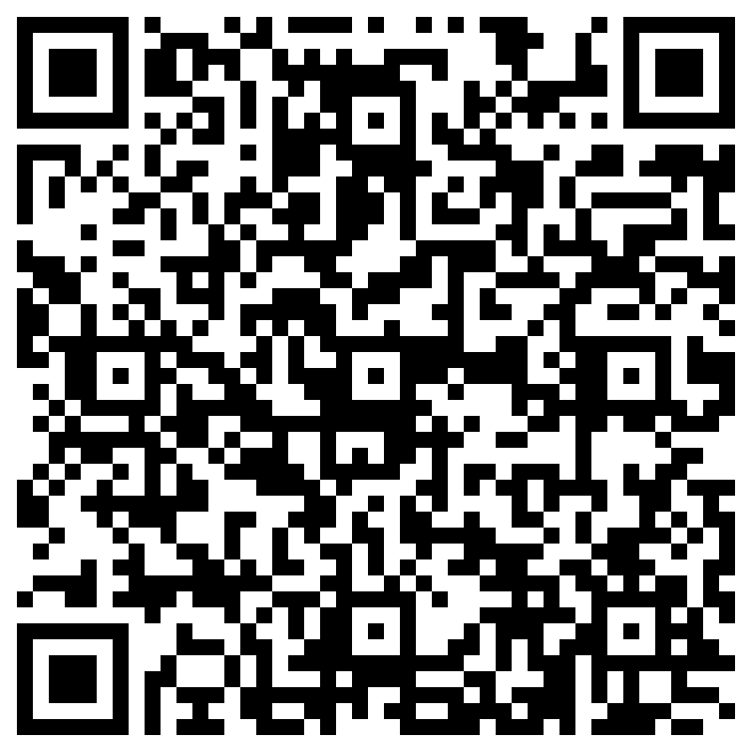
THANK YOU –
Your feedback is critical
Scan with your mobile device camera
-OR-
We’re committed to making your Customer Hub experience the best it can be – and your feedback is a critical component to that.
Before you scoot, please take a moment to provide some feedback.
Visit
Customer Hub Survey
aka.ms/CustomerHubSurvey
Select GPT-5 in Copilot Series

Slide 54

Q&A
1
Please raise your hand and unmute when called on
2

