Slide 1
Reimagine Marketing
Processes with
Copilot & Agents
Copilot & Agents Spotlight Series: Your Role; Reinvented
Microsoft confidential
Notes:
Hi everyone, welcome! My name is Nick Stillings, I'm a Global Solutions Architect with Microsoft — which is a fancy way to say Copilot rep. Joining me today are Andrea Fogel and Jignesh Thakkar. This session is part of our Customer Hub series, and today we're focused on reimagining marketing processes with Microsoft 365 Copilot and Agents. We'll walk through the art of the possible and share how marketing professionals are putting these tools to work right now.

Slide 2
Agenda
Introductions
AI Built for Work
Reimagining Marketing
Next Steps / Call to Action
Questions & Answers
Notes:
So here's our roadmap for today. We'll start with quick introductions, then Andrea will set the stage with AI Built for Work — what makes Copilot different from generic AI tools. Then Jignesh will take us through the Reimagining Marketing section with real examples and demos. We'll wrap up with next steps, calls to action, and open Q&A. Feel free to drop questions in the chat as we go — we have folks monitoring and we'll get to everything.

Slide 3



Your presenters
Andrea Fogel
Microsoft
Global Solution Architect
Jignesh Thakkar
Microsoft
Global Solution Architect
Notes:
A quick introduction to our presenters today. Andrea Fogel and Jignesh Thakkar are both Global Solution Architects at Microsoft, peers on my team. What I love about these two is they've been working with the Copilot product since before it even launched to customers. So you're getting insights from people who've lived and breathed this technology from day one. Andrea, over to you!

Slide 4
During the presentation
After the presentation
We will mute your microphone for the first part of today’s call
Raise your hand and we will
call on you
Ask your questions via chat, we will get to all of them, live or after. Common questions will get addressed out loud
Open mic – come off mute and ask away!
Notes:
Just a couple of housekeeping items before we dive in. We've got everyone's mics muted during the presentation portion, but please go ahead and drop questions or comments into the chat — we've got a few of us keeping an eye on it and answering as we go. Toward the end, we'll open up the mics for live Q&A. You can raise your hand in Teams and we'll enable your microphone. This session is being recorded and we'll post the recording and slides on the Customer Hub.

Slide 5
AI Built for Work
Notes:
Now let's talk about what makes Copilot different. This is a really important foundation to set before we get into the marketing scenarios. Unlike generic AI assistants you might use in your personal life, Microsoft Copilot is purpose-built for the realities of business — where speed, accuracy, and integration with real work data are absolutely critical.

Slide 6


AI Built for Work
Notes:
So what does "AI Built for Work" actually mean? We take the latest AI innovations and tailor them specifically for work situations. Copilot is connected to both the web and your work data. It's integrated into the flow of work — you don't have to leave your apps or switch contexts. It comes with agents that get work done on your behalf, and all of this is delivered with built-in security, management, and compliance. Copilot is now the front door to AI in your organization. It's not just another tool — it's the interface that puts advanced AI in the hands of every marketer, from analysts to executives.

Slide 7


Copilot
Copilot Studio
Agents
Copilot Control System
Notes:
The real shift happens when Copilot works alongside agents. Instead of fragmented manual processes, you get a unified, AI-powered marketing engine. Agents automate tasks, surface the right data, and embed expertise directly into your workflows. You spend much less time on busywork, which frees you up for focused, strategic thinking. And this is all delivered with enterprise-grade security and compliance — we're not just boosting productivity, we're unlocking domain-specific value safely and at scale.

Slide 8

Microsoft 365 Copilot is built on trust
Microsoft commitments and controls
Microsoft 365 Copilot is built on trust
Tools
to manage
M365 Copilot
Notes:
This is a critical point — security and trust are built into the product, not bolted on as an afterthought. From day one, we set out to make Copilot the most secure and trusted AI solution on the market. What does that mean in practice? Encryption for data in transit and at rest, hardened data centers, enterprise data protection, copyright safeguards, GDPR compliance, ISO standards adherence, and legal commitments. You don't have to choose between the latest AI capabilities and responsible safeguards — they go hand in hand. We continuously bring the latest models into Copilot without compromising security.

Slide 9

Copilot Control System
Microsoft 365 Copilot
Security & Governance
Management Controls
Measurement & Reporting
Data security
AI security
Compliance & privacy
Licensing & metering
Configuration & customization
Integrations
Usage & Adoption
Impact & Productivity
Business value & ROI
Notes:
Let me walk you through the Copilot Control System — it's the backbone for managing AI in your marketing workflows. It's built on three pillars. First, Security and Governance ensures your marketing data stays protected within Microsoft's security trust boundary. You don't want to accidentally upload competitive analysis data to an unprotected tool. Second, Management Controls help prevent AI sprawl — making sure the right people have the right tools, aligned with your business goals. Third, Measurement and Reporting through Copilot analytics lets you track adoption, usage, and business impact so you can continuously optimize. This is how we move from ad hoc marketing to a strategic, data-driven, AI-powered marketing organization.

Slide 10
Reimagine Marketing with Copilot & Agents
Notes:
Alright, now we're getting to the exciting part! I'm super happy to hand over to Jignesh, who will walk us through how Copilot and agents are transforming marketing in practice. He's going to share real examples and actionable insights using a scenario you can relate to. As he goes through this, I encourage you to think about how you could start using and infusing these tools in your own work.

Slide 11



Reimagining Marketing: A day in the life of Maya Patel
Microsoft 365 Copilot
1. Frame Problem
2. Find Competitive Intelligence
3. Create POV and Position
Maya has a board meeting in 10 days and needs to understand why pipeline growth has stalled. Maya needs to understand why – and fast! She'll use Copilot Chat to summarize recent competitive losses and positioning challenges.
Before Copilot, Maya would spend days pulling analyst reports, sales emails, and field notes. Now she'll use Copilot Search to help pull it all together fast!
Now that she has the raw inputs, she needs a clear point of view. Something she can put in front of her leaders. She'll use the Researcher Agent to produce a recommended competitive stance.
Microsoft 365 Copilot Chat
Microsoft 365 Copilot Search
Researcher Agent
5. Produce Executive Brief
4. Draft a Sales BattleCard
Maya needs to walk into the Board meeting with a tight narrative. She'll use Notebook to gather everything up and produce a decision-ready brief.
With her competitive stance worked out, Maya needs something Sales can use tomorrow –Fast! She'll use Copilot Create to help create a one-slide battlecard that sellers can drop into customer decks.
Microsoft 365 Copilot Notebook
Microsoft 365 Copilot Create
Notes:
So let me introduce you to Maya Patel. She's the Director of Product Marketing at NovaTech Industries. Maya is facing increased competitive pressure from Salesforce Marketing Cloud, and she has a board review coming up in 10 days. With a stalled pipeline, she needs to rapidly reposition NovaTech's marketing narrative. Using Copilot Chat, Search, Agents, and Create, Maya is going to transform her approach faster than her competitors. Let's walk through the five steps she'll take — from framing the problem, to finding competitive intelligence, creating a point of view, drafting a battle card, and producing an executive brief. Without Copilot, this would take days. With it, Maya gets it done in a fraction of the time.

Slide 12
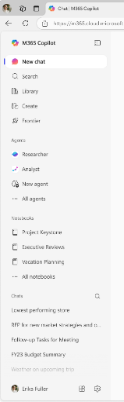
Microsoft 365 Copilot: AI Built for work
Create
Chat
Notebooks
AI-generated images, posters, banners, videos, and more that are aligned to your organization’s brand identity.
Secure AI chat with the latest models available and Work IQ intelligence layer.
Copilot is grounded in your project’s diverse content types to provide targeted responses and engaging audio overviews.
Search
Agents
AI search enhanced by Work IQ for fast and relevant results.
A broad ecosystem of pre-built agents available in the Agent Store and build your own agents in Copilot Studio.
Notes:
Before we dive into Maya's specific steps, let's quickly orient on the tools she'll be using. Copilot offers Create for building visual content like battle cards and banners. Chat provides secure AI conversation with the latest models and Work IQ intelligence. Notebooks ground Copilot in diverse content types in a single workspace. Search integrates natural language understanding with semantic indexing. And Agents — both first-party agents from Microsoft and custom ones you can build — give you specialized capabilities. All of these work together, and Maya will use several of them in her workflow.

Slide 13
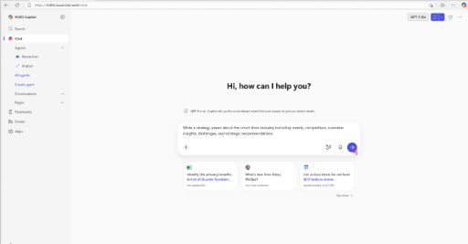
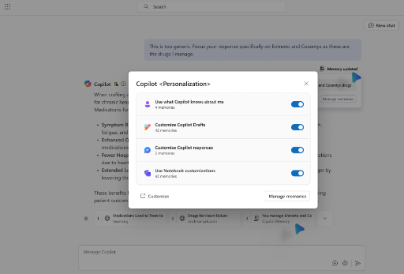
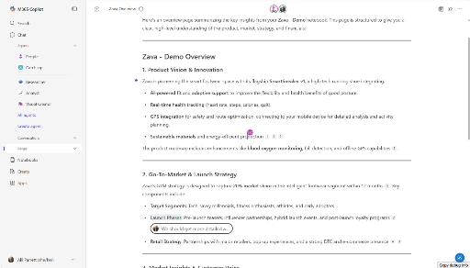
AI for Work: Chat
AI Chat for work
Personalized responses
Multiplayer collaboration
Ask Copilot to be your thought partner to explore new ideas and problem solve. Copilot uses Work IQ to understand your work and leverages advanced reasoning models for more complex queries.
Personalize your Copilot experience. Work IQ understands your style, habits, and preferences to deliver responses that are tailored and aligned to how you work best.
Convert AI outputs into durable content in Copilot Pages, designed for dynamic collaboration with AI and your teammates.
Notes:
Copilot Chat is like having a thought partner available anytime. You can ask it to help explore ideas, problem-solve, or work through complex queries using advanced reasoning models. A really powerful feature is personalized responses — you can tell Copilot to remember your preferences, like "I like concise responses" or "I prefer bulleted format," and it keeps that in your profile. Every time you prompt Copilot after that, it adapts to your style. You can also convert AI outputs into durable content through Copilot Pages for collaboration with teammates. It's designed for dynamic, multiplayer collaboration with AI.

Slide 14
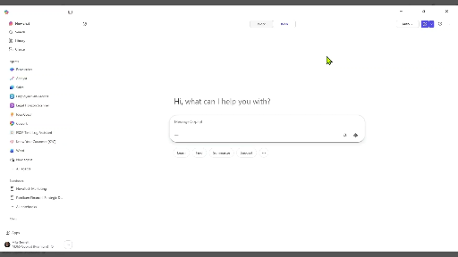
Marketing Experience: Chat
Example Prompt
Summarize recent competitive losses and understand positioning challenges
Using the attached files, write a board-prep brief with:
(1) the top 3 reasons NovaTech deals are stalling/losing to Salesforce Marketing Cloud (include a short quote or paraphrase + source),
(2) the competitor message that’s landing (1–2 bullets),
(3) where our current messaging is weakest (3 bullets), and
(4) 3 messaging adjustments we can make this week.
Close with a 20–30 second spoken setup I can say to open the board discussion. If anything is missing, list the specific gaps and questions to ask Sales.
/[Competitive_Win_Loss_Summary.docx]
/[Sales_Call_Notes_Field_Feedback.docx]
✨
✨
Notes:
Jignesh
Maya Patel is preparing for a board meeting in 10 days. Pipeline growth has slowed, and Salesforce Marketing Cloud is winning deals by positioning itself as the “AI-first marketing platform.” Maya needs to understand why — and fast.
Note how Maya makes sure to click on the “work” tab. She also has different models to choose from , and in this case she chooses the Claude Sonnet model. By adding two documents to her prompt, she is feeding Copilot exactly the right information for it to create a great response.

Slide 15
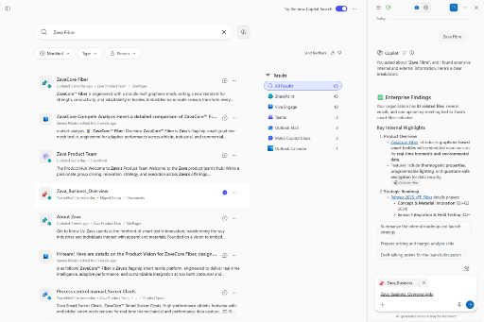
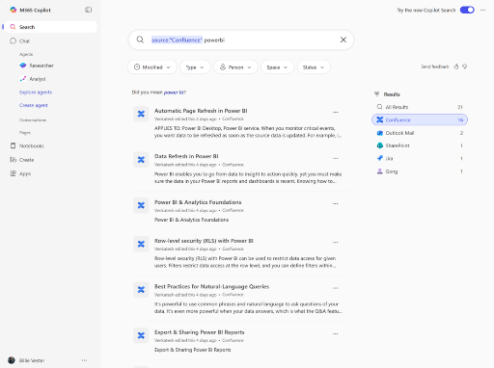
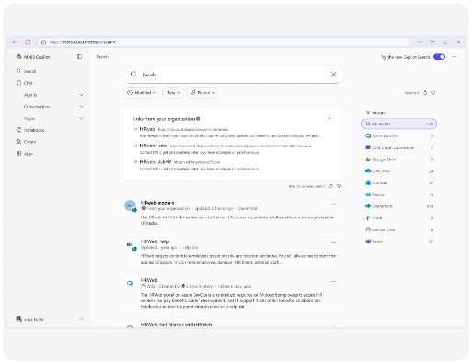
Search
Intelligent search
Broad connector ecosystem
Authoritative results
Integrates Copilot Chat’s natural language understanding with semantic indexing to uncover deeper, more relevant results and create a springboard for work.
Search across Microsoft 365,
on-premises, and other
LOB applications and services
using the extensive 100+ connectors ecosystem.
Allows admins to curate answers that provide concise, authoritative results that are especially relevant to your organization.
Notes:
Now let's talk about Search. Copilot Search integrates natural language understanding with semantic indexing to uncover deeper, more relevant results. It's not just keyword matching — it understands what you're actually looking for. It works across Microsoft 365, on-premises data, and other applications through connectors. And admins can curate authoritative results that provide concise, reliable answers. Without this, Maya would spend days pulling various reports and digging through sales emails. With Copilot Search, she gets everything surfaced in moments.

Slide 16
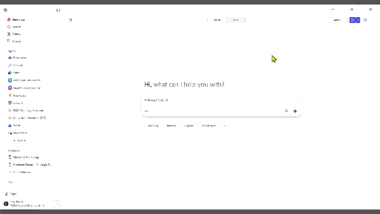
Marketing Experience: Search
Example Prompt
Surface information from multiple sources
“Search the last 6 months for “Salesforce Marketing Cloud” and “SFMC” across analyst reports, internal emails/Teams, and slide decks. Return:
(1) the top 5 recurring claims/themes (with the best supporting source for each),
(2) 6–8 high-signal results with a one-line why-it-matters, and
(3) a recommended short list of 4–6 sources to use for a repositioning work session. Prioritize content tied to late-stage deals, exec escalations, or explicit competitive takeaways.”
✨
✨
Notes:
Jignesh
Before Copilot, Maya would spend days pulling analyst reports, sales emails, and field notes. Watch how this changes.

Slide 17
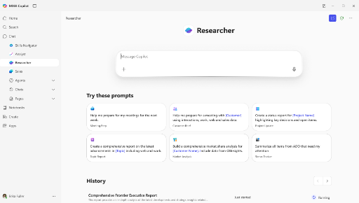
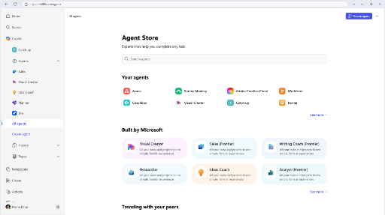
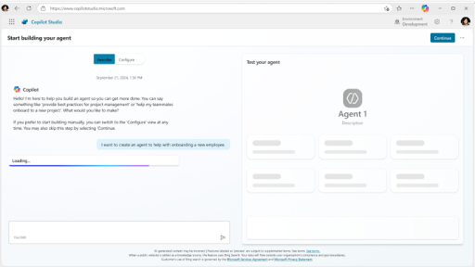
Agents
Use Microsoft agents
Discover agents
Build custom agents
Leverage agents built by Microsoft that use advanced reasoning
like Researcher and Analyst or specialized agents like Facilitator
for meeting management.
From Microsoft to trusted
third party agents, Agent Store
is where you find agents that
are ready to work for you.
Build your own agents with
Copilot Studio using natural
language or pro code tooling with the Microsoft 365 Agent SDK.
Notes:
Now we get to agents — an extremely powerful part of the Copilot ecosystem. Think of it this way: when you use an agent, you're scoping the boundaries of your requirement. For example, I worked with a customer last week who needed to monitor a US government website for newly approved patents every two weeks. They had a team of people doing this manually. During our training, they built an agent in about five minutes that pointed to that site with a simple prompt. Now the agent does all the work automatically. You can use Microsoft's first-party agents like Researcher and Analyst, discover agents in the Agent Store, or build your own with no-code or low-code approaches.

Slide 18













Automate tasks with pre-built agents by Microsoft
Researcher
Analyst
Surveys
Interpreter
Facilitator
Advanced reasoning
Advanced reasoning
End-to-end survey mgmt.
Multi-lingual translation
Teams meeting moderation
Generally available
Generally available
Generally Available
Generally available
Generally available
Knowledge
Channels
Project Manager
Communities
Workforce Insights
Content mgmt. & organization
AI teammate
Automate project mgmt.
Community mgmt.
Organizational insights
Public preview
Public preview
Public preview
Public preview
Frontier Program
Word
Excel
PowerPoint
People
Learning
Document creation
and iteration
Data visualizations
and insights
Build and iterate on presentations
Colleague connector & collaboration planner
Curated AI skill building resources
Frontier Program
Frontier Program
Frontier Program
Frontier Program
Frontier Program
Gain agent best practices at our AI Agent Hub AI agents – Microsoft Adoption
Notes:
Jignesh

Slide 19
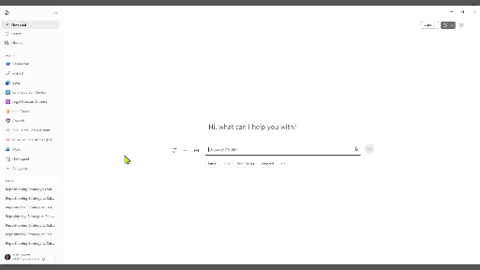
Marketing Experience: Agents
Example Prompt
Use Microsoft 1P Agents like Researcher to recommend competitive stance and the evidence behind it!
“You are supporting product marketing at NovaTech. Using the attached files, produce a decision-ready point of view on how we should reposition vs Salesforce Marketing Cloud.”
/[Existing_Value_Proposition_Framework.docx]
/Product_Capability_Comparison_Notebook.xlsx]
✨
✨
Notes:
Jignesh
Maya has raw inputs. Now she needs a clear point of view—fast—and something she can put in front of leaders without hand-stitching insights from multiple documents.

Slide 20





Researcher Agent
Included with Microsoft 365 Copilot
Researcher gives organizations the capability they’d expect from a highly paid strategist or researcher, by combining the most advanced deep reasoning models with your organization’s work data and information on the web.
 | Campaign Brief | Competitive Messaging Dossier | Trend & Content Gap Analysis | Campaign Performance Review | Audience & Persona Research
Pain point | Marketing teams waste time stitching together audience insights, past campaign results, and competitive context — often missing critical signals before a campaign launches. | Competitor messaging evolves quickly and is scattered across websites, press releases, and analyst reports — making it hard for marketers to build confident counter-narratives. | Content teams miss editorial opportunities because trend monitoring is manual and slow —“white space” becomes stale before content can be planned. | Preparing campaign performance reports for leadership is time-consuming — marketers manually pull metrics, context, and next steps from scattered sources. | Building accurate audience personas requires synthesizing CRM data, customer interviews, survey results, and market research — a process that takes days and often goes stale.
How Researcher can help | Researcher reviews emails, past briefs, CRM data,and public industry news to produce astructured, insight-rich campaign brief. | Researcher summarizes top competitors’ recent campaigns, messaging themes, and positioning weaknesses and surfaces counter-messaging strategies. | Researcher scans industry publications, search trends, and competitor content to highlight emerging topics and content gaps the team should own. | Researcher compiles campaign results, benchmarks them against goals and industry norms, and drafts a forward-looking recommendations section. | Researcher pulls together internal customer data, feedback, and external market research to produce rich, evidence-backed persona profiles with behavioral insights and messaging implications.
Prompt | Prepare a campaign brief for our upcoming [product] launch. Analyze my last 60 days of emails, Teams chats, and campaign files; merge with recent industry news and competitor activity to produce a brief covering audience segments, key messages, objections, and recommended channels. | Create a competitive messaging dossier for our [category]. Summarize the top 3 competitors’ recent campaigns, taglines, and messaging angles; identify weaknesses and provide counter-positioning recommendations for each. | Scan [industry] for trending topics and content gaps over the last 30 days. Highlight signals like rising search themes, underserved audience questions, or competitor content gaps, and recommend 5 content plays with suggested formats and channels. | Create a campaign performance review for our Q1 campaigns. Use my recent work artifacts and data files to summarize results vs. goals, highlight top-performing assets, include relevant industry benchmarks, and recommend 3 optimization priorities for Q2. | Build an audience persona profile for our [segment] buyers. Analyze my CRM notes, customer email threads, and survey files; cross-reference with public industry research to surface key demographics, motivations, objections, and preferred content formats. Produce 3 distinct personas with messaging recommendations foreach.
Notes:
Let me go deeper on the Researcher Agent. It gives organizations the capability you'd expect from a highly paid strategist. For marketing specifically, it can help with campaign briefs, competitive messaging, trend and content gap analysis, campaign performance reviews, and audience analysis. You can direct it to focus on specific sources — web research, your organization's data through Work IQ, or specific files you attach. It recently added infographic output, so you can get one or two pages of beautifully formatted HTML output. You can also export to Notebook, PowerPoint, or PDF.

Slide 21





Included with Microsoft 365 Copilot
Analyst Agent
Your personal data analyst that can reason over raw data from multiple sources to provide insights and visualizations in minutes. Analyst works with both structured (.xlsx, .csv) and unstructured (.docx, .pptx, .pdf) data, conducting advanced data analysis by executing Python code.
 | Audience Segmentation | Campaign Performance | Content Effectiveness | Competitive Intelligence | Market Opportunity
Pain point | Researchers rely on broad demographic profiles and gut instinct to define target segments, missing the behavioral signals that predict engagement. | Campaign results are measured in siloed channel metrics, making it hard to understand what truly drives pipeline and revenue contribution. | Content decisions are made by volume and creative intuition, not data on which assets actually move buyers through the funnel. | Competitive insights are scattered across win/loss reports, analyst briefs, and ad hoc sources — hard to synthesize quickly or reliably. | Market sizing relies on static TAM reports rather than real behavioral and engagement signals showing where demand actually exists.
How Analyst can help | Surface behavioral, firmographic, and engagement patterns across your data to build precise, actionable audience segments. | Correlate campaign attributes — channel, content, audience — with pipeline outcomes to reveal what actually works. | Map content consumption to pipeline stage progression to reveal which assets accelerate deals at each stage. | Synthesize win/loss and competitive data to surface where and why deals are won or lost by competitor and segment. | Identify under-served segments with high engagement signals but low conversion to uncover untapped demand pockets.
Prompt | Analyze my customer and prospect data to identify distinct segments based on behavior and firmographics...​ Rank segments by engagement level and pipeline contribution...​ Summarize messaging recommendations for each segment /[CRM_Export.xlsx] /[Engagement_Q1.csv] | Analyze campaign performance across channels for the last two quarters...​ Compare MQL conversion rates by channel, asset type, and audience segment...​ Identify top and bottom performing campaigns and recommend realignment actions /[Campaign_Results.xlsx] /[MQL_Data.csv] | Analyze content engagement data across all assets and funnel stages. Compare average stage cycle times for deals where specific content was consumed vs. not. Identify content gaps by stage and persona. Output a prioritization matrix with top 3 actions [Content_Engagement.csv] [Pipeline_State_Data.xlsx] | Analyze win/loss outcomes against our top 5 competitors over the last 6 months...​ Compare win rates by competitor, segment, and deal size...​ Identify recurring patterns in losses... Recommend 3 differentiation messaging actions per competitor /[WinLoss_Data.xlsx] /[Competitor_Research.pdf] | Map current market coverage against ICP criteria, engagementsignals, and pipeline density...​ Identify industries or segments with high interest signals butlow conversion rates...​ Flag top target segments for demand generation investment /[Market_Coverage.xlsx] /[ICP_Scoring.csv]
Notes:
Now let's look at the Analyst Agent. This is your personal data analyst that reasons over raw data from multiple sources to provide insights and visualizations in minutes. For marketing, think audience segmentation, campaign performance analysis, content effectiveness measurement, competitive intelligence, and market opportunity assessment. It works with both structured data like Excel and CSV files, and unstructured data like Word docs and PDFs. A great example — I worked with a customer who had a messy Excel file. They pointed Analyst at it and asked for the top 10 items to focus on. The agent delivered exactly what they needed. Survey outputs from Microsoft Forms in CSV format are another perfect use case.

Slide 22
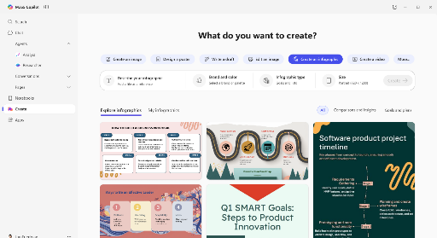
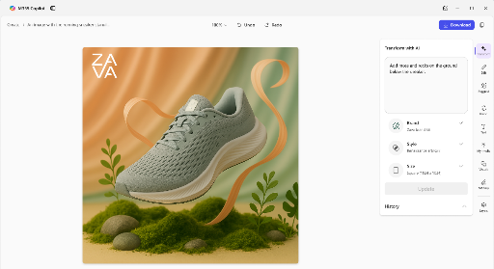
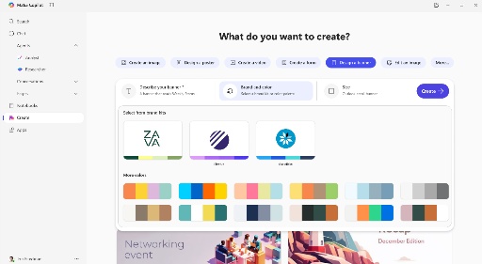
Create
AI-powered creation
Company brand kit
Full editing experience
Design and edit a wide range of visual artifacts personalized to you and your organization with Work IQ and OpenAI’s latest video model Sora2.
Choose from thousands of templates or create brand kits that include your company’s logos, color palettes, fonts, and more, ensuring brand consistency across all creative outputs.
Fine tune your work with built-in visual editing tools that make it easy to edit text, add effects, and make sophisticated adjustments to get the asset you need.
Notes:
Create is Copilot's AI-powered creation tool. You can design and edit a wide range of visual content — one-pagers, battle cards, posters, banners, even videos using OpenAI's latest models. It has a company brand kit feature so you can pull from thousands of templates or use your own brand assets. There's a full editing experience built in, and it can generate AI images based on your prompts. If Maya is building her case against Salesforce Marketing Cloud, Create can even generate relevant images for her presentation. Most customer tenants have Create rolled out by now — you should be able to see it in yours.

Slide 23
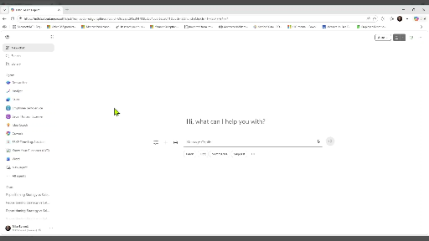
Marketing Experience: Create
Example Prompt
Generate a single, infographic-ready sales battlecard that Sales Enablement can drop into a slide!
“Using the attached file, write a one-page Sales Battlecard (infographic-ready) for competing against Salesforce Marketing Cloud.
Output format: Use the headings below, with concise bullets that can be pasted into a single slide. Keep each bullet under ~10 words and do not invent metrics (label any missing proof as “needs validation”).
Sales Battlecard: NovaTech vs Salesforce Marketing Cloud
Positioning (1 sentence)
When we win (3 bullets)
When we lose (3 bullets)
Top objections & best responses (4 objections; each with 2 response bullets)
Proof points (5 bullets)
Discovery questions (5 questions)
Landmines / say this instead (3 pairs)”
/[Competitive_Win_Loss_Summary.docx]
✨
✨
Notes:
Jignesh

Slide 24
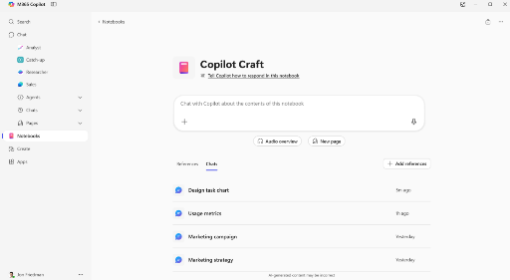
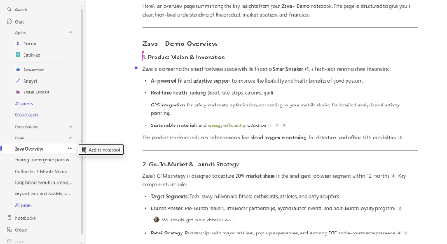
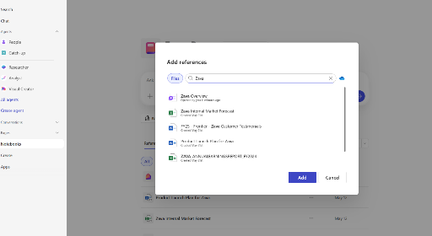
Notebooks
Intelligent workspace
Audio overviews
Suggestions and updates
Copilot is grounded in the Notebook, which holds diverse types of content in a single workspace, resulting in more relevant responses.
AI-generated podcast style summaries of your Notebook content help you quickly catch up and share content with teammates.
Intelligent suggestions recommend additional content and updates to your source material automatically reflect in the Notebook.
Notes:
Notebooks are a really powerful feature, especially with the updates we've shipped recently. Think of it as an intelligent workspace where Copilot is grounded in everything you put into the Notebook — diverse content types in a single place, resulting in more relevant responses. It offers audio overviews, which are AI-generated podcast-style summaries of your Notebook content — great for catching up quickly or sharing with teammates. It also provides intelligent suggestions that recommend additional content and updates to your source material, automatically reflecting in the Notebook.

Slide 25
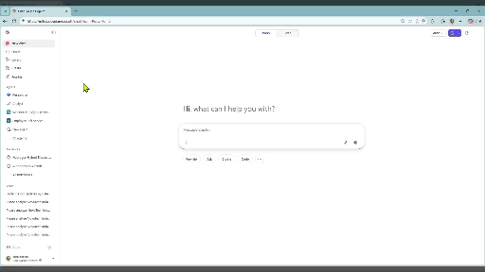
Marketing Experience: Notebook
Example Prompt
Use Notebook to help produce a clear point of view on how to reposition vs. a competitor.
“Using the attached file (match the tone of the Prior Executive Update if provided), draft a one-page executive brief that includes:
(1) Situation (3–4 sentences) — what changed competitively + why it matters now
(2) What we learned — 4 bullets, each tied to a specific notebook item/source
(3) Recommended stance — 3 bullets + the battlecard’s positioning statement
(4) 30‑day plan — 5 actions with owners (Marketing/Sales/Product) and expected impact (qualitative is fine)
(5) Leadership asks — 2–3 decisions/supports needed
Finish with a “read‑aloud” section: 3 bullets that take ~15 seconds total. Keep it crisp and avoid new claims not supported by the notebook content.”
/[Executive_Brief_Board_Update_Template.docx]
✨
✨
Notes:
Jignesh
Maya needs to walk into the CFO/board review with a tight narrative. A notebook lets her pull the best evidence and outputs into one place, then generate a decision-ready brief—in the correct format without losing track of sources.
This is the shift from reactive marketing to strategic product marketing. Copilot doesn’t replace Maya — it gives her the leverage to outmaneuver competitors in real time.

Slide 26
Next Steps
&
Call to Action
Notes:
That wraps up our walkthrough of Maya's marketing scenario. Now let's shift to next steps and calls to action for you. As you think about what you've seen today, consider: where in your own marketing workflow could you start infusing these tools? What's the first problem you'd frame with Copilot Chat? What research would you hand off to the Researcher Agent? The best way to learn is to just try it out — there's nothing you can break. It's you and the system, and it's the most individualistic technology we've ever seen.

Slide 27



Visit Customer Hub website for upcoming sessions, updates, and on demand contents!
https://aka.ms/CustomerHubSessions​
Notes:
Head over to the Customer Hub website for upcoming sessions, updates, and all our on-demand content. If you missed a previous session or want to revisit something, it's all there. Just scan the QR code with your phone or click the link. We post all recordings and slide decks after each session. We also heard requests for the Copilot Innovation Briefing and the legal session to be posted sooner — we'll follow up with our marketing team to bump those up in the queue.

Slide 28

Microsoft investments to accelerate your time to value
Microsoft 365 Copilot
End User Help and
Learning, Support Articles, How-to Videos
Get started building
AI Agents for
Microsoft 365 Copilot
Onboard at scale with resources enabling adoption, usage, change management and business outcomes.
Find Partners to help with Microsoft 365 Copilot Scenarios, Adoption and Agentic Transformation
Microsoft 365 Copilot
Help and Learning
AI Agents Hub
adoption.microsoft.com
Microsoft 365 Copilot
Partner Directory
Enterprise skilling plan, Microsoft Instructor-led training, Microsoft Certification discounts
Eligible customers
can request technical and deployment
assistance from Microsoft.
Microsoft Unified Support offerings and workshops focused on business value, governance, and enablement..
Enterprise Skilling Initiative
Microsoft FastTrack
Microsoft Unified
Notes:
Microsoft has made significant investments to help you accelerate time to value with Copilot. There are multiple support options available — from our partner ecosystem, to FastTrack, to unified support. There's a whole ecosystem designed to help you plan, deploy, and scale Copilot as effectively as possible across your organization. This isn't just about what you do in marketing — it's about being part of this tectonic shift as we all embrace AI and find our footing with this technology.

Slide 29
Make a difference
Become a
Champion
Get more from Copilot and Microsoft 365
Help others do the same
Expand your knowledge and enhance your career
Get more from Copilot and Microsoft 365
Help others do the same
Expand your knowledge and enhance your career
Join the free program at aka.ms/M365Champions
Notes:
I want to highlight our Champions program. If you want to really gear up and become the go-to Copilot expert in your organization, this is your path. Champions get more from Copilot, help others do the same, and expand their knowledge and career. Think of it like the wave at a football stadium — it works best when everyone knows what they're doing. Be the lighthouse in your marketing organization. Start sharing knowledge, take each other on with innovative thinking, and see how your team can reinvent entire workflows together. Join the free program at aka.ms/M365Champions.

Slide 30

THANK YOU –
Your feedback is critical
Scan with your mobile device camera
-OR-
We’re committed to making your Customer Hub experience the best it can be – and your feedback is a critical component to that.
Before you scoot, please take a moment to provide some feedback.
Visit
Customer Hub Survey
aka.ms/CustomerHubSurvey
Select
Copilot and Agents Spotlight:
Your Role, Reinvented
Notes:
Before we wrap up, we'd really appreciate your feedback! Please take a moment to fill out our Customer Hub survey — scan the QR code or visit the link. Your feedback is critical to helping us make these sessions better. Be ruthless with it! Tell us what worked, what didn't, and what you'd like to see in future sessions. That's the one way we can keep improving and zooming in on what matters most to you.

Slide 31

Q&A
1
Please raise your hand and unmute when called on
2
Notes:
Alright, let's open it up for Q&A! If you've got a question, you can raise your hand in Teams and I'll enable your microphone, or just drop it in the chat. A few things that came up during the session: if you're not seeing all the features Jignesh showed, check whether you have the full Microsoft 365 Copilot license versus Copilot Chat. Notebook requires the full license. And for Teams meetings, the Facilitator agent is fantastic — just remember that transcription needs to be turned on. Copilot reads the transcript, not the audio itself. Also, whatever Microsoft 365 Search can see, Copilot can see too — and only what you have permission to access.

Slide 32
Notes:
Thank you so much for joining us today! We hope this session gave you practical, actionable ideas for reimagining your marketing processes with Copilot and Agents. Remember — the best way to learn is to dive in and start experimenting. Happy Copiloting, everyone!

Slide 33

Reimagine Marketing
Processes with
Copilot & Agents
We’ll begin shortly
Copilot & Agents Spotlight Series: Your Role; Reinvented
Microsoft confidential
Notes:
Welcome! We'll be getting started in just a few moments. While you're waiting, feel free to introduce yourself in the chat. We've got about 120 people registered today and we're excited to have you join us for this Customer Hub session on Reimagining Marketing Processes with Copilot and Agents.

Slide 34
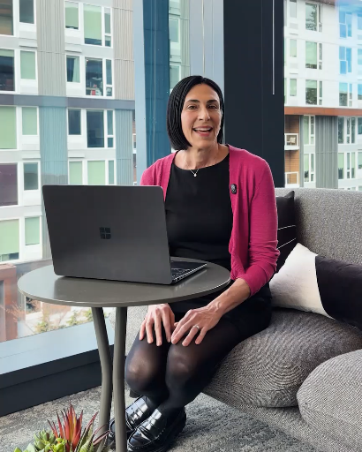

Marketing Professional
Day in the Life
Market Research and Campaign Development
Nicole Herskowitz
Vice President, Marketing
AI at Workforce, Microsoft
Notes:
I love this example of how Dawn is transforming her work.
How many of you would find value in delivering easier workforce insights to your leaders and organization?

