Slide 1
Copilot Chat Prompt Mastery Series
March 25, 2026

Slide 2
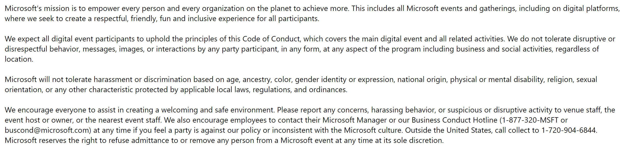
Microsoft Digital Event Code of Conduct

Slide 3
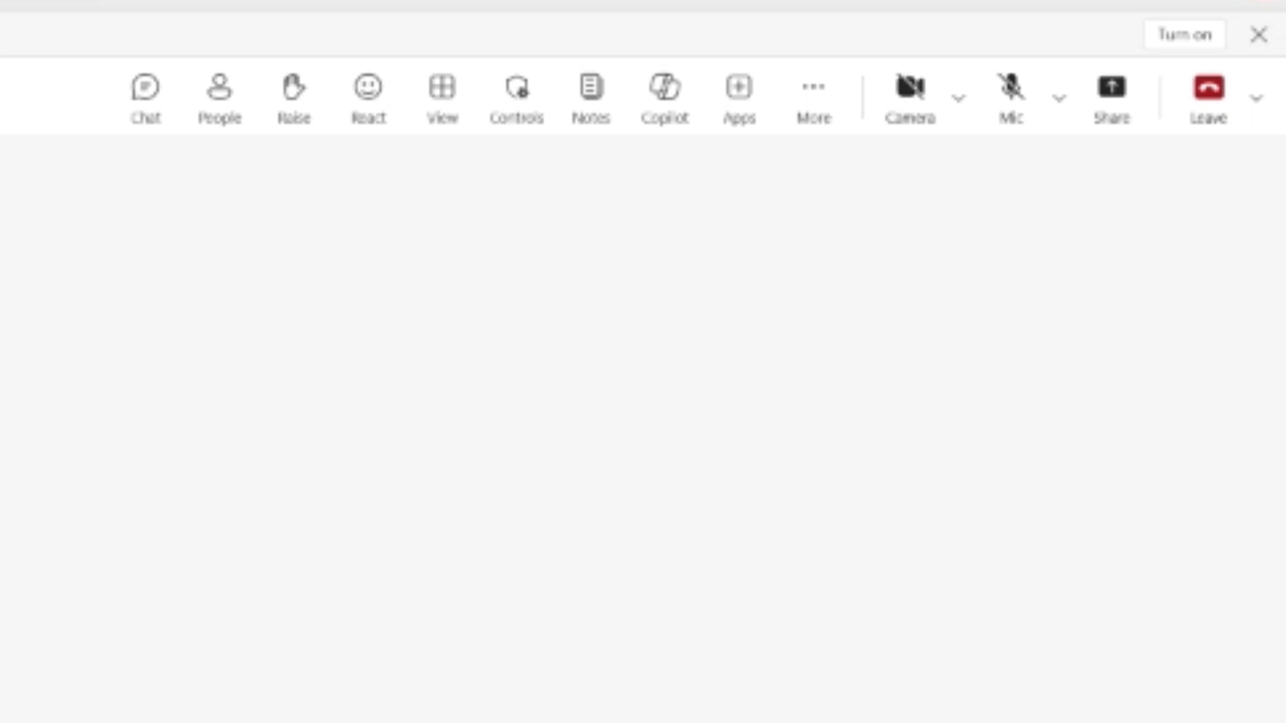

Accessibility Settings for your preference
Close Captioning (on/off)
Select More > Language and speech >
Turn on (off) live captions
Enlarge Content to your screen
Press Windows logo Key and (+) to zoom in
Press Windows logo Key and (Esc) to zoom out
High contrast view
Select Settings > Appearance and accessibility
Under Theme choose High contrast.

Slide 4
Participation
Session will be recorded
Use Q&A for questions
Resources will be shared during and after session
Share feedback and request assistance

Slide 5






Sponsor & Lead
Host
Stephanie Hernandez
Customer Success Lead
Director, Cloud Solution Architect – Oil Gas & Energy
Sharon Salazar
Cloud Solution Architect
Copilot
Moderators
Jennifer Snoddy
Senior Cloud Solution Architect Copilot
Armando Hernandez
Senior Cloud Solution Architect Copilot
Wes Horn
Senior Cloud Solution Architect Copilot
Karina Leal
SR LEARNING MGR
Notes:
Karina

Slide 6
Agenda
1
A day in the life of Riley using Copilot Chat
Meet Riley – The role & daily challenges
Morning: Using files in Copilot Chat
Late morning: Grounding & better prompts
Afternoon: Integrations & research-style tasks
Late afternoon: Refinement & summaries
2
Q&A

Slide 7

A Day in the Life with Copilot Chat
Responsibilities:
Reviewing daily operational reports
Validating safety and compliance documentation
Preparing summaries for field managers
Tracking production KPIs & risks
Name: Riley Thompson Role: Operations Analyst Company Type: Contoso Energy Provider

Slide 8
“I have information everywhere—PDFs, Excel files, emails but not enough time.”
Daily Challenges
“I’m constantly translating technical details into executive‑ready summaries.”
“My production data, safety logs, and maintenance notes are all in different files—and I don’t have time to read everything in detail.”
Notes:
“These are exactly the moments where Copilot Chat helps Riley reduce friction—not replace expertise.”

Slide 9
Morning Scenario (8:30 AM)
Using Files with Copilot Chat
Riley starts the day by reviewing yesterday’s production and safety data.
Late Morning (10:30 AM)
Grounding Copilot with Context
Riley needs to send a summary to leadership—but wants the tone executive‑friendly.

Slide 10
Afternoon Scenario (1:00 PM)
Integration-Style Use (Research & Knowledge Tasks)
Riley is preparing for a discussion about compressor downtime impacts.
Late Afternoon (3:30 PM)
Combining Files + Knowledge
Riley now wants to combine insights.
End of Day (4:45 PM)
Copilot Chat as a Thought Partner
Before logging off, Riley prepares notes for tomorrow.

Slide 11
Key Takeaways
🗂️ You must provide the data (files or pasted text)
🧭 Grounding matters – be explicit about sources
🔍 Great for research, summaries, drafting, and thinking
🤖 Works best as a copilot, not an autopilot

Slide 12
Q&A

Slide 13
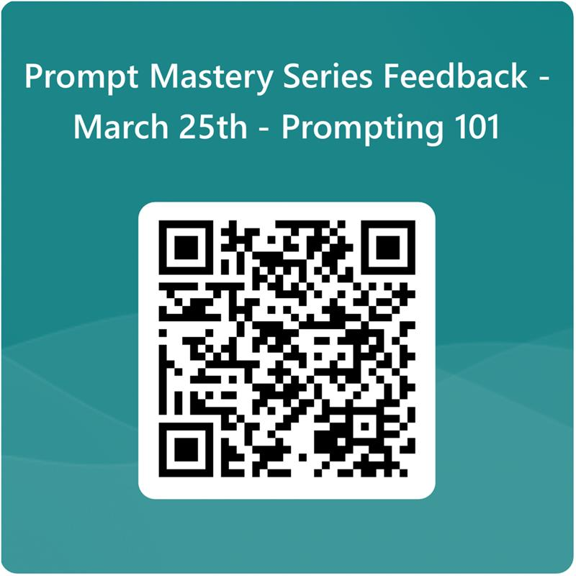

Slide 14
Thank you

