Slide 1
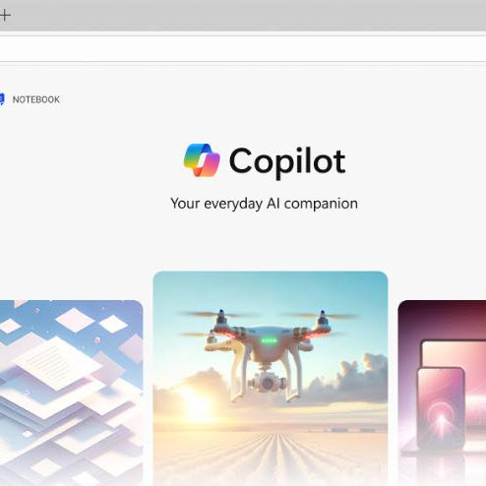
New Year, New You with Microsoft 365 Copilot Chat
Microsoft confidential

Slide 2


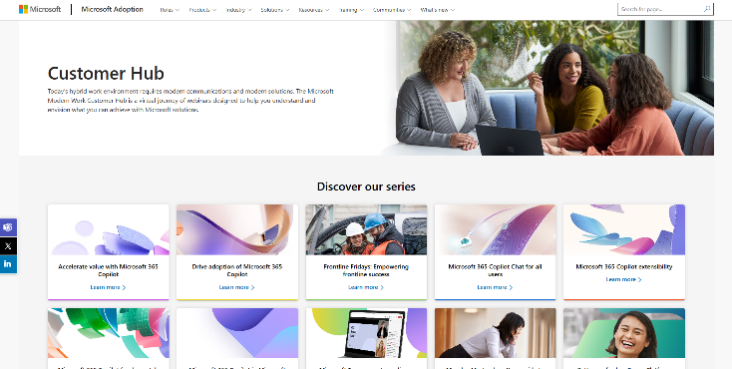
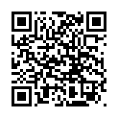
Visit Customer Hub website for upcoming sessions, updates, and on demand contents!
https://aka.ms/CustomerHubSessions​

Slide 3

Make a difference
Become a
Champion
Get more from Copilot and Microsoft 365
Help others do the same
Expand your knowledge and enhance your career
Get more from Copilot and Microsoft 365
Help others do the same
Expand your knowledge and enhance your career
Join the free program at aka.ms/M365Champions

Slide 4



During the presentation
After the presentation
We will mute your microphone for the first part of today’s call
Raise your hand and we will
call on you
Ask your questions via chat, we will get to all of them, live or after. Common questions will get addressed out loud
Open mic – come off mute and ask away!

Slide 5
Agenda
Microsoft 365 Copilot Chat (level set)
The Art of the Prompt
New Year, New You: Working Alongside AI
  Action Follows Meaning
  Define, then Refine
  Operationalize Best Practices
Agents: Idea Coach, Prompt Coach
Next Steps & Resources

Slide 6
New Year, New You with Microsoft 365 Copilot Chat
Benefits of working alongside AI with tools like Copilot Chat
65%
50%
77%
of enterprise users report a measurable productivity boost with Copilot and Copilot Chat
Of workers use AI regularly, doubling in the last two years
Start with AI because tools like Copilot Chat are always available, fast,
and high‑quality.
Source: Work Trend Index Report, April 2025

Slide 7


Copilot is the UI for AI
Microsoft 365 Copilot and Copilot Chat
Agents

Slide 8
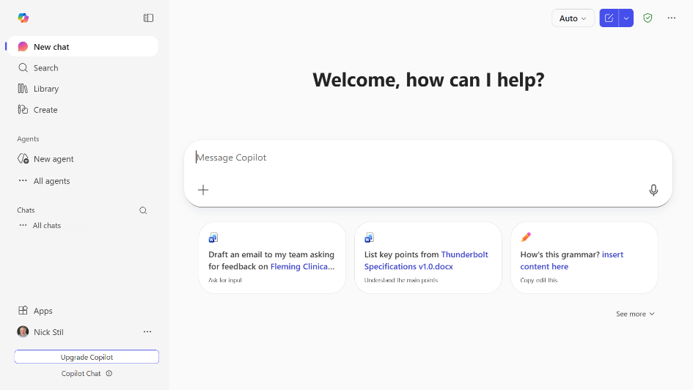
Start a new chat button
Clear your past chat and start a new conversation.
Library
Access workspaces in Copilot Pages and generated images
Create
Generate text‑based content like agendas, documents, presentations.
Prompt box
Start your conversation here
Agents
Use existing agents or create new ones.
Dictation
Use dictation if you prefer to speak rather than type when you’re chatting with Copilot
Chat history
View past conversations
Add content
Expand to upload files and images or reference a file on OneDrive or SharePoint
Suggested prompts
Get started with prompt suggestions
Copilot Prompt Gallery
Expand the suggested prompts to view the full Copilot Prompt Gallery, including saved prompts and prompts from your team

Slide 9
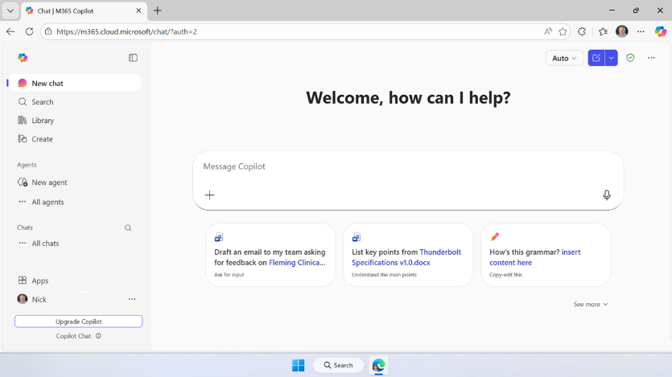
Where to find Copilot Chat
On the Web
Powered by the
Latest GPT Model
Secure AI chat powered by the latest models, grounded in web data, and context-aware, understanding the content you’re working on and tailoring responses accordingly.
m365.cloud.microsoft/chat

Slide 10
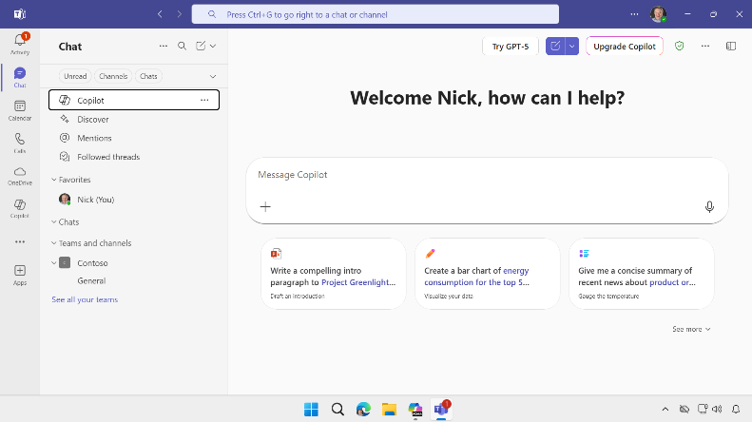
Where to find Copilot Chat
Microsoft
Teams
Prefer to work in Teams or Use “one pane of glass?”
Open Microsoft Teams. Go to Chat on the left side of Teams. Select Copilot from the top of your Teams chat list.

Slide 11

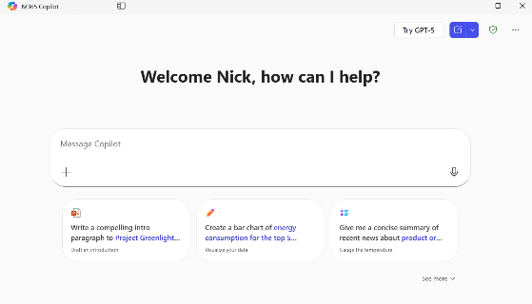
Where to find Copilot Chat
Windows and
Mac App
macOS: Launch from the Dock or Press Option + Spacebar
Windows: Launch from the Taskbar or press Windows Key + C or Copilot Key.

Slide 12
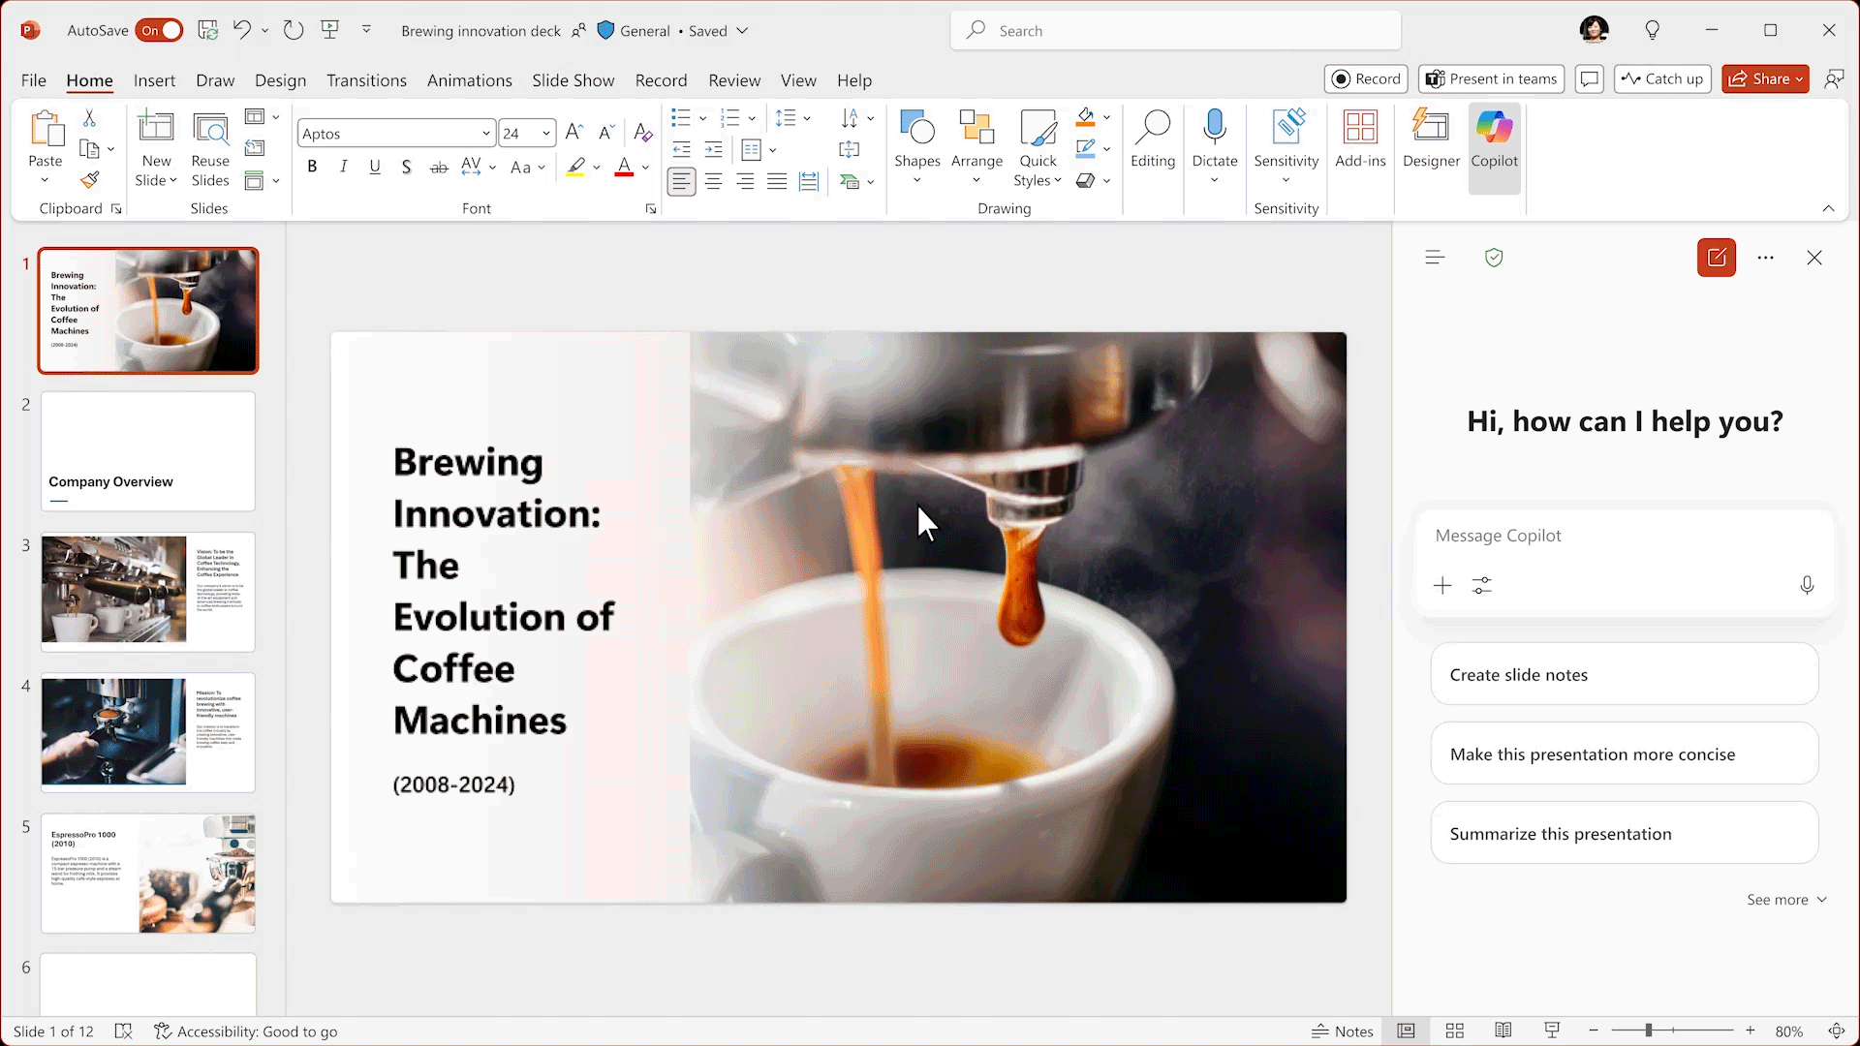






Where to find Copilot Chat
Microsoft 365 Apps
Copilot Chat pane for unlicensed Users in Word, Excel, PowerPoint, Outlook, OneNote, and Teams, grounded on the current file or content, and the web.

Slide 13
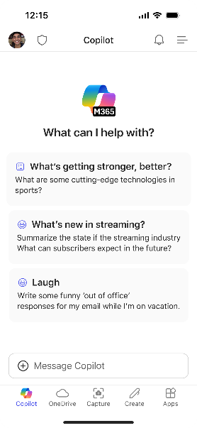
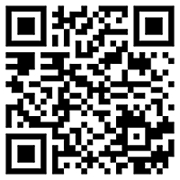
Microsoft 365 Copilot Mobile App
Windows, iOS and Android
Download the Microsoft 365 Copilot mobile app and sign in with your work or school account to access Copilot Chat on the Go
aka.ms/copilotmobile

Slide 14
● Included ο Limited ▲ Metered
Microsoft 365 Copilot (licensed) and Copilot Chat (included)
Microsoft 365
Copilot Chat
Microsoft 365
Copilot
w/o Copilot license
$30 pu/pm
Grounding | Web data, referenced files, uploaded files | ● | ●
 | Work IQ¹ | - | ●
Models | GPT-5.2 | Standard | Priority
 | Model choice | - | ●
Microsoft 365 Copilot App | Chat | ● | ●
 | Search² | ο | ●
 | Notebooks | - | ●
 | Create | Standard | Priority
 | Memory and personalization | ● | ●
 | Voice on mobile, desktop, web | Standard | Priority
 | Sora 2⁴ | - | ●
 | Copilot Mode in Edge⁵ | ο | ●
 | Role-based AI solutions (Sales, Service, Finance) ⁶ | - | ●
M365 Apps | Agent Mode in M365 apps and Chat for Office artifact creation⁴ | Standard | Priority
 | Copilot in Teams and Teams mode | - | ●
 | Advanced AI skills in M365 apps | - | ●
Agents & tools | Agent creation using Copilot Studio⁷ | ● | ●
 | Agent usage | ▲ | ●
 | Copilot Tuning⁸ | ▲ | ●
 | Employee Self Service agent | ▲ | ●
 | Pre-built Microsoft agents, including deep reasoning⁹ and app-based agents | - | ●
 | Copilot connectors³ for external data sources | ο | ●
 | App Builder and Workflows⁴ | - | ●
Security and management | Enterprise Data Protection (EDP), management, compliance, and controls | ● | ●
 | Copilot Analytics | ο | ●
 | SharePoint Advanced Management | - | ●
Today’s Session ➔
Copilot Chat Users can access Outlook inbox, emails, and files
Basic search (not semantically indexed) included for Copilot Chat Users;
AI-powered search included for M365 Copilot Users
Reasoning applies to M365 Copilot Users only; external data includes 3P and LOB data
Available via the Frontier program
Copilot Chat Users access Copilot Mode w/web data and open documents only
Rollout of Service to GA and Sales and Finance to Public Preview Dec. 2025
Agent Builder for Copilot Chat and Agent Builder and Copilot Studio for M365 Copilot subscribers
Public Preview in Dec; Tuning experience restricted to tenants with >5K seats
Researcher and Analyst agents have combined limit of 25 interactions pu/pm

Slide 15
Agenda
Microsoft 365 Copilot Chat (level set)
The Art of the Prompt
New Year, New You: Working Alongside AI
  Action Follows Meaning
  Define, then Refine
  Operationalize Best Practices
Agents: Idea Coach, Prompt Coach
Next Steps & Resources

Slide 16
The Art and Science of prompting
Include the right prompt ingredients
To get the best response, it’s important to focus on some of the key elements when phrasing your Copilot prompts.
Goal
Context
Expectations
Goal
Context
Source
Expectations
Source
What response do you want from Copilot?
Why do you need it and who is involved?
Which information sources or samples should Copilot Use?
How should Copilot respond
to meet your expectations?
aka.ms/CopilotPromptIngredients

Slide 17
Include the right prompt ingredients
Brainstorm ideas for an icebreaker at a team meeting
aka.ms/CopilotPromptIngredients

Slide 18
Include the right prompt ingredients
Goal
Context
What outcome are you trying to achieve?
Why do you need it and who is involved?
Generate a list of simple icebreaker activities
that don't require props or setup. I'll use them to open our team offsite meeting. Use team facilitator best practices suitable for a work environment. Include a numbered list of the steps for each one.
Which information sources or samples should Copilot use?
How should Copilot respond
to best meet your expectations?
Source
Expectations
aka.ms/CopilotPromptIngredients

Slide 19
Agenda
Microsoft 365 Copilot Chat (level set)
The Art of the Prompt
New Year, New You: Working Alongside AI
  Action Follows Meaning
  Define, then Refine
  Operationalize Best Practices
Agents: Idea Coach, Prompt Coach
Next Steps & Resources

Slide 20

Action Follows Meaning
Action is easier when ambiguity is removed
Mistakes arise when we act before understanding
Karl Weick: Enactment > Sensemaking > Action
Summarize this email into a short executive brief: 2–3 sentences that capture the main point, key context, and any actions or decisions required.
Create a meeting summary from this whiteboard. Focus on decisions and risks discussed. Then give me a one-sentence executive recap.
Distill long documents or email threads into key points
Ask Copilot Chat to surface assumptions or areas of ambiguity
Turn rough notes into a coherent summary of what was discussed

Slide 21
Define, then Refine
Separate Thinking from Polishing
Mixing idea generation and evaluation slows both
Draft first, improve deliberately
Help me brainstorm a new project. Ask me clarifying questions to understand the problem space, constraints, and intended outcome.
Reply to this email – didn’t get the artwork done, very sorry, vendor didn’t respond, working on it, give me till Friday
Brainstorm a Project
Draft an Email Reply
Try Idea Coach

Slide 22
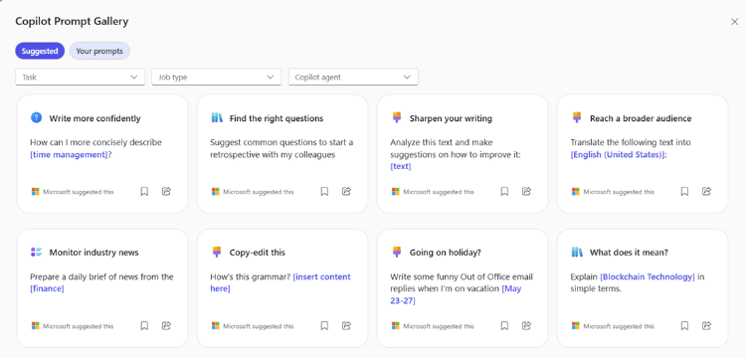
Operationalize
Best Practices
Quality improves when best practices are made repeatable and embedded into the system - not individual heroics.
Copilot Chat
Prompt Gallery
Copilot Chat
Custom Instructions
Copilot Chat
Memory

Slide 23
Agenda
Microsoft 365 Copilot Chat (level set)
The Art of the Prompt
New Year, New You: Working Alongside AI
  Action Follows Meaning
  Define, then Refine
  Operationalize Best Practices
Agents: Idea Coach, Prompt Coach
Next Steps & Resources

Slide 24
Meeting Prep Prompt
Meeting Prep Agent
Name and Description
Goal
Context
The Client Meeting Prep Agent streamlines client meeting preparation by summarizing past activity into concise and actionable insights. Its primary focus is on reviewing specific email, chat, and work data to extract relevant updates, decisions, and action items
What response do you want from Copilot?
Why do you need it and who is involved?
Instructions and Parameters
Generate 3-5 bullet points to prepare me for a meeting with Client X to discuss their “Phase 3+” brand campaign. Focus on email and Teams chats since June. Please use simple language so I can get up to speed quickly.
- Look for occurrences of the phase provided in the user’s work data
- Ignore information older than 18 months ago
- Extract important updates, decisions, or action items
- Summarize the findings in 3-5 simple bullet points, one sentence each
Knowledge Sources
https://sharepoint.contoso.com/sites/prospecting/files/intake
https://sharepoint.contoso.com/bizdevteam
https://www.marketwatch.com/latest-news
Which information sources or samples should Copilot use?
How should Copilot respond
to best meet your expectations?
Conversation Starters
Source
Expectations
Latest News
What’s the latest news about /client?
Recent Meetings
List meetings from the last 30 days with /client

Slide 25





Built-in Agent Templates in Copilot Chat
 | Agent Name | Description
 | Writing Coach | Provides detailed feedback on writing. Helps change the tone of messages, translates text, and assists in writing tasks
 | Idea Coach | Helps users brainstorm and organize ideas
 | Prompt Coach | Assists users in creating effective well-structured prompts for Copilot
 | Career Coach | Provides personalized career development suggestions including role understanding, skill gap analysis, learning opportunities, and career transition plans
 | Learning Coach | Helps users understand complex topics by breaking them down into simple, intermediate, and advanced summaries. Provides guided practice and learning plans
Microsoft 365 Admin Center > Settings > Integrated Apps

Slide 26
Agenda
Microsoft 365 Copilot Chat (level set)
The Art of the Prompt
New Year, New You: Working Alongside AI
  Action Follows Meaning
  Define, then Refine
  Operationalize Best Practices
Agents: Idea Coach, Prompt Coach
Next Steps & Resources

Slide 27
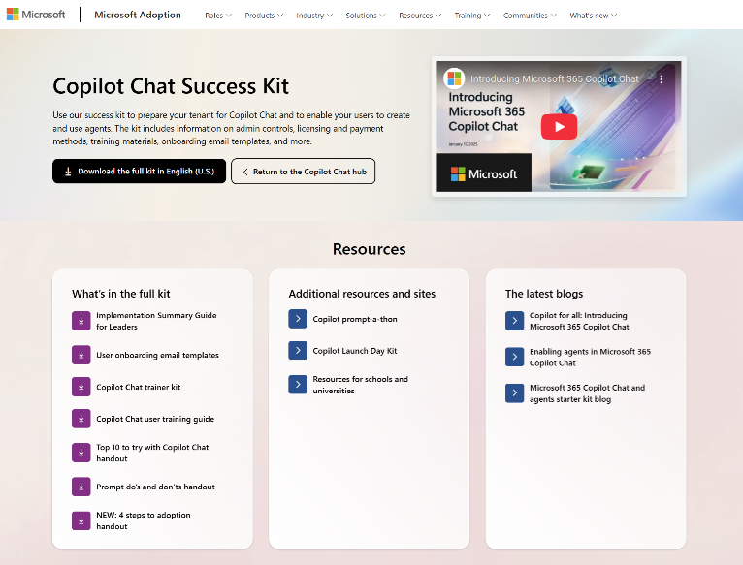

Microsoft 365 Copilot Chat Success Kit
adoption.microsoft.com/copilot-chat/success-kit
Use the success kit to prepare your organization for Copilot Chat with information on admin controls, licensing and payment methods, training materials, onboarding email templates, and more.

Slide 28
Visit Customer Hub website for upcoming sessions, updates, and on demand contents!
https://aka.ms/CustomerHubSessions​

Slide 29

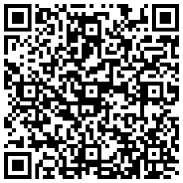
THANK YOU –
Your feedback is critical
Scan with your mobile device camera
-OR-
We’re committed to making your Customer Hub experience the best it can be – and your feedback is a critical component to that.
Before you scoot, please take a moment to provide some feedback.
Visit
Customer Hub Survey
aka.ms/CustomerHubSurvey
Select Frontline Friday Series

Slide 30

Q&A
1
Please raise your hand and unmute when called on
2

