Slide 1
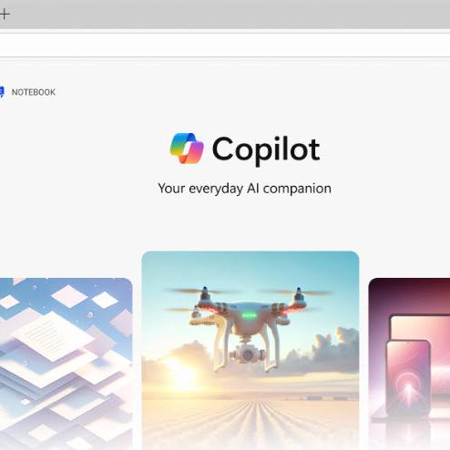
New Year, New You for Microsoft 365 Copilot Subscribers
Microsoft confidential

Slide 2


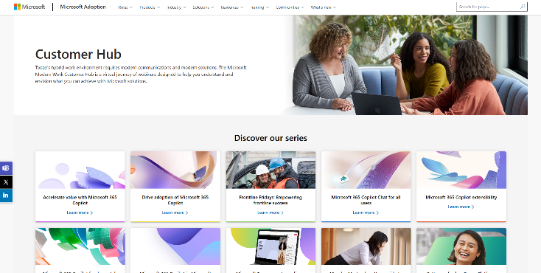
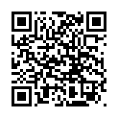
Visit Customer Hub website for upcoming sessions, updates, and on demand contents!
https://aka.ms/CustomerHubSessions​

Slide 3
Agenda
Microsoft 365 Copilot Level-Set
Art of the Prompt
New Year, New You: Working Alongside AI
Urgent ≠ Important
Action Follows Meaning
Define, then Refine
Operationalize Best Practices
Resources and Next Steps

Slide 4

Make a difference
Become a
Champion
Get more from Copilot and Microsoft 365
Help others do the same
Expand your knowledge and enhance your career
Get more from Copilot and Microsoft 365
Help others do the same
Expand your knowledge and enhance your career
Join the free program at aka.ms/M365Champions

Slide 5
Resources after Today
Microsoft 365 Copilot Help & Learning support.microsoft.com/copilot-skilling Short how-to videos, help articles
Great Copilot Journey aka.ms/GreatCopilotJourney 30-day skilling, daily tips and templates
Top 10 Things to Try First aka.ms/Copilot/Top10TryFirst PDF Handout of sample prompts
Art of the Prompt aka.ms/CopilotPromptIngredients How to write a good Prompt
Copilot Prompt Gallery aka.ms/prompts Samples and prompts you saved
Microsoft 365 Copilot Adoption adoption.microsoft.com/copilot Resources for Adoptioon specialists
Trainer Kit aka.ms/Copilot/TrainerKit PowerPoint decks for End User Training
Copilot Scenario Library aka.ms/copilot/scenariolibrary Examples of business use cases
Microsoft 365 Champions Program aka.ms/M365Champions Champs community, monthly calls,
Technical Documentation for IT Pros learn.microsoft.com/copilot/microsoft-365

Slide 6



During the presentation
After the presentation
We will mute your microphone for the first part of today’s call
Raise your hand and we will call on you
Ask your questions via chat, we will get to all of them, live or after. Common questions will get addressed out loud
Open mic – come off mute and ask away!

Slide 7
Agenda
Microsoft 365 Copilot Level-Set
Art of the Prompt
New Year, New You: Working Alongside AI
Urgent ≠ Important
Action Follows Meaning
Define, then Refine
Operationalize Best Practices
Resources and Next Steps

Slide 8
New Year, New You with Microsoft 365 Copilot Benefits of working alongside AI with tools like Copilot
65%
50%
77%
of enterprise users report a measurable productivity boost with Copilot and Copilot Chat
Of workers use AI regularly, doubling in the last two years
Start with AI because tools like Copilot Chat are always available, fast, and high‑quality.
Source: Work Trend Index Report, April 2025

Slide 9


Copilot is the UI for AI
Microsoft 365 Copilot
Agents

Slide 10
















Work IQ
Your style, habits, relationships, and workflows
Your organization and individual content like files, emails, and meetings – plus line of business data
Contextual insights and predictive actions from across your data and memory
Memory
Data
Inference
EMAIL
MEETINGS
sendChat
manager
CHAT
FILES
sendsMail
attendsCall
TEAMSITE
worksWith
memberOf
CALENDAR
worksWith
DOCUMENTS
“Copilot, make a list of files I need to review . . . for my most important meeting next week. Include a three-sentence summary for each.”
“Copilot, make a list of files I need to review . . . for my most important meeting next week. Include a three-sentence summary for each.”
“Copilot, make a list of files I need to review . . . for my most important meeting next week. Include a three-sentence summary for each."
DATA

Slide 11

Work IQ
Your style, habits, relationships, and workflows
Contextual insights and predictive actions from across your data and memory
Memory
Inference
You at work
Your organization and individual content like files, emails, and meetings – plus line of business data
Data

Slide 12
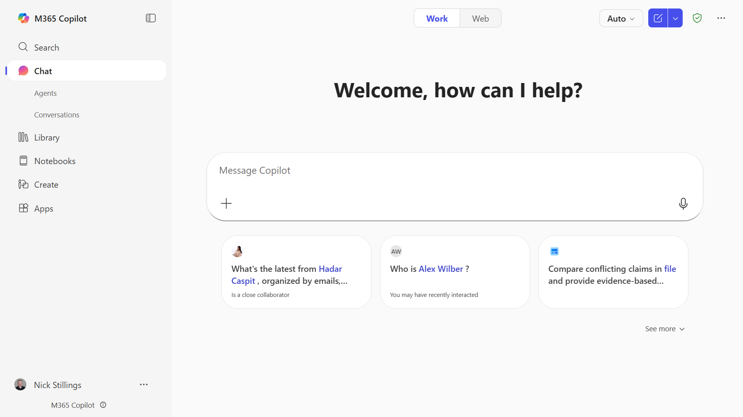
Agents Use existing agents or create new ones.
Copilot Search AI-powered universal search experience
Copilot Create Generate images, videos, agendas, documents, presentations, and more
Work/Web Toggle Ground on Work data or web search
Model Selector Quick response or Think Deeper
Start a new chat. Clear your past chat and start a new conversation.
Conversations Copilot chat history
Library Access your Copilot generated Pages and Create content
Prompt box
Start your conversation here
Dictation
Use dictation if you prefer to speak rather than type when you’re chatting with Copilot
Notebooks
Organize files, pages, Copilot chats and more into an AI project space
Add content Expand to upload files and images or reference a file on OneDrive or SharePoint
Suggested prompts Get started with prompt suggestions
Copilot Prompt Gallery Expand the suggested prompts to view the full Copilot Prompt Gallery, including saved prompts and prompts from your team

Slide 13
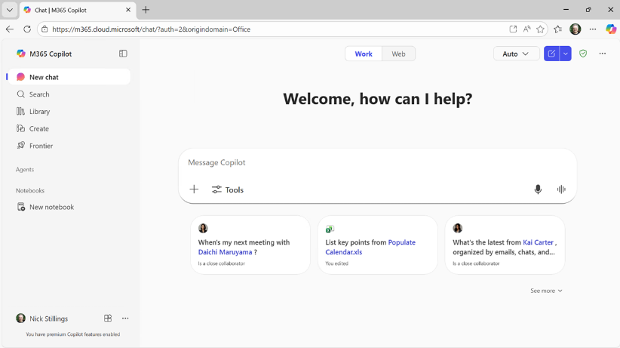
Where to find Copilot On the Web
Secure AI chat powered by the latest models, grounded in web data, and context-aware, understanding the content you’re working on and tailoring responses accordingly.
m365.cloud.microsoft/chat

Slide 14
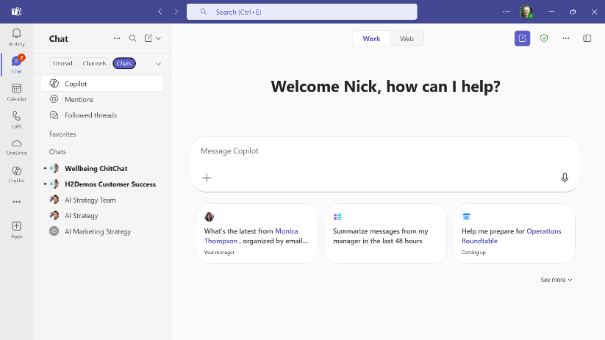
Where to find Copilot Microsoft
Teams
Prefer to work in Teams or use “one pane of glass?”
Open Microsoft Teams. Go to Chat on the left side of Teams. Select Copilot from the top of your Teams chat list.

Slide 15
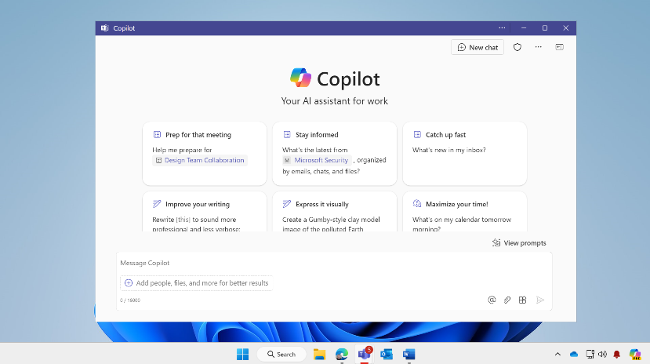
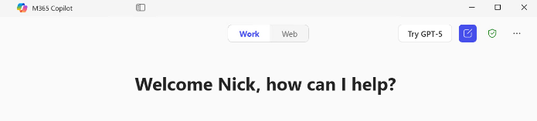
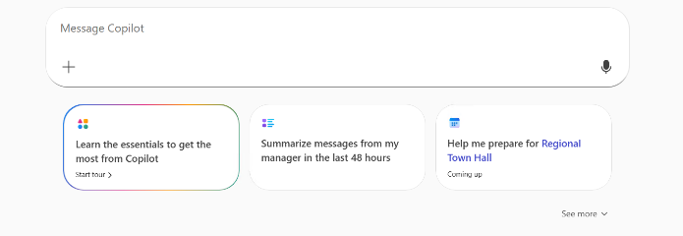
Where to find Copilot Windows and Mac App
macOS: Launch from the Dock or Press Option + Spacebar
Windows: Launch from the Taskbar or press Windows Key + C or Copilot Key. Hold for Press-to-Talk Copilot Voice
aka.ms/copilotmobile

Slide 16
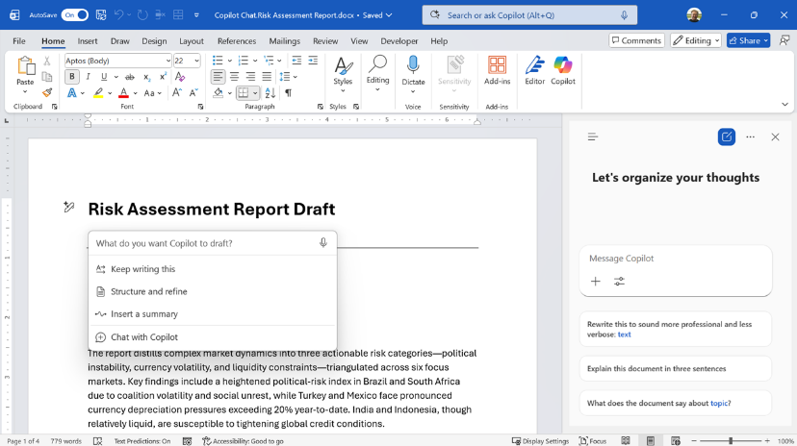
Where to find Copilot Microsoft 365 Apps
Copilot Chat pane for unlicensed users
Copilot Chat pane and integrated into the app UI for licensed Microsoft 365 Copilot users

Slide 17
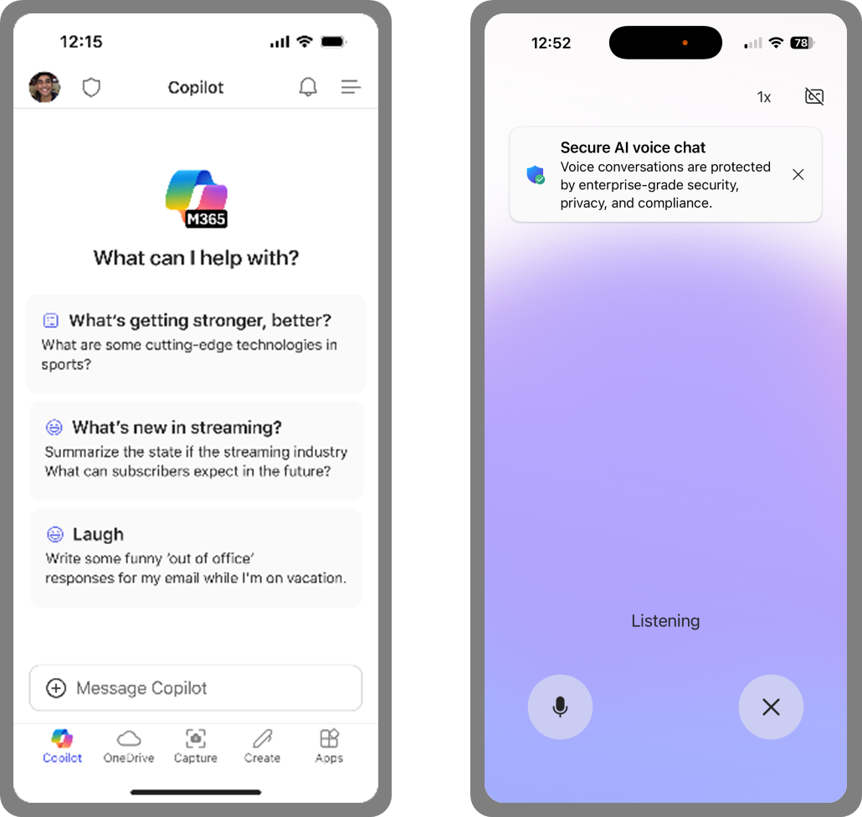
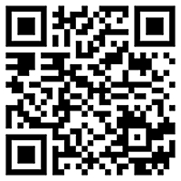
Microsoft 365 Copilot Mobile App Windows, iOS and Android
Download the Microsoft 365 Copilot mobile app and sign in with your work or school account to access Copilot Chat on the Go
aka.ms/copilotmobile

Slide 18
Where to Find Copilot
Microsoft 365 Copilot Mobile App
Download and sign in with your work or school account
aka.ms/copilotmobile

Slide 19
Agenda
Microsoft 365 Copilot Level-Set
Art of the Prompt
New Year, New You: Working Alongside AI
Urgent ≠ Important
Action Follows Meaning
Define, then Refine
Operationalize Best Practices
Resources and Next Steps

Slide 20
The Art and Science of prompting
Include the right prompt ingredients
To get the best response, it’s important to focus on some of the key elements when phrasing your Copilot prompts.
Goal
Context
Expectations
Goal
Context
Source
Expectations
Source
What response do you want from Copilot?
Why do you need it and who is involved?
Which information sources or samples should Copilot Use?
How should Copilot respond
to meet your expectations?
aka.ms/CopilotPromptIngredients

Slide 21
The Art and Science of Prompting
Include the right prompt ingredients
To get the best response, it’s important to focus on some of the key elements when phrasing your Copilot prompts.
Summarize this /[Vendor RFP response]
Microsoft 365 Copilot

Slide 22
The Art and Science of Prompting
Include the right prompt ingredients
To get the best response, it’s important to focus on some of the key elements when phrasing your Copilot prompts.
Goal
Context
What response do you want from Copilot?
Why do you need it and who is involved?
Help me compare two vendor RFP replies. I need a summary and recommendation for my manager. Use the criteria in /[rfp] to evaluate [vendor_rfp_1] and /[vendor_rfp_2]. Make a table comparing the vendors then provide a recommendation.
Help me compare two vendor RFP replies. I need a summary and recommendation for my manager. Use the criteria in /[rfp] to evaluate [vendor_rfp_1] and /[vendor_rfp_2].
Help me compare two vendor RFP replies.
Help me compare two vendor RFP replies. I need a summary and recommendation for my manager.
Which information sources or samples should Copilot use?
How should Copilot respond
to best meet your expectations?
Source
Expectations
Microsoft 365 Copilot

Slide 23
Agenda
Microsoft 365 Copilot Level-Set
Art of the Prompt
New Year, New You: Working Alongside AI
Urgent ≠ Important
Action Follows Meaning
Define, then Refine
Operationalize Best Practices
Resources and Next Steps

Slide 24

Urgent ≠ Important
“What is important is seldom urgent, and what is urgent is seldom important.”
Urgency is loud, importance is quiet
Use Copilot to understand context and prioritize
Review my emails, chats, meetings, and documents from the last seven days. Recommend my top priorities for today, emphasizing importance over urgency using the Eisenhower Matrix.
Help me prepare for /[meeting] by reviewing related emails, chats, and documents. Identify key topics, documents to review (with brief summaries), and questions or decisions I should be ready to address.
Use Start and End My Day prompts to align on priorities and review your impact
Ask Copilot to help you understand what matters, not just recap and summarize
Catch up on people, projects, and situations wherever work happens

Slide 25
Action Follows Meaning
Action is easier when ambiguity is removed
Mistakes arise when we act before understanding
Karl Weick: Enactment > Sensemaking > Action
Summarize this email into a short executive brief: 2–3 sentences that capture the main point, key context, and any actions or decisions required.
Create a meeting summary from this whiteboard. Focus on decisions and risks discussed. Then give me a one-sentence executive recap.
Distill long documents or email threads into key points
Ask Copilot to provide analysis and insights from raw data
Turn rough notes into a coherent summary of what was discussed

Slide 26
Define, then Refine
Separate Thinking from Polishing
Mixing idea generation and evaluation slows both
Draft first, improve deliberately
Help me brainstorm a new project. Ask me clarifying questions to understand the problem space, constraints, and intended outcome.
Reply to this email – didn’t get the artwork done, very sorry, vendor didn’t respond, working on it, give me till Friday
Brainstorm a Project
Draft an Email Reply
Try Idea Coach

Slide 27
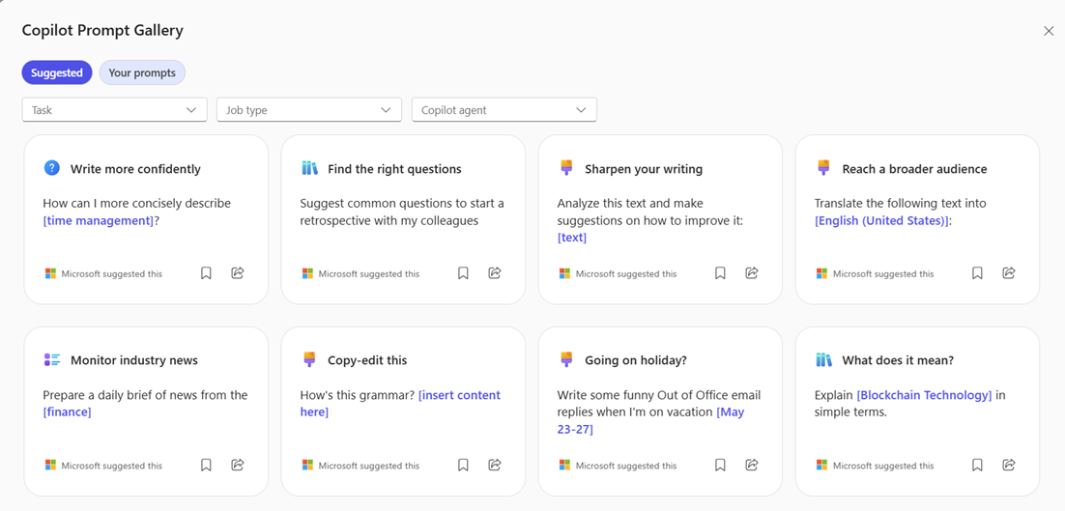
Operationalize Best Practices
Quality improves when best practices are made repeatable and embedded into the system - not individual heroics.
Copilot Chat Prompt Gallery
Copilot Chat Custom Instructions
Copilot Chat Memory

Slide 28
Agenda
Microsoft 365 Copilot Level-Set
Art of the Prompt
New Year, New You: Working Alongside AI
Urgent ≠ Important
Action Follows Meaning
Define, then Refine
Operationalize Best Practices
Resources and Next Steps

Slide 29
Resources after Today
Microsoft 365 Copilot Help & Learning support.microsoft.com/copilot-skilling Short how-to videos, help articles
Great Copilot Journey aka.ms/GreatCopilotJourney 30-day skilling, daily tips and templates
Top 10 Things to Try First aka.ms/Copilot/Top10TryFirst PDF Handout of sample prompts
Art of the Prompt aka.ms/CopilotPromptIngredients How to write a good Prompt
Copilot Prompt Gallery aka.ms/prompts Samples and prompts you saved
Microsoft 365 Copilot Adoption adoption.microsoft.com/copilot Resources for Adoptioon specialists
Trainer Kit aka.ms/Copilot/TrainerKit PowerPoint decks for End User Training
Copilot Scenario Library aka.ms/copilot/scenariolibrary Examples of business use cases
Microsoft 365 Champions Program aka.ms/M365Champions Champs community, monthly calls,
Technical Documentation for IT Pros learn.microsoft.com/copilot/microsoft-365

Slide 30
Visit Customer Hub website for upcoming sessions, updates, and on demand contents!
https://aka.ms/CustomerHubSessions​

Slide 31

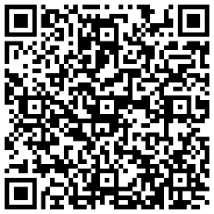
THANK YOU – Your feedback is critical
Scan with your mobile device camera
-OR-
We’re committed to making your Customer Hub experience the best it can be – and your feedback is a critical component to that.
Before you scoot, please take a moment to provide some feedback.
Visit
Customer Hub Survey
aka.ms/CustomerHubSurvey
Select Frontline Friday Series

Slide 32

Q&A
1
Please raise your hand and unmute when called on
2

Slide 34

Hello and Welcome to Customer Hub
New Year, New You for Microsoft 365 Copilot Subscribers The recording and slides from today’s session will be posted to https://adoption.microsoft.com/customer-hub/ microsoft-365-copilot-for-all-seasons/

