Slide 1
Hello and welcome to Customer Hub
We’ll get started at 2 minutes past the hour

Slide 2


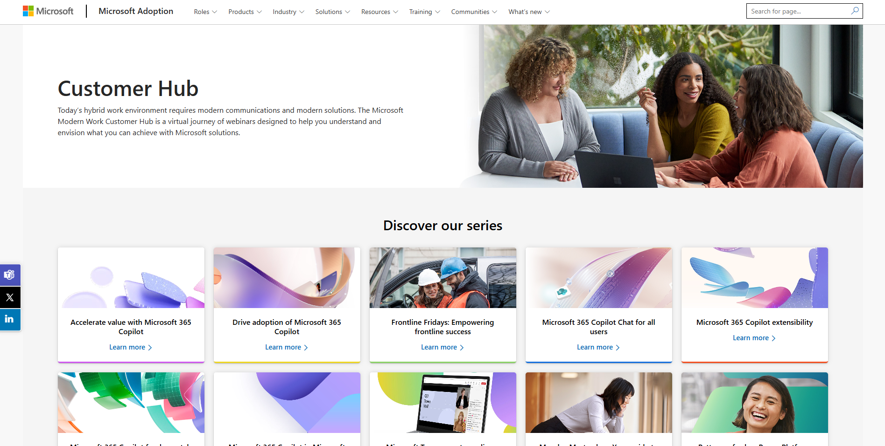
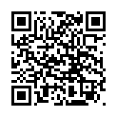
Visit Customer Hub website for upcoming sessions, updates, and on demand contents!
https://aka.ms/CustomerHubSessions​

Slide 3

Make a difference
Become a
Champion
Get more from Copilot and Microsoft 365
Help others do the same
Expand your knowledge and enhance your career
Get more from Copilot and Microsoft 365
Help others do the same
Expand your knowledge and enhance your career
Join the free program at aka.ms/M365Champions

Slide 4



After the presentation
During the presentation
We will mute your microphone for the first part of today’s call
Raise your hand and we will call on you
Ask your questions via chat, we will get to all of them, live or after. Common questions will get addressed out loud
Open mic – come off mute and ask away!

Slide 5
Teams Events Migrating from Teams Live Events to Teams Town Halls

Slide 6
Agenda
Feature Comparison
Creating a Town Hall vs Live Event
Producing a Town Hall vs Live Event
Post Event Resources Town Hall vs Live Event
Next Steps & Call to Action

Slide 7
Feature Comparison

Slide 8
Teams Town Halls vs Live Events: Feature Comparison
Pillar​​ | Capability​​ | Teams Live Events​ | Townhall Base​ | Townhall Premium​
Scale​​ | Broadcast capacity​​ | 20K​ (100k scalable) | 10K​ | 100k
 | Concurrent Events​ | 15​ | 15​ | 50​
 | Attendee reporting​​ | ✓​​ | ✓​​ | ✓​​
 | eCDN ​​ | All​ | All​ | All​
 | Ultra Low Latency |  |  | ✓​​ (coming soon)
 | Duration​​ | 16 hours​ | 30 hours​​ | 30 hours​​
Production​​ | RTMP in​​ | ✓​​ | ✓​ | ✓​​
 | Producer UX​​ | ✓​ | Meeting Views & Manage Mode​ | Meeting Views & Manage Mode​
 | Layouts​​ | Single Video, Video + Content​​ | Dynamic Grid/W focused view​ | Dynamic Grid/W focused view​
 | Customizable layouts |  |  | ✓​​ (coming soon)
 | Preloaded 1080P video |  |  | ✓​​ (coming soon)
 | Stream to​​ | ​​ | ✓​ | ✓​
Host Controls​ | Green Room​ | ✓​ | ✓​ | ✓​
 | Back Channel Chat​​ | ✓​ | ✓​ | ✓ ​
 | Shared Slide PPT Control |  |  | ✓​ (coming soon)
 | External Presenter​​ | ✓​ | ✓​ | ✓ ​
 | Anonymous Attendees | ✓​ | ✓​ | ✓​
 | AI Generated Captions​ | ✓​ | ✓​ | ✓​
​ | Live Translated Captions​ | ✓​ | ✓ (6 languages)​ | ✓(10 languages)​
​ | 708 Embedded Captions​ | ✓​ | ✓​ | ✓​

Slide 9
Teams Town Halls vs Live Events: Feature Comparison
Pillar​​ | Capability​​ | Teams Live Events​ | Townhall Base​ | Townhall Premium​
Engagement / Interactivity​​ | Q&A ​​ | 10K​ | 10K ​​ | 100k
 | Enhanced Q&A Functionality |  | ✓ | ✓
 | Reactions​ | ​ | ​ | ✓​
 | Streaming Chat​ | ​ | ​ | ✓
 | Raise Hands |  |  | ✓ (coming soon)
 | Polls |  |  | ✓​ (coming soon)
 | Video On Demand​ | ✓​ | ✓​ | ✓​
 | Custom Email Communications​ | ​ | ​ | ✓​
 | DVR​ | ✓​ | ✓​ | ✓​
​Monitoring/Analytics​​ | Rehearsals​​ | ✓​ | ✓​ | ✓​
 | Enhanced attendee reporting |  | ✓​​ | ✓​​
 | ​CQD/RTOA - (Presenters) (admin needed) | ​✓​ | ✓​​ | ✓​
 | Microsoft eCDN Analytics (admin needed) | ✓​ | ✓​ | ✓​
 | Town hall Insights (orgs/co-orgs) |  |  | ✓​

Slide 10
Creating a Town Hall vs Live Event

Slide 11
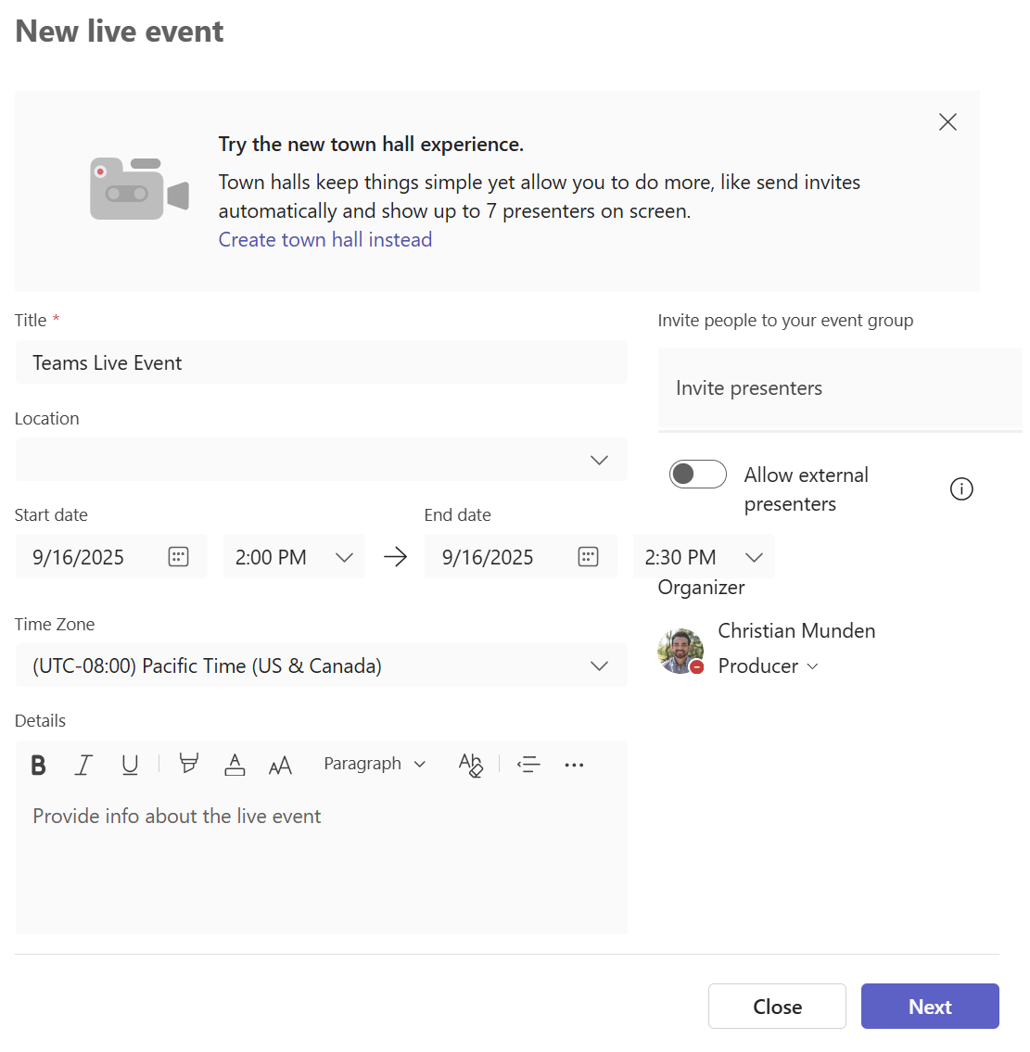
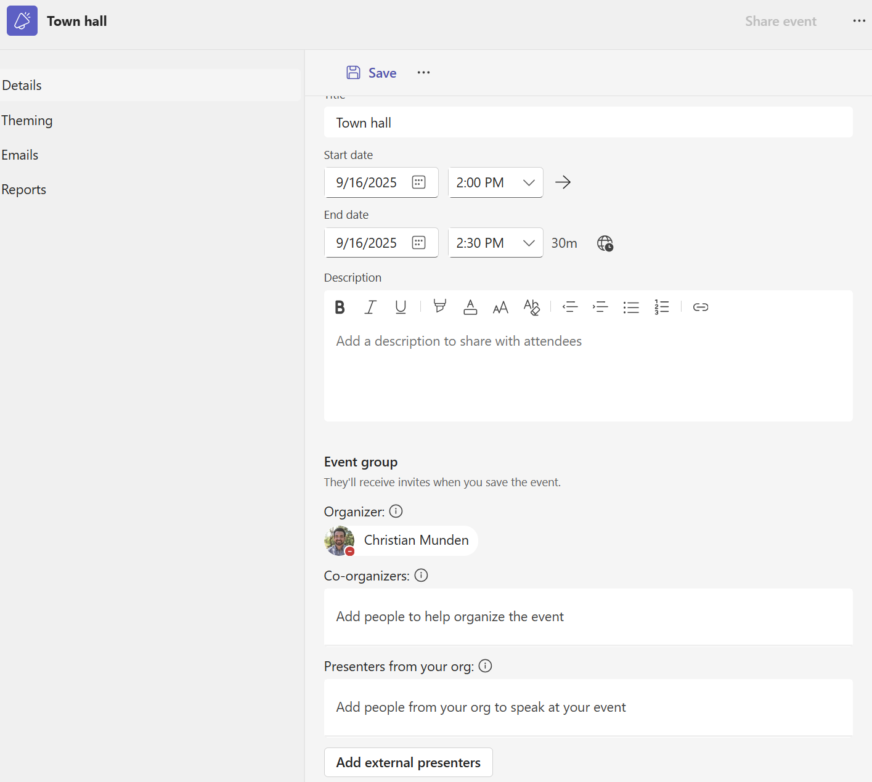
TH vs TLE: Key Event Creation Differences
Live Events | Town halls
Scheduled from Teams | Scheduled from Teams/Outlook
Invites sent to presenters/producers | Invites sent to producer, presenters, attendees
Producer is a role (in drop down menu) | Producer are RIGHTS (in meeting options)
Q&A off by default | Q&A on and unmoderated by default
No theming/branding | Theming/Branding available
RTMP selected as “Teams Encoder” | RTMP configured under meeting options
Preview content on by default | Preview content off by default (in Meeting options)
Can’t add a room as a location | Can add a room as a location
Support URL in scheduling form | No dedicated support URL, customizable email
Hit Schedule to create event and send invites | Hit Save to send invites, and Publish to create event

Slide 12
Town Hall Event Creation Demo

Slide 13
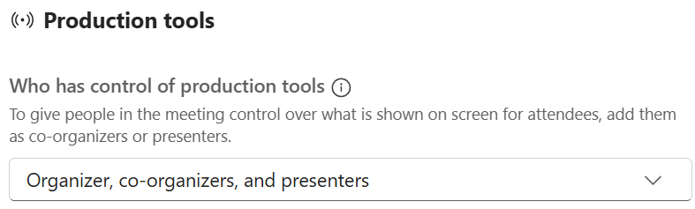
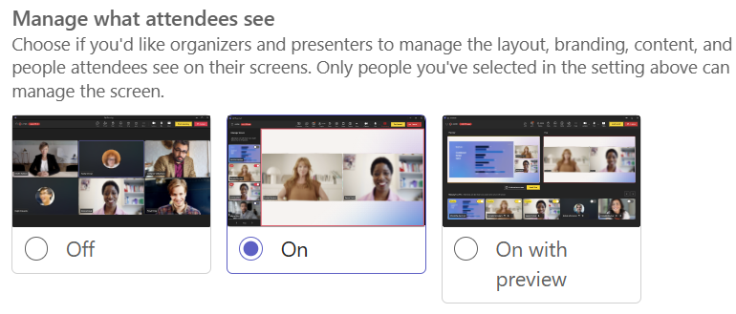
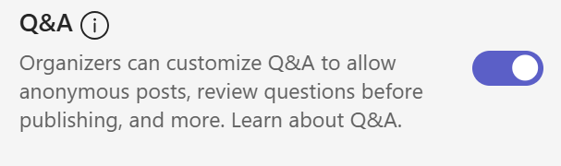
Town Hall Event Creation: Notable departures from Live Events
Producer rights are in Meeting options
(Organizers, Co-organizers, Presenters have control by default)
Preview content is in Meeting options
(off by default)
Q&A, Chat, Reactions On by Default

Slide 14
Producing a Town Hall vs Live Event

Slide 15
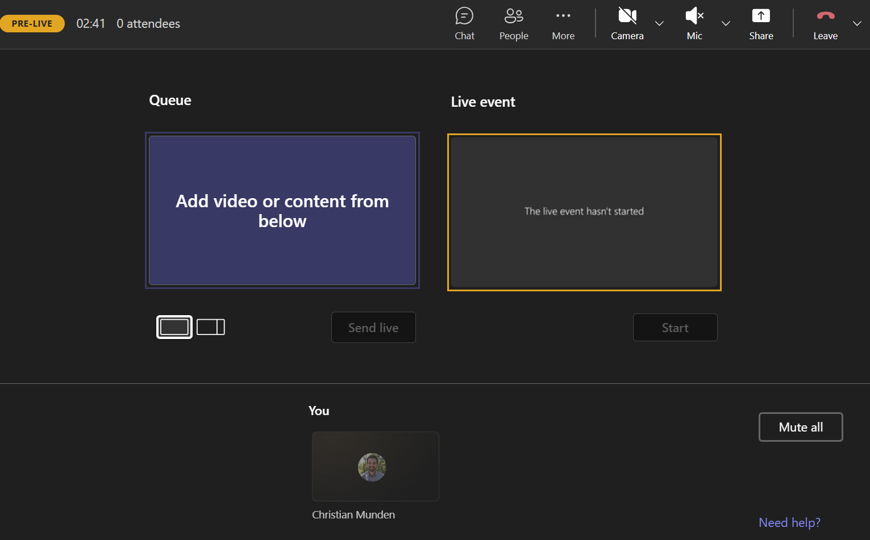
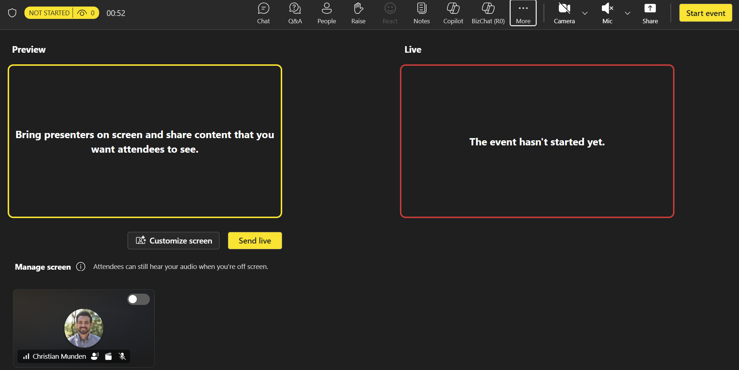
TH vs TLE: Differences in Producing an Event
Live Events | Town halls
Send live to stage | Toggle on stage
One camera with content | Up to seven camera feeds with content
No attendee chat | Attendee Chat (Premium - on by default)
No Reactions | Reactions (Premium - on by default)
No optimized video | Optimized video in Screen share (increased FPS)
Basic Q&A | Q&A enhanced functionality
Three layout options | Customized layouts

Slide 16
Town Hall Event Producing Demo

Slide 17
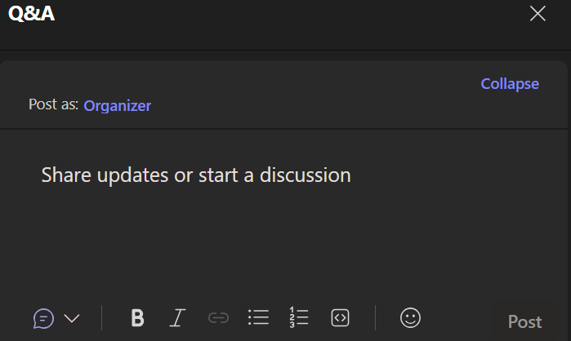

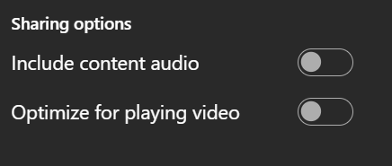
Town Hall Event Production: Notable departures from Live Events
Q&A enhanced functionality
Up to seven people on screen vs One
Optimized video for smoother playback

Slide 18
Post-Event Resources Town Hall vs Live Event

Slide 19
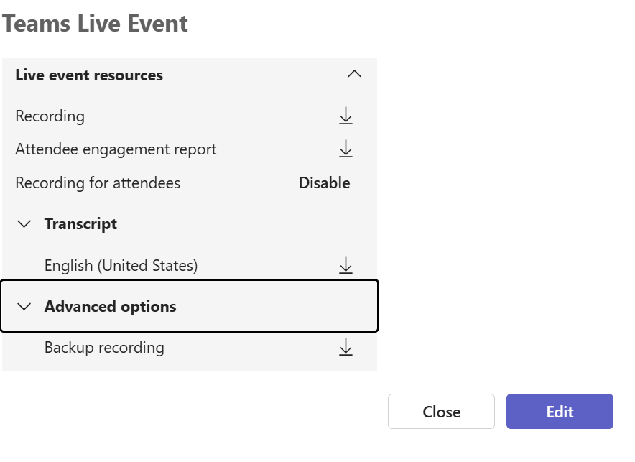
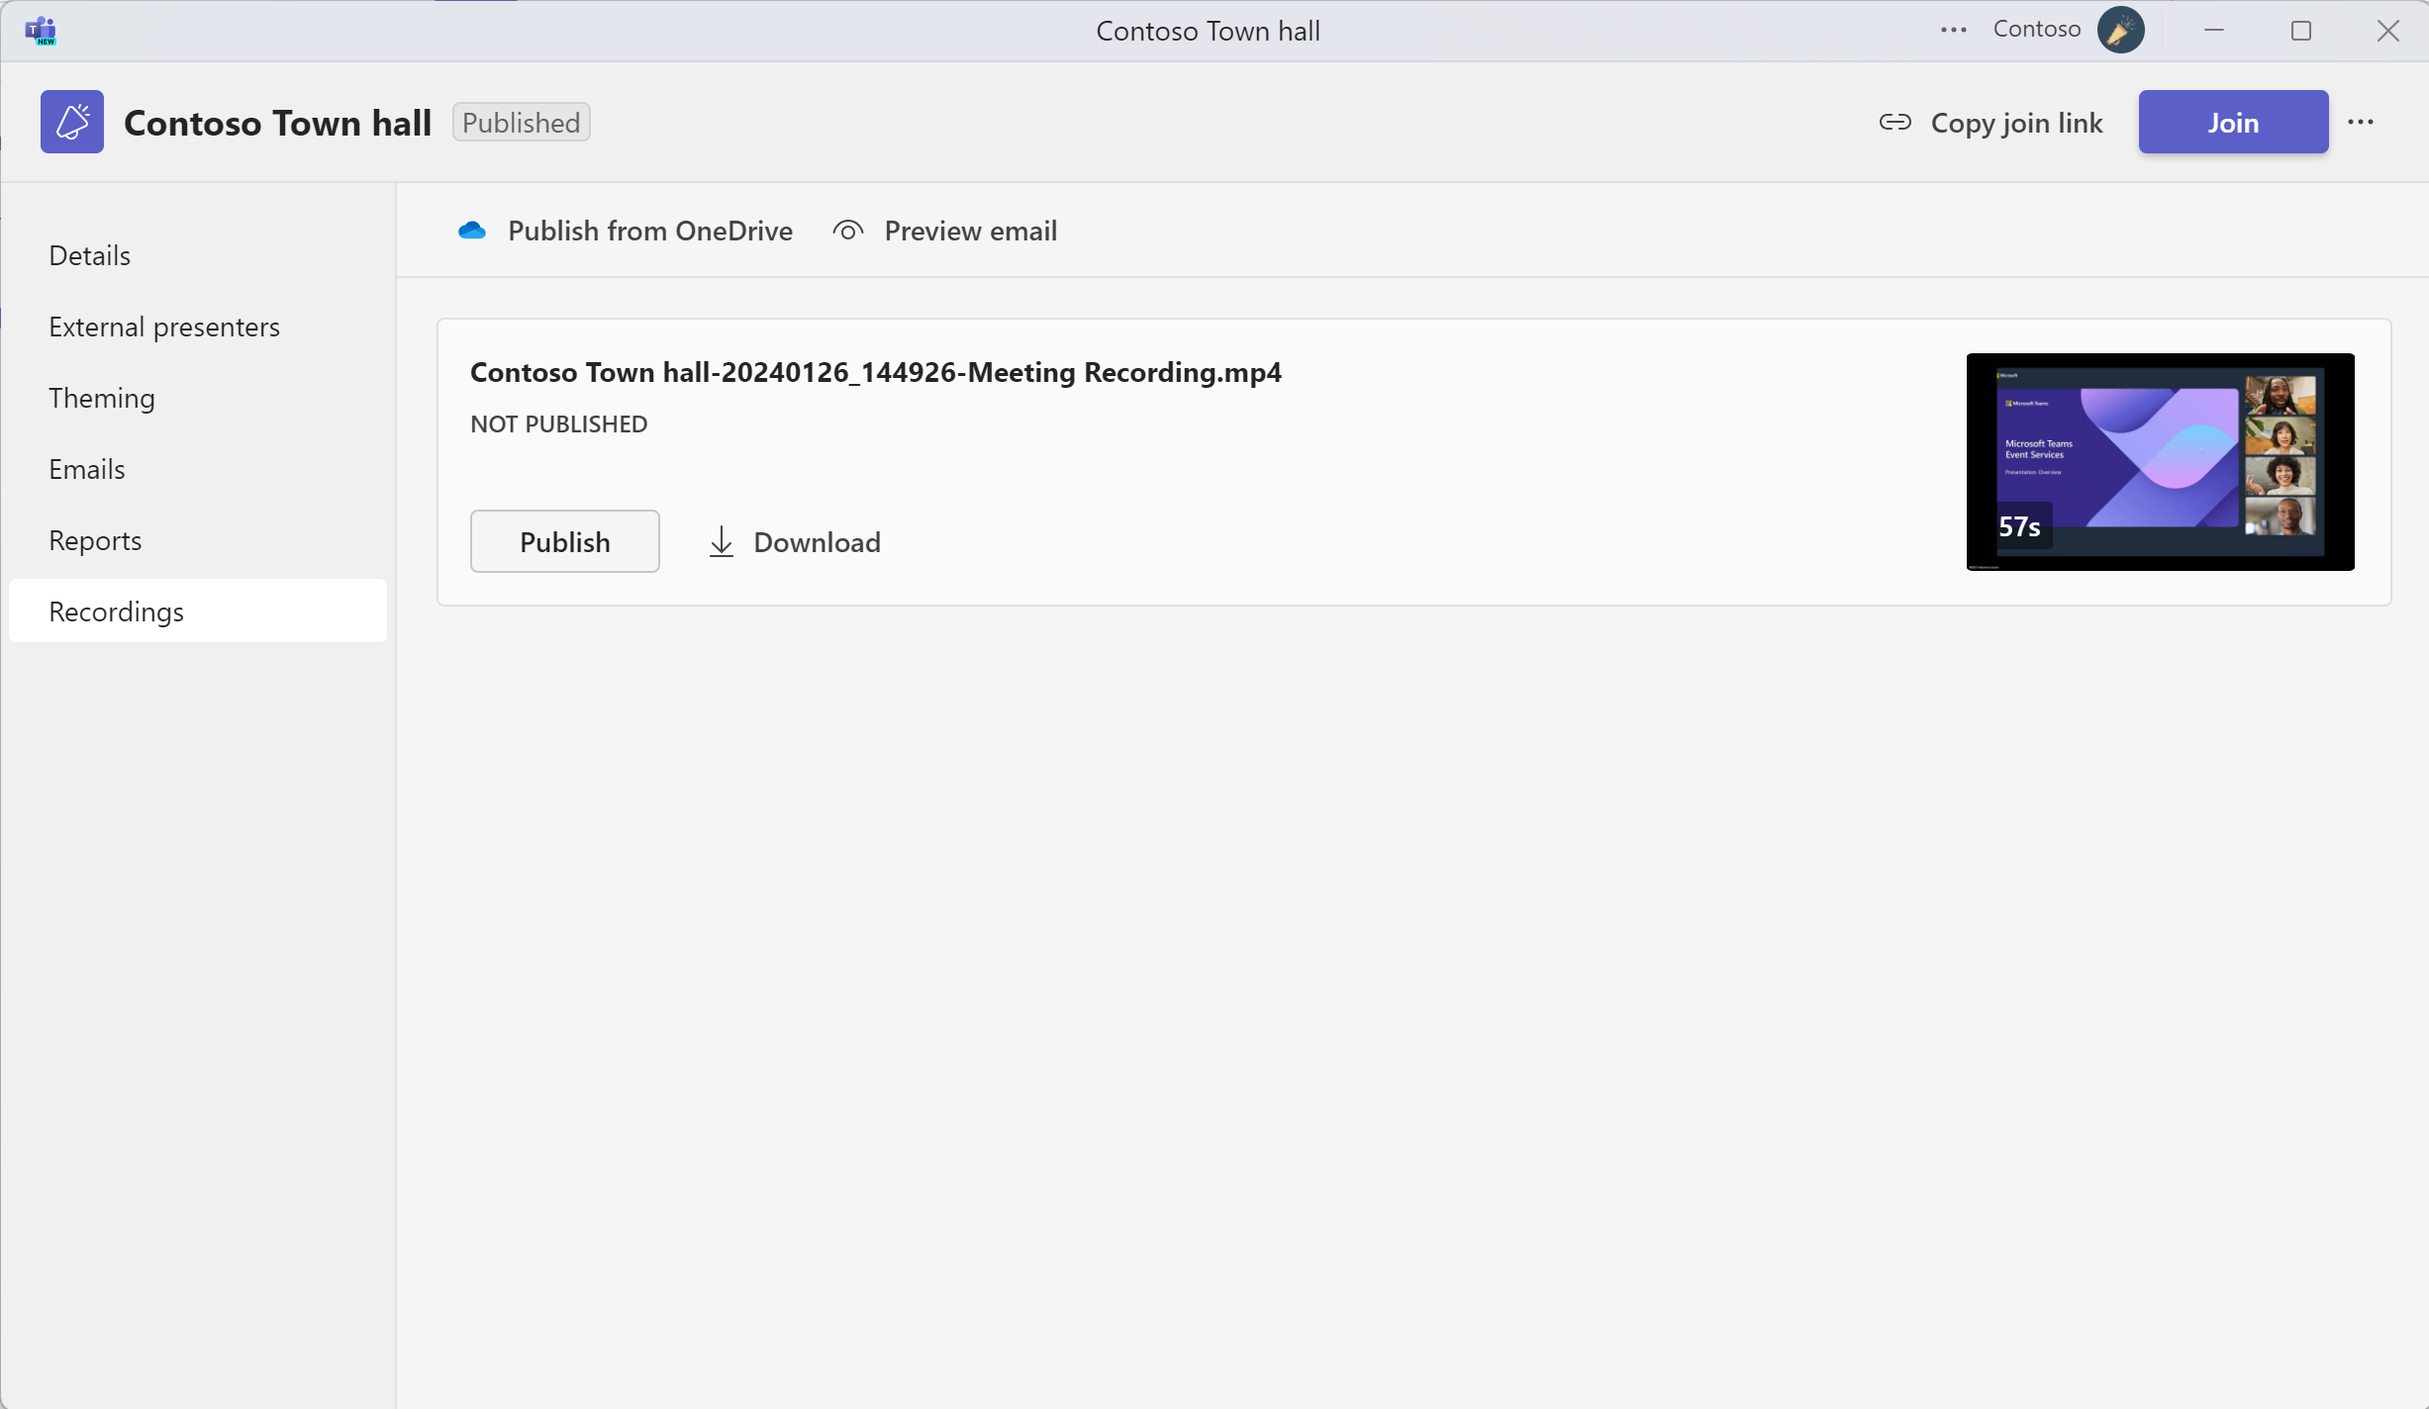
TH vs TLE: Post Event Resources
Live Events | Town halls
Basic attendee report information | Detailed Attendee reports
Admin needed to access analytics | NO Admin needed to access Analytics
Teams Admin Center has attendance and Q&A reports available to IT Admins | No reports in Teams Admin Center yet for IT Admins (fix coming soon)

Slide 20
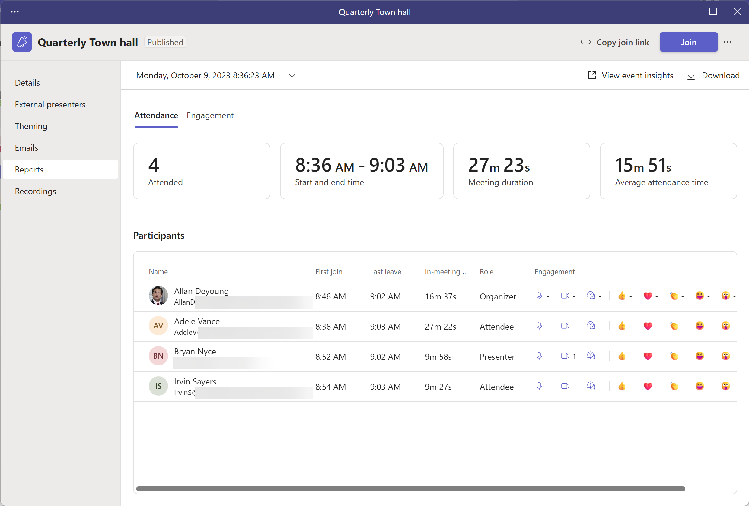
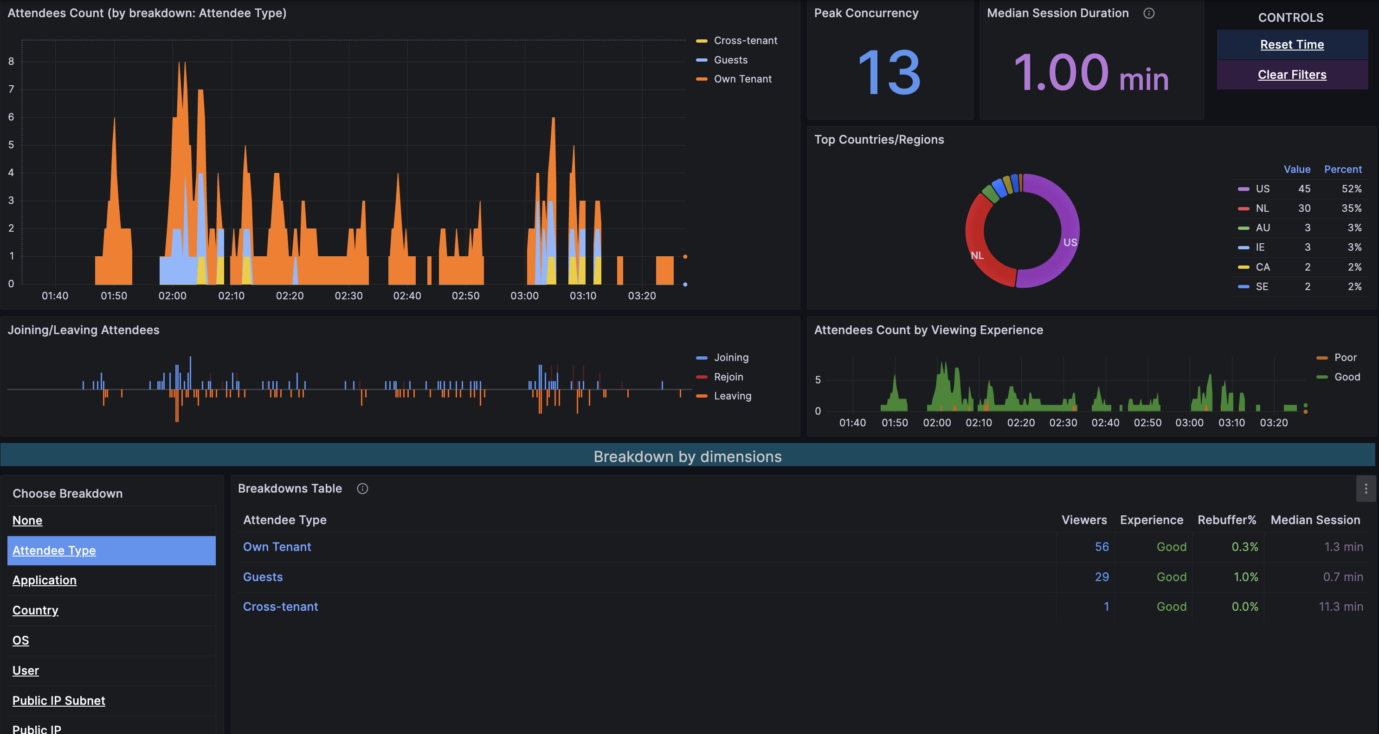
Town halls: Reporting
Organizer Resource: Reports
Reports tab will show the attendance report (including attendees) once the event is complete
Click Download in the upper right to download a copy
Click on View event insights to see real-time insights for the Town hall (Premium)

Slide 21
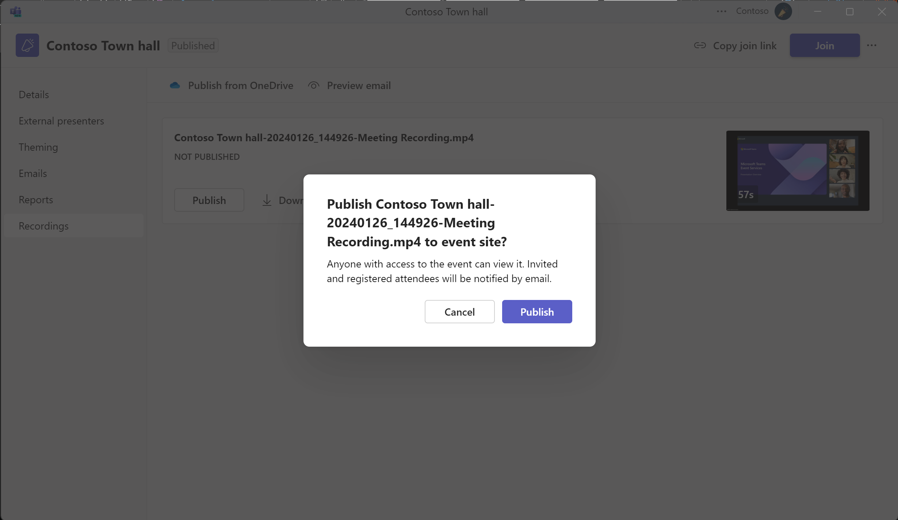
Town halls: Post event actions
Organizer Resource: Recording and Video on Demand
Open the Townhall event from Teams calendar.
Go to Recordings tab.
Select your recording and Select Publish and select Publish again in the confirmation pop up to publish the existing recording.
To edit the existing recording file, you can Download the recording file and upload the edited recording to OneDrive for Business and select Publish from OneDrive to publish the edited recording.
Recording available post event
Publishing recording for Town hall

Slide 22


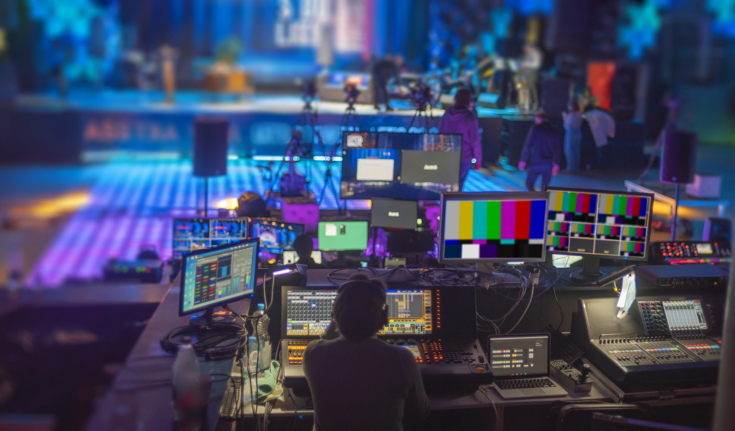
Advanced Events Team Customer Support
Leveraging the Microsoft Advanced Events Team (AET)
Objectives: Help strategic customers successfully transition to a virtual or hybrid world with Teams Events. Support for all event types, including leadership summits, learning & development, virtual offsites, complex hybrid, or even external-facing webinars.
How: Contact Your Local Microsoft Account or Email Us Directly:
AdvancedEventsTeam@microsoft.com
Activities:
Define event format and approach
Demonstrate the technology capabilities
Educate and transfer knowledge to your Production and/or Technology team
Advise on recommended best practices to create the ideal virtual event experience
Assist in the preparation activities for the event to best leverage our solutions
Provide Support and/or Moderation during practice sessions, dry runs and/or for the actual virtual event

Slide 23
Questions?

Slide 24
Thank you!
Next session…
10/8/25 – Tips, tricks and traps for town halls and webinars in Microsoft Teams

Slide 25

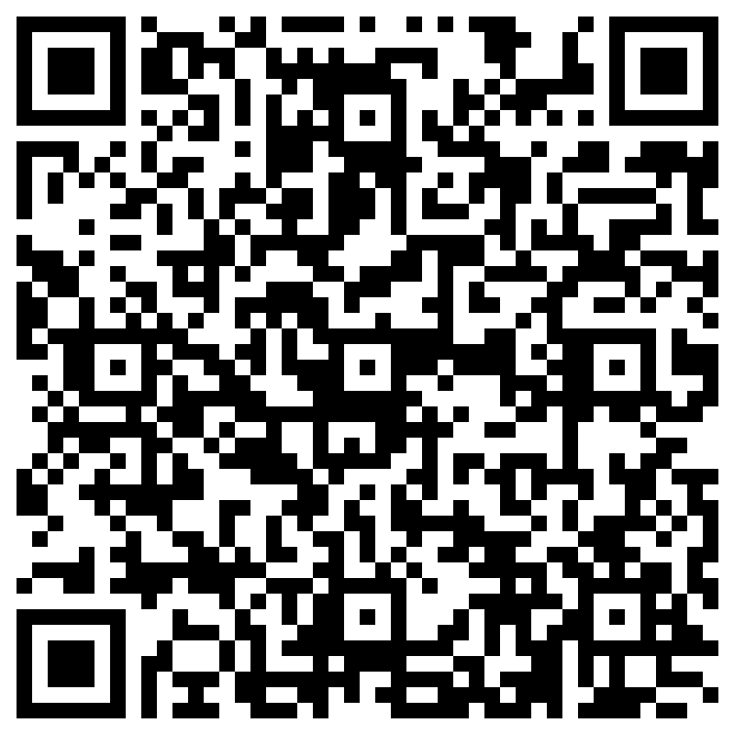
THANK YOU – Your feedback is critical
Scan with your mobile device camera
-OR-
We’re committed to making your Customer Hub experience the best it can be – and your feedback is a critical component to that.
Before you scoot, please take a moment to provide some feedback.
Visit
Customer Hub Survey
aka.ms/CustomerHubSurvey
Select Frontline Friday Series

Slide 26
Visit Customer Hub website for upcoming sessions, updates, and on demand contents!
https://aka.ms/CustomerHubSessions​

Slide 27
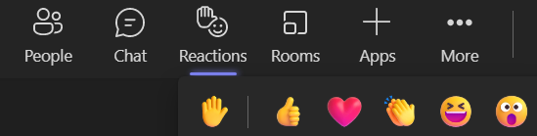
Q&A
1
Please raise your hand and unmute when called on
2

Slide 28
Thank you

