Slide 1



Hello and welcome to the Modern Work Customer Hub!
We’ll get started at 2 minutes past the hour

Slide 2


Microsoft Teams Events Readiness
Session 5
Microsoft eCDN

Slide 3
Customer Hub Sessions
Teams Events
Teams Town Hall Deep Dive and Demo | 2/19/2025
Teams Webinar Deep Dive and Demo | 3/5/2025
Teams Town Hall NDA Road Map: Discover the latest developments and planned innovations | 3/19/2025
Teams Events Advanced Production How to create and deliver TV broadcast quality events | 4/2/2025
Microsoft eCDN Designed for IT Admins, this session helps you plan and prepare for your next large event | 4/16/2025
Microsoft Real Time Analytics Introduction to performance analytic tools | 4/30/2025

Slide 4
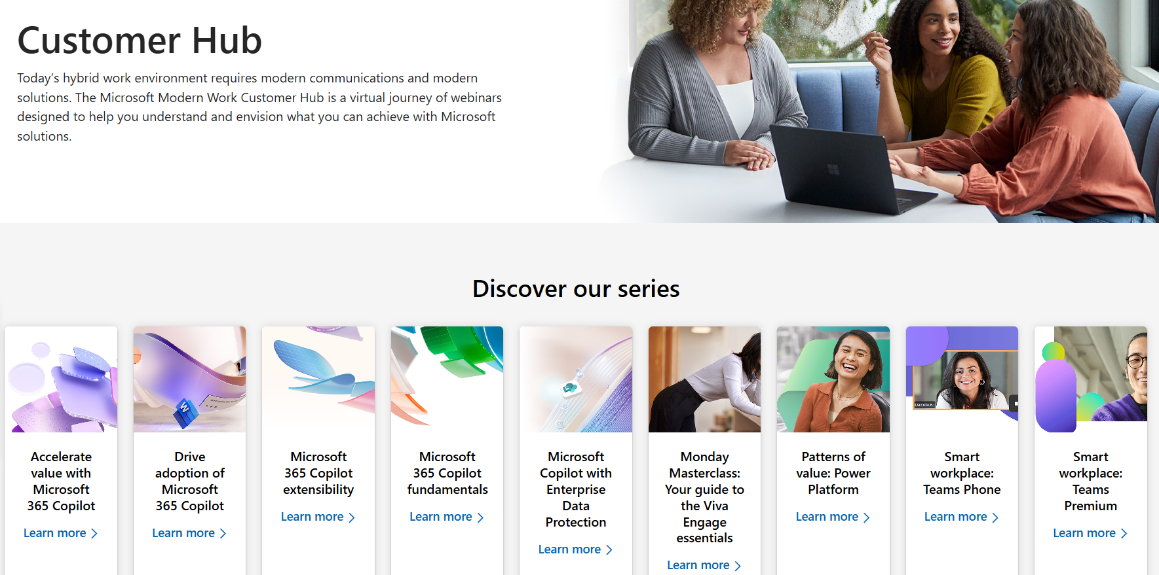


Visit Customer Hub Website for upcoming sessions, updates, and on demand contents!
Scan me!
https://aka.ms/CustomerHubSessions

Slide 5

Make a difference Become a Champion
Get more from Copilot and Microsoft 365
Help others do the same
Expand your knowledge and enhance your career
Join the free program at aka.ms/M365Champions

Slide 6




In-Event Etiquette
During the presentation
After the presentation
We will mute your microphone for the first part of today’s call
Raise your hand and we will call on you
Ask your questions via chat, we will get to all of them, live or after. Common questions will get addressed out loud
Open mic 🙌 Come off mute and ask away!

Slide 7
Microsoft Teams Events Microsoft eCDN
Teams Event Customer Hub Session 4| April 2nd
Jim Garland | Cloud Solution Architect

Slide 8
Agenda
eCDN Overview and Efficiency Example
What’s special about Microsoft eCDN?
Network Setup Requirements
Subnet Mapping
Management Console
Silent Testing
ULL

Slide 9


Bandwidth Requirements Use Case
Why
eCDN?

Slide 10
Bandwidth Requirements Use Case
Why
eCDN?
Building Capacity: 1000 Employees
Building Internet Bandwidth: 1 Gbps
Teams Town hall Bandwidth Reqs:
1.5 Mbps Per Attendee Stream
1.5 Mbps x 1000 Attendees
1.5 Gbps Total Bandwidth
0.5 Gbps Bandwidth Shortfall

Slide 11
Bandwidth Requirements Use Case
Why
eCDN?
Previous Solutions
buy more bandwidth/upgrade network
use low resolution/low bit rate video or audio-only
physically congregate in large spaces, e.g. cafeteria, auditorium, etc.
restrict video streaming usage company-wide
hope for a small audience

Slide 12
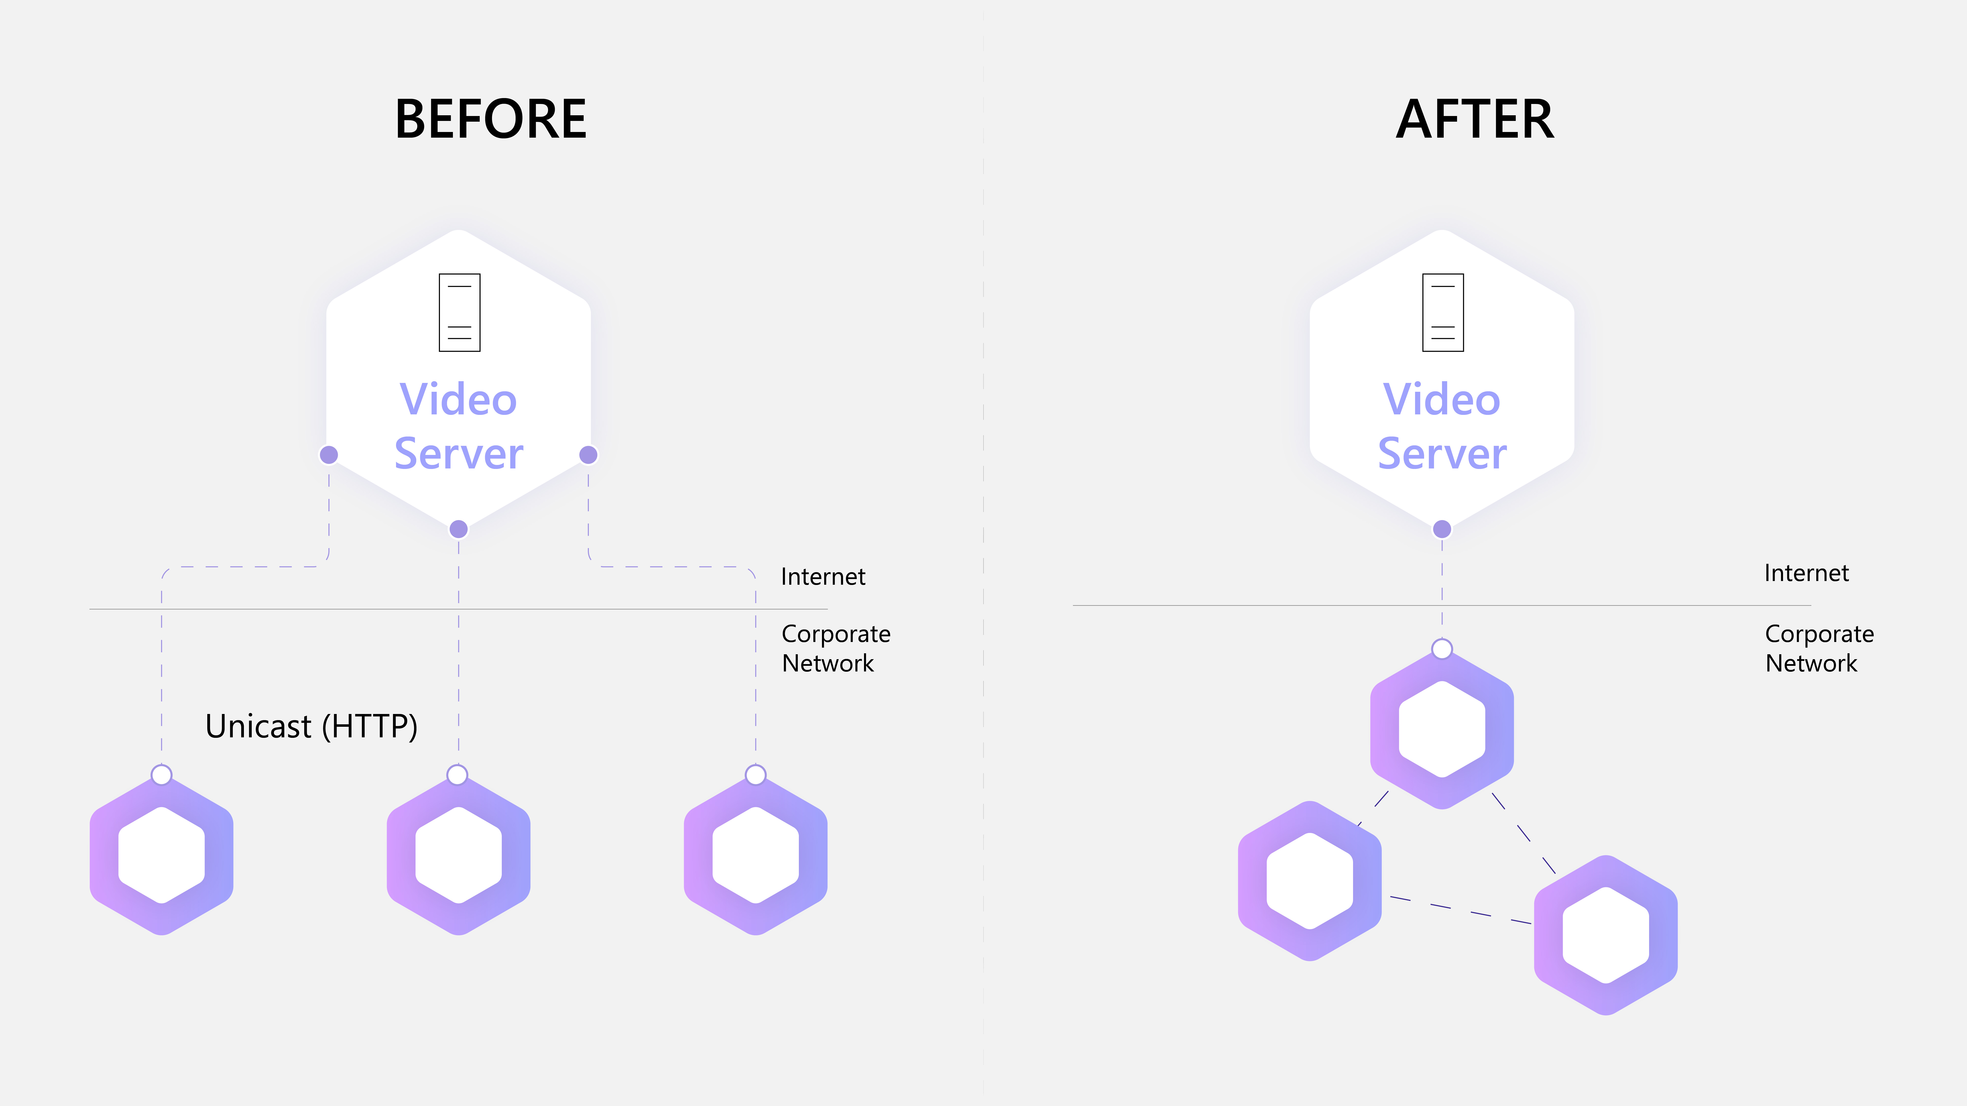

Bandwidth Requirements Use Case
Why
eCDN?
1000
viewers
Bandwidth Required
1.5 Gbps

Slide 13
Offload Example – 90% less bandwidth required
Why
eCDN?
With
eCDN
1000
viewers
1000
viewers
Bandwidth required
Bandwidth required
~200 Mbps
1.5 Gbps

Slide 14


Where are your viewers?
Where Do We Need an eCDN?
eCDN
VPN Split Tunneling

Slide 15
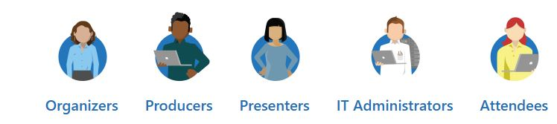
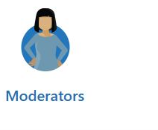
Whose Problem Are We Trying to Solve with eCDN?
IT/Network Administrators
Network Stability
Network Configuration/Troubleshooting
Ensures Efficient Teams Traffic
Event Bandwidth Estimates and Requirements
Monitoring/Troubleshooting Attendee Viewing Experience

Slide 16
Microsoft eCDN – Enterprise Content Delivery Network
Enhance live video streaming experience with
optimized network performance in Teams Events
Enhanced Network Reliability
Ease of Adoption
Trusted solution built on Microsoft Cloud

Slide 17

Trusted eCDN Solution built on Microsoft Cloud
Microsoft acquired Peer 5 in 2021 completing the integration in late 2022
Microsoft 365 compliant and managed on Microsoft’s secure Azure cloud
Reduce total cost of ownership by providing an end-to-end streaming solution from Microsoft
Compatible with third-party video streaming services

Slide 18
Why Microsoft eCDN?
Works Out of the Box
Integrated in Microsoft Teams Admin Center
No Hardware/Software Installation
Unlimited Usage
Advanced Site and VPN Detection
Delivers near-zero cross-site traffic
Minimizes traffic over VPN
Improves peering efficiency and reduces rebuffering
First Zero-Config eCDN Solution
Eliminates need for subnet mapping
Included in Teams Premium and eCDN Stand Alone SKU
Intelligent Peering

Slide 19
Intelligent Peering - Microsoft’s eCDN Network and Tracker
Intelligent Peering
All peers are connected to Microsoft eCDN’s network and coordinator (tracker). Microsoft eCDN builds a map of the network and understands which peers are located next to each other (from a network perspective) and intelligently decides how to build the peering network.

Slide 20
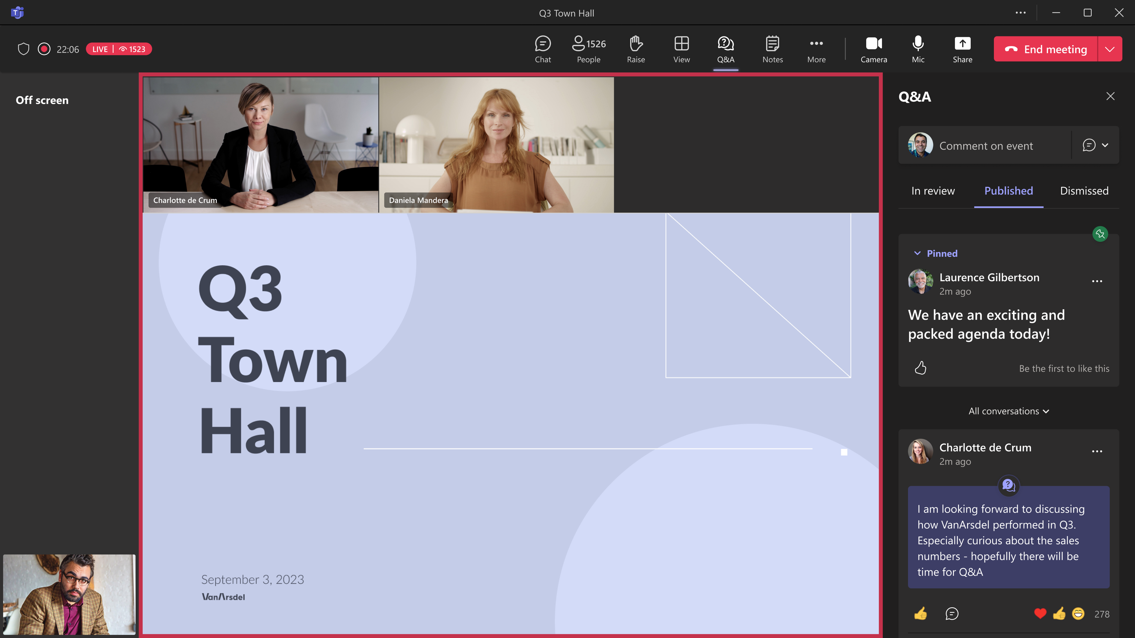
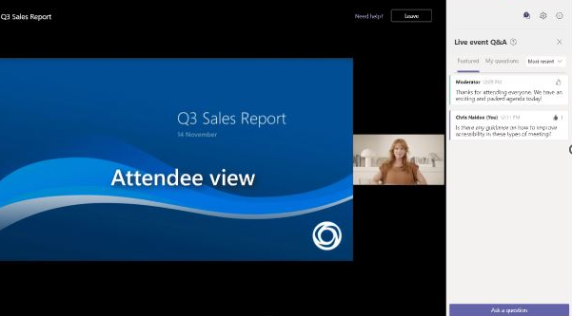
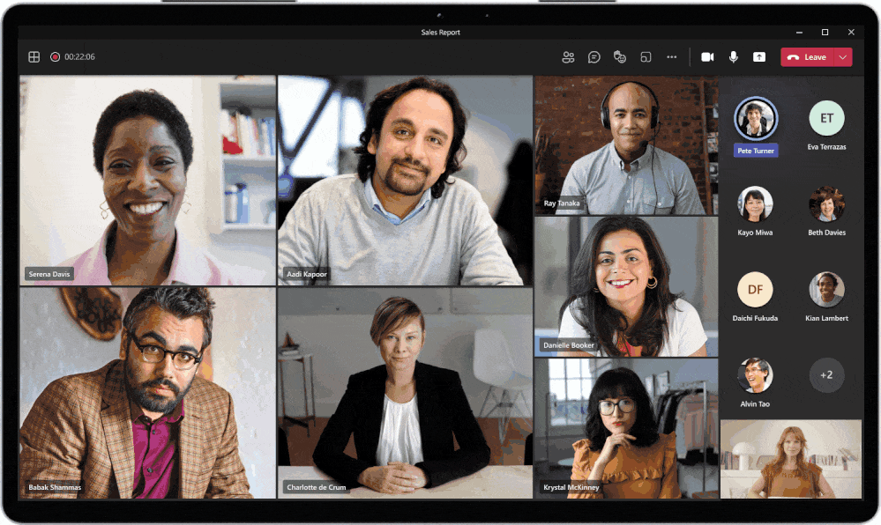
Microsoft eCDN – Enterprise Content Delivery Network
Microsoft eCDN - Teams Events
Town Hall
Teams Live Event
View Only Mode in Teams Meetings

Slide 21
Microsoft eCDN is designed to work with:
HTTP-based streaming protocols such as HLS and MPEG-DASH
HTML5-based video players (JWPlayer, Video.js, Clappr, Kaltura, etc.) as well as any native Android or iOS player (ExoPlayer, AVPlayer, etc.)
HTTP-based CDNs: Akamai, Fastly, CloudFront, Cloudflare, Azure CDN, etc.
Streaming Services: Kaltura, MediaPlatform, Brightcove, Intrado, etc.
DRM technologies: Widevine, PlayReady, FairPlay, etc.
Each viewer can download resources from both the P2P network and the HTTP network simultaneously.

Slide 22

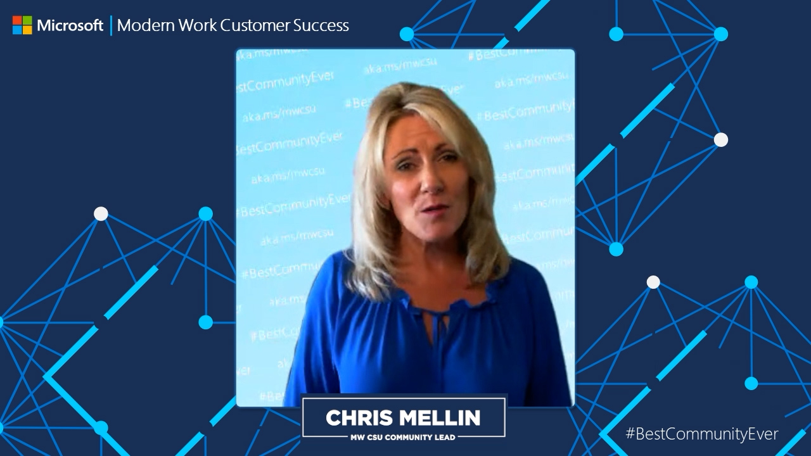
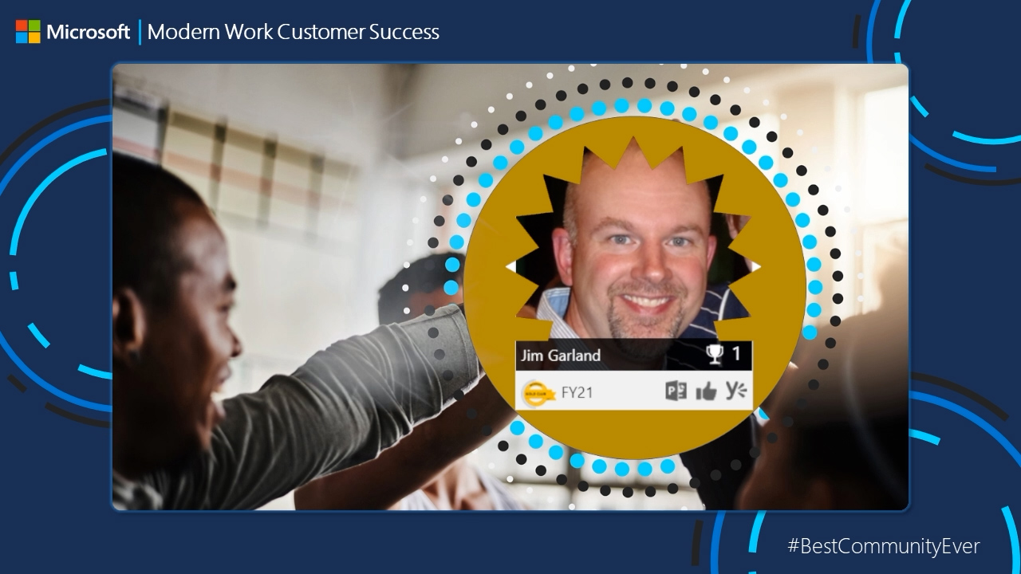
Microsoft eCDN Technical Specifications
The performance impact of peering on the client device (CPU or memory) is negligible by design
HTTP fallback if P2P is not possible / optimal
Wireless networking is done through SSID/AP with negligible impact – customers can adjust wifi users to only consume if desired
Protocols – WebSocket (TLE encryption 1.2 or 1.3) to the backend, ICE for signaling and SCTP for peer-to-peer communications
Microsoft eCDN supports SSO via Azure Active Directory
Encryption – all communication is HTTPS/TLS

Slide 23

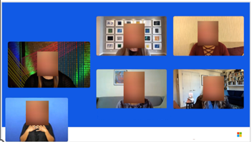
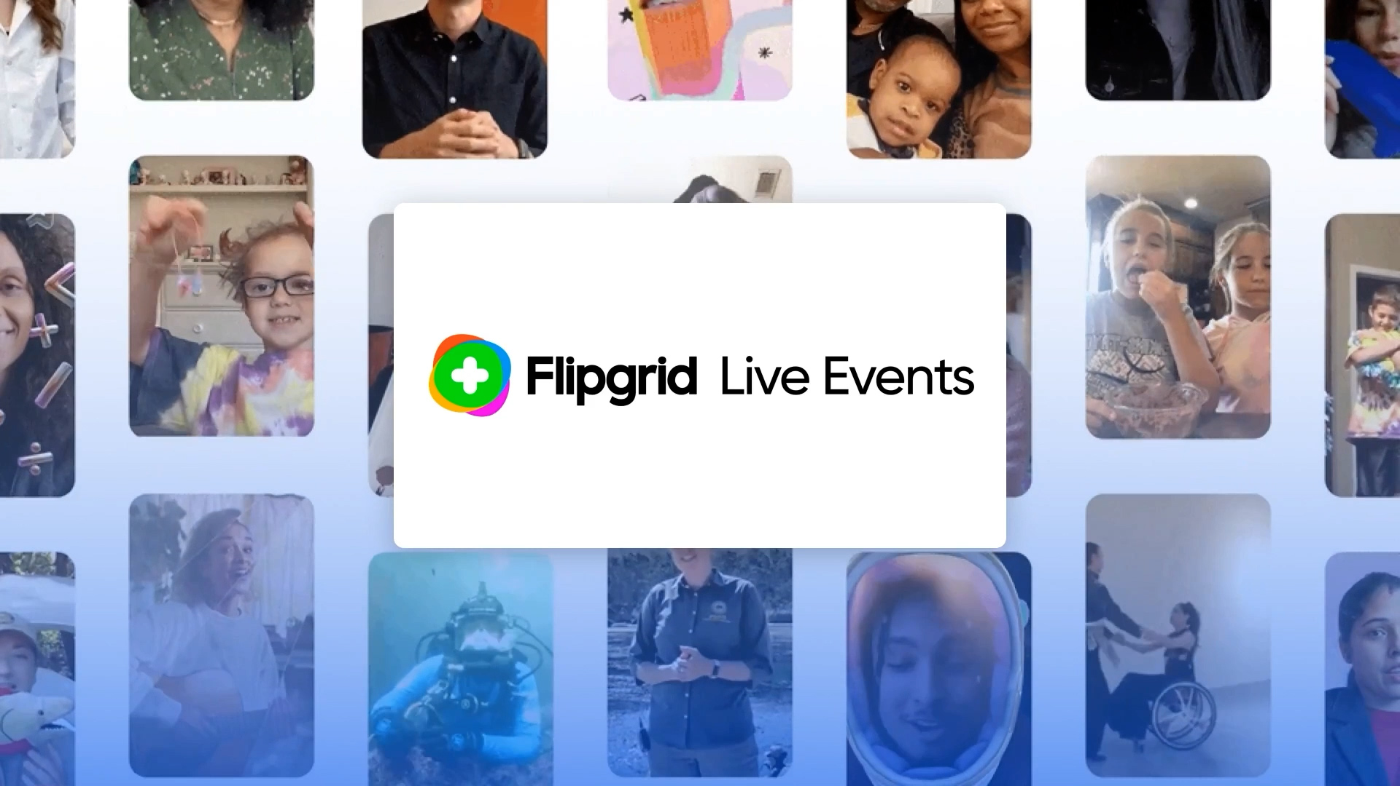
Additional Technical Specifications
Advanced Monitoring is available in near real-time to give insights on all of your users
The Maximum number of peers that can be connected to a single client device is 30, but this is configurable
You can easily disable peering for VPN subnets
Only users that are authenticated by the video platform authentication mechanism will be able to peer
Microsoft eCDN takes anywhere from 4-24 hours to propagate once enabled on Teams Admin Center
Use the MSFT eCDN tester page to ensure websocket connections are not blocked
Make sure *.ecdn.teams.microsoft.com is allowed for network and firewalls

Slide 24
Network Setup Requirements
When a user browses to the event page, it downloads the Microsoft eCDN script - that requires an http or https connection to *.ecdn.teams.microsoft.com .
After downloading our script the user will create a secure WebSocket connection to our backend.
The peer-to-peer connection itself is a UDP connection over the port range 1025-65535, chosen randomly by the browser. Edge and Chrome allows to configure that port using Chrome for administrators.

Slide 25
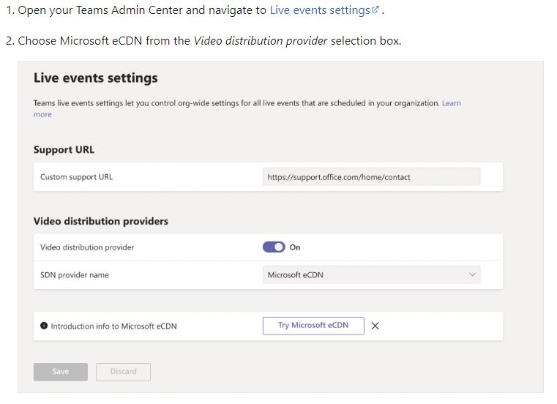
Teams Admin Center

Slide 26
Microsoft eCDN – 90-day trial
There's a three-month trial available to customers in the Microsoft 365 admin center for the standalone eCDN SKU.
Access the M365 Admin Center.
Billing > Purchase services > search eCDN
Once you locate the SKU, select "Start free trial."
Select "Try now."
A 90-day trial will be applied to the tenant.

Slide 27
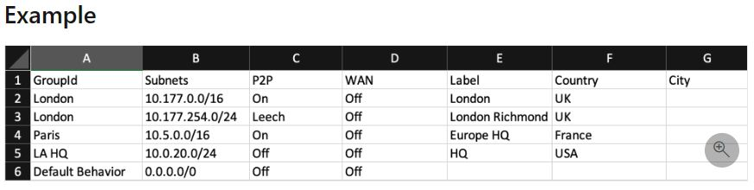
Peering Groups
Set up Subnet Peering groups to enhance your org experience
Upload a subnet mapping CSV file

Slide 28
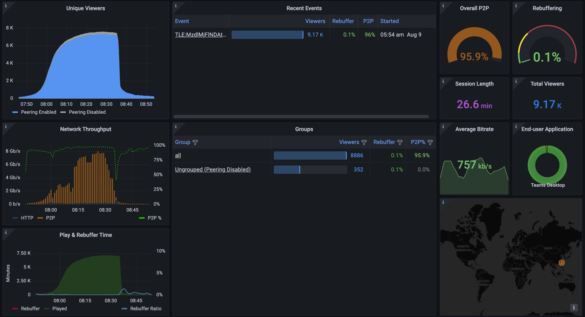
Silent Testing
Live Event Simulation allows for pre-event network testing
Test peering efficiency throughout your network and troubleshoot issues prior to your event
It is recommended to use a minimum of 5 users, ideally 20-30 devices are used

Slide 29
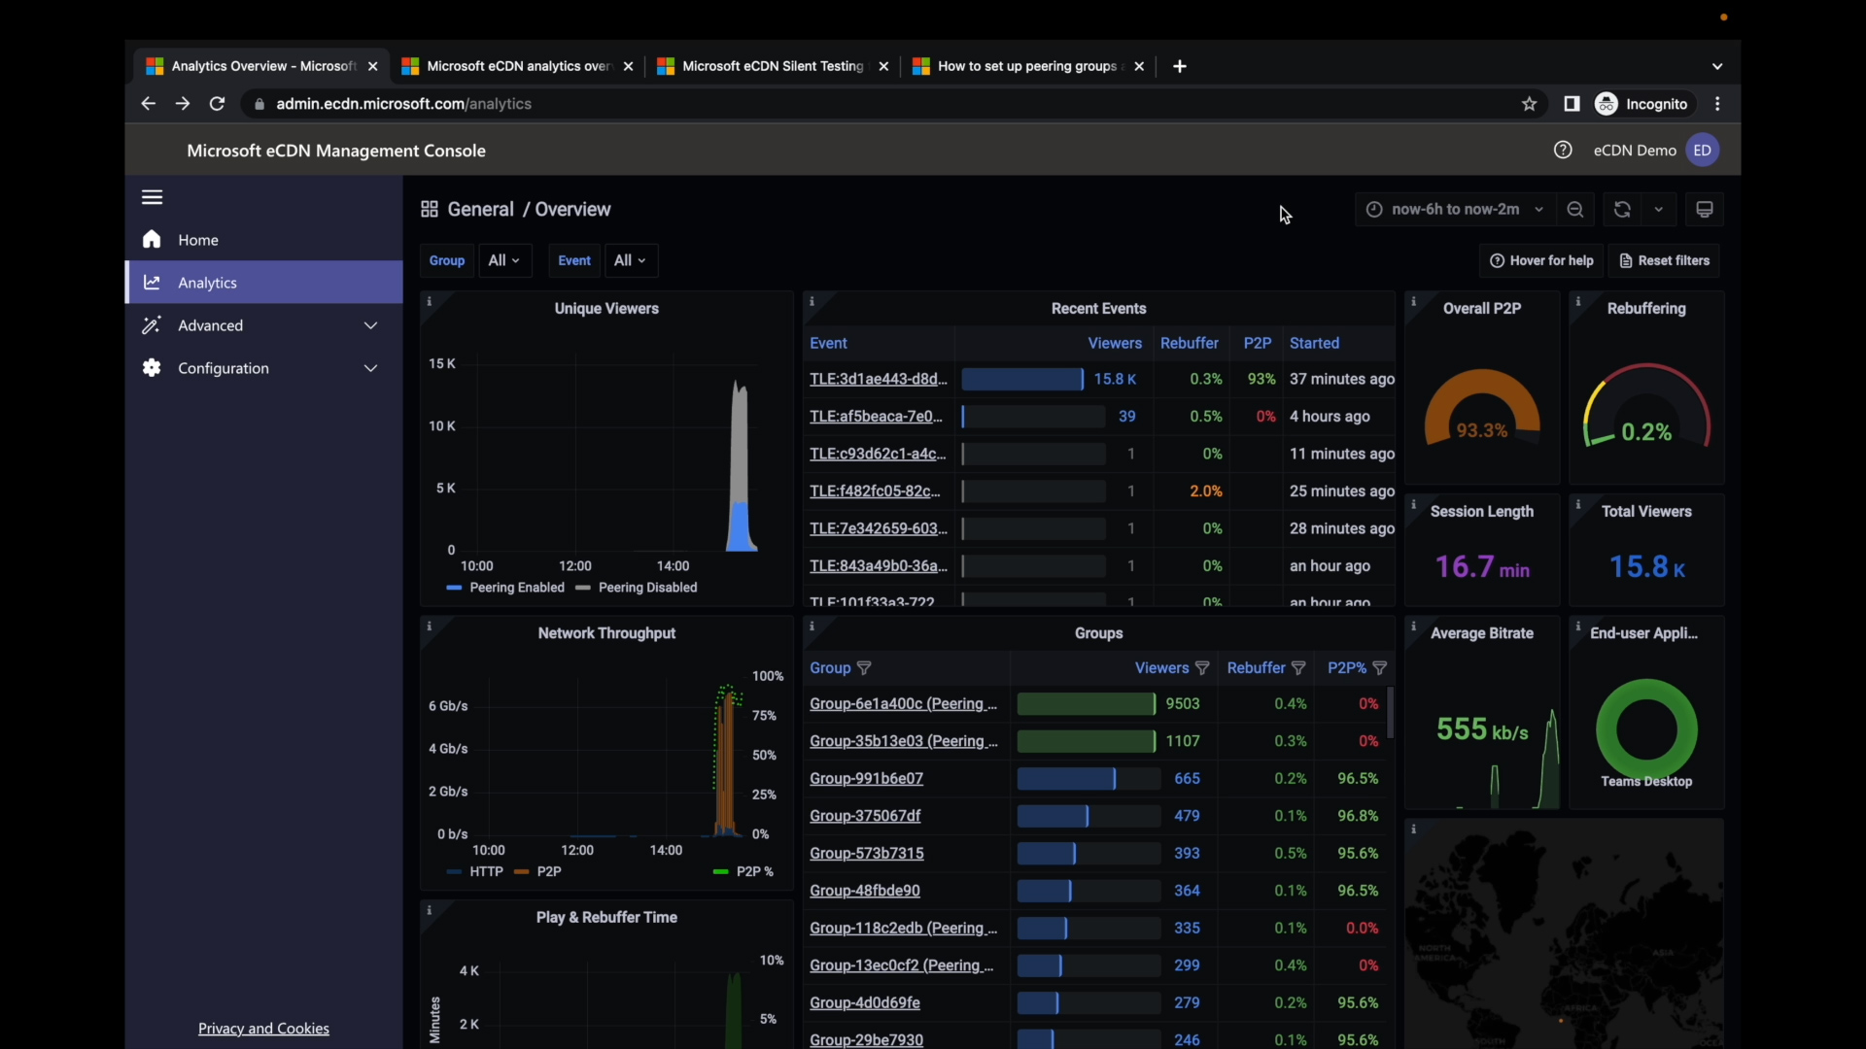
Azure Active Directory

Slide 30
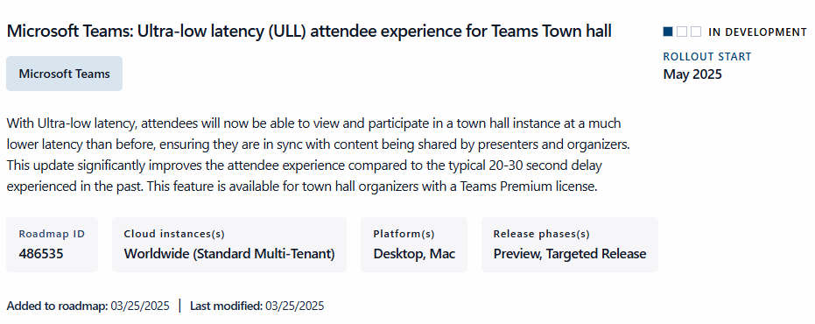
Microsoft Teams Town hall Ultra-low latency Compatibility

Slide 31
DEMO

Slide 32
Ready to Engage the Advanced Events Team?
Email us – AdvancedEventsTeam@microsoft.com

Slide 33
Thank you
Copyright© 2024 Microsoft Corporation. All rights reserved.

Slide 34

Your feedback is critical
Scan with your mobile device camera
We’re committed to making your Modern Work Customer Hub experience the best it can be – and your feedback is a critical component to that.
Before you scoot, please take a moment to reply to provide some feedback.
-OR-
Visit
Customer Hub Survey
aka.ms/CustomerHubSurvey

Slide 35
Visit Customer Hub Website for upcoming sessions, updates, and on demand contents!
Scan me!
https://aka.ms/CustomerHubSessions

Slide 36
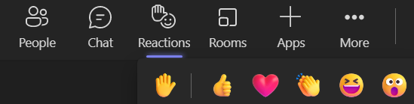
Q&A
1
Please raise your hand and unmute when called on
2

Slide 37

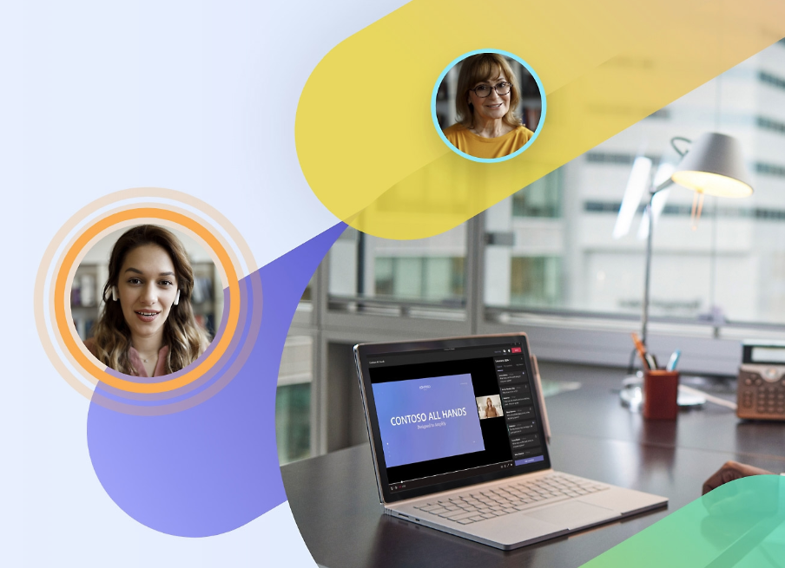

Microsoft eCDN available in GCC
Generally available now
Availability for GCC Customers
Microsoft eCDN SKU can be purchased via M365 Admin Center
Benefits of Microsoft eCDN
Reduces bandwidth consumption during large live events
Delivers high-quality video
Ease of Use
Works out of the box
No software or hardware installation required

Slide 38
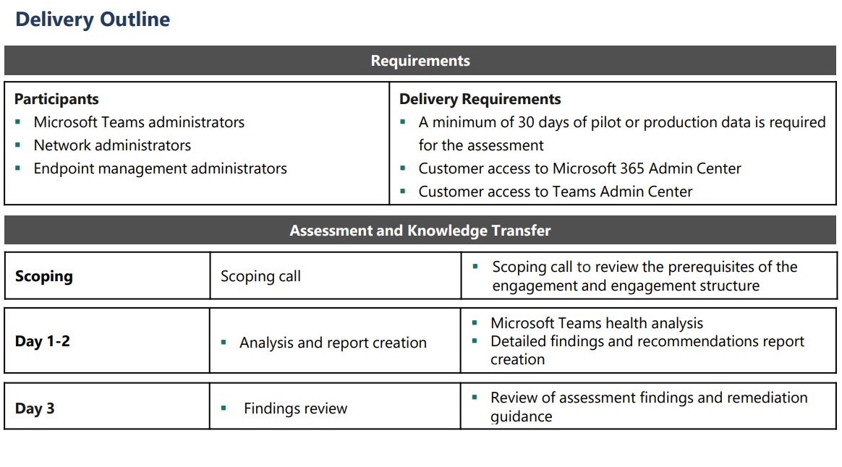
Microsoft Teams Media Quality Assessment

Slide 39
Purchasing Options
Volume
Contact your Microsoft Technical Specialist
M365 Admin Center
Billing/Marketplace > Purchase services > search eCDN > click details > enter required fields
Microsoft Cloud Solutions Providers (CSP)
Contact CSP
Teams Premium
If your organization has one paid license or a trial you can turn on Microsoft eCDN for testing and usage.

Slide 40

What customers are saying
The evaluation of [Microsoft eCDN] has been surprisingly easy and implementation straightforward and seamless! The solution is ideal for our needs, our company conducts 6-8 Teams Live Events every week, ranging from a few hundred attendees for some events and up to 6,000-7,000 for enterprise-wide events.
Because we have been so impressed with the service, we recently migrated all events to Microsoft eCDN, bypassing our current streaming solution. We are also very impressed with the available analytics and eCDN Management Console. The final thing I would add is, we love the fact it does not require an application or agent to run on our end users’ computers.
Joe Aube
Director, Collaborative Technologies
Unum IT – Portland Campus

Slide 41
Microsoft eCDN Licensing
License entire tenant for optimal experience:
Standalone: $0.50/user/month USD ERP (with annual commitment)
Included in Teams Premium: $7/user/month USD*
Geo availability: Worldwide
Segment availability: Commercial (including Worldwide Commercial Public Sector), Non-profit
Channel availability: Enterprise Agreement (EA)/Enterprise Subscription (EAS), New commerce experience (NCE) – CSP or buy online (Web Direct), legacy Web Direct
Compatibility: Microsoft Teams Live Events, Yammer/Viva/Stream Events

Slide 42
Introducing Microsoft eCDN
$0.50 user/month
(annual subscription)
New value for video steaming:
Microsoft 365 compliant
Enhanced network reliability for Teams by reducing the load on the corporate network
Vendor consolidation and reduced total cost of ownership
Browser-based technology
Advanced analytics during and after event
Silent tester to troubleshoot network issues before event
Compatible with third-party video streaming services
Deliver secure, high-quality, large-scale live video streaming with optimized network performance in Microsoft Teams
Microsoft eCDN (Enterprise Content Delivery Network) is a new standalone offer which optimizes network performance for live video streaming and distribution within an enterprise. As organizations deliver large scale events such as all-hands meetings and town halls or live stream video for org-wide trainings, eCDN reduces the load on the corporate network.
Network reliability
Ease of adoption
Trusted solution
Reduces connectivity failure, poor video quality, and user frustration
Provides advanced analytics tools for troubleshooting
No agent, no software, or hardware to install
Secure and compatible with firewalls and Digital Rights Management (DRM) software
Microsoft 365 compliant—Built and managed on the Microsoft Cloud
Reduce total cost of ownership with an end-to-end streaming solution from Microsoft

