Slide 1
Teams Events Diagnostics
Advanced Events Team

Slide 2

Event Diagnostic Cycle
Network Health:
Split Tunneling / eCDN
Network Connectivity Tests / QoS
TQRA - QER/Report
Call Quality Dashboard
Mock Events / eCDN Silent Testing
Pre-Event:
Tech Checks and Dry Runs
Appropriate Devices (Drivers, hardware, software, etc)
Presenter Best Practices / User Behaviors
Teams Real-Time Analytics (RTA)
Teams Media Quality Alerts
Teams Meeting Call Health (End-User)
During Event:
Teams Real-Time Analytics (RTA)
Teams Media Quality Alerts
Town Hall Insights
eCDN Analytics Dashboard
Microsoft Event Intelligence
Post-Event:
Event Team Debrief
Analyze Attendee Feedback
Review Consolidated Analytics Reporting
During-Event
Pre-Event
Event Diagnostic Cycle
Post-Event
Network Health Adjustments

Slide 3


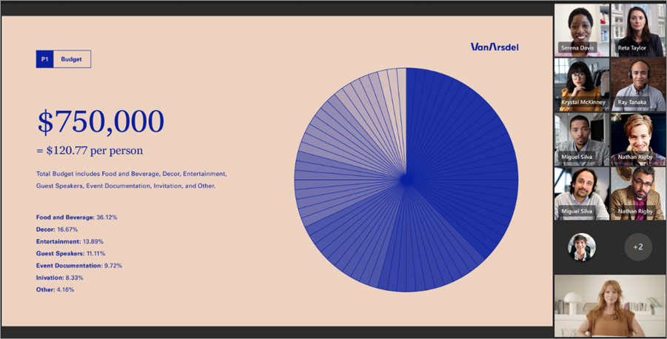


Microsoft Teams Meeting
Overview
RTA/Alerts
RTA/Alerts
Presenters
Organizers
Moderators
Producers
Attendees/Participants
Virtual Presenter
SDI
RTMP
Physical Presenter
Event Team
Live Content

Slide 4
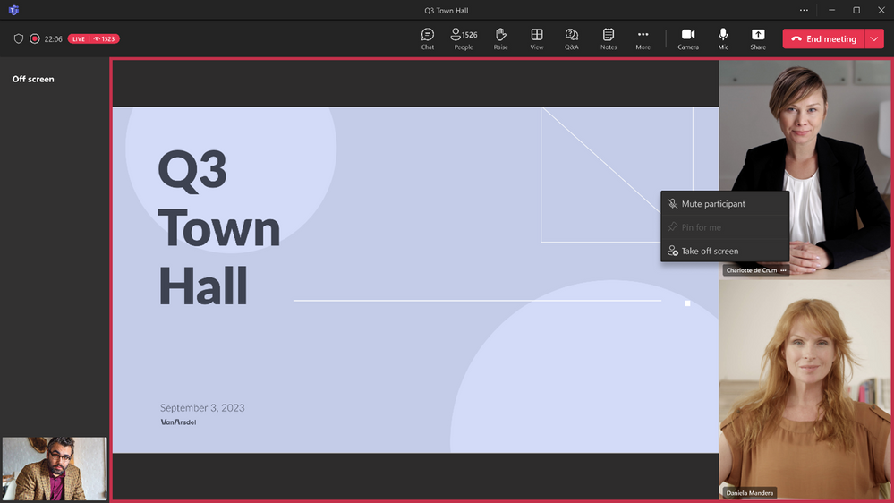
Microsoft Teams Town Hall
Overview
RTA/Alerts
Unified Event Support
Town Hall Insights/eCDN
Presenters
Organizers
Moderators
Producers
Microsoft Event Intelligence
Attendees
Virtual Presenter
SDI
Physical Presenter
RTMP
Event Team
Live Content

Slide 5

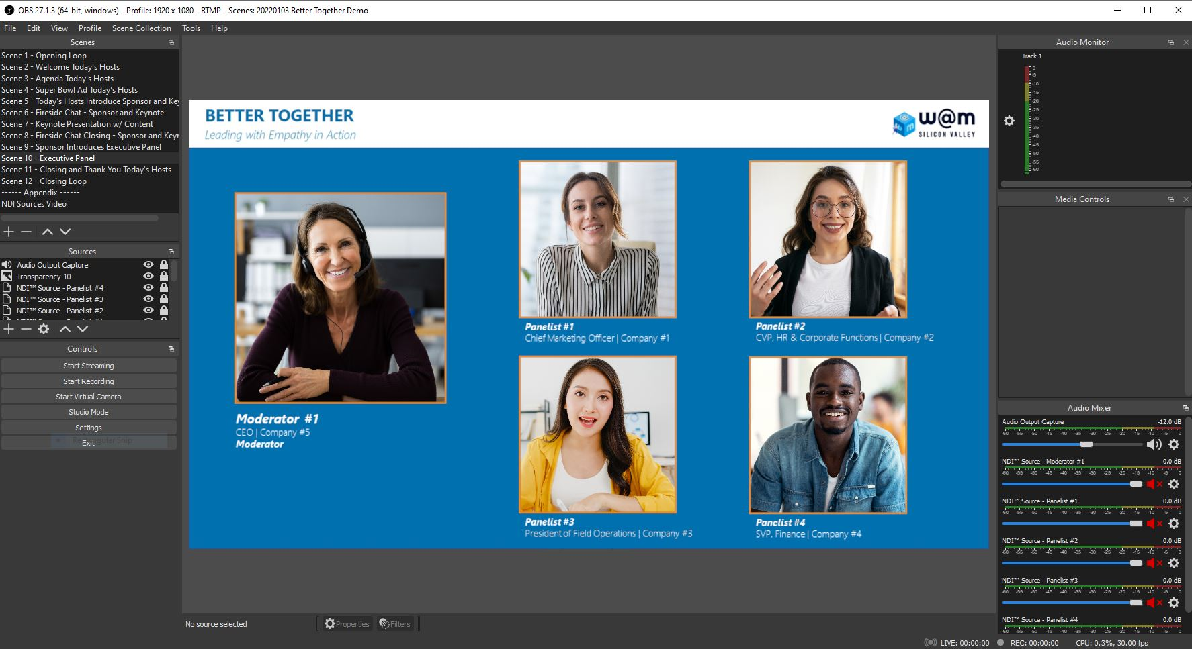
Microsoft Teams Advanced Event – Hybrid and Virtual
Overview
RTA/Alerts
LEAP
RTA/RTOA(TH)/1PeCDN
Presenters
Producers
Attendees
Teams Live Event
Teams Town Hall
Teams Meeting
Azure Media
Viva Engage
Any Streaming Platform
High Quality Recording
NDI Audio and
Video
Program
View
In-person Studio or Office
Production Software
Live Content
Production Software=Software Media Encoder’s such as OBS, Wirecast and Vmix. Hardware + Software solutions such as Tricaster which all-in-one packages.

Slide 6

The Keys to Success
Champion
Drive
Automate
Implement
The Quality Champion is a group or individual passionate about the user experience and accountable for quality.
The Quality Champion Role
Consistently monitor the health of your tenant and drive improvements using the Call Quality Dashboard and Power BI.
Leverage the IP address Web Services to automate updates to your Firewall Rules and/or PAC files.
Implement process for ongoing health reviews and remediate issues as discovered.

Slide 7

Quality/Reliability Checklist
1.
Ensure the right ports and protocols are open
Subnets, 13.107.64.0/18, 52.112.0.0/14, 52.120.0.0/14, 2603:1063::/38 and Ports: UDP 3478-3481 & TCP 443 are needed for Teams signalling and media traffic.
2.
Bypass proxy and deep packet inspection
Bypass on-premises and cloud-based proxy and inspection services commonly used for Internet browsing.
There are 7 key configuration areas to validate – start here
3.
Implement split tunnelling for VPN solutions
Facilitate direct connectivity to these cloud endpoints for VPN users by implementing split tunneling.
4.
Exclude important processes from anti virus/DLP scanning
Excluding teams.exe, for example, from scanning keeps then from interrupting the operation of team which can lead to slow system performance.
5.
Local DNS resolution
Microsoft services are deployed globally and use geo-based DNS and Anycast IP to load balance and allocate services closest to the endpoint.
6.
Take the shortest path to the Internet
Route traffic to the Internet as close as possible to the endpoint. This ensure traffic enters the Microsoft managed network faster with fewer hops and points of failure in between.
NOTE: Some of these changes can have perceived security risks, please see the Teams Security Guide to understand how we ensure the security of our traffic.
7.
Deploy Quality of Service (QoS) where needed
In congested networks, media workloads should be prioritized into proper queues to protect packets on managed networks.

Slide 8
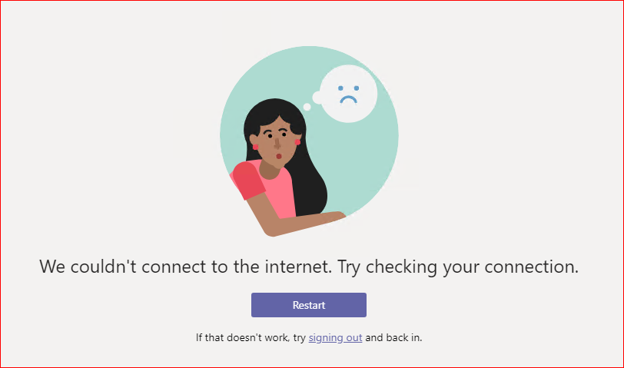
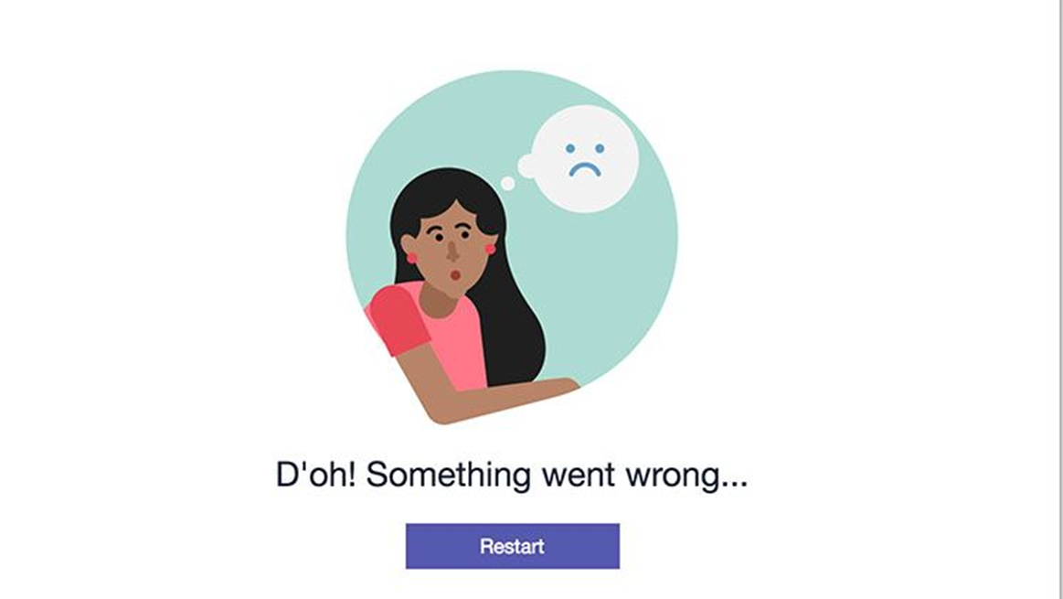
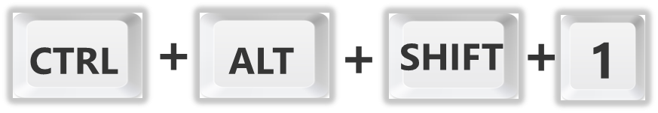
Troubleshooting Workflow
Ask the triage questions
Have you done a crosscheck? (client vs. browser)
Is this happening only for your or are peers also encountering this issue?
Are you using a wired or wireless headset? (distance between client and device)
Check Call Analytics or CQD
Run Fiddler and/or Wireshark
Reproduce the issue
Analyze traces
Open a support ticket with Microsoft

Slide 9
What could possibly go wrong with Media?
Setup Failure
Dropped calls
TCP instead of UDP
Streams over VPN
Media Reliability
Streams over Proxy
Endpoint version
Devices

Slide 10
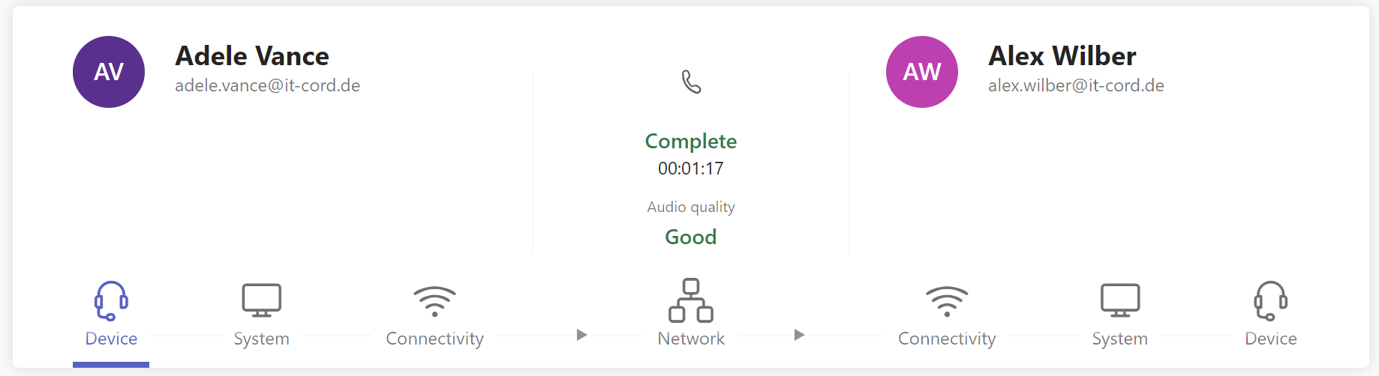
Call Analytics
You can search for a specific users calls/meetings
30 days of calls/meetings are stored – data is accessible within 15 minutes
Audio streams are classified as Poor based on the same metrics used in CQD
Data is organized by call component

Slide 11
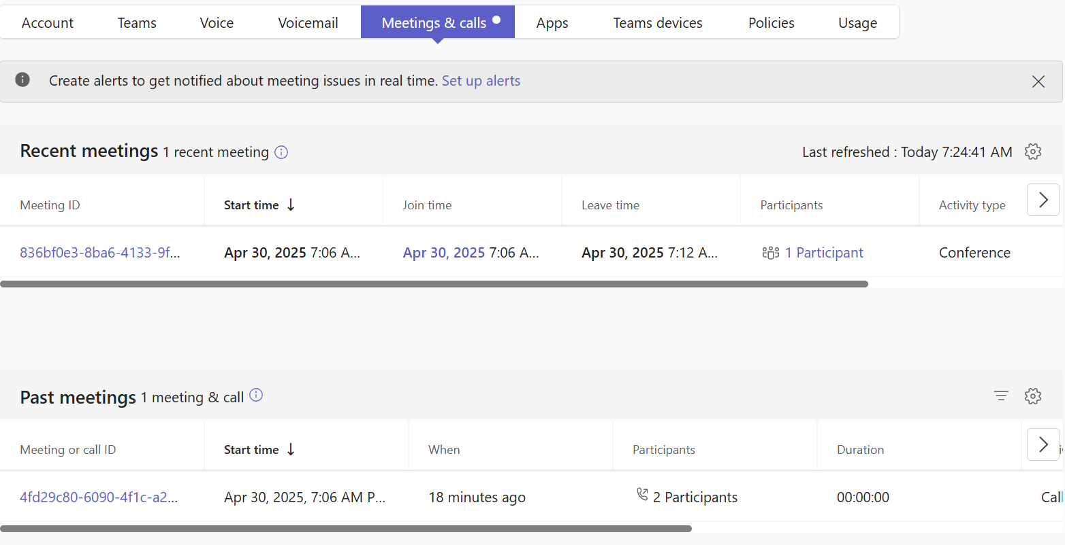
Real-time telemetry vs. past meetings
For users who have a Teams Premium license, real-time telemetry is gathered automatically and is retained for seven days.
For users who don't have a Teams Premium license, real-time telemetry is only gathered when you access the in-progress meeting in the Teams Admin Center and is retained for 24 hours.
If the meeting isn't in progress or doesn't have real-time telemetry data, it's listed under Past meetings.

Slide 12
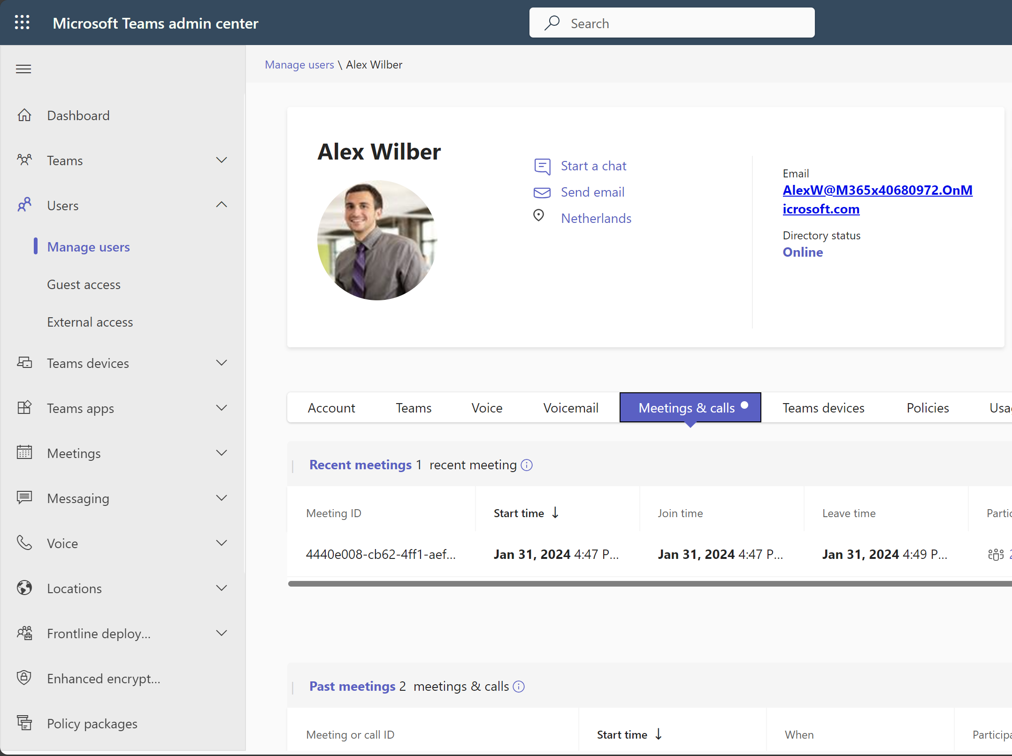
Call Analytics
1
Navigate to
Manage users
2
Then to
Meetings & calls

Slide 13
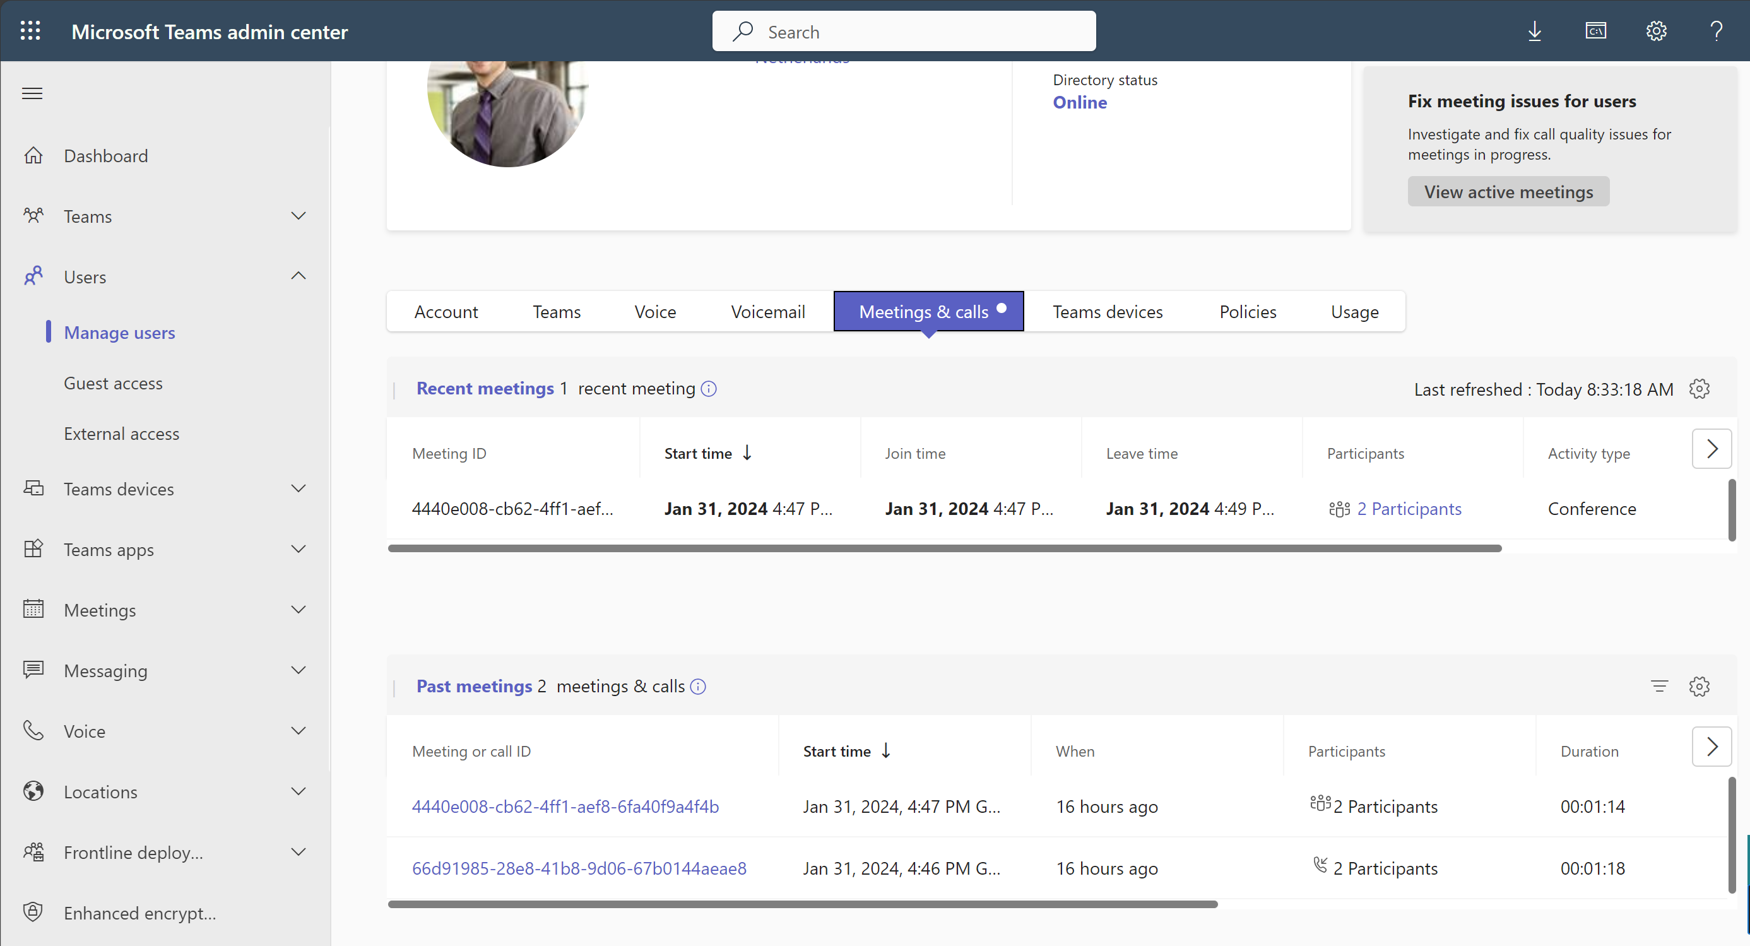
Call Analytics
Overview of all meetings and call that took place in the last 30 days

Slide 14
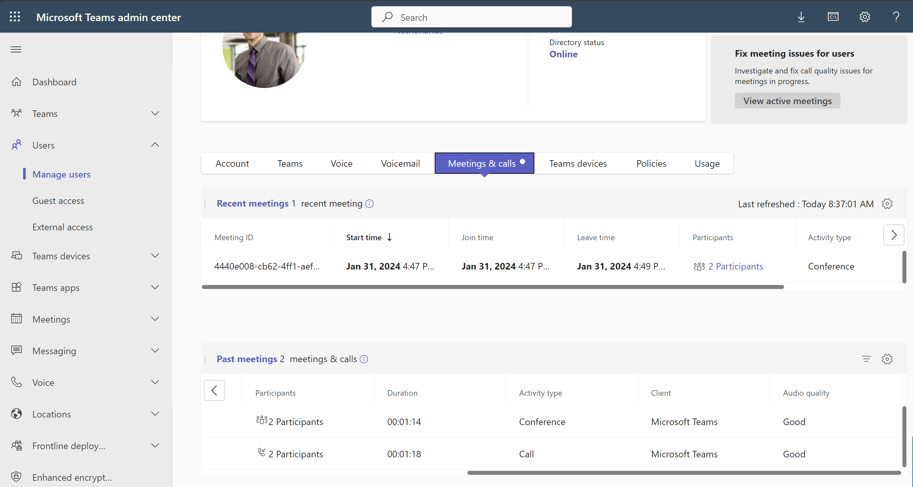

Call Analytics
Identify poor calls
!
Call details based on the following criteria:
Start time
When
Participant
Duration
Activity type
Client
Audio Quality

Slide 15
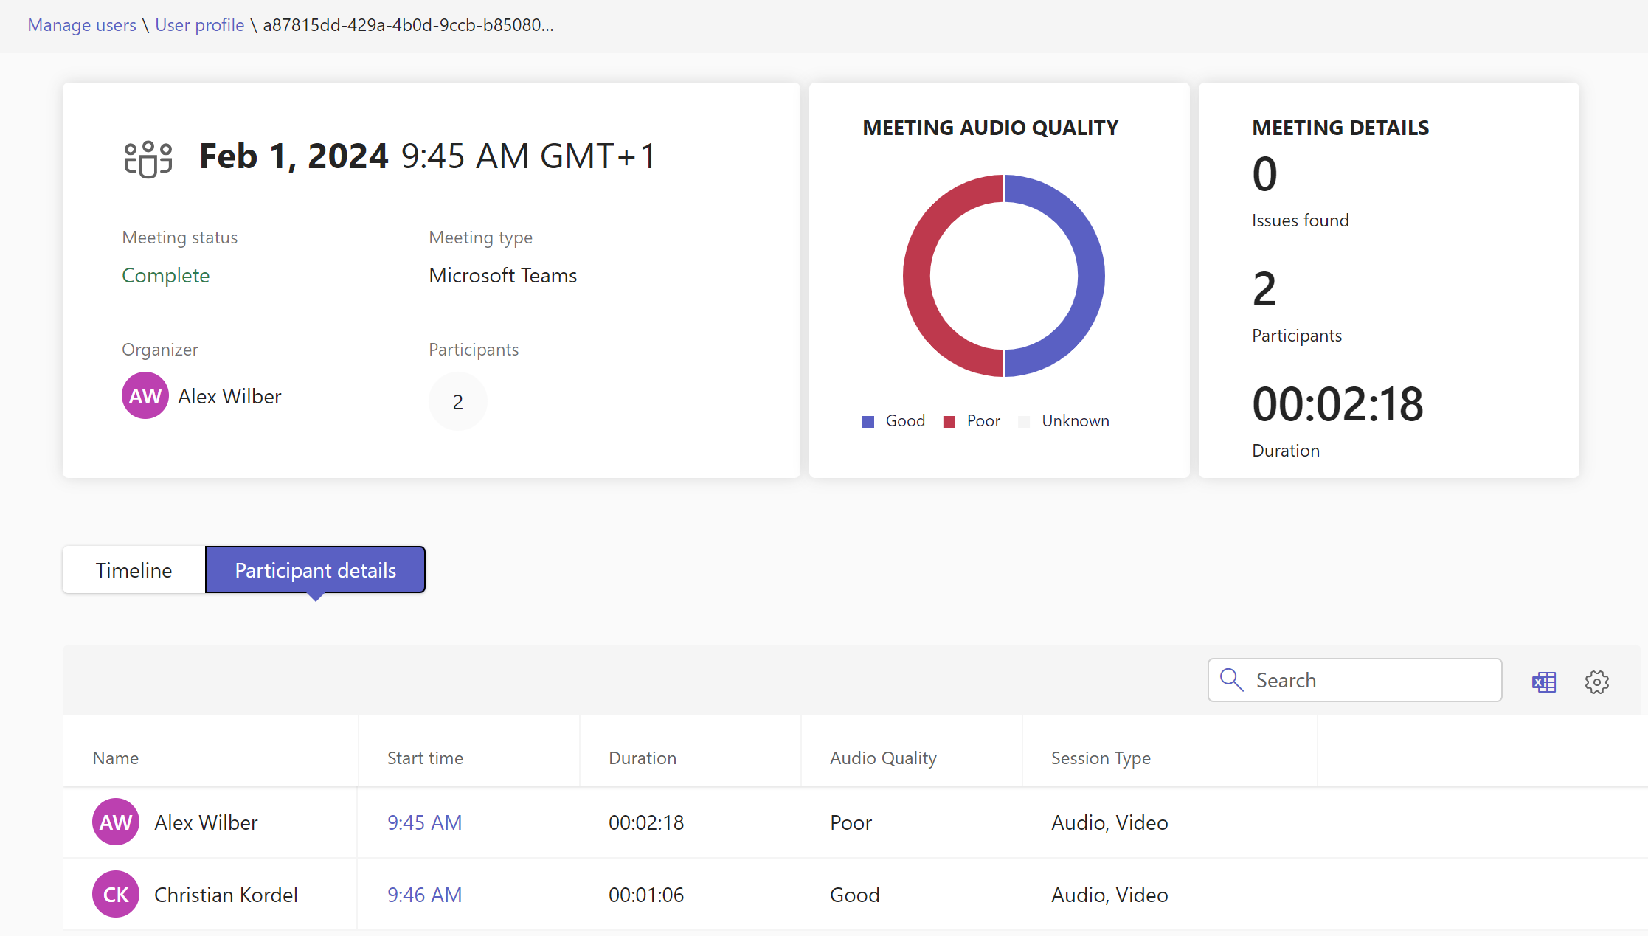
Call Analytics
Overview of every participant to see, who suffered from poor quality
Overview of audio quality for the session

Slide 16
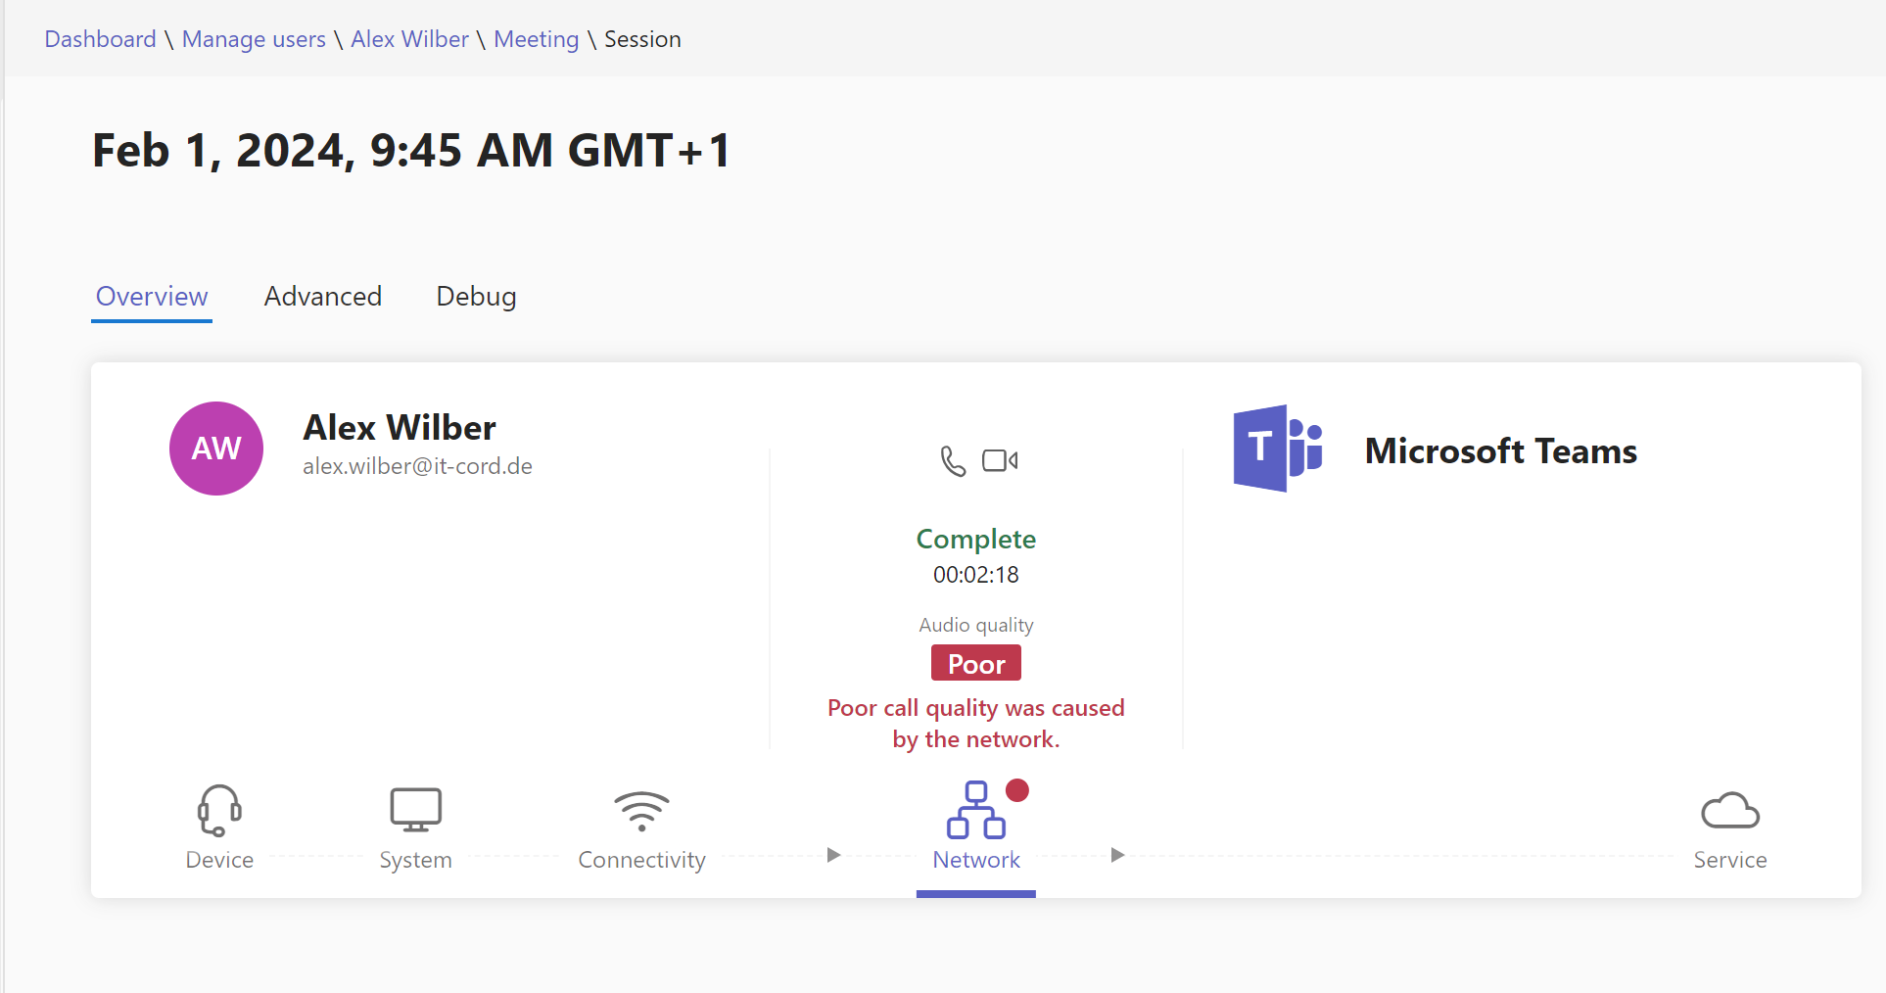
Call Analytics
Three tabs to deepen troubleshooting
Clear indicator why exactly the stream was considered „Poor“

Slide 17
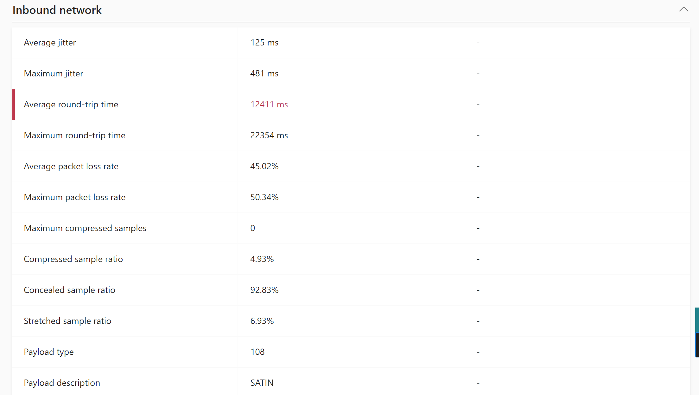
Call Analytics
A closer look in the “Advanced” section helped to identify that RTT is the main cause for the poor quality.

Slide 18
Proactive Meeting Quality Monitoring
Meetings, Webinars, and Town Halls – Premium Event Administration

Slide 19
Proactive Meeting Quality Monitoring
Benefits:
Enable alerts for a team so they’re notified in real time when a meeting’s quality degrades
Edit separate rules for audio, video, or screen sharing quality issues
Choose specific networks and users to target, as well as the monitoring conditions
Access real-time telemetry to identify potential causes for poor quality
Prerequisites:
To be targeted by an alert rule, an end user must have either an assigned Teams Premium license or an assigned Teams Rooms Pro license

Slide 20
Proactive Meeting Quality Monitoring
Dependencies and Limitations:
Real-time telemetry is only available for scheduled meetings and Meet Now
Use Cases:
Marketing – To ensure important presenters are maintaining optimal media quality during a product launch, the IT team can set up alert rules so they’re notified within a Teams channel when an issue arises; from there, they can use the telemetry to try and resolve the problem

Slide 21
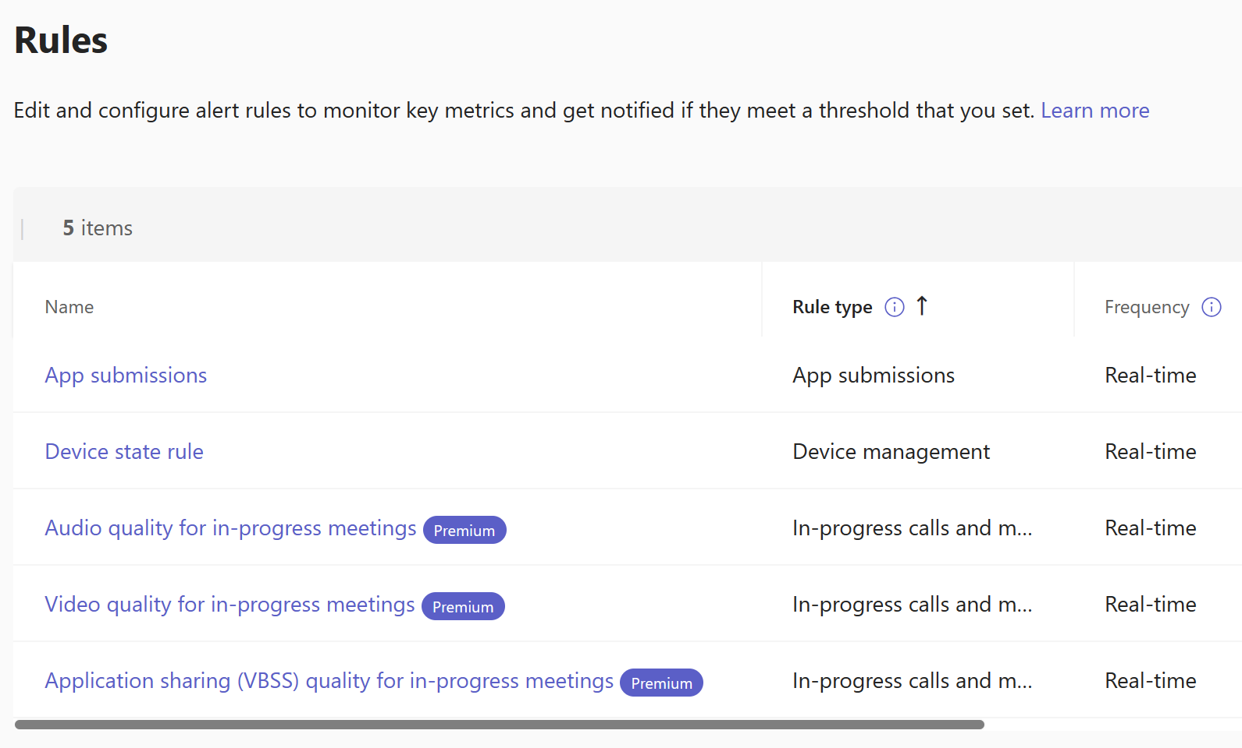
Admin Guidance: Edit a media quality alert rule
Proactive Meeting Quality Monitoring
Access the alert rules by performing the following steps:
Go to the Teams Admin Center
Expand Notifications & alerts, then select Rules
Within Rules, select one of the three media quality rules shown below:
Audio quality for in-progress meetings
Video quality for in-progress meetings
Application sharing (VBSS) quality for in-progress meetings
Microsoft Confidential

Slide 22
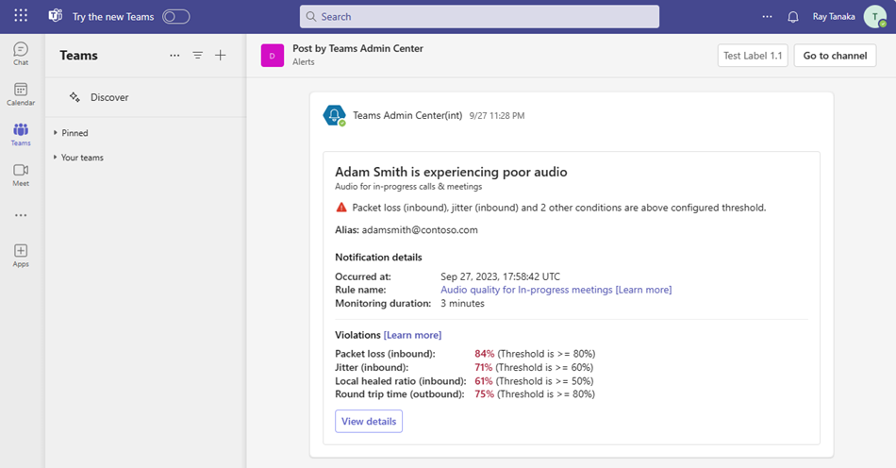
User Experience: Receiving a media quality alert
Proactive Meeting Quality Monitoring
If a user is targeted to receive notifications about media quality issues, they’ll receive the notification either in a Teams channel or via a webhook.
Channel receiving the alert
Identifies user and type of issue they’re experiencing
Information about which meeting quality metrics were not being met
Link to the real-time telemetry data in the Teams Admin Center
Microsoft Confidential

Slide 23
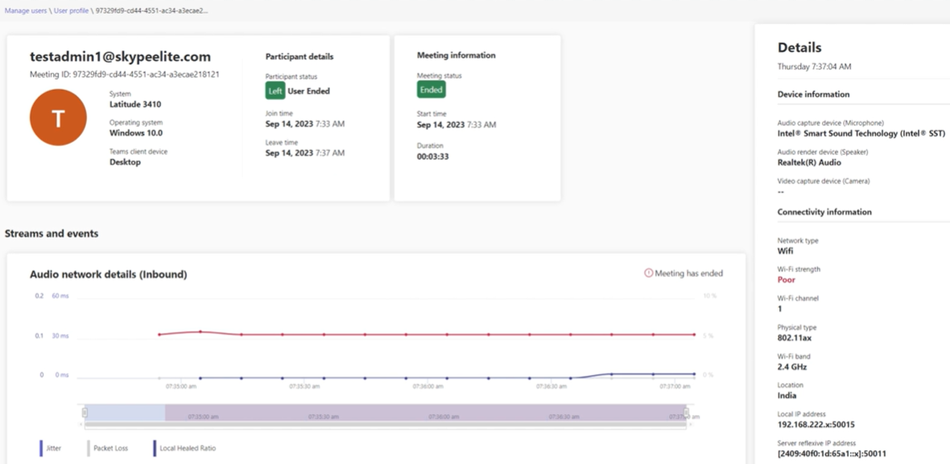
User Experience: Receiving a media quality alert
Proactive Meeting Quality Monitoring
Audio metrics include:
Jitter
Packet loss
Round trip time
Video metrics include:
Source freeze count
Loss recovery attempt rate
Video encoder hardware failure
Screen sharing metrics include:
Freeze
Frame rate
Loss recovery attempts
Above is an example of the real-time telemetry that can be accessed and analyzed after receiving an alert
Microsoft Confidential

Slide 24
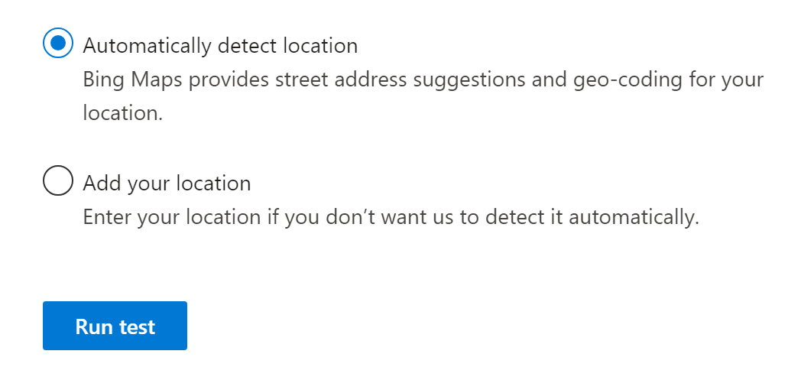
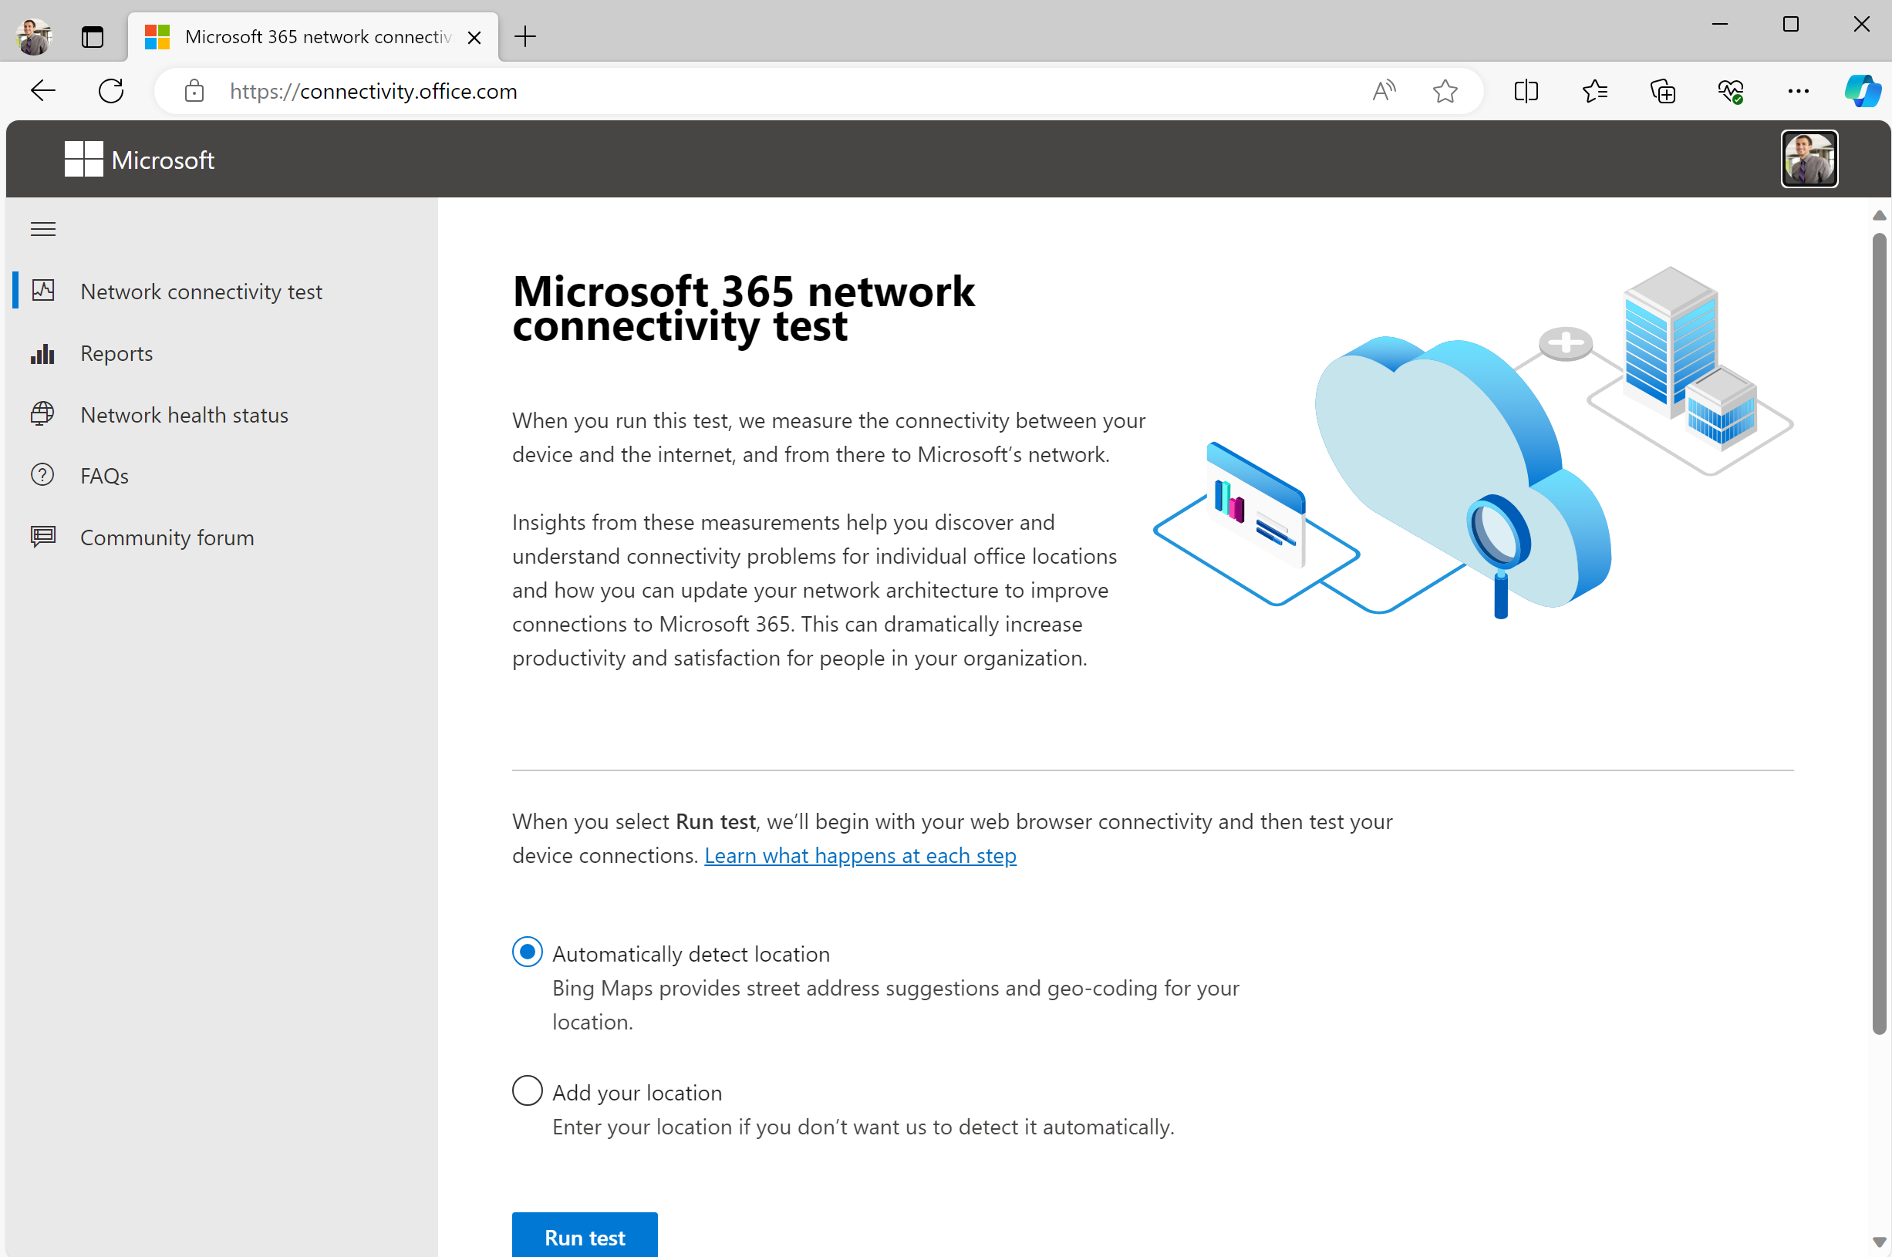
Microsoft 365 Network Connectivity Test
Evaluates the quality of your network connection to Microsoft 365 services
https://connectivity.office.com
To troubleshoot network connection issues for someone in your organization, simply send this page to them and have them run the test for their location after logging in with their Entra ID account
Just click on “Run test” – the location detection usually works

Slide 25
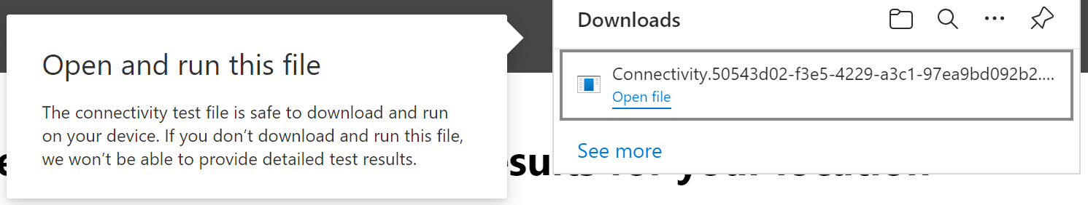
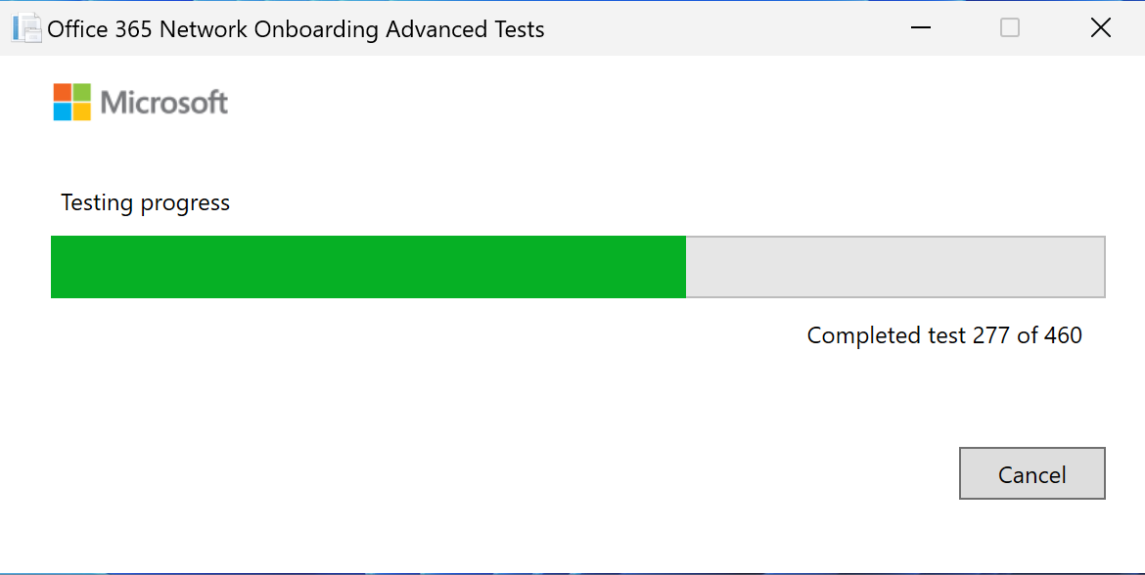
Running the tool
The advanced tests require .Net Desktop Runtime 6
Evaluate the quality of your network connection to Microsoft 365 services
After clicking Run Tests, it starts several high-level tests. After they are done, a file will be downloaded.
This file is specific to that computer! Do not save and use again on another computer!
Run the file downloaded, it does not require admin privileges on the workstation
The tool will report the findings back to the browser and display the report

Slide 26
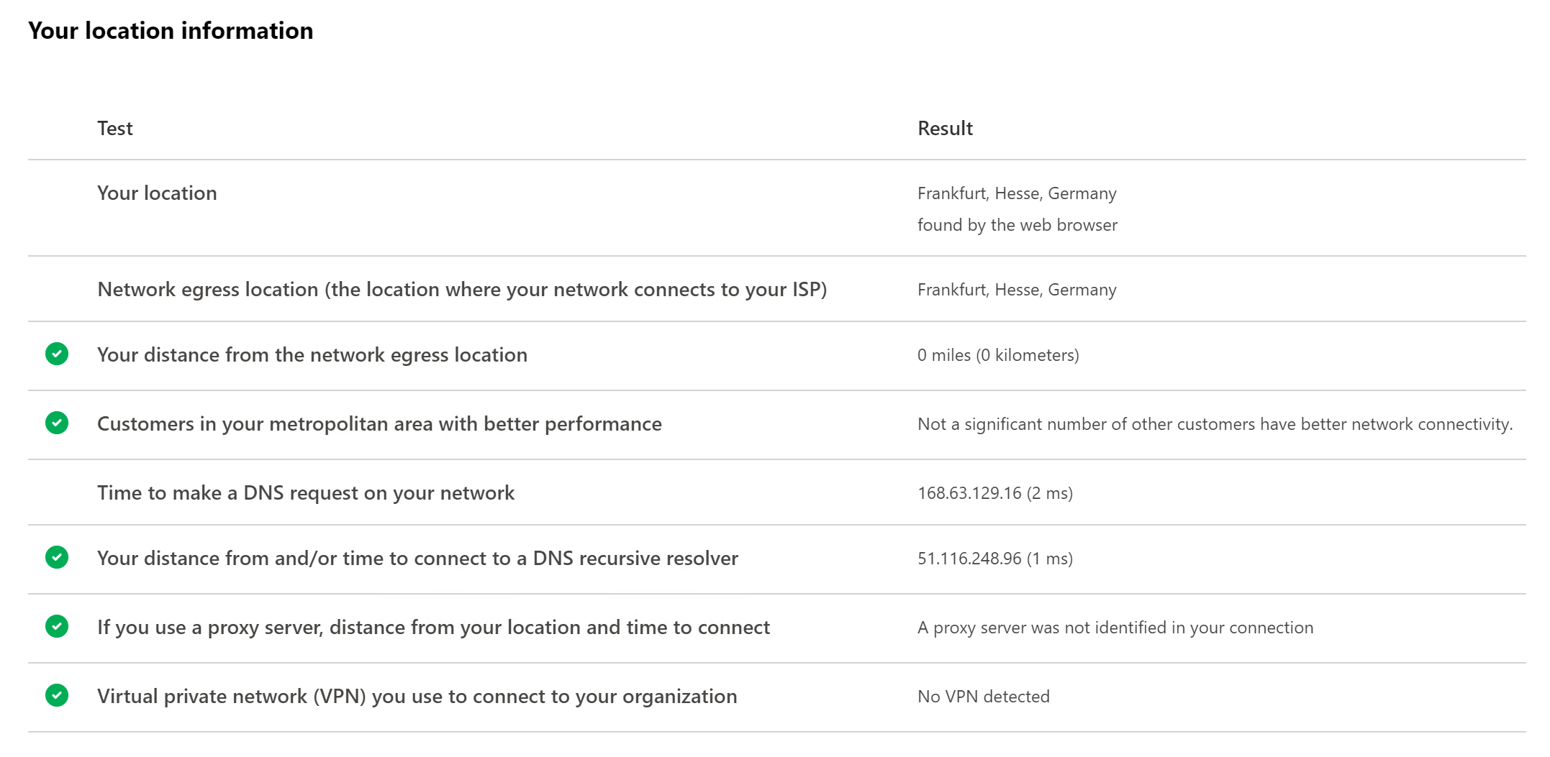
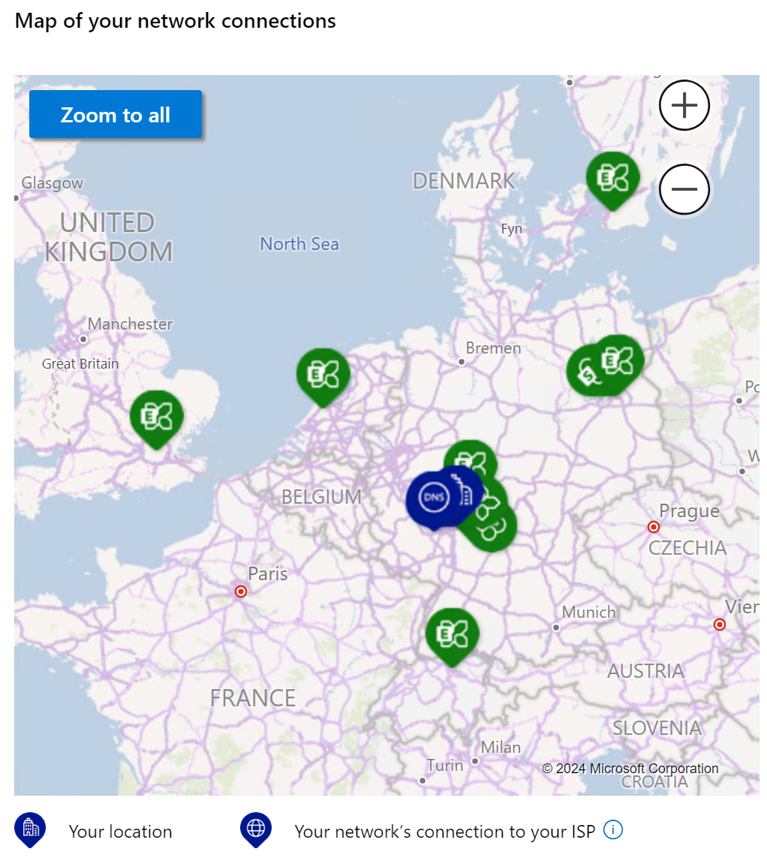
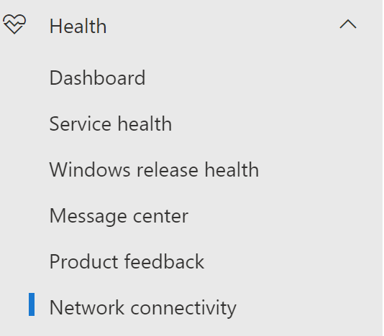
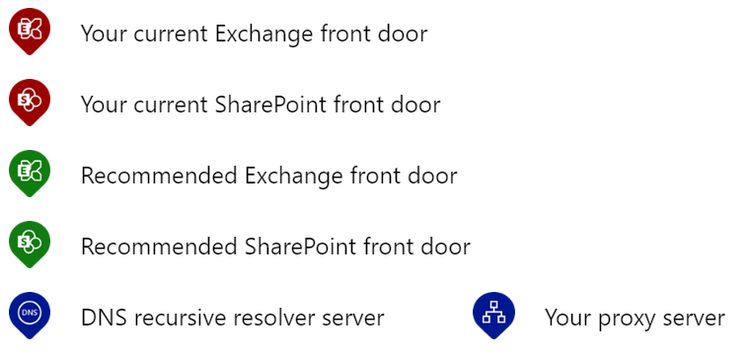
Review the results
Review the results and note any recommended actions
If the user is logged in, the results will automatically be uploaded to the tenant for Admins to review

Slide 27
Thank you
Copyright© 2024 Microsoft Corporation. All rights reserved.

Slide 28

Your feedback is critical
Scan with your mobile device camera
We’re committed to making your Modern Work Customer Hub experience the best it can be – and your feedback is a critical component to that.
Before you scoot, please take a moment to reply to provide some feedback.
-OR-
Visit
Customer Hub Survey
aka.ms/CustomerHubSurvey

Slide 29
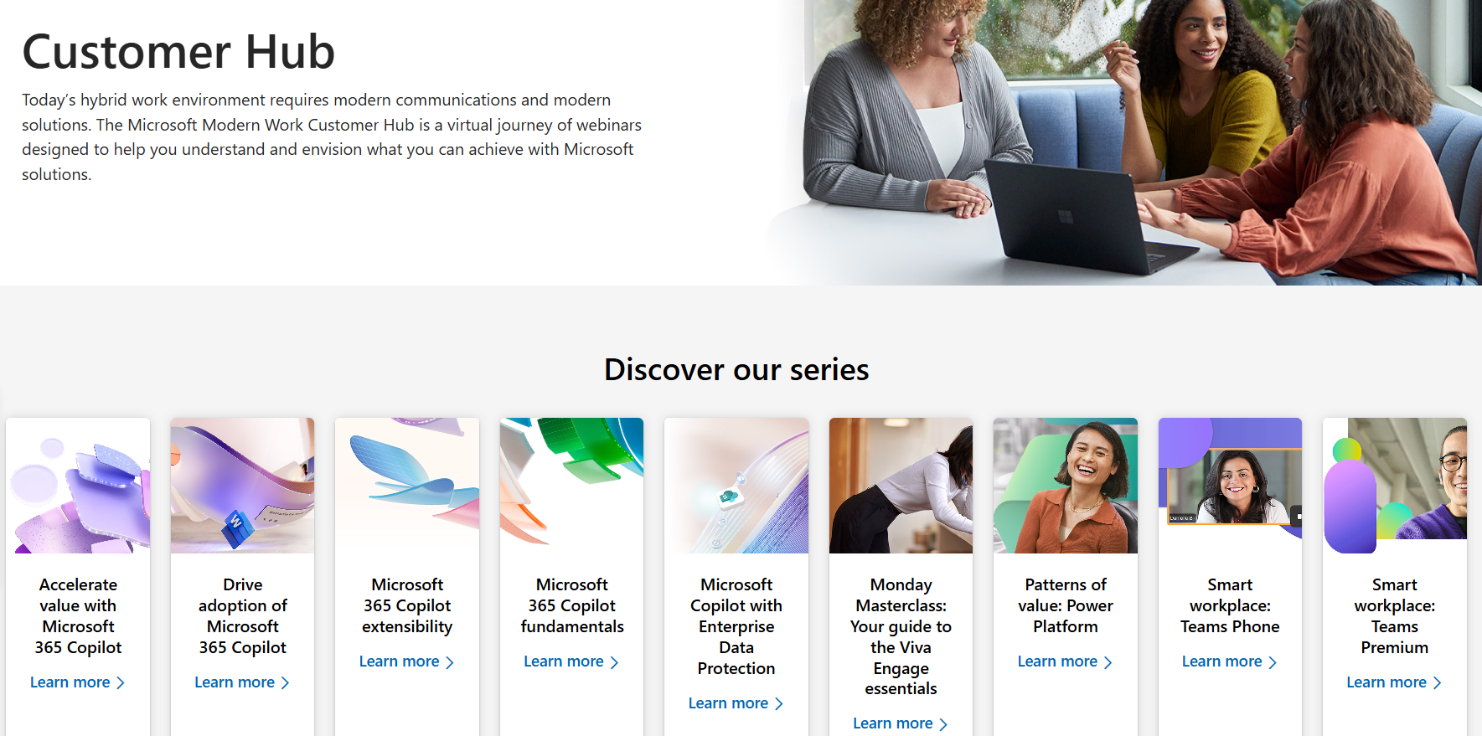


Visit Customer Hub Website for upcoming sessions, updates, and on demand contents!
Scan me!
https://aka.ms/CustomerHubSessions

Slide 30
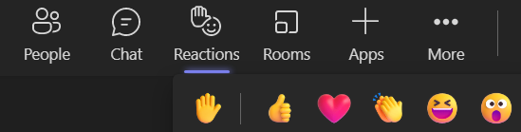
Q&A
1
Please raise your hand and unmute when called on
2

Slide 31

Latency
Delays packets between endpoints
Symptoms
Talking over one another
Latency can also lead to dropping packets, showing the same symptoms as packet loss
Limiting delays
Improving Wi-Fi reception in case of Wi-Fi
Allow direct connection between internal endpoints
Optimize routing to Office 365 network

Slide 32

Packet Loss
Packets are lost or discarded between two endpoints
Symptoms
Loss of audio or choppy (broken) audio
“Robotic” voice due to Audio Healer
Frozen video or video with lots of fragments
Delays in your hearing—or being heard by—the other party
Limiting Packet Loss
Using wired network instead of Wi-Fi
Improving Wi-Fi reception in case of Wi-Fi
Increase bandwidth

Slide 33


Jitter
Symptoms
Jitter buffer increases latency leading to same symptoms as latency
If packets arrive too late, they are dropped and lead to same symptoms as packet loss
Limiting Jitter
Reduce network congestion
Increase bandwidth
Used to buffer some packets to restore the original sequence
How much longer do we have to wait for #2?
4
3
1
The audio packet waiting room

Slide 34


Packet reorder
Impact on quality
Percentage of packets that do not arrive in the order they were sent. Out of order packets will be discarded.
A high amount of out of order packets will lead to audio being dropped, increasing the packet loss. It will have the same kind of effect as packet loss on quality
2
1
3
When is this common?
High latency networks
VPN Connectivity
TCP or HTTPS media transport
Proxy or Deep Packet Inspection
Throttled internet connections
Oversubscribed networks without QOS

