Slide 1

Mastering Microsoft 365 Copilot, Copilot Chat and Agents – 2026
Engage in six interactive sessions designed to help you leverage the features of Microsoft 365 Copilot and develop effective prompting skills.
  Learn how to use Copilot Apps within various M365 applications
  Develop expertise in crafting prompts
  Participate in a guided demonstration on applying Copilot and Copilot Chat for everyday productivity
Join two practical sessions focused on unlocking the potential of Microsoft 365 Copilot agents.
  Explore a range of built-in agents such as Facilitator, Interpreter, and Coaches, and discover how to use Agent Builder in Microsoft 365 Copilot and SharePoint Online to create customized agents for your organization
  Gain insights into the Researcher and Analyst agents, understanding how they provide executive-level research and actionable insights by analyzing your work data and online sources
Participate in two hands-on sessions centered around the Microsoft 365 applications you use daily.
  Learn to create documents, presentations, and spreadsheets with Word, PowerPoint, and Excel Agents - from drafting and designing to data integration, explore how these agents help you work more efficiently
  Experience working collaboratively with Copilot in Copilot Cowork, where you can co-create, co-edit, and co-think with AI to address real tasks, transforming Copilot from a tool into a partner
Attend a multi-session training series focused on designing and managing AI agents with Microsoft Copilot Studio. Over five sessions, you will cover:
  An overview of Copilot Studio and its role within the Microsoft AI platform
  Techniques for writing effective agent instructions and prompts
  Understanding generative orchestration for coordinating AI, tools, and data
  Best practices for building and managing autonomous agents at scale
End-User webinars
(Free to all MFM Customers)
Session details and registration:
https://aka.ms/MasteringCopilotAndAgents2026
https://aka.ms/MasteringCopilotAgents2025Content - Content will be updated here
Notes:
Good morning everyone, and welcome to this continued series on Mastering Microsoft 365 Copilot, Copilot Chat, and Agents.
We're really excited to have you here for the 2026 edition.
As you can see on this slide, we have six interactive sessions designed to help you leverage the full power of Microsoft 365 Copilot and build real expertise in prompting.
Across these sessions, you'll learn how to use Copilot within various M365 applications, develop skills in crafting effective prompts, and participate in guided demonstrations.
We also have two sessions focused on built-in agents like Facilitator, Interpreter, and Coaches, as well as how to use Agent Builder in M365 Copilot and SharePoint Online to create customized agents for your organization.
And finally, there are hands-on sessions where you'll work directly in Word, PowerPoint, and Excel with their respective agents.
You can find session details and registration at the link shown on screen.
Now let's dive into today's focus area.

Slide 2

Mastering Microsoft 365 Copilot
Hands-on Experience:
Microsoft 365 Copilot in Word
Microsoft 365 Copilot in PowerPoint
MFG Use Cases
Notes:
So today's session is a hands-on experience focused specifically on Microsoft 365 Copilot in Word and PowerPoint.
We're going to walk through real scenarios showing you how to create content, modify content, and get insights from content using Copilot in both of these applications.
My name is Angel Aviles, I'm a principal CSA here at Microsoft, and I'll be working with you this morning to cover this subject matter.
We'll also touch on some real-world manufacturing use cases to make this as practical as possible.
So let's get started with a few housekeeping items before we jump in.

Slide 3
Important information before we start!
✓
The meeting is recorded, recording will be provided in the following days.
✓
During the first part of the session, microphones and videos are turned off
✓
Post all your questions into the chat and our moderators will answer
To ask a question during the Q&A section, simply raise your hand using your meeting controls as shown below. A moderator will take care of letting you unmute.
✓
Notes:
Before we get started, a few important housekeeping items to cover.
First, this meeting is being recorded, and we'll try to get the recording out by the end of the day.
There will also be a content link through the registration site where you can access both the recordings and the PowerPoint presentations from the session.
During the first part, Microsoft video and microphones are turned off due to the size of the audience.
However, we do have a chat and Q&A that's moderated, so please feel free to post your questions there.
If at any time there's a mass loss of audio or the PowerPoint goes blank, go ahead and raise your hand using the meeting controls shown here to let us know.
For anyone having individual audio or content sharing issues, we recommend restarting your webinar session or joining via the web experience, which often fixes those problems.
Alright, with that out of the way, let's look at what we'll cover today.

Slide 4
Agenda
Microsoft 365 Copilot in Action:
Copilot in Word
Copilot in PowerPoint
Q&A Session
Introduction to Microsoft 365 Copilot
How does Microsoft 365 Copilot
work?
Creating a new Word Document with Microsoft 365 Copilot
Modifying an existing document with Microsoft 365 Copilot
Analyzing an existing document with Microsoft 365 Copilot
Formatting a document with Microsoft 365 Copilot
Creating New Deck from a Document with Copilot for M365
Adding a new slide with Copilot for M365
Organizing the deck with Copilot for M365
Formatting the deck with Copilot for M365
Analyzing the deck with Copilot for M365
Open Forum
Notes:
Here's our agenda for today.
We'll start with a brief introduction to Microsoft 365 Copilot and how it works under the hood.
Then we'll jump into the first big section, which is Copilot in Word.
We'll cover creating a new Word document with Copilot, modifying an existing document, analyzing a document, and formatting with Copilot.
After that, we'll shift to Copilot in PowerPoint, where we'll look at creating a new deck from a document, adding new slides, organizing a deck, formatting, and analyzing presentations.
And then we'll wrap things up with an open Q&A forum where you can ask any questions that come up.
So let's start with that foundational overview of Microsoft 365 Copilot.

Slide 5
Microsoft 365 Copilot Overview
Overview
Notes:
Alright, this is our section divider for the Microsoft 365 Copilot overview.
Before we get hands-on with Word and PowerPoint, I want to make sure everyone has a solid understanding of what Copilot is, how it works, and what makes it unique.
This context will help frame everything we do in the demos that follow.
Let's take a closer look at the architecture.

Slide 6

Microsoft 365 Copilot
Natural Language
Large Language Models
Microsoft Graph
- Your Data -
Microsoft 365 Apps
Copilot Agents
The
Web
Notes:
So what is Microsoft 365 Copilot?
At its core, Copilot is the AI interface into your M365 tenant.
What we've done is taken large language models from partners like OpenAI and Anthropic, and connected them to the Microsoft Graph — that's all the data contained within your tenant that you have visibility to.
And then we've embedded this AI directly into the Microsoft 365 apps you already use every day.
This is what makes Copilot truly unique.
You don't have to leave your application to use AI — it's built right in, with both standalone tools and the Copilot experience.
It also enables contextual referencing, meaning instead of uploading documents into a separate AI tool, you can simply open a document, open the Copilot flyout within that app, and now there's a live context link between your prompts and the document you're actively working on.
We've also extended this to agents — no-code, low-code applications built on agentic AI that let you combine prompts into automated workflows for multi-step processes.
And of course, you have access to the web as well, so you can pull in web data alongside your work data.
Your data is enterprise data protected, meaning the same permissions and protections that apply to any document in your tenant apply to Copilot too.
Your data is your data — we don't claim any ownership of what you create.
Now let's look at how Copilot is embedded across the M365 app ecosystem.

Slide 7










Microsoft 365 Copilot
Embedded across Microsoft 365 apps
Notes:
As you can see here, Copilot is embedded across the entire Microsoft 365 suite.
Whether you're working in Word, Excel, PowerPoint, Outlook, Teams, OneNote, Loop, or Whiteboard, Copilot is right there with you.
This unified experience means your data is contained within the M365 tenant, protected with enterprise data protection, and integrated into each app.
So you get the most efficient and direct way of using AI against the data you're working with, without having to switch between applications or upload files to external tools.
The key thing to remember is that Copilot doesn't use any special set of permissions — it has the same access as you do.
What you can see, it can see, but it can't see or act on anything beyond what's defined for your user account.
Now, there are actually two versions of Copilot available, and I want to walk you through the differences.

Slide 8
Microsoft 365 Copilot
Copilot Chat¹
M365
Copilot
● Included ο Limited ▲ Metered
w/o Copilot license
$30 pu/pm
Grounding | Web data, referenced files, uploaded files | ● | ●
 | Work IQ | - | ●
 | Use Copilot connectors to access external data sources | ▲ | ●
Models | Latest OpenAI models: GPT-5.X | Standard | Priority
 | Model choice | - | ●
Microsoft 365 Copilot App | Chat | ● | ●
 | Search² | ο | ●
 | Notebooks | - | ●
 | Create³ | Standard | Priority
 | Memory and personalization | ● | ●
 | Voice on mobile, desktop, web | - | ●
 | Sora 2⁴ | - | ●
 | Copilot Mode in Edge⁵ | ο | ●
M365 Apps | Copilot in Outlook⁶ | Standard | Priority
 | Word, Excel, and PowerPoint agents accessed via Chat | Standard | Priority
 | Copilot in Word, Excel, PowerPoint, and OneNote | - | ●
 | Copilot in Teams | Standard | ●
Agents & tools | Pre-built Microsoft agents, including Researcher, Analyst, and Facilitator⁷ | - | ●
 | Sales, Service, and Finance agents | - | ●
 | Agent creation using Agent Builder and Copilot Studio | ● | ●
 | App Builder and Workflows agents⁴ | - | ●
 | Agent usage | ▲ | ●
Security and management | Enterprise Data Protection (EDP), management, compliance, and controls | ● | ●
 | Analytics to measure adoption, usage, and business impact⁸ | ο | ●
 | SharePoint Advanced Management | - | ●
Applies to customers with 2K or more M365 seats
Lexical search included for Copilot Chat users
Access to brand kits and surveys requires M365 Copilot license
Available via Frontier program, pricing final upon GA
Copilot Chat users access Copilot Mode w/web data and open documents only
For unlicensed users, Copilot Chat in Outlook reasons over organizational data in Outlook, Teams, OneDrive, and SharePoint (limited).
Researcher and Analyst, have combined limit of 25 interactions pu/pm
Basic reporting available with Copilot Chat
Notes:
So here's a detailed comparison between Copilot Chat and Microsoft 365 Copilot Premium.
Copilot Chat comes included with your M365 license and gives you basic chat capabilities grounded to the web.
That means the Microsoft Graph — your work data — isn't exposed with this license.
You can still use work data with Copilot Chat, but you have to explicitly upload it rather than having Copilot pull it in automatically.
It's still protected by enterprise data protection, so it's a much better option than consumer off-the-shelf AI solutions.
The premium license, on the other hand, is an add-on that unlocks grounding to work data, first-party agents like Researcher, Analyst, and Facilitator, the in-app Copilot experience within Word, Excel, and PowerPoint, model choice between OpenAI and Claude Anthropic, and capabilities like Work IQ for personalization.
As you can see in the table, the differences are significant — premium delivers AI that's truly built for work with embedded agentic capabilities and model diversity.
Let's now look at some common scenarios where Copilot really shines.

Slide 9

Copilot Scenarios
Effective meetings
Search & Data analysis
Content creation
Email processing
Quickly catch up on meetings you missed
Summarize a meeting and identify next steps
Run a more effective meeting
Get answers from across all your data
Instantly uncover key insights
Gain powerful insights & perspective they way you want to see it
Jumpstart creativity, and write and edit like a pro
Quickly catch up on the key points of a document or presentation
Create documents & presentations
Draft email replies instantly
Personalize the tone and length even on the go
Quickly summarize a long email thread
Notes:
So what are some common Copilot scenarios?
When you think about what Copilot is designed for, it's really about automating and optimizing your work day.
First up is effective meetings.
We spend so much time managing meetings — attending them, taking notes, figuring out which ones were relevant.
Copilot can recap meetings, summarize key points, identify next steps, and even facilitate meetings automatically with the Facilitator agent.
You can even get podcast-style audio recaps of your meetings at the end of the day.
Second is search and data analysis.
Copilot can see both web and work data, so you can use it to find specific information within your tenant, get deep insights, and with premium, bring in Researcher and Analyst agents for even more powerful analysis.
Third is content creation, which is what we're focusing on today.
Whether it's starting a document from scratch, converting a Word document into a PowerPoint, or generating a spreadsheet, Copilot does a fantastic job as a starter and a converter.
And fourth is email processing.
Copilot can summarize your inbox priorities, draft replies, generate tasks, and really manage your mailbox, especially when paired with Cowork on the premium license.
The bottom line is that Copilot isn't replacing users — it's making them dramatically more efficient.
Now let's talk about how to communicate effectively with Copilot through prompts.

Slide 10

Key ingredients of a good prompt
Goal
Context
Source(s)
Expectations
What do you want
from Copilot?
Why do you need it
and who is involved?
What information or samples do you want Copilot to use?
How should Copilot respond to best fulfill
your request?
+
+
+
“I was late to attend and need a brief overview of the project timeline.”
"Include the project timeline in a table and any proposed changes from Adele."
Recap this Teams meeting.
“Did Adele Vance propose any changes?”
=
Final Prompt
Recap this Teams meeting. I was late to attend and need a brief overview of the project timeline. Did Adele Vance propose any changes? Include the project timeline in a table and any proposed changes from Adele.
Notes:
So we've been talking about prompts, and this is really foundational.
A prompt is simply how you talk to AI — it's a conversation, no different from speaking with a colleague.
The key insight is that AI doesn't think, but it does reason.
So the more explicit you are about what you want, the better it can facilitate a useful response.
The more vague you are, the more you leave it to interpretation.
There's a framework called GCSE that captures the key ingredients of a good prompt.
G is for Goal — what do you want Copilot to do?
C is for Context — why do you need it and who's involved?
S is for Sources — what information or samples should Copilot use?
And E is for Expectations — how should Copilot format its response?
Look at the example on screen.
A zero-shot prompt like 'Recap this Teams meeting' will work, but the response will be very general.
But when you add context — 'I was late and need a brief overview of the project timeline' — plus a source — 'Did Adele Vance propose any changes?' — plus expectations — 'Include the project timeline in a table' — now you get something very specific and actionable.
The more of these ingredients you combine, the more controllable and useful AI becomes.
We have an advanced prompting webinar later this week if you want to deep dive into this.
Alright, now let's get hands-on with Copilot in Word.

Slide 11
Microsoft 365 Copilot – Copilot in Word
Web Content extension on
Notes:
Now we're moving into our first major hands-on section — Copilot in Word with web content extension enabled.
We're going to walk through a complete workflow, from creating a brand-new document using the Word first-party agent, to modifying and analyzing that document using the AI tools built right into Word.
I want to emphasize that we always recommend using the first-party agents for content creation because they've been specifically refined for creating content within each Office application.
The Word agent will even ask you follow-up questions to refine your document — things like who's the audience, what's the focus, what tone should it use, and how long should it be.
Let me first walk you through the prerequisites you'll need.

Slide 12
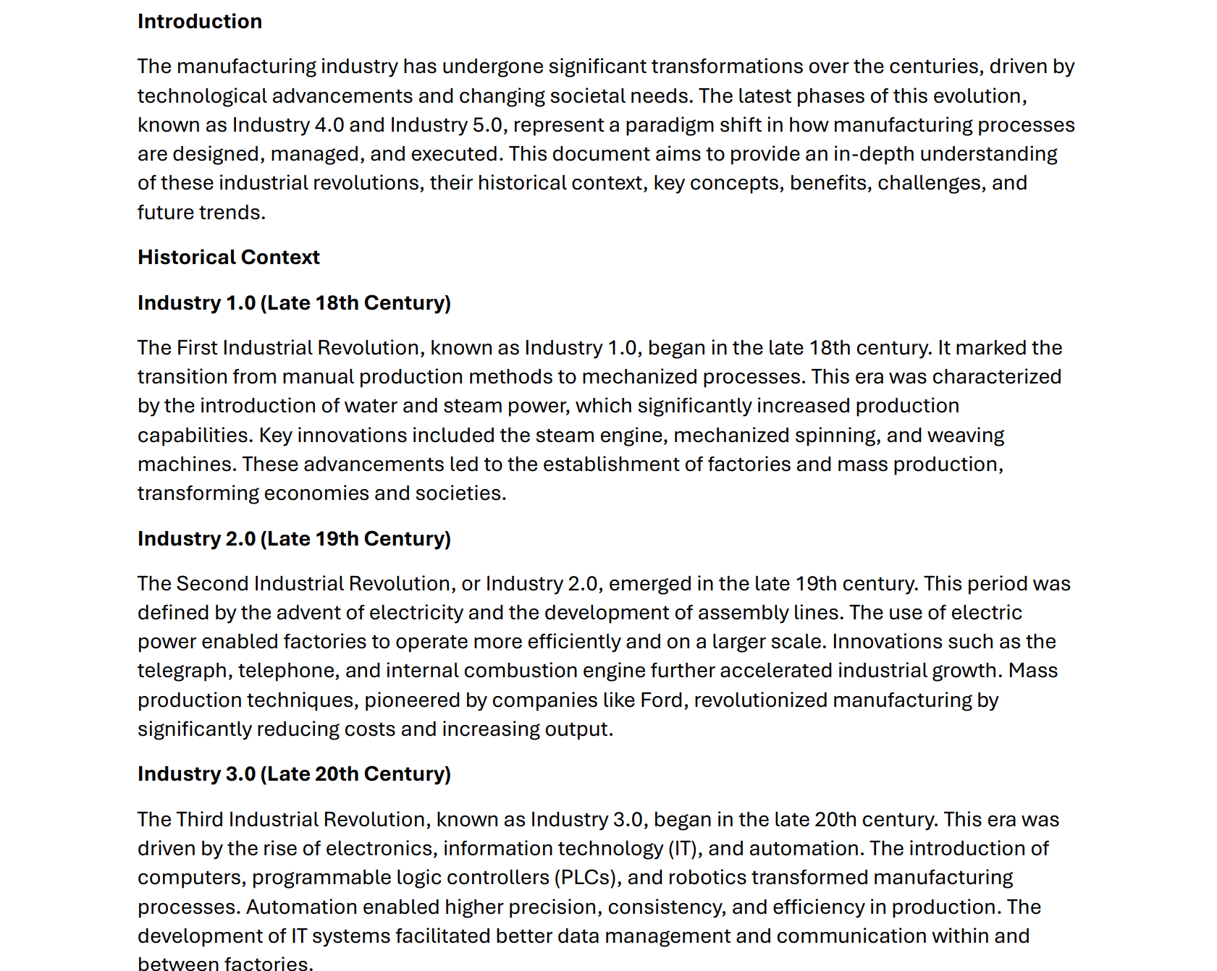
Prerequisites
Review the Industry 5.0 Primer.pdf data brief.
Save this PDF document in your OneDrive.
Notes:
Before we jump into the demo, there's a quick prerequisite.
You'll want to review the Industry 5.0 Primer PDF data brief and save it to your OneDrive.
We'll be using this document as a reference source during our Copilot demonstrations, both for Word and PowerPoint.
Having it saved in your OneDrive means Copilot can access it directly through the Microsoft Graph when you reference it in your prompts.
Once you have that ready, let's walk through creating a new document.

Slide 13
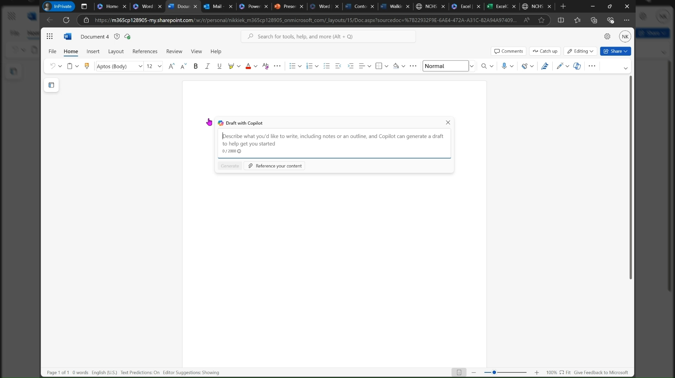
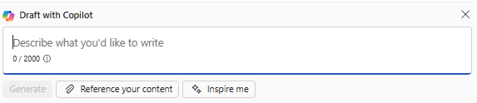
Create a new document with Copilot in Word
Open a blank Word document.
Click on Draft with Copilot or Alt + I.
Example Prompt:
“Create a document for leadership on Industry 4.0 and 5.0, focusing on the historical context, key concepts, benefits, challenges, and future trends.”
Notes:
Alright, here's our first hands-on exercise — creating a new document with Copilot in Word.
The process is straightforward: open a blank Word document, then click on Draft with Copilot or use the Alt+I keyboard shortcut.
The example prompt you see on screen asks Copilot to create a document for leadership on Industry 4.0 and 5.0, focusing on historical context, key concepts, benefits, challenges, and future trends, with an introduction and summary, plus a section to provoke audience curiosity about the implications of these shifts in manufacturing.
What's powerful here is that Copilot doesn't just generate text — the Word agent will ask you follow-up questions to refine the output.
It might ask about your audience, focus areas, desired length, and tone.
In my demo earlier, I created an executive summary about Copilot licensing, and the agent asked me whether it was for IT leaders, what I wanted to focus on, and whether I wanted a concise or detailed document.
Those refinements made a huge difference in the quality of the output.
Let's now look at how to fine-tune the content before adding it to your document.

Slide 14
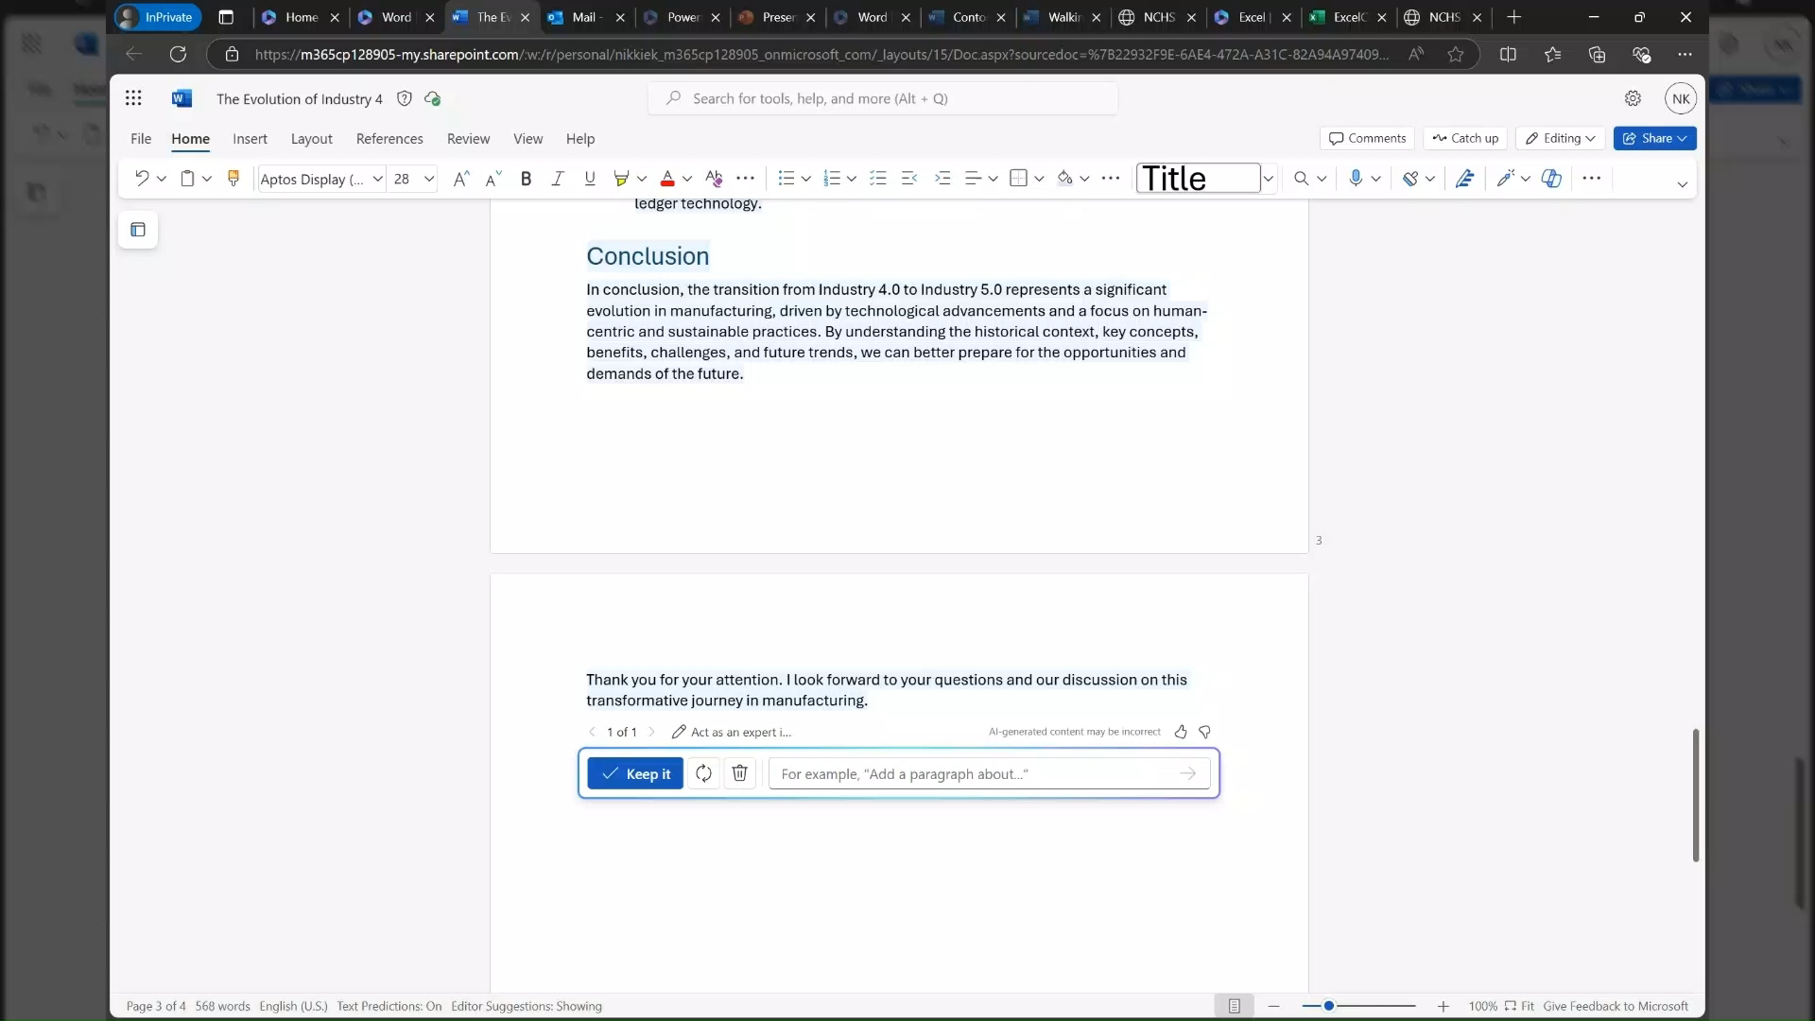
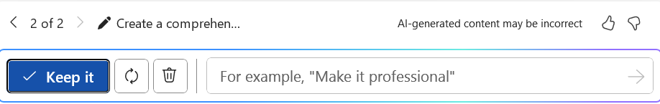
Create a new document with Copilot in Word
Before adding the newly created content to your word document, enter the prompt below to fine tune.
"The document should include an introduction to the current manufacturing technology landscape, the benefits of using technology in manufacturing, and step-by-step instructions on implementing these technologies in a manufacturing setting.”
Notes:
Before you accept the newly created content into your Word document, you can enter additional prompts to fine-tune it.
In this example, we're asking Copilot to make sure the document includes an introduction to the current manufacturing technology landscape, the benefits of using technology in manufacturing, and step-by-step instructions on implementing these technologies.
This iterative approach is really powerful.
Instead of accepting the first draft and then manually editing, you can have Copilot refine and expand the content right there in the drafting stage.
Think of it as giving Copilot more specific instructions before it finalizes the document.
This saves you a lot of editing time on the back end.
Once you're happy with the draft, you can accept it and then use additional AI tools built into Word to further enhance it.
Let's look at one of those tools next — the Inspire Me feature.

Slide 15
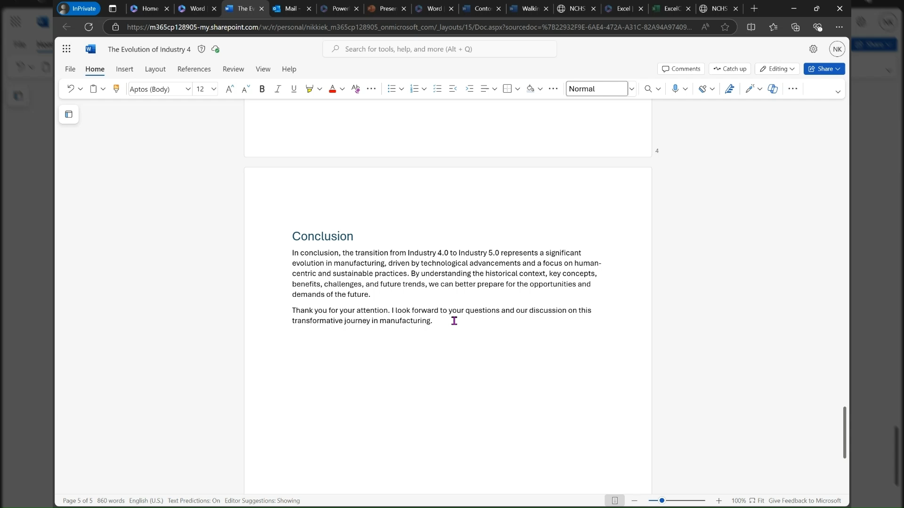
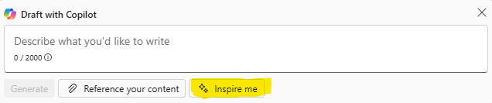
Be Inspired with Copilot in Word
Now you have a first draft of the comprehensive guide.
Using "Inspire Me" by Copilot, Copilot will use the context of your document to provide you with more content to elevate your document.
3. Navigate to a new line in any section of your document.
4. Click on the "Inspire Me" button. Your document needs to have content for this feature to work.
​
​
Notes:
Now that you have a first draft of your comprehensive guide, let's talk about the Inspire Me feature.
This is a really handy tool built right into Word.
What it does is use the context of your existing document to generate additional content that can elevate and expand what you already have.
To use it, navigate to a new line in any section of your document, then click the Inspire Me button.
Just keep in mind that your document needs to already have some content for this feature to work — it needs context to build upon.
This is different from drafting with Copilot because it's specifically designed to extend and enhance existing content rather than creating from scratch.
It's like having a writing partner who reads your document and says, 'Hey, here's something else you might want to include.' Now let's move to another powerful capability — creating documents from reference materials.

Slide 16
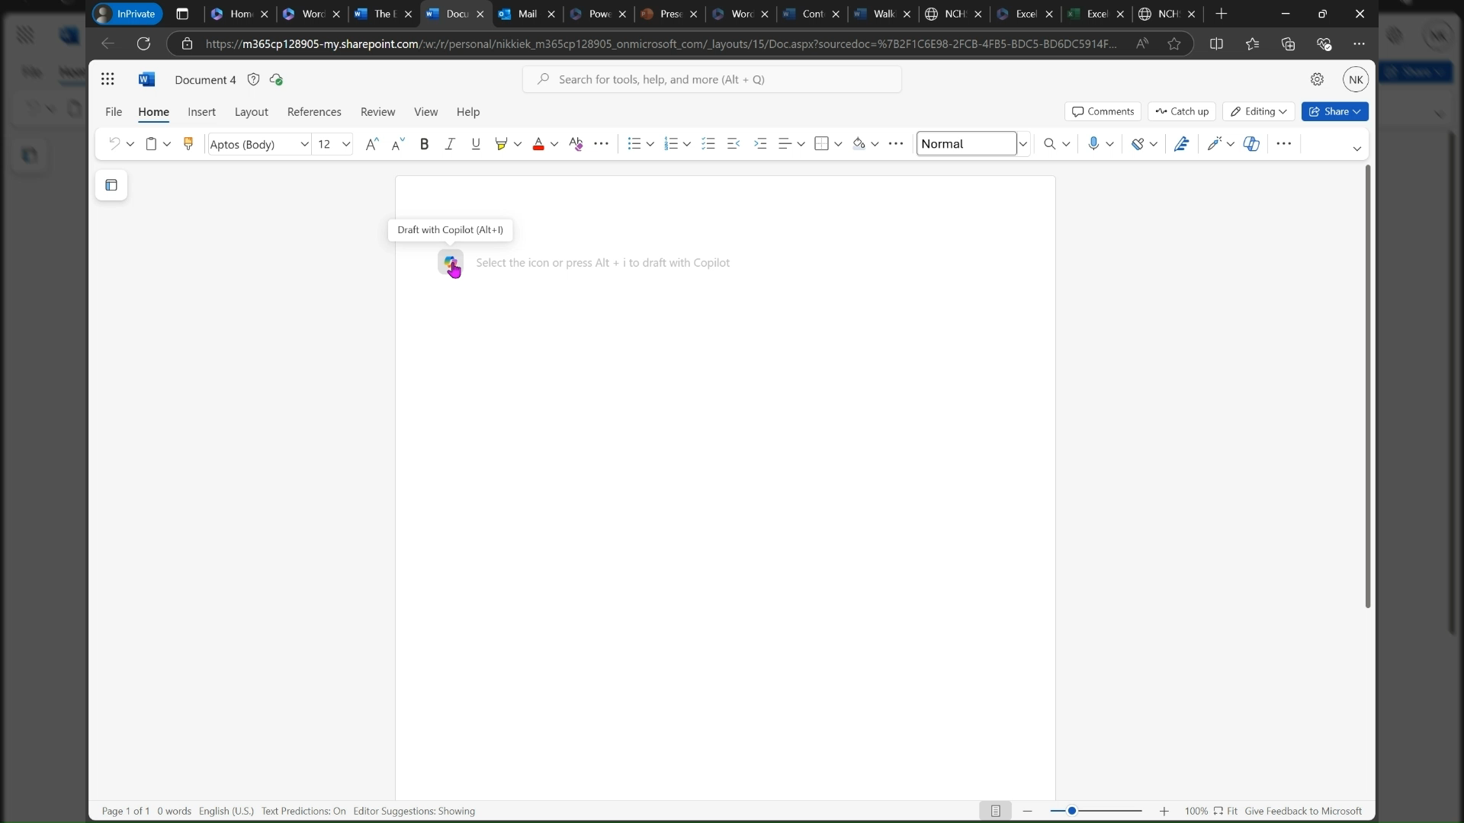
Create a new Document with Reference Materials
Copilot in Word can reference up to 3 documents when you Draft with Copilot.
Copilot can also reference PDF documents.
Using the Walking for Leisure and Transportation Amount Adults PDF document, prompt Copilot to:
"Create One-Pager from /Industry 5.0 Primer.pdf that will catch the attention of the viewer. Include an impact statement at the beginning on how this study relates to anybody who is reading it. "
​
Notes:
Here's another really popular workflow — creating a document from reference materials.
Copilot in Word can reference up to three documents when you use Draft with Copilot, and it supports PDF documents too.
In this example, we're using the Industry 5.0 Primer PDF and asking Copilot to create a one-pager that will catch the viewer's attention, with an impact statement at the beginning about how the study relates to the reader.
Notice the forward slash before the filename — that's how you reference a file stored in your OneDrive.
Copilot will search your OneDrive for matching files when you type that slash.
This is incredibly powerful for repurposing existing content.
Instead of manually reading through a long PDF and creating a summary document, you let Copilot do the heavy lifting.
You saw in our Word demo how quickly Copilot could create, refine, and coach you on a document.
It even went out and found additional evidence to strengthen the content.
Alright, now let's switch gears and look at Copilot in PowerPoint.

Slide 17
Microsoft 365 Copilot - Copilot in PowerPoint
Notes:
Now we're jumping into our second major section — Copilot in PowerPoint.
Just like with Word, PowerPoint has a first-party agent specifically designed for creating presentations.
The workflow is very similar to what we saw with Word.
You go to the Copilot interface, navigate to Agents, find the PowerPoint agent, and open it.
You'll see prompts specifically tailored for creating PowerPoint presentations, you can choose your data sources, and you can upload content directly — which is a very popular use case.
If you have a Word document, an Excel spreadsheet, a meeting recap, or even an email that you want to turn into a presentation, you can upload it right into the PowerPoint agent.
The agent will also ask you follow-up questions about your audience, desired length, visual style, and theme — just like the Word agent did.
Let's walk through the process of creating a new presentation.

Slide 18
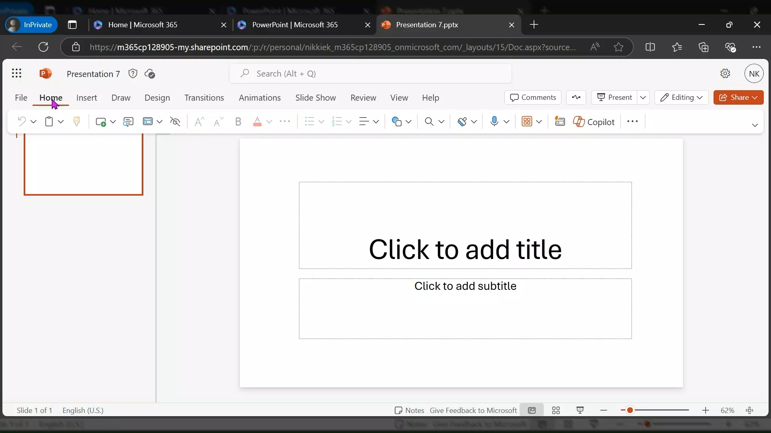
Create a new presentation with Copilot in PowerPoint
1. Create a new PowerPoint presentation.
2. Click on the Copilot icon found under
Home > Copilot.
3. Example Prompt:
"Create a presentation from /Industry 5.0 Primer.pdf”
Hint: Don't forget the forward slash (/) when referencing the PDF or Microsoft Word document. If the document is not listed, it may be because it is not stored on your OneDrive.
Notes:
Here's the step-by-step for creating a new presentation with Copilot in PowerPoint.
Start by creating a new PowerPoint presentation, then click on the Copilot icon found under Home, then Copilot.
The example prompt is straightforward — 'Create a presentation from /Industry 5.0 Primer.pdf.' Remember that forward slash is key for referencing your OneDrive files.
If the document isn't showing up, make sure it's actually saved to your OneDrive.
In our demo, I uploaded the Word document we had created earlier and asked Copilot to create an executive slide deck from it.
The agent then asked about the primary audience, preferred length, visual style — whether I wanted it more visual, more text-heavy, or balanced — and then asked me to select a theme.
Once I provided those inputs, Copilot went to work.
It analyzed the document, created a structure, tested the output, and generated a complete 12-slide presentation.
Everything was pulled directly from that document — I didn't add or modify anything, and it did a fantastic job right out of the box.
Now let's talk about what happens when Copilot can't find your file.

Slide 19
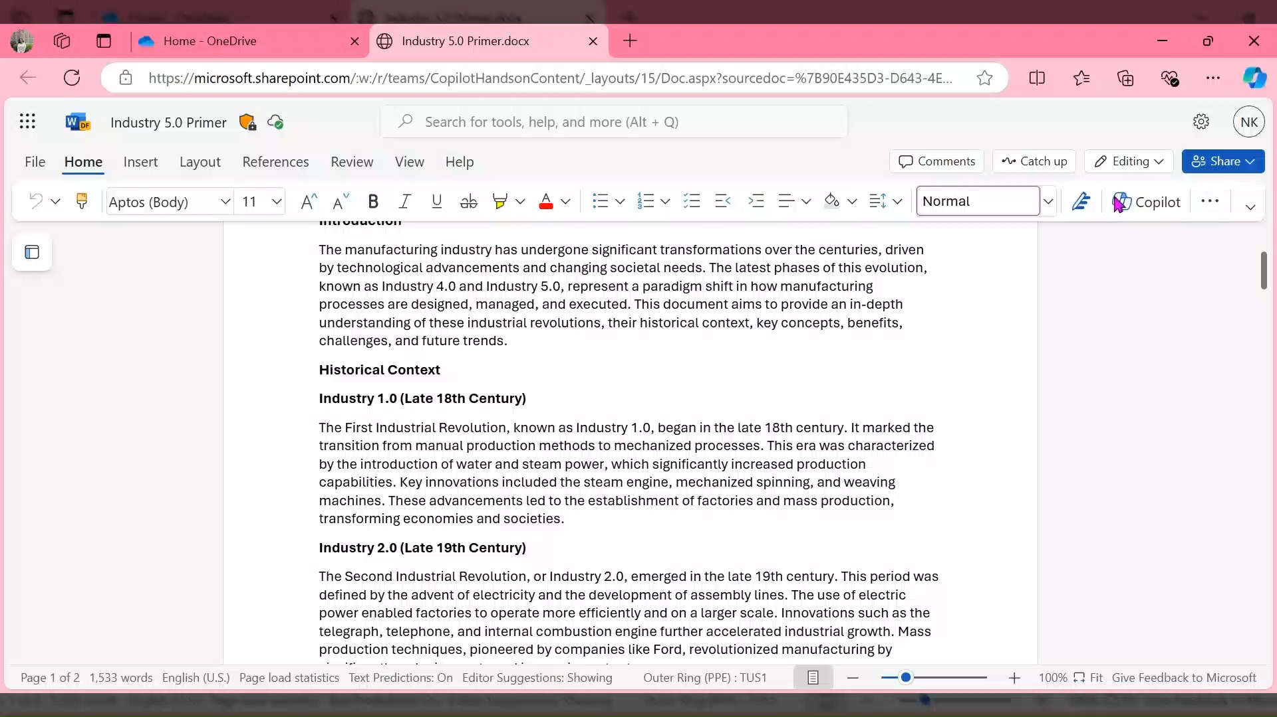
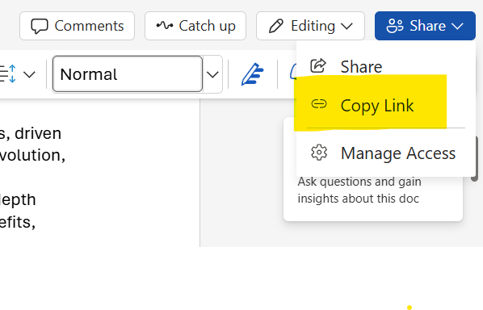
Create a new presentation with Copilot in PowerPoint
If M365 Copilot is unable to locate the file you want to reference, you can simply paste the document link into the prompt.
Notes:
Sometimes Copilot might not be able to locate the file you want to reference through the slash search.
No problem — you can simply paste the document link directly into the prompt.
Just grab the sharing link or URL from your OneDrive or SharePoint, paste it in, and Copilot will use that file as the source.
This is a good workaround for files that might be deeply nested in folder structures or stored in SharePoint sites where the search index hasn't caught up yet.
It also works for files shared by colleagues — as long as you have access to the document, Copilot can reference it.
Let's now look at another way to create content within an existing presentation.

Slide 20
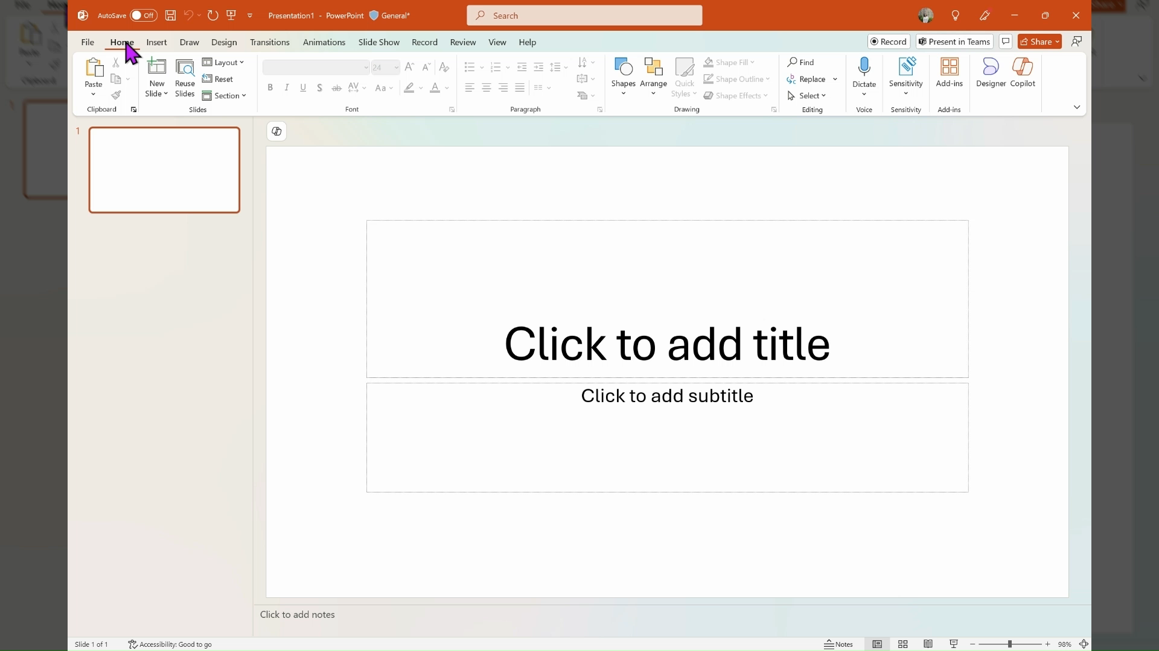
Create a new presentation with Copilot in PowerPoint
Click on the Copilot button in the top right of your screen.
Example prompt:
"Draft research proposal slides on [any of the topics]. Include a section on methodology and expected outcomes.”
Example research topics:
Cobots (Collaborative Robots): Work alongside human employees to perform tasks more efficiently.
Training and Development: Equipping employees with the necessary skills to work alongside advanced technologies.
Notes:
Now let's look at creating slides from within an existing presentation using the Copilot panel.
Click the Copilot button in the top right of your screen, and you can prompt it directly.
In this example, we're asking Copilot to draft research proposal slides on specific topics, including methodology and expected outcomes.
You can choose from topics like collaborative robots — or cobots — working alongside human employees, or training and development for equipping employees with skills to work alongside advanced technologies.
What's really powerful here is that Copilot can also do research.
When I asked it to create a competitor comparison slide, it asked me whether it should research the latest competitor landscape or just use general knowledge.
I told it to research first, and it went out to both the internet and my tenant data to pull in real information.
It's aware of the document format and the existing presentation style, so the new slides it generates will match what's already there.
Let's look at adding a single slide with a specific purpose.

Slide 21
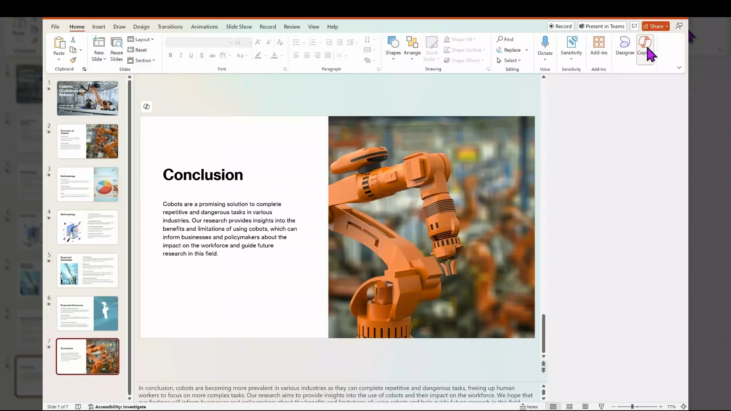
Add a slide with Copilot
Copilot will create the new slide below the slide that is currently selected.
Select the slide. In our case will be the last slide
Example Prompt:
“Add a slide thanking the audience for attending and allowing time for a Q&A.”
Notes:
Adding a slide with Copilot is really straightforward.
There's one important thing to know — Copilot will create the new slide directly below whichever slide you currently have selected.
So select the slide you want the new one to appear after.
In our case, we'll select the last slide.
Then enter your prompt — in this example, 'Add a slide thanking the audience for attending and allowing time for a Q&A.' Copilot will generate that slide and insert it right where you specified.
This is great for quickly adding transitional slides, section breaks, thank-you slides, or any content you need without manually designing a new slide from scratch.
Now let's talk about how Designer and Copilot work together to make your slides look even better.

Slide 22
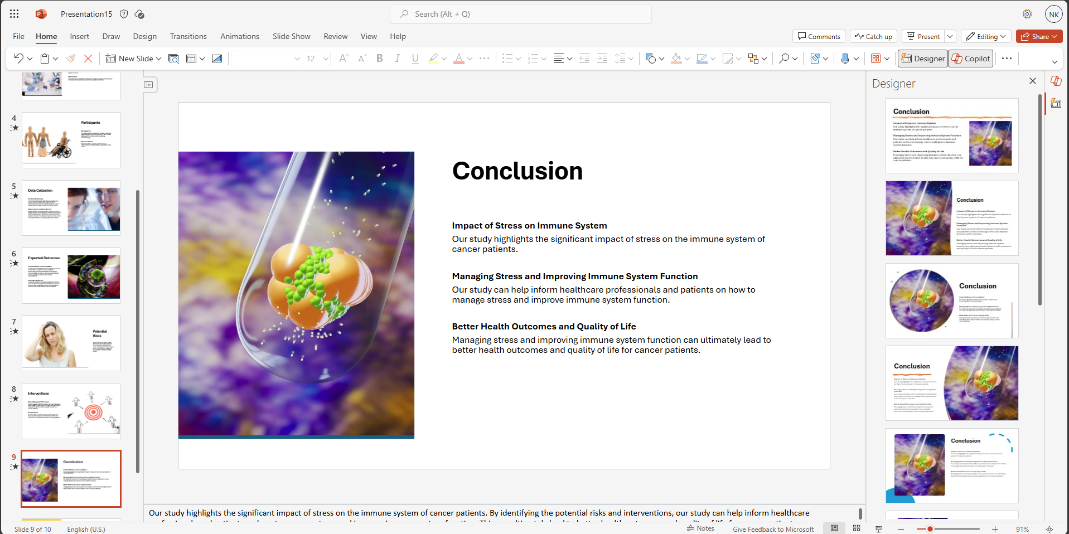
PowerPoint Designer and Copilot
Designer and Copilot work hand in hand.
You can use Designer with your Copilot generated slides to further improve your slide layouts.
Notes:
Designer and Copilot work hand in hand in PowerPoint.
Once Copilot has generated your slides, you can use Designer to further improve the slide layouts.
Just select a slide, click on the Designer link, and review the design options that are offered.
This gives you the ability to change the design of each individual slide to find the layout that works best for your content.
You can also use AI directly within PowerPoint to modify images.
For example, if you have an image with a background you want to remove, you used to have to take it to a separate image editor.
Now you can edit that picture right within PowerPoint using AI — remove backgrounds, apply effects, and accept the changes all without leaving the application.
So between Copilot for content generation and Designer for visual polish, you have a really powerful one-two combination for creating professional presentations.
Now let's shift to our prompt library section, where we'll give you ready-to-use prompts for every stage of your content workflow.

Slide 23
Microsoft 365 Copilot – Prompt Samples and Use Cases
Notes:
Alright, we're now moving into a section on prompt samples and use cases.
This is really practical material that you can take away and start using immediately.
We've organized over 30 ready-to-use prompts across eight categories that cover the entire content lifecycle — from understanding existing content all the way through to final polish and delivery.
Think of this as your prompt toolkit.
Whether you're preparing for an executive meeting, building a customer deck, or just trying to make sense of a long document, there's a prompt pattern here that can help.
Let's walk through each category, starting with why prompts matter so much.

Slide 24
Why Prompts Matter
The difference between average and exceptional Copilot results comes down to how you prompt. This library gives you 30+ ready-to-use prompts across 8 categories. [1]
Content Lifecycle — 8 Categories
Step 1
Step 2
Step 3
Step 4
Summarize & Understand
Gain Insights & Analyze
Create New Content
Modify & Improve
Distill lengthy content into actionable summaries
Uncover decisions, risks, and themes
Generate documents and decks from scratch
Elevate tone, clarity, and narrative
Step 5
Step 6
Step 7
Step 8
Refine Slide Quality
Review & Validate
Shape & Polish
Usage Patterns
Tighten titles, cut density, build storyline
Ensure consistency and accuracy
Format, condense, and externalize output
Match prompts to your workflow scenario
Microsoft 365 Copilot Training | 2026
Notes:
The difference between average and exceptional Copilot results really comes down to how you prompt.
This library gives you over 30 ready-to-use prompts organized across eight categories that map to a complete content lifecycle.
It starts with Summarize and Understand — distilling lengthy content into actionable summaries.
Then Gain Insights and Analyze — uncovering decisions, risks, and themes.
Then Create New Content — generating documents and decks from scratch.
From there, Modify and Improve helps you elevate tone, clarity, and narrative.
Refine Slide Quality tightens titles and cuts density.
Review and Validate ensures consistency and accuracy.
Shape and Polish handles formatting and condensing.
And finally, Usage Patterns helps you match prompts to your specific workflow scenario.
Let's dive into each one, starting with summarizing and understanding content.

Slide 25
Summarize and Understand Content
Start any project by extracting what matters most from documents and decks — Copilot can distill lengthy content into actionable summaries in seconds. [1]
1
2
3
4
Executive Summary
Slide-by-Slide Summary
Long Document Condensation
Key Points Only
"Summarize this document for an executive audience. Focus on objectives, key points, risks, and recommendations."
"Extract the most important points from this content. Limit the output to 5-7 bullets."
PowerPoint
Word
"Provide a concise summary of each slide, highlighting the main message and takeaway."
"Summarize this document in one page while preserving key arguments and conclusions."
Broad Summary
Focused Key Points
Notes:
Let's start with the first category — Summarize and Understand Content.
This is usually your starting point for any project.
We have four key prompts here.
First, Executive Summary — ask Copilot to summarize a document for an executive audience, focusing on objectives, key points, risks, and recommendations.
Second, Slide-by-Slide Summary — have Copilot provide a concise summary of each slide, highlighting the main message and takeaway.
This works in PowerPoint.
Third, Long Document Condensation — ask Copilot to summarize a document in one page while preserving key arguments and conclusions.
Perfect for those 50-page reports you need to digest quickly.
And fourth, Key Points Only — extract the most important points and limit the output to five to seven bullets.
These prompts work across both Word and PowerPoint, and they're incredibly effective at helping you quickly get up to speed on any content.
Next, let's look at going deeper with insights and analysis.

Slide 26
Gain Insights and Analyze Content
Go beyond summaries -- use Copilot to uncover decisions, risks, audience fit issues, and recurring themes hiding in your content. [1]
Decision and Action Analysis
Risk and Gap Assessment
"Identify decisions made or implied in this document and list any associated action items."
"Review this content and highlight risks, assumptions, or gaps that may require further clarification."
Audience Fit Check
Thematic Analysis
"Evaluate whether this content is appropriate for an executive audience. Suggest improvements where needed."
"Analyze this document and identify recurring themes, priorities, or strategic focus areas."
Microsoft 365 Copilot Training | 2026
Notes:
Category two is Gain Insights and Analyze Content — and this is where you go beyond simple summaries.
Decision and Action Analysis asks Copilot to identify decisions made or implied in a document and list any associated action items.
This is huge for meeting recaps and project documents.
Risk and Gap Assessment asks Copilot to review content and highlight risks, assumptions, or gaps that may require further clarification.
Think of this as your quality check before presenting to stakeholders.
Audience Fit Check evaluates whether content is appropriate for a specific audience — like executives — and suggests improvements.
This is great for making sure your messaging lands correctly.
And Thematic Analysis identifies recurring themes, priorities, or strategic focus areas across a document.
These analytical prompts are really powerful when you combine them — run a decision analysis, then a risk assessment, and you'll have a comprehensive view of any document.
Now let's look at creating new content from scratch.

Slide 27

Create New Content
Whether starting from scratch or transforming existing notes, Copilot can generate structured Word documents and PowerPoint decks ready for review. [1]
Create a New Word Document
"Create a structured Word document on [topic] with an executive summary, background, key discussion points, and next steps."
Create a PowerPoint Deck
"Create a 10-slide PowerPoint deck on [topic] suitable for executive review. Include: title slide, agenda, context, key insights, recommendations, and next steps."
Convert Notes into a Document
"Turn these notes into a polished Word document suitable for sharing with leadership."
Convert Content into Slides
"Convert this document into a PowerPoint presentation with clear, concise slide titles and bullet points."
Notes:
Category three is all about creating new content, and this ties directly back to our hands-on demos earlier.
Create a New Word Document — prompt Copilot to create a structured document with sections like executive summary, background, key discussion points, and next steps.
Create a PowerPoint Deck — ask for a specific number of slides suitable for executive review, including title slide, agenda, context, key insights, recommendations, and next steps.
Convert Notes into a Document — take rough notes and turn them into a polished Word document suitable for sharing with leadership.
This is a huge time saver.
And Convert Content into Slides — transform a document into a PowerPoint presentation with clear, concise slide titles and bullet points.
As we demonstrated earlier, these creation prompts are incredibly effective, especially when you combine them with the GCSE prompting framework — give Copilot a goal, context, sources, and expectations.
Once you've created content, the next step is to improve and refine it.

Slide 28
Modify and Improve Content
Transform rough drafts into polished deliverables — Copilot helps you elevate tone, sharpen narrative, and simplify language for any audience. [1]
1
2
3
4
Executive Tone
Clarity and Flow
Narrative
Simplicity
Rewrite this content to be more concise and executive-ready. Remove unnecessary detail.
Rewrite this section to improve clarity, structure, and professional tone.
Improve the storytelling and logical flow so it reads as a cohesive narrative.
Simplify this content so it is easy to understand without losing meaning or accuracy.
Microsoft 365 Copilot Training | 2026
Notes:
Category four is Modify and Improve Content — this is where you transform rough drafts into polished deliverables.
Executive Tone asks Copilot to rewrite content to be more concise and executive-ready, removing unnecessary detail.
This is one of the most frequently used prompts because we often write more than executives want to read.
Clarity and Flow focuses on improving structure and professional tone.
If your document feels disjointed, this prompt helps smooth it out.
Narrative improves the storytelling and logical flow so the content reads as a cohesive story rather than a collection of bullet points.
And Simplicity asks Copilot to simplify content so it's easy to understand without losing meaning or accuracy.
Perfect for technical documents that need to reach a broader audience.
Remember in our Word demo how we used Copilot's coaching feature to get recommendations and then implement them one by one?
These prompts give you that same power with more specific direction.
Next, let's look at prompts specifically designed for improving PowerPoint slides.

Slide 29

Refine PowerPoint Slide Quality
Great slides communicate one clear idea per screen — use these prompts to tighten titles, cut text density, and build a compelling executive storyline. [1]
Improve Slide Titles
"Rewrite the slide titles so they clearly communicate the key takeaway of each slide."
Reduce Text Density
"Reduce the amount of text on each slide while preserving the core message."
Executive Storyline
"Reorder the slides to create a stronger executive storyline."
Visual Guidance
"Suggest where visuals or diagrams could improve understanding, without changing the slide design."
Notes:
Category five is Refine PowerPoint Slide Quality — and great slides communicate one clear idea per screen.
Improve Slide Titles asks Copilot to rewrite titles so they clearly communicate the key takeaway of each slide.
Good titles do a lot of heavy lifting in a presentation.
Reduce Text Density asks Copilot to reduce the amount of text on each slide while preserving the core message.
We've all seen slides that are basically walls of text — this prompt fixes that.
Executive Storyline asks Copilot to reorder slides to create a stronger narrative flow for an executive audience.
Sometimes the order you created content in isn't the best order to present it.
And Visual Guidance asks Copilot to suggest where visuals or diagrams could improve understanding, without changing the actual slide design.
This gives you a roadmap for where to add visual elements.
These prompts are especially useful after Copilot has generated an initial deck — think of them as your second pass to polish and refine.
Now let's move to reviewing and validating your content.

Slide 30
Review, Validate, and Work Across Documents
Before sharing, ensure consistency and accuracy — and when working across multiple files, Copilot can compare, consolidate, and unify your content. [1]
Validation
Multi-Document
Consistency Check
Compare Documents or Decks
"Check this document for consistency in terminology, tone, and messaging."
"Compare these two documents and identify overlaps, differences, and conflicting messages."
Accuracy Check
"Review this content for potential inaccuracies, contradictions, or unclear statements."
Consolidate Content
"Consolidate these documents into a single, streamlined version."
Stakeholder Perspective
Master Narrative
"Review this content from the perspective of [executive/customer/IT leadership]. What questions might they ask?"
"Create a single coherent narrative across these files that aligns to a common objective."
Notes:
Category six is Review, Validate, and Work Across Documents — the quality assurance step before you share anything.
On the validation side, you have Consistency Check, which asks Copilot to review terminology, tone, and messaging across a document.
Nothing looks more unprofessional than using different terms for the same concept.
Accuracy Check reviews content for potential inaccuracies, contradictions, or unclear statements.
This is like having a fresh pair of eyes on your work.
And Stakeholder Perspective asks Copilot to review content from the perspective of a specific audience — an executive, a customer, or IT leadership — and flag what questions they might ask.
This is gold for presentation prep.
On the multi-document side, Compare Documents identifies overlaps, differences, and conflicting messages between two documents or decks.
Consolidate Content merges multiple documents into a single, streamlined version.
And Master Narrative creates a coherent story across multiple files aligned to a common objective.
These are incredibly valuable for teams working on shared deliverables.
Let's move to final polish.

Slide 31
Shape and Polish Your Output
Final polish matters — format output as tables, trim length by 30%, or convert internal content into a customer-ready version with a single prompt. [1]
Step 1
Step 2
Step 3
Structure
Condense
Externalize
"Present the output in a table with Key Point, Impact, and Recommendation."
"Condense this content by 30% without losing critical meaning."
"Rewrite this content so it is appropriate for external customer sharing."
Microsoft 365 Copilot Training | 2026
Notes:
Category seven is Shape and Polish Your Output — the final touches that make a real difference.
Structure asks Copilot to present output in a specific format, like a table with columns for Key Point, Impact, and Recommendation.
This is great for taking narrative content and making it scannable.
Condense asks Copilot to trim content by 30 percent without losing critical meaning.
Sometimes you just need to make things shorter, and giving a specific percentage target helps Copilot calibrate.
And Externalize asks Copilot to rewrite content so it's appropriate for external customer sharing.
Internal documents often have jargon, abbreviations, or context that doesn't translate well for outside audiences — this prompt handles that conversion.
These three prompts work well as a final pass right before you hit send or present.
Now let's look at how to match these prompts to specific workflow scenarios.

Slide 32
Recommended Usage Patterns
Match the right prompts to your scenario — this quick-reference guide maps five common workflows to the best prompts in the library. [1]
 | Scenario | Recommended Prompts
 | Executive Prep | Executive Summary+Executive Storyline
 | Customer Decks | Slide Quality Prompts+Audience Fit Check
 | Delivery Planning | Action Analysis+Risk Assessment
 | Rapid Reuse | Convert Document to Slides
 | Final Polish | Consistency Check+Reduce Length
Source: Generate a set of copilot.docx
Notes:
This table maps five common workflows to the best prompts in the library — think of it as your quick-reference guide.
For Executive Prep, combine the Executive Summary prompt with Executive Storyline to create content that's both comprehensive and well-structured for leadership.
For Customer Decks, use the Slide Quality prompts alongside Audience Fit Check to make sure your presentation is polished and appropriate for external audiences.
For Delivery Planning, pair Action Analysis with Risk Assessment to make sure you've identified all the key decisions and potential issues.
For Rapid Reuse, the Convert Document to Slides prompt lets you quickly transform existing content into a new format.
And for Final Polish, combine Consistency Check with Reduce Length to tighten everything up before sharing.
The key is that mastery comes from consistent use, not memorization.
Let's talk about how to actually get started.

Slide 33
Get Started Today
Pick one workflow you do every week, try the matching prompts, and iterate — mastery comes from consistent use, not memorization.
1
2
3
4
Choose Your Scenario
Try a Prompt
Refine the Output
Share with Your Team
Pick a scenario from the usage patterns table that matches your most frequent task.
Open Copilot in Word or PowerPoint and try the recommended prompt verbatim.
Review the result and iterate using the Modify and Improve prompts to polish.
Share your best results with colleagues to build a shared prompt practice.
Bookmark this prompt library for daily reference
Notes:
The path to Copilot mastery is really about picking one workflow and practicing.
Step one — choose your scenario.
Pick a scenario from the usage patterns table that matches your most frequent task.
Don't try to learn everything at once.
Step two — try a prompt.
Open Copilot in Word or PowerPoint and try the recommended prompt verbatim.
Don't overthink it on the first try.
Step three — refine the output.
Review the result and iterate using the Modify and Improve prompts to polish.
Remember, the first result is a starting point, not the final product.
Step four — share with your team.
Share your best results with colleagues to build a shared prompt practice.
When people see what's possible, adoption accelerates.
I'd recommend bookmarking this prompt library for daily reference.
The more you use these prompts, the more natural they become, and the more time you'll save.
Now let's talk about some adoption tips for rolling this out more broadly.

Slide 34
Adoption Tips
Notes:
We're now in our adoption tips section.
Getting individual users up to speed with Copilot is one thing, but driving adoption across an organization requires a more structured approach.
The prompts and techniques we've covered today are incredibly powerful, but they only deliver value if people actually use them consistently.
So in these next couple of slides, I want to share some practical strategies for rolling Copilot out to your end users and making adoption stick over the long term.
Let's start with a structured rollout plan.

Slide 35
Rolling Out to End Users
A structured rollout plan turns this prompt library from a document into an organizational habit.
1
2
3
4
Curate
Distribute
Train
Reinforce
Select 5-8 starter prompts per role (executive, project manager, customer-facing, engineer) from the full library.
Share prompts via a Teams channel, SharePoint page, or pinned chat message so they are always one click away.
Run a 30-minute workshop with live demos of 3-4 prompts on real Teams data; show the chain-prompting pattern.
Send a weekly "Prompt of the Week" to keep engagement high and introduce new prompts gradually.
Consider creating role-based prompt cards (one-pagers) so each team gets only what is relevant to them.
Microsoft 365 Copilot Prompt Library
Notes:
A structured rollout plan turns this prompt library from a document into an organizational habit.
There are four key stages.
First, Curate.
Select five to eight starter prompts per role — whether that's executive, project manager, customer-facing, or engineer — from the full library.
Don't overwhelm people with everything at once.
Second, Distribute.
Share the prompts via a Teams channel, SharePoint page, or pinned chat message so they're always one click away.
Accessibility is key — if people can't find the prompts easily, they won't use them.
Third, Train.
Run a 30-minute workshop with live demos of three to four prompts using real data.
Show the chain-prompting pattern where one prompt builds on another.
And fourth, Reinforce.
Send a weekly Prompt of the Week to keep engagement high and introduce new prompts gradually.
A great tip is to consider creating role-based prompt cards — one-pagers so each team gets only what's relevant to them.
Now let's look at some additional tips for maximizing adoption.

Slide 36

Tips for Maximizing Adoption
Small, practical habits drive sustained Copilot usage far more than one-time training events.
Start small: have each user commit to one prompt per day for their first two weeks
Use champions: identify 1–2 early adopters per team who can model prompt usage and share wins
Measure usage: track Copilot activity in the Microsoft 365 admin center to identify teams that need extra support
Share success stories: when a prompt saves someone 30 minutes, make that visible to the organization
Iterate the library: collect feedback from users and add new prompts or refine existing ones quarterly
Pair with recording: enable meeting recording and transcription policies so prompts have rich source data
Microsoft 365 Copilot Prompt Library
Notes:
These are the practical habits that drive sustained Copilot usage far more than one-time training events.
Start small — have each user commit to just one prompt per day for their first two weeks.
That low barrier to entry builds muscle memory without feeling overwhelming.
Use champions — identify one or two early adopters per team who can model prompt usage and share their wins with colleagues.
Peer influence is incredibly powerful.
Measure usage — track Copilot activity in the Microsoft 365 admin center to identify teams that need extra support.
Data helps you focus your enablement efforts.
Share success stories — when a prompt saves someone 30 minutes, make that visible to the whole organization.
Nothing drives adoption like real, relatable results.
Iterate the library — collect feedback from users and add new prompts or refine existing ones quarterly.
The library should be a living document, not a static resource.
And pair with recording — enable meeting recording and transcription policies so prompts have rich source data to work with.
These small, practical habits compound over time into a truly AI-enabled organization.
Now let's open it up for questions.

Slide 37
Q&A
Notes:
Alright, we're at the Q&A portion of our session.
Thank you all so much for your time today.
Hopefully you learned something valuable and could see just how easy and time-saving it is to use Copilot in both Word and PowerPoint.
These are areas where I think you'll really see the power of Copilot — generating Word documents and PowerPoint presentations quickly, modifying them with AI-powered tools, and using the coaching features to iteratively improve your content.
At the end of the day, Copilot is meant to be a time saver, and that's where you'll get the biggest return on investment.
Please do fill out the survey linked in the chat — your feedback helps us make sure this content is hitting the mark.
Now, let's take your questions.
Feel free to raise your hand or post in the Q&A panel.

