Slide 1

Mastering Microsoft 365 Copilot, Copilot Chat and Agents – 2026
Engage in six interactive sessions designed to help you leverage the features of Microsoft 365 Copilot and develop effective prompting skills.
  Learn how to use Copilot Apps within various M365 applications
  Develop expertise in crafting prompts
  Participate in a guided demonstration on applying Copilot and Copilot Chat for everyday productivity
Join two practical sessions focused on unlocking the potential of Microsoft 365 Copilot agents.
  Explore a range of built-in agents such as Facilitator, Interpreter, and Coaches, and discover how to use Agent Builder in Microsoft 365 Copilot and SharePoint Online to create customized agents for your organization
  Gain insights into the Researcher and Analyst agents, understanding how they provide executive-level research and actionable insights by analyzing your work data and online sources
Participate in two hands-on sessions centered around the Microsoft 365 applications you use daily.
  Learn to create documents, presentations, and spreadsheets with Word, PowerPoint, and Excel Agents - from drafting and designing to data integration, explore how these agents help you work more efficiently
  Experience working collaboratively with Copilot in Copilot Cowork, where you can co-create, co-edit, and co-think with AI to address real tasks, transforming Copilot from a tool into a partner
Attend a multi-session training series focused on designing and managing AI agents with Microsoft Copilot Studio. Over five sessions, you will cover:
  An overview of Copilot Studio and its role within the Microsoft AI platform
  Techniques for writing effective agent instructions and prompts
  Understanding generative orchestration for coordinating AI, tools, and data
  Best practices for building and managing autonomous agents at scale
End-User webinars
(Free to all MFM Customers)
Session details and registration:
https://aka.ms/MasteringCopilotAndAgents2026
https://aka.ms/MasteringCopilotAgents2025Content - Content will be updated here
Notes:
Welcome everyone to our Mastering Microsoft 365 Copilot session. Today we’re going to focus on Copilot in the collaboration space, specifically in Teams. This is where many users really start understanding how to use Copilot to optimize their day and organize tasks across the various tools within M365. My name is Angel Aviles, Principal CSE at Microsoft, helping customers in the manufacturing mobility space. All sessions are recorded and will be available through the registration website, along with the PowerPoint presentations which contain useful prompts for your reference.

Slide 2

Mastering Microsoft 365 Copilot
Hands-on Experience:
Microsoft 365 Copilot in Teams
MFG Use Cases
Notes:
So today we’re going to be focusing specifically on Copilot in Teams. If you’ve been attending our sessions this week, we’ve covered the Copilot chat perspective and Copilot within specific applications. Now we’re moving into the collaboration space, which is where I find users really start to see the value of Copilot in their daily workflow.

Slide 3
Important information before we start!
✓
The meeting is recorded, recording will be provided in the following days.
✓
During the first part of the session, microphones and videos are turned off
✓
Post all your questions into the chat and our moderators will answer
To ask a question during the Q&A section, simply raise your hand using your meeting controls as shown below. A moderator will take care of letting you unmute.
✓
Notes:
Just some quick housekeeping before we start. The meeting is being recorded, and the recording will be available through the content link on the registration website. You’ll also be notified when the recording is ready through the webinar system. There’s no audio or video from attendees due to the session size, but we have moderators monitoring the chat and Q&A so feel free to interact there. If you experience issues with content or audio sharing, try restarting your Teams client or switching to the web version.

Slide 4
Agenda
Q&A Session
Introduction to Microsoft 365 Copilot
Microsoft 365 Copilot in Action:
Copilot in Teams
How does Microsoft 365 Copilot
work?
Open Forum
Summarize\Search Teams Chats and Channels with Microsoft 365 Teams
Summarize\Search Teams Meetings with Microsoft 365 Teams
Meeting Recaps and Action Items with Microsoft 365 Teams
Audio\Video Recaps with Microsoft 365 Teams
Meeting Facilitator with Microsoft 365 Teams
Schedule a Meeting based on availability with Microsoft 365 Teams
Gain insights, action items, and tasks across Teams Chats\Channels\Meeting Recaps with Microsoft 365 Teams
Notes:
Here’s what we’ll cover today. We’ll start with a brief Copilot introduction for anyone joining for the first time. Then we’ll dive into Copilot in Teams — covering one-on-one chat conversations, the Copilot interface, channels, meeting recaps, the meeting facilitator, scheduling meetings, and a powerful cross-context prompt that pulls insights from Teams, Outlook, and other sources. We’ll finish with an open Q&A forum.

Slide 5
Microsoft 365 Copilot Overview
Overview
Notes:
Let’s start with a quick overview of what Microsoft 365 Copilot is. Even if you’ve seen this before, it’s important context for understanding how Copilot works within Teams and why the collaboration features are so powerful.

Slide 6

Microsoft 365 Copilot
Natural Language
Large Language Models
Microsoft Graph
- Your Data -
Microsoft 365 Apps
Copilot Agents
The
Web
Notes:
So what makes Microsoft 365 Copilot unique is that we’ve embedded the AI interface directly into the tenant. We leverage large language models from our partnerships with OpenAI and Anthropic — you get the latest models as soon as they’re publicly available. This is bundled with Microsoft Graph, which is the interface into your data and how applications access information within the tenant. Then we embed it directly into the M365 apps you use daily. Unlike third-party tools that sit outside your ecosystem, you don’t have to pull data into a separate interface. We also pair this with Copilot agents — no-code and low-code conversational AI applications built through Agent Builder and Copilot Studio for automating workflows and customizing how Copilot interacts with your data.

Slide 7


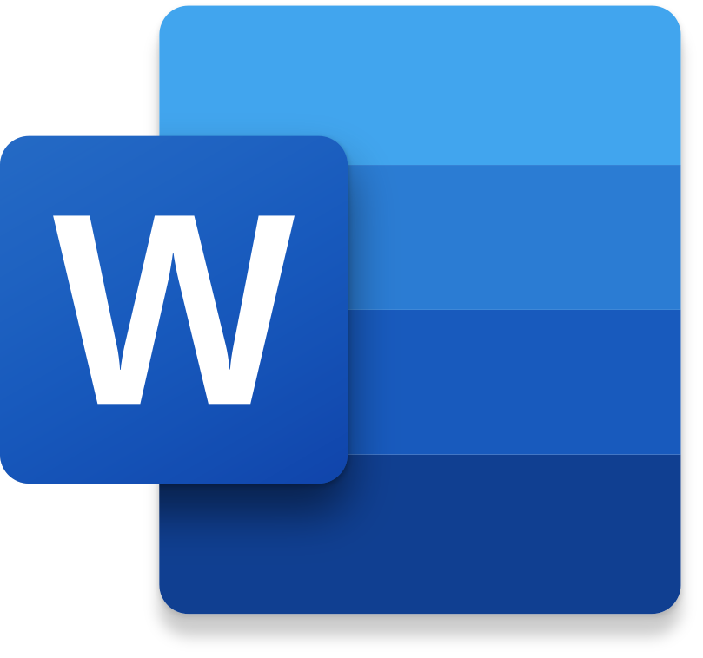
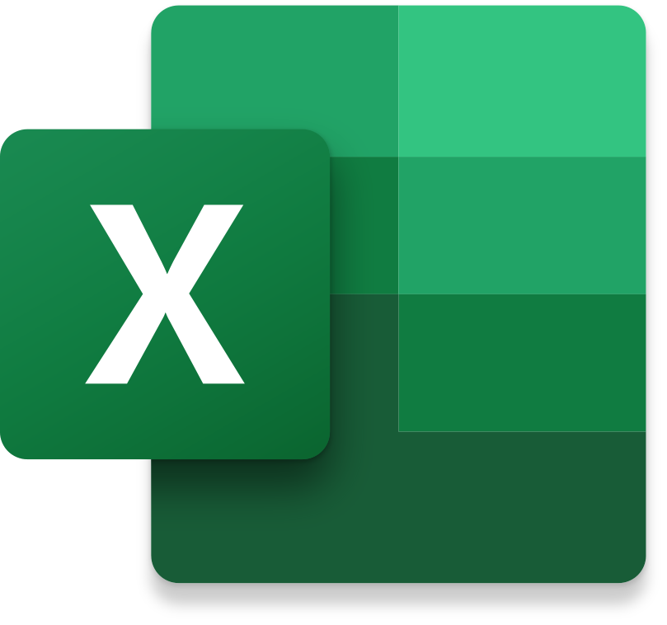
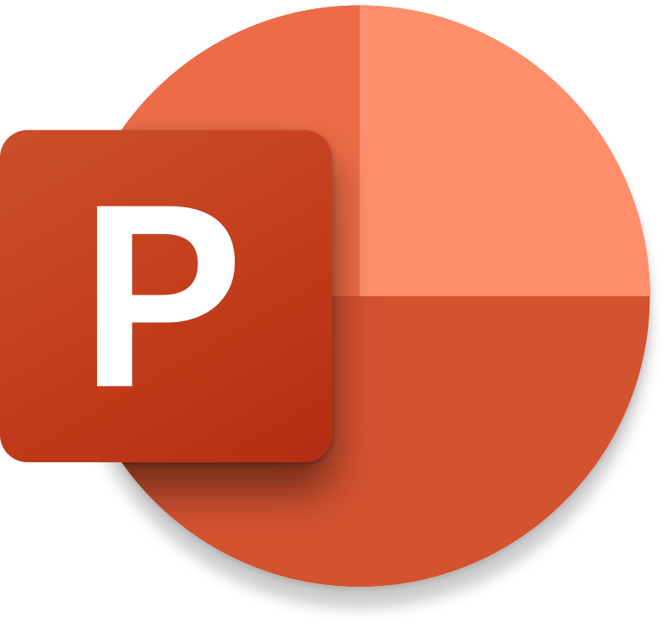

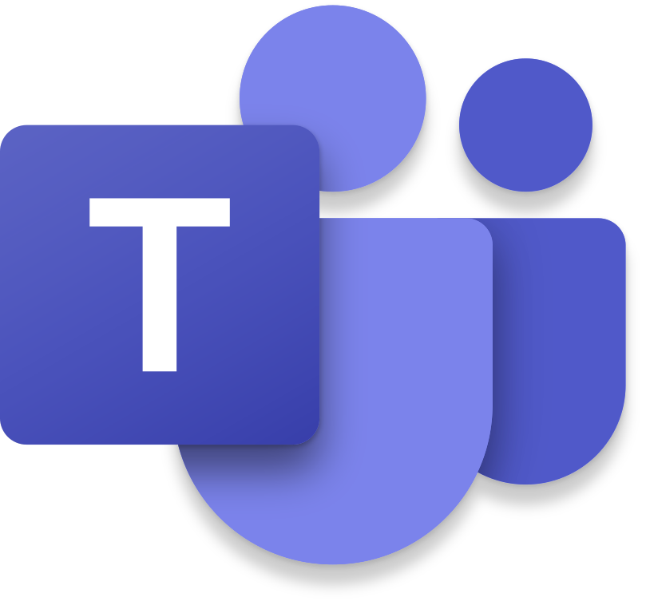



Microsoft 365 Copilot
Embedded across Microsoft 365 apps
Notes:
The key differentiator is that Copilot is embedded directly within each application. So whether you’re in Teams, Word, Excel, PowerPoint, Loop, Whiteboard, or OneNote, you’ll see a Copilot interface associated with tasks specific to that application. You still have an independent Copilot application, but the embedding within apps combined with direct data access through the tenant is what makes this such a powerful enterprise-grade AI tool.

Slide 8
Microsoft 365 Copilot
Copilot Chat¹
M365
Copilot
● Included ο Limited ▲ Metered
w/o Copilot license
$30 pu/pm
Grounding | Web data, referenced files, uploaded files | ● | ●
 | Work IQ | - | ●
 | Use Copilot connectors to access external data sources | ▲ | ●
Models | Latest OpenAI models: GPT-5.X | Standard | Priority
 | Model choice | - | ●
Microsoft 365 Copilot App | Chat | ● | ●
 | Search² | ο | ●
 | Notebooks | - | ●
 | Create³ | Standard | Priority
 | Memory and personalization | ● | ●
 | Voice on mobile, desktop, web | - | ●
 | Sora 2⁴ | - | ●
 | Copilot Mode in Edge⁵ | ο | ●
M365 Apps | Copilot in Outlook⁶ | Standard | Priority
 | Word, Excel, and PowerPoint agents accessed via Chat | Standard | Priority
 | Copilot in Word, Excel, PowerPoint, and OneNote | - | ●
 | Copilot in Teams | Standard | ●
Agents & tools | Pre-built Microsoft agents, including Researcher, Analyst, and Facilitator⁷ | - | ●
 | Sales, Service, and Finance agents | - | ●
 | Agent creation using Agent Builder and Copilot Studio | ● | ●
 | App Builder and Workflows agents⁴ | - | ●
 | Agent usage | ▲ | ●
Security and management | Enterprise Data Protection (EDP), management, compliance, and controls | ● | ●
 | Analytics to measure adoption, usage, and business impact⁸ | ο | ●
 | SharePoint Advanced Management | - | ●
Applies to customers with 2K or more M365 seats
Lexical search included for Copilot Chat users
Access to brand kits and surveys requires M365 Copilot license
Available via Frontier program, pricing final upon GA
Copilot Chat users access Copilot Mode w/web data and open documents only
For unlicensed users, Copilot Chat in Outlook reasons over organizational data in Outlook, Teams, OneDrive, and SharePoint (limited).
Researcher and Analyst, have combined limit of 25 interactions pu/pm
Basic reporting available with Copilot Chat
Notes:
Here’s a detailed comparison between Copilot Chat and the Microsoft 365 Copilot license. Copilot Chat is included with any M365 subscription and gives you secure AI chat grounded to web data. The premium license adds Microsoft Graph access for work data, model choice including Claude, first-party agents like Facilitator, Researcher, and Analyst, plus Copilot embedded in Word, Excel, and PowerPoint. Both versions offer Enterprise Data Protection — anything you upload or interact with honors your tenant’s data protection policies. If a file has a sensitivity label that prevents access, Copilot can’t access it either. For Teams specifically, you get the integration whether you have premium or just Copilot Chat Basic, so there’s a lot of value here regardless of your license.

Slide 9

Copilot Scenarios
Effective meetings
Search & Data analysis
Content creation
Email processing
Quickly catch up on meetings you missed
Summarize a meeting and identify next steps
Run a more effective meeting
Get answers from across all your data
Instantly uncover key insights
Gain powerful insights & perspective they way you want to see it
Jumpstart creativity, and write and edit like a pro
Quickly catch up on the key points of a document or presentation
Create documents & presentations
Draft email replies instantly
Personalize the tone and length even on the go
Quickly summarize a long email thread
Notes:
Let’s talk about the key scenarios where Copilot adds real value. In the effective meetings space, you can ask Copilot questions during, before, and after meetings. Summarizing meetings is probably the most popular capability — even if you missed a meeting, as long as the transcript was enabled, you can query it for specific content. For search and data analysis, Copilot has visibility into both your work data and web data for comprehensive answers. Insights are huge — don’t just use Copilot as a task manager, use it to challenge you and give you different perspectives. And for content creation, you can jumpstart documents and presentations using natural language prompts, then iterate with Copilot to refine them.

Slide 10

Key ingredients of a good prompt
Goal
Context
Source(s)
Expectations
What do you want
from Copilot?
Why do you need it
and who is involved?
What information or samples do you want Copilot to use?
How should Copilot respond to best fulfill
your request?
+
+
+
“I was late to attend and need a brief overview of the project timeline.”
"Include the project timeline in a table and any proposed changes from Adele."
Recap this Teams meeting.
“Did Adele Vance propose any changes?”
=
Final Prompt
Recap this Teams meeting. I was late to attend and need a brief overview of the project timeline. Did Adele Vance propose any changes? Include the project timeline in a table and any proposed changes from Adele.
Notes:
Building a good prompt is key to getting the most out of Copilot. We use the GCSE format — Goal, Context, Sources, and Expectations. Start with what you want, like recapping a meeting. Add context about why you need it and who’s involved. Layer in specific sources or references. Finally, set your expectations for the output format — maybe a table, an email, or a spreadsheet. You don’t always have to nail it on the first prompt since Copilot is conversational — you can keep refining. But a well-structured prompt will give you much more targeted results. We also have an advanced prompting course on Fridays that goes deeper into this.

Slide 11
Microsoft 365 Copilot – Copilot in Teams
Notes:
Now let’s dive into the heart of today’s session — using Copilot directly within Teams. I’m going to walk you through the interface, demonstrate prompts across chats, channels, and meetings, and show you how to turn conversations into real, actionable work items. When you open the Copilot app in Teams, you’ll see your chat history, agent section, the message box for prompts, and options to attach work content, upload files from your device or OneDrive, and select which data sources to ground to.

Slide 12
The Five Prompt Categories at a Glance
The library is organized around the three Teams surfaces users interact with daily, plus cross-surface insights and output optimization.
1
2
3
4
5
1:1 & Group Chats
Teams Channels
Meetings
Cross-Surface Insights
Copilot Optimization
5
5
5
4
3
Catch up, extract actions, scan decisions and risks, surface stakeholder insights
Digests, executive summaries, thematic analysis, accountability views, signal filtering
Recaps, decision logs, action registers, executive briefs, alignment checks
Weekly summaries, follow-up readiness, escalation scans, customer health
Refine any output for executive tone, actionability, or brevity
Notes:
We’ve organized our prompt library around five categories that map to how you actually use Teams every day. One-on-one and group chats for catching up on conversations. Teams channels for digesting busy workstreams. Meetings for recaps, decisions, and action tracking. Cross-surface insights for pulling a unified view across all Teams activity. And optimization prompts for refining any output to match your audience. Each category has proven, ready-to-use prompts designed for specific real-world scenarios.

Slide 13
1:1 & Group Chats — Core Prompts
These five prompts help users turn chat noise into structured, actionable summaries in seconds. [1]
Quick Catch-Up
Action Items Only
Decision & Risk Scan
"Summarize the key points from this chat, focusing on decisions, open questions, and next steps."
"From this chat, extract all action items, owners, and any implied deadlines. Exclude FYI or social messages."
"Identify any decisions made, risks raised, or blockers discussed in this chat. Highlight anything requiring leadership attention."
Customer/Stakeholder Insights
My Responsibilities
"Summarize customer or stakeholder feedback mentioned in this chat, including sentiment (positive, neutral, concern)."
"From this chat, list only the items that require my action or follow-up."
Admin tip: Recommend "Quick Catch-Up" and "My Responsibilities" as the two starter prompts for new users.
Notes:
These five chat prompts are your bread and butter for turning chat noise into actionable summaries. Quick Catch-Up gives you decisions, open questions, and next steps in seconds. Action Items Only strips out the social messages and gives you just tasks with owners and deadlines. Decision and Risk Scan is perfect for managers — it highlights decisions made, risks raised, blockers, and anything requiring leadership attention. Customer Insights captures stakeholder sentiment. And My Responsibilities filters everything down to just what you need to act on. For new users, I’d recommend starting with Quick Catch-Up and My Responsibilities — those two alone will save significant time every day.

Slide 14
Teams Channels — Core Prompts
Channel prompts cut through the noise of busy workstream threads and surface only what matters. [1]
Channel Digest (Time-Bound)
Executive Summary
Thematic Analysis
"Summarize the most important updates from this channel over the last [day/week], focusing on progress, blockers, and decisions."
"Create an executive-level summary of this channel: current status, key outcomes, risks, and upcoming milestones."
"Analyze this channel and identify recurring themes, common issues, and emerging priorities."
Accountability View
Signal vs Noise
"Extract action items from this channel and group them by owner. Call out any overdue or unassigned actions."
"Distill this channel down to only high-impact information. Exclude routine updates, acknowledgements, and automated messages."
Admin Tip:
"Channel Digest" is ideal for managers; "Signal vs Noise" suits executives skimming high-volume channels.
Notes:
Channel prompts cut through the noise of busy workstream threads and surface only what matters. Channel Digest is time-bound — ask for the last day, week, or even 30 days, and it’ll focus on progress, blockers, and decisions. This is great when you’re new to a group or returning after time away. Executive Summary gives a leadership-ready view of current status. Thematic Analysis identifies recurring patterns and emerging priorities. Accountability View groups action items by owner and flags overdue tasks. And Signal vs Noise is my personal favorite for executives — it strips away routine updates and automated messages to show only high-impact information. Channel Digest works best for managers, while Signal vs Noise suits executives skimming high-volume channels.

Slide 15

Meetings — Core Prompts
Meeting prompts replace manual note-taking and ensure no decision or action item falls through the cracks. [1]
Meeting Recap
Decision Log
Action Register
"Summarize this meeting, focusing on objectives, decisions made, action items, and unresolved issues."
"List all decisions made in this meeting, including context and any follow-up actions tied to each decision."
"Extract all action items from this meeting with owner, priority, and target date if mentioned."
Executive Brief
Alignment Check
"Create a concise executive summary of this meeting suitable for leadership review. Limit to key outcomes, risks, and next steps."
"Identify any misalignment, unresolved debate, or conflicting viewpoints discussed in this meeting."
Admin Tip: Always recommend pairing "Meeting Recap" with "Action Register" for maximum coverage.
Microsoft 365 Copilot Prompt Library
Notes:
Meeting prompts are where Copilot really shines and where you’ll see the biggest time savings. Before Copilot, your only option was to listen through the entire recording and take manual notes. Now you have multiple options. Meeting Recap captures objectives, decisions, action items, and unresolved issues. Decision Log documents every decision with context and follow-up actions. Action Register extracts tasks with owners, priorities, and target dates. Executive Brief creates a concise leadership-ready summary. And Alignment Check flags any conflicting viewpoints or unresolved debates. Always pair Meeting Recap with Action Register for maximum coverage — you get both the narrative and the concrete tasks. You can also use custom summaries, audio recaps in podcast style, and even video recaps with AI-generated highlights.

Slide 16
Cross-Surface Insights — Big Picture
These prompts aggregate across chats, channels, and meetings to give users a unified operational view — ideal for leadership prep and weekly planning. [1]
Weekly Operating Summary
Follow-Up Readiness
"Across my recent Teams chats, channels, and meetings, summarize the top priorities, risks, and decisions from the last week."
"Based on recent chats and meetings, what follow-ups am I expected to drive this week?"
Leadership Escalation Scan
Customer Health Snapshot
"Identify items across my Teams activity that may require escalation or leadership awareness."
"Summarize customer sentiment, risks, and progress indicators discussed across recent Teams conversations and meetings."
Admin tip: Position these as "Monday morning" prompts — run them at the start of each week to set priorities.
Notes:
These are what I call Monday morning prompts — run them at the start of each week to set your priorities. They aggregate across chats, channels, and meetings to give you a unified operational view. Weekly Operating Summary pulls the top priorities, risks, and decisions from the past week. Follow-Up Readiness tells you what you’re expected to drive this week. Leadership Escalation Scan flags items requiring leadership awareness. And Customer Health Snapshot summarizes sentiment and risks from your recent conversations. I actually have the daily summary version of this scheduled as a recurring prompt — it runs automatically and sends me an email with the results so I can start my day with a clear picture.

Slide 17
Optimization Prompts — Refine Any Output
These three follow-up prompts let users refine any Copilot response to match their audience, format, and length requirements. [1]
Make It More Executive
Make It Actionable
Reduce Length
"Rewrite this summary to be more concise and executive-ready. Remove tactical detail."
"Reformat this output into a table with Action, Owner, Priority, and Due Date."
"Condense this summary to 5 bullets or fewer without losing critical meaning."
Chain prompts:
Run these after any initial summary to tune the output. Teach this pattern early — it is the fastest way to improve perceived Copilot quality.
Microsoft 365 Copilot Prompt Library
Notes:
These three follow-up prompts let you refine any Copilot response to match your audience. Make It More Executive strips out tactical detail for leadership audiences. Make It Actionable reformats output into a table with Action, Owner, Priority, and Due Date columns — great for turning a summary into a workable tracker. And Reduce Length condenses everything to five bullets or fewer without losing critical meaning. Teach users this chain-prompting pattern early. Running any initial summary prompt followed by one of these optimization prompts is the fastest way to improve the quality of what Copilot delivers. This is the pattern that makes Copilot feel like a true productivity partner.

Slide 18
Recommended Usage Patterns
Matching the right prompt to the right surface and scenario is the key to consistent results. [1]
Chats
Channels
Use "Action Items Only," "Decision & Risk Scan," and "My Responsibilities" prompts
Use "Channel Digest" combined with "Executive Summary" for a complete view
Meetings
Leadership Prep
Always pair "Meeting Recap" with "Action Register" to capture both narrative and tasks
Use Cross-Surface Insights prompts to aggregate all Teams activity before executive reviews
Encourage users to bookmark their top 2-3 prompts for daily use and expand from there
Notes:
Here’s how to match the right prompts to the right scenarios for consistent results. For chats, focus on Action Items Only, Decision and Risk Scan, and My Responsibilities. For channels, combine Channel Digest with Executive Summary for a complete view. For meetings, always pair Meeting Recap with Action Register to capture both narrative and tasks. And for leadership prep, use the Cross-Surface Insights prompts to aggregate all your Teams activity before executive reviews. The key is to encourage users to bookmark their top two or three prompts for daily use and expand from there as they get comfortable.

Slide 19
Adoption Tips
Notes:
Now let’s shift to practical advice for rolling Copilot out to your teams and driving sustained adoption. This is critical because small, practical habits drive long-term usage far more than one-time training events.

Slide 20
Rolling Out to End Users
A structured rollout plan turns this prompt library from a document into an organizational habit.
1
2
3
4
Curate
Distribute
Train
Reinforce
Select 5-8 starter prompts per role (executive, project manager, customer-facing, engineer) from the full library.
Share prompts via a Teams channel, SharePoint page, or pinned chat message so they are always one click away.
Run a 30-minute workshop with live demos of 3-4 prompts on real Teams data; show the chain-prompting pattern.
Send a weekly "Prompt of the Week" to keep engagement high and introduce new prompts gradually.
Consider creating role-based prompt cards (one-pagers) so each team gets only what is relevant to them.
Microsoft 365 Copilot Prompt Library
Notes:
A structured rollout turns this prompt library from a document into an organizational habit. There are four phases. First, curate — select five to eight starter prompts per role, because executives, project managers, engineers, and customer-facing staff each need different prompts. Second, distribute — share prompts via a Teams channel, SharePoint page, or pinned chat message so they’re always one click away. Third, train — run a 30-minute workshop with live demos using real Teams data, and make sure to show the chain-prompting pattern. Fourth, reinforce — send a weekly Prompt of the Week to keep engagement high and introduce new prompts gradually. Consider creating role-based prompt cards — one-pagers so each team gets only what’s relevant to them.

Slide 21

Tips for Maximizing Adoption
Small, practical habits drive sustained Copilot usage far more than one-time training events.
Start small: have each user commit to one prompt per day for their first two weeks
Use champions: identify 1–2 early adopters per team who can model prompt usage and share wins
Measure usage: track Copilot activity in the Microsoft 365 admin center to identify teams that need extra support
Share success stories: when a prompt saves someone 30 minutes, make that visible to the organization
Iterate the library: collect feedback from users and add new prompts or refine existing ones quarterly
Pair with recording: enable meeting recording and transcription policies so prompts have rich source data
Microsoft 365 Copilot Prompt Library
Notes:
Here are six practical tips for driving sustained Copilot adoption. Start small — have each user commit to just one prompt per day for their first two weeks. Use champions — identify one or two early adopters per team who can model prompt usage and share their wins with colleagues. Measure usage through the Microsoft 365 admin center to identify teams that need extra support. Share success stories — when someone saves 30 minutes with a prompt, make that visible across the organization. Iterate the library by collecting user feedback and refining prompts quarterly. And critically, pair with recording — enable meeting recording and transcription policies so Copilot prompts have rich source data to work with. Without transcripts, many of the best meeting prompts won’t have anything to analyze.

Slide 22
Q&A
Notes:
Thank you all for attending today’s session. Hopefully you’ve picked up some valuable techniques for using Copilot in Teams — from chat summaries and channel digests to meeting recaps and cross-surface insights. The prompts we covered today are all included in this presentation for your reference. Don’t forget to check the registration website for the recording and content links. Please fill out our survey to help us improve future sessions. Tomorrow we’ll be covering Copilot in Outlook for email processing, so I hope to see you there. Happy co-piloting!

