Slide 1


Hello and welcome to the
Microsoft Copilot Customer Hub
We’ll get started at 2 minutes past the hour

Slide 2




Microsoft Copilot Customer Hub
Measuring Impact with Copilot Analytics - Deep Dive
Level 200
__________________________________________________Accelerate Value with Microsoft 365 Copilot

Slide 3
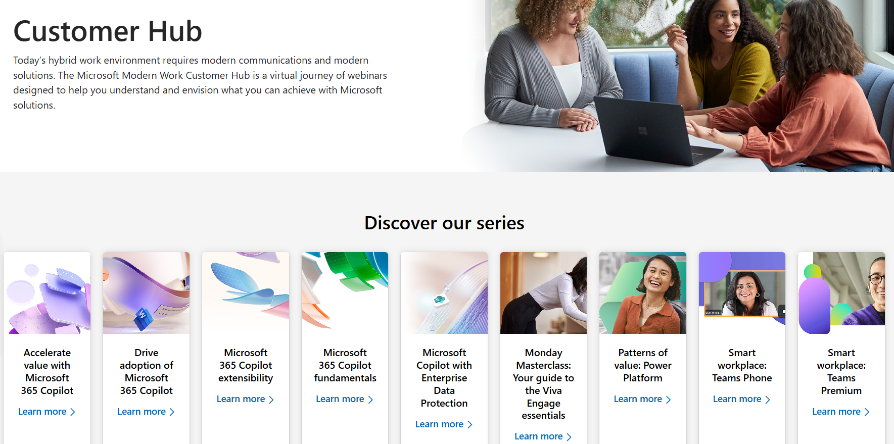

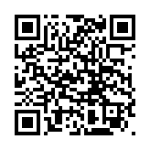
Visit Customer Hub Website for upcoming sessions, updates, and on demand contents!
Scan me!
https://aka.ms/CustomerHubSessions

Slide 4




Presentation time criteria: During and After
During the presentation
After the presentation
We will mute your microphone for the first part of today’s call
Raise your hand and we will call on you
Ask your questions via QnA App, we will get to all of them, live or after. Common questions will get addressed out loud
Open mic 🙌 Come off mute and ask away!

Slide 5





Measuring Impact with Copilot Analytics
Deep Dive - Level 200
Karen Croteau Principal Cloud Solution Architect
Joe Fazzari
Modern Work Usage Architect
Matt Hickey Modern Work Usage Architect
Polly Moore
Modern Work Usage Architect
Mike Walsh Director Product Marketing

Slide 6



Today’s Agenda
Level 200
Approach to measuring Copilot adoption and impact
Copilot Analytics in M365 Service
Follow along
3
Copilot Dashboard Deep Dive
Follow along
Advanced Copilot reporting with Viva Insights
Follow along
5
Q&A, Closing

Slide 7

Prerequisites for follow along:
For the M365 Service and Copilot Dashboard topics, please follow along with us in your own tenant. Sign in with appropriate permissions to be prepared:
Minimum 50 M365 Copilot licensed users
Global Admin or Report Reader for access to Microsoft 365 Copilot Usage Reports
Report.Read Graph permission or Global Admin for Graph API demo
Global Admin or have been granted access to Microsoft Copilot Dashboard
Viva Insights Analyst Role for Advanced Reporting demo
Look for this banner and get ready to follow along in your tenant

Slide 8
Questions that can be addressed with Copilot Analytics
Deployment Planning & Usage
Who should I give Copilot licenses to?
How is my rollout of licenses going?
Are the assigned users using their license?
How is Adoption going?
What groups are effectively using Copilot and how?
What groups are not using?
How do users feel about Copilot Analytics?
What additional ACM efforts should be undertaken to increase adoption?
What is the Impact we are seeing from the use of Copilot?
What personal productivity gains are being realized?
What impact is Copilot having on KPIs?

Slide 9
Simple approach to M365 Copilot measurement
Sentiment: How are people feeling?
Subjective: Direct user feedback and anecdotes
+
Signals: What are people doing?
Objective: Productivity gains, assisted hours and value
Impact on Business KPIs

Slide 10
Prescriptive approach to business value and ROI
Measure productivity gains via time saved
Copilot Assisted Hours - Estimate of the time employees were assisted by using Copilot. Employees can re-invest time savings from Copilot in and have a greater business impact
US Bureau of Labor Statistics estimates 3X increase to productivity index over the next 5 years*
Measure business outcomes via key performance indicators
Identify KPIs for key personas and track business value impact
Understand how Copilot usage relates to business outcomes based on your business data and KPIs
Identify best practices based on what Copilot activities and collaboration patterns lead to successful business outcomes
*US Bureau of Labor Statistics estimates AI to deliver 3X increase to productivity index over the next 5 years based on hypothetical data, illustrating a steady increase in productivity as AI technologies continue to be integrated into the workplace

Slide 11
Copilot Analytics available in Microsoft 365 Admin Center
Copilot Analytics capabilities in M365 Admin are targeted for IT Admins involved in planning and monitoring deployment and usage.
Many common Copilot for Microsoft 365 adoption questions can be answered using the base M365 service:
Who is using/not M365 Copilot license?
When is the last time a user has interacted with Copilot?
Where, in which apps, are users using Copilot?
Which users are good candidates for Copilot?
Who is using free Copilot Chat?
PRO TIP: By default, M365 Usage reports conceal usernames. Change this in the Admin Center
Get ready to follow along with us in this section

Slide 12
Microsoft 365 Copilot Usage Reports in the M365 Admin Center
Report on how people in your business are using Microsoft 365 services:
Microsoft 365 admin center activity reports - Microsoft 365 admin | Microsoft Learn
Copilot Usage Report (Readiness | Adoption | Agent)
Copilot Chat Usage Report
Admin roles that can view Copilot usage reports:
Global Admin
Reports Reader
IMPORTANT: Deleted users will still show in Activity chart totals but user details will be deleted within 30 days
Follow along in your tenant by navigating to https://admin.microsoft.com
Reports | Usage | Microsoft 365 Copilot

Slide 13
Microsoft 365 Copilot Usage Report – Readiness Tab
Use this report to see how ready your organization is to adopt Microsoft 365 Copilot:
Microsoft 365 admin center Microsoft 365 Copilot readiness - Microsoft 365 admin | Microsoft Learn
Assigned and Available Licenses
Identifies which users are technically eligible for Copilot
Suggested Candidates for Copilot based on app usage
Monitor usage of Microsoft 365 apps that Copilot integrates best with
Data covers the past 28 days
PRO TIP: Use the Suggested Candidates in Readiness Tab to identify users who will benefit the most

Slide 14
Microsoft 365 Copilot Report – Usage Tab
View a summary of user adoption, retention, and engagement, including activity details for all M365 Copilot users in your organization:
Microsoft 365 admin center Microsoft 365 Copilot usage - Microsoft 365 admin | Microsoft Learn
View summary and trends for M365 Copilot adoption by app and user
Enabled users and active users including last activity date
Scope: All users who were licensed at any point over the past 180 days, even if the user had the license removed or never used
PRO TIP: Export regularity to derive individual user usage intensity

Slide 15
Microsoft 365 Copilot Report – Agent Tab
View the adoption of M365 Copilot Agents in your tenant:
Agent usage in Microsoft 365 Copilot - Microsoft 365 admin | Microsoft Learn
Captures usage of agents in Microsoft 365 Copilot Chat (work), Copilot in Word and Copilot in PowerPoint
Active agents shows the distinct number of apps with a declarative agent element in that app with at least one active
SharePoint agents and agents built by Microsoft and Microsoft partners are not yet included
Reports cover the past 7, 30, 90, or 180 days
IMPORTANT: Agent Tab is currently limited to agents built by your org through Copilot Studio, Teams Toolkit and admin-approved agents and agents created by users through agent builder

Slide 16
Microsoft 365 Copilot Chat Usage Report
View active usage of Microsoft 365 Copilot Chat:
Microsoft 365 admin center – Microsoft 365 Copilot Chat usage - Microsoft 365 admin | Microsoft Learn
Includes active users, average daily active users, and active users per app
Edge category includes all browsers
Summary and Trends for total active users, average daily active users, and active users per app
Report covers the past 7, 30, 90, or 180 days
Note: Copilot Chat Usage Report captures only users without M365 Copilot License

Slide 17
AI Assistance Category in Adoption Score
Measures how users in an organization are leveraging available Copilot services:
AI assistance category in Adoption Score - Microsoft 365 admin | Microsoft Learn
A score of 100 means that all licensed Microsoft 365 Copilot users in your organization used Copilot features for more than half of working days over the prior month
Use the insights on the page to understand what behaviors and features contribute to your score, and to identify actions to take to boost your score
Peer benchmark allows you to compare your organization's score
with organizations like yours
Follow along in your tenant by navigating to https://admin.microsoft.com
Reports | Adoption Score
Tip: Adoption Score is in the M365 Admin Center – Reports | Adoption Score

Slide 18
Microsoft Graph API Beta - Copilot for Microsoft 365 Usage
Copilot for Microsoft 365 usage Microsoft Graph API for customized reporting and analytics
Metrics included in the Graph API will match those available in the Copilot for Microsoft 365 usage report
PRO TIP: Check out my Graph PowerShell scripts:
Hickey7737/CopilotUsageGraph: Get Copilot User Usage Details and export to CSV
getMicrosoft365CopilotUsageUserDetail: Activity data for enabled users of Microsoft 365 Copilot apps
getMicrosoft365CopilotUserCountSummary: Aggregated number of active and enabled users
getMicrosoft365CopilotUserCountTrend: Trend in the daily number of active and enabled users
Follow along https://developer.microsoft.com/en-us/graph/graph-explorer and paste
https://graph.microsoft.com/beta/reports/getMicrosoft365CopilotUsageUserDetail(period='D180')

Slide 19
Configuring Copilot Usage Reports
By default, M365 Usage reports conceal user information. Change this setting to show actual usernames: M365 Admin Center | Settings | Org Settings | Services | Reports | and uncheck Display concealed user. Since employee usage data privacy is a significant issue worldwide, ensure you have approval from leadership and legal before revealing user data.
Delegate others to see M365 Usage Reports. By default, Global Admins, Exchange Admins, SharePoint Admins, Skype for Business Admins, Global Reader, Usage Summary Reports Reader, Reports Reader, Teams Administrator, Teams Communications Administrator, User Experience Success Manager can see these reports. Delegate Report Reader to allow access.
Export usage report data to a CSV by using the Export link icon in the report page

Slide 20
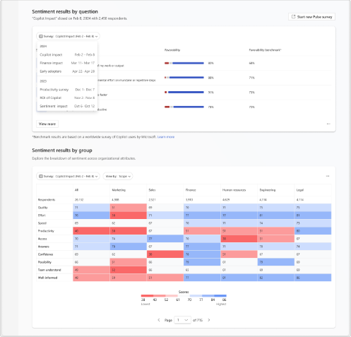
Tools to collect user sentiment
Gather user feedback using employee survey listening tools
Choose survey for visualizing results
Initiate Pulse survey from Copilot Dashboard
Viva Pulse and Via Glint offer M365 Copilot survey templates. A Pulse survey with the four “golden” questions can be initiated from Copilot Dashboard
Include these 4 survey questions with favorability benchmarks:
Copilot improves my work quality – 68%
Copilot reduces mental effort for routine tasks – 71%
Copilot speeds up task completion – 73%
I am more productive with Copilot – 70%.
If not using Viva Pulse or Glint, use these instructions to upload survey results manually: Upload survey results to Copilot Dashboard

Slide 21
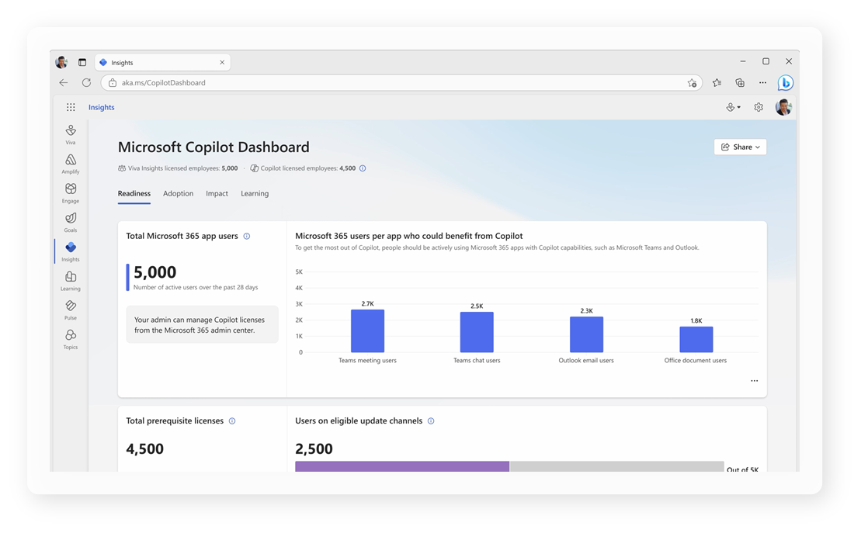
Maximize the value of M365 Copilot with Copilot Dashboard
The Microsoft Copilot Dashboard helps business leaders and IT managers plan AI readiness, track adoption, and measure the impact of their Copilot investment.
Plan and track Copilot readiness in Microsoft 365 by app
Evaluate adoption by app and feature
Analyze Copilot's impact on meetings, email, chat, and documents
Measure impacts on work patterns using behavioral, collaboration, and sentiment data
View employee feedback on Copilot's value
Stay updated with the latest AI research and findings
Follow along in your tenant by navigating to https://aka.ms/copilotdashboard

Slide 22

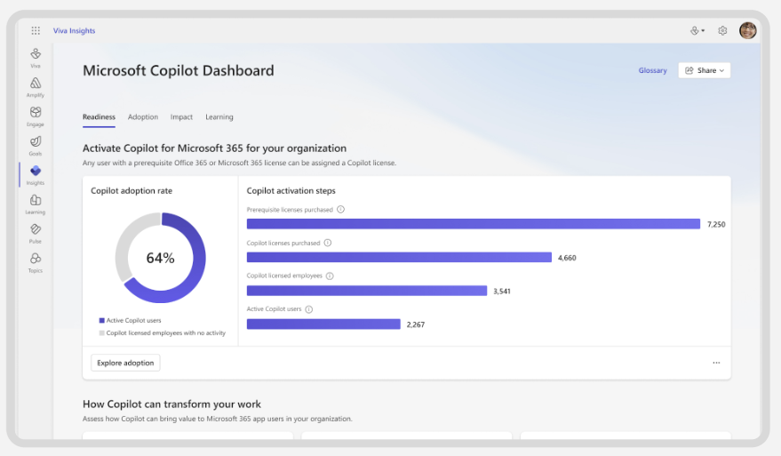
Microsoft Copilot Dashboard Demo

Slide 23
Configuring Microsoft Copilot Dashboard
Manage access to the Dashboard – Settings | Viva | Viva Insights | Manage access settings for Microsoft Copilot Dashboard. Add users or groups to allow access to Copilot Dashboard
Dashboard filters are determined by Microsoft Entra ID by default. You can override this with an organizational data file in Microsoft 365 that your admin uploads. There are currently two paths Viva: Prepare organizational data in Viva Insights | Microsoft Learn and MODIS: Import your organizational data | Microsoft Learn
User sentiment on Impact page - start a new Pulse Survey or upload user sentiment survey results. Uploading survey results requires Viva Insights Admin role. Viva Insights | Data connections | Manage data sources | M365 Copilot Impact Survey Data. Full instructions here: Connect to the Microsoft Copilot Dashboard for Microsoft 365 customers | Microsoft Learn

Slide 24
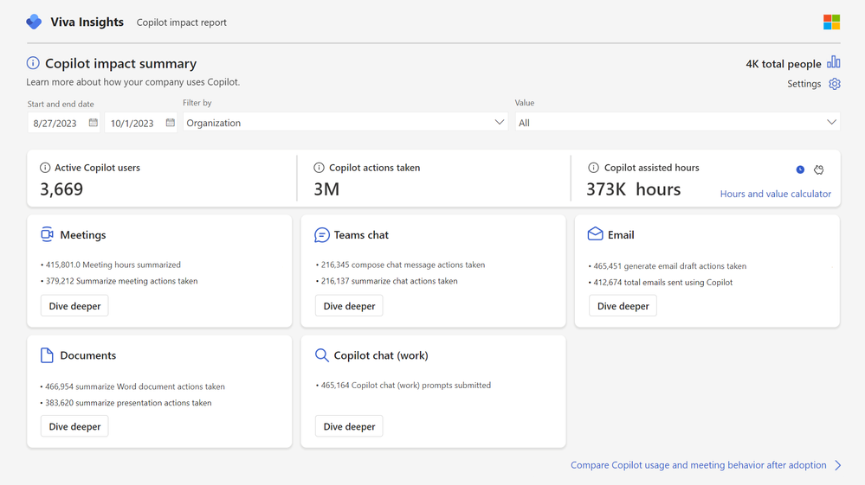
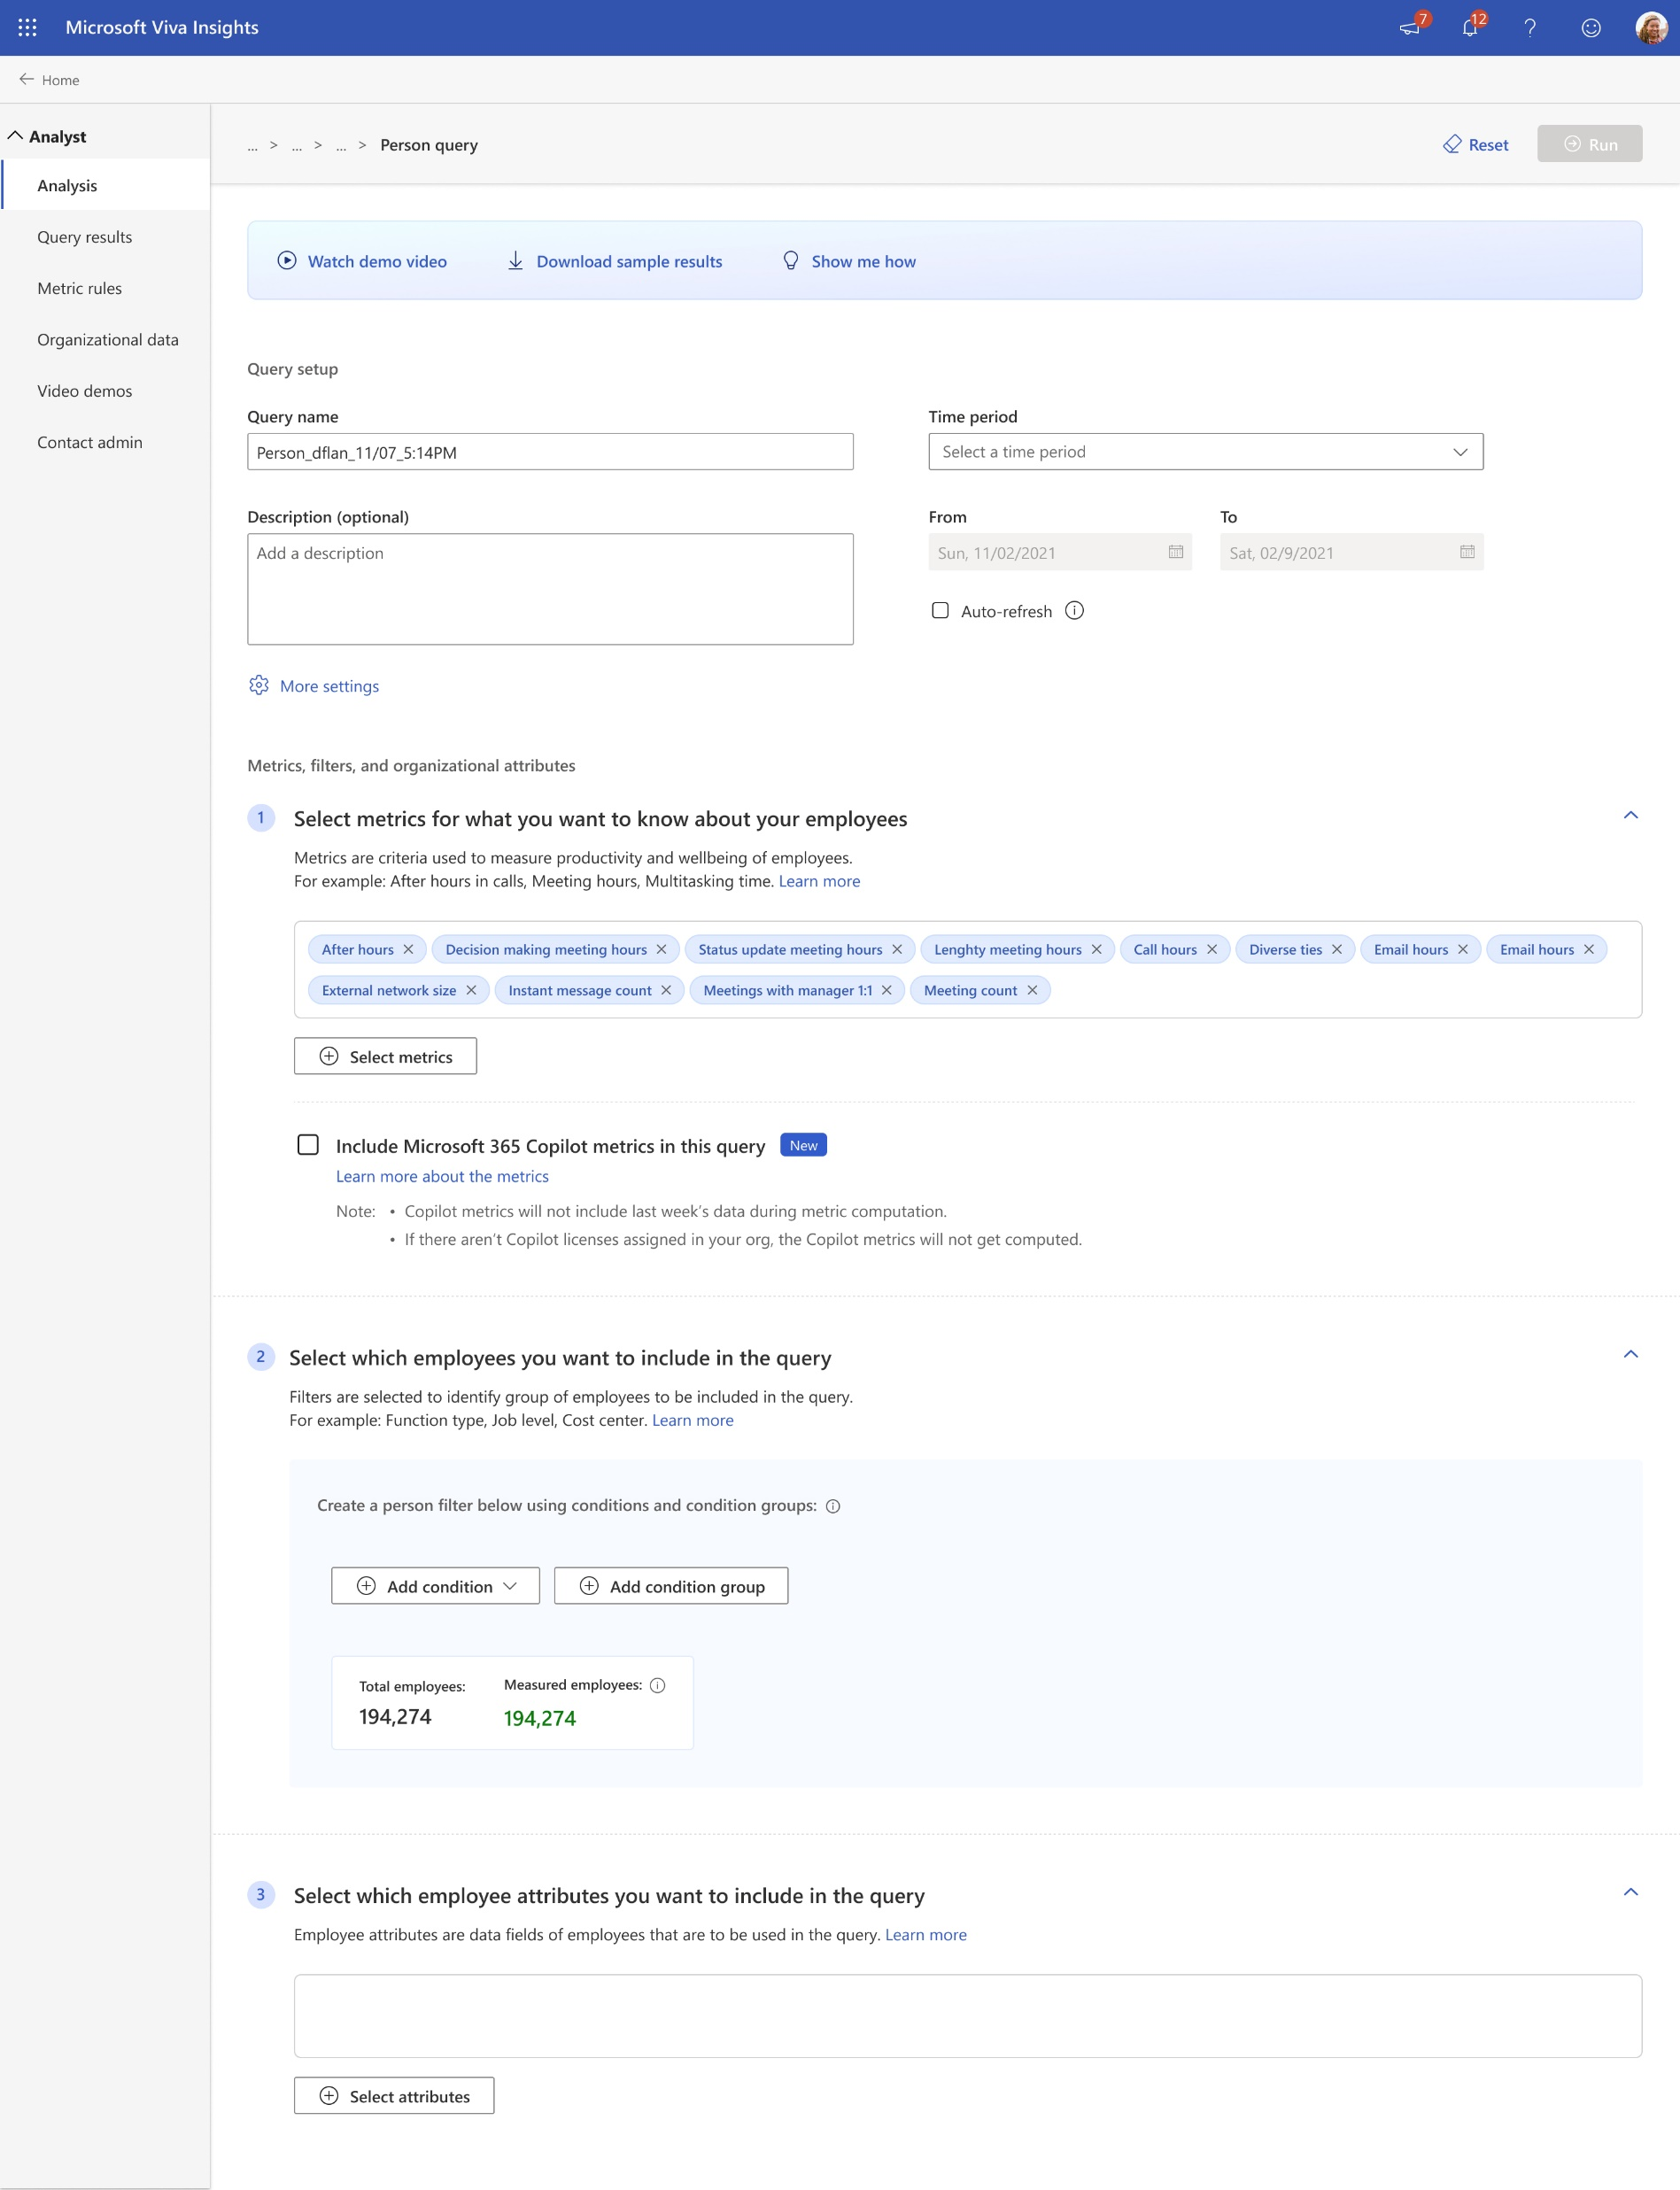
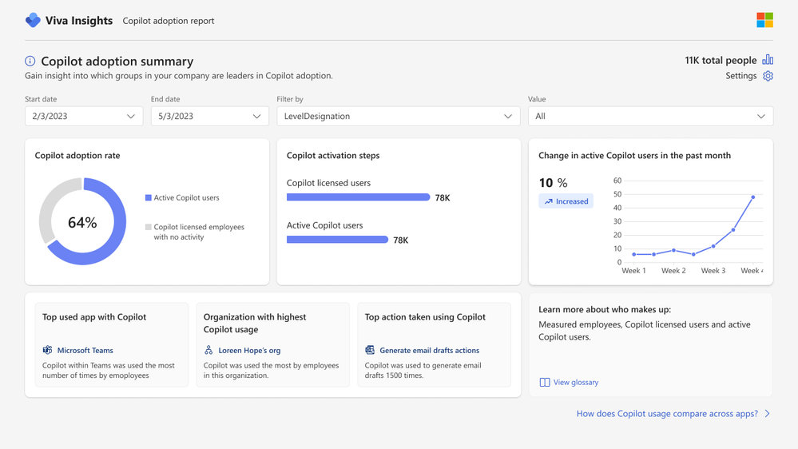
Advanced Copilot Reporting with Viva Insights
Explore Copilot's advanced features and Viva Insights' library of templates to create personalized reports. Build custom views, dashboards, and analyses with detailed data.
Filter and group by attributes such as region, team, or tenure.
Access data beyond 28 days using dynamic time ranges.
Integrate 3rd party data, such as sales performance or service KPIs, to find business correlations.
Define active Copilot users and other metrics as needed for your reports.
Pro Tip: License analyzed users with Viva Insights and assign the Insights Analyst role in Viva Insights to get started

Slide 25
Copilot Reporting Templates in Viva Insights
The Analysis page in Microsoft Viva Insights offers several predefined Power BI templates for analyzing workplace collaboration:
Microsoft 365 Copilot adoption report: Helps leaders track Copilot usage and promote its adoption.
Microsoft 365 Copilot impact report: Assesses the impact of Copilot on collaboration and measures assisted hours.
Copilot for Sales adoption report: Provides insights into Copilot for Sales usage and adoption patterns.
Copilot Business Impact Report: Links Copilot usage to business outcomes.
Follow along in your tenant by navigating to https://analysis.insights.viva.office.com/

Slide 26
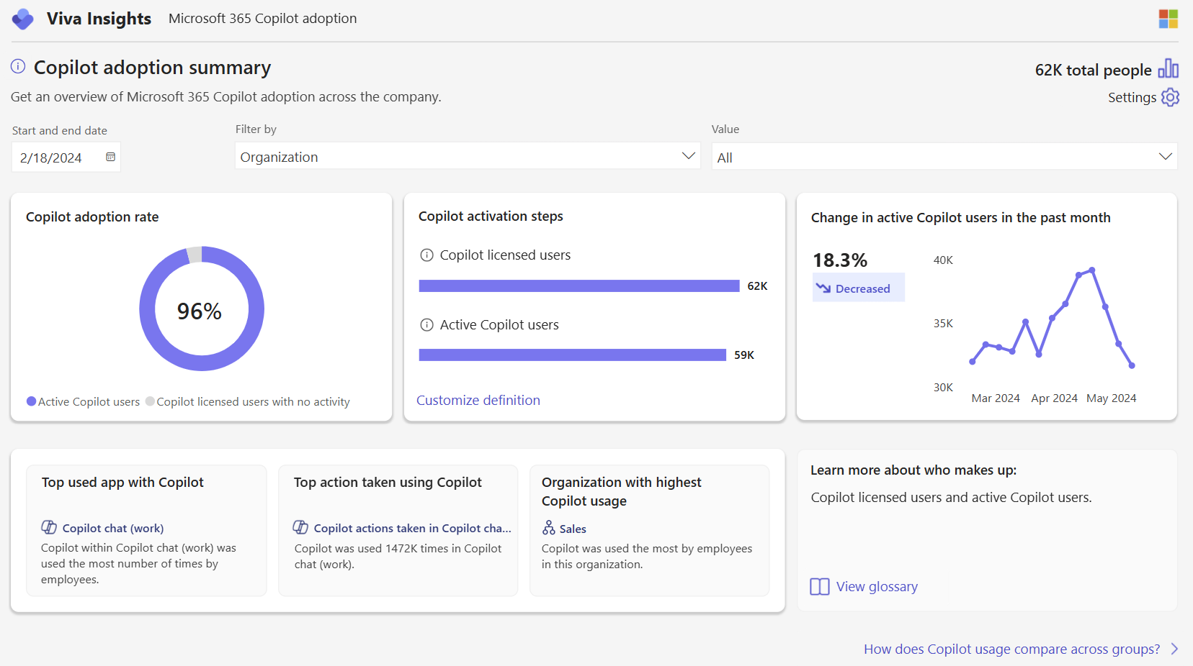
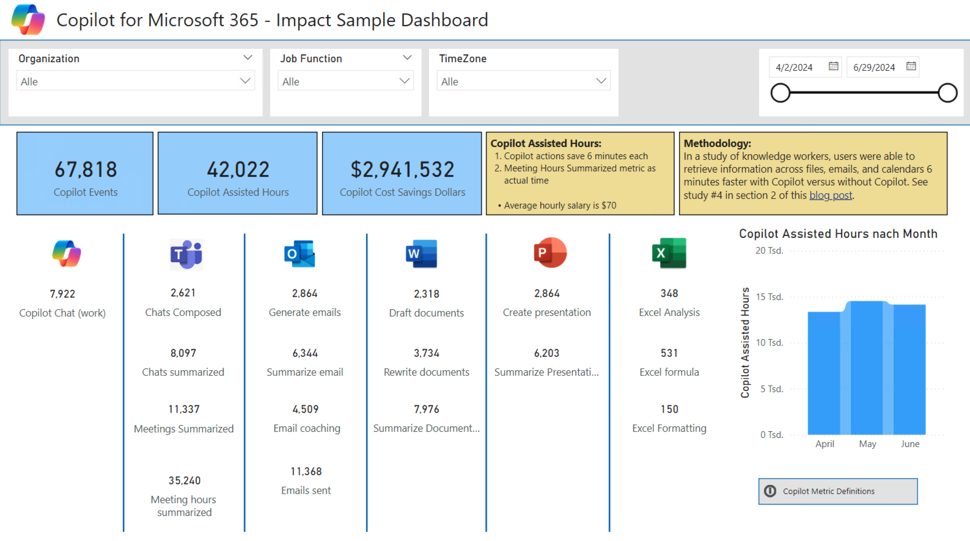
Demo
Advanced Copilot Reporting with Viva Insights Template Reports

Slide 27
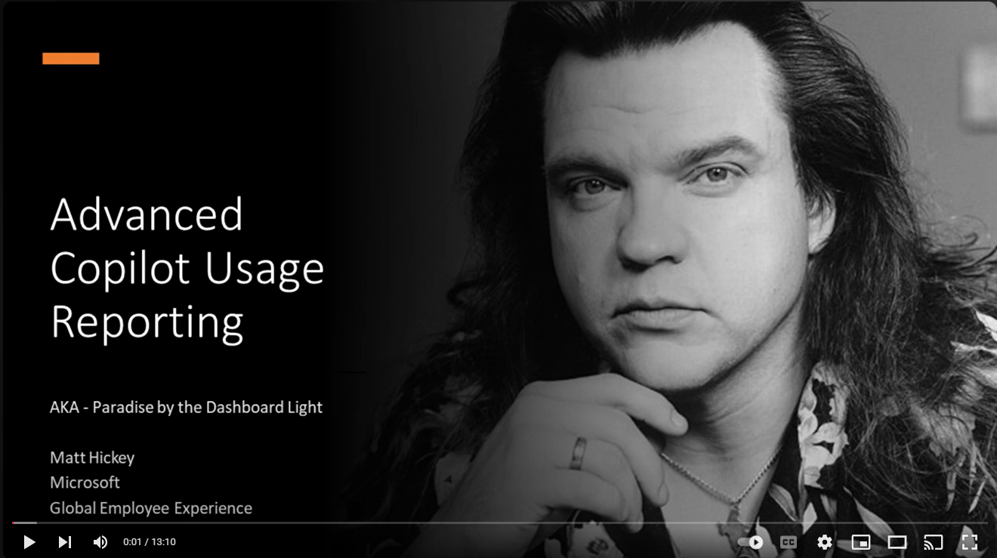
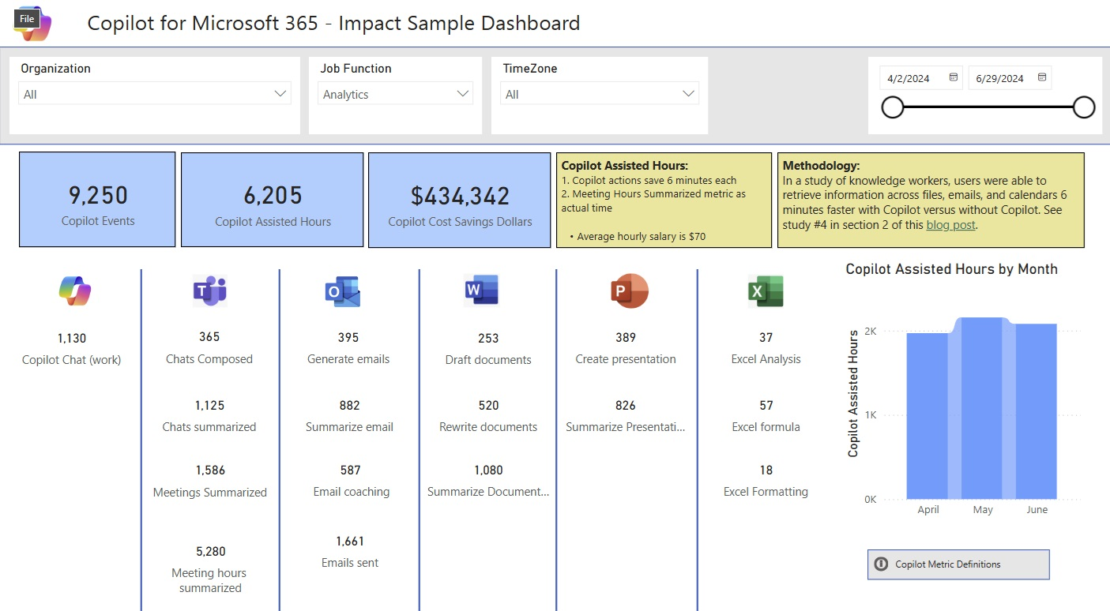
Custom Analytics and Copilot Dashboards
Why build a custom dashboard:
Report on Copilot usage data older than 28 days
Report on Copilot usage with daily frequency
Slice Copilot adoption and impact for custom cohorts created from a list of HR attributes (beyond 3 slicers in Copilot Dashboard)
Advanced reporting due to data sovereignty, multi-tenant or complex requirements
Prerequisites:
Viva Insights License Assigned to Copilot users
Viva Insights License Assigned to to compare cohorts
Viva Insights Analyst Role
Power BI Pro License and Power BI Desktop
Optionally, an organization file to enable Job Function or other custom HR slicers
Steps:
Run Custom Person Query in Analyst Workbench Create a custom person quer y - Person query | Microsoft Learn
Import results into Power BI and start crafting reports
Step by Step Video: https://youtu.be/QNyZxOiL6cs
Hickey7737/Copilot-for-M365-Custom-Dashboard-Samples: Custom Copilot M365 Dashboard samples for Impact and Adoption

Slide 28
Configuring Advanced Copilot Reporting in Viva Insights
Manage Microsoft Viva Insights licenses for entire analyzed population for template reports or custom dashboards - Assign licenses | Microsoft Learn
Configure Viva Insights Partitions: Partitions are analyst workspaces that only contain certain employee data and attributes. This will help with privacy or data sovereignty blockers as in a partition, analysts can only create queries based on the data in that partition - Partitions in Viva Insights | Microsoft Learn
Assign Viva Insights Admin Role: Required for Org file upload - Roles in Viva Insights | Microsoft Learn
Assign Viva Insights Analyst Role which is required to run template reports and custom person queries - Roles in Viva Insights | Microsoft Learn

Slide 29
What to use when – Best Practices to Consider
Deployment Planning
M365 Admin Report
Copilot Dashboard – Readiness Tab
Usage
M365 Admin Report
Copilot Dashboard – Readiness & Adoption Tabs
Adoption and Change Management
Copilot Dashboard – Adoption, Impact & Learning Tabs
Advanced Insights
PBI Templates
Value
Copilot Dashboard – Impact Tab
Advanced Insights
PBI Templates

Slide 30
Copilot Analytics - What to use When
Identifying individual users' behavior
Protecting User Privacy
Purview Audit logs
Microsoft Copilot Dashboard
Readiness, Adoption, Impact and Sentiment
Copilot Security and compliance. Not recommended for adoption and impact
Out of the box
Copilot Usage Reports in MAC
Who is/is not using their entitlement?
Who are good candidates for Copilot?
Who is using Agents?
Who is using free Copilot Chat?
AI Assistance Score
Benchmarking and guidance
Viva Template Reports:
Copilot Impact Report, Copilot Adoption Report, Copilot for Sales Adoption Report
Copilot Business Impact Report
Upload Business KPIs
Copilot Usage Graph API
getMicrosoft365CopilotUsageUserDetail: Activity data for enabled users of Microsoft 365 Copilot apps. Derive user usage intensity.
Custom
Viva Insights Custom Copilot Dashboard
Custom reporting with Viva Insights Analyst Workbench

Slide 31

Calls to Action
Modern Work Customer Hub

Slide 32
Microsoft investments to accelerate your time to value
Find Partners to help with Microsoft 365 Copilot Analytics at the
Eligible customers can request technical and deployment assistance from
Get started on your Copilot journey with expert-led services through
Microsoft 365 Copilot Partner Directory
Microsoft FastTrack
Microsoft Unified
Connect with your Microsoft representative for more information.

Slide 33
Resources to get started on your AI Measurement Journey
Ignite on demand session: Measure AI adoption and value
Learn Articles:
Microsoft 365 Copilot readiness
Microsoft 365 Copilot usage
Agent usage in Microsoft 365 Copilot
Microsoft 365 Copilot Chat usage
AI adoption category in Adoption Score
Copilot Dashboard
Copilot Business Impact Report
Viva Insights
Copilot Scenario Library

Slide 34
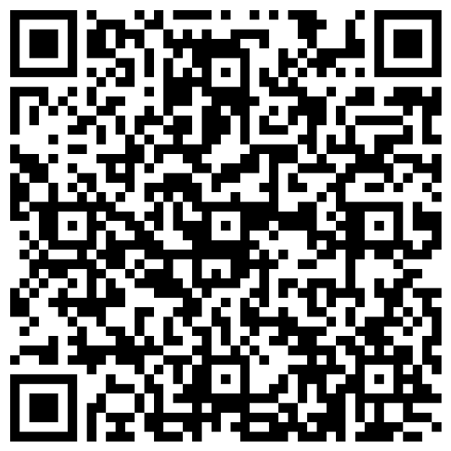
Your feedback is critical
Scan with your mobile device camera
We’re committed to making your Modern Work Customer Hub experience the best it can be – and your feedback is a critical component to that.
Before you scoot, please take a moment to reply to provide some feedback.
-OR-
Visit
Customer Hub Survey
aka.ms/CustomerHubSurvey

Slide 35
Visit Customer Hub Website for upcoming sessions, updates, and on demand contents!
Scan me!
https://aka.ms/CustomerHubSessions

Slide 36

Q & A

Slide 37

Thank
You
Copyright © 2025 Microsoft Corporation. All rights reserved.

