Slide 1
Business Value Series
Maximizing Business Value & ROI with Copilot
Microsoft confidential

Slide 2


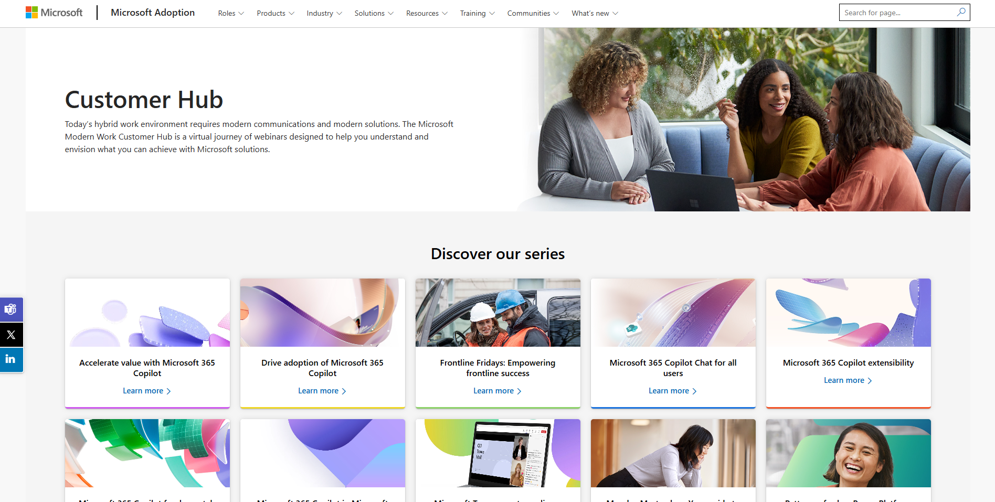

Visit Customer Hub website for upcoming sessions, updates, and on demand contents!
https://aka.ms/CustomerHubSessions​
Notes:
Encourage you to explore the Customer Hub for additional sessions and resources.

Slide 3
Join our upcoming Copilot Customer Hub sessions
Driving business value with Copilot
Defining business value for your organization
Follow-Along: Measuring impact with Copilot Analytics
Maximizing business value & ROI
📅 Thursday, October 2, 2025
🕑8 AM PST
🔗Register now
📅 Thursday, October 9, 2025
🕑8 AM PST
🔗Register now
📅 Thursday, September 25, 2025
🕑8 AM PST
🔗Register now
https://aka.ms/CustomerHubSessions​
Notes:
Last two weeks’ topics: Defining business value of AI for organizations. AND Deep dive into Microsoft tools for measuring Copilot agent usage and value.
Today’s session: Maximizing business value and ROI.
You can use the QR code or the link on the screen to go directly to the Customer Hub web page for details on each of these sessions.

Slide 4

Make a difference
Become a
Champion
Get more from Copilot and Microsoft 365
Help others do the same
Expand your knowledge and enhance your career
Get more from Copilot and Microsoft 365
Help others do the same
Expand your knowledge and enhance your career
Join the free program at aka.ms/M365Champions
Notes:
Champions Link Resource: Encourage you to check out the Champions program if you haven’t already —https://aka.ms/M365Champions
Purpose: The Champions program is designed to help individuals promote Copilot usage within their organizations by offering tools, community support, and best practices.
Encouragement to Join: Explore the Champions site to find upcoming sessions and share them with colleagues.

Slide 5



During the presentation
After the presentation
We will mute your microphone for the first part of today’s call
Raise your hand and we will
call on you
Ask your questions via chat, we will get to all of them, live or after. Common questions will get addressed out loud
Open mic – come off mute and ask away!

Slide 6


Maximizing Business Value & ROI with Copilot
Jennifer Stoll
Copilot ROI Advisor
Benjamin Ho
Business Value Advisor

Slide 7
Agenda
Value is conveyed through storytelling, not data
Purpose of demonstrating the value of Copilot
Types of value messaging & metrics
Value & ROI measurement: Illustration
Custom Super Usage report
Copilot Studio Agent report
Copilot Business Impact report
Capturing value & ROI: Wrap Up
Q&A, Closing

Slide 8




Value is conveyed through storytelling, not data
First steps to maximising value & ROI… “PAMI”
Purpose:
Clarify if the value narrative is for a renewal, expansion, or a current state assessment.
  Renewal: Emphasise realized benefits and ROI since initial Copilot rollout.
  Expansion: Highlight new use cases and additional value Copilot can unlock.
  Current State: Focus on baseline adoption, usage, and early outcomes.
Audience:
Tailor the narrative to the audience’s needs and level of detail.
  Executives: Use concise, high-level summaries with clear business outcomes and ROI.
  Analysts: Provide detailed analytics, usage data, and technical insights.
  End Users: Share relatable success stories and practical benefits.
Notes:
Before we jump deep into the world of copilot value and metrics, we would like to put for ward the idea that value is conveyed through storytelling, not data.
So the first steps to maximising value & ROI is understanding Purpose, Audience, Message and Implication or PAMI
Purpose is key, because this will guide you on the type of value metrics that is needed. Examples of purpose include a Copilot renewal, expansion or a current state assessment.
So for example, if it’s for a Renewal, you will want to reinforce metrics on the realised benefits (e.g. time savings, adoption growth) and ROI since the initial rollout of Copilot.
Or if it’s for an Expansion, highlight new use cases and additional value Copilot can unlock via financial forecasting
Audience: Tailor the narrative to their needs and manage the level of detail.
With executives be concise and make links to business outcomes – show that money has been well spent
On the other hand, with end users – Keep it light and memorable, share relatable success stories and practical benefits.

Slide 9


Value is conveyed through storytelling, not data
First steps to maximising value & ROI… “PAMI”
Message:
Define the key takeaways you want to communicate.
  “Copilot has driven a 25% reduction in time spent on routine tasks resulting in greater efficiency.”
  “User satisfaction with digital tools has increased by 30% since Copilot adoption, deepening confidence in the technology.”
  “Copilot enables faster proposal turnaround, improving sales conversion by 45%, positively impacting a strategic KPI.”
Implication:
Explain the “so what?”— what should the audience do with this information?
  “Based on these results, we recommend scaling Copilot to Engineering & Operations.”
  “The data supports investing in further Copilot training for existing users.”
  “Senior leadership should champion Copilot adoption to accelerate the pace of digital transformation.”
Notes:
Message: two things to bear in mind - observation and the impact
For example, Copilot enables faster proposal turnaround, improving sales conversion by 45%, positively impacting this FY’s strategic objective.
Implication: Explain the “so what?”— what should the audience do with this information?
True value happens when there’s action attached to the insights
For example, based on these results, we recommend scaling Copilot to Engineering & Operations because of the high value use cases
The data supports investing in further Copilot training existing users because usage tapers off after the third month
So remember P.A.M.I – Purpose, Audience, Message and Implication – first steps to maximizing value & ROI

Slide 10
Agenda
Value is conveyed through storytelling, not data
Purpose of demonstrating the value of Copilot
Types of value messaging & metrics
Value & ROI measurement: Illustration
Custom Super Usage report
Copilot Studio Agent report
Copilot Business Impact report
Capturing value & ROI: Wrap Up
Q&A, Closing

Slide 11



Purpose of demonstrating the value and ROI of Copilot
Accelerates Adoption and Behavioural Change
Why: Users and managers adopt faster when they see tangible outcomes, not just “cool tech”. People need to see “what’s in it for me” to change habits.
Impact: Value stories (e.g., time saved, quality gains) create momentum, reduce resistance, and help embed Copilot into daily workflows.
Demonstrating value through adoption metrics and experience gains helps drive prompt fluency, confidence, and cultural readiness.
Protects Against the “Time‑Savings Trap”
Why: Claiming value based only on theoretical time savings can sometimes undermine credibility.
Impact: A structured evidence chain (adoption → operational KPIs → business outcomes) and/or articulation of resultant productivity value ensures realistic, defensible ROI.
Builds a Repeatable Measurement Framework
Why: Early proof sets the baseline for continuous improvement and prioritisation.
Impact: Organisations can compare scenarios, allocate resources to high‑impact use cases, and retire low‑value ones.
Notes:
Accelerates Adoption and Behavioural Change. Maximising of value comes from stronger and wider adoption and when there are tangible outcomes (e.g. increase productivity, quality gains), that creates momentum and helps embed Copilot into daily workflows, then produce even more value
Protects Against the “Time‑Savings Trap”. Going beyond theoretical time savings and articulating tangible ROI ensures that there’s realistic, defensible view of the value of Copilot.
Demonstrating value and ROI at the outset builds a repeatable measurement framework. Once you’ve developed a way to measure value and ROI, it can then be repeated and tracked over time to see if there are sustained benefits, and informs decisions to retire low value use cases

Slide 12


Purpose of demonstrating the value and ROI of Copilot
Links Copilot to Business Priorities
Why: Without proof, AI can be seen as a side project rather than a lever for revenue growth, cost reduction, or risk mitigation.
Impact: Connecting usage → KPI shifts → financial outcomes ensures AI is aligned with strategic goals like customer experience, compliance, and operational efficiency
Secures Executive Sponsorship and Budget
Why: Leaders need evidence that investments deliver measurable benefits before committing further funding.
Impact: Demonstrating value builds confidence for scaling beyond pilots and protects budgets during cost‑optimisation cycles.
Bottom line: Demonstrating the value and ROI of Copilot is about building trust, accelerating adoption, enabling safe scale, and ensuring AI investments deliver strategic, operational, and cultural benefits.
Notes:
These other two purposes are perhaps more obvious.
Value and ROI helps to link Copilot to Business Priorities and that show that Copilot matters. The last thing we want is for Copilot to be seen as a side project or experiment. It needs to be seen as a lever for revenue growth, cost reduction etc.
Secures Executive Sponsorship and Budget. Builds confidence for scaling beyond pilots and protects budgets during cost‑optimisation cycles.
Bottom line: Demonstrating value and ROI of Copilot is about building trust, accelerating adoption and scale, and ensuring investments deliver strategic, operational, and cultural benefits.

Slide 13
Agenda
Value is conveyed through storytelling, not data
Purpose of demonstrating the value of Copilot
Types of value messaging & metrics
Value & ROI measurement: Illustration
Custom Super Usage report
Copilot Studio Agent report
Copilot Business Impact report
Capturing value & ROI: Wrap Up
Q&A, Closing

Slide 14
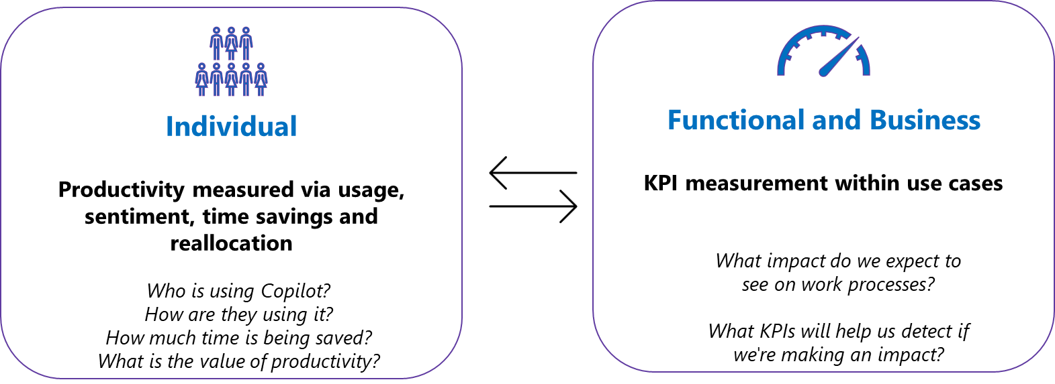
Types of value messaging & metrics: Overview
Value is the improvement in intermediate and end outcomes attributable to Copilot. It can be quantitative or qualitative in nature.
Value is captured across a continuum from adoption and behavioral change, through process performance (operational KPIs), to business outcomes (revenue, cost, risk), with experience layered in.
Different levels of value: building blocks
In practice, you connect leading signals (usage/engagement) to near‑term operational shifts and lagging financial outcomes, and it’s an iterative process.
Notes:
Value can be conveyed in different ways, so in this section we want to spend some time breaking down this concept of value in the context of Copilot.
Value is the improvement in intermediate and end outcomes attributable to Copilot. It can be quantitative or qualitative in nature.
Value is captured across a continuum from adoption and behavioral change, through process performance (operational KPIs), to business outcomes (revenue, cost, risk), including experience.
We can measure value at different levels: Individual and Functional/Business – neither one is better than the other – they are more like building blocks
Logical starting point: individual value – You are asking things like…
With functional/business value, you are asking questions like….
In practice, you connect leading signals (usage) to near‑term operational shifts and lagging financial outcomes, and it’s an iterative process.

Slide 15
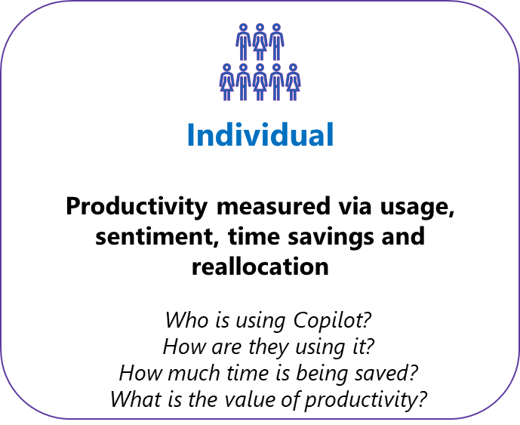
Types of value messaging & metrics: Adoption
Are people using Copilot?
Adoption: A set of metrics that capture reach, frequency/intensity, depth/quality of use, stickiness, and distribution of Copilot/agent usage across target populations—instrumented via Copilot Dashboard/Analytics.
MAC
Copilot dashboard
Superuser report
  Habit strength: Higher WAU/MAU and active days per user (weekly stickiness), not just MAU.
  Depth/quality: Users engage across multiple Copilot surfaces (Outlook + Word/Excel/Teams).
  Distribution: Usage is concentrated in particular functions and less so in others
High adoption value predicts movement in process KPIs and, over time, business outcomes.
Notes:
The first type value that you can convey is Adoption - Are people using copilot?
These metrics capture reach, frequency/intensity, depth of use, and distribution of usage across target populations
You can get information from places like the Microsoft admin centre, Copilot dashboard and Superuser report
Examples of metrics include:
Depth: Users engaging across multiple Copilot surfaces (Outlook + Word/Excel/Teams).
Distribution: How usage is concentrated in particular functions and less so in others

Slide 16
Types of value messaging & metrics: Experience
Are people confident about Copilot?
Experience: A set of metrics that assess how Copilot improves the perceived quality, ease, and satisfaction of work or service experiences for employees and customer. These metrics include targeted surveys, sentiment analysis, and observational feedback.
User reports
  Sentiment uplift: Positive change in employee or customer sentiment scores post-Copilot adoption (e.g., “Copilot makes my work easier”).
  Perceived quality: Survey-based ratings of Copilot-generated outputs (e.g., clarity, relevance, tone, formatting).
  Confidence & trust: Increase in user-reported confidence in decisions or communications made with Copilot’s help.
High experience & quality value predicts improvements in engagement, retention, and trust—both internally and externally.
Notes:
The second type value that you can convey is Experience – Are people confident about Copilot?
These metrics assess how Copilot improves the perceived quality, ease of use, and satisfaction of work
You can get them typically via targeted surveys, sentiment analysis, observational feedback.
It is less likely to come from analytical dashboards, and if there are, it tends to be at a high level (e.g. rating of an agent)
Examples of metrics include:
Perceived quality: Survey-based ratings of Copilot-generated outputs (e.g., clarity, relevance, tone, formatting).
Confidence & trust: Increase in user-reported confidence in decisions made with Copilot’s help.

Slide 17
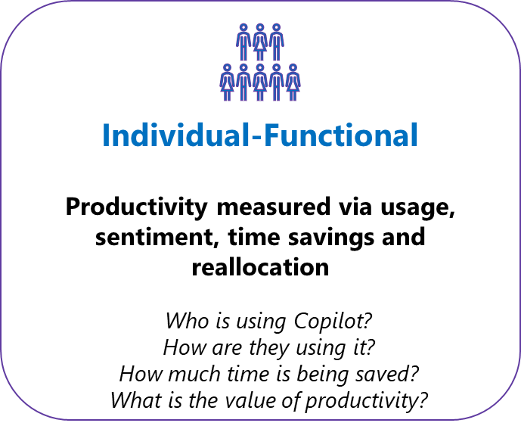
Types of value messaging & metric: Productivity
Are activities benefiting from Copilot?
Productivity & Time‑Reallocation: A set of metrics that quantify the extent to which Copilot enables users to complete tasks faster, reduce manual effort, and reallocate saved time toward higher-value activities. These metrics are captured through telemetry (e.g., Copilot Dashboard/Analytics), complemented by targeted surveys and observational studies.
User reports
Copilot dashboard
Superuser report
  Time saved per task: Reduction in time spent on common tasks (e.g., drafting, summarising).
  Task substitution: Percentage of tasks completed via Copilot vs traditional methods (e.g., manual editing, spreadsheet modelling).
  Reallocation quality: Survey-based insights on how saved time is reinvested (e.g., strategic planning, stakeholder engagement).
High productivity & time‑reallocation value predicts improvements in process efficiency, employee satisfaction, and strategic focus.
Notes:
The third type value that you can convey is Productivity & time‑reallocation – Are activities benefiting from Copilot?
These metrics quantify the extent to which Copilot enables users to complete tasks faster, reduce manual effort, and reallocate saved time toward higher-value activities
You can get information from places like the user reports/surveys, Copilot dashboard and Superuser report
Examples of value include:
Time saved per task: Reduction in time spent on common tasks (e.g., drafting, summarising, analysing).
Reallocation quality: Survey-based insights on how saved time is reinvested (e.g., strategic planning, stakeholder engagement).

Slide 18
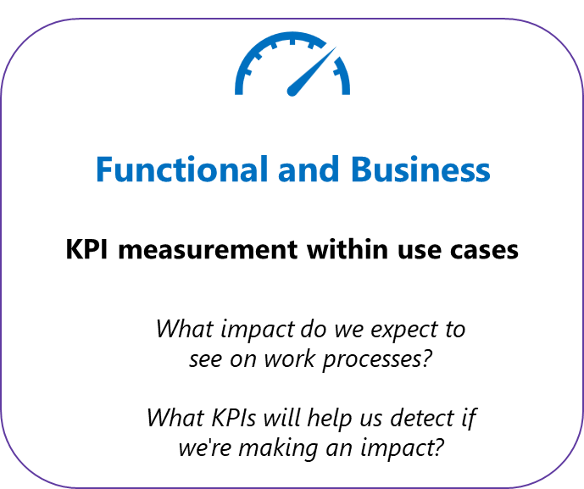
Types of value messaging & metrics: Process
Are functions getting value from Copilot?
Process Performance: A set of metrics that capture short-term, observable improvements in operational workflows and task execution resulting from Copilot usage. These metrics reflect how Copilot affects process speed, accuracy, throughput, and responsiveness— Instrumented via telemetry, workflow analytics, and operational dashboards.
Functional / business reports
Agent usage
Business outcome
Superuser report
  Cycle time reduction: Decrease in time required to complete key workflows (e.g., ticket resolution, contract review).
  Error rate improvement: Fewer manual errors or rework cycles in Copilot-assisted tasks (e.g., fewer formatting issues, missed insights).
  Throughput uplift: Increase in volume of completed tasks per user or team (e.g., more proposals, summaries, reports).
High process performance value predicts early movement in business KPIs and validates Copilot’s impact on core operations.
Notes:
The fourth type value that you can convey is Process performance – Are functions getting value from Copilot?
These metrics capture short-term, observable improvements in operational workflows and task execution resulting from Copilot usage
You can get information from places like the functional/business reports, Copilot agent report, Copilot business outcome report, Super user report
Examples of metrics include:
Error rate improvement: Fewer manual errors or rework cycles in Copilot-assisted tasks (e.g., fewer formatting issues, missed insights).
Throughput uplift: Increase in volume of completed tasks per user or team (e.g., more proposals, summaries, reports).

Slide 19
Types of value messaging & metrics: Outcome
Are business outcomes positively impacted by Copilot?
Business Outcome: A set of metrics that usually quantify direct, measurable financial outcomes resulting from Copilot adoption—such as reduced operational costs, avoided expenditures, and increased revenue.
These metrics are derived from telemetry, financial modelling, and validated business cases, and are often linked to specific workflows, automation gains, or strategic initiatives.
Functional / business reports
Business outcome
  Cost avoidance: Elimination of planned or potential costs through Copilot use (e.g., avoiding third-party transcription services by using Copilot meeting summaries).
  Revenue impact: Increase in sales conversion, upsell/cross-sell rates, or customer retention driven by Copilot-enhanced engagement or faster response times.
  Efficiency-to-cost ratio: Improved output per dollar spent on workforce or tooling, benchmarked against pre-Copilot baselines.
High hard financial value predicts tangible ROI and supports budget justification for scale-out.
Notes:
The fifth type value that you can convey is Business outcome – Are business outcomes positively impacted by Copilot?
These metrics usually quantify direct, measurable financial outcomes resulting from Copilot adoption
You can get information from places like the functional/business reports, Copilot business outcome report
Examples of metrics include:
Cost avoidance: Elimination of planned or potential costs through Copilot use (e.g., avoiding third-party transcription services by using Copilot meeting summaries).
Revenue impact: Increase in sales conversion, upsell/cross-sell rates, or customer retention driven by Copilot-enhanced engagement or faster response times.

Slide 20



Types of value messaging & metrics: Recap
AI Value Metrics Continuum
Leading Indicators Lagging Indicators
Usage, engagement, and retention of AI products, use cases, and agents
Foundational value metrics
Examples:
Copilot adoption and usage frequency
Use case or app usage
Agent adoption, repeat usage
Confidence & quality
Performance of a specific process or function within an organization
KPI impacted most directly by the AI use case or agent
Examples:
Sales opportunities created
Support case resolution time
Customer risk score
Time for application review
Strategic results that reflect the overall impact of AI tools and solutions
Broader strategic result that reflects overall impact of AI on organizational goals
Examples:
Revenue per seller
Support cost savings
Customer retention
Time to hire
Adoption, Experience, Productivity
Process, Operational
Business, Organisation
Push beyond this boundary & Connect the dots
Telemetry | Experience → KPI shift → Outcome impact over time.
Notes:
To wrap up this section, something else to consider is the nature of the value metrics that you convey.
Some of them would be more leading in nature (e.g. adoption, sentiment value), and more readily available, while others would more lagging in nature, requiring some time to lapse before you are able to report on it (e.g. business outcomes). When conveying value and ROI, it will be ideal if you are able to include both leading and lagging indicators, but it will be a journey rather than a one-point in time exercise where everything metric is accounted for
But when you are able to tie activity to outcomes, the messaging becomes more effective because of the cause and effect relationship

Slide 21
Agenda
Value is conveyed through storytelling, not data
Purpose of demonstrating the value of Copilot
Types of value messaging & metrics
Value & ROI measurement: Illustration
Custom Super Usage report
Copilot Studio Agent report
Copilot Business Impact report
Capturing value & ROI: Wrap Up
Q&A, Closing

Slide 22



Value & ROI Measurement: Illustration
Building on the foundations of employee value, business value is realised when personal productivity is combined with business process transformation
Individual
Functional
Business
How well is the workforce taking to the new technology?
What is the impact of Copilot on process and productivity?
What’s Copilot impact on the bottom line?
Employee Value
Enhanced efficiency
Capacity to create & collaborate
Improved employee experience
1. Copilot Usage Patterns & Experience
Understand Copilot usage archetypes (intensity) and usage patterns
2. Productivity & Process Gains
Quantify productivity and articulate process improvements
Uncover value at the organization and functional level
3. Impact on Business Outcomes
Connect Copilot activity with KPI Impact (e.g., revenue growth and cost savings)
Business Value
Accelerated revenue growth
Cost optimization & avoidance
Faster time-to-value
Super Usage Report
Super Usage Report
Agent Report
Business Impact Report
Notes:
IN this next section, we’re going to dive deeper into the levels of value that Ben described for you
I’m going to walk you through 3 example reports to show how you can use them to better understand each of these levels of value

Slide 23
Value & ROI Measurement: Illustration
Individual
How well is the workforce taking to the new technology?
Adoption
Growth in general adoption
Adoption timeline
Distribution of super users
Identifying Copilot champions
1. Copilot Usage Patterns & Experience
Understand Copilot usage archetypes (intensity) and usage patterns
Super Usage Report
Notes:
Starting off with the individual level of value.
Here we’re trying to understand how well the workforce is really taking to Copilot. What is the value that individuals are getting from Copilot?
We’ll answer this question through a closer look at our super usage report, and start out by looking at 4 analyses designed to give us a better understanding of our top users

Slide 24





Super Usage analysis
Why should we study super users?
Getting started
We recommend a minimum of 1000 active users to generate reliable usage patterns.
Studying super users reveals how they've successfully navigated the adoption curve—from initial experimentation to habit formation —within the unique context and workflows of their organization.
By understanding their specific journey and milestones, we can pinpoint critical moments that transform casual users into dedicated adopters, enabling us to replicate and scale this adoption across the company.
Users
1-2 quarters of active usage before you begin analysis to really see the benefits of Copilot in the business.
Time
Analyst access to Viva Insights – Analyst Workbench and PowerBI Desktop
Technology
Setting up the report is quick and easy : aka.ms/decodingsuperusage.
Launching
Notes:
We have developed a template which is right now on GitHub, which functions like just just like any other Viva Insights template, which is you run a query, you load that into a power BI report and this template answers a few questions.
What does super usage look like in your company?
What's the volume of action, the breadth of actions, the frequency of usage?
What was the path to super usage?
How many actions did it take for somebody to become a super user?
What did they do differently in the early days compared to the rest of the users?
How are they using Copilot?
What are some of the behavioral attributes of super users themselves? Are they the ones who are most active with customers? Are they the ones who have the longest work span?
What are some of the attributes of these super users? What impact does Copilot have on their work? Are they able to make some kind of improvements in their own work patterns because of Copilot?
Where do you find the Super users? Where are they located?
This is a report you can run yourselves – the link and technical requirements are on the right.

Slide 25
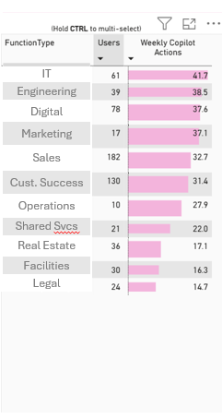
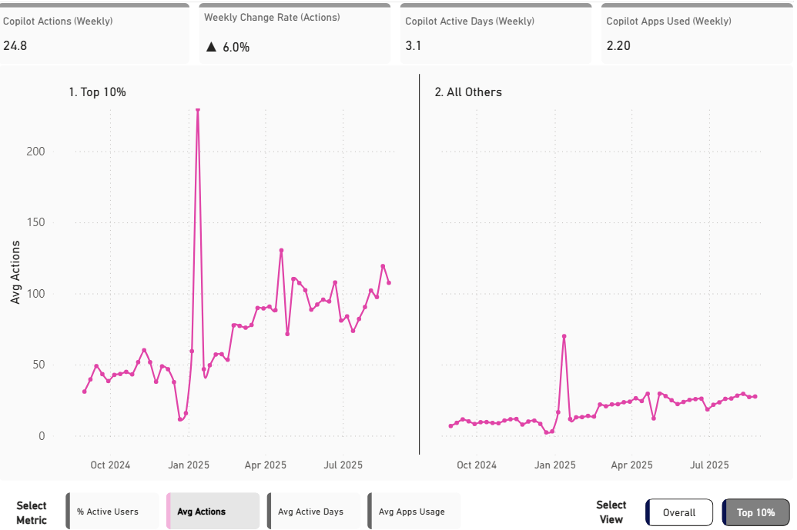
Super Usage Report
Value measurement through impact on usage patterns
Growth in adoption
Individual value
Weekly Copilot actions per person
Example visual
Takeaways
Copilot actions have risen at an average rate of 6% each week and now stand at 24.8 actions per user per week.
The Top 10% average 73 actions a week, indicating what great looks like.
Average weekly active days is trending over 3, signaling Copilot becoming a daily habit.
IT leads the way with over 41 weekly actions.
Notes:
For example, we can look at the usage patterns of our top users- here, our top 10%, and compare them directly to the rest of the population. For both groups, we see average actions per week increasing, but at very different rates, and at very different volumes.
When we think about this from a value context, we can start to see how much more value top users are deriving from Copilot than the average user. This provides us a good target for action and enablement. How can we help the rest of our population get similar value from their Copilot usage?

Slide 26
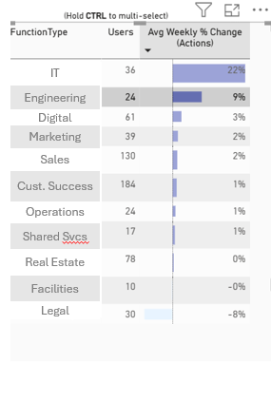
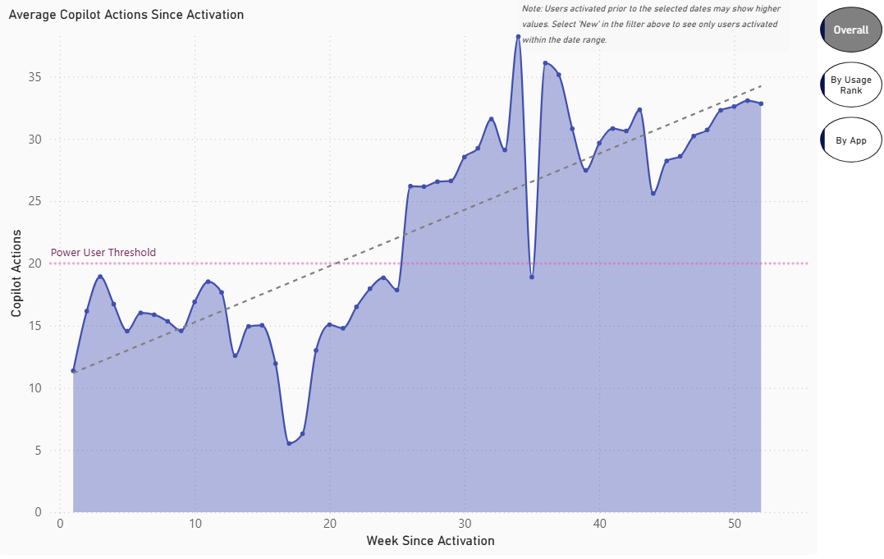
Super Usage Report
Value measurement through impact on usage patterns
Adoption timeline
Individual value
Weekly Copilot actions by weeks since activation
Example visual
Takeaways
Linear calendar views mask growth due to rolling licensing; a ‘weeks-since-activation’ view reveals stronger adoption by aligning users from their start.
Ramp time to power usage is 26 weeks.
IT has shown the highest weekly acceleration, reaching the power user threshold in only 14 weeks.
Note
The view here is based on weeks since activation and not a chronological sequence.
Notes:
This chart shows a slightly different view of usage. As opposed to reviewing trend over time, this chart looks at usage since license activation.
This view can be really helpful to understand common adoption patterns. How long does it take for people to build a habit? What apps do people latch onto first?
And of course, all of these charts can be filtered by usage tiers, so we can look at super users to see their adoption trend and compare it to other users
This is important to understand because it takes several weeks for Copilot habit to build. This chart underscores the importance of giving people enough time with their licenses to build that habit.
Again, when we think about this in terms of value – it takes time for users to really derive the full value out of their Copilot license. Often leaders will want to see immediate ROI, and charts like this can help demonstrate the importance of looking at longer-term value as well.

Slide 27
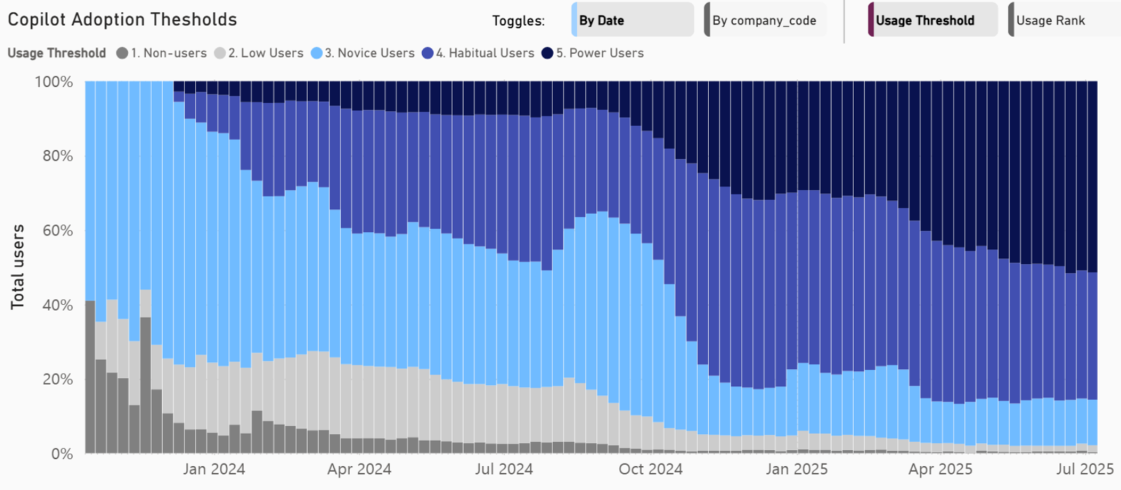
Super Usage Report
Value measurement through impact on usage patterns
Distribution of super users
Individual value
Distribution of users by usage bands
Example visual
Takeaways
There has been a gradual shift toward more consistent and intensive usage patterns among users
Power users and Habitual users now form over 80% of the company.
In the last 6 months, the % of non-users has shrunk from 8% to 1%.
Metrics
Power users: 20+ Copilot actions per week and habitual; Habitual users: Active in at least 9 out of 12 weeks; Novice users: Average at least 1 weekly action over the past 12 weeks; Low users: Having any Copilot action in the last 12 weeks; Non users: Zero Copilot actions in the past 12 weeks
Notes:
Rather than looking at total numbers, we can also try to understand the ratio of top users to low and non-users.
In this example, the dark blue bars reflect power and habitual users, and the gray bars represent low and non-users
Over time, our goal is to see the percent of power and habitual users increasing, and the percentage of low and non-users decreasing.
There are a couple of important points here:
First, we know that the higher usage tiers (power users and habitual users) are getting the most value out of their Copilot license – so when we’re looking at how we can really measure the value of Copilot, the higher the % of users in these categories, the better the return on our Copilot investment.
Second, obviously we want to see those gray bars shrinking, indicating a lower percentage of low and non-users. These licenses cost the same as the licenses for our power and habitual users, but we’re not getting the same value out of them.
We can filter on these populations to better understand where these groups are in the organization, so our enablement efforts can be better targeted. We can also look at our top users to capture best practices from them.
This type of targeted learning and enablement can help us derive value faster and more methodically across the organization.

Slide 28
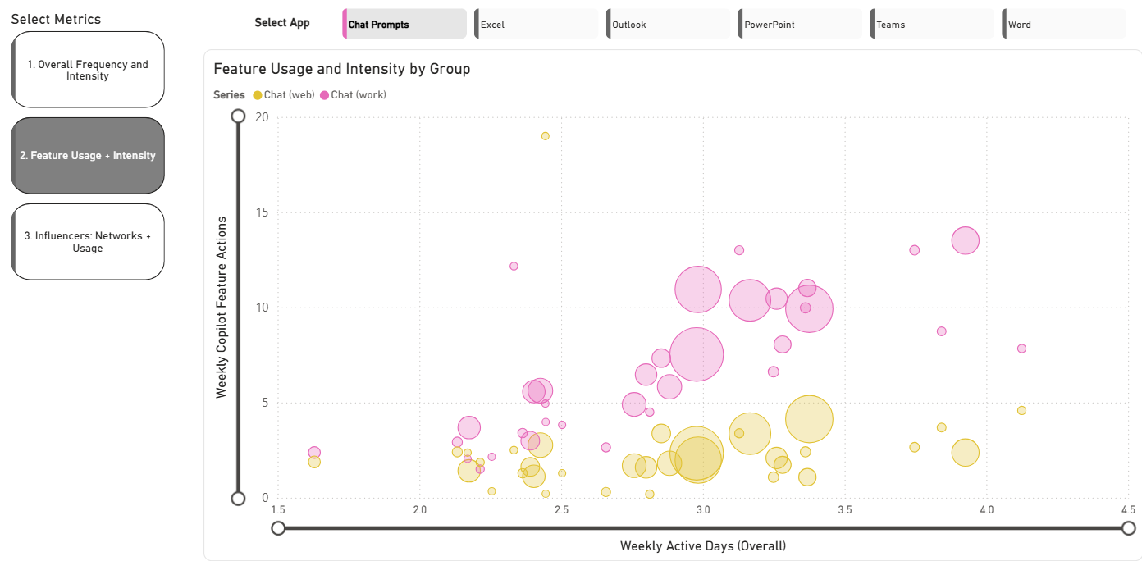
Super Usage Report
Value measurement through impact on usage patterns
Identifying Copilot champions
Individual value
Heatmap by various metrics
Example visual
Takeaways
Group X and Y lead the way with adoption of Copilot in Word showing consistent and high intensity usage.
There is an opportunity for Groups A, B, C with similar work charters to adopt best practices from these groups to drive usage.
Bubble size represents team size
Notes:
And finally, we can also compare usage across groups as a way of identifying teams that are getting the most value out of their Copilot licenses.
Charts like this one can be an important way to view success across teams. Here we can see that our largest teams – denoted by the largest bubbles – are right in the middle in terms of average active days, and on the higher end of weekly actions
This visual gives us a quick way to see which teams are really embracing Copilot, and where there may be opportunities for more enablement. This is especially important when those teams are large, as they represent a larger share of the Copilot expenditure.
This is also where we really start to see the impact of things like executive sponsorship and role modelling – usually the teams with the highest Copilot usage are the teams where leaders are most vocally and visibly advocating and role modelling good Copilot habits

Slide 29
Value & ROI Measurement: Illustration
Functional
What is the impact of Copilot on process and productivity?
Productivity | Process
Increased capacity
Impact on key behaviors
2. Productivity & Process Gains
Quantify productivity and articulate process improvements
Uncover value at the organization and functional level
Super Usage Report
Agent Report
Notes:
Once we have a good understanding of what individual adoption patterns look like – who our super users are, where they sit, and understand their usage patterns, we can move onto functional value
With functional value, here we’re trying to look at the impact that Copilot is having on the way work gets done.
We look at this to better understand both if – and how – we’re creating increased capacity, and also how we’re impacting people’s work patterns and behaviors.
We’ll do this by first turning back to the super usage report.

Slide 30
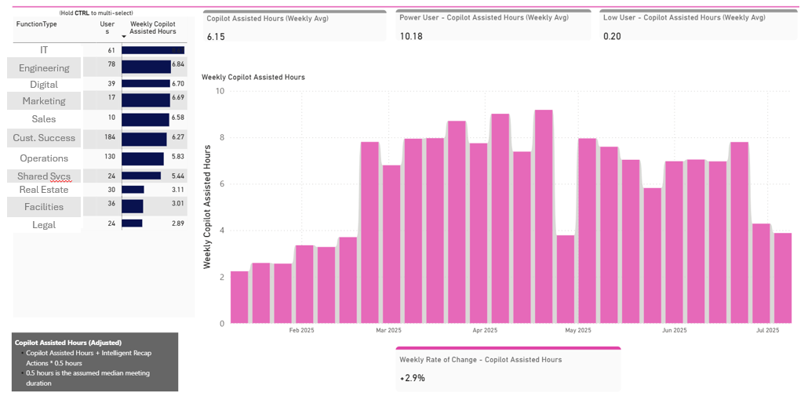
Super Usage Report
Value measurement through impact on process and productivity
Assess increased capacity
Functional value
Actions driving high intensity usage
Example visual
Takeaways
While Copilot Assisted Hours has increased to 6 hours/week, there is a wide disparity in benefits realized by Power users compared to Low users.
Legal, Facilities, and Real Estate have realized the lowest benefits from Copilot.
More positively, the top 10% average ~17 hours a week of assistance from Copilot
Notes:
So here we’re taking a different view on value, looking at the estimated impact of Copilot usage on people’s time. You could think of this in terms of time savings, but you could also think of it in terms of increased capacity – how Copilot usage helps people reallocate their time to focus on higher-value work.
Estimating the number of hours Copilot has assisted with can be tricky, but sometimes it can be a really helpful way to give you a sense of the impact Copilot is having – particularly for leadership teams who are really looking for a traditional ROI calculation.
This calculation is based off Microsoft’s estimate that each Copilot prompt accounts for 6 minutes of assisted time. When added with the time from Intelligent Recap (assumed to be 30 minutes per action), this gives you a sense of the overall impact on employees’ time that Copilot is having.
For example, here we see that for this group, assisted hours peaked around late April, and has dipped a bit since then. We can then take this information to look at what has been going on over this time period.
Were there special enablement efforts going on in the spring, and maybe we need to re-evaluate what we’re currently doing?
We can look at this same chart filtered for our power users. Does that chart follow the same pattern?
We can use this assisted hours calculation as a way to determine where users are really deriving more value than the cost of the license. Based on your own populations, how might you value one hour of someone’s time? And based on that, how many hours of time savings – or increased capacity – balance out the cost of that Copilot license?

Slide 31
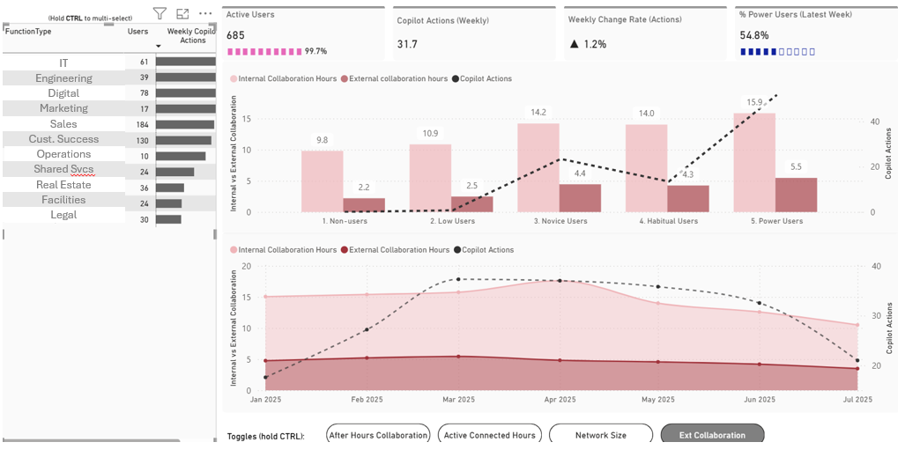
Super Usage Report
Value measurement through impact on process and productivity
Impact on key user behaviors
Functional value
Behavioral differences between Power users and the rest
Example visual
Takeaways
With rising Copilot usage, internal collaboration is declining, especially in customer-facing teams where time is shifting toward external engagement
Power users have higher internal and external collaboration hours.
Internal collaboration hours have seen a steady decline over time
Notes:
An additional way to measure value is not just by hours or dollars, but by impact on user behavior. Is Copilot usage impacting when and how much people collaborate, for example?
On charts like these, we look at the patterns between metrics measured from Viva Insights and Copilot usage to see if there is a correlation.
We might look at active connected hours or after-hours work, for example. Has Copilot changed those numbers? We might see improved work-life balance with increased Copilot usage, as users are able to use Copilot to cut down on the time they spend on repetitive or manual tasks.
The impact on user behavior can become especially apparent when we look at results by specific functions or divisions. For example, we might see an increase in external collaboration as people in customer-facing roles are able to spend more time dealing directly with customers because they can use Copilot to save time on drafting emails. This is really critical when we think about functional value – different teams will use Copilot in different ways to accomplish different tasks – so it can be essential to consider these different use cases and value cases when determining overall value.

Slide 32
Value & ROI Measurement: Illustration
Functional
What is the impact of Copilot on process and productivity?
Productivity | Process | Experience
Organization agentic value
Agent-specific value
2. Productivity & Process Gains
Quantify productivity and articulate process improvements
Uncover value at the organization and functional level
Super User Report
Agent Report
Notes:
We can also try to measure the impact or value of agents through this functional lens.
We’ll turn to the Copilot Studio agent report next for this analysis.

Slide 33
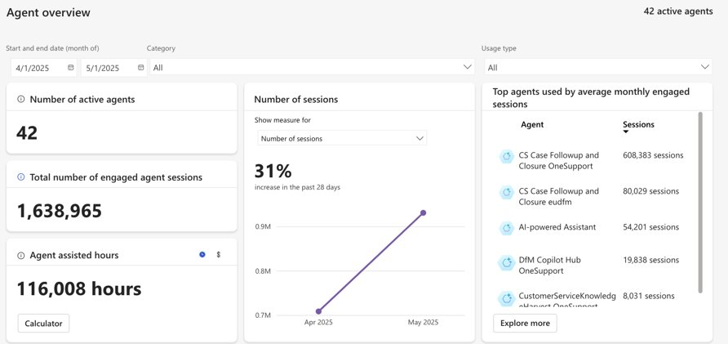
Copilot Studio Agent Report in Viva Insights
Value measurement through impact on process and productivity
Organization agentic value
Functional value
Customer Service Agent
Finance Explorer
HR Help Desk
Copilot Help Agent
Analytics Helper
Notes:
And finally, we can also look at impact on process and productivity by looking at the agent report.
Not only can we look at which agents are being used most often, but we can see how many hours they are actually helping to save. The calculation here is a little more complicated; it takes into account the type of knowledge source being referenced, and you can customize the values. You can also view this as a dollar savings if you prefer.
*** only agents built in MS Copilot Studio

Slide 34
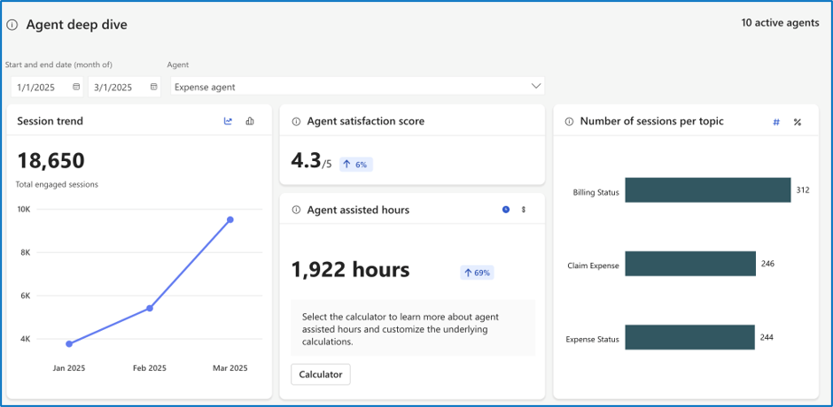
Copilot Studio Agent Report in Viva Insights
Value measurement through impact on process and productivity
Agent-specific value
Functional value
Notes:
Knowing the overall value derived from agents is helpful, but where it gets really insightful is when we look at the data for a specific agent.
In the deep dive report, we can look at the assisted hours by agent along with the usage trend and satisfaction score.
We can also look at the sessions per topic on the right; this tells us HOW people are using the agent.
This is important to know because if there is a high-value or time-consuming scenario that is being underutilized, we can make adjustments either to the agent or to our enablement.

Slide 35
Value & ROI Measurement: Illustration
Business
What’s Copilot’s impact on the bottom line?
Business outcome | Adoption | Productivity
Linking business outcome with Copilot activity
Untapped value potential
3. Impact on Business Outcomes
Connect Copilot activity with KPI Impact (e.g., revenue growth and cost savings)
Copilot Business Impact Report
Notes:
And finally, we’ll turn to the third pillar of value measurement – impact on the business.
For this discussion, we’ll be looking at the Copilot business impact report

Slide 36

Copilot Business Impact Report in Viva Insights
Measure the value of Microsoft 365 Copilot using your key business metrics
Upload your own business outcome measures.
Link Copilot usage to business results in a PBI report template.
Tailor your analysis with your business data metrics for any function.
Discover best practices from Copilot activities that drive success.
Identify ways to enhance low Copilot usage for better adoption and impact.
Notes:
What we’ve been looking at so far in the super usage report and agent report has been looking at productivity gains and ROI by way of assisted hours and assisted value. Another key way to measure ROI is to look at the actual business impact.
The Business Impact Report in Viva Insights provides a framework to track impact to real-world business KPIs. Some of you may remember this report when it was covered in last week’s session.
Making this connection allows you to answer several different business questions, including:
Which Copilot usage behaviors influence the business outcome?
How do the employees who are responsible for most favorable results use Copilot?

Slide 37
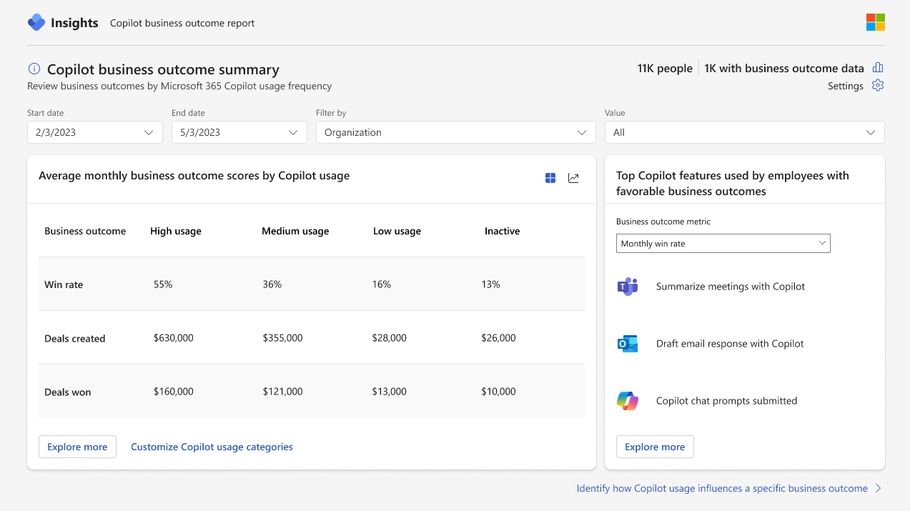
Copilot Business Impact Report in Viva Insights
Value measurement through…
Impact on business outcomes
Business value
Notes:
First off we can start with a high-level summary that shows us how Copilot usage is correlated with business outcomes
Each customer can define these outcomes. To do this, you’ll upload business outcome data into Viva Insights so we can connect metrics - like deal win rate, customer satisfaction, or productivity figures – with actual Copilot usage. We’re looking at sales outcomes here, but as you saw a couple of weeks ago, these outcomes could be anything from customer service call resolution time to IT tickets resolved to contract review time.
Having this information tells us how strongly this outcome correlates with Copilot usage. For example, here we see that those in the highest tier of Copilot usage have a win rate of 55%; compared to a 36% win rate for this with medium Copilot usage, 16% for Low usage, and 13% for those with no usage.
We can see similar patterns for deals created and deals won. Again, these metrics can be whatever you want to load into the system. For a sales group, metrics like these might make sense, but you’ll want to determine the appropriate metrics for your specific population.

Slide 38
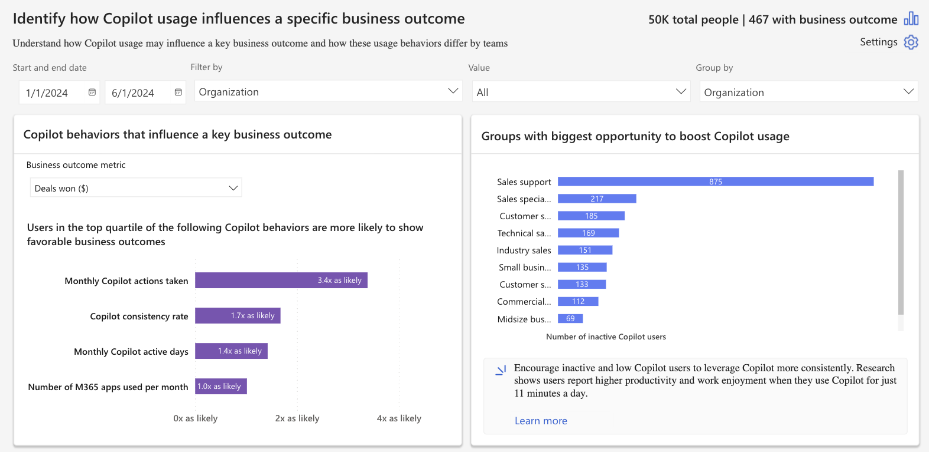
Copilot Business Impact Report in Viva Insights
Value measurement through…
Impact on business outcomes
Business value
Notes:
We can take this one step further to understand specifically which Copilot behaviors correlate most with business success.
For example, on this page we see that users in the top quartile of monthly Copilot actions are more likely to show favorable business outcomes – here, they are 3.4x more likely to be in the top in terms of deals won (you can define a successful metric yourself once uploaded)
So essentially, what this tells us is that our top salespeople in terms of deals won are also much more likely to be among the top users of Copilot in terms of actions taken
We also see they are more consistent in their activity and are active more days in Copilot. But the biggest difference is that total actions taken.
We can also see on the right the number of inactive Copilot users by group.
Having this information tells us where we should be targeting our enablement efforts – here, our sales support team – but also HOW we should be targeting them. From this data, we’re seeing that encouraging usage in terms of getting people to use Copilot more frequently is our best path to emulating the success of our top performers.
This is kind of similar to what we were looking at a few slides ago with the super usage report, but instead of looking at the habits of top Copilot users, this is actually looking at the habits of your top performers.
When you’re looking to show the value of Copilot, being able to make connections like this – our top performers are also over 3x as likely to be top Copilot users – is a really powerful argument for the value of Copilot and how it impacts business performance.

Slide 39
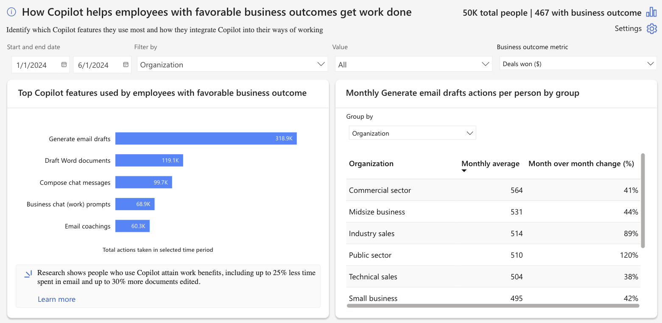
Copilot Business Impact Report in Viva Insights
Value measurement through…
Impact on business outcomes
Business value
Notes:
This next chart takes us one click further to understand what are our top performers actually doing with Copilot.
This takes us beyond just total actions to see which features are they utilizing most. Here, we can see that they are using the “generate email” feature by far the most; given that this data represents a sales org, it makes sense to see our top salespeople are taking advantage of the ability to draft higher quality emails to potential customers, faster.
Knowing HOW our top performers are using Copilot gives us further guidance on how we can better enable under-performing teams. We can use their habits as best practices to drive performance among everyone else.
On the right, we can then look at this top action by different teams so we can see how much each team is utilizing this feature – again, showing us where we should be targeting our enablement efforts.

Slide 40
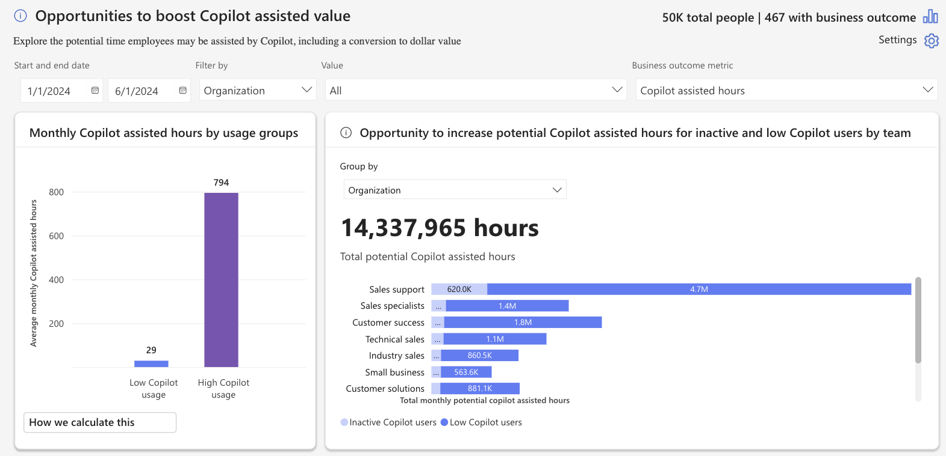
Copilot Business Impact Report in Viva Insights
Value measurement through…
Impact on business outcomes
Business value
Notes:
The first two pages explored the connection between Copilot usage and business performance. This chart is a little different because it is really focused on the UNREALIZED potential of Copilot.
On the left we can see the average Copilot assisted hours for our high usage groups compared to low usage groups. This is similar to what we looked at in the super usage report. Not surprising that there’s a huge difference here!
But on the right, it takes this a step further to look at the inactive (no usage) and low Copilot users by group to calculate how much Copilot COULD be helping if these inactive and low users were converted to high users.
You also have the option to display this in terms of dollar value if that resonates more than assisted hours.
This can be an incredibly powerful way to look at the ROI equation – not just how much value are we getting from Copilot, but how much value are we leaving on the table?

Slide 41



Value & ROI Measurement: Recap
Building on the foundations of employee value, business value is realised when personal productivity is combined with business process transformation
Individual
Functional
Business
How well is the workforce taking to the new technology?
What is the impact of Copilot on process and productivity?
What’s Copilot impact on the bottom line?
Employee Value
Enhanced efficiency
Capacity to create & collaborate
Improved employee experience
Increased adoption
Change in behavior / process
Impact on a business outcome
Business Value
Accelerated revenue growth
Cost optimization & avoidance
Faster time-to-value
Super Usage report
Super Usage report
Copilot Studio Agent report
Copilot Business Impact Report
Notes:
So just to recap, when we’re looking at measuring value, it’s important to look at value across all three of these levels. And this is a quick refresher on the reports I just highlighted to demonstrate each of these.
In doing so, we’re able to combine both employee value with process value to really measure overall business value.

Slide 42
Agenda
Value is conveyed through storytelling, not data
Purpose of demonstrating the value of Copilot
Types of value messaging & metrics
Value & ROI measurement: Illustration
Custom Super Usage report
Copilot Studio Agent report
Copilot Business Impact report
Capturing value & ROI: Wrap Up
Q&A, Closing

Slide 43
Capturing value & ROI: Wrap Up
Track adoption of solution
Collect feedback to validate and refine solution
Monitor success metric trends over time
Use tools like Copilot Analytics to track:
  Active users
  Frequency
  Usage over time
  Feature adoption
Gather user feedback through:
Surveys (e.g., Viva Glint/Pulse)
Interviews or focus groups
Product ratings
Telemetry
Measure operational KPIs and business outcomes at regular intervals
Compare against baseline or comparison groups to highlight improvement and causal impact of the AI solution.
Adoption Value
Experience Value
Productivity Value
Process Value
Business Outcome Value
Leading Indicators Lagging Indicators
4. Calculate realized ROI
Compare benefits (changes in operational KPIs and business outcomes) to actual costs to compute ROI and payback time
Notes:
To close, we’ll take one final look at the overall process for measuring value and ROI.
As Ben introduced earlier, we move from measuring leading indicators like adoption metrics toward lagging indicators that may not be as immediately apparent – business outcomes and operational KPIs.
The important thing to remember here is that this not a one-and-done, but something that you should continually revisit and re-evaluate.

Slide 44
Agenda
Value is conveyed through storytelling, not data
Purpose of demonstrating the value of Copilot
Types of value messaging & metrics
Value & ROI measurement: Illustration
Custom Super Usage report
Copilot Studio Agent report
Copilot Business Impact report
Capturing value & ROI: Wrap Up
Q&A, Closing

Slide 45
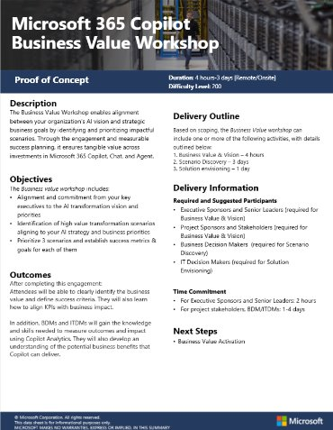
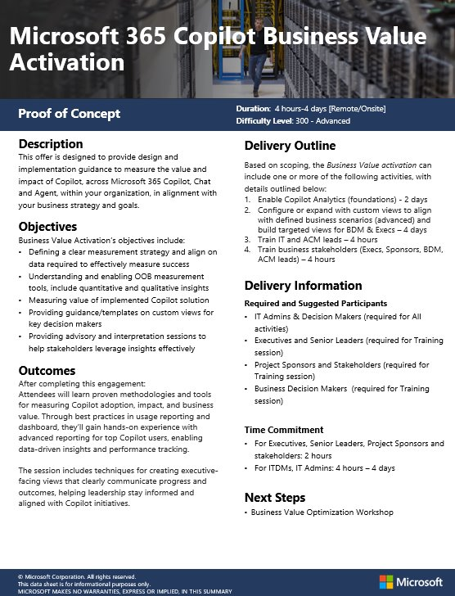
Looking for more? Business Value Unified Offers
Description
Create alignment between your organization’s AI vision and strategic goals, and prioritize high value use cases that will drive measurable impact with your Copilot investment.
Guidance to measure Copilot’s value and impact, aligned with your business goals.
Objectives
Executive alignment on AI Strategy
Identify high value AI transformation scenarios
Establish success metrics for 3 prioritized scenarios
Set a clear measurement strategy.
Measure Copilot’s value with built in dashboards and custom views .
Advise decision makers on interpreting insights.
Outcomes
Identify AI Business Value objectives unique to your business
Define success criteria, align KPIs with AI influenced Business impact
Develop plan to measure impact with Copilot Analytics
Learn how to measure Copilot adoption and impact.
Get hands-on with advanced reporting.
Build executive views to show progress.
Notes:
If you liked some of the ideas presented here , and are interested in taking this methodology and applying directly at your organization, please reach out to your account team . If you’re a Microsoft Unified customer we currently have two offerings aligned to driving Copilot BV, and the concepts we discussed today are foundational to the Business Value Activation offering in particular.
Turn Ambition Into Action:
This isn’t just a theoretical exercise. The workshop provides a structured, hands-on approach to connect your organization’s ambitions with practical, actionable steps. You’ll walk away with a clear roadmap for value creation and measurement, tailored to your unique business needs.

Slide 46
Review the Copilot Customer Hub sessions
Driving business value with Copilot
Defining business value for your organization
Follow-Along: Measuring impact with Copilot Analytics
Maximizing business value & ROI
📅 Thursday, October 2, 2025
🕑8 AM PST
🔗Register now
📅 Thursday, October 9, 2025
🕑8 AM PST
🔗Register now
📅 Thursday, September 25, 2025
🕑8 AM PST
🔗Register now
https://aka.ms/CustomerHubSessions​
Notes:
This was the third session of our three-part Business Value series. On-demand recording and deck will all be posted on our Customer Hub website.

Slide 47
Join our upcoming Copilot Customer Hub sessions
Microsoft 365 Copilot Chat for All Users
Realize value with Microsoft 365 Copilot Chat for all
Secure AI with Microsoft 365 Copilot Chat
Unlock the power: Navigating Microsoft 365 Copilot Chat
Maximize your Microsoft 365 Copilot Chat experience
📅 Tuesday, October 14, 2025
🕑8 AM PST
🔗Register now
📅 Thursday, October 16, 2025
🕑8 AM PST
🔗Register now
📅 Tuesday, October 21, 2025
🕑8 AM PST
🔗Register now
📅 Thursday, October 23, 2025
🕑8 AM PST
🔗Register now
AI Agents
Agents in an hour
Agents governance
Deep reasoning agents in action
📅 Wednesday, October 22, 2025
🕑8 AM PST - 🔗Register now
📅 Wednesday, November 5, 2025
🕑8 AM PST - 🔗Register now
📅 Wednesday, October 8, 2025
🕑8 AM PST - 🔗Register now
https://aka.ms/CustomerHubSessions​
Notes:
Upcoming Copilot sessions – Feel free to register on Customer Hub website

Slide 48

Unlock the full potential of Copilot with exclusive programs and expert support
Customized support and expert-led services to transform the way you work with AI through
Expert guidance for technical and deployment
assistance to ensure a smooth rollout from
Find trusted Partners to help with Microsoft 365 Copilot solution, integration & innovation at the
Microsoft Unified
Microsoft FastTrack
Microsoft 365 Copilot
Partner Directory
Connect with your Microsoft representative for more information and to discuss the best options for your organization.
Notes:
For further support, we’ve also included links here for our
Unified offerings to provide you with customized support
FastTrack for technical assistance
As well as our partner network

Slide 49
Explore key resources to accelerate your Copilot journey
Customer Hub
Discover upcoming sessions, updates and on-demand content
Customer Adoption
Access guides, success kits, and best practices
Microsoft Learn
Take training, get certified, deep-dive into Copilot and AI productivity topics
Copilot Scenario Library
Explore real-world use cases and inspiration
Notes:
And finally, some links to helpful resources to learn more about what we’ve talked about today as well as other Copilot and AI topics

Slide 50

Q&A
1
Please raise your hand and unmute when called on
2

Slide 52
Running the Super Usage report
You can entirely self-serve the Super Usage report in 2 steps:
Download user data from Viva Insights
    Run Custom Person Query in Analyst Workbench​
    Import results into Power BI​
Download the report template (.pbit) and instructions from Github:
aka.ms/decodingsuperusage
Note: Currently, only English is supported in this report
1
2
Notes:
Running the report is simple. All of the steps are listed on the Github page listed here
The user data needs to be downloaded from Viva Insights
That data is then loaded into the PBI template that can be accessed from the Github page

Slide 53

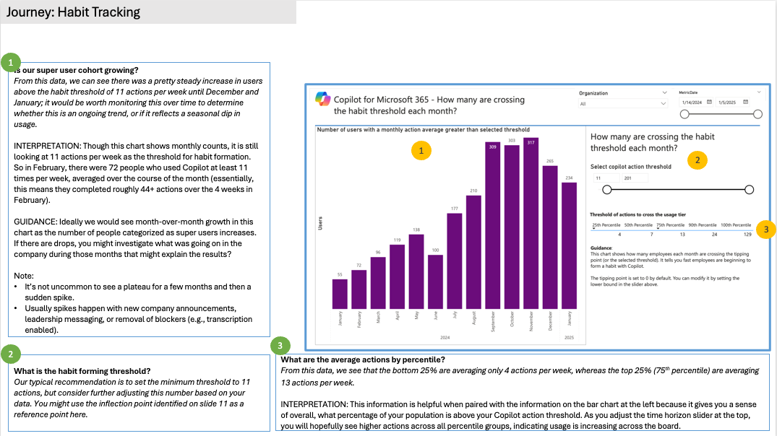
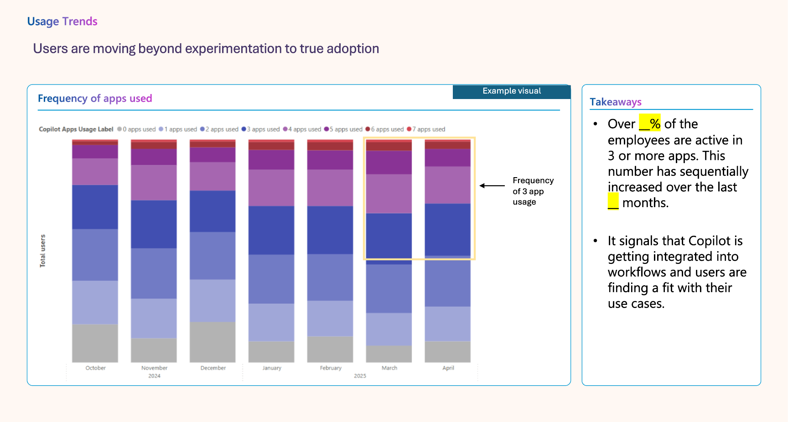
Additional resources
Super Usage Interpretation Guide
Super Usage Storyboard
This document walks users slide-by-slide through the Super Usage report and gives them detailed background to help interpret the data.
An additional section details common findings and trends, and provides recommended actions.
This document offers a starting point to craft a compelling narrative using insights from the Super Usage report.
Customers can update the template with visuals from their own report and tailor the text to reflect their own findings.
Both of these documents are available as part of the download package on Github
Notes:
Lastly, when you visit the Github page for this report, you’ll see two additional assets as part of the download package:
The interpretation guide is immensely helpful for understanding each page and metric in the report. More than just explaining the data, it also describes common patterns and trends, and provides suggestions for further analysis or action
The second asset is what we call the storyboard. It’s a PPT template where you can drop in screen shots from the report and customize a bit of text to quickly create a deck that is designed to help tell the story of your data. This is particularly helpful when you’re sharing the report with senior stakeholders.

