Slide 1
Customer Hub Session: Maximizing M365 Copilot Adoption
Context setting up front for each session and how all these sessions fit together and takeaway slide at the end highlighting other sessions
Date: January 28, 8AM PST (Americas)
Target Audience: BDM & Change Management
Duration: 1 hour
Objective: Provides adoption overview & best practices to inspire attendees and empower them with the knowledge and tools to drive Copilot adoption in their organization
LinkedIn Community Promotion & CTA to stay connected
Agenda Topic | Duration | Content Owner | Presenter | Notes
Adoption Planning Fundamentals: Getting started Proven best practices CTA: Resources to help you on your journey (Copilot Success Kit and Adoption Foundations course) | :25 | Cynthia/Daryl | Cynthia | Use and update Igniteadoption deck as the foundation
End-User Adoption Tools: Launch Day Kit User Engagement Toolkit, Prompt Gallery Prompt-A-Thon Champion Activation Viva Engage & Learning | :20 | Andrea, Anne, Alyson, Jamal | Andrea
Measurement | :5 | Cynthia/Daryl | Andrea | Romance Viva Engage and Viva Learning

Slide 2
Hello and welcome to the Modern Work Customer Hub!
We’ll get started at 2 minutes past the hour

Slide 3
Drive Adoption of Microsoft 365 Copilot Customer Hub
Maximize Organizational Adoption of Microsoft 365 Copilot

Slide 4
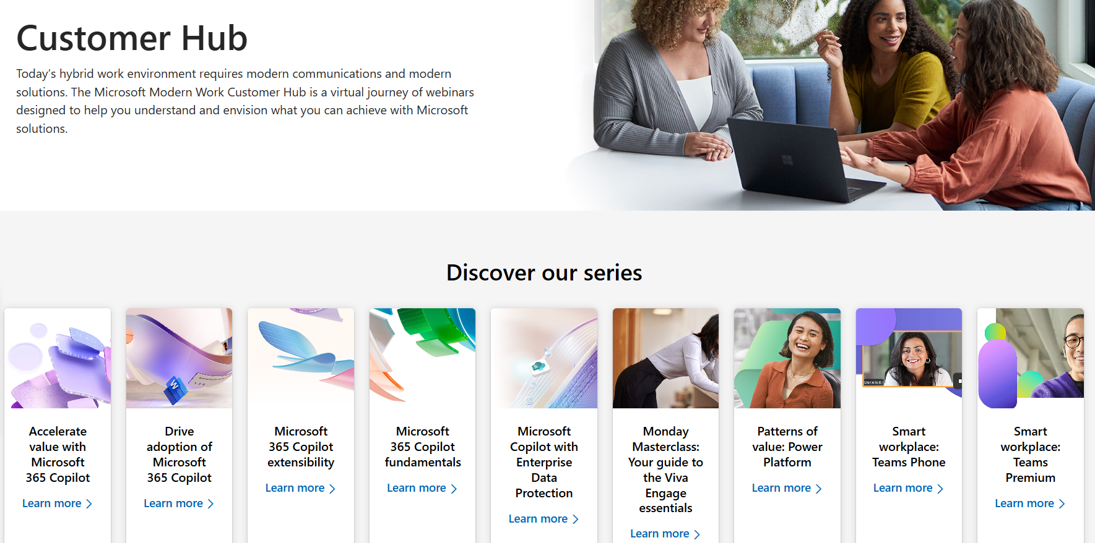
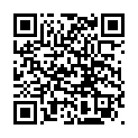
Visit Customer Hub Website for upcoming sessions, updates, and on demand contents!
Scan me!
https://aka.ms/CustomerHubSessions

Slide 5
Presentation time criteria: During and After
During the presentation
After the presentation
We will mute your microphone for the first part of today’s call
Raise your hand and we will call on you
Ask your questions via chat, we will get to all of them, live or after. Common questions will get addressed out loud
Open mic 🙌 Come off mute and ask away!

Slide 6
Copilot is the UI for AI
Copilot
Agents
Copilot Control System

Slide 7
Realizing the AI opportunity
Personal productivity
Business value
Individual efficiency
Time savings
Increase creativity
Revenue growth
Cost optimization
Employee experience

Slide 8
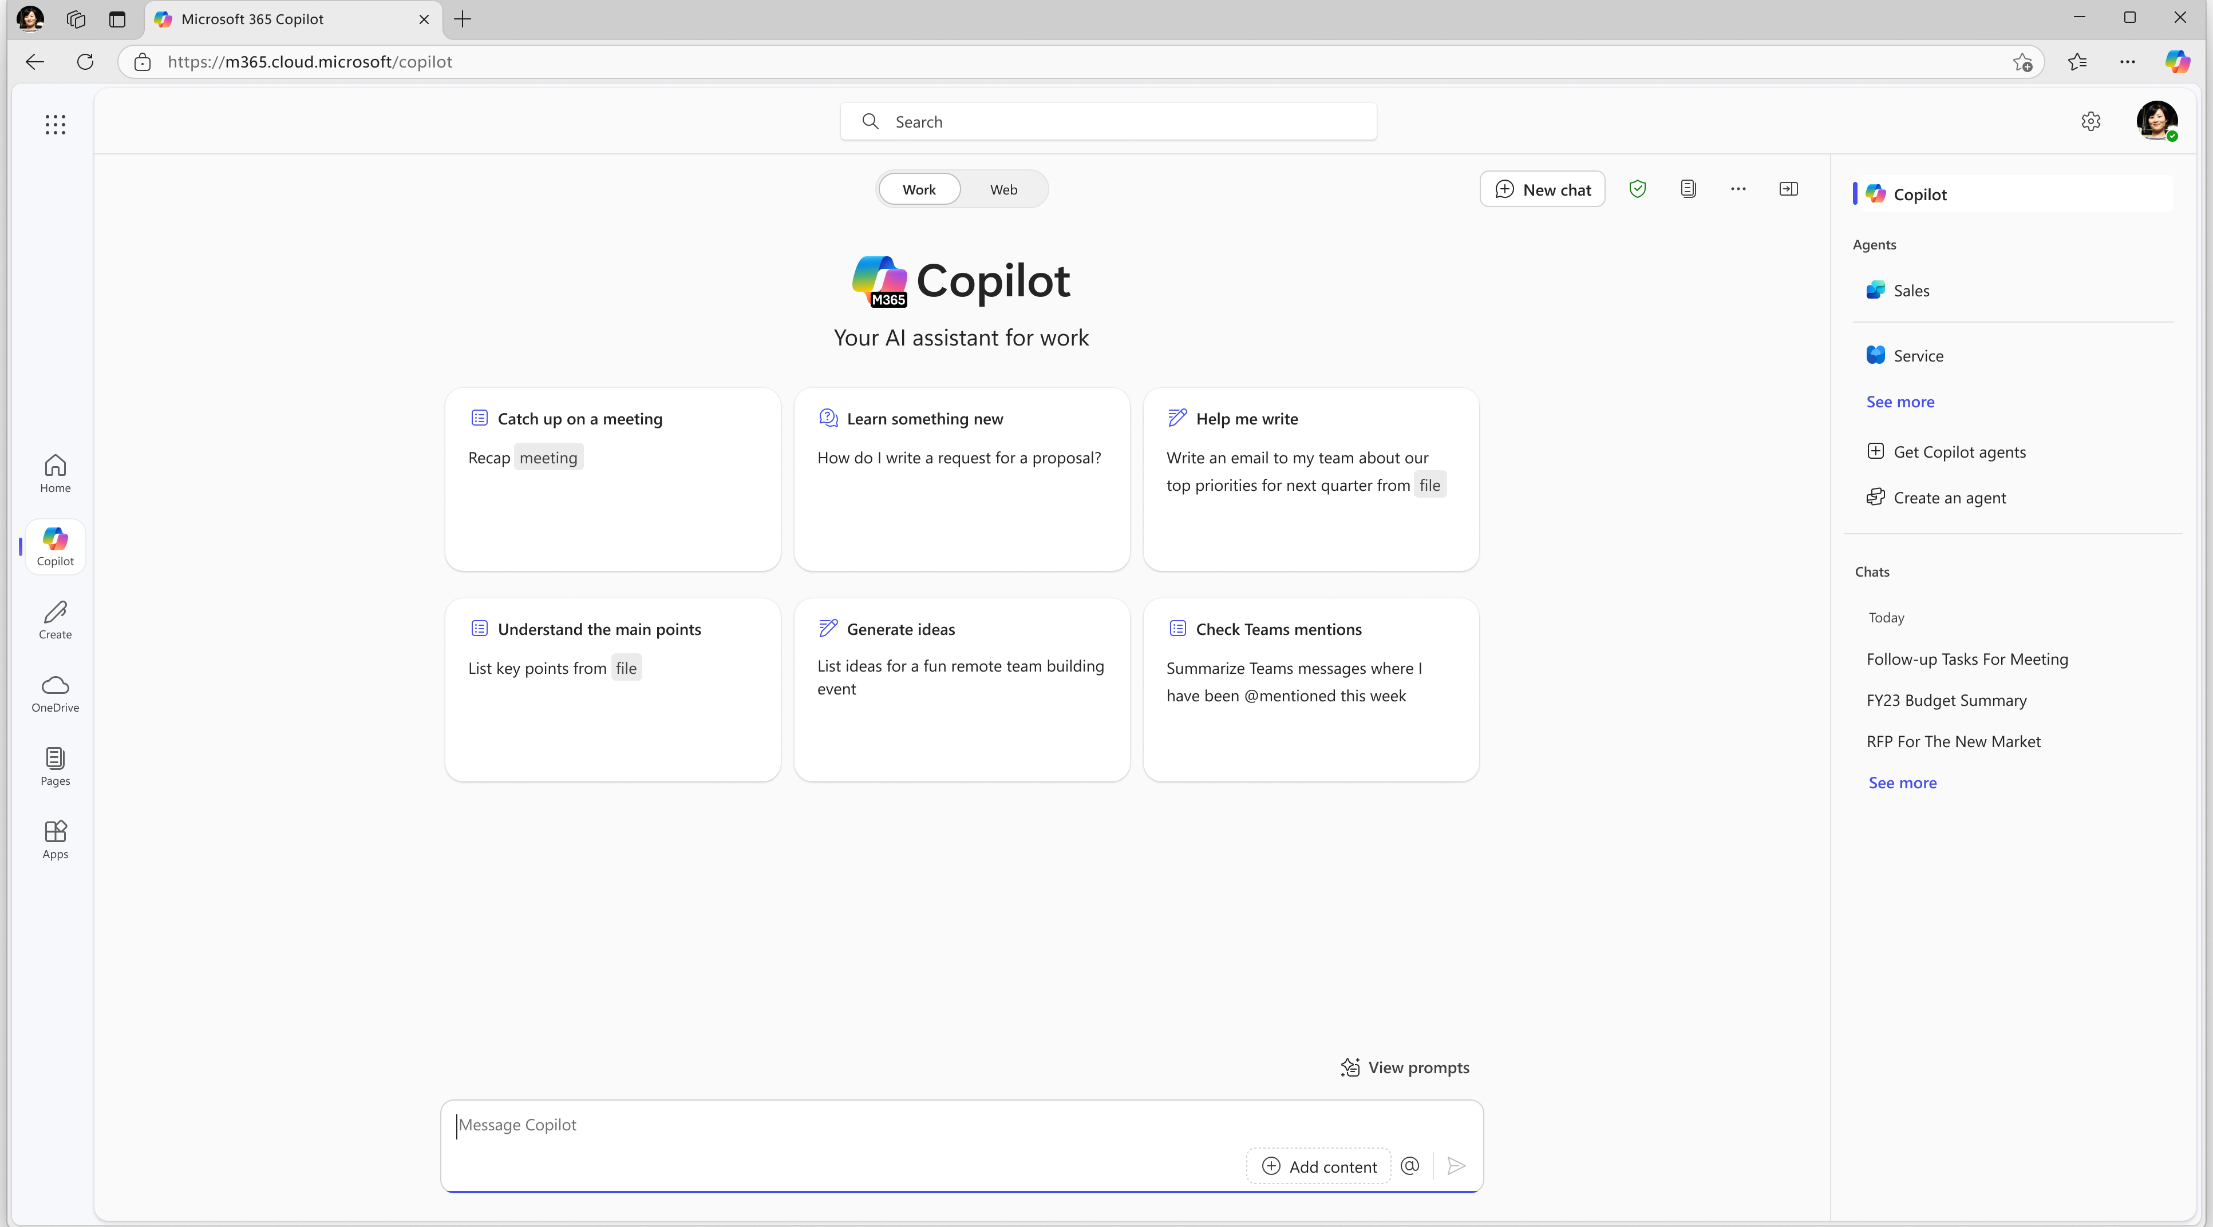
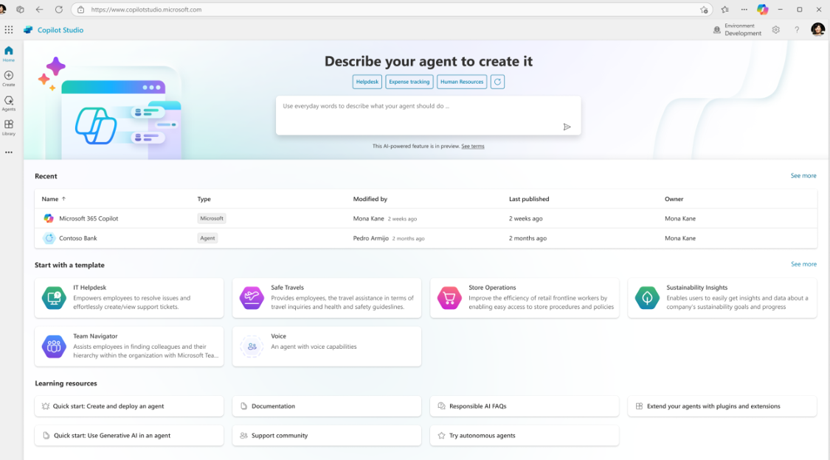
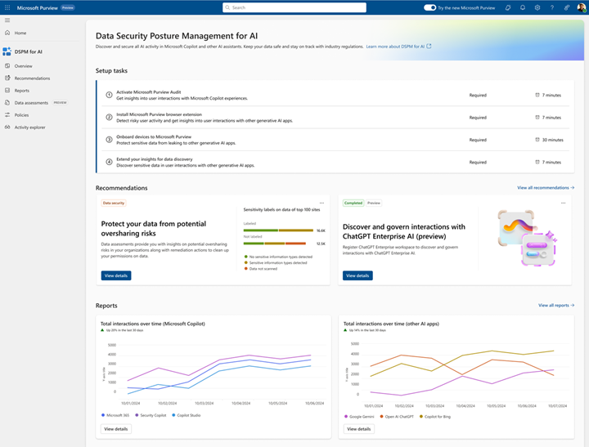
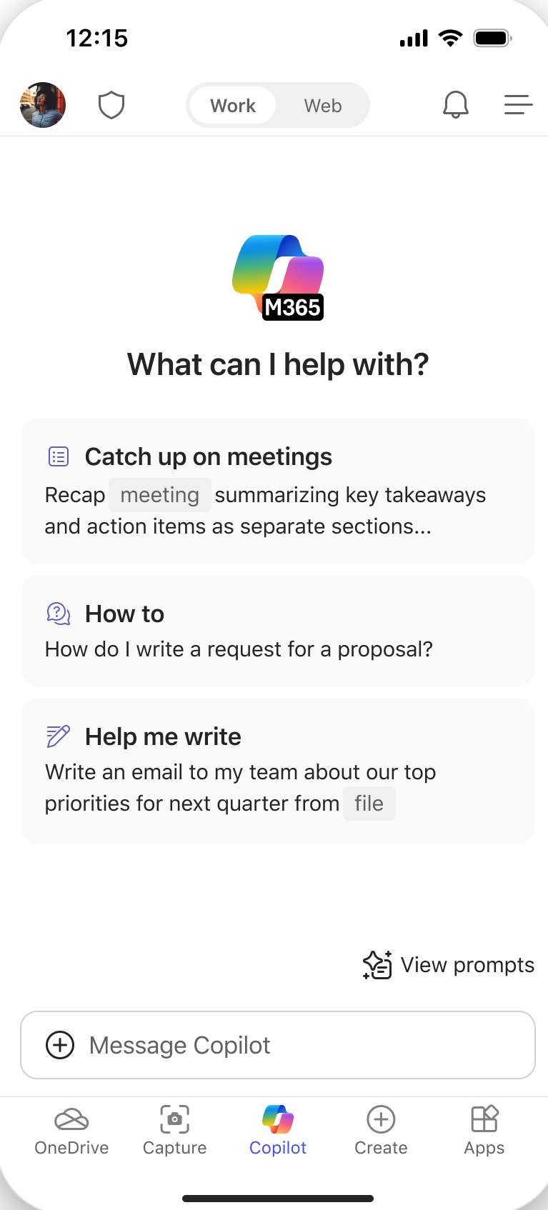
Introducing Microsoft 365 Copilot Chat
Chat
Agents
IT Controls
Free, secure AI chat –
powered by GPT 4o and web grounded
Integrated into the chat experience and paid for on a consumption basis
Enterprise Data Protection
and agent management

Slide 9
Microsoft 365 Copilot
Copilot Chat
Chat
Free, secure AI chat
Chat Work scope
Copilot in Microsoft 365 apps Teams, Outlook, Word, Excel, PowerPoint
Your personal AI assistant
Agents
Copilot Control System
Copilot Analytics

Slide 10
Scaling AI Transformation
Copilot Chat
M365 Copilot

Slide 11
Scaling AI Transformation
Copilot Chat
M365 Copilot

Slide 12
Scaling AI Transformation
Copilot Chat
M365 Copilot

Slide 13
Key barriers to usage
The Confidence Gap
The Knowledge Gap
The Skill Gap
37%
53%
46%
of the org believe they are able to realize the full potential of Copilot
of the org know what tasks to use Copilot for
of the org feel equipped to make the best use of Copilot
Source: MW + BA Marketing Copilot Experiment. Baseline survey deployed 7/1; n= 110

Slide 14
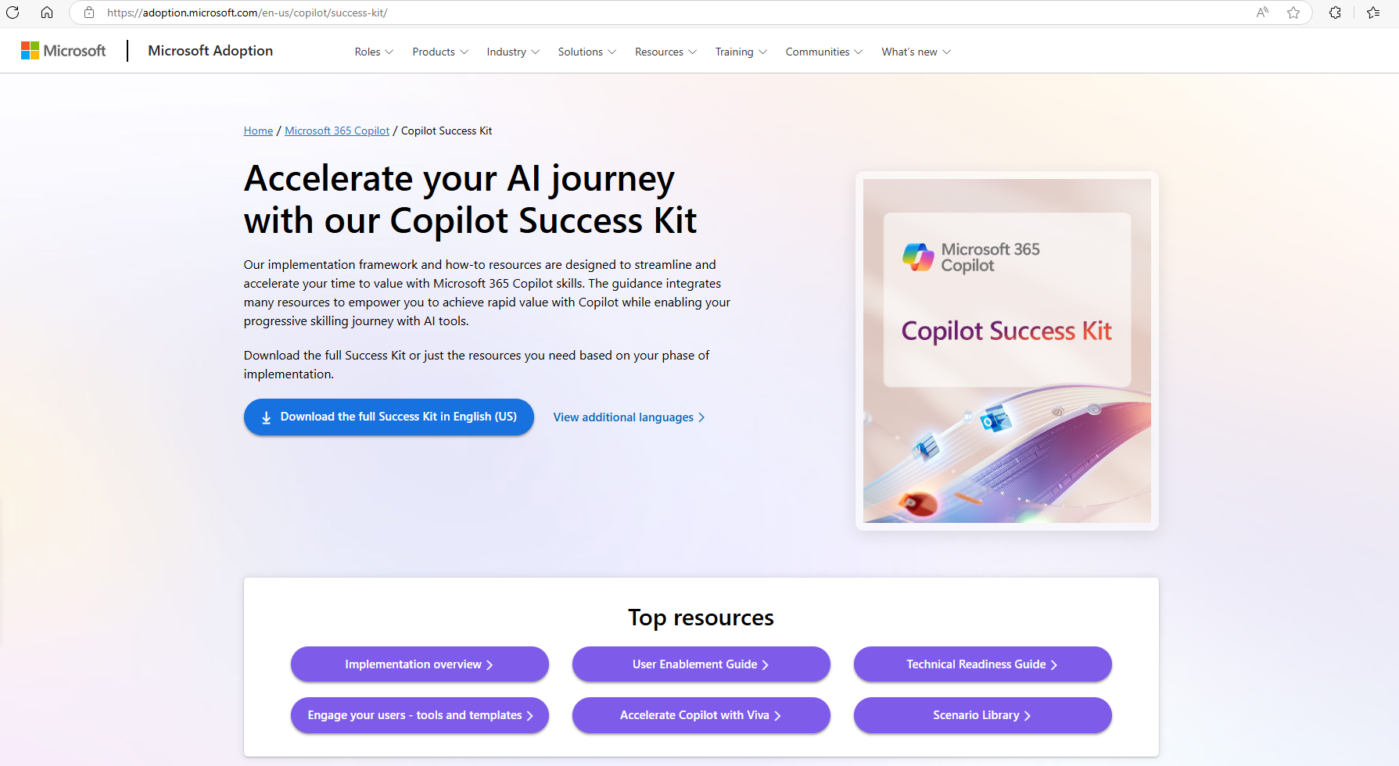

Slide 16
3 Steps to Copilot Adoption
1
2
3
Get ready
Drive adoption
Measure impact
Are your leaders engaged and employees ready?
Do you have a culture of learning and the right skills?
Can you measure business value and continuously improve?

Slide 17
3 Steps to Copilot Adoption
1
2
3
Get ready
Drive adoption
Measure impact

Slide 18
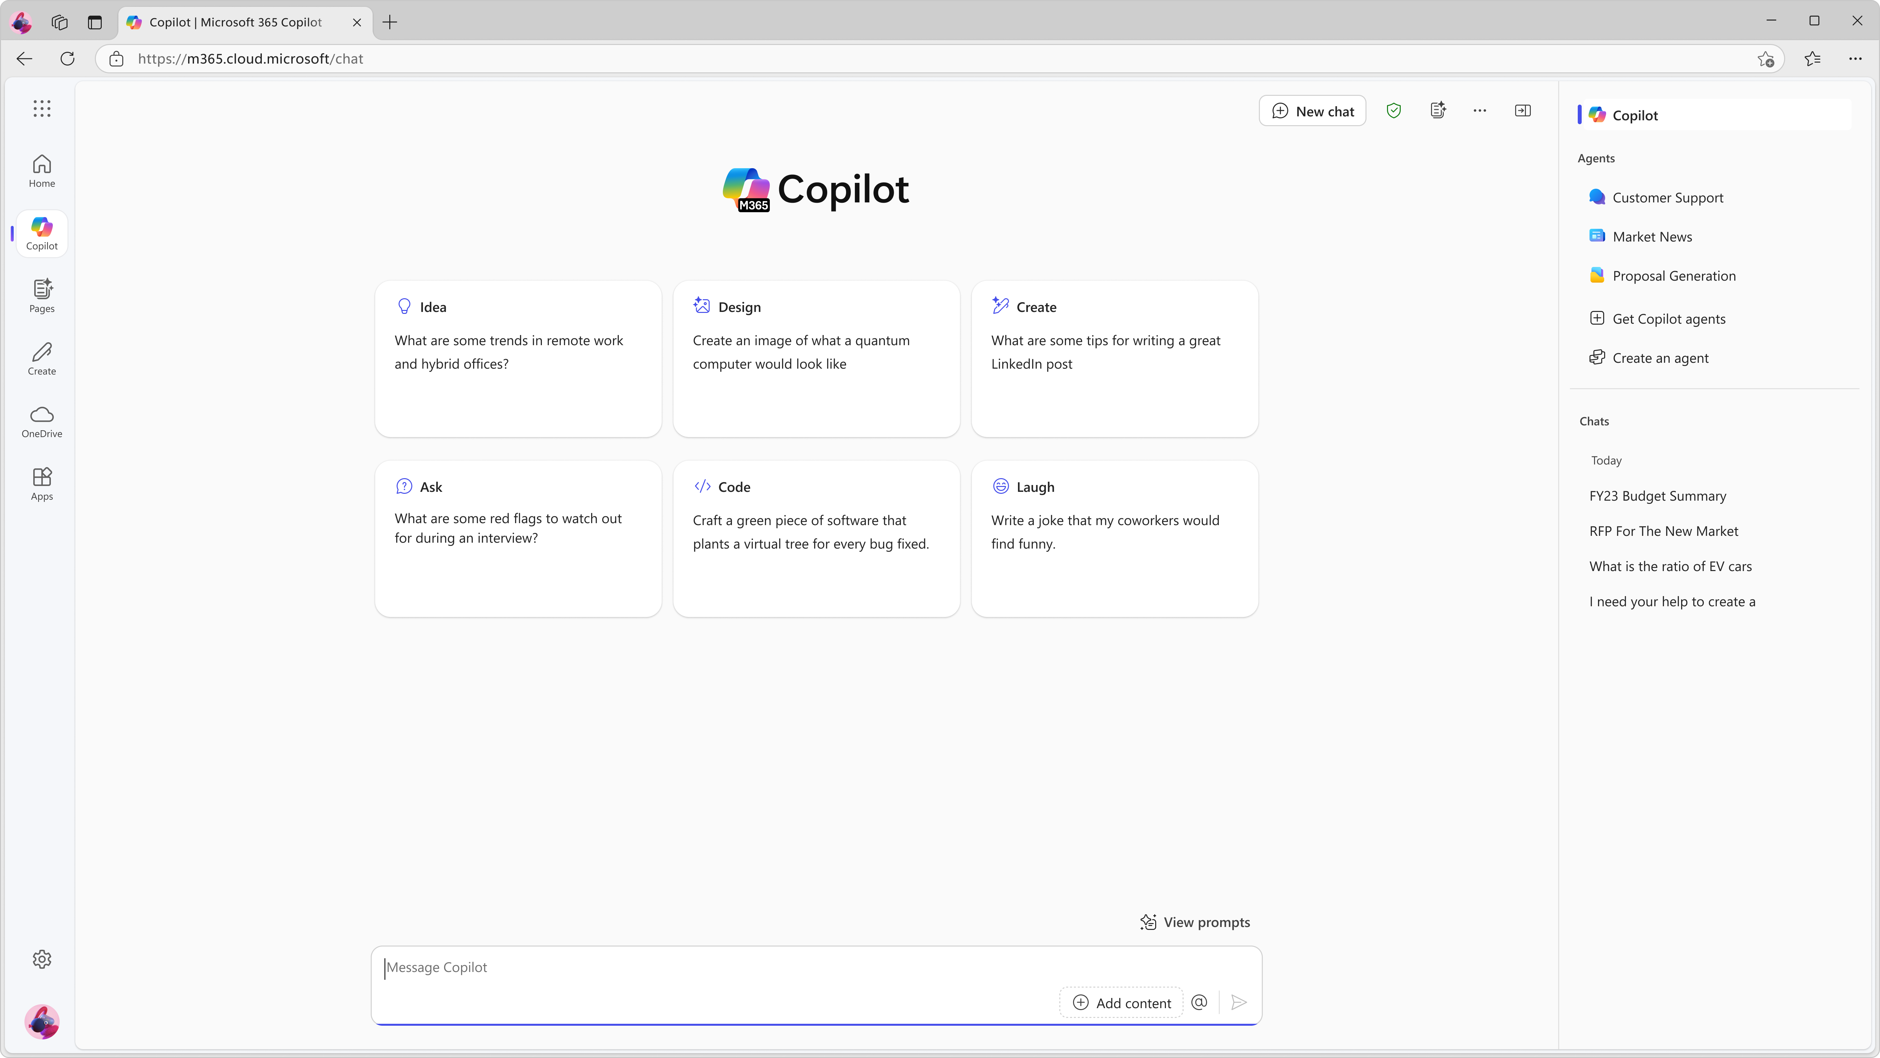
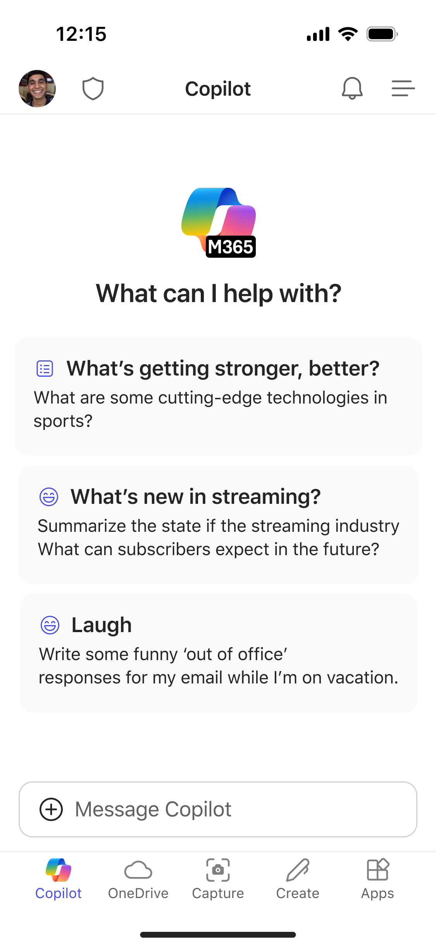
Free, secure AI Chat
Copilot is the UI for AI
Copilot Chat makes it easier than ever for every employee in your organization to interact with AI using a single chat experience with powerful capabilities, including:
Secure AI chat (web scope) powered by GPT-4o
File uploads
Code interpreter
Image generation
Copilot Pages

Slide 19
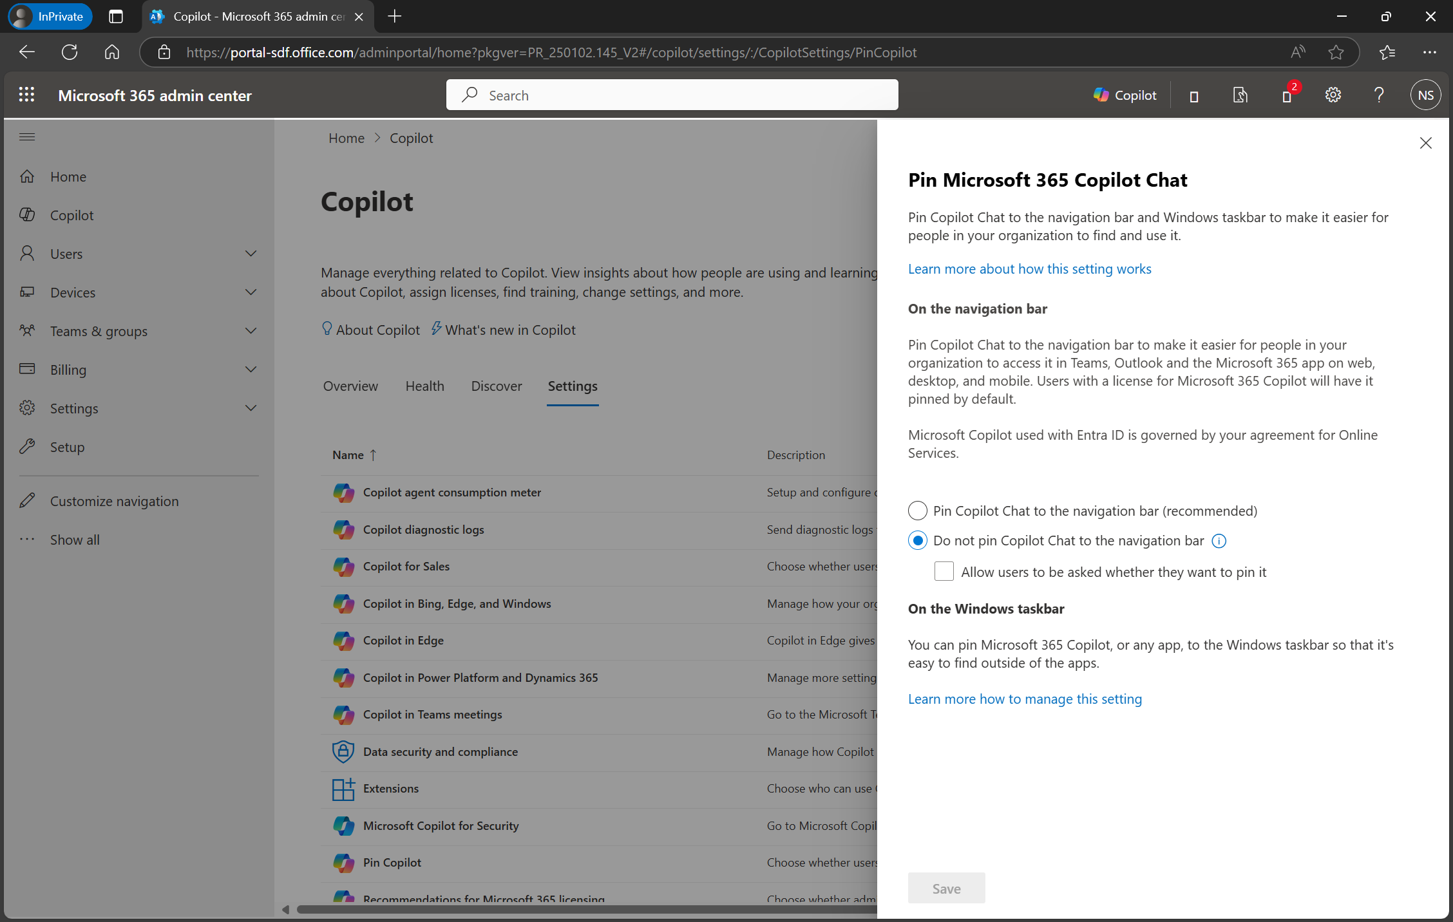
Provide access to your users
aka.ms/Copilot/ITControlsGuide
Pin Copilot Chat to the navigation bar
Provide access for users to create agents
Configure agent billing through capacity licenses or pay as you go (can use MACC)

Slide 20
Where do I start?
Sales
IT
Marketing
HR
Increase revenue
Finance
Optimize costs
Employee experience
Legal
Customer service

Slide 21
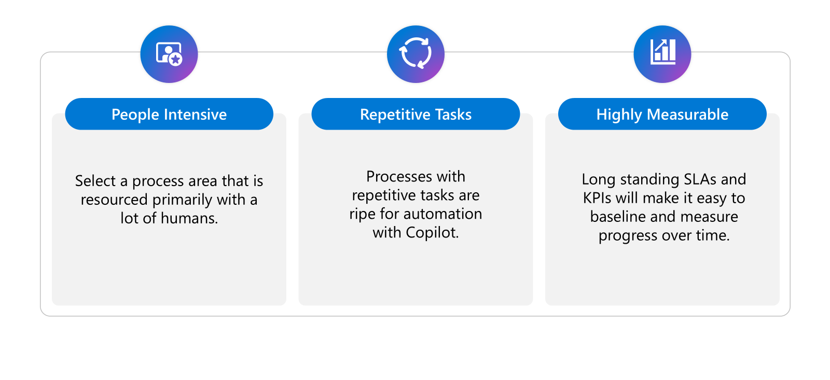
Tips for Selecting a Process Area

Slide 22
Key processes
Customer Service
Sales
Finance
Marketing
HR
Legal
IT
Self-help
Issue diagnosis
Lead generation
Negotiations & closing
Post-sale follow-up & upsell
Sales analysis & forecasting
Quote to cash
Record to report
Procure-to-pay
Demand generation
Content creation
Campaign execution
Personalization
Employee engagement
Recruiting
Compensation & benefits
Learning & development
Contracting
Risk management
Consultation
Advisory services
Software management& acquisition
Device management
Information security
Change management & user adoption

Slide 23
KPIs by function
Customer Service
Sales
Finance
Marketing
HR
Legal
IT
First Call Resolution (FCR) rate
Calls answered by agents
Average call time
Customer experience (CSAT)
Opportunities pursued
Deal size
Win rate/Close rate
Sales cycles length
Finance outsourcing spend
Cost per analysis request
Time to close
Day sales outstanding
Leads generated
Agency spend
Customer retention
Lead conversion rate
Revenue per lead generated
Employee onboarding time
Issue resolution time
Employee retention
Hiring costs per employee
Outside counsel spend
Cost per internal review
IT operation costs
IT issue/ticket resolution time
IT outsourcing costs
NSAT-User Satisfaction

Slide 24
Microsoft Commercial Sales
60,000+ sales professionals
200+ countries
Customer meetings
Updating CRM records
Sales team collaboration
Custom presentations and proposals

Slide 25
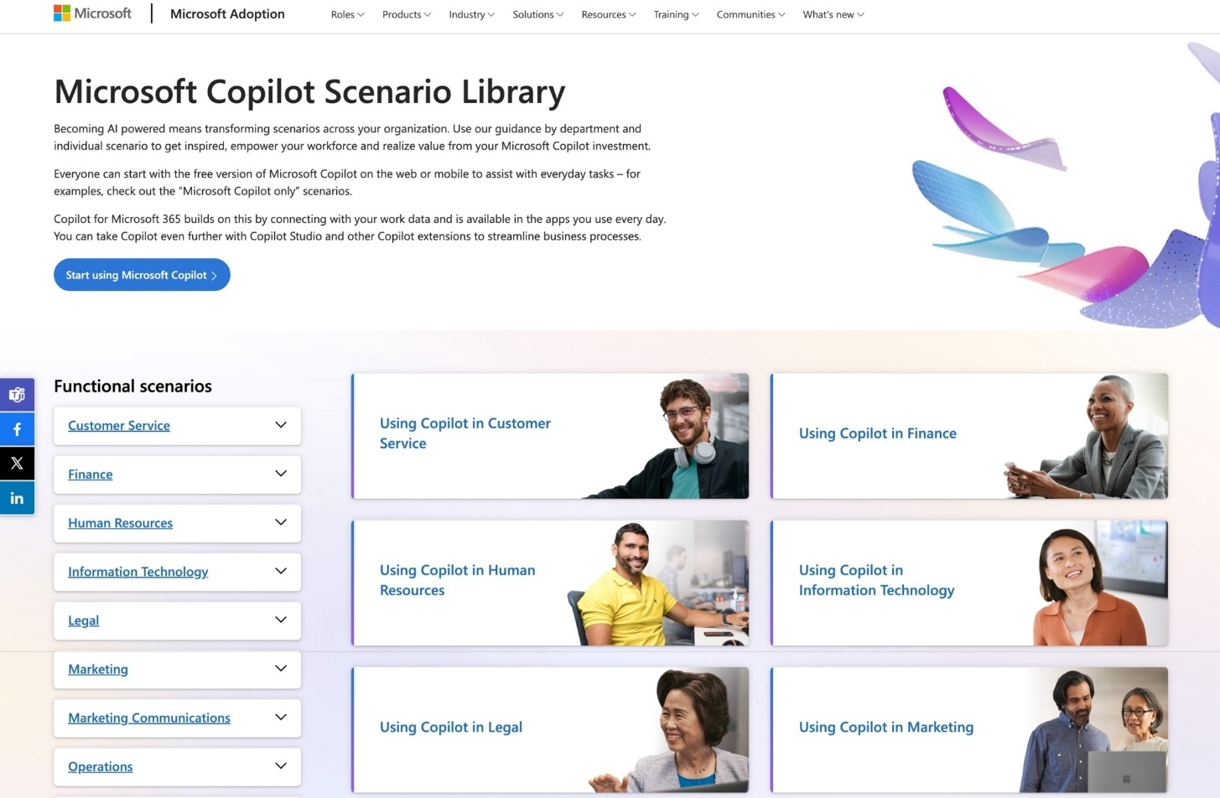
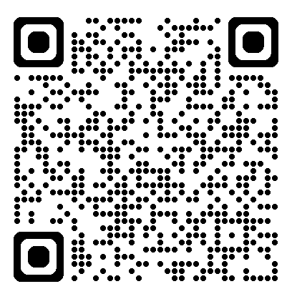
Copilot Scenario Library
LIVE DEMO
aka.ms/copilot/scenariolibrary

Slide 26
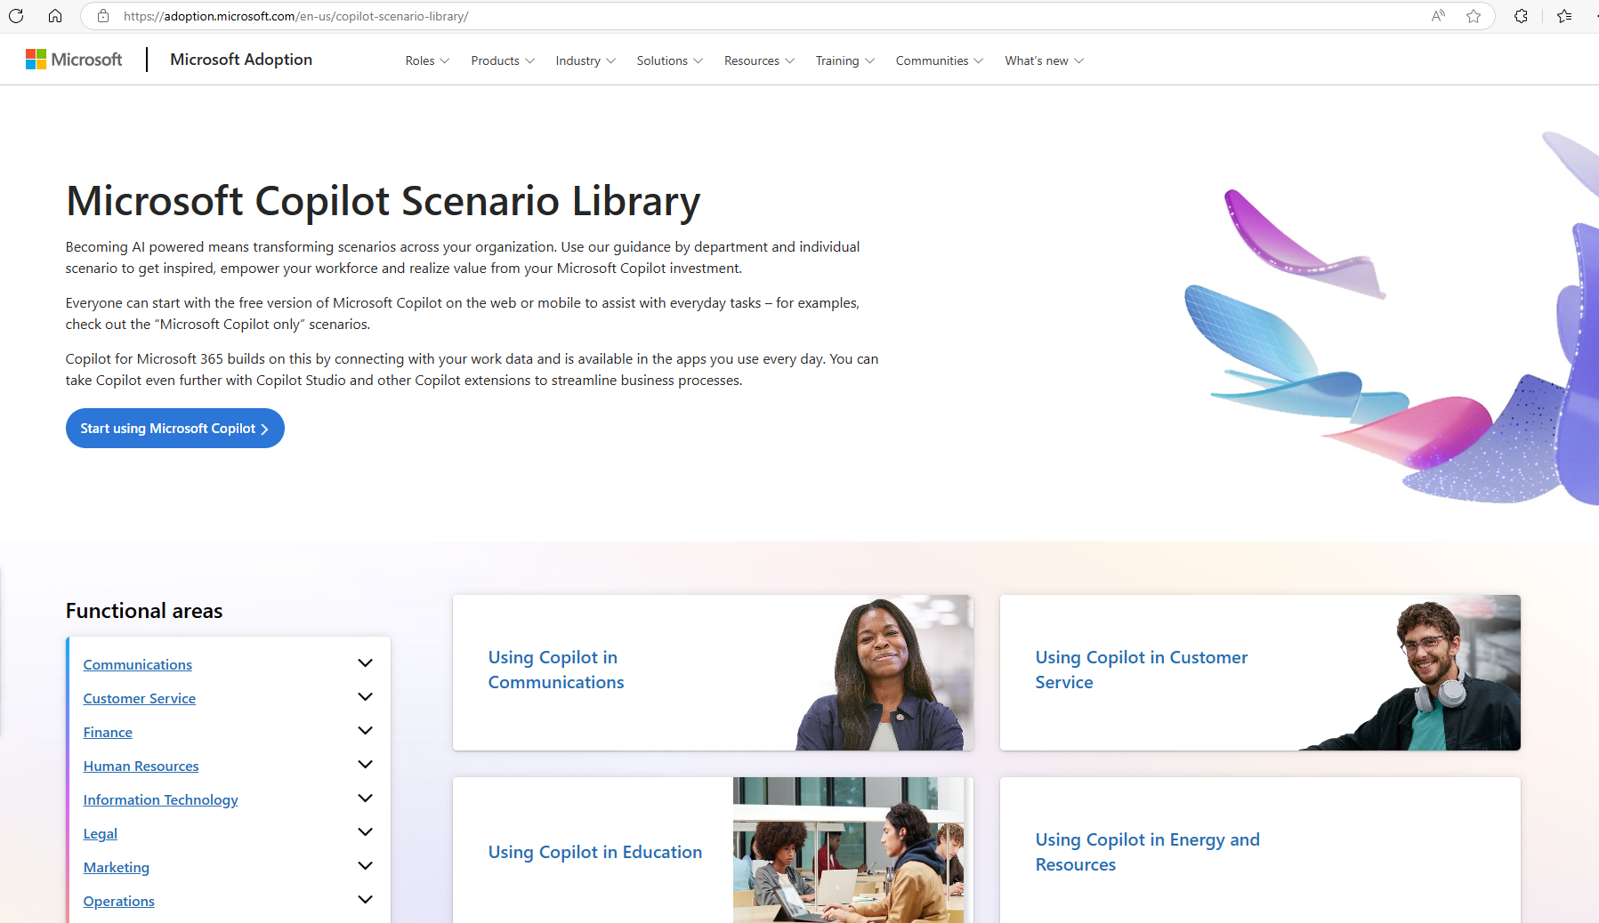

Slide 27
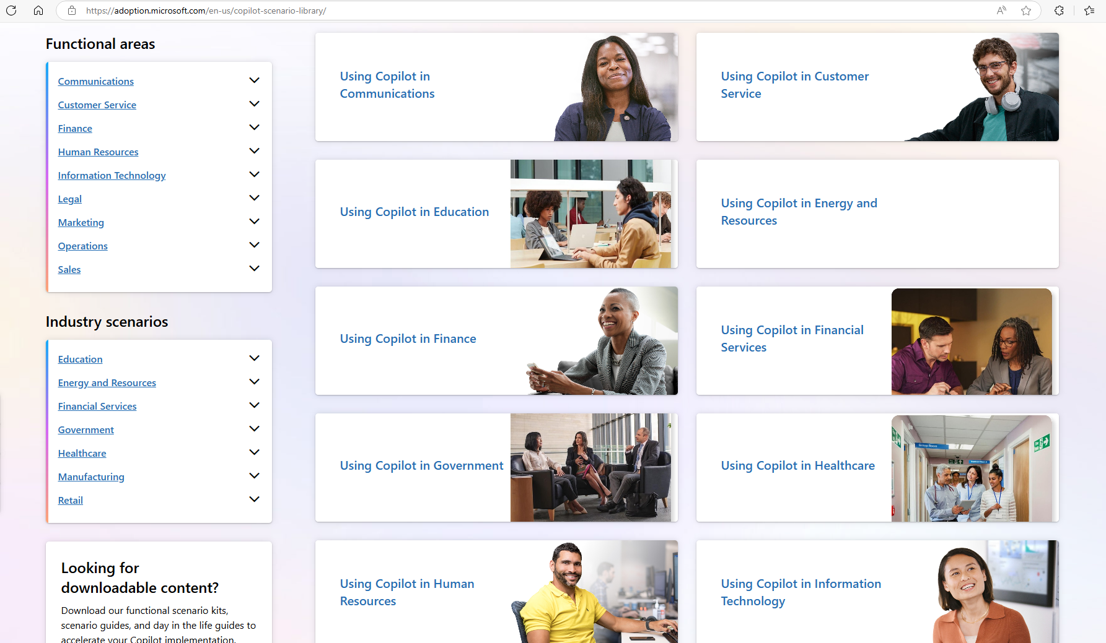

Slide 28
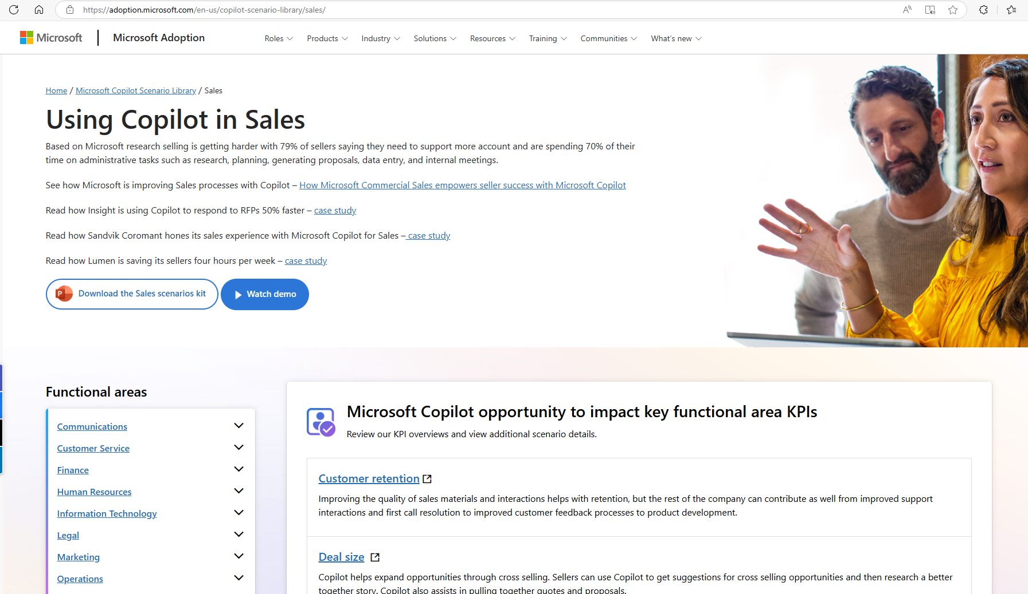

Slide 29
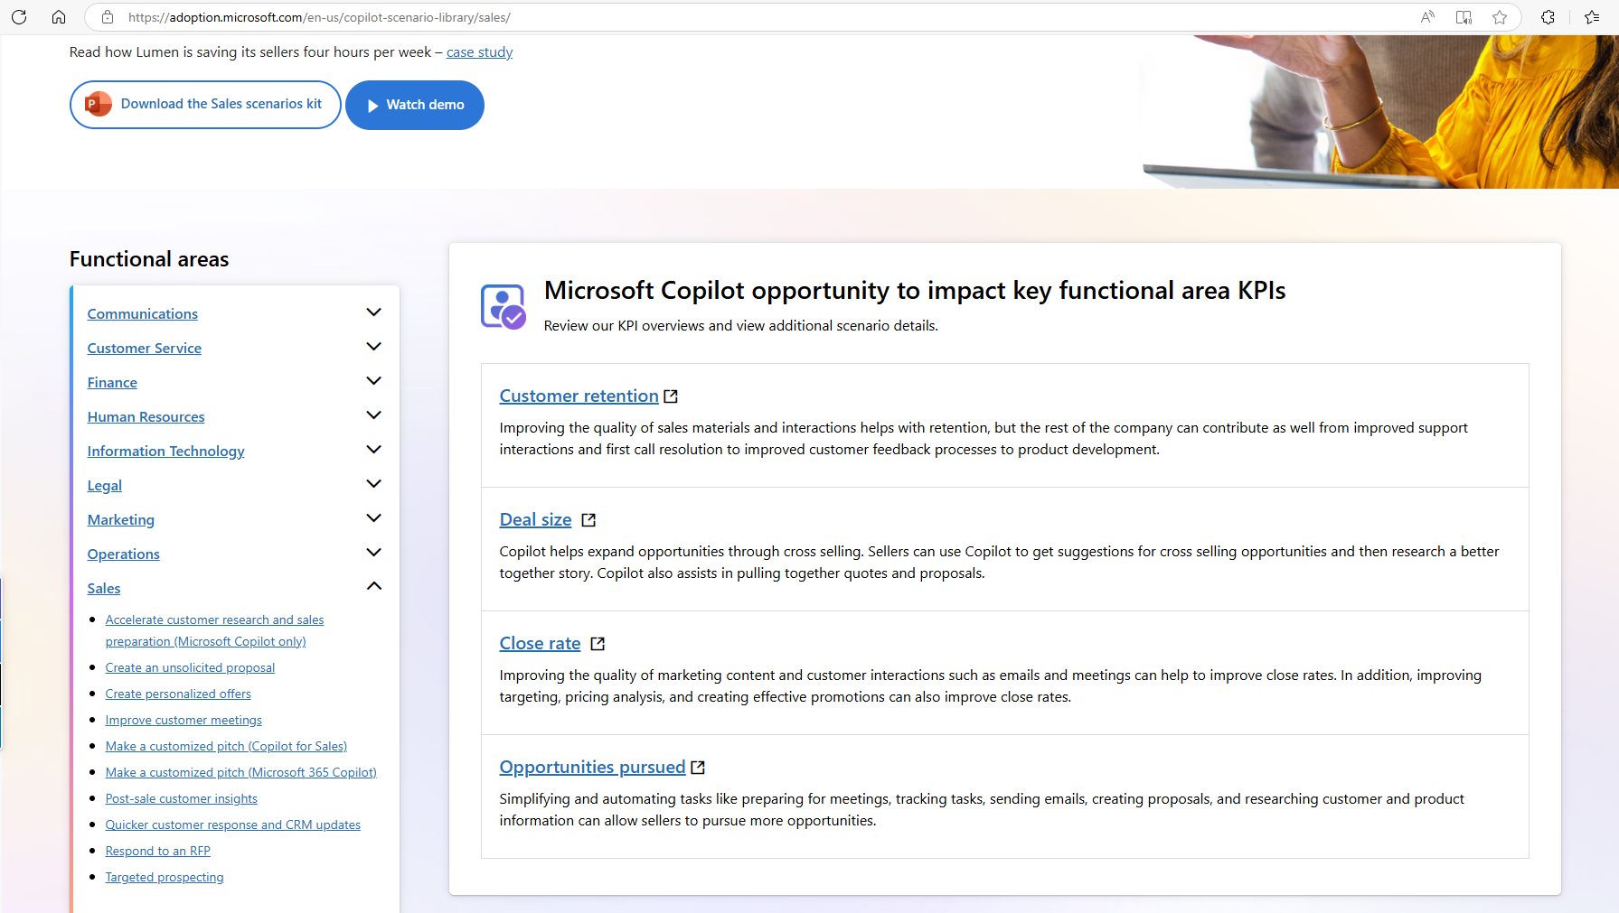

Slide 30
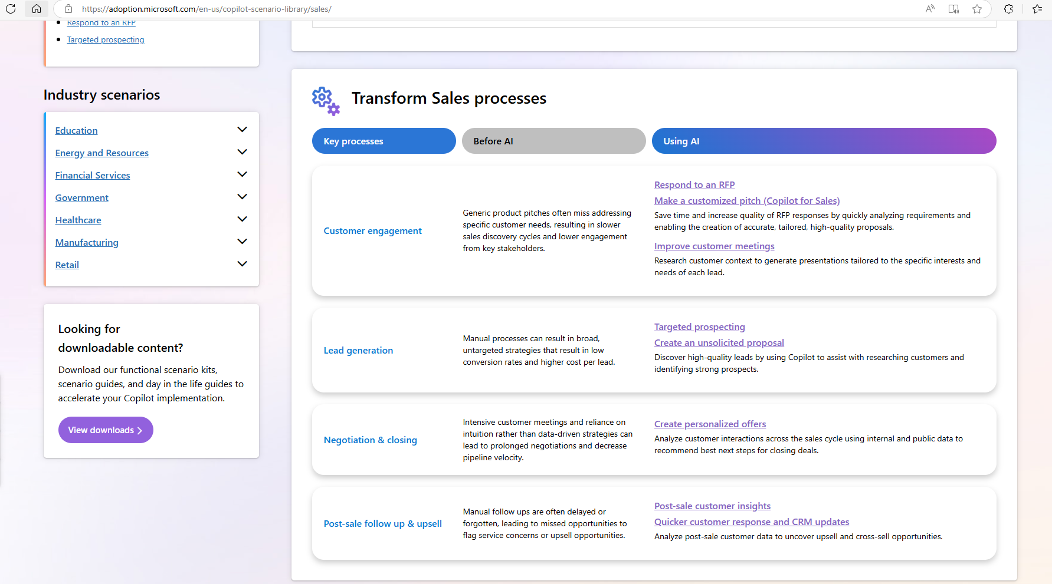

Slide 31
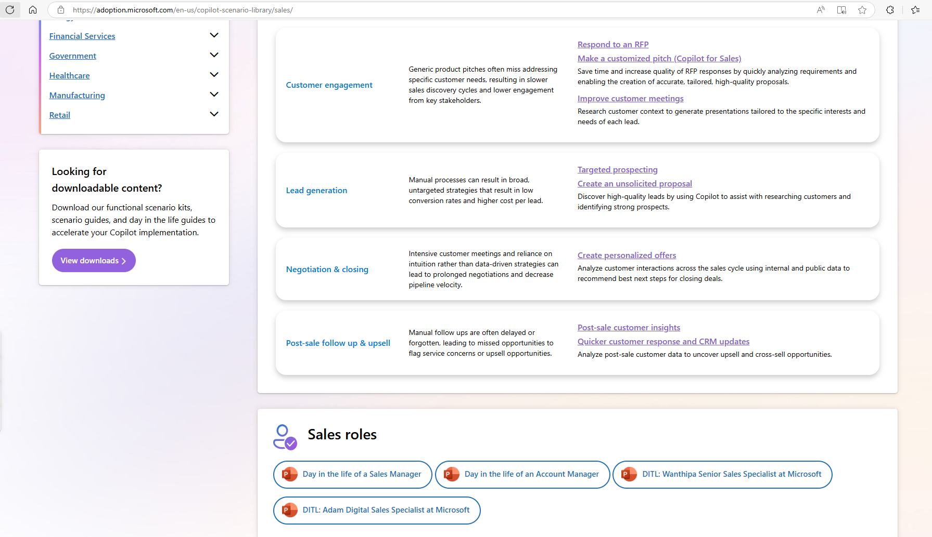

Slide 32
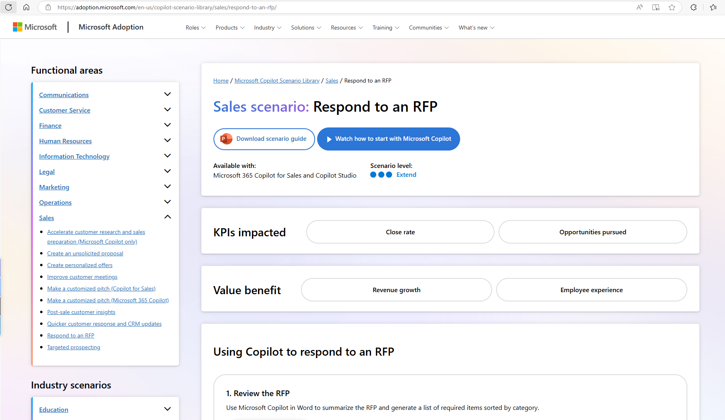

Slide 33
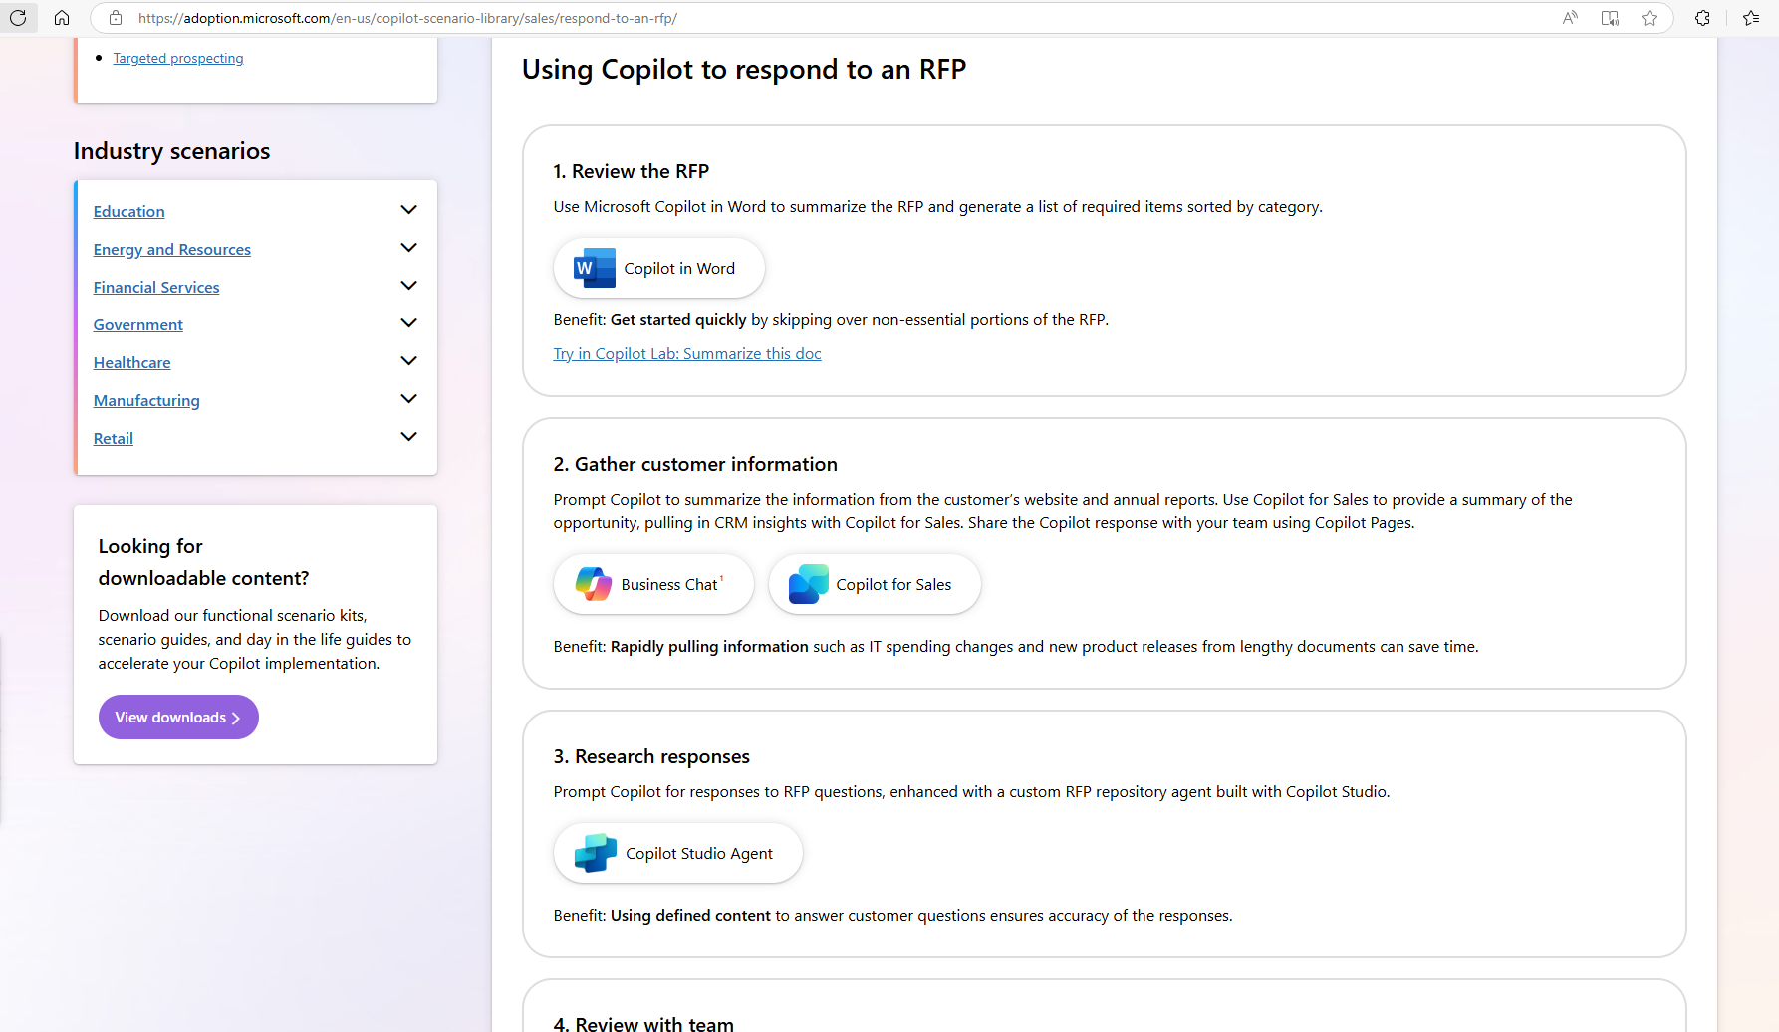

Slide 34
Sales | Respond to an RFP
LIVE DEMO
Available with:
Scenario level:
a
a
a
Microsoft 365 Copilot for Sales and Copilot Studio
Extend
KPIs impacted
Close rate
Opportunities pursued
Value benefit
Revenue growth
Employee Experience
1. Review the RFP
2. Gather customer information
3. Research responses
Use Microsoft Copilot in Word to summarize the RFP and generate a list of required items sorted by category
Prompt Copilot to summarize the information from the customer’s website and annual reports. Use Copilot for Sales to provide a summary of the opportunity, pulling in CRM insights with Copilot for Sales. Share the Copilot response with your team using Copilot Pages
Prompt Copilot for responses to RFP questions, enhanced with a custom RFP repository agent built with Copilot Studio
Copilot in Word
Business Chat¹
Copilot for Sales
Copilot Studio Agent³ + Connection to RFP repository
Benefit: Get started quickly by skipping over non-essential portions of the RFP
Try in Copilot Prompt Gallery: Summarize this doc
Benefit: Rapidly pulling information such as IT spending changes and new product releases from lengthy documents can save time
Benefit: Using defined content to answer customer questions ensures accuracy of the responses
6. Communicate response
5. Revise responses
4. Review with team
Prompt Copilot for Sales to draft an email to the customer with a summary the RFP response. Copilot for Sales includes relevant CRM details like product information in the email
Use Copilot in Word to revise the document to make it more compelling
Copilot in Teams generates a list of talking points, questions, and ideas during the meeting with your team
Copilot for Sales
Copilot in Word
Copilot in Teams
Benefit: Quickly create professional emails that are concise and more likely to be read and can lead to higher close rates
Benefit: Quickly make answers more readable to improve the quality of the RFP response
Try in Copilot Prompt Gallery: Improve this document
Benefit: Don’t miss any updates by asking Copilot for all the suggestions made during the meeting
Try in Copilot Prompt Gallery: Summarize meetings and videos
¹Access Copilot at copilot.microsoft.com or the Microsoft Copilot mobile app and set toggle to “Web”.
²Access Business Chat at copilot.microsoft.com, the Microsoft Copilot mobile app, or the Copilot app in Teams, and set toggle to “Work”.
³Copilot agents allow Microsoft 365 Copilot to access your company-specific apps. In the past this would have required an API call to get data from a system of record.
The content in this example scenario is for demonstration purposes only. You should evaluate how Copilot aligns with your organization’s business processes, regulatory requirements, and responsible AI principles.

Slide 35
Request for Proposal

Slide 36
Copilot impact on Microsoft Commercial Sales
9.4%
20%
5%
higher revenue per seller*
increase in deals closed among high users of Copilot*
increase in sales opportunities**
*Internal Microsoft sales team data based on 687 sellers of Microsoft 365 Copilot from Jan. – June 2024, as compared with sellers with low usage of Copilot. Regular usage of Copilot means sellers who use Copilot daily at least 50% of the time during the testing period.
**Internal Microsoft sales team data based on 24,000 sellers. Oct. 2023 – June 2024. As compared with sellers with low usage of Copilot. Regular usage of Copilot means sellers who use Copilot daily at least 50% of the time during the testing period.

Slide 37
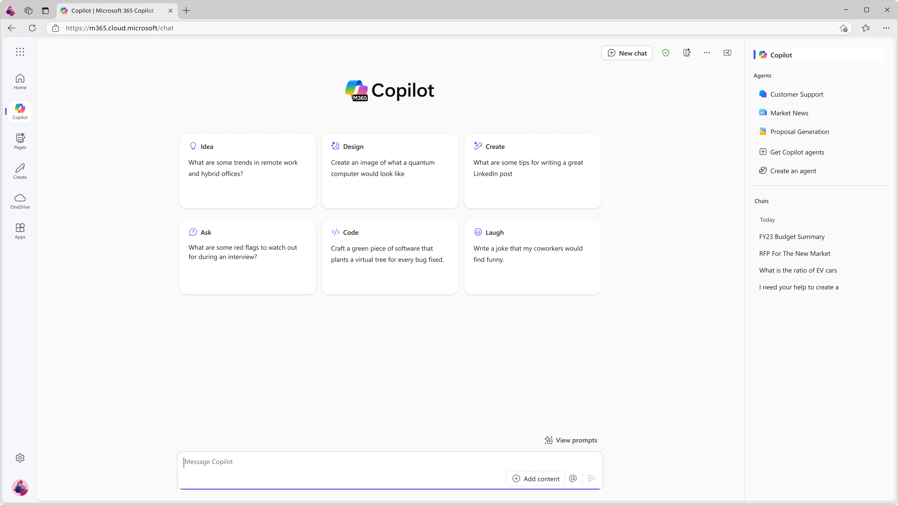
Every user can start with Copilot Chat
M365copilot.com

Slide 42
3 Steps to Copilot Adoption
1
2
3
Get ready
Drive adoption
Measure impact

Slide 43
Adoption Best Practices
Top-down communications
Peer network effects
Experimentation and learning
Source: MW + BA Marketing Copilot Experiment

Slide 44
Top-Down Communications
37%
Leadership signals are incredibly impactful
increase in Copilot usage after leadership comms were sent¹
¹Source: MW + BA Marketing Copilot Experiment. Leaders sent out comms every Monday throughout the 6-week experiment encouraging Copilot usage. At the end of the experiment, the researchers denoted a 37% statistically significant boost in usage on Tuesdays.

Slide 45
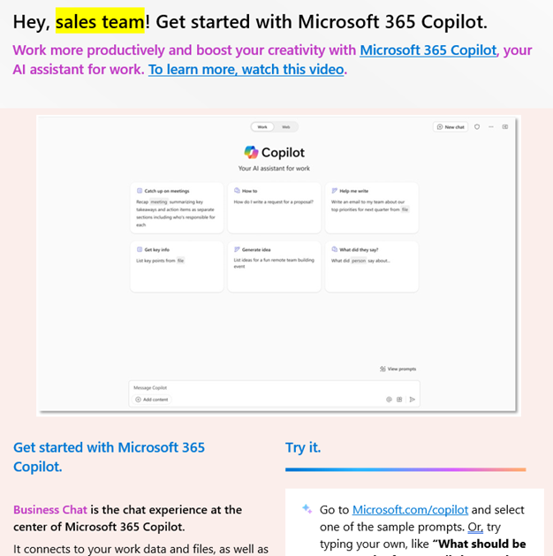
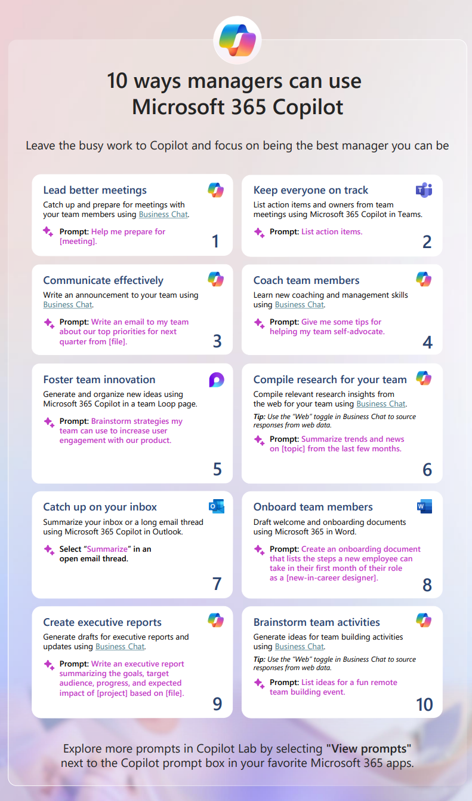
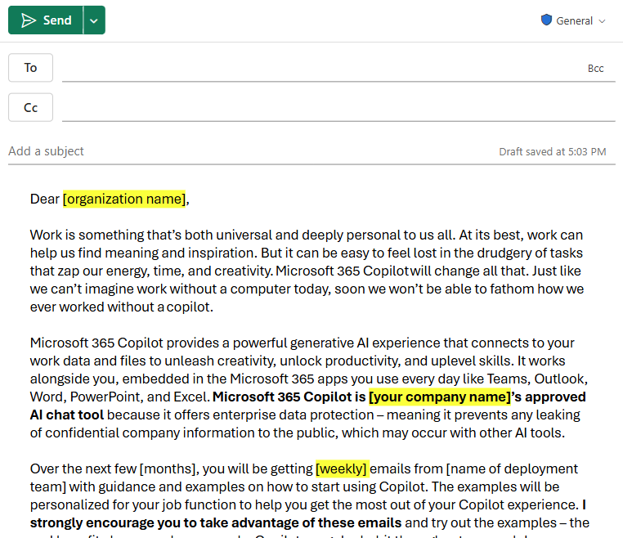
Importance of benefit communication
Getting users to embrace a new AI tool requires building trust, like sharing potential benefits and overcoming emotional barriers.
Inspire through leadership with a leadership keynote and exec comms
Download at aka.ms/Copilot/UserEngagementTools

Slide 46
Peer network effects
Power users are 4.5x more likely¹ to say that they help people learn about Copilot
Every adoption strategy should include a power user pathway
¹Source: MW + BA Marketing Copilot Experiment; n-size 72 (final survey). The 1.7x and 2.4x differences refer to power users who identified as having received interventions. The 4.5x difference refers to all power users in the survey, whether they received interventions or not.

Slide 47
Copilot Prompt Gallery
Boost AI confidence and success through prompting
Inspirational Prompt Collections
In-App Prompt Ideas & Suggestions
Viral Prompt Sharing & Discovery
Explore prompts tailored to a variety of roles, industries, or scenarios.
Find and use prompts directly in Microsoft 365 Copilot, Copilot Chat, and agents.
Empower users to save and share their own prompts and learn from others.
Novice
Proficient

Slide 48
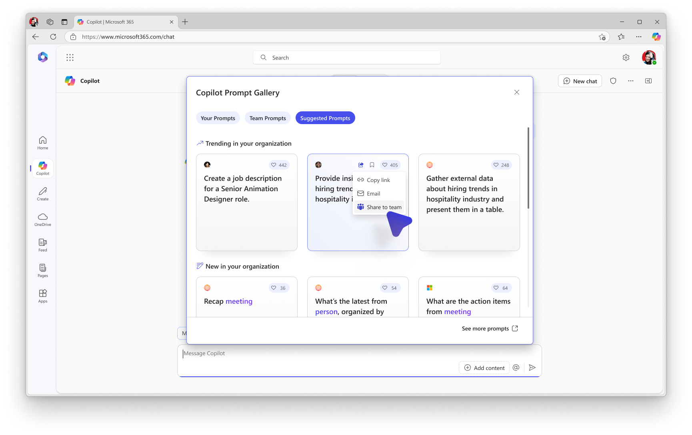
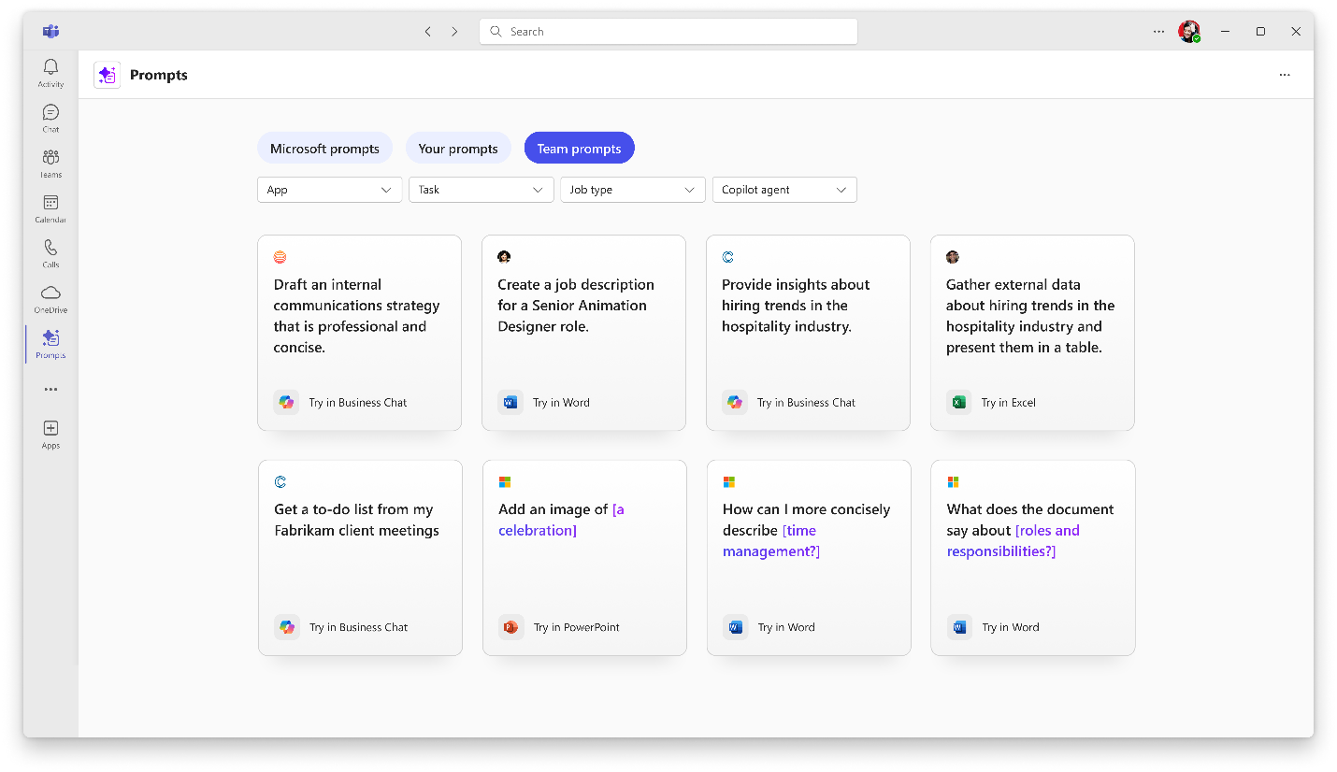
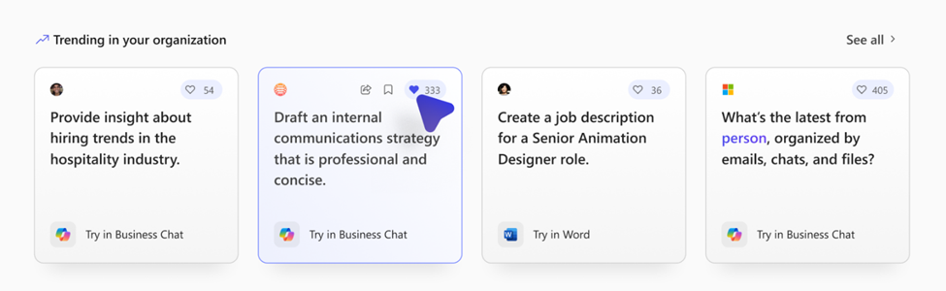
New Copilot Prompt Gallery Capabilities
`
Available now
Coming soon
Save and share your prompts
Copilot Prompt Gallery app
“Like” prompts
Save your favorite prompts and share them with colleagues.
A central place to find and use prompts across Microsoft 365 Copilot, Copilot Chat, and agents.
“Like” ( ) your favorite prompts and see total likes on the prompt cards.

Slide 49
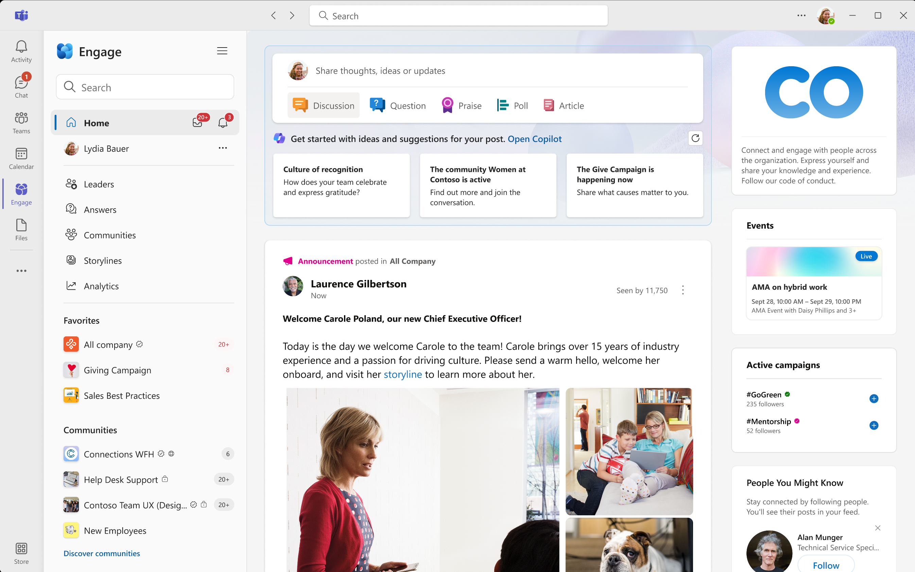
Copilot Communities in Viva Engage
Copilot adoption community templates in Viva Engage make it easy to drive user engagement
Share Copilot prompt examples and best practices
Ask and answer questions about Copilot
Connect with experts

Slide 50
Experimentation and learning
60%
Experimentation happens collectively, synchronously
boost in Copilot usage after a 6-week experiment designed to drive experimentation
1Source: MW + BA Marketing Copilot Experiment. This number represents a statistically significant increase in usage of M365 Chat for participants in the treated group, comparing their usage from the beginning to the end of the experiment with participants in the control group.

Slide 51
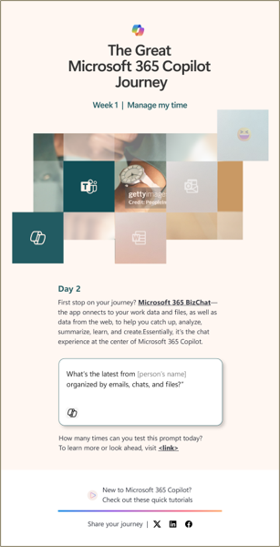
The Great Microsoft 365 Copilot Journey
30-day guided experience for users to learn how to use Copilot, one prompt at a time.
Understand how to use Microsoft 365 Copilot through daily, actionable prompt examples
Campaign is available as a web experience and downloadable email kit
Coming soon: Microsoft-managed emails and virtual training events.
Check it out at aka.ms/GreatCopilotJourney

Slide 52
Microsoft 365 Copilot Prompt-a-thon
What’s in the kit.
Full-day employee engagement event that provides practical experience with Microsoft 365 Copilot.
Learn how to build effective prompts through expert-led workshops
Discover how to use Copilot improve specific role-related processes
Event Resources
Overview & guidance
Session content for the full day
Supporting materials for communications
Download at aka.ms/Copilot/UserEngagementTools

Slide 53
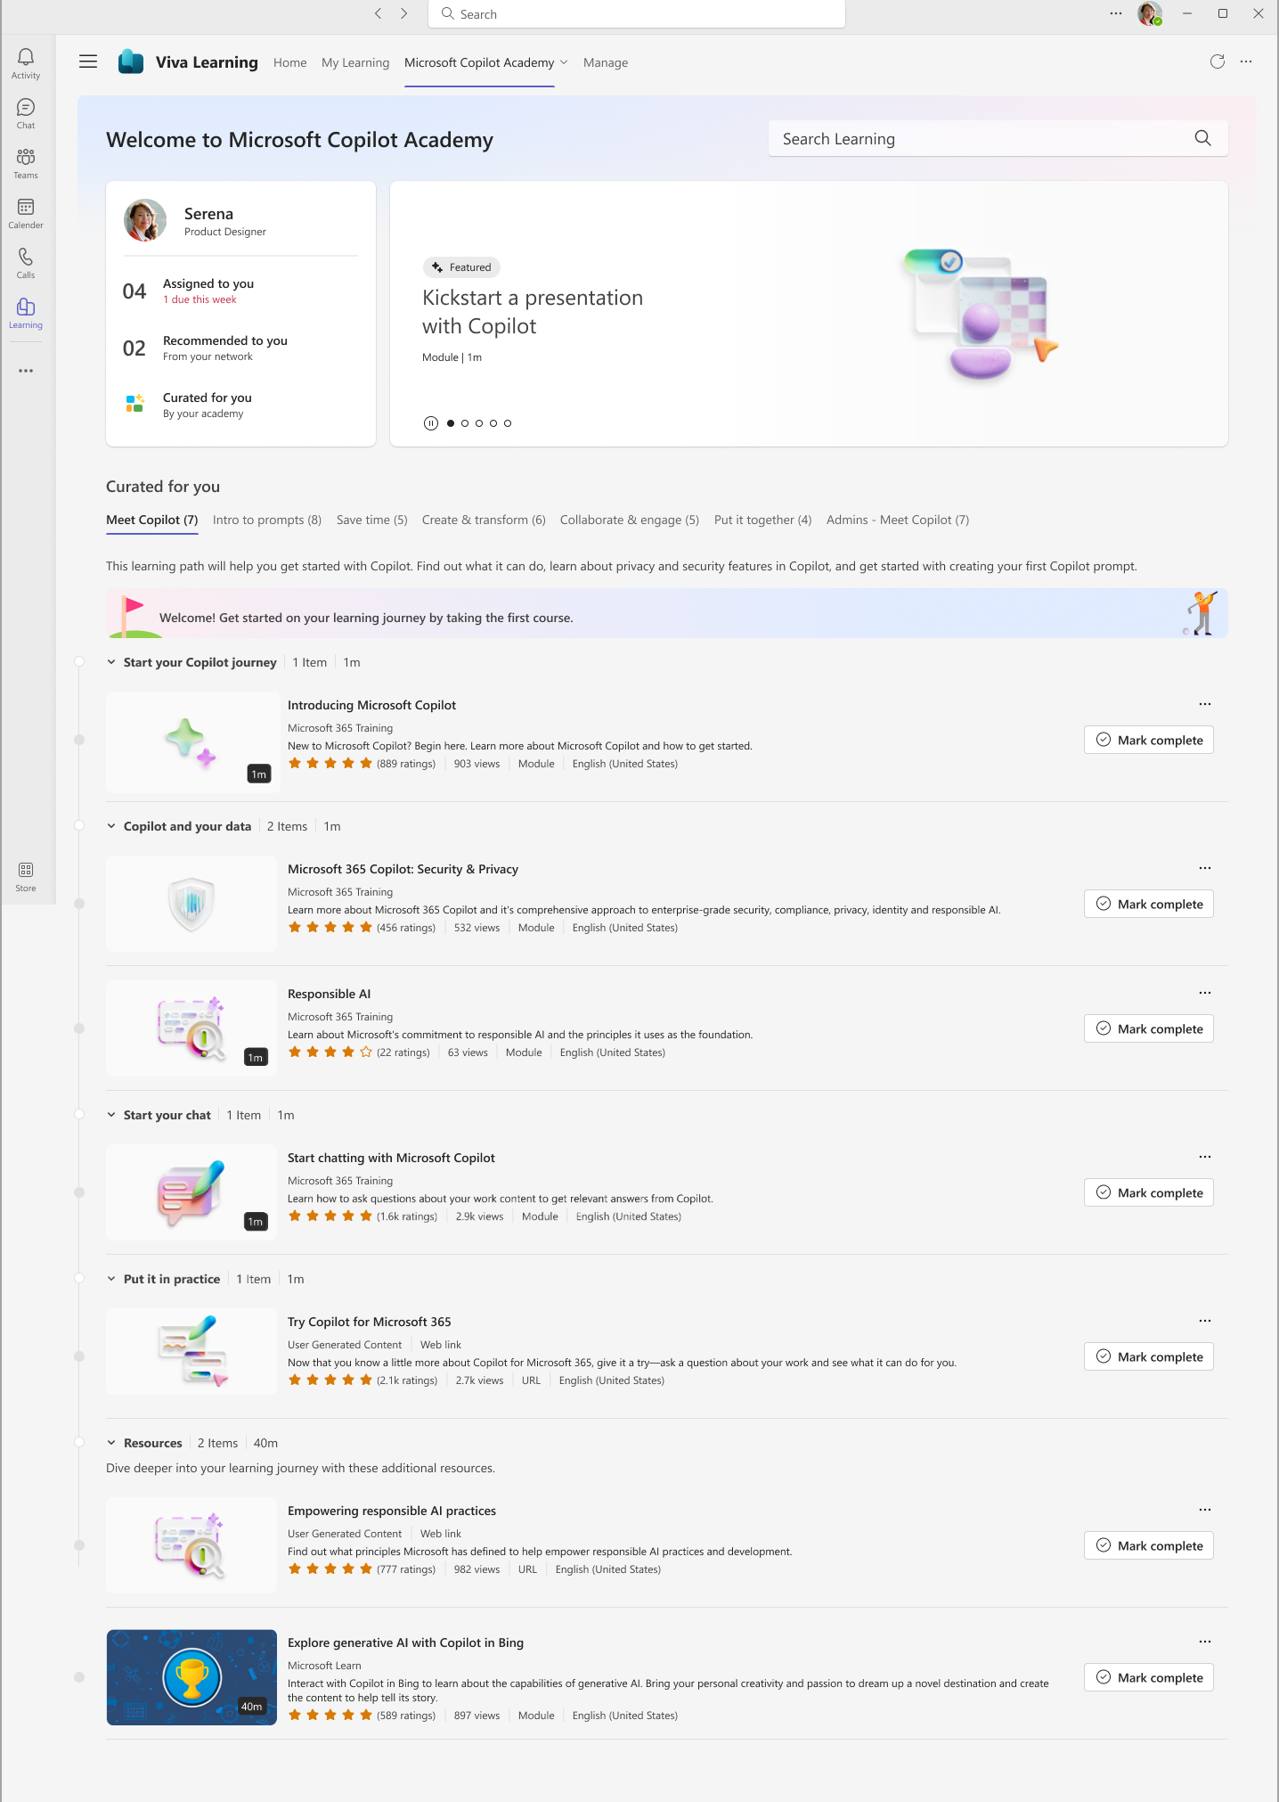
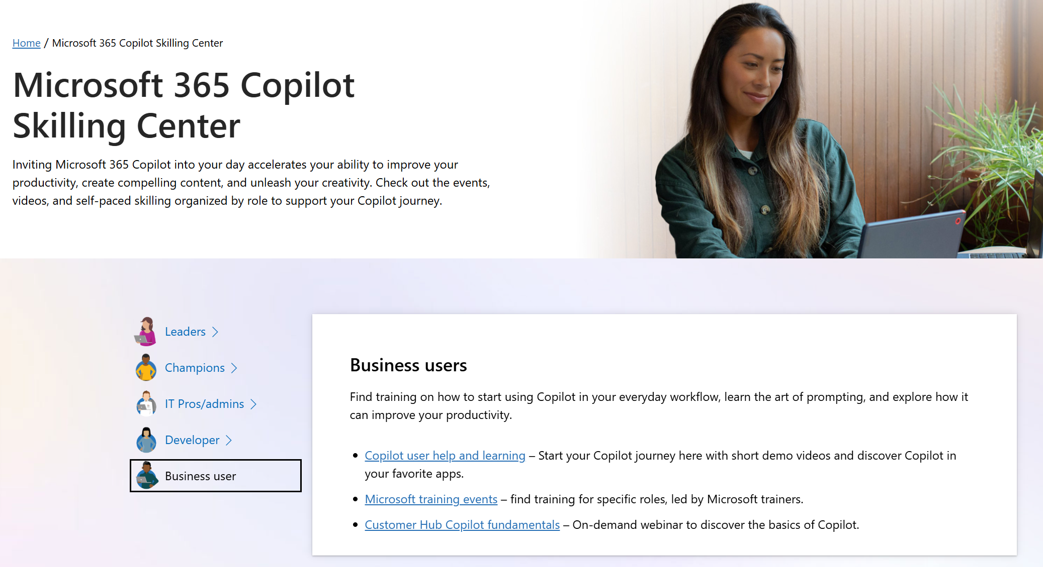
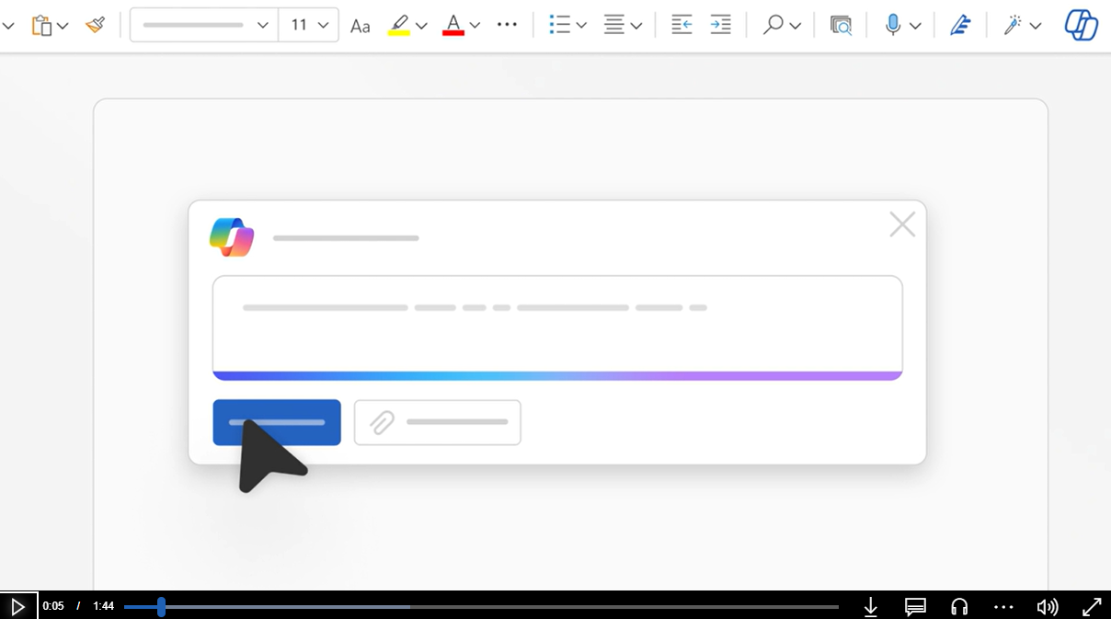
Drive Copilot upskilling
Copilot Academy in Viva Learning
A tailored learning experience crafted by Microsoft experts in the Viva Learning app in Microsoft Teams.
Copilot Skilling Center
https://aka.ms/Copilot/SkillingCenter
Resource site with Microsoft 365 Copilot skilling resources for leaders, IT admins, and business users.
Check it out at aka.ms/CopilotAcademy
Check it out at aka.ms/Copilot/SkillingCenter

Slide 54
3 Steps to Copilot Adoption
1
2
3
Get ready
Drive adoption
Measure impact

Slide 55
Announcing
Copilot Analytics
Viva Insights included in Microsoft 365 Copilot ^{New}
Out-of-the-box reporting to measure Copilot adoption
Copilot Dashboard*
Customizable reporting for deeper Copilot impact analysis
Copilot Business Impact report ^{New}
*Additional reporting included in Microsoft 365 admin center

Slide 56
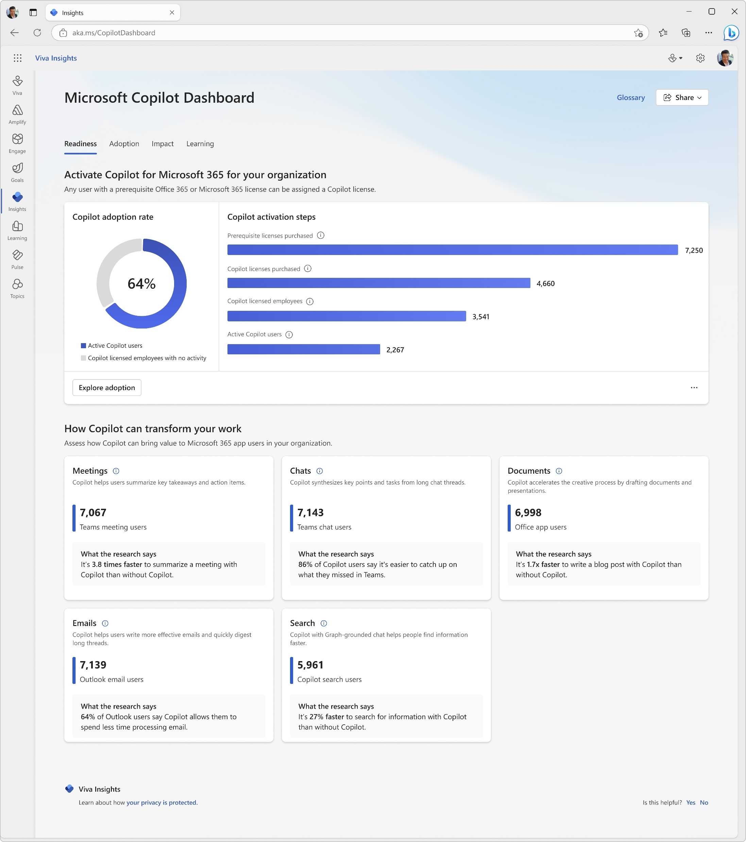
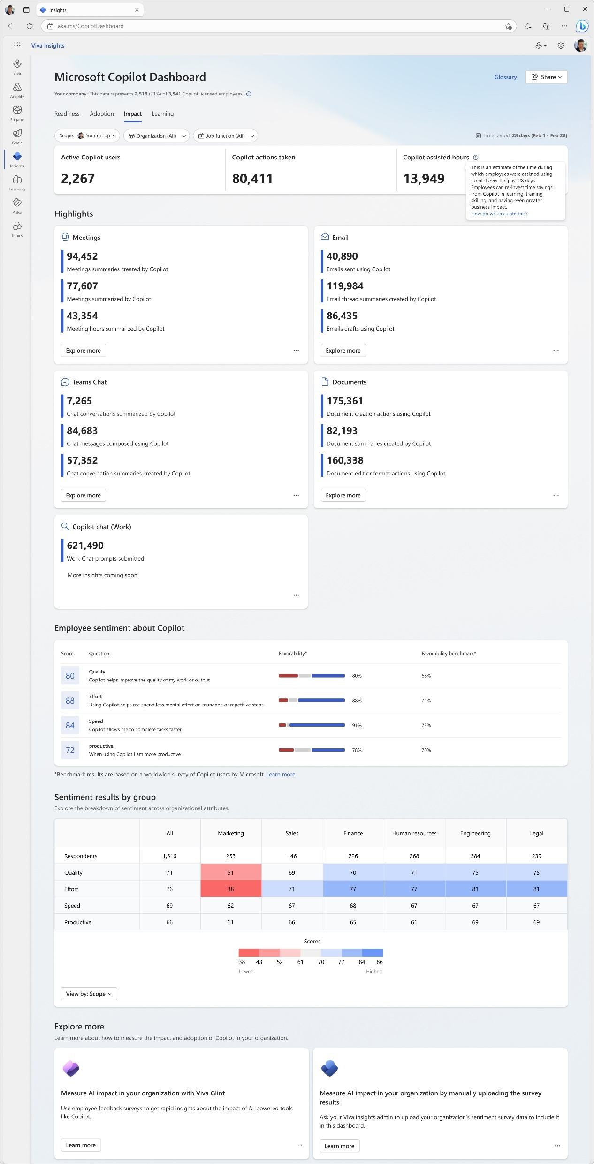
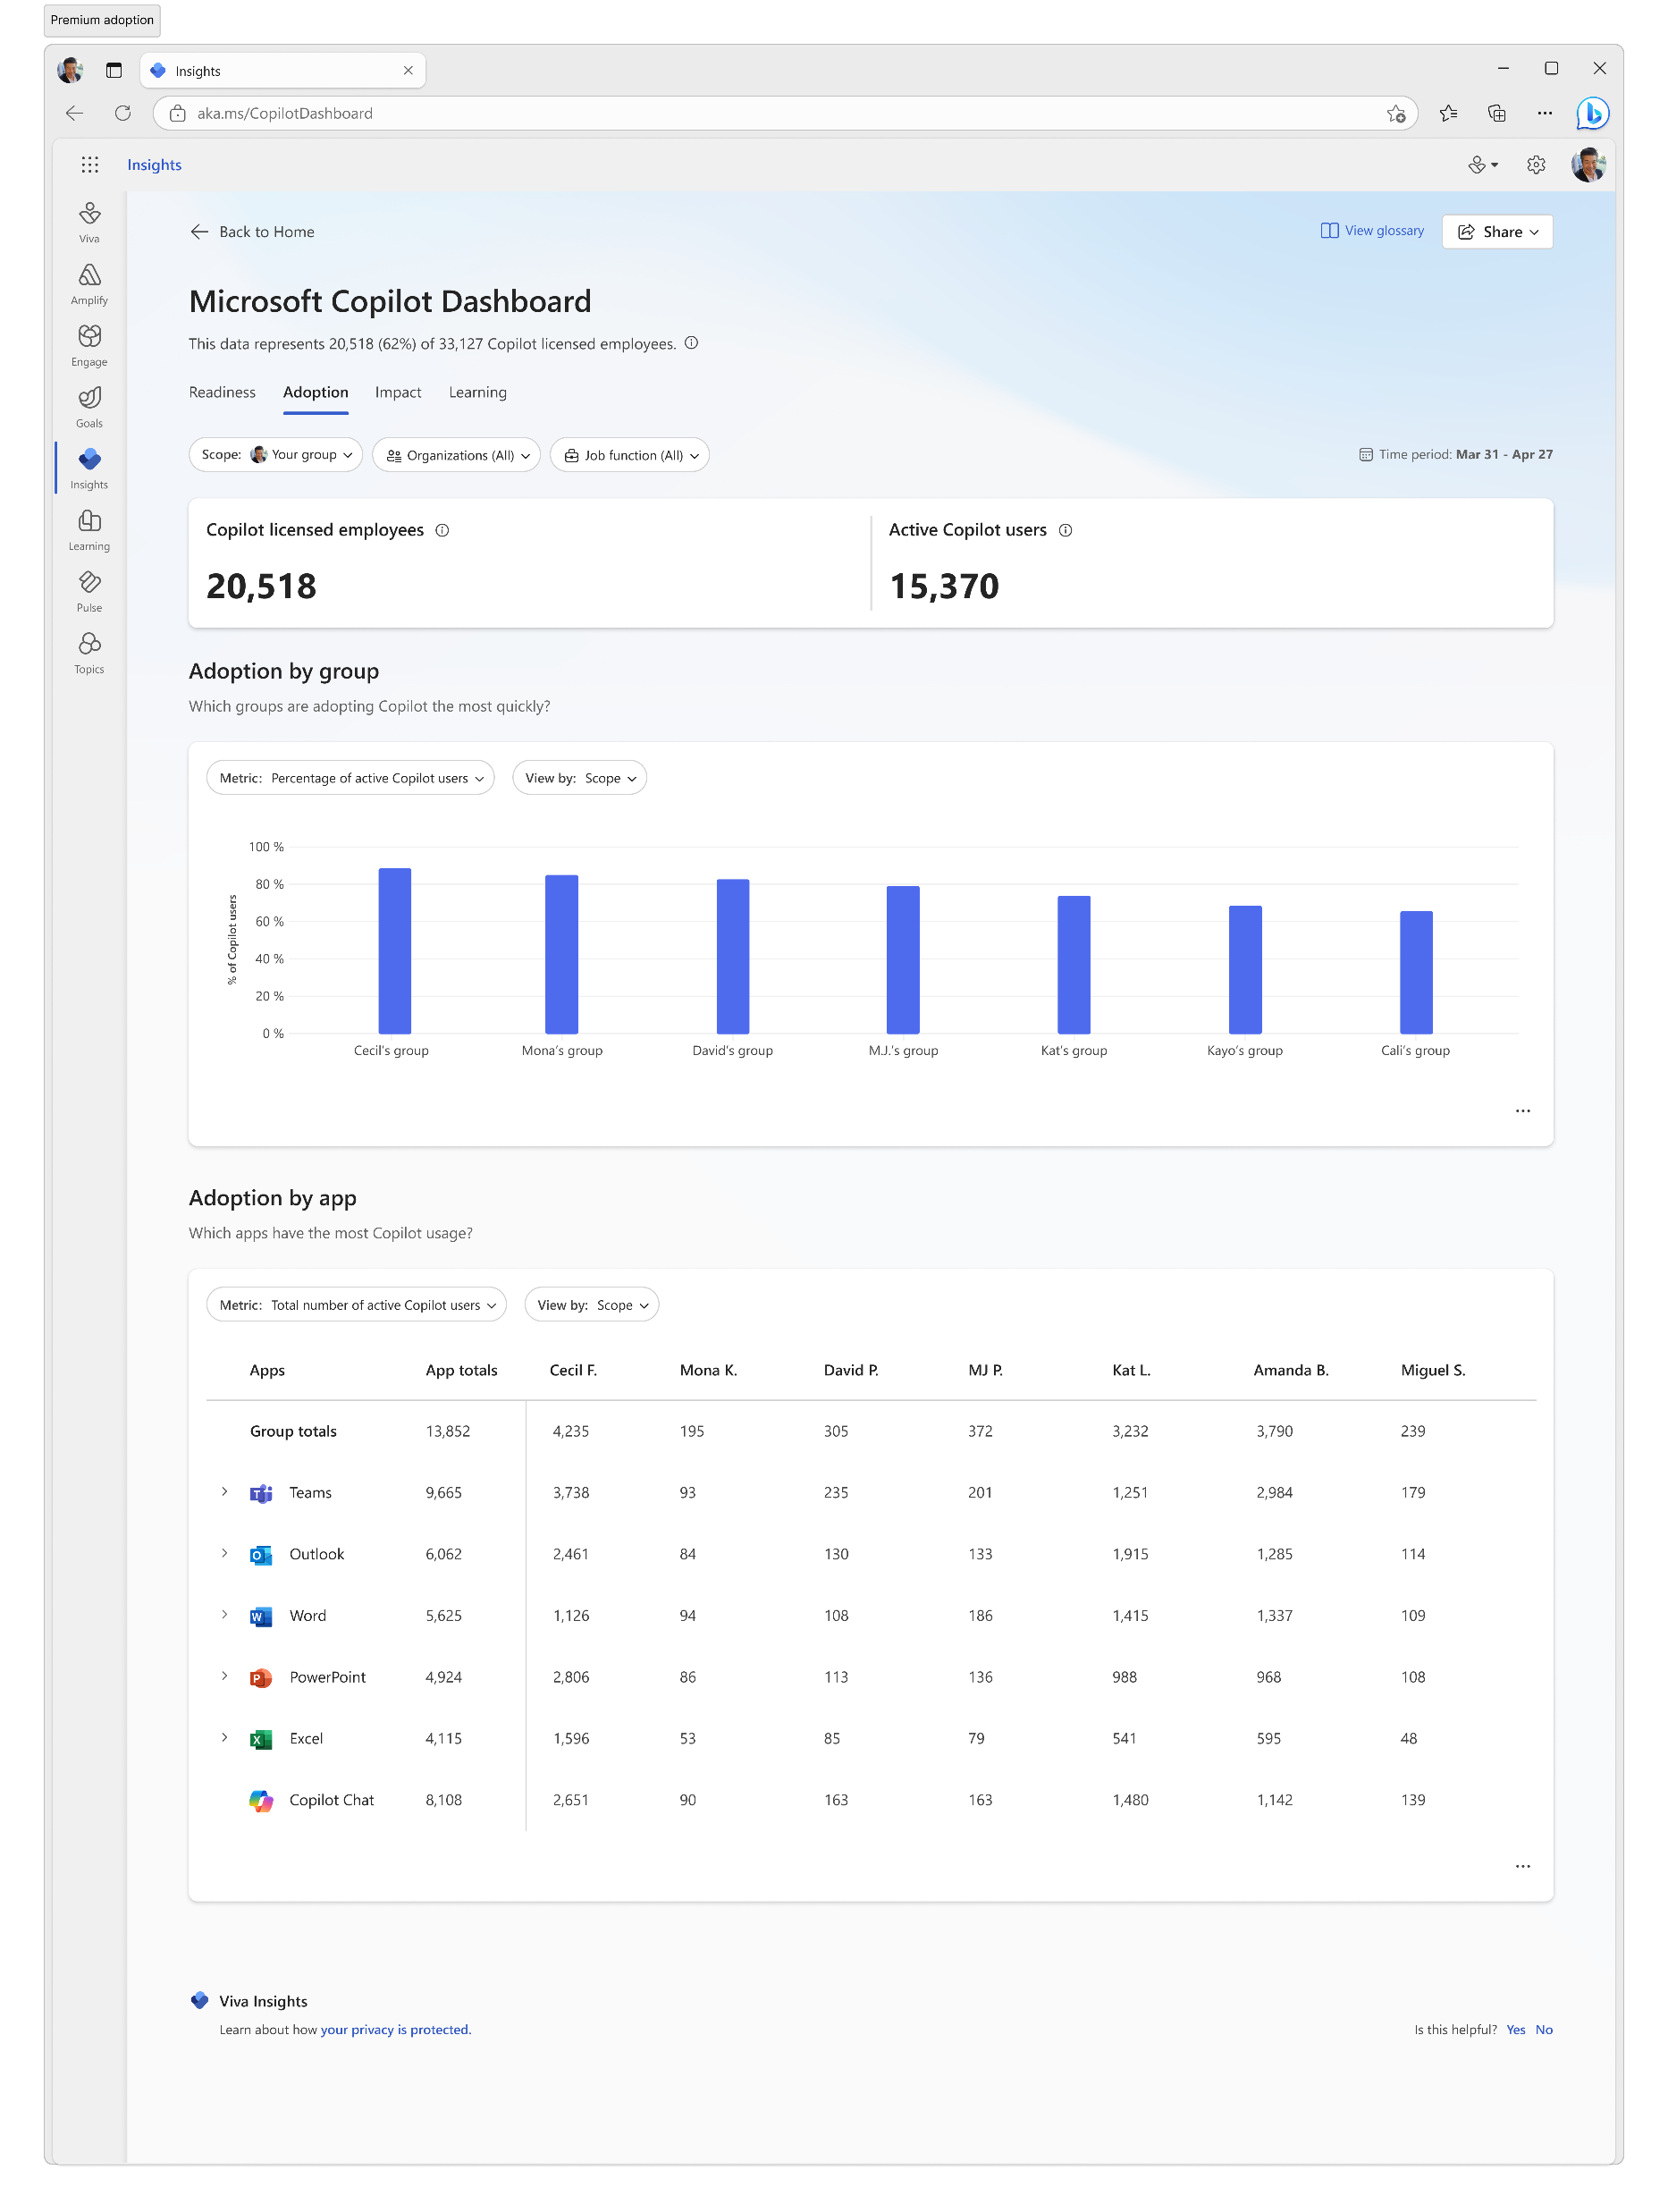
Microsoft Copilot Dashboard
Get Ready
Activate Copilot by understanding eligibility based on licensing status
Drive adoption
Understand usage and adoption trends across products, groups, organizations and job functions
Measure impact
Measure time savings and Copilot user behavior before and after adoption, as well as user sentiment

Slide 57
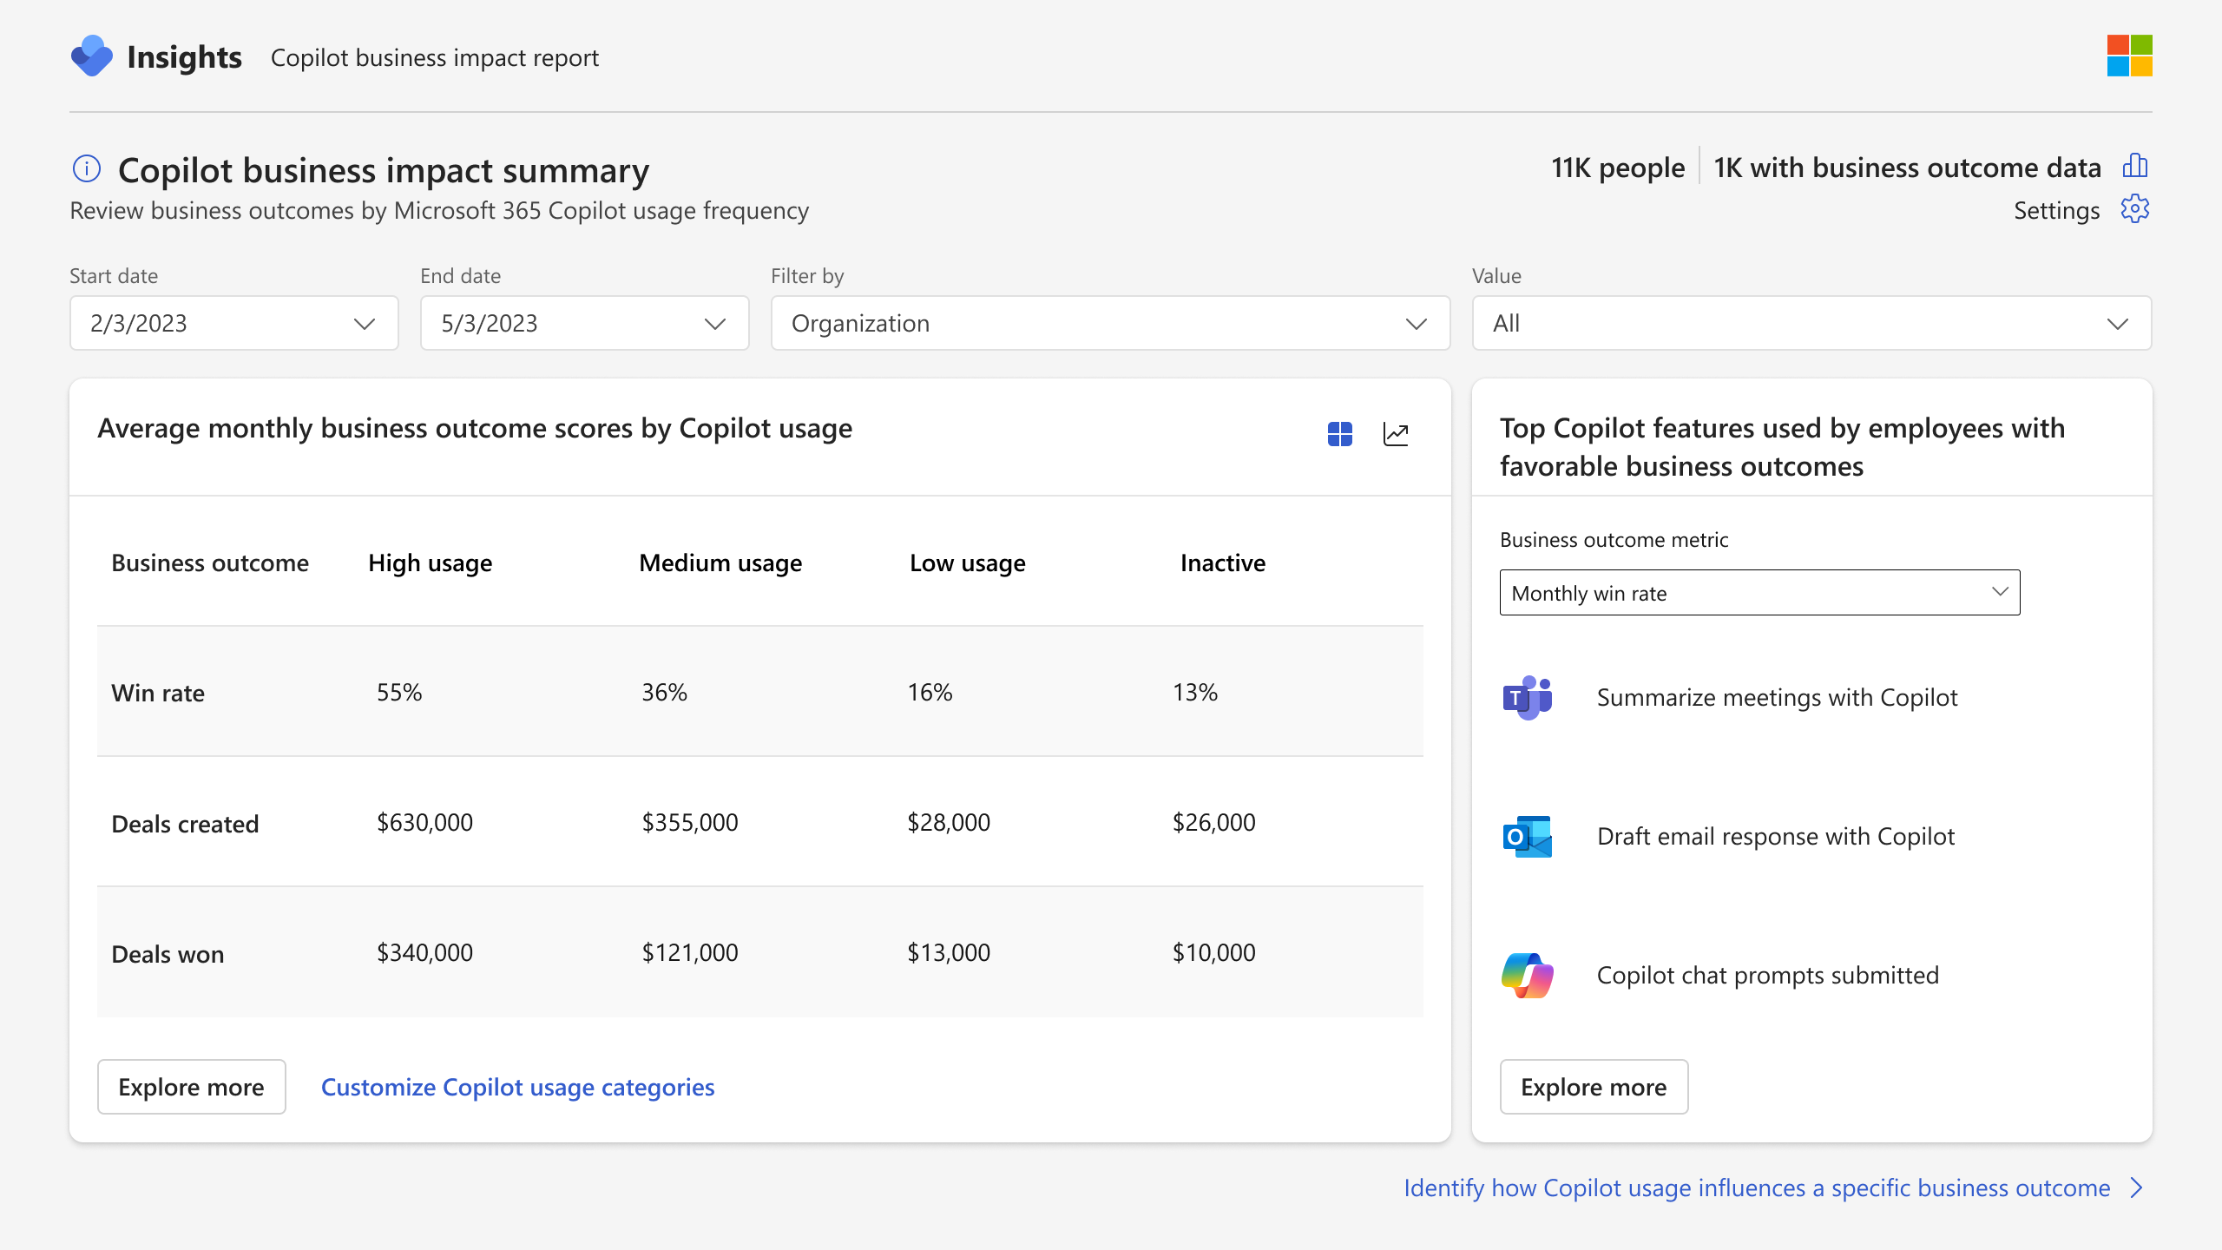
Copilot business impact report
Measure the value of Microsoft 365 Copilot with your key business metrics
Understand how Copilot usage relates to business outcomes in a Power BI report template
Customize your analysis for any function with your metrics from your business data
Identify best practices based on what Copilot activities lead to successful business outcomes
Pinpoint opportunities to improve low Copilot usage to improve adoption and impact

Slide 58
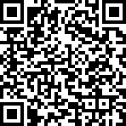
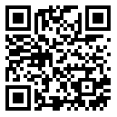
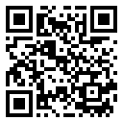
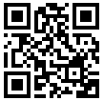
The tools to support your journey
1
2
3
Get ready
Drive adoption
Measure impact
For Business Leaders
For IT & Adoption Specialists
For Business Leaders
Scenario Library aka.ms/Copilot/ScenarioLibrary
User Engagement Resources aka.ms/Copilot/ UserEngagementTools
Copilot Dashboard aka.ms/CopilotDashboard
For End Users
Copilot Prompt Gallery aka.ms/Prompts

Slide 59
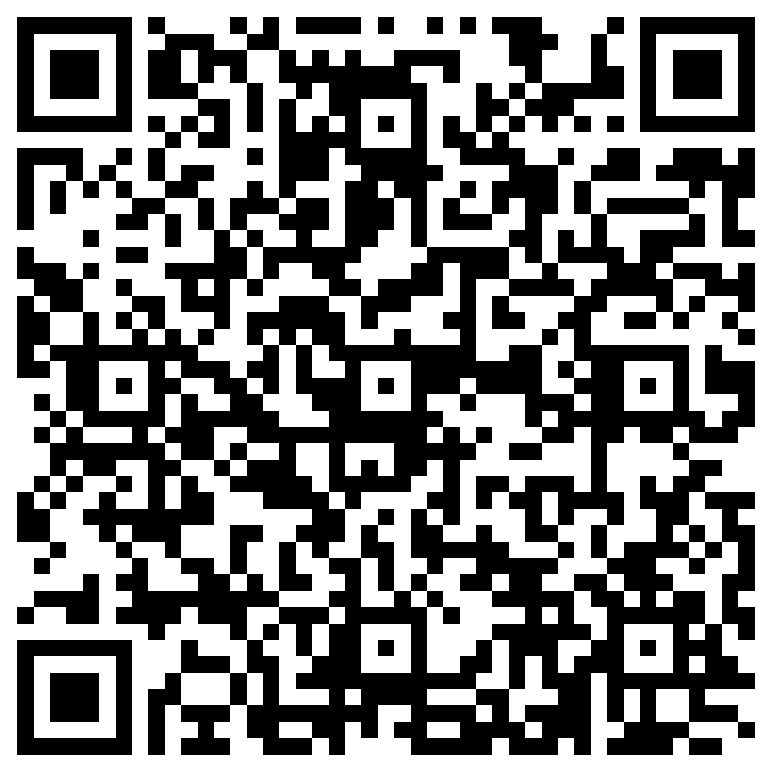
THANK YOU - Your feedback is critical
Scan with your mobile device camera
We’re committed to making your Modern Work Customer Hub experience the best it can be – and your feedback is a critical component to that.
Before you scoot, please take a moment to provide some feedback.
-OR-
Visit
Customer Hub Survey
aka.ms/CustomerHubSurvey

Slide 60
Visit Customer Hub Website for upcoming sessions, updates, and on demand contents!
Scan me!
https://aka.ms/CustomerHubSessions

Slide 61
Q&A
1
Please raise your hand and unmute when called on
2

Slide 62
Customer Hub Survey
THANK YOU - Your feedback is critical
Scan with your mobile device camera
We’re committed to making your Modern Work Customer Hub experience the best it can be – and your feedback is a critical component to that.
Before you scoot, please take a moment to provide some feedback.
-OR-
Visit
Customer Hub Survey
aka.ms/CustomerHubSurvey

