Slide 1
Events Monetization
Changes
Effective: April 1, 2026
Harsh Gupta,
Group Principal Product Manager
Topics:
Events licensing changes
License Management
Enforcements
Notes:
Today we’re going to walk through some important updates to how Teams Events are licensed and monetized. These changes are designed to make things simpler, more predictable, and better aligned with how customers actually run events at scale.
We’ll cover three main areas. First, what’s changing with events licensing overall. Second, how license management works going forward, especially with the introduction of attendee packs. And third, how enforcement works at different points in the event lifecycle so there are no surprises.
All of these updates take effect on April 1, 2026, and the goal throughout is to provide more clarity, reduce friction, and ensure customers can plan events confidently without worrying about feature tradeoffs or unexpected constraints.

Slide 2
Events Monetization Changes
Market Alignment
  Provide customers clarity on pricing and value of Teams Events to
    simplify competitive analysis
    have predictability of costs with Teams Events
  Sell based on scale and not features
Deliver a market-leading events offering
  Priced highly competitive
  Offers higher value than competition
Core Principles
Avoid Takebacks
  Preserve existing event capabilities (e.g., 10K view-only)
  Ensure current Teams Premium customers retain benefits through the end of their contracts
Notes:
On this slide, I want to ground everyone in why these changes are happening. Everything we’re doing here is anchored in a few core principles. First, we’re aligning with the market so customers can more easily compare Teams Events to other platforms. Second, we’re focused on clarity and predictability, so customers can understand pricing and plan costs without surprises. Third, we’re shifting how events are sold — moving away from feature-based licensing and instead selling based on scale. And finally, we were very intentional about avoiding takebacks. Existing customers keep the event capabilities they rely on today, including large view-only events, through the end of their current contracts.

Slide 3
Purchase to scale events
Effective: April 1, 2026
All events features available in Teams Enterprise
Scale-based purchase
All advanced events features move from Teams Premium to Teams Enterprise
No additional purchase required for event features
eCDN included
Add-ons for scale:
New add-on attendee packs introduced (5K, 10K, 20K, 35K, 50K, 75K, 100K)
  No differentiation between internal and external attendees
enable unlimited events during the term, with each event supporting up to the pack’s capacity
  Concurrency limits apply
Included with Teams Enterprise
Base includes events up to 3K interactive or 10K view-only attendees — no attendee pack required
Notes:
This is where the model really changes. Starting April 1, all advanced event features are included with Teams Enterprise — there’s no separate purchase required for functionality like production tools or performance enhancements. Instead, customers only purchase additional capacity when they need it. Attendee Packs are introduced in defined sizes, and they apply equally to internal and external attendees. Once an organizer has an Attendee Pack assigned, they can run an unlimited number of events during the term, as long as each event stays within that capacity. The base Teams Enterprise license already includes events up to 3,000 interactive attendees or 10,000 view-only, so many events won’t require any additional purchase at all.

Slide 4

Advanced Events Capabilities moving to Teams Enterprise
Performance
1P eCDN
Ultra-low latency (ULL)
Teams Events silent testing (Doppler)
Production & Control
Production Studio & layouts
Event templates (custom)
Hide participant list/ anonymize attendees
Advanced presenter & attendee verification
Attendee Experience
Polls, reactions, raise hands
Connected Apps tab
Email customization
Enterprise Event Discovery
Reporting
Event analytics
Advanced registration (reporting, customization, management)
Real-time monitoring (Town Hall Insights)
Notes:
Here’s a snapshot of what’s now included by default. Attendee engagement features like polls, reactions, and raise hands are available without extra licensing. Organizers also get richer reporting and analytics, including registration insights and real-time monitoring. From a performance standpoint, capabilities like built-in eCDN and low-latency delivery are included. And for production teams, tools like custom layouts, event templates, and enhanced presenter controls are part of the core experience. The big takeaway is that event quality and sophistication are no longer gated by premium licensing.

Slide 5

Existing Teams Premium
Customer Transition
No disruptions until the end of Teams Premium term
Customers with Teams Premium licenses will be able to host events up to 100K
After the Teams Premium term ends
Events up to 3,000 attendees continue as before
Events above 3,000 customers require Events Attendee Packs based on desired capacity
Applies to customers who purchased Teams Premium before April 1, 2026
Notes:
This slide is especially important for customers already using Teams Premium. If Teams Premium was purchased before April 1, nothing changes during the active contract term. Customers continue hosting large events — even up to 100,000 attendees — without disruption. After the term ends, events up to 3,000 interactive or 10,000 view-only remain included. For events above that, Attendee Packs are required. The goal here is a smooth, predictable transition with no sudden loss of capability.

Slide 6
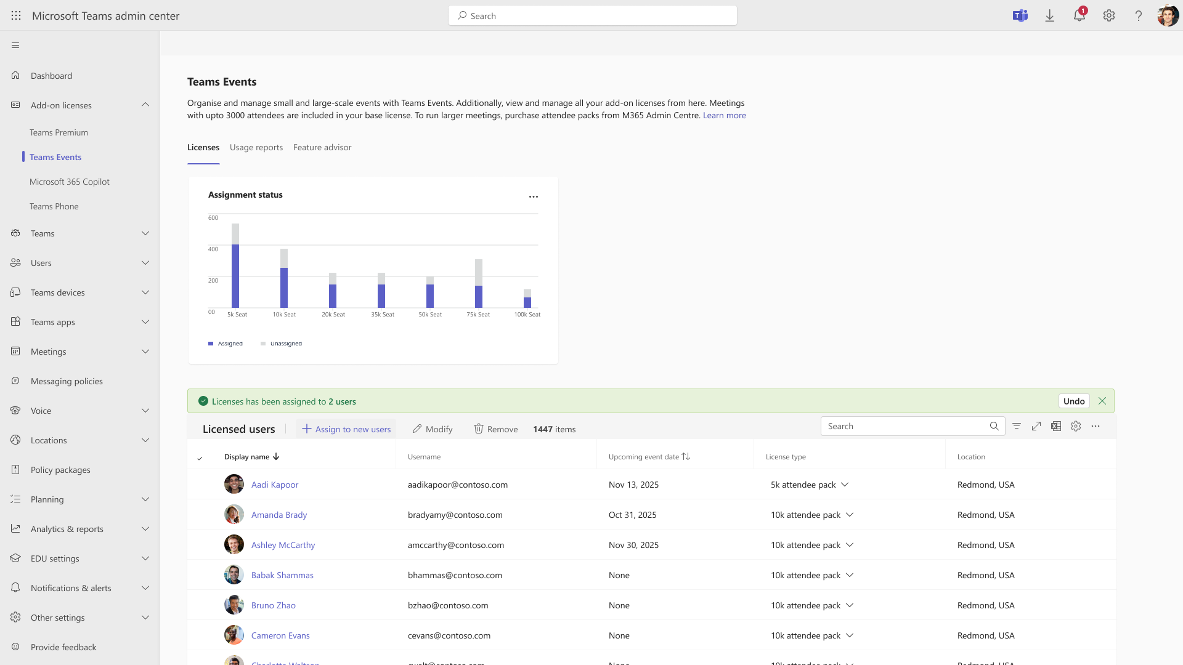
Teams Admin Center enhanced for Attendee Packs
Dedicated section for Events in TAC
Attendee Pack assignment report
User-level reporting with upcoming event context
Notes:
From an admin perspective, we’re simplifying management. There’s now a dedicated Events section in the Teams Admin Center that provides visibility into attendee capacity, usage, and assignments. Admins can see who has which Attendee Pack, how capacity is being used, and which upcoming events may be impacted. This brings everything related to events into one centralized place, making it much easier to manage at scale.

Slide 7
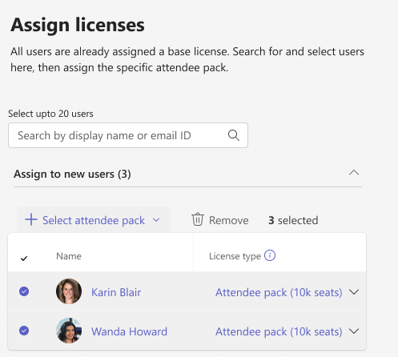
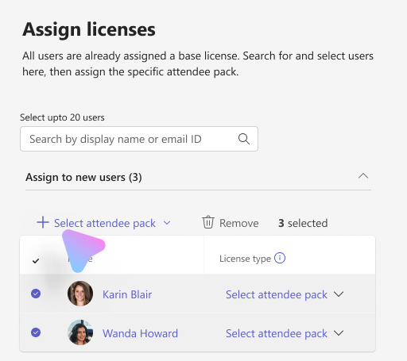
Simplified License Management – Assignment
1
2
3
Click “Assign to new users”
Select User(s)
Assign Attendee Pack
Assign attendee packs to single or multiple users at once
Notes:
Assigning Attendee Packs works much like assigning any other license. Admins can assign packs to one or multiple users at a time, directly from the Admin Center. Each organizer can have one Attendee Pack assigned, and that pack determines the maximum capacity for the events they host. This approach keeps things simple and predictable while still allowing flexibility through reassignment when needed.

Slide 8
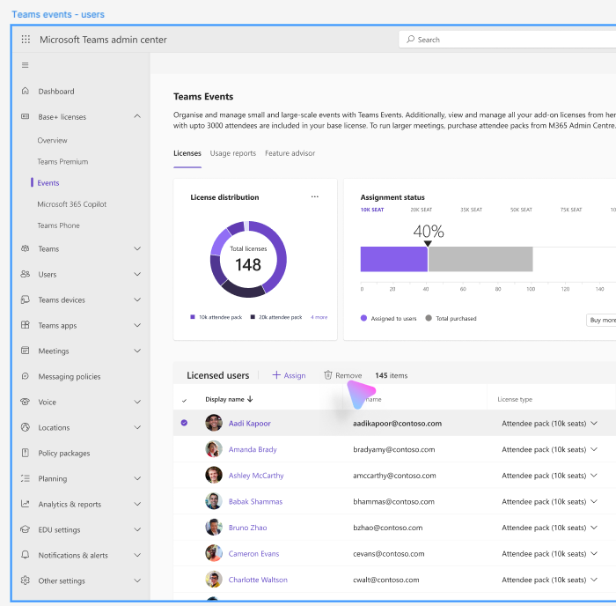
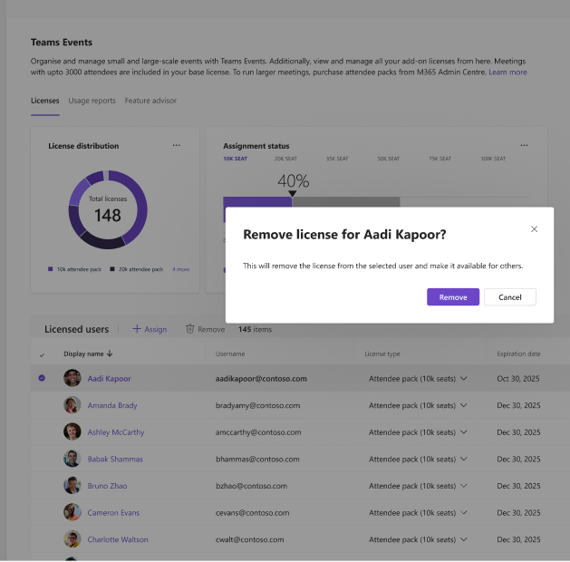
Simplified License Management – Removal
1
2
Select User(s) -> Remove
Confirm the Removal
Removed license is moved back into the pool
Note: To transfer attendee packs between users, attendee packs must be removed from a user before being assigned to another user.
Notes:
If an Attendee Pack needs to be moved to another organizer, it must first be removed and returned to the license pool. When an admin removes a pack from someone who has scheduled events, they’re warned that upcoming events may be affected. Once removed, the pack becomes available for reassignment. This ensures admins have control while also preventing accidental disruption.

Slide 9
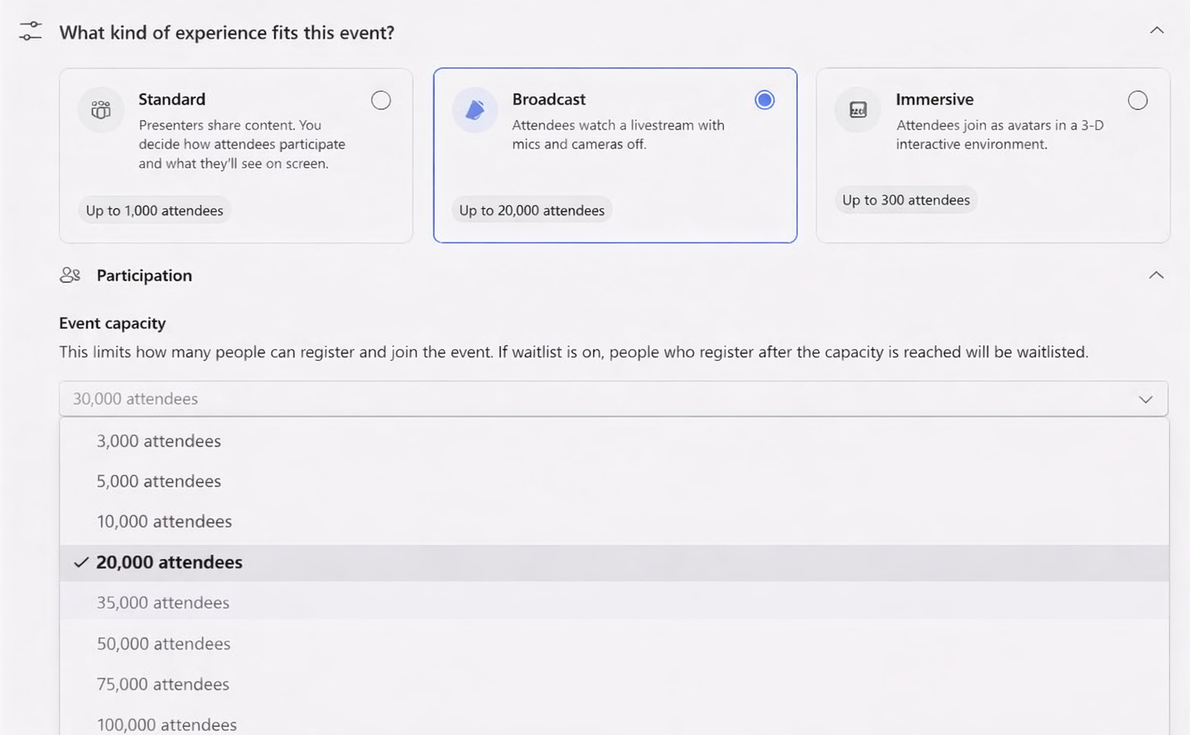
Event Creation with Attendee Packs
  Organizers can select the Event capacity up to their assigned Attendee Pack
Example: Organizer with a 20K Attendee Pack.
Selections above 20K are disabled
Notes:
When an organizer creates an event, the capacity options available to them are based on the Attendee Pack assigned. They can select any capacity up to that limit, and options above it are unavailable. This ensures organizers always stay within licensed capacity, while still giving them flexibility to choose the right size for each event.

Slide 10
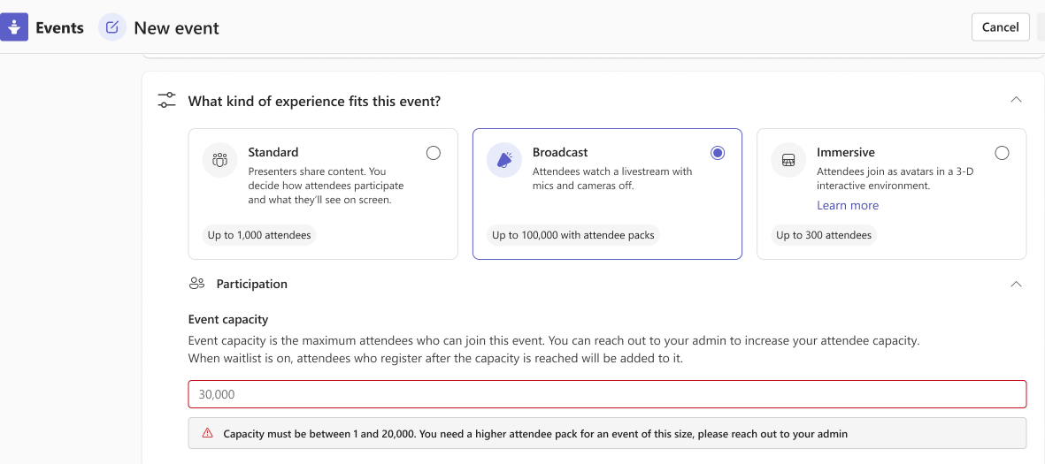
Enforcement: event creation
Organizers are prompted to work with their admin to ensure the appropriate Attendee Pack is assigned before continuing.
Notes:
If an organizer attempts to schedule an event that exceeds their assigned capacity, they’re prompted to work with their admin before proceeding. This enforcement happens at scheduling time, helping prevent issues later. The message is clear and actionable, guiding organizers to resolve capacity needs early rather than discovering problems right before the event.

Slide 11
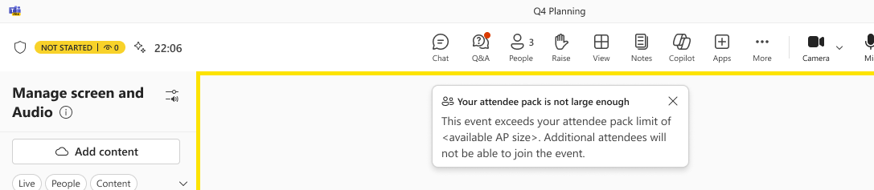
Enforcement: event join time
  Attendees are admitted up to the capacity defined by the assigned Attendee Pack.
After capacity is reached, additional attendees are unable to join the event.
Notes:
Capacity is also enforced when attendees join the event. Once the licensed limit is reached, additional attendees aren’t able to join. This ensures events stay within supported limits and deliver a consistent experience for everyone who is admitted.

Slide 12
Attendee pack revoked after scheduling (before event)
When an admin revokes an attendee pack from an organizer who has scheduled events, the admin receives a warning that upcoming events may be impacted
Event Inventory view highlights all events affected
Admin
Impact
The organizer receives an email notification informing them that attendee pack was removed and identifying impacted events
In Meet App → Manage, the organizer sees an alert indicating the attendee pack is missing
Organizer can edit the event properties but not increase the attendee capacity without the right attendee pack
When event hosts enter the Green Room, a banner warning appears indicating the missing attendee pack
Organizer Impact
Note: If no attendee pack is assigned before the event begins, capacity is limited to 3,000 attendees.
Notes:
If an Attendee Pack is removed after events have already been scheduled, there are multiple safeguards. Admins receive warnings, affected events are highlighted, and organizers are notified by email. Organizers can still manage most event settings, but they can’t increase capacity without the appropriate pack. If no pack is assigned by the time the event starts, the event defaults to a maximum of 3,000 attendees.

Slide 13
Maximum Events Concurrency Guidelines
Tenant Level
A tenant can host up to 50 concurrent
events across all organizers
Organizer Level
An organizer can run up to 3 concurrent events at a time.
Notes:
Finally, there are concurrency limits to ensure platform stability. At the tenant level, up to 50 events can run at the same time. At the organizer level, an individual can host up to three concurrent events. These guidelines help balance flexibility with reliability across the platform.

