Slide 1
Introducing Value with Microsoft 365 Copilot Chat for All Users
Notes:
Hi everyone, welcome! Thanks so much for joining us today. My name is Nick Stillings—I’m a Global Solutions Architect at Microsoft, which is really just a fancy way of saying I’m a Copilot rep. I’m presenting today with my colleague Mike Bennett. This is our Customer Hub session on Introducing Microsoft 365 Copilot Chat. We’re going to walk through what Copilot Chat is, what it can do for you, and why it matters for your organization. Whether you’re an end user, IT pro, or helping drive adoption, the goal today is to show you how Copilot Chat is a practical, everyday tool that helps everyone get more done.

Slide 2



Visit Customer Hub website for upcoming sessions, updates, and on demand contents!
https://aka.ms/CustomerHubSessions​
Notes:
Before we jump in, I want to quickly point you to the Microsoft Customer Hub. This is where you’ll find upcoming sessions like this one, on-demand content, and updates as new Copilot features roll out. We have a series of four sessions covering Copilot Chat—today is the introduction. Next week, we’ll cover securing and deploying it. In two weeks, Mike and I will be back talking about adoption best practices. And then in about a month, we’ll go deep into prompting tips and power user tricks. So bookmark the Customer Hub—it’s a great resource to keep learning and share with your team.

Slide 3
During the presentation
After the presentation
We will mute your microphone for the first part of today’s call
Raise your hand and we will
call on you
Ask your questions via chat, we will get to all of them, live or after. Common questions will get addressed out loud
Open mic – come off mute and ask away!
Notes:
Quick note on how today’s session works. For the first part, we’ll keep everyone’s microphone and camera off just to keep things smooth. But drop your questions into the chat at any time—we’ll get to all of them, either live or after the main presentation. At the end, we’ll open things up so you can come off mute, raise your hand, and ask questions directly. We’ve got a small group today, so we can keep things pretty interactive as we go.

Slide 4
Poll #1
What *best* describes your role?
    End User
    Champion / Power User
    IT Professional / System Admin
    Organizational Leadership
    Other
Notes:
Alright, let me launch a quick poll just to get a sense of who’s in the room. This is totally confidential—it’s not saved anywhere. It just helps Mike and me steer the conversation. So let us know: are you joining as an end user, a champion or power user, an IT professional, a manager or leader, or something else? This way we can tailor the demo and discussion to what’s most useful for you.

Slide 5
Make a difference
Become a
Champion
Get more from Copilot and Microsoft 365
Help others do the same
Expand your knowledge and enhance your career
Get more from Copilot and Microsoft 365
Help others do the same
Expand your knowledge and enhance your career
Join the free program at aka.ms/M365Champions
Notes:
For those of you who said you’re a champion or power user, let me quickly plug our Microsoft 365 Champions program. We host a call once a month—actually twice a month at two different time zones—and it’s just for that kind of person who everyone leans over the cubicle wall to ask how to do an Excel function. Anyone is welcome to join. It’s a great way to deepen your knowledge, support others, and make a broader impact. I’ll drop the link to the program in the chat.

Slide 6
Copilot Chat
Microsoft 365 Copilot
Secure, AI Chat
Grounded on the Web
and referenced files
Standard Access
Metered Agents
Enterprise Data Protection
Included in Microsoft 365
Copilot Chat plus:
Microsoft 365 Work IQ
Priority Access
Advanced Skills in the
Microsoft 365 Apps
Access to Agents and Tools
Copilot Analytics
$30 USD / user / month
↑ Today’s Session
Notes:
So let me take a second to level set here, because Microsoft has a lot of products with the word Copilot in it. On the right side, you see Microsoft 365 Copilot—that’s our licensed offering at $30 per user per month. It gives you everything you’ll see today plus the ability to reason over all your work data in Microsoft 365, like your calendar, Teams chats, SharePoint files, and more. On the left is what we’re focused on today: Copilot Chat. It’s included in your Microsoft 365 subscription—no extra license needed. It’s more limited than the full version, but it gives everyone in your organization a safe, secure AI tool right out of the box. We don’t like to say it’s free—we like to say it’s included.

Slide 7
Poll #2
What is your organization’s plan for
Microsoft 365 Copilot?
    Copilot Chat for all users (included in Microsoft 365)
    Microsoft 365 Copilot for all users (US $30/user/month)
    Mixed Licenses: Copilot Chat / Microsoft 365 Copilot
    Still Evaluating / Don’t Know
Notes:
Here’s my second poll question. I’m curious—do you know what your organization is planning? Are they going to enable Copilot Chat for everyone with a Microsoft 365 license, go with the full Copilot license for all users, do a mix of both, or still figuring things out? Again, totally anonymous—it just helps us tailor the conversation. A lot of organizations we talk to are doing a mixed approach: giving the included version to everybody and then evaluating who needs the full license.

Slide 8
Agenda
Welcome and Intros
Microsoft 365 Copilot Chat
Benefits and Value:
Microsoft 365 Copilot Chat
Agents in Microsoft 365 Copilot Chat
Next Steps & Call to Action
Notes:
Here’s our agenda for today. We’ll start with a quick overview of Microsoft 365 Copilot Chat, then talk about the real benefits and value it delivers. After that, we’ll introduce agents and what they mean in the context of Copilot Chat. And we’ll wrap up with next steps and resources to help you move forward. Let’s jump in.

Slide 9
Poll #3
What’s your Experience with Copilot Chat?
    Experienced Microsoft 365 Copilot Chat user
    New to Copilot Chat, familiar with other AI tools
    New to AI tools
Notes:
Last housekeeping question—what’s your experience with Copilot Chat? Are you an experienced user already? Or maybe you haven’t used Copilot Chat specifically but you’ve worked with other tools like ChatGPT, Gemini, or Grok? Or is all of this kind of new to you? This helps us know how much context to give. And if you said you’re new, I’d especially encourage you to come back in four weeks when Mike and I go deep into prompting—those skills apply to all AI tools, not just Copilot.

Slide 10
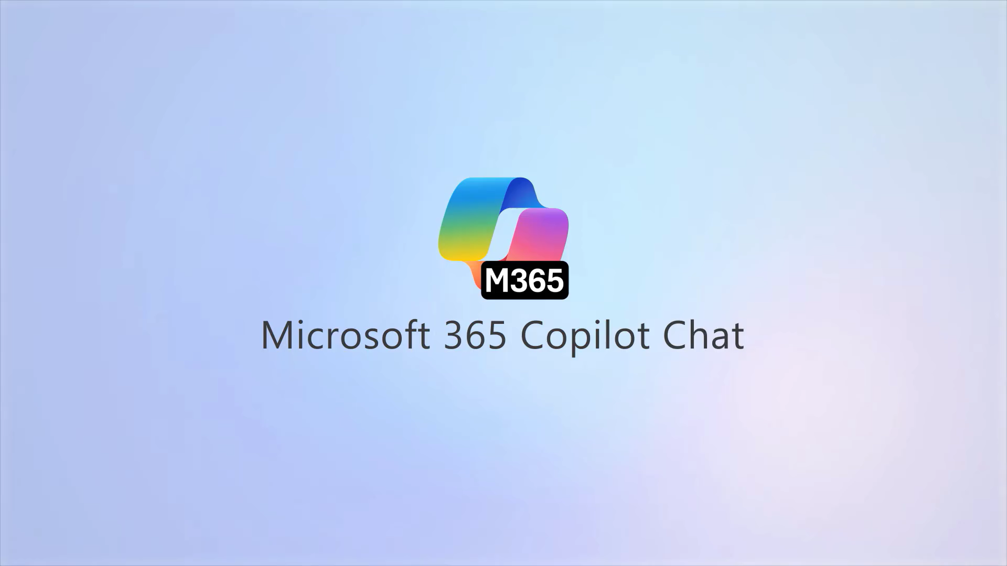
Overview
Microsoft 365
Copilot Chat
Notes:
Alright, let me start with a quick overview. I’m going to play a short three-minute video that walks through Copilot Chat—what it is and what it does. After that, I’ll jump into some live demonstrations. If you have questions as we go, just drop them in the chat and we’ll address them.

Slide 11
Notes:
So that’s Copilot Chat in a nutshell. Essentially, it’s included as part of Microsoft 365 and has three main components. First is the chat experience you just saw—you can use it on the web, mobile, Windows, or Mac. Second is agents, which Mike will show us in more detail shortly—these help automate multi-step tasks. And third, out of the box, you’re just retrieving information, so you can experiment freely. You’re not going to break anything, and it can only see things you already have access to. That’s the beauty of the security trimming already in place.

Slide 12

AI for All
Chat
Web-grounded
Copilot Chat
Agents
Free, secure AI chat
IT controls
Notes:
Here’s the big picture of what Copilot Chat brings together. At its core, it’s free, secure AI chat powered by the latest models and grounded in web data. Then you’ve got agents—little AI-powered tools that can automate tasks and business processes. And finally, IT controls for enterprise-grade security, privacy, and compliance. Leaders want broader AI access while navigating budget constraints, and Copilot Chat makes that possible—ensuring no employee is left behind.

Slide 13
Microsoft 365 Copilot Chat
Benefits of working alongside AI with tools like Copilot Chat
65%
50%
77%
of enterprise users report a measurable productivity boost with Copilot and Copilot Chat
Of workers use AI regularly, doubling in the last two years
Start with AI because tools like Copilot Chat are always available, fast,
and high‑quality.
Source: Work Trend Index Report, April 2025
Notes:
Let me share some compelling numbers from our Work Trend Index Report, which Microsoft Research produces every spring. About 65% of workers now use AI regularly—that’s nearly doubled in two years. We’re seeing a shift where people start with AI because it’s always available and gives consistently high-quality responses. And 77% of enterprise users report a measurable productivity boost with Copilot. These aren’t small numbers—this is a real behavior shift in how people work. It’s one of the reasons we wanted to make Copilot Chat part of the standard Microsoft 365 experience.

Slide 14
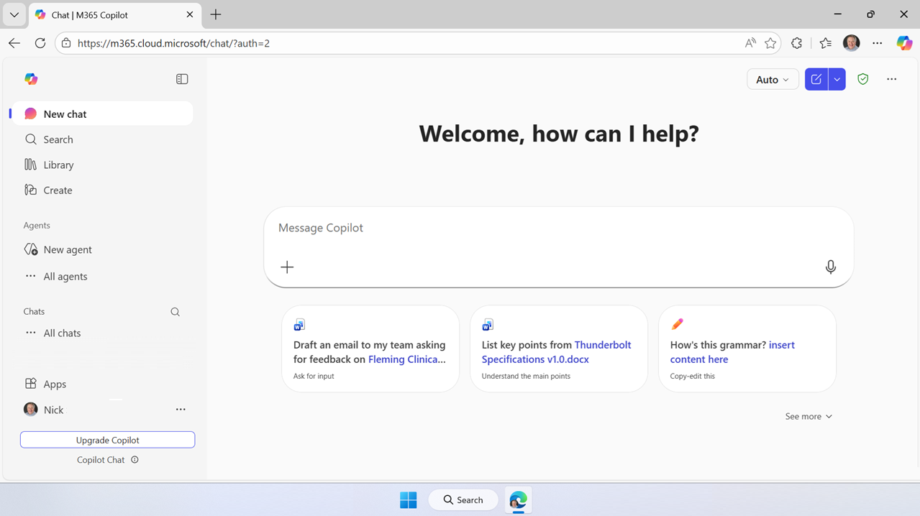
Where to find Copilot Chat
On the Web
Powered by the
Latest GPT Model
Secure AI chat powered by the latest models, grounded in web data, and context-aware, understanding the content you’re working on and tailoring responses accordingly.
m365.cloud.microsoft/chat
Notes:
So where do you actually find Copilot Chat? The first place is on the web. The official URL is m365.cloud.microsoft/chat—but honestly, I can never remember that. I just sign in to microsoft365.com with my work credentials and the Copilot Chat interface pops right up as the landing page. It’s the fastest way for most people to get started.

Slide 15
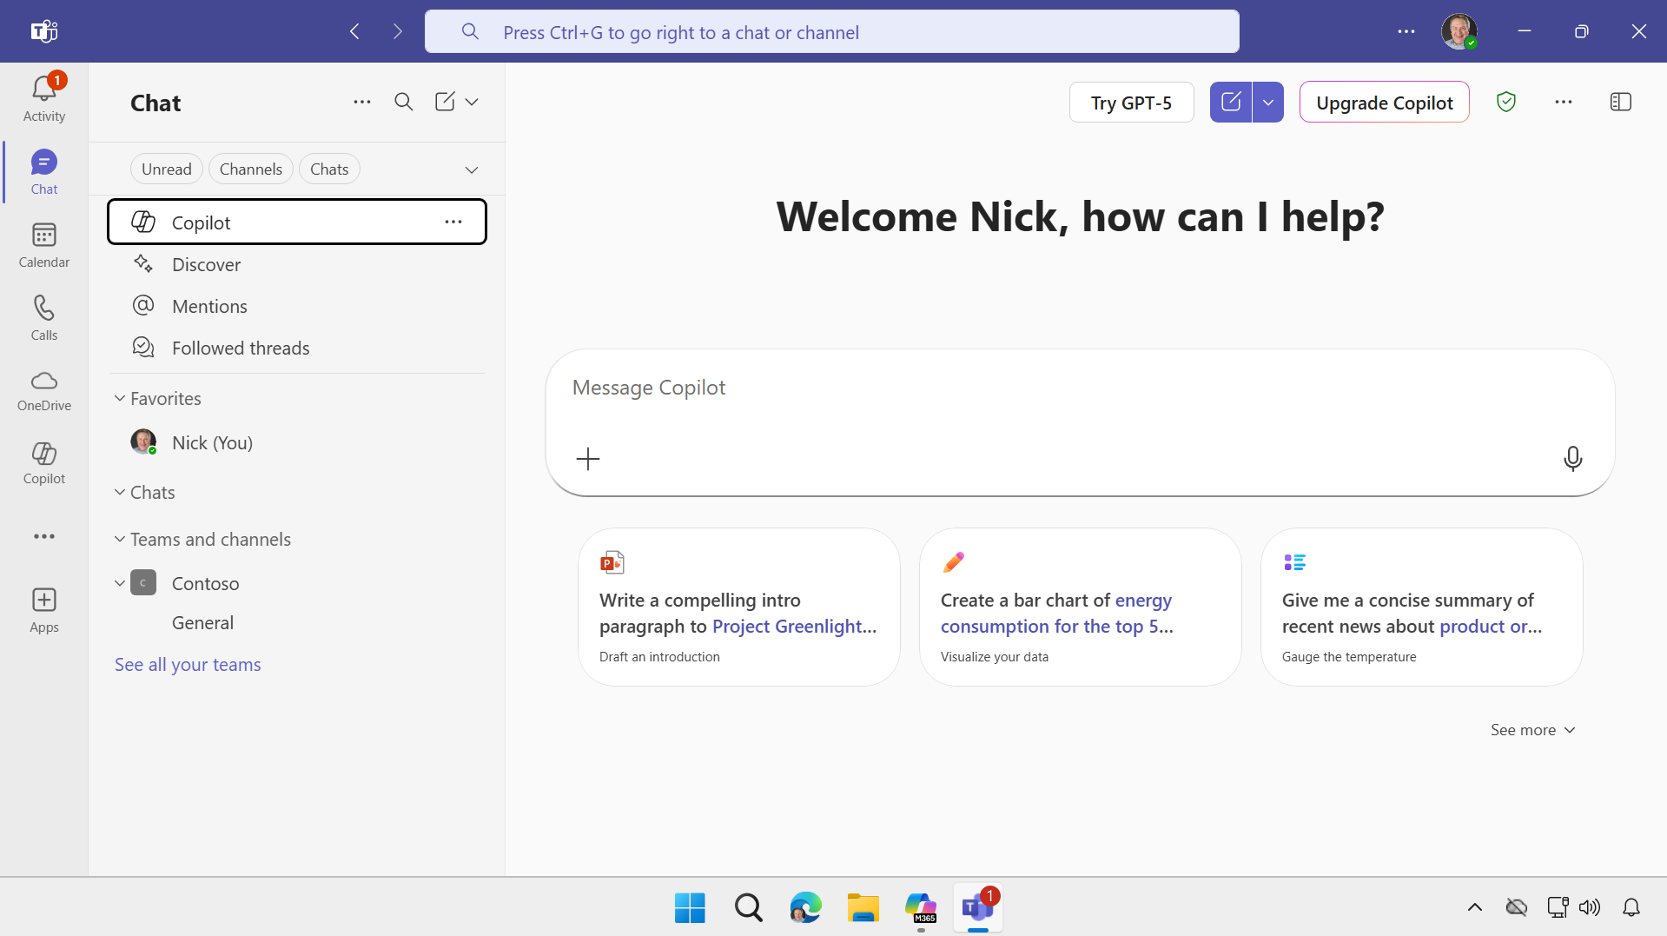
Where to find Copilot Chat
Microsoft
Teams
Prefer to work in Teams or Use “one pane of glass?”
Open Microsoft Teams. Go to Chat on the left side of Teams. Select Copilot from the top of your Teams chat list.
Notes:
Copilot Chat is also available inside Microsoft Teams. If you go to Chat in Teams and scroll to the top of your chat list, you’ll see Copilot listed right there. It’s the exact same experience—it just works as a chatbot inside Teams instead of in the browser. We did this because a lot of users are really comfortable with Teams and prefer to work in one pane of glass alongside their actual work.

Slide 16
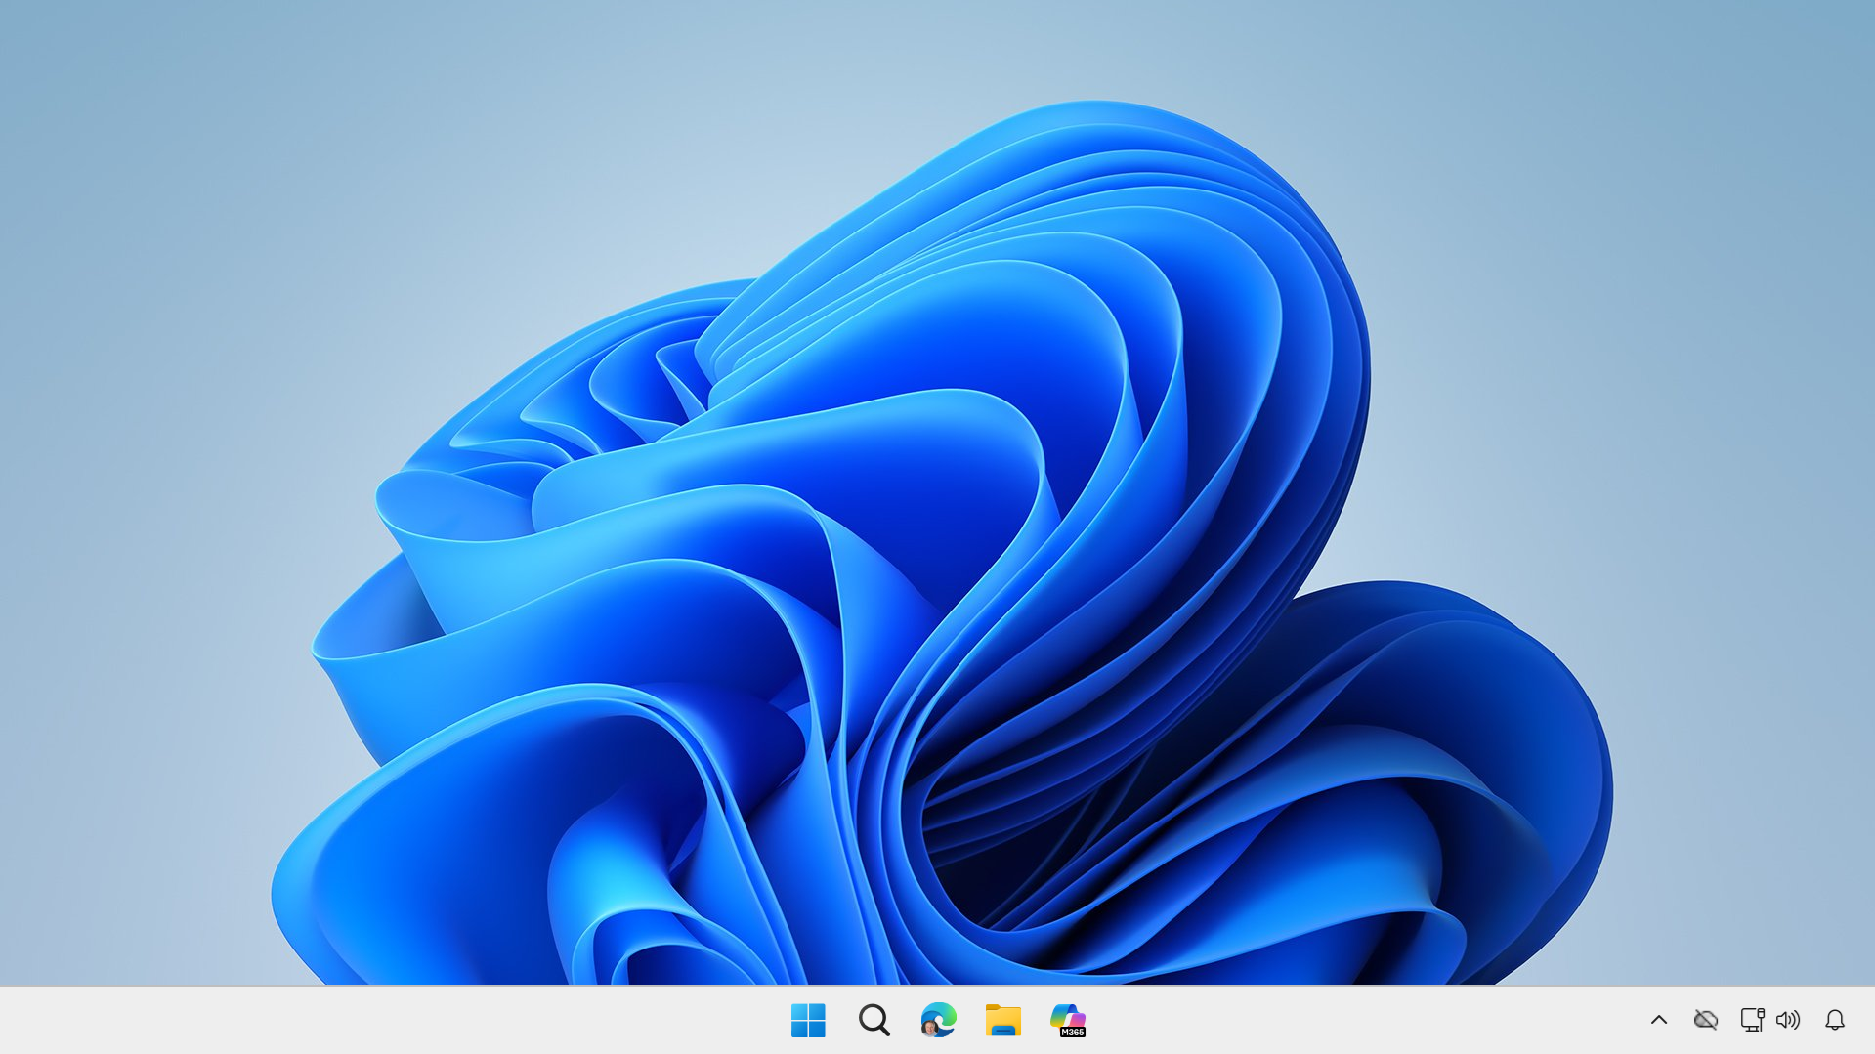
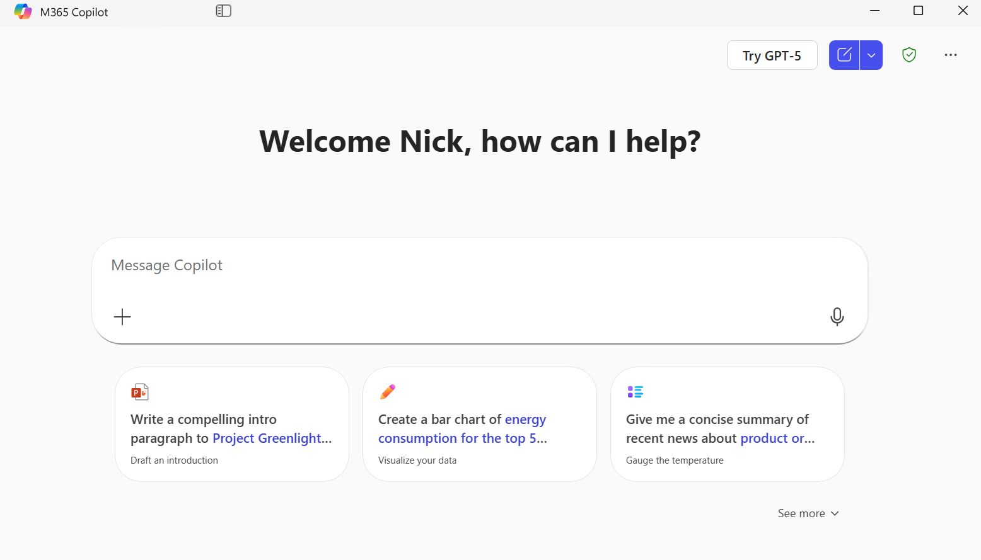
Where to find Copilot Chat
Windows and
Mac App
macOS: Launch from the Dock or Press Option + Spacebar
Windows: Launch from the Taskbar or press Windows Key + C or Copilot Key.
Notes:
There’s also a standalone desktop app for both Windows and Mac. On Mac, you can pin it to the Dock or press Option + Spacebar. On Windows, press the Windows key and the letter C, or if you have a newer computer, there might even be a dedicated Copilot key. Personally, this is usually how I use it—I dock it on my second monitor so I’ve got my work on one screen and my AI assistant running alongside me on the other.

Slide 17
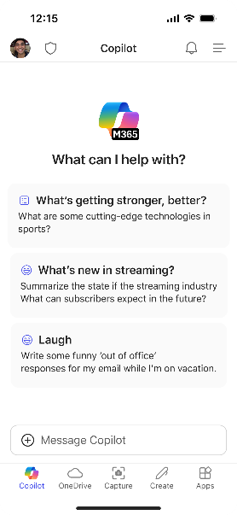
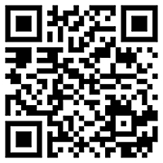
Microsoft 365 Copilot Mobile App
Windows, iOS and Android
Download the Microsoft 365 Copilot mobile app and sign in with your work or school account to access Copilot Chat on the Go
aka.ms/copilotmobile
Notes:
And Copilot Chat is available as a mobile app too. Just search for Microsoft 365 Copilot in your app store, install it, and sign in with your work credentials. What’s nice is it remembers your conversations across devices. So if I start something on my computer and then pick up my phone later, I can see my chat history and continue right where I left off. It’s a great way to extend AI access beyond the desk.

Slide 18
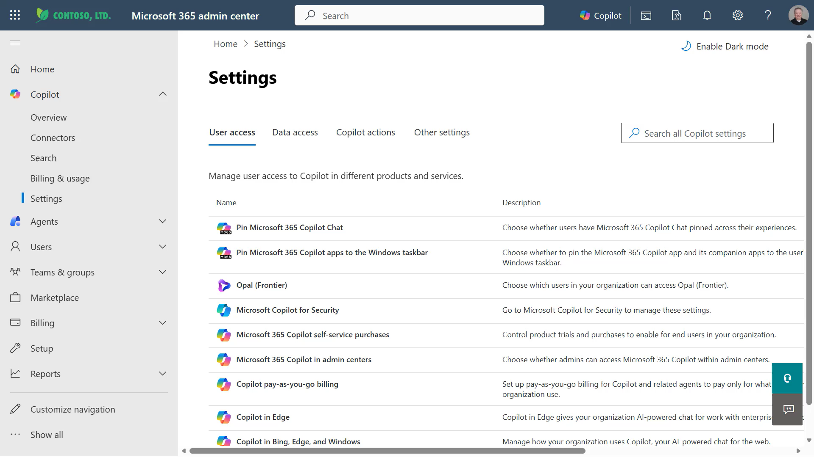
Where to find Copilot Chat
Pin Copilot Chat
Open the M365 Admin Center
Go to Copilot Control System > Settings.
Select Pin Copilot Chat
Toggle On
Users will now see Copilot Chat pinned in Teams, Outlook, and the Microsoft 365 app.
Windows: Click Pin to Windows Taskbar for Intune managed devices
Notes:
Here’s a tip that’s especially helpful for IT professionals trying to prevent shadow IT. If you go into the Microsoft 365 Admin Center, click Copilot, then Settings, there’s a control where you can pin Copilot Chat so it appears on the Windows taskbar, in Teams, and in Outlook for unlicensed users. It’s a simple step, but reducing friction makes a huge difference in driving consistent usage and habit-building across your organization.

Slide 19
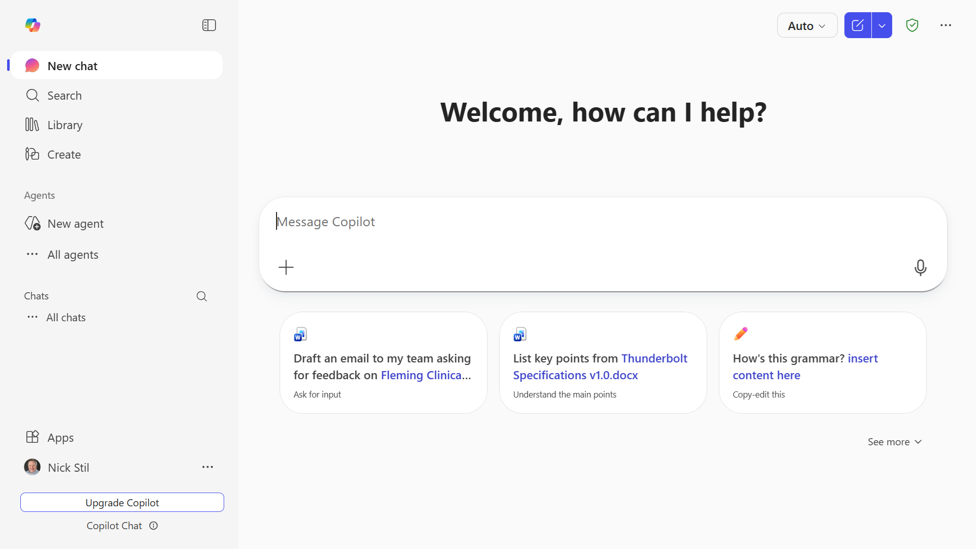
Microsoft 365 Copilot Chat
Library
Workspace for Copilot Pages and AI-generated
content
Start a new chat button
Clear your past chat and
start a new conversation.
Enterprise Data Protection
Secure, safe AI
Create
Generate an image, video, infographic, document and more
Prompt box
Start your conversation here
Agents
Use included
agents, with advanced agents available via metered billing
Dictation
Use dictation if you prefer to speak rather than type when you’re chatting with Copilot
Chat history
View past conversations
Add content
Expand to upload files and images or reference a file on OneDrive or SharePoint
Suggested prompts
Get started with prompt suggestions
Copilot Prompt Gallery
Expand the suggested prompts to view the full Copilot Prompt Gallery, including saved prompts and prompts from your team
Notes:
Let me walk through the Copilot Chat interface real quick. The prompt box in the middle is where all the magic happens—you just type in whatever you want to work on in natural language. Out of the box, Copilot Chat has access to the internet through a secure, enterprise version of Bing. Those searches are anonymized, so no one can see what you’re searching or which organization it’s coming from. You’ll also see suggested prompts to help you get started, a prompt gallery where you can save your favorites, and your chat history on the left. I always check the source citations at the bottom of responses—remember, it’s Copilot, not pilot. I want to double-check the work.

Slide 20
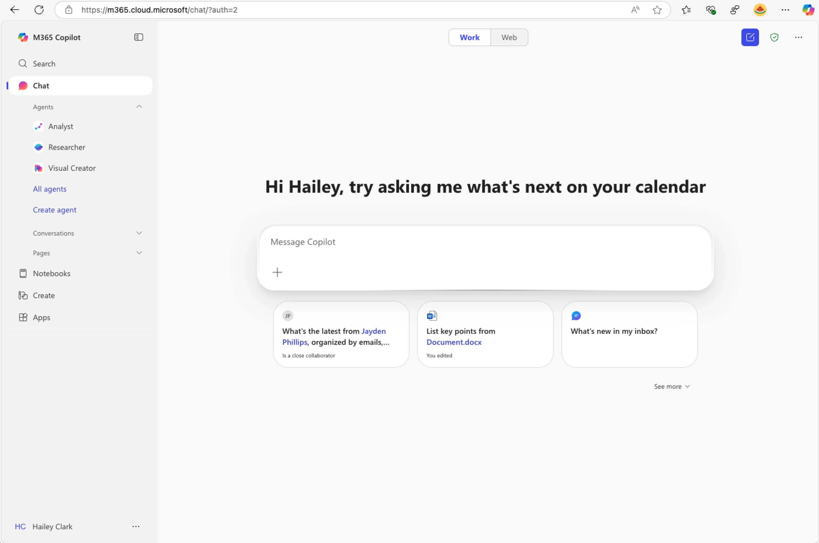
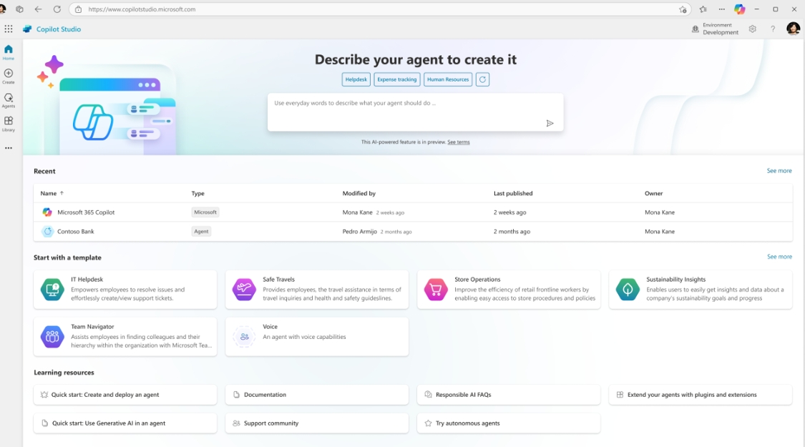
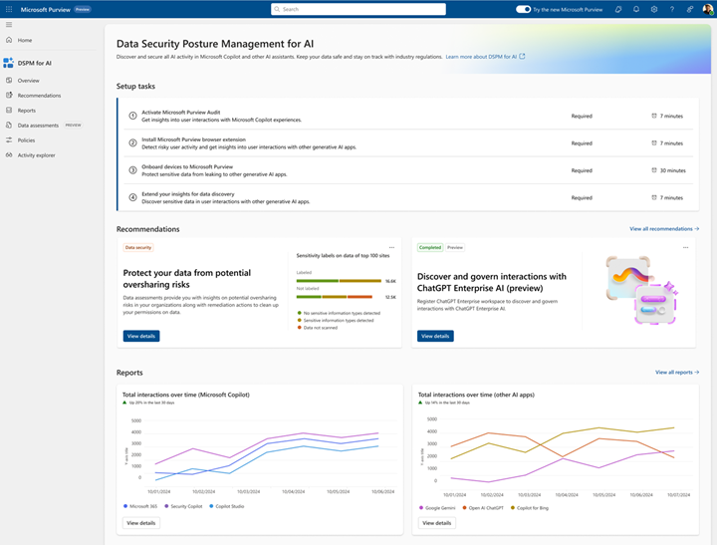
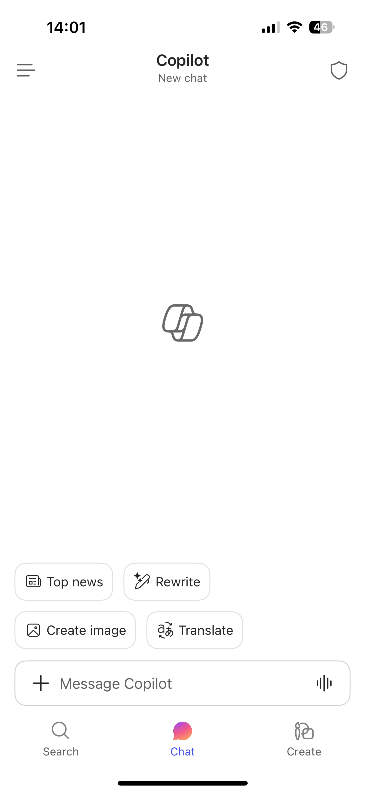
learn.microsoft.com/copilot/overview
Microsoft 365 Copilot Chat
Components
Chat
Agents
IT Controls
Free, secure AI chat –
powered by the latest GPT models and web grounded
Integrated into the chat experience and paid for on a consumption basis
Enterprise Data Protection
and agent management
Notes:
So to recap the three components of Copilot Chat. First, secure AI chat powered by the latest models and grounded in web knowledge. Second, agents that are integrated right into the chat experience—some are included free, and more advanced ones are available on a pay-as-you-go basis. And third, robust IT controls for enterprise-grade security, privacy, compliance, and management. It gives you the same level of protection for chat as you already get from Microsoft 365 for email and documents.

Slide 21
Agenda
Welcome and Intros
Microsoft 365 Copilot Chat
Benefits and Value:
Microsoft 365 Copilot Chat
Agents in Microsoft 365 Copilot Chat
Next Steps & Call to Action
Notes:
Alright, that wraps up our overview of Copilot Chat itself. Now let’s shift gears and talk about the real-world benefits and value—why this matters for how people actually work day to day.

Slide 22
Benefits and value of Microsoft 365 Copilot Chat
Notes:
Thanks, Nick. So we’re going to change gears a little bit here. Nick walked you through what Copilot Chat is and how to use it. Now I want to go through some of the benefits and real value that Copilot Chat can bring you and your organization. There are three main benefits I want you to walk away with today.

Slide 23
Copilot Chat Benefits
Inspiring Creativity: It inspires creativity by providing insights and suggestions that can help users think outside the box
Boosting Productivity: Copilot Chat boosts productivity by allowing users to accomplish more in less time
Enabling Focus: It enables busy teams to focus on what really matters by handling routine tasks
Notes:
So here are the three key benefits. First, Copilot Chat inspires creativity. You should never have writer’s block again—never have that moment where you don’t know how to get started with a project. Copilot Chat gives you insights, suggestions, and can even create documents for you. Second, it boosts productivity by saving you time. Need to summarize a sales meeting? Take a photo of a whiteboard and get it documented instantly? That time saved adds up fast. And third, it enables focus. The more we can offload routine tasks to AI—like logging hours or drafting reports—the more time we have for the strategic work that really matters. Our whole team uses Copilot Chat for things like categorizing weekly hours, and it saves us real time every week.

Slide 24
Key Use Cases for Copilot Chat
Summarization of Document: Copilot Chat can help users quickly summarize lengthy document.
Generating Creative Content: Users can leverage Copilot Chat to generate creative content such as stories, poems, and other written materials.
Providing Quick Answers and Explanations: Copilot Chat can be used to provide quick answers to questions and explanations on various topics, enhancing productivity.
Helping with Research: Copilot Chat can help to perform research for industries, markets, competitors, and products.
Notes:
Now let’s talk about the four key use cases where Copilot Chat really shines. First, summarization—next time someone sends you a 150-slide deck, don’t waste your time going slide by slide. Let Copilot Chat summarize it for you. Second, generating creative content—if you’re creating anything at all, you should be using Copilot Chat. It can draft emails, documents, tables, charts, even images. Third, providing quick answers and explanations—it’s actually better than traditional search engines at this. And fourth, helping with research. It’s great at horizon scans, competitive analysis, even pulling SEC documents. Take advantage of the deeper thinking model built into Copilot Chat—you’ll be surprised how good it is.

Slide 25
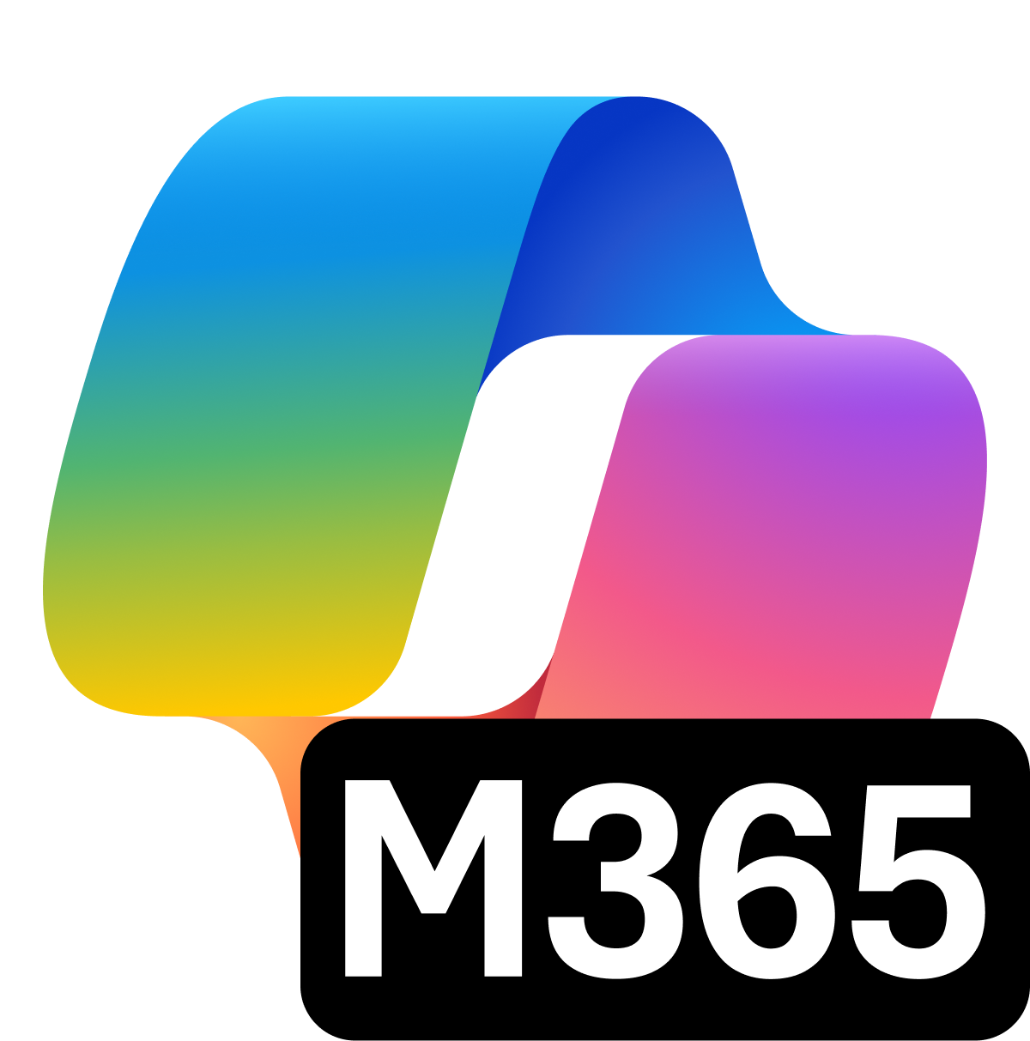
Scaling AI Transformation
Copilot Chat
Microsoft 365 Copilot
Notes:
Now, not every organization adopts AI the same way—it’s not one-size-fits-all. What we see is that flexibility is critical. Many organizations start by giving Copilot Chat to everyone and then evaluating who needs the full Copilot license over time. As people find more use cases, some will naturally grow into needing the full license. But the great thing is, as you get really good with Copilot Chat, those skills scale right up when you move to a licensed version. The two work together to accelerate your AI transformation.

Slide 26
The Risks of Shadow IT
2x
Data security incidents from the use of AI applications nearly doubled in 2024. ²
78%
80%
Of leaders cite leakage of sensitive data as a main concern of AI use. ³
of employees bring their own AI tools to work.¹
93%
Of companies took proactive action, implementing new controls for employee use of generative AI. ²
Source: 1. AI at Work Is Here. Now Comes the Hard Part 2: Microsoft Data Security Index Blog, 3: Microsoft Security Whitepaper,
Notes:
Here’s something that should get your attention: 78% of employees bring their own AI tools to work—that’s shadow IT, and it comes with real risk. Data security incidents from unsanctioned AI nearly doubled in 2024. 80% of leaders cite leakage of sensitive data as their main concern. And 93% of companies are taking proactive steps to address it. That’s exactly why providing a secure, sanctioned AI tool like Copilot Chat is so important—it gives people what they need without the risk of third-party tools that IT can’t control.

Slide 27

Microsoft 365 Copilot Chat is Built on Trust
Remove the desire for Shadow IT by providing secure, sanctioned AI tool with Copilot Chat.
We secure your data at rest and in transit
Security and Governance
Protect data, enforce compliance, mitigate risk
You control your data
Microsoft 365 Copilot Chat
is built on trust
Management Controls
Licensing/metering, lifecycle management, customization
Your data is not used to train or enrich foundation models
You're protected against AI security and copyright risks
Measurement and Reporting
Track adoption, usage patterns, productivity impact, and ROI
Find and block unapproved AI tools with
Shadow IT discovery and control in Microsoft 365
Microsoft Commitments
Copilot Control System
Notes:
Copilot Chat is built on trust, and I want to make sure you understand what that means. Your data is secured at rest and in transit. You control your data—not Microsoft. Your prompts and responses are not used to train or enrich our foundation models. And you’re protected against AI security and copyright risks. You should always see a little green icon in the Copilot Chat interface—that tells you enterprise data protection is in place. On the IT side, you get the Copilot Control System with security and governance controls, management tools for licensing and agent lifecycle, and measurement and reporting to track adoption, productivity, and ROI.

Slide 28

Top 10 to try first with Microsoft 365 Copilot Chat
1
2
3
4
5
Ask a question
Get insights and answers to your questions.
Draft an email
Generate an email draft and personalize the tone and length.
Summarize a document
Simplify a long document, article, or PDF.
Generate new ideas
Boost your creativity with ideas for your tasks such as agendas, image creation, social media posts, etc.
Draft a document
Start from a full draft rather than a blank page.
Draft an email to [name] that informs them that Project X is delayed two weeks. Make it short and casual in tone.
How does [product] compare to [competitor product]? Provide the comparison in a table.
Give me a bulleted list of key points from <insert file>.
Suggest 10 compelling taglines based on <insert file>.
Write an outline for a creative brief for a video project.
6
7
8
9
10
Improve your writing
Write and edit like a pro.
Learn something new
Quickly learn new skills and topics.
Create an image
Leave behind stock images and text-only reports by creating images easily.
Translate a message
Read and write content in other languages.
Lighten up your work
Add some fun to your emails, messages, and meetings.
Illustrate a romantic pop art image of an office worker experiencing a dramatic coffee crisis.
Generate three ways to say [text].
Explain how a large language model works in simple terms.
Translate the following text into French: [text].
Suggest 5 office-friendly jokes.
For more prompt examples, select “View prompts” below the Copilot Chat prompt box
Notes:
We wanted to make sure you walk away with some concrete things to try. Here are ten prompts to get you started with Copilot Chat. You’ll see some of those key use cases we talked about—summarizing a document, drafting an email, generating ideas, creating images, translating content, and more. These are on a handout that we’ll share—I’ll drop the PDF link in the chat. Don’t be afraid to experiment. You’re not going to break anything, and Copilot Chat can’t see any information you don’t already have access to.

Slide 29
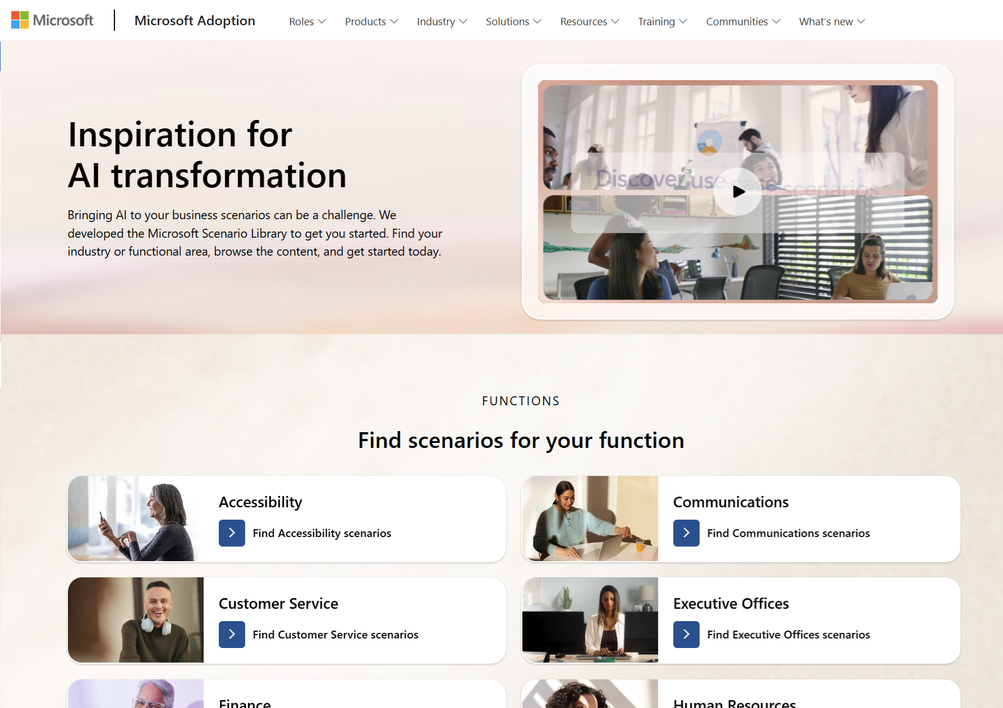
Microsoft 365 Copilot Chat Scenario Library
aka.ms/scenariolibrary
Explore Copilot Chat scenarios by industry, role and function to see what’s possible.
Downloadable scenarios guides have sample KPIs and day-in-the-life use cases to inspire users and uncover business value.
Notes:
One more resource I want to highlight is the Copilot Chat Scenario Library at aka.ms/scenariolibrary. This is a website where you can search and find use cases broken down by industry, role, or function. So if you’re in marketing, for example, you can find scenarios specific to what you do. There are downloadable scenario guides with sample KPIs and day-in-the-life use cases to help inspire you and uncover business value. Definitely check this out.

Slide 30
Agenda
Welcome and Intros
Microsoft 365 Copilot Chat
Benefits and Value:
Microsoft 365 Copilot Chat
Agents in Microsoft 365 Copilot Chat
Next Steps & Call to Action
Notes:
Alright, we’ve covered the overview and the benefits. Now let’s move into something really exciting—agents. Mike’s going to show us what agents are and how they work within Copilot Chat.

Slide 31
Agents in Microsoft 365 Copilot Chat Overview
Notes:
So let’s talk about agents. Agents extend Copilot Chat by helping automate repeatable tasks and workflows. Think of them as purpose-built helpers—little mini programs—that focus on a specific job. Microsoft’s vision is that there will be an agent for every business process. They make Copilot Chat more powerful without adding complexity for users.

Slide 32

Copilot Chat + Agents
Copilot
Copilot Studio
Agents
Copilot Control System
Notes:
Here’s how it all fits together. Copilot is the front end—the user interface for everything, including agents. Copilot Studio is where more advanced agents get built. And the Copilot Control System gives admins the tools to manage and govern agents across the organization. The important thing is that agents are accessed through the same familiar chat experience you already know.

Slide 33

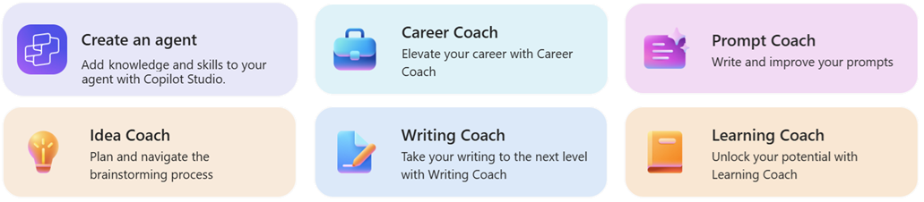

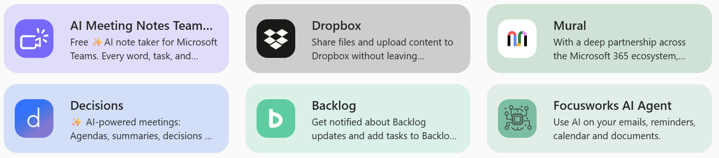
Agents in Copilot Chat
Included Agents in Copilot Chat
Microsoft 365 Copilot Agents grounded in instructions and public websites, including custom agents, can but used by unlicensed Copilot Chat users at no additional cost.
Copilot Chat
Every employee
has access to safe, secure AI
Metered Agents in Copilot Chat
Agents that access business data, such as SharePoint, Line of Business Systems, and Work IQ billed based on the user’s metered consumption..
Agents
Every business process transformed by agents
Notes:
So what are agents, exactly? They’re available to both Copilot and Copilot Chat users. As a Copilot Chat user, you get access to a set of Microsoft-created agents like Idea Coach, Writing Coach, Learning Coach, and some agent templates to help you build your own. There are two types: included agents that are free—these are grounded in instructions and public websites—and metered agents that access business data like SharePoint or line-of-business systems, which are billed based on consumption. Your IT admin would need to enable the metered ones, but the included agents are ready to go right away.

Slide 34
Explore a Continuum of Agent Solutions
IT Helpdesk agent
Device Refresh agent
Lead Gen agent
How do I connect to the corporate network?
Request a new laptop and send approvals via IT Service tool.
The agent has identified and researched 15 new leads for you to review.
Simple
Advanced
Project Tracker agent
Budget Management agent
Customer Support agent
What is the status of phase 2 for project X and the remaining budget?
Review outstanding open PO’s and begin financial planning.
The agent has identified new support issues and triaged to other agents.
Notes:
Agents can range from very simple to quite advanced. On the simple side, think of an IT helpdesk agent where you type in your laptop issue, it searches a knowledge base, and gives you an answer. Or a project tracker agent that keeps everyone informed on project status. On the advanced end, you could have a customer support agent that integrates with third-party systems like ServiceNow to create tickets or check statuses. Simple agents can be built right in Agent Builder—it’s very easy to use. More advanced ones would be built in Copilot Studio or even Azure.

Slide 35
Demos
Notes:
Alright, let me show you this in action. I’m going to demo a couple of agents so you can see what the experience looks like. First, I’ll show you the Idea Coach—one of Microsoft’s built-in agents. And then I’ll show you a custom agent I created called Trend Tracker Tech Edition, so you can see how easy it is to build your own. The key thing to notice is that the agent experience looks exactly like Copilot Chat—same prompt box, same interface. You wouldn’t even know you’re in an agent.

Slide 36
Agenda
Welcome and Intros
Microsoft 365 Copilot Chat
Benefits and Value:
Microsoft 365 Copilot Chat
Agents in Microsoft 365 Copilot Chat
Next Steps & Call to Action
Notes:
Great overview and walkthrough from Mike. You know, one of the reasons we wanted you to be aware of agents in the free version is that there’s a whole class of users who don’t necessarily need the full license but could really benefit from an agentic experience—like someone in a call center, for example. If you want to go deeper on agents, check out the Customer Hub website where we have dedicated deep-dive sessions on building them.

Slide 37
Next Steps
Pin Microsoft 365 Copilot Chat for quick and easy access
Provide quick and easy access to Microsoft 365 Copilot Chat by pinning Copilot Chat to the navigation bar of Teams, Outlook, and the Microsoft 365 App. Pin Microsoft Copilot to the navigation bar | Microsoft Learn
Encourage the use of Microsoft 365 Copilot Chat within your organization. Accelerate its adoption by designating a sponsor to oversee communication and support change. Increase awareness and usability by demonstrating practices that emphasize “what’s in it for them”. Microsoft 365 Copilot Chat Adoption.
Introduce Microsoft 365 Copilot Chat
Manage Microsoft 365 Copilot Chat
Begin leveraging the capabilities of Generative AI for significant impact. Provide support to your organization with technical documentation and enablement for Microsoft 365 Copilot Chat.
Notes:
So what should you do after today? Three things. First, pin Copilot Chat so it’s easy for everyone to find—go to aka.ms/pinchat for the instructions. Reducing friction is the single biggest thing you can do to drive adoption. Second, introduce Copilot Chat in your organization—designate a sponsor, communicate the value, and show people what’s in it for them. The adoption site has email templates, training resources, and more. And third, start managing it—there’s technical documentation and enablement guidance for IT pros at learn.microsoft.com.

Slide 38
Resources after Today
Microsoft 365 Copilot Chat Help & Learning
support.microsoft.com/copilot-microsoft365-chat
Short how-to videos, help articles
Top 10 Things to Try First
aka.ms/Copilot/Top10ChatHandout
PDF Handout of sample prompts
Art of the Prompt
aka.ms/CopilotPromptIngredients
How to write a good Prompt
Copilot Prompt Gallery
aka.ms/prompts
Samples and Prompts you Saved
Copilot Scenario Library
aka.ms/copilot/scenariolibrary
Examples of business use cases
Microsoft 365 Copilot Chat Adoption
adoption.microsoft.com/en-us/copilot-chat/
Resources for Adoptioon specialists
Copilot Chat Training Deck
aka.ms/Copilot/ChatUserTrainingGuide
PowerPoint deck for End User Training
Great Journey for Copilot Chat
aka.ms/Copilot/ChatJourney
30-day skilling, daily tips and templates
Technical Documentation for IT Pros
learn.microsoft.com/copilot/overview
Customer Hub Sessions
aka.ms/CustomerHubSessions​
Notes:
Let me share some resources to help you keep going after today. We’ve got Help and Learning articles with how-to videos, the Top 10 Things to Try First handout we just showed you, the Art of the Prompt guide which we’ll cover in depth in our session in two weeks, the Prompt Gallery for browsing and saving prompts, and the Scenario Library for business use cases. For adoption specialists, there’s also a training deck, a 30-day skilling journey, and technical documentation. I’m going to drop all these links in the chat—and yes, I’m dating myself by calling them hyperlinks.

Slide 39

Microsoft Resources to Accelerate your Time to Value
Microsoft 365 Copilot
End User Help and
Learning, Support Articles, How-to Videos
Get started building
AI Agents for
Microsoft 365 Copilot
Onboard at scale with resources enabling adoption, usage, change management and business outcomes.
Find Partners to help with Microsoft 365 Copilot Scenarios, Adoption and Agentic Transformation
Microsoft 365 Copilot
Help and Learning
AI Agents Hub
adoption.microsoft.com
Microsoft 365 Copilot
Partner Directory
Enterprise skilling plan, Microsoft Instructor-led training, Microsoft Certification discounts
Eligible customers
can request technical and deployment
assistance from Microsoft.
Microsoft Unified Support offerings and workshops focused on business value, governance, and enablement..
Enterprise Skilling Initiative
Microsoft FastTrack
Microsoft Unified
Notes:
For those in larger organizations—enterprises, schools, nonprofits—there are additional resources available. We have a partner directory with certified Copilot partners, the Enterprise Skilling Initiative if you want sessions like this delivered internally, Microsoft FastTrack for technical deployment help, and Microsoft Unified Support with paid workshops ranging from four to sixteen hours covering everything from technical enablement to use case discovery.

Slide 40

THANK YOU –
Your feedback is critical
Scan with your mobile device camera
-OR-
We’re committed to making your Customer Hub experience the best it can be – and your feedback is a critical component to that.
Before you scoot, please take a moment to provide some feedback.
Visit
Customer Hub Survey
aka.ms/CustomerHubSurvey
Select Copilot Chat for All Users series
Notes:
Before you go, we’d really appreciate your feedback. Go to aka.ms/CustomerHubSurvey, select the Copilot Chat for All Users series, and let us know how we did. Your input directly shapes future sessions and helps us make sure the resources stay aligned with what you actually need. It only takes a minute.

Slide 41

Q&A
1
Please raise your hand and unmute when called on
2
Notes:
Alright, now let’s open things up for questions. Feel free to raise your hand and we’ll unmute you, or just drop questions in the chat. We’re happy to clarify anything or go deeper on topics that stood out. Don’t be shy—no question is too basic or too technical for this group.

Slide 42
Notes:
Thank you all so much for spending time with us today. We really appreciate your engagement. These slides and the recording will be posted to the Customer Hub website in about a week or so. And remember—Mike and I will be back for the next sessions in the series, so we hope to see you again. Have fun with Copilot Chat!

Slide 43
Microsoft 365 Copilot
Copilot Chat¹
M365
Copilot
● Included ο Limited ▲ Metered
w/o Copilot license
$30 pu/pm
Grounding | Web data, referenced files, uploaded files | ● | ●
 | Work IQ | - | ●
 | Use Copilot connectors to access external data sources | ▲ | ●
Models | Latest OpenAI models: GPT-5.X | Standard | Priority
 | Model choice | - | ●
Microsoft 365 Copilot App | Chat | ● | ●
 | Search² | ο | ●
 | Notebooks | - | ●
 | Create³ | Standard | Priority
 | Memory and personalization | ● | ●
 | Voice on mobile, desktop, web | - | ●
 | Sora 2⁴ | - | ●
 | Copilot Mode in Edge⁵ | ο | ●
M365 Apps | Copilot in Outlook⁶ | Standard | Priority
 | Word, Excel, and PowerPoint agents accessed via Chat | Standard | Priority
 | Copilot in Word, Excel, PowerPoint, and OneNote | - | ●
 | Copilot in Teams | - | ●
Agents & tools | Pre-built Microsoft agents, including Researcher, Analyst, and Facilitator⁷ | - | ●
 | Sales, Service, and Finance agents | - | ●
 | Agent creation using Agent Builder and Copilot Studio | ● | ●
 | App Builder and Workflows agents⁴ | - | ●
 | Agent usage | ▲ | ●
Security and management | Enterprise Data Protection (EDP), management, compliance, and controls | ● | ●
 | Analytics to measure adoption, usage, and business impact⁸ | ο | ●
 | SharePoint Advanced Management | - | ●
Applies to customers with 2K or more M365 seats
Lexical search included for Copilot Chat users
Access to brand kits and surveys requires M365 Copilot license
Available via Frontier program, pricing final upon GA
Copilot Chat users access Copilot Mode w/web data and open documents only
For unlicensed users, Copilot Chat in Outlook reasons over organizational data in Outlook, Teams, OneDrive, and SharePoint (limited).
Researcher and Analyst, have combined limit of 25 interactions pu/pm
Basic reporting available with Copilot Chat
Notes:
For those who said your organization is going with the full Copilot license, or if you’re curious about the differences, here’s a detailed comparison. You can see that Copilot Chat users get secure AI chat with web grounding and standard access. The full Copilot license adds things like Work IQ—which can see all your work content at once—priority access to the latest models, advanced skills in the Microsoft 365 apps, Copilot in Word, Excel, PowerPoint, and Teams, and more. This slide is a great reference to keep handy as you evaluate what’s right for different users in your organization.

Slide 44
Standard and Priority access
Microsoft has moved to a capacity-based model in order to provide more flexible and scalable experience for our users.
Microsoft 365 Copilot Chat
users without Microsoft 365 Copilot license
Standard access: subject to service capacity, which may vary throughout the day. If capacity isn't available, users are notified in-product, but any task already in progress continues uninterrupted. This standard capacity applies to:
Image generation
File upload
GPT-5.2
Microsoft 365 Copilot
users with Microsoft 365 Copilot license
Priority access: faster response times and more consistent availability, including peak periods.​ This priority capacity applies to:
Image generation
File upload
GPT-5.2
Learn more on Microsoft Support
Notes:
One more thing to understand about the Copilot Chat experience is the difference between standard and priority access. Microsoft has moved to a capacity-based model. As a Copilot Chat user without a license, you get standard access—which means availability may vary throughout the day based on service capacity. If capacity isn’t available, you’ll see a notification, but anything already in progress won’t be interrupted. Licensed Copilot users get priority access with faster response times and more consistent availability, even during peak periods.

Slide 45
Join our upcoming Copilot Customer Hub sessions
Microsoft 365 Copilot Chat for All Users
Introducing Value with
Copilot Chat for All Users
Secure and Deploy AI with Copilot Chat
Enable AI for All: Copilot Chat Adoption Best Practices
Maximize Your
Copilot Chat Experience
📅 [day], [month] [dd], 2026
🕑8 AM PDT
🔗Register now
📅 Tuesday, April 21, 2026
🕑8 AM PDT
🔗Register now
📅 Tuesday, April 28, 2026
🕑8 AM PDT
🔗Register now
📅 Tuesday, May 5, 2026
🕑8 AM PDT
🔗Register now
Prompt Mastery
Agents in Copilot Chat
Sessions on Microsoft Teams, Copilot, Power Platform, and more!
Prompting 101: Prompt
Mastery Series
Bring your own Agents to Copilot Chat
Third Party Agents in Copilot Chat
▶️ Watch on Demand
📅 [day], [month] [dd], 2026
🕑8 AM PDT
🔗Register now
📅 [day], [month] [dd], 2026
🕑8 AM PDT
🔗Register now
GPT-5 in Copilot
GPT-5 in Copilot: What every
eader & user should know
▶️ Watch on Demand
https://aka.ms/CustomerHubSessions​
Notes:
We’ve got more Customer Hub sessions coming up, and I’d encourage you to register for the ones that interest you. There are sessions on securing and deploying Copilot Chat, adoption best practices, prompt mastery, and even deep dives into agents. You can find all of them at aka.ms/CustomerHubSessions. Some past sessions are also available on demand if you want to watch those right away.

Slide 46

Hello and welcome to Customer Hub
Introducing Value with Microsoft 365 Copilot Chat for All Users
We will begin shortly.
Notes:
Welcome to the Customer Hub! We’ll be getting started in just a moment. Today’s session is all about introducing value with Microsoft 365 Copilot Chat for all users. While you wait, feel free to get comfortable—we’ll kick things off shortly.

