Slide 1
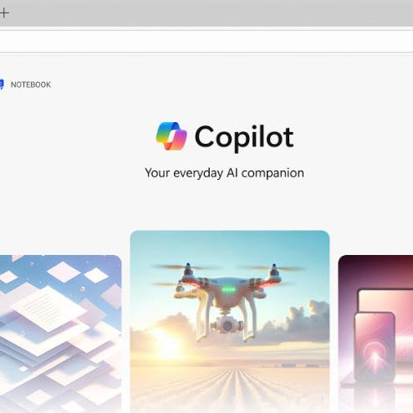
Holiday Hustle, Copilot Style: Stay Productive While You Unplug
Notes:
Today, we’re exploring how Copilot can help us manage time off more effectively.
Before a holiday or break, many of us find ourselves extremely busy, trying to wrap up outstanding tasks. Personally, I notice that my most productive day is often the one right before vacation—everything gets focused, and I tackle only what’s essential.
Sometimes, even as my time off begins, I’m still finishing up loose ends. Similarly, just before returning to work, I might spend part of the day getting things in order. Copilot can help with these transitions. I believe in truly disconnecting during time off, but sometimes it’s necessary to check in, and Copilot can support that as well. We’ll walk through practical scenarios together.
Finally, when we come back from a holiday—whether it’s a long weekend, a week, or more—there’s often a moment of reorientation.
Feel free to use this anecdote or come up with your own
I sometimes feel like the character in Office Space who asks, “What exactly do you do here?” On my first day back, I wonder, “What was my job? What am I supposed to be doing? Who’s my boss?”
Today, we’ll look at how Copilot can help us get back on track after time away.

Slide 2
Agenda
Microsoft 365 Copilot
Holiday Hustle Handout
The Art of the Prompt
Holiday Hustle
  Before the Holiday:
  Clear the Clutter, Complete what Matters
  During the Holiday:
  Triage with Boundaries, Reflect with Intent
  After the Holiday
  Reorient, Reset, Relaunch
Next Steps & Calls to Action
Notes:
Here’s our plan for the next 40 minutes, followed by Q&A:
We’ll start with a brief orientation on Microsoft 365 Copilot. If you’re new to this tool, I recommend checking out our Introduction to Copilot and Copilot Chat sessions on the [Customer Hub, Support.microsoft.com/Microsoft-365-copilot or wherever you keep training content]
I’ll walk you through a quick overview, and we have a handout you can use. I’m breaking the usual presentation rule by sharing the handout while I’m speaking, so you can follow along and refer to it later.
My goal is to help you make the most of these tools. I’ve noticed that our familiarity with them can fade during time off, especially since cloud interfaces change over time. When you return after a break, you might wonder, “Where did that button go?” or “What was that prompt that worked so well?”
I encourage you to take a few extra seconds to review things before leaving on a vacation and again when returning. These tips are designed to help you stay productive and avoid help desk calls or confusion.
Next, we’ll discuss the art of prompting—best practices for working with AI tools.
Then, we’ll explore how to use Copilot before, during, and after a holiday to solve common challenges: focusing on what matters, clearing out clutter before you leave, maintaining boundaries during your time off, and reorienting when you return.
Ideally, time off should be a true break, but sometimes you need to check ins. Copilot can help make those check-ins quick and curate what you need for your return.
After the holiday, we’ll look at how Copilot can help you get back up to speed and reorient yourself.

Slide 3


Copilot is the UI for AI
Copilot
Agents
Notes:
This slide is optional and mostly useful if you have some users with a Copilot license and some people using the Copilot capabilities that some with Microsoft 365.
Let me give you a quick overview of Copilot, just as a reminder of what this app is all about. Copilot is designed to be the user interface for artificial intelligence—think of it as the UI for AI. It sits alongside all the familiar Microsoft tools, like Outlook and Word, and even newer ones like Microsoft Loop and Teams. The idea is that Copilot works with these tools in context, helping you as you go about your work.
Feel free to use this anecdote or choose you own
I always compare Copilot to spell check. Back in the day, I had a dictionary sitting on my desk to look up words I didn’t know how to spell. Then, spell check came along—first in Word, then Outlook, and eventually everywhere. Now, it’s just part of how I work, and I don’t even think about it. AI is becoming the same way: Copilot sits right next to you, ready to help out whenever you need it.
If you need to do something more complex, like a business process with lots of steps, you can use agents. Agents let you structure multi-step tasks and work autonomously, all within your workflow. We won’t dive into agents today, though—we’ll stick to the basics of Copilot, which comes in two versions.
If you have a Microsoft 365 Copilot license you get full integration into the apps and your work data. But even without the full license, you get secure AI as part of any Microsoft 365 subscription. That means you have a secure AI tool, and your users don’t have to rely on consumer offerings or paste work data into tools you can’t control.
I always remind people not to do what we call “shadow IT.” Please don’t put your files on Facebook and send them to customers—use OneDrive and send an external link instead. The same with AI tools. Please don’t send your work data to companies that aren’t part of our ecosystem. It’s a recurring part of the job to encourage everyone to use the tools we’ve set up for them.

Slide 4
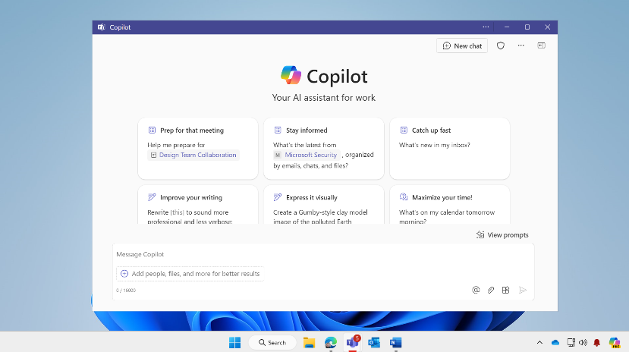
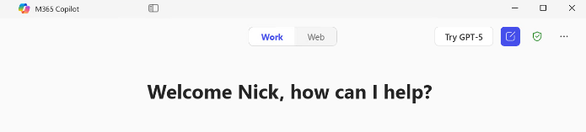
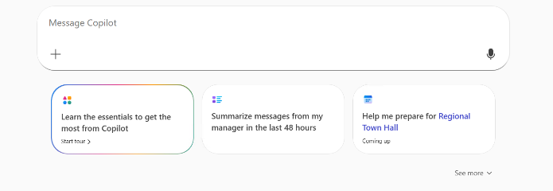
Where to find Copilot
Windows and
Mac App
macOS: Launch from the Dock or Press Option + Spacebar
Windows: Launch from the Taskbar or press Windows Key + C or Copilot Key. Hold for Press-to-Talk Copilot Voice
Notes:
Copilot is available as a dedicated application for both Windows and Mac. You can pin it to your dock or taskbar, making it easy to launch whenever you need it.
On a Mac, pressing the Option key and the spacebar will instantly open Copilot and activate voice mode, so you can start speaking your questions right away.
On Windows, you can do the same by pressing the Windows key and the letter C. If you hold down the Windows key and C together, Copilot immediately switches to voice interaction—just like using a push-to-talk button on a walkie-talkie.
I find this feature especially handy. When I’m at my computer, I simply press Windows key + C, hold it down, and start asking Copilot questions. It feels a bit like having a conversation with the computer. Depending on your license Copilot responds based on your work data and/or information from the web, making it a powerful tool for quick, grounded answers.

Slide 5
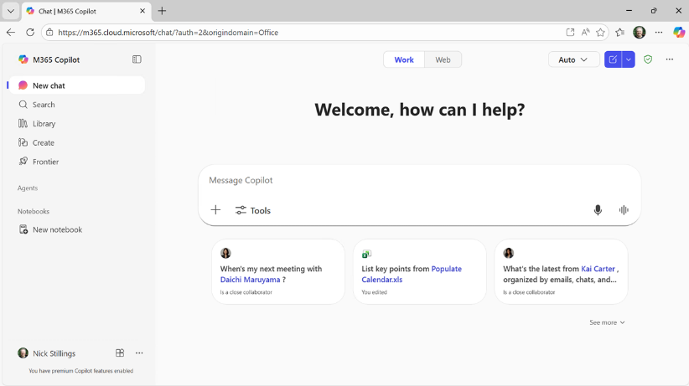
Where to find Copilot
On the Web
Secure AI chat powered by the latest models, grounded in web data, and context-aware, understanding the content you’re working on and tailoring responses accordingly.
m365.cloud.microsoft/chat
Notes:
Copilot is available in the browser—go to m365.cloud.microsoft/chat for the Copilot app. It's available on different platforms, with slightly different UI depending on platform—optimized for keyboard or touch.

Slide 6
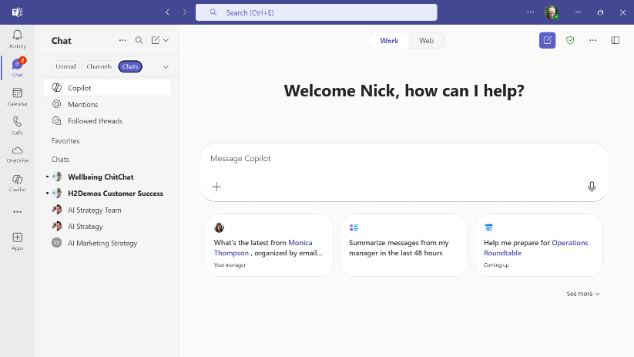
Where to find Copilot
Microsoft
Teams and Outlook
Left sidebar in Teams
Copilot app selection
Already in Teams or Outlook and want to get to the Copilot app?
Open Microsoft Teams or Outlook. Go to App selection bar on the left side. Select Copilot from your list of apps.
Notes:
The Copilot app is also integrated into Microsoft Teams and Outlook. If you go to the left sidebar, you see Copilot in the list of available apps such as Chat, Calendar, Calls, etc. for Teams and Mail, Calendar, People, Tasks, etc. for Outlook. This selection opens Copilot Chat within Teams or Outlook and lets you interact with Copilot Chat the same as you would in the Web app or desktop app. But note that its only Chat features so only Chat and agents. To Search or Create you’ll need to open the full Copilot app on the web or the desktop.
Now you may notice that Teams and Outlook also have a Copilot icon in the ribbon. Clicking here will open a task pane on the right side of the app. These in-app Copilot Chat experiences are all customized for that app and let you use Copilot to work with your content in that app. At first, I found the two different UIs a little confusing. The key difference is that opening the app on the left sidebar let’s you use Copilot Chat without a preset context, while using the app on the right pop-out pane let’s you work within the context of the document that is open.
I’ll talk about this more on the next slide.

Slide 7
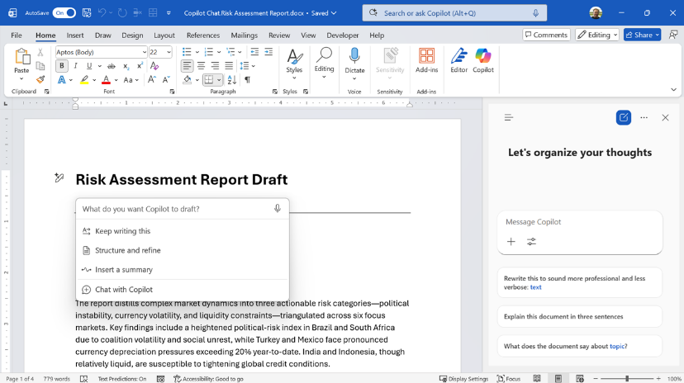
Where to find Copilot
Microsoft 365 Apps
Use Copilot right in the app
Copilot pane in Word
Copilot Chat pane
Copilot Chat pane and integrated into the app UI for licensed Microsoft 365 Copilot users
Notes:
As I was just saying, Copilot Chat is also integrated directly into Microsoft apps like Outlook and Teams. It’s also in Word, Excel, PowerPoint, and OneNote. For example, in Word, you can click the Copilot button in the ribbon, and Copilot will help you work with the document you have open.
If you’re using a licensed version of Copilot, you’ll notice additional features in the app user interface. For example, in Excel, when you select a range of cells, a Copilot button appears. Clicking it prompts Copilot to ask what you’d like to do—such as analyzing the data or looking for trends and insights. This makes the AI experience feel natural and embedded right into the tool, so you can get help as you work.
The goal is to make Copilot a seamless part of your workflow, offering support and insights exactly when you need them, without interrupting your process.

Slide 8
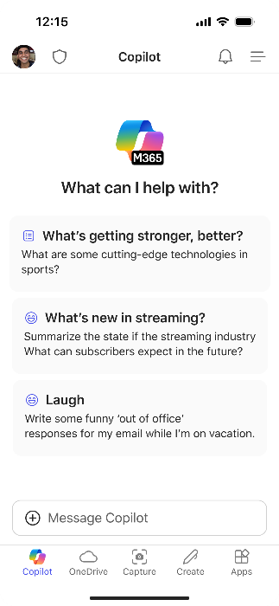
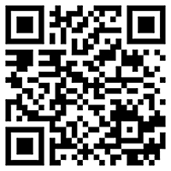
Use Copilot on the go with Copilot Mobile
Download the Microsoft 365 Copilot mobile app and sign in with your work or school account to access Copilot Chat
aka.ms/copilotmobile
Notes:
Copilot is also available on mobile devices. You can download the app by visiting aka.ms/copilotmobile, or by searching for Copilot in the Google Play Store or the Apple App Store. Once installed, simply sign in with your work or school credentials.
Having Copilot on your phone is especially helpful when you’re not in the office. You can access Copilot’s features wherever you are. For example, you can quickly ask questions, get summaries, or manage tasks directly from your mobile device.

Slide 9
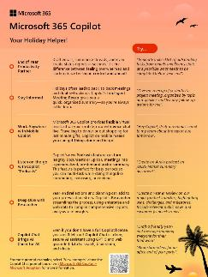
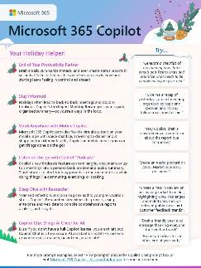
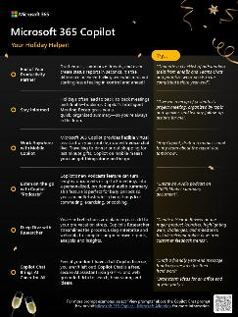
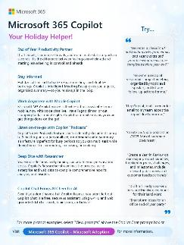
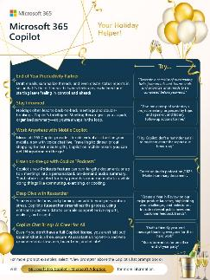
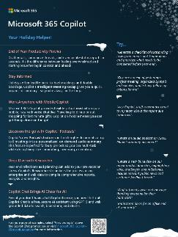
Holiday Hustle Handout
Empower your Users! aka.ms/Copilot/HolidayPrompts
Notes:
Present this slide if you haven’t already prepared the handouts.
You’ve probably heard that you shouldn’t pass out handouts during a talk—people tend to focus on the paper instead of listening. But today, I’m breaking that rule because I want you to have a chance to explore these resources and play with them as we go. So download them now at the link here: https://aka.ms/Copilot/HolidayPrompts
Feel free to look through the handout as we move along. If you have any questions about what you see, just drop them into the chat and we’ll address them together.
I’ve included several examples of how you can use these tools, and I’ll actually demonstrate more than what’s on the handout. My goal is to keep things simple and approachable, especially if you plan to share these resources with other users. I don’t want to overwhelm anyone or scare them away from trying AI. It’s best to start simple—crawl, walk, then run—as people get comfortable with these new tools.
Even though we’re a few years into the AI transformation, I find that many people still use these tools like basic search engines. They’re just asking simple questions, instead of taking advantage of the potential to use Copilot as a real assistant and get more work done.

Slide 10
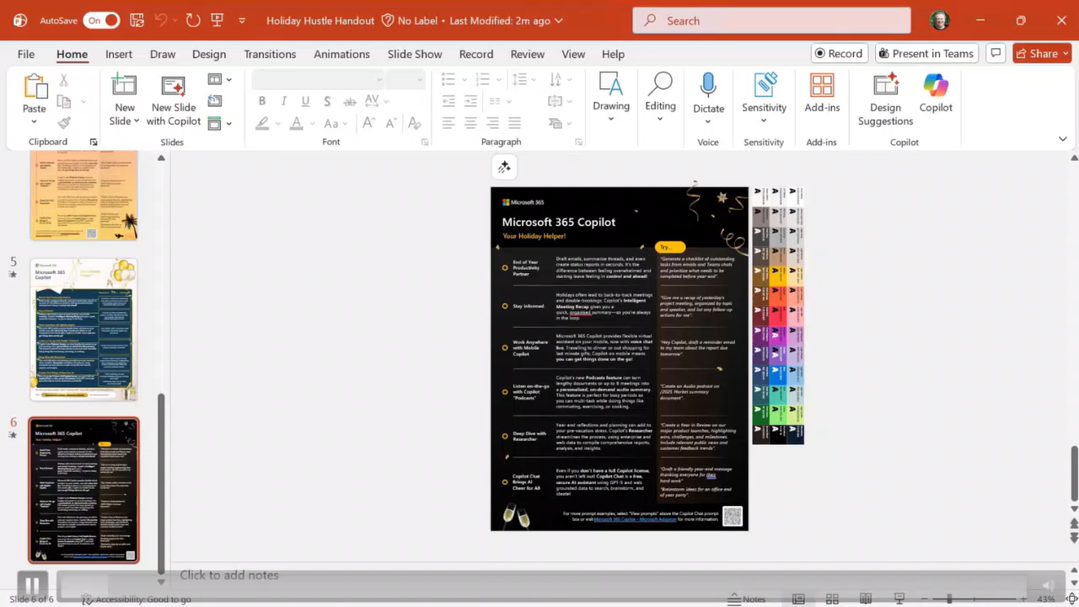
Demo to create an image
Notes:
You have the option to do this demo live, show the demo with the audio, or show the demo and use the speaker notes to narrate it.
Demo Prompt: Generate a photo of a candle-lit winter solstice yule log next to a laptop. The background should be dark so it will blend into a black PowerPoint slide background.
Let’s walk through how you can use Copilot to create images for your presentations or handouts. For this demo, I’m focusing on winter holiday themes, but you can adapt these steps for any occasion.
First, I open the handout in PowerPoint. I click the Copilot button and enter a prompt—for example, “Generate a photo of a candlelit winter solstice Yule log next to a laptop.” This combines a festive holiday element with a work setting, making it relevant and visually engaging.
I ask Copilot to make the image dark, so it fits well as a background on my slide. Once Copilot generates the image, I click the plus sign to add it as an object in PowerPoint. Now, I can move, resize, or layer the image however I want.
If you want a more neutral or culturally inclusive holiday theme, Copilot’s create tools make it easy to adjust the style. In the full Copilot app, you get even more controls—like choosing the style, color palette, or using your company’s brand kit. Your IT admin can set up a brand kit with graphics and logo colors to ensure everything matches your organization’s guidelines.
You can also upload a sample image and ask Copilot to base the new image on it, or continue refining your prompt for more specific results. The key is to experiment and make these resources your own. Don’t feel limited by the initial layouts—Copilot is designed to help you customize and iterate until you get exactly what you need.

Slide 11
The Art and Science of prompting
Include the right prompt ingredients
To get the best response, it’s important to focus on some of the key elements when phrasing your Copilot prompts.
Goal
Context
Expectations
Goal
Context
Source
Expectations
Source
What response do you want from Copilot?
Why do you need it and who is involved?
Which information sources or samples should Copilot use?
How should Copilot respond
to meet your expectations?
aka.ms/CopilotPromptIngredients
Notes:
Let’s talk about prompting and how to get the best results from Copilot. Maybe you’ve seen this before because Microsoft promotes these best practices frequently, but it’s always worth revisiting. Many people use Copilot almost like a search tool, but you can get much better results by providing context about what you want to accomplish.
Think of Copilot as a helpful intern—eager to assist, but needing clear instructions. When you ask Copilot for help, include what you’re trying to do, your goal, and any relevant context or background information. If there’s specific data Copilot should reference, mention that as well. Finally, let Copilot know how you want the results delivered—maybe as a table, a bulleted list, or in a format you plan to use in PowerPoint or Teams.
For example, if you’re preparing for a holiday and want Copilot’s help, start by explaining your objective and the context. Remember, Copilot’s responses are shaped by the information you provide, so the more details you share, the more tailored and useful the results will be.
I will often say something like, I plan to paste this into PowerPoint or paste it into Teams, which usually results in simple text and formatting.
Let’s see this in action.

Slide 12
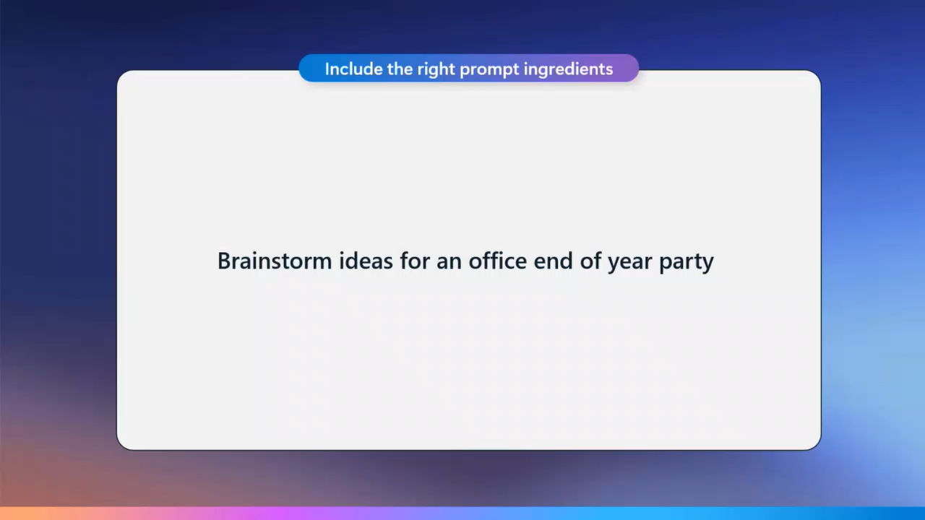
Demo to create an image
Notes:
You have the option to do this demo live, show the demo with the audio, or show the demo and use the speaker notes to narrate it.
Prompt: Brainstorm ideas for an office end-of-year party.
Let’s look at a practical example of using Copilot with a simple prompt. For this demo, I want to brainstorm ideas for an office end-of-year party. I type that prompt into Copilot and quickly see how it responds.
Now, I enter my prompt: “Brainstorm ideas for an office end-of-year party.” When I run this with the licensed version of Copilot, it looks at my work data as well as information from the internet. Under the hood, Copilot is referencing the Microsoft Graph—sometimes called Work IQ—which tracks your work interactions, like SharePoint sites you visit, Teams posts you like, emails, calendar events, meetings, and transcriptions. Work IQ also includes your history of working with Copilot, such as previous chats and tasks. It builds a profile of how you interact with AI tools, learning from your preferences and style.
So this gave me a couple of quick, nice ideas, which is what I was hoping to see, but I'd like to do a little bit more. I'm going to tell it to ignore all of my work data and just look at what it can find on the internet.
If you don’t have the full Copilot license, you’ll only see web-based suggestions. The toggle for work data won’t be available, so Copilot will just use Internet sources.

Slide 13
Include the right prompt ingredients
Goal
Context
What response do you want from Copilot?
Why do you need it and who is involved?
Generate a concise list of simple, creative, workplace-appropriate end-of-year party games. I’ll use them at our office party. Use corporate event planning best practices and current celebration trends. Include brief descriptions of each idea, suitable for a diverse office environment.
Which information sources or samples should Copilot use?
How should Copilot respond
to best meet your expectations?
Source
Expectations
Notes:
Let’s put the prompting principles into practice. Instead of simply asking Copilot for a list of party ideas, I focus on what I actually need help with during the event.
So, I use the framework of goal, context, source, and expectations in my prompt. For example, I ask Copilot to generate a list of activities or simple party games that would work well at our office party. I specify that it should use corporate event planning best practices and ensure the suggestions are culturally appropriate for a work setting. I also request brief descriptions for each activity, making sure they’re suitable for our environment.

Slide 14
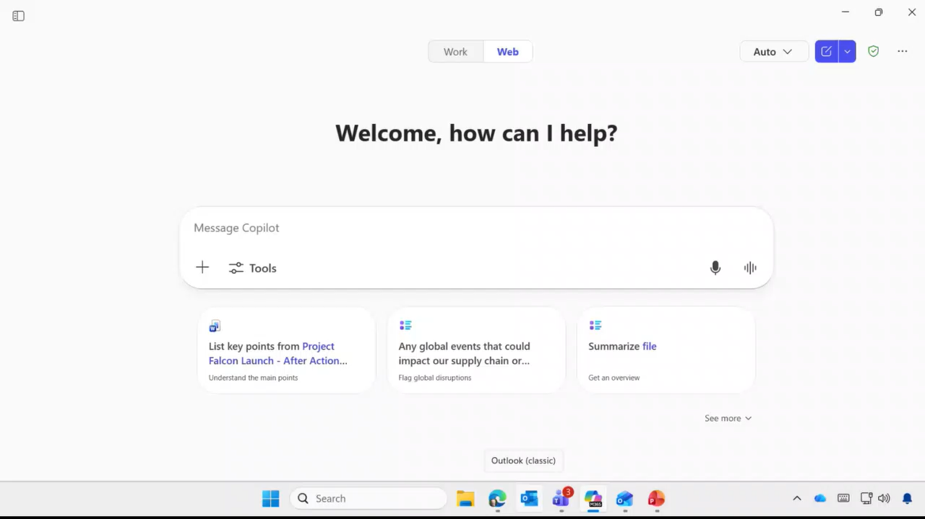
Demo to create an image
Notes:
You have the option to do this demo live, show the demo with the audio, or show the demo and use the speaker notes to narrate it.
Prompt: Generate a concise list of simple, creative, workplace-appropriate end-of-year party games. I’ll use them at our office party. Use corporate event planning best practices and current celebration trends. Include brief descriptions of each idea, suitable for a diverse office environment.
By providing this extra context, Copilot understands that I’m not looking for generic party themes or activities that wouldn’t fit a professional setting. Instead, it offers quick, practical suggestions that I can easily implement. If I want more details about any of the ideas, I can ask follow-up questions and dive deeper as needed.

Slide 15
Before the Holiday:
Clear the Clutter, Complete what Matters

Slide 16

Before the Holiday
Clear the Clutter, Complete what Matters
Habit: Include Goal, Context, Source, Expectations
Brainstorm ideas for an office end of year party
Generate a concise list of simple, creative, workplace-appropriate end-of-year party games or activities. Use corporate event planning best practices and current celebration trends. Include brief descriptions of each idea, suitable for a diverse office environment.
Notes:
When you’re working with Copilot, the way you frame your prompt makes a big difference. The best results come when you provide clear context, state your goal, set expectations, and mention any relevant sources of information. This approach helps Copilot understand exactly what you’re looking for and tailors its response accordingly.
For example, instead of asking a vague question, try to include details about what you want to achieve and any background that might help Copilot generate a better answer. The more specific you are, the more useful and accurate the results will be.
As we continue through the holiday examples, I’ll show you how these best practices play out in real scenarios. You’ll see that giving Copilot the right context leads to much better outcomes, whether you’re planning an event, organizing tasks, or catching up after time off.
Before the holiday begins, it’s important to focus on what truly matters. Copilot can help you set priorities by encouraging you to concentrate on essential tasks, check in only when necessary, and defer less urgent items until you’re fully back. Once your break is over, Copilot can also help you reorient—catching up on missed information and refreshing your understanding of ongoing projects. This way, you can smoothly transition from wrapping up work, to enjoying your time off, and then returning with clarity and purpose.

Slide 17
Before the Holiday
Clear the Clutter, Complete what Matters
Habit: Express Gratitude
  Identify my top collaborators from the past year based on shared projects and impact. Create a table with columns: Name | Project | Personalized Thank You Message. Each thank-you should feel fun, warm, and relatable, like a genuine shout-out, not corporate cringe. Highlight what made their contribution special (creativity, reliability, humor, etc.).
Notes:
Another habit that I can do with Copilot is to thank my team for work that they've done or identify the people that I've worked with at the end of a business cycle and use that as a way to express gratitude and be able to share that out with people kind of based on our work and our interaction.

Slide 18
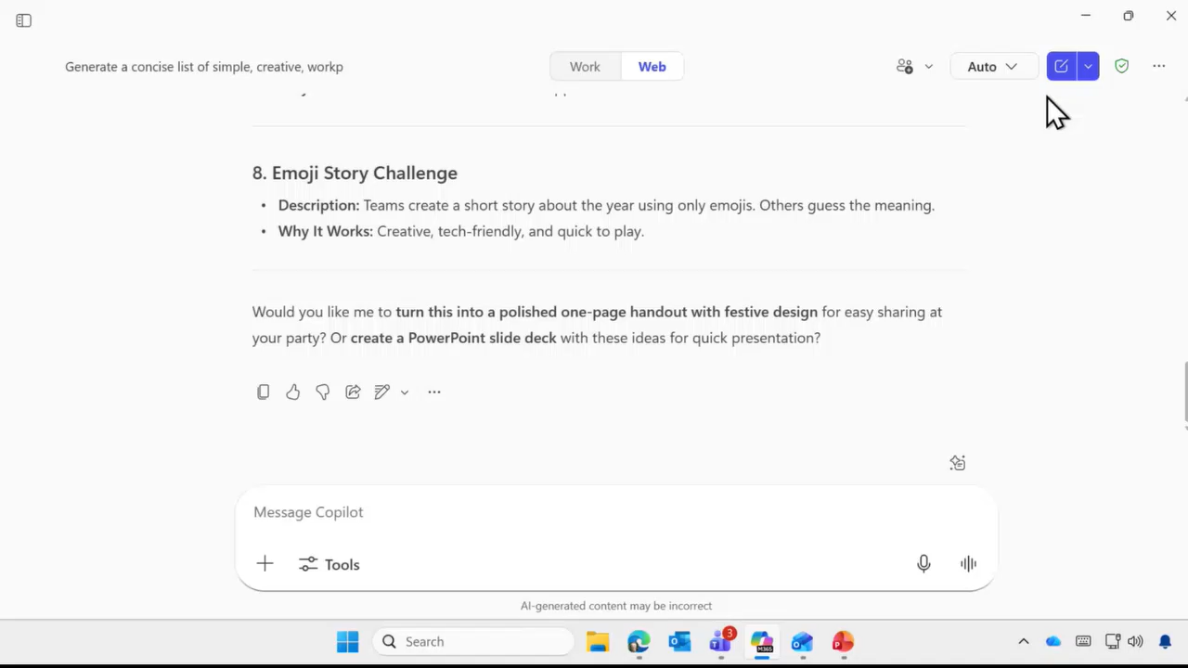
Demo to create an image
Notes:
You have the option to do this demo live, show the demo with the audio, or show the demo and use the speaker notes to narrate it.
Prompt: Identify my top collaborators from the past year based on shared projects and impact. Create a table with columns: Name | Project | Personalized Thank You Message. Each thank-you should feel fun, warm, and relatable, like a genuine shout-out, not corporate cringe. Highlight what made their contribution special (creativity, reliability, humor, etc.).
I’ll start by clicking the upper right button in Copilot and beginning a new chat. The reason for starting fresh is to avoid any confusion—especially so I don’t accidentally mix up work tasks with games or casual interactions with peers and collaborators. Instead, my goal is to find out who I’ve been working with over the course of the year and get a sense of our contributions.
I’ll ask Copilot to present this information as a table. This is useful whether I’m sending holiday cards, saying goodbye for the year, or just sending a quick note in Teams or email. I want to have some context so my messages aren’t generic.
As Copilot starts processing, it may notice that my prompt is fairly long. It will begin working on it, but also offer to provide a quick answer if I prefer. I appreciate this flexibility because if I forget to specify exactly how I want the reply, I can always change it after the fact. For now, I’ll ask Copilot to go ahead and give me a quick answer.
Copilot responds with a table listing my top collaborators, the projects we worked on, and even generates personalized messages for each person. In this example, the table includes columns for name, project, and a personalized note. However, I notice that the message is a bit generic, and I see the suggestion that I might want to orient the results more toward work. I toggle the setting, re-enter the prompt, and the let it run.
Now it reviews my Teams chats, emails, documents, Outlook calendar, and Viva Engage activity. It looks for all the ways I’ve collaborated with people and builds a comprehensive portfolio of our shared work and projects.
This is one of my favorite habits as the holidays approach: expressing gratitude and asking Copilot to remind me about the work we’ve done and the things that are happening. It helps me make my year-end communications more meaningful and personal.

Slide 19
Before the Holiday
Clear the Clutter, Complete what Matters
Habit: Prioritize Where to Focus
Generate a checklist of outstanding tasks from emails and Teams chats and prioritize what needs to be
completed before year-end.
Notes:
Before heading into a holiday or the end of a business cycle, it’s important to focus on what truly matters. Copilot can help you prioritize your work by reviewing your Teams chats, emails, calendar, and outstanding tasks, so you know exactly what needs to be completed before you take time off.

Slide 20
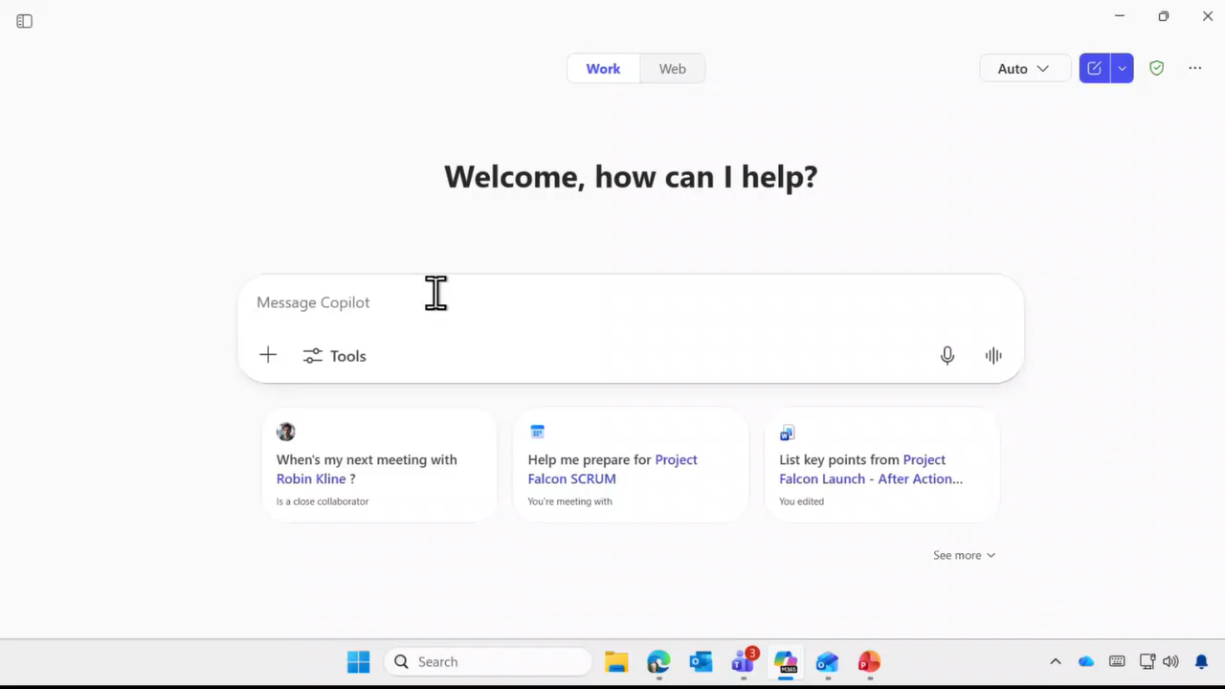
Demo to create an image
Notes:
You have the option to do this demo live, show the demo with the audio, or show the demo and use the speaker notes to narrate it.
Prompt 1: Help me prioritize what matters. Review my Teams chats, Teams channels, Outlook inbox, calendar invites, and Viva Engage communities. Generate a checklist of outstanding tasks. Prioritize what needs to be completed before year end.
Prompt 2: Please place these into an Eisenhower matrix.
As I get ready to go on holiday, I want to make sure I don’t leave anything important unfinished. I ask Copilot to help me prioritize what matters most. My prompt is simple: “Review my Teams, chats, email, and calendar. Generate a list of anything outstanding and help me prioritize what I need to complete before the end of the year.”
Copilot looks across all my work data and comes back with a summary. It identifies a few high-priority items, such as year-end reports, a year-end summary, and some follow-up tasks. Medium-priority items include prepping for my holiday and working on the holiday hustle handout. Copilot also notes some things I can probably defer, like personal reflection, which might wait until after the holiday, or tasks I can check with Copilot later.
One habit I like is not just relying on a single prompt. Instead, I take the result Copilot gives me and refine it further. For example, I ask Copilot to place my tasks into an Eisenhower matrix. This method, made famous by President Eisenhower from the United States in the 19050s, organizes work into four quadrants based on two axes: importance and urgency. People often focus on what’s urgent, even if it’s not important, so this matrix helps me shift my attention intentionally.
If you’ve read Stephen Covey’s productivity books, you’ll recognize this approach as the “four quadrants.” I ask Copilot to break down my results into what I need to do right now (urgent and important), what I can schedule or defer until after the holiday, what’s urgent but not important (which I could delegate), and what’s neither urgent nor important (which I can postpone or ignore).
This process gives me a clear way to prioritize my focus before the holiday.

Slide 21
Before the Holiday
Clear the Clutter, Complete what Matters
Habit: Solve Dependency Blockers
List all email and Teams chats I’ve sent that haven’t received a reply in the last three weeks. For each one, include the subject line, one to two sentences of context, and a short bullet list of the key details so everything’s easy to scan.
Notes:
Let me show you another favorite habit of mine, which is closely related to what we just discussed. I think of this as solving dependency blockers. I ask myself: What am I waiting for someone else to do before I can move forward? To address this, I use a prompt that asks Copilot to go through my email and Teams chats that I’ve sent but haven’t received a reply to and then give me a quick summary of those outstanding items.

Slide 22
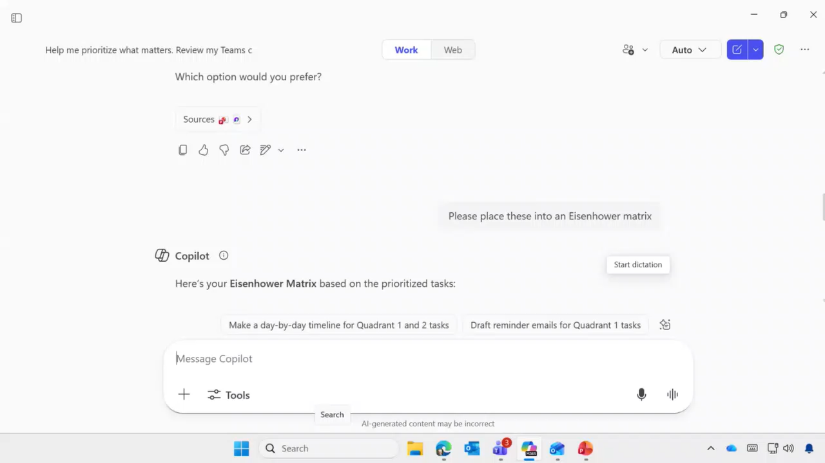
Demo to create an image
Notes:
You have the option to do this demo live, show the demo with the audio, or show the demo and use the speaker notes to narrate it.
Prompt: List all email and Teams chats I’ve sent that I haven’t received a reply from in the last three weeks. For each one include the subject line, one to two sentences of content, and a short bullet list of the key details so everything’s easy to scan.
I’ll ask it to just give me a quick answer. This limits the scope a bit—it won’t go as deep, like checking Viva Engage or looking at reactions in Teams versus posts I’ve made. Copilot then provides a summary: “Here are things you’ve sent that haven’t received a reply in the last three weeks.” For example, I requested an update from Corey and Daichi, sent an email asking for feedback, and asked someone to look at a document.
These are the three main items where I might want to follow up. At this point, I could ask Copilot to help me compose a quick message or bump the request up to someone else. Copilot gives me quick guidance, acting almost like an executive assistant. It helps me keep track of the things I’m doing, ensures I’m not missing anything, and reminds me if someone else needs a nudge.
So you can see I'm really using Copilot almost like an executive assistant to say help me keep track of the things that I'm doing and ensure that I'm not missing something.

Slide 23

Before the Holiday
Clear the Clutter, Complete what Matters
Habit: Draft with Context
Draft a friendly year-end message thanking everyone for their hard work.
Draft a friendly year-end message thanking
everyone for their hard work.
Base it on the completed /[document].
Notes:
Let’s start by drafting a friendly message to thank everyone for their hard work. You’ll find a sample of this in the handout, so you can try it out yourself. Now, let’s take it a step further and add some context by uploading a document. In Copilot, you can do this by clicking the little plus sign in the prompt and selecting a file to reference.
If you have the full Copilot license, you can simply use the forward slash to bring up a search box, type in the file name, and Copilot will find it for you. If you don’t have the full license, Copilot can still reason over a file—you just need to type in the name manually.

Slide 24
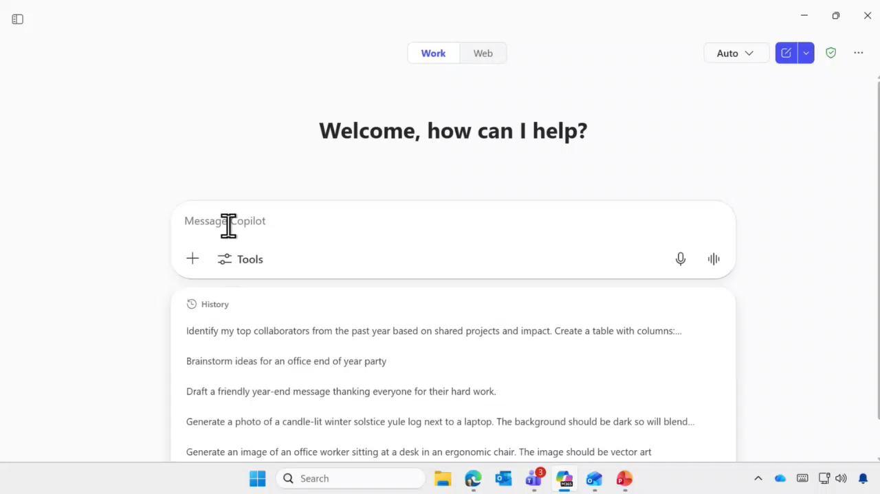
Demo to create an image
Notes:
This demo relies on a separate document so will be difficult to do live, but you may have a similar document you can use. You can also show the demo with the audio or show the demo and use the speaker notes to narrate it.
Prompt 1: Draft a friendly year-end message thanking everyone for their hard work. Base it on the completed /AfterActionReport.docx
Prompt 2: Please add a note in individual contributions
Let’s see how this works in practice. I’ll start a new chat and prepare to draft the message, including some context from a document. For example, my team recently completed a major marketing event, and after it was over, we held a debrief and created an after-action report. This kind of report—sometimes called a post-mortem or project debrief—helps us reflect on what went well and what we could improve next time.
Instead of just sharing my own thoughts, I’ll ask Copilot to use the uploaded file for context. I’ll send the prompt, and Copilot will review the data. This works with both the free and licensed versions of Copilot—the only difference is how you upload the file.
Copilot will analyze the document, deciding whether to provide a quick answer or go deeper. You can let it run automatically or override its settings. If you want more detail, you can expand the steps and see exactly how Copilot arrived at its response.
Once Copilot processes the file, it generates a friendly message you can send. For example, it might pull in details from the after-action report, such as challenges faced during the event, individual contributions, and leadership highlights. You can then send a heartfelt thank you, mentioning specific achievements like the Project Falcon launch and expressing gratitude for the team’s leadership.
If you want to personalize the message further, you can ask Copilot to add notes on individual contributions. Copilot will rewrite the message, calling out what each person did, based on the document’s content. While Copilot does a good job interpreting your intent—even if your spelling isn’t perfect—it’s still important to review and adjust the message to match your own style.

Slide 25
During the Holiday:
Triage with Boundaries, Reflect with Intent

Slide 26
During the Holiday
Triage with Boundaries, Reflect with Intent
Year in Review
Create a Year in Review on our major product launches, highlighting wins, challenges, and milestones. Include relevant public news and customer feedback trends.
Notes:
As a holiday break approaches, I like to use my time off for reflection and personal development. I’ll admit, this can be a bit of a struggle—I want to make sure I’m intentional about how I spend my time, rather than accidentally working through my vacation. This is where the “important but urgent” matrix comes into play. It’s easy to fall into the trap of thinking, “I’ve got a few days off, maybe I should focus on my job, learn something new, or update my LinkedIn profile.” These are tasks that are hard to tackle during the regular workday, but the holidays offer a unique opportunity for thoughtful reflection.
If you find yourself with a quiet moment Copilot can help you look back over your accomplishments. You can upload documents like your performance review or objectives and ask Copilot to help you reason through them. I’ve found that many challenges are more about mindset than ability; often, I just need to pause and be intentional about my next steps.
Copilot is great for sorting through the noise and pointing you toward what matters. Try experimenting with prompts that scope your reflection to a specific project or goal. For example, you can ask Copilot to review your work for the upcoming period and make recommendations on where to focus. This kind of guided reflection can help you set meaningful goals and make the most of your time off.

Slide 27
During the Holiday
Triage with Boundaries, Reflect with Intent
Habit: Recap What You Missed
Give me a recap of yesterday’s project meeting, organized by topic and speaker, and list any follow-up actions for me.
TIP: Follow the meetings you don’t attend
Notes:
Most people feel overwhelmed by the number of meetings on their calendars and rarely wish they could attend more. Catching up on what you missed is one of the things Copilot does exceptionally well. Let me show you how this works with a few demos.

Slide 28
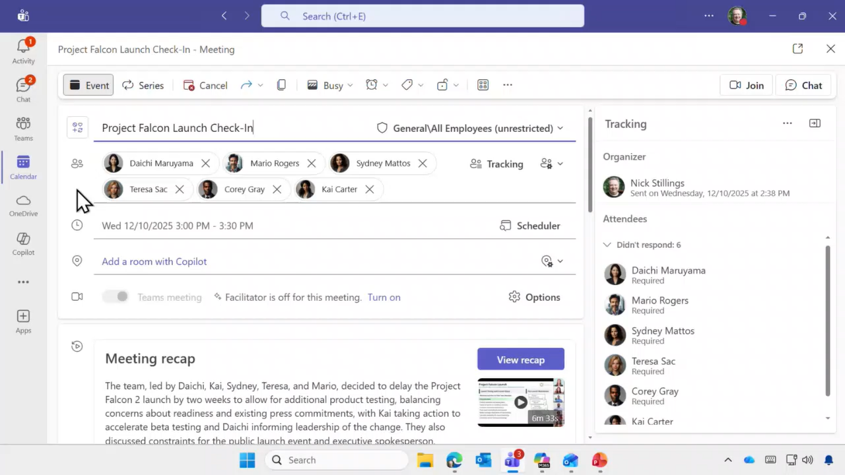
Demo to create an image
Notes:
You have the option to do this demo live, show the demo with the audio, or show the demo and use the speaker notes to narrate it.
I jump over to Teams and reshare my screen. The reason for this is that I want to turn on sound in the Team Share so everyone can hear the audio. In Teams, I navigate to a meeting that happened yesterday and look at the recap. If I have a Copilot license, one of the features available is the ability to get a recap of a meeting.
I can listen to the recording if I want, but that’s not as popular as getting a summary. Since I also have Teams Premium, there’s an extra feature at the bottom: it shows the exact timestamp when people spoke. I can jump directly to those moments, or view the meeting broken into chapters. Everything else you see here can be done with regular Copilot.
Copilot automatically summarizes the meeting for me. The key is that the meeting must have transcription turned on. By default, when you record a meeting, Teams also generates a transcript. Copilot uses this transcript to reason over the meeting content.
I can pop out the Copilot pane to discuss the meeting. For example, I can ask, “Was I mentioned in this meeting?” Copilot knows who I am because I’m logged in, and it checks the transcription for mentions.
Longer examples include asking Copilot to recap the meeting, catch me up, or make a list of all the action items. There’s an example of how to do this right from within the chat itself in the handout.

Slide 29
During the Holiday
Triage with Boundaries, Reflect with Intent
Habit: Leverage Audio Overviews
Ask Copilot for Audio Overviews of one or more meetings
Turn long Word documents and PDFs into an Audio Overview with Copilot. From Word or OneDrive, just ask Copilot to read the file aloud—perfect for listening while you multitask. And if something sparks a question, you can ask Copilot for clarifications as it plays
Notes:
Next we’ll look at another way to get a recap of your meetings – audio overviews. These are an amazing way to catch up while you’re on the go or doing another activity. And although this demo is about meetings you can get audio overviews of documents as well.

Slide 30
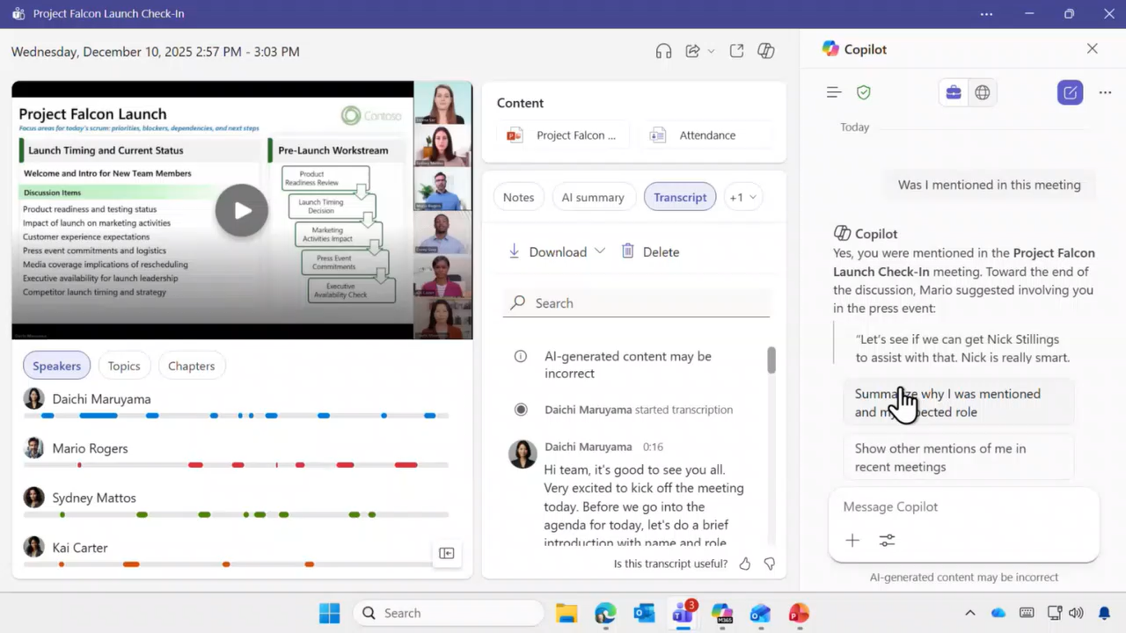
Demo to create an image
Notes:
You have the option to do this demo live, show the demo with the audio, or show the demo and use the speaker notes to narrate it.
Let me show you a really cool feature. At the top of the Teams interface, there’s a newer capability—a little headphones icon. If I click on that, it turns on something called Audio Recap.
Alternatively, in Microsoft Teams, you can find this feature on the left-hand side, or by clicking the three dots if you don’t see it. Look for the button called "Meet." This is an aggregated view of all your Teams meetings—an app dedicated to managing meetings, separate from other calendar items like doctor’s appointments.
Audio Recap creates something similar to a podcast of the meeting. While you could play the full recording, telemetry shows that most people don’t—if you missed a meeting, you probably don’t have another hour to listen to the whole thing. What you really want is a summary.
You can ask for a list of all your meetings from a specific time period, like the last 14 or 30 days. You can generate an audio recap of up to eight meetings at once, and Teams will summarize all of them and play the summaries for you.
Once it’s ready, you’ll see the summary. For example, today is Thursday, December 11th, 2025, and we’re covering the Project Falcon Launch Check-in. This session focused on two big decisions: when to launch Falcon Q and which executive will be the public face of the event.
The audio recap iterates through the transcription as if two people are discussing it.
As the summary is generated, you can scroll down and jump to individual chapters. When the recap is complete Teams creates an MP3 file of the recap.
I’ve used this feature on mobile while on vacation. If I open the camera on my mobile app and select "Listen on mobile," Teams generates a QR code. Scanning it takes me to Teams on mobile, where I can play the audio summary.
When the summary is finished generating, you’ll see a notification pop up so you can start the process and go do something else—Teams will let you know when it’s done.

Slide 31
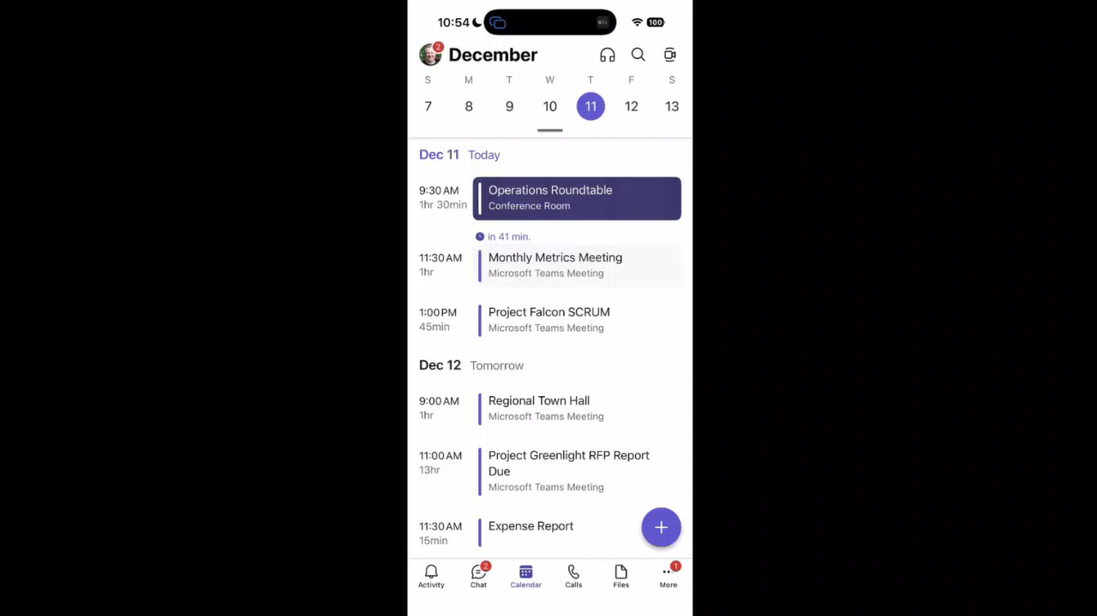
Demo to create an image
Notes:
If you have the Copilot Mobile app you have the option to do this demo live using screen sharing, show the demo with the audio, or show the demo and use the speaker notes to narrate it.
Now, I’m in Teams on my phone. If you look in the upper right, you’ll see the same icon for audio recap that we saw earlier. I can simply tap it to generate a recap and start listening. While you saw me do this on my computer, that’s not how I typically work. Usually, I’m commuting, waiting on something, or traveling—maybe on a plane—and I need to quickly catch up on my meetings.
Imagine I was on holiday while the rest of the team was working. I’d want to quickly catch up on what happened today. At the bottom right, I tap “New Recap,” select the last 24 hours, and let it generate a summary. In my demo environment, there’s only one meeting, but normally I’d have three or four. I can choose the style I want—podcast, newscast, or executive. The podcast style is conversational, while newscast sounds like a reporter, and executive is more of a back-and-forth.

Slide 32
During the Holiday
Triage with Boundaries, Reflect with Intent
Habit: Triage with Boundaries
Copilot, give me a 24-hour vacation check-in. Review my Teams chats, Teams channels, Outlook inbox, and Viva Engage communities. Summarize the key updates I should know about. List anything that is urgent and requires attention while I’m out. Then create a separate list of action items I should complete when I return. Exclude newsletters, promotions, and automated notifications. Keep everything concise, prioritized, and grouped by source.
Notes:
Remember the prompt I showed earlier—the one that helps me review all the important things I need to do before starting my day? Now, let me show you a version that’s perfect for checking in during a holiday season. I think of this as my way of triaging with boundaries.

Slide 33
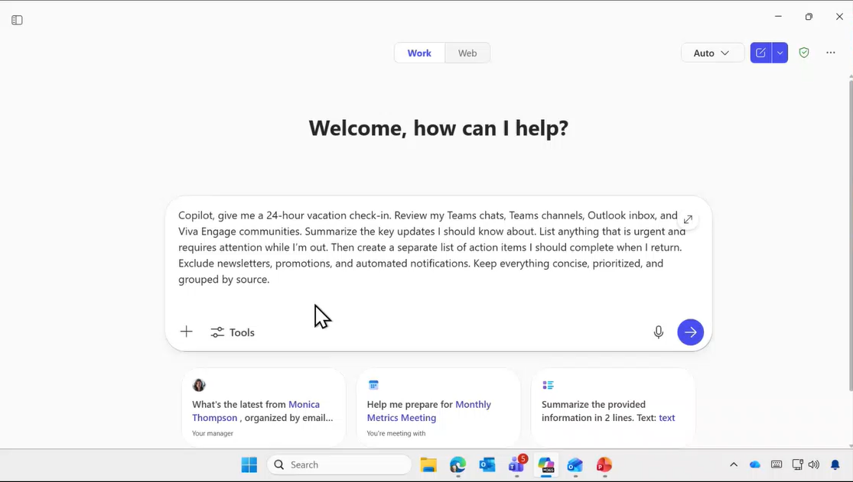
Demo to create an image
Notes:
You have the option to do this demo live, show the demo with the audio, or show the demo and use the speaker notes to narrate it.
Prompt: Copilot, give me a 24-hour vacation check-in. Review my Teams chats, Teams channels, Outlook inbox, and Viva Engage communities. Summarize the key updates I should know about. List anything that is urgent and requires attention while I’m out. Then create a separate list of action items I should complete when I return. Exclude newsletters, promotions, and automated notifications. Keep everything concise, prioritized, and grouped by source.
For this demo, I use Copilot to give me a 24-hour vacation check-in. I ask Copilot to review all my stuff, make a list of action items, and highlight what I need to do. This process takes a few minutes, so—like Gordon Ramsay—I’ve already prepared one in advance.
Let’s jump in and take a quick look at the results. I go into my conversation history to see what Copilot comes back with. It provides a summary of what happened in the last day.
When I get a prompt written just right and I’m happy with how it works, I save it in the upper right corner—let’s call it “daily check-in.” The goal is to avoid getting sucked into work. Instead, I use my phone, go to my saved prompt, run it, get a quick summary of what’s going on, and then I’m off again.
So, please take your vacation time when you can. If you must check in, use Copilot to make it a quick and easy process, so you don’t get pulled into all the details of work.

Slide 34
During the Holiday
Triage with Boundaries, Reflect with Intent
Personal Prompts
I’m planning a holiday road trip from [origin] to [destination]. Create a detailed itinerary with drive times, recommended stops, food options, and 2–3 backup plans in case of weather or delays.
Generate a festive holiday dinner menu for [X] adults and [X] children. Include appetizers, mains, sides, and desserts with these preferences and restrictions: [vegan, nut-free, gluten-free, etc.]. Provide a shopping list and prep timeline. Include 5 vegan holiday dishes that are easy to prep ahead.
Give me conversation starters and connection questions I can use with family during the holidays - some light, some reflective, and none that touch on politics.
Create a warm holiday toast for me. Ask me 5 quick questions about my favorite moments from the year, then write a polished toast in my voice.
Let’s play a yes/no guessing game: Think of a cartoon character and I’ll try to guess it in 20 questions.
Notes:
Here are some additional ways to use Copilot while you’re not working. Since these are all web-based prompts they will work for everyone.

Slide 35
After the Holiday
Review, Refocus, Restart

Slide 36
After the Holiday
Review, Refocus, Restart
Habit: Review . . . What Did I Miss?
Copilot, catch me up on everything that matters from Dec. 20 to today. Review my Teams chats, Teams channels, Outlook inbox, calendar invites, and Viva Engage communities. Create three sections: (1) Key updates and decisions made, (2) Anything urgent I need to act on this week, (3) A list of follow-up actions that can wait until later. Keep it focused on impact—exclude newsletters, FYIs, and automated noise.
Notes:
Once my holiday is over, I use Copilot to help me catch up on everything I missed. For example, I can ask Copilot, “What did I miss?” and it will look through all my recent work and provide a summary of the key items I need to review and focus on.
This process helps me reorient and refresh, so I can get back to work efficiently. I simply enter a date to scope the catch-up period however I want. Copilot then gathers the most important updates, tasks, and conversations from that timeframe.
If you’d like to try this, you don’t have to wait until the holidays are over. You can use this catch-up feature at any point to stay on top of your work.

Slide 37

After the Holiday
Review, Refocus, Restart
Habit: Start with the End
Guide me in creating my 2026 vision and goals. Ask me 5 sequential, thoughtful questions based on my role, recent projects, and organizational context. Then synthesize a compelling 2026 narrative, a 2026 affirmation, and my top 5 goals, aligned to my priorities
Use this context: [insert Core Priorities/Objectives].
Career Coach
Notes:
I'm going to use Copilot and the Career Coach agent to guide me through the work I need to do. To get started, I’ll upload my objectives and let Copilot review what’s going on. This way, I can get personalized guidance and recommendations for my tasks and goals.
For example, if I have a high school reunion coming up this year, I want to make the most of my limited time to prepare and impress. Copilot can help me organize my work, set priorities, and track my progress, so I can focus on what matters most.
We’ll explore these features in more detail during our next session in January.

Slide 38

After the Holiday
Review, Refocus, Restart
Habit: Grow and Learn
Create a 30-day challenge to help me improve
a skill of my choice. Each day should include:
A small task to practice
A reflection prompt or a new concept to explore
Organize it so I can track progress and stay
motivated throughout the month.
Learning Coach
Notes:
For example, I can ask Copilot to give me a 30-day set of goals that will guide my progress. There's a helpful built-in agent inside Copilot called Learning Coach, which makes it easy to create a short, practical learning plan for developing a new skill or habit.
As we approach the new year, many of us come back with great intentions and plenty of resolutions. Copilot is a great tool to help you achieve those goals. Whether you're aiming to improve your fitness, learn something new, or build better habits, Copilot can support you with personalized plans and ongoing guidance.
We'll explore these features in more detail during our next customer hub session in January.

Slide 39
Use Copilot Chat on the go
Download the Microsoft 365 Copilot mobile app and sign in with your work or school account to access Copilot Chat
Notes:
Reminder to download the mobile app to make check ins easy while you are out of the office.

Slide 40
Holiday Hustle Handout
Empower your Users! aka.ms/Copilot/HolidayPrompts
Notes:
Don’t forget to download the handout if you haven’t already!

Slide 41

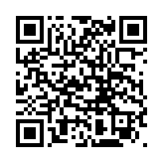
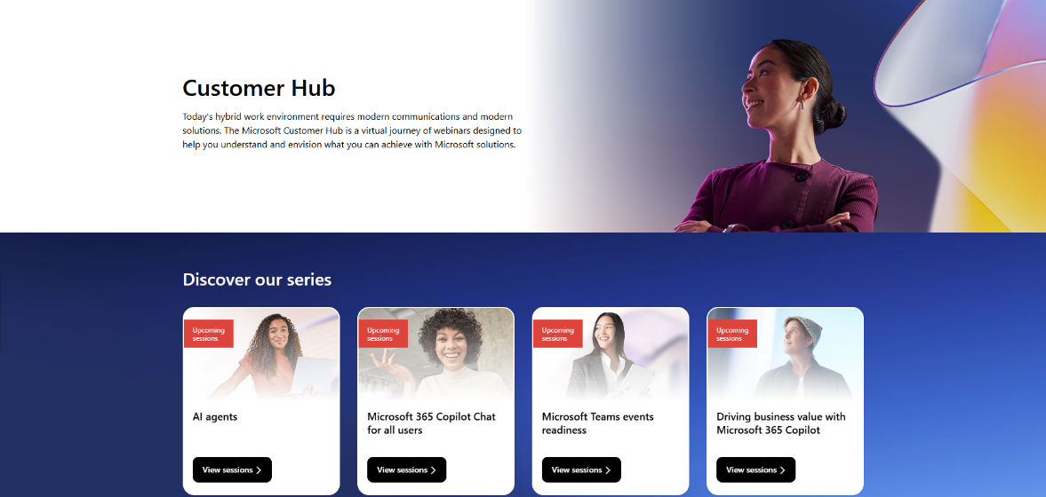
Customer Hub
Visit Customer Hub website for upcoming sessions, updates, and on demand contents!
https://aka.ms/CustomerHubSessions​
Notes:
As we wrap up, I want to highlight some resources that can help you and your organization get even more value from Copilot such as Customer Hub where you can get the latest information from Microsoft experts with extensive demos.
If you want to see the full version of this course you can access is on Customer Hub here - https://msit.events.teams.microsoft.com/event/361e683b-acdc-4887-b03f-983561d189cf@72f988bf-86f1-41af-91ab-2d7cd011db47

Slide 42

Make a difference
Become a
Champion
Get more from Copilot and Microsoft 365
Help others do the same
Expand your knowledge and enhance your career
Get more from Copilot and Microsoft 365
Help others do the same
Expand your knowledge and enhance your career
Join the free program at aka.ms/M365Champions
Notes:
We hope everyone here is ready to take the next step and deliver sessions like this to your peers. Copilot can help everyone with their tasks, but it often takes people on the same team to work together to get the most from it.

Slide 43
Thank you

