Slide 1
Copilot Chat Prompt Mastery Series
February 18, 2025
Notes:
Today’s session is part of our Prompt Mastery Series focused on Copilot Chat. The goal is to help you feel more confident using Copilot through better prompting—especially in real, everyday work scenarios.

Slide 2
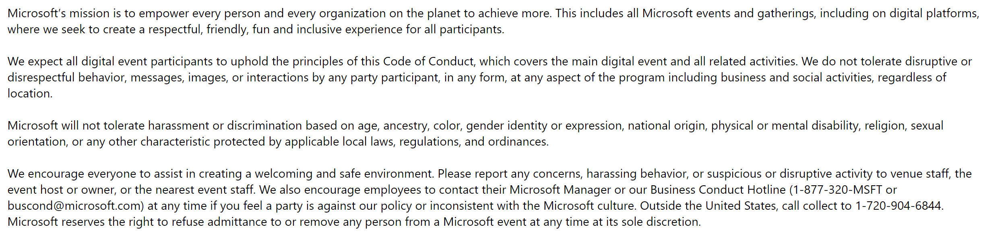
Microsoft Digital Event Code of Conduct
Notes:
Before we dive in, a quick reminder that this event follows Microsoft’s Digital Event Code of Conduct. We’re committed to creating a respectful, inclusive, and welcoming experience for everyone. Please review this and help us maintain a positive environment throughout the session.

Slide 3
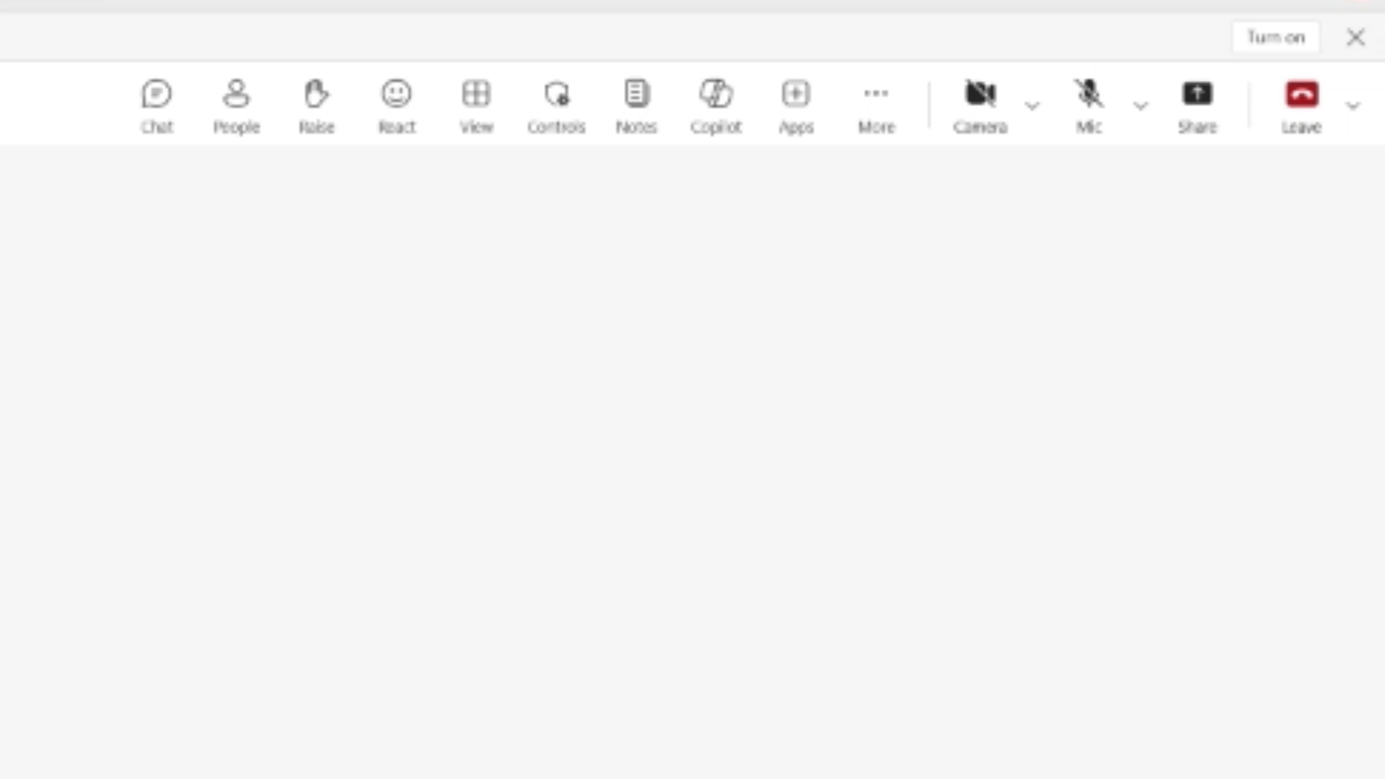

Accessibility Settings for your preference
Close Captioning (on/off)
Select More > Language and speech >
Turn on (off) live captions
Enlarge Content to your screen
Press Windows logo Key and (+) to zoom in
Press Windows logo Key and (Esc) to zoom out
High contrast view
Select Settings > Appearance and accessibility
Under Theme choose High contrast.
Notes:
We want this session to be accessible to everyone. You can turn live captions on or off, adjust zoom, or enable high‑contrast mode depending on your needs. Please use whatever settings help you participate comfortably.

Slide 4
Participation
Session will be recorded
Use Q&A for questions
Resources will be shared during and after session
Share feedback and request assistance
Notes:
This session is being recorded and will be available on demand. We encourage you to use the Q&A for questions, and resources will be shared during and after the session. We also welcome your feedback so we can continue improving future sessions.

Slide 5








Sponsor & Lead
Host
Stephanie Hernandez
Customer Success Lead
Director, Cloud Solution Architect – Oil Gas & Energy
Jennifer Snoddy
Senior Cloud Solution Architect Copilot
Moderators
Tony Rodighiero
Senior Solution Engineer
Copilot
Sharon Salazar
Cloud Solution Architect
Copilot
Armando Hernandez
Senior Cloud Solution Architect Copilot
Wes Horn
Senior Cloud Solution Architect Copilot
Greg Yee, Jr.
Cloud Solution Architect
Global Solution Architect | Copilot
Valene Samuels
Principal Cloud Solution Architect
Global Solution Architect | Copilot
Notes:
You’re supported today by a team of Copilot and solution experts who will help answer questions throughout the session. They’ll be active in the Q&A, so don’t hesitate to ask questions as they come up.

Slide 6
Agenda
1
Plan for Success
2
The Prompt Ladder
3
Dive in to Our Scenario
Notes:
Here’s what we’ll cover today. We’ll start by setting you up for success, introduce the Prompt Ladder, and then walk through a practical scenario so you can see these concepts applied in context.

Slide 7

Microsoft Copilot Chat
Microsoft Copilot Chat
Understand M365 Copilot Chat
Have you confirmed that you have access to M365 Copilot Chat? Try m365.cloud.microsoft/chat/
Copilot Chat Tutorial:
🔗 Microsoft 365 Copilot Chat video tutorial
1
GPT-5 model update in Copilot chat: GPT‑5—OpenAI’s best AI system to-date—is rolling out today. 🔗 Available today: GPT-5 in Microsoft 365 Copilot
2
GPT-5 Thinking Modes
3
Memory & Personalization
A more productive and personalized AI for the way you work: A new capability that makes your Copilot smarter, more helpful, and more in tune with how you work.
🔗 Get Started with personalizing what Copilot Chat remembers
🔗 Copilot Blog: Introducing Copilot Memory
4
Prompt Gallery
🔗 Try Copilot Prompt Gallery 🔗 Video Tutorial Copilot Promptt Gallery
Copilot Chat in Outlook without and add-on license: you can use Copilot Chat in Outlook to ask questions about your inbox, calendar, meetings and other limited data and take action directly in Outlook. 🔗 Chat with Copilot in Outlook
5
Roadmap
Notes:
We’ll begin with an overview of Microsoft 365 Copilot Chat—what it is, how to access it, and how it differs from other Copilot experiences. We’ll also touch on memory, personalization, and resources like the Prompt Gallery to help you get started quickly.

Slide 8

Copilot Chat Capabilities
Copilot Chat is an AI chat tool built specifically for work. It uses the latest AI models and data from the web to answer your questions, generate content and ideas, and find information. It also protects your data so information from your chat conversation does not get exposed to the public.
In addition, with Copilot Chat you can:
Upload files to get responses based on information from your work documents, presentations, etc¹.
Create images, infographics, visualizations and more.
Upload an image and chat about it or extract text from it
Refine and collaborate on chat responses.
Copilot Chat
Get started by going to M365Copilot.com
¹Image generation and file upload limits apply.
Notes:
Bing Chat Enterprise backed by the power of the latest GPT models, the latest in AI models,
Using non-approved AI web services can expose our company’s data to the public. So always use Bing Chat Enterprise for AI chat to help keep our company data safe with built-in Enterprise Data Protection from Microsoft.
Copilot Chat is designed specifically for work. It can summarize documents, analyze files, generate content, and help you reason over information—while protecting your enterprise data. You can upload files, work with images, and refine responses collaboratively, all within a secure environment.

Slide 9
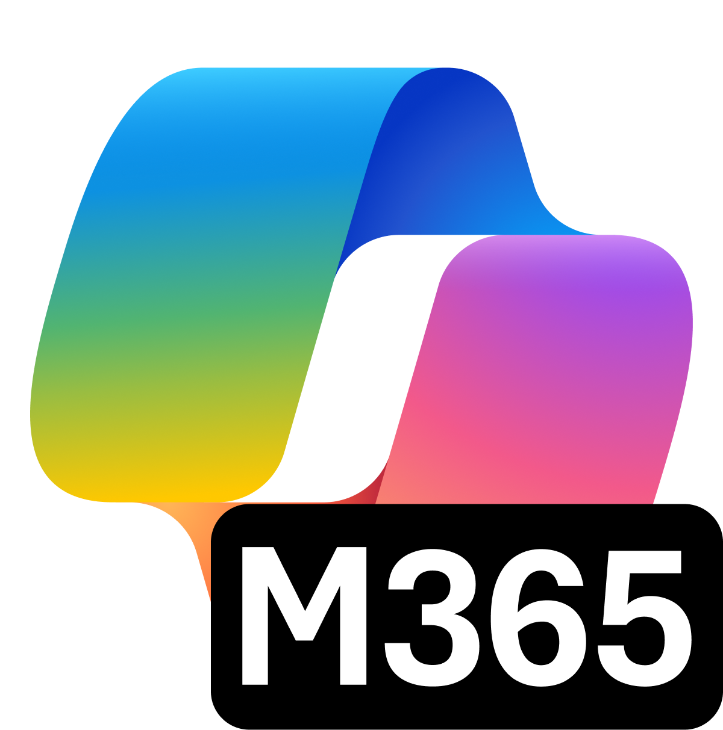

How can Microsoft 365 Copilot Chat help you with your work?
Summarize a document
Give me some ideas for …
Tell me what’s new about topic
Give me a bulleted list of key points from file
Suggest 10 compelling taglines based on file
Tell me what's new about topic broken out by news that’s within the last month
Notes:
Working with Microsoft 365 Copilot Chat is easy. It can help you with all sorts of things like catching up on a meeting you missed, or drafting an email. It just starts with a prompt!

Slide 10


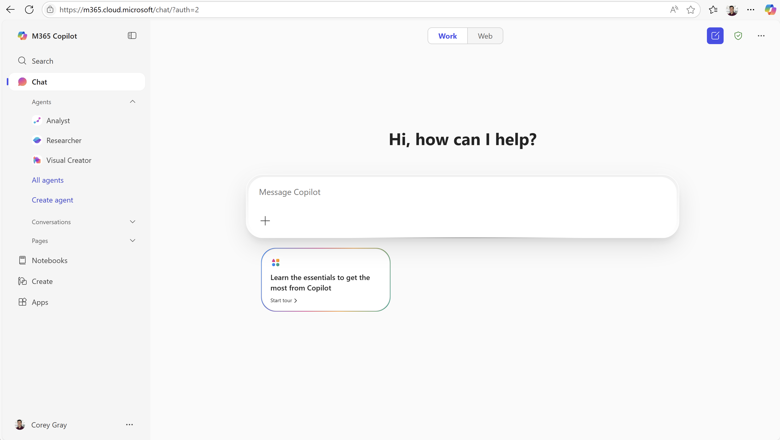
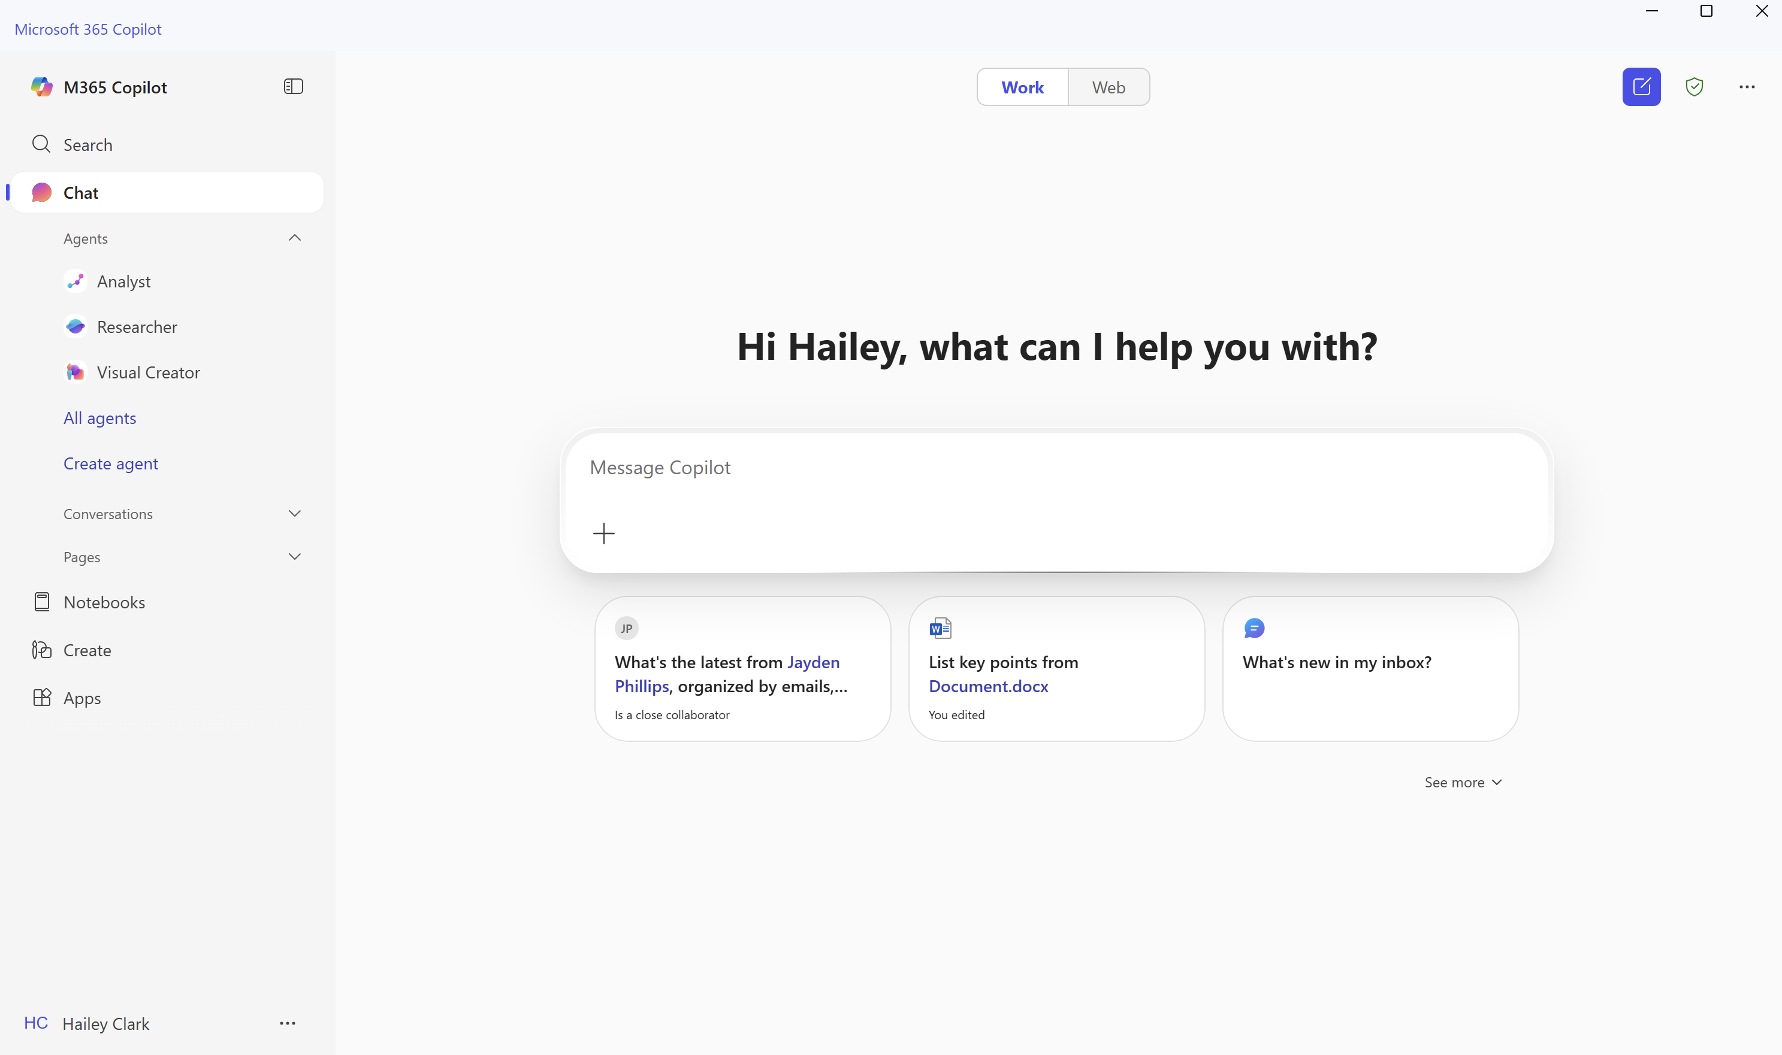
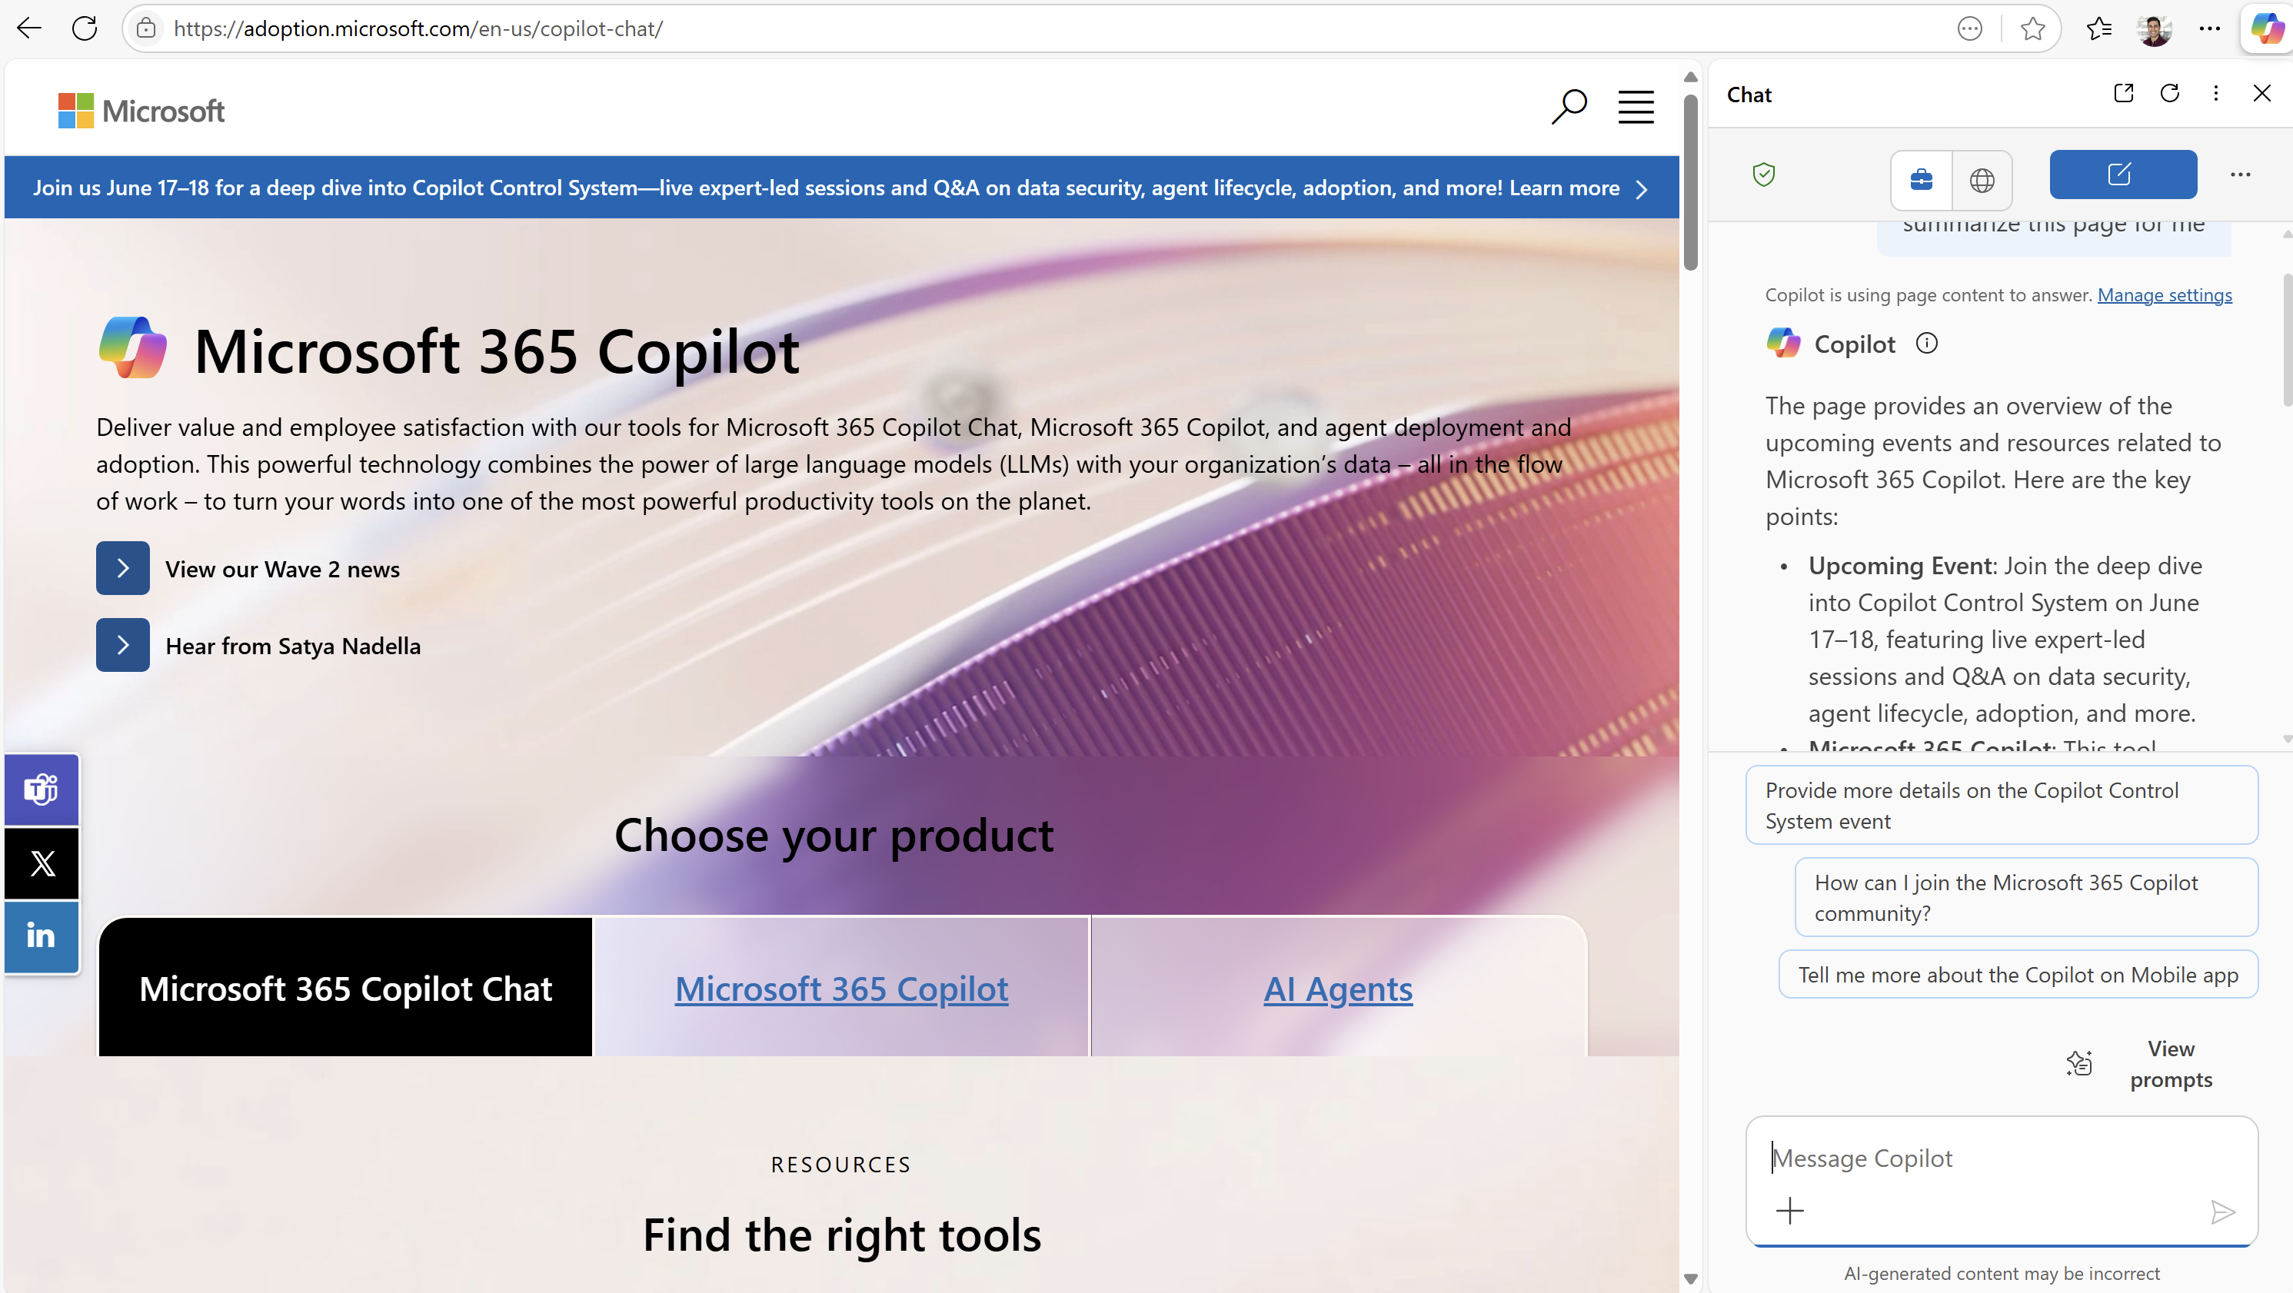
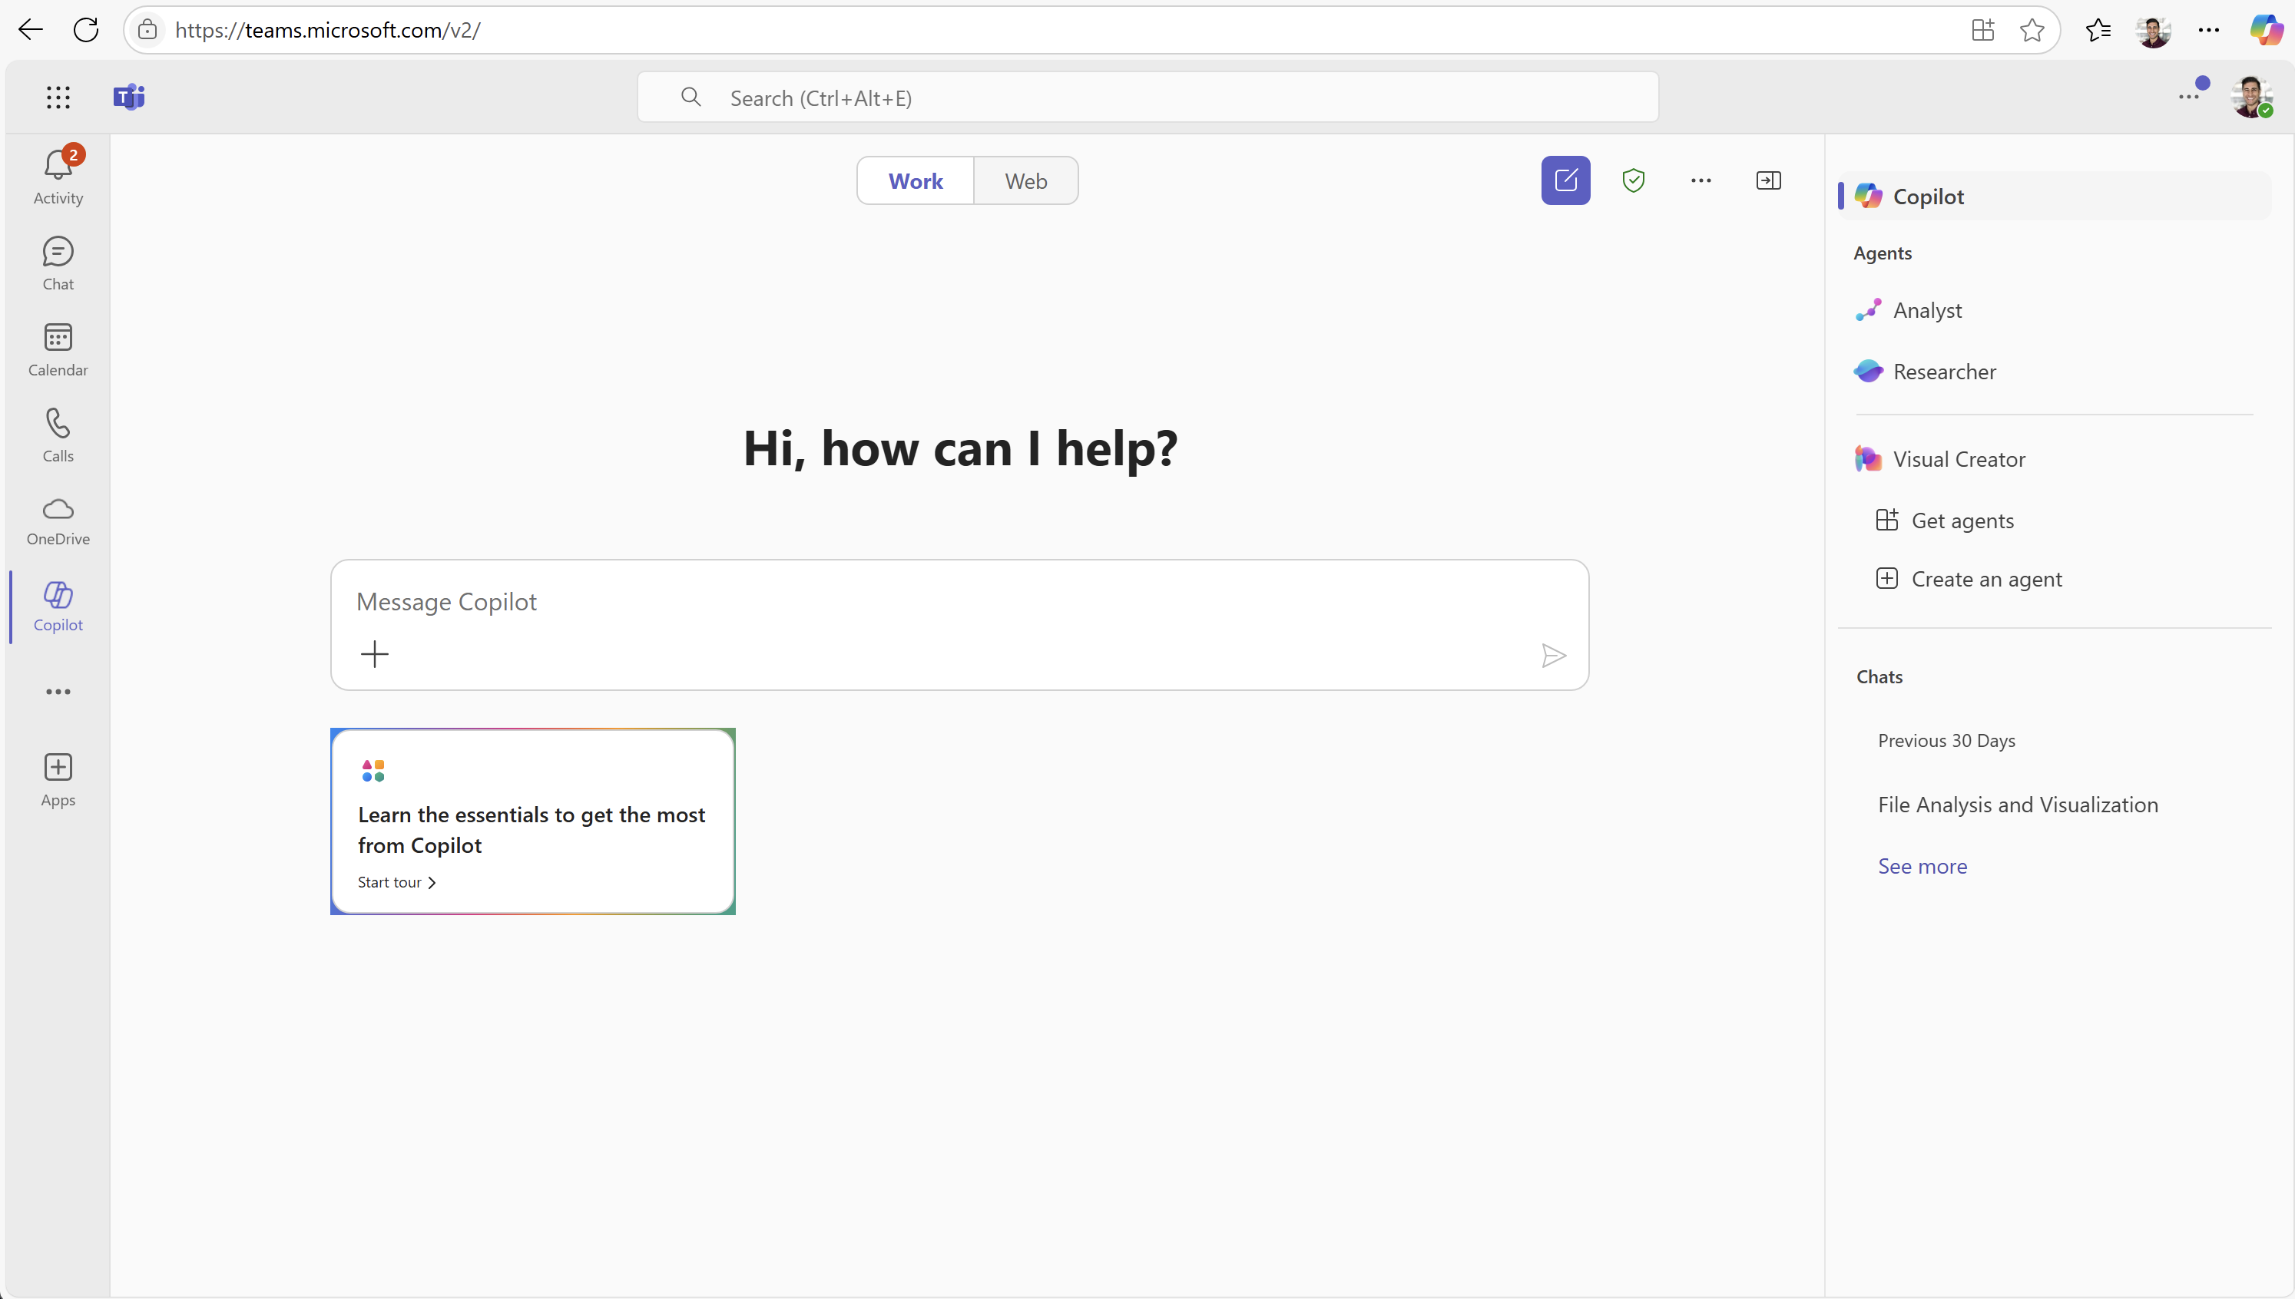
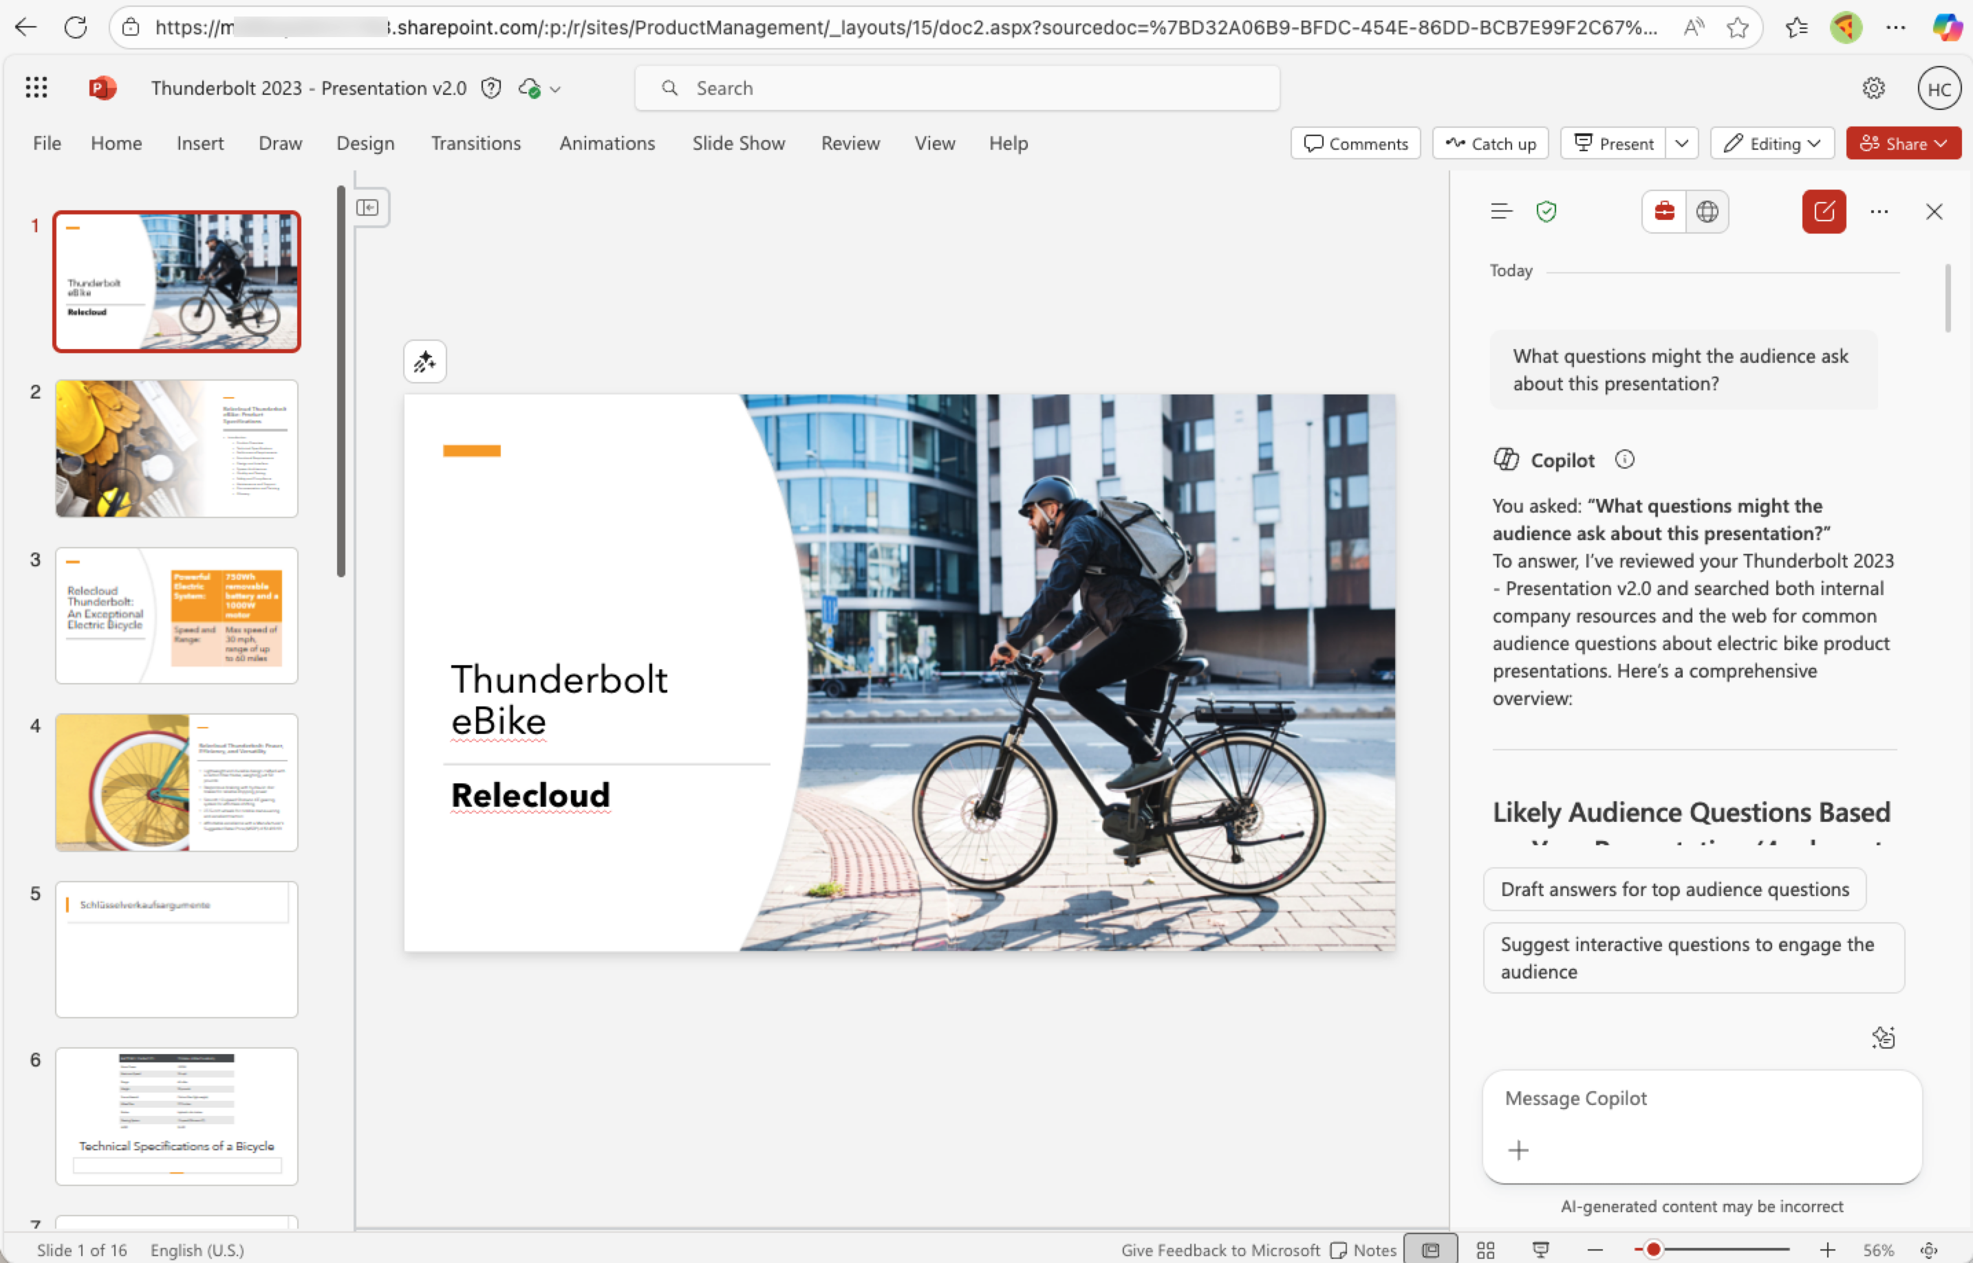
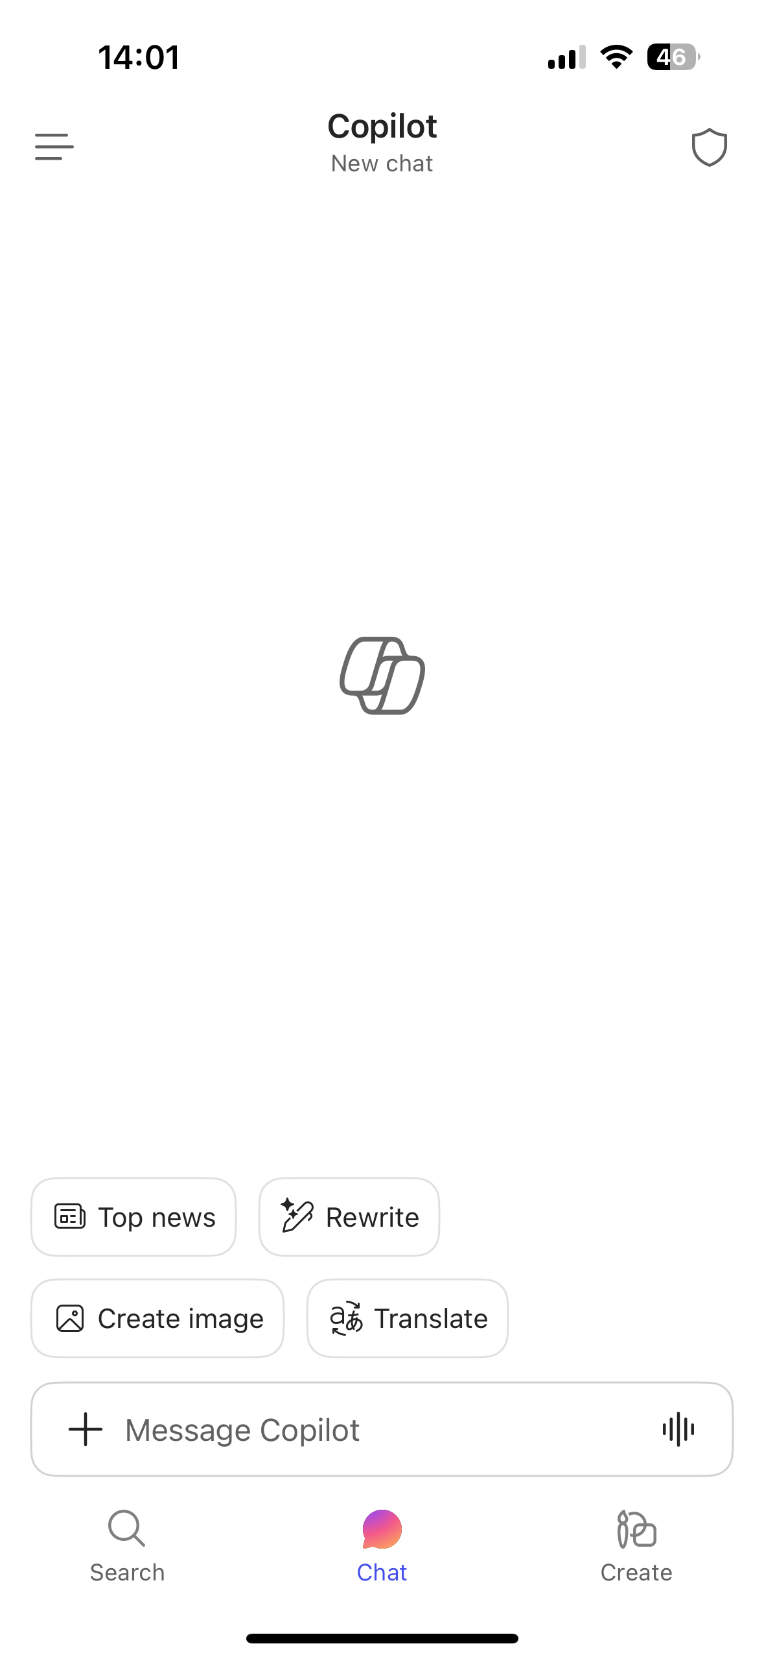
Access to Copilot Chat from where you’re working
m365copilot.com
Microsoft 365 Copilot app
Edge browser sidebar
Microsoft 365 app
copilot.cloud.microsoft
Microsoft 365 app
Microsoft Teams
Microsoft 365 Apps
Microsoft 365 Copilot mobile app
Notes:
Copilot Chat is available across multiple entry points, including the Microsoft 365 app, Edge, Teams, and mobile. The experience is designed to meet you where you already work, without fragmenting how you access AI assistance.
Entry points:
m365copilot.com,
Microsoft 365 Copilot app,
Edge sidebar,
Teams,
Microsoft 365 apps,
mobile app.
Emphasize choice without fragmentation.

Slide 11
Copilot Chat GPT-5 Thinking Modes
The GPT-5 model selector let’s users control reasoning depth with three modes.
Auto (Copilot Decides)
Quick Response
Think Deeper
Notes:
Copilot Chat includes GPT‑5 thinking modes that let the system decide how much reasoning is needed. Whether it’s a quick response or deeper analysis, Copilot adapts automatically to the complexity of your request.

Slide 12
Demo
Notes:
We’ll now move into a live demonstration to show these capabilities in action and connect the concepts to real usage.

Slide 13

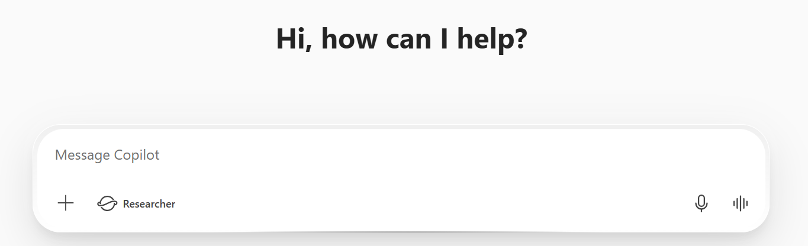
Copilot Chat powered by latest GPT-5 models
Try the latest model from OpenAI today
Copilot Chat with GPT-4o
Copilot Chat with GPT-5 models
GPT-5 real-time router
GPT-4o
Quick response High-throughput
Think deeper Deeper reasoning
Prompt sent to GPT-4o
GPT-5 real-time router analyzes complexity of prompt
Simple prompts routed to GPT-5 high-throughput model
Complex prompts routed to GPT-5 deeper reasoning model
Users can also manually choose the best option for their prompt
Both models are made secure with enterprise data protection and optimized for work
Notes:
GPT-5 brings two major upgrades to Copilot Chat:
Advanced Reasoning Models
Automated real-time router
You type a prompt as usual and hit enter.
Instead of going directly to GPT-4.0, the system now uses a real-time router.
The switcher analyzes your prompt and decides:
If it’s simple → routes to GPT-5 high throughput model (fast, concise answers).
If it’s complex → routes to GPT-5 Advanced reasoning model (thoughtful, context-aware responses).
Why This Matters
Reasoning models are now part of mainline Copilot Chat for the first time.
They allow Copilot to better understand and process complex work data—especially when user context is missing.
You’ll see chain-of-thought reasoning in responses, showing how Copilot builds its understanding step-by-step.
No User Effort Required
Users don’t need to choose a model—Copilot does it automatically.
This removes friction and makes advanced capabilities accessible to everyone.
Unlike other tools with manual model switching (which users rarely use), Copilot’s real-time router is seamless and smart.
As users get familiar with this new class of models, Copilot will default to GPT-4o with the option to Try GPT-5. Eventually, GPT-5 will be the default model.
This new model is available now for all licensed users and is currently rolling out to Copilot Chat users. Standard access to GPT-5 will be available to all our unlicensed Copilot Chat users within a few weeks. Licensed users will be given priority access.

Slide 14
Personalize what Copilot Chat remembers
Copilot personalizes your chat experience and it’s responses by:
Saving memories to Copilot Memory
Using your Copilot custom instructions
Notes:
Copilot Chat can personalize your experience by remembering preferences, working style, and recurring topics. This personalization helps Copilot respond more effectively over time while staying under your control.

Slide 15
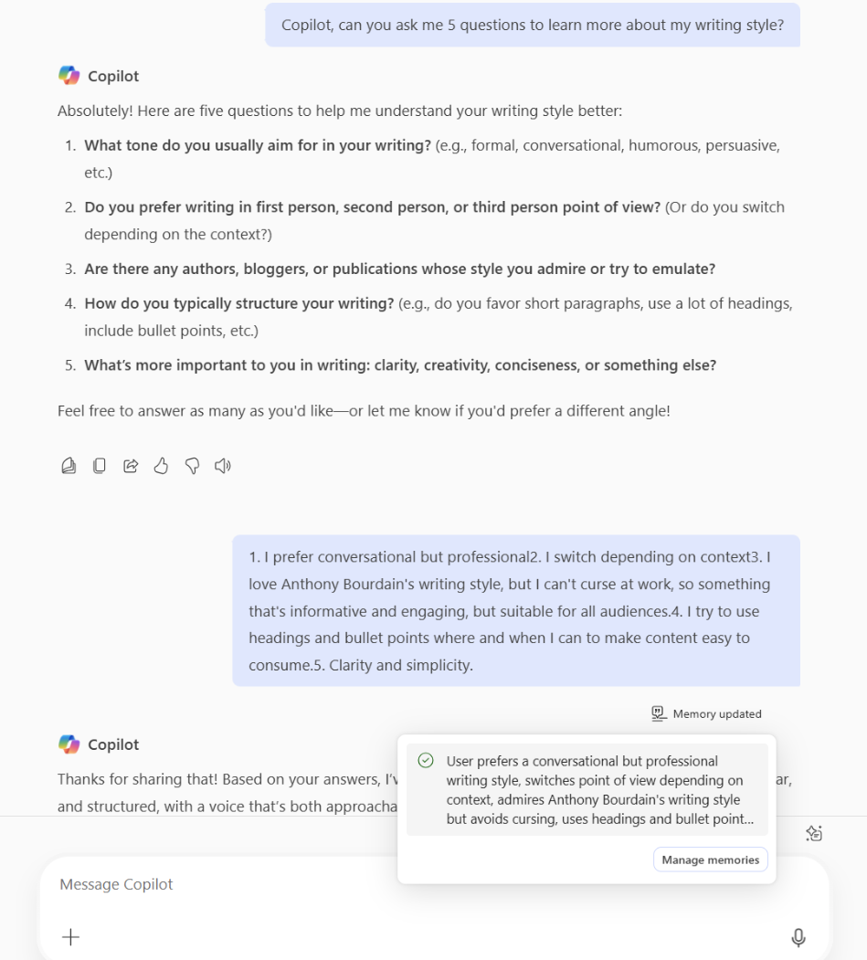
Copilot Memory
Copilot Memory is a Copilot Chat capability that remembers key facts about users—like their preferences, working style, and recurring topics.
It captures meaningful details from users’ conversations (for example, “I prefer Python for data science”) and applies them to future responses.
Notes:
Copilot Memory captures meaningful details—like tone preferences or formatting styles—and applies them to future responses. This makes Copilot feel more consistent and tailored to how you work, without requiring you to repeat yourself.

Slide 16
Scenarios to try
Writing style and structure:
“Please remember I prefer bulleted lists and clear headings.”
“Ask me 10 questions to learn more about my writing style.”
Tone and length:
“Remember to keep tone professional and friendly.”
“Keep replies to 5-7 sentences.”
Citations and links:
“Remember to include source links at the end of responses when available.”
Visuals:
“Remember to generate images in icon size.”
Follow-up depth:
“Remember to ask clarifying questions if my prompt is ambiguous.”
Notes:
These examples show how you can guide Copilot using memory—whether it’s writing style, tone, length, visuals, or follow‑up depth. Small instructions like these can dramatically improve response quality.

Slide 17
Demo
Notes:
We’ll pause again for a short demo to show how personalization and memory work in practice.

Slide 18
Prompt Gallery
Prompt Gallery is an in-product experience designed to help users discover, share, and utilize relevant prompts within Copilot Chat.
Discover Prompts
Save Prompts
Share Prompts with a Team
Notes:
The Prompt Gallery is an in‑product experience that helps you discover, save, and share prompts. It’s a great way to learn from others and reuse prompts that work well for your team.

Slide 19
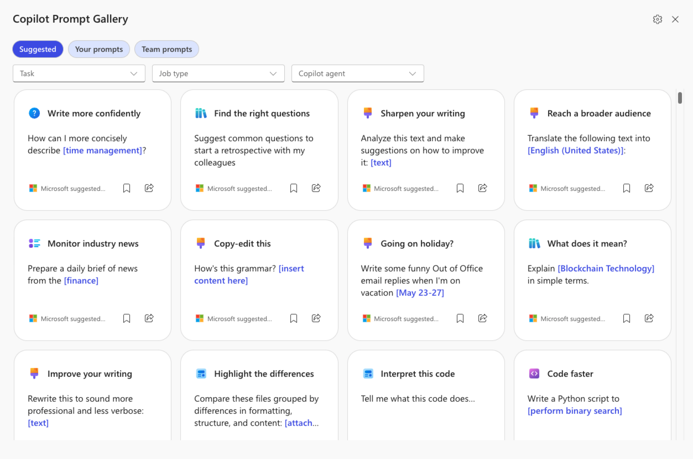
Prompt Gallery
In-product experience
Click on “See more” and scroll at the end of the sample prompts to get access to the “Prompt Gallery”. Here, you’ll see suggested Copilot prompts and your saved prompts including the ones shared with your teams.
Notes:
Within the Prompt Gallery, you can browse suggested prompts, view team‑shared prompts, and save your own. This helps standardize prompting and reduces the effort needed to get started.

Slide 20
Demo
Notes:
We’ll walk through another quick demo to show how Prompt Gallery fits into your workflow.

Slide 21
Copilot Chat in Outlook
Copilot Chat in Outlook expanding to support reasoning over a user’s entire inbox, calendar and other enterprise.
Rolling Out Now
Notes:
Copilot Chat is expanding in Outlook to reason over inboxes, calendars, and enterprise data. This enables scenarios like summarizing emails, drafting responses, and managing meetings directly from Outlook.

Slide 22
Copilot Chat in Outlook expands to reason over inbox, calendar, and enterprise data.
You can use Copilot Chat in Outlook to ask questions about your inbox, calendar, meetings and other limited data and act directly in Outlook.
Here are examples of the types of prompts you can use:
“Summarize my emails from the last week related to [project or customer name].”
“When is my next 1:1 meeting with /name?”
“Draft an email update summarizing the customer escalations from this week.”
“Schedule a meeting with my manager.”
“Flag all unread emails from my manager.”
“Setup an automatic reply for next Friday.”
Notes:
Here are examples of prompts you can use in Outlook, from summarizing recent emails to scheduling meetings or drafting updates. These are practical, time‑saving scenarios you can apply immediately.

Slide 23
Q&A
Notes:
We’ll pause here to address questions from the audience. Please continue to use the Q&A so we can make sure nothing gets missed.

Slide 24
Resources
Notes:
We’ll share resources and follow‑up materials to help you continue learning after the session.

Slide 25
Microsoft Copilot Chat
Microsoft Copilot Chat
Understand M365 Copilot Chat
Have you confirmed that you have access to M365 Copilot Chat? Try m365.cloud.microsoft/chat/
Copilot Chat Tutorial:
🔗 Microsoft 365 Copilot Chat video tutorial
1
GPT-5 model update in Copilot chat: GPT‑5—OpenAI’s best AI system to-date—is rolling out today. 🔗 Available today: GPT-5 in Microsoft 365 Copilot
2
GPT-5 Thinking Modes
3
Memory & Personalization
A more productive and personalized AI for the way you work: A new capability that makes your Copilot smarter, more helpful, and more in tune with how you work.
🔗 Get Started with personalizing what Copilot Chat remembers
🔗 Copilot Blog: Introducing Copilot Memory
4
Prompt Gallery
🔗 Try Copilot Prompt Gallery 🔗 Video Tutorial Copilot Prompt Gallery
Copilot Chat in Outlook without and add-on license: you can use Copilot Chat in Outlook to ask questions about your inbox, calendar, meetings and other limited data and take action directly in Outlook. 🔗 Chat with Copilot in Outlook
5
Copilot Chat Outlook
Notes:
This slide recaps key links and resources, including Copilot Chat tutorials, Prompt Gallery, personalization guides, and Outlook support. These are great references as you continue experimenting with Copilot.

Slide 26
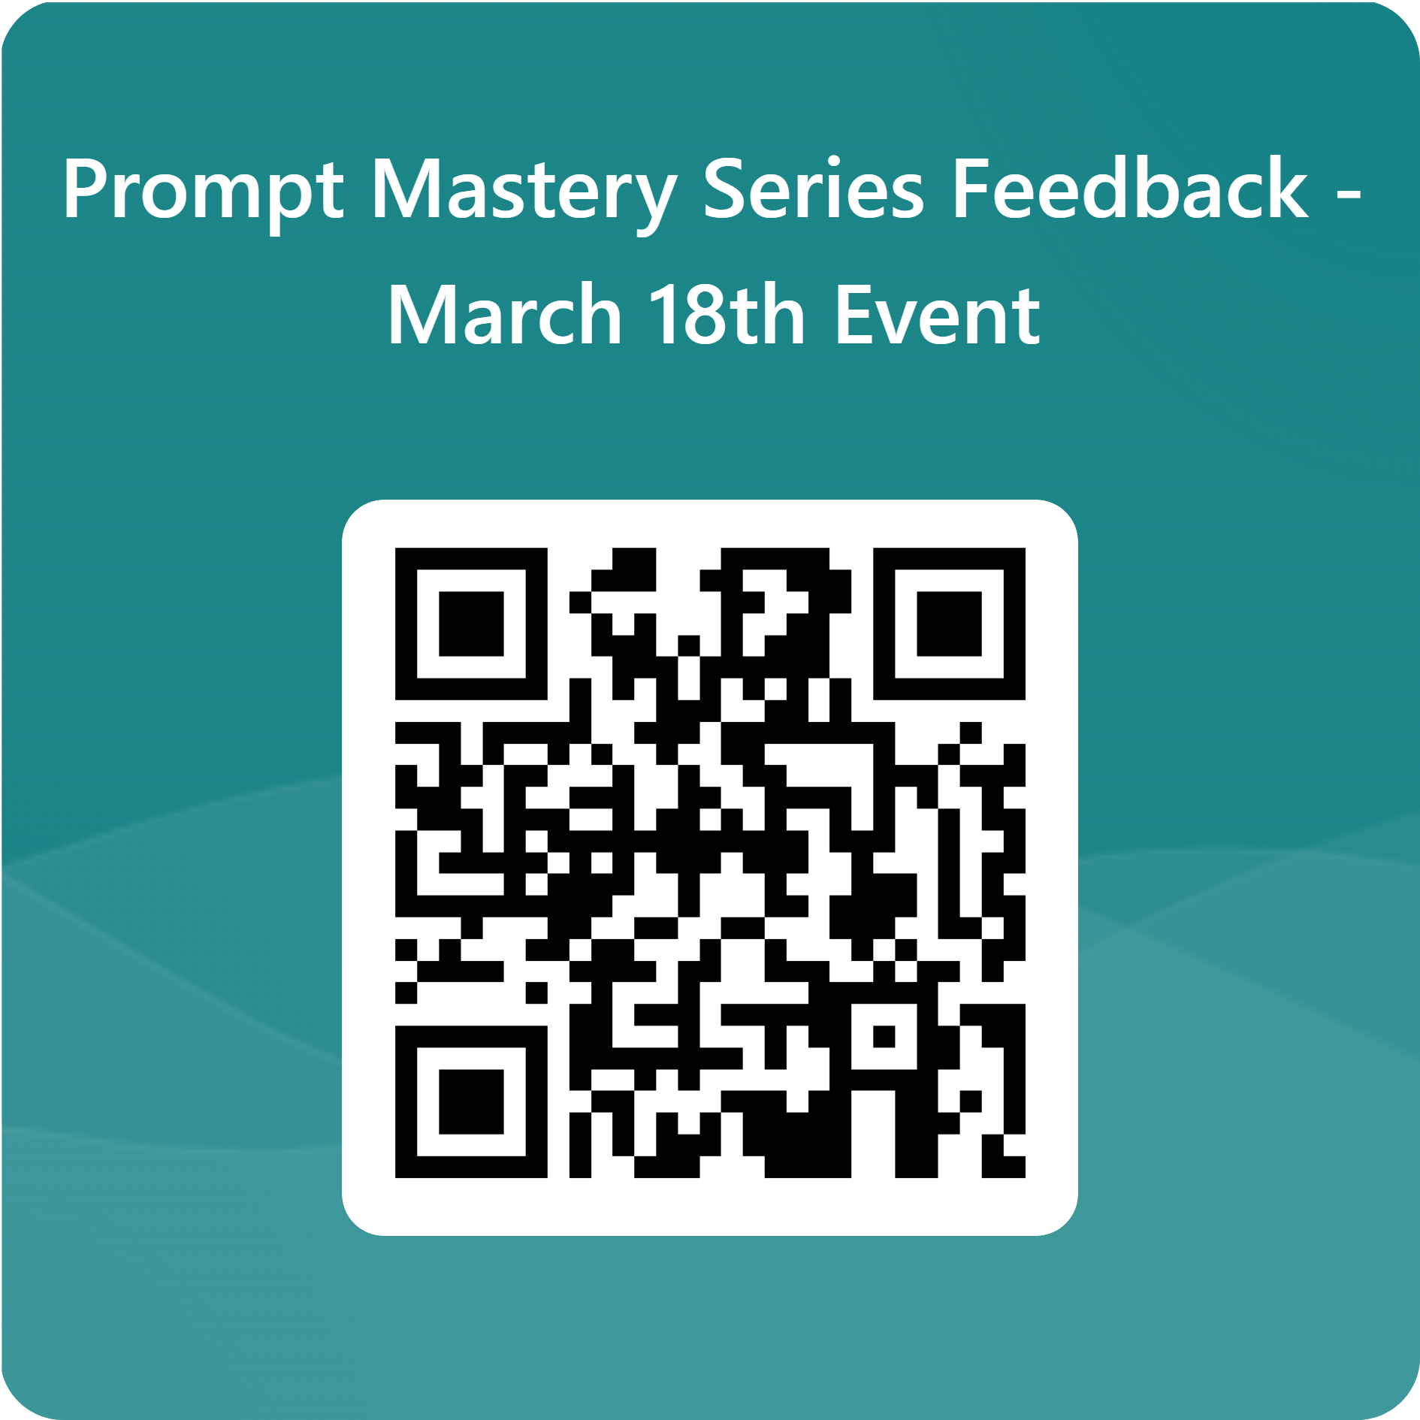
Prompt Mastery Series Feedback - March 18th
Notes:
Your feedback matters. Please take a moment to complete the feedback form so we can improve future Prompt Mastery sessions.

Slide 27
Thank you
Notes:
Thank you for spending time with us today. We hope you leave feeling more confident using Copilot Chat and crafting prompts that work for you. We appreciate your participation and look forward to seeing you in future sessions.

