Slide 1
Hello and welcome to Customer Hub
We’ll get started at 2 minutes past the hour

Slide 2


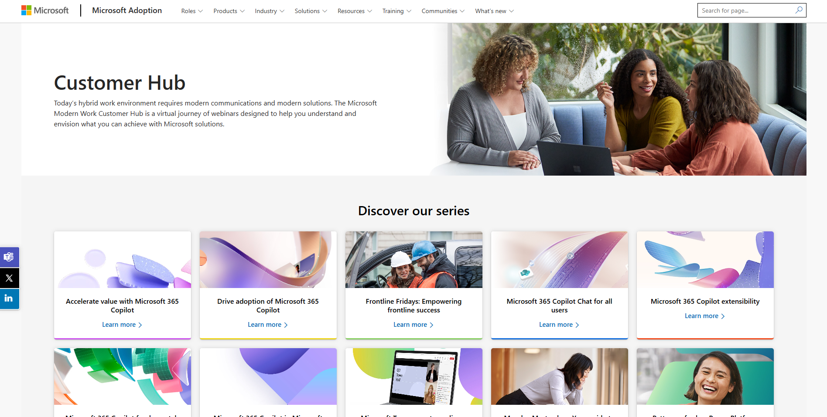
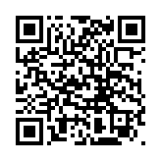
Visit Customer Hub website for upcoming sessions, updates, and on demand contents!
https://aka.ms/CustomerHubSessions​

Slide 3

Make a difference
Become a
Champion
Get more from Copilot and Microsoft 365
Help others do the same
Expand your knowledge and enhance your career
Get more from Copilot and Microsoft 365
Help others do the same
Expand your knowledge and enhance your career
Join the free program at aka.ms/M365Champions

Slide 4



After the presentation
During the presentation
We will mute your microphone for the first part of today’s call
Raise your hand and we will call on you
Ask your questions via chat, we will get to all of them, live or after. Common questions will get addressed out loud
Open mic – come off mute and ask away!

Slide 5
Teams Events Extensibility: How to Integrate Microsoft Teams Webinars with Marketing Automation and Learning Management Platforms

Slide 6
Agenda
Topic
Topic
Topic
Next Steps & Call to Action

Slide 7
Microsoft Teams Events Extensibility Overview
Sheharyar Mehmood

Slide 8
Graph APIs Use Case Break Down (Townhall + Webinar)
GET APIs
Get and List APIs
CRUD APIs
Notification APIs
Data Sync:
Using this set of APIs, a 3rd party App can sync event data and subscribe to notifications for their events. These APIs consist of:
Registration APIs
Using these APIs Customers can register participants for their webinars.
Event create:
Registration:
These APIs include:
Create,
Update,
Delete
Using these APIs Customers can create Townhalls and webinars.

Slide 9







App Integration Approach
Native Integrations
Low-Code No-Code
Custom Solutions
Marketing Automation Platforms
Lightweight Middleware solution
Provide Graph APIs for customers who want to build their own custom-made solution.

Slide 10
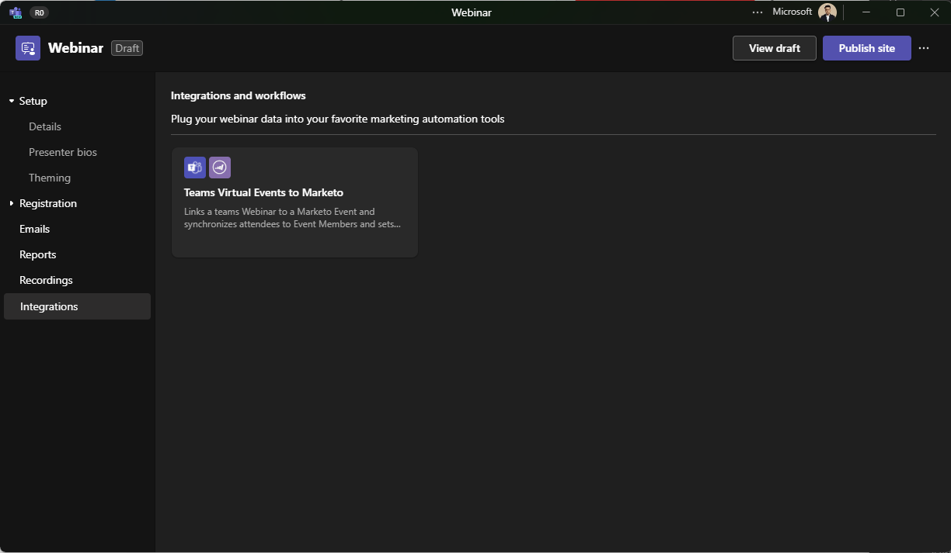
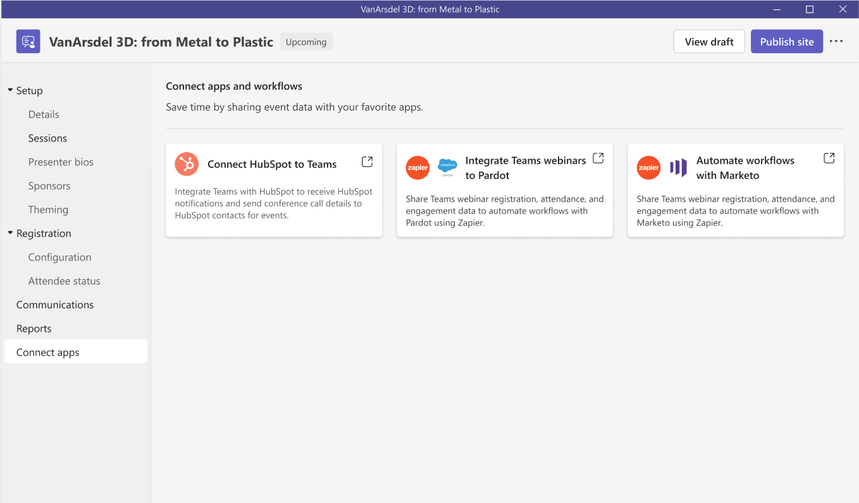

App Integration

Slide 11
Documentation Links
Use cases for virtual events webinar APIs in Microsoft Graph - Microsoft Graph | Microsoft Learn
virtualEventWebinar – Used to create, get, update, publish, cancel, and list Teams webinars.
virtualEventRegistration – Used to create, get, cancel, and list registration records of registrants of a webinar. Provides the unique Teams webinar join URL for the registered registrant.
virtualEventRegistrationQuestion – Used to create, list, and delete either custom registration questions or predefined registration questions for registrants to answer when they register for a webinar.
virtualEventRegistrationConfiguration – Contains information about a webinar registration configuration that stores the registration portal URL of the webinar.
virtualEventPresenter – Used to create, get, list, update, and delete a presenter for a Teams webinar.
virtualEventSession – A webinar created via Microsoft Graph APIs only has one session that inherits the properties of online meetings.
meetingAttendanceReport – Each time a webinar ends, an attendance report is generated for the session but doesn’t include attendee data.
attendanceRecord – Provides webinar attendee data in the attendance report.
virtual event webhooks – Can receive notifications for changes to a webinar, webinar registration, session, attendance report, and so on.
Use cases for virtual events town hall Microsoft Graph APIs - Microsoft Graph | Microsoft Learn
virtualEventTownhall – Used to create, get, update, publish, and cancel a Teams town hall.
virtualEventPresenter – Used to create, get, list, update, and delete a presenter for a Teams town hall.
virtualEventSession – A town hall created via Microsoft Graph APIs has one session that inherits the properties of online meetings.

Slide 12



Advanced Events Team (AET) Hybrid Event Support
Leveraging the Microsoft Advanced Events Team (AET)
Objectives: Help strategic customers successfully transition to a virtual or hybrid world with Teams Events. Support for all event types, including leadership summits, learning & development, virtual offsites, complex hybrid, or even external-facing webinars.
How: Contact Your Local Microsoft Account or Email Us Directly:
AdvancedEventsTeam@microsoft.com
Activities:
Define event format and approach
Demonstrate the technology capabilities
Educate and transfer knowledge to your Production and/or Technology team
Advise on recommended best practices to create the ideal virtual event experience
Assist in the preparation activities for the event to best leverage our solutions
Provide Support and/or Moderation during practice sessions, dry runs and/or for the actual virtual event

Slide 13
Thank you!
We are planning more Customer Hub sessions for early 2026… Stay tuned!

Slide 14

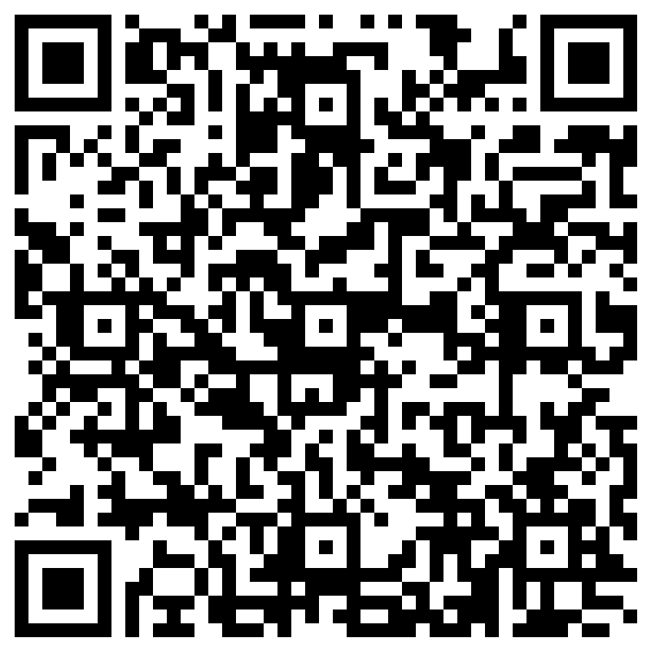
THANK YOU – Your feedback is critical
Scan with your mobile device camera
-OR-
We’re committed to making your Customer Hub experience the best it can be – and your feedback is a critical component to that.
Before you scoot, please take a moment to provide some feedback.
Visit
Customer Hub Survey
aka.ms/CustomerHubSurvey
Select Frontline Friday Series

Slide 15
Visit Customer Hub website for upcoming sessions, updates, and on demand contents!
https://aka.ms/CustomerHubSessions​

Slide 16
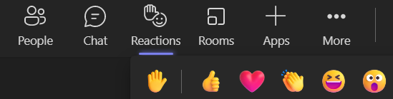
Q&A
1
Please raise your hand and unmute when called on
2

