Slide 1
Enable AI for All:
Copilot Chat
Adoption Best Practices
Notes:
Today we're diving into adoption best practices - how to get the most out of Copilot Chat and help your organization embrace it. Let's get started!

Slide 2



Visit Customer Hub website for upcoming sessions, updates, and on demand contents!
https://aka.ms/CustomerHubSessions​
Notes:
Quick plug for the Customer Hub - this is our go-to landing page on adoption.microsoft.com where we host live Microsoft-led sessions covering Microsoft 365 and Copilot adoption. You can find all our upcoming and on-demand sessions there, so definitely bookmark that link.

Slide 3
Copilot Chat
Microsoft 365 Copilot
Secure, AI Chat
Grounded on the Web
and referenced files
Standard Access
Metered Agents
Enterprise Data Protection
Included in Microsoft 365
Copilot Chat plus:
Microsoft 365 Work IQ
Priority Access
Advanced Skills in the
Microsoft 365 Apps
Access to Agents and Tools
Copilot Analytics
$30 USD / user / month
↑ Today’s Session
Notes:
Let's do a quick level set on what we're talking about today. On the left is Copilot Chat - it's included free in any Microsoft 365 license. It gives you secure AI chat grounded on the web, with enterprise data protection built in. On the right is the full Microsoft 365 Copilot at $30/user/month, which adds Work IQ, deeper app integration, agents, and analytics. Today we're focused on that included Copilot Chat experience on the left.

Slide 4
During the presentation
After the presentation
We will mute your microphone for the first part of today’s call
Raise your hand and we will
call on you
Ask your questions via chat, we will get to all of them, live or after. Common questions will get addressed out loud
Open mic – come off mute and ask away!
Notes:
A few housekeeping items before we dive in. We'll keep mics muted during the main presentation, but feel free to drop questions into the chat as we go - Mike and I will take turns answering them. When we get to the Q&A section at the end, we'll open up mics so you can ask questions live using the raise-hand feature.

Slide 5
Poll
What *best* describes your role in Microsoft 365 Copilot Chat Adoption?
    IT Professional / System Admin
    Adoption / Change Management
    Business User
    Organizational Leadership
    Other
Notes:
Let's do a quick poll to get a sense of who's in the room today. Are you an IT pro, an adoption specialist, a business user, in leadership, or something else? This helps us tailor our conversation. In past sessions, we usually see a mix of adoption folks and IT pros, so let's see where today's group lands.

Slide 6
Agenda
Microsoft 365 Copilot Chat
Art of the Prompt:
Prompting Best Practices
Adoption Best Practices
  Copilot Chat Success Kit
  Great Journey for Copilot Chat
  Copilot Chat Trainer Kit
  Prompt Gallery
  Scenario Library
Next Steps & Calls to Action
Notes:
Here's our roadmap for today. We'll start with a refresher on Copilot Chat, then Mike will walk us through the art of prompting - which is really the secret sauce for getting great results. After that, I'll cover adoption best practices and walk through the resources in our Success Kit, including the Great Journey email templates, Trainer Kit, Prompt Gallery, and Scenario Library. We'll wrap up with next steps and Q&A.

Slide 7
Refresher: Microsoft 365 Copilot Chat
Notes:
Let's start with a quick refresher on what Copilot Chat actually is and where it fits in the Microsoft 365 ecosystem. This is especially important because Microsoft has several products with Copilot in the name, and we want to be crystal clear about which one we're focusing on today.

Slide 8

AI for All
Chat
Web-grounded
Copilot Chat
Agents
Free, secure AI chat
IT controls
Notes:
Think of Copilot Chat as the tool that enables AI for everyone in your organization because it's already included in Microsoft 365. It has three main components: a chat experience, limited access to agents through metered pay-as-you-go, and IT controls for security and compliance. Importantly, your data never leaves your Microsoft 365 subscription, and we never use your prompts or data to train AI models. Web searches are anonymized through Enterprise Data Protection.

Slide 9
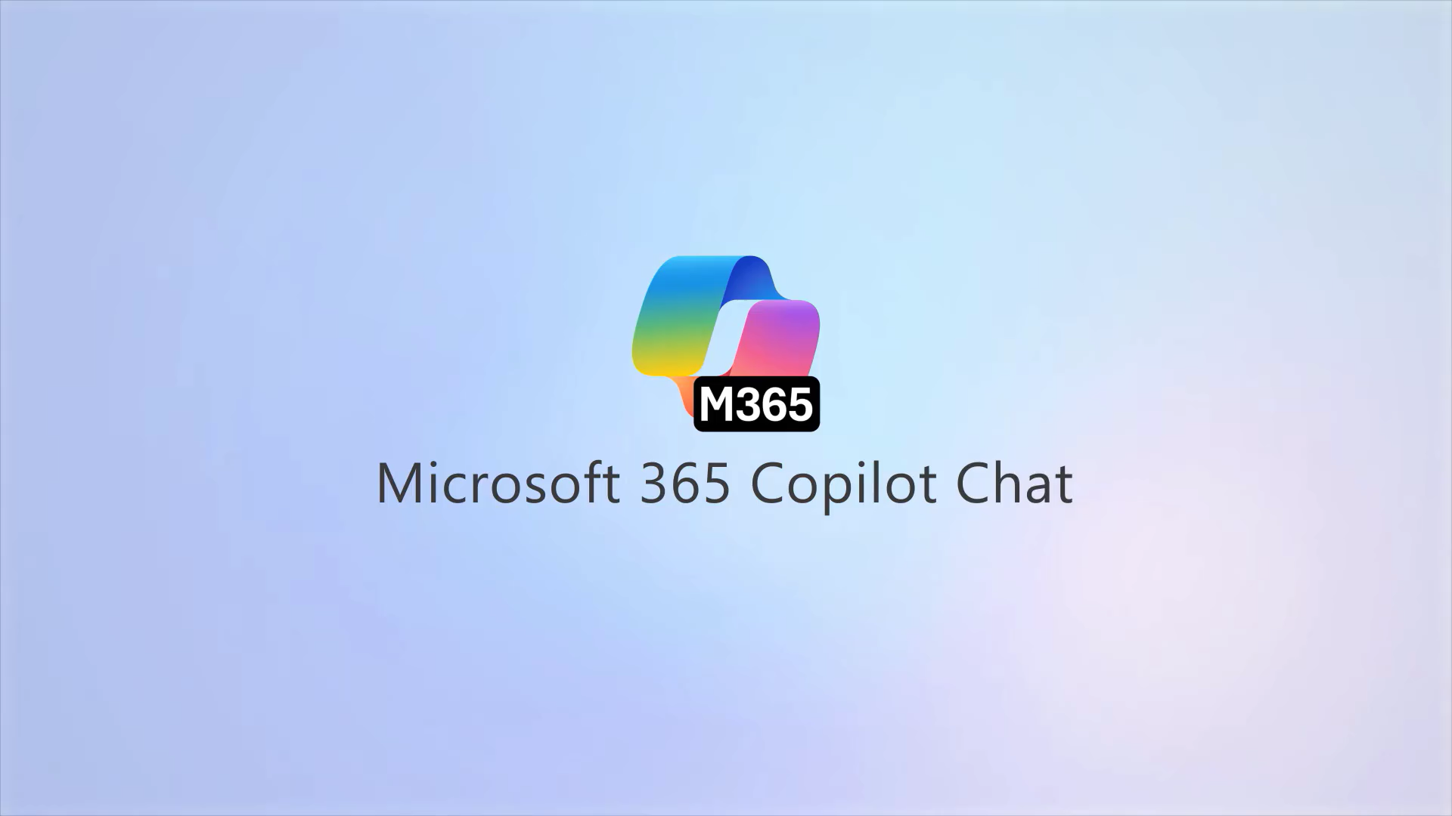
Overview
Microsoft 365
Copilot Chat
Notes:
Now let's look at a quick overview demo of Copilot Chat in action. This will give you a feel for the interface and what's possible right out of the box - from asking questions, to uploading files for analysis, to creating content.

Slide 10
Notes:
In the demo you just saw, notice how conversations get saved on the left sidebar and you can pick up right where you left off. Retention follows your organization's Microsoft 365 policies, and conversations are stored in a hidden folder in the user's Exchange Online mailbox for compliance and eDiscovery. There's also a personalization feature under Settings that builds up a memory of your preferences and context over time - things like your location, your writing style preferences, and your role.

Slide 11
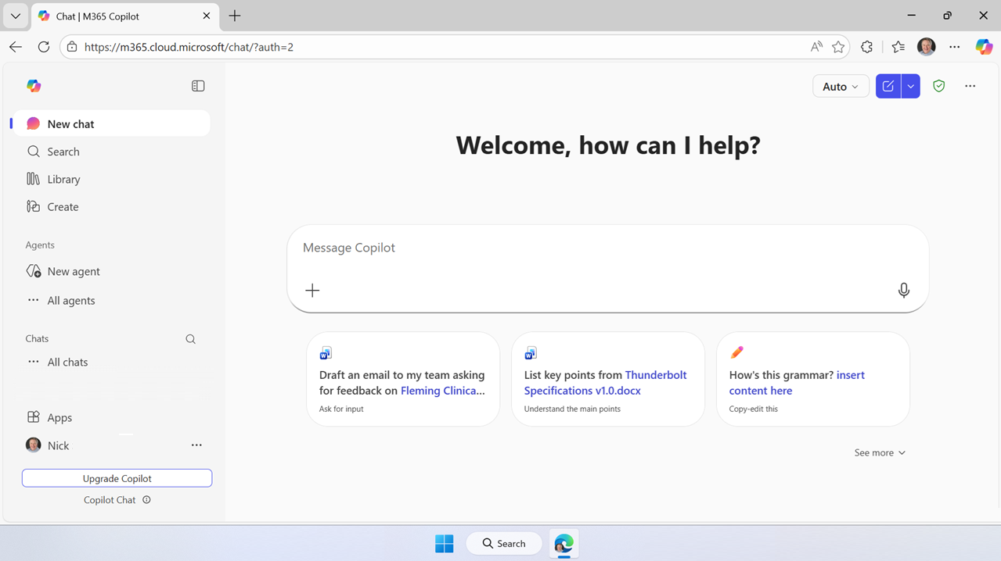
Microsoft 365
Copilot Chat
Secure AI chat powered by the latest models, grounded in web data, and context-aware, understanding the content you’re working on and tailoring responses accordingly.
On the Web
m365.cloud.microsoft/chat
Windows and MacOS
Microsoft Teams
iOS and Android
Notes:
Copilot Chat is available across multiple platforms - not just the web. There's a standalone app for Windows and Mac, it's built into Teams, and there are mobile apps for iOS and Android. A lot of people love docking the app on a second monitor while they work on their main screen. The key thing is you can access it anywhere you work.

Slide 12

Scaling AI Transformation
Copilot Chat
Microsoft 365 Copilot
Notes:
Organizations move through the AI adoption curve at their own pace - it's not one-size-fits-all. The flexibility is critical because needs shift as you progress. Together, Copilot Chat and the full Microsoft 365 Copilot let organizations accelerate their AI transformation at every step. Everyone can start today with Copilot Chat as a safe, managed entry point, and then you can expand to full Copilot licenses where it makes sense.

Slide 13
Agenda
Microsoft 365 Copilot Chat
Art of the Prompt:
Prompting Best Practices
Adoption Best Practices
  Copilot Chat Success Kit
  Great Journey for Copilot Chat
  Copilot Chat Trainer Kit
  Prompt Gallery
  Scenario Library
Next Steps & Calls to Action
Notes:
Alright, that's our Copilot Chat refresher. Now let's move into what I think is the most fun and practical part of today's session - the art of the prompt. Mike's going to walk us through how to write prompts that actually get you great results.

Slide 14
What is Prompting ?
Prompts are the way you ask Copilot to perform tasks for you. It’s a unique and emerging skill that differs from traditional web searching.
Notes:
So what is prompting? A prompt is simply what you ask Copilot to do - summarize a document, research a topic, create content, whatever it is. The key thing to understand is this is a unique and emerging skill. It's very different from traditional web searching. You don't want to treat it like a search engine with just a few keywords. Research shows that about 21 words on average is the sweet spot for getting the best results.

Slide 15
The Art and Science of prompting
Tell Copilot Chat what you need
Prompts are how you ask Copilot to do something for you — like creating, summarizing, editing, or transforming.
Think about prompting like having a conversation, using plain but clear language and providing context like you would with an assistant.
Learn about competing products:
"What are the top competitors to [Product] and who are the key Companies working on it?"
Edit text:
"Check this product launch rationale for inconsistencies."
Transform documents:
"Transform this FAQ doc into a 10-slide onboarding guide."
Summarize information:
"Write a session abstract of this [presentation]."
Create engaging content:
"Create a value proposition for [Product X.doc]."
Notes:
Think of prompting like having a natural conversation. You're going to talk to Copilot just like you would a colleague - using plain, clear language. You can ask it to learn about competitors, edit text, transform documents, summarize information, or create new content. The key is being conversational and specific rather than using terse search-style queries.

Slide 16
The Art and Science of prompting
Include the right prompt ingredients
To get the best response, it’s important to focus on some of the key elements when phrasing your Copilot prompts.
Goal
Context
Expectations
Goal
Context
Source
Expectations
Source
What response do you want from Copilot?
Why do you need it and who is involved?
Which information sources or samples should Copilot use?
How should Copilot respond
to best meet your expectations?
Notes:
Here's the framework that makes all the difference. There are four key ingredients to a great prompt: Goal - what do you want? Context - why do you need it and who's it for? Source - what information should Copilot use? And Expectations - how do you want the response formatted? If you include all four, I guarantee you'll get a solid result. An easy way to remember: Giraffes Can See Everything - GCSE.

Slide 17
Include the right prompt ingredients
Give me some icebreaker ideas.
aka.ms/CopilotPromptIngredients
Notes:
Let's look at a simple example. A basic prompt like 'give me some icebreaker ideas' will give you a generic response. But when we add all four GCSE ingredients, we get something much more useful. Also, check out the link at the bottom - aka.ms/CopilotPromptIngredients - it's a one-pager you can print out and tack on your wall as a quick reference.

Slide 18
Include the right prompt ingredients
Goal
Context
What outcome are you trying to achieve?
Why do you need it and who is involved?
Generate a list of simple icebreaker activities
that don't require props or setup. I'll use them to open our team offsite meeting. Use team facilitator best practices suitable for a work environment. Include a numbered list of the steps for each one.
Which information sources or samples should Copilot use?
How should Copilot respond
to best meet your expectations?
Source
Expectations
aka.ms/CopilotPromptIngredients
Notes:
Here's the full prompt with all four pieces. Goal: generate a list of simple icebreaker activities that don't require props or setup. Context: I'll use them to open our team offsite meeting. Source: use team facilitator best practices suitable for a work environment. Expectations: include a numbered list of the steps for each one. See how each ingredient adds specificity? That's what gets you great results.

Slide 19
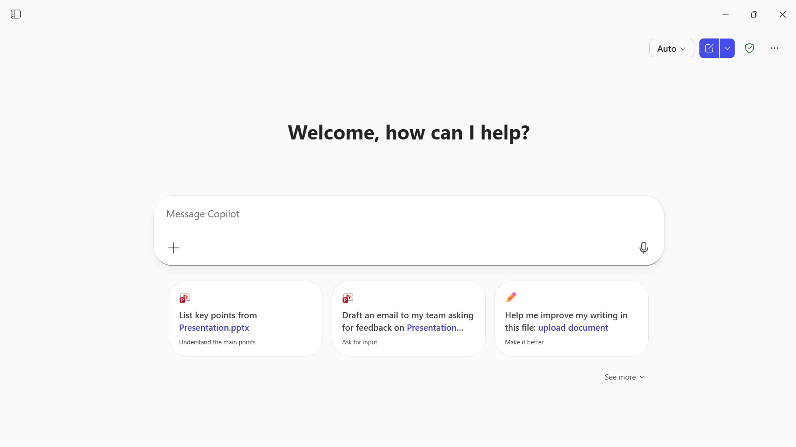
DEMO
Art of the Prompt
Goal, Source,
Context, Expectations
Notes:
Let's see this prompt in action. When we fire it off, Copilot comes back with eight structured icebreaker ideas, each with a clear purpose, estimated time, and step-by-step facilitation guidance. That's a ready-to-use facilitation guide - immediately usable in a live session. All because we included those four ingredients.

Slide 20
Include the right prompt ingredients
Goal
Context
I'm a financial analyst at Contoso and have been tasked with putting together a view of our business in H2. Help me understand how Tariffs might disrupt my company's business over the next 6 months. Only use information from credible web sources. Provide back a thorough a summary including how my company can mitigate any possible disruptions you might find.
Source
Expectations
aka.ms/CopilotPromptIngredients
Notes:
Here's a more business-oriented example. Notice the goal isn't first this time - the context leads: I'm a financial analyst at Contoso tasked with putting together a view of our business in H2. Then the goal: Help me understand how tariffs might disrupt my company's business over the next six months. Source: Only use credible web sources. Expectations: Provide a thorough summary including mitigation strategies. Personas work great as context - telling Copilot who you are helps it tailor the response.

Slide 21
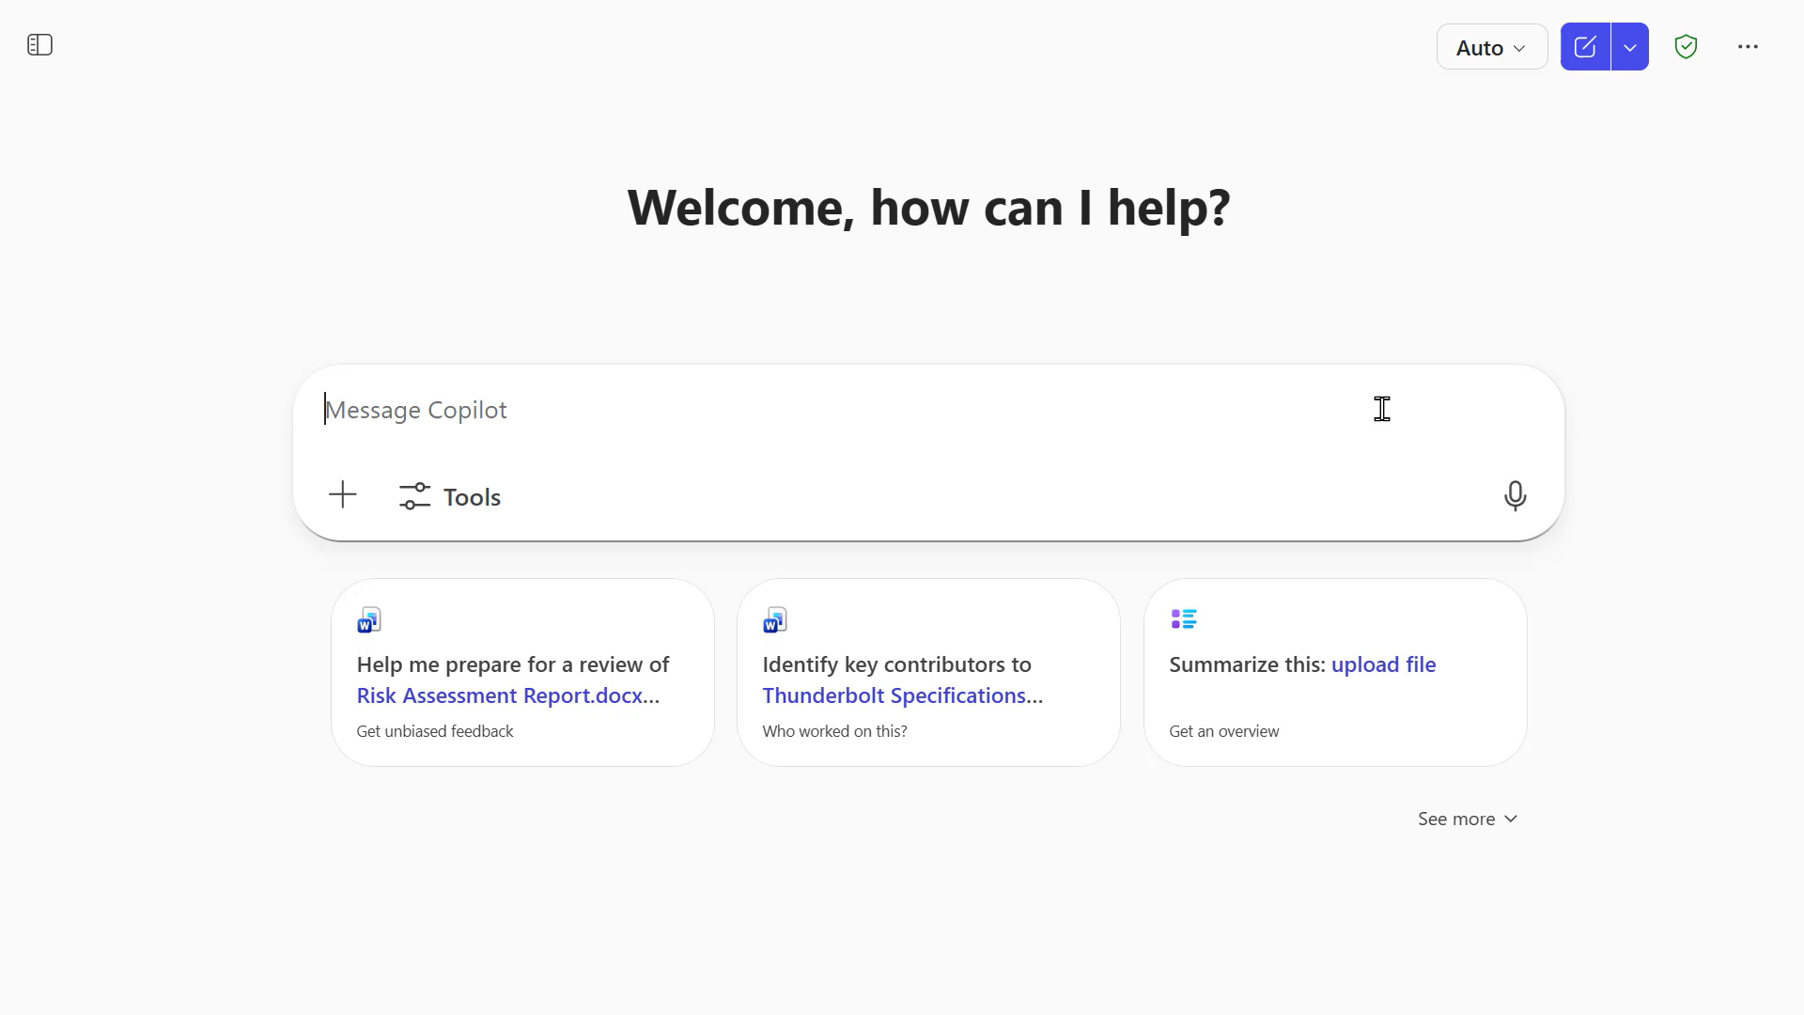
Copilot Chat
DEMO
Art of the Prompt
Simple Example
Notes:
When we run this prompt, Copilot delivers an executive summary of tariff risks, breaks down specific disruptions for Contoso, maps out P&L and operational impacts, and provides a mitigation playbook - all with credible sources cited. That one sentence about credible web sources really made it work harder to validate its information. This is a great example of how a well-crafted prompt can do some serious heavy lifting for research and analysis.

Slide 22
Prompt Examples
Goal | “Recipe for lasagna"
Context | "I'm a beginner cook trying to make Italian cuisine"
Source | “Top rated recipes"
Expectations | “Want it in list format, for ease of readability”
Prompt: | I'm a beginner cook trying to make Italian cuisine. Can you provide a simple, easy to follow recipe for lasagna based on top rated recipes from the web? Write it as a step-by-step list.
Goal | “To understand exception handling”
Context | "I’m new to software development"
Source | “Working on a Python project"
Expectations | “An easy to understand response without super technical vocabulary"
Prompt: | I'm a new software developer working on a Python project. Can you explain how to implement exception handling in Python like I am five years old?
Goal
Context
Source
Expectations
Notes:
Here are a couple more examples to get you thinking. First, a cooking example: you're a beginner cook trying Italian cuisine, want a lasagna recipe from top-rated sources in a step-by-step list format. Second, a technical example: you're a new developer needing Python exception handling explained like you're five years old. Both have all four GCSE ingredients, and both would give you excellent, tailored responses.

Slide 23
The art and science of prompting
Keep the conversation going
Generating content ideas
Lead with broader requests, then give specific details about the content.
Gaining insights
Ask for a summary of a specific file, then ask relevant questions to gain deeper insights.
Following up on your prompts helps you collaborate with Copilot, to gain more useful, tailored responses.
Storytelling assistance
Ask Copilot to write a story, then guide it by giving more specific, relevant details​.
Translating languages
Ask Copilot to translate a sentence to one of the supported languages, then ask for more context or a regional dialect.
Solving technical problems
Present a technical problem, then narrow it down, or ask for step-by-step guidance​.
aka.ms/CopilotPromptIngredients
Notes:
This is a really important concept - keep the conversation going. When you get a response from Copilot, it remembers the context. You don't have to start over. You can drill deeper, refine, redirect. Start broad if you're not sure what you need, then narrow down. This contextual prompting is incredibly powerful for things like generating content ideas, storytelling, solving technical problems, or just iterating until you get exactly what you need.

Slide 24
What makes an effective prompt?
More Effective
Less Effective
Specific and detailed
In full sentences, with instructions
States the tone, purpose, preferred format, etc.
Example: I work in marketing and focus on competitor research. Give me a concise summary of recent news about [company name]. Focus on announcements about new product lines. Provide the answer in two to three paragraphs and use a business tone.
Vague
Just a few words
No context on preferred output
Example: Summarize news about [company name].
The recap may be more vague than desired, or in a format that you were not seeking.
But there are no ‘wrong’ prompts because natural, conversational language is welcome.
Experiment away!
Notes:
To sum up the prompting section: be specific and detailed, write in full sentences, and include instructions when needed. Copilot actually handles structured instructions really well. Always state the tone, purpose, and preferred format in your expectations. And remember - there are no wrong prompts. If your first attempt doesn't nail it, that's totally fine. Use what comes back to refine your next prompt. Have fun with it, and try to remember: Giraffes Can See Everything!

Slide 25
Agenda
Microsoft 365 Copilot Chat
Art of the Prompt:
Prompting Best Practices
Adoption Best Practices
  Copilot Chat Success Kit
  Great Journey for Copilot Chat
  Copilot Chat Trainer Kit
  Prompt Gallery
  Scenario Library
Next Steps & Calls to Action
Notes:
Great, that wraps up the prompting best practices. Now let's shift gears and talk about adoption - how do you actually get your organization to embrace Copilot Chat and build it into their daily workflows?

Slide 26
Key Use Cases for Copilot Chat
Summarization of Document: Copilot Chat can help users quickly summarize documents or web pages.
Generating Creative Content: Users can leverage Copilot Chat to generate creative content such as stories, poems, and other written materials.
Providing Quick Answers and Explanations: Copilot Chat can be used to provide quick answers to questions and explanations on various topics, enhancing productivity.
Helping with Research: Copilot Chat can help to perform research for industries, markets, competitors, and products.
Notes:
The first step in driving adoption is helping people understand what's possible. The quick query stuff - summarizing a document, asking a question - that's table stakes. But there's so much more. People can create new content, do research across public sources, analyze uploaded files, and even build up their own prompt libraries. When people see the range of what's possible, that's when adoption really takes off.

Slide 27

Top 10 to try first with Microsoft 365 Copilot Chat
1
2
3
4
5
Ask a question
Get insights and answers to your questions.
Draft an email
Generate an email draft and personalize the tone and length.
Summarize a document
Simplify a long document, article, or PDF.
Generate new ideas
Boost your creativity with ideas for your tasks such as agendas, image creation, social media posts, etc.
Draft a document
Start from a full draft rather than a blank page.
Draft an email to [name] that informs them that Project X is delayed two weeks. Make it short and casual in tone.
How does [product] compare to [competitor product]? Provide the comparison in a table.
Give me a bulleted list of key points from <insert file>.
Suggest 10 compelling taglines based on <insert file>.
Write an outline for a creative brief for a video project.
6
7
8
9
10
Improve your writing
Write and edit like a pro.
Learn something new
Quickly learn new skills and topics.
Create an image
Leave behind stock images and text-only reports by creating images easily.
Translate a message
Read and write content in other languages.
Lighten up your work
Add some fun to your emails, messages, and meetings.
Illustrate a romantic pop art image of an office worker experiencing a dramatic coffee crisis.
Generate three ways to say [text].
Explain how a large language model works in simple terms.
Translate the following text into French: [text].
Suggest 5 office-friendly jokes.
aka.ms/Copilot/Top10ChatHandout
Notes:
Here are the top 10 things to try first with Copilot Chat. These range from asking questions and drafting emails, to summarizing documents, generating ideas, and drafting documents from scratch. On the next set, you'll see improving your writing, learning new skills, creating images, translating messages, and even having some fun with it. This handout is a great resource to share with your users - download it at the link shown.

Slide 28
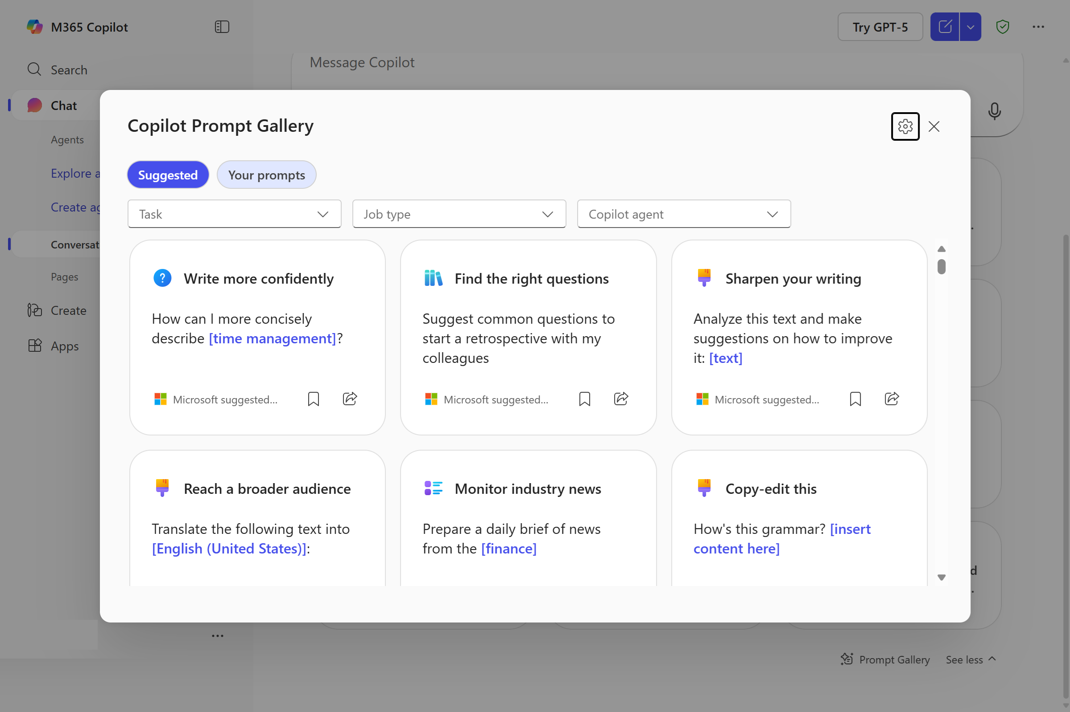
Discover and share Copilot Chat prompts
Microsoft 365 Copilot Chat Prompt Gallery
https://aka.ms/copilotgallery
The Prompt Gallery is a collection of prewritten, optimized prompts designed to enhance interactions with Microsoft Copilot Chat.
Explore prompts based on task, role, and industry.
Save and reuse your own prompts to stay organized and work smarter.
Notes:
The Prompt Gallery is like a clearinghouse of pre-written, optimized prompts from Microsoft. You can filter by task, role, and industry. But here's the cool part - there's also a My Prompts section where your saved prompts live. As you refine prompts over time and save the ones that work great, you build up a personal library that makes you faster every day.

Slide 29
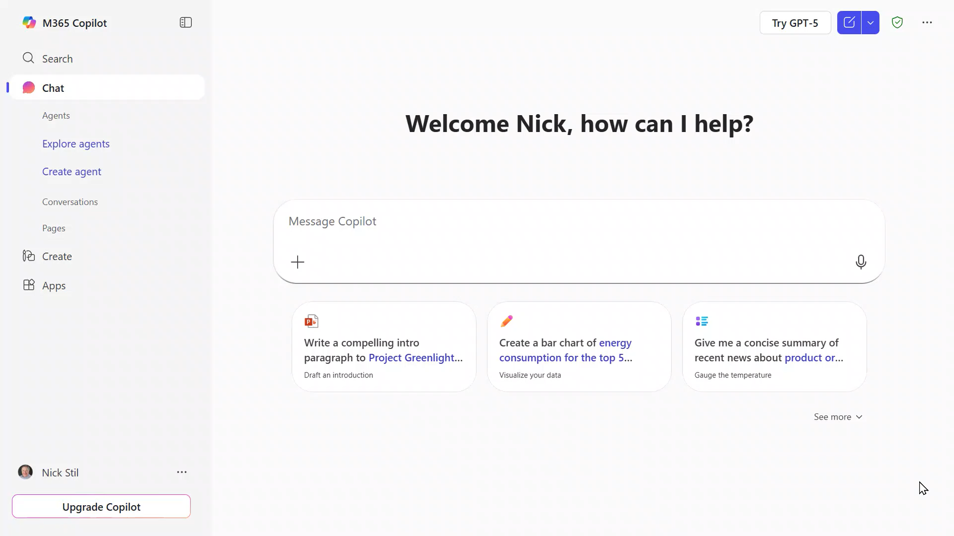
Prompt Gallery Animation
Notes:
Here's how the Prompt Gallery works in practice. When you start a new chat, you'll see a Prompt Gallery button at the bottom. Click it, filter by what you need, pick a prompt, and it drops right into the chat box. It saves you from having to remember or copy-paste prompts from somewhere else. Super handy for building consistency across your team.

Slide 30
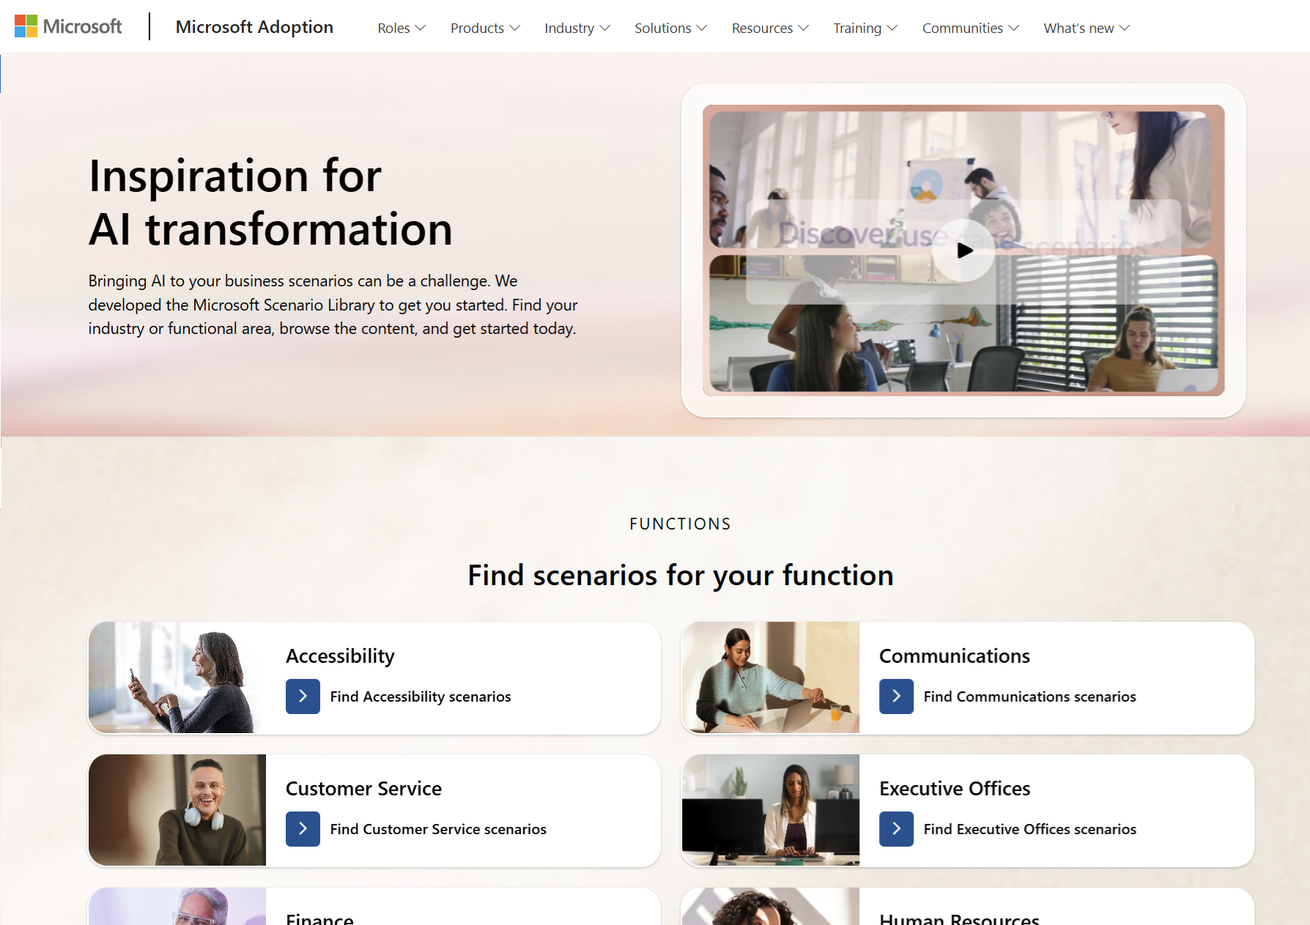
Microsoft 365 Copilot Chat Scenario Library
aka.ms/scenariolibrary
Explore Copilot Chat scenarios by industry, role and function to see what’s possible.
Downloadable scenarios guides have sample KPIs and day-in-the-life use cases to inspire users and uncover business value.
Notes:
The Scenario Library is another fantastic resource. It's organized by industry, role, and function, and you can filter specifically for Copilot Chat scenarios. Each scenario includes a short video testimonial, day-in-the-life use cases, and downloadable materials. These are perfect for lunch-and-learns or department meetings where people are asking what do I actually do with this?

Slide 31
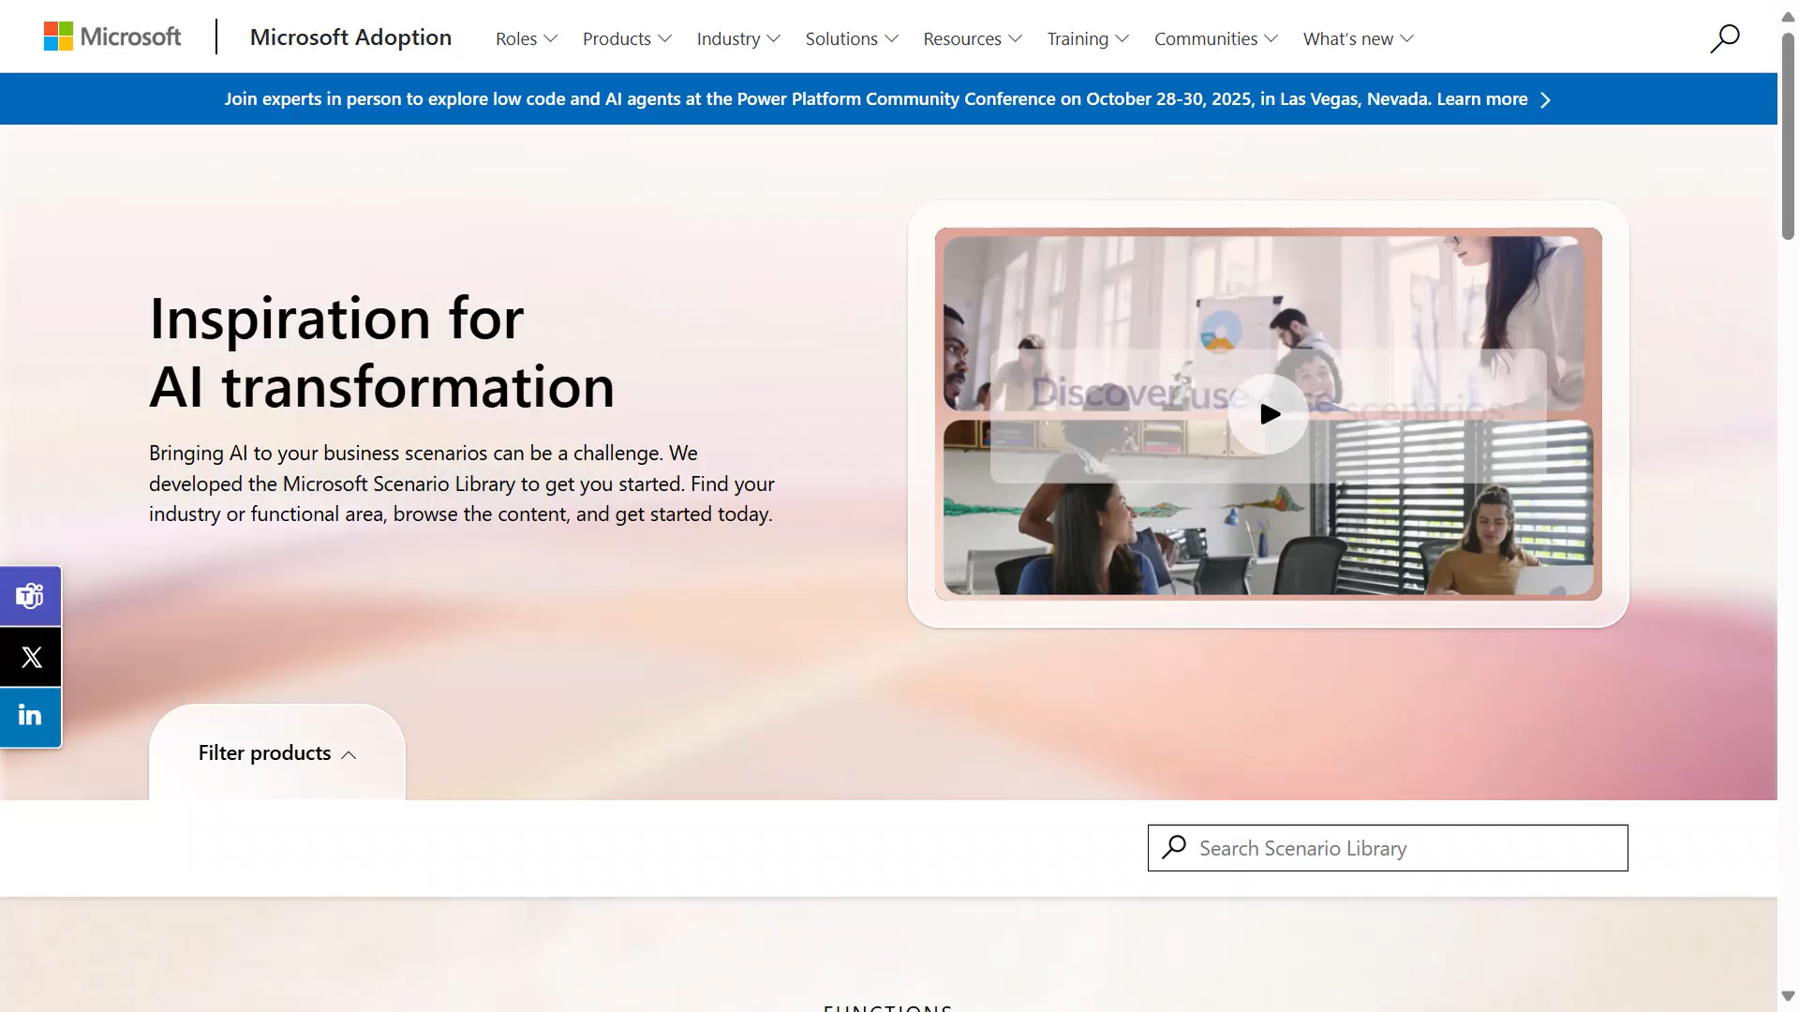
Scenario Library Animation
Notes:
Let me show you the Scenario Library in action. When you expand a scenario, you get practical examples, downloadable guides, and sample KPIs. These really help bridge the gap between this tool exists and here's exactly how someone in your role can use it to save time and do better work.

Slide 32
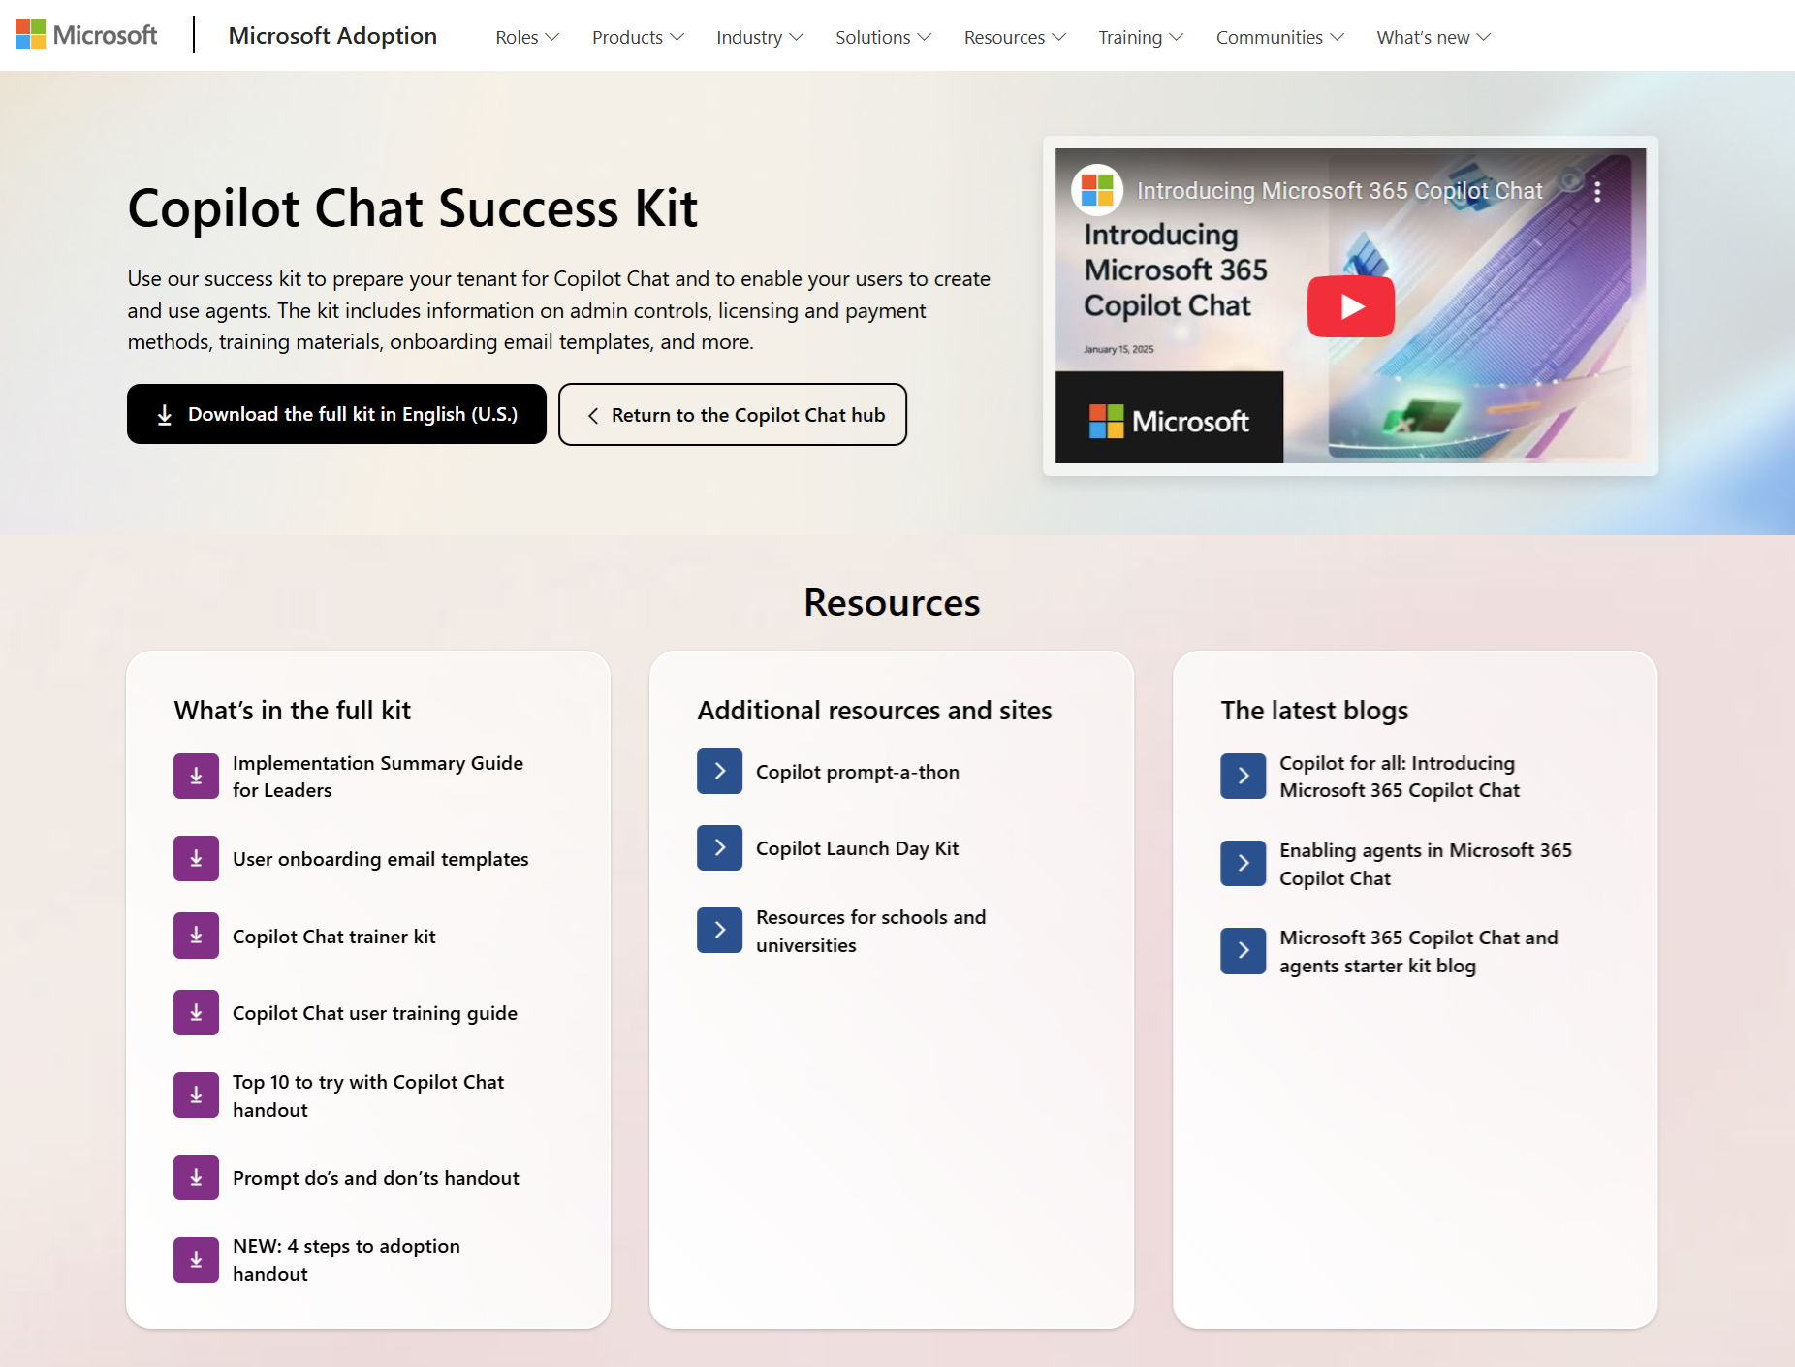
Microsoft 365 Copilot Chat Success Kit
adoption.microsoft.com/copilot-chat/
Use the success kit to prepare your organization for Copilot Chat with information on admin controls, licensing and payment methods, training materials, onboarding email templates, and more.
Notes:
All of these resources live in the Copilot Chat Success Kit on adoption.microsoft.com/copilot-chat. You can download resources individually or grab them all at once in a zip file. It includes everything we've talked about - admin controls documentation, licensing info, training materials, onboarding email templates, and more. It's a couple hundred megabytes of really useful stuff.

Slide 33
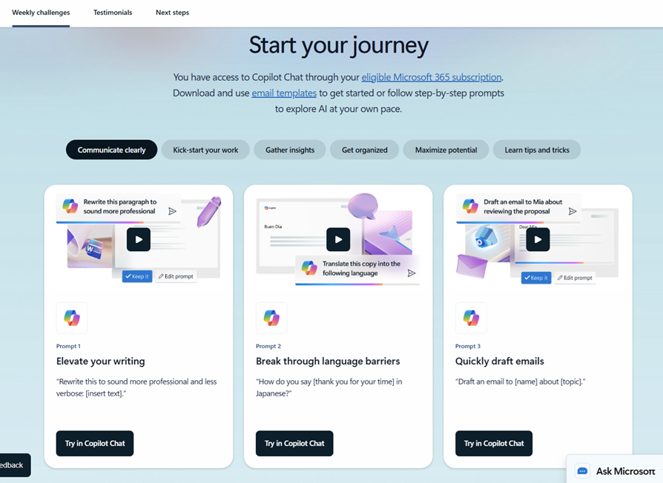
Great Journey for Copilot Chat
aka.ms/Copilot/ChatJourney
Ready-to-use email templates for a 30-day skilling experience that teaches users what’s possible with Copilot Chat and drives usage
Notes:
The Great Journey for Copilot Chat is one of my favorites. It's a collection of 30 ready-to-use email templates - one per day - each with a tip or trick for Copilot Chat. This is perfect for a 30-day onboarding campaign. Remember, don't be one-and-done with change management. These gentle daily nudges are one of the most effective ways to build new habits and drive sustained adoption.

Slide 34
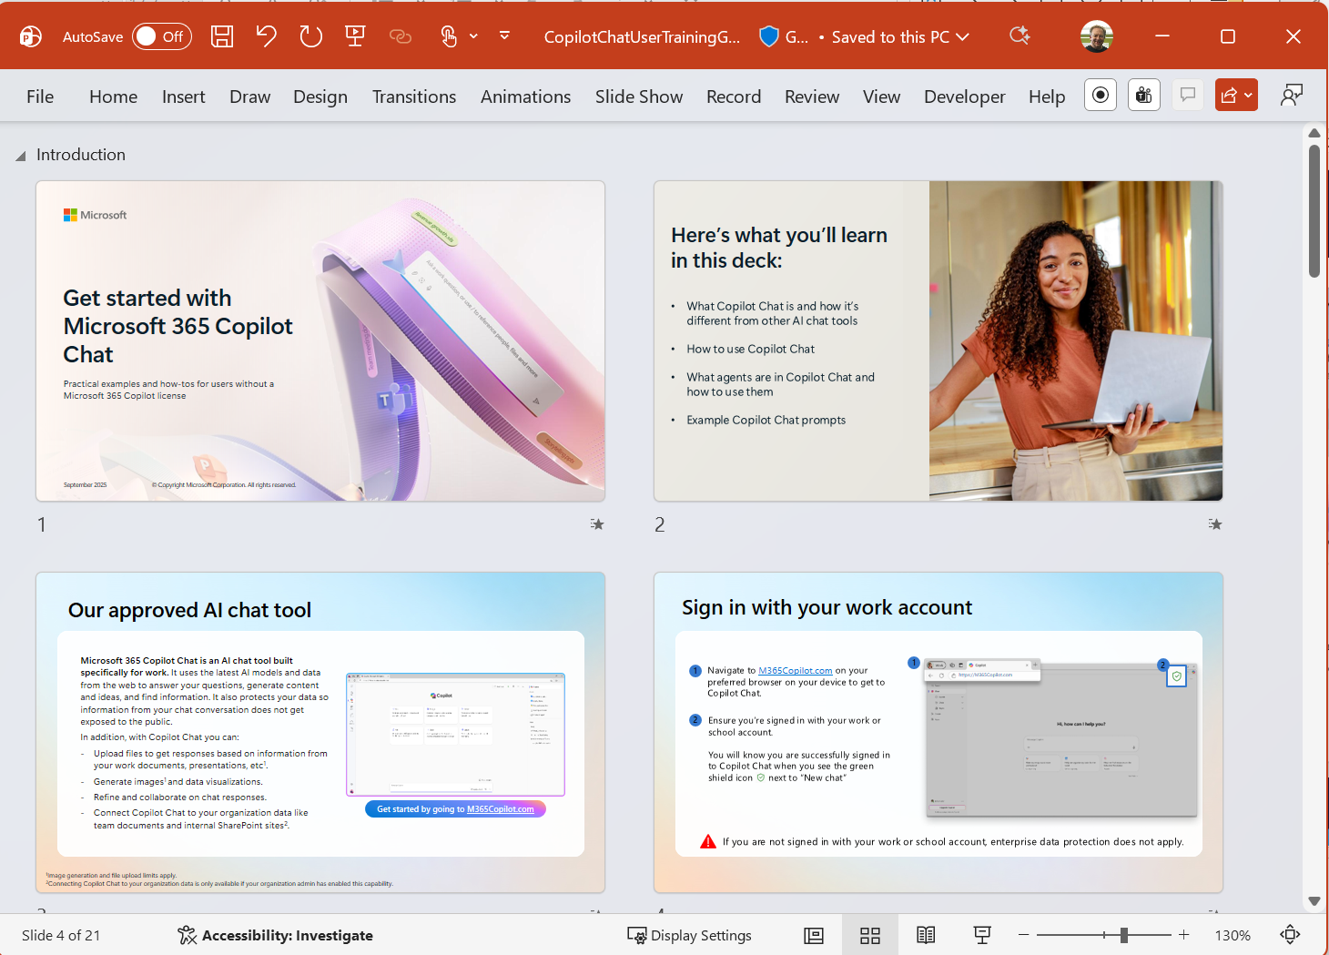
Microsoft 365 Copilot Chat
Trainer Kit
aka.ms/CopilotChat/TrainerKit
PowerPoint deck to use with users introducing Microsoft 365 Copilot Chat and how to use it for common scenarios.
Practical guide to Copilot prompts, terminology, and actionable tips.
Handout to share with users on the top 10 use cases to try first with Copilot Chat
Notes:
The Copilot Chat Trainer Kit is a full slide deck designed for delivering lunch-and-learns or training sessions to your users. It walks through what Copilot Chat is, how to use it, common scenarios, and prompting best practices. It even includes embedded demos so you don't have to do live demos that might take too long. There's also a handout covering the top 10 use cases to share with attendees.

Slide 35
Agenda
Microsoft 365 Copilot Chat
Art of the Prompt:
Prompting Best Practices
Adoption Best Practices
  Copilot Chat Success Kit
  Great Journey for Copilot Chat
  Copilot Chat Trainer Kit
  Prompt Gallery
  Scenario Library
Next Steps & Calls to Action
Notes:
Alright, we've covered all the key adoption resources. Let's recap and point you to the next steps and calls to action.

Slide 36
Resources after Today
Microsoft 365 Copilot Help & Learning
support.microsoft.com/copilot-microsoft365-chat
Short how-to videos, help articles
Top 10 Things to Try First
aka.ms/Copilot/Top10ChatHandout
PDF Handout of sample prompts
Art of the Prompt
aka.ms/CopilotPromptIngredients
How to write a good Prompt
Copilot Prompt Gallery
aka.ms/prompts
Samples and Prompts you Saved
Customer Hub Sessions
aka.ms/CustomerHubSessions​
Microsoft 365 Copilot Adoption
adoption.microsoft.com/en-us/copilot-chat/
Resources for Adoptioon specialists
Copilot Chat Training Deck
aka.ms/Copilot/ChatUserTrainingGuide
PowerPoint deck for End User Training
Great Journey for Copilot Chat
aka.ms/Copilot/ChatJourney
30-day skilling, daily tips and templates
Copilot Scenario Library
aka.ms/copilot/scenariolibrary
Examples of business use cases
Technical Documentation for IT Pros
learn.microsoft.com/copilot/overview
Notes:
Here's your one-stop reference slide with all the links we've covered today. From help and learning, to the top 10 handout, prompt ingredients guide, Prompt Gallery, Customer Hub sessions, adoption resources, trainer kit, Great Journey emails, Scenario Library, and technical docs for IT pros. I'd suggest bookmarking adoption.microsoft.com as your central hub - everything hangs off of there, filtered by product.

Slide 37

Microsoft Resources to Accelerate your Time to Value
Microsoft 365 Copilot Chat
End User Help and
Learning, Support Articles, How-to Videos
Get started building
AI Agents for
Microsoft 365 Copilot
Onboard at scale with resources enabling adoption, usage, change management and business outcomes.
Find Partners to help with Microsoft 365 Copilot Scenarios, Adoption and Agentic Transformation
Microsoft 365 Copilot Chat
Help and Learning
AI Agents Hub
adoption.microsoft.com
Microsoft 365 Copilot
Partner Directory
Enterprise skilling plan, Microsoft Instructor-led training, Microsoft Certification discounts
Eligible customers
can request technical and deployment
assistance from Microsoft.
Microsoft Unified Support offerings and workshops focused on business value, governance, and enablement..
Enterprise Skilling Initiative
Microsoft FastTrack
Microsoft Unified
Notes:
Microsoft offers a range of support options to help you succeed. For self-service, there's the Help and Learning site, the AI Agents Hub, and adoption.microsoft.com. For partner help, check out the Copilot Partner Directory. For enterprise customers, there's the Enterprise Skilling Initiative for Microsoft-delivered training, FastTrack for technical onboarding support, and Microsoft Unified for comprehensive workshops and planning. If you have 150+ licenses, you can access FastTrack right from the Microsoft 365 Admin Center.

Slide 38
Make a difference
Become a
Champion
Get more from Copilot and Microsoft 365
Help others do the same
Expand your knowledge and enhance your career
Get more from Copilot and Microsoft 365
Help others do the same
Expand your knowledge and enhance your career
Join the free program at aka.ms/M365Champions
Notes:
If you're passionate about Copilot or play a role in adoption, check out the Microsoft 365 Champions program. It's free, and it's a great way to deepen your knowledge, help others in your organization, and expand your career. We host monthly calls for power users and adoption specialists to share best practices. Sign up at aka.ms/M365Champions.

Slide 39

THANK YOU –
Your feedback is critical
Scan with your mobile device camera
-OR-
We’re committed to making your Customer Hub experience the best it can be – and your feedback is a critical component to that.
Before you scoot, please take a moment to provide some feedback.
Visit
Customer Hub Survey
aka.ms/CustomerHubSurvey
Select Frontline Friday Series
Notes:
Before you head out, we'd really appreciate your feedback! Your input directly shapes how we improve these sessions. Please use the Customer Hub Survey link and select the Copilot Chat for All Users series - not the Frontline Friday option. Let us know what was helpful and what topics you'd like us to cover next time.

Slide 40

Q&A
1
Please raise your hand and unmute when called on
2
Notes:
Alright, it's Q&A time! If you've got questions, drop them in the chat or use the raise-hand feature and we'll unmute you. Don't be shy - if you have a question, guaranteed other people are wondering the same thing.

Slide 41
Notes:
Thanks for sticking with us through the session! Remember, this recording and slide deck will be posted to the Customer Hub site within a few days. Scroll up through the chat to grab any links you missed, and head to adoption.microsoft.com for everything you need. We hope Copilot Chat enables your users and gives your organization a safe, productive alternative. See you next week when we go deeper into Copilot Pages and image creation!

Slide 42
Microsoft 365 Copilot
Copilot Chat¹
M365
Copilot
● Included ο Limited ▲ Metered
w/o Copilot license
$30 pu/pm
Grounding | Web data, referenced files, uploaded files | ● | ●
 | Work IQ | - | ●
 | Use Copilot connectors to access external data sources | ▲ | ●
Models | Latest OpenAI models: GPT-5.X | Standard | Priority
 | Model choice | - | ●
Microsoft 365 Copilot App | Chat | ● | ●
 | Search² | ο | ●
 | Notebooks | - | ●
 | Create³ | Standard | Priority
 | Memory and personalization | ● | ●
 | Voice on mobile, desktop, web | - | ●
 | Sora 2⁴ | - | ●
 | Copilot Mode in Edge⁵ | ο | ●
M365 Apps | Copilot in Outlook⁶ | Standard | Priority
 | Word, Excel, and PowerPoint agents accessed via Chat | Standard | Priority
 | Copilot in Word, Excel, PowerPoint, and OneNote | - | ●
 | Copilot in Teams | - | ●
Agents & tools | Pre-built Microsoft agents, including Researcher, Analyst, and Facilitator⁷ | - | ●
 | Sales, Service, and Finance agents | - | ●
 | Agent creation using Agent Builder and Copilot Studio | ● | ●
 | App Builder and Workflows agents⁴ | - | ●
 | Agent usage | ▲ | ●
Security and management | Enterprise Data Protection (EDP), management, compliance, and controls | ● | ●
 | Analytics to measure adoption, usage, and business impact⁸ | ο | ●
 | SharePoint Advanced Management | - | ●
Applies to customers with 2K or more M365 seats
Lexical search included for Copilot Chat users
Access to brand kits and surveys requires M365 Copilot license
Available via Frontier program, pricing final upon GA
Copilot Chat users access Copilot Mode w/web data and open documents only
For unlicensed users, Copilot Chat in Outlook reasons over organizational data in Outlook, Teams, OneDrive, and SharePoint (limited).
Researcher and Analyst, have combined limit of 25 interactions pu/pm
Basic reporting available with Copilot Chat
Notes:
This comparison table breaks down the key differences between Copilot Chat and the full Microsoft 365 Copilot license. The main things to note: Copilot Chat gets you web-grounded chat, standard access to the latest models, file upload, and Enterprise Data Protection - all included. The full license adds Work IQ, priority access, deep integration across all Microsoft 365 apps, pre-built agents like Researcher and Analyst, and admin analytics. Agents are available on a metered basis for Chat users through pay-as-you-go.

Slide 43
Standard and Priority access
Microsoft has moved to a capacity-based model in order to provide more flexible and scalable experience for our users.
Microsoft 365 Copilot Chat
users without Microsoft 365 Copilot license
Standard access: subject to service capacity, which may vary throughout the day. If capacity isn't available, users are notified in-product, but any task already in progress continues uninterrupted. This standard capacity applies to:
Image generation
File upload
GPT-5.2
Microsoft 365 Copilot
users with Microsoft 365 Copilot license
Priority access: faster response times and more consistent availability, including peak periods.​ This priority capacity applies to:
Image generation
File upload
GPT-5.2
Learn more on Microsoft Support
Notes:
A quick note on the capacity-based access model. Copilot Chat users get standard access, which may vary throughout the day based on service capacity. If capacity isn't available, you'll get a notification but any task already in progress keeps going. Licensed Microsoft 365 Copilot users get priority access with faster response times and more consistent availability, even during peak periods. This applies to features like image generation, file upload, and the latest GPT models.

Slide 44
Join our upcoming Copilot Customer Hub sessions
Microsoft 365 Copilot Chat for All Users
Introducing Value with
Copilot Chat for All Users
Secure and Deploy AI with Copilot Chat
Enable AI for All: Copilot Chat Adoption Best Practices
Maximize Your
Copilot Chat Experience
📅 [day], [month] [dd], 2026
🕑8 AM PDT
🔗Register now
📅 [day], [month] [dd], 2026
🕑8 AM PDT
🔗Register now
📅 [day], [month] [dd], 2026
🕑8 AM PDT
🔗Register now
📅 [day], [month] [dd], 2026
🕑8 AM PDT
🔗Register now
Prompt Mastery
Agents in Copilot Chat
Sessions on Microsoft Teams, Copilot, Power Platform, and more!
Prompting 101: Prompt
Mastery Series
Bring your own Agents to Copilot Chat
Third Party Agents in Copilot Chat
▶️ Watch on Demand
📅 [day], [month] [dd], 2026
🕑8 AM PDT
🔗Register now
📅 [day], [month] [dd], 2026
🕑8 AM PDT
🔗Register now
GPT-5 in Copilot
GPT-5 in Copilot: What every
eader & user should know
▶️ Watch on Demand
https://aka.ms/CustomerHubSessions​
Notes:
We've got more Customer Hub sessions coming up! The series covers everything from introductory sessions to deep dives on prompting, agents, and the latest GPT models. Check out aka.ms/CustomerHubSessions to register for upcoming sessions or watch the on-demand recordings. These sessions are designed to keep you current as capabilities continue to evolve.

Slide 45

Hello and welcome to Customer Hub
Enable AI for All:
Copilot Chat
Adoption Best Practices
We’ll begin shortly.
Notes:
Welcome! We'll begin shortly. While you wait, feel free to say hello in the chat. Today's session is the third in our four-part series on Copilot Chat, focused on adoption best practices. We're excited to have you here!

