Slide 1
Microsoft
Copilot Studio 101
Agent Mastery Series
A high-level introduction to the classic Copilot Studio authoring experience
60 minutes
Beginner-friendly
Simple agent build
We’ll get started around 5 after the hour!
1
Notes:
Welcome everybody to our Copilot Studio 101 session, part of our Agent Mastery series. We'll give folks a few minutes to join and get started around five after the hour, so grab a drink or take a quick break. I'm Wes Horn, a Cloud Solution Architect in Microsoft's Oil, Gas, and Energy segment, focused on Copilot, Power Platform, and Copilot Studio. Today is a high-level, beginner-friendly introduction to the classic Copilot Studio authoring experience, so we'll keep it light and build a simple agent together as we go.

Slide 2
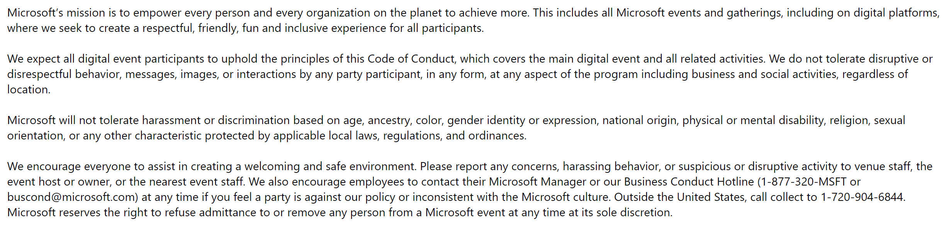
Microsoft Digital Event Code of Conduct
Notes:
Quick housekeeping before we dive in. This is our digital event code of conduct. Every time we run a Microsoft event we want it to be a welcoming, inclusive environment for everyone, so please take a moment to review this and help make it a great session for all of us.

Slide 3
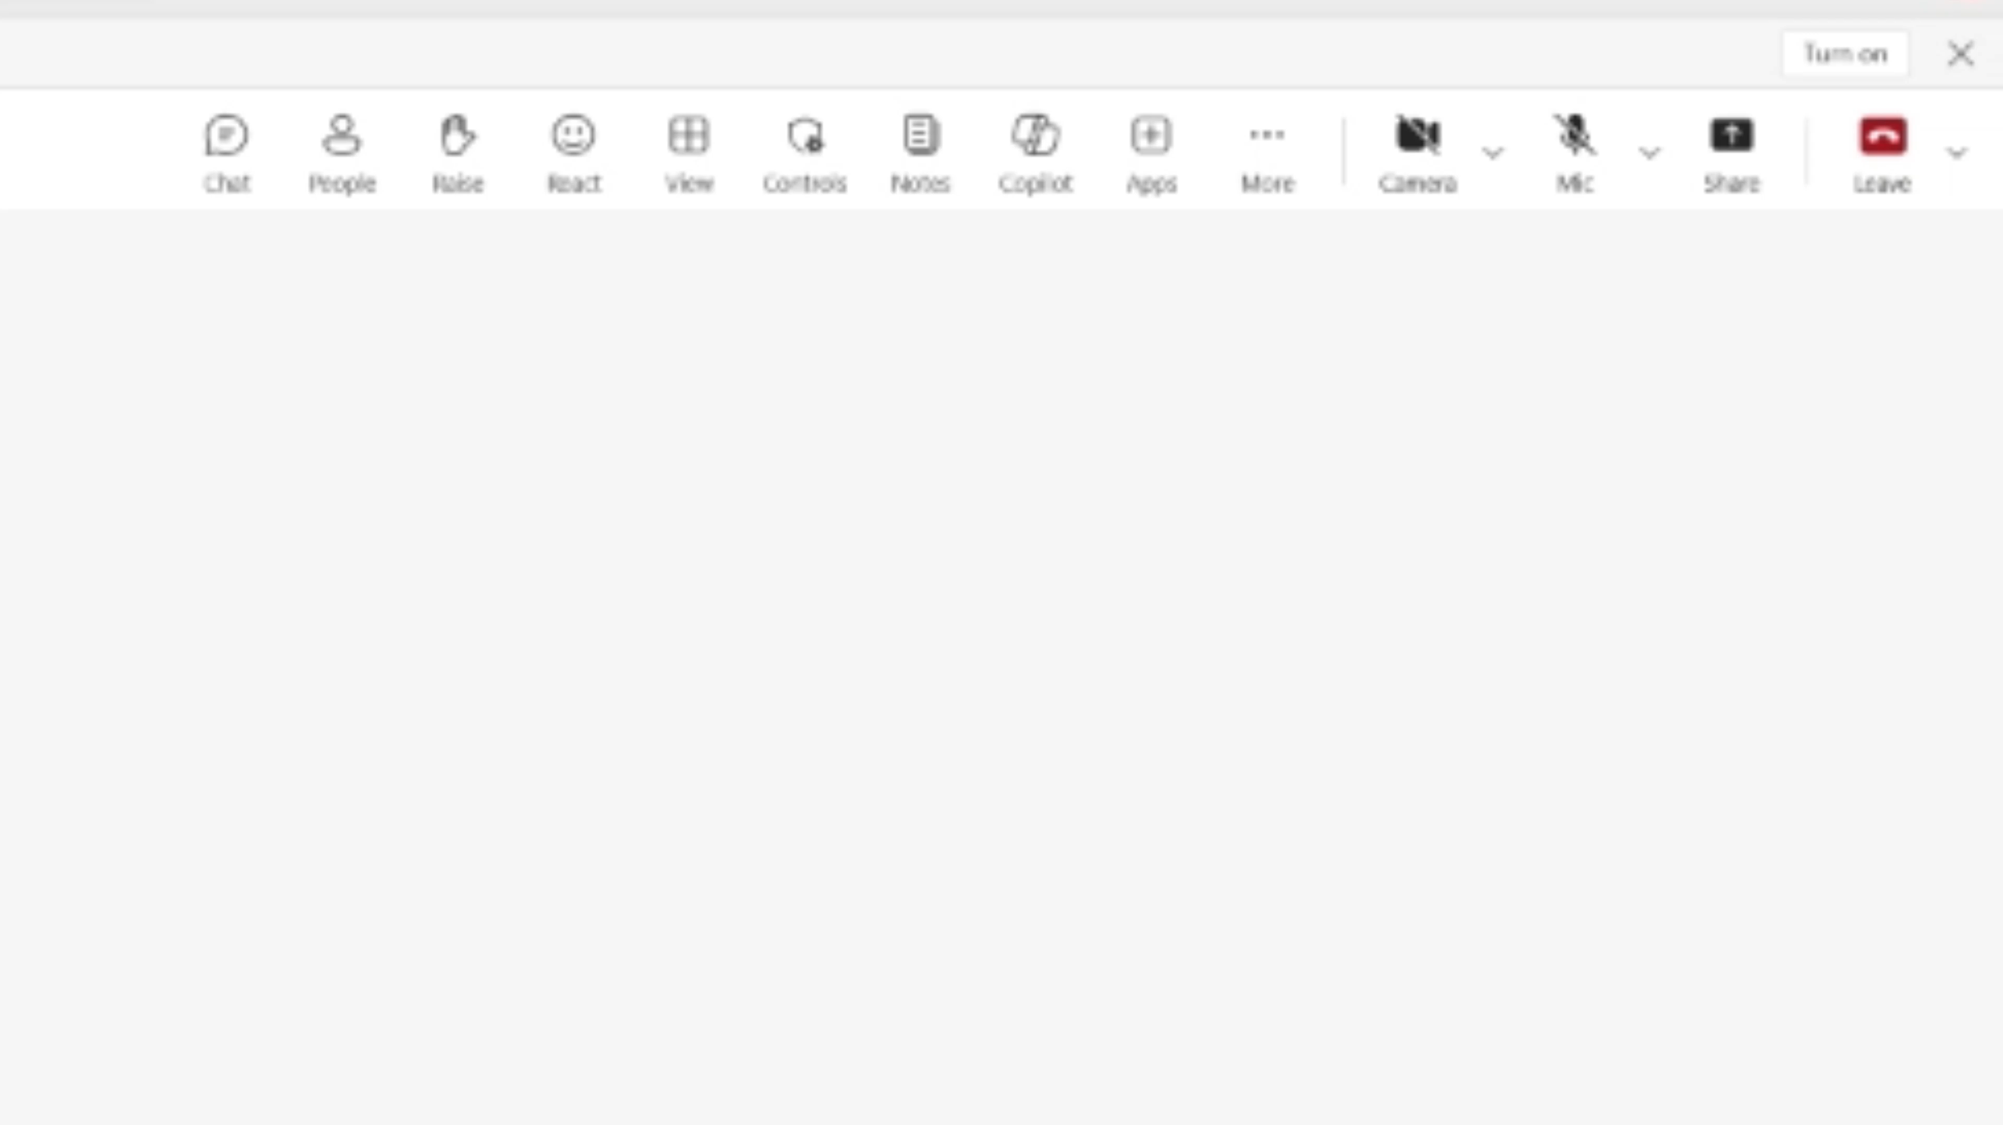

Accessibility Settings for your preference
  Close Captioning (on/off)
  Select More > Language and speech >
  Turn on (off) live captions
  Enlarge Content to your screen
  Press Windows logo Key and (+) to zoom in
  Press Windows logo Key and (Esc) to zoom out
  High contrast view
  Select Settings > Appearance and accessibility
  Under Theme choose High contrast.
Notes:
Accessibility matters to us, so let's make sure everyone can participate comfortably. You can toggle closed captioning on or off from your Teams window under More, then Language and speech, then live captions. If you need to enlarge content, Windows users can press the Windows key with plus or minus to zoom in and out, and Mac users can do the same with the Option key. And if you'd prefer a higher-contrast view because some of the slide colors are hard to see, you can switch on high contrast settings. We only have about six or seven slides, so we'll be into the demo before long.

Slide 4
Participation
  Session will be recorded
  Use Q&A for questions
  Resources will be shared during and after session
  Share feedback and request assistance
  All content will be available HERE!
Notes:
A few notes on participation. This session is being recorded, and we'll share the recording, the slides, and some accompanying content afterward, including a follow-along workbook and sample data you can use to build this on your own. Please drop any questions in the Q&A; our moderators are watching it and I'll answer what I can as we go. At the end there's a feedback form, so let us know what you'd like to see in future sessions. The link to all the content is right here, and I'll make sure everyone has it before we wrap.

Slide 5




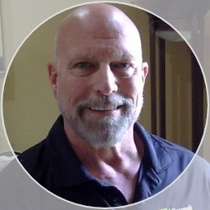

Sponsors
Stephanie Hernandez
Customer Success Lead
Director, Cloud Solution Architect – Oil Gas & Energy
Shawn Henderson
Customer Success Lead
Director, Cloud Solution Architect – Oil Gas & Energy
Presenters & Moderators
Wes Horn
Senior Cloud Solution Architect
Gerald Ramich
Principal Cloud Solution
Architect
Tony Rodighiero
Senior Cloud Solution Architect
Armando Hernandez
Senior Cloud Solution Architect
Notes:
I want to thank our sponsors, Stephanie Hernandez and Shawn Henderson, the directors of our Cloud Solution Architect team here in Oil, Gas, and Energy. They give us the time to prepare and deliver these sessions, so a big shout-out to them. I'm your presenter today, and our moderators Gerald, Tony, and Armando are here to answer your questions in the chat and may chime in now and then. They're a great resource, so lean on them throughout the session.

Slide 6
SESSION STARTER
Agenda
Welcome and scenario framing
Outcome
Copilot Studio basics
Attendees understand the editor, follow a basic agent build, and know where to go deeper later.
Interface overview
Build the simple agent
Wrap up/Q&A
Copilot Studio 101
2
Notes:
Here's our high-level agenda. The goal is for you to walk away with a basic understanding of the Copilot Studio editor, to follow along with a simple agent build, and to know where to go to dig deeper later. We'll cover a bit of Power Platform architecture, an overview of the interface and its tabs, build a very simple agent, and leave time for Q&A at the end. We've got about an hour and a half, and there are usually plenty of questions, so we'll see how the timing flows.

Slide 7
Agent Builder vs. Copilot Studio
Use the simplest tool that meets the scenario, then move up when you need more control.
Use Agent Builder when...
Use Copilot Studio when...
• You need a quick, lightweight agent
• The scenario is personal, team-level, or narrow
• You mainly need instructions + grounding
• You want to prototype before formal buildout
• You do not need complex topics, tools, or lifecycle controls
• The agent is business-critical or shared broadly
• You need topics, actions, connectors, or MCP tools
• You need controlled publishing and channels
• You need analytics, governance, or environment strategy
• You expect the agent to grow over time
Think: fast start, simple scope, lower ceremony.
Think: governed build, extensibility, operational readiness.
Rule of thumb: start simple, but choose Copilot Studio when the agent needs enterprise controls, integrations, or repeatable business process support.
Copilot Studio 101
7
7
Notes:
Let's talk about when to use Agent Builder versus Copilot Studio, since you can build agents in both. Reach for Agent Builder when you need a quick, lightweight agent grounded in a knowledge source, something simple for yourself, a handful of people, or a department, where you don't need complex capabilities. Choose Copilot Studio when you need the advanced stuff: tools, integrations like email, triggers, analytics, governance, and a full dev-test-prod lifecycle, especially when you expect the agent to be widely used across the enterprise. The rule of thumb is start simple, but move up to Copilot Studio when you need those enterprise controls and integrations.

Slide 8
SESSION STARTER
The agent we will build
Oil & Gas Insights Assistant: a simple agent that answers from trusted data and can call one external tool.
Scenario: help engineers and operations teams quickly answer safety, maintenance, and production questions.
3
What it is
3
How it works
What it can do
A focused Copilot Studio agent for an Oil & Gas operations scenario. It is not a general chatbot; it has a defined role, audience, and scope.
The agent uses instructions to understand its role, Dataverse knowledge to ground answers, and one MCP-style tool to retrieve current operational data.
Answer safety procedure questions, look up asset maintenance information, summarize production data, and ask clarifying questions when details are missing.
Copilot Studio 101
3
Notes:
The agent we'll build today is a simple Oil, Gas, and Energy insights assistant. I've preloaded some data into Dataverse, and we'll use that as a knowledge source so we can ask questions about it, things like asset maintenance records, safety guidelines, and well production output. I'll show an example of grounding on that knowledge, maybe touch on a topic to direct the conversation, and then wire up an MCP tool so you can see how that works. It's intentionally simplistic; we're not going deep on prompt building, but any instruction-writing skills you've picked up in Agent Builder carry right over.

Slide 9
What we will cover — and what we will not
What we will cover
What we won't cover
Basic introduction to Power Platform architecture
Copilot Studio editor overview
High level editor overview
Simple Agent Build
• Governance, DLP, or ALM
• Security, licensing, or pricing deep dives
• Complex integrations
• Advanced topic engineering or tool usage
Goal: confidence with the core building blocks.
We will point to these as next-step topics.
Copilot Studio 101
5
5
Notes:
To set expectations: we'll cover a very basic introduction to Power Platform architecture so you understand how Copilot Studio plugs in, an overview of the editor and its screens and tabs, and a simple agent build just to go through the motions. What we won't cover is governance, data and DLP policies, application lifecycle management, security, licensing, and pricing deep dives, complex integrations, or advanced topic engineering and tool usage. Each of those could be a whole session on its own, so we'll keep this one light and point to them as next-step topics.

Slide 10
FOUNDATION
How Copilot Studio building blocks
Environment first, solution second, resources inside the solution.
Environment
Solution
Resources
The workspace boundary
The package
The parts you build
Where makers build and run agents. It includes access, Dataverse data, connections, policies, and lifecycle boundaries.
A container used to group related components so they can be organized and moved together across environments.
Agents, topics, actions, tools, knowledge sources, Dataverse tables, connections, flows, and supporting components.
For this demo: we will build one simple agent and explain where knowledge, an MCP tool, and topics fit — without going deep into ALM or deployment strategy.
Copilot Studio 101
4
4
Notes:
Since Copilot Studio is built on the Power Platform, it helps to understand a few building blocks. Everything lives inside an environment, which is a workspace and security boundary; one environment is isolated from another. Inside an environment you have solutions, which are containers that group related resources, like an agent with its flows and Dataverse tables, so you can move them together across dev, test, and prod. And the resources themselves, agents, topics, tools, knowledge sources, tables, and connections, live inside that solution. For this demo we'll build one simple agent and point out where knowledge, an MCP tool, and topics fit, without going deep into lifecycle or deployment.

Slide 11
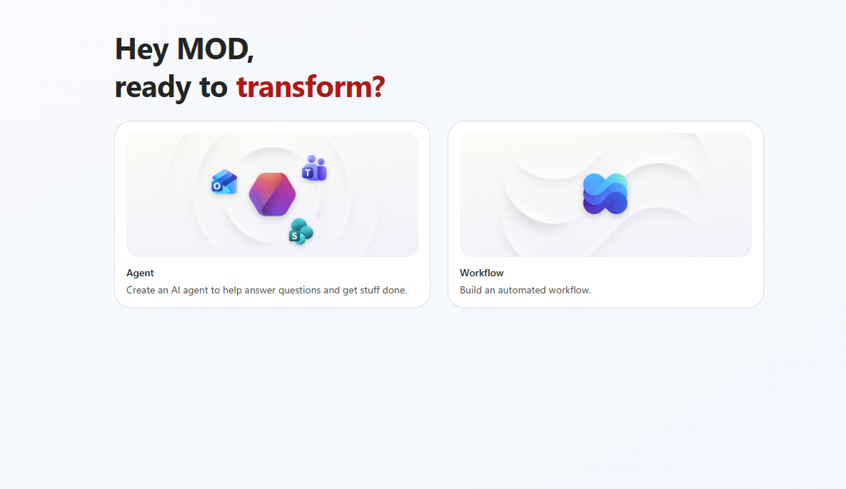
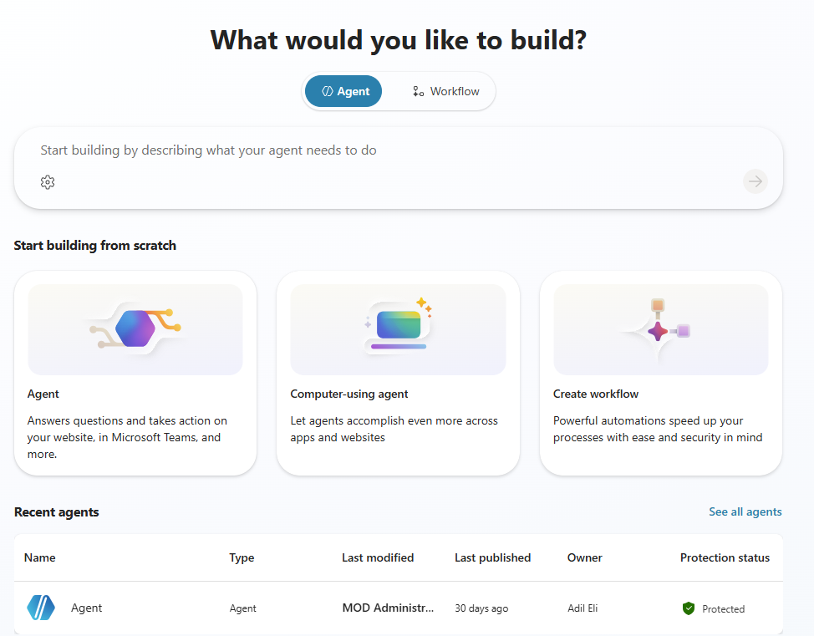
SESSION STARTER
Copilot Studio experiences
New experience is rolling out; today's demo uses the classic experience.
New experience rolling out
Classic experience for demo
Copilot Studio 101
6
6
Notes:
One last thing before we jump into the demo: the Copilot Studio experience. Microsoft recently started rolling out a new experience, and some of you may have seen it; it's still in the process of being released and depends on how your environment is set up. The new home page looks like this on the left, and the classic experience is on the right. We're going to work in the classic experience today, and we'll probably do a future session on the new one once it's more fully ready.

Slide 12

Thank You
Agent Mastery Series Feedback
June 23rd
Link to complete feedback survey HERE
Notes:
That's a wrap, and I hope this gave you a solid high-level overview and a better understanding of Copilot Studio. There's a lot more we could cover, so please fill out the feedback survey using the QR code or the link here; it genuinely helps us build better sessions for you. I'll also drop a link in the chat to where all the content lives, including the recording and our previous Agent Mastery sessions. Thank you all for participating, thank you to our moderators for fielding the questions, and have a great rest of your day and an awesome week.

