Slide 1
Microsoft Copilot Customer Hub
Copilot Extensibility Series
Copilot Agents Overview
May 28, 2025

Slide 2
Hello and welcome to the
Microsoft Copilot Customer Hub
We’ll get started at 2 minutes past the hour

Slide 3
During the presentation
After the presentation
We will mute your microphone for the first part of today’s call
Raise your hand and we will call on you
Ask your questions via chat, we will get to all of them, live or after. Common questions will get addressed out loud
Open mic 🙌 Come off mute and ask away!

Slide 4
Copilot Agents Overview
PRODUCTIVITY
Presenters
Kellen Winters
Mike Francis
Vas Perchuk
COMPLIANCE
PRIVACY
COPILOT
SECURITY
RESPONSIBLE AI
Moderators
Frank Chen

Slide 5
What are Agents
Agents offer a tailored Copilot experience
Agents look and function like Copilot, but:
Tailor the experience to a specific use case
Focus on the data (inside or outside of M365) that’s applicable for your specific business needs
Can be equipped with skills, such as sending emails, updating records, or creating support tickets
Example Agents
Legal
agent
HR
agent
IT
agent

Slide 6
Copilot is the UI for AI
Copilot
Agents

Slide 7
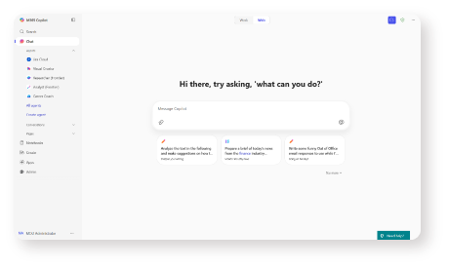
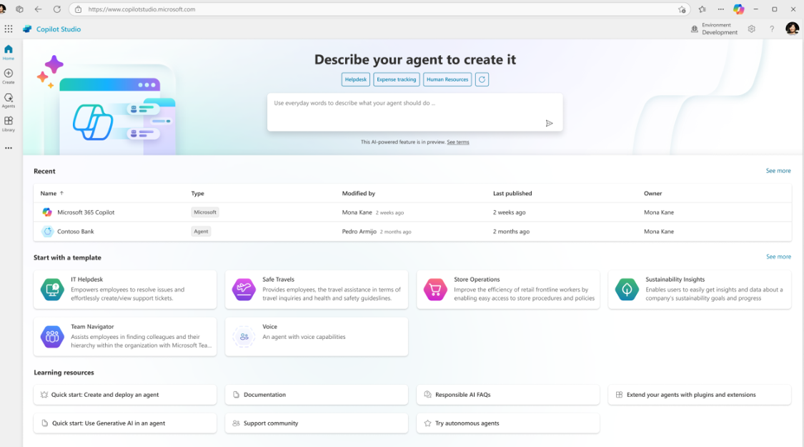
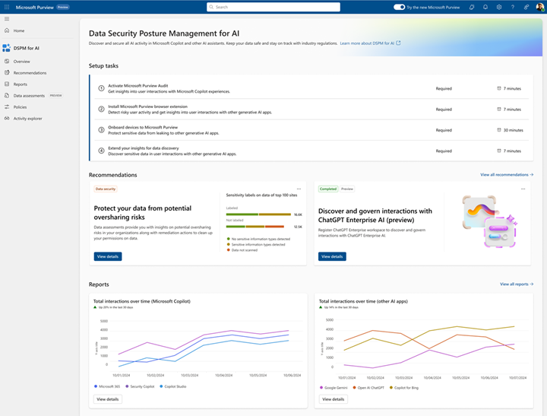
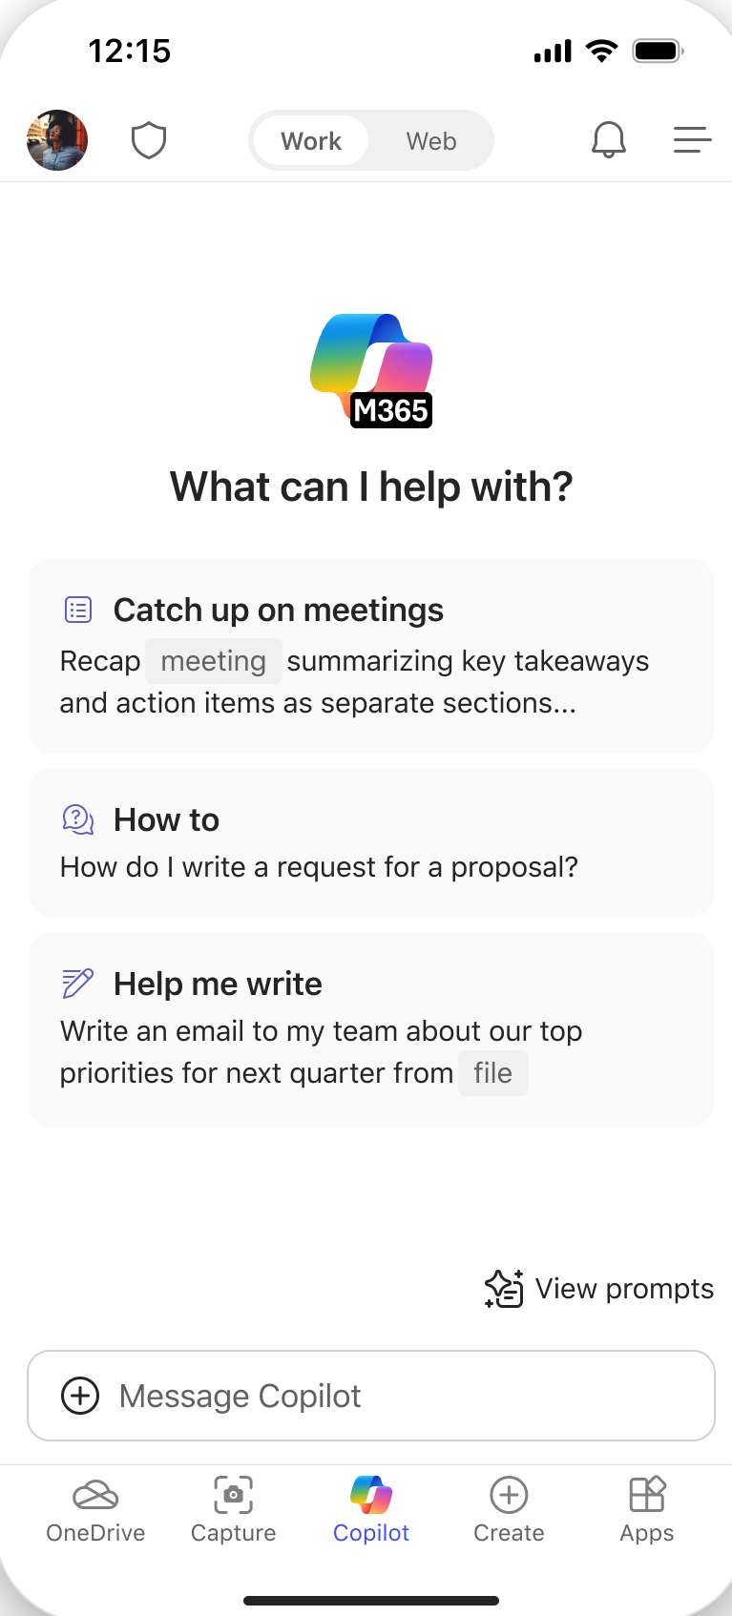
Introducing Copilot Chat
Chat
Agents*
IT Controls
Free, secure AI chat –
powered by GPT 4o and web grounded
Integrated into the chat experience and paid for on a consumption basis
Enterprise Data Protection
and agent management
* Usage limits apply; agents with work grounding are metered and require an active Copilot Studio subscription

Slide 8
Enabling agents in Microsoft 365 Copilot Chat
Microsoft 365 Copilot Chat has both agents that can be used at no additional cost and agents that are billed based on metered consumption.
Free/Unpaid
Paid/Metered
Grounded in Instructions and/or public websites
Available by default
No additional cost
Grounded in shared tenant data - SharePoint or Copilot Connector content (former Graph Connector)
Off by default
Requires PAYG or Message Packs

Slide 9
Activate Copilot Studio subscription to use agents with Microsoft 365 Copilot Chat
New!
Agent usage burns “messages”
Agents use different amounts of messages based on their complexity, frequency of use, and the specific features they use
Burn rate parity across message pack and metered offering (Rate card in next slide)
Leverage your existing Azure commitments (MACC)
Message packs
Pay-as-you-go
Tenant-wide message packs
25,000 messages/month
$200 per pack/month
New PAYG meter
$0.01/message
Can decrement MACC

Slide 10
Utilization rates depend on agent capabilities
 | M365 Copilot Users | Copilot Chat Users
Web-grounded answers Dynamically-generated responses based on the web as a knowledge source. | 0 | 0
Generative answers Dynamically-generated responses based on knowledge sources and context that provide flexible and natural interactions. | 0 | 2 messages
Tenant graph grounding for messages Grounding to enhance AI agents with up-to-date, context-aware knowledge from Microsoft 365 and external data, offering built-in security and inheriting data access governance policies | 0 | 10 messages
Agent actions / tools AI-led orchestration for triggers, topics, Power Platform premium and custom connectors, cloud flows and GPT 4o prompts to automate complex business processes. Not available in agent builder. | 0 | 5 messages
Notes
Each interaction with an agent could utilize multiple utilization rates simultaneously i.e., an agent grounded in Tenant graph could use 32 messages (30 for the graph grounding and 2 for Generative Answer) to respond to a single complex prompt from the user. Most agents built natively in SharePoint or Copilot Chat will have Tenant graph Grounding enabled by default.
Generative answers, tenant graph grounding for messages, web-grounded answers and autonomous actions / tools apply to both declarative agents and custom engine agents.

Slide 11
What can be extended with Agents
Connectors
Actions / Tools
Your agents
Grounding knowledge
Available skills
Focused user experiences

Slide 12
User experience (optional)
Knowledge
Instructions and Grounding
Agents
Agent architecture
Skills
Actions / Tools, capabilities, triggers, workflows
Orchestrator
Autonomy
Planning, exceptions, self-learning
Foundation models

Slide 13
Building blocks of an Agent
Instructions
A prompt that defines how the agent should work to achieve its specific goals
Knowledge
Data that agent uses to provide responses, based on the context of the requests
Actions / Tools
Operations that Agent performs to execute tasks in Line-of-Business (LOB) systems
You are Product Catalog agent. You answer queries related to Contoso Electronics product catalog and refuse to answer any other questions.
You can return product details in the following format: Product Title: **title in bold font**
Category: category of product here
Description: description of the product rephrased to be more relevant for user query.
You can send details by email if requested by user.
Be polite and use professional tone.
You can search in…
If you’re requested to send an email, gather input information from the user:
Email address of recipient
Subject of email
Body content of the email
SharePoint sites
contoso.sharepoint.com/sites/catalog
contoso.sharepoint.com/sites/products
Outlook connector – Send an email

Slide 14
Spectrum of Agent Capabilities
Conversational
Advanced
Retrieval
Retrieve information from grounding data, reason, summarize, and answer user questions
Task
Take actions when asked, automate workflows, and replace repetitive tasks for users
Autonomous
Operate independently, dynamically plan, orchestrate other agents, learn and escalate
Agents vary in levels of complexity and capabilities depending on your need

Slide 15
Spectrum of agents
IT Helpdesk
Device Refresh
Lead Gen
How do I connect to the corporate network?
Request a new laptop and send approvals via IT Service tool.
The agent has identified and researched 15 new leads for you to review.
Simple
Advanced
Project Tracker
Expense Report
Customer Support
What is the status of phase 2 for project X and the remaining budget?
Review outstanding open purchase orders and begin financial planning.
The agent identified new support issues and triaged to multi-agents to handle.

Slide 16
Optimize and reinvent your business processes with agents
Transform complex and dynamic processes
Reimagine possibilities with multi-agent collaboration
Enable every employee to augment their jobs with agents
Agents can handle highly variable situations in real time, using judgment to plan their steps and perform specialized tasks required to complete the job.
Agents can collaborate with multiple users and other agents to accomplish tasks that span disconnected systems, long time horizons, and organizational boundaries.
Using natural language, any employee can be empowered to design and operate custom tailored agents for their workflows.

Slide 17
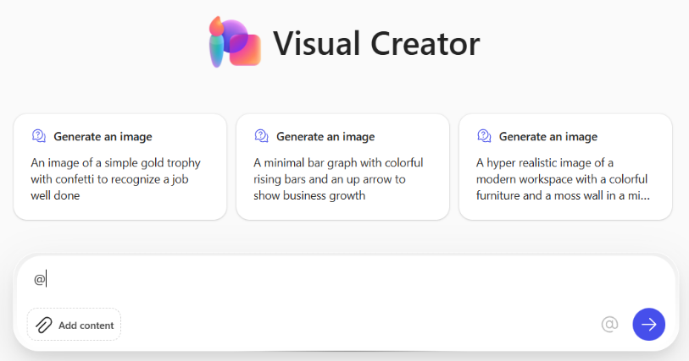
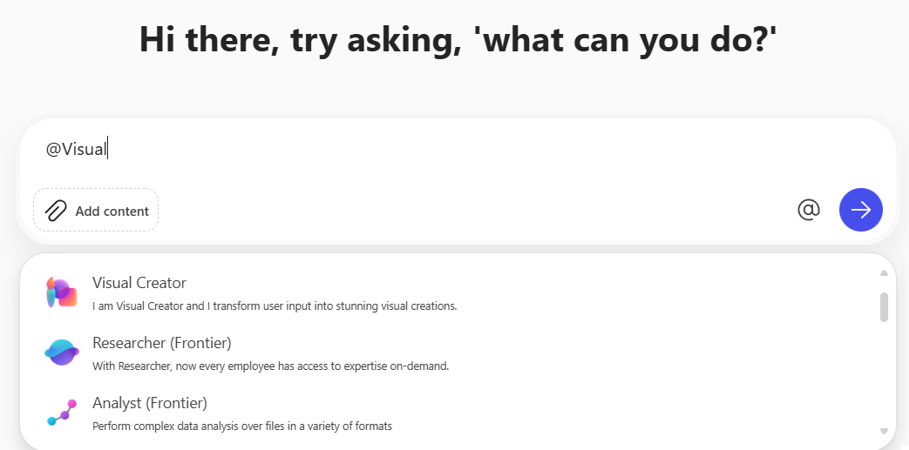
Agents User Experience
Immersive
In-context
Immersive Experience​
The full experience of the Copilot app in Microsoft 365. Users chat directly with the agent embedded in Copilot.​
In-context Experience​​
Users interact in the context of an app, such as a Teams chat or a Word document. Users can @-mention the agent and interact with it directly within the app experience.​

Slide 18
Elevate productivity of every employee with agents
Use built-in agents in Microsoft 365
Find agents in the store
Build your own agents

Slide 19
Built-in agents in Microsoft 365
Employee Self-Service Agent
Project Manager
Agents in SharePoint
Facilitator
Interpreter
Public preview
Public preview coming soon
Public preview
Limited private preview
Generally available

Slide 20
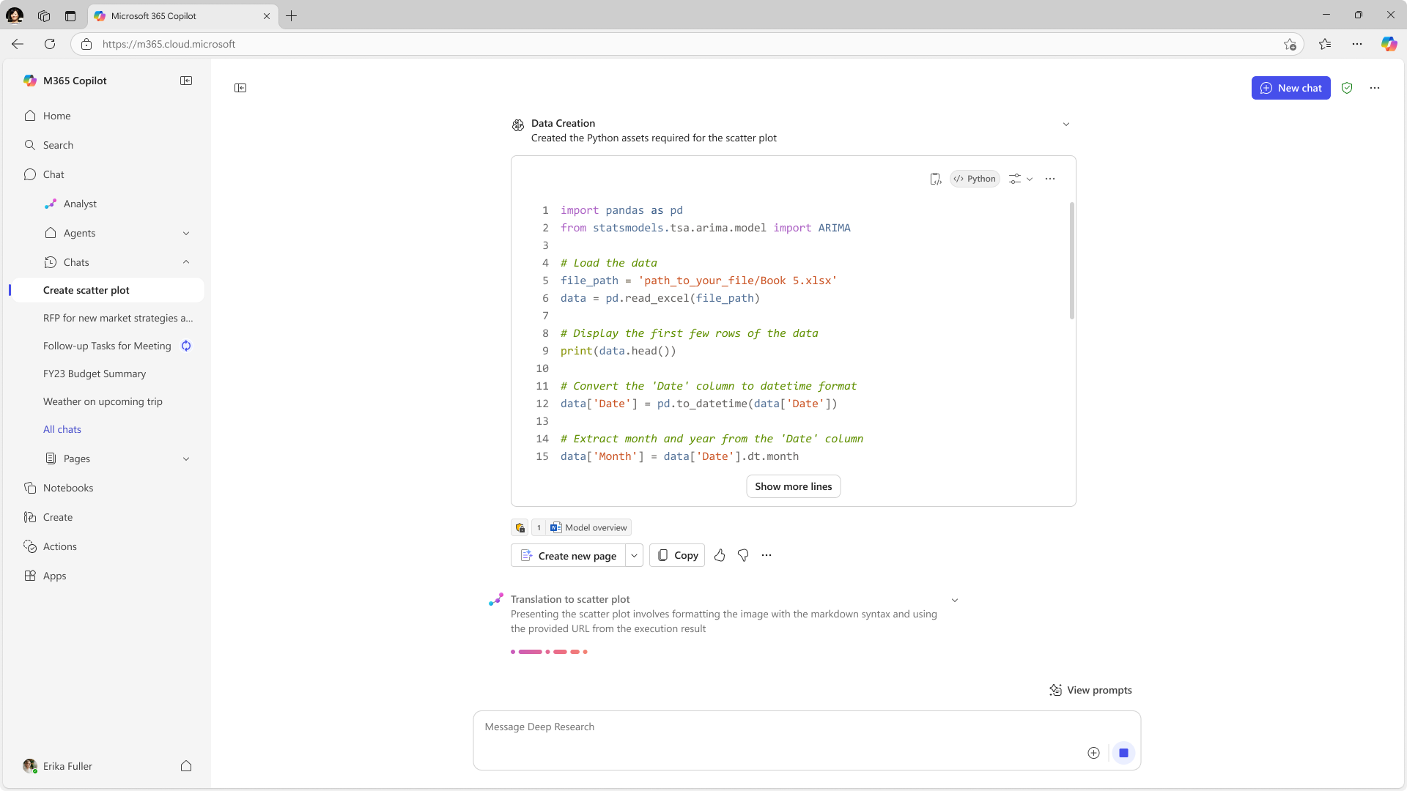
Analyst agent
Deep Reasoning
Leveraging a state-of-the-art reasoning model Microsoft has optimized for advanced data analysis, organizations get the power of a highly-skilled, on-demand data analyst. Users are empowered to unlock powerful insights across their work data, giving both data novices and data professionals a powerful new tool .
The Analyst agent uses a Python reasoning engine to help users make sense of complex data across documents and spreadsheets, including the ability to generate advanced data visualizations.
Screenshots are intended to be conceptual and not indicative of future product UI.

Slide 21
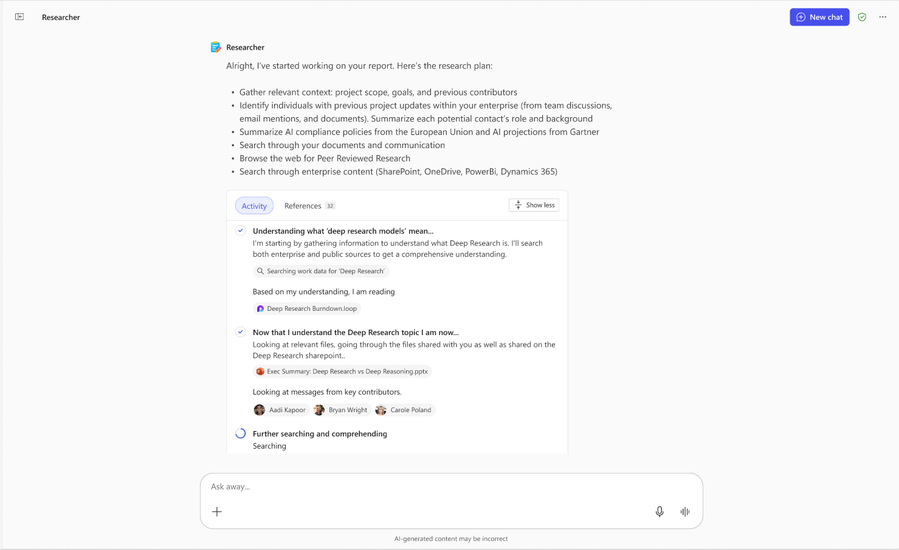
Researcher agent
Deep Reasoning
The Researcher agent empowers organizations with the strategic insights and deep reasoning capabilities of a highly paid research analyst, seamlessly integrating deep research models with work data, the web, and other agents to make informed decisions and develop strategic insights.
Screenshots are intended to be conceptual and not indicative of future product UI.

Slide 22
Examples of agent templates
The simplest way to get started with agents. Once enabled by an admin, users can @mention the agent in Copilot Chat or open it directly by selecting it from the right-side pane.
 | Agent Name | Description
 | Writing Coach | Provides detailed feedback on writing. Helps change the tone of messages, translates text, and assists in writing tasks
 | Idea Coach | Helps users brainstorm and organize ideas
 | Prompt Coach | Assists users in creating effective well-structured prompts for Copilot
 | Career Coach | Provides personalized career development suggestions including role understanding, skill gap analysis, learning opportunities, and career transition plans
 | Learning Coach | Helps users understand complex topics by breaking them down into simple, intermediate, and advanced summaries. Provides guided practice and learning plans
 | Visual Creator | Assists users with creating images and videos

Slide 23
Examples of agent templates
The simplest way to get started with agents. Once enabled by an admin, users can @mention the agent in Copilot Chat or open it directly by selecting it from the right-side pane.
 | Agent Name | Description
C | Customer Insights Assistant | An agent designed to help the team get to know their customers by providing relevant information and insights.
 | Interview Questions Assistant | Provides professional guidance in question generation tailored to specific job roles, or industries. It provides questions with fairness, inclusivity, relevance and appropriateness.
 | Meeting Coach | Designed to assist meeting organizers in creating and running effective meetings.
 | Quiz Tutor | Creates interactive, fun, and engaging quizzes based on training documentation
 | Scrum Assistant | Supports scrum team members in facilitating scrum ceremonies, backlog management, and continuous improvement.

Slide 24
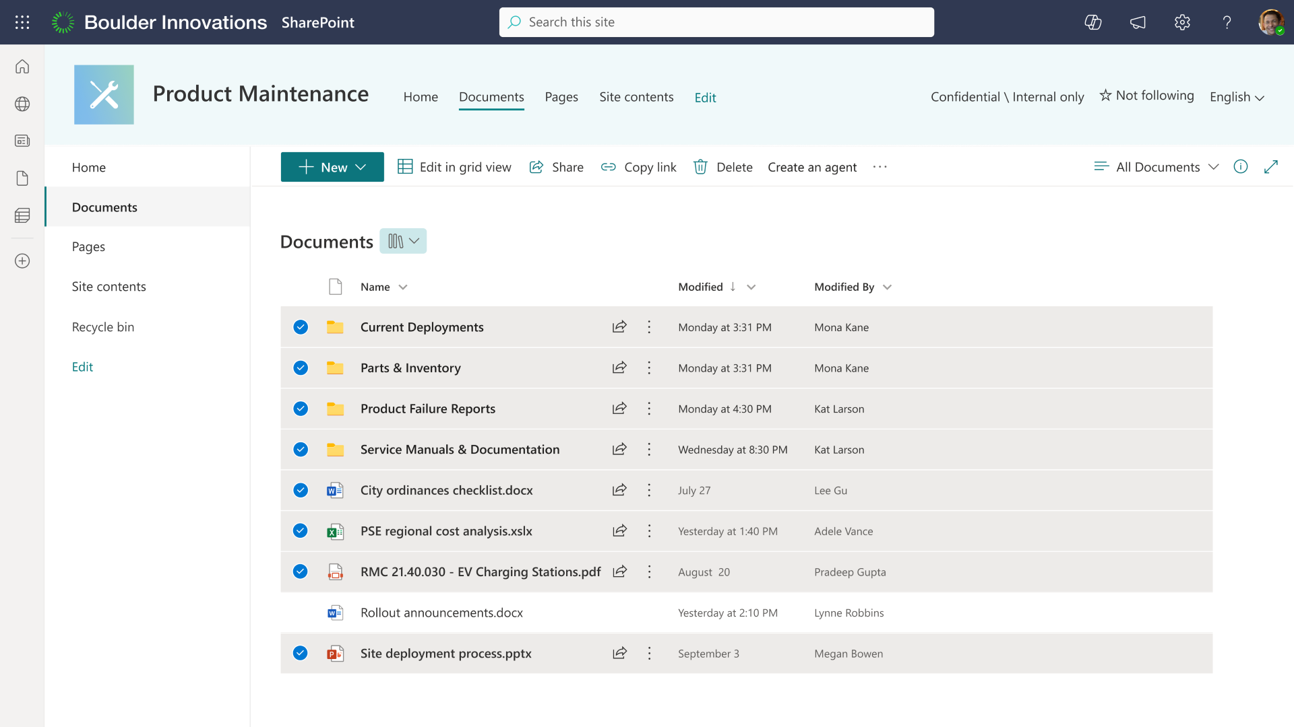
SharePoint agents
Ready-made or make your own
Use the ready-made agent or create a custom agent with specific SharePoint content
Easy to share
Just like other Microsoft 365 apps, share the link via email or Teams chat
Increase collaboration
Add to a Microsoft Teams chat and @mention the agent for instant interaction
Secure
Defaults to your existing SharePoint permissions and sensitivity settings​
Learn more at aka.ms/SharePoint/AgentsAdoption

Slide 25
Microsoft 365 Copilot subscription or pay-as-you-go meter option available
SharePoint agents
Microsoft 365 Copilot license
$30 user/month with an annual subscription
Microsoft 365 Pay-as-you-go
Pay-as-you-go with Azure subscription managed in Microsoft 365 Admin Center
https://learn.microsoft.com/en-us/SharePoint/microsoft-365-pay-as-you-go-pricing

Slide 26
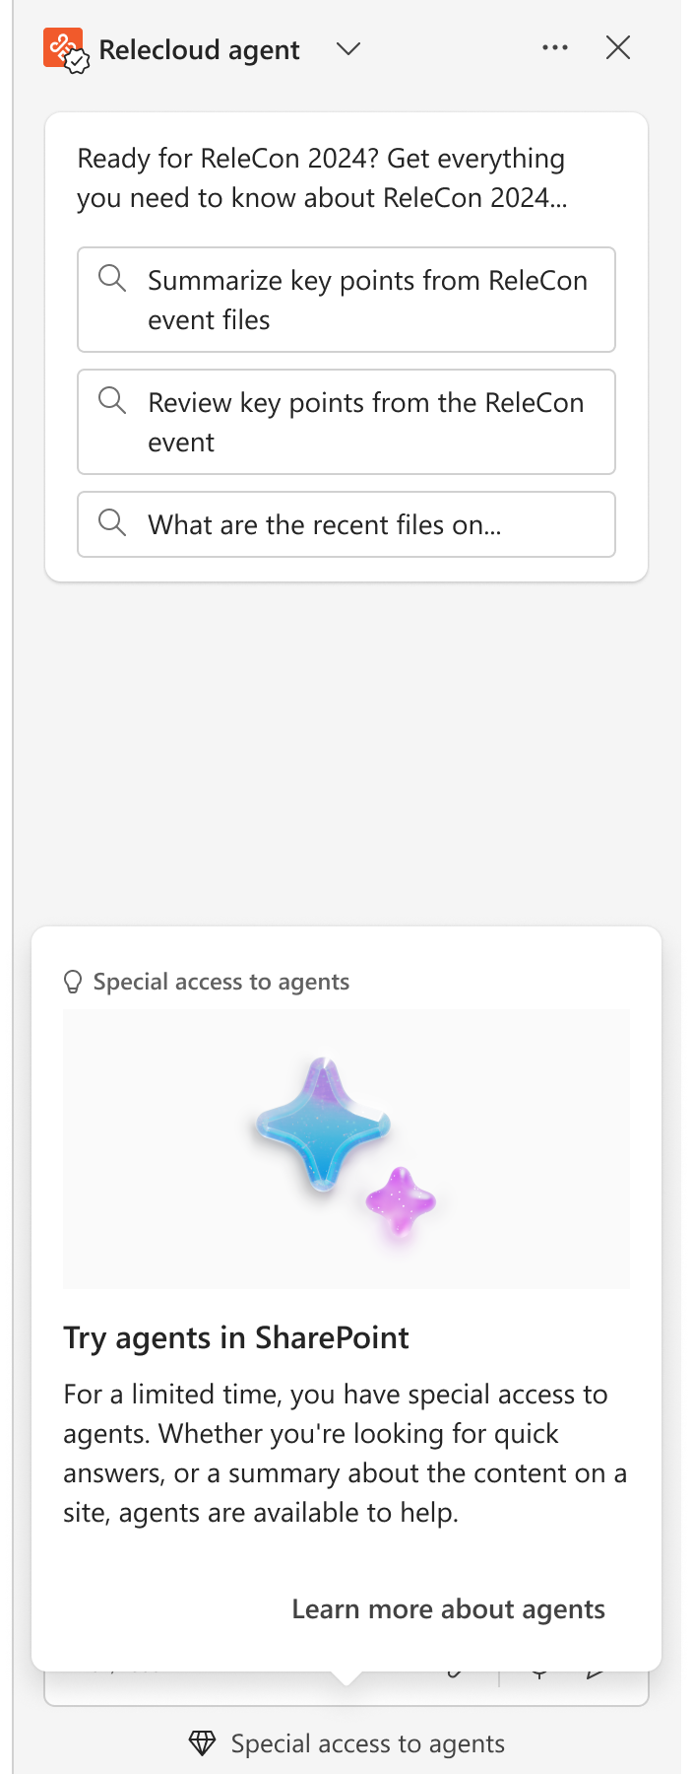
Take advantage of our SharePoint agent promotion
Allow everyone to experience
For a limited time, anyone in organizations with at least 50 Microsoft 365 Copilot licenses will be able to create, share, and interact with SharePoint agents
Have time to evaluate
Organizations will receive credit for 10,000 queries each month until June 30, 2025. Credits refresh on the first of each month
Love agents and want more?
Talk to your organization about getting you a Microsoft 365 Copilot license to interact with SharePoint agents with no limits
aka.ms/agentsinsharepointpromo

Slide 27
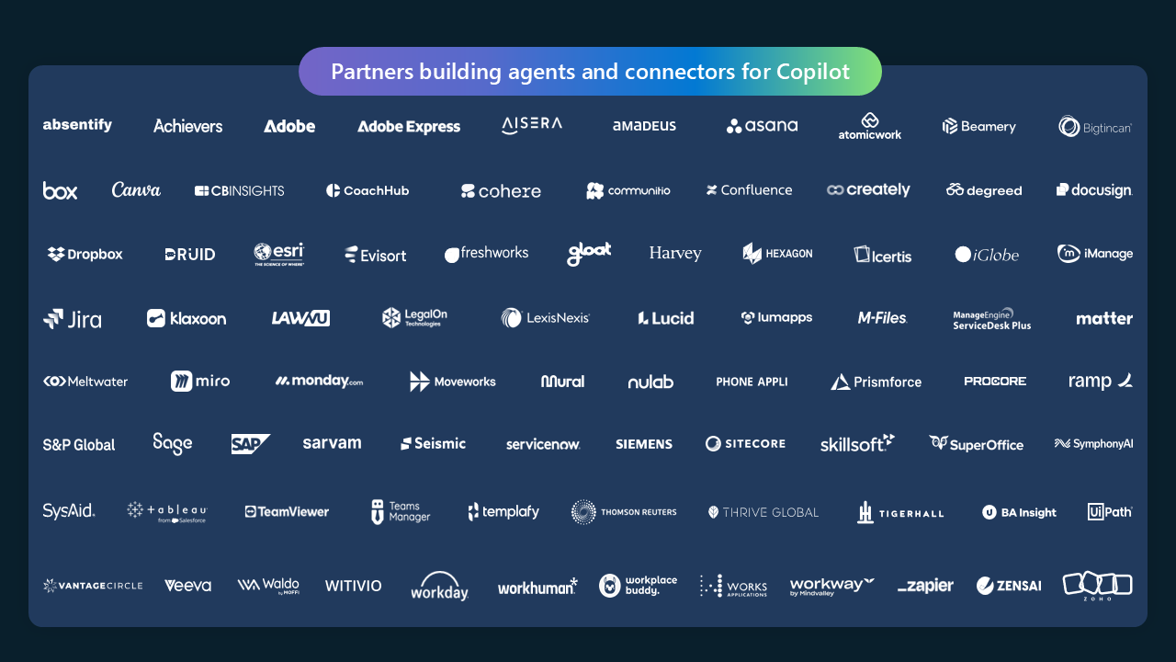

Slide 28
Build your own agents
Declarative agents
Custom engine agents
Build with
Copilot Studio, Agent Builder, SharePoint (no-code and low-code)
Visual Studio Code (code-first)
Copilot Studio (no-code and low-code)
Visual Studio Code (code-first)
Agent runtime
Bring your own orchestrator and foundational models
Microsoft Copilot
Microsoft 365 Copilot
Copilot Chat
Microsoft Teams,
Web
+ 10 other channels
Microsoft 365 Copilot
Copilot Chat
Microsoft Teams
SharePoint
Public Preview
Public Preview
Deploy across

Slide 29
Declarative agents
User experience
Knowledge
Instructions and Grounding
Agents
Instructions and Grounding
Skills
Actions, capabilities, triggers, workflows
Actions / tools, capabilities
Orchestrator
Autonomy
Planning, exceptions, self-learning
Microsoft provided
Foundation models
Developer provided

Slide 30
Building blocks of a declarative Agent
Instructions
A prompt that defines how the agent should work to achieve its specific goals
Knowledge
SharePoint sites, files, Copilot Connectors for external data
Actions / Tools
Power Platform connectors, Power Automate flows, AI Builder prompts, REST APIs
You are Product Catalog agent. You answer queries related to Contoso Electronics product catalog and refuse to answer any other questions.
You can return product details in the following format: Product Title: **title in bold font**
Category: category of product here
Description: description of the product rephrased to be more relevant for user query.
You can send details by email if requested by user.
Be polite and use professional tone.
If you’re requested to send an email, gather input information from the user:
Email address of recipient
Subject of email
Body content of the email
Outlook connector – Send an email

Slide 31
Copilot Connectors (former Graph Connectors)
“Can you give me guidance on operational efficiency?”
Large Language Model
Microsoft Graph
Indexed Items
Microsoft 365 boundary
External system
When reasoning over a Copilot connector, Copilot Orchestrator does not need to make calls outside the Microsoft Boundary, as the connector pushes content directly into Microsoft Graph.

Slide 32
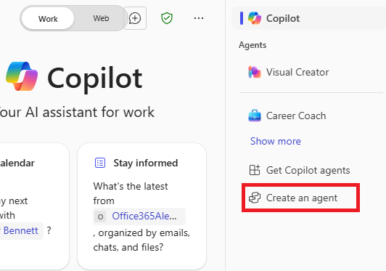
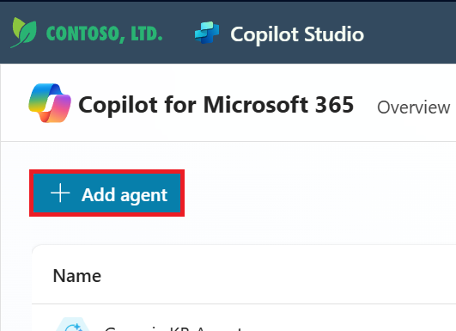
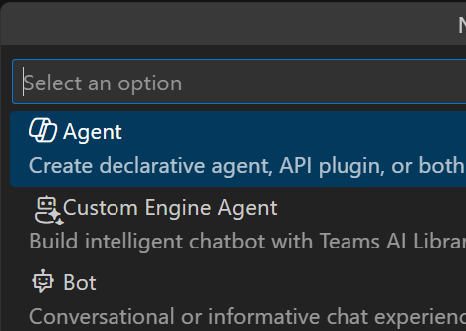
Tools for building declarative agents
Various agent authoring experiences are available to cater to different audiences
Agent Builder
A simple UI to build agents, either by using natural language or manually
Copilot Studio
Build agents with full code flexibility with no limitations
Visual Studio Code and Teams Toolkit
Build agents with full code flexibility with no limitations
Business Users
Makers
Developers

Slide 33
When & Why to Use Declarative Agents
Scenario that requires Focus or Specialization
Layer on top of the full capability of Microsoft 365 Copilot
Boost personal productivity or target specific teams / roles / areas
Scope to specific data sources
Add domain knowledge as instructions to enable nuanced interpretation of data received from sources like plugins

Slide 34
Demonstrations

Slide 35
Custom engine agents
User experience
Microsoft Teams
Microsoft 365 Copilot
Messenger
White label Web chat
Email
Other channels
Agents
Knowledge
Instructions and Grounding
Agents
Orchestrator
Skills
Actions, triggers, workflows
Autonomy
Planning, exceptions, self-learning
Microsoft provided
Foundation models
Developer provided

Slide 36
Building blocks of a custom engine agent
Instructions
A prompt that defines how the agent should work to achieve its specific goals
Knowledge
SharePoint sites, Azure AI Search, databases, files, repositories, etc.
Actions / Tools
Power Platform connectors, Power Automate flows, AI Builder prompts, REST APIs, MCP servers
Triggers
When you receive a mail, when you receive a message, when a new file is added, etc.
You are Product Catalog agent. You answer queries related to Contoso Electronics product catalog and refuse to answer any other questions.
You can return product details in the following format: Product Title: **title in bold font**

Slide 37
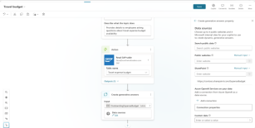
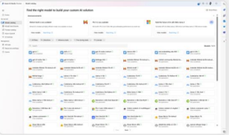
Tools to build custom engine agents
Low code
Pro code
For Makers
For Developers
Visual Studio Code
Teams Toolkit
Azure AI Foundry
Copilot Studio

Slide 38
Why custom engine agents?
Scenarios that require usage of specific LLM/SLM (open source or custom, instead of Microsoft 365 Copilot)
Publish agents to external users who are not on Microsoft 365
Enable Custom user experiences
More control over experience than Declarative agents (i.e. Custom Moderation, regulatory frameworks, custom legal & compliance etc.)
Full control on Prompt Management, Actions, Triggers, Planner, Orchestration

Slide 39
Building an autonomous agent
Demo

Slide 40
Copilot Control System
Equipping IT to lead AI transformation
The Copilot Control System is designed to enable IT confidently adopt and accelerate the business value of Copilot and agents. This includesc
Data Protection
Management Controls
Measurement & Reporting
Identify and mitigate oversharing
Control which agents are available and who can access agents
View core usage telemetry and track license utilization
Intelligent grounding respects your permissions and security controls
Review agent permissions and actions before making available in your tenant
Track improvements in user productivity and compare impact across groups
RAI checks for every prompt protect from AI risks
Track and manage agent lifecycle, access usage and operational insights
Analyze Copilot & agents impact to business outcomes

Slide 41
Resources

Slide 42
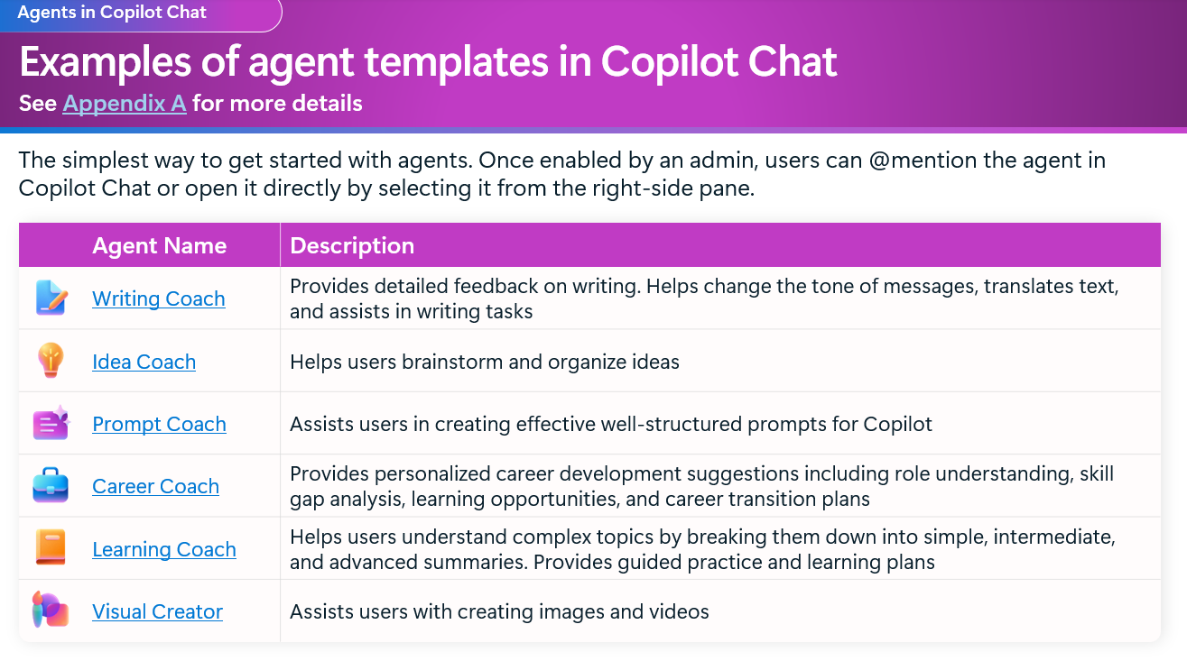
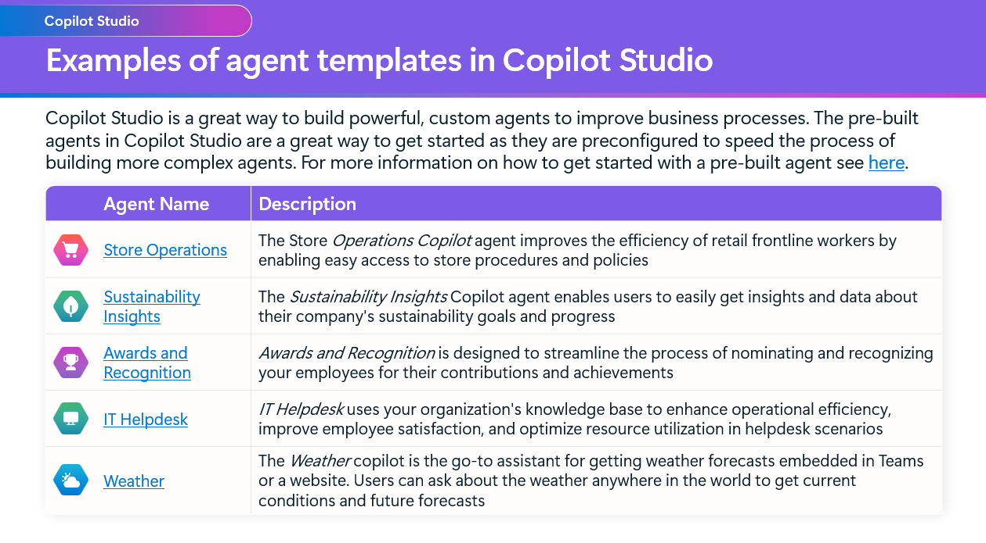
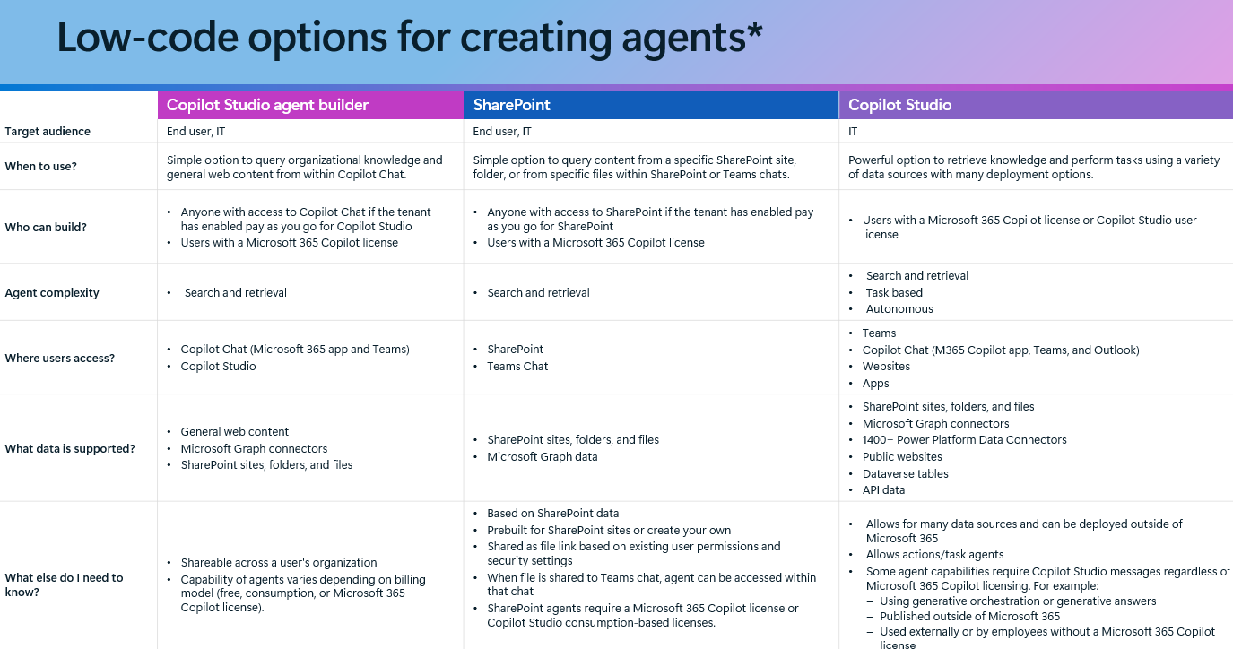
Agent Overview Guide
aka.ms/Copilot/AgentOverviewGuide
Learn how to quickly unlock the value of Copilot through agents. See the easiest ways to get started across Copilot Chat, SharePoint, and Copilot Studio with lots of examples and templates that will help you quickly build and use your first agents.

Slide 43
IT Set up and Controls Guide
Deploy Transformational Ent-Wide agents : Microsoft as Customer Zero
aka.ms/Copilot/ITControlsGuide
Get the latest on IT set up and controls guidance for Copilot Chat and agents. Manage access to Copilot Chat for your users and set up required data governance controls. Then set up access to agents including licensing and billing plans. Learn how to monitor and manage consumption.
Robust Security & Governance for Agents in M365 Copilot
Adopt & Administer Copilot Studio with managed security & governance

Slide 44
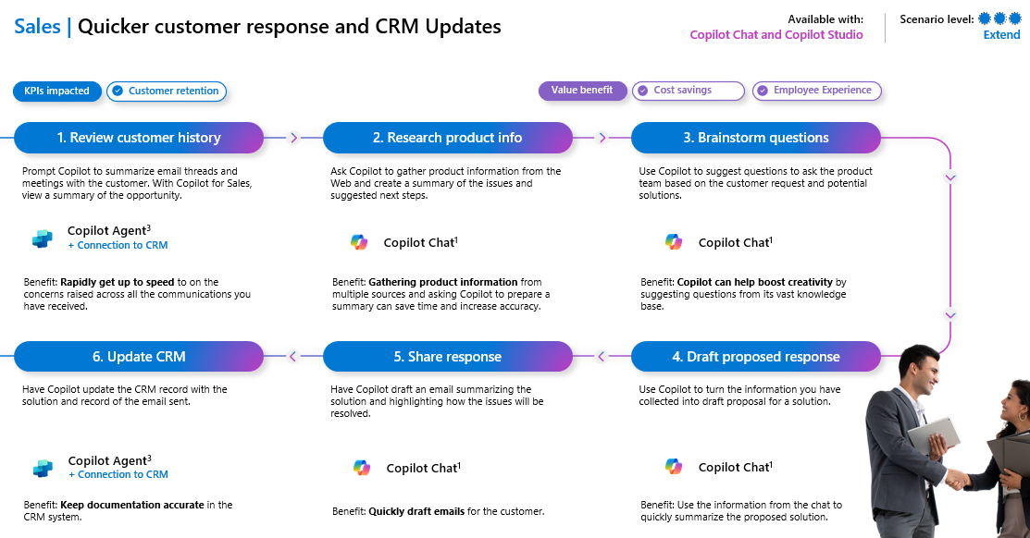
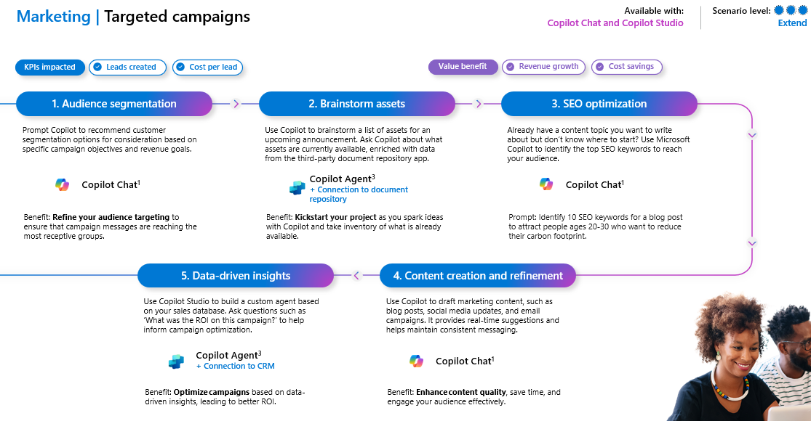
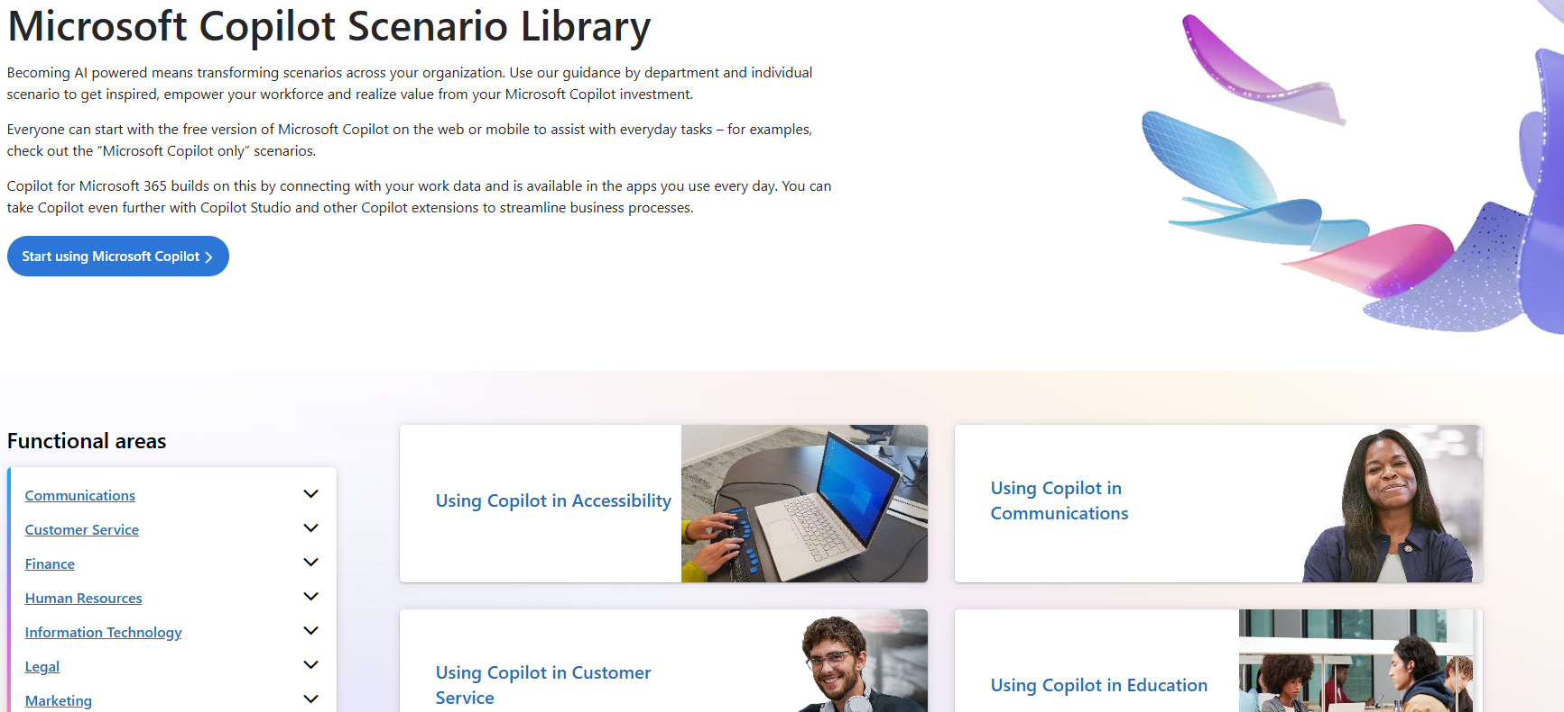
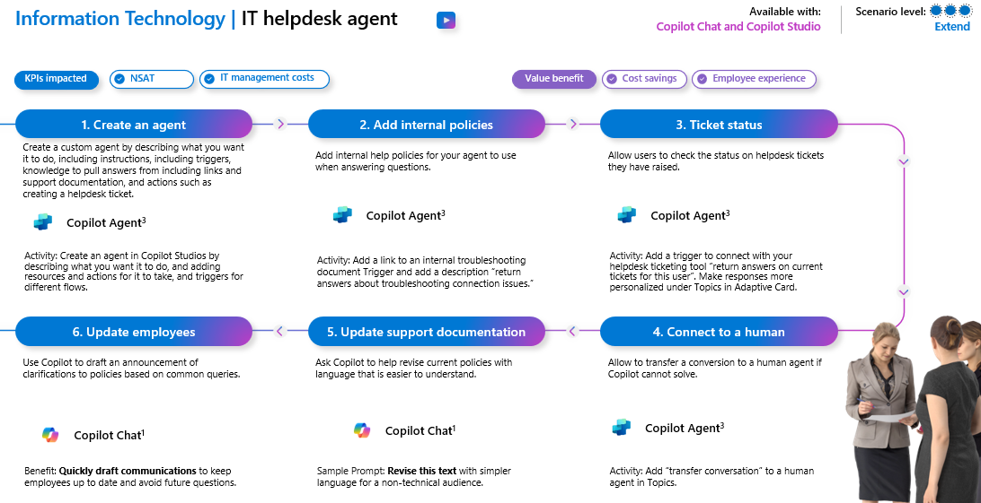
Agent scenarios
We have launched new agent (consumption) scenarios to the Scenario Library, with easy steps for each of your functional teams to get started.

Slide 45
Microsoft investments to accelerate your time to value
Find Partners to help with Microsoft 365 Copilot Extensibility at the
Eligible customers can request technical and deployment assistance from
Get started on your Copilot journey with expert-led services through
Microsoft 365 Copilot Partner Directory
Microsoft FastTrack
Microsoft Unified

Slide 46
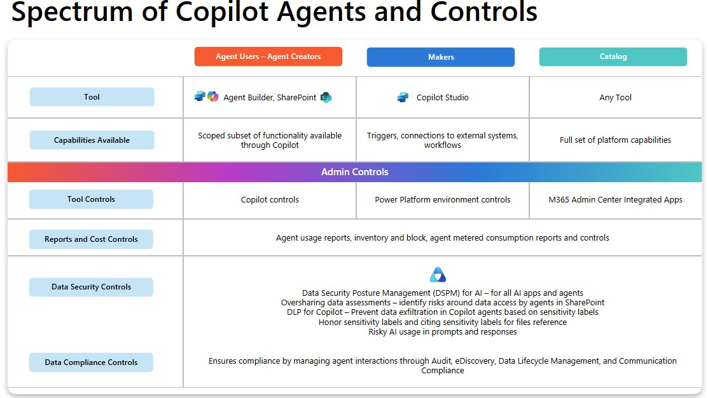
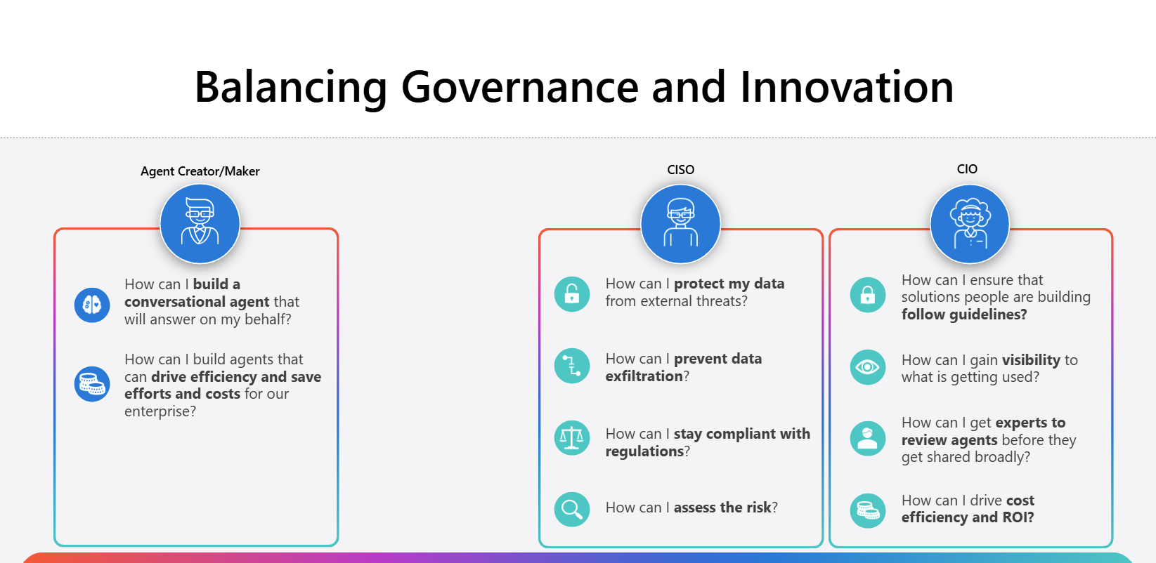
Agent Governance Support Engagement
Guidance on Agent Governance Controls and Implementation Best Practices
Key Benefits
Next Steps
Practical steps to operationalize agent governance for M365 Copilot and Copilot Chat
Self-Serve Skilling
Get familiar with Agent Administration & Governance on demand resources
Best practices for agent message consumption, cost forecasting, and reporting tailored to your organization.
Webinars
Register for an upcoming Agent Governance webinar here
(To be published soon)
Assistance in designing your agent governance strategy with technical discussions and interactive demos
Engagement Structure
Agent Fundamentals & Architecture
Demos on agents built on Agent
Builder, Copilot Studio & SharePoint
Governance, Data protection &
Reporting across graph connector
& agent creation experiences
Workshop
Contact your Microsoft Representative to schedule agent governance (M365 Copilot Extensibility COE) Engagement
Share one pager with your customers - https://aka.ms/AgentGovernanceSupportEngagement

Slide 47
Agent Governance CoE unified Offering
Jump Start your Agent Journey with standardized Governance and Adoption best practices
Current Challenges
M365 Copilot Extensibility CoE
Set up right governance controls to manage agents
Unlock value of Copilot and agent by access to quick start agents
Track and grow org wide AI Agents
Core Pillars & Assets
Customers are expressing concern about Agent Governance as it scales to end users, with many restricting end user access to Agent builder
Guidance for AI Leads, Architects, Automation/ Innovation Leads,
Cloud Admin , IT Team
Vision & Strategy
Admin & Govern
Nurture and Support
Customer requiring guidance on agent landscape, decision frameworks, and licensing guidelines due to continuous product & taxonomy changes
COE Overview
Agent fundamental & Extensibility Guidance
Agents Admin & Governance Guidance
Graph Connector Admin & Governance Guidance
Agent Starter Kit
Agent Hackathon
Customer’s ambiguity between build vs buy vs extend solutions leads to slow start on starting agentic journey at scale ​
CALL TO ACTION: Please reach out to your Microsoft representatives to schedule 1-Day Offering on Agent Governance CoE.

Slide 48
Call to Action
Modern Work Customer Hub

Slide 49
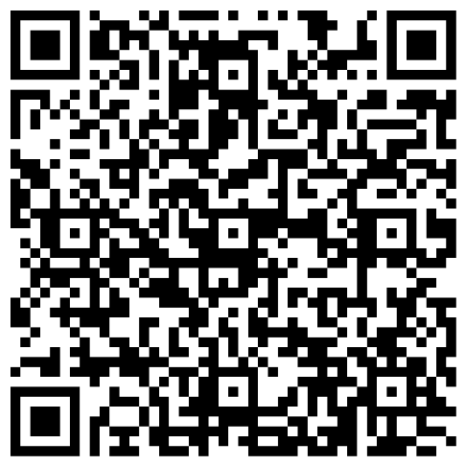
Your feedback is critical
Scan with your mobile device camera
We’re committed to making your Modern Work Customer Hub experience the best it can be – and your feedback is a critical component to that.
Before you scoot, please take a moment to reply to provide some feedback.
-OR-
Visit
Customer Hub Survey
aka.ms/CustomerHubSurvey

Slide 50
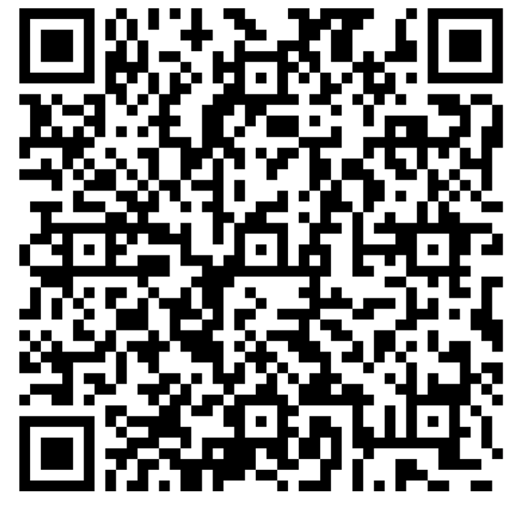
How can we help you?
aka.ms/MSCopilotHelp

Slide 51
Q & A

Slide 52
Thank
You
Copyright © 2025 Microsoft Corporation. All rights reserved.

